Slide 1
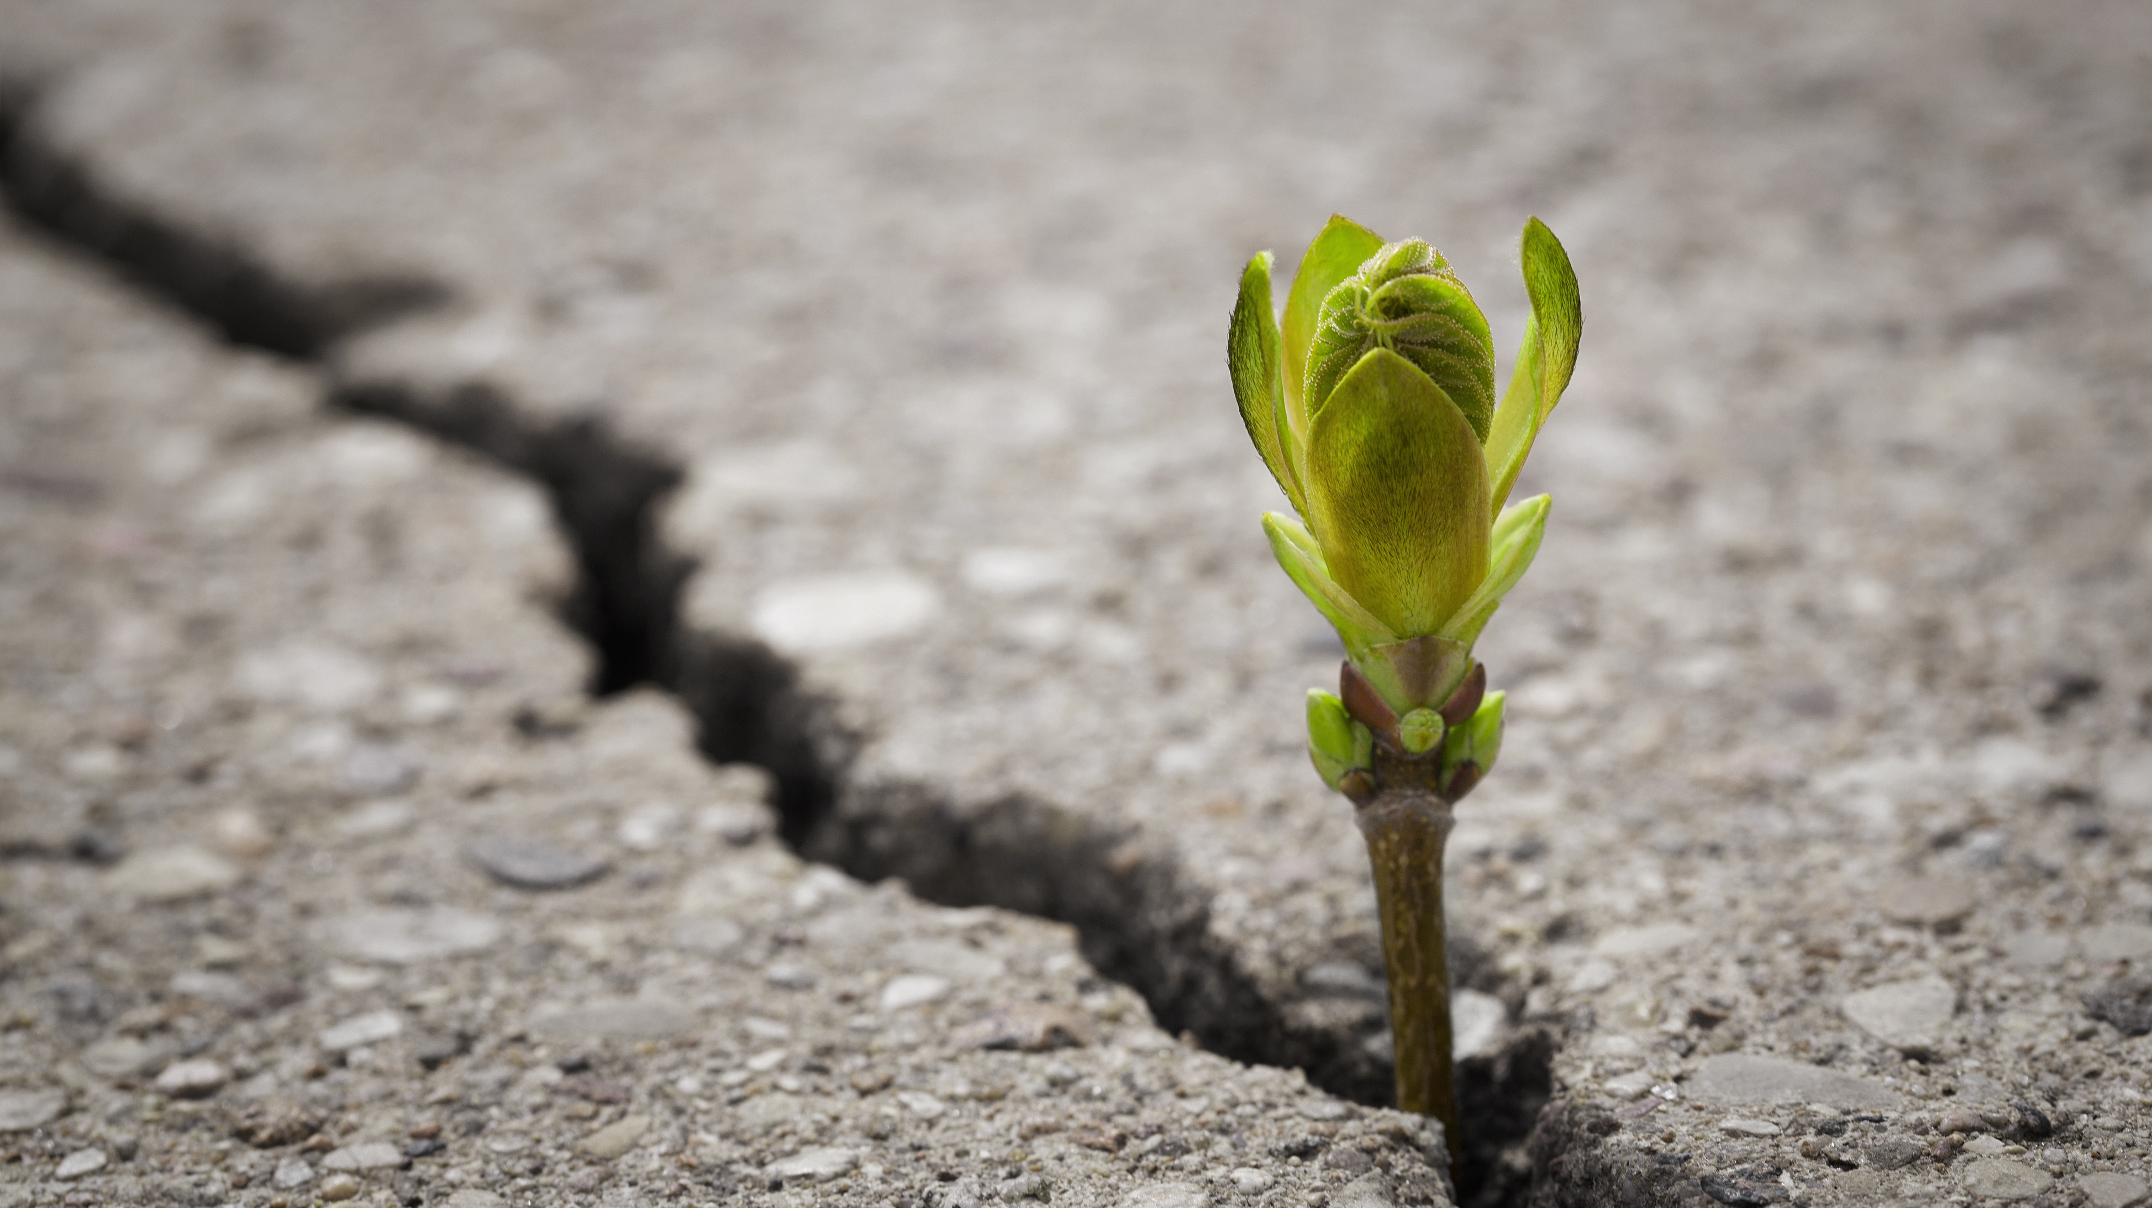
Finding a sustainable science a grassroots perspective
Peter Millington
UKRI Future Leaders Fellow, University of Manchester
UK HEP Forum, Abingdon, 2024

Slide 2
Finding a sustainable science a grassroots perspective (AND AN UNAVOIDABLY PERSONAL ONE)
Peter Millington
UKRI Future Leaders Fellow, University of Manchester
UK HEP Forum, Abingdon, 2024

Slide 3
The climate crisis is here.
“Human activities, principally through emissions of greenhouse gases, have unequivocally caused global warming, with global surface temperature reaching 1.1°C above 1850-1900 in 2011-2020. Global greenhouse gas emissions have continued to increase, with unequal historical and ongoing contributions arising from unsustainable energy use, land use and land-use change, lifestyles and patterns of consumption and production across regions, between and within countries, and among individuals (high confidence).”
Excerpted from IPCC 2023 Synthesis Report, Summary for Policymakers.

Slide 4
It is not fair.
“Widespread and rapid changes in the atmosphere, ocean, cryosphere and biosphere have occurred. Human-caused climate change is already affecting many weather and climate extremes in every region across the globe. This has led to widespread adverse impacts and related losses and damages to nature and people (high confidence). Vulnerable communities who have historically contributed the least to current climate change are disproportionately affected (high confidence).”
Excerpted from IPCC 2023 Synthesis Report, Summary for Policymakers.

Slide 5
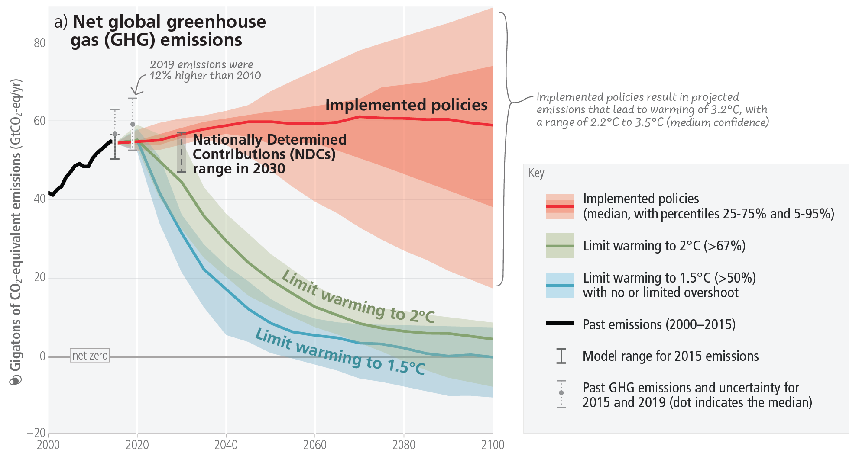
And we are not on track.
Figure excerpted from IPCC 2023 Synthesis Report, Summary for Policymakers.

Slide 6
Plans to commit to a bolder pledge in UK NDC are welcome.
81% reduction on 1990 levels in territorial emissions (excludes international aviation and shipping) by 2035.
But it needs to happen.
See https://www.gov.uk/government/news/uk-shows-international-leadership-in-tackling-climate-crisis

Slide 7
The ambitions of UKRI’s Environmental Sustainability Strategy are welcome.
“embed environmental sustainability in everything we do”
“achieve ‘net-zero’ for our carbon emissions” by 2040
But it needs to happen.
See https://www.ukri.org/wp-content/uploads/2020/10/UKRI-050920-SustainabilityStrategy.pdf

Slide 8
We need to make it happen.

Slide 9
Who do I think I am?

Slide 10
Who gets to talk about sustainability?

Slide 11
EVERYONE

Slide 12
So who do I think I am?
The perspective of a theoretical physicist, working in high energy physics, cosmology and astroparticle physics (HECAP).

Slide 13
There are no proxy problems when it comes to sustainability.
vacuum
cow

Slide 14
The climate crisis is a wicked problem.
A wicked problem:
No definitive formulation
No stopping rule
Not true-or-false, but good-or-bad
No solution test
No trial and error
No enumerable set of solutions
Essentially unique
A symptom of other problems
Numerous representations
No right to be wrong
(Rittel and Webber 1973)

Slide 15
The climate crisis is an interdisciplinary problem.
Economics
Politics
Sociology
STEMM
Law
Solution Space

Slide 16
So what about us (HECAP)?
Beware: climate whataboutery

Slide 17
We have moral and pragmatic reasons to act.
As scientifically literate citizens, we have a responsibility to lead by example and limit our negative environmental impacts.
And if we believe our science is of value to society (and I do) then we want to be allowed to keep doing it.

Slide 18
Our social licence to operate is a fragile privilege.
The public, funders and governments entrust us with financial and material resources, and we are accountable for how we use them.

Slide 19
We need to take ownership of our positive and negative externalities.
An externality:
A cost or benefit caused by one party on another.
We need to ask:
How does our science benefit society?
How does our science cost society?

Slide 20
Our emissions are too high.
Based on self-reported data from institutional reports; see HECAP+ reflective document for full references.

Slide 21
Our emissions profile is different.
Based on H. Ritchie et al., “CO2 and Greenhouse Gas Emissions,” Our World in Data 2020
and self-reported data from institutional reports; see HECAP+ reflective document for full references.

Slide 22
Energy will be scarce & expensive.
From H Ritchie et al. “Energy”, Our World in Data 2020, reused and adapted in the HECAP+ reflective document under CC BY 4.0.

Slide 23
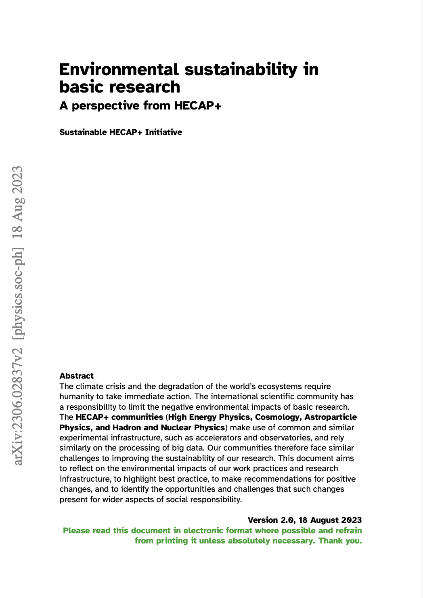
Environmental sustainability in basic research: a perspective from HECAP+
arXiv:2306.02837 to appear in JINST (2024)
Grassroots reflection on sustainability in the context of HECAP+: High Energy Physics, Cosmology, Astroparticle plus Hadron and Nuclear Physics
Conceived at the 2021 Sustainable HEP workshop
Relevance across big science

Slide 24
Other sources are available.
Young High Energy Physicists association, “yHEP recommendations on improvement of environmental sustainability in science”, 2020.
Nature Astronomy, “The climate issue,” Nature Astronomy 4, pp. 811, 2020.
ALLEA, “Towards climate sustainability of the academic system in Europe and beyond,” 2022.
K. Bloom et al., “Climate impacts of particle physics,” in 2022 Snowmass Summer Study 3, 2022.
V. Lang et al., “Know your footprint -- Evaluation of the professional carbon footprint for individual researchers in high energy physics and related fields”, 2024.
J. Alimena et al., “Sustainable computing workshops in high-energy physics at DESY”, 2024.
K. Bloom and V. Boisvert, “Sustainability and carbon emissions of future accelerators”, 2024.
Astronomers for Planet Earth
Labos1point5

Slide 25
We took a holistic approach.
Areas of focus:
With recommendations targeted at:
Computing
Energy
Food
Mobility
Resources
& Waste
Research
Infrastructure
& Technology
Hardware
Software
Data Centres
Sources
Saving
Recuperation
Conferences
Canteens
Commuting
Conferences
Collaboration
Life Cycle
F-Gases
Consumables
E-Waste
Individuals
Groups
Institutions

Slide 26
There is no one-size fits all solution.
Sustainability is a systems problem.

Slide 27
Environmental sustainability and equity can be in tension.
An example: limiting business air travel
Positives
Reduction in emissions
Negatives
Further entrenching geographic disparities
Disproportionate impacts on career progression
Disproportionate impacts on those unable to take longer trips

Slide 28
The conclusion:
“Assessing, reporting on, defining targets for, and undertaking coordinated efforts to limit our negative impacts on the world’s climate and ecosystems must become an integral part of how we plan and undertake all aspects of our research.”
From HECAP+ reflective document

Slide 29
Life Cycle Assessment should be standard practice.
Assess the environmental impact of a project over its entire life cycle, cradle to grave.
Transportation
Processing
Manufacture/ Construction
Decommissioning
Disposal
Operation
Resource extraction

Slide 30
But this is only a start …

Slide 31
We need to drive our field toward a social tipping point.
A social tipping point: small changes trigger a rapid shift in social norms.

Slide 32
There are good signs.
Governance
Platform
Strategy
Research
ILC and CLIC LCA (Evans 2023)
collaborations
Dedicated conferences, e.g., Sustainable HEP
European Strategy Update in PP 2026
labos1point5
Process
institutions
funders
Plenary talks and parallel tracks, e.g., ICHEP2024
Innovate for Sustainable Accelerating Systems
Green computing
CERN Environmentally Responsible Procurement Policy
Reduction in F-gases (e.g. LHCb)
Snowmass 2021 and P5 Report 2023
ICFA Sustainable Accelerators & Colliders 2024
ESO and GRAND LCAs
This UK HEP Forum!
See accompanying references for links.

Slide 33
Are we ready to go further?

Slide 34
What can we achieve by addressing perverse incentives?
Competition versus collaboration
Hypermobility
Metric-driven science

Slide 35
What can we achieve by siting infrastructure differently?
Ensuring proximity to sources of renewable energy.
Climate
Addressing systemic geographic disparities.
Equity

Slide 36
What does a truly sustainable, global and equitable cutting-edge science look like?
And how might we get there?

Slide 37
References
IPCC, 2023: Summary for Policymakers. In: Climate Change 2023: Synthesis Report. Contribution of Working Groups I, II and III to the Sixth Assessment Report of the Intergovernmental Panel on Climate Change [Core Writing Team, H. Lee and J. Romero (eds.)]. IPCC, Geneva, Switzerland, pp. 1-34, https://doi.org/10.59327/IPCC/AR6-9789291691647.001.
GOV.UK, ”Press release: UK shows international leadership in tackling climate crisis”, 12 November 2024, https://www.gov.uk/government/news/uk-shows-international-leadership-in-tackling-climate-crisis.
UKRI, “UKRI Environmental Sustainability Strategy”, https://www.ukri.org/wp-content/uploads/2020/10/UKRI-050920-SustainabilityStrategy.pdf.
H.W.J. Rittel and M. M. Webber, “Dilemmas in a general theory of planning”, Policy Sci 4, 155–169, 1973. https://doi.org/10.1007/BF01405730.
SustainableHECAP+ Initiative, “Environmental sustainability in basic research: A perspective from HECAP+”, 2023, available at: https://sustainable-hecap-plus.github.io/.
Hannah Ritchie, Pablo Rosado and Max Roser (2023) - “CO₂ and Greenhouse Gas Emissions” Published online at OurWorldinData.org. Retrieved from: 'https://ourworldindata.org/co2-and-greenhouse-gas-emissions' [Online Resource].
Hannah Ritchie, Pablo Rosado and Max Roser (2023) - “Energy” Published online at OurWorldinData.org. Retrieved from: 'https://ourworldindata.org/energy' [Online Resource].
Young High Energy Physicists association, “yHEP recommendations on improvement of environmental sustainability in science”, 2020, https://yhep.desy.de/sites/sites_custom/site_yhep-association/content/e61887/e122133/yHEPStatementonenvironmentalsustainabilityinScience_final.pdf.
Nature Astronomy, “The climate issue,” Nature Astronomy, vol. 4, pp. 811, Sep 2020, https://doi.org/10.1038/s41550-020-01216-9.
ALLEA, “Towards climate sustainability of the academic system in Europe and beyond,” 2022, https://doi.org/10.26356/climate-sust-acad.
K. Bloom et al., “Climate impacts of particle physics,” in 2022 Snowmass Summer Study 3, 2022, https://doi.org/10.48550/arXiv.2203.12389.
Lang et al., “Know your footprint -- Evaluation of the professional carbon footprint for individual researchers in high energy physics and related fields”, 2024, https://arxiv.org/abs/2403.03308.
J. Alimena et al., “Sustainable computing workshops in high-energy physics at DESY”, 2024, https://arxiv.org/abs/2410.02501.
K. Bloom and V. Boisvert., “Sustainability and carbon emissions of future accelerators,” 2024, https://doi.org/10.48550/arXiv.2411.03473.
Astronomers for Planet Earth, https://astronomersforplanet.earth/.
labos1point5, https://labos1point5.org/.
ECFA, “ECFA guidelines for inputs from national HEP communities to the European Strategy for Particle Physics”, CERN, Geneva 2024, https://ecfa.web.cern.ch/ecfa-guidelines-inputs-national-hep-communities-european-strategy-particle-physics-0.
Butler et al., “Report of the 2021 U.S. Community Study on the Future of Particle Physics (Snowmass 2021) Summary Chapter”, https://arxiv.org/abs/2301.06581.
Asai et al., “Pathways to Innovation and Discovery in Particle Physics. Report of the 2023 Particle Physics Project Prioritization Panel”, 2023, https://www.usparticlephysics.org/2023-p5-report/investing-in-the-future-of-science-and-technology.html#69sustainability-and-the-environment.
S. Evans and B. Castle, “Life Cycle Assessment. Comparative environmental footprint for future linear colliders CLIC and ILC. Final Report. July 2023,” Geneva, 2023. https://edms.cern.ch/ui/#!master/navigator/document?D:101320218:101320218:subDocs
ESO, “Environmental sustainability at ESO, “https://www.eso.org/public/germany/about-eso/green/”.
C. Aujoux et al., “Estimating the carbon footprint of the GRAND project, a multi-decade astrophysics experiment,” Astroparticle Physics, vol. 131, p. 102587, 2021. https://doi.org/10.1016/j.astropartphys.2021.102587
IPT Department, CERN, “Mitigating the environmental impact of CERN procurement”, CERN, 2024, https://home.cern/news/news/cern/mitigating-environmental-impact-cern-procurement.
ICFA Panel on Sustainable Accelerators and Colliders, https://icfa.hep.net/icfa-panel-on-sustainable-accelerators-and-colliders/.
J. D'Hondt, “Innovate for Sustainable Accelerating Systems (iSAS)”, 2023, https://indico.cern.ch/event/1242680/attachments/2583397/4456219/Sustainability-HorizonEurope-JDH-v3-Jan2023.pdf.
LHCb Collaboration, “Framework TDR for the LHCb Upgrade II – Opportunities in flavour physics, and beyond, in the HL-LHC era,” https://cds.cern.ch/record/2776420, CERN, Geneva, Tech. Rep., 2021.
L. Lannelongue, J. Grealey and M. Inouye, “The Green Algorithms project”, 2022, https://www.lannelongue.eu/research/green-algorithms/.

