Slide 1

Sustainability at CERN now and future
R. Losito, ATS/DO
UK-HEP Forum, Abingdon, 26 November 2024

Slide 2
CERN and the UN Sustainable Development Goals

Slide 3
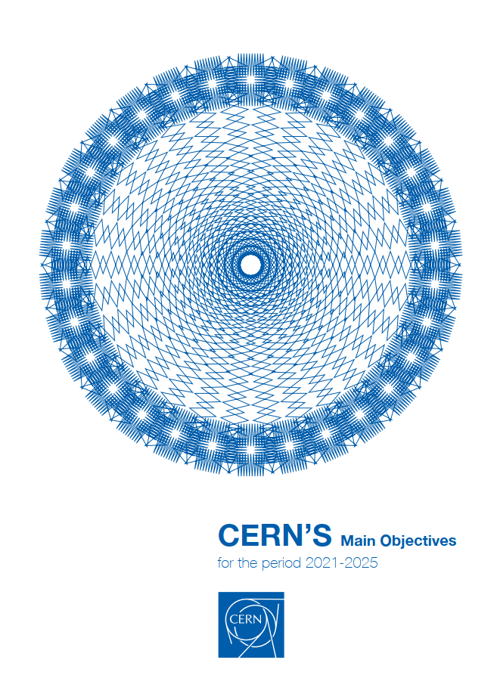
Management Objectives 2021-2025
Commitment to SDGs
‘One of the Management’s top objectives for the next five-year period is to increase CERN’s impact on society, thereby boosting the Organization’s visibility and consolidating the support of governments and the general public’.
‘Across all these areas of activity, CERN will continue to ensure that their impact also contributes to advancing the Sustainable Development Goals (SDG), adopted by all United Nations Member States in 2015. Collaboration with CERN’s Member and Associate Member States, with international organisations and other partners will be enhanced to identify and pursue further synergies in support of the SDGs, building on CERN values, competencies and technologies.

Slide 4
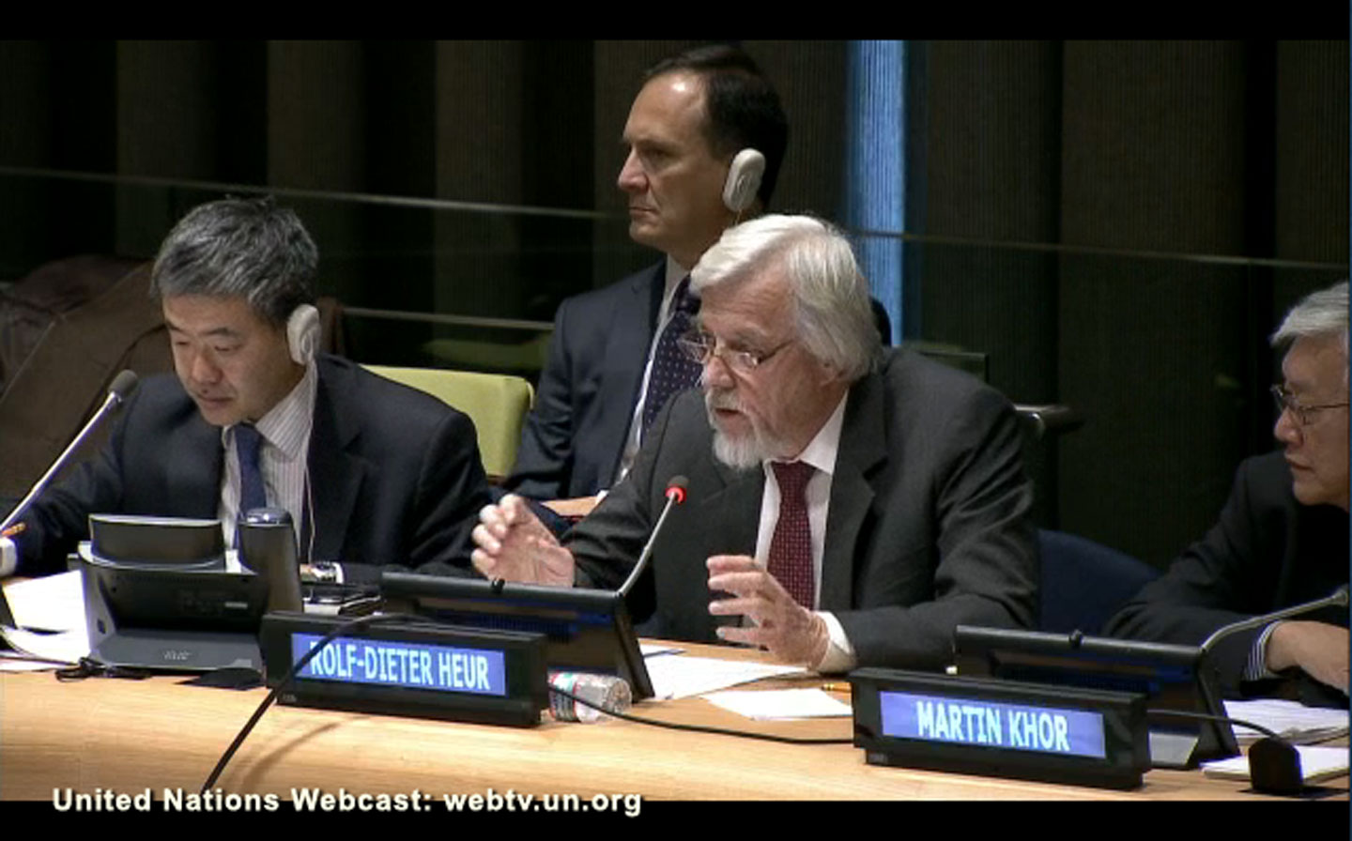
Sustainable Development Goals
CERN input in the process
The adoption of the SDGs followed two years of consultation and engagement with civil society and other stakeholders around the world.
As an Observer to the United Nations General Assembly, CERN contributed with input in the Open Working Group on Sustainable Development Goals, promoting sustained and ring-fenced support for scientific research, and STEM education.
CERN Director-General Rolf Heuer addressing the Open Working Group on Sustainable Development Goals in December 2013.
The CERN input may be found at https://sustainabledevelopment.un.org/content/documents/4628cern.pdf

Slide 5
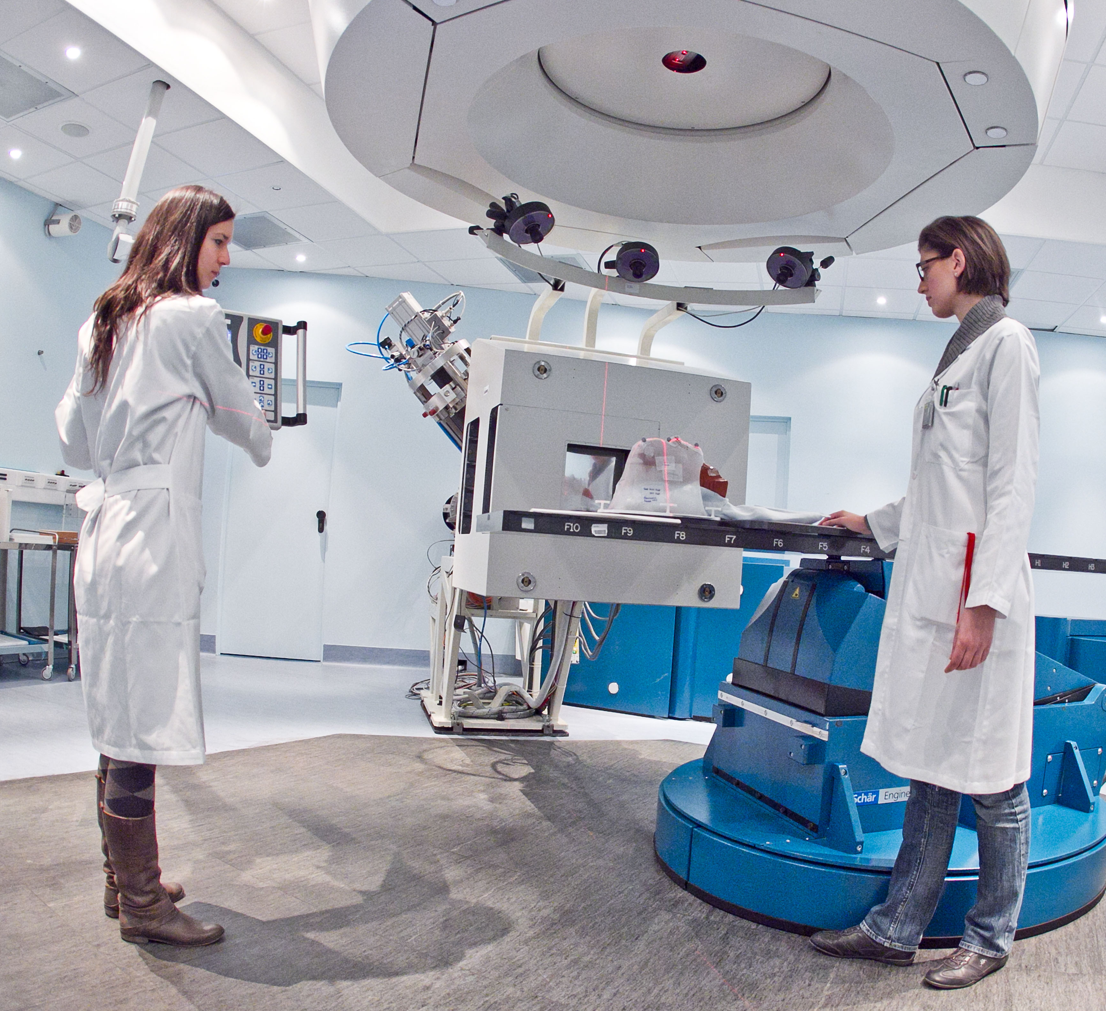
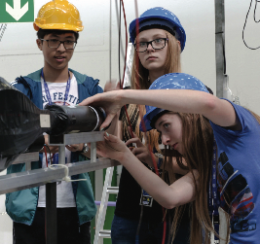

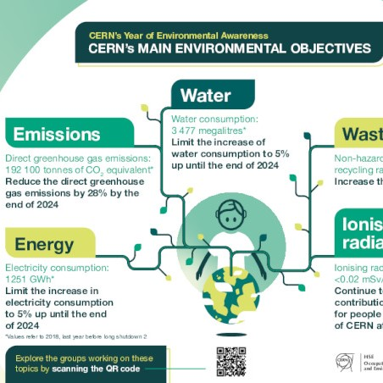
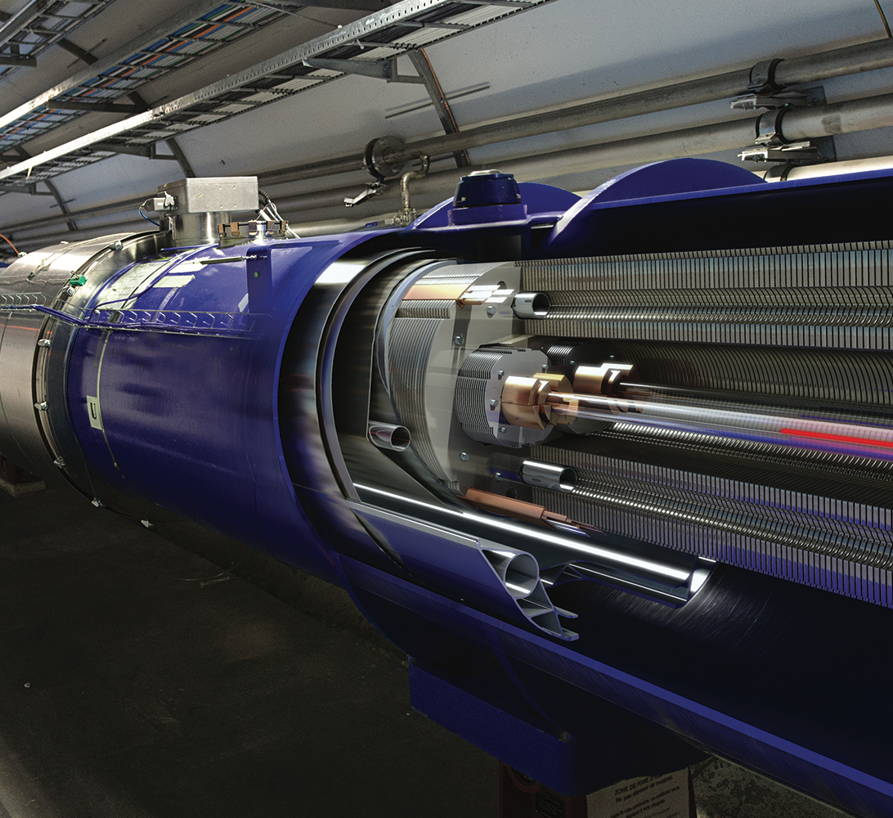
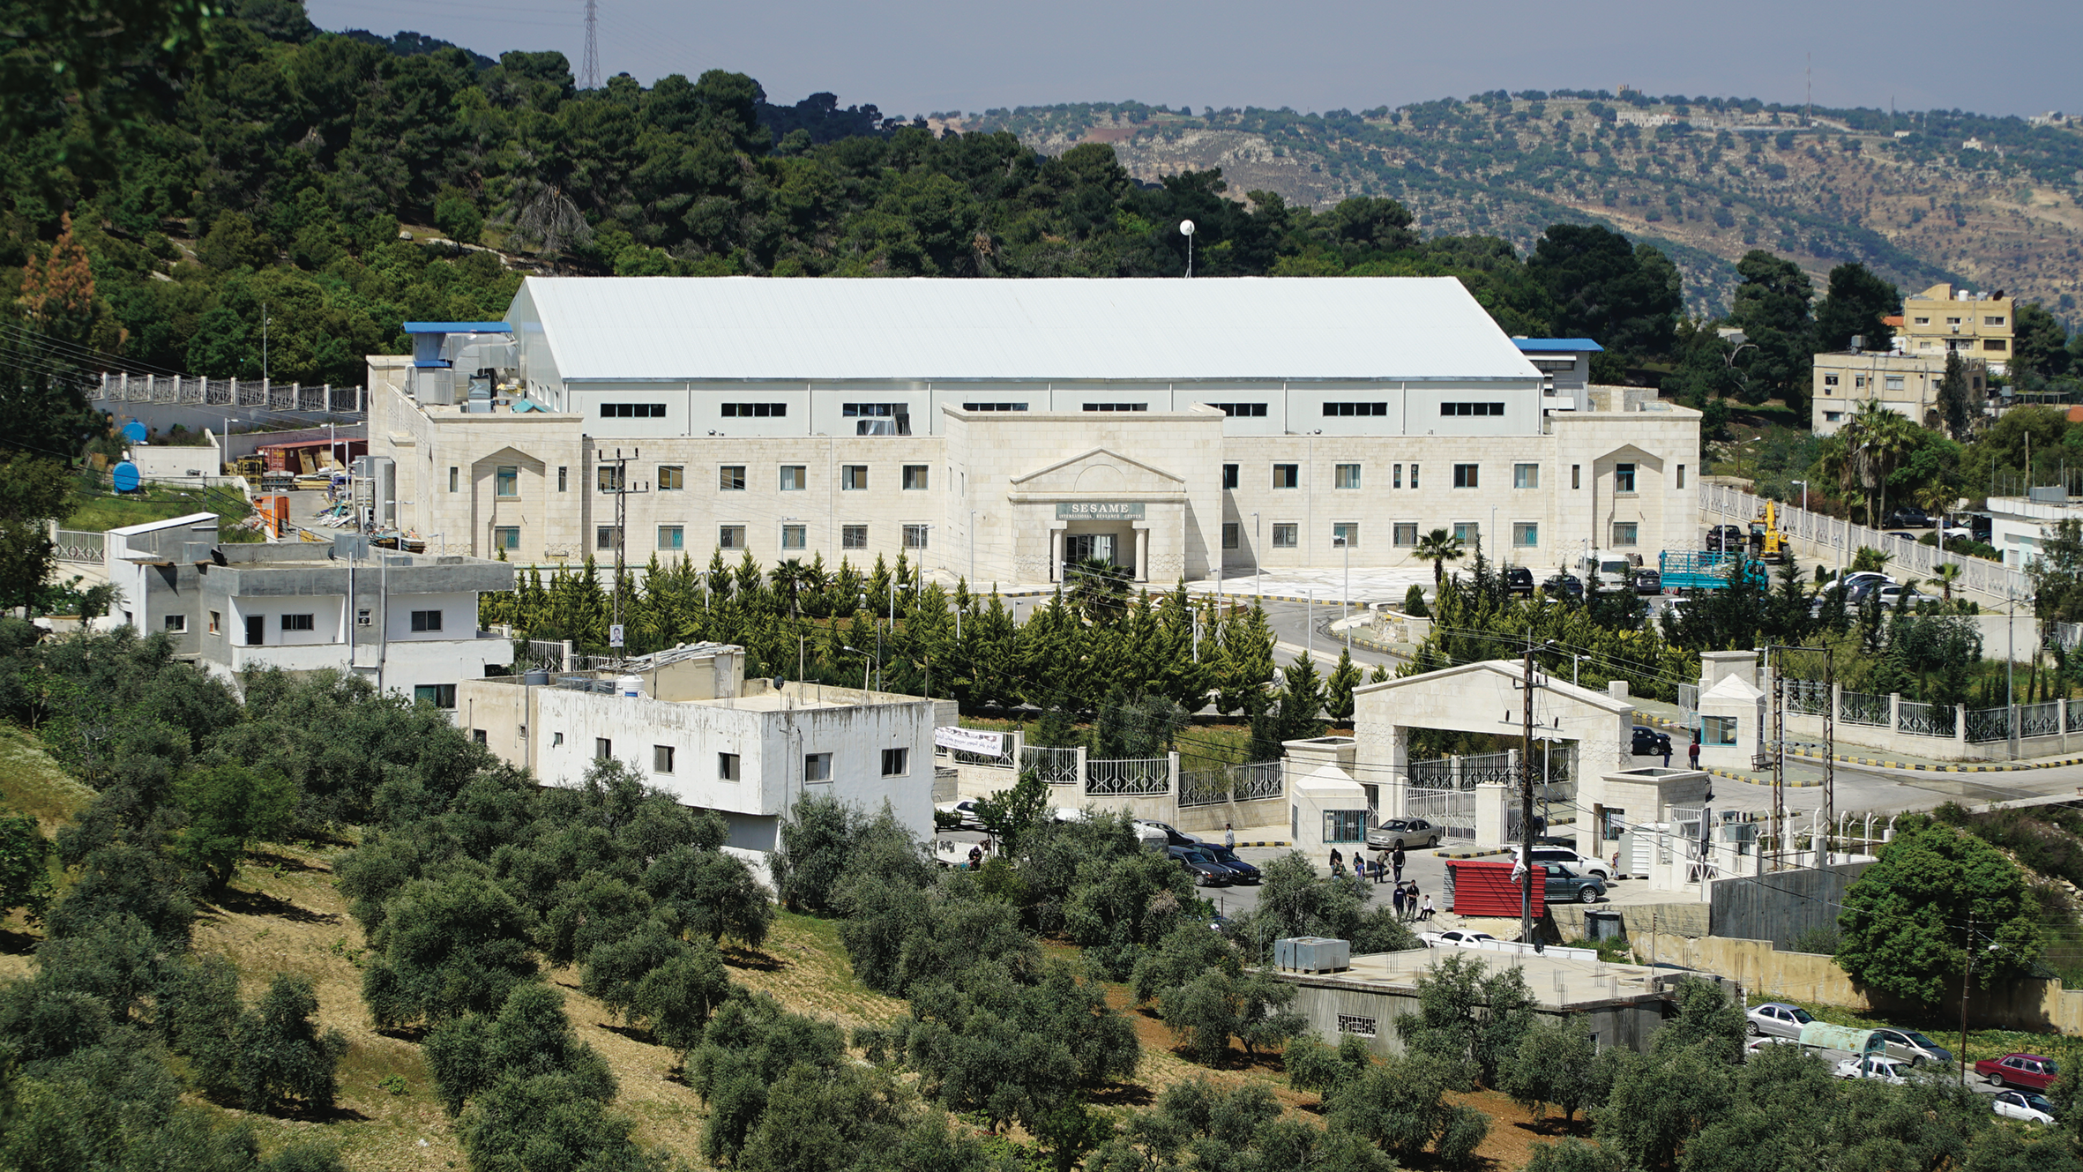
Mapping
CERN contribution to the Goals
2017 initial mapping => 5 Goals identified for priority
2021 updated mapping => 2 further Goals added – SDG5 and SDG7 => to align with Management Objectives
SDG 3 - HEALTH
CERN helps to develop technologies that contribute to better healthcare for all, such as medical imaging and hadron therapy.
SDG 4 - EDUCATION
Education is one of CERN’s core missions. We offer high quality programmes that inspire thousands of students, teachers and young researchers each year.
SDG 5 - GENDER
Diversity is a core value for CERN. Our diversity policy aims at leveraging the added value that comes from bringing together people of different nationalities, genders, professions and ages.
SDG 7 - ENERGY
CERN develops strategies to minimise the increase of energy consumed by the installations, increase energy efficiency and implement energy recovery.
SDG 9 - INNOVATION
CERN inventions are brought to industry through knowledge transfer, to have a positive impact on society and innovation.
SDG 16 & 17 - INTERNATIONAL COOPERATION
CERN is a successful model for international collaboration. CERN gathers researchers from all over the world, contributing to human knowledge and peace, for the benefit of all.
THERAPY
Accelerators provide particle beams for more targeted cancer treatment.
BEAMLINE FOR SCHOOLS
COMPETITION
Students from the two winning teams spend a week at CERN to carry out their experiment using a CERN accelerator.
25 BY 25 DIVERSITY & INCLUSION INITIATIVE
First ever targets-based strategy to boost the nationality and gender diversity within the Staff and Fellows population.
.
HEATING LOCAL HOUSING
Heat recovered from CERN's accelerator cooling systems to heat a new residential area in the town of Ferney-Voltaire, benefiting up to 8000 people.
A MAGNET IN THE LHC TUNNEL
Exploring the universe requires new technologies and ingenious engineering to build the machines that explore physics at a new frontier.
SESAME
This new synchrotron light source in Jordan started operation in 2017. It is a unique collaboration between eight Middle East members, modelled on CERN’s governance structure.

Slide 6
Sustainability at CERN in a nutshell

Slide 7
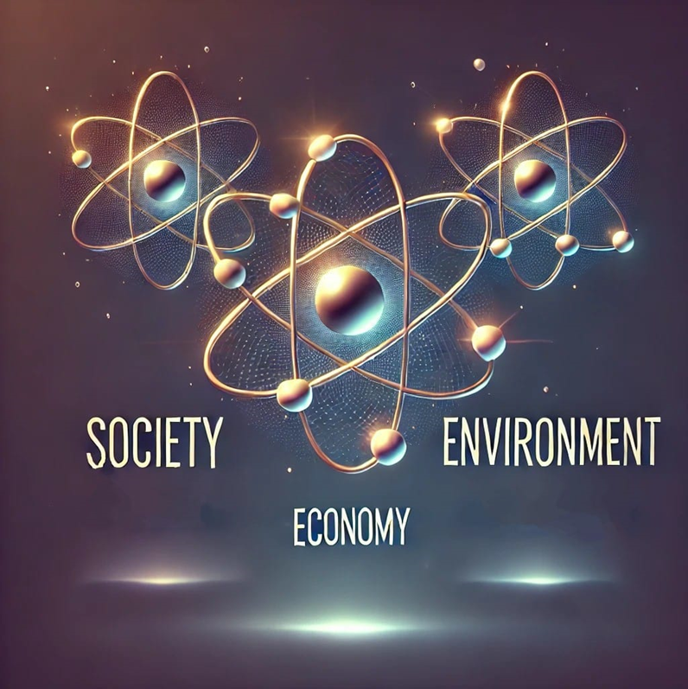
The three pillars of sustainabiltiy
Sustainability is not just about Environment. We need to measure the effects and the impact also from the Economic and Social point of view
Future colliders will have to produce SocioEconomic impact studies to be considered for funding by a number of funding agencies: EU, BEI …
It is also expected by the general public in order to decide about support to a scientific project:
  What do we gain in our day-to-day life?
  Why should I pay with my taxes ?
  Why should I be bothered by construction works?
  …

Slide 8

Socioeconomic impact studies in HL-LHC
The study identified and measured KPIs to quantify the return to society
  Scientific papers and citations
  Increased turnover of industries involved in HL-LHC
  Positive impact of discoveries (through new technologies, patents, training of scientists, etc.)
https://doi.org/10.1093/icc/dty029
https://arxiv.org/pdf/1603.03654

Slide 9

CERN and the Environment

Slide 10

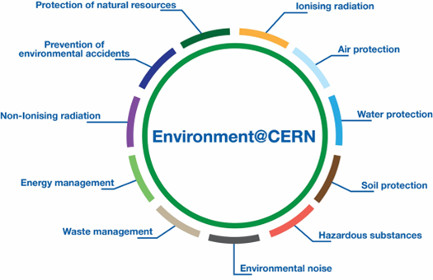
CERN & the Environment

Slide 11
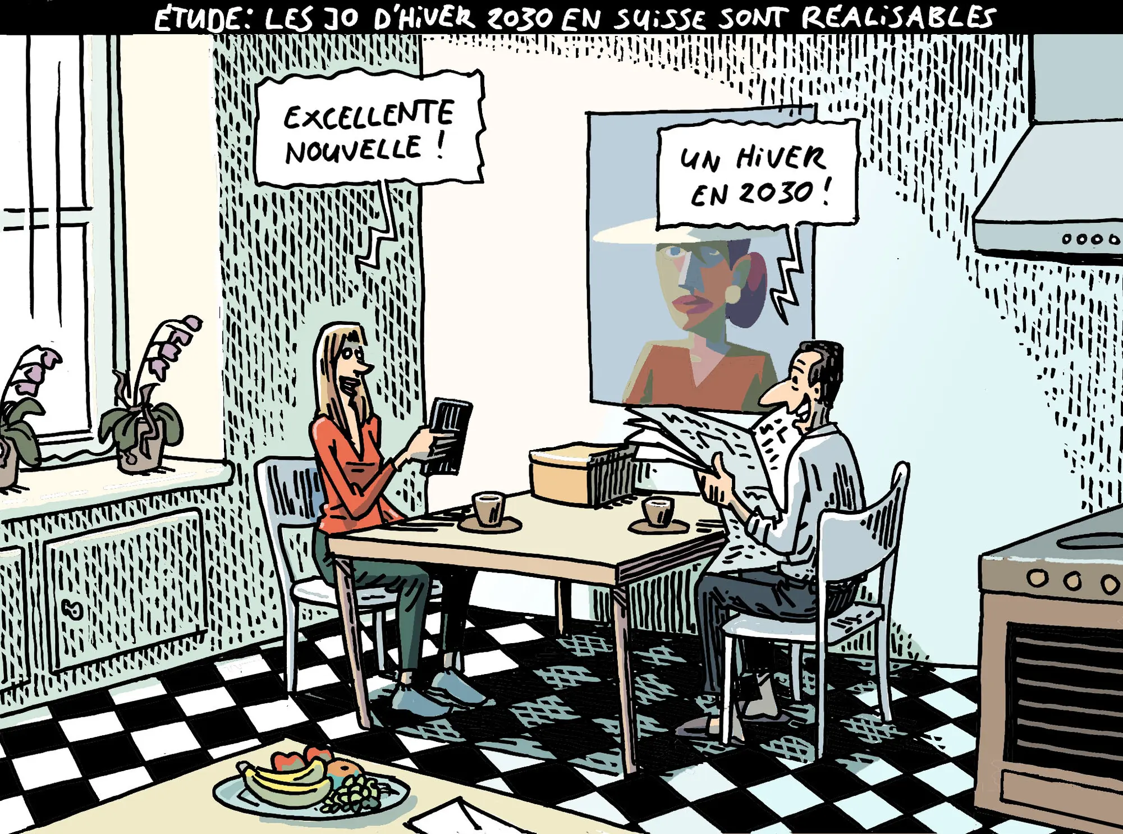
Hermann,
TDG 19/10/2023

Slide 12
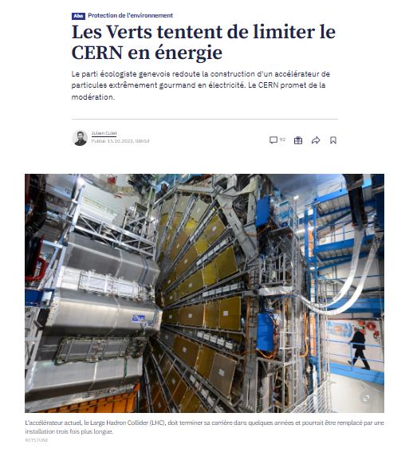
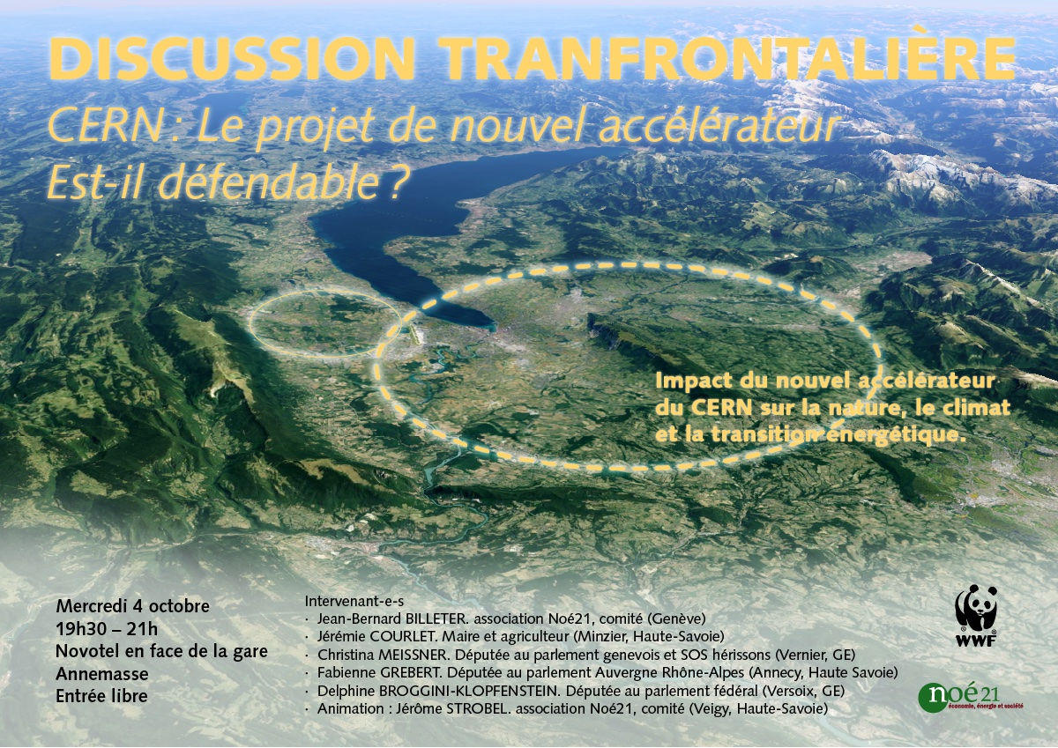

Slide 13
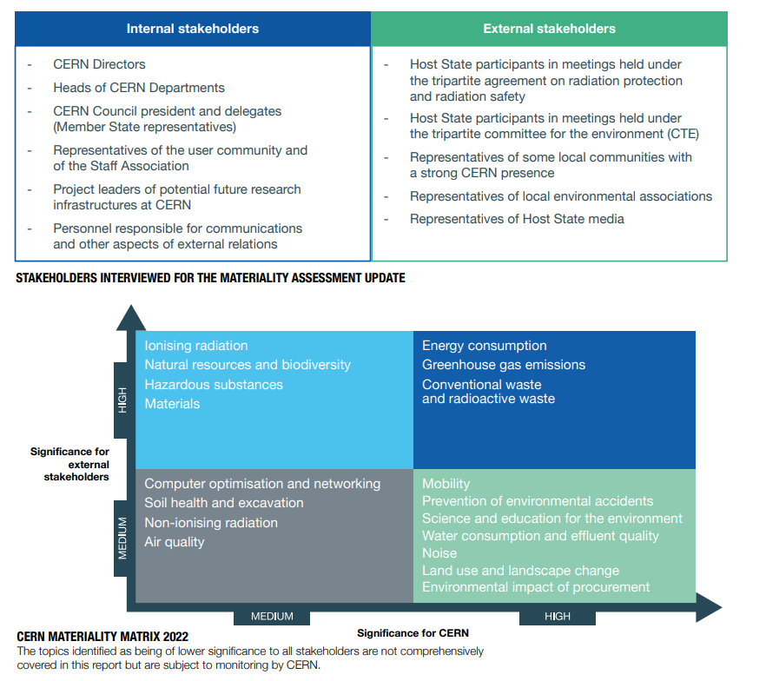
Environmental report: Materiality assessment

Slide 14
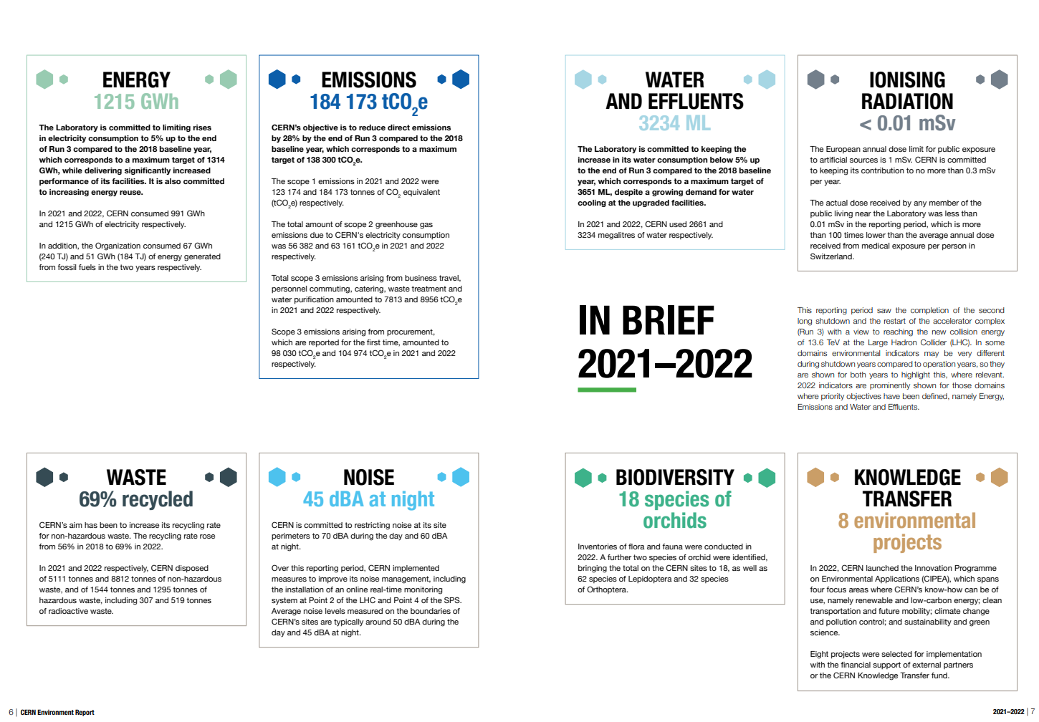
Environmental report

Slide 15
Initiatives/panels linked to the Environmental impact
CERN Enlarged Directorate
Mainly accelerator-related
CERN-wide
Mainly campus-related
International Organisations
Sustainable Accelerator Panel
EMP
Enlarged EMP
CEPS
Resp. Procurement
CIPEA
Gr. Village
CERN Contribution to the goals
Present
Medium-term
Present
Medium-term
Present
Medium-term
Long-term
Present
Medium-term
Long-term
Present
Medium-term
Present
Medium-term
Long-term
Housed in ATS
Housed in HSE
Housed in FHR
Housed in IR

Slide 16
CERN Environmental Protection Steering Board
Main body for prioritization and implementation of environmental objectives
Created in 2017, involves members of the ED, line management and units for management of energy and environmental footprint.
Steers budget for environmental projects
  Retention basins and new STEP to control wastewater effluents
  Cooling towers upgrades
  Dismissal of oil-based transformers
  Replacement of GHG in detectors
  Inventory of Scope 1, 2, 3 emissions, biodiversity, Noise & waste managements….
Coordinates the editing of the CERN Environmental report

Slide 17



CERN High priority environmental objectives – Horizon 2025
The laboratory is committed to limiting rises in electricity consumption to 5% up to the end of Run 3 (baseline 2018) – Target max 1314 GWh/y
CERN’s objective is to reduce direct CO₂e emissions by 28% by the end of Run 3 (baseline 2018) – Target max 138 300 tCO₂e
The laboratory is committed to keeping the increase in its water consumption to 5% up to the end of Run 3 (baseline 2018) – Target max 3651 ML

Slide 18
High priority – Horizon 2030
While the number of collisions will be multiplied by a factor of 5 to 7.5 during RUN4 (2030-2033) with respect to the nominal LHC design, CERN commits to limiting its electricity consumption to 1.5 TWh/y – This equates to an increase of 14%, compared to 2025 objective
Direct CO₂e emissions are linked to CERN’s core operations. CERN’s objective is to reduce them by 50% vs baseline 2018
Despite a growing demand for cooling water, CERN will strive to keep the water consumption below 3600 ML

Slide 19
Energy Management
&
Electricity sourcing
Courtesy N. Bellegarde & S. Claudet

Slide 20
CERN’s energy consumption
CERN’s energy consumption breakdown
Run2+Run3 average – Total : 1’250 GWh
4 sources of energy used at CERN:
  Electricity (for most uses)
  Gas (heating)
  Fuel (car fleet, diesel generators and heating back-up)
  Liquid nitrogen (helium cooling in the LHC)
Accelerator operation
Accelerator operation
Long
shutdown
  Energy procurement currently represents 5 to 10% of CERN’s annual budget
  when the accelerators are running

Slide 21
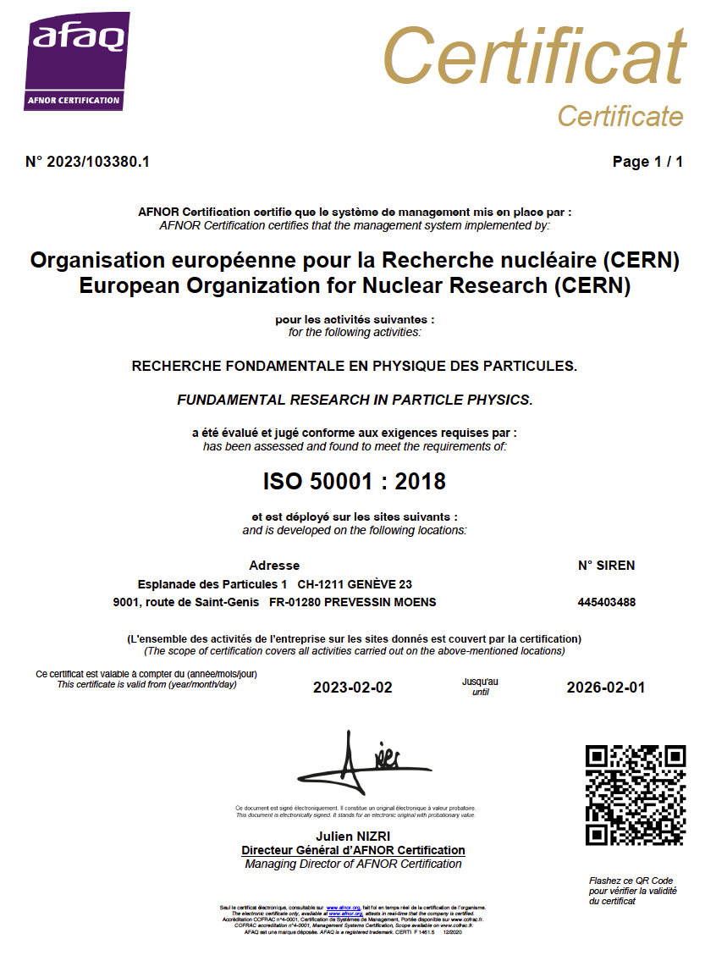
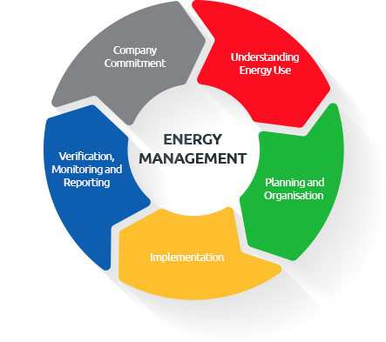
ISO 50001 certification
Certification implies the establishment of improvement goals, and of continuous monitoring.
The process is not limited to the experts on the field: the line and top management have to be continuously informed of the status of the KPIs and take action.
The Energy Management Panels (standard and Enlarged) are the bodies used to manage and control Electricity Consumption.

Slide 22
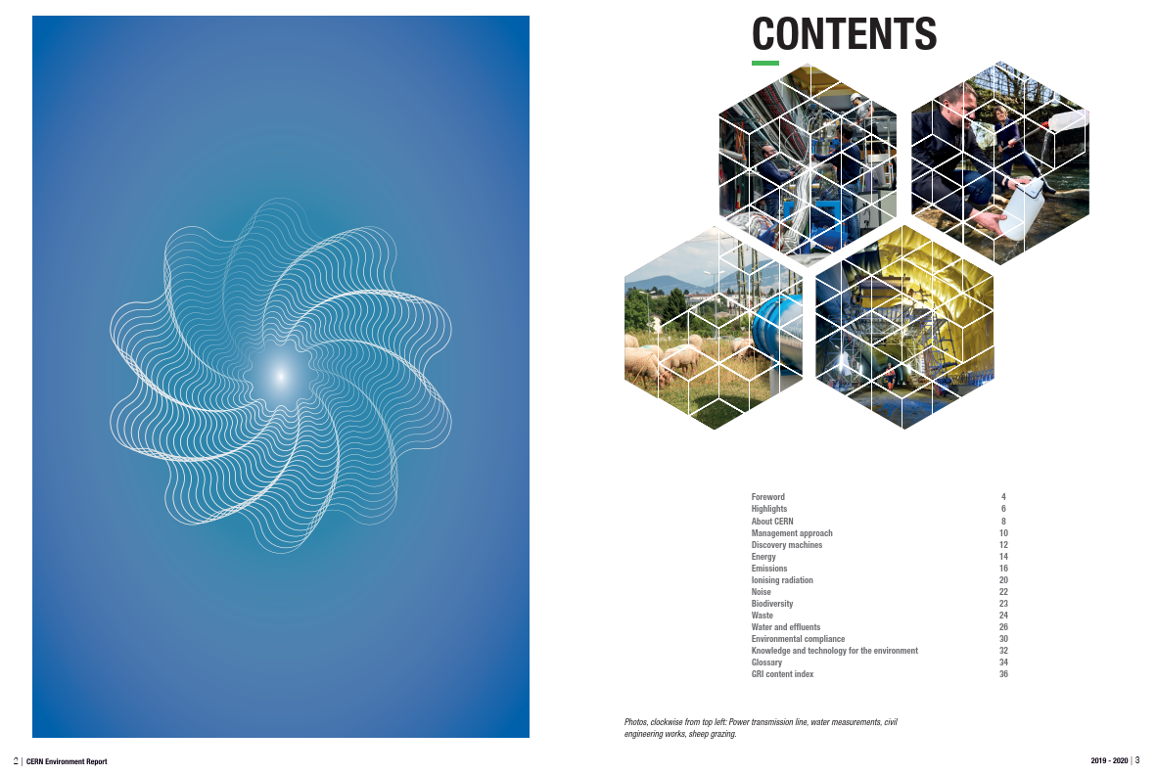
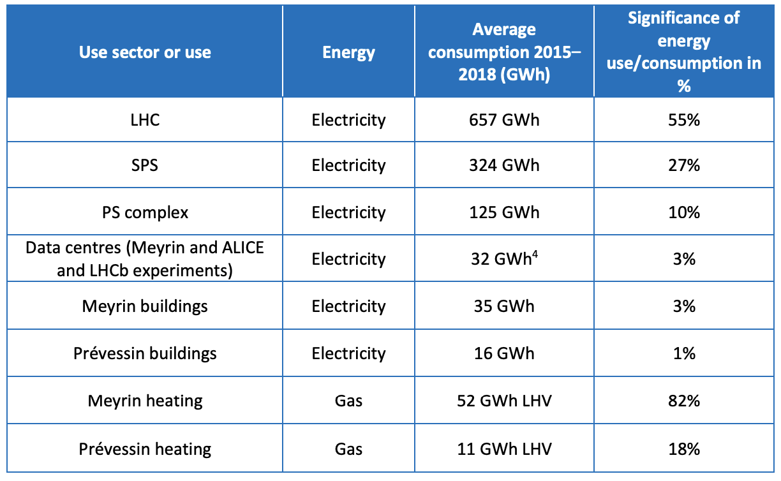
Energy performance plan (2022-2026)
  Main technical document together with the
  « energy review » including the:
    Retained perimeter
    Energy baseline
    Summary of actions carried out in the past
    Energy performance indicators
    Objectives and targets for the next 5 years
    Action plan for the next 5 years
    Benchmark against other research institutes
  Definition of 8 Significant Energy Uses (SEUs)
    Energy use accounting for substantial energy consumption and/or offering considerable potential for energy performance improvement
95%

Slide 23
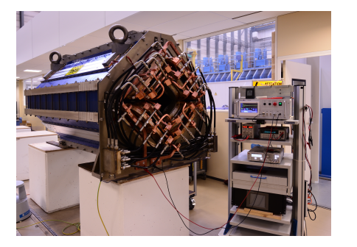
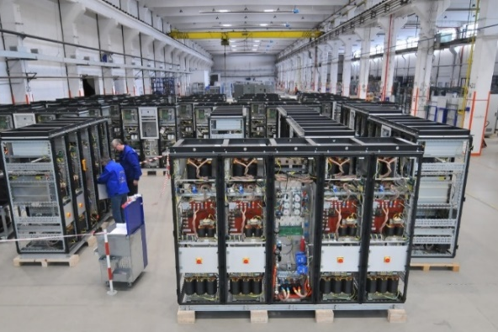
LESS: Improved efficiency
Facility upgrades: East Area Renovation (done during LS2)
Powering energy:
From 11 GWh/year to around 0.6 GWh/year
(> 90% reduction)

Slide 24
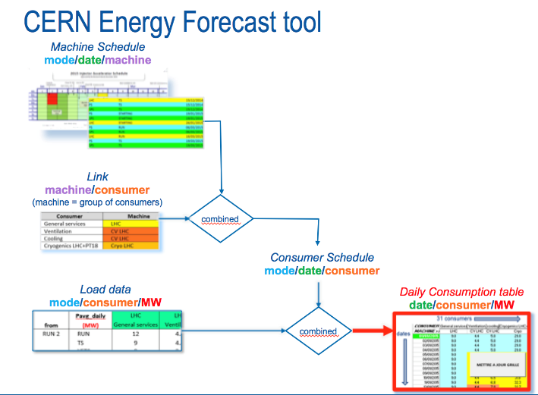
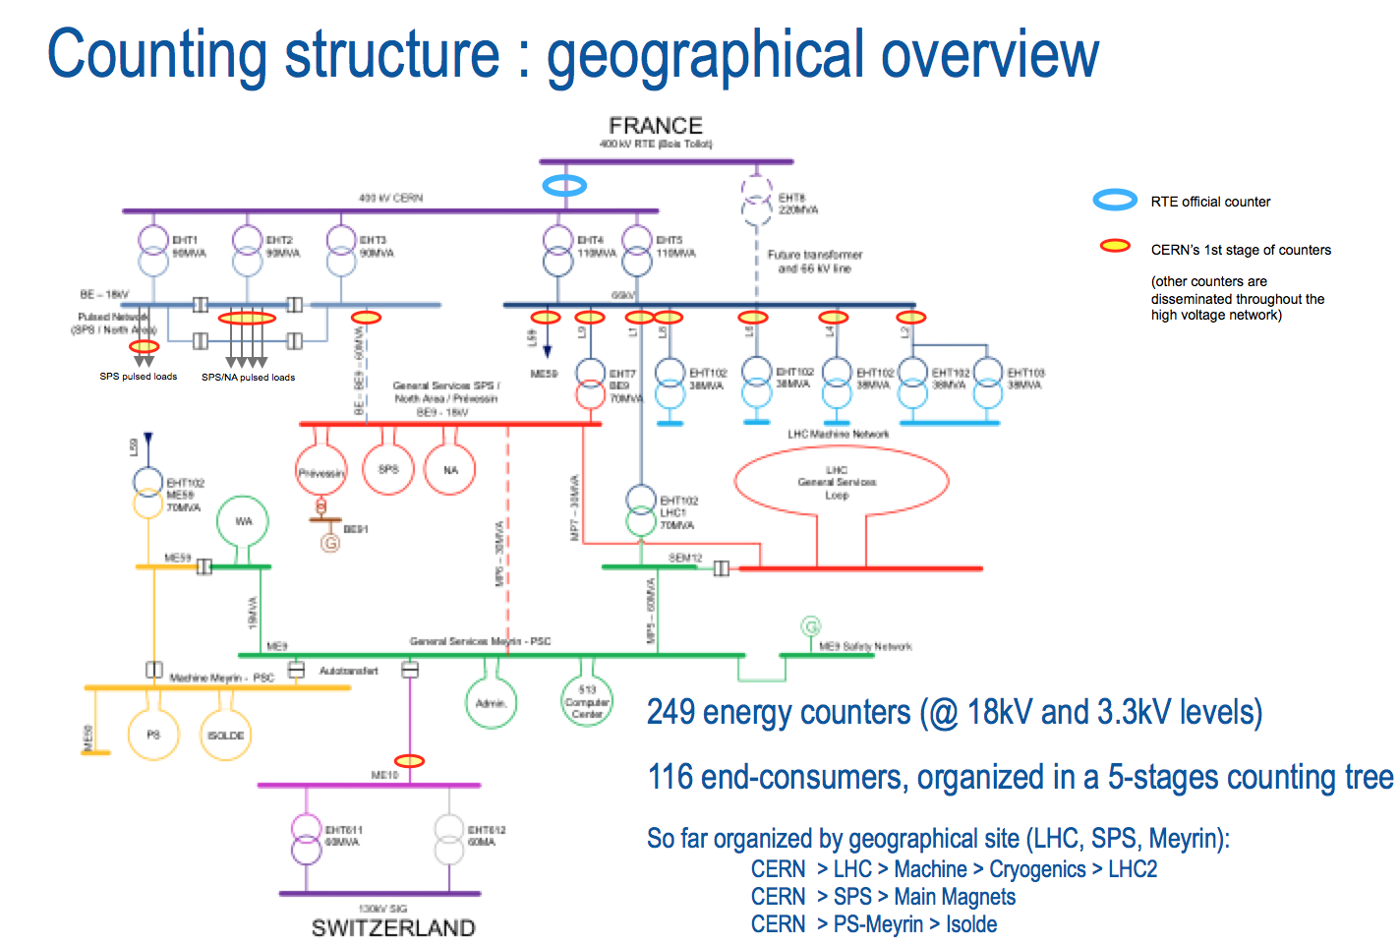
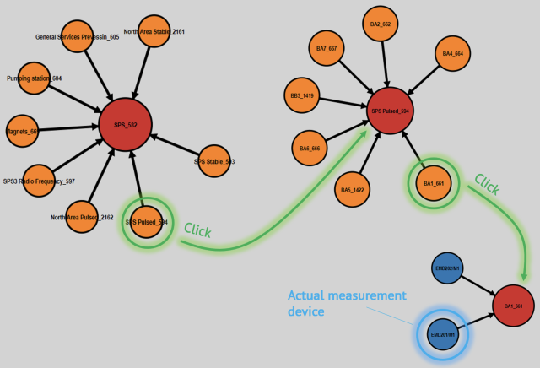
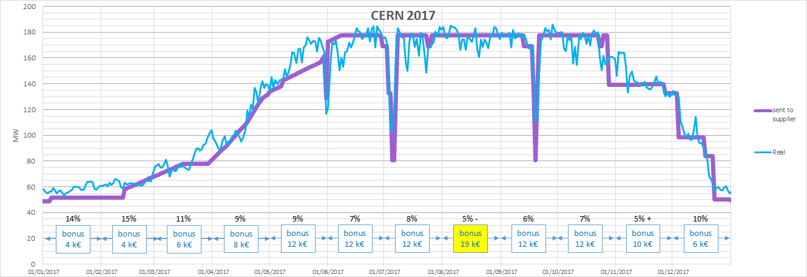
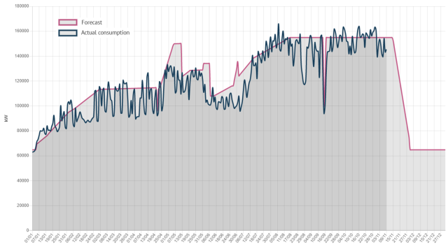
BETTER: Forecasts & measures
2nd version, integrated in Web-Energy tool to combine forecasts & measures
Measures: global accuracy better than 1% !
Model output sent to Energy Contractor
= model − communication and modelisation delays
Bonus for accuracy: 12/12 => 120 k€ !!!
2021

Slide 25
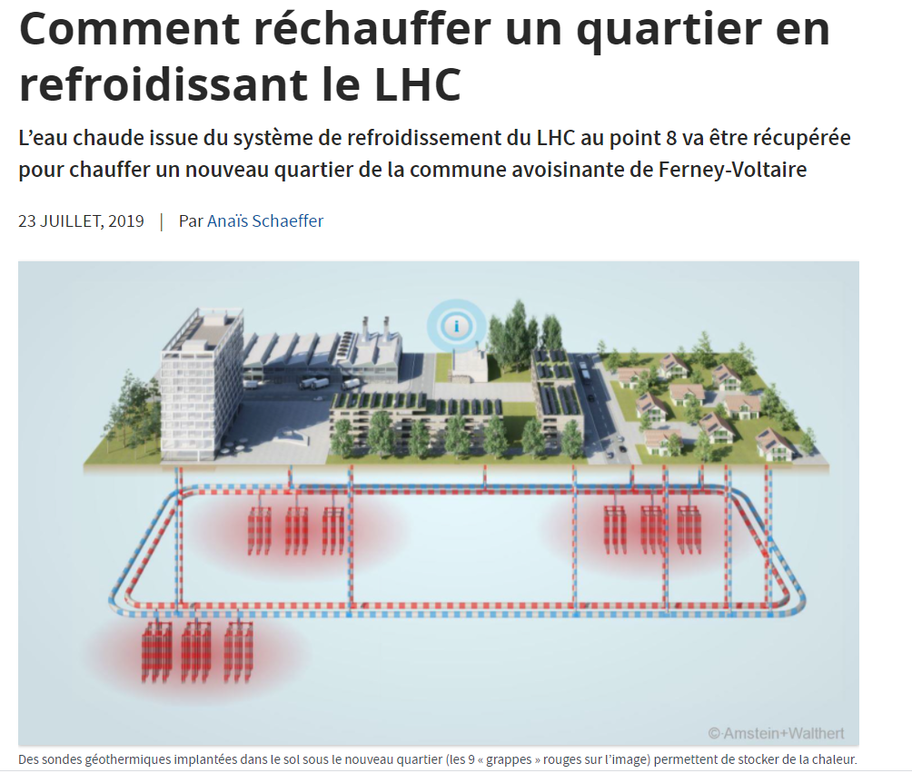
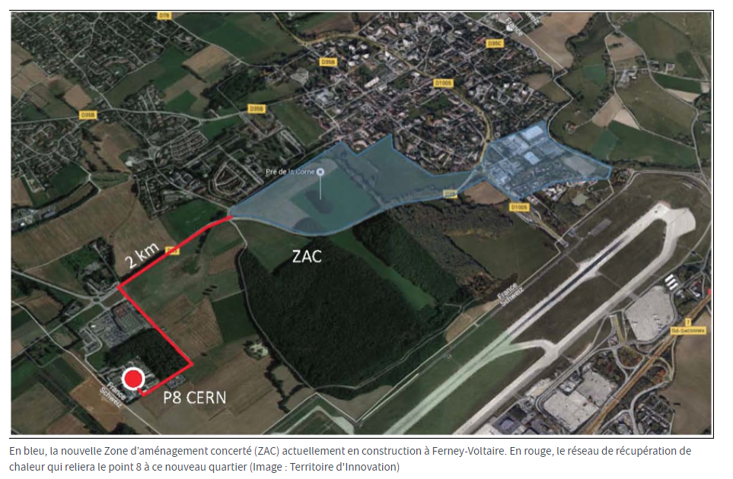
RECOVER

Slide 26
Action plan
 | Energy saved
Cooling and ventilation consolidation projects | 6 GWh/year
75 consolidation projects for buildings | 10 GWh/year
Science Gateway | 200+ MWh/year
Optimisation of Cryo operations mode | 25 GWh/year
Heat recovery projects
Meyrin and Prévessin | 30+GWh/year
Ferney-Voltaire | 20 GWh/year (for the neighbourhs)
  Total energy savings in place since 2010: 100+ GWh/year, mainly thanks to facility upgrades (e.g. East Area new magnets and power converters), changes in operation modes (e.g. SPS magnets powering, eco-mode for cryoplants) and large building consolidation
  Planned savings at horizon 2030 of about 80-100 GWh/year (e.g. consolidation of cooling and ventilation plants, heat recovery projects, building consolidation)

Slide 27
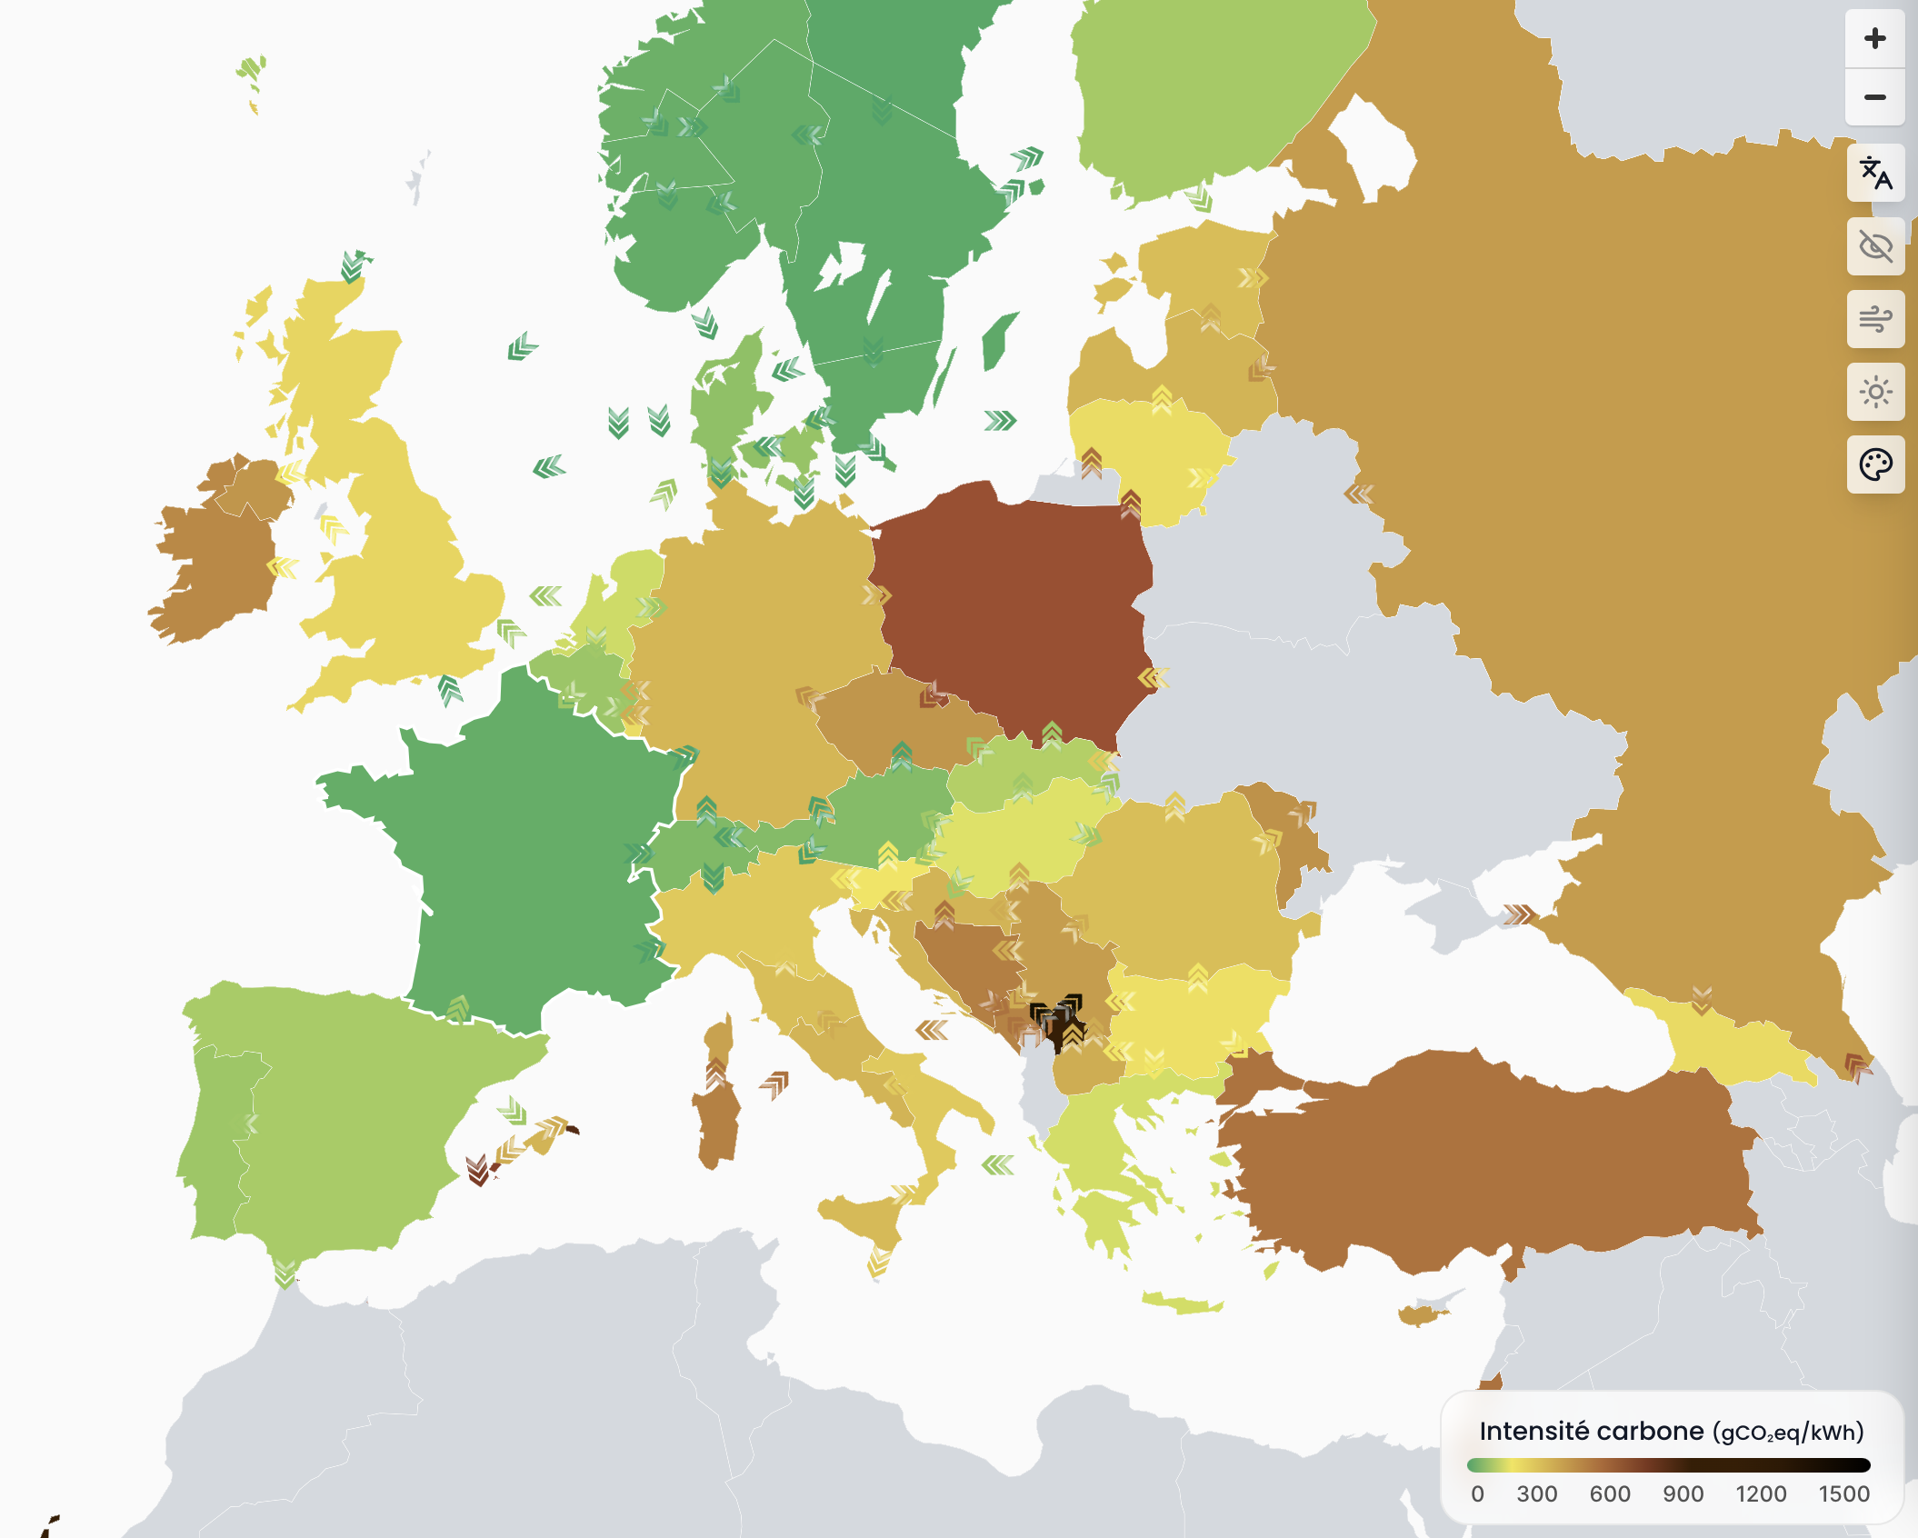
CERN’s electricity supply
  Under normal circumstances, electricity is entirely procured from France, where the energy grid mix is more than 90% low-carbon (scope 2 emissions)
  Main source (400 kV)
  Back-up source from Switzerland (limited power)
  https://app.electricitymaps.com/zone/FR

Slide 28

PPA implementation at CERN
Main contract
3+1+1 years
BVFM (flexibility)
Calendar baseload
~ 90%, less?
~ 10%, more?
Aggregator contract
Balancing services
1 to 3 years
PPA-PV contract #1
Physical « as produced »
15 years
PPA-PV contract #2
Physical « as produced »
15 years
Other PPA contracts
To be further studied

Slide 29
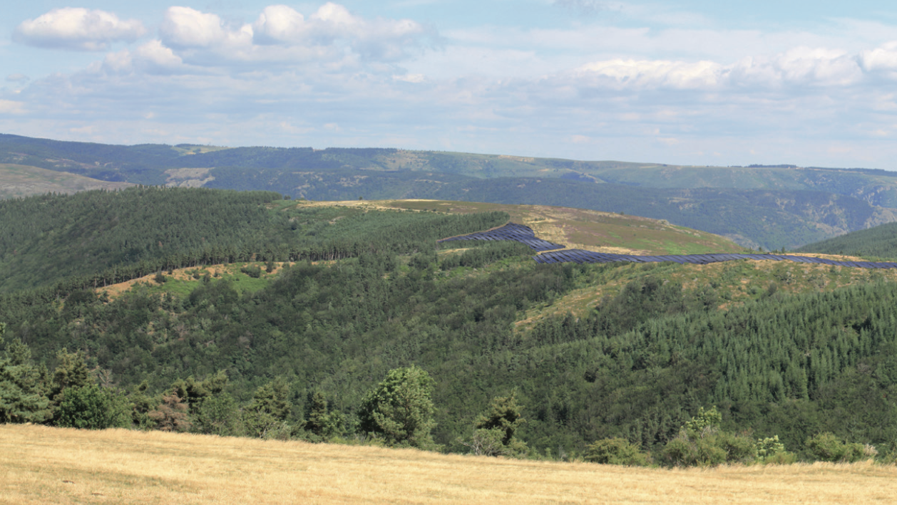
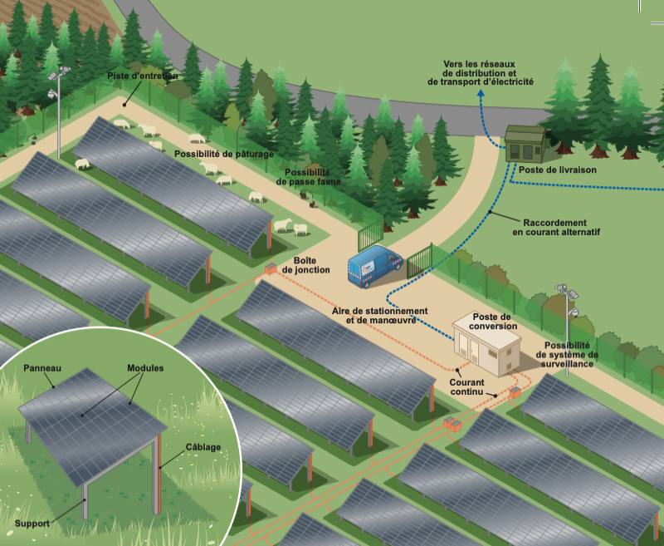
Renewable energy
  Three physical photovoltaic Power Purchase Agreements signed between CERN and producers in France (mandatory as CERN is supplied from France)
  Total of 95 MW peak, 140 GWh/year (~ 10% of CERN’s annual electricity consumption during Run periods,
  ~ 25% during LS periods)
  Solar plants representing a total area of 90 ha, i.e. ~ 40 % of CERN’s fenced perimeter – difficult to envisage onsite!
  All projects still have to be built (estimated start of electricity supply: January 2027)
  Contract duration: 15 years from the start of electricity supply

Slide 30
EMISSIONS

Slide 31
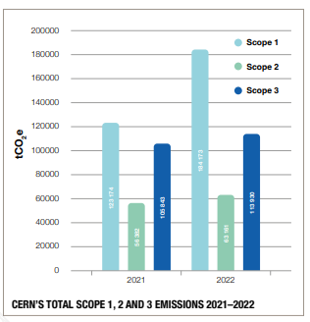
CO₂ eq emissions
Scope 1 emissions are direct greenhouse (GHG) emissions that occur from sources that are controlled or owned by an organization (e.g., emissions associated with fuel combustion in boilers, gas in detecto
Scope 2 emissions are indirect GHG emissions associated with the purchase of energy (electricity, steam, heat or cooling).
Scope 3 emissions are the result of activities from assets not owned or controlled by the reporting organization, but that the organization indirectly affects in its value chain

Slide 32
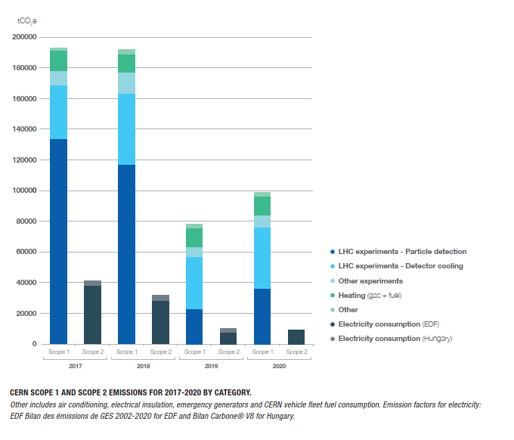
Scope 1
  Scope 1 emissions dominate CERN’s footprint
  Most of them due to (now) obsolete design of detectors
  Difficult to eliminate in near future in LHC, but experiments have promised to reduce by at least ~30% with LS3, and by 50% later (around 2030).
    Repair leaks
    Change fluids
      Massive use of CO₂ as coolant
For the next generation of colliders, this line will (almost) not be there anymore!!!

Slide 33
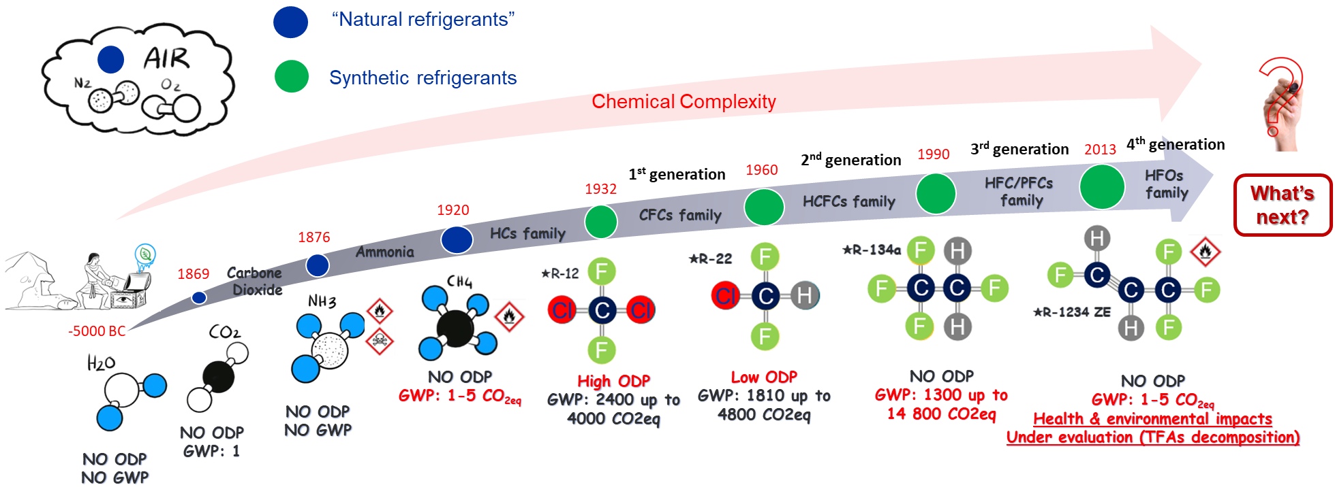
Refrigerant families and history
Courtesy R. Guida CERN
ODP: Ozone depletion potential
GWP: Global Warming Potential
PFAS: “Forever chemicals”
TFAs: Trifluoroacetic acids
No environmental restrictions
Banned
Phase out ongoing
Restrictions to come?

Slide 34
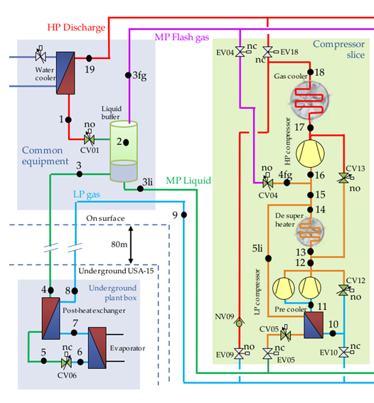
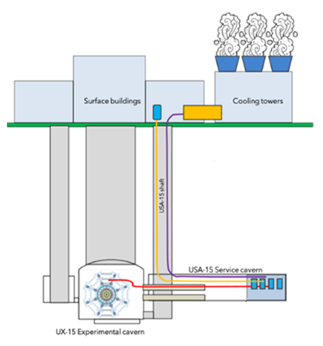
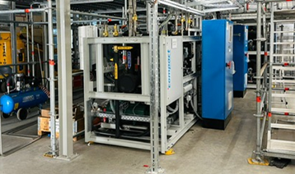


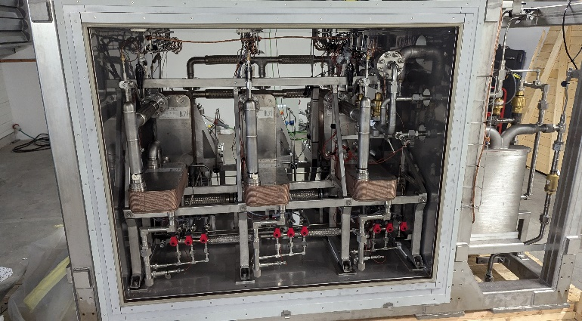
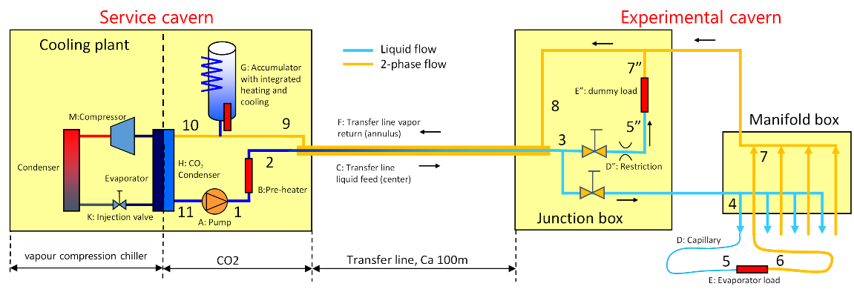
The new detector cooling architecture
Refrigeration production choice: “R744 Primary system”
Common module
Production module
First set (out of 11) of R744 chillers being installed @ CMS
~ 82 m
First (out of 15) CO₂ 2PACL loop received @ CERN
Cooling loop choice: “2PACL system”

Slide 35
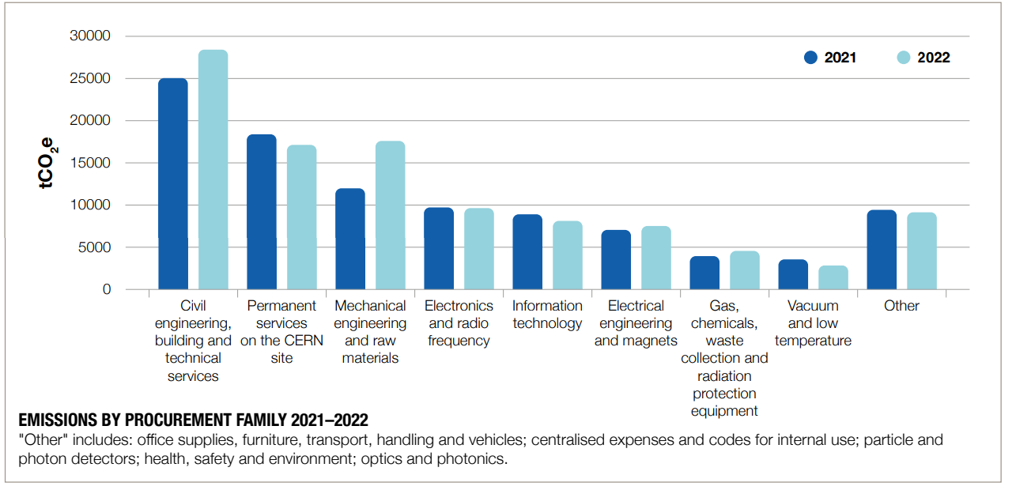
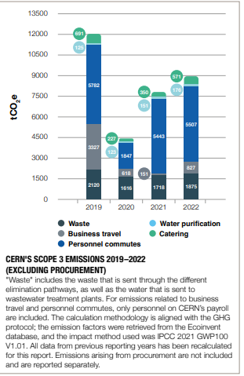
SCOPE 3

Slide 36
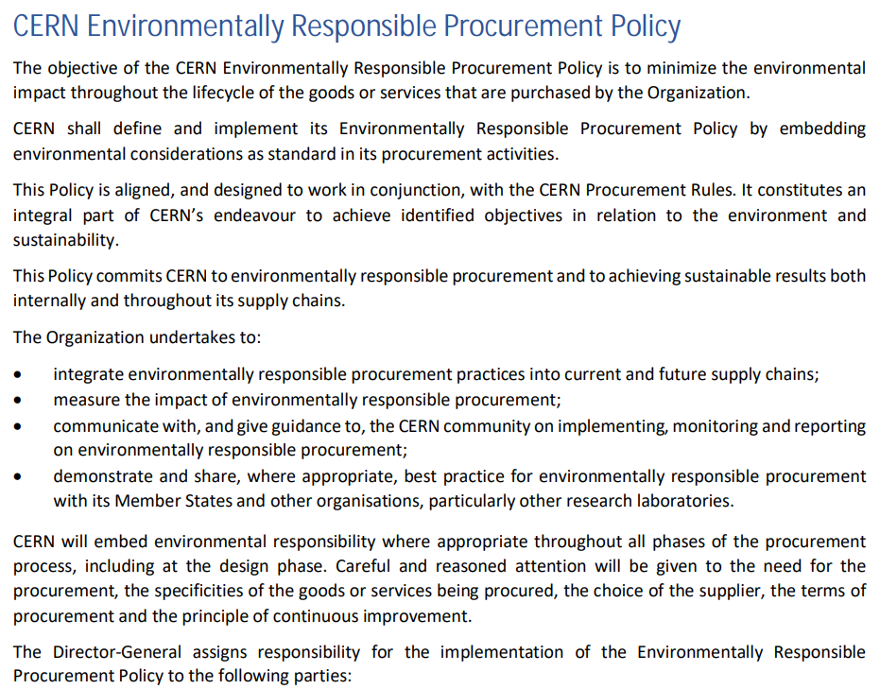
CERN and Sustainability – Responsible Procurement
Procured materials, components and services are a substantial part of CERN’s CO₂ footprint
In order to control the indirect (Scope 3) CO₂ emissions generated by CERN activities, the ED approved in July 2023 a Responsible Procurement Policy
  The implementation is being prepared in line with the provisions of ISO 20400:2017 – Sustainable Procurement
Key factors will be:
  Adjudication based on Total Cost of Ownership: CAPEX+OPEX
  Engagement with suppliers
  Alignment of CERN specifications with International environmental standards (e.g. for new buildings)

Slide 37
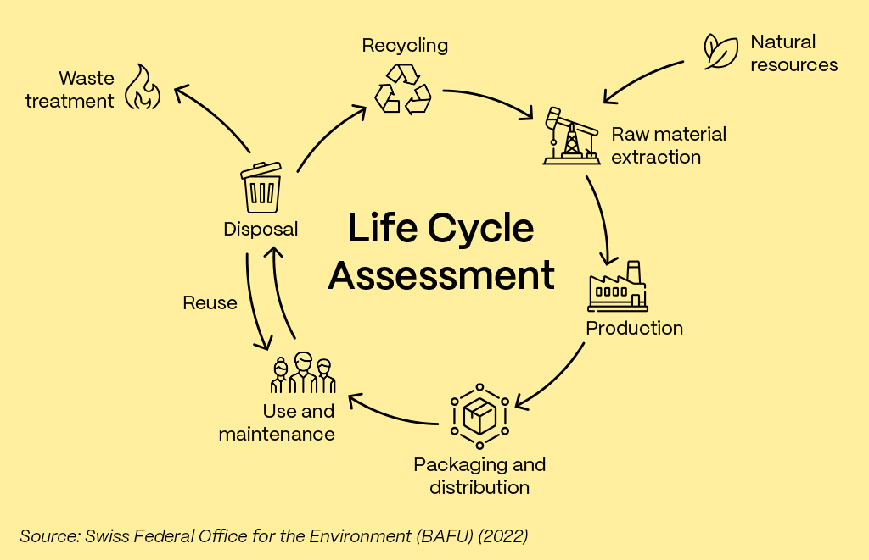

Slide 38

Lifecycle assessment
In a project, we follow this model*:
Ideally, we want to progressively shift the start of the LCA process more and more at the beginning of a project conceptual design
That requires the involvement of every (not only technical) person involved in the conceptual design, the choice of materials, the selection of operational modes etc…
* OpenSE Framework

Slide 39

CERN and Sustainability
Lifecycle Assessment training
Available on our learning hub for free! (need a CERN account)
Link available here
We are evaluating LCA software packages and have the intention to provide a common platform, ideally in collaboration also with other laboratories worldwide, to allow anybody to perform (simple) LCA from the beginning of a new project
We still advice, for large projects, to get professional help …

Slide 40
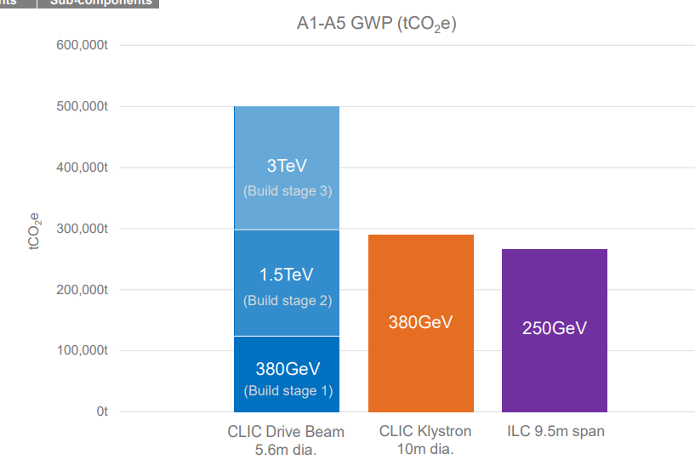
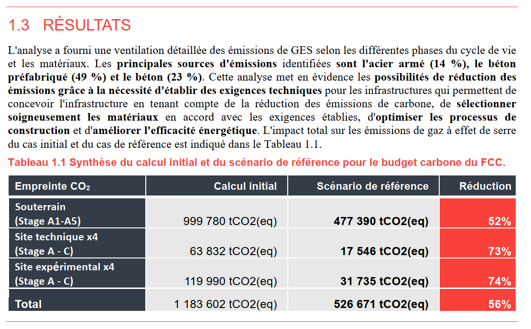
Examples: CLIC, ILC and FCC tunnels
CLIC & ILC
FCC

Slide 41
New Technologies

Slide 42
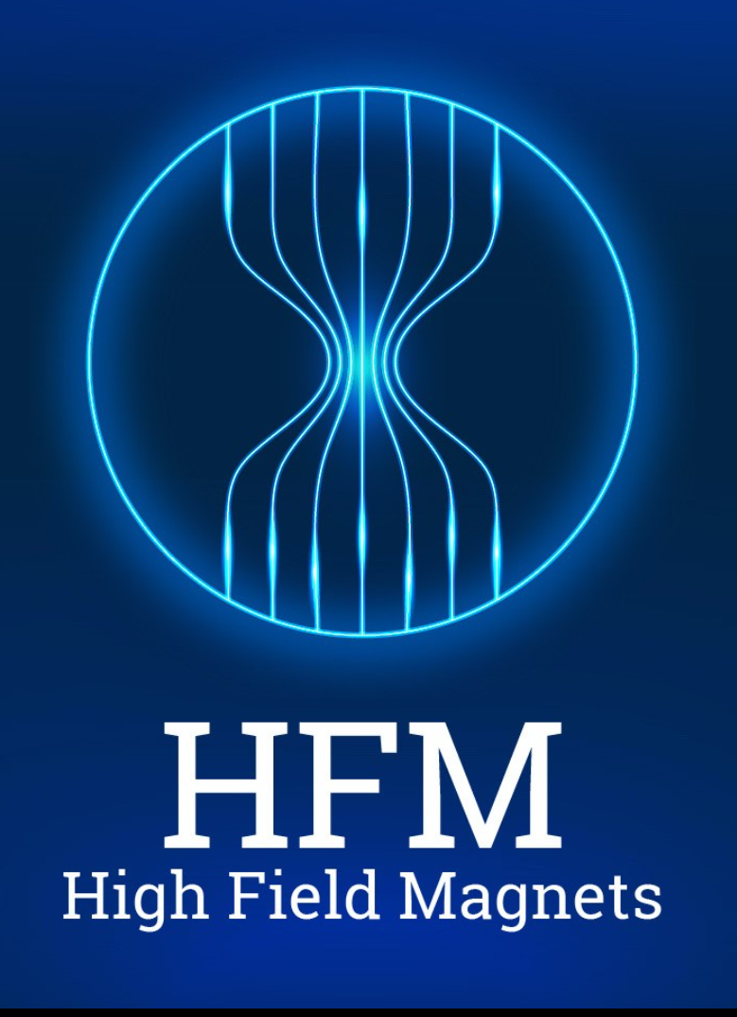
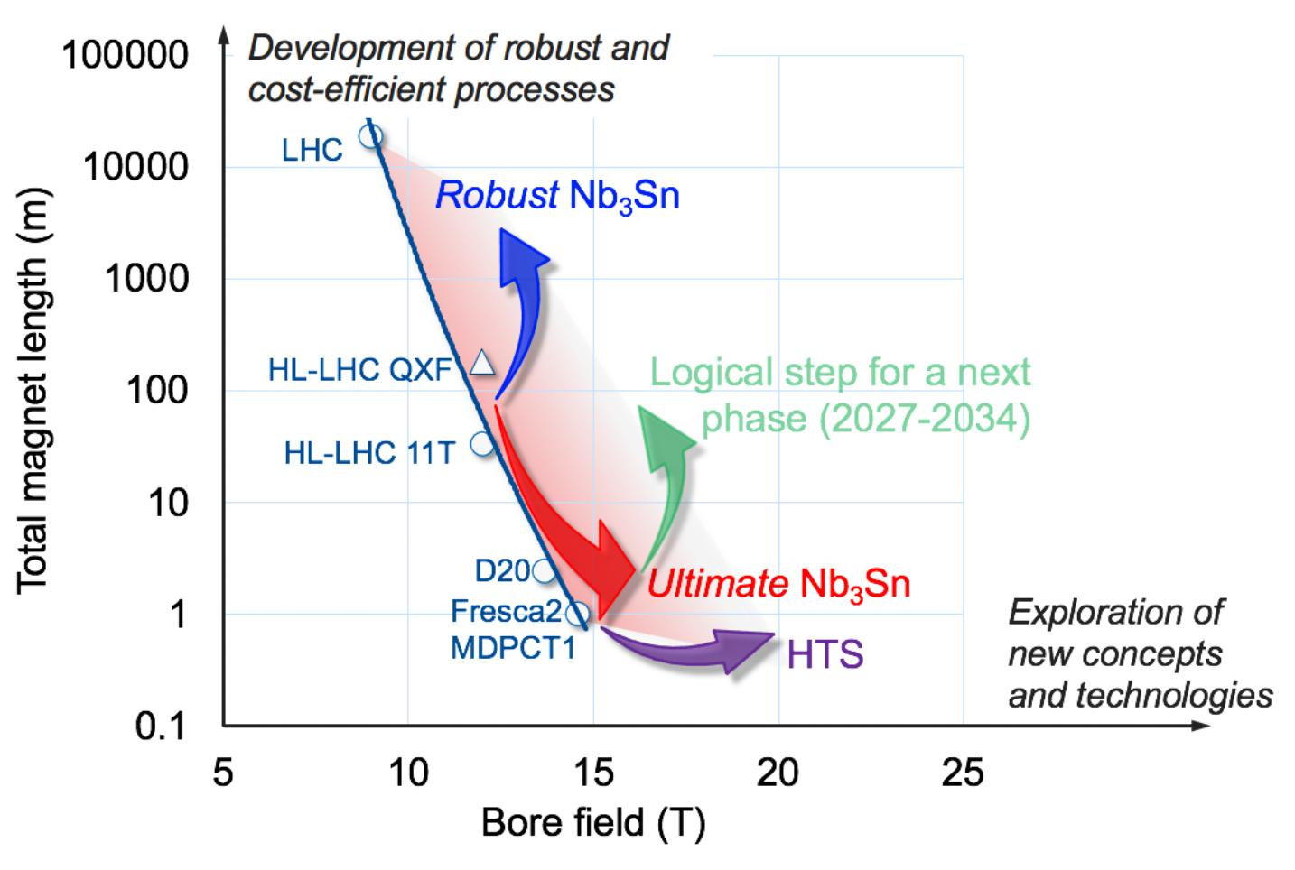
Superconductivity: High Field Magnets

Slide 43

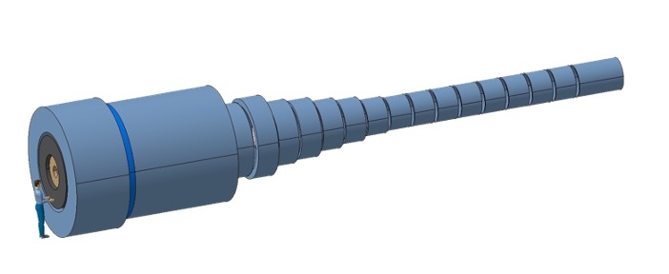
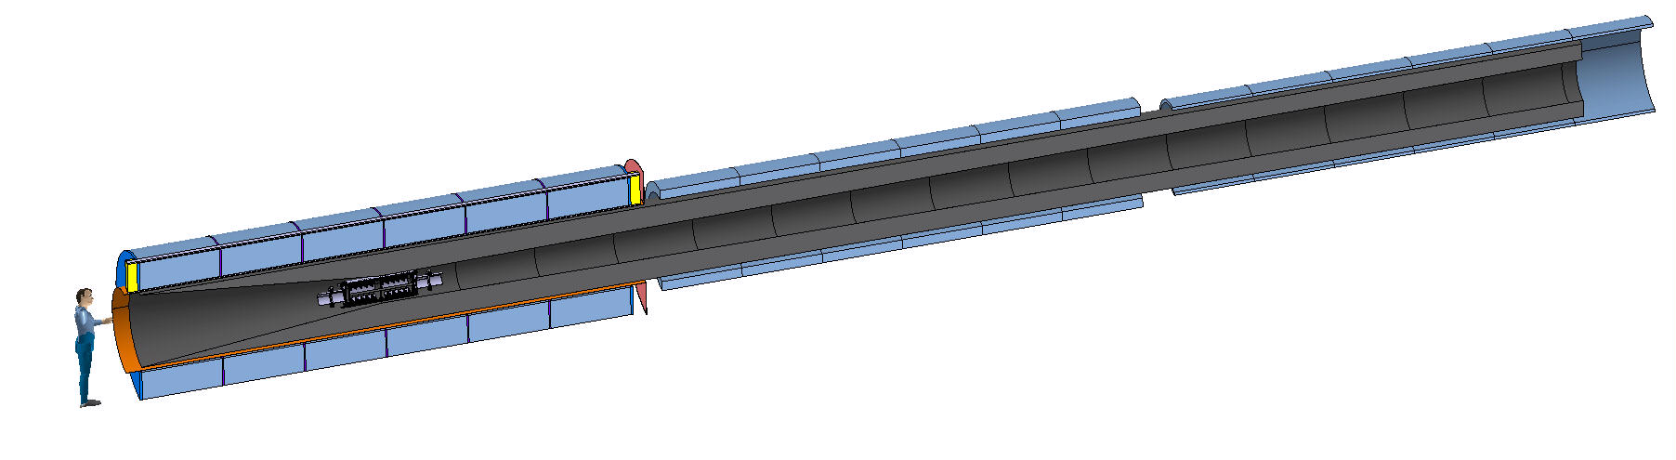
HTS is the future?
Target & Capture Solenoids for the Muon Collider
E_{M} = 2.9 GJ
T_{op} = 4.2 K
M_{coils} = 200 tons
M_{shield} = 300 tons
P = 12 MW
EM = 1 GJ
Top = 10…20 K
Mcoils = 110 tons
Mshield = 196 tons
P = 1 MW
US-MAP
Proposal
(<2016)
IMCC
Proposal
(2023)

Slide 44
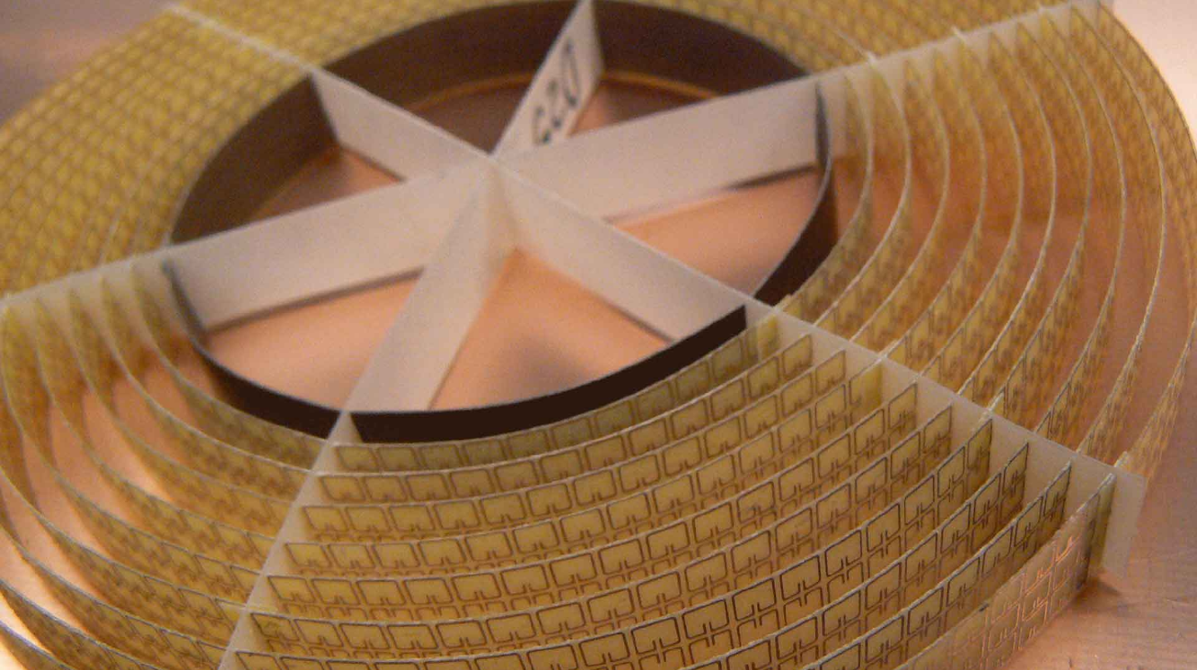

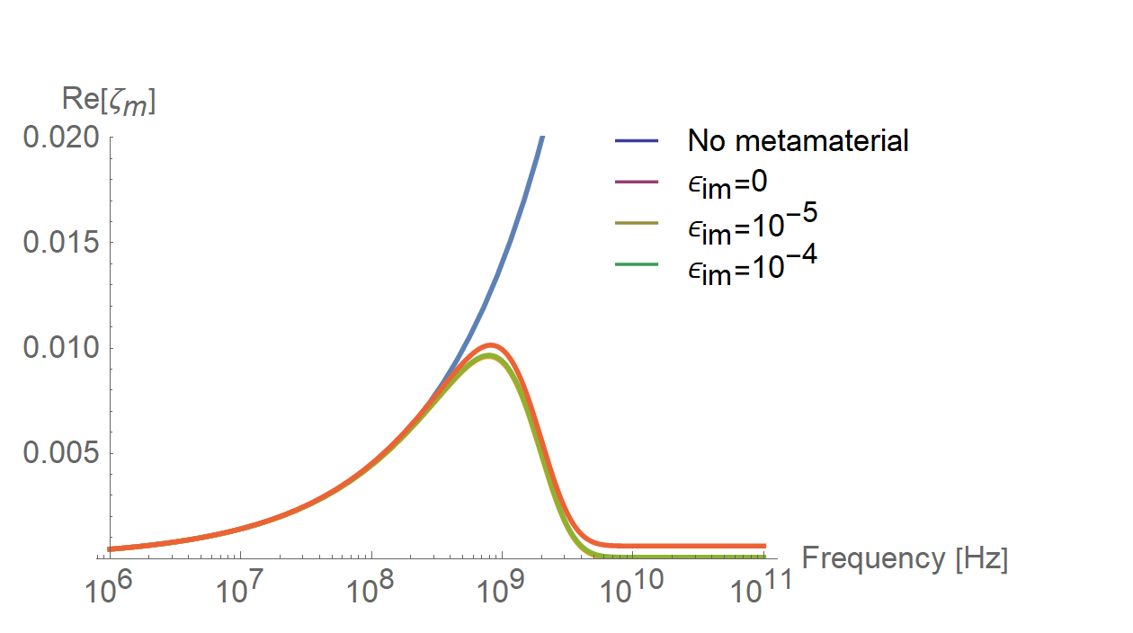


New Technologies for sustainability - metamaterials
Source of the picture
Source of the picture
Meta-conductive regime
Courtesy C. Zannini

Slide 45
Thank you for your attention!

Slide 46


Trainings available at CERN
(if you have a CERN account…)
LCA Training
Responsible Procurement Training

Slide 47
SPARE

Slide 48
CERN’s electricity consumption
CERN’s electricity consumption breakdown
Run2+Run3 average – Total : 1’180 GWh
  Electricity consumption breakdown
  Electricity consumption monitored through 300+ measuring devices
  Measurements available on WebEnergy tool, developed internally and also used for short and long-term forecasting (see energy.cern.ch, available to everyone with a CERN account)

Slide 49

BETTER: Forecasts & awareness
In order to raise awareness, already since years the line management (group leaders, equipment owners) receive a “virtual” invoice for the equipment under their responsibility
It is virtual in the sense that groups are not charged with the mentioned cost, but gives them a sense of the impact of their work, and the possibility to follow up along the years.

Slide 50


Where/why are GHGs used at CERN?
Gas used | Reason to use | Detector
R410a (GWP 1430) | Cool down to prevent self-heating and annealing behaviour | Silicon detector
R404a (GWP 22800)
R23 (GWP 12400)
C₃F₈ (GWP 8830)
C₆F₁₄ (GWP 9300)
R134a (GWP 1430)
 | Containment of charge Rate capability | Resistive Plate Chamber
SF₆ (GWP 22800)
CF₄ (GWP 7390) | Mitigation of ageing effects | Cathode Strip Chamber
 |  | Multi Wire Proportional Chamber
 | Time resolution | Micro Pattern Gaseous Detector
 | Cherenkov radiator | Cherenkov detector
C₄F₁₀ (GWP 8860)
Detector cooling
Particle detection

Slide 51

Lifecycle assessment
Process to evaluate the impact of a human activity
Long term (~5 - 10 years) vision: every component designed at CERN should integrate LCA from the start of the design process and be optimised
See Int J Life Cycle Assess (2017) 22:138–147) for the ReCiPe Methodology (2016) --- https://doi.org/10.1007/s11367-016-1246-y

Slide 52


End of Life
The main issue of CERN accelerators is that most of the components cannot be free-released at the end of their lifetime.
We have powerful tools today to anticipate the level of activation in components based on operational scenarios:
FLUKA.CERN is the Radiation physics code used to evaluate activation of materials, ambient dose, emission to atmosphere etc..
Is used in all our communication with Radioprotection authorities in the two host States, including for the characterisation of radioactive waste.
Can be downloaded at no charge for non-commercial (and non-military!) use, but requires some specific competence

Slide 53



Activation benchmarking
Dose rate as function of cooling time for different distances between sample and detector
Cu target
120GeV
pos. hadrons
t_{c} < 2 hours : mostly
¹¹C (β⁺, t_{1/2} = 20min)
CERF
Irradiation of samples of different materials to the stray radiation field behind the hadron beam target
2 hours < t_{c} < 2 days :
²⁴Na (β⁻γ, t_{1/2} = 15h)
[M. Brugger et al., Radiat. Prot. Dosim. 116 (2005) 12-15]

Slide 54

ActiWiz
Inhouse development based on CERN FLUKA
Within seconds it calculates radionuclide inventories and associated hazards for arbitrary materials & radiation fields
Comes with 80 built-in radiation scenarios specific to CERN’s accelerators
Main use:
  Radiologically optimized material selection
  Radiological characterization of radioactive waste
Safety benefit
Lower dose rates and committed doses
Operational benefit
Reduced downtime due to faster access
Less restrictions for manipulation & access
End of life-cycle benefit
Smaller amount and less critical radioactive waste
Smaller financial burden

Slide 55

















PREVESSIN COMPUTING CENTER
Purpose : The Contract is for the design, construction and 10-year M&O of the building and equipment.
Needs : Initial capacity of 4 MW available for IT equipment with stepwise future increases to 12 MW.
To meet CERN's environmental goals the project incorporates the following considerations :
The PCC is designed to be energy efficient with a target PUE (Power Usage Efficiency) of 1.10 (1.15 contractual)
Optimised water consumption via a recirculation system lowering consumption in hot periods
All cleared vegetation will be reconsolidated
The acoustic study used for design of the building follows CERN commitments
A heat recovery system is foreseen for up to 25% of power produced to be recovered
Green terrace on the roof
  CIVIL WORKS EXECUTION :
  Building foundations – 80%
  Ground level concrete works – 50%
  Below slab networks – 25%
  TESTING & COMPLETION :
  PCC Testing – Mar to Sept 23
  Operational from October 23
  PREVESSIN HEATING PLANT :
  MTP request 2021 and again in 2022
  Operational from 2026 if approved in this MTP

Slide 56



Heat Recovery Plant & Prévessin Data Center
Heating Plant
2025
Sept 2022
PDC (B.774)
Inaugurated February 2024
The new boiler room will include a 2 MW heat pump (with back-up boilers) and the possibility of installing a second heat pump in the future.
The heat pump will cover 60 to 85% of the Prévessin site's heating needs
Estimated reduction in emissions: 1,500 tCO2e from 2027 (80% reduction compared with current emissions in 2023-2024, which have already been significantly reduced compared with 2018)
PAC = 60 - 85%

Slide 57


Roadmap of the European Cement Producers Association (CEMBUREAU)

