Slide 1


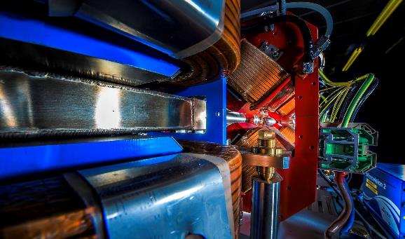
Making a brighter future through advanced accelerators
Prospects for Making Accelerators More Sustainable
The UK HEP Forum 2024,
26th November 2024
Jim Clarke
Director of ASTeC
STFC Daresbury Laboratory

Slide 2
Contents
Context
What are our UK facilities already doing?
What can be done with accelerator technologies?
Energy recovery linacs
Assessing an accelerator at the design stage
Centre of Excellence in Sustainable Accelerators
Summary

Slide 3
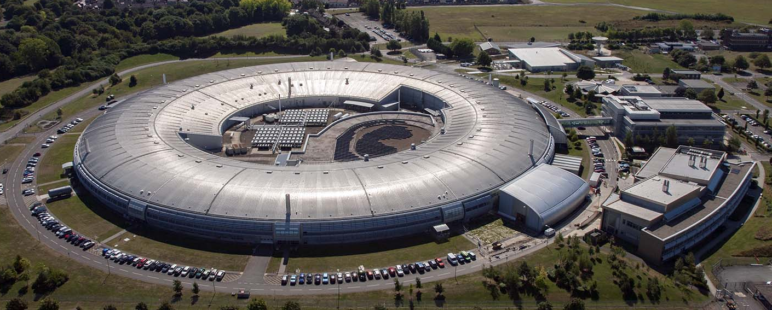
Particle Accelerators
Particle Accelerators are core to many of the UK’s existing major science facilities:
  ISIS neutron and muon source
  Diamond Light Source
  Large Hadron Collider at CERN
  European X-ray Free Electron Laser in Hamburg
  European Synchrotron Radiation Facility in Grenoble
They consume very large amounts of electrical power and other resources
They are essential tools for enabling research that will help the world achieve NetZero

Slide 4
Bigger and Better?
In general, the next generation facilities are physically larger and consume more power, concrete, and other resources than their predecessors
CERN Example:
  Future Circular Collider is proposed as a potential successor to LHC
  Power demand during operations is currently predicted to be 1.8 TWhr/year
  The estimate for the FCC-hh configuration which would follow after FCC-ee is 4 TWhr/year
  In comparison, the whole of the Geneva region only uses 3 TWhr/year!
  The tunnel is planned to be 91 km
  For comparison, LHC uses 0.8 TWhr/year and the tunnel is 27 km
CERN and the member states take sustainability very seriously and are making great efforts to reduce their environmental impact today and are acutely aware that all future projects will be carefully judged against their sustainability credentials
JP Burnett, FCC Week 2023
F Gianotti, FCC Week 2023

Slide 5
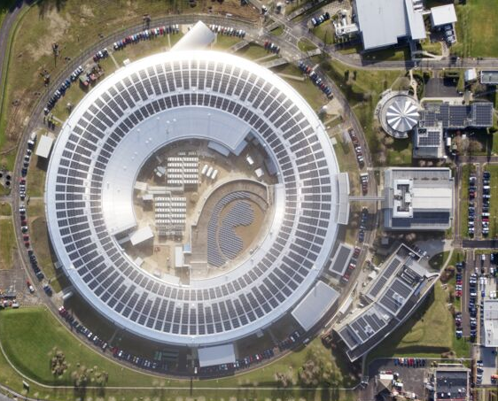
“Just Cover Them in Solar Panels!”
Operating facilities are making changes to their existing infrastructure to lower their energy demand from the grid
Diamond Light Source
32,000 m² roof now covered in solar panels which will generate 2.3GWh/y but this is only 5% of the total annual energy consumption
Four times these savings have already been made with less visible changes, such as variable speed drives on pumps and LED lighting

Slide 6
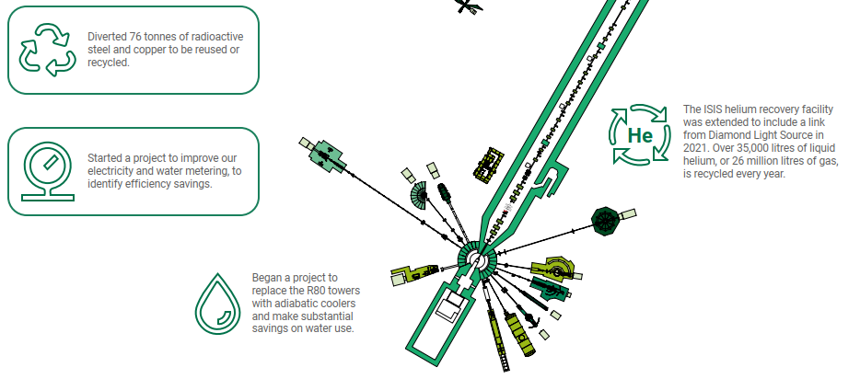
What is ISIS doing?
Solar Panels
The ISIS buildings are also covered in solar panels which generate 2.4GWh/y (3% of their total annual energy consumption)
These are just a few examples taken from a talk by Mike Glover at the Sustainable Accelerators 2022 workshop
Notes:
Don’t go through all. Mention one from each. 1. Sustainable design training package. 2: 76 tonnes of active steel and copper reused or recycled. 3. Sync RF cavity upgrade. 4.Computing sustainability working group. 5. D Lab recovery project.

Slide 7
What is the energy split for a research accelerator?
There is no simple, single, answer – it depends upon the type of accelerator
However, the two dominant technologies within the accelerator part of the facility are the RF and Magnet systems so improvements in both of these areas will be beneficial to the vast majority of accelerators
During construction concrete typically dominates the carbon footprint
Note that data is increasingly becoming a major contributor to the facility operating footprint

Slide 8
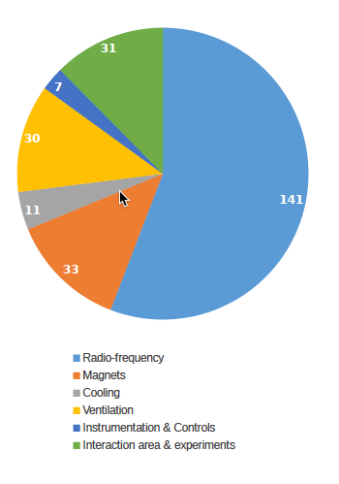
How much of the power budget for future colliders is RF?
1.5 TeV CLIC Power MW
Just drive beam RF
RF power includes all DC power, modulators, chillers, liquefiers and pumps, and magnets required as part of the entire RF system
Most linacs have between 40-77% of their total site power going into the RF system.
Synchrotron need more RF power at higher energy due to frequency scaling of synchrotron radiation
Stapnes CLIC mini workshop 2023
Graeme Burt Sustainable Accelerators Workshop 2024

Slide 9
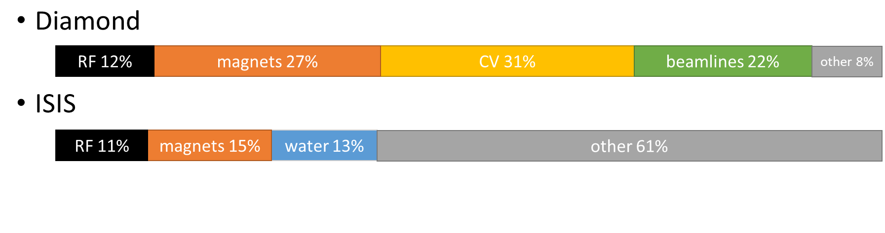
What about Neutrons and Light Sources?
ESS:
5 MW beam power
128 MW peak RF power requires 20.5 MW AC Power for RF sources
Cryo adds another 4.3 MW so about 20% of the RF power goes into the beam overall
Total site power is 53 MW (about 250 GWh/year) including experiments and facilities so RF makes up 47% of the total site power and 85% of the accelerator power
ISIS: 88 GWh/yr (expected to increase 2x for ISIS-II and higher percentage RF)
Diamond: 42 GWh/yr and 12% RF
EU XFEL is 90.4 GWh/yr = 33 GWh/year RF and 24 GWh/y Cryo around 60% RF
Graeme Burt Sustainable Accelerators Workshop 2024

Slide 10
RF amplifiers
RF amplifiers are not particularly efficient, the most common type is a klystron
Typically have a max efficiency 40-70%
  10% of the power goes to modulator losses
  35% is heat in the collector from the spent beam
  Efficiency limited by extraction of spent beam without reflection and beam energy spread (limited by slowest electrons)
But only have that efficiency at max power, need LLRF headroom so typically operate backed off (for example ESS uses 25%), reducing the operational efficiency by around 10%
Nuria Catalan Lashera, IFAST meeting, 2023
Graeme Burt Sustainable Accelerators Workshop 2024

Slide 11
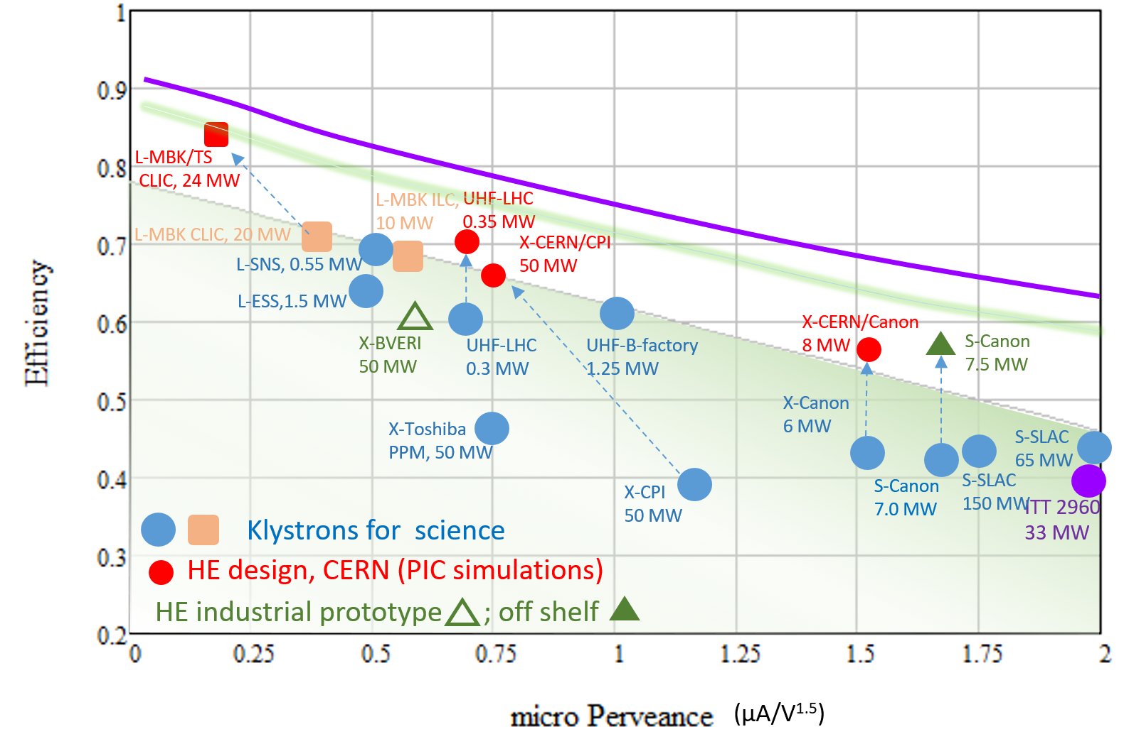
How efficient can RF amplifiers be?
Recent studies have shown we can increase efficiency by around 10-15% from current maximum
There is an active programme of demonstrating more efficient versions of existing catalogue klystrons being hosted at CERN, with strong Lancaster involvement
Very important to involve industry partners so these new versions are commercially available later
Graeme Burt Sustainable Accelerators Workshop 2024

Slide 12
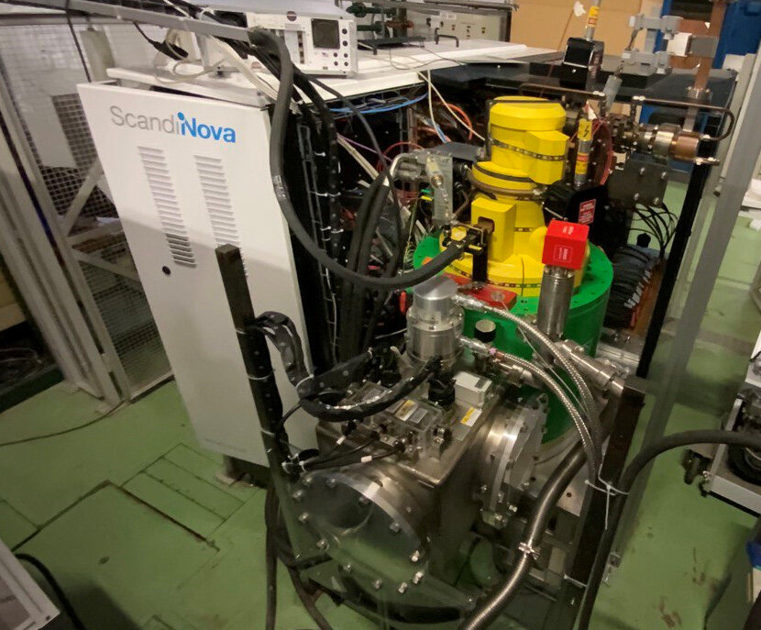
High field pulsed solenoids
All klystrons are wrapped in a solenoid which also uses significant power to operate
An X-band klystron requires a beam-focusing solenoid with magnet field: Bc = ~ 0.6 T in a warm bore-diameter of 0.24 m
A normal conducting electromagnet requires ~20 kW, corresponding to ~ 100 MW for ~ 5,000 Klystrons for CLIC-380.
The superconducting magnet option would require < 2 kW (Corresponding to ~ 10 MW for Cryogenics. --> 90 % power saving) - Recently tested by CERN/Hitachi
A permanent magnet solenoid would reduce this down to zero
Graeme Burt Sustainable Accelerators Workshop 2024

Slide 13
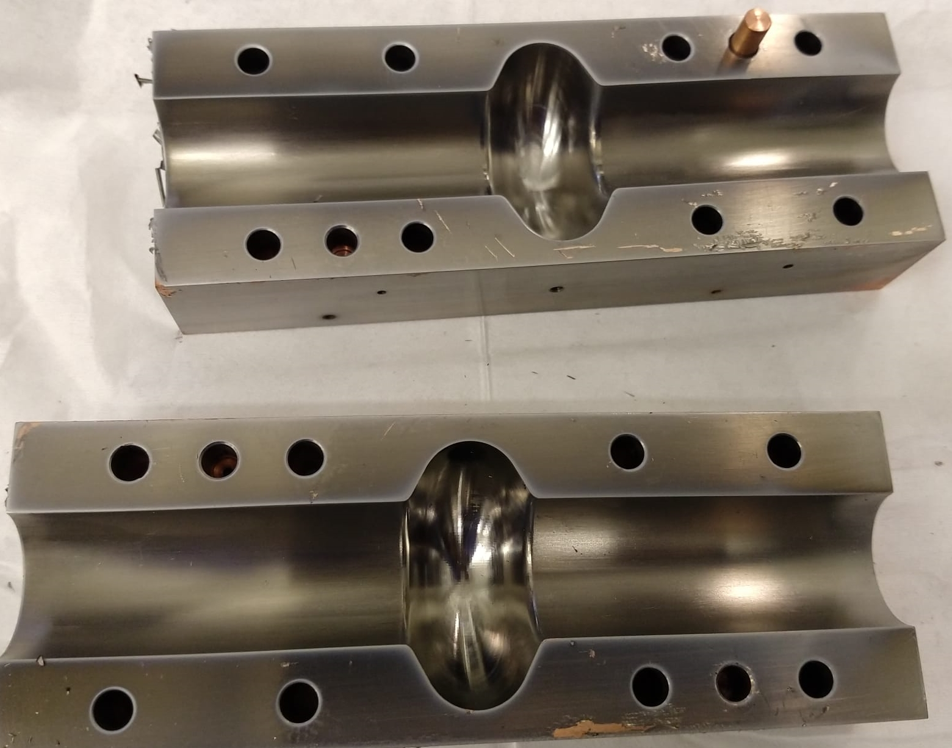
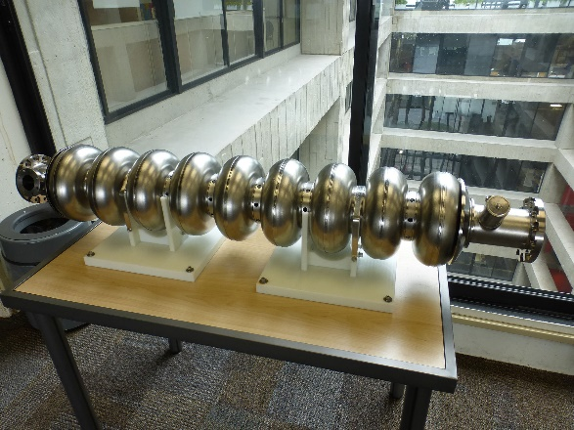
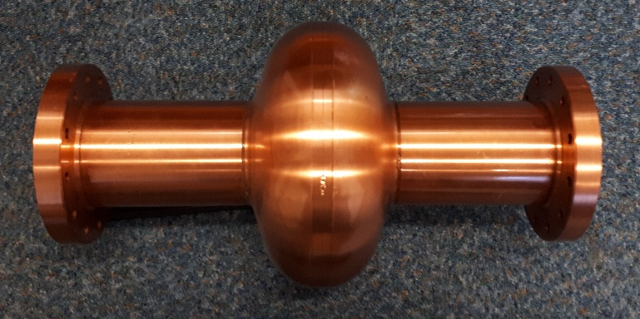
Superconducting RF Cavities
Many accelerators now rely on superconducting RF cavities
The RF losses in the cavity drop dramatically and so can accelerate many more bunches and have much higher particle beam powers
These cavities are constructed from high purity niobium and operate at 2 K
Many groups are developing the use of thin superconducting coatings onto a copper cavity as an alternative to solid niobium. By using alternative materials the cavity will be able to operate at >4 K
A 4 K cryogenic system uses one third the electrical power of a 2 K system

Slide 14
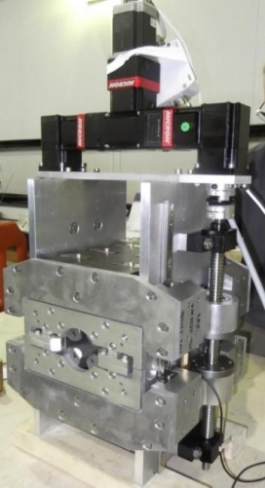
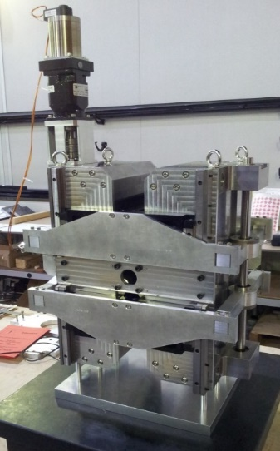
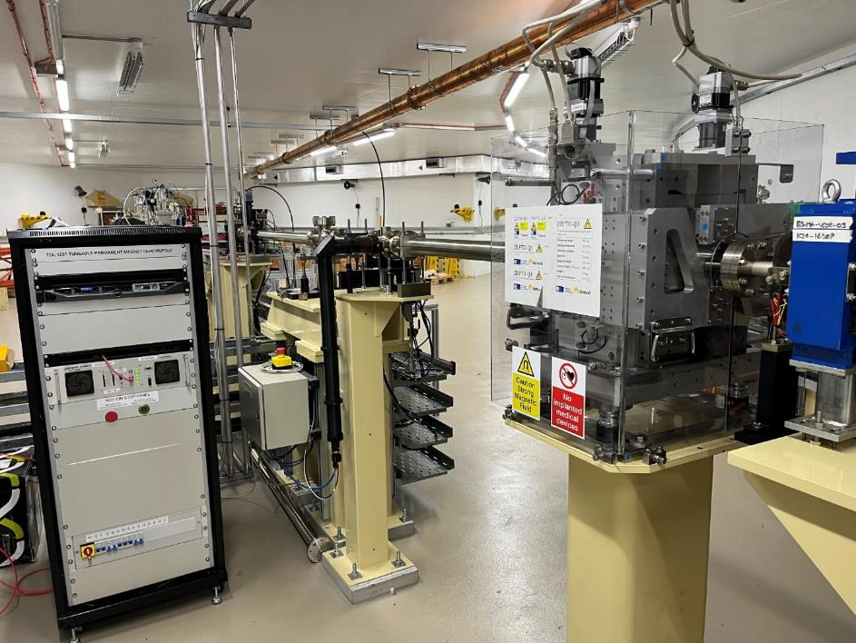
Permanent Magnets
Particle accelerators use large numbers of magnets to steer and focus the particle beams
STFC has built several prototypes that can replace standard accelerator electromagnets
  No power consumption
  No water cooling
  No power supply or power cabling
  Same footprint as electromagnet
  Adjustable strength
We have installed one as Proof of Concept into Diamond and it has been operating successfully for over a year, replacing an (~1kW) electromagnet – this magnet has just been removed from Diamond as planned and will now be re-measured to check that the field strength and quality is unchanged
We are now designing an improved version to replace an electromagnetic quadrupole in the CLARA accelerator at Daresbury as well, to be installed in 2025

Slide 15
Example of Potential Impact: UK XFEL
UK XFEL is a proposed new X-ray laser light source which is presently in the conceptual design & options analysis phase
The baseline relies on today’s technologies:
  Superconducting RF cavities using solid niobium cavities at 2K
  Room temperature electromagnets
Baseline energy consumption estimates for magnets and RF:
Total per year: 113 GWh, £29m, 7,900 tCO₂e
Using the new technologies under development huge savings will be possible:
Total per year: 28 GWh, £7m, 1,900 tCO₂e
Cryogenics 70 GWh
SRF 32 GWh
Magnets 11 GWh
Cryogenics 23 GWh
3.2
1 .1
Notes:
Caveat for these numbers, not intended to be accurate, just for illustration.
Similar savings are possible for other Big Projects like ISIS-II and FCCee. Scale and mix of technologies will be different in each case.

Slide 16
Energy Recovery Linacs
Jorgen D’Hondt

Slide 17
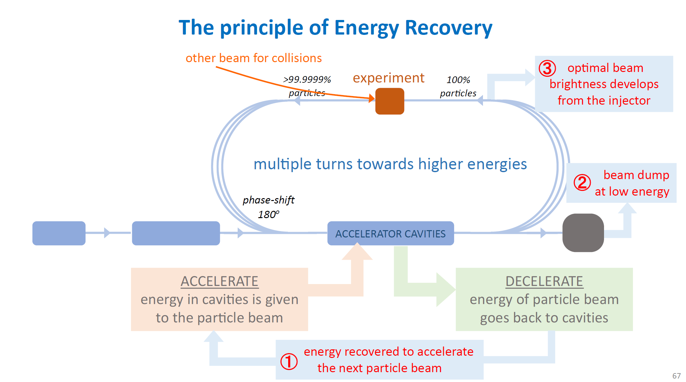
Jorgen D’Hondt

Slide 18
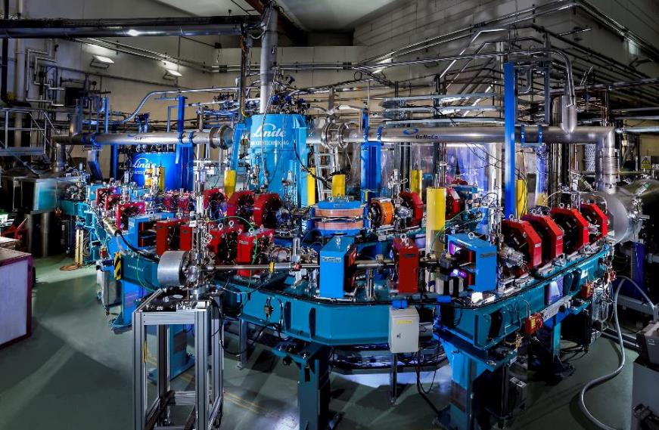
ALICE ERL
The UK successfully designed and built the first ERL in Europe.
It worked !
The power extracted from the beam = the power given to the beam by the RF system
No losses were measureable, 100% recovery

Slide 19
Jorgen D’Hondt

Slide 20
Jorgen D’Hondt

Slide 21
Assessing the Sustainability of an Accelerator
STFC has recently completed an assessment of sustainable practice in particle accelerators, using a new facility called RUEDI as a case study
  To deepen our understanding of the carbon footprint of an accelerator based user facility – during both construction and operation – and so we know where to focus our efforts to have the greatest positive impact
This wasn’t a full life cycle assessment
Looking for the worst offenders and opportunities to reduce the carbon footprint
Influence the design before we start construction to minimise overall lifetime emissions

Slide 22


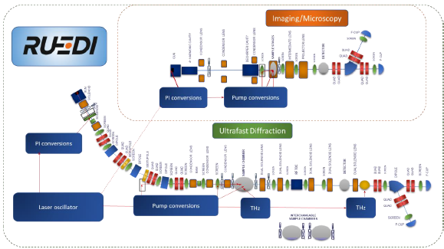
https://ruedi.uk/
Relativistic Ultrafast Electron Diffraction and Imaging
Facility to be built at STFC’s Daresbury Laboratory
  4 MeV; diffraction at 10-100 fs; imaging at 10-100 nm; fC-pC bunches
TDR was completed early 2024
£124m for construction announced March 2024
RUEDI will be a small and low energy accelerator that will support a broad multidisciplinary user base

Slide 23
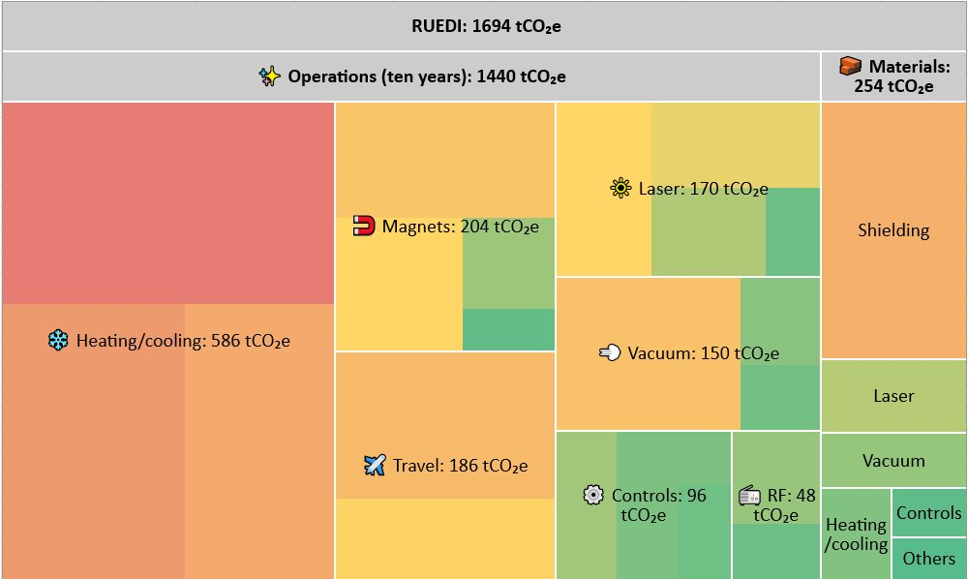
Summary
Assumes a ten year operating period and published government figures for carbon intensity in the next decade

Slide 24
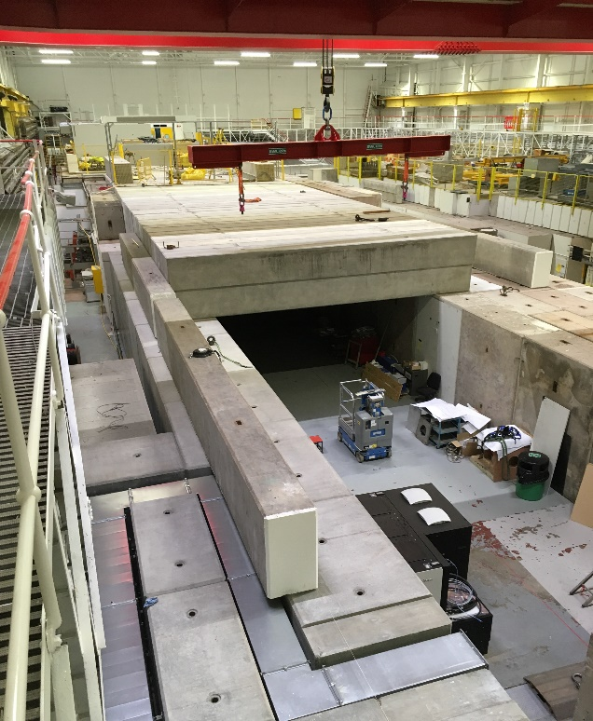
Shielding
Concrete: almost the ideal shielding material
  Absorbs gammas and neutrons well
  Long-lasting and durable
  Easy to manufacture
  Acts as a structural material – fulfils two roles
BUT: big carbon impact
  High temperatures involved in cement production (1450°C)
  Emission of CO2 is fundamental to the process: CaCo₃ -> CaO + CO₂
  Concrete production accounts for 8% of global CO₂ emissions
For RUEDI, need 0.7m thick walls, plus roof
  Using existing building, no need for new floor
  Total 927 tonnes of concrete ➔ 137 tonnes CO₂e
Can we do better?
  Reuse old blocks (long history of this at our 60-year old lab)
  Use concrete with additives in place of 100% cement
  Including 50% GGBS can reduce carbon intensity of concrete by 42%
  ISIS looking at alternatives to standard concrete for ISIS-II
Images credit: Jim Clarke, UKRI

Slide 25
CESA
and has actioned ASTeC to lead and develop the Business Case
We held several stakeholder engagement sessions in 2023 and established a working group comprising of UK stakeholders.
The WG members are:
Stefania De Vido (CLF) Ben Shepherd (ASTeC) Stewart Boogert (Cockcroft) Cristina Hernandez-Gomez (CLF) Mike Glover (ISIS) Peter Coll (DLS) Giles Davis (STFC Carbon Manager) Fergus Wilson (PPD) Phil Burrows (John Adams) | Jim Clarke (ASTeC) Ailidh Snook (SPC) Lisa Howard (ASTeC) Phil Atkinson (TD) Massimo Noro (BID) David Brown (PD) Anne-Marie Scott (Finance) Stuart Buxton (Estates) Stacey Latham (Estates)

Slide 26
CESA
STFC has ambitious plans for a Centre of Excellence in Sustainable Accelerators
Our vision is that CESA is a “centre of mass” for UK-based accelerator R&D with a specific mission to make accelerators significantly more sustainable
  To increase the technology readiness levels (TRLs) of accelerator technologies to a point that they can be adopted by existing and future facilities
  Partnering directly with industry so that new products can be procured commercially as they are developed and proven, enhancing the UK economy and return from CERN
  Has a small core team who provide training to engineers, technicians and scientists in sustainable design practices backed up by providing access to sustainability software tools and databases
  Working collaboratively with international partners
We need to invest now to ensure we are ready in time for the potential huge projects which are on the horizon – such as ISIS-II, UK XFEL, and FCC
  It will take many years to demonstrate new technologies
  We still have time but need to get going as they aim to start construction from the early ‘30s

Slide 27
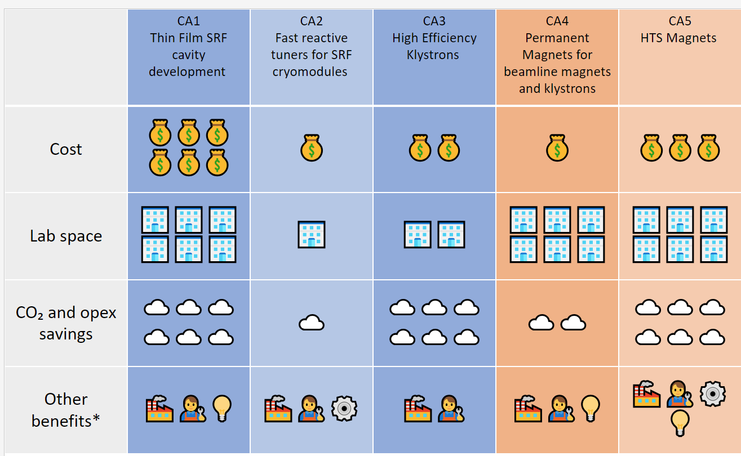
CESA Technology Areas: one-page overview

Slide 28
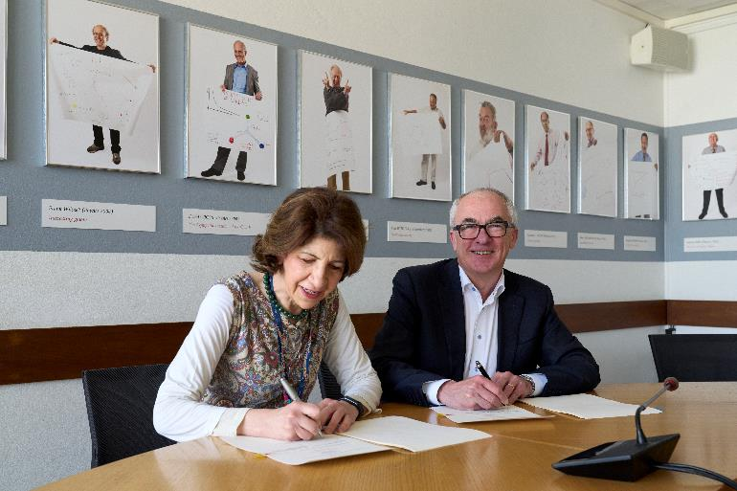
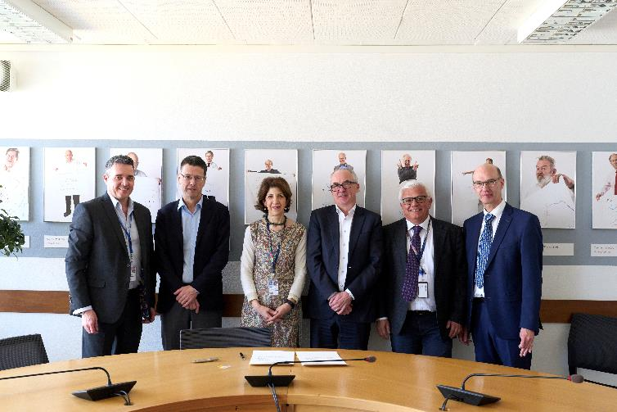
CESA – Agreement with CERN
STFC and CERN have signed an agreement to work together on sustainable accelerators
In recognition of the aims of CESA and the status of our activities CERN have signed an agreement to work with us on sustainable accelerator technology developments and CESA in particular
On 22nd March 2024, Mark Thomson and Fabiola Gianotti signed the agreement at CERN.

Slide 29
National Cryogenic Facility Proposal
CESA needs direct access to a large-scale cryogenic facility which provides the cooling for the superconducting RF and magnet developments
This facility would also be beneficial for the fusion energy sector (UK AEA/STEP, industry) and combining our HTS ambitions, with direct support from CERN, also makes sense
Another strategically important sector that needs access to large-scale cryogenic capability is Quantum Computing
  PsiQuantum already has a very active presence at Daresbury because they wanted access to our existing cryogenic system – they have already identified a need for access to a much more powerful system to take their research to the next stage
There are similar cryogenic requirements from the liquid hydrogen for transport sector, the UK space sector, power transmission and generation
Supporting accelerators, fusion, quantum computers, transport, space, energy and so on with a single large-scale facility makes sense for the UK and so STFC is actively discussing this concept now with all the stakeholders.

Slide 30
Summary
Particle accelerators sit at the heart of many of our most impactful user facilities and will help us develop the skills, knowledge and technologies to achieve NetZero
The UK particle accelerator community, national labs, academia and industry, are recognised internationally as being long term leaders in the area of sustainability
  Accelerator technology R&D
  Analysing the sustainability of future facilities
STFC has the ambition to scale up accelerator technology developments since the social and economic benefits could be very significant
  Aim to minimize the carbon impact over the lifetime of each facility without compromising on the science output
  Maximise the commercial benefit for the UK
The emerging concept of a National Cryogenic Facility would also support many other strategically important areas such as Quantum Computing and Energy

