Slide 1
Greening the Grid
UK HEP Forum
Coseners, Abingdon
27th Nov 2024
David Britton GridPP Project Leader
WLCG Deputy Leader

Slide 2
Towards NetZero Computing
Capture
NetZero
Offset
Scope-2: Indirect emission of CO₂ due to power used.
Scope-3: (Embodied) CO₂ emitted during the manufacture of hardware.
Reduce Scope-2
Reduce Volume
Reduce Scope-3
Software
Buy Lower Scope-3 HW
Reduce Power
Greener Power
Techniques
Hardware Lifetime
Newer Hardware
Supply Choice
Computing Models
Hardware Choice
Usage Pattern
Some of these things are not under direct site control.
Many of these things are costly.
Lower PUE
Benchmark Hardware
Measure Power Use
Life-Cycle Assessment
Carbon Inventory
Carbon Model
Carbon Allocation
Measure + Model + Monitor → Moderate
Notes:
Roadmap towards NetZero and of this talk. First part of talk is about VOLUME.

Slide 3
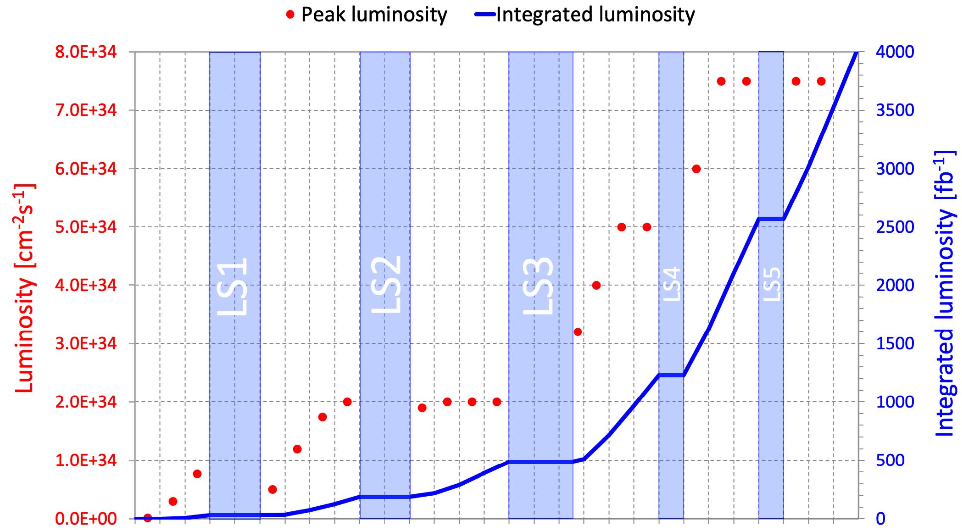
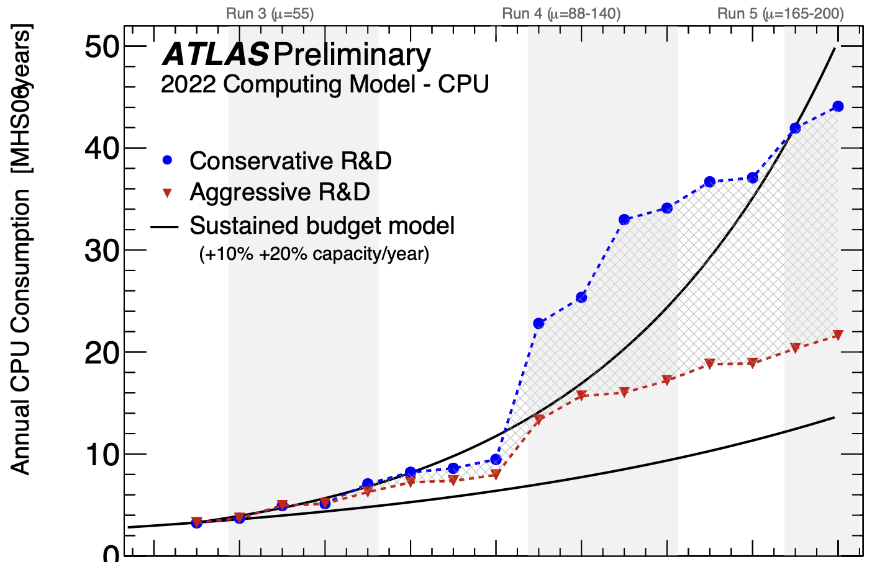
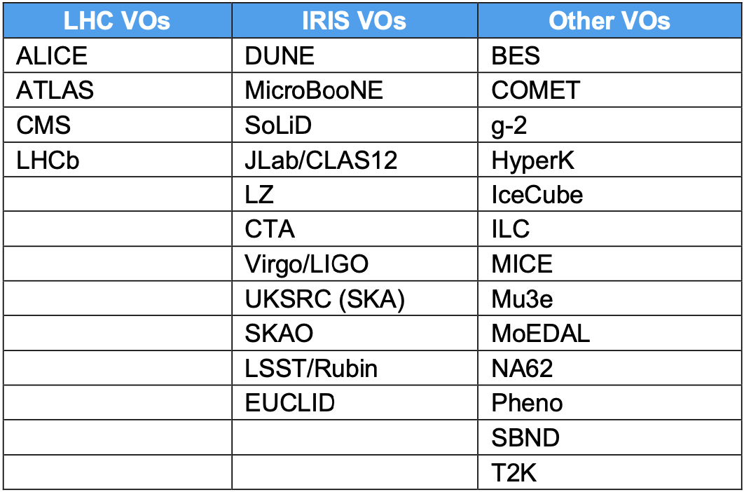
Volume of Compute
The LHC volume of compute (and storage) will at ~ double by 2030’s.
DUNE will ramp-up on same timescale.
Other PPAN science running on the Grid will continue to grow.
2026-2030
Experiments using the Grid
2030-2034
2026-2030
Notes:
Volume is increasing; For LHC complexity is ALSO increasing (due to pile-up) so need scales bigger than linear.

Slide 4
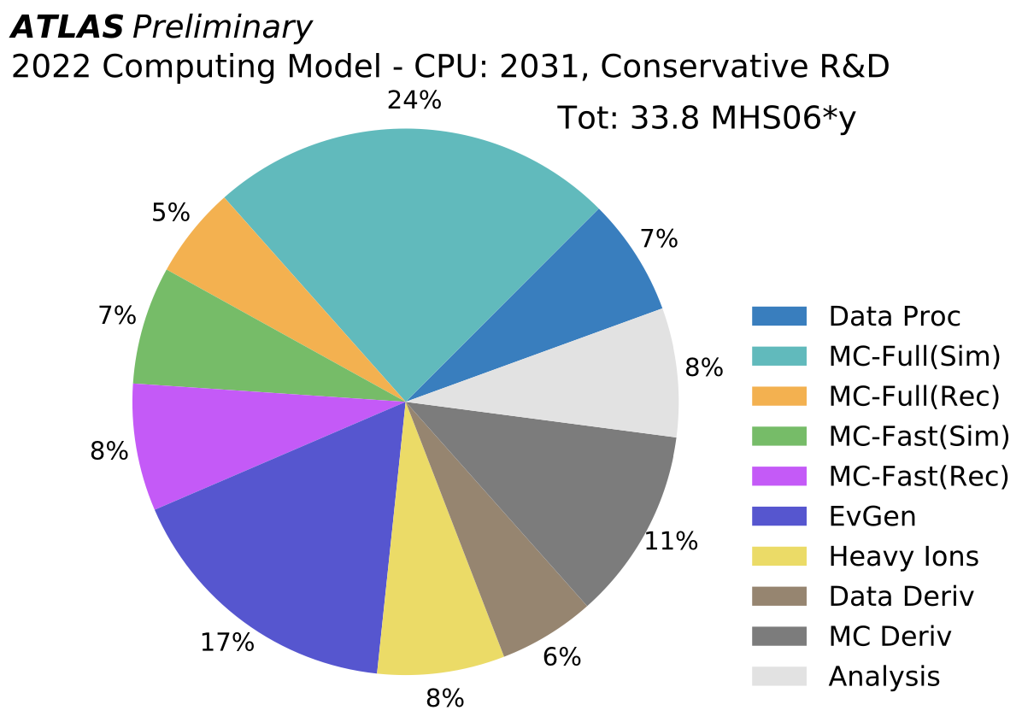
Software Improvements (Why we need UK Swift-HEP)
Full Sim
Full reco
2022: Dedicated profiling of EvGen stage has reduced computing cost of CPU-based multi-leg event generation by factor 40x–80x.
https://arxiv.org/abs/2209.00843
https://indico.cern.ch/event/1466097/contributions/6216468/attachments/2965443/5217083/cg_swifthep_warwick.pdf
EvGen
MC Deriv
Fast Sim
Fast reco
Analysis
p-p/HI Data
Data Proc
Data Deriv
pp → e⁺ e⁻
(LO+NLO)
-
pp → t t
(LO+NLO)
40x
Notes:
Work improving event generation single-handedly reduced ATLAS requirements (globally) by 10% (BOUNCE – doesn’t reduce present but DOES reduce future)

Slide 5
Software Improvements (Why we need to fund Experiment software)
Full Sim
Full reco
EvGen
MC Deriv
2020-2023: The ATLAS MC-Full(Sim) software has been progressively improved by almost a factor of 2x in speed.
Fast Sim
Fast reco
Analysis
p-p/HI Data
Data Proc
Data Deriv

Slide 6
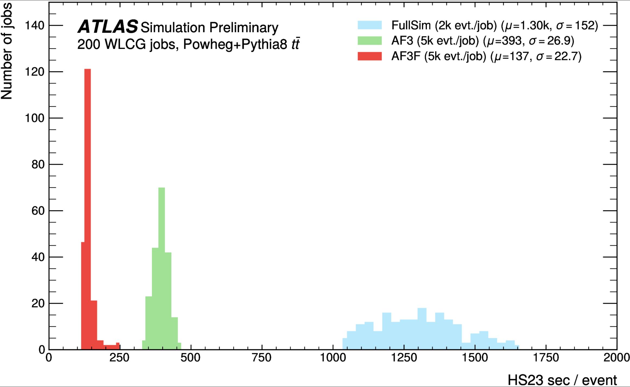
Software Improvements (Why we need to fund upgrade software)
Full Sim
Full reco
EvGen
MC Deriv
Development of AF3 (ATLAS Fast Sim) and AF3F (adding ‘fast tracking’) saves massive amounts of Full Sim compute time.
Fast Sim
Fast reco
Analysis
p-p/HI Data
Data Proc
Data Deriv

Slide 7
Constraining Volume
Notes:
2023 optimism (in slide) tempered more recently by hardware prices

Slide 8
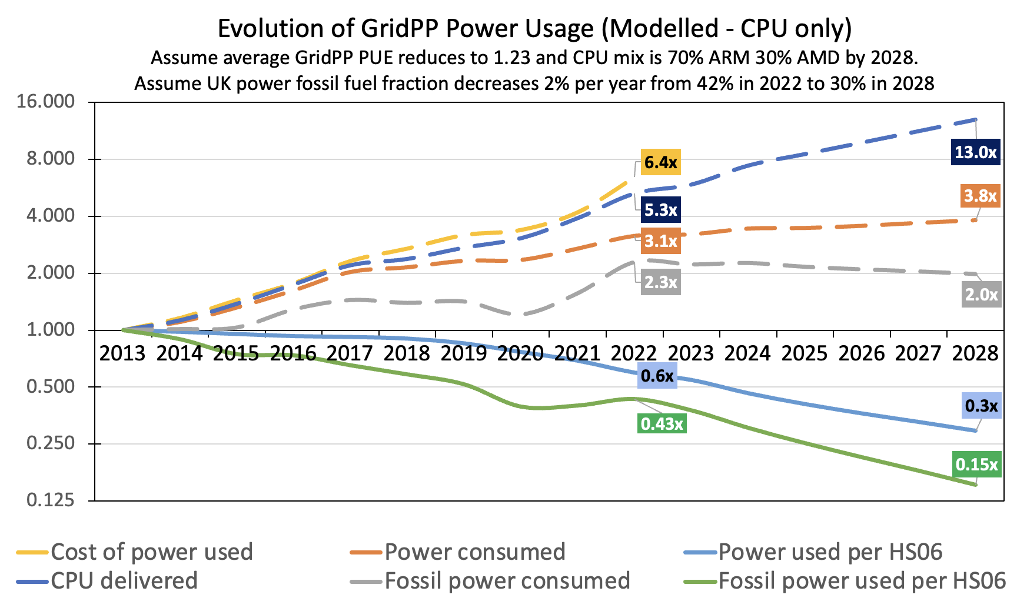
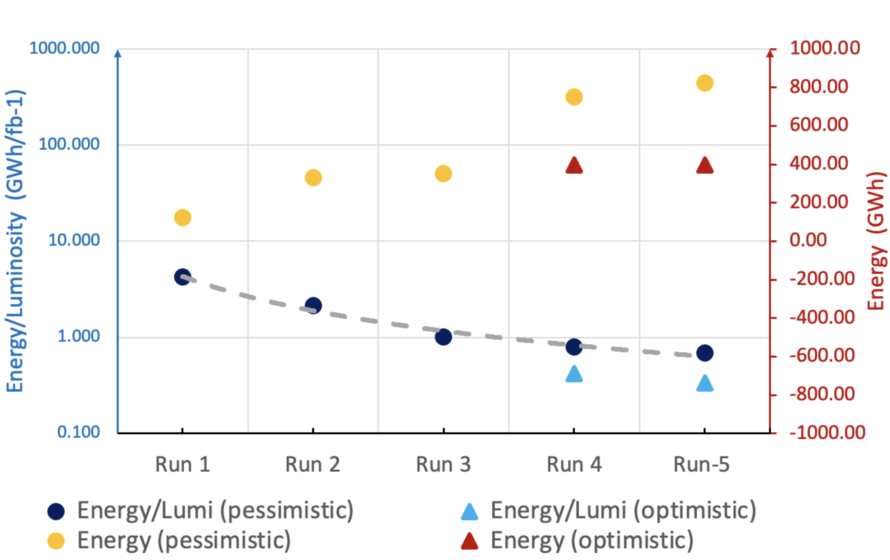
Modelling Carbon
GridPP: 2022 study showed (grey curve) that Carbon Footprint could fall over GridPP7 (2024-2028) due to more efficient hardware and facilities.
https://indico4.twgrid.org/event/25/contributions/1211/attachments/746/901/230324_ISGC-v1.pptx
2022 GridPP Study
WLCG: 2023 study of long-term energy needs showed that the GWh/fb⁻¹ should drop by a factor of 10x between Run-1 and Run-5 (factor of 2x difference between optimistic and pessimistic assumptions).
https://indico.jlab.org/event/459/contributions/11499/attachments/9236/14205/WLCGEnergyNeedsCHEP2023.pdf
2023 WLCG Study
Notes:
How does this Volume translate to Energy and Carbon? These are out-of-date and need (will be) redone. But aspiration remains – reduce carbon footprint even in the face of significantly more computing.

Slide 9
Interim Summary: Volume
Capture
NetZero
Offset
Volume is increasing as we do more physics (HL-LHC, DUNE, SKA, etc) but for LHC we hope to reduce our carbon footprint.
The LHC experiments have made enormous progress in constraining volume through better software, techniques, and computing models.
Investment in improving software is vital.
Investment in LHC software benefits wider scientific community.
Reduce Scope-2
Constrain
Reduce Scope-3
Reduce Volume
Software
Buy Lower Scope-3 HW
Reduce Power
Greener Power
Techniques
Hardware Lifetime
Newer Hardware
Supply Choice
Computing Models
Hardware Choice
Usage Pattern
Lower PUE
Benchmark Hardware
Measure Power Use
Life-Cycle Assessment
Carbon Inventory
Carbon Model
Carbon Allocation
Measure + Model + Monitor → Moderate

Slide 10
Scope2: Newer Hardware?
Hardware efficiency (amount of compute per watt) has improved over time.
But, noticed that this was mainly associated with step-changes in technology.
In 2022, we asked, could ARM be the next step?
ARM CPUs run a different instruction-set (non x86) so experiment code would need to be ported and validated.
From 2022, GridPP led/pushed this agenda within WLCG with investigations at Glasgow (
(ARM is now accepted for 2025 pledges by ATLAS; other experiments soon).
Efficiency gain associated with technology step
Different generations of Glasgow CPU
What about ARM (used in phones)?
ARM was SLOW but energy efficient in 2013
ACAT 2013

Slide 11
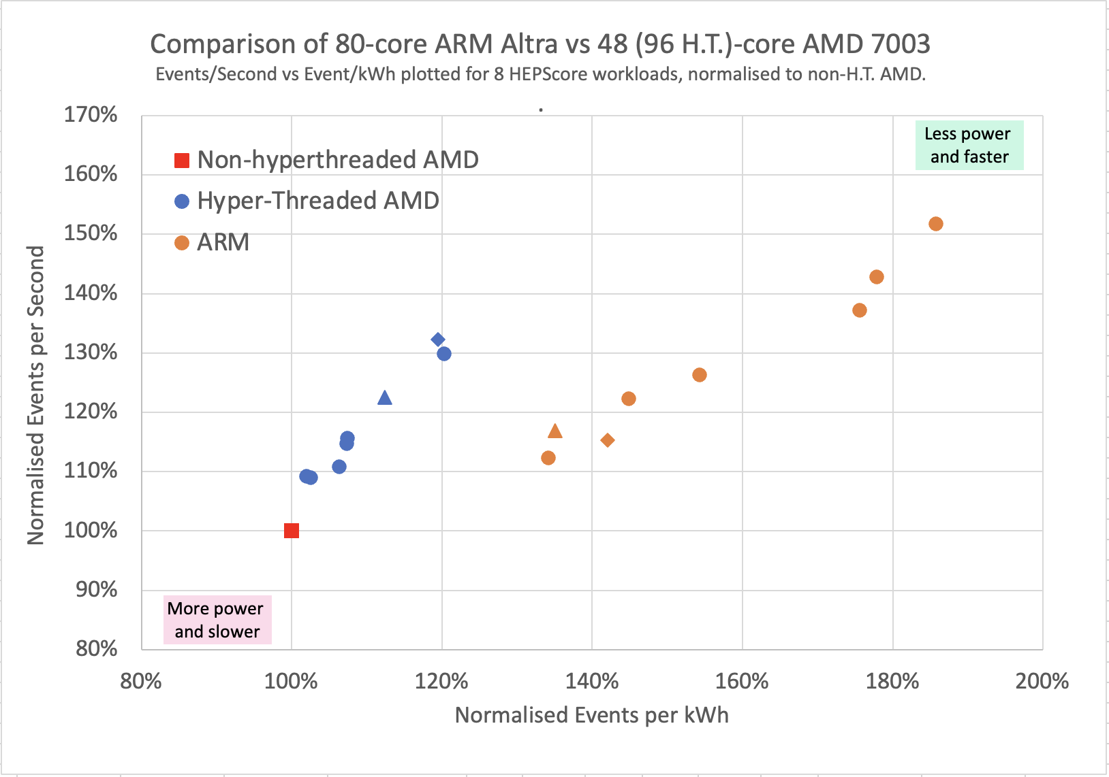
Hardware Choice (2022 Data)
Compared two same-price (but different core-count) machines: AMD EPYC 7643 48C/96T @ 2.3GHz TDP 225W, 48-cores (96 HT). ARM Q80-30 80 core 210W TDP processor, 80-cores (no HT).
This work demonstrated that (in 2022) ARM was faster and more carbon-efficient for no additional cost!
Ran 8 candidate HEPScore workloads:
On AMD, HT improves speed (energy efficiency) by up to 30% (20%) depending on workload.
On ARM, average speed is a little quicker, but average energy efficiency is much better (~50%).

Slide 12
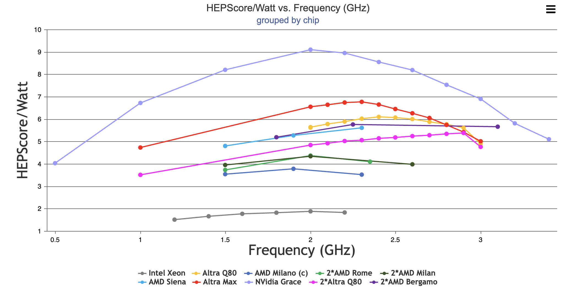
Extended Studies (2023-4)
Top plot is a comparison of different CPUs to which we had access.
But this is not the full story!
Efficiency (and HEPScore23)
depend on clock speed set.
We started to perform ‘frequency scans’, as shown in lower plot, which shows the complexity.
Particularly for ARM, reducing the operating frequency can significantly increase the efficiency… but at what cost?
M128-28
Grace Superchip
M128-30

Slide 13
Smart Procurement Utility
2023/4: Needed to procure CPU, so started to think about the cost-dimension…
https://www.ppe.gla.ac.uk/smartpro/

Slide 14
Hardware Choice?
Each point on a curve still corresponds to a different frequency but the curves move left/right relative to each other as costs change.
For Glasgow 2024 procurement the red curve was the best compromise between cost (x-axis) and energy efficiency (y-axis)

Slide 15
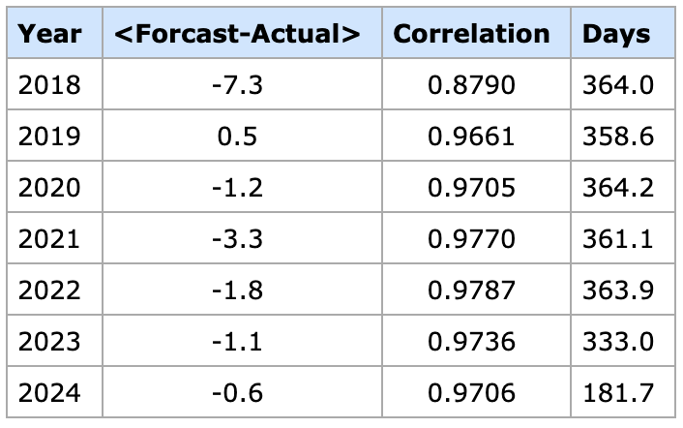
Hardware Operation
Having chosen the hardware, can Carbon be minimised by intelligent operation?
How much HS23 would be lost and how much carbon saved, if the operation frequency was reduced during periods of high Carbon Intensity?
gCO₂/kWh
e.g. UK National Grid ESO data provides actual and forecast (48 hours in advance) data at 30min intervals.
Can we use forecast carbon intensity to help optimise farm?
Data missing for some days
cf. average of 150-250 gCO₂/kWh

Slide 16
UK Carbon Intensity
gCO2/kWh
2024
2018
Carbon Intensity is decreasing; eventually (2050) the Scope-2 problem goes away, leaving just Scope-3; the optimum compromises will become different!
gCO2/kWh
Fluctuations on the scale of hours and, perhaps, days might be exploitable!

Slide 17
Tools
Simulation of Glasgow Tier-2 site (developed by Dwayne Spitari based on original work by Gordon Stewart; presented previously here):
Define different nodes (specific x86 and ARM types) and form a compute cluster
Define a job mix (length and memory requirements) and create a job scheduler
Step through a year of carbon-intensity data, running cluster in chosen mode
Output
- Jobs run
- Energy used
- Carbon produced
Program that directly calculates the same outputs for a specific node operated with a specific clock-down schedule by looking at average time above and below a given Carbon Threshold (developed by Steve Lloyd - PHP script reading the ESO data and some JavaScript to make plots, output shown here).
The results in this presentation were calculated with the Program but six simulations were run to spot-check: all results agree within 0.5%.

Slide 18
Example Result
Threshold = 0 (frequency always reduced)
This is the frequency set when carbon intensity rises above threshold
Altra Max using 2023 Carbon Data
“Increased Carbon Efficiency“ means the same work is done for less Carbon (but it takes longer to complete!)
Running at 1 GHz too much of the time (low threshold), has a negative effect.
Threshold = 300 (frequency never reduced)
Each point represents a calculation/simulation of running an Altra Max node for a year, reducing the frequency from max (3.0 GHz) whenever the predicted carbon intensity rises above a chosen threshold. The points on an individual curve show the effect of changing the threshold

Slide 19
Results Summary
If the rate of work is reduced by 5% (or 10%), how much carbon would be saved?
Nvidia Grace using 2023 Carbon Data
 | 2018 Carbon Data |  | 2023 Carbon Data
 | 95% rate | 90% rate | 95% rate | 90% rate
NVidia Grace | 18.9% | 27.2% | 21.1% | 29.5%
Altra Max | 13.9% | 20.0% | 15.4% | 21.5%
Altra Q80 | 13.9% | 17.2% | 14.5% | 18.1%
2xAltra Q80 | 10.8% | 9.2% | 10.9% | 8.8%
Xeon | 2.4% | 3.5% | 3.7% | 5.2%
Milan | - | 5.7% | 4.6% | 8.3%
Genoa | - | 2.5% | 2.8% | 4.7%
Bigger effect in 2023 because denominator is smaller.
Bigger gains with ARM.
Dual socket Altra Q80 shows reduced effect...
More complicated strategies (multiple clock-down steps) give further small gains.

Slide 20
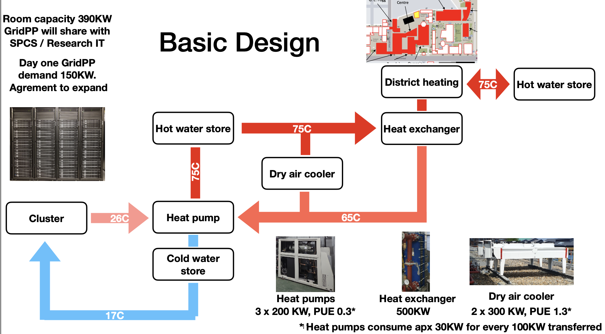
Improved Facilities
RAL Site
High cost to update facilities.
Gains depend on how bad you are to start with!
Take the opportunity when possible.
ABOVE: New data centre room at RAL designed to efficiently host high power density kit.
RIGHT: New data centre at QMUL designed to recycle heat into the district heating system.
QMUL Site

Slide 21
Interim Summary: Scope-2
Capture
NetZero
Offset
Newer hardware tends to be more efficient but new hardware embodies new carbon.
At present, compared to x86 hardware, ARM tends to be greener/faster/cheaper.
ARM efficiency shows more significant dependence on operating frequency…
…which gives opportunities for operational tactics to further reduce CO2e.
Improve facilities where possible.
Reduce Scope-2
Reduce Volume
Reduce Scope-3
Software
Buy Lower Scope-3 HW
Reduce Power
Greener Power
Techniques
Hardware Lifetime
Newer Hardware
Supply Choice
Computing Models
Hardware Choice
Usage Pattern
Lower PUE
Benchmark Hardware
Measure Power Use
Life-Cycle Assessment
Carbon Inventory
Carbon Model
Carbon Allocation
Measure + Model + Monitor → Moderate

Slide 22
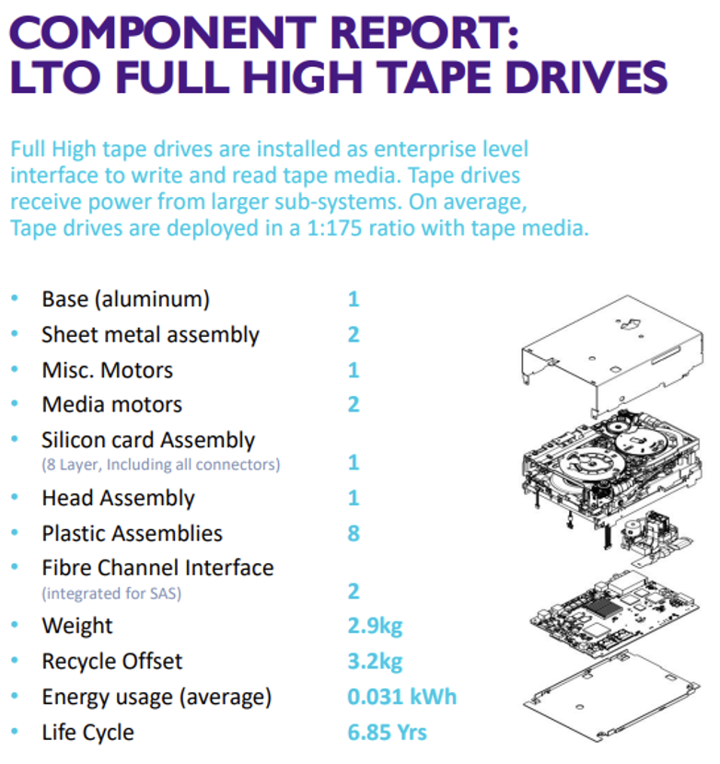
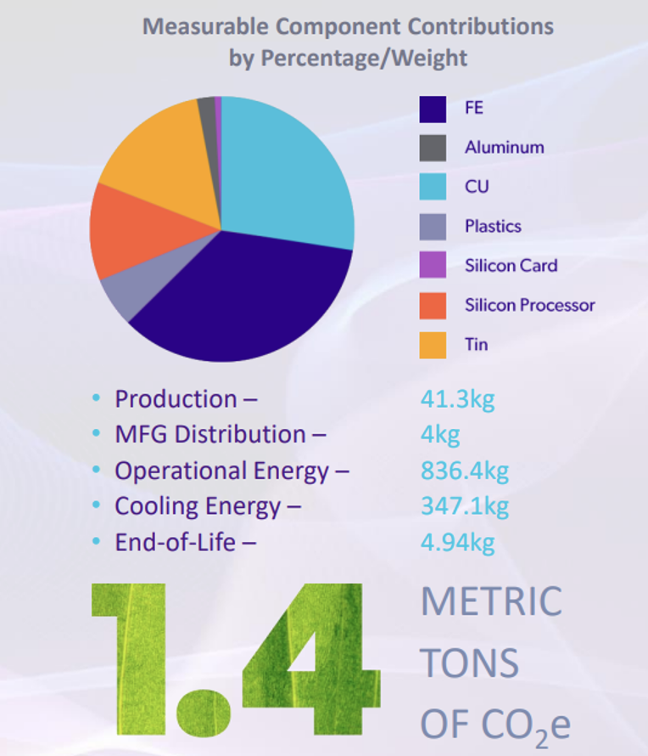
Scope-3
Carbon footprint of LTO Tape Drive
Embodied carbon data is gradually becoming more available.
Will enable us to make a carbon-inventory and identify best ways to minimise.
We’ve started to look, for example, at the carbon footprint of storage (tape -vs- disk). https://indico.cern.ch/event/1338689/contributions/6010862/attachments/2953752/5193074/GridPP-Storage-CHEP24-v6.pptx
Carbon footprint of typical server
https://dataviz.boavizta.org/serversimpact
Scope-2 for 5yrs UK usage
Scope-3 due to Manufacturing
16 x 32 GB RAM

Slide 23
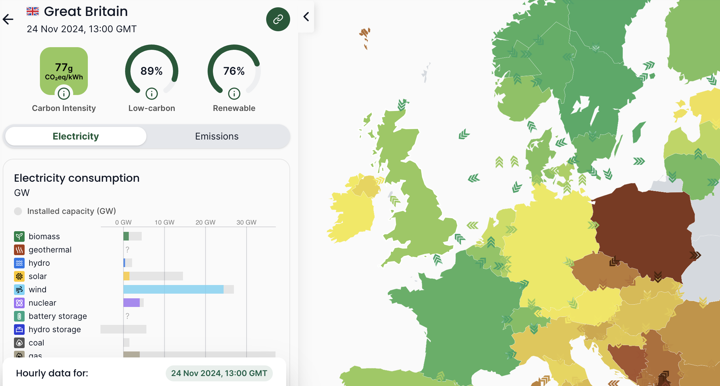
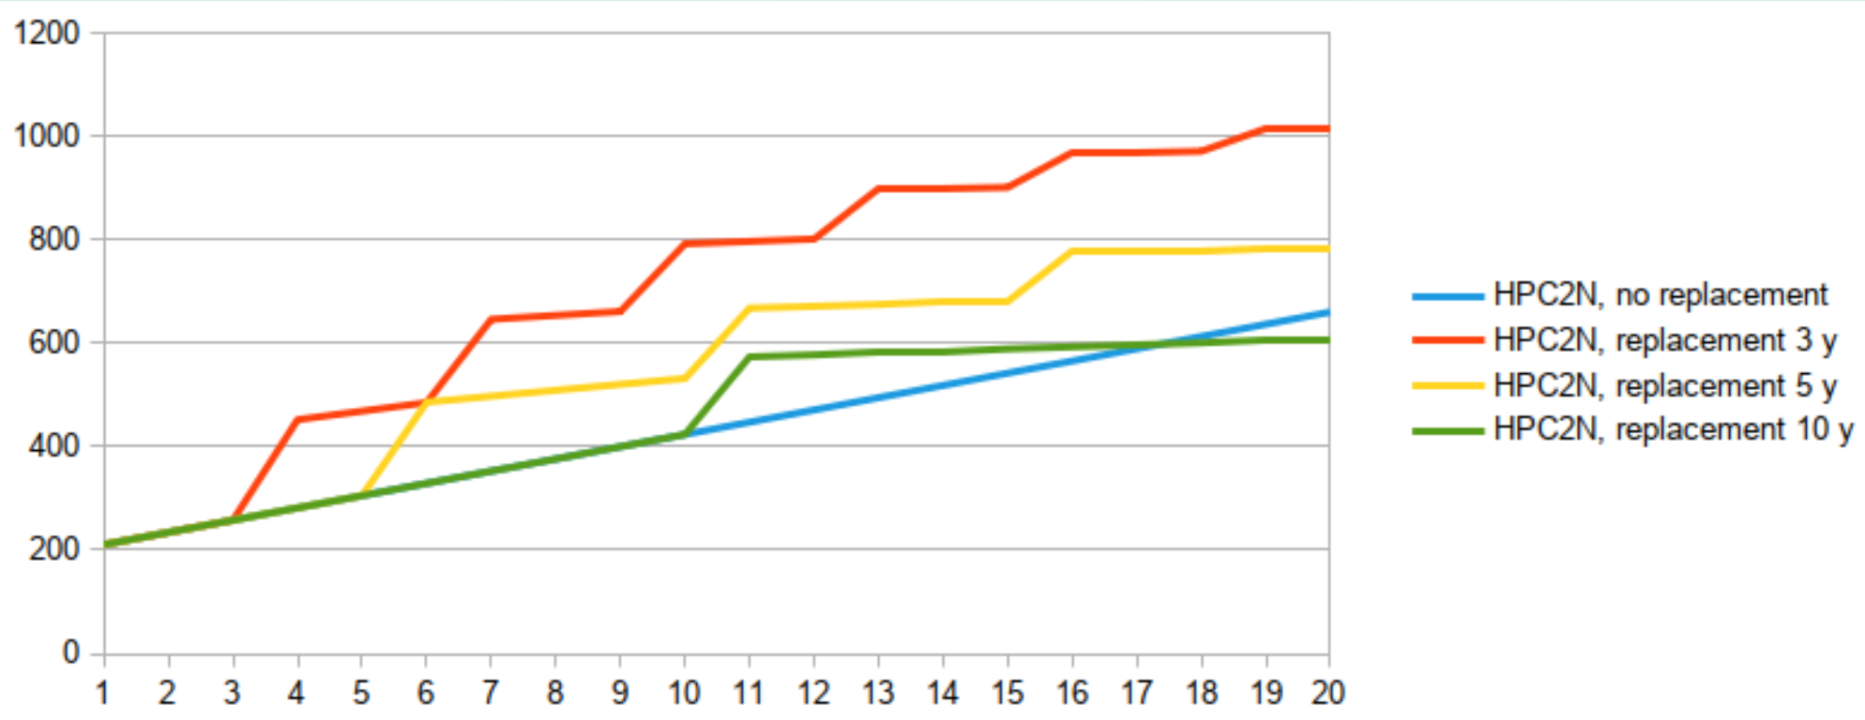
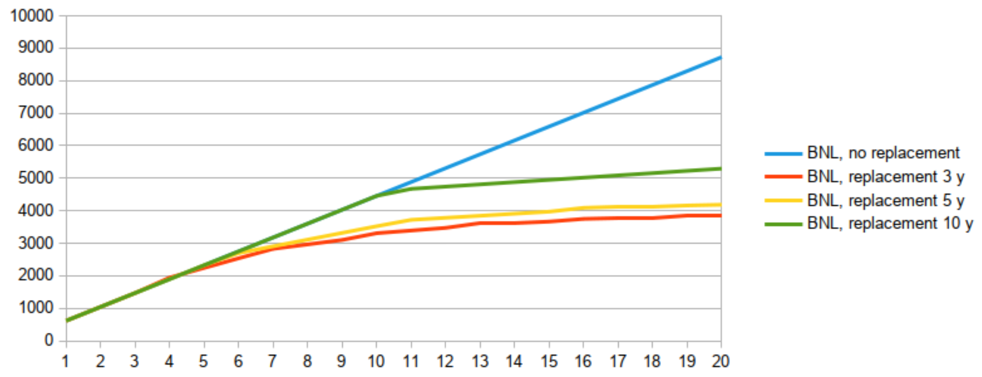
Hardware Lifetime
https://app.electricitymaps.com/zone/GB/24h
Newer hardware tends to be more efficient (reduces Scope-2) but new hardware also embodies a new dose of Scope-3.
Replacement strategy depends very much on the local power.
https://indico.cern.ch/event/1377701/contributions/5894041/attachments/2839432/4962697/20240418-lca.pdf
Sweden
Carbon
In high emission locations, replace old servers by new as soon as financially viable.
In low emission locations: Running old servers for a long time might be better.
Years
USA
Carbon
Years

Slide 24
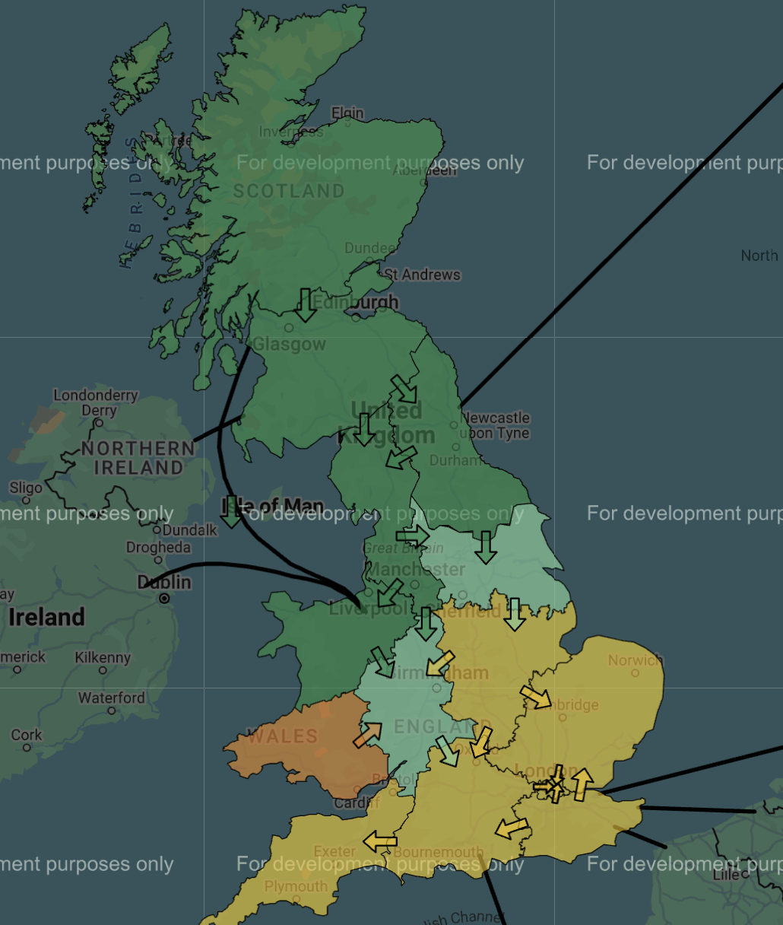
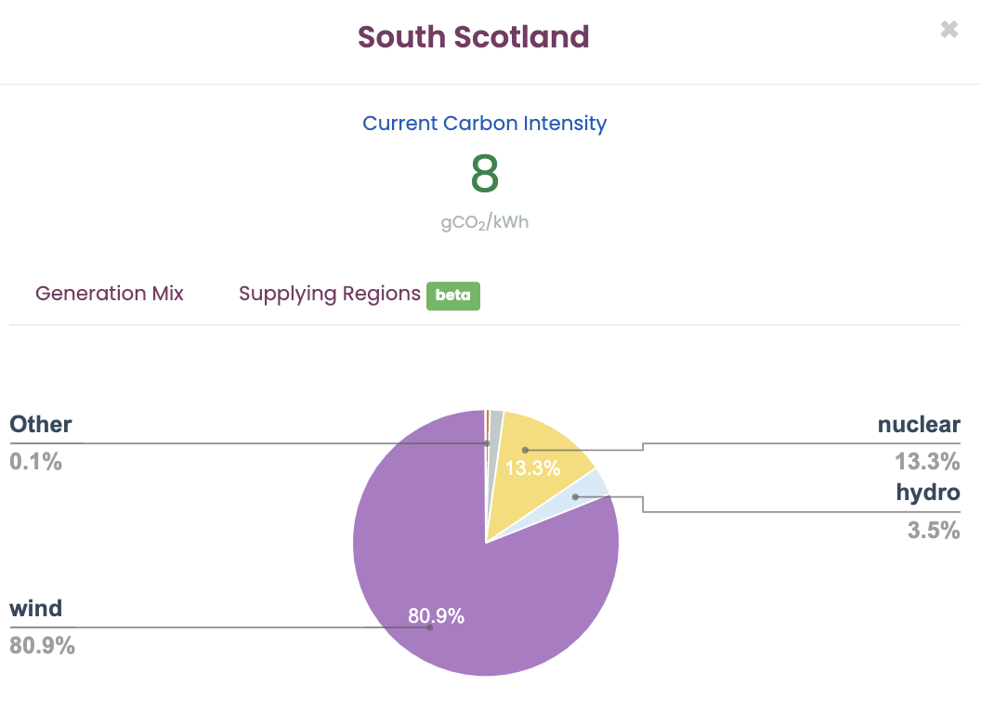
Regional Variation Sunday 24th Nov 2024
https://carbonintensity.org.uk/

Slide 25
Interim Summary: Scope-3
Capture
NetZero
Offset
Embodied Carbon is a complicated discussion.
In the UK, we are in the regime where extending hardware lifetime a bit, seems sensible.
We now plan ~6 years but there are compromises to explore between:
Costs
Carbon
Capacity
Reduce Scope-2
Reduce Volume
Reduce Scope-3
Software
Buy Lower Scope-3 HW
Reduce Power
Greener Power
Techniques
Hardware Lifetime
Newer Hardware
Supply Choice
Computing Models
Hardware Choice
Usage Pattern
Lower PUE
Benchmark Hardware
Measure Power Use
Life-Cycle Assessment
Carbon Inventory
Carbon Model
Carbon Allocation
Measure + Model + Monitor → Moderate

Slide 26
Offsetting and Capture
x40
x40
Source - International Energy Agency: https://www.iea.org/about
But, carbon capture is also about 40x cheaper than compensating the lost work due to clocking-down an ARM CPU to do the work 20% more efficiently, by purchasing additional hardware.
Source - Carbon Neutral Britain: https://carbonneutralbritain.org/
We need a carbon mill-rate that defines the best way to spend money on reducing carbon.
Spending £20m on a new data centre to reduce PUE by 20% may be laudable, but is it the best way to spend money to reduce carbon?

Slide 27
Bigger Picture
UK 2025 LHC CPU pledges = 1,034,997 HS23
(Tier-1 + Tier-2) == 493 Altra Max
Yearly offsetting cost = 493 * 0.519tonnes * £7.75 = £1983 !!
Yearly Carbon Capture cost = 493 * 0.519tonnes * £300(?) = £76,760
Big, but still <5% of hardware spend
(UK is ~12% of WLCG (T1 + T2)
Of course, it is better not to produce CO2e in the first place, but carbon-capture has merit. (Offsetting may have a place, but only when we get the problem down to a manageable level).

Slide 28
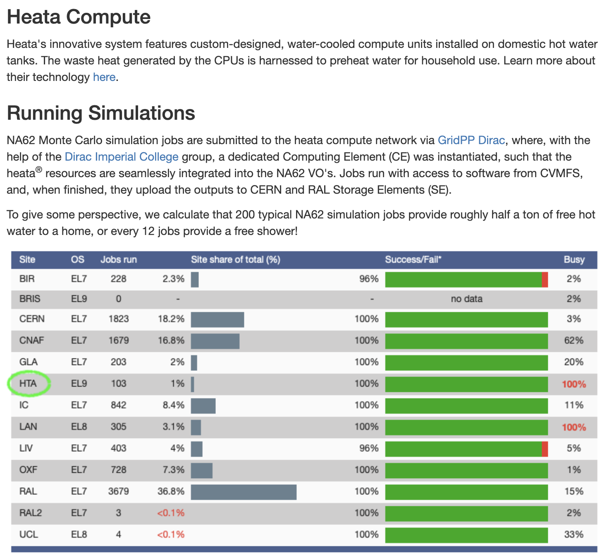
Small Steps - Heata
Heating water in social housing with NA62 simulations.
Joint Glasgow-Imperial project to submit from the DIRAC service at IC to the Heata Cloud as part of the Glasgow NA62 Grid production system.

Slide 29
Conclusions
Greening the Grid?
Many things will need to contribute to the journey to NetZero including:
Better software,
more efficient hardware,
improved facilities,
and refined operational strategies.
We need to fully explore the compromises between Costs, Carbon, and Capacity to optimise our strategies.
There is a lot we can do; are doing; and need to do; but most of it doesn’t come for free.
Money should be spent where it does the most good.
We still need to deliver the physics.

