Slide 1
Introduction and UK relationship to European roadmap
Stewart Boogert
ECFA-UK Meeting on UK studies for the European Strategy Particle Physics Update
25th September 2024

Slide 2
European Strategy for Particle Physics
the particle physics community should ramp up its R&D effort focused on advanced accelerator technologies, in particular that for high-field superconducting magnets, including high-temperature superconductors;
should investigate the technical and financial feasibility of a future hadron collider at CERN with a centre-of-mass energy of at least 100 TeV and with an electron-positron Higgs and electroweak factory as a possible first stage.
The timely realisation of the electron-positron International Linear Collider (ILC) in Japan would be compatible with this strategy and, in that case, the European particle physics community would wish to collaborate.
The European particle physics community must intensify accelerator R&D and sustain it with adequate resources. A roadmap should prioritise the technology, taking into account synergies with international partners and other communities such as photon and neutron sources, fusion energy and industry. Deliverables for this decade should be defined in a timely fashion and coordinated among CERN and national laboratories and institutes.

Slide 3
European Strategy for Particle Physics
High field magnets
Establish feasibility of FCC-ee
Realise ILC in Japan
The European particle physics community must intensify accelerator R&D and sustain it with adequate resources. A roadmap should prioritise the technology, taking into account synergies with international partners and other communities such as photon and neutron sources, fusion energy and industry. Deliverables for this decade should be defined in a timely fashion and coordinated among CERN and national laboratories and institutes.

Slide 4
Introduction
Boundary conditions
  Institutes, funding etc.
National accelerator agenda
  Diamond II
  RUEDI (Relativistic ultra-fast electron diffraction and imaging)
  UK X-ray free electron laser
  ISIS 2 Neutron and muon source
Current large contributions to international HEP and nuclear
  HL-LHC @ CERN
  PIP-II @ FNAL
  EIC @ BNL
Sustainability
Technology foundation applied to HEP
  Beam instrumentation
  Machine detector interface
  Beam dynamics
  Superconducting RF
Not talking about
  ILC/CLIC
  future neutrino facilities
  more exotic ideas (C3, HELEN)

Slide 5
Boundary conditions
Accelerator community in the UK
  Cockcroft institute (CI)
  John Adams Institute (JAI)
  Accelerator Science Technology Centre (ASTeC)
  Strong plasma acceleration community (JAI + CI + QUB + UCL + CLF)
Support collider HEP community in ESPPU and international projects
Maximise UK return from investment in international projects in collaboration with industry
  E.g. industrial return from CERN
Enhance synergies with other scientific areas
  Other applications of HTC superconductors
  Technological developments from other accelerator projects

Slide 6
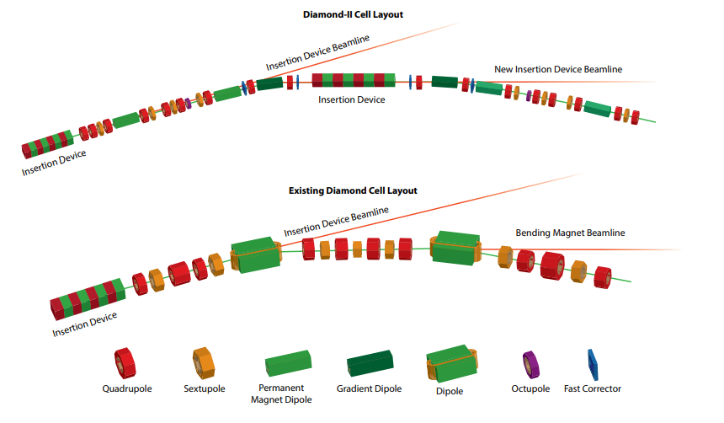
Diamond-II and REUDI (funded)
Diamond-II
£350M from infrastructure fund
3 GeV → 3.5 GeV
New lattice based on double triple bend achromats
Relativistic electron ultrafast diffraction and imaging
£124M from infrastructure fund
4 MeV, 10s fs diffraction and imaging

Slide 7
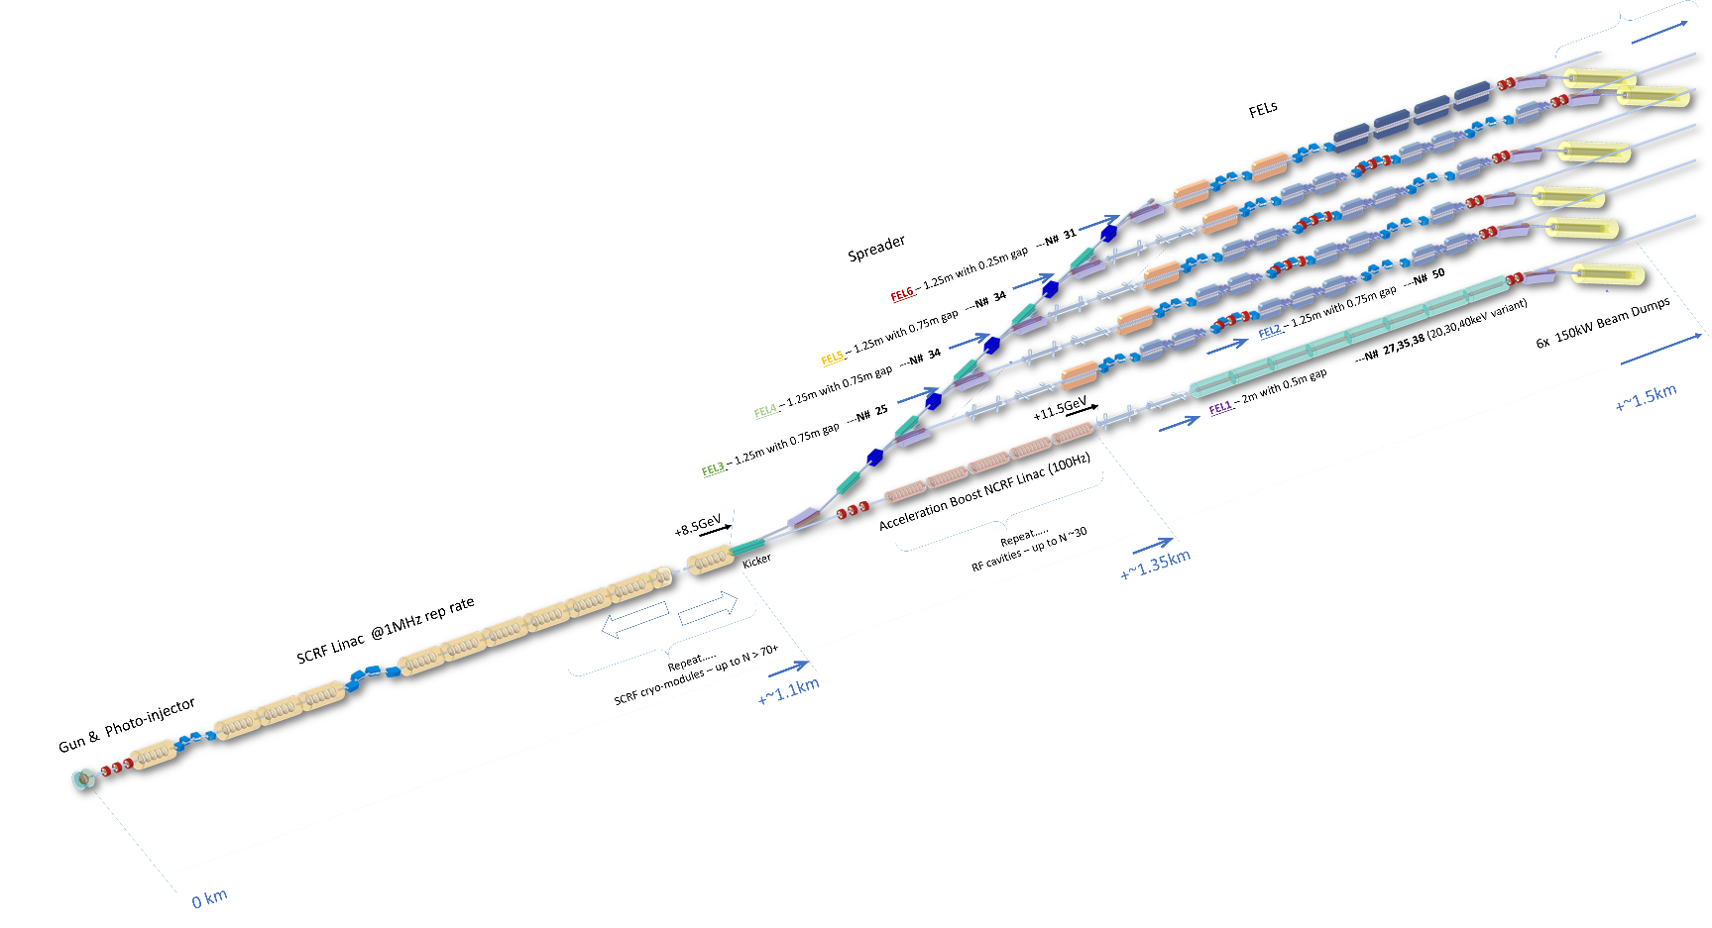
UK XFEL and ISIS II (not yet funded)
UK XFEL
Cost ~O(1B)
Superconducting 8 GeV MHz bunch rate LINAC
Multiple colour X-ray beams with high throughput
ISIS II
Cost ~O(£1B)
Options (RCS, FFAG, SC full energy LINAC to accumulator ring)
1.2 GeV full energy SC LINAC to accumulator ring

Slide 8
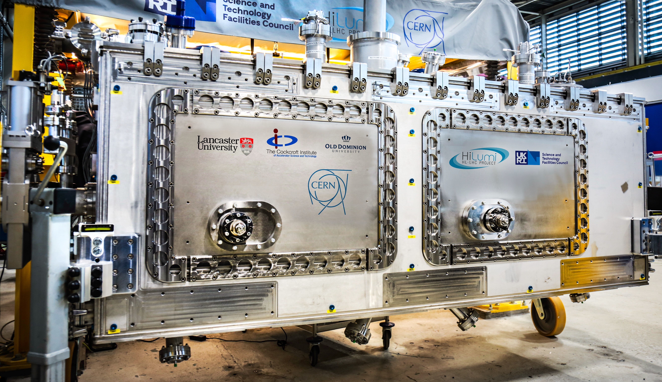
Substantial investments in the HEP
HL-LHC Crab cavity prototype
PIP-II 650 MHz high-beta cryomodules
Other contributions to HL-LHC : beam instrumentation and dynamics, cold powering, laser
engineered surfaces

Slide 9
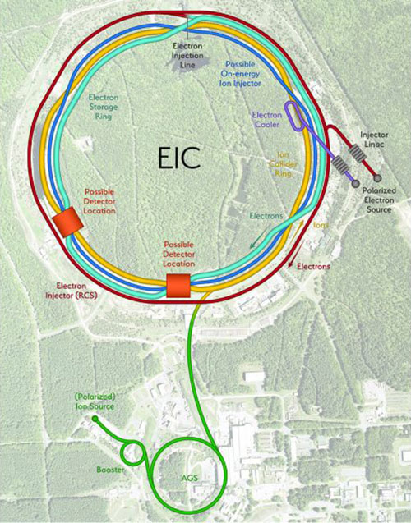
Electron ion collider
UK accelerator contributions
  UKRI-IF is funding £6M of cryomodule construction
  Three PhD students funded 100% by Jlab
  Jlab are funding STFC TD to do a design of tooling for the 200 MHz crab cryomodule
  Interest in NEG vacuum coating

Slide 10
European Strategy for Particle Physics
Accelerator R&D Roadmap
Roadmap divided in following sections
High field magnets (Gibson’s talk)
  Industrial 16T magnets for FCC-hh, 11T for MC
High-gradient RF structures and systems
  SC thin films
High-gradient plasma and laser accelerators (D’Arcy’s talk)
  Staging, plasmas at collider beam powers
Bright muon beams and colliders (Rogers’ talk)
Energy recovery linacs
Sustainability

Slide 11
High field magnets
Main development around Nb₃Sn
  No current UK activity in this area
  High capital cost for involvement in R&D
  Synergies with other scientific areas e.g. fusion
Opportunity to engage other disciplines
  engineering and material sciences
  HTC magnets
Example is PSI initiated a high field magnet program
PSI Magnet Section activities: Horizon 2020 and beyond

Slide 12
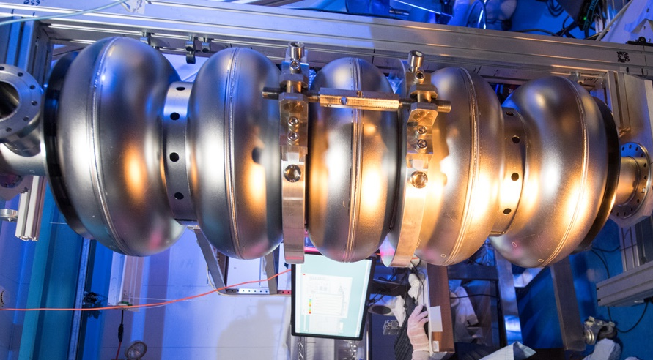
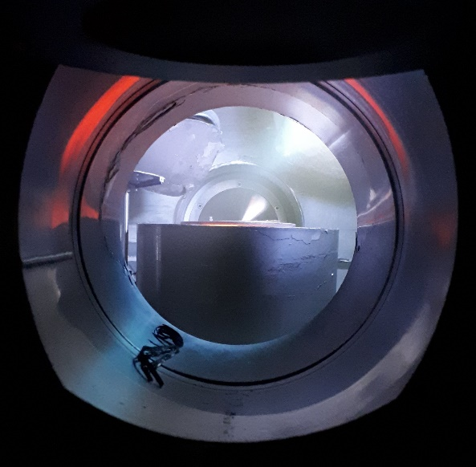
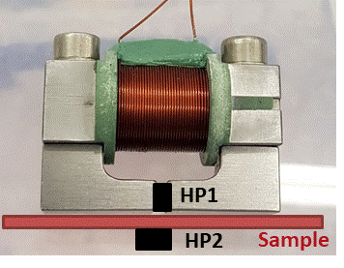
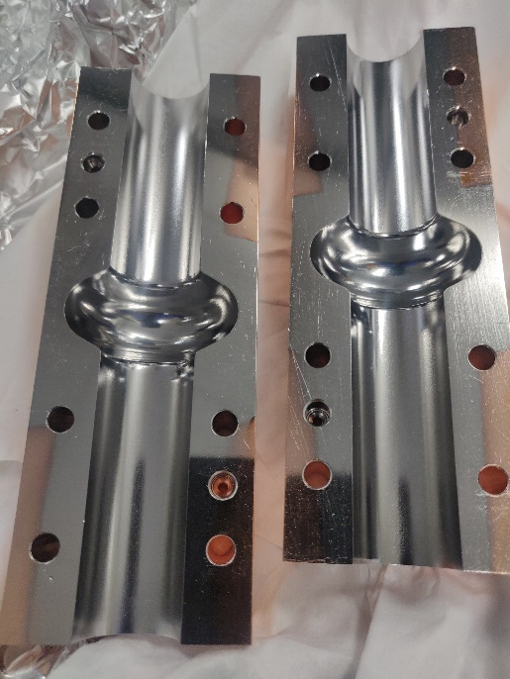
Superconducting RF
Daresbury (TD and ASTeC) is a contributor to international SCRF projects
  PIP-II
  HL-LHC (+Lancaster University)
  Electron ion collider
Sustainability developments
  High efficiency klystrons
  Fast reactive tuners
  Super conducting thin films (Nb and higher T_{c} superconductors)
Deposit
Fundamental
measurements
Acc structure
measurements

Slide 13
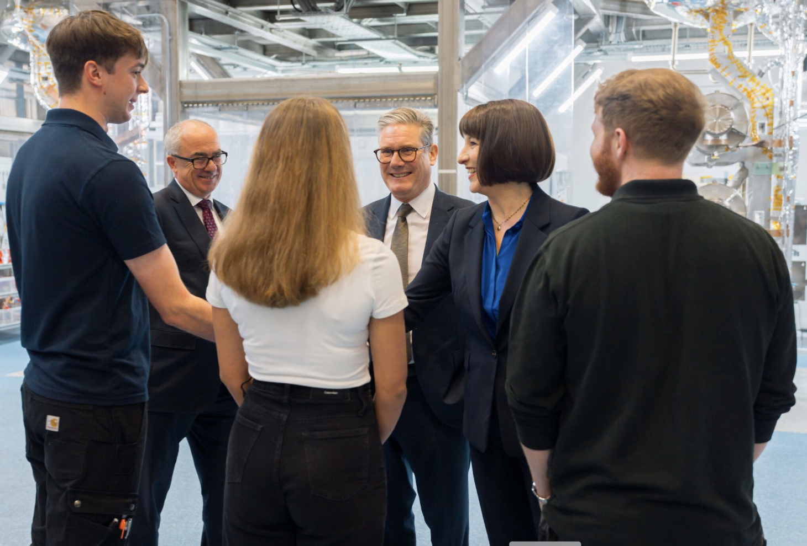
Superconducting RF?
PM visit to Daresbury 22nd September 2024

Slide 14
Advanced acceleration
Extreme photonics applications centre
10 Hz PW class laser system
Primarily multi-GeV electron beams for applications and X-rays
Stable operation of LWFA
CLARA/FEBE
250 MeV FEL quality beam
125 TW laser system
Achieve GeV beams (PWFA, LWFA)
EPAC webpage
PHYSICAL REVIEW ACCELERATORS AND BEAMS 27, 041602 (2024)

Slide 15
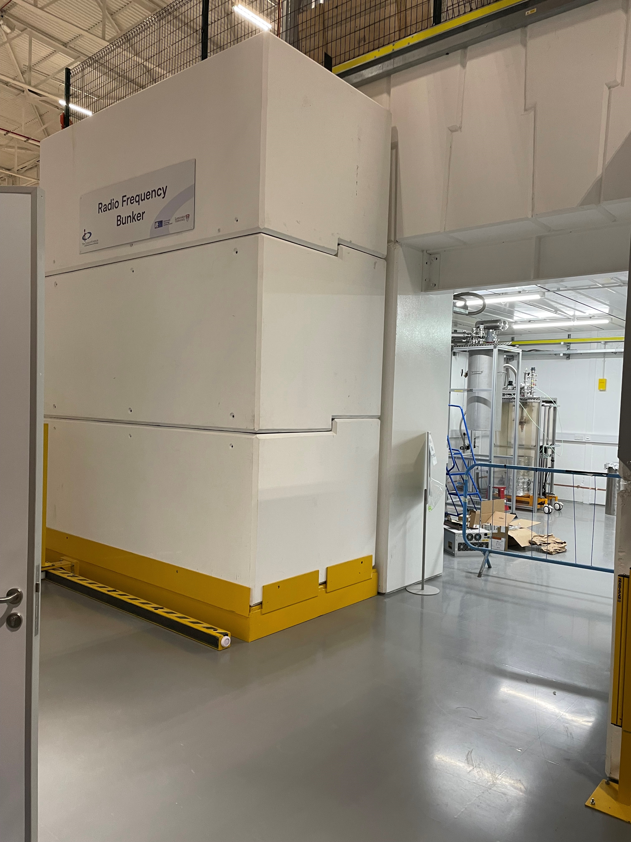
Muon beams
UK focus in muon production and capture
  Targets and capture
  Cooling
  Early acceleration
Demonstration of muon cooling with MICE
Proton target systems
Testing RF in high fields
  Cockcroft RF shielded bunker in Daresbury
  Bring together high fields and RF

Slide 16
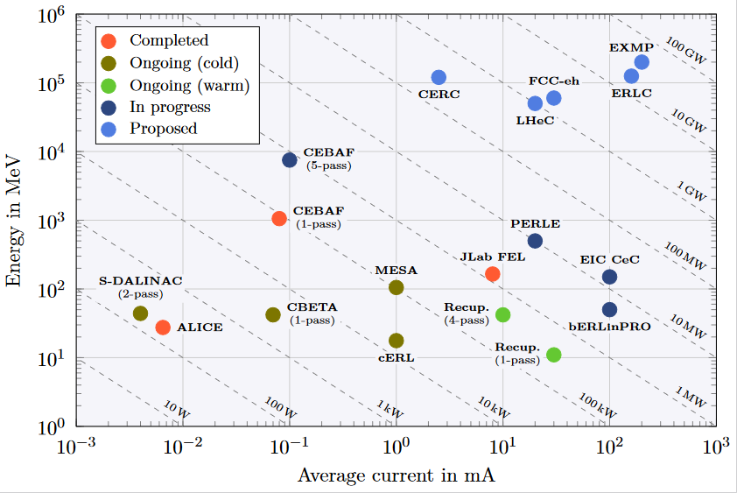
Energy recovery LINACs (ERLs)
ALICE @ Daresbury was first operating ERL in Europe
PERLE being constructed in IJCLab
Small involvement from CI (Liverpool, Lancaster and ASTeC)
  Beam instrumentation
  ERL beam dynamics
  Backgrounds during acceleration/deceleration
PERLE collaboration meeting
https://indico.cern.ch/event/1417048/

Slide 17
UK accelerator community involvement in collider HEP projects
ILC/CLIC
JAI (Oxford)
ASTeC/CI SCRF for main LINACs
UK academic accelerator community forged in 2000s working on ILC
FCC-ee
Institute core grants
Fundamental SCRF R&D
Beam instrumentation and machine detector interface
FCC-hh
…
Muon collider
Funding from Europe, consolidated grants
Warwick, ICL, Strathclyde, ISIS RAL, Lancaster
RF structures in high fields, targets, cooling
HALHF
Institute core grants
UK “ownership” of the idea (Foster and D’Arcy)
Leverage EPAC and CLARA/FEBE
Provide input to the ESPPU and take design to next level of development

Slide 18
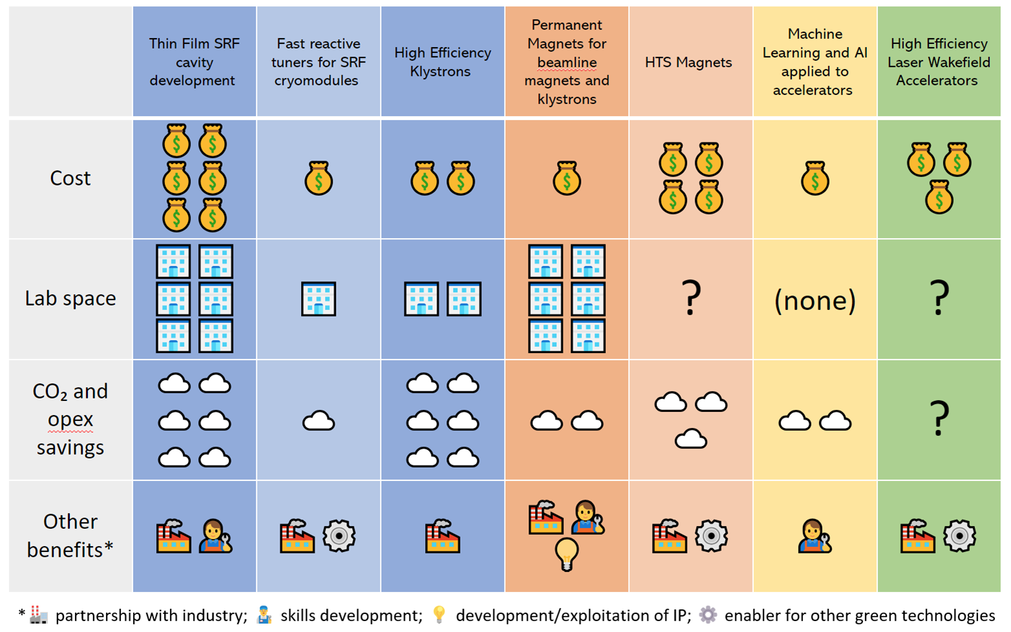
Accelerator sustainability (CESA)
B Sheppard Talk at IoP PAB meeting 2024

Slide 19
Mapping research onto projects
Research area | ILC | CLIC | FCC-ee | HALHF | MC | LHeC | FCC-hh | UK XFEL | ISIS2
SCRF | Main LINACs |  | Replace SR losses | 500 GeV and 30 GeV LINAC? | Proton linac | ERLs |  | 8 GeV LINAC | 1.2 GeV p LINAC (AR)
NCRF |  | High gradient cavities |  | Drive LINAC? | Breakdown in high fields
High field magnets |  |  |  |  | Collider ring and capture |  | Collider ring
RCSs/FFAs |  |  |  |  | Rapid acc |  |  |  | High power
Advanced acceleration |  |  |  | Plasma staging |  |  |  | After burner (>8 GeV)
Targets | e+ prod | e+ prod |  | e+ prod | mu prod |  |  |  | n prod
Machine detector interface | Involvement since LC-ABD | Involvement since LC-ABD | Significant IR radiation | See ILC | Complex IR
Beam instrumentation | Lots of capability | Lots of capability | See P. Burrows talk | Lots of capability (e- LINAC) |  |  |  | Lots of capability | Lots of capability
Beam dynamics | leading | leading | capability | leading | capability | Former leadership | capability | leading | Int leading

Slide 20
Summary
Majority of UK academic accelerator community is focused on underpinning technologies, advanced acceleration and national projects
  Focus is towards projects involving SCRF compared to NCRF
Foundational technology and capability in accelerator physics can contribute to collider projects
  Test facilities are available
  Sustainability related technology research seen as key for future facilities
Novel acceleration is academically interesting, pathway for HEP relevance relies on projects like HALHF
High field magnets are relevant to FCC-hh and MC but we have a long way to go
  10 TeV future requires it
Assuming a UK, European and international HEP consensus, funding will be needed for any impactful contribution to any project strongly endorsed by the ESPP
Accelerator community is ready and excited to engage with recommendations from national and European plans for HEP colliders

