Slide 1



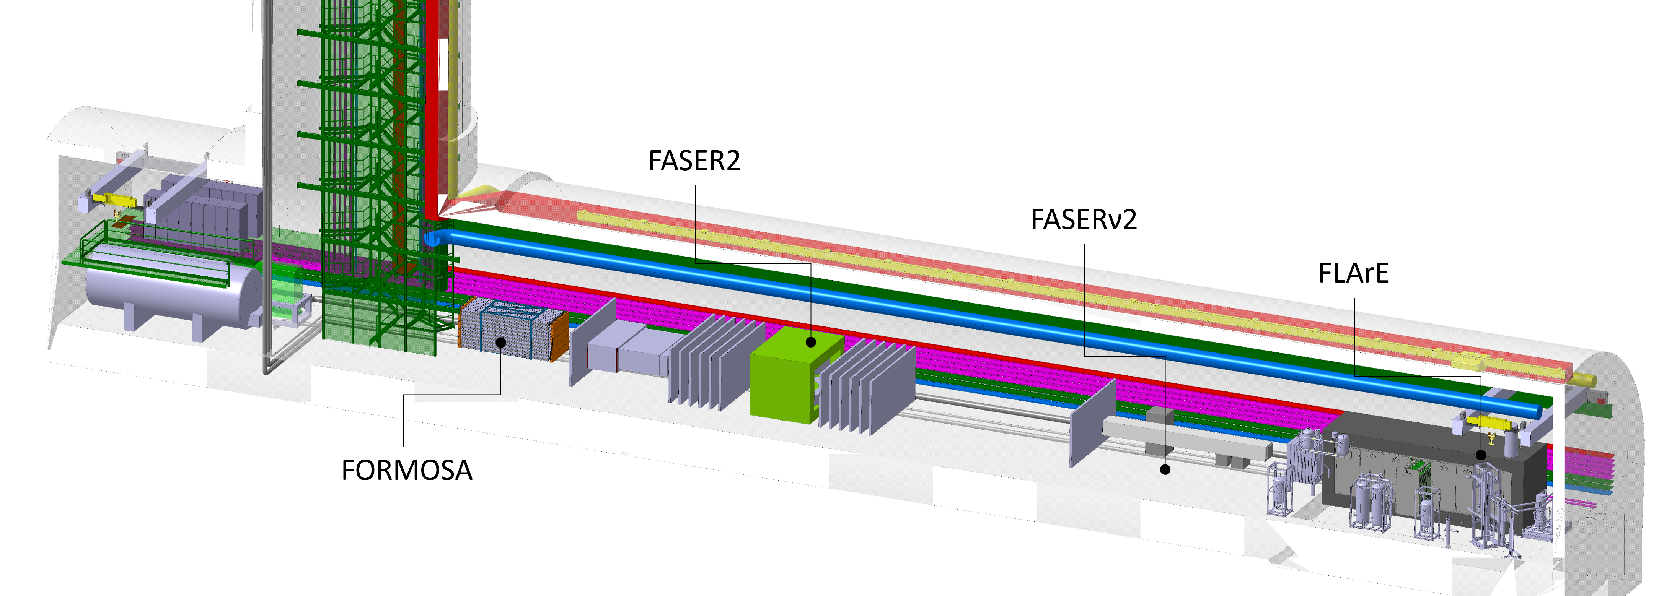
Alan Barr
ECFA UK 2024

Slide 2
Physics Motivation
The Forward Physics Facility has a rich and broad physics programme
Three main physics motivations
  Beyond Standard Model (BSM) “dark sector” searches
  Neutrino physics
  QCD physics
In order to fully benefit from the increase in luminosity from the HL-LHC, the FPF will allow:
  Longer detectors to increase target/decay volume
  Wider detectors to increase sensitivity to heavy flavour produced particles
  Space for new detectors with complementary physics capabilities

Slide 3
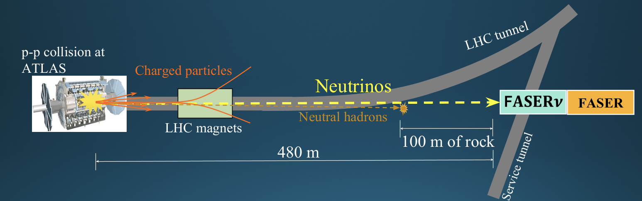
Introduction
Light LLPs /
FASER
FASER designed to search for new, light, long-lived particles (LLPs), and study neutrinos.
These are produced in the decay of light hadrons which are produced in the LHC collisions.
Light hadron production is very peaked in the forward direction, extremely collimated with the beam collision axis line of sight (LOS), hence even small detectors covering the angular region less than a miliradian around the LOS have good physics sensitivity.

Slide 4
Physics Motivation
The Forward Physics Facility has a rich and broad physics programme
Three main physics motivations
  Beyond Standard Model (BSM) “dark sector” searches
  Neutrino physics
  QCD physics
In order to fully benefit from the increase in luminosity from the HL-LHC, the FPF will allow:
  Longer detectors to increase target/decay volume
  Wider detectors to increase sensitivity to heavy flavour produced particles
  Space for new detectors with complementary physics capabilities

Slide 5
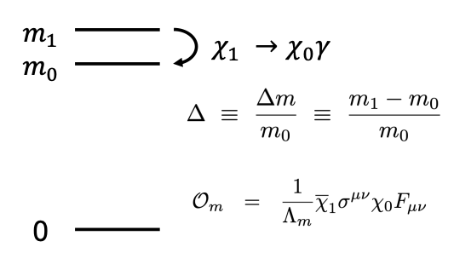
BSM Physics
The FPF experiments have strong sensitivity in all of the dark sector PBC benchmark models
In some cases the sensitivity is not as strong as that of SHiP
There are classes of models where the FPF is more powerful than SHiP
LLPs can result from weak couplings
They can also arise generically from
compressed spectra
In this case soft photons are difficult to detect
At the LHC the parents have Lorentz boosts of order 1000.
FASER2 can detect GeV particles with even ~MeV mass splittings
Difficult at SHiP
Further examples in the backup slides

Slide 6
Neutrinos at the FPF
LHC provides a strongly collimated beam of TeV energy neutrinos
of all three flavours in the far forward direction.
Proposed FPF experiment have potential to detect O(1M) neutrinos:
O(10⁵) electron neutrinos, O(10⁶) muon neutrinos, O(10⁴) tau neutrinos

Slide 7
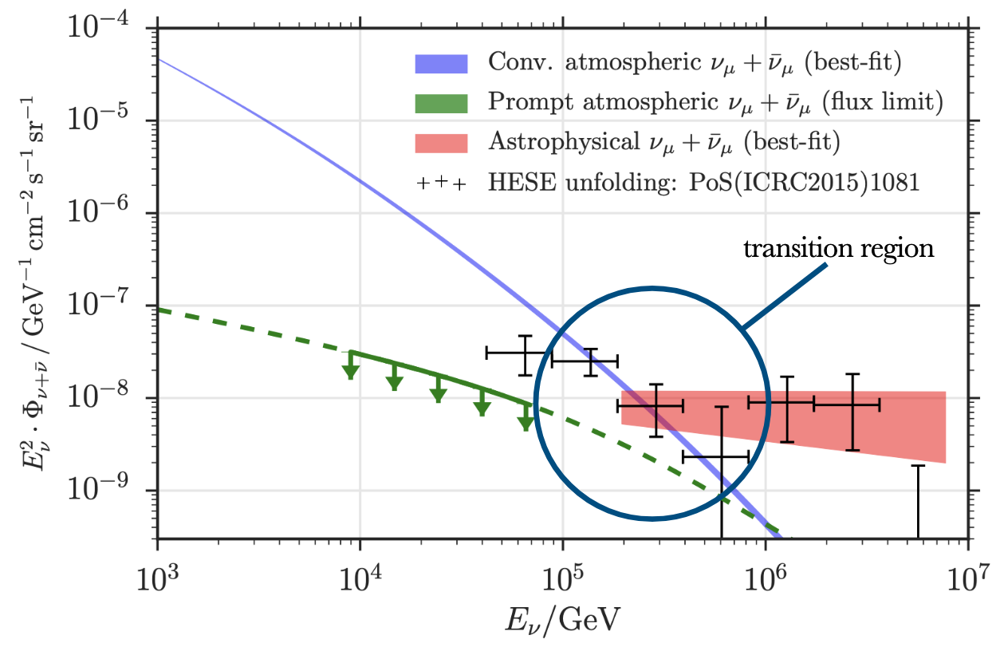
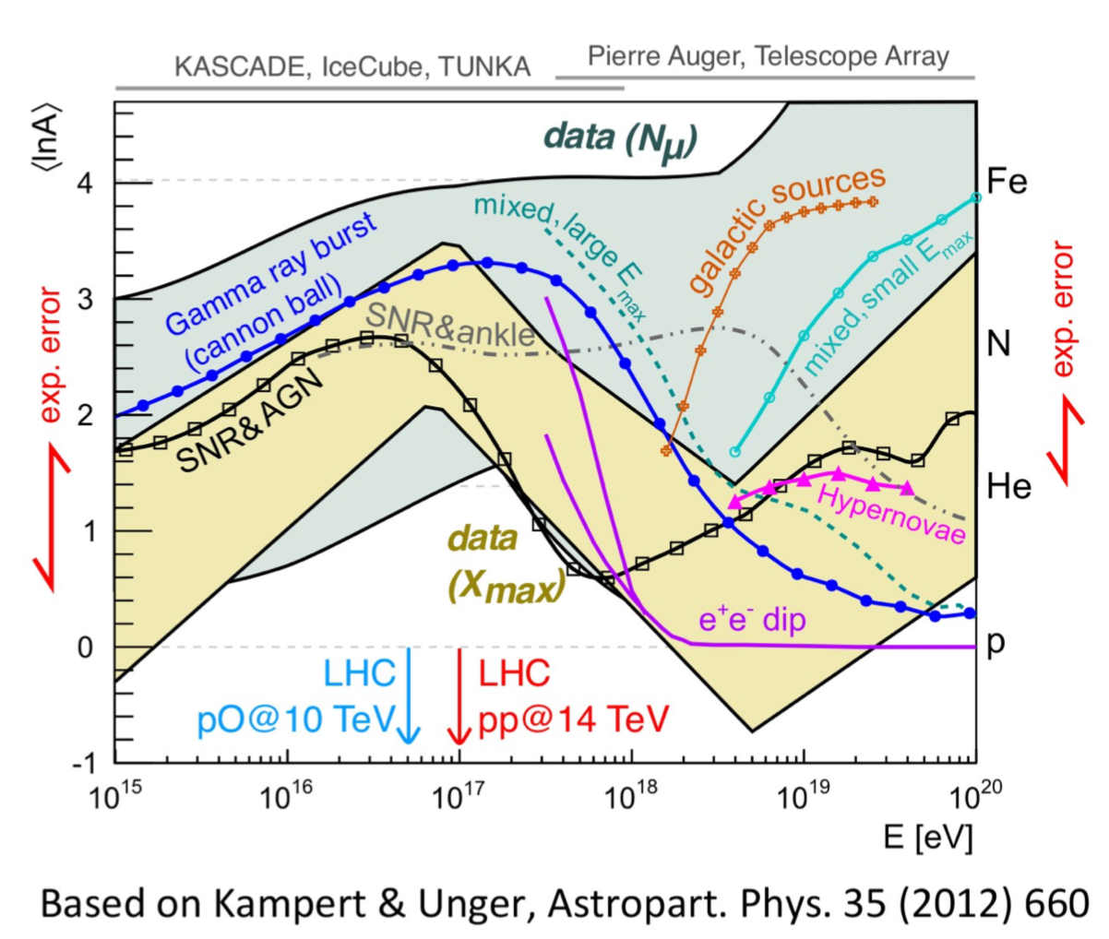
Application: Astroparticle Physics
Forward charm production at the LHC
Constraints on prompt atmospheric neutrino flux at IceCube
https://arxiv.org/pdf/1201.0018
cosmic ray muon puzzle:
observed excess of muons compared to hadronic interaction models
forward pion/kaons fluxes will provide
crucial input
See also:
Talk Subir Sarkar

Slide 8


Application: QCD
TeV Energy Neutrino Interaction
l
intrinsic
charm
neutrino DIS at TeV scale
large x PDFs: x~1
charm
fragmentation
color transparency
p
g,q
D
hadronization in nuclear medium
v
cc
BFKL dynamics
forward charm
¹⁸⁴W
q
p
g,q
ultra low-x
PDFs: x~10⁻⁷
color glass condensate
strangeness
nuclear PDFs
shadowing
EMC effect
Forward Particle Production

Slide 9
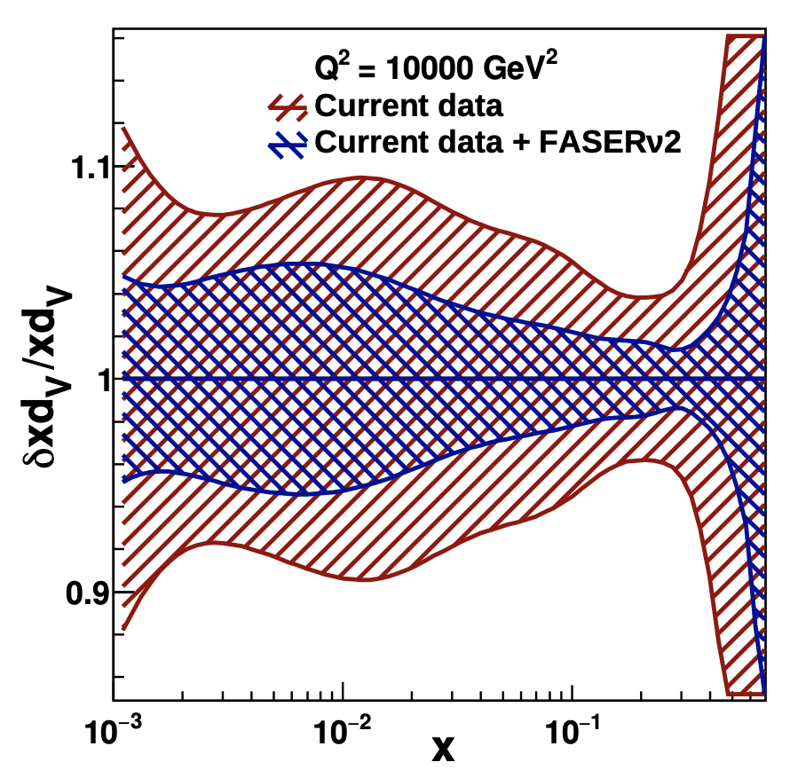
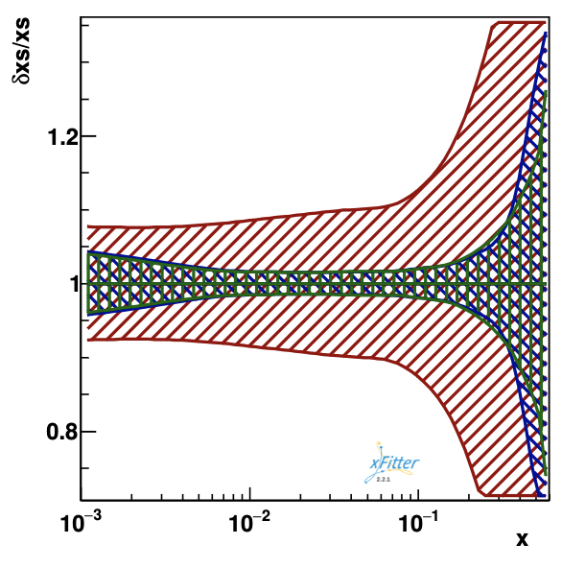
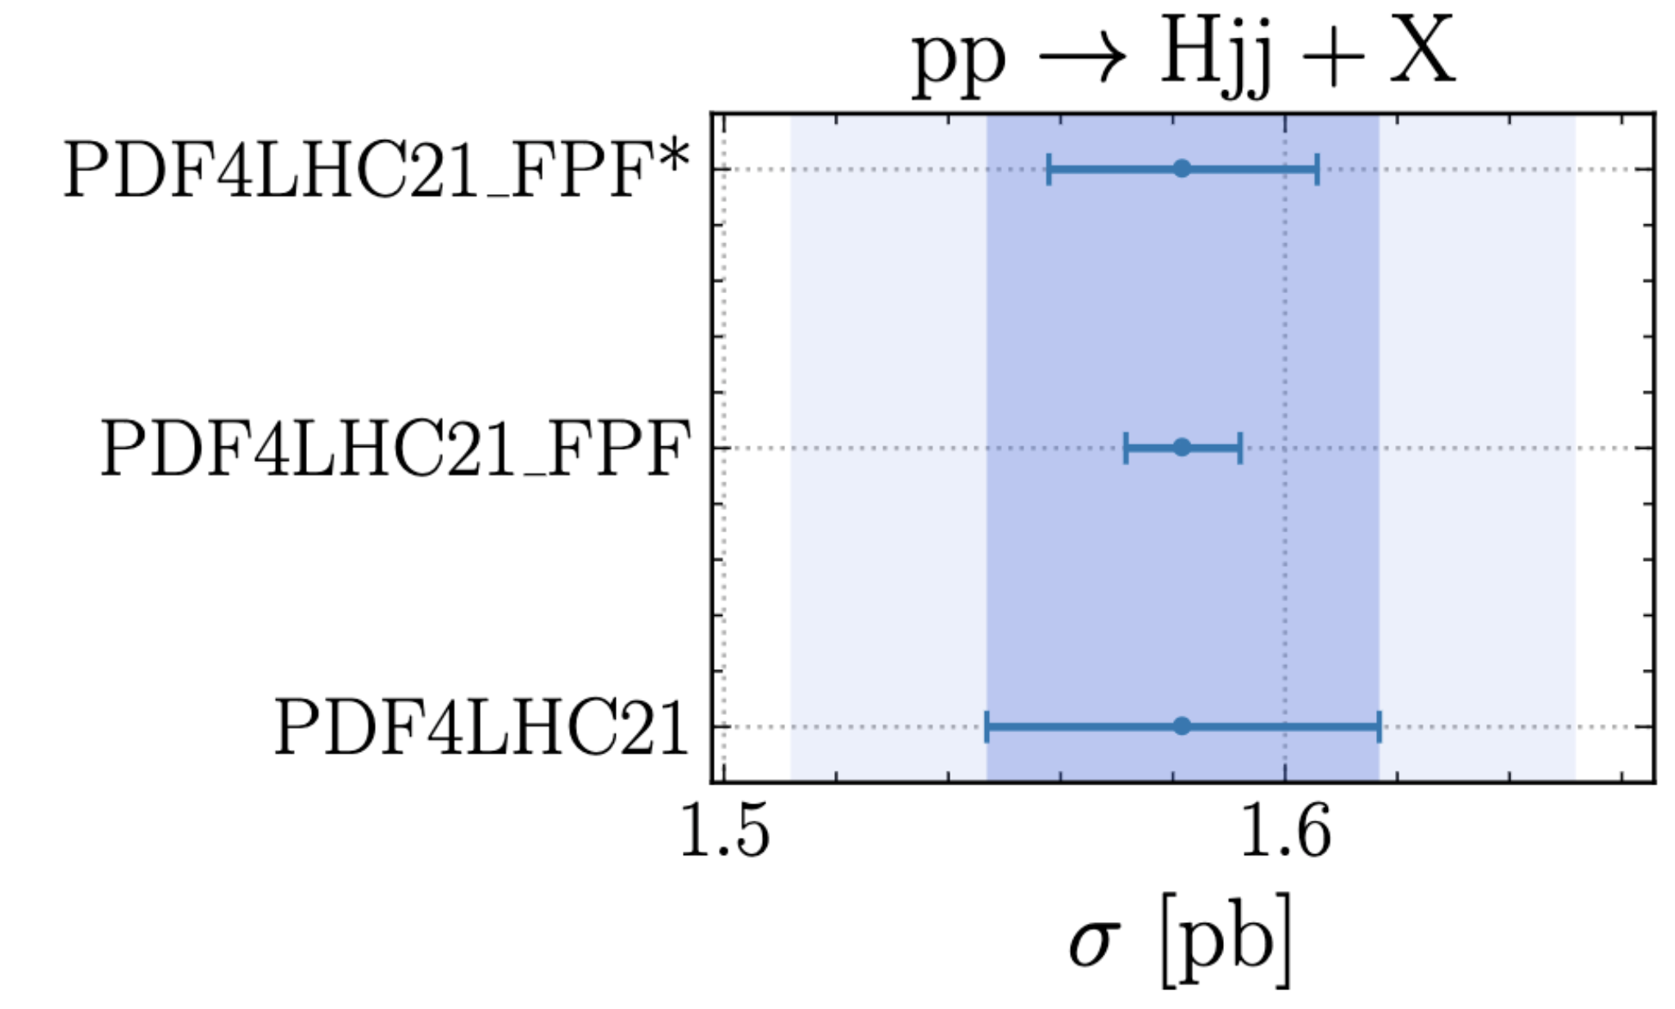
Neutrino DIS at the FPF
neutrino DIS data will improve PDFs
[FPF, P5 Input] [Cruz-Martinez et al. 2309.09581]
Collider Neutrino Experiments
are a Neutrino-Ion Collider
at EIC center of mass energies
l
neutrino DIS at TeV scale
color transparency
v
hadronization in nuclear medium
reduced PDF uncertainties for
many LHC processes
¹⁸⁴W
q
strangeness
content of proton
nuclear PDFs
shadowing
EMC effect
breaks PDF/BSM degeneracy for main LHC experiments
[Rojo, FPF7 Talk]

Slide 10
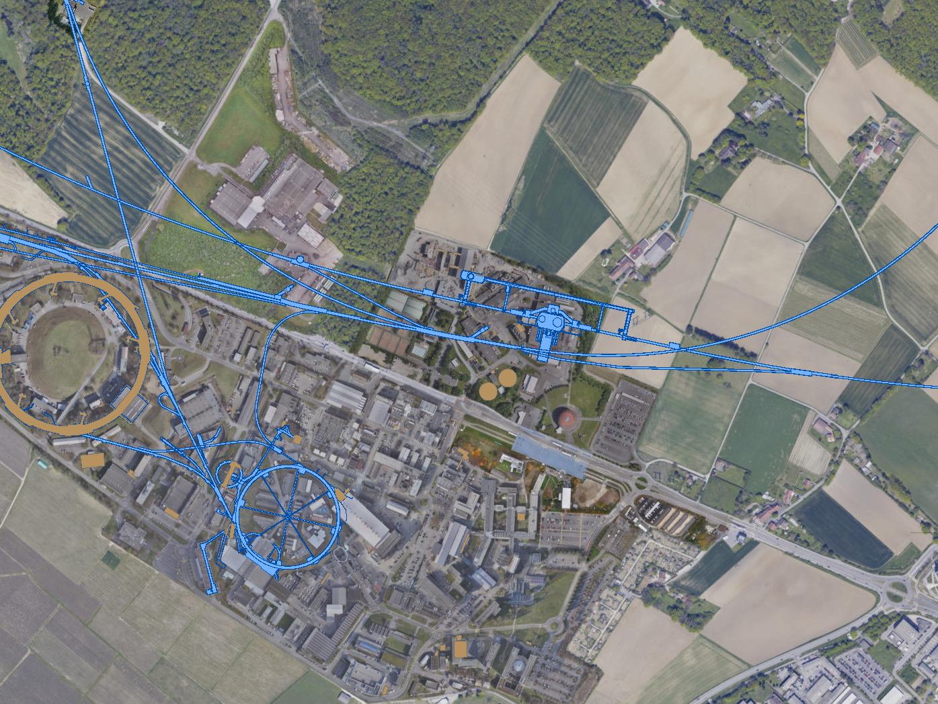
FORWARD PHYSICS FACILITY
A comprehensive site selection study by the CERN Civil Engineering group has identified an ideal location ~600 m west of ATLAS.
J. Phys. G 50 (2023) 030501, 1-410
ATLAS
SPS
LHC
LOS
The site is on CERN land in France
The cavern is 65 m-long, 9 m-wide/high
Shielded from ATLAS by 200m of rock
Disconnected from LHC tunnel
Cost: ~CHF 40M
Vibration, safety studies: can construct FPF without disrupting LHC operations
Radiation studies: can work in FPF while LHC is running (HL-LHC starts 2029)
https://cds.cern.ch/record/2851822/
CERN GIS

Slide 11
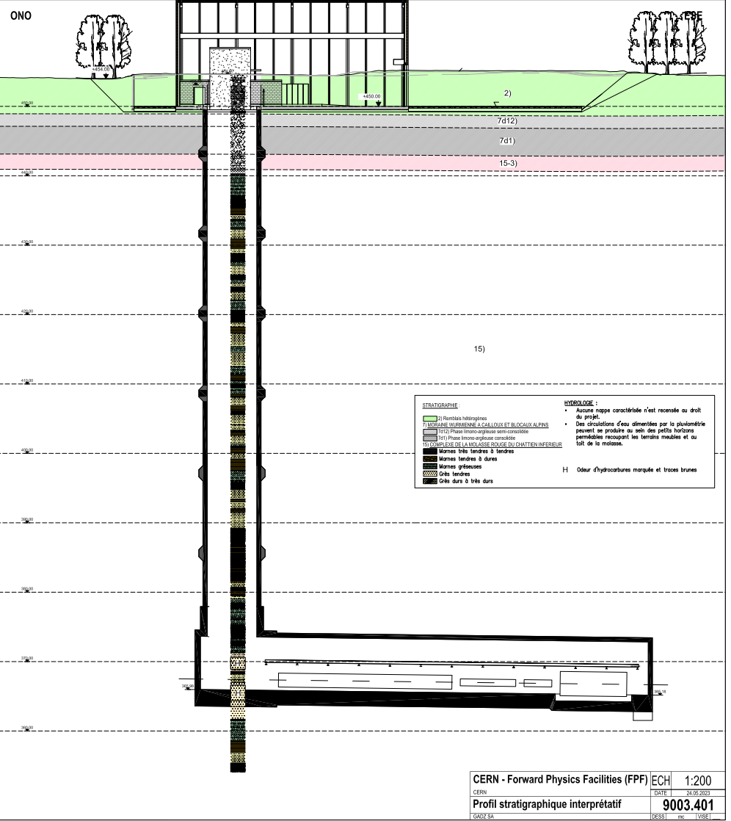
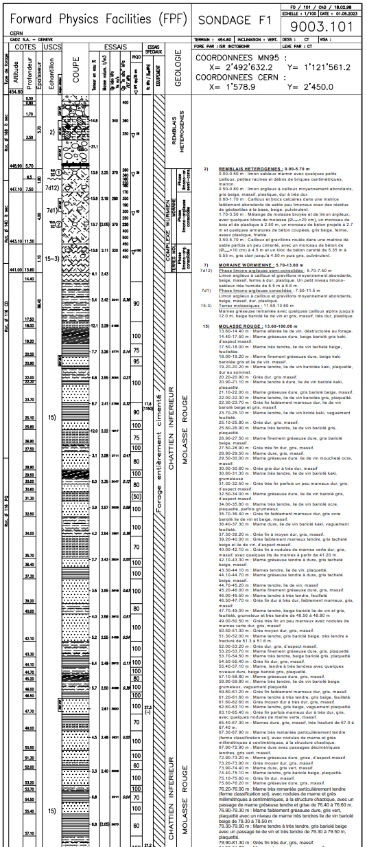
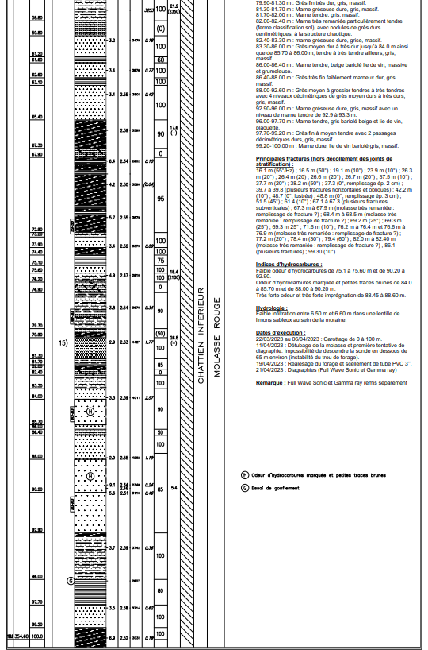
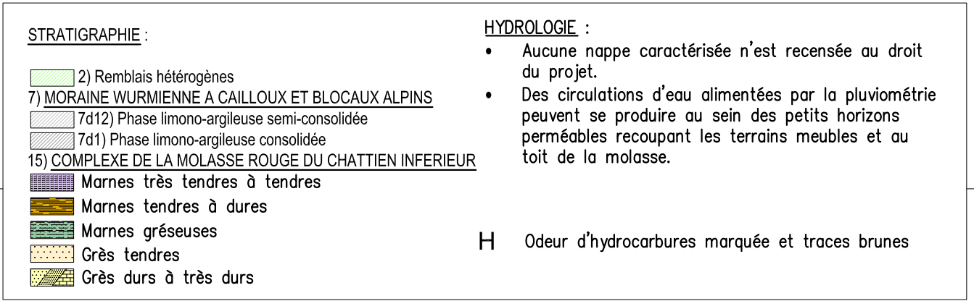
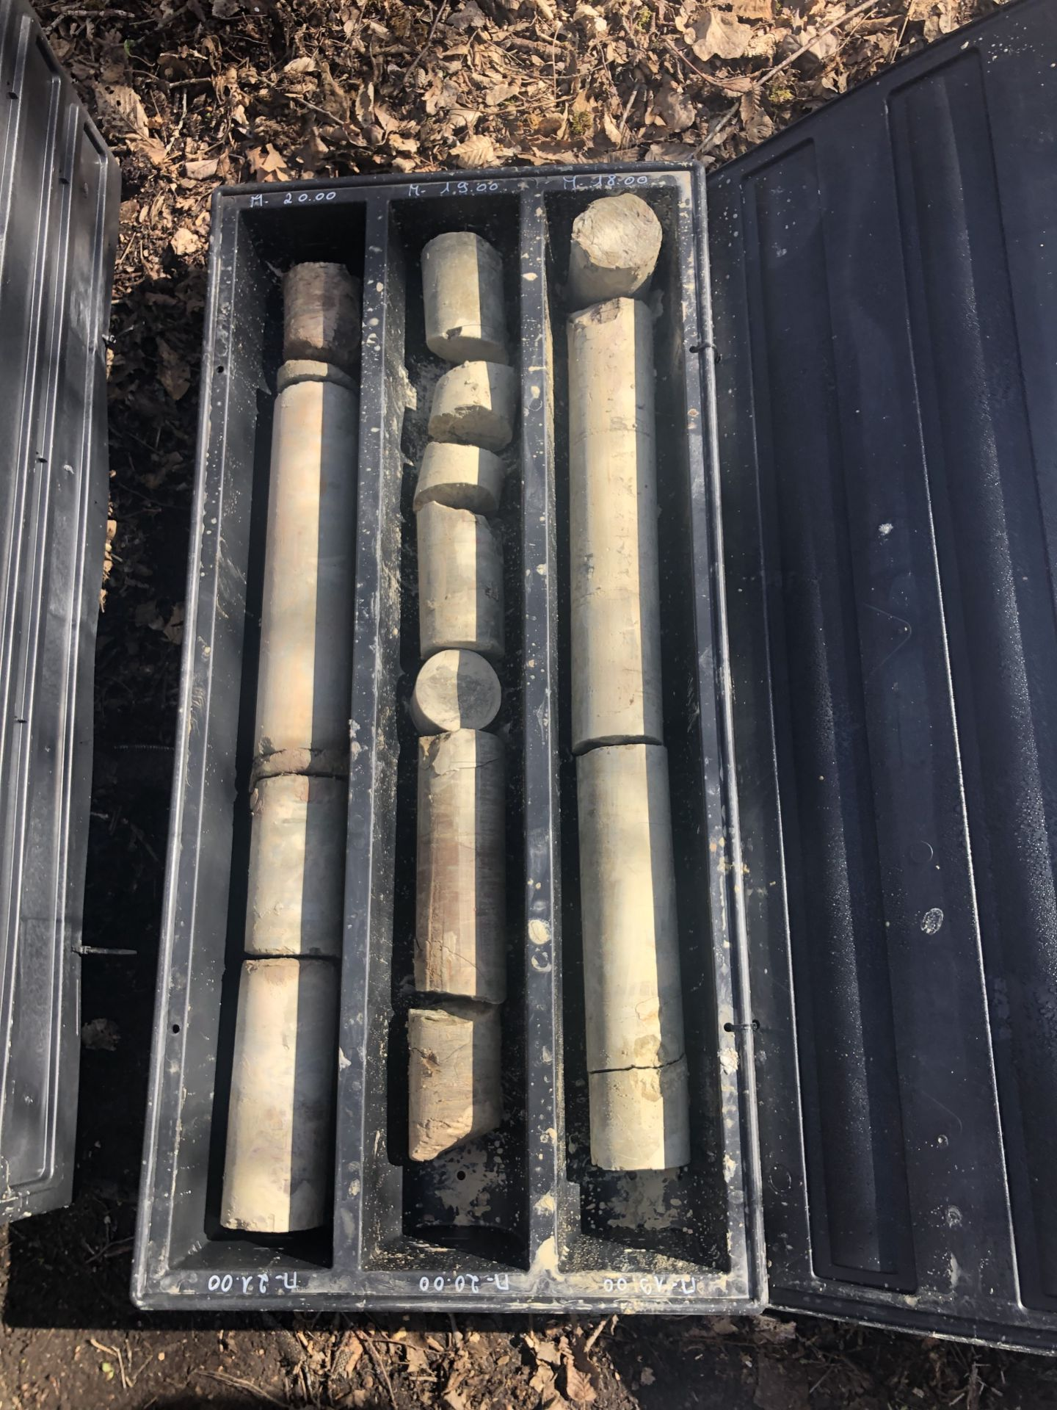
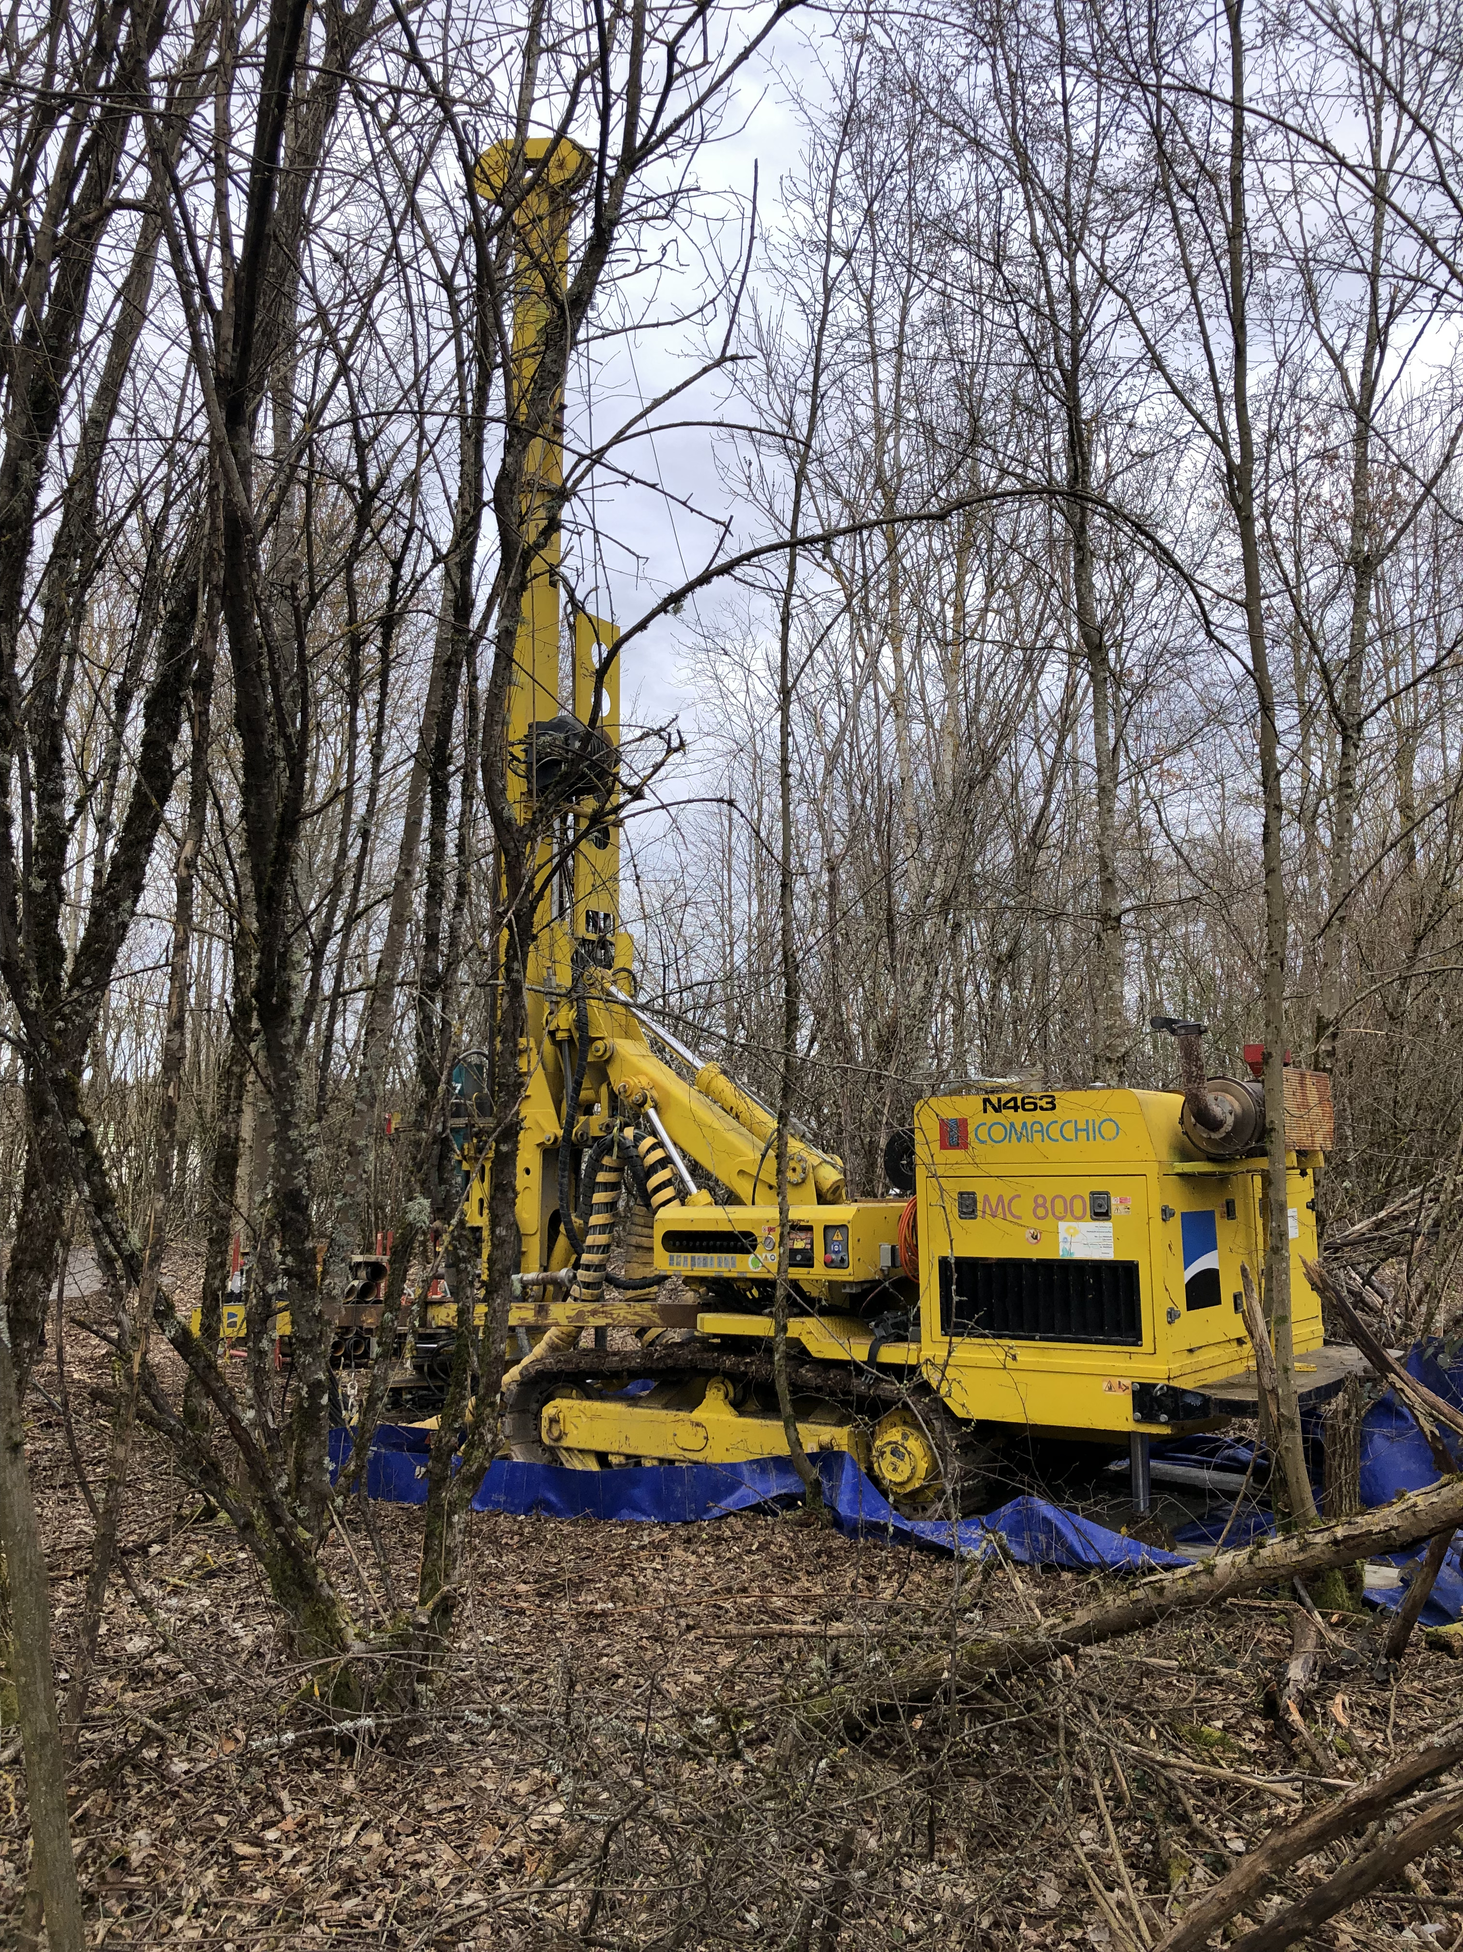
FPF CE Site Investigation Works
20cm diameter core taken to 100m depth at proposed FPF location
Detailed geological study of core carried out
  No showstoppers identified
  Area looks good for excavation
11
11

Slide 12
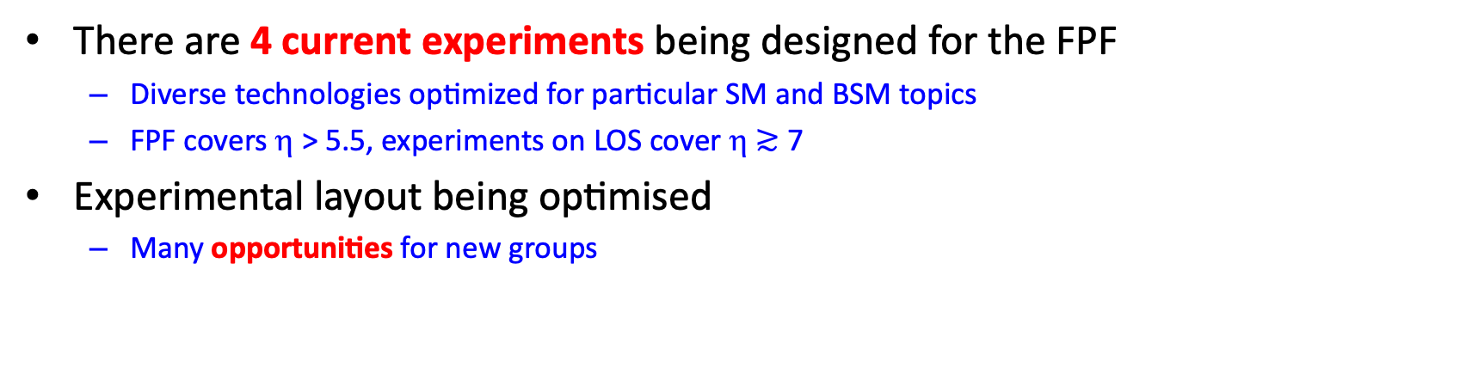
FPF Experiments
J. Phys. G 50 (2023) 030501, 1-410
There are 4 current experiments being designed for the FPF
  Diverse technologies optimized for particular SM and BSM topics
  FPF covers η > 5.5, experiments on LOS cover η $≳$ 7
Experimental layout being optimised
  Many opportunities for new groups

Slide 13
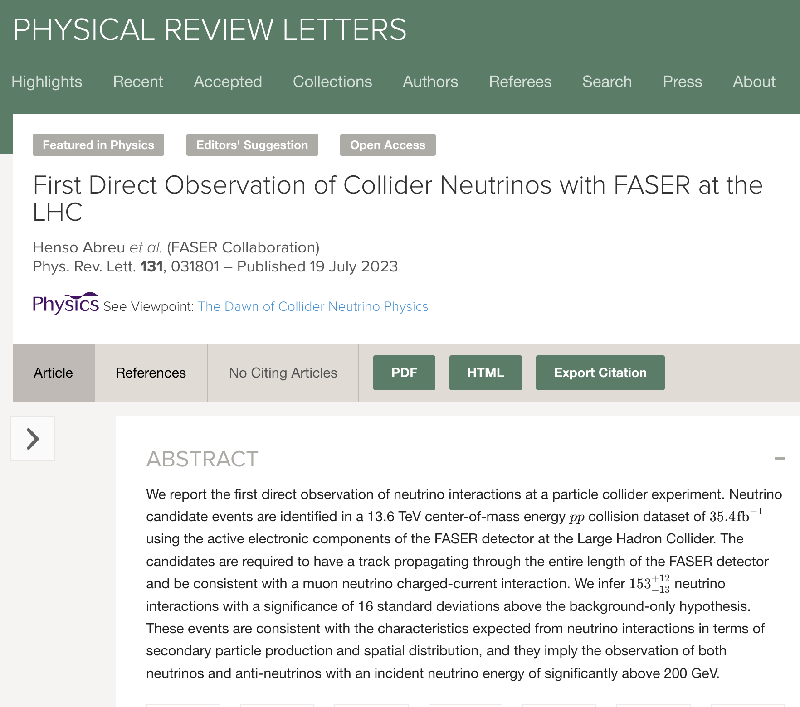
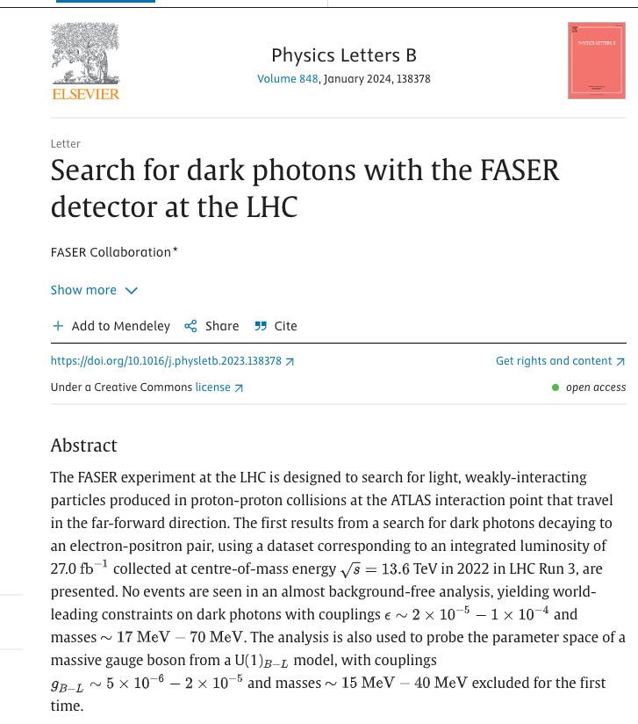
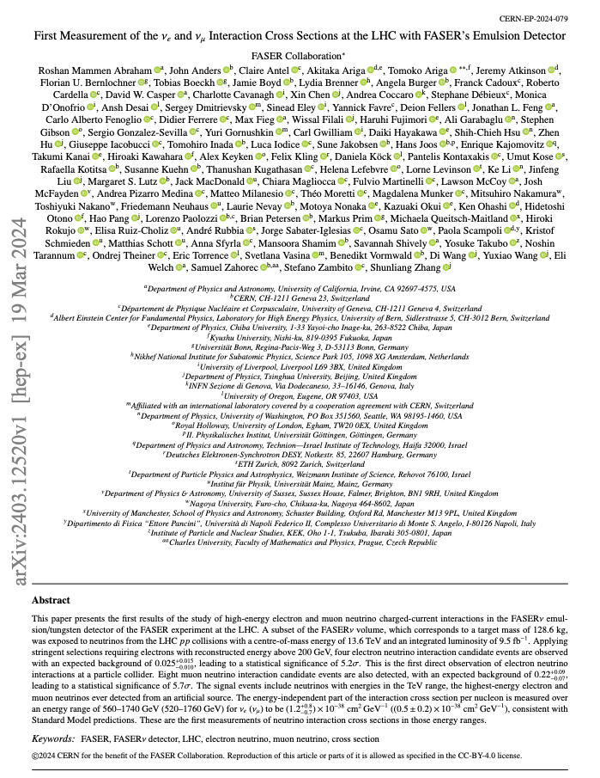
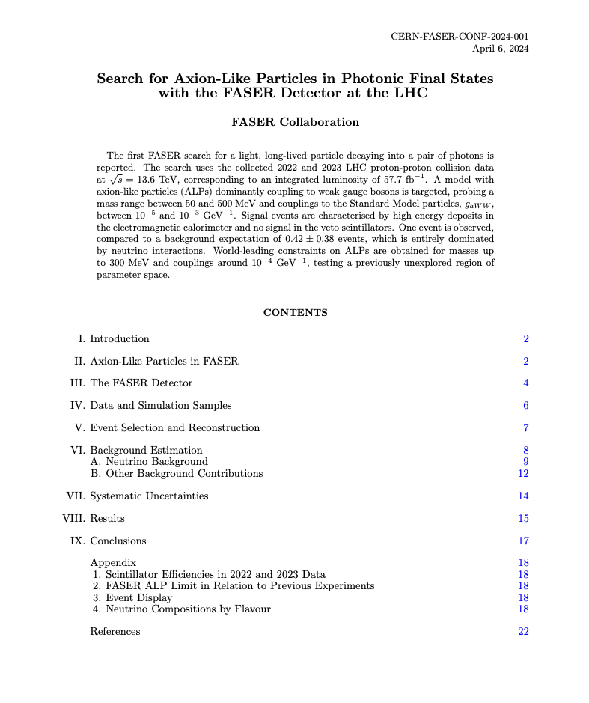
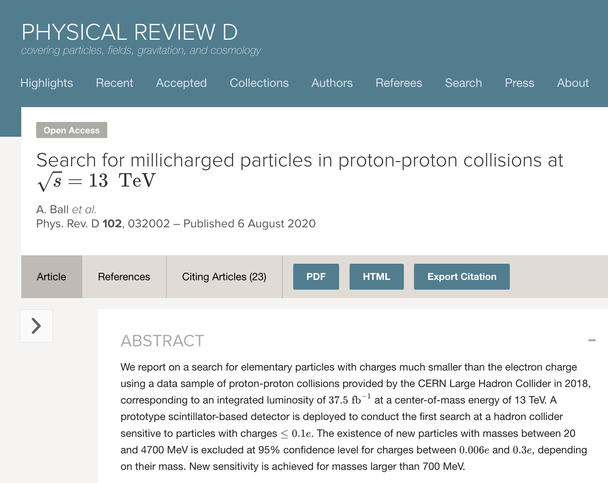
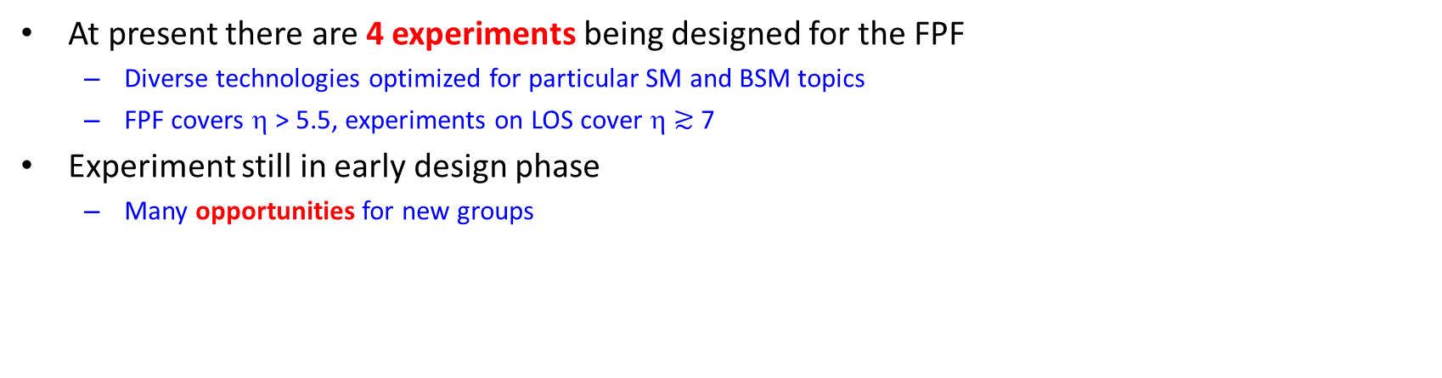
FPF Experiments
J. Phys. G 50 (2023) 030501, 1-410
At present there are 4 experiments being designed for the FPF
  Diverse technologies optimized for particular SM and BSM topics
  FPF covers η > 5.5, experiments on LOS cover η $≳$ 7
Experiment still in early design phase
  Many opportunities for new groups
Phys. Rev. D 102, 032002
Phys. Rev. Lett. 131, 031801
Phys. Let B, 848, 138378
arxiv: 2403.12520
CERN-FASER-CONF-2024-001
All but one of the proposed FPF experiments have pathfinder versions already running at the LHC
  FASER, FASERν, milliQan
  Physics results from these experiments give confidence that the FPF physics potential can be realized

Slide 14
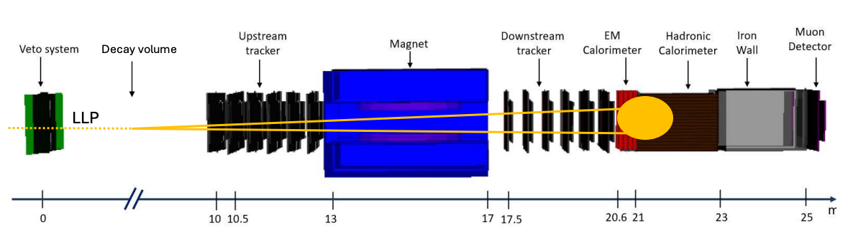
FASER2 detector overview
FASER2 scaled up version of FASER experiment.
Designed to search for decaying BSM LLPs (100x larger transverse size to FASER, and 7x longer decay volume) and to measure charge/momentum of muons from neutrino interactions in FLArE and FASERν2)
Larger transverse size => need to use to different technologies than in FASER:
Investigated different options for tracking detector technology and magnets.
Baseline tracker – SciFi tracker (maybe able to re-use LHCb modules removed in LS3 depending on timing).
Two options for magnet:
Custom made super-conducting dipole (2Tm bending power 1.7x1.7m² square air-core apperture):
  Prelimiary quote from Toshiba: 4.1MCHF 3-4y lead-time
4 off-the-shelf crystal-puller magnet units (2Tm (central) bending power 1.6m diameter air-core apperture):
  Prelimiary quote from Toshiba: 2.3MCHF 1-2y lead-time

Slide 15
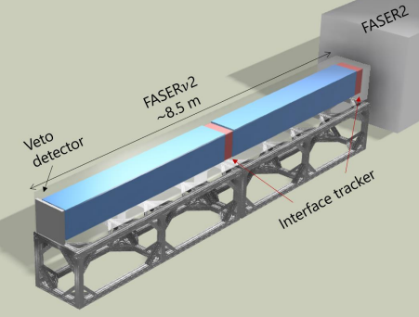
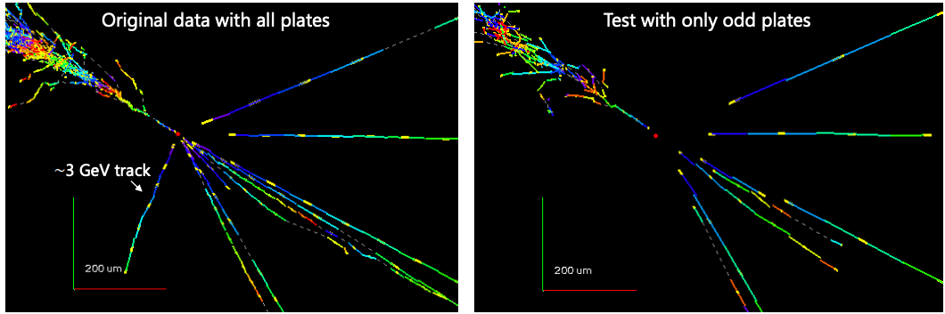
FASERν2 detector overview
Emulsion tungsten neutrino detector, scaled up version of FASERν.
20tonne target mass:
80x20cm² in transverse plane (64x25cm² also under consideration)
8m long
3300x 2mm thick tungsten plates interleaved with emulsion film
Electronic detectors to allow to timestamp events and connect muons from neutrino interactions with those reconstructed in the FASER2 spectrometer (for charge/momentum measurement).
Emulsion needs to be replaced with track occupancy of O(10⁵) tracks/cm² (about 2months of HL-LHC running)
To save cost would like to improve this to have one set of emulsion per year:
reduce track multiplicity by factor of 3 with sweeper magnet,
or improve tools to allow analysis with higher occupancy
Under study…
Several testbeam studies and R&D ongoing related to:
Detector assembly
Emulsion film optimization (long term operation, higher track occupancy)
Analysis tools (re-reconstruct FASERν data skipping every-other-film to mimic 2mm thick tungsten)

Slide 16
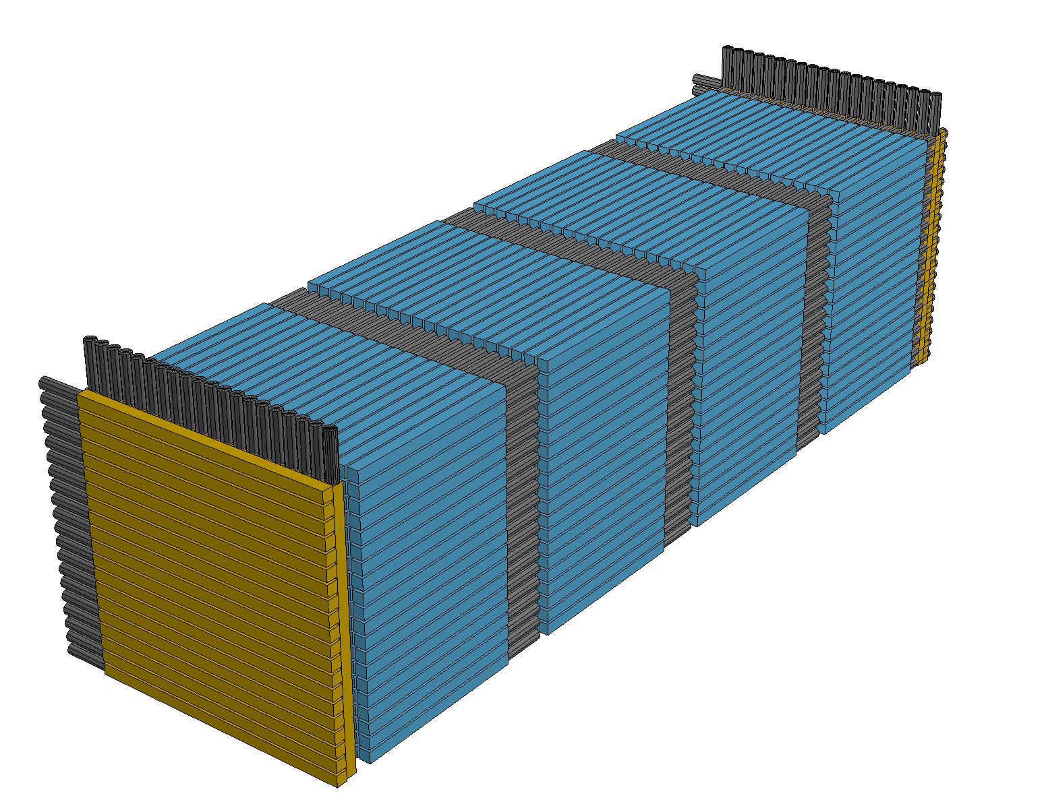
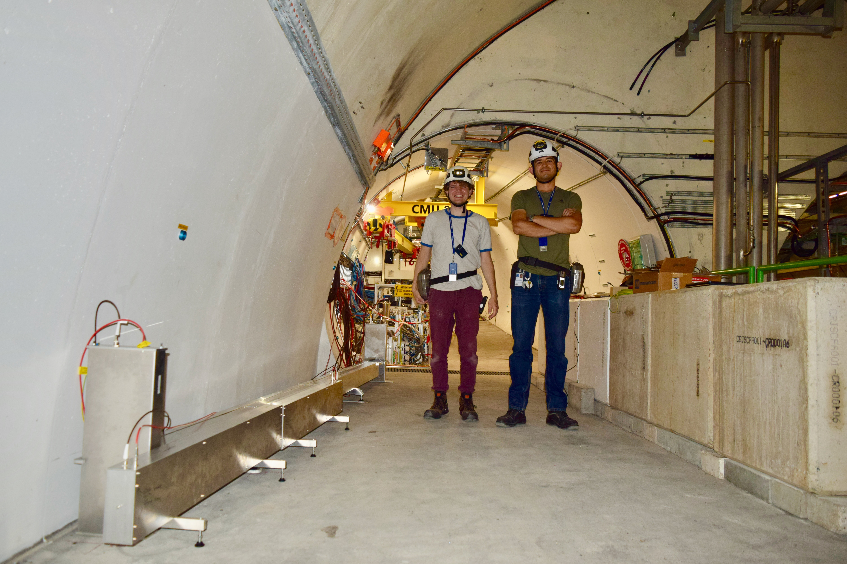
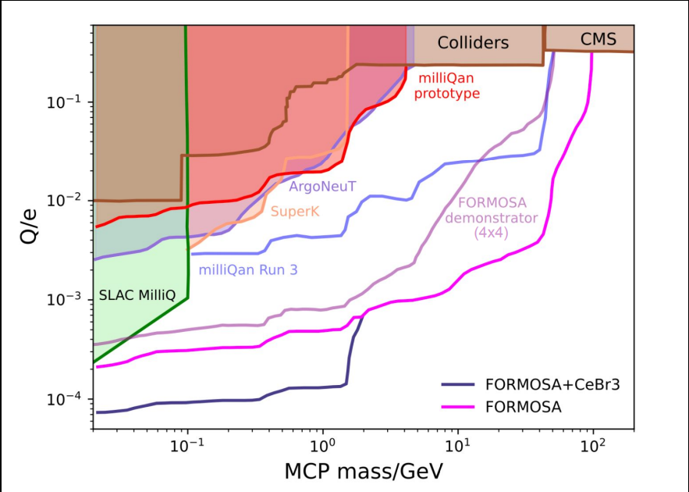
FORMOSA detector overview
FORMOSA is a scintillator based millicharged particle detector (similar to the running miliQan experiment).
Idea is to see low scintillation signal in multiple bars pointing at IP.
Baseline design: 20x20 array of scintillator bars (with surrounding scintillators to veto backgrounds)
At start of 2024 a small demonstrator detector was installed in TI12 (FASER location) to study the performance with a large rate of through going muons from the IP. Using this demonstrator the DAQ concept for FORMOSA has been validated.
Team studying updated design with central submodule of CeBr3 scintillator
~35 higher light yield, allows significant increase in sensitivity for low charges.

Slide 17
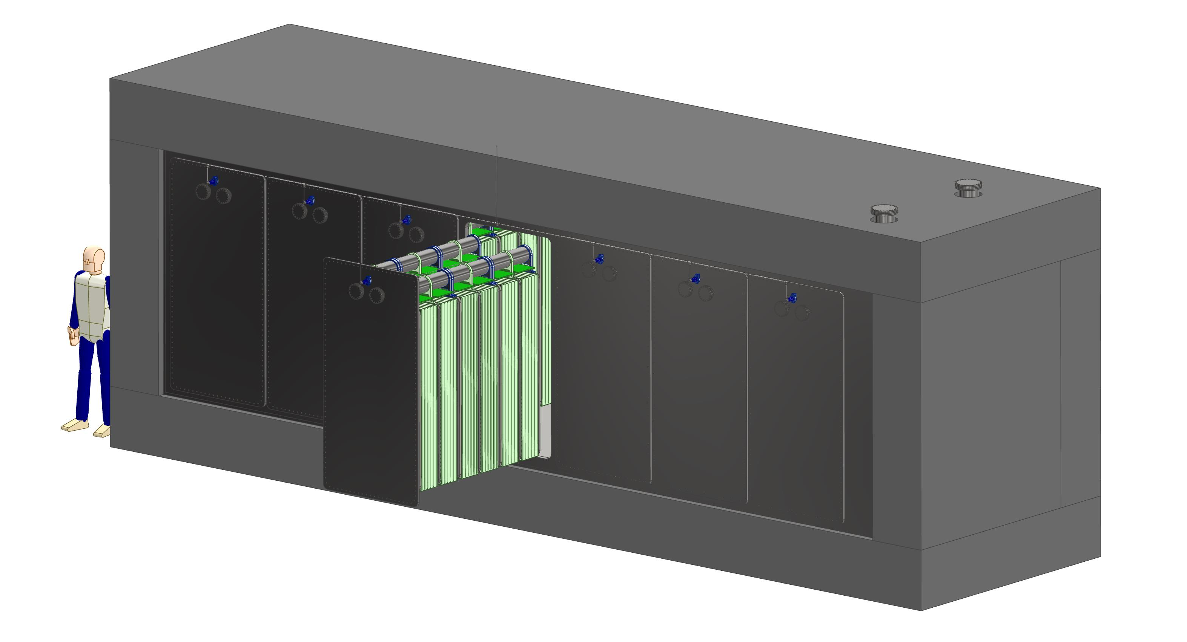
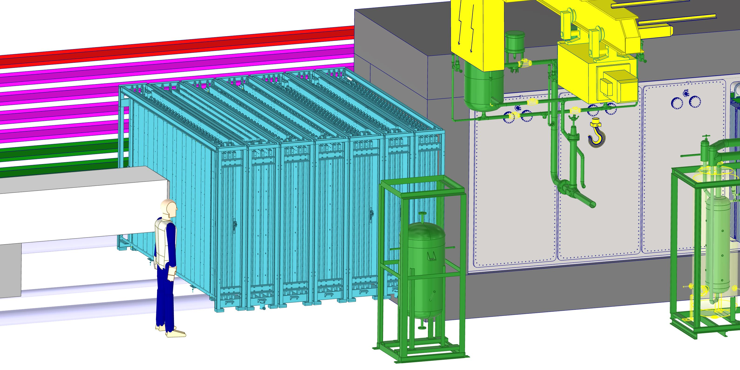
FLArE detector overview
Liquid Argon TPC
Builds on investment in liquid noble gas detectors
Fiducial (active) mass 10 (30) tons
Single-wall 8.8 x 2.0 x 2.4 m foam-insulated cryostat
7x3 modules, for space charge, scintillator light (trigger)
Anode charge readout pixelated ~5mm size
Alternative readout 3D optical TPC (ARIADNE)
TimePix detects wavelength-shifted secondary scintillation light
THick Gaseous Electron Multiplier in gas phase of a dual-phase LArTPC
Horizontal “filing cabinet” installation
Cryogenic plant downstream of all detectors
(noise/vibration)
Hadron calorimeter/muon spectrometer downstream
for low mmtm
Magnetized iron plates interleaved with scintillator modules
FASER2 provides the spectrometer for high mmtm
Notes:
Drift field 500V/cm

Slide 18
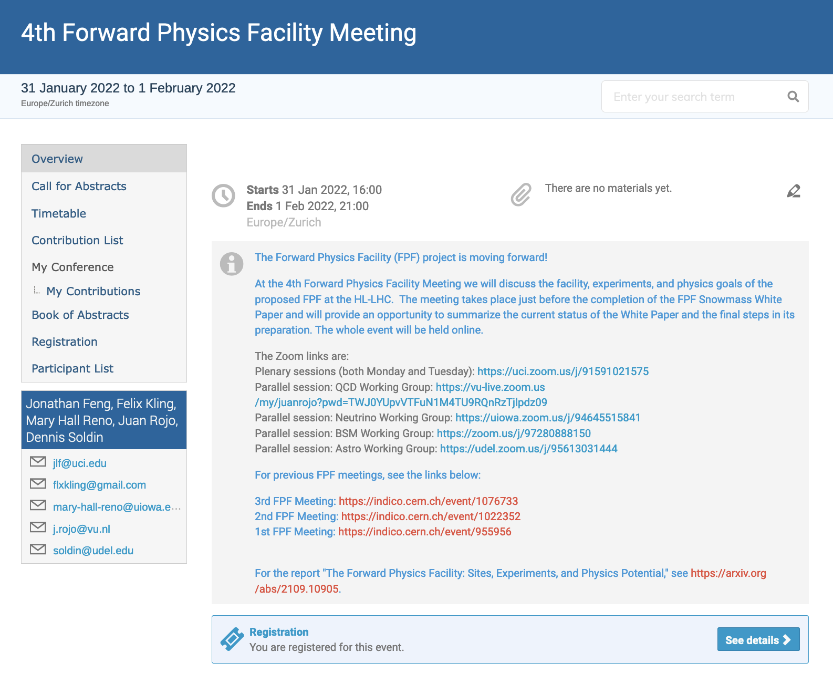
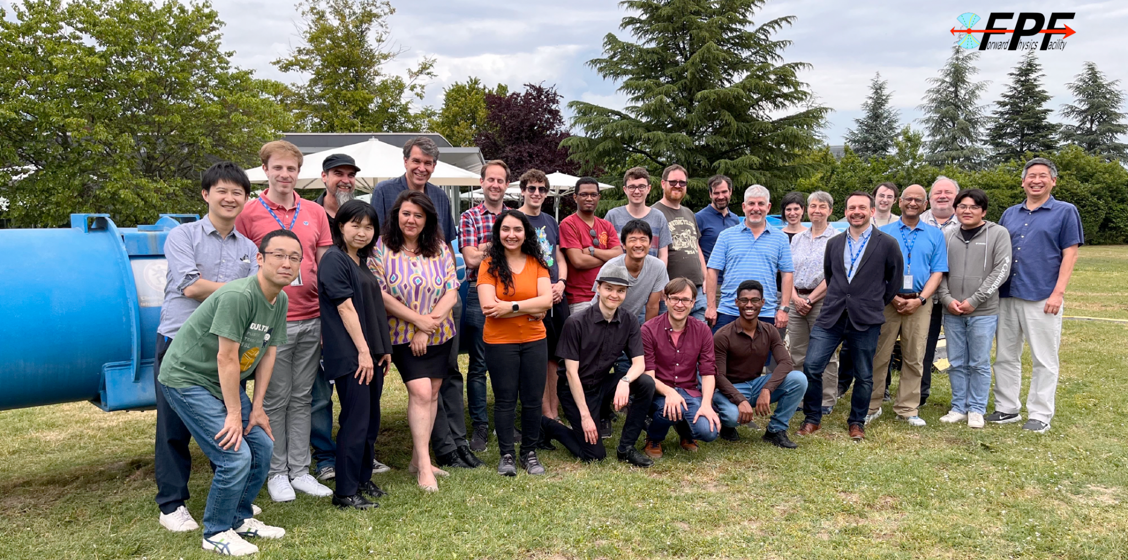
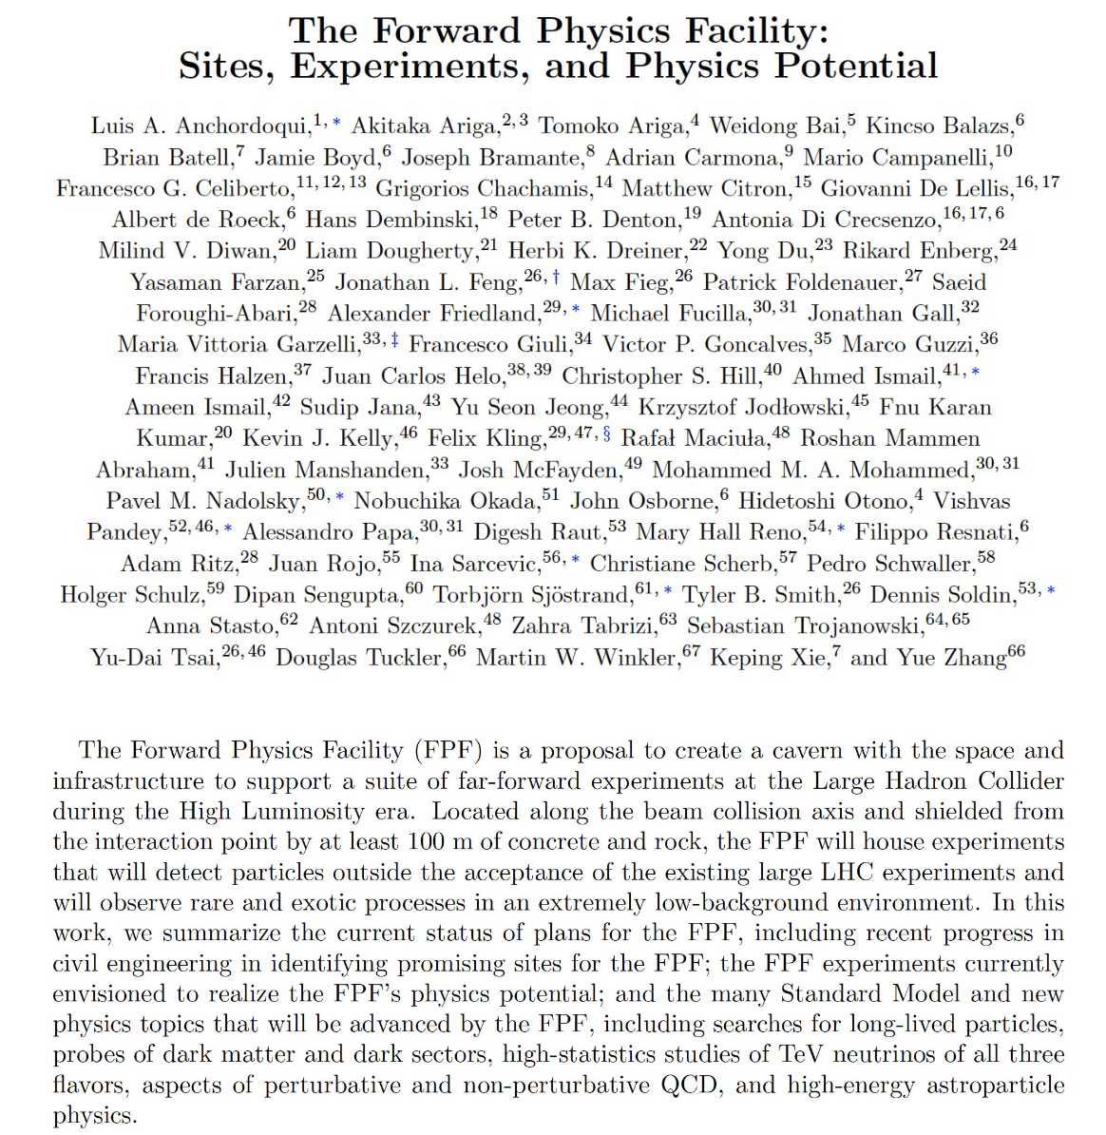
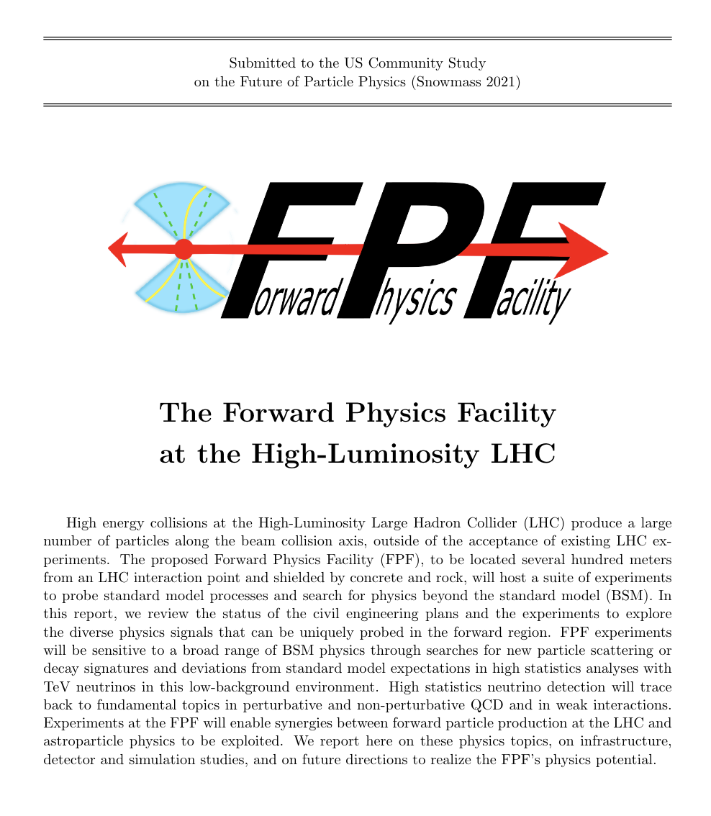
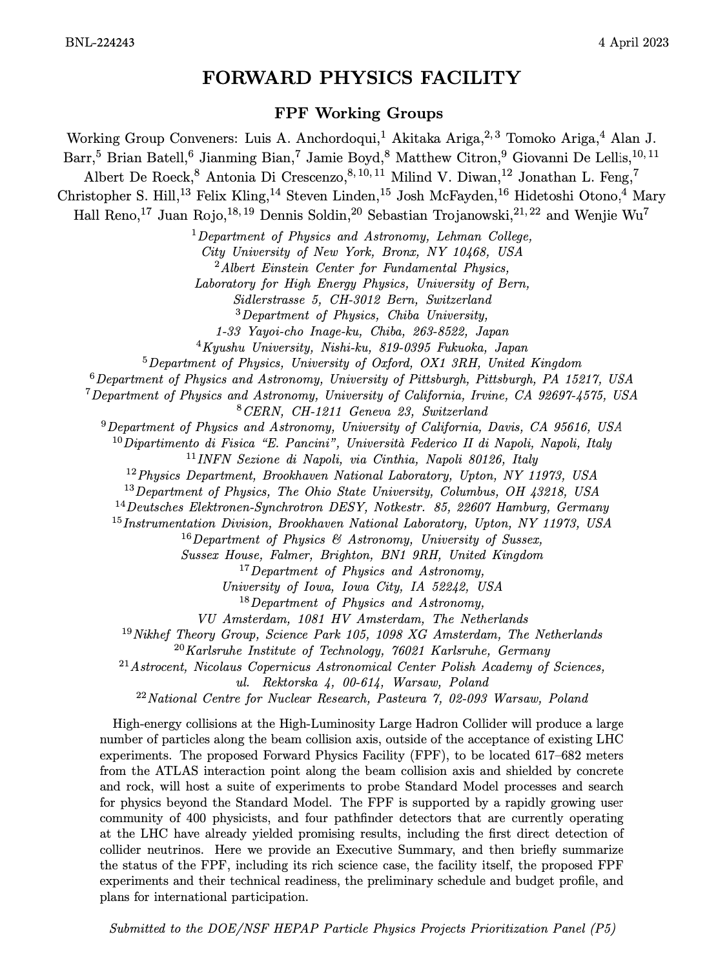
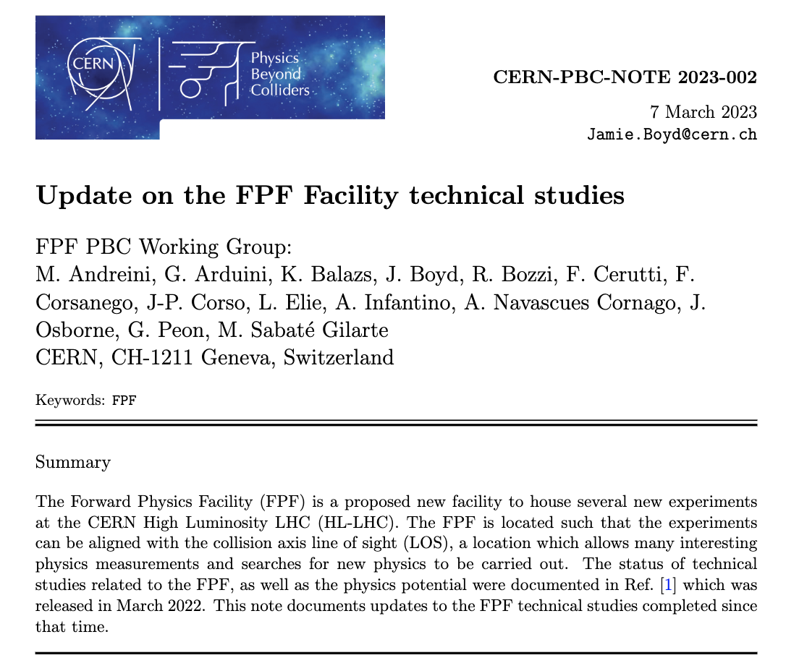
FPF Documentation
FPF workshop series:
FPF1, FPF2, FPF3, FPF4, FPF5,
FPF6, FPF7, FPF Theory Day
FPF Paper:
2109.10905
~75 pages, ~80 authors
Snowmass Whitepaper:
2203.05090
~450 pages, ~250 authors
Recent Summary:
FPF Update
Technical Documents:
Facility Technical Study
Muon Flux Study
Vibration Study
Geotechnical Report

Slide 19
ANUBIS
MATHUSLA
CODEX-b

Slide 22
Summary
The FPF greatly expands the LHC physics progamme
The beam is there already
Broad and interdisciplinary physics programme
  Neutrinos, QCD, Cosmic Ray, BSM, …
The cost is modest
Fully aligned with existing European strategy
Great test-bed for new ideas
Could run in LHC Run 4

Slide 23
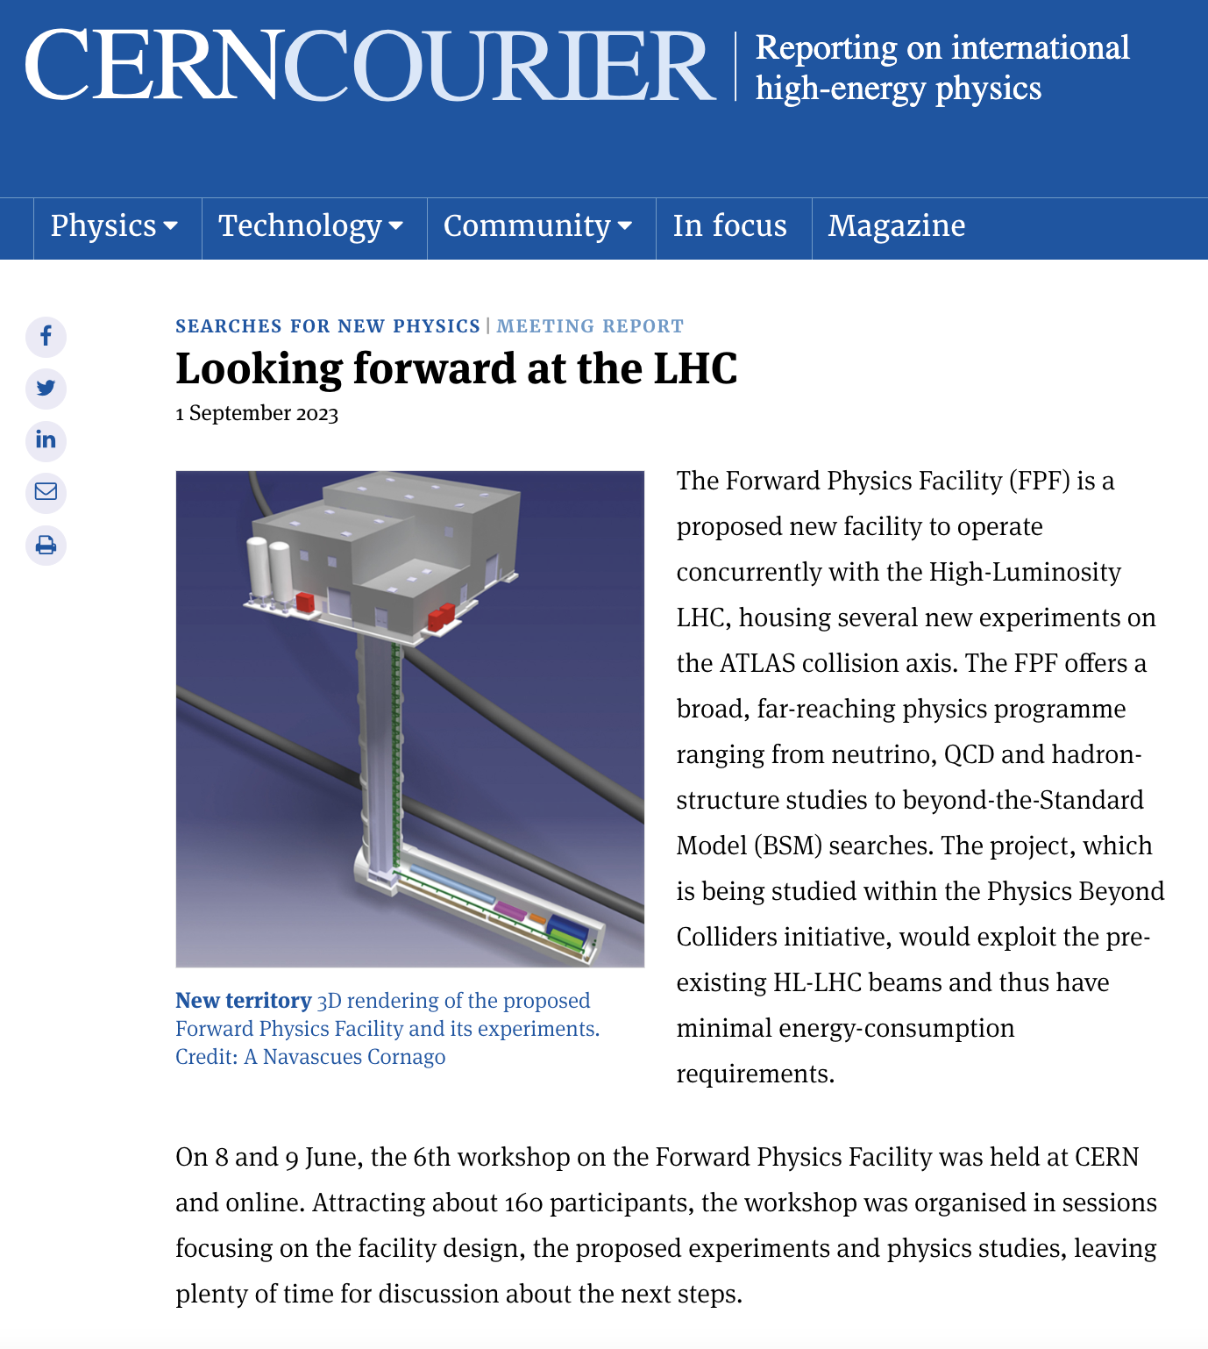
EXTRAS

Slide 24
FPF is a proposed new facility to house several experiments on the collision axis line-of-sight in the HL-LHC era
  Maximise the physics from the HL-LHC
The FPF experiments would :
  Have world leading sensitivity in several BSM models
  Study O(1M) TeV neutrinos (covering all flavours) with important implications for:
    Neutrino physics
    QCD
    Astroparticle physics
Following many studies within the PBC we have come-up with a baseline design for the facility that can house the proposed experiments
  No showstoppers identified for implementing the facility or for operating the experiments
  Facility cost of only ~40MCHF
Conceptual designs of the experiments are ongoing with baseline solutions available for the different detector components
  More studies will allow better optimizations and improved physics reach
Plan to submit a proposal for the FPF to the ESPP in Q1 2025
  If viewed favourably the facility can be implemented to allow first physics during Run 4

Slide 26
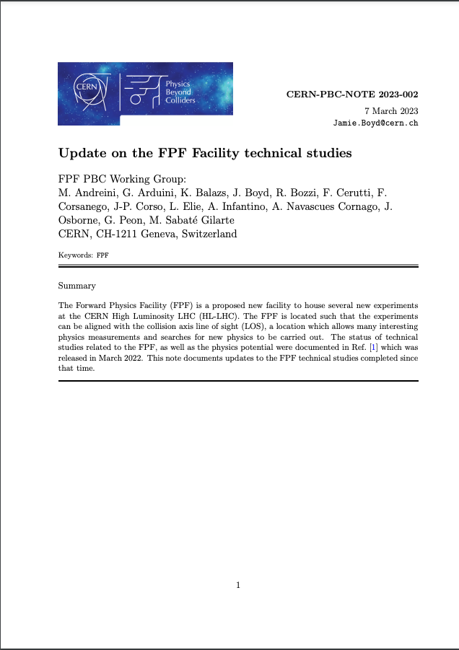
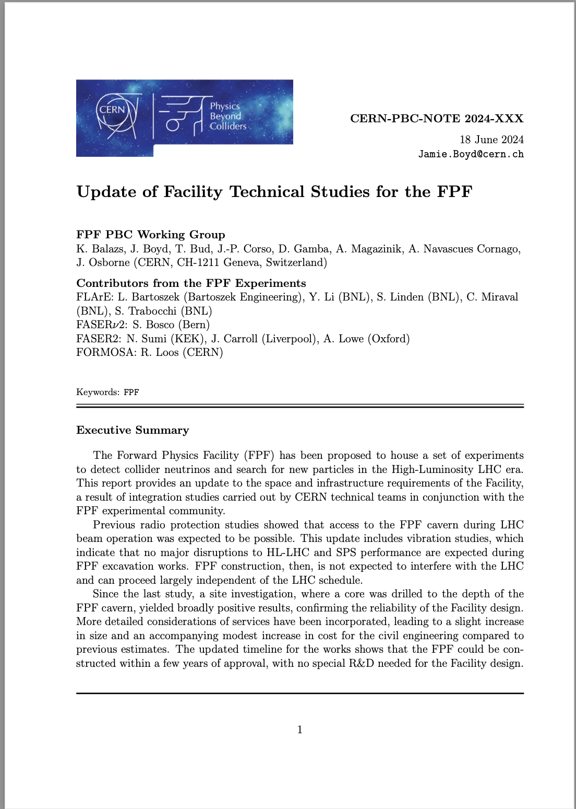
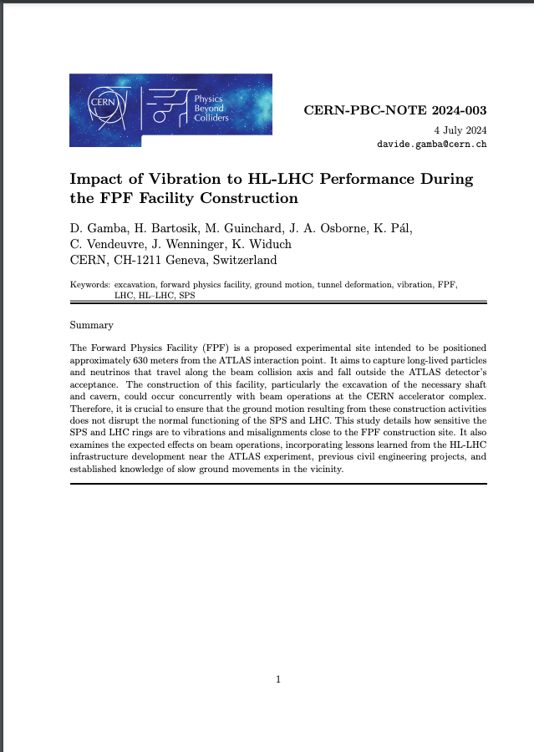
Documentation on facility studies
CERN-PBC-NOTE 2023-002
https://cds.cern.ch/record/2851822/
CERN-PBC-Notes-2024-004
https://cds.cern.ch/record/2904086
CERN-PBC-NOTE 2024-003
https://cds.cern.ch/record/2901520/

Slide 27
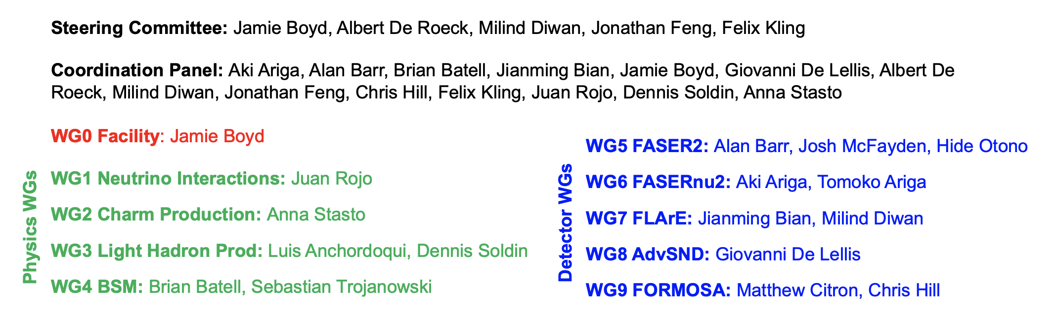
FPF Organization
Technical group:
Bringing together experts from CERN, BNL, and an external engineering contractor Bartoszek engineering:
BNL: M. Diwan, S. Linden, Y. Li, C. Miraval + L. Bartoszek
CERN: J. Boyd, J.P Corso (integration), A. Magazinik (integration), F. Resnati (neutrino platform)
Meeting bi-weekly on Fridays.

Slide 28
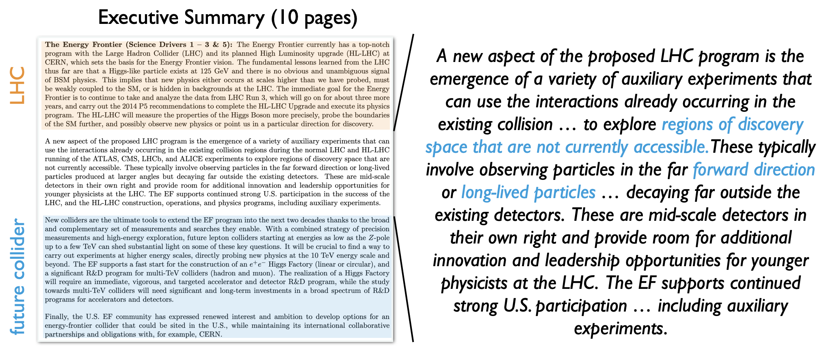
Strongly Reviewed in Snowmass.

Slide 29
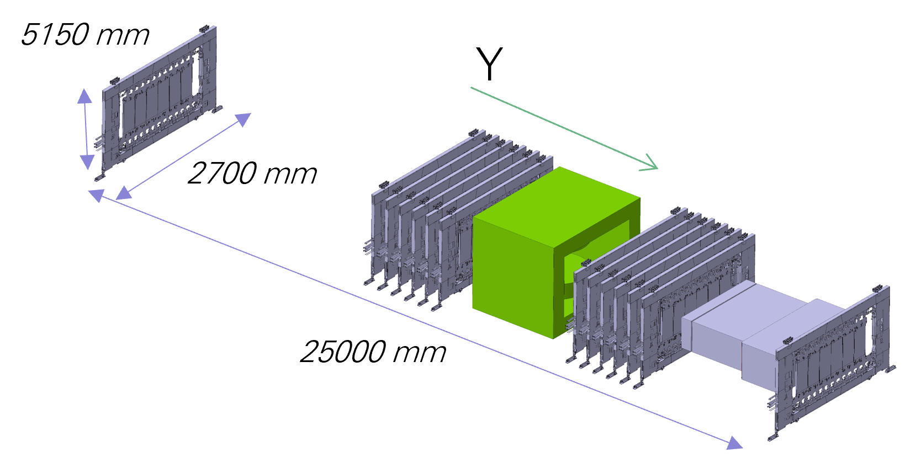
FASER2 Magnet
Two possible magnet solutions investigated for the FASER2 magnet:
Custom made SC dipole based on (descoped) SAMURAI experiment magnet
  2Tm bending power, 1.7m x 1.7m apperture
  SAMURAI magnet built by Toshiba, JP, but similar magnet could be built by TESLA, UK
  Cost (Toshiba) 730 MJPY (4.1 MCHF today), 3-4y lead-time
Off the shelf ‘crystal puller’ magnets:
  4 units: 0.4T central field 1.25m depth => 2Tm bending power (central region)
  1.6m diameter
  Available from both Toshiba and TESLA
  Cost (Toshiba) with modified mechanics to operate on side: 400 MJPY (2.3MCHF), 1-2y lead-time

Slide 30
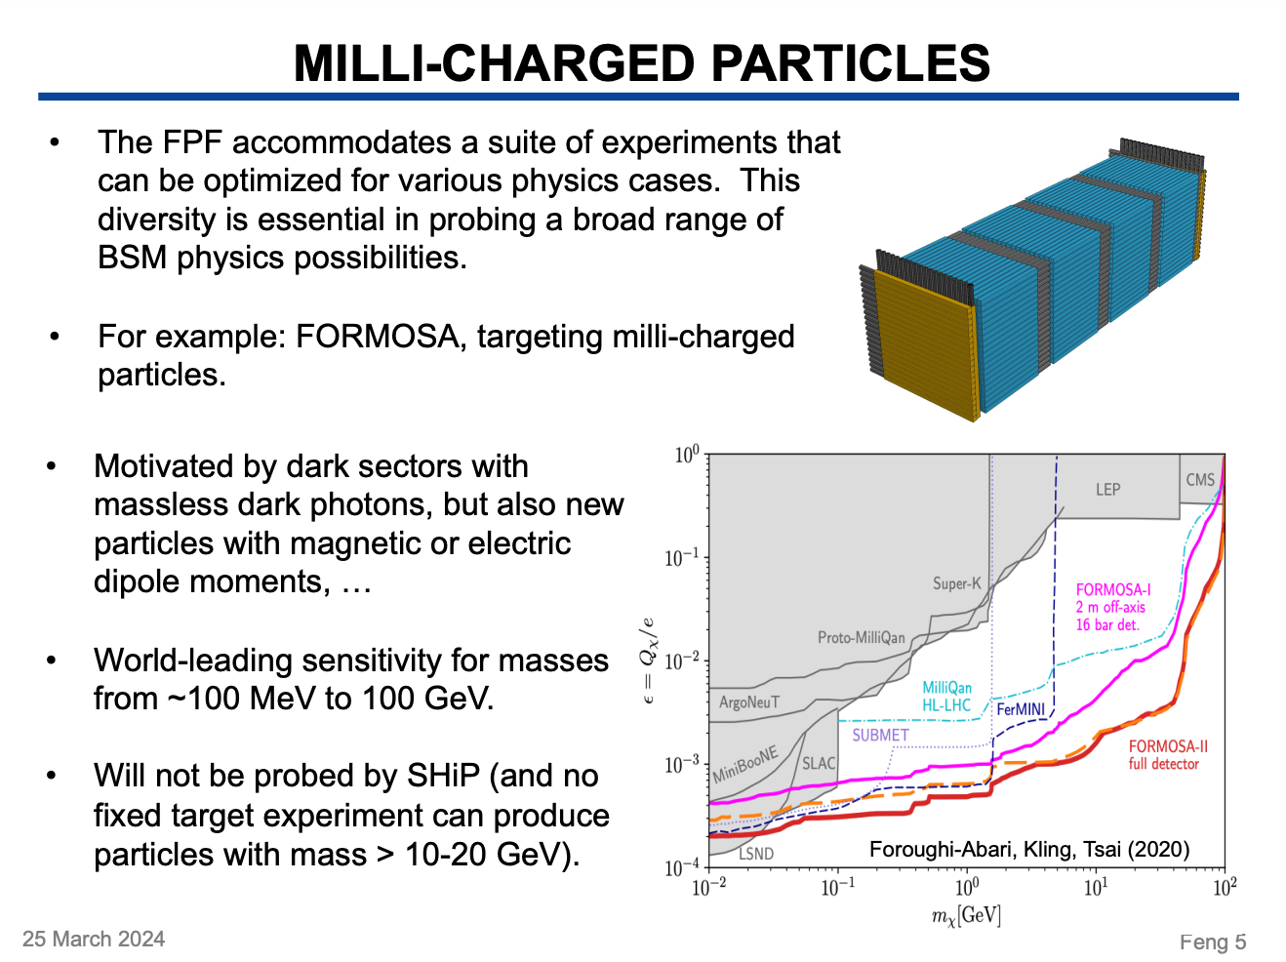
BSM Physics
The FPF experiments have strong sensitivity in all of the dark sector PBC benchmark models
In some of these the sensitivity is not as strong as that of SHiP
There are several classes of models where the FPF is more powerful than SHiP

Slide 31
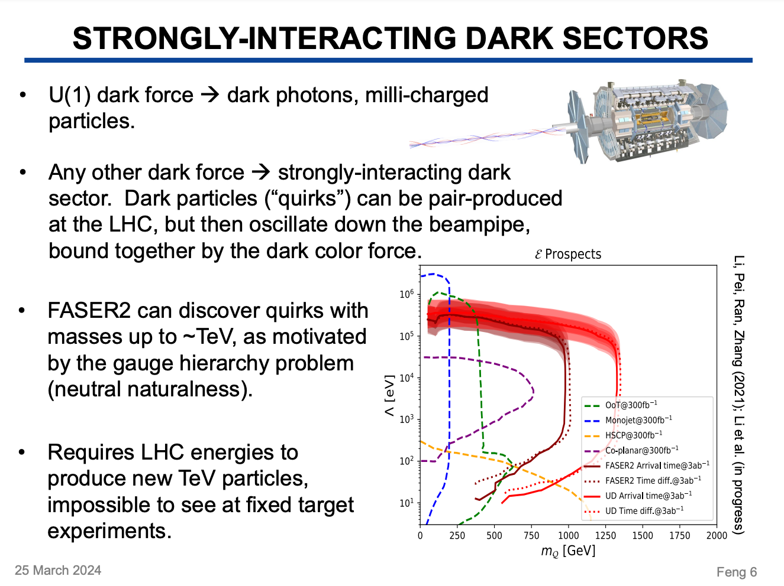
BSM Physics
The FPF experiments have strong sensitivity in all of the dark sector PBC benchmark models
In some of these the sensitivity is not as strong as that of SHiP
There are several classes of models where the FPF is more powerful than SHiP

Slide 32
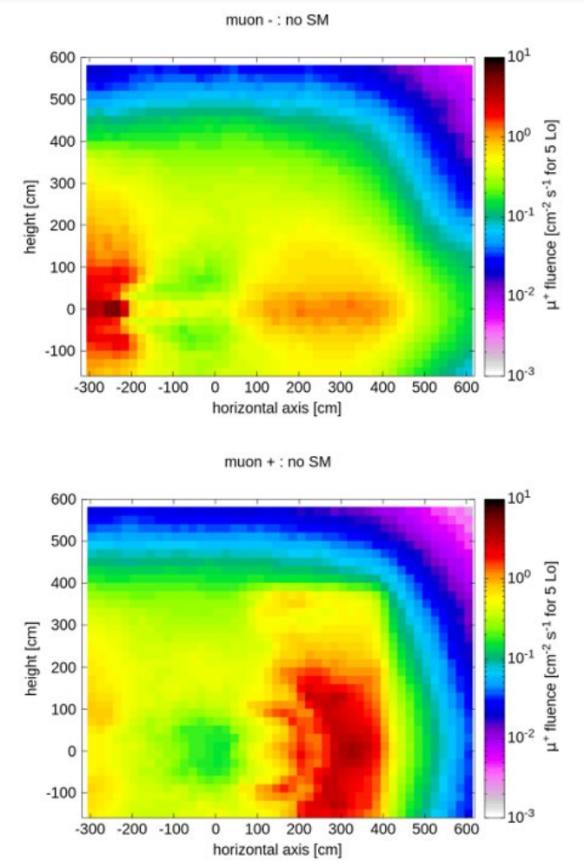
Backgrounds
Muon background flux estimatewd to be 0.6Hz/cm² at L=5e34cm⁻²s⁻¹ in region 20cm from LOS.
Muon hotspots horizontally +/-2m from the LOS.
Reducing the muon flux would be beneficial for some experiments, investigating the possibility of a sweeper magnet to reduce the flux.
Detailed FLUKA simulations used to:
Estimate muon background
Estimate radiation levels (RP)
Estimate radiation to electronics / detector
All look encouraging for implemtning the FPF experiments
FLUKA simulation of Run 3 LHC setup validated at 20% level by FASER/SND@LHC data
(Note for HL-LHC much of the LSS changes => signifciantly reduces estimated muon flux per fb⁻¹)

Slide 33

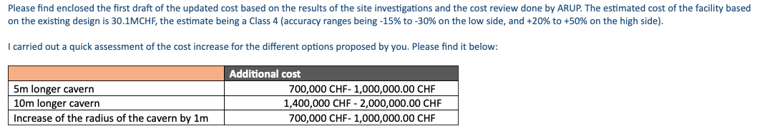
Facility Costing
Very preliminary estimate of cost increase to make cavern larger (to accommodate additional infrastructure etc..):
Very preliminary costing of technical infrastructure for cavern at 10MCHF level.
Total cost of facility (no experiments): ~40MCHF

Slide 34
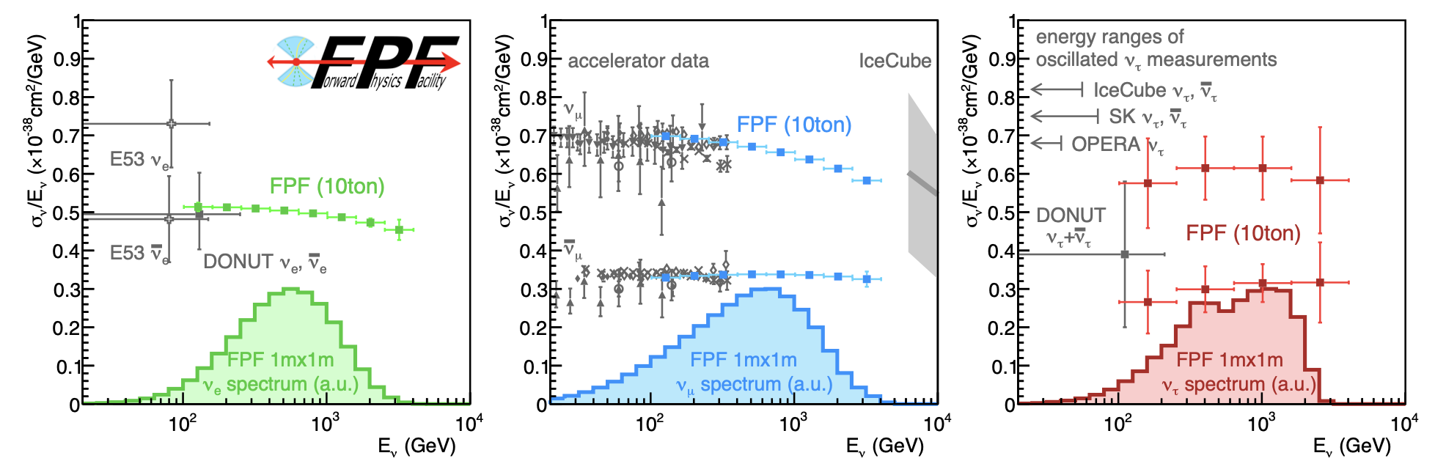
Neutrinos at the FPF
LHC provides a strongly collimated beam of TeV energy neutrinos
of all three flavours in the far forward direction.
Proposed FPF experiment have potential to detect O(1M) neutrinos:
O(10⁶) muon neutrinos, O(10⁵) electron neutrinos, O(10⁴) tau neutrinos

Slide 35
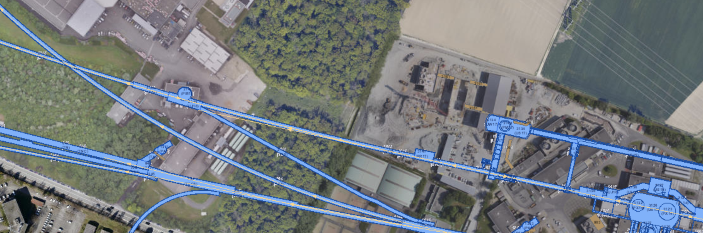
Muon Background: Sweeper Magnet
FPF
FLUKA:
Muon energy spectra
IP1
Placing a sweeper magnet on the LOS can deflect these muons and reduce the background.
Best place for such a magnet would be between where LOS leaves LHC magnets and where it leaves the LHC tunnel (200m lever-arm for deflected muons).
Based on quick integration study required (will likely require some small local modifications to cryogenic infrastructure in the tunnel).

Slide 36
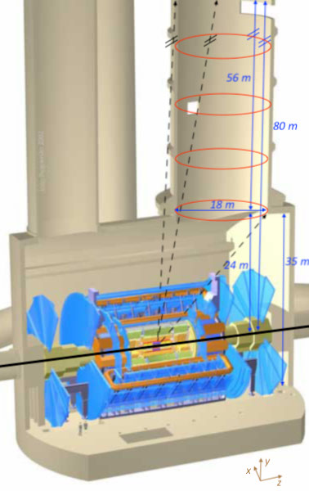











Motivation
Motivation
RPC
ANUBIS
fiducial volume
ANUBIS proposal:
Extend fiducial volume
$→$ harvest sensitivity!
EXPERIMENT
ANUBIS Detector requirements:
RPC
RPC
RPC
$→$ Adapt and exploit
ATLAS Phase II RPC technology!
Ongoing RPC work at U Cambridge:
RPC construction & characterisation
Eco-gases for RPCs
Quality assurance (Q/A) of ATLAS Phase II RPC
  Gas leak studies
  Mechanical stability
Within DRD1 context
projection envelope
PBC model BC5
Happy to share effort & expertise!
Adapted from ATL-PHYS-PUB-2022-007

Slide 37


Our involvement in ATLAS RPCs
Our current involvement in ATLAS RPCs:
    Quality Assurance (Q/A) & prospective Quality Checks (Q/C):
        Study leak formation, electric faults & ageing in RPCs:
            Apply mechanical stress through thermal cycling
                Capitalise on our expertise in ITk Q/A & Q/C
                USP: three (!) climate rooms at UCam
            Our proposal endorsed by ATLAS RPC community
Our potential future involvement in ATLAS RPCs:
    Q/C: commissioning tests on significant RPC fraction
    Contribute to installation & commissioning of Phase II RPCs
      Need technicians (installation) & PDRAs (commissioning)
      Project very short of experienced PRDAs
        we could easily share expertise
        build up expertise base in the UK
    Produce BOR/BOM type RPC chambers (80/120)
        Establish RPC production line in UK!
    Preserve UK leadership in ANUBIS also on detector front

Slide 38

proANUBIS location: similar to ANUBIS
path through air-filled volume
IP

