Slide 1
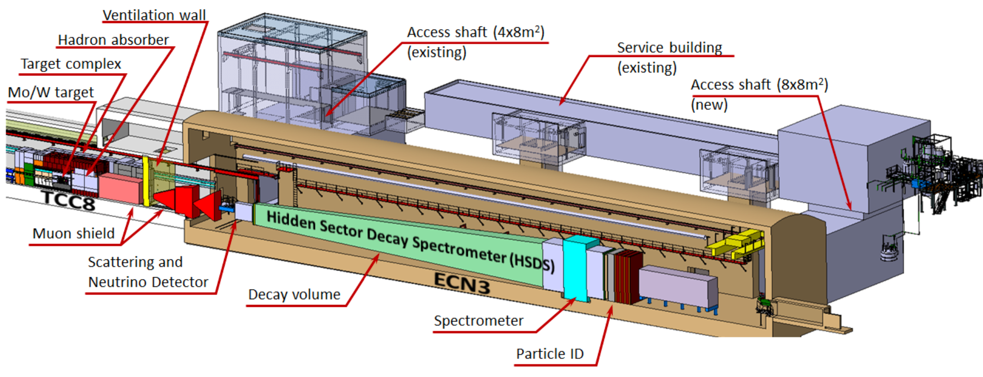


The Search for Hidden Particles (SHiP) experiment
Mitesh Patel (Imperial College London)
ECFA-UK Meeting Sept 23rd-26th 2024

Slide 2
Physics Motivation
[Rep.Progr.Phys.79(2016) 124201]
Low-mass, feebly-interacting new particles can solve many problems of the SM
  pattern of neutrino-masses and oscillation parameters; properties of dark matter, origin of cosmic inflation…
SHiP will make the world’s leading direct searches for such particles in all the major sectors
  probe coupling strengths ~10⁴ times smaller than ever before
SHiP will observe 10³ times more tau (anti-)neutrino interactions than any previous experiment
  1st observation of tau antineutrino, 1st measurement structure functions, tests of lepton universality in neutrino sector…
[Report by Physics Beyond Collider (PBC) study group, arXiv:1901.09966; Maryland Dark Sector Workshop 2017, arXiv:1707.04591; SLAC Dark Sector Workshop, arXiv:1608.08632… ]

Slide 3
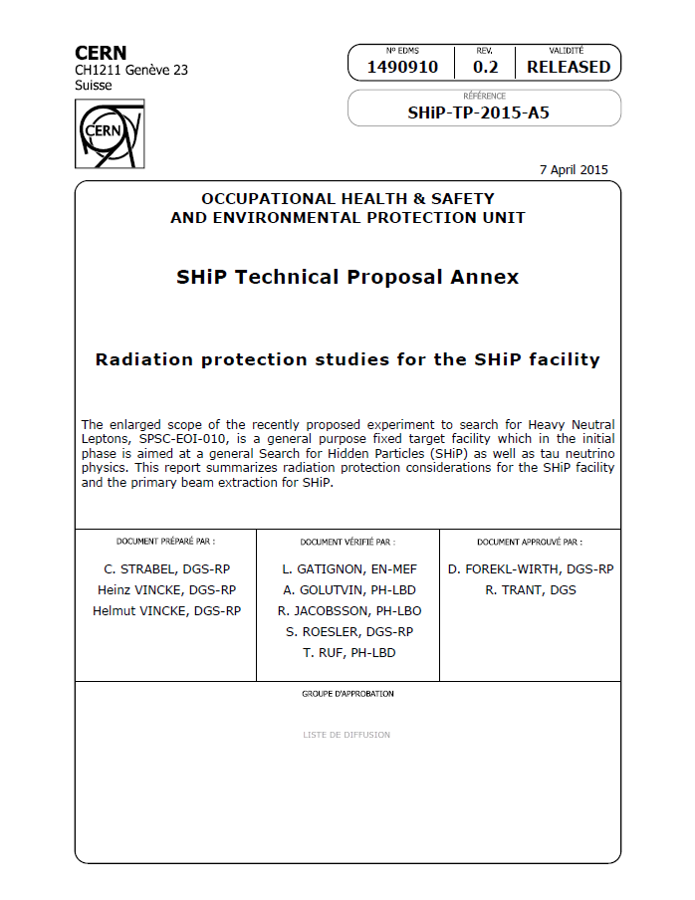
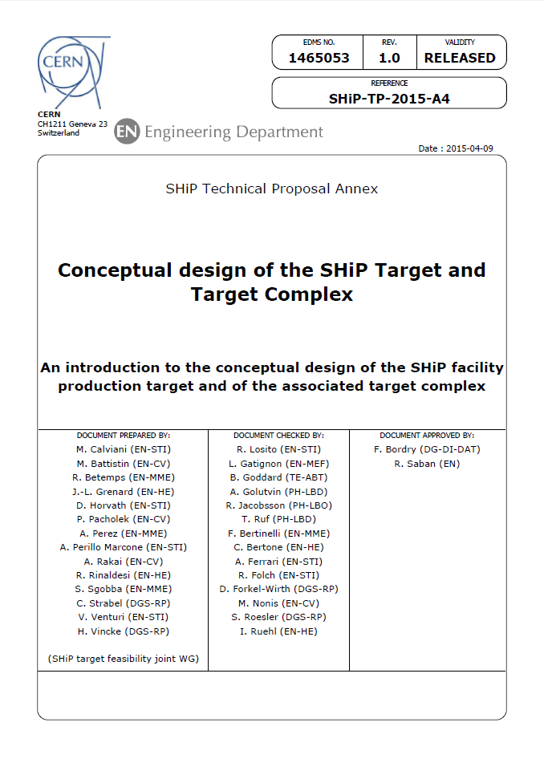
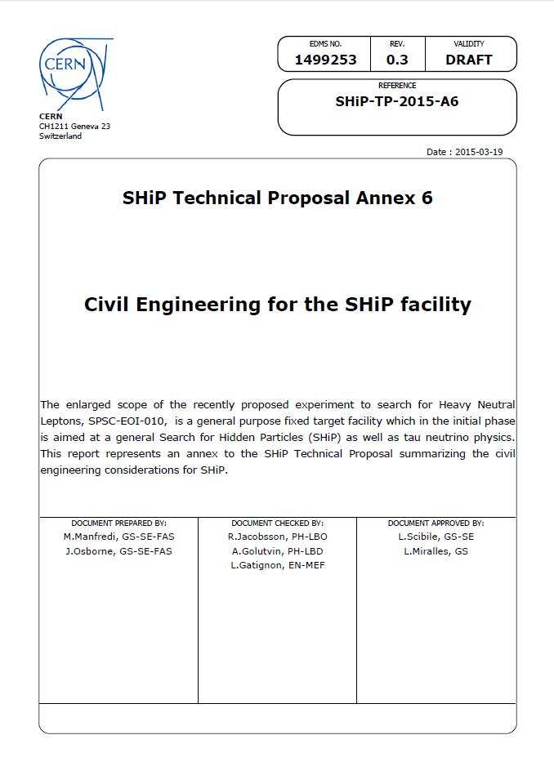
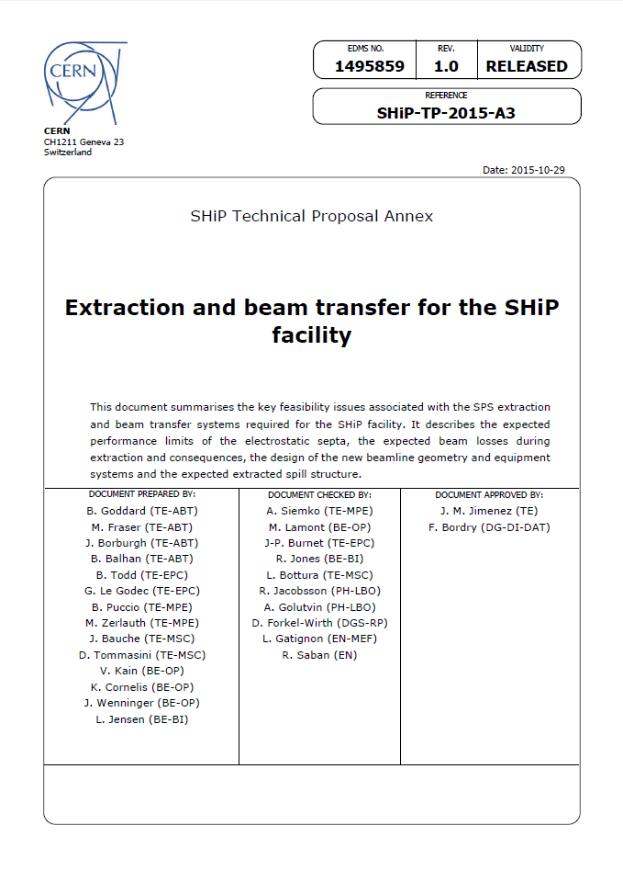
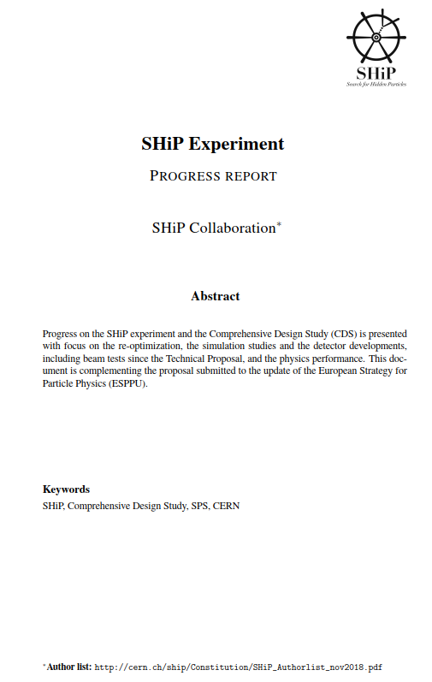
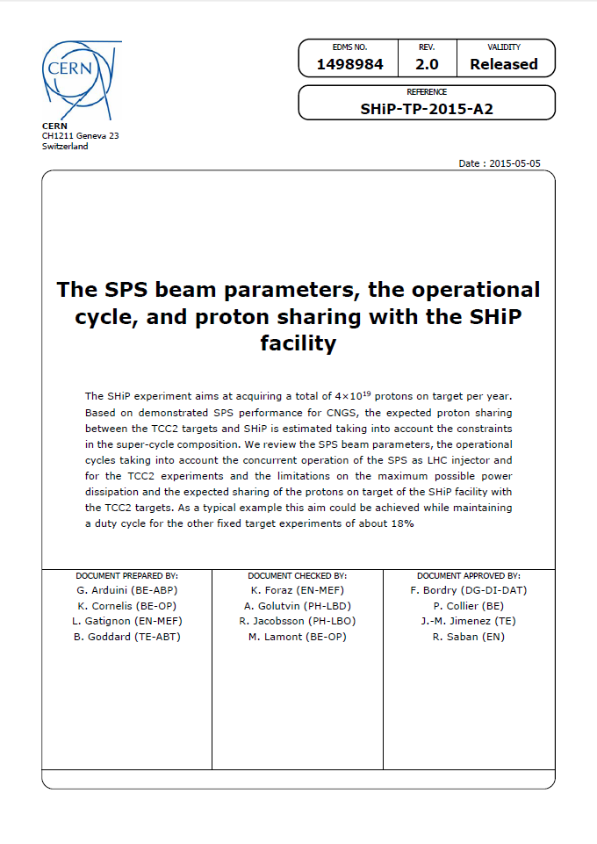
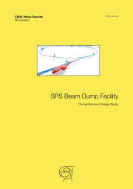
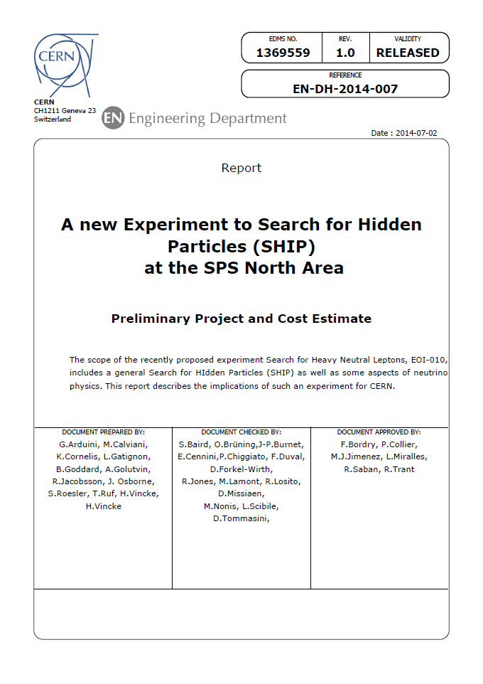
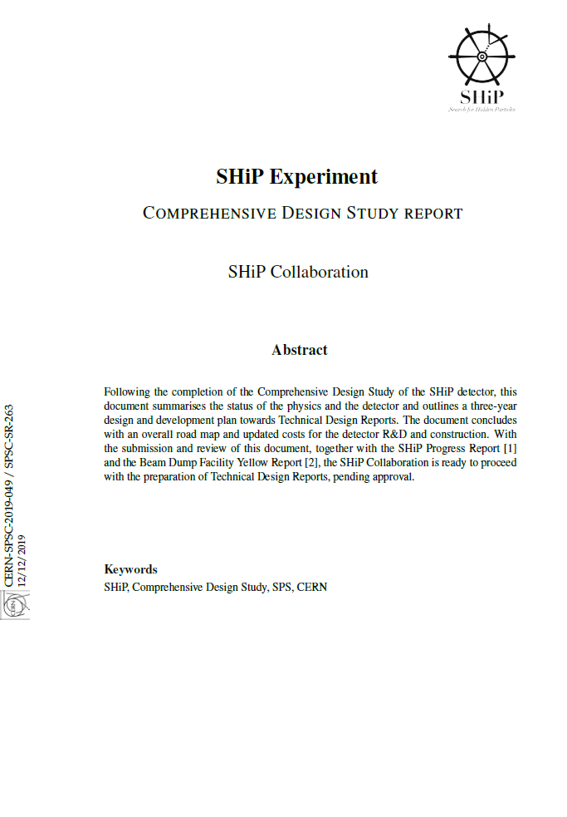
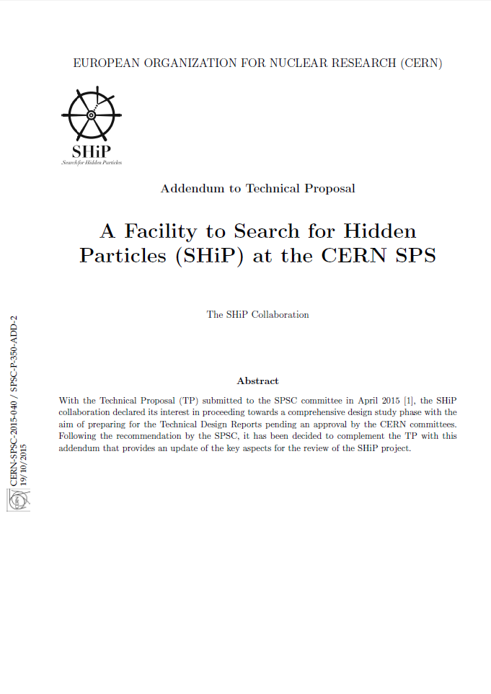

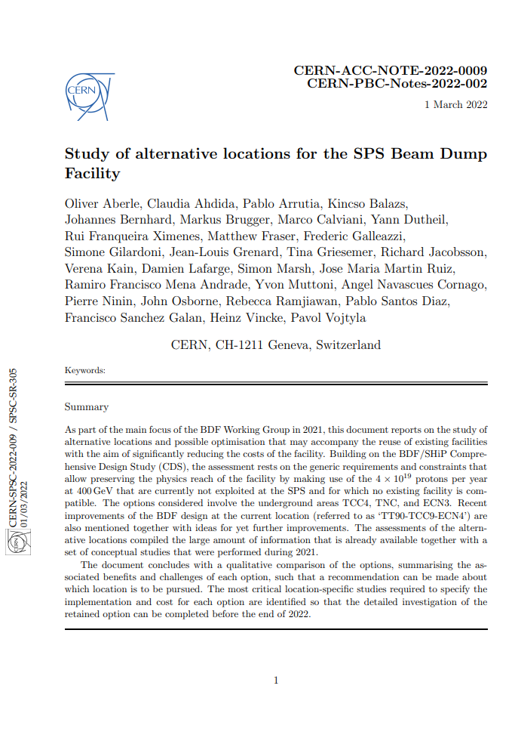

Status of the facility/experiment
CERN approved the experiment in Mar 2024
  Committed 69MCHF to construction of beam-dump facility (BDF) for which SHiP is the sole user
  Aim to take first commissioning data 2031
Collaboration currently involves 38 institutes from 15 countries
UK collaboration currently comprises Bristol, Cambridge, Imperial, RAL-TD, Liverpool, UCL
  Interested in developing large conventional magnets required for major subsystem (…) – opportunity for UK industrial return
BDF/SHIP reports/publications
17 reports submitted to SPSC and ESPPSU2020
26 on the facility development
37 on the detector development
11 on physics studies
20 on theory developments dedicated to SHiP
20 PhD theses and counting…
Proposal, BDF/SHiP at the ECN3 high-intensity beam facility, CERN-SPSC-2023-033
Letter of Intent, BDF/SHiP at the ECN3 high-intensity beam facility, CERN-SPSC-2022-032
Notes:
Before LS4

Slide 4
Status of the facility/experiment
UK physicists proposed experiment in 2013(!)
UK spokesperson since collaboration’s inception
In addition, UK currently has chair of the collaboration board and one of group conveners for major detector system

Slide 5
A hidden sector
L = L_{SM} + L_{mediator} + L_{HS}
Visible Sector
Hidden Sector
Naturally accommodates Dark Matter
(may have rich structure)
Mediators or portals to the HS:
vector, scalar, axial, neutrino
New hidden-sector particles not charged under any of the SM fields
Only interactions with the dark sector mediated by so-called portal particles
  Depending on spin, portal particles can mix with their SM equivalents - vector, scalar, axial, neutrino portals

Slide 6
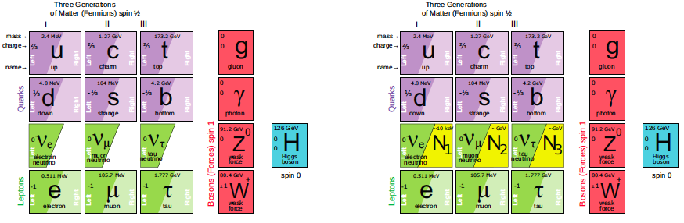
Example hidden sector model
[T.Asaka, M.Shaposhnikov PLB 620 (2005) 17]
Neutrino minimal Standard Model adds three Heavy Neutral Leptons (HNL): N₁, N₂ and N₃
  N₁ → Light Dark Matter M(N₁) ~ 1-100keV
  N_{2,3} → Neutrino masses and Baryon Asymm M(N_{2,3}) ~ O(GeV)

Slide 7
Generic hidden sectors models
Production and decay rates strongly suppressed cf SM
  Branching fractions O(10⁻¹⁰)
  Long-lived objects
  Interact very feebly with matter
  May decay to various final states, e.g.
Full reco & PID essential to minimise model dependence
Experimental challenge is background suppression
Portal models | Final states
HNL Vector, scalar, axion portals HNL Axion portal | l⁺π⁻, l⁺K⁻, l⁺ρ⁻ l⁺l⁻ l⁺l⁻ν γγ

Slide 8
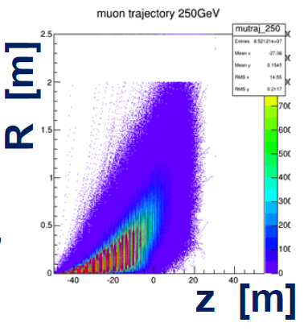
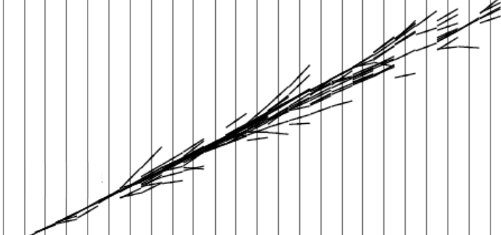
Experimental concept
Hidden sector searches
Proton-nucleon interactions in beam-dump produce vast numbers of SM mesons
The SM mediators involved in decays of such mesons can mix with hidden-sector mediators
Once produced, hidden-sector particles will fly through material with tiny probability of interacting
  interaction (or a visible decay) requires them to first mix back into a SM particle
Absorber/sweeper
Decay volume
SM
Protons
HP
Spectrometer
SM
Visible decay to SM particles
Neutrino physics
Absorber/sweeper
Heavy target + detector
Protons
Long
high-Z/A target
Scattering off atomic electrons and nuclei

Slide 9
Experimental concept
Hidden sector searches
Sensitivity depends on three factors
  Yields (protons on target)
  Acceptance (lifetime & angular coverage)
  Background level
Exhaustive search should aim at a “model-independent” detector setup
  Full reco and id of both fully- and partially-reconstructible modes
  Latter a proxy for the unknown
Absorber/sweeper
Decay volume
SM
Protons
HP
Spectrometer
SM
Visible decay to SM particles
Neutrino physics
Absorber/sweeper
Heavy target + detector
Protons
Long
high-Z/A target
Scattering off atomic electrons and nuclei

Slide 10
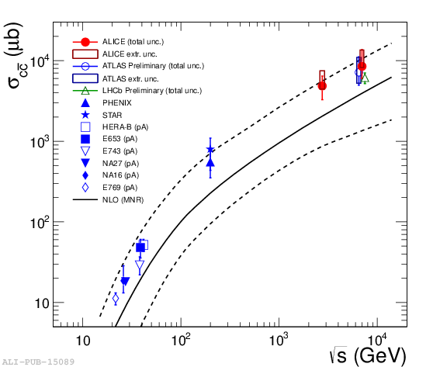

The beam-dump
Optimal target design :
  Very thick → use full beam and secondary interactions (12λ)
  High-A&Z → maximize production cross-sections (Mo/W alloy)
  Short λ (high density) → stop pions/kaons before decay
4x10¹⁹ protons on target per year currently available at CERN’s SPS – no technical limitation to operation for 15 years
$$BDF @ \sqrt{s}=27 GeV$$
σ(pp→ssbar X)/σ(pp→X) ~ 0.15
σ(pp→ccbar X )/σ(pp→X) ~ 2x10⁻³
σ(pp→bbbar X)/σ(pp→X) ~ 1.6 x10⁻⁷
Cascade prodn, e.g. >2 for charm
(gives uncert in neutrino flux prodn)

Slide 11
The beam-dump
BDF/SHiP annual yields in the detector acceptance:
  ∼ 2×10¹⁷ charmed hadrons (>10× HL-LHC yield)
  ∼ 2×10¹² beauty hadrons
  ∼ 2×10¹⁵ tau leptons
  O(10²⁰) photons above 100 MeV
Neutrino interaction yields with 3t-W ν-target:
  3500 𝜈_{𝜏}+𝜈_{𝜏} per year
  2×10⁵ 𝜈_{𝑒}+𝜈_{𝑒} / 7×10⁵ 𝜈_{𝜇}+𝜈_{𝜇} regardless of target design
$$BDF @ \sqrt{s}=27 GeV$$
σ(pp→ssbar X)/σ(pp→X) ~ 0.15
σ(pp→ccbar X )/σ(pp→X) ~ 2x10⁻³
σ(pp→bbbar X)/σ(pp→X) ~ 1.6 x10⁻⁷
Cascade prodn, e.g. >2 for charm
(gives uncert in neutrino flux prodn)

Slide 12
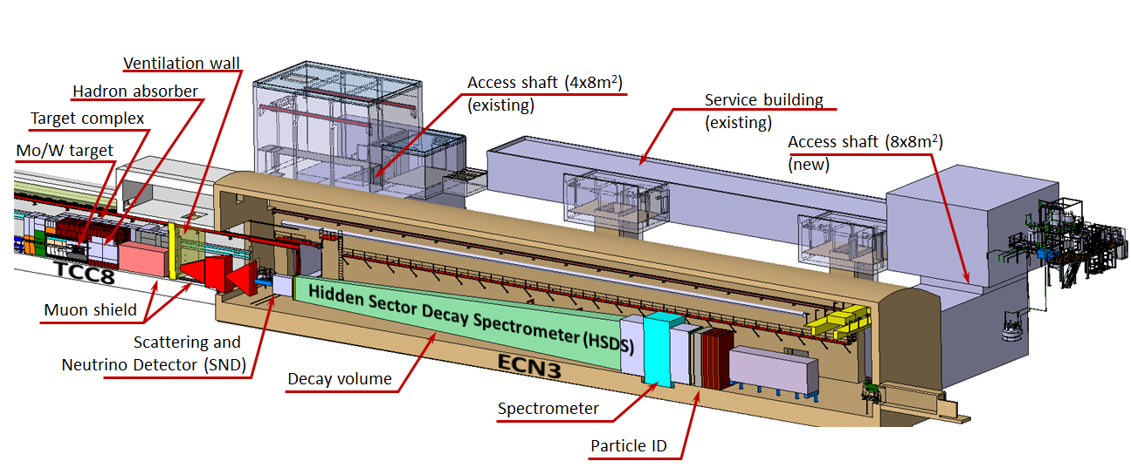
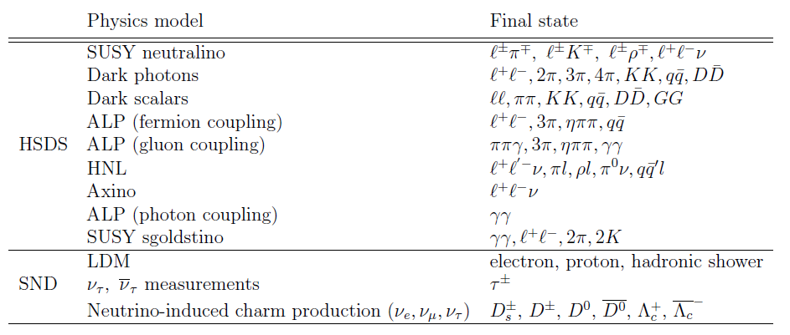
Adapting BDF/SHiP to CERN’s ECN3 hall
Two separate detector systems: Scattering Neutrino Detector (SND) and Hidden Sector Decay Spectrometer (HSDS)
Reduce transverse size of detector wrt original design
Shorten muon-shield

Slide 13
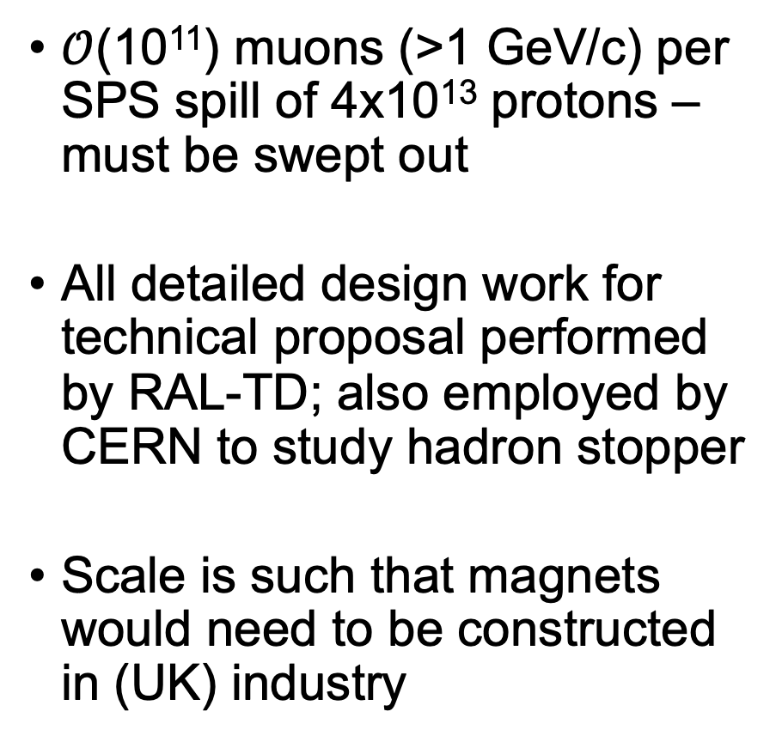
Muon shield
$𝒪$(10¹¹) muons (>1 GeV/c) per SPS spill of 4x10¹³ protons – must be swept out
All detailed design work for technical proposal performed by RAL-TD; also employed by CERN to study hadron stopper
Scale is such that magnets would need to be constructed in (UK) industry

Slide 14
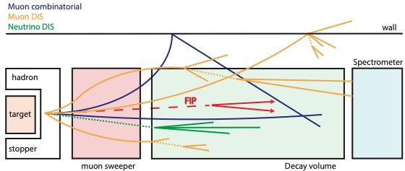
Bkgrd evaluation for FIP decay search
Background evaluation based on full GEANT simulation
Simple, common selection for both fully and partially reconstructed events – model independence
Envisage measuring bkgrd with data, relaxing vetoes and selection cuts, muon shield etc.
Expected background for 6×10²⁰ pot (15 years of operation)

Slide 15
Hidden sector sensitivity
Neutrino portal
Vector portal
SHiP sensitivities to FIPs are orders of magnitude better than competing projects
Sensitivity is not limited by backgrounds in 6 x 10²⁰ PoT

Slide 16
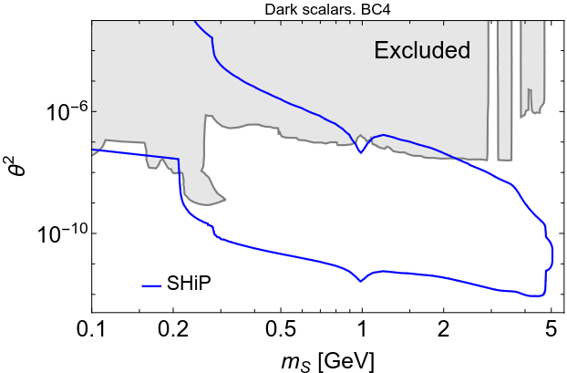
Hidden sector sensitivity
Scalar portal
Axions
SHiP sensitivities to FIPs are orders of magnitude better than competing projects
Sensitivity is not limited by backgrounds in 6 x 10²⁰ PoT

Slide 17
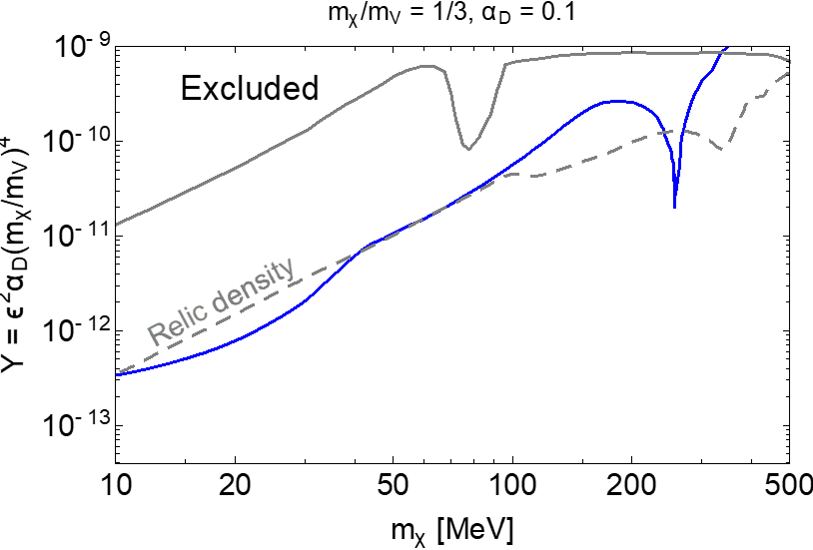
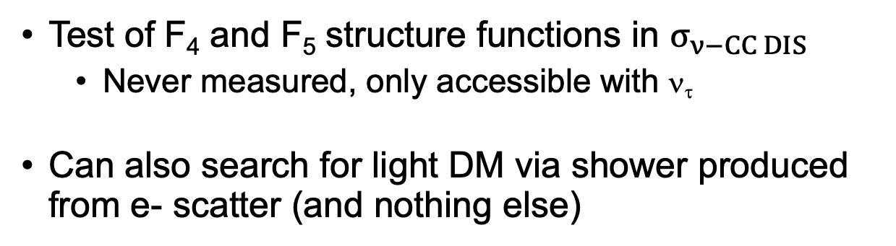

Tau neutrino physics with SND
Lepton Flavour Universality in neutrino interactions
  σ_{stat+syst}~3% precision in ratios: ν_{e} /ν_{μ} , ν_{e} /ν_{τ} and ν_{μ} /ν_{τ}
Measurement of neutrino DIS cross-sections up to 100 GeV
  $E_{ν}$< 10 GeV as input to neutrino oscillation programme (DUNE in particular)
  ν_{τ} cross-section at higher energies input to cosmic neutrino studies
  $σ_{stat+syst}$< 5%
Test of F₄ and F₅ structure functions in $σ_{ν−CC DIS}$
  Never measured, only accessible with ν_{τ}
Can also search for light DM via shower produced from e- scatter (and nothing else)

Slide 18
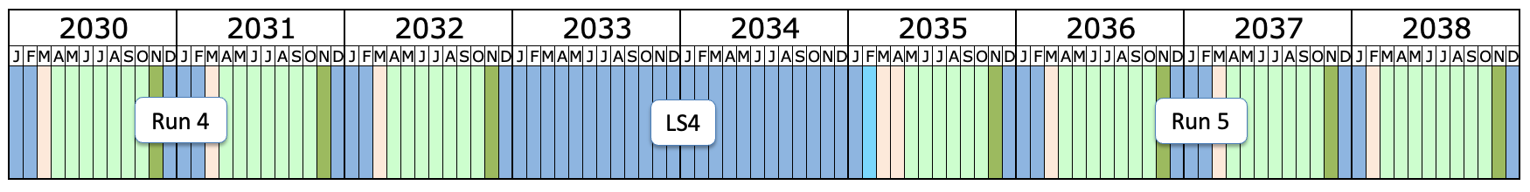

Schedule
~2.5 years for detector TDRs
Construction / installation of facility and detector is decoupled from NA operation
Availability of test beams challenging
Important to start data taking >1 year before LS4
BDF
commissioning
BDF/SHiP operation ➔
Opportunity for
consolidation/extension
SPS decoupled from injector role in 2042, fully dedicated to proton/ion FT physics
2042
2043
2044
2045
2046
2047
D
J
F
M
D
J
F
M
D
J
F
M
D
J
F
M
D
J
F
M
D
J
F
M
D
LSx
Opportunity…
End of LHC

Slide 19
Summary
SHiP will make the world’s leading direct searches for low-mass, very feebly interacting particles via all accessible portals
  probe coupling strengths ~10⁴ times smaller than ever before
SHiP will observe 10³ times more tau (anti-)neutrino interactions than any previous experiment
  1st observation of tau antineutrino, 1st measurement structure functions, tests of lepton universality in neutrino sector
UK has played a leading role in the experiment – have a significant opportunity to involve UK industry in construction of a critical system

Slide 21
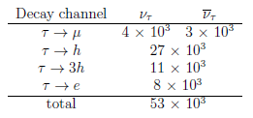
Tau neutrino physics with SND
Large sample of tau neutrinos available at SHIP via D_{s}→ τν_{τ} → σ_{stat}< 1% for all neutrino flavours
Precision determined by systematic uncertainties
  Uncertainty from cascade production in thick Mo/W SHiP target gives ~5% uncertainty in neutrino flux
c

Slide 22
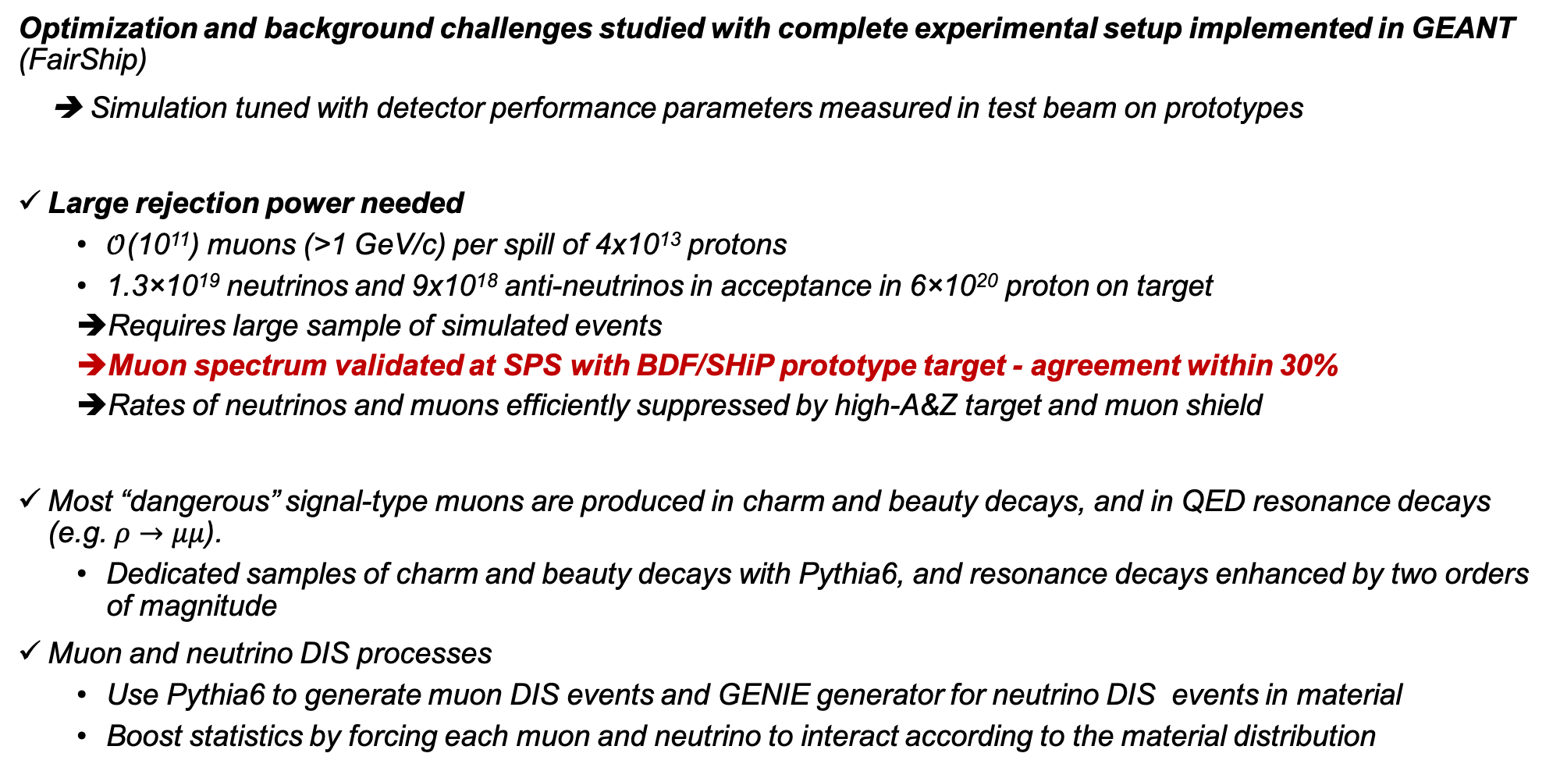
Background simulations
Optimization and background challenges studied with complete experimental setup implemented in GEANT (FairShip)
➔ Simulation tuned with detector performance parameters measured in test beam on prototypes
Large rejection power needed
  $𝒪$(10¹¹) muons (>1 GeV/c) per spill of 4x10¹³ protons
  1.3×10¹⁹ neutrinos and 9x10¹⁸ anti-neutrinos in acceptance in 6×10²⁰ proton on target
  Requires large sample of simulated events
  Muon spectrum validated at SPS with BDF/SHiP prototype target - agreement within 30%
  Rates of neutrinos and muons efficiently suppressed by high-A&Z target and muon shield
Most “dangerous” signal-type muons are produced in charm and beauty decays, and in QED resonance decays (e.g. $ρ→μμ$).
  Dedicated samples of charm and beauty decays with Pythia6, and resonance decays enhanced by two orders of magnitude
Muon and neutrino DIS processes
  Use Pythia6 to generate muon DIS events and GENIE generator for neutrino DIS events in material
  Boost statistics by forcing each muon and neutrino to interact according to the material distribution
(Eur. Phys. J. C 80 (2020) 284)

Slide 23
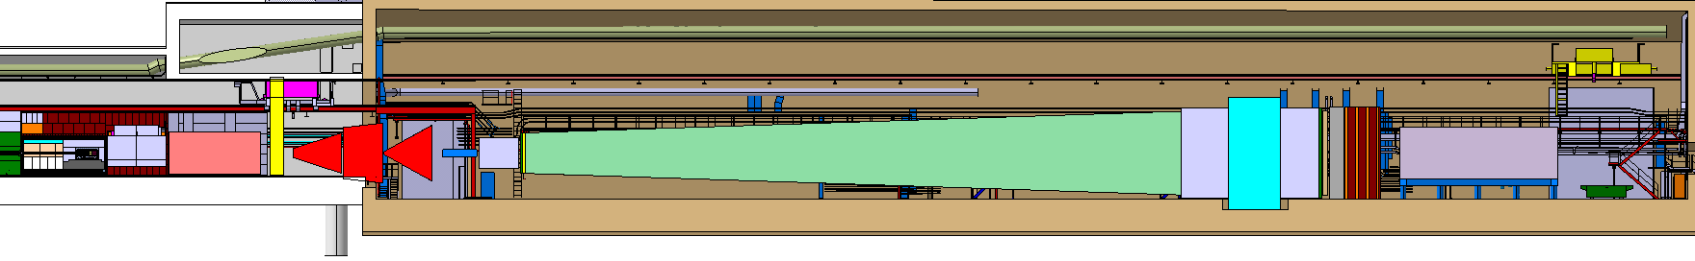
The SHiP detector
Upstream Background Tagger
(MRPC)
Surrounding Background Tagger
(LiqSci)
Timing detector
(SciBar)
PID - ECAL/HCAL
(SciBar/μ−megas)
Target tracker
(SciFi)
Magnetised
μ-system
HSDS Tracker
(Straw tracker)
Decay volume
Instrumented
Neutrino target
4x6 m²
SND detector
Hidden Sector Decay Spectrometer (HSDS)
Target complex
SC μ-shield
NC μ-shield
Spectrometer magnet (SC)
Designed for “zero background” in decay search
Muon shield
Decay volume under low air pressure (or He)
Background veto taggers (SBT & UBT)
Momentum and decay vertex information
Impact parameter at target
Time coincidence
Magnetised
hadron stopper

Slide 24
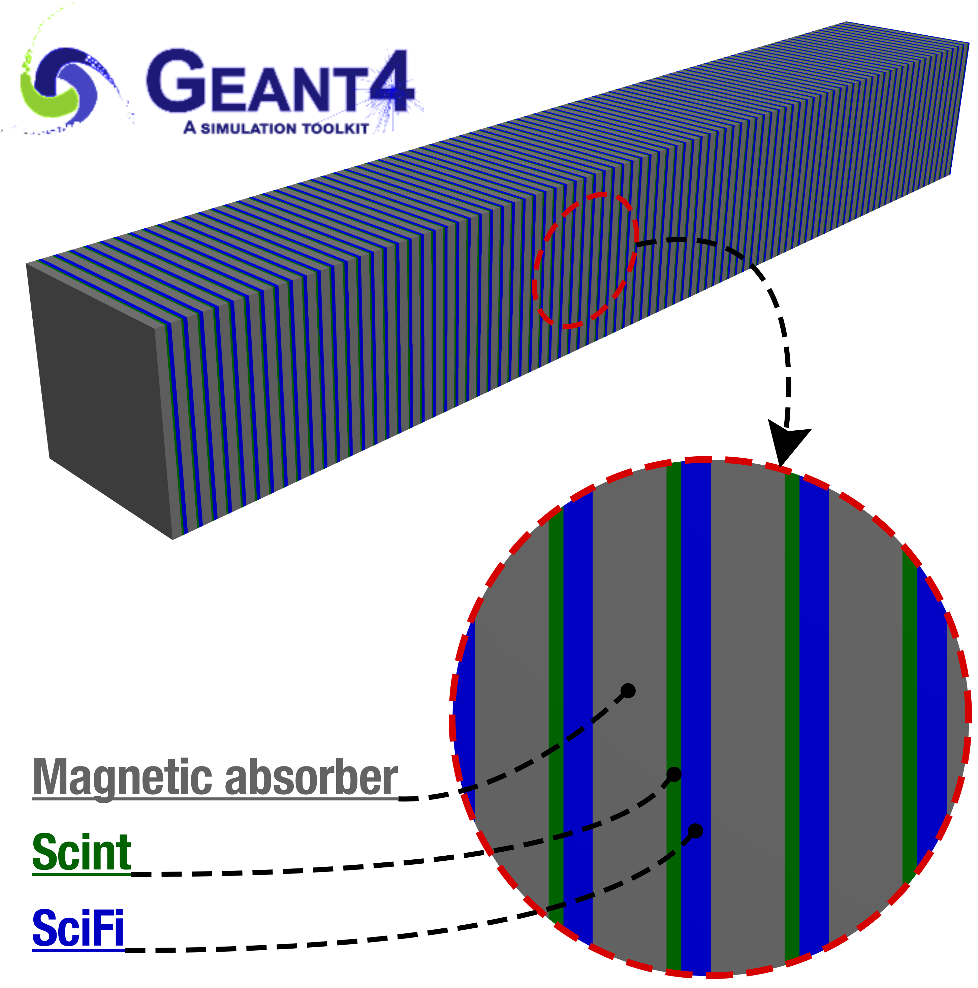
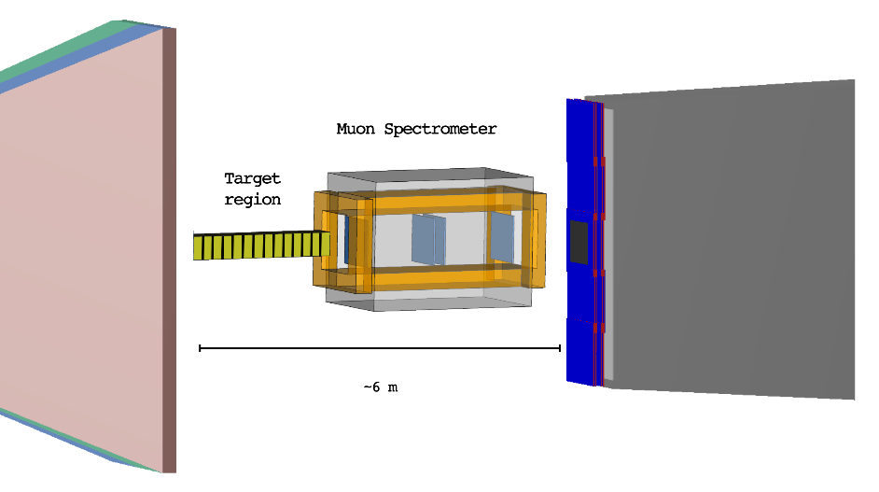
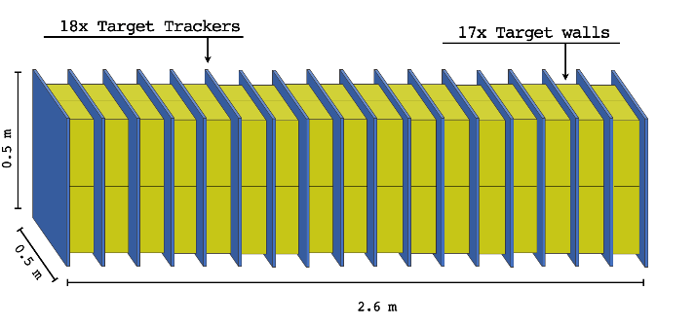
SND detector optimization
ν/LDM target system
ECC + SciFi
Muon spectrometer
Magnetised
HCAL/Tracker
μ-shield
HSDS decay volume
Replace emulsion films
with electronic detectors
6m
UBT
W/Si vertex
detector
3.1 t W / 145 m² emulsion
Parameters to be optimised
LDM/neutrino W-target instrumented with layers
of emulsion films (topological analysis only)
SND muon spectrometer measures muon charge and momentum (10% accuracy in 1T field)
Finely segmented tracking calorimeter with magnetised
absorber (missing P_{t} analysis + Impact parameter (?)),
integrated to the muon shield

