Slide 1
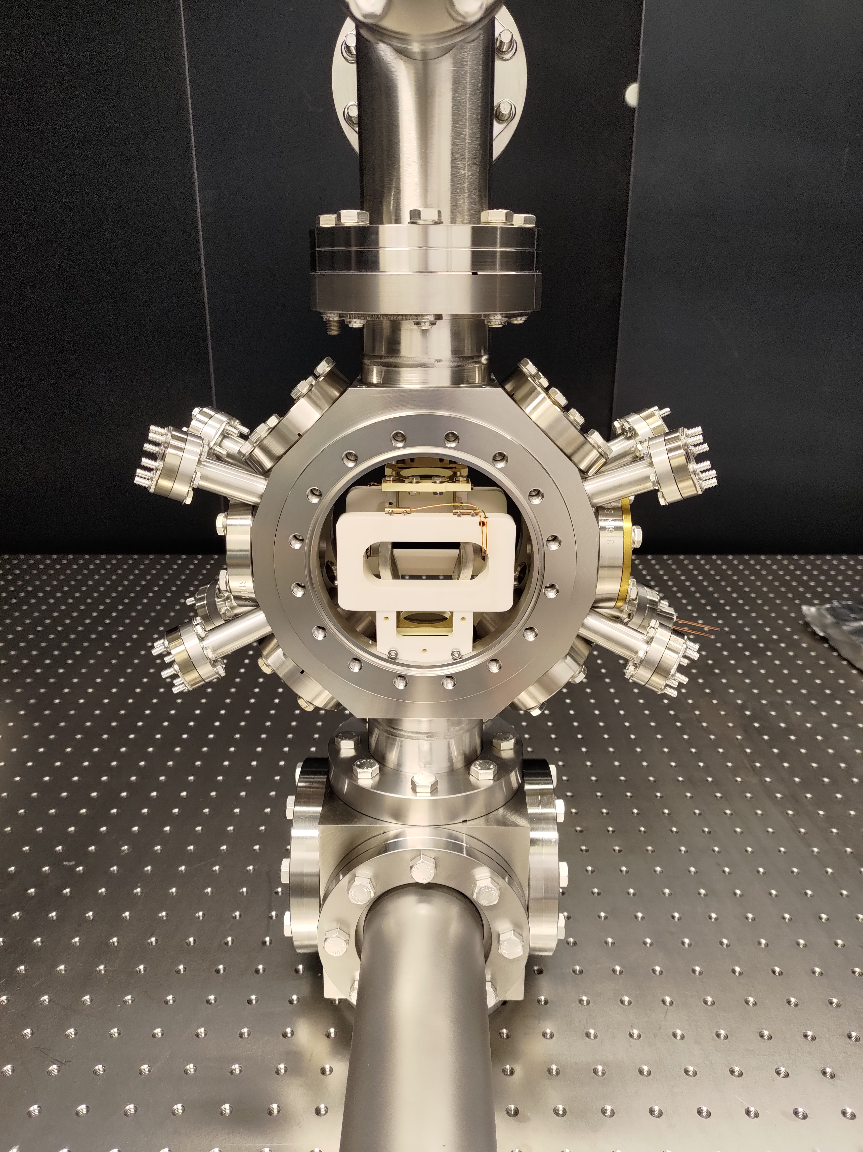
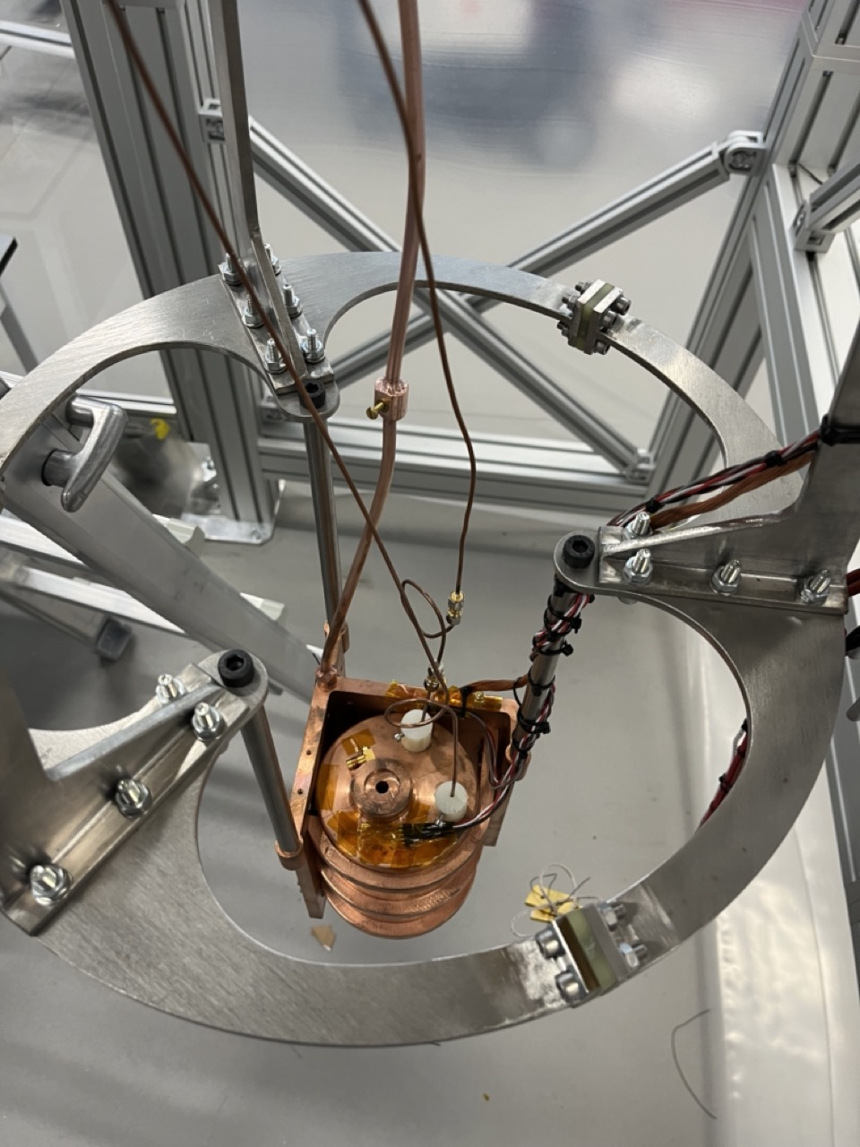

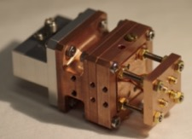

Quantum Technology for
High Energy Physics
Ed Daw (Univ. of Sheffield)
ECFA-UK meeting, Durham, 23rd-26th September 2024
Detector Research and Development (DRD) 5

Slide 2
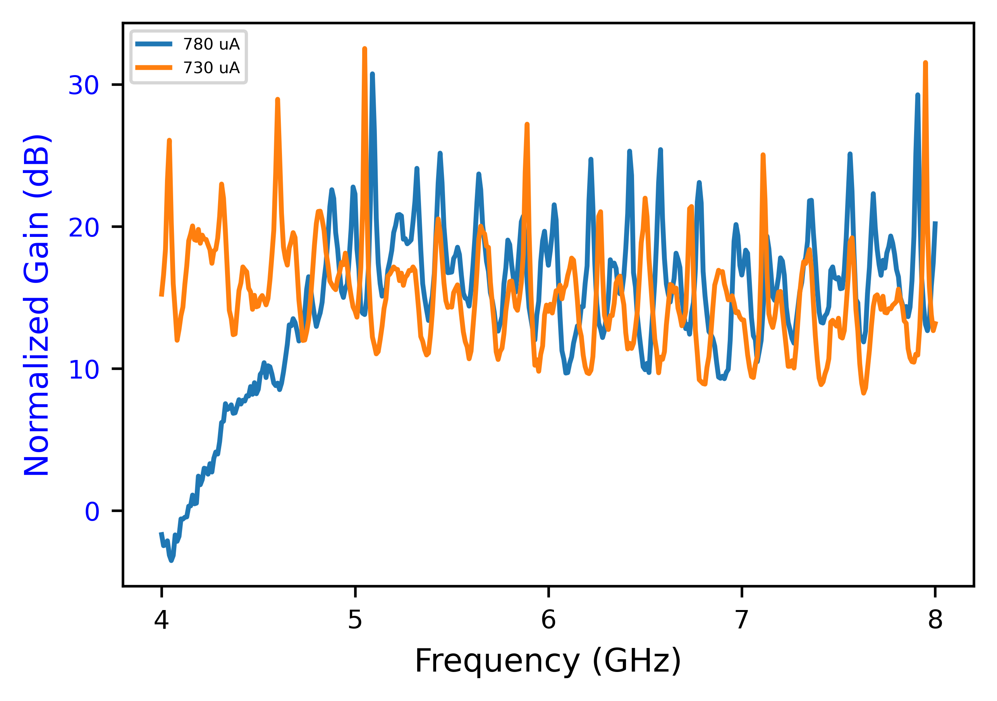
What Quantum Technology?
Detector Control & Stabilisation
Detector
VTT (Finland)
Technology
Frequency
QTNM – 18GHz microwave amplifier development.
QSHS – 3 to 20GHz microwave sensor development.
Squeezing for GW detector readout
QI group experiments
ALPS2 @ DESY
AION optical drive/probe for ion beams.
QUEST-DMC superconducting nanowire readout
AION signal detection band
Ground-based GW signal band
Lumped-element wave-like dark matter searches like DMRadio

Slide 3

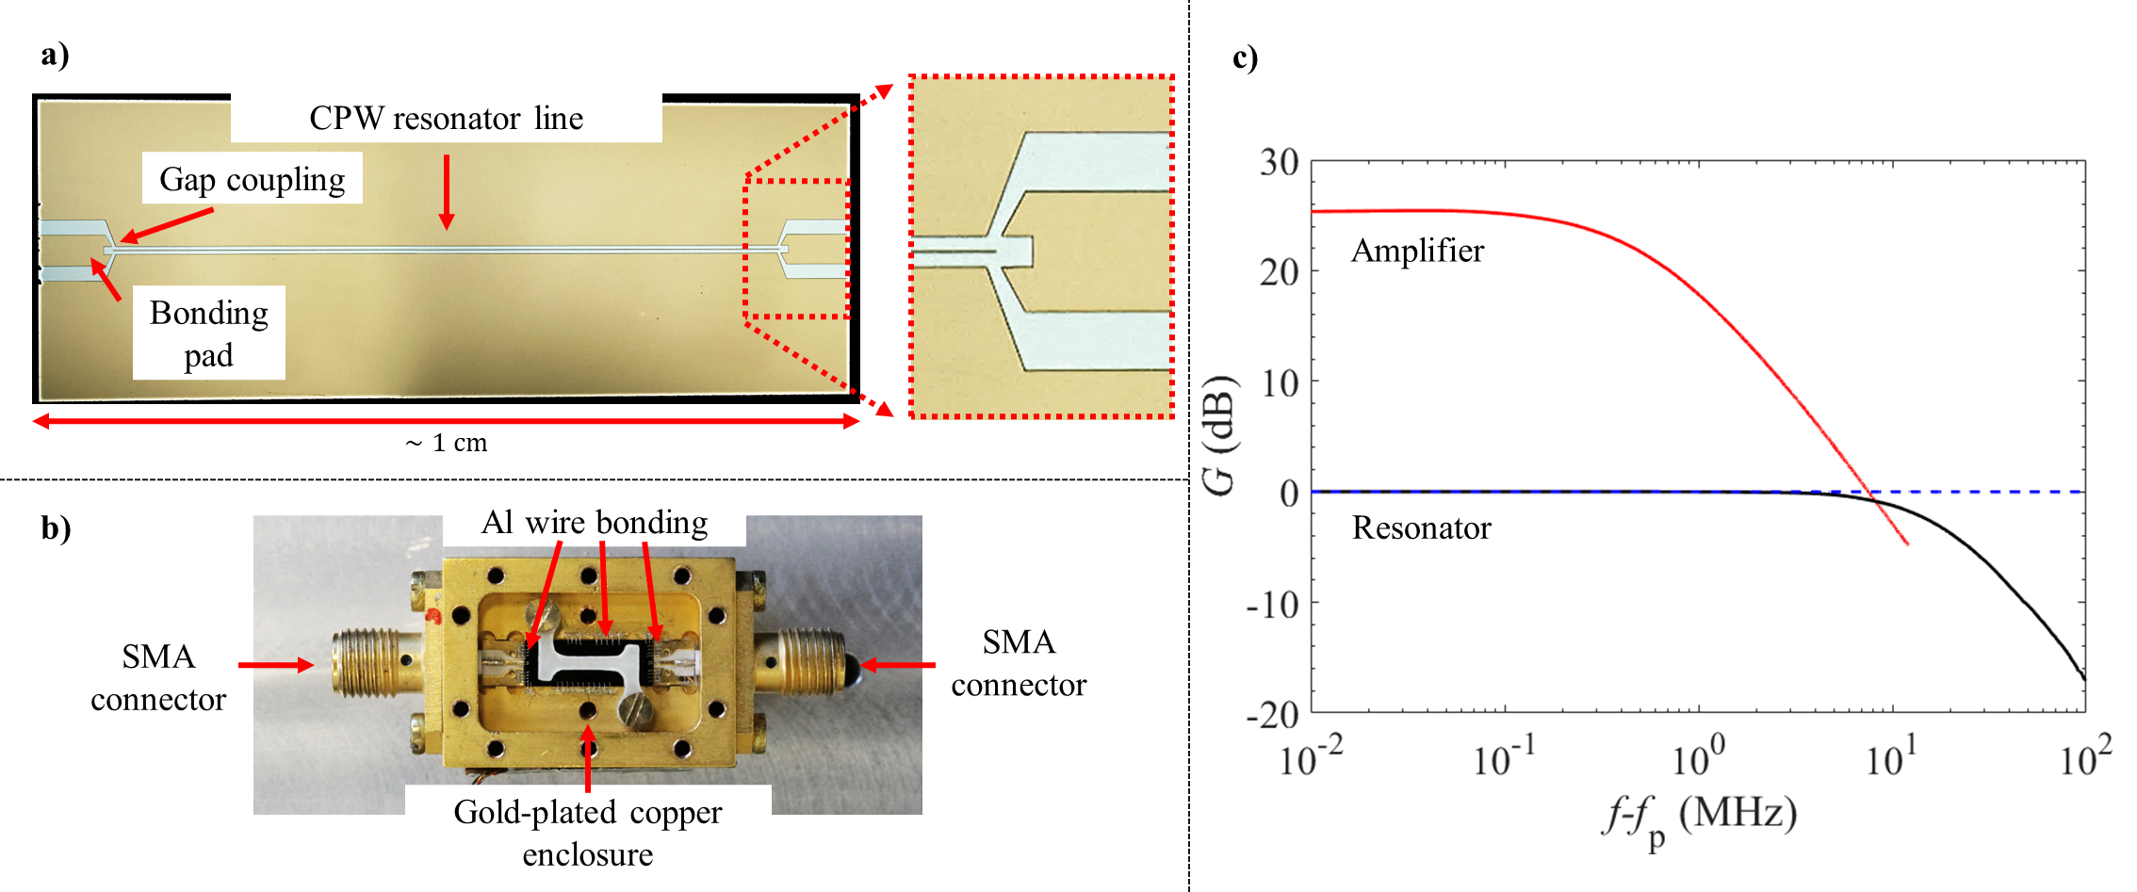
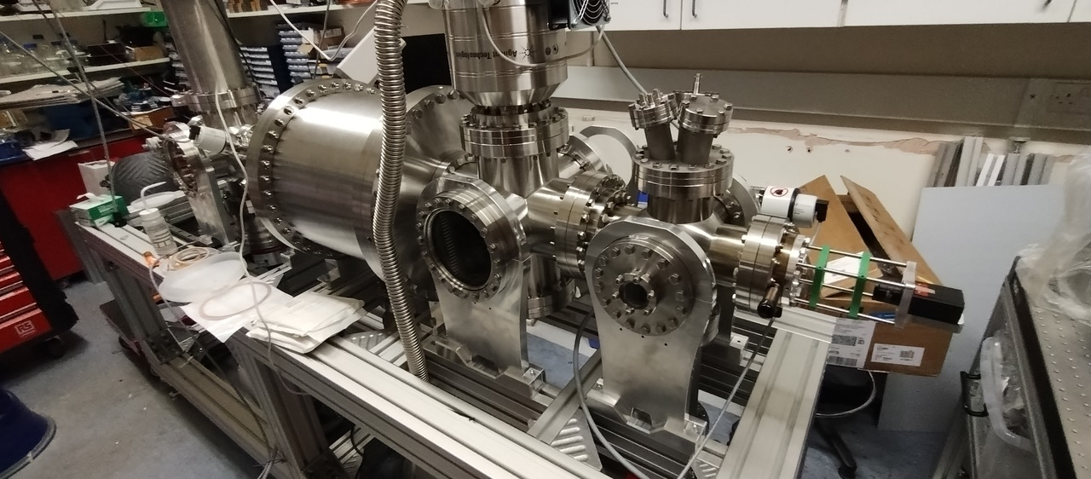
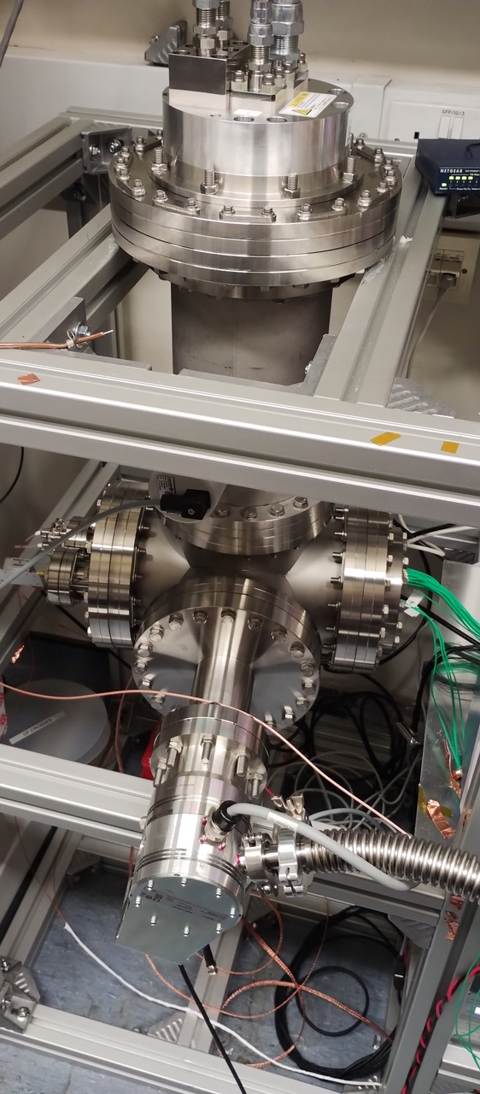
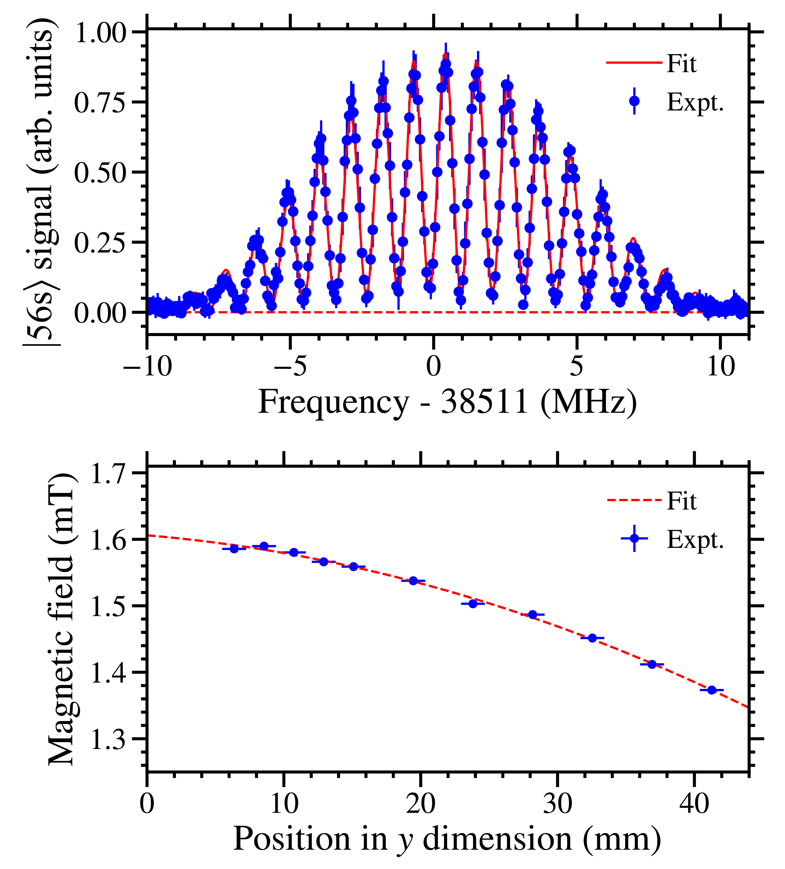
QTNM goals connected to DRD5
QTNM aims to probe the neutrino mass in a tritium end point experiment with ultra-low-noise readout of GHz microwave radiation from magnetically trapped tritium.
O(10 GHz) microwave amplifiers operating at (or below) quantum noise level
Robust and repeatable fabrication, quantum-noise limited performance for multi-channel readout
Quantum amplifier systems TRL 3-6 and above
Precision position sensitive magnetometry and electrometry with Rydberg atoms as quantum sensors
New quantum sensing protocols
  E-field sensing with atoms in superpositions of states with opposite EDM
  Frequency resolved Rydberg atom microwave sensing
Achievements
NbN, Nb, Al, Ti paramps fabricated and tested at 18 GHz for QTNM
Operation at ~100mK and 4K possible for two-stage readout
Atomic hydrogen source.
QTNM: 1𝜇T with 0.9mm spatial resolution demonstrated
Penning electron source

Slide 4
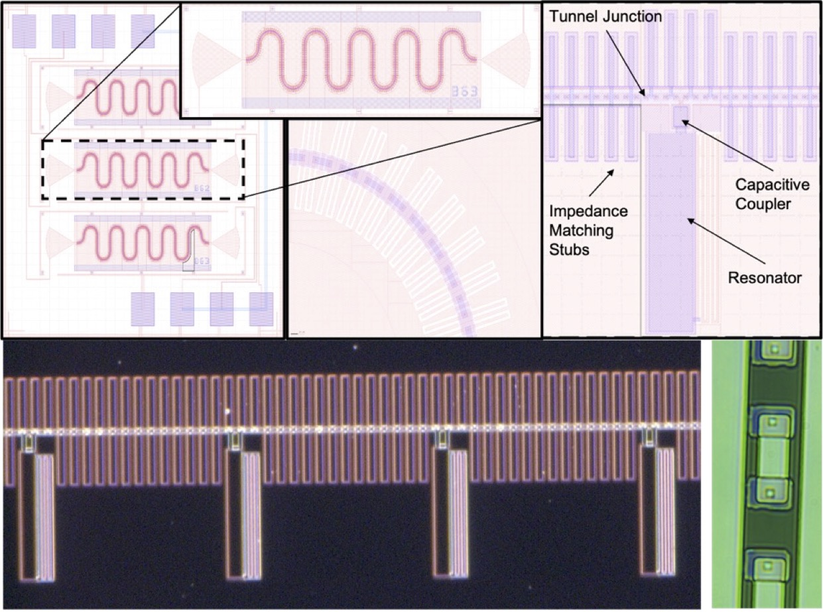
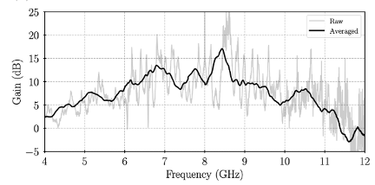
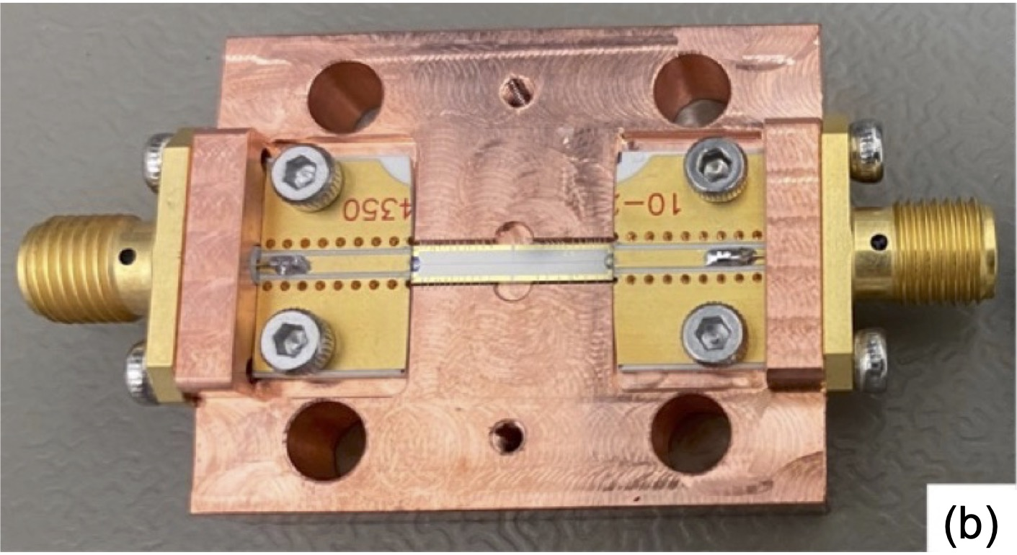
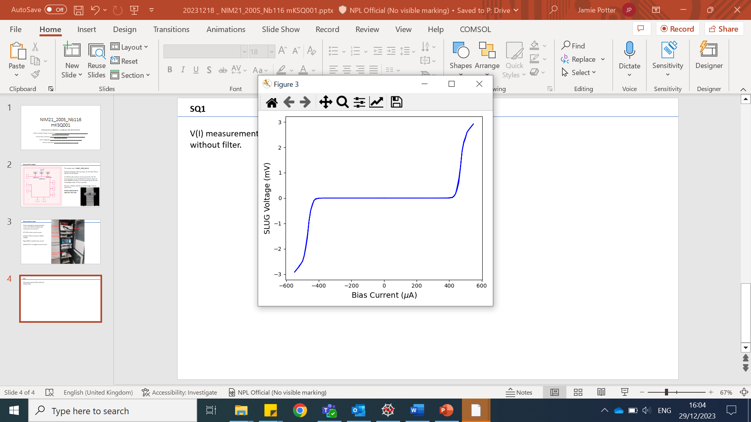
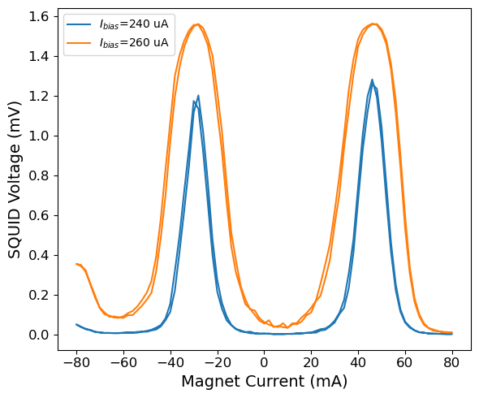
Quantum Electronics for QSHS
Travelling Wave Parametric Amplifiers, Boon Kok Tan group, Oxford
SLUG microwave SQUID amplifiers, Ling Hao, Ed Romans groups, NPL/UCL
500 nm

Slide 5
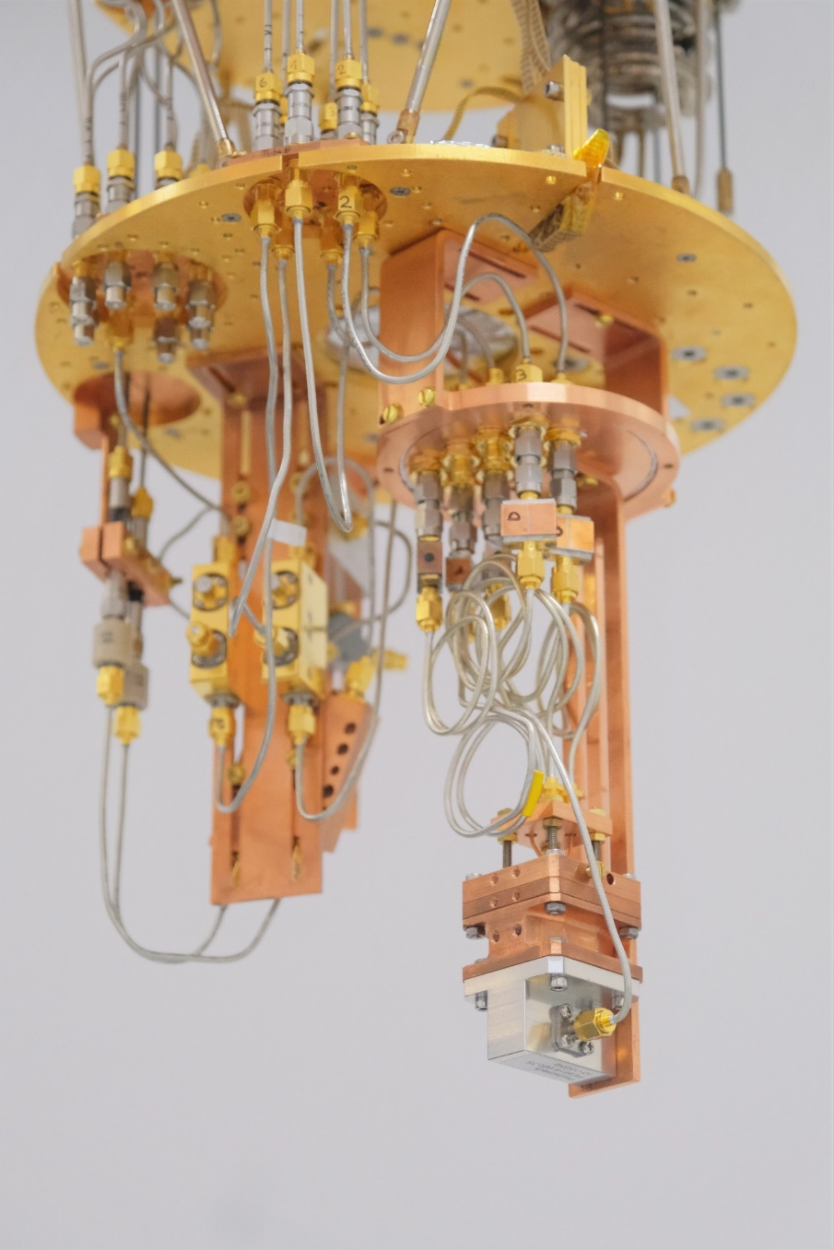
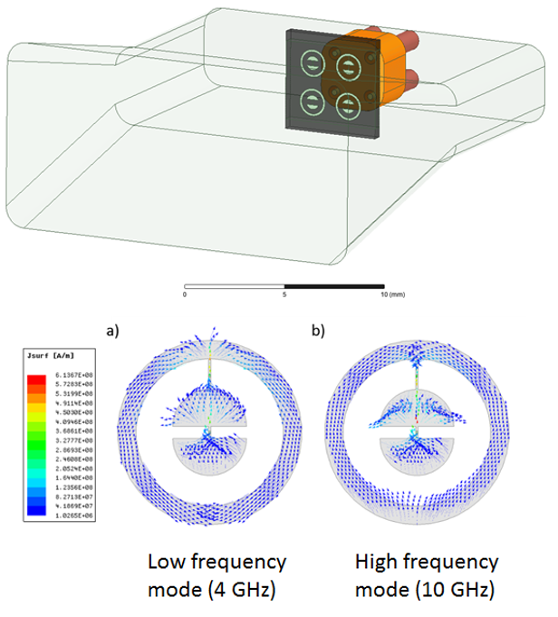
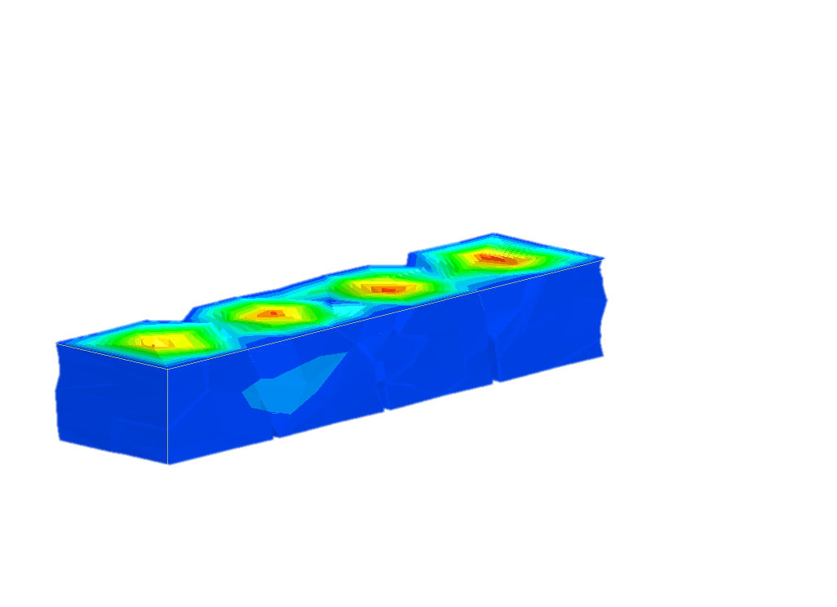
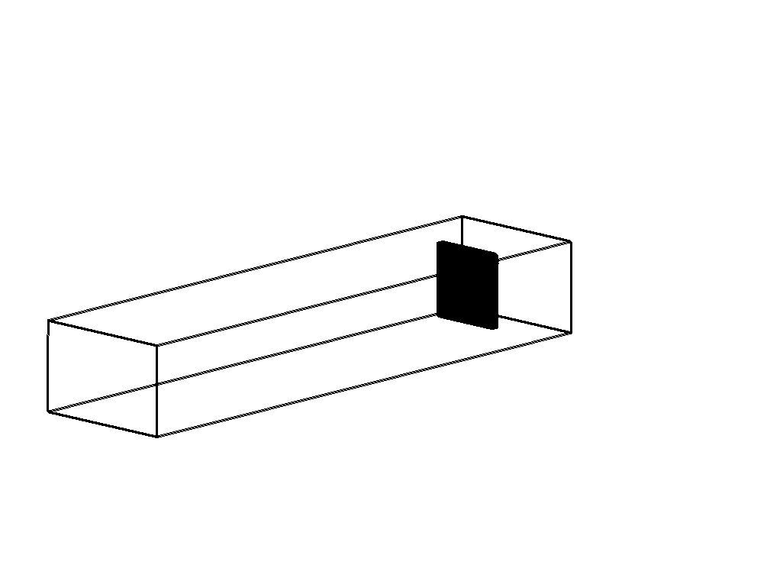
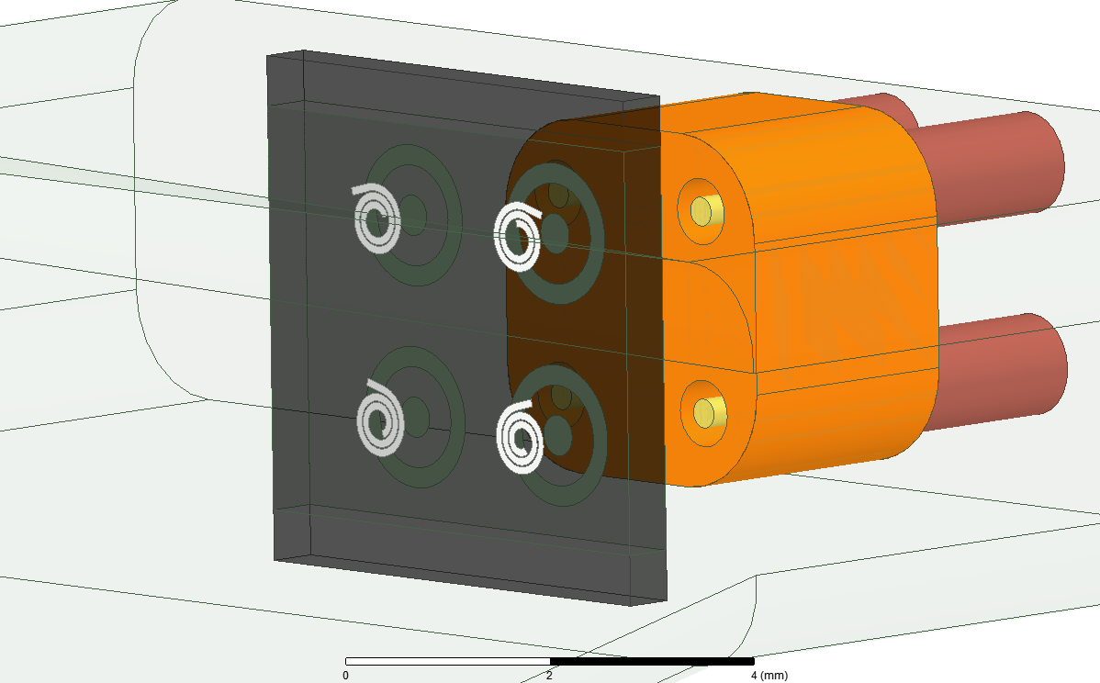
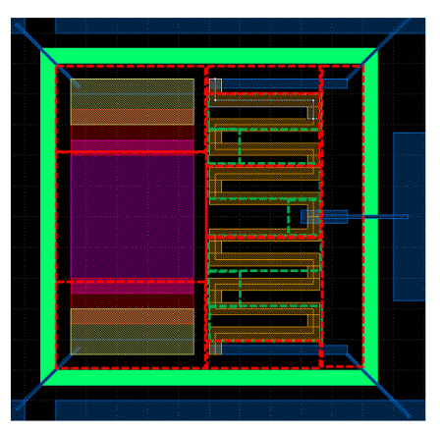
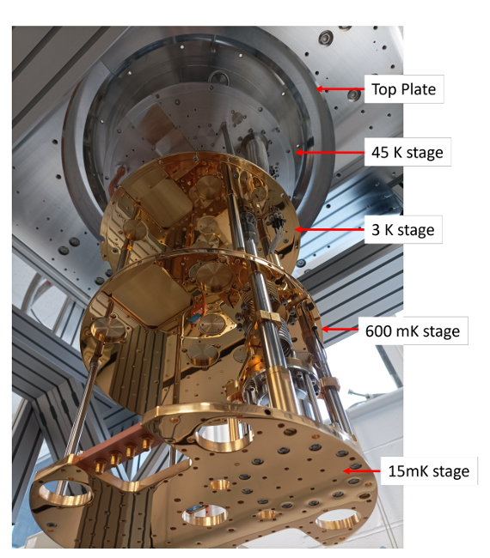
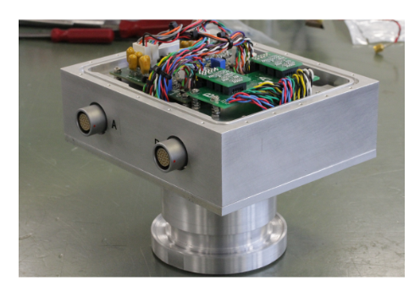
More Quantum Electronics for QSHS
Transmon Qubit arrays, Leek group, Oxford
Coaxial Control
Ports
Device
Waveguide Input
Port
Homodyne Detection Schemes, Parametric Amplifier Design, Withington Group, Oxford

Slide 6
Optical Experiments and DRD5
In HEP, energy scale of 1TeV probes a distance scale of about 1 attometer.
This is about the same as the detected displacement of the LIGO mirrors from a binary inspiral event.
This is possible because mirrors are heavy and macroscopic, hence their surfaces have an average position that is well defined on the attometer scale.
The AVERAGE position of the surface can be measured without single particle TeV-scale collisions that tend to produce new particles, rather than permitting precision measurements of position.
Further improvements in accuracy involve using squeezed laser light. Quantum effects appear at room temperature in the optical, which is in large part why quantum mechanics was first discovered through optical observations (atomic spectroscopy, photoelectric effect).
Einstein telescope, ALPS2, QI experiments, and AION all rely on quantum optics in the quest to achieve sensitivity to small signals.
QI in particular aims to probe hypotheses of quantized space-time (QUEST), ultra-light wave like dark matter AND gravitational waves using ‘table-top’ optics.

Slide 7
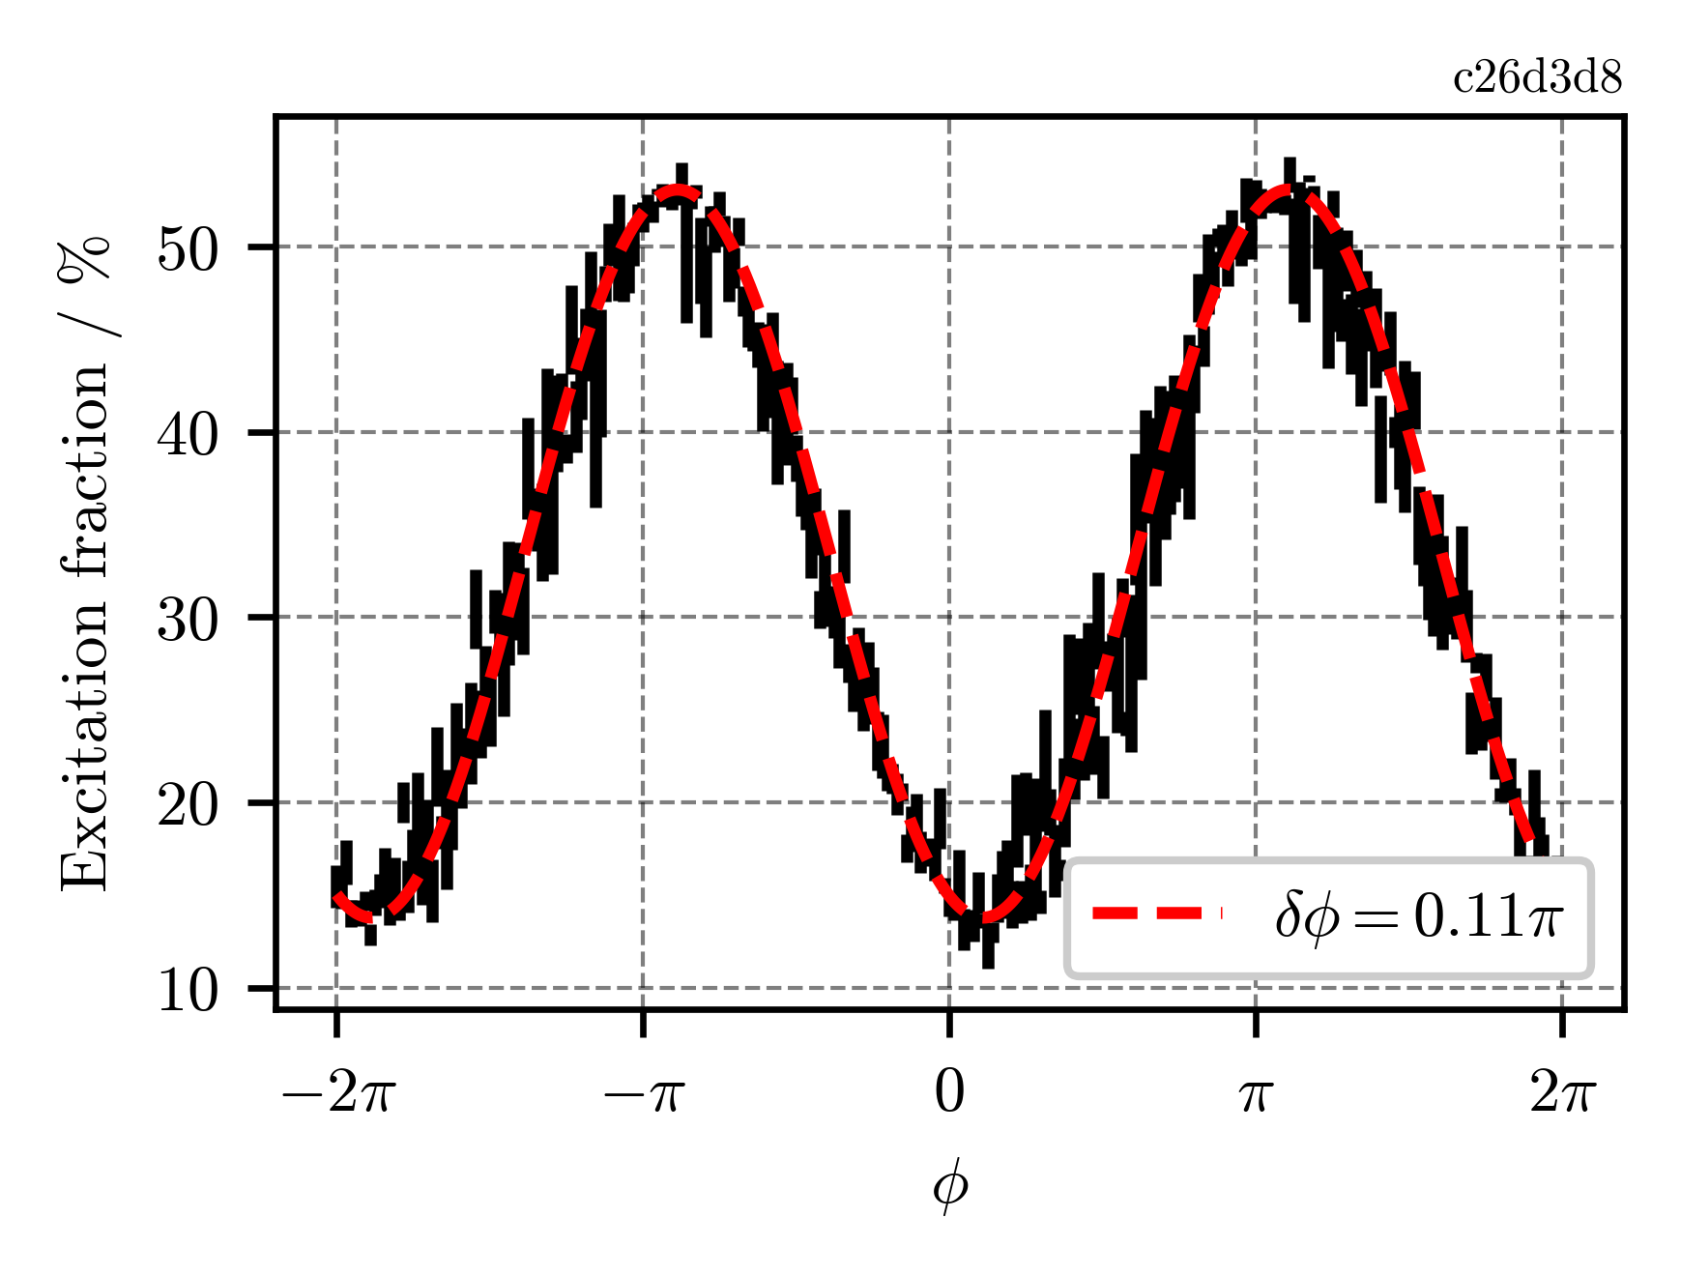
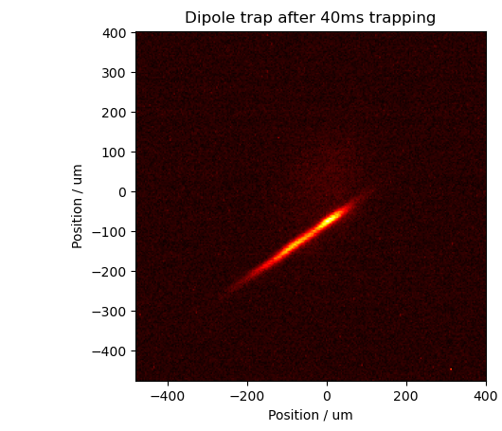
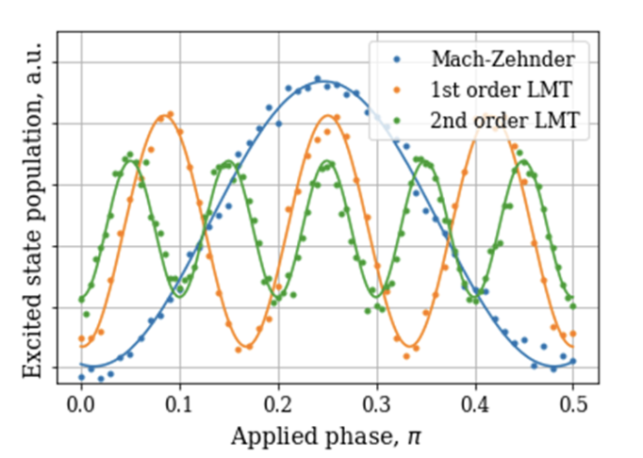
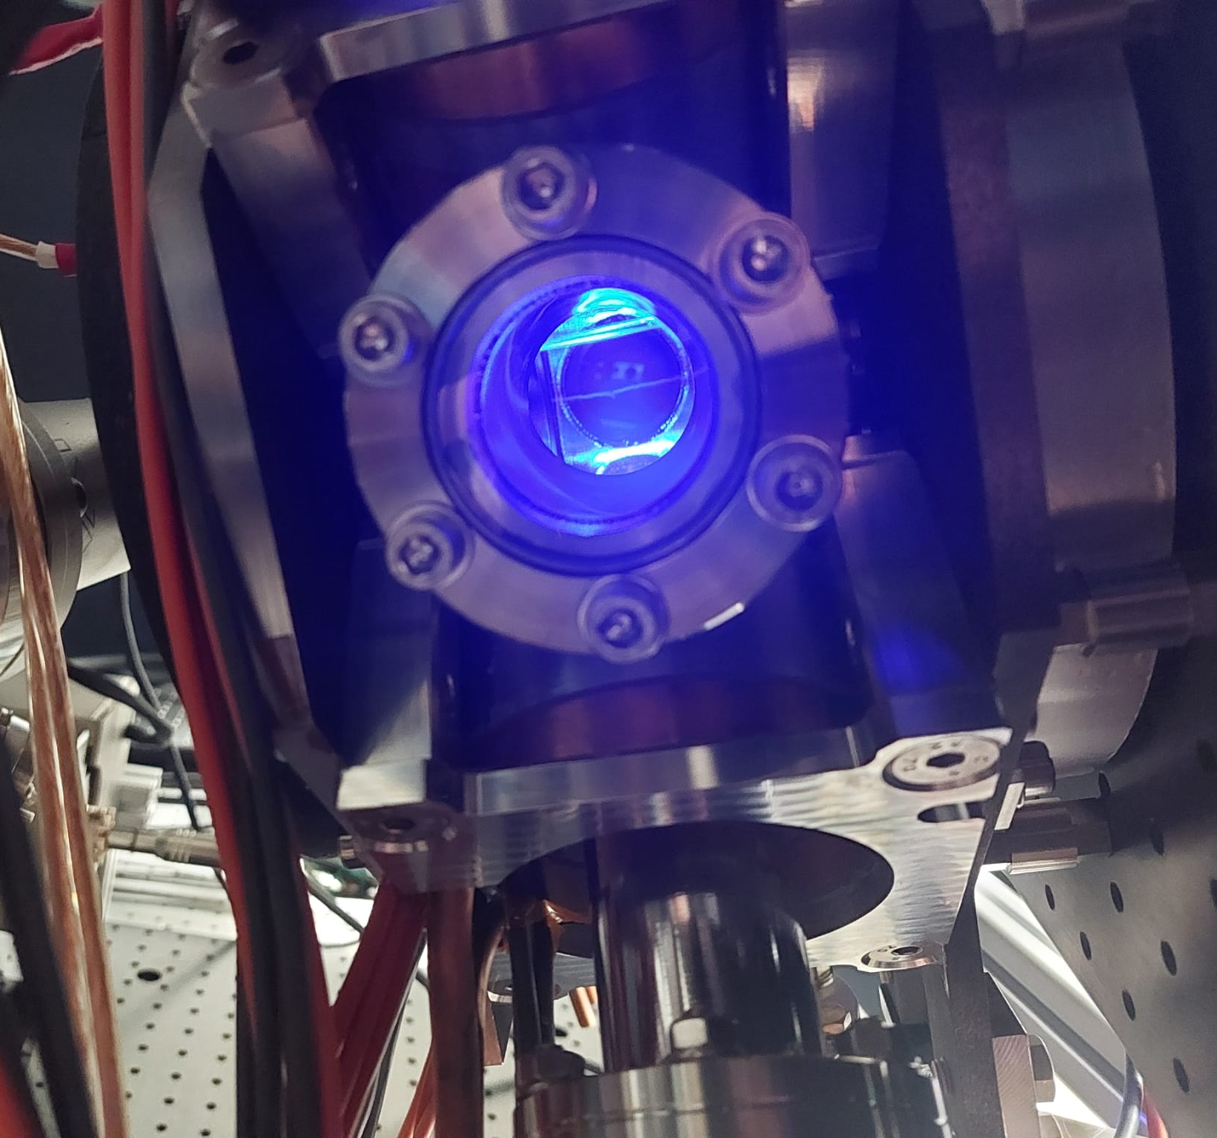
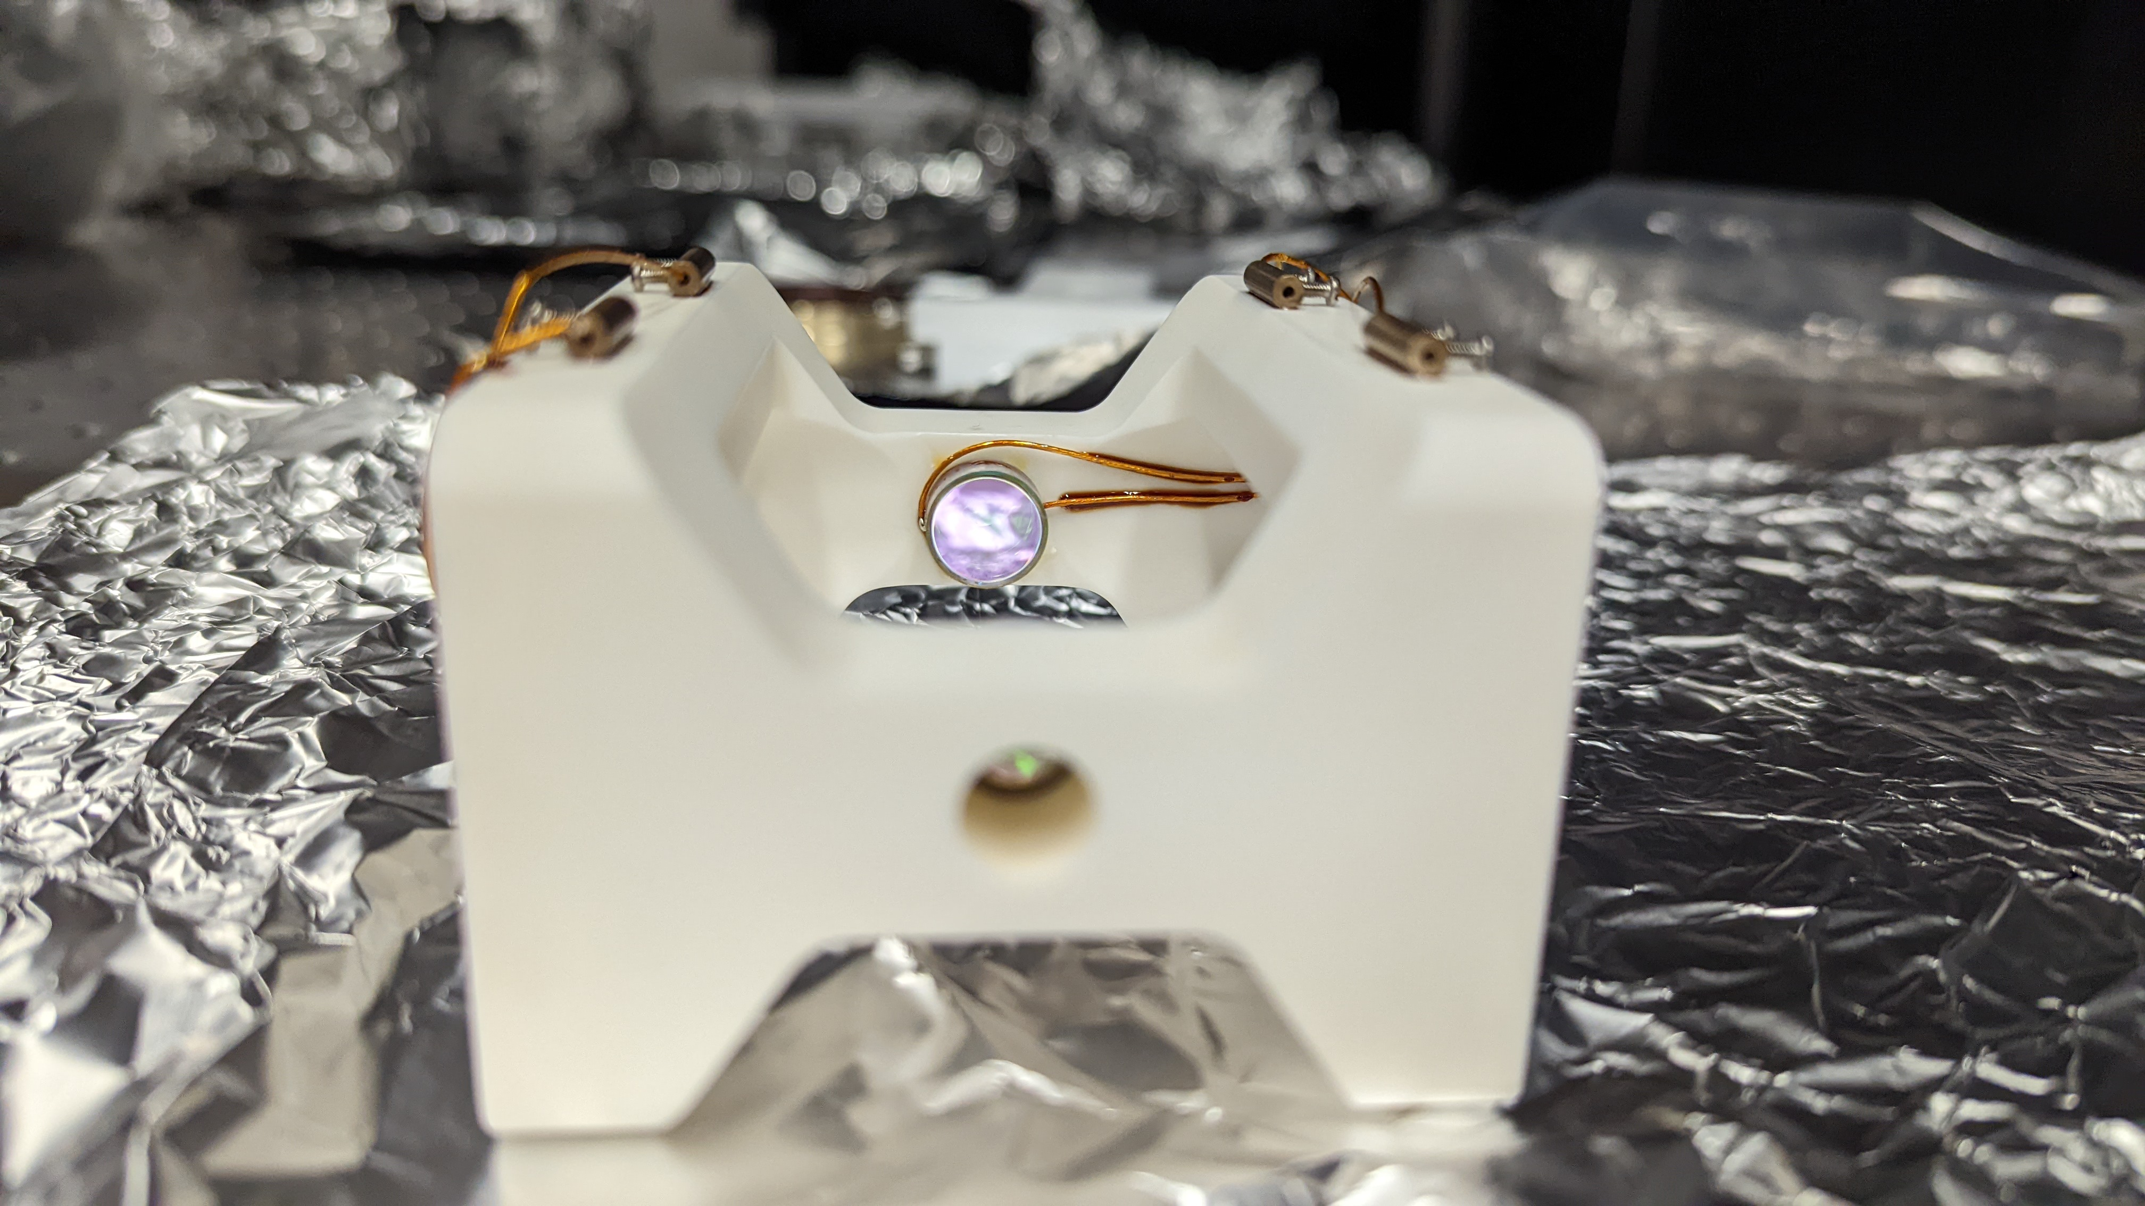
AION in DRD5 (WP-1b)
AION Labs (UoB, Cam, ICL, Oxf, RAL) participate in the Atom Interferometer (AI) WP-1b of DRD5, focus on High-Flux AI, Squeezing, and TVLBAI community building process.
Experimental Progress:
  Squeezing cavity installed, with 200k finesse
  Blue MOT, red MOT, dipole trap, 689 nm interferometry, and intracavity lattice-trapped atoms
  First LMT established
(left) Preliminary Mach-Zender configuration atom interferometry fringes using the ¹S₀ to ³P₁ transition, with an applied phase shift $φ$. (right) Atoms confined in a dipole trap in preparation for squeezing / entanglement.
2D MOT source
Squeezing cavity
Atom interferometry outputs of the strontium apparatus at increasing
orders of large momentum transfer.

Slide 8
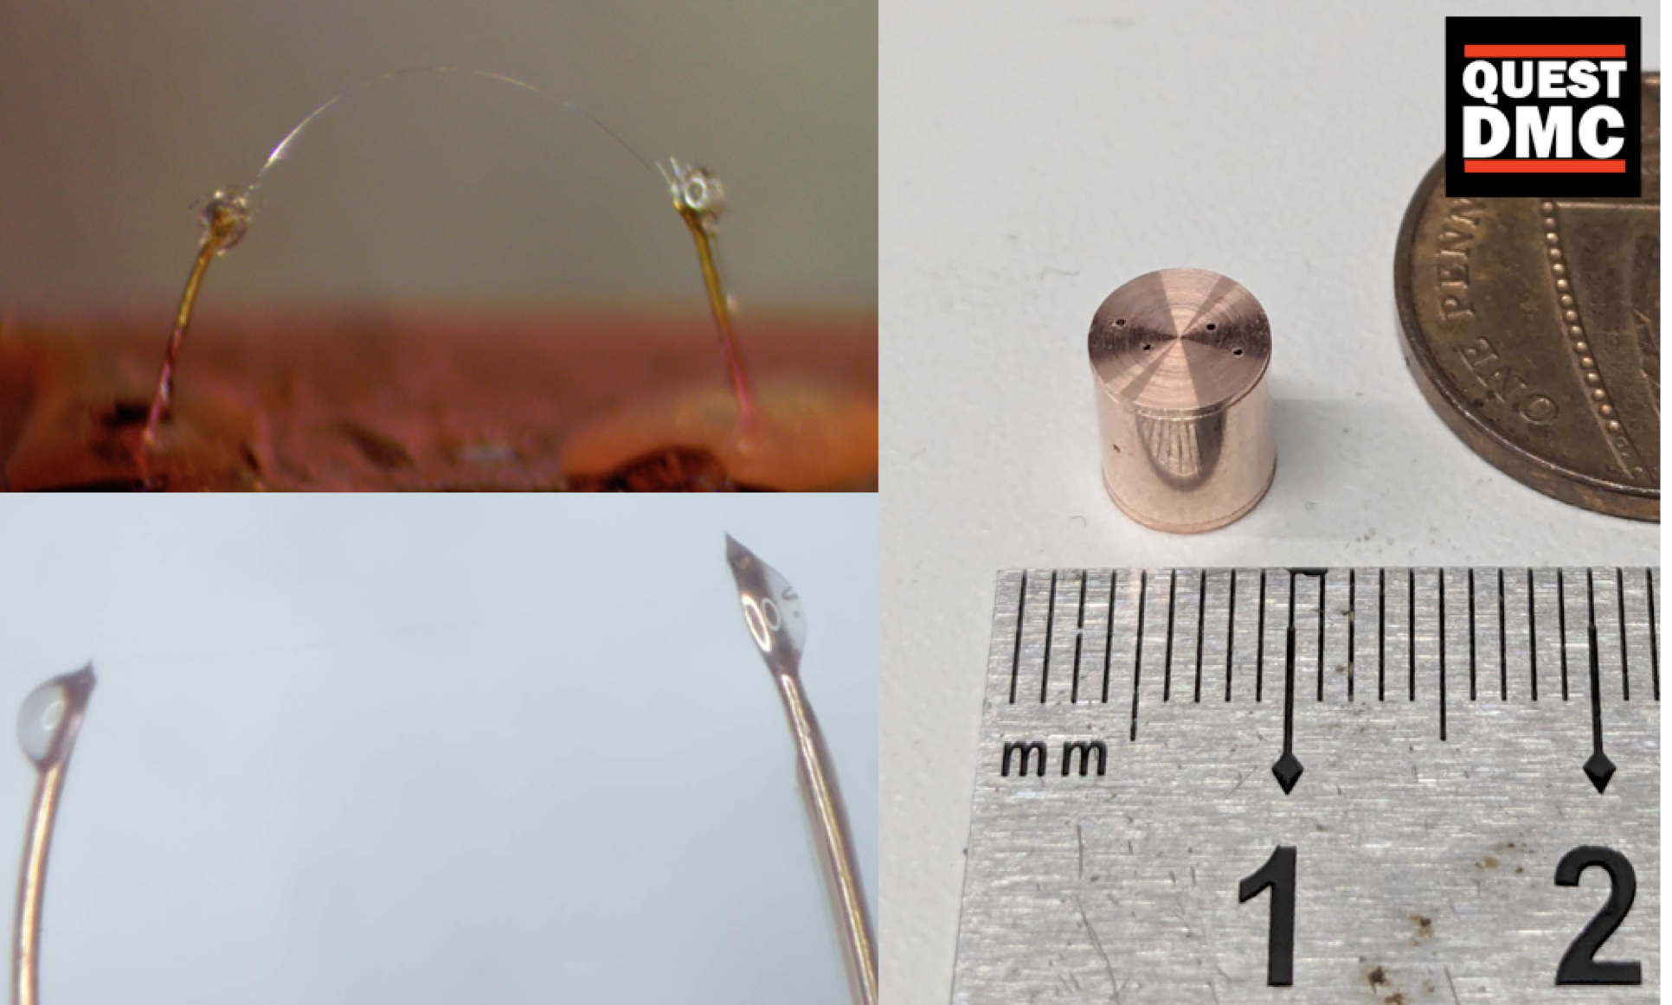
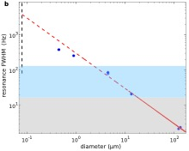
Mechanical Readout of QUEST-DMC using Superconducting Nanowires
Autti, S., Casey, A., Eng, N. et al. QUEST-DMC: Background Modelling and Resulting Heat Deposit for a Superfluid Helium-3 Bolometer. J Low Temp Phys (2024).

Slide 9
Work packages
DRD5.0 – Coordination
DRD5.1 – Atom Interferometry – further development of technologies
including new beam optics, laser atom interaction studies.
DRD5.2 – Coherent ultra low noise electronics, targeting 1-20GHz.
for wave-like dark matter, neutrino mass, quantum
instrumentation and quantum computing.
DRD5.3 – Incoherent ultra low noise electronics, targeting 1-20GHz.
Bolometry, homodyne detectors, relevant to wideband
wavelike dark matter searches.
DRD5.4 – Qubit sensors – alternative technology for wave-like dark
matter, also of interest for more general quantum instrumentation.
DRD5.5 – CryoMulti – multi-channel quantum detectors.
DRD5.6 – CryoFPGA – cryogenic control for quantum systems.

Slide 10
Summary
Though the landscape is complicated, there are many cases of measurements at or below the standard quantum limit being critical for probing beyond-the-standard-model particle physics.
Several technology developments are critical in multiple experiments, notably microwave-band cryogenic amplifiers for QTNM/QSHS and squeezed light optical readout for QI and gravitational wave experiments.
Both electromagnetic and mechanical transduces are critical.
Ultra-sensitive detectors are frequently less naturally stable than their less sensitive cousins. CONTROL of quantum limited elements often by classical feedback circuits is a critical area of research.
Control circuitry may also need to be cryogenic in the future.
See talks in the QTFP session and panel discussion after coffee.

