Slide 1
Quantum Sensing for Axions, ALPs and sub-GeV dark matter
Ed Daw, The University of Sheffield
https://cajohare.github.io/AxionLimits/

Slide 2








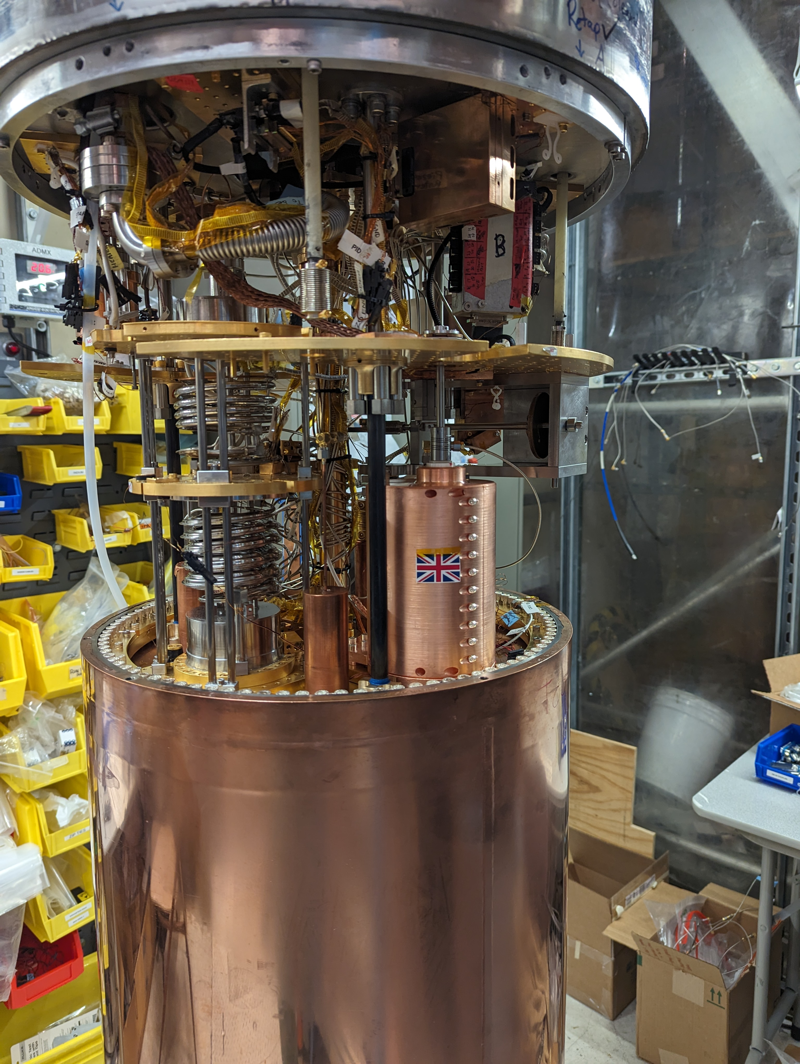
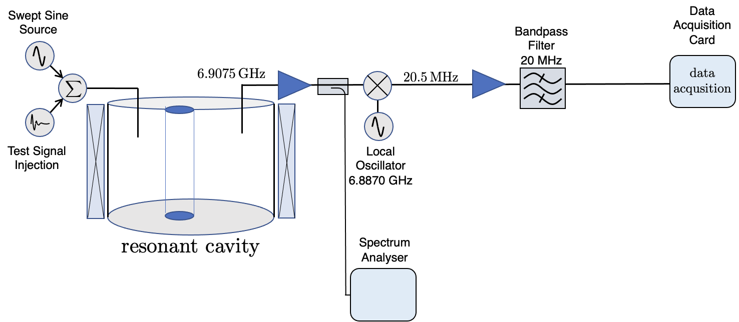
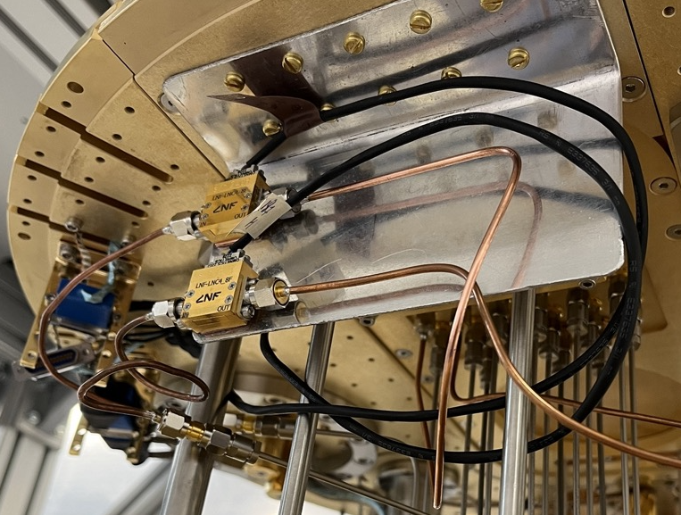
QSHS Collaboration
CRYOGENIC
ROOM TEMPERATURE
a
low noise
amplifiers
magnetic field

Slide 3
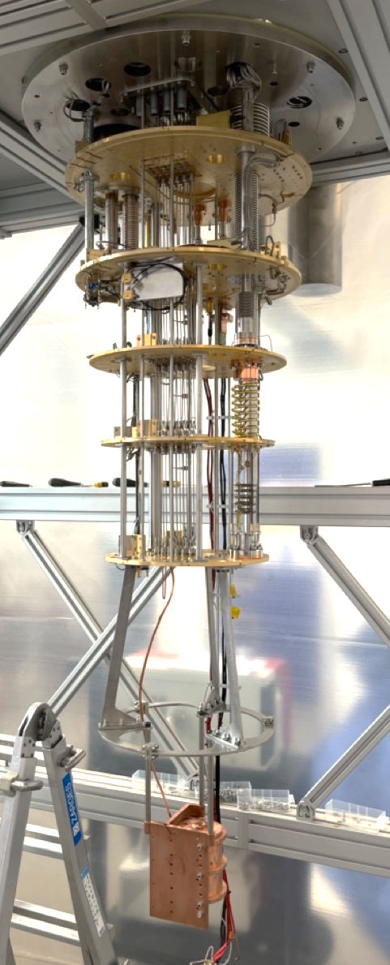
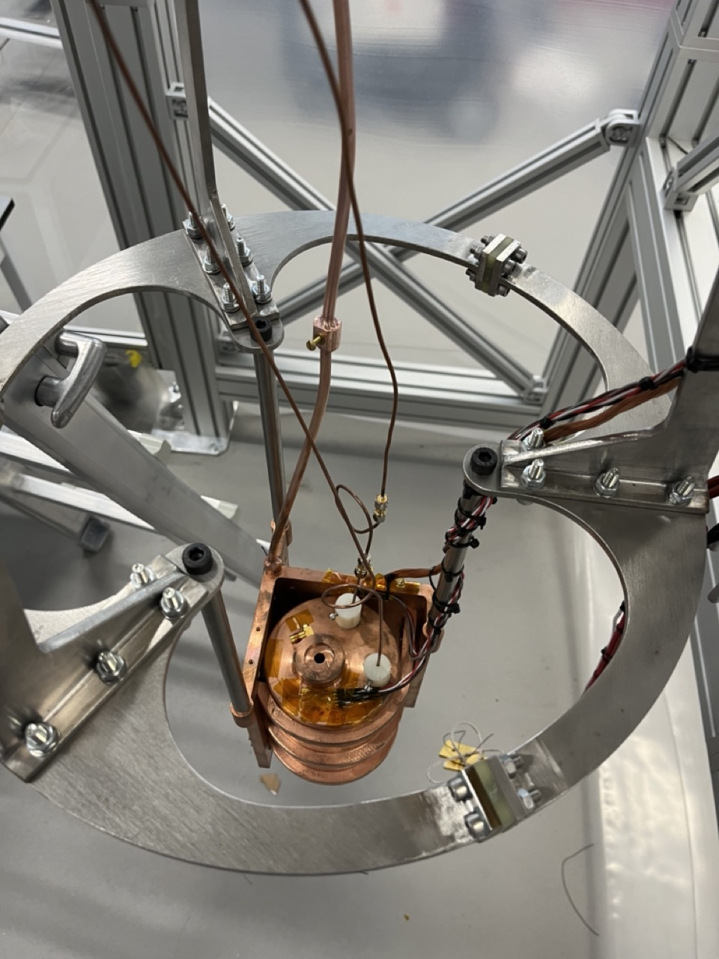
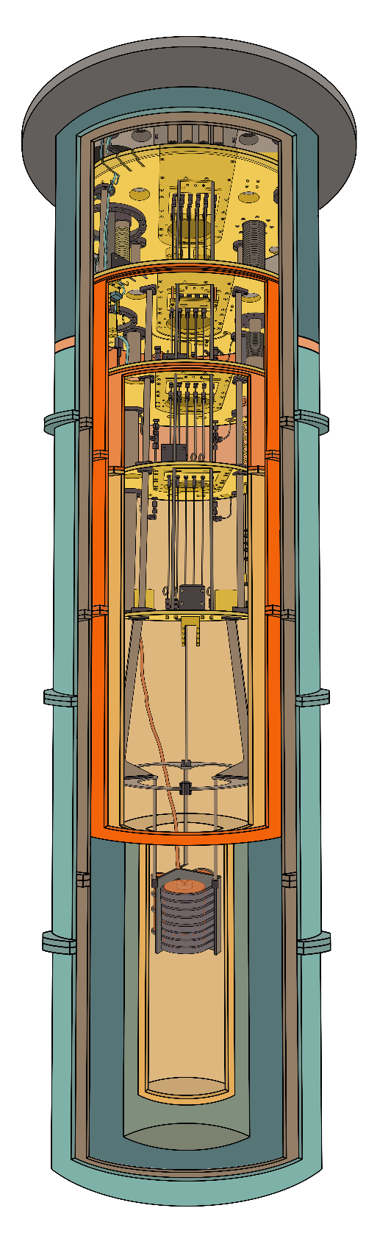
Steel frame designed by Trevor Gamble. Frame and cavity built by M&J Engineering, Eroda Tools Ltd, and Simon Dixon

Slide 4
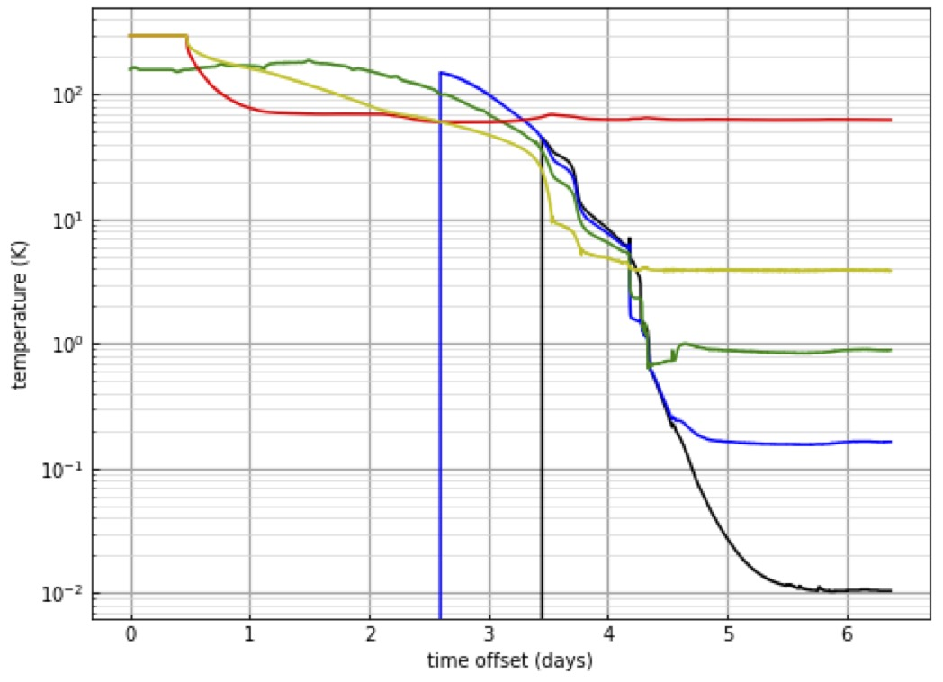
First Cavity Cool-down

Slide 5
Quantum Interferometry (QI) collaboration
Cardiff, Birmingham, Glasgow, Strathclyde, Warwick
International Partners: Fermilab / U Chicago, NIST, MIT, Caltech (US), DESY, PTB, Max Planck (Germany), Vienna (Au), U Western Australia (A)
Ultra-low-mass halo axion search by detection of the plane of polarization of light (LIDA)
PHYSICAL REVIEW LETTERS 132, 191002 (2024)
DarkGEO - New J. Phys. 26 (2024) 055002

Slide 6

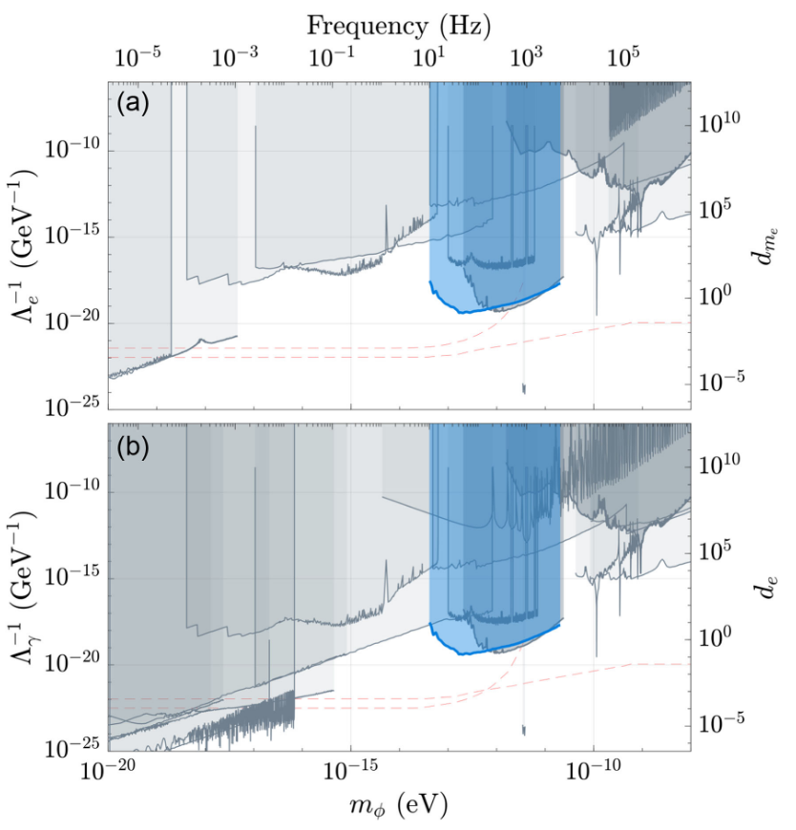
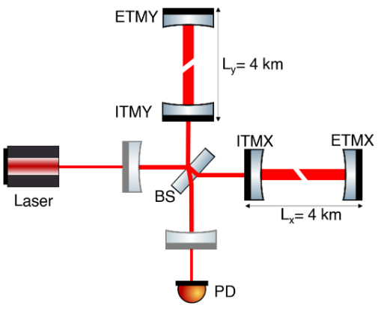
Spin-off work in QI:
Scalar field Dark Matter Search with Gravitational-Wave Detectors
Discovered novel coupling path of scalar
field dark matter to gravitational-wave detectors
Conducted searches for GEO600,
Holometer, and LIGO detectors
Nature 600, 424 (2021); PRL 128, 121101 (2022);
PRL 133, 101001 (2024)
6

Slide 7
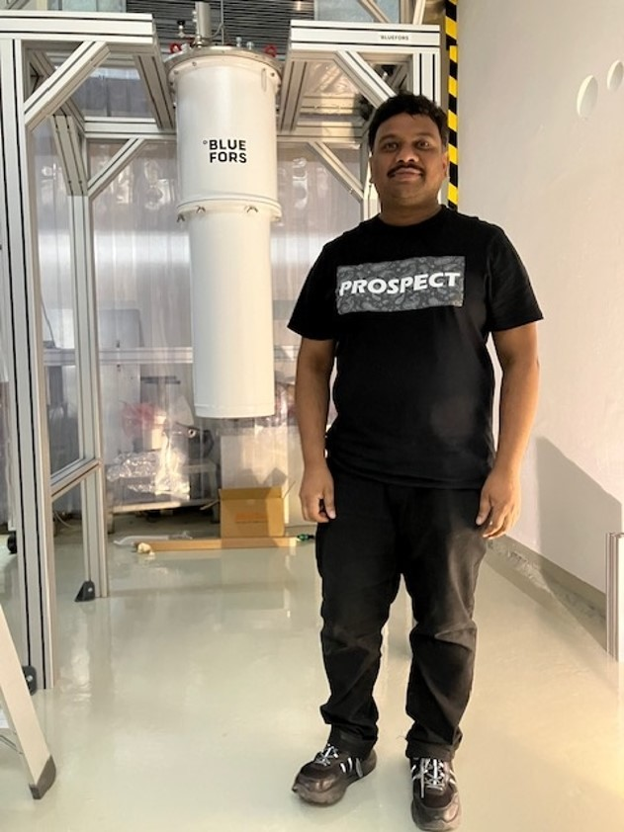
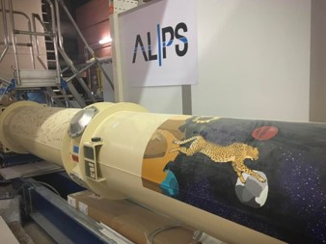
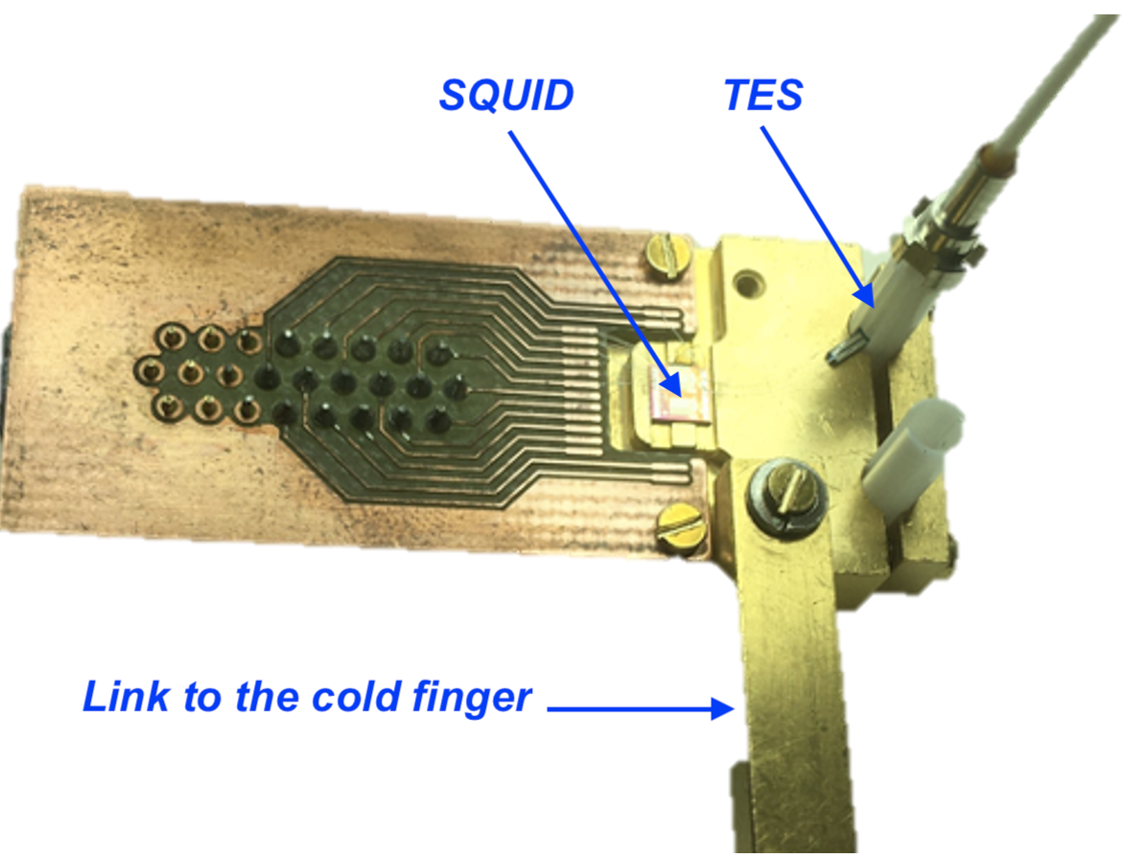
WP 2: Support for the ALPS II
Axion search experiment
ALPS II is a new particle search experiment at DESY in Hamburg, 2 x 120m linear cavities
APLS II is a light-shining through a wall experiment using fabry perot cavities on either side of a wall.
QI support to commissioning (optics and control expertise): Milestone of current first science run reached, science output paper in preparation
World record for light storage time in 2-mirror cavity (67 ms)
New TES detector under commissioning (50% QTFP funded)
7

Slide 8
Sub-GeV Particle Dark Matter
There are various models that encourage the search for sub-GeV particle-like dark matter, for example asymmetric dark matter. There have been several excellent talks at this meeting about current and proposed experiments in this area. QUEST-DMC and UltraDark were presented earlier today by Elizabeth Leason. DarkSphere was presented by Patrick Knights. QTFP has been critical to getting QUEST-DMC off the ground, in particular.
An appeal to stop using the term ‘light dark matter’ meaning light particle dark matter. All these particles are enormously more massive than wave-like candidates
There is a strong possibility that dark matter may consist of many candidates co-existing in the galactic halo. This would not be good news for groups focused on any one candidate, but we should not underplay this possibility. Gravity does not discriminate!

Slide 9
Conclusions
Particle dark matter searches continue in the UK, with the net widening to support more sensitive searches below 1GeV.
Wave-like dark matter search activity in the UK has been successfully kickstarted through the QTFP programme.
QSHS has achieved cooldown of a cavity resonator for axion searches in the micro-eV mass range to 17mK. This is the lowest temperature resonant axion search worldwide.
QI have published first results from the LIDA halo axion detector over a narrow band, activities towards a broadband search underway. Also significant involvement in ALPS2, scalar dark matter, and a proposal to turn GEO600 into an axion detector.
AION moving towards a pilot 10m atom interferometer with the long term aim of sensitivity to ultra-light axions. See the next talk by Jeremiah Mitchell
With the appropriate infrastructure available and diverse collaborations, more diverse projects can be carried out in the quantum world (e.g. recent Liverpool initiative being explored to develop resonant circuits for fundamental QED tests and axion searches)
It is critical to continue to support the QTFP community.

