Slide 1

Quantum Sensing Interferometry
Laser and Atomic
Jeremiah Mitchell
24 September 2024
ECFA-UK
SENSE

Slide 2
Overview
Interferometry and Quantum Enhancements
Science Reach with Quantum Interferometry
Atom Interferometry and AION

Slide 3
Interferometry
Measurement using interference of superposed waves
Coherent periodic input
Splitting and recombination
Detection of interference fringes

Slide 4
Atomic interferometry
Mach-Zehnder laser interferometer
Mach-Zehnder atom interferometer
delay
detector
beamsplitter
mirror
beamsplitter
mirror
beamsplitter
Atom interferometry tutorial:
J. M. Hogan et al., arXiv:0806.3261 [physics] (2008).

Slide 5
Where is the Quantum?

Slide 6
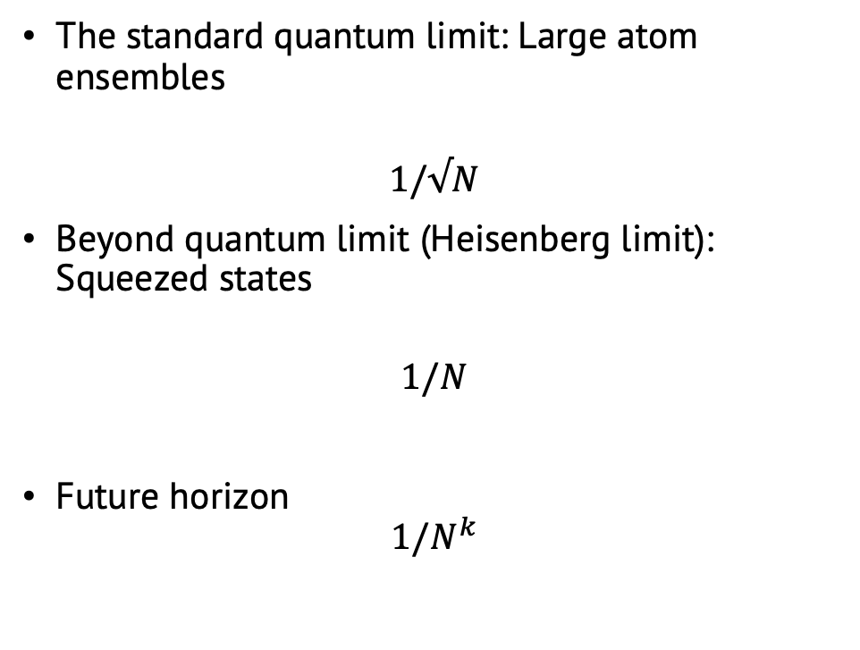
Quantum upgrades
The standard quantum limit: Large atom ensembles
$$1/√N$$
Beyond quantum limit (Heisenberg limit): Squeezed states
$$1/N$$
Future horizon
$$1/N^{k}$$
S. Boixo et al., Phys. Rev. Lett. 98, 090401 (2007).
E. Rocco et al., New J. Phys. 16, 093046 (2014).
L. Salvi et al., Phys. Rev. Lett. 120, 033601 (2018).

Slide 7
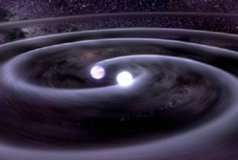
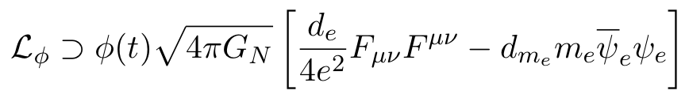


Fundamental physics across scales
Ultralight dark matter
Gravitational waves
Ultralight scalar dark matter → high density, wave-like characteristics
10⁻²² eV
10⁻¹⁷ eV
10⁻¹² eV
10⁻⁷ eV
Photon Couplings
Electron Mass Couplings
Phys. Rev. D 97, 075020 (2018).
Phys. Rev. Lett. 110, 171102 (2013).

Slide 8
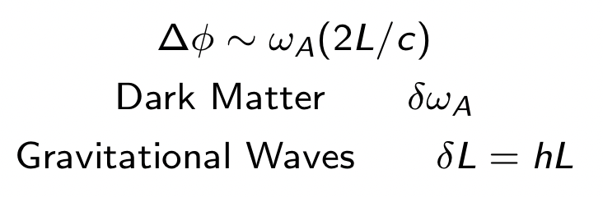
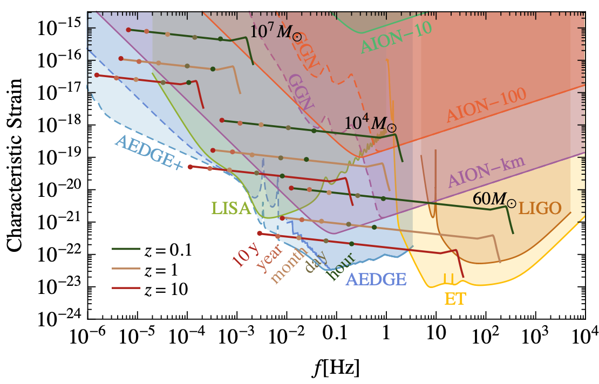
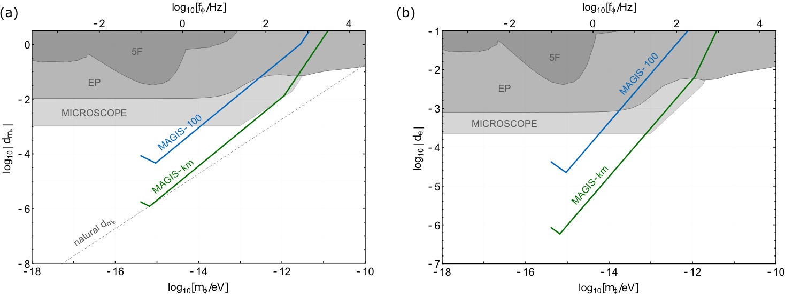
Potential sensitivities
Gravitational wave searches
Single-baseline detectors
Ultralight dark matter searches
L. Badurina et al., AION: An Atom Interferometer Observatory and Network, JCAP 05 (2020) 011

Slide 9

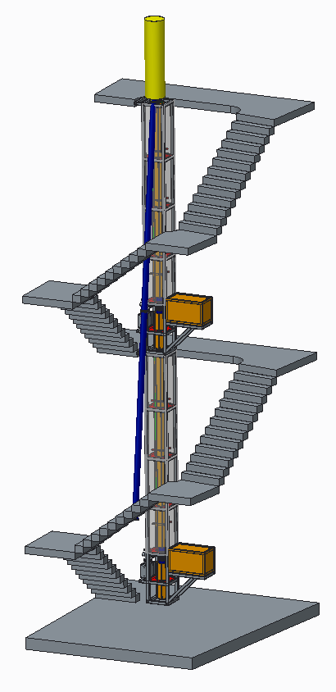
AION
Atom Interferometer Observatory and Network
UK consortium of 7 institutions
Multi-stage project
Develop 5 ultracold strontium UK laboratories for atom interferometry R&D
Design and deploy increased baseline atom interferometers 10m -> 100m -> 1km
Investigate technology development and network with MAGIS-100 for large-scale science goals
14.7m
Ground level
AI-10
10.0m
7.7m
Project executed in national partnership with UK National Quantum Technology Hub in Sensors and Timing, Birmingham, UK,
and international partnership with The MAGIS Collaboration
and The Fermi National Laboratory, US
5.0m
L. Badurina et al JCAP05(2020)011

Slide 10




Summary and Thanks
Interferometers provide extreme sensitivity platform for measurement for dark matter and gravitational waves
Quantum technologies and enhancements have the potential to unlock unprecedented sensitivity for key scientific questions in particle physics and beyond
RAL

Slide 11
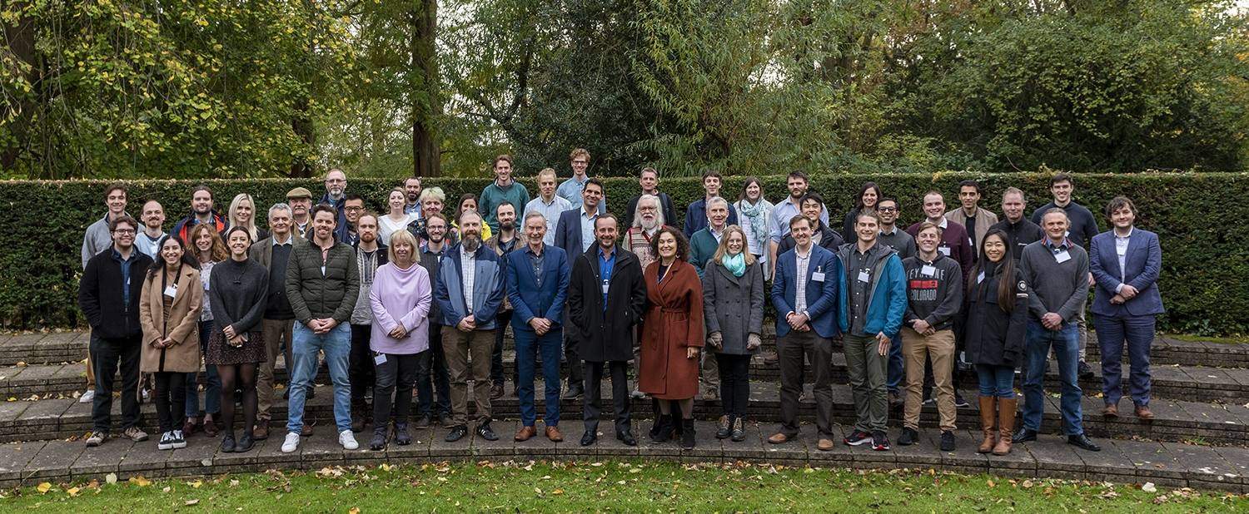


@AION_Science
Follow our progress!
aion_science

Slide 12
Backups

Slide 13
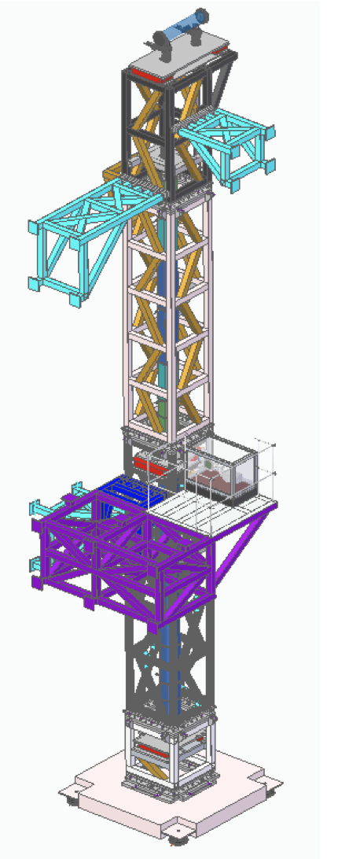
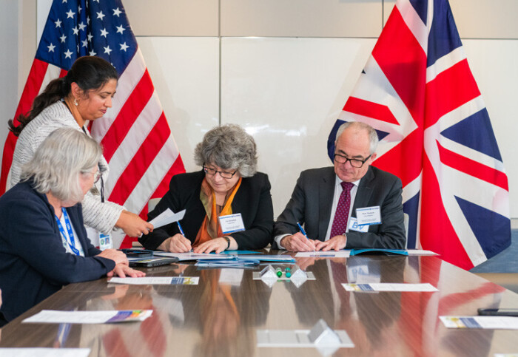
Major Milestones in First Phase (30 months)
Design of Oxford 10 m detector
Formalise UK-US Partnership
5 ultracold Sr labs built in less than 24 months using large-scale Particle Physics production methods to significantly accelerate the turnaround – this will be critical for future success!
More than doubled the ultracold Sr R&D capacity in the UK and increased it by about 25% worldwide.
https://doi.org/10.1116/5.0172731
[published AVS Quantum Sci. 6, 014409 (2024)]
Discussing with established UK companies Torr Scientific and Kurt J. Lesker potential for spin-off.
Formalising the long-standing UK-US partnership between MAGIS-100 and AION, in conjunction with the participating UK institutions.
This stands as a successful instance of UK-US cooperation in the fields of science and quantum technology development, with the potential to unlock additional synergies and opportunities.

Slide 14
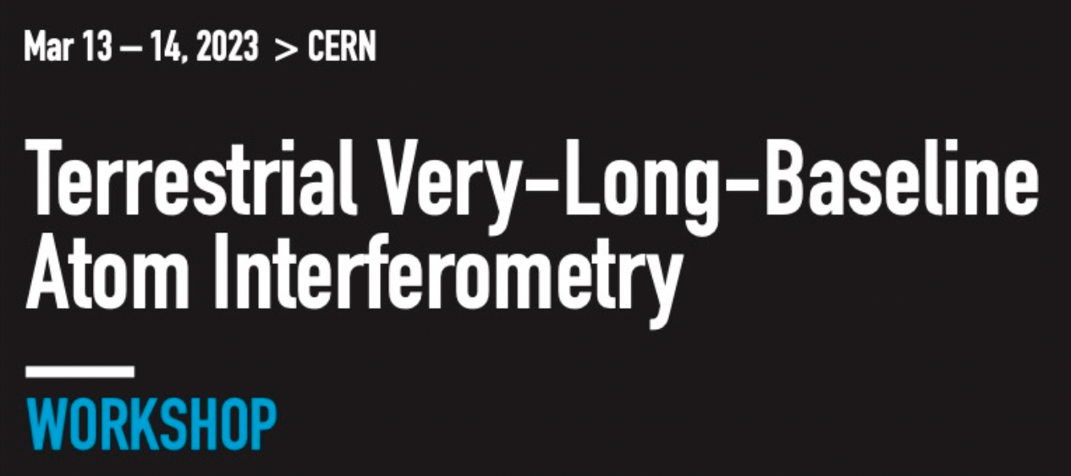
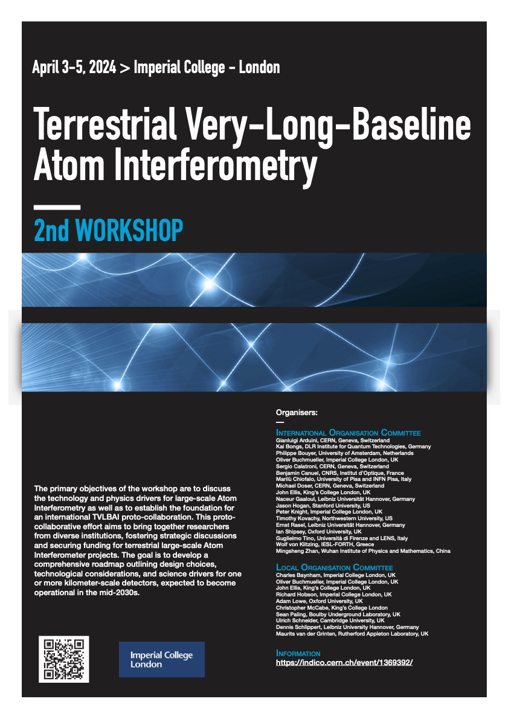
Progressive Expansion of Quantum Detectors
Stage Expansion of Detector Length**
Stage 1: 2024 to 2027
10 m detector protype to be built in Oxford, focus fundamental science and R&D
10–20 m AION “spin-off” from Oxford design & experience at Boulby focus Earth Science applications.
Stage 2: 2028 to 2035
(Multi-)100 m detector: Site options are Boulby or Daresbury (UK), possibly also at CERN (France/Switzerland).
Stage 3: 2035 onwards
Km-scale detector: Site options are Boulby and other international sites
AVS Quantum Science (Vol. 6, Issue 2)
https://doi.org/10.1116/5.0185291
** Sensitivity scales with length of detector

Slide 15
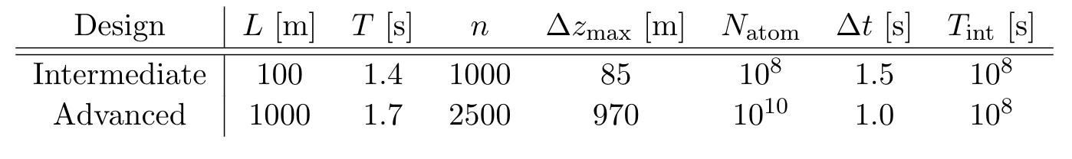
Multi-gradiometry
Multiple atom interferometers synchronized along the baseline run in tandem
Badurina, et al. Phys. Rev. D 107, 055002

Slide 16
GGN
Low and High noise global bounds
Rayleigh surface waves (fundamental mode)

Slide 17
Sensitivity with GGN backgrounds
L. Badurina et al., Phys. Rev. D 107, 055002 (2023).

Slide 18
Multi-gradiometer impact

Slide 19
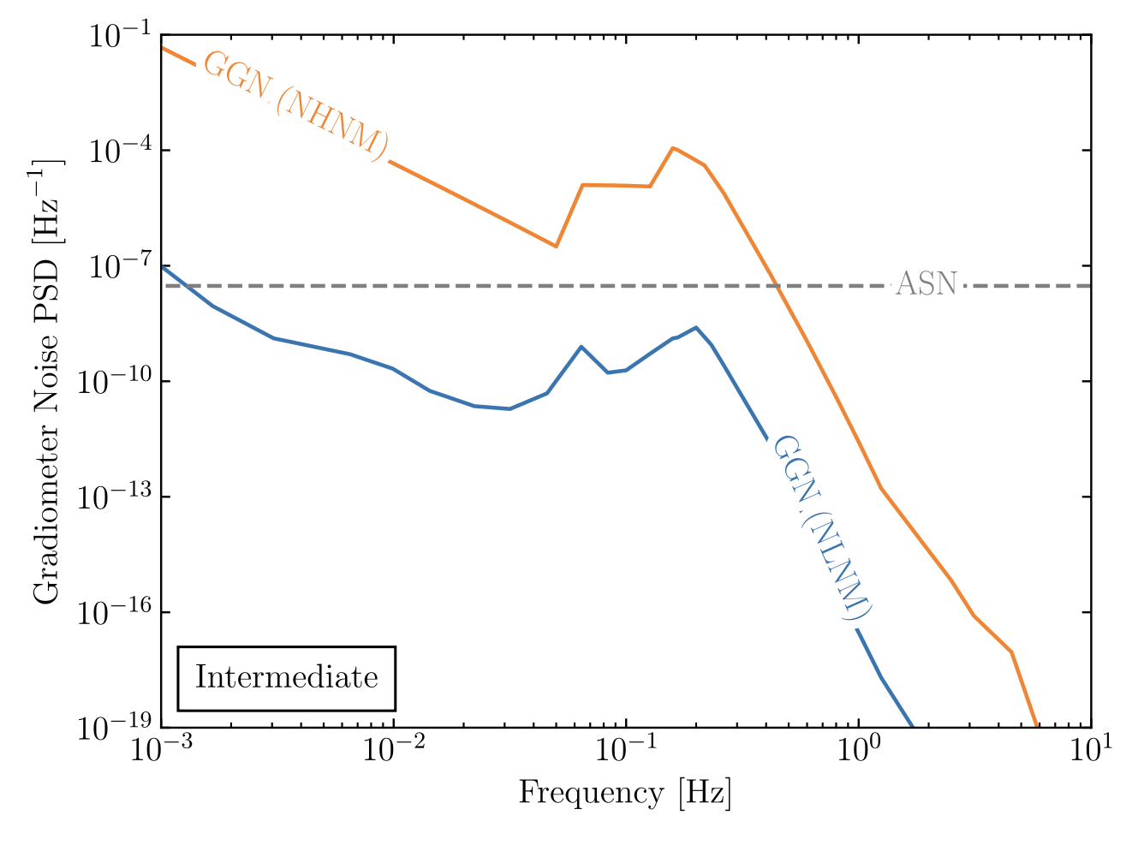
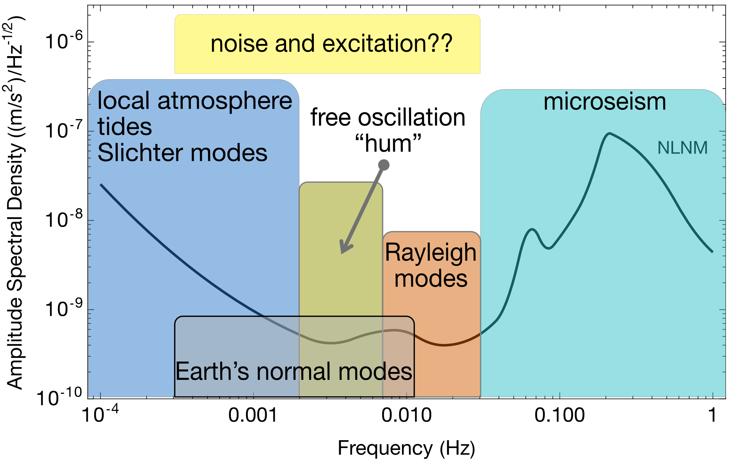
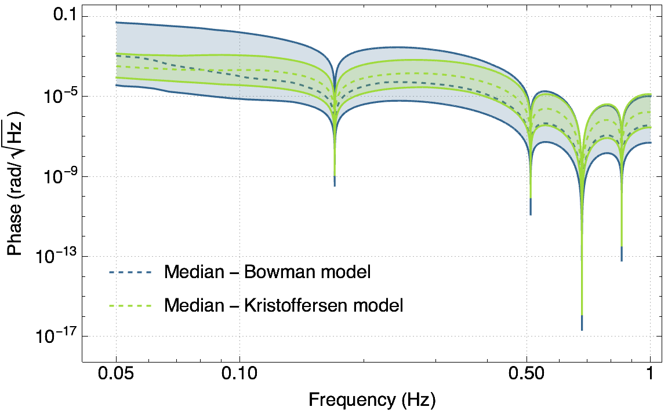
Earth Science: backgrounds and signals
Terrestrial backgrounds cause gravity gradient noise limiting fundamental physics searches
AION can use gravitational signal channel to answer open questions in Earth science
  Earth’s free oscillation and normal modes
  Low-frequency Earth dynamics
Rayleigh seismic waves source gravitational fluctuations
Seismic Frequency Spectrum
Atmospheric infrasound and temperature gradient noise
Preliminary!
Mitchell et al., J. Inst., vol. 17, 01, 2022.
Badurina, et al. Phys. Rev. D 107, 055002

