Slide 1
Planning an Accessible Academic Conference
New guidelines as informed by the BGA PGRiP meeting 2023.
Sophia Baker, School of Geosciences, University of Aberdeen.
Notes:
Hello everybody and thank you so much for coming to my talk this morning. My name is Sophia Baker and I am a PhD student in Geophysics at the University of Aberdeen. I did my undergrad degree in Physics here at Durham and it is really nice to be back!
Today's talk is not about physics or geophysics, but rather, one of the environments in which we work - conferences. Last year, I lead the organisation of the British Geophysical Association's Postgraduate Research in Progress Meeting, PGRiP for short, including the overseeing of equality, diversity and inclusion for the event.
The work we did on this event led to the publication of the British Geophysical Association's Accessible and Inclusive Meeting Organisation Guidelines and an accompanying article in the Royal Astronomical Society's monthly magazine, A&G, which due to be published this August.

Slide 2
In this presentation
The case for more accessible conferences - why accessibility matters.
What the British Geophysical Association (BGA) is.
Case study: BGA Postgraduate Research in Progress meeting 2023 (PGRiP).
Tour through BGA’s guidelines for hosting an accessible conference.
Signposting to helpful resources.
Notes:
In this talk, I'll give a brief overview of what the British Geophysical Association (which I'll now refer to as BGA) is, then move on to state the case for making conferences more accessible and inclusive. I'll talk about the BGA’s postgrad meeting, PGRiP, and how we mitigated common issues before, during and after the conference, Then we'll take a tour through BGA's accessible and inclusive conference guidelines.
I'll finish off by signposting some helpful resources for conference organisers, presenters, exhibitors and attendees, and then we'll have a Q&A with me and the IPPP EDI group.

Slide 3
Disclaimer
This is just the tip of the iceberg.
Notes:
Before we dive in, I want to state that what I’m going to cover is just the tip of the accessibility and inclusion icebergs. I am learning every day, just like the rest of us. However, rather than shying away from the topic, I’d like to encourage more conversations so that we can keep learning together.

Slide 4
Accessibility and Inclusion
Notes:
Meetings and conferences like these can be amazing opportunities to share our work and connect with colleagues - but too often, a lack of consideration for accessibility and inclusion results in the exclusion of talented, hard-working scientists.

Slide 5
Accessibility
“The practice of making information, activities, and/or environments sensible, meaningful, and usable for as many people as possible.”
Source: https://www.seewritehear.com/learn/what-is-accessibility/
Notes:
Accessibility is a term that's most often used in the context of disability. It's the practice of making information, activities and / or environments sensible, meaningful, and usable for as many people as possible.
I like this definition because it highlights that accessibility aids everyone – it doesn’t just benefit the people requesting the accommodations, it makes things easier for everyone

Slide 6
Inclusion
“Diversity typically means proportionate representation across all dimensions of human difference. Inclusion means that everyone is included, visible, heard and considered. Belonging means that everyone is treated and feels like a full member of the larger community, and can thrive.”
Source: https://edib.harvard.edu/files/dib/files/dib_glossary.pdf
Notes:
Inclusion pairs with accessibility. This definition from Harvard summarises the concept nicely: if something is inclusive, everyone is included, visible, heard and considered.

Slide 7
Conferences are often inaccessible and exclusionary.
It’s not on purpose: “It is lack of awareness that most commonly results in things being inaccessible.”*
We wanted to change that at BGA PGRiP 2023.
*Source: https://accessibility.blog.gov.uk/2016/05/16/what-we-mean-when-we-talk-about-accessibility-2/
Notes:
The lack of accessibility and inclusion we see too often at academic conferences is not on purpose or out of any malicious intent. But it does happen, usually because people aren't aware of the barriers they and their peers are facing.

Slide 8
The British Geophysical Association
Joint Association of the Geological Society of London & the Royal Astronomical Society
Aims: to promote the subject of geophysics and strengthen its relationship with other natural sciences in the UK.
Source: https://geophysics.org.uk/about/what-is-the-bga/
Notes:
With that said, let's talk about BGA quickly!
BGA is a joint association of the Geological Society of London and the Royal Astronomical Society. I imagine a good proportion of the audience today are fellows of the Royal Astronomical Society - those of you who are are all eligible to become BGA members.
The association exists to promote geophysics and strengthen its relationship with the other natural sciences.
It does this by encouraging the publication of research results and contributing consultation documents on relevant subjects to national enquiries and committees.
BGA also annually presents the Bullerwell Lecturer award of to an outstanding young geophysicist, and providing funding for events such as PGRiP and the annual New Advances in Geophysics meetings.

Slide 9
The British Geophysical Association Postgraduate Research in Progress meeting
The British Geophysical Association Postgraduate Research in Progress meeting.
For geophysics postgrad students, by geophysics postgrad students.
Notes:
Part of what makes this conference special is that it is run for postgraduates, by postgraduates.
Last year it was hosted by the Universities of Aberdeen and Edinburgh, as is denoted in the logo.
When organising PGRiP, we wanted to do as much as we could to make the event accessible and inclusive.

Slide 10
EDI Issues flagged included:
Financial barriers.
Travel and transport issues.
Alcohol-centred social events.
Inaccessible venues and materials.
Limited food and drink options.
Tight schedules and lack of downtime.
Notes:
When planning PGRiP, one of the first things we did was flag some of the EDI issues we face in the conference-space.
Financial hardship, travel issues, and inaccessible venues can stop people from being able to attend an event in the first place. Social events centred on alcohol can foster an exclusionary environment for those who don't drink, and limited food and drink options can mean people with dietary requirements have to miss parts of the conference to find food or spend more than other attendees. Exhaustion and burnout from intense, tight schedules was also flagged as an issue.

Slide 11
Ways we addressed them included:
Providing fee waivers, travel grants, and grants for parents and carers.
Asking attendees for their access and dietary requirements at registration.
Scheduling regular breaks, avoiding combining poster sessions and breaks.
Hosting varied social events in accessible, comfortable settings.
Notes:
Ways we addressed these issues included:
Providing fee waivers.
Asking attendees for dietary requirements.
Scheduling regular breaks and separating poster sessions from said breaks.
Hosting accessible, comfortable socials.

Slide 12
EDI Issues flagged included:
Exclusion of early career and underrepresented scientists.
Lack of diversity in speakers.
Little to no support for parents/carers.
Harassment and inappropriate behaviour.
Notes:
These problems feed into the unintentional exclusion of early career and under-respresented scientists, as does underrepresentation and lack of diversity in invited speakers and panel members.
Parents and carers can also face barriers in attending conferences if they are unable to find alternative care for their child or the person they are caring for.
Harassment and inappropriate behaviour also remain an issue in the scientific community.

Slide 13
Underrepresented Groups in Physics
Gender data from IOP membership figures, January 2022. N=13,340. Data includes working members from the UK only.
Source: https://www.iop.org/sites/default/files/2022-02/IOP-response-to-house-of-commons-science-technology-committee-inquiry-into-diversity-in-STEM.pdf
Notes:
Let’s now briefly remind ourselves who is underrepresented in physics by looking at statistics from the latest IOP EDI policy document.
The gender disparity in physics is massive. 78% of IOP members are male, with 21% female and 1% identifying otherwise. This is reflected in undergraduates, too.

Slide 14
Underrepresented Groups in Physics
Sexuality data from the IOP Member Diversity Survey, 2019. N=1908
Source: https://www.iop.org/sites/default/files/2022-02/IOP-response-to-house-of-commons-science-technology-committee-inquiry-into-diversity-in-STEM.pdf
Notes:
89% of physicists identify as straight, with 11% disclosing LGBTQ+ identities in the IOP Member diversity survey in 2019.

Slide 15
Underrepresented Groups in Physics
Ethnicity data from the IOP Member Diversity Survey, 2019. N=2,005.
Source: https://www.iop.org/sites/default/files/2022-02/IOP-response-to-house-of-commons-science-technology-committee-inquiry-into-diversity-in-STEM.pdf
Notes:
Of respondents to the same survey who disclosed their ethnicity, 92% were White, leaving just 1% from Black backgrounds, 1% Chinese, 2% Indian, and 4% other ethnic backgrounds.
For context, the proportions of Pakistani and Bangladeshi physicists are each half of the equivalent proportions across all disciplines, and the proportion of black physicists is about a third of the equivalent proportions across all disciplines.

Slide 16
Underrepresented Groups in Physics
Disability data from the IOP Member Diversity Survey, 2019.
Source: https://www.iop.org/sites/default/files/2022-02/IOP-response-to-house-of-commons-science-technology-committee-inquiry-into-diversity-in-STEM.pdf
Notes:
People with disabilities are also underrepresented in physics. 9% of IOP respondents reported having a disability, compared to the 21% of the UK’s whole population who are disabled, and the 19% of the UK workforce. As of 2019, 13% of undergraduate physicists reported they were disabled.
Of the 9% who reported a disability, 26% had a longstanding illness or health condition, 25% had a mental health condition such as depression, schizophrenia, or anxiety disorder, 19% had a physical impairment or mobility issues, and 17% were on the autistic spectrum.

Slide 17
Underrepresented Groups in Physics
Ethnicity data from the IOP Member Diversity Survey, 2019. N=1,954.
Source: https://www.iop.org/sites/default/files/2022-02/IOP-response-to-house-of-commons-science-technology-committee-inquiry-into-diversity-in-STEM.pdf
Notes:
The IOP collected data on religious beliefs. Non-religious and Christian physicists are relatively overrepresented in the UK compared to those of other faiths, who collectively make up 7% of the surveyed physicists.

Slide 18
Underrepresented Groups in Physics
Data on parental qualification from the IOP Member Diversity Survey, 2019.
Source: https://www.iop.org/sites/default/files/2022-02/IOP-response-to-house-of-commons-science-technology-committee-inquiry-into-diversity-in-STEM.pdf
Notes:
Finally, let’s look at the data collected on socio-economic background.
The IOP used highest parental qualification as a proxy for the socio-economic background of respondents. 7% of respondents’ parents held no qualifications and 55% had a first degree or higher. The remainder of respondents did not know their parents’ level of qualification, or did not disclose it.

Slide 19
Ways we addressed them included:
Advertising the conference via networks for underrepresented researchers.
Providing grants for parents and carers.
Inviting a range of speakers from industry and academia at a range of career stages.
Clearly signposting the harassment reporting procedure, and mandating agreement to our Code of Conduct, with solid consequences for any breaches.
Notes:
Having considered all these factors, we tried to address them in various ways, including by:
Advertising via networks for underrepresented researchers.
Providing grants to parents and carers.
Inviting a range of speakers.
Signposting our harassment reporting procedure, and ensuring our code of conduct was agreed to upon registration.

Slide 20
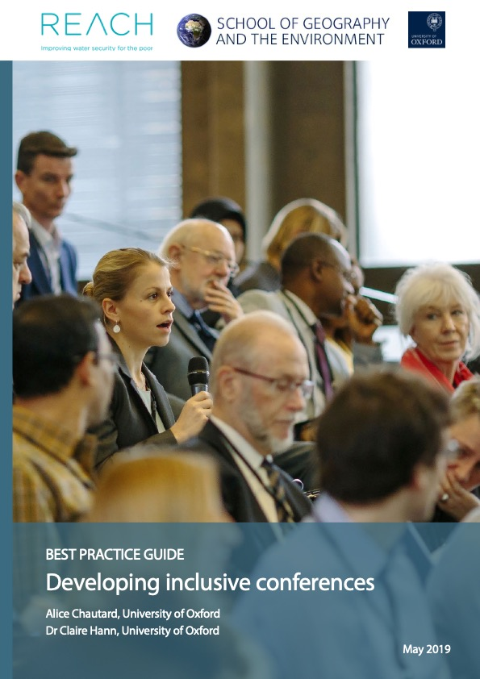
Learning from each other
Existing resources
Conversations with colleagues and peers
Engagement with diverse media
*Image: https://www.geog.ox.ac.uk/sites/default/files/2023-07/190522_Inclusive_Conference_Guide.pdf/
Notes:
We didn’t pull these ideas from thin air - we benefitted greatly from existing resources such as this excellent guide by Alice Chautard and Clair Hann from the University of Oxford, from conversations with colleagues and peers about their conference experiences - positive, negative and neutral - and from engagement with a diverse range of media, including media presenting different experiences to our own.
The Oxford guide is so good because it’s so clear, so concise, yet so comprehensive. I highly recommend it.

Slide 21
92%
of respondents said the conference was very accessible and inclusive.
Notes:
Having implemented the aforementioned EDI measures, the feedback we got for PGRiP was overwhelmingly positive, with the vast majority saying that the meeting had been very accessible and inclusive …

Slide 22
100%
of respondents said we met their access needs.
Notes:
… And every feedback form respondent saying we met their access needs.

Slide 23
The BGA Accessible Meeting Guide
Notes:
With the EDI strategies implemented at PGRiP clearly proving successful, the BGA got together and developed a set of guidelines for accessible conference planning.

Slide 24
The BGA guidelines are based on:
Successful strategies implemented at BGA PGRiP 2023.
Resources including “Developing Inclusive Conferences”, a guide by University of Oxford School of Geography and the Environment.
Policies of the Royal Astronomical Society (RAS) and Geological Society (GeolSoc).
Feedback from Diversity in Geoscience-UK (DiG) leaders.
Notes:
These guidelines were based not only on the work we did for PGRiP, but also on resources such as the Developing Inclusive Conferences guide I mentioned before, the policies of the BGA parent societies, and feedback from the leaders of Diversity in Geoscience-UK, the UK chapter of the International Association for Geoscience Diversity.

Slide 25
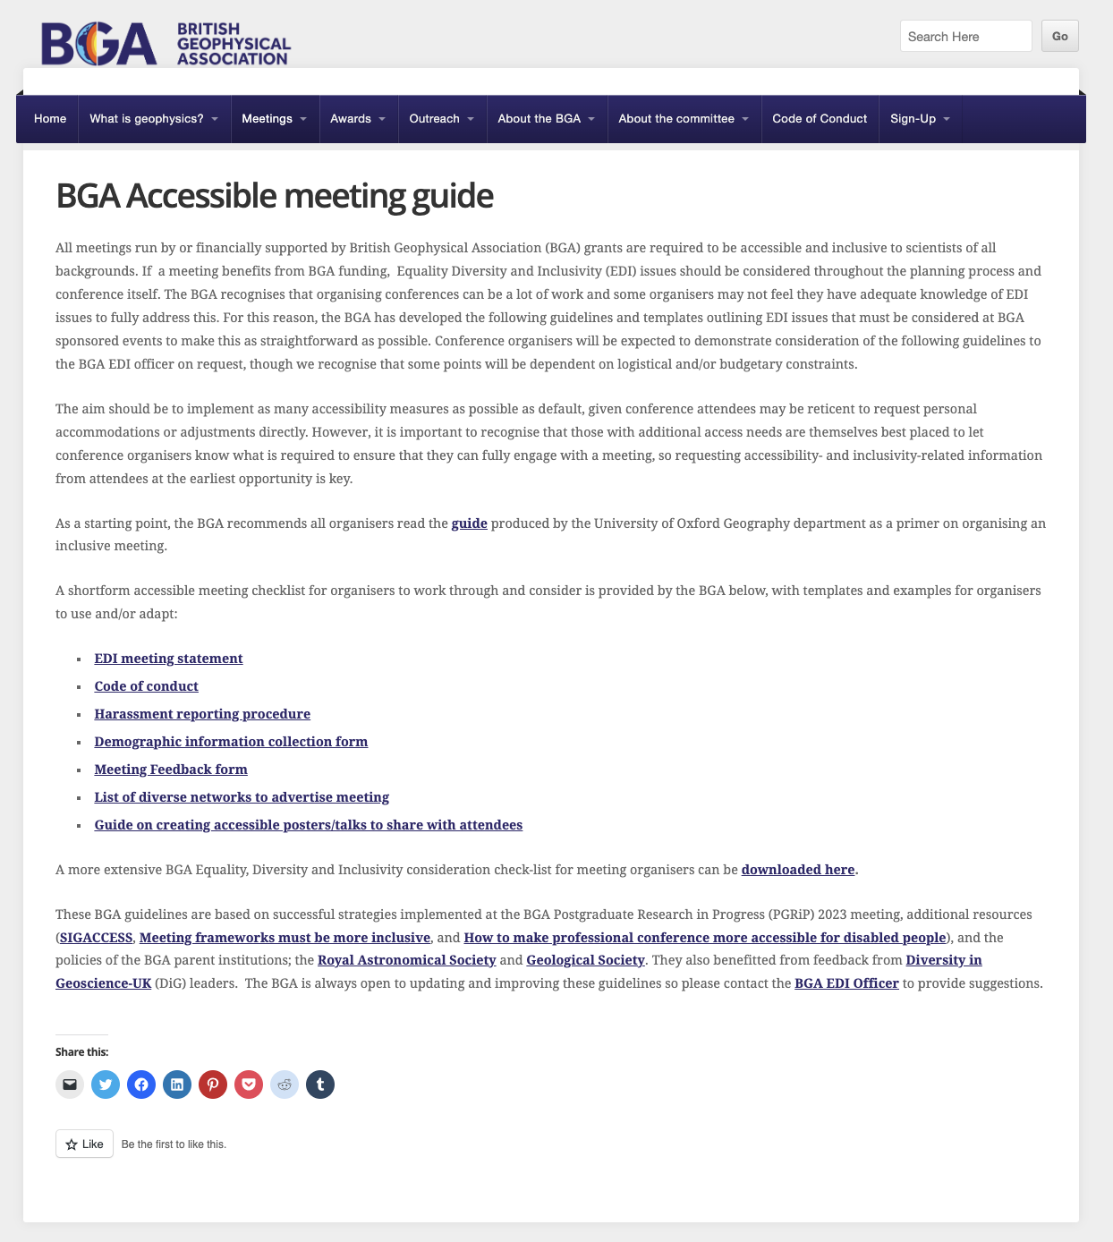
BGA Guidelines
Links to resources
*Source: https://geophysics.org.uk/bga-accessible-meeting-guide/
Notes:
Full details of the other resources used in the development of these guidelines can be found at the bottom of the page.

Slide 26
BGA Guidelines
EDI considerations are a requirement for BGA funding.
*Source: https://geophysics.org.uk/bga-accessible-meeting-guide/
Notes:
BGA states that the guidelines need to be followed by any conference organiser who wishes to benefit from BGA funding.
I understand that as busy academics, who may not have any EDI-specific training and for whom organising a conference one of many, many tasks that must be done, an ultimatum like this might feel really overwhelming at first.
It’s also very easy, when overwhelmed, or if you don’t feel it will affect you personally, to say “I’ll leave this to someone else”. Unfortunately, when this happens, it’s disproportionately people in minority groups who pick up the slack. Everyone can and should get involved – working together is the best way to make effective progress.

Slide 27
BGA Guidelines
EDI considerations are a requirement for BGA funding.
The guidelines should help make organising an accessible and inclusive meeting easier than ever.
*Source: https://geophysics.org.uk/bga-accessible-meeting-guide/
Notes:
The BGA committee know that many academics may be feeling daunted by EDI. This is why the guidelines, whilst very comprehensive, have been organised into bitesize pieces …

Slide 28
BGA Guidelines
Templates and examples for organisers
*Source: https://geophysics.org.uk/bga-accessible-meeting-guide/
Notes:
… and templates and examples have been provided for key documents such as the feedback form and Code of Conduct.

Slide 29
BGA Guidelines
The full guidelines
*Source: https://geophysics.org.uk/bga-accessible-meeting-guide/
Notes:
As well as this short-form list, the full guidelines are available for download on this page. We are now going to take a tour through the key guidelines to consider before, during and after your conference …

Slide 30
BGA Guidelines
The BGA guidelines are a living document.
*Source: https://geophysics.org.uk/bga-accessible-meeting-guide/
Notes:
… But before we start, I’d like to remind everybody that the guidelines are a living document. This means that BGA are open to improve upon and update the guidelines at any time – so if you think of anything that is missing, do please get in touch with the BGA EDI Officer, whose details I will provide at the end of the talk. I personally think that there is still a lot that could be added still.

Slide 31
Before the Conference
Notes:
So, before the conference.

Slide 32
Accessibility and inclusion starts within your committee.
The climate of your organising committee makes an impact on your event.
Don’t make assumptions about your committee members and colleagues.
Consider HR training on bias, safeguarding, and dealing with difficult situations.
Notes:
Accessibility and inclusion starts within your committee. A functional, cohesive committee, where everybody’s access needs are met, and as many demographics are represented as is feasible, can provide a solid foundation for planning an event that’s not only inclusive and accessible, but high quality in other regards.
Talk to your fellow committee members. If you feel comfortable doing so, talk about your experiences and offer each other support throughout the planning process. Don’t assume your fellow committee members all share your background – it is easy to fall into an uncomfortable “us and them” mentality.

Slide 33
Logistical Foundations
Notes:
With your committee assembled, it’s time to lay some logistical foundations.

Slide 34
Initial Logistics
Date and duration
Venue(s)
Hybrid options
Budget and sponsors
Notes:
This may seem like common sense, but you will need your date and venue to be inclusive and accessible to as many people as possible. You’ll also want to consider hybrid options – for example, streaming the conference, or using a tool like GatherTown to facilitate online networking, for those who cannot attend in person. Exactly what you choose and how you go about it will be interdependent with your budget - you’ll need to find sponsors and apply for funding.

Slide 35
Default Accessibility Measures
“The aim should be to implement as many accessibility measures as possible as default, given conference attendees may be reticent to request personal accommodations or adjustments directly …
Source: https://geophysics.org.uk/bga-accessible-meeting-guide/
Notes:
Making sure your venue and date are accessible is easier said than done, though. Different people have different access requirements. How do you know what’s going to be accessible for your attendees before they’ve registered and provided their access requirements?
The answer is, you don’t, and so you’ll need to implement as many accessibility measures as is feasible from the start.

Slide 36
Choosing your date
Avoid major religious holidays.
Avoid school holidays/weekends.
Consider university term dates.
Consider other events.
Notes:
This starts with choosing your date. It’s best to avoid major religious holidays so that you don’t inadvertently exclude people of particular faiths. School holidays are also best avoided, for childcare reasons.
Having your conference outside of university term dates can be a helpful way of securing cheaper accommodation and obviously also reducing the chance that attendees will have teaching commitments.
You’ll also want to check what other events are happening in your ideal date range, be that a clashing conference or a local event that might make accommodation and parking scarcer.

Slide 37
Choosing your venue
All locations must be accessible:
Accommodation
Social venues
Seminar rooms
Poster halls
Auditoriums
Notes:
When choosing your venue, as well as considering cost and suitability for the format of your meeting, remember to consider accessibility not just for the main venue, but also for accommodation if you’re providing it, and social event venues.

Slide 38
Venue Accessibility
Mobility (step-free access, parking spaces, seating in all areas, shuttles)
Toilets (closely located disabled & gender neutral)
Quiet spaces (for sensory breaks, prayer, breastfeeding, etc.)
Sound (microphones, speakers, hearing loops, interpreters, subtitles)
Remote access (livestreams, recordings, online poster repositories)
Notes:
The full guidelines contain a detailed list of venue accessibility examples, which I have summarised into 5 key points here.
Consider mobility-related requirements like step-free access, disabled parking, seating, and shuttles between venues if they’re far apart
Make sure your venue has disabled and gender-neutral toilets, and that they’re close to the centre of the conference. You don’t want people having to go three floors away to go to the loo.
Book multiple small rooms to be used by anyone who needs a quiet space to take a break, pray, breastfeed, or catch up on some work. We found that at PGRiP, even people who hadn’t specifically requested quiet space ended up using it.
Check your venue has an appropriate sound system, with microphones, speakers and hearing loops. Consider hiring sign language interpreters.
And make sure you’ll be able to effectively provide remote access to those who cannot attend in person. Platforms like Zoom can auto-generate subtitles, so streaming can double as subtitling for people both physically and virtually attending the conference.
Medical model vs social model

Slide 39
Removing financial barriers
Minimise costs for attendees
Provide fee waivers and grants
Provide childcare.
Notes:
Providing an online or hybrid attendance option at a reduced rate can be helpful for people who would not otherwise be able to afford to attend your conference.
To ensure as many people can attend in person as possible, though, try to minimise costes on, for example, venue hire and catering, and seek to maximise contributions from sponsors.
At PGRiP, we provided fee waivers to postgrads who could not otherwise afford to attend the conference, requiring their supervisor to state why they were not able to fund their student. We also gave out accessibility grants to carers and those with additional access needs, to help cover the additional costs of care, specific transport and accommodation.
Providing childcare, for example, an on-site creche, is an excellent move at larger conferences with the resources to do so.

Slide 40
Representation and inclusivity matter
Invite a diverse speaker/panel line-up that includes people who are underrepresented in your field, considering factors such as:
Gender
Ethnicity
Career stage
Career path
Disability
but be mindful of the extra burden this can place on invitees, who may not be able to accept all requests.
Notes:
Another way to foster inclusion is to give a platform to people who are underrepresented in your field. When you’re inviting speakers and panel members, as well as considering academic merit, think about gender, ethnicity, career stage and path, and disability. Ideally, you should have a diverse range of speakers from a variety of backgrounds.
However, bear in mind that some invitees may not be able to accept your invitation if they are receiving lots of requests.

Slide 41
First Contact
Notes:
With the basics organised, it’s now time to make contact with your would-be attendees!

Slide 42
Your Audience
Meeting should be advertised over diverse networks in diverse formats:
Email lists, e.g., JISCmail lists.
Social media, e.g., Bluesky, X (Twitter), LinkedIn.
Notes:
When advertising your conference, consider who you are reaching and how. Email lists can be a good tool, as can social media …

Slide 43
Your Audience
Meeting should be advertised over diverse networks in diverse formats:
Networks, societies and organisations within your specific sub-field.
Networks, societies and organisations representing groups underrepresented in your field.
Women in Physics Group
LGBT+ Physical Sciences Network
Notes:
… but you want to make sure you’re not stuck in a bubble. As well as reaching out to what you percieve as the broader community, get in touch with more specific networks and groups of scientists, particularly those representing groups that are underrepresented in your field. Some examples of such networks include the Blackett Lab Family, which is a group for black physicists, the Institute of Physics’ Women in Physics Group, and the LGBT+ Physical Sciences Network.

Slide 44
Key Details
Advertise these details as early as possible to assist attendees in planning, making care arrangements, etc.:
Dates and (planned) structure of each day, including catering plans.
Venue information, including layout map(s) highlighting toilets and quiet rooms.
Directions to venue(s).
Notes:
I apologise if this seems like common sense, but it’s explicitly stated in the guidelines, so I’ll say it anyway:
get a provisional schedule and full venue details out as early as possible.
Venues should be able to provide full access guides and floorplans. If they do not, push for them to provide these.
This will be a huge help for anybody needing to make additional arrangements.

Slide 45
Formatting your Resources
Example Text
Here is some example text.
How easy is it to read?
Example Text
Here is some example text.
How easy is it to read?
Example Text
Here is some example text.
How easy is it to read?
Notes:
There isn’t a one specific font, or universal combination of colours for text and background, that is accessible to everyone. However, the format you present that information in is of non-trivial importance. It might be tempting to use a “fun” font, but that may end up being less fun for, say, your visually impaired or dyslexic attendees!

Slide 46
Formatting your Resources
Example Text
Here is some example text.
How easy is it to read?
(Arial)
Example Text
Here is some example text.
How easy is it to read?
(Helvetica)
Example Text
Here is some example text.
How easy is it to read?
(Verdana)
Notes:
If in doubt, use simple, sans-serif fonts (e.g., Arial, Helvetica, Verdana). It’s also recommended that you avoid all-caps, underline and italics. Bold is best for emphasis.
Measures like this help everybody.

Slide 47
Formatting your Resources
Example Text
Here is some example text.
How easy is it to read?
(Arial)
Example Text
Here is some example text.
How easy is it to read?
(Helvetica)
Example Text
Here is some example text.
How easy is it to read?
(Verdana)
Notes:
Colour is also important. Let’s say you really love the idea of lime green and white text. Even with a clear font, it’s really hard to read, because the contrast ratio is so low. You therefore want to aim for high contrast between your text and background, including for hyperlinks and titles.

Slide 48
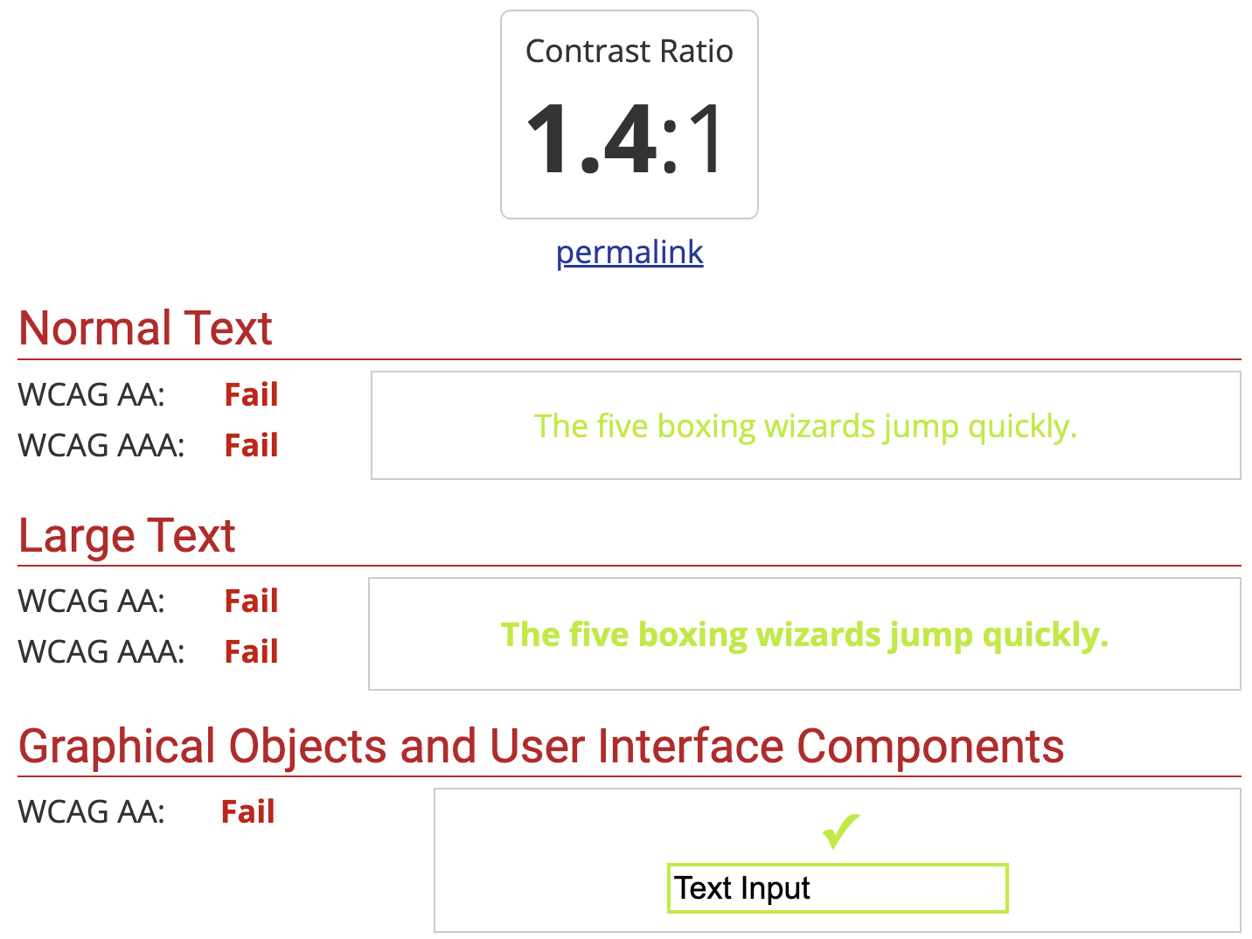
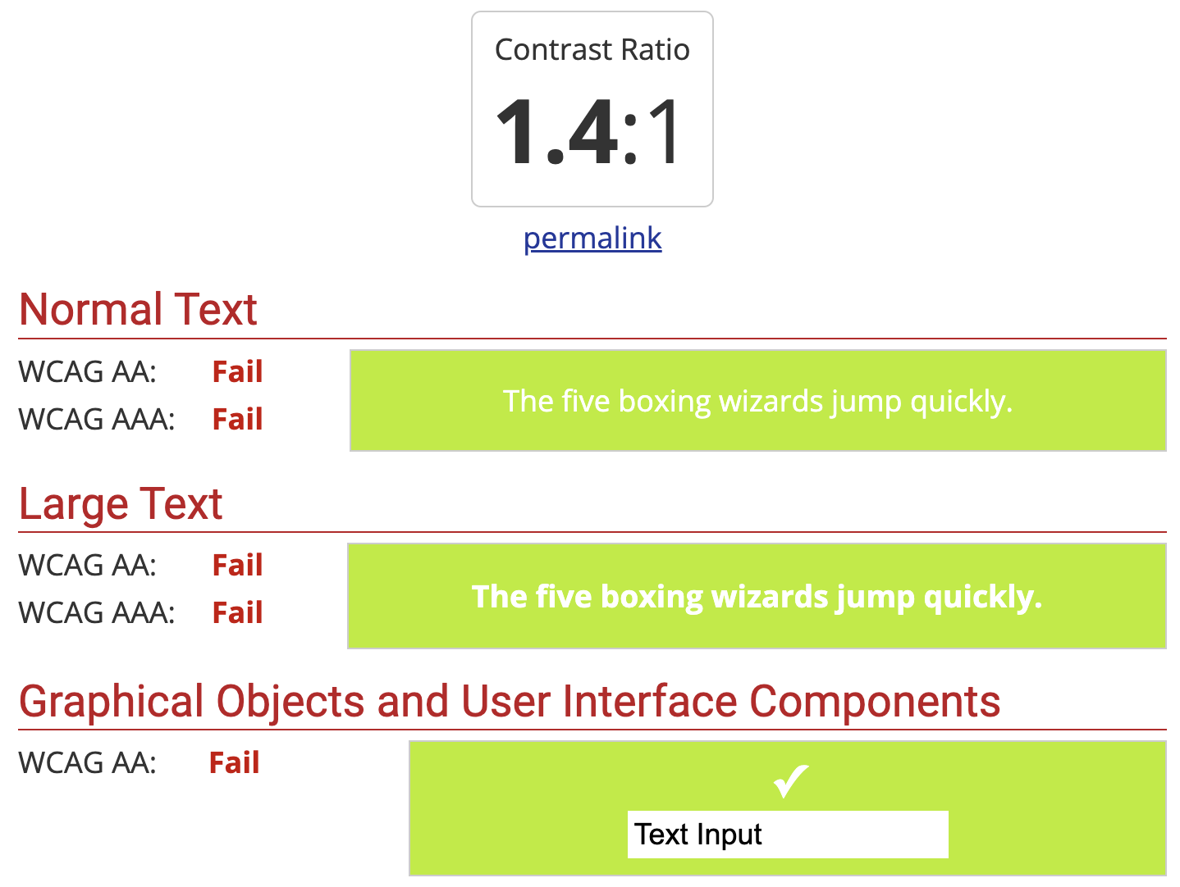
Formatting your Resources
Notes:
This is a screenshot of the WebAIM contrast checker, which is linked in the BGA guidelines. It gives a nice quantitative measure of whether your colour combination is accessible or not. As we can see, lime green fails the accessibility test for both white on green (click) and green on white.

Slide 49
Formatting your Resources
Example Text
Here is some example text.
How easy is it to read?
(Arial)
Example Text
Here is some example text.
How easy is it to read?
(Helvetica)
Example Text
Here is some example text.
How easy is it to read?
(Verdana)
Notes:
On the other extreme, dark green and white is more legible to most people ….

Slide 50
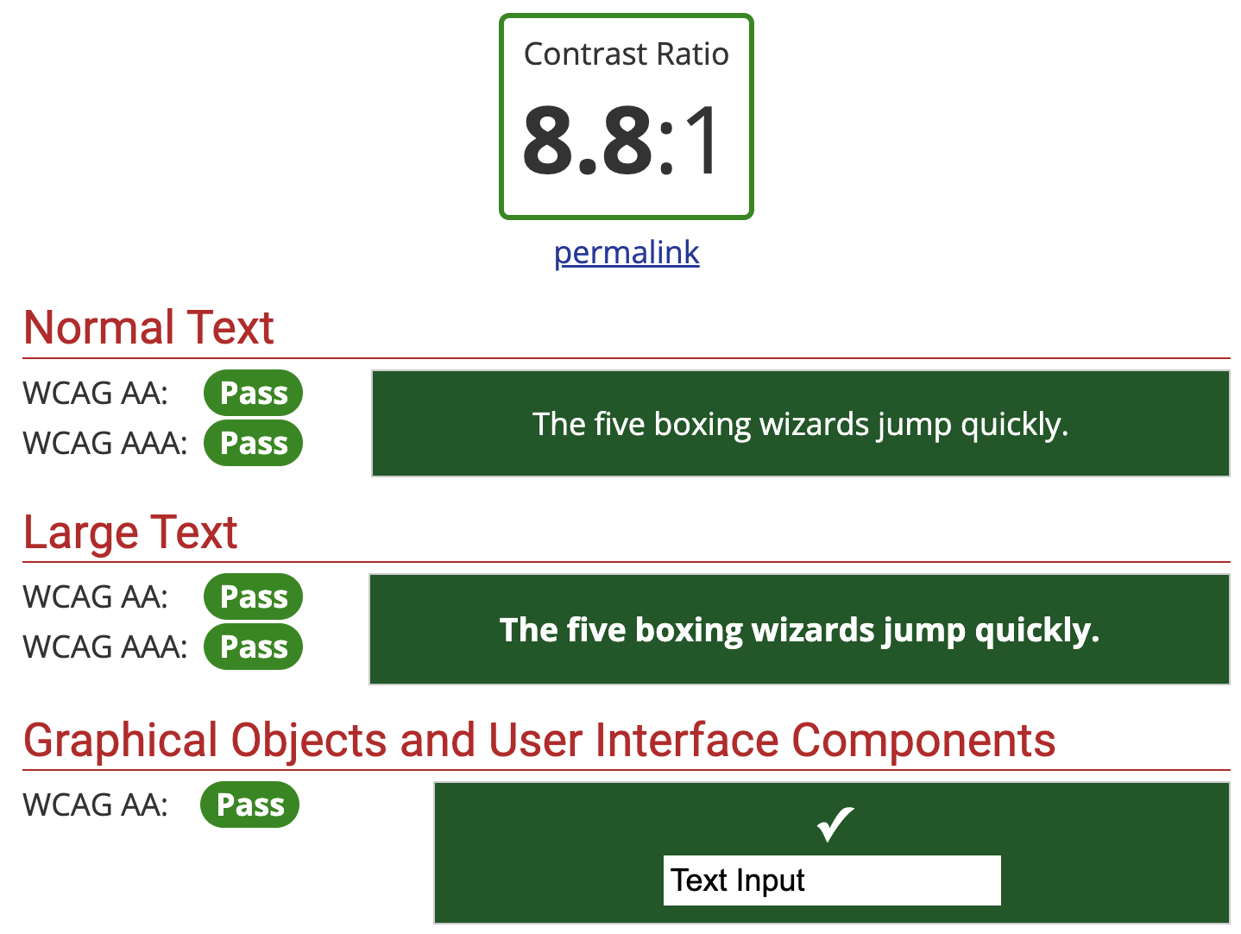
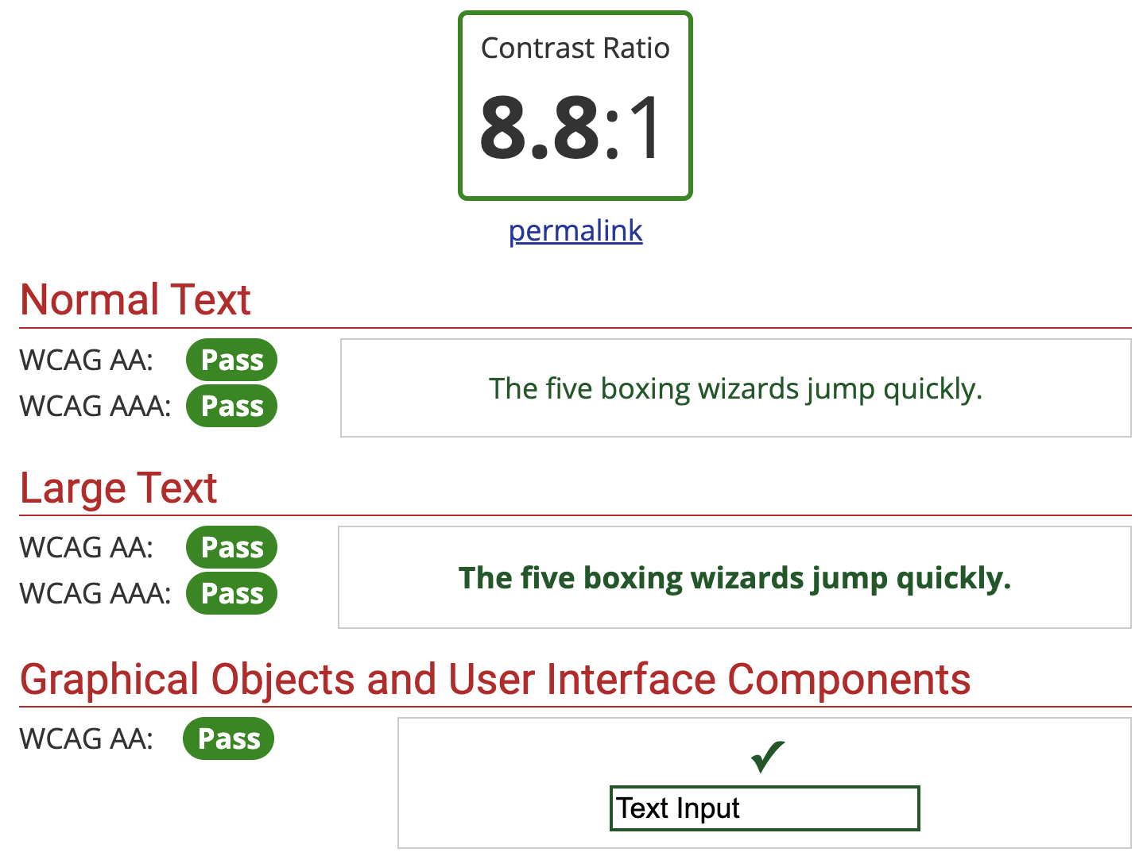
Formatting your Resources
Notes:
But as we can see, this is a very high contrast colour scheme, and though it passes the WebAIM test here, it can make reading more difficult for some people, especially those with dyslexia. Here’s for white on green (click) and green on white.

Slide 51
Formatting your Resources
Example Text
Here is some example text.
How easy is it to read?
(Arial)
Example Text
Here is some example text.
How easy is it to read?
(Helvetica)
Example Text
Here is some example text.
How easy is it to read?
(Verdana)
Notes:
Light grey or off-white with black text is cited as the ideal colour combination by many dyslexic people, but everyone has different preferences. If you were determined to keep using green, for example, there are shades that are better, such as this one:

Slide 52
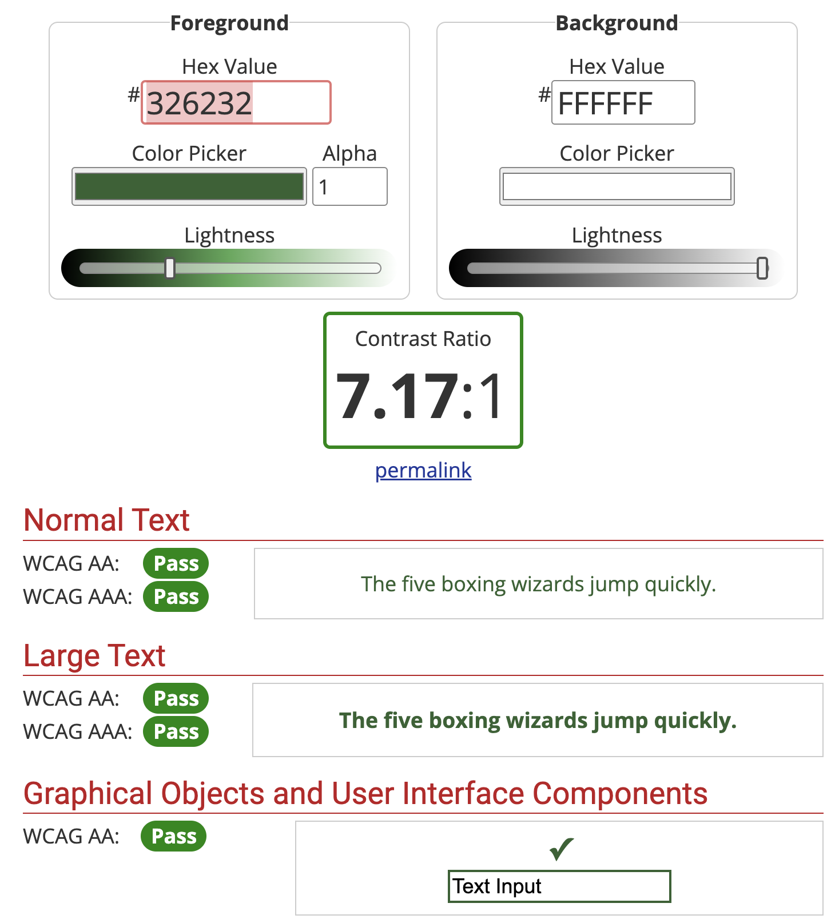
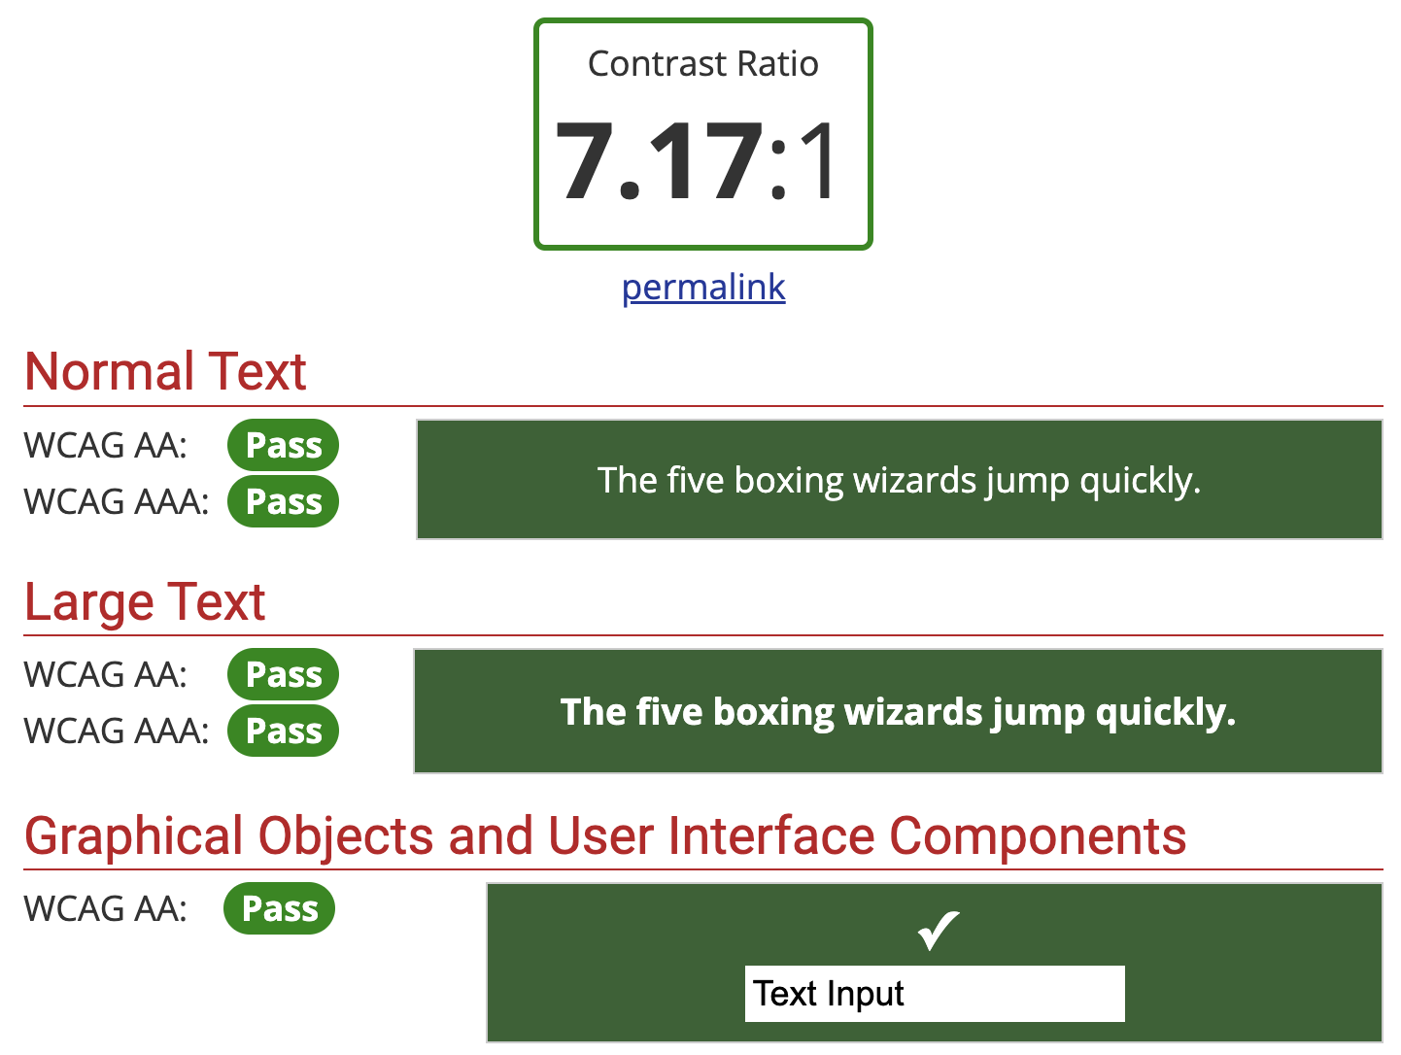
Contrast Ratios
Notes:
Here’s the contrast ratio for this new green with white, for white on green (click) and green on white.
As you can see, the WebAIM site lets you test different colours really easily via sliders, HEX codes, and a colour picker tool. Again, you can find details in the BGA guidelines.
• You can also test your content using online colour-blindness simulators – there are a couple recommended in the BGA guidelines.

Slide 53
Screen Readers & Editable
.doc / .html format.
Alt text.
Contents page / menu.
Notes:
Of course, even the most carefully chosen font and colour combinations won’t agree with everyone. That’s why providing editable versions of, say, your conference guide are so important.
Some users might be using screen readers to access information about your event, too, and will need formats compatible with these.
This is why the BGA recommends the distribution of Word Documents alongside any PDFs.
I know this may be painful for the LaTeX lovers amongst you to hear this, but don’t worry. I did some digging and found that it’s possible to export to html format, which is more likely to be screen-reader compatible than a standard PDF; information on this is provided in the resource list I’ll be linking at the end of the talk.
Alt text and image descriptions, especially for images containing text, will also benefit screen reader users greatly, as well as helping people who are, say, trying to view your content but are unable to load images due to poor internet connection; and having a contents page or menu means that that those using screen readers don’t have to listen to the entire document to find the section they need.
Offering alternative formats upon request is a smart move, too.

Slide 54
Abstract Submission
Organisers: provide advice for creating accessible poster and talk content to attendees with abstract acceptance.
Attendees: follow this advice to the best of your ability.
Notes:
You’ll want to recommend that your presenters follow these guidelines, too, so that the posters and talks at your conference are as accessible as possible. BGA has a specific set of guidelines you can provide when you confirm an abstract submission has been successful.

Slide 55
Default Accessibility Considerations
You know to be prepared for common accessibility requests such as alternative document formats, step-free access, quiet spaces, and disabled toilets, but …
Notes:
I’ve now covered quite a few accessibility measures you should be considering as default ….

Slide 56
“Accessibility is not something that is either true or false. It can only be measured in relation to a specific ability or scenario. Something can be accessible to some people while being inaccessible to others.”
Source: https://accessibility.blog.gov.uk/2016/05/16/what-we-mean-when-we-talk-about-accessibility-2/
Notes:
…. But as we know, making something 100% accessible to one person won’t make it 100% accessible for everyone, and may even negate accessibility for someone else.

Slide 57
Consult your attendees
“… it is important to recognise that those with additional access needs are themselves best placed to let conference organisers know what is required to ensure that they can fully engage with a meeting, so requesting accessibility- and inclusivity-related information from attendees at the earliest opportunity is key.”
Source: https://geophysics.org.uk/bga-accessible-meeting-guide/
Notes:
That’s why it’s so important that we consult our attendees, and find out what they want and need in order to fully engage with the conference.

Slide 58
Registration
Notes:
The easiest time to do this is at registration.

Slide 59
Consult your attendees
Request information from attendees re: access, care and dietary requirements.
Ask if attendees require the abstract submission and registration forms, conference guides, etc. in a specific format: e.g. printed, braille, editable digitally, compatible with screen readers, etc.
Allow attendees to select their own free-form name badge contents, including titles and pronouns.
Notes:
Registration is the perfect opportunity to ask your attendees if they have any access, care or dietary requirements. We provided a set of free-text boxes on the registration form for PGRiP which enabled people to write as much or as little as they wanted to about their situation and any accommodations they wanted to request.
As we just discussed, it can be helpful to offer alternative formats of forms and documents.
It is also good practice to give your attendees the opportunity to include their pronouns on their conference badge, or even to allow free-form contents rather than limiting people to first name, surname, and institution.

Slide 60
Demographic Data Collection
Collect anonymous demographic data at registration.
(BGA template available.)
Notes:
We learned from experience that doing demographic data collection after the conference did not get as large a turnout as we hoped. BGA recommend that you collect demographic data at the same time as registration (but separately, so that respondents can remain anonymous).

Slide 61
Consult your attendees
Provide an overview of default accessibility measures, e.g., venue floor plans and access information.
Notes:
We’ll just jump back to registration now and quickly go through the accessibility section of the PGRiP registration form. We start with an overview of the accessibility measures we’ve already put in place, then we ask attendees how else we can help them get the most out of PGRiP …

Slide 62
Consult your attendees
Ask attendees about any additional access requirements they have.
Notes:
By asking if they have any accessibility requests

Slide 63
Consult your attendees
Ask your attendees for their dietary requirements.
Notes:
Dietary requirements

Slide 64
Consult your attendees
Give the opportunity for attendees to make care-related requests.
Notes:
Or care related-requests. We also asked people to provide a phone number for an emergency contact. This form is just a starting point, and there are more specific questions we could and should have asked.

Slide 65
Consult your attendees
Required reading of code of conduct at sign-up, with check box
Notes:
Registration finishes with the requirement that attendees read and agree to the Code of Conduct.

Slide 66
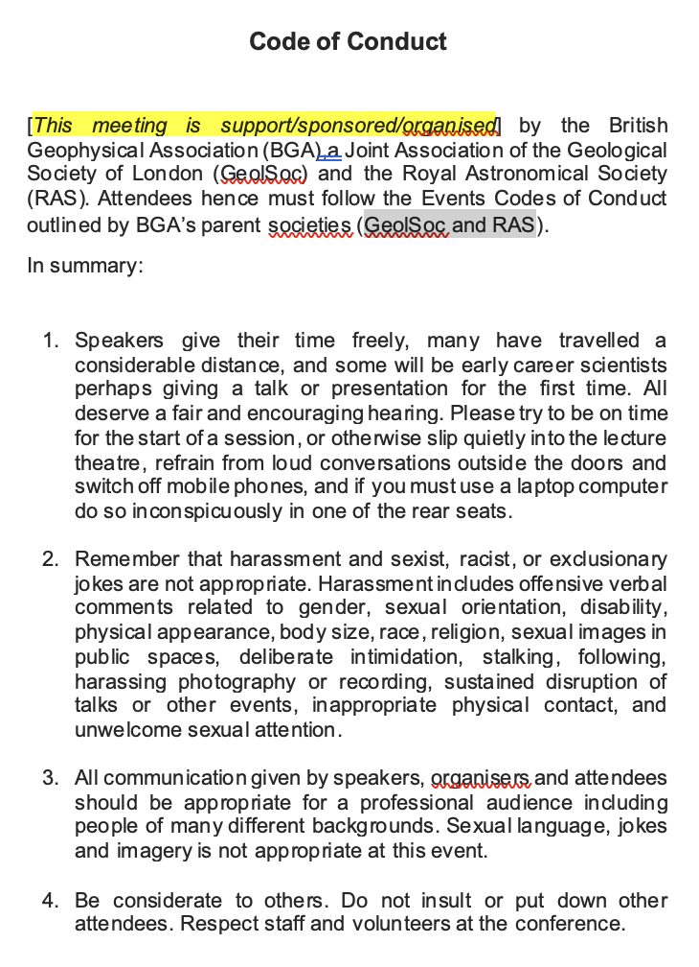
Code of Conduct
Ensure all attendees are familiar with the Code of Conduct.
Include a clear reporting strategy and consequences for breaches.
(Full BGA template available online.)
Notes:
Having a clear Code of Conduct with clear consequences reduces any doubts anyone might have about what is appropriate conference behaviour and what is not, and provides a framework for the identification and reporting of harassment and other incidents.
At PGRiP, we reminded people of the Code of Conduct in the welcoming remarks. We also made sure everybody was aware of what to do in the event of a breach of the code …

Slide 67
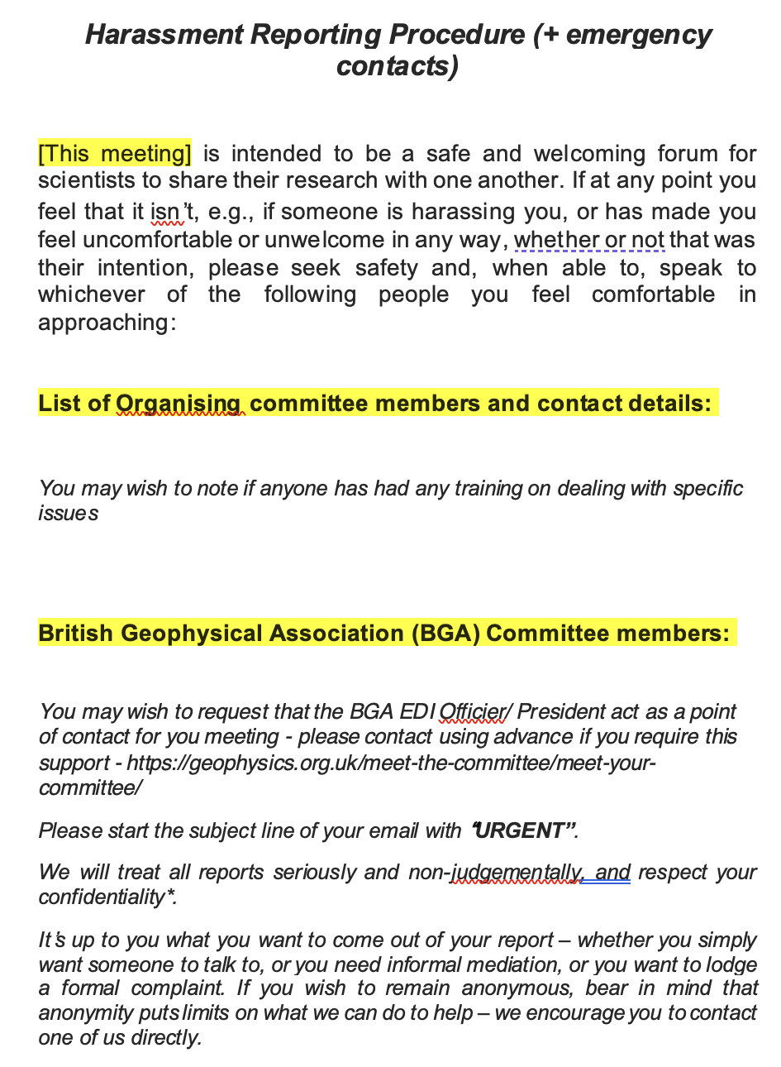
Harassment Reporting Procedure
Ensure reporting contacts have sufficient training to deal with any serious incidents.
Anonymity – consider pros and cons.
(Full BGA template available online.)
Notes:
… and what to do if they experienced harassment or any behaviour that made them feel unwelcome or uncomfortable.
I won’t go into the full details of the Code of Conduct and Harassment Reporting Procedure right now, but I will say that you should have a couple of people as designated contacts in the event that anything does go wrong, and that those people should have some training on how to handle anything serious. This should be available from your institution.

Slide 68
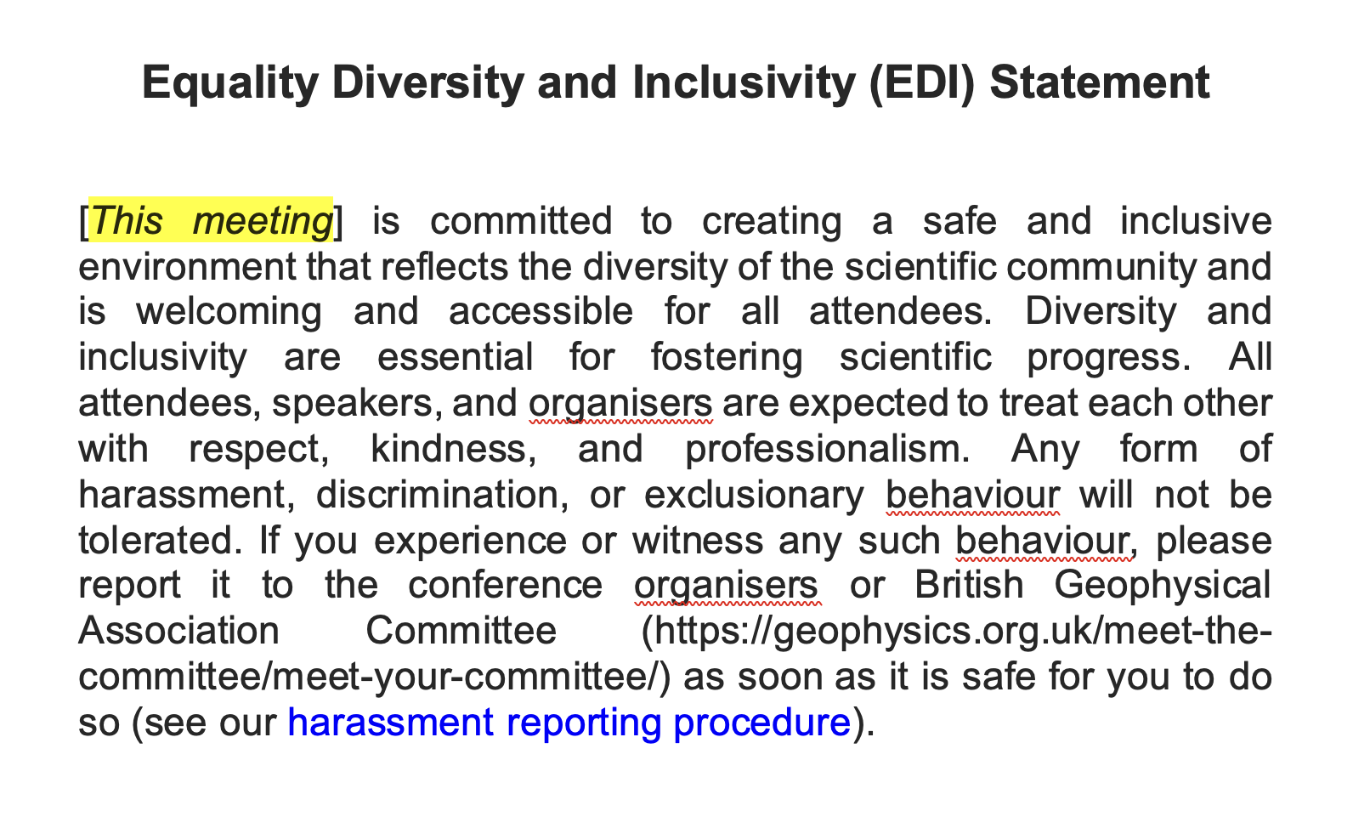
EDI Statement
Notes:
As well as templates for the Code of Conduct and Harassment Reporting Procedure, BGA provides this little EDI statement template. An EDI statement is a simple way to state your intention to be an inclusive and welcoming space, and is a good first step in fostering a positive conference ethos.

Slide 69
BGA Guidelines
Templates and examples for organisers
*Source: https://geophysics.org.uk/bga-accessible-meeting-guide/
Notes:
All of the templates we just looked at are available on the BGA accessible meeting guide page.

Slide 70
It will be worth it!
Notes:
When we were organising PGRiP, I had to push surprisingly hard for a lot of the EDI considerations that are now part of the BGA guidelines to be accepted. People told me that ‘no one would notice’ either way. Funnily enough, people did notice, and they did voice their appreciation.
The next couple of slides show feedback we got from PGRiP to remind ourselves that considering EDI and accessibility is really worth it.

Slide 71
Feedback
“I was pleased at the recognition of EDI and actually felt that the speakers were diverse and from a great range of backgrounds.”
BGA PGRiP 2023

Slide 72
Feedback
“Each session being just over an hour was great for reducing burnout.”
BGA PGRiP 2023

Slide 73
Feedback
“It felt very inclusive, with considerations on dietary requirements, activities, as well as a quiet room to allow a space for anyone who wanted time to decompress during the event.”
BGA PGRiP 2023

Slide 74
At & After the Conference
Notes:
So, it’s here! The first day of your conference!
This second half of the talk is much shorter than the first – you will now have done most of the work, and a lot of what we spoke about before carries through to the conference itself and beyond.

Slide 75
Setting up the venue
Ensure you and the venue are on the same page about who is setting up what.
Be prepared for last-minute accessibility requests.
Ensure rooms are well-labelled and signposted.
Charge microphones etc.
Notes:
Communication between you and the venue is key to make sure things go smoothly. Who is laying out your poster boards? Is that person aware of access requirements poster presenters and viewers may have?
Someone’s access needs could change last minute – do you have flexibility built in?
This is also the time to make sure your venue is clearly labelled up.

Slide 76
Welcoming your Attendees
Introduce key people to your attendees (the committee, any specific contacts).
Give directions to different areas of the conference.
Go over the basic schedule.
Notes:
Communication with your attendees is vital too. Introduce key people, such as the committee, first aiders, and your designated harassment reporting contact. Talk though the layout and schedule of the conference, and give people the chance to ask questions.
Make sure people have their alternate format documents

Slide 77
Hybrid Format
Test your livestream and online poster repository.
Consider how you will balance audience questions.
Are conveners happy with the tech?
Notes:
People joining your event online are just as much a part of it as people who are attending in person. It’s awful when the online audience seems like it’s just an afterthought.
Be sure to test out all your tech before the event starts, and make sure your session conveners are comfortable navigating the online conference space, be it on zoom, teams, or another platform. Either check that they’ll be okay handling technical issues, or if they’re not, have someone on hand who can help.
Actively engaging with your online participants will make the event a much more inclusive space.

Slide 78
Audience Questions
Consider letting early career researchers ask questions first.
Conveners, select questions from a diverse range of audience members.
Keep an eye on the time!
Notes:
This includes when the audience are invited to ask speakers questions post-talk.
Some other things you might want to consider doing are reserving the first couple of questions for early career researchers, and, just as BGA encourage the selection of a diverse range of speakers, selecting questions from a diverse range of audience members.
Conveners should be advised to keep an eye on time to ensure one person isn’t taking all the Q&A time – maybe gently suggest that a conversation continues in the participants’ own time if things are getting prolonged!

Slide 79
Getting Feedback
Helps you know your hard work was worth it.
Pinpoints what you and other conference organisers need to improve in future.
Attendees, please give feedback! It really helps.
Notes:
With the conference drawing to a close, now is the time to ask your attendees for feedback. As mentioned earlier, BGA has a template Feedback form that organisers can refer to. Attendees, even if your only comment is that the conference was fine, please leave feedback still!
Not only does feedback help organisers know their hard work was worth it, but it can shine light on things they may not have managed to do to as high a standard as the rest of their organisational efforts.

Slide 80
Feedback
“It would have been good if there were some more accessible plugs in the actual talk space for laptops etc.”
BGA PGRiP 2023
Notes:
Some of the ”negative” feedback we got for PGRiP included requests for plug sockets,

Slide 81
Feedback
“… finding my way to the ECCI on the first morning … Google Maps took me around the back to a fence I couldn't cross! Perhaps a slightly more detailed map or directions in the handbook would have been helpful here.”
BGA PGRiP 2023
Notes:
Better directions to the venue,

Slide 82
Feedback
“Don't think catering needs to be meat-free. Would have been good to have the slide clicker working throughout.”
BGA PGRiP 2023
Notes:
for broader catering options, and for a slide clicker.
Whilst this was the only comment we had about lack of meat, for future events with a vegetarian menu, we'd let people know this would be the case in advance in case they specifically wished to request meat options as a dietary requirement. PGRiP was meat free for environmental reasons.

Slide 83
Using Feedback
Pass it on to future organisers.
Apply it yourself.
Notes:
This feedback, good and bad, has all been passed on to next year’s PGRiP organisers, and was also a part of the development of the BGA guidelines that we have just explored together.

Slide 84
Wrapping Up
Examples in this talk ≠ exhaustive.
Communicate, listen, engage.
Notes:
With that, we’ve made it through the BGA accessible and inclusive conference guidelines. If you feel overwhelmed, don’t worry - this is a year’s work squashed into less than an hour. This is a learning curve for all of us, me included.
It’s worth mentioning that the examples in this talk aren’t exhaustive. The BGA guidelines online are much more detailed and extensive, and even they don’t cover every scenario – so whilst they are a wonderful springboard into becoming more aware of what you can do to foster a more accessible and inclusive conference environment, there is so much to learn from elsewhere, whether that’s from each other, from other resources, or from your own experiences.
Even if you aren’t anticipating planning a conference yourself any time soon, I strongly encourage everybody to go and at least check out the BGA’s guide to accessible presentations and posters, and the Oxford University conference guide I mentioned at the start of the talk.

Slide 85
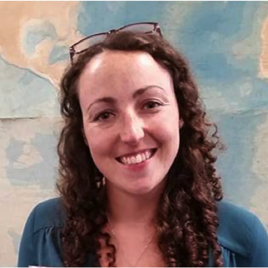
Acknowledgements
Jenny Jenkins, Andrew Curtis, Alison Stokes from DiG-UK, and everyone else on the BGA committee who contributed to the BGA Accessible meeting guide.
Ben Fernando, RAS Committee on Diversity in Astronomy and Geophysics 2022, who advised on the BGA PGRiP 2023 Code of Conduct and Harassment Reporting Procedure.
The BGA PGRiP 2023 committee: Heather Kennedy, Frederik Dahl Madsen, and Aideliz Montiel Alvarez.
The IPPP for inviting me to give this talk!
Jenny Jenkins
BGA EDI Officer
Department of Earth Sciences
University of Durham
Andrew Curtis
BGA President
School of Geosciences
University of Edinburgh
Notes:
The work I just presented was not just my own. I would like to thank Jenny Jenkins, the BGA EDI officer, Andrew Curtis, the BGA president, and the rest of the BGA committee for their work on the BGA Accessible meeting guide; Ben Fernando for his advice on the PGRiP Code of Conduct and harassment reporting procedure; the rest of the PGRiP committee, Heather from Aberdeen and Fred and Aideliz from Edinburgh; and the IPPP for inviting me to speak today!

Slide 86
BGA PGRiP 2024
Abstract submission is open until Friday 28th June.
Postgraduates in planetary and lunar sciences are welcome to submit!
Registration opens in July.
www.pgrip2024.co.uk
Notes:
I’d also like to invite any students whose work borders on geophysics to submit abstracts for BGA PGRiP 2024, which will be hosted by Imperial at the end of August. We’d love to have as many different voices as possible and everyone would be thrilled to find out about your research!

Slide 87
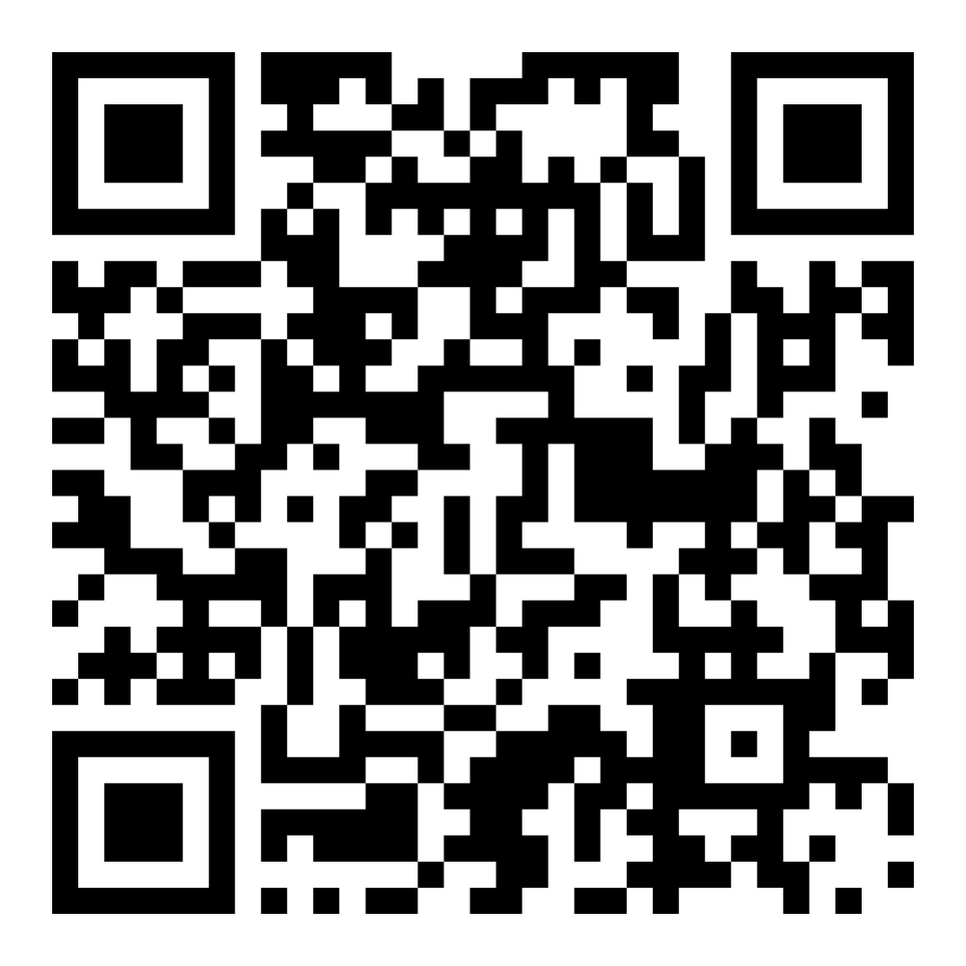
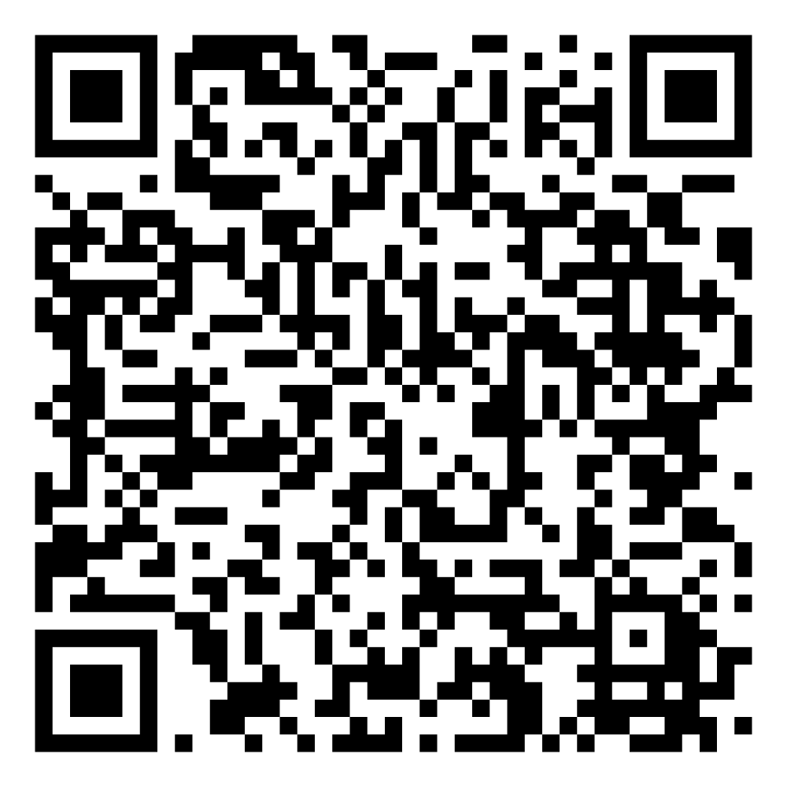
Resources
BGA Meeting Guide
Further Resources
Notes:
And I will leave you with these QR codes, which will take you to the BGA guidelines we’ve been talking about, and other resources referenced in this talk.
Thank you very much for having me, I’m happy to take questions!

