Slide 1
Sequestered Conformal Anomaly Mediation (SCAM)
LR w/ Michael (Mick) Nee

Slide 2
Introduction
Supersymmetry somewhat out of fashion
Not found at LHC
Been well studied
But
Essential to string theory
Likely essential to stable vacua
Relevant to some axion models
Tool to study strongly interacting theories

Slide 3
Intro Continued
Supersymmetry breaking even less fashionable
Messy and unsatisfying
Need both to break susy and to communicate it
Often flavor a probem when susy broken
But essential and interesting questions remain
How to stabilize moduli
Moduli a feature of superymmetric theories
How isolated can SUSY breaking be
Can superpartners be protected from supersymmetry-breaking

Slide 4
Anomaly-Mediation
Anomaly mediation seemed to address latter
Idea is that gravity mediates supersymmetry breaking universally
Always suppressed by gravity scale
In extra-dimensional context usually suppressed by volume
Conformal compensator otoh couples to any violation of 4d scale invariance, no matter where in space
So if conformal compensator has an F term, susy breaking loop-level masses for all
Seems NOT suppressed by size of extra dimension
More universal

Slide 5
Anomaly Mediation
Superpotenttial
Kahler potential but for sequestering f more natural
Conformal compensator
Introduces spurious scale symmetry
Plays important role
Potential has kinetic term
Contributions from superpotential, gauge interactions

Slide 6
SUSY Potential and AM
Notice the unique negative contribution

Slide 7
Compensator F term
So we see that in the presence of a nonzero superpotential, the F_{C} term turns on
Value determined to cancel supersymmetry breaking energy to get flat space.
Notice that F_{C} really has nothing to do with susy breaking. It’s value is determined by susy breaking but its source is whatever generates negative energy through F_{C}.
This leads to predictive susy breaking masses.

Slide 8
Take gaugino mass as an example
Important point is that masses through scale dependence
Virtually guaranteed in a physical field theory
Mass proportional to beta function
Proportional to F_{C}

Slide 9
AM Most Interesting When Sequestering
AM suppressed by gravity, loops
If other sources of communication of SUSY breaking those likely dominate
AM might however be dominant source of gaugino mass in theories without singlets Randall, Sundrum/ Giudice Luty, Murayama, Rattazzi
But unlikely to be dominant source of scalar mass in general
Expect direct interactions in Kahler potential
Exception is sequestering; no direct interactions Randall, Sundrum
Would be fine-tuned unless motivated by an extra dimension
So we study anomaly mediation in a five-dimensional setup

Slide 10
Sequestering and an Extra Dimension
Without sequestering
If this structure, direct interaction forbidden
Motivation for this structure is locality
Most natural with extra dimensions and branes
Need to communicate susy breaking through an extra dimension

Slide 11
Raises Several Puzzles
When you have nontrivial geometry, why doesn’t communication from 5d F- term depend on position (that is wavefunction)?
4d result seems robust
Physicists have assumed negative energy generated by superpotentials
on branes!
Seems natural; sequester susy breaking and sequester superpotential
But: if you “generate” negative energy on one brane, why isn’t susy breaking spectrum sensitive to location
Also we know 4d cc same on every slice if warped; how does theory account for this?

Slide 12
More Puzzles
As we will see you naturally have no-scale N=2 in bulk. Equation of motion for modulus sets F_{C} to zero!
Has been argued this implies F_{C} term depends on stabilization mechanism for the extra dimension
By this logic, can’t just ask about F_{C}; need to know what stabilizing field is doing too
Also 5d with branes is a singular space
Do delta functions affect the answer?
Final question is why has no one actually worked it out fully in 5d, given these uncertainties !!

Slide 13
Toy Models
The answer to last question is probably that it’s messy
And didn’t seem necessary
4d Theories seemed to suffice
We will see this is not the case
To illustrate, I’ll present two toy models
Model I: Problem from No-Scale
Model II: Problem from singular space

Slide 14
Toy Model I: Problem from No-Scale
No-scale structure physically motivated
Lowest component of Sigma is the radion
M_{p}² =M³ r
So expect f scales like Sigma
Recall f=e^{-K/3}

Slide 15
Toy Model I: Compensator F term Vanishes!

Slide 16
Toy Model II: Potentially Dangerous Singularities
Break No-Scale; eg at loop level
Proportional to β as you would expect
Potential no longer vanishes
However, it is badly singular

Slide 17
How to Handle Singular Terms?
Standard approach is to use eft at level of superpotential
Integrate over y; seems fine
However, standard eft applies at level of potential
There is no justification for this procedure (it’s wrong)
Alternatively add counterterm
But delta squared counterterm leads to higher order in delta
Nonrenormalizable theory with arbitrary counterterms
Our approach; as with nonsusy theories solve for zero modes first
Apply same approach to auxiliary fields
Solve for bulk fields and integrate them ouut
But solve for auxiliary fields too
Derive potential of low-energy theory
What we would do in non-SUSY theories

Slide 18
Why Nontrivial
Fields sourcing with delta function conventional
Fields are dynamical, delta function source and solve equation of motion for bulk field
Auxiliary fields different
Nondynamical
Delta function in F term remains
At end all squares of such terms have to cancel
Usually in each F term individually
Which means sourcing bulk fields to cancel delta functions
We will however see that it is possible for delta squared to cancel in potential
When loop corrections break no-scale form, requires stabilizing bulk fields that adjust

Slide 19
Heads up on bottom line: Implication
Boundary superpotentials generate zero or positive energy contributions
Not negative energy as expected from superpotential
So not responsible for 4d anomaly mediation!
But can generate susy breaking, “5d anomaly mediation”
4d Anomaly Mediation derives from bulk superpotential

Slide 20
However
Can get brane anomaly-mediation in 5d
Suppressed by breaking of no-scale structure
Such terms have to be added explictly as susy-breaking terms in low-energy theory
Note that compensator roles for anomaly-mediation and generating negative energy can decouple in 5d theory
When this happens won’t be captured in 4d EFT

Slide 21
We now see how this works
Also see how brane superpotentials sometimes act as sources (even if nominally field-independent!
See what is needed for negative energy
Key will be breaking no-scale structure in bulk and bulk superpotential
Note difference to what is generally assumed

Slide 22
First: Add Source Terms to Stabilize Generalizes Goldberger-Wise to SUSY

Slide 23
Find Background Solution
SUSY GW Stabilization!

Slide 24
SUSY GW
Found a 5d supersymmetric solution for particular value of r
If additional perturbations—energy for example—one has a nonsusy solution
Then see full solution to second order eq (as with nonsusy)
Necessary to satisfy both boundary conditions
Supersymmetric if relation above satisfied and model has no additional terms
Can also see in 4d: 4d EFT is mimimized for susy value of r

Slide 25
Now Add Boundary Superpotentials
Nonzero radion auxiliary
This leads to Scherk-Schwartz supersymmetry breaking
Pomarol, Marti
F_{Σ} ~W, F_{C}~0
No-scale still preserved so energy vanishes
Since we are interested in anomaly mediation
Need to break no-scale
Here we do it with a loop correction term

Slide 26
Issue here is δ squared terms
Because of form of no-scale potential (F_{C}⁺F_{C}+F_{C}F_{Σ}+hc)
F_{Σ} can turn on when F_{C}=0 (when F’s~δ(r)
Now with β term F_{Σ}⁺F_{Σ}
So F_{Σ}induces δ squared; need to eliminate
We need hypermultiplet fields to turn on or adjust
Find both compensator and radion have nonzero vevs
But still zero energy at minimum!

Slide 27
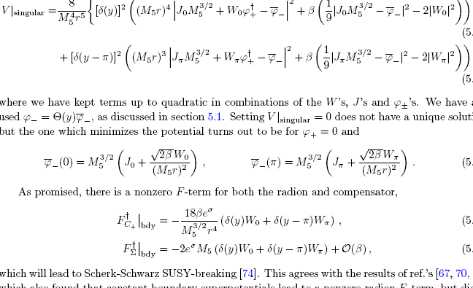
Solve in presence of perturbation

Slide 28
Effective Potential
Perfectly well-defined solution
Just not what we want/expected
Note interesting phenomenon characteristic of Scherk Schwartz
We broke supersymmetry but can still find zero energy minimum
This is true even though we broke no-scale with beta!
Means more work if we want to get negative energy minimum (to cancel positive susy breaking energy)
Also note boundary superpotential acting as a correction to source term

Slide 29
Even Cooler
We will show how to get what we want (negative energy) shortly
But for now note the interesting phenomenon: Sourced a field with a constant superpotential
Let’s turn off J’s and see if we can just source with superpotential alone (even though superficially field-independent!)
Answer is yes and yields a supersymmetric stabilization

Slide 30
Superpotential as Source
Set Js to zero for now
Potential (without breaking no-scale)
Clearly we can eliminate singularities with zero fields
But we eliminate potential too in the process!
Result of no-scale potential
So we need to break no-scale
Can happen naturally at loop level

Slide 31
Superpotential as Source -with No-Scale Breaking
We can’t solve all F terms=0 but can solve delta squared term in potential vanishes!
W plays role of J!
SUSY soln so again not neg energy

Slide 32
Status…
We found a viable model with loop no-scale breaking and superpotentials on branes
But that did not lead to negative energy

Slide 33
Now Finally: Negative Energy
Reminder that conventional 4d anomaly mediation relies on negative energy that sources FC^2~V, where V is negative energy cancelling positive susy breaking energy
We clearly need two things
Break No-Scale
Bulk superpotential
Solely boundary superpotentials doesn’t work
We present two types of breaking:
I: β kinetic term correction (as above) and W_{bulk}
II: W_{bulk} and condensate

Slide 34
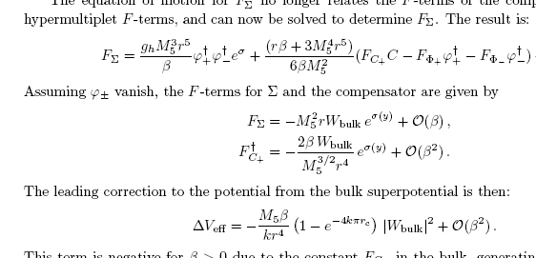
Breaking No-Scale With Loop Corrections
Add correction to kinetic term
Notice here we are assuming stabilizing through SUSY GW
As before, F_{C} no longer contrained to be ~0
F_{Σ}equation relates F_{C} to βF_{Σ}
Also include constant bulk superpotential
Success! Negative energy

Slide 35
Alternative: Break No-Scale: Gaugino Condensate
Previous model assumes that radion independenty stabilized
One important lesson is that stabilizing radion is not the same as breaking no-scale
Next model we stabilize both at same time
Add gauge group to bulk
Assume gaugino condensation
Strange in 5d
Makes sense only at low energy below KK scale
So 5d bulk potential constant related to zero mode

Slide 36
Model
Also include constant superpotential in bulk
α indicates no-scale breaking

Slide 37
Potential at minimum
Note FC, negative energy both set by no-scale breaking gaugino condensate
Also note we can stabilize radion without hypermultiplets
Again, success; negative energy

Slide 38
Gaugino Condensate with Brane Superpotential
Minimum like before
But here we find supersymmetry breaking
Surprising aspect is that integral of F_{Σ} vanishes
So low-energy theory very similar to bulk superpotential case

Slide 39
Effective Theory and 4d Anomaly Mediation
Note that the only case where our low-energy theory matches “naïve EFT” where we integrate over superpotential is flat extra dimensions
Low-energy (4d) theory remains no-scale
Superpotential constant in bulk
All other cases would give wrong low-energy theory

Slide 40
EFT and Anomaly Mediation
Also note that boundary superpotentials can yield brane field “anomaly mediation”
Not communicating between branes, just local to wherever W sits
Such terms must be included explicitly in 4d theory
Same when F_{Σ} nonvanishing

Slide 41
4d EFT
However, 4d EFT does generate conventional anomaly mediation
We see how and why it accommodates universal form
In the 5d theory associated with constant superpotential and constant F_{C}
Up to possible warp factor

Slide 42
So Back to Original Question
How is 5d result consistent with 4d EFT
Answer is 4d theory reproduces only anomaly-mediation that arises from a bulk superpotential
Since has definite y dependence not so surprising it can be consistent with single FC in 4d theory
However, in 4d theory FC determines both anomaly-mediation and negative energ
Not true in 5d theory
There are nonzero F terms whose effects must already be included in 5d theory
Boundary FC or Fsigma
These supersymmetry breaking terms not generated in 4d theory

Slide 43
Comment on KKLT
This model was not KKLT
We had radion, gaugino condensate in bulk
KKLT has brane radion, brane condensate
They assume no-scale structure of bulk not present
Integrated out all other moduli
We are doing a toy model to work this out too
Seems you do get SUSY breaking in our toy model, unlike claim from 4d EFT (stay tuned)

Slide 44
Conclusions
In reality, we did full N=2 broken to N=1 on orbifolds
Showed constraints imposed by bulk no-scale structure
Included breaking through loop effects or gaugino condensate
Found EFT must be derived at level of potential
Exception flat case when supersymmetry preserved
Also included superpotential
Showed needed superpotential to be in bulk to get negative energy
Boundary superpotentials are essentially sources (but can also lead to Scherk Schwartz supersymmetry breaking
Associated with positive or zero energy
For future, points to correct way to deal with supersymmetry on singular spaces, including string theory

