Slide 1
Sea dynamics in the octupole moment of baryons
Preeti Bhall
(Supervisor: Prof. Alka Upadhyay)
Department of Physics and Material Science
Thapar Institute of Engineering and Technology, Patiala, India
1

Slide 2
Overview
Internal structure of hadrons
Quark Model with ‘Sea’
Statistical model
Electromagnetic properties
Results and discussion
Summary
Department of Physics and Material Science, Thapar Institute of Engineering and Technology, Patiala
2

Slide 3
Internal structure of hadrons
Hadrons are the composite particles made of quarks (baryons - qqq, mesons - q$\overline{q}$), governed by Quantum Chromodynamics (QCD).
QCD is the theory of strong interactions that describe the internal structure and dynamics of hadrons in terms of quarks and gluons degree of freedom.
The study of internal structure is one of the most challenging area in particle physics and very complex to understand.
The electromagnetic Form Factors (FFs) are the most fundamental quantities for probing the internal structure of hadrons.
They characterizing the EM properties such as masses, charge radii, quadrupole moment, and other high-order multipole moments and provide information about their inner geometrical arrangement.
Department of Physics and Material Science, Thapar Institute of Engineering and Technology, Patiala
3

Slide 4
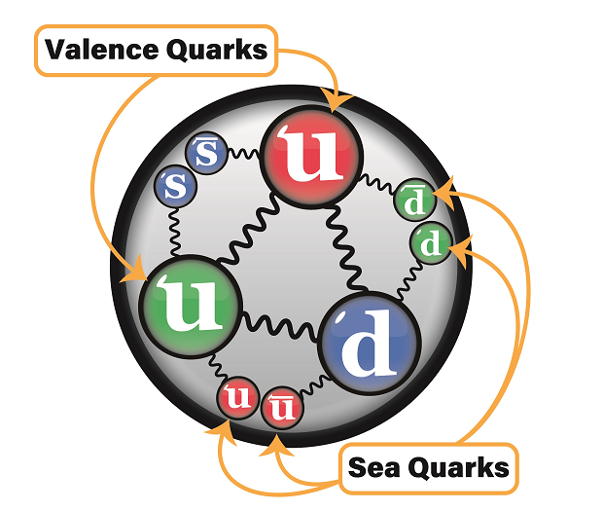
Quark model with ‘Sea’
Baryons (qqq)
are bound states of three quarks.
proton = uud, Λ= uds, ∆⁺⁺ = uuu
Mesons (qq)
are bound states of quark-antiquark.
π⁺= $u\overline{d}$, π⁻ = $d\overline{u}$
The wavefunction for the valence and sea part is written as:
𝛹= 𝜱[ |𝜙⟩_{flavor} |𝜓⟩_{color} |𝜒⟩_{spin} |𝜉⟩_{spatial} ] H, G
Sea should be in corresponding states with the baryon to form the required conditions.
“Sea” contains quark- antiquark pairs interacting with gluons
Valence
Sea
H: Spin
G: Color
Department of Physics and Material Science, Thapar Institute of Engineering and Technology, Patiala
4

Slide 5
Sea (quarks and gluons)
Spin gg : 1 ⊗ 1 = 0_{s} ⊕ 1a ⊕ 2_{s}
Color gg : 8 ⊗ 8 = 1_{s} ⊕ 8_{s} ⊕ 8_{a} ⊕ 10_{a} ⊕ $\overline{10}$_{a} ⊕ 27_{s}
Valence quarks (qqq)
Spin uud : 1/2 ⊗ 1/2 ⊗ 1/2 = 2(1/2) ⊕ 3/2
Color uud : 3 ⊗ 3 ⊗ 3 = 1_{a} ⊕ 8_{ms} ⊕ 8_{ma} ⊕ 10_{s}
Conditions for the Total
Anti-symmetric wavefunction
Spin = 3/2
Color = 1 (singlet)
Flavor = 10 (decuplet)
| ϕ_{3/2}^{(↑)}⟩ = $\frac{1}{N}$a₀ Φ₁^{(3/2↑)} H₀G₁ + b₁(Φ₁^{(3/2)} ⊗ H₁)↑G₁ + b₈ (Φ₈^{(1/2)} ⊗ H₁)↑G₈ + d₁ (Φ₁^{(3/2)} ⊗ H₂)↑G₁
+ d₈ (Φ₈^{(1/2)} ⊗H₂)↑G₈
Normalisation constant N = a₀² + b₁² + b₈² + d₁² + d₈²
Statistical coefficients
Department of Physics and Material Science, Thapar Institute of Engineering and Technology, Patiala
5

Slide 6
Statistical model
A physical hadron state is expanded as a complete set of quark-gluon Fock states
i, j, l = no. of $u\overline{u}, d\overline{d} , s\overline{s }$pairs respectively
k = no. of gluons
The probability to finding hadron in the Fock state |{q},{i, j, k},{l}⟩ is:
where ρ_{i j l k} satisfies the normalization condition.
The baryonic wavefunction can also be expressed as:
| ϕ_{1/2}⟩ = $\sum_{μυ}{\text{(} \text{n}μυ}\text{∗}\text{d}$_{sea} ) ϕ_{val} ϕ_{sea}
Multiplicity
uuu/gg
Spin : $\frac{\text{ρ}\text{1}\text{/}\text{2 0}}{\text{ρ}\text{1}\text{/}\text{2 1}}$ = $\frac{\frac{4}{8}\text{ .} \frac{3}{9} \text{. }\frac{2}{6}}{\frac{4}{8}. \frac{1}{9}. 1}$
Color : $\frac{\text{ρ}\text{1}\text{1} }{\text{ρ}\text{88}\text{s}}$ = $\frac{\frac{1}{27}\text{ .} \frac{1}{64} \text{. }1}{\frac{16}{27}. \frac{8}{64}.\frac{1}{64}}$
Statistical coefficients
(a₀ , b₁ , b₈ , d₁ , d₈)
n_{𝜇υ} (𝜇 = 0,1,2 and υ=1,8,$\overline{10}$): relative probability of Fock states with appropriate multiplicities in spin and color space
d = common multiplier for each combination of valence and sea.
Department of Physics and Material Science, Thapar Institute of Engineering and Technology, Patiala
6

Slide 7
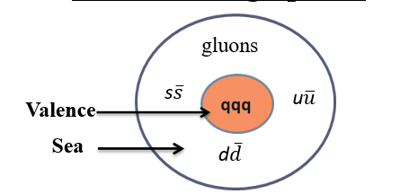
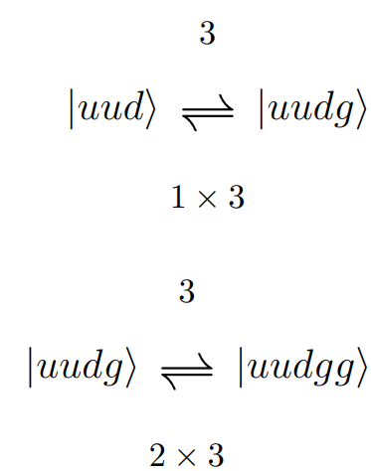
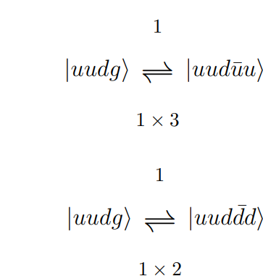
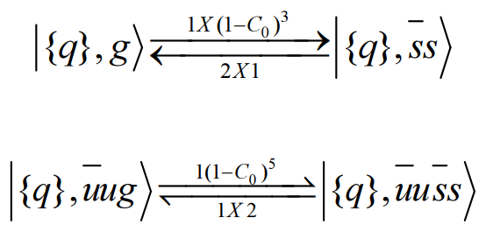
The principle of detailed balance is concerned with the probability distributions of each Fock state inside the hadrons in flavor space.
Considering transition sub-processes like q ⇔ qg, g ⇔ gg, g ⇔ q$\overline{q}$the probabilities of various Fock states is calculated.
q ⇔ qg, g ⇔ gg
g ⇔ q$\overline{q}$
To accommodate the strange sea, the process g⇔ $s\overline{s}$ is considered with a suppression factor k (1-C_{l})^{n-1}
where, C_{l} = $\frac{2Ms}{MB− 2 l Ms}$
Department of Physics and Material Science, Thapar Institute of Engineering and Technology, Patiala
7

Slide 8
i | j | l | 𝜌_{i, j, l, k} | k=0 | k=1 | k=2
0 | 0 | 0 | uuu | 0.1518 | 0.0779 | 0.0299
0 | 0 | 1 | uuu $s\overline{s}$ | 0.1518 | 0.0363 | 0.0032
0 | 1 | 0 | uuu d$\overline{d}$ | 0.0759 | 0.0250 | 0.0054
1 | 0 | 0 | uuu $u\overline{u}$ | 0.0506 | 0.0166 | 0.0036
0 | 1 | 1 | uuu $d\overline{d}s\overline{s}$ | 0.0759 | 0.0102 | 0.0004
1 | 0 | 1 | uuu $u\overline{u}s\overline{s}$ | 0.0506 | 0.0068 | 0.0002
1 | 1 | 1 | uuu $u\overline{u}d\overline{d}s\overline{s}$ | 0.0253 | 0.0019 | 0.00003
a₈ = (n₀₈ d_{sea})_{|gg⟩} + (n₀₈ d_{sea})_{|uūg⟩} + (n₀₈ d_{sea})_{|dd̄g⟩} + (n₀₈ d_{sea})_{|ss̄g⟩} +……
b₁ = (n₁₁ d_{sea})_{|gg⟩} + (n₁₁ d_{sea})_{|uūg⟩} + (n₁₁ d_{sea})_{|dd̄g⟩} + (n₁₁ds_{ea})_{|ss̄g⟩} +……
b$\overline{10}$ = (n₁$\overline{10}$ c_{sea})_{|gg⟩} + (n₁$\overline{10}$ c_{sea})_{|uūg⟩} + (n₁ $\overline{10}$ c_{sea})_{|dd̄g⟩} + (n₁$\overline{10}$ c_{sea})_{|ss̄g⟩}…
Department of Physics and Material Science, Thapar Institute of Engineering and Technology, Patiala
8

Slide 9
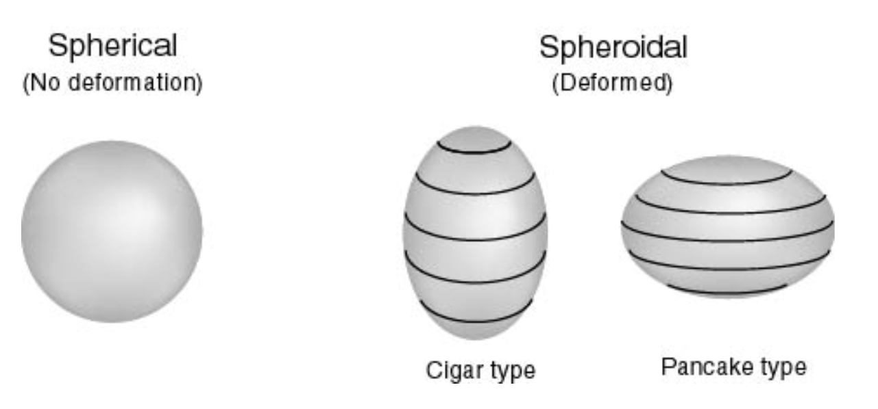
Electromagnetic properties
Magnetic Octupole Moment is a higher-order EM property that characterize the third-order complex spatial distributions of magnetic current inside the baryons.
Unlike lower-order moments, octupole moments are sensitive to more complex deformations and asymmetries in the hadron’s internal structure and reveal deeper dynamics of quark-gluons.
For Ȏ_{B} > 0, a prolate (cigar-shaped) magnetic moment distribution, while for Ȏ_{B} < 0, an oblate (pancake-shaped) magnetic moment distribution.
e_{k} = charge of k^{th} quark (u,d,s)
σ_{i} = spin of the quark
C is a constant which characterize the matrix elements of color and orbital space.
Department of Physics and Material Science, Thapar Institute of Engineering and Technology, Patiala
9

Slide 10
| ϕ_{3/2}^{(↑)}⟩ = $\frac{1}{N}$a₀ Φ₁^{(3/2↑)} H₀G₁ + b₁(Φ₁^{(3/2)} ⊗ H₁)↑G₁ + b₈ (Φ₈^{(1/2)} ⊗ H₁)↑G₈ + d₁ (Φ₁^{(3/2)} ⊗ H₂)↑G₁
+ d₈ (Φ₈^{(1/2)} ⊗H₂)↑G₈
<ϕ_{3/2}^{(↑)}| Ȏ_{B} |ϕ_{3/2}^{(↑)}> = a₀² < Φ₁^{(3/2↑)} | Ȏ_{B} | Φ₁^{(3/2↑)} > + b₁² < Φ₁^{(3/2)} | Ȏ_{B} | Φ₁^{(3/2)} > + . . . .
Φ₁^{(3/2↑)} = Φ(10, 3/2, 1_{c}) = F_{s} ψ_{a}
F_{s} = ϕ^{λ} χ^{λ} + ϕ^{ρ}χ^{ρ})
Operator
Spin-flavor wavefunction
Ȏ_{∆++} = a₀²(8C) + b₁²($\frac{56C}{15}$) + d₁²($\frac{−8C}{15}$) + d₈²($\frac{−28C}{15}$)
Input parameters: C and statistical coefficients (a₀ ,b₁ , b₈ , d₁ , d₈)
Department of Physics and Material Science, Thapar Institute of Engineering and Technology, Patiala
10

Slide 11
Results and Discussion
The octupole moment is calculated for ∆⁺⁺ baryon including the effect of valence and sea quarks.
The ∆⁺⁺ exhibits a -ve value which correspond to the oblate current distribution.
The separate contribution of sea in terms of scalar (spin-0), vector (spin-1) and tensor sea (spin-2) is computed.
The contribution of spin-0 (scalar sea) is more than 90% to the octupole moment value.
If the ‘sea’ is completely excluded from the statistical model, the results gets deviated upto 80%.
Particle | Octupole moment | Valence + Sea (g → uū, dd̄, ss̄ ) | Without sea
∆⁺⁺ (uuu) | 7.6492C | -0.0249 | -0.0182
Numerical values of Magnetic Octupole Moment (MOM) of ∆ baryon in the units of [fm³] with parameter C= -0.0032
Scalar sea (spin-0) | Vector sea (spin-1) | Tensor sea (spin-2) | GPM[1]
-0.02494 | -0.00009 | 0.00006 | -0.024
Individual Contribution of Sea components to the Magnetic Octupole Moment
[1] A.J. Buchmann, Few-Body Systems 59, 145 (2018)
Department of Physics and Material Science, Thapar Institute of Engineering and Technology, Patiala
12

Slide 12
Summary
The statistical model in conjugation with principle of detailed balance is very useful to analysed the internal dynamics of quarks and gluons by studying the various low energy properties such as charge radii, quadrupole moment, masses, semi-leptonic decays etc.
The most interesting part of statistical model is to study the SU(3) symmetry breaking in sea quarks by including the condensates. Also, no additional parameter is used.
The dynamics of sea are captured through the probabilities of various Fock states, represented by statistical coefficients (a₀, b₁, b₈, d₁, d₈). We obtained non-zero magnetic octupole moments, demonstrating that their current distribution deviates from spherical symmtery.
The individual contribution of sea in terms of scalar (spin-0), vector (spin-1) and tensor sea (spin-2) is also calculated.
Department of Physics and Material Science, Thapar Institute of Engineering and Technology, Patiala
13

Slide 13
Thankyou

