Slide 1
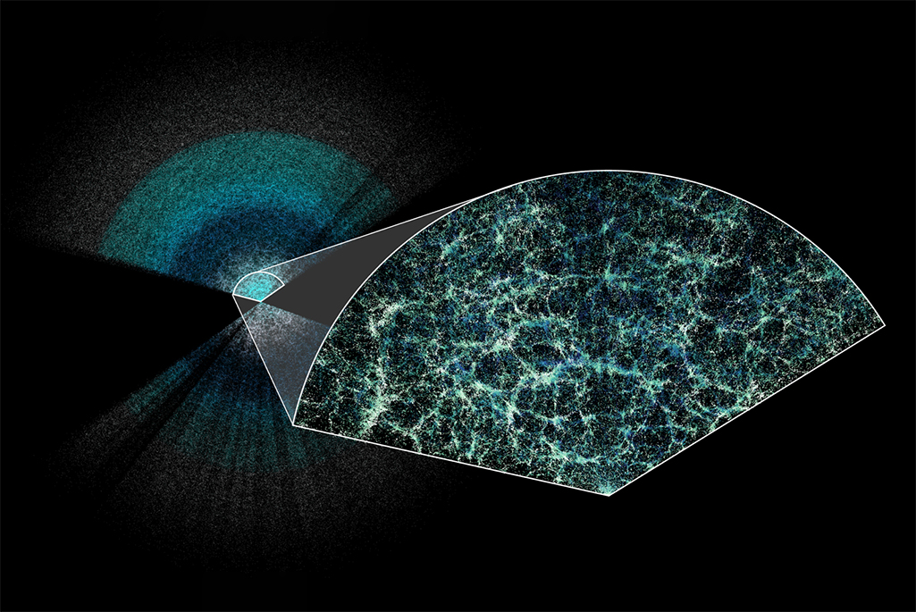

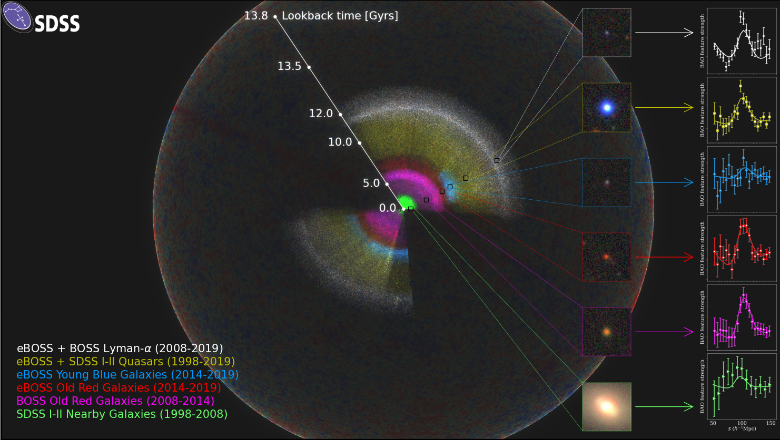
Cosmological implications of massive galaxy surveys
Gong-Bo Zhao
National Astronomical Observatories, CAS July 25, 2025

Slide 2
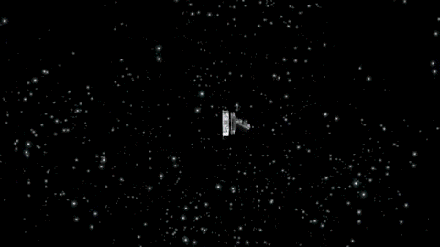
Multiple cosmological probes
CMB

Slide 3

Multiple cosmological probes
CMB
1978, 2006

Slide 4
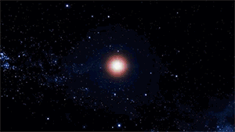
Multiple cosmological probes
CMB
1978, 2006
SNe

Slide 5
Multiple cosmological probes
CMB
1978, 2006
SNe
2011

Slide 6
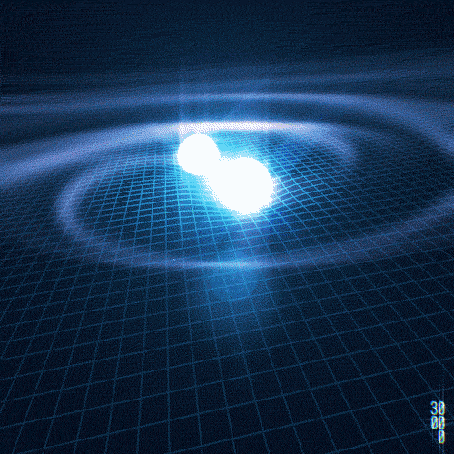
Multiple cosmological probes
CMB
Gravitational waves
1978, 2006
SNe
2011

Slide 7
Multiple cosmological probes
CMB
Gravitational waves
1978, 2006
2017
SNe
2011

Slide 8
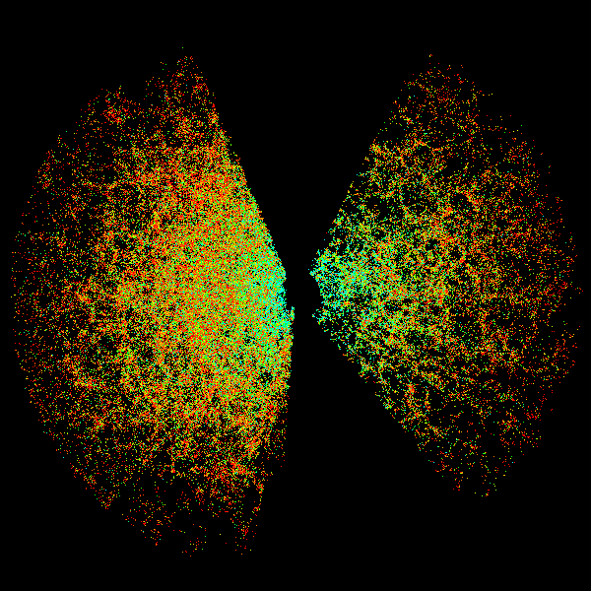
Multiple cosmological probes
CMB
Gravitational waves
1978, 2006
2017
SNe
LSS
2011

Slide 9

Multiple cosmological probes
CMB
Gravitational waves
1978, 2006
2017
SNe
LSS
2011
2014

Slide 10
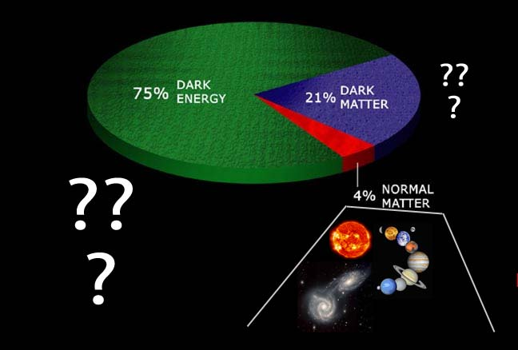
100 x

Slide 11
CMB (1978)
Gravitational waves (2017)
CMB (2006)
Theoretical cosmology (2019)
Cosmic Acceleration (2011)
Black holes (2020)
100 x

Slide 12
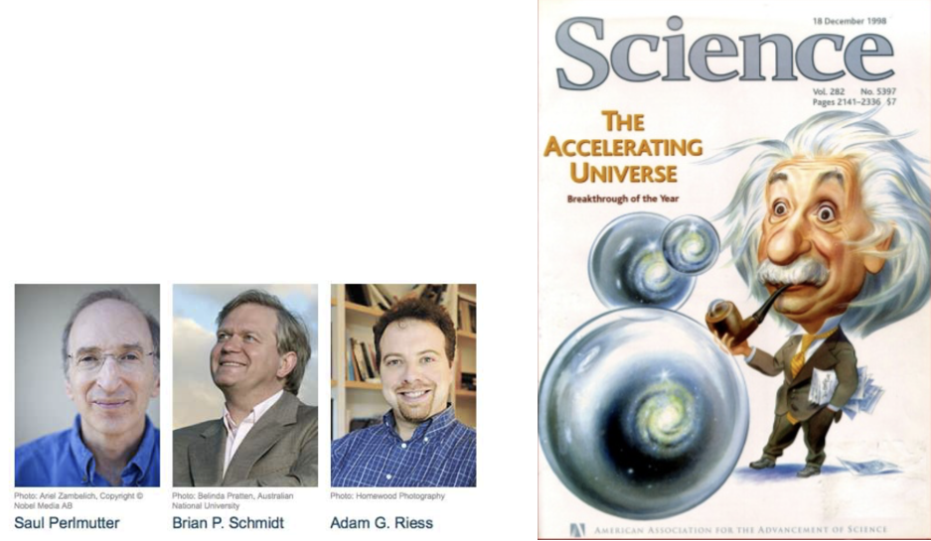
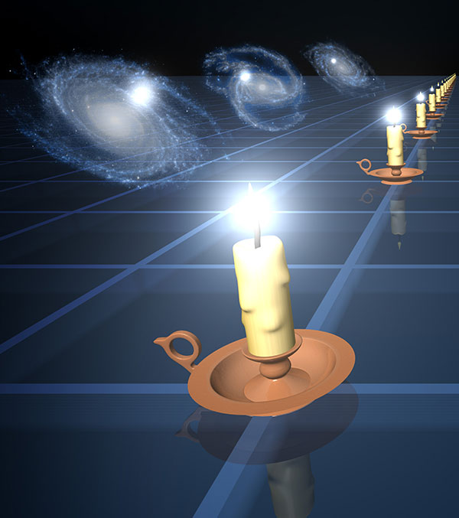
The accelerating
Universe!
2011

Slide 13

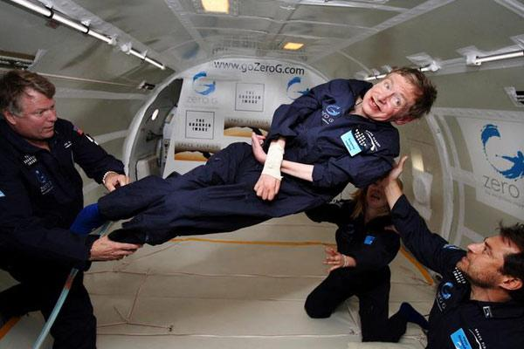

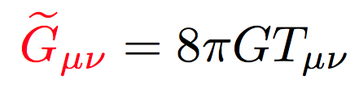
The expansion of the Universe can accelerate if
In GR, to add new ‘repulsive matter’, which contributes 70% total energy
To modify General Relativity
NASA/Jim Campbell/Aero-News Network
Dark Energy
Modified Gravity

Slide 14
The expansion of the Universe can accelerate if
In GR, to add new ‘repulsive matter’, which contributes 70% total energy
To modify General Relativity
NASA/Jim Campbell/Aero-News Network
Dark Energy
Modified Gravity
Galaxy surveys can break the dark degeneracy!

Slide 15
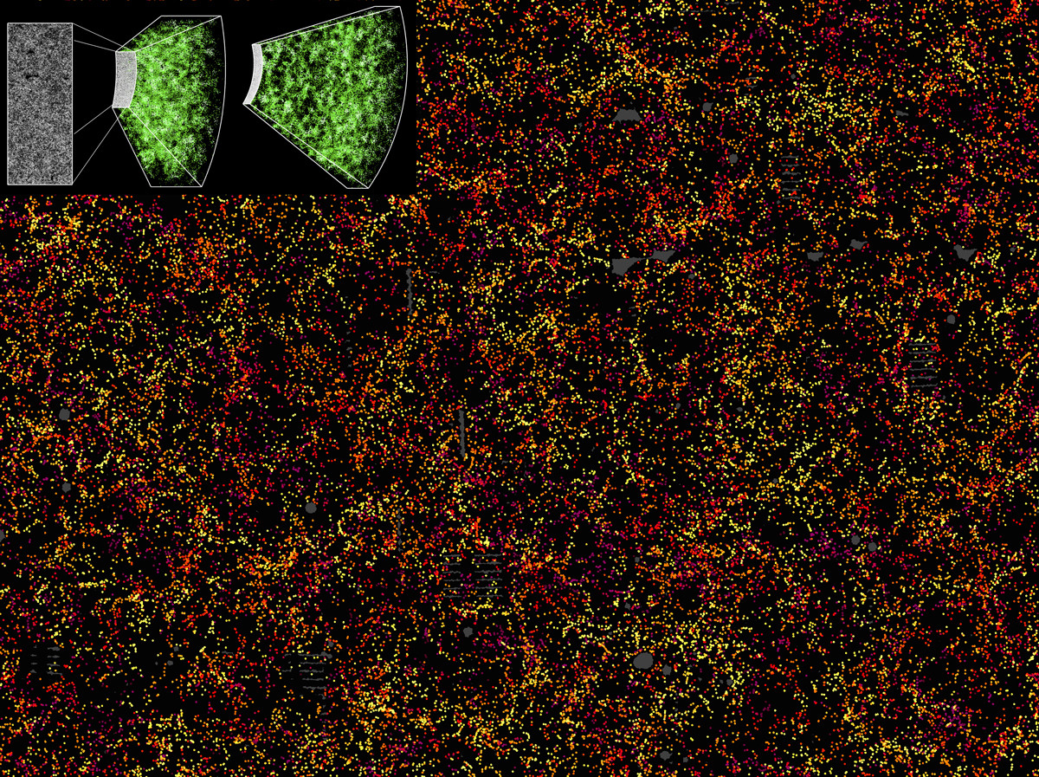
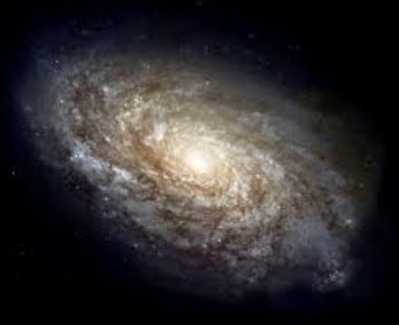

Massive redshift surveys as
a key cosmological probe
BOSS

Slide 16
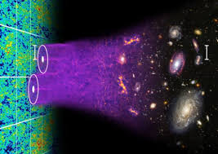
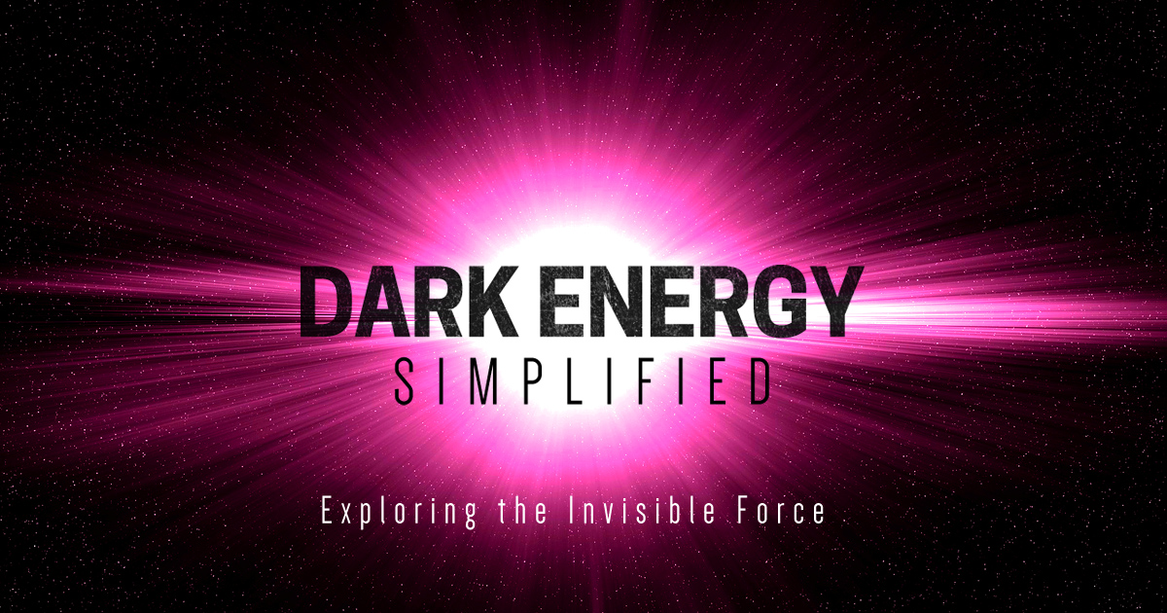
Large z-surveys：a key probe of the Universe
BAO
Dark Energy

Slide 17
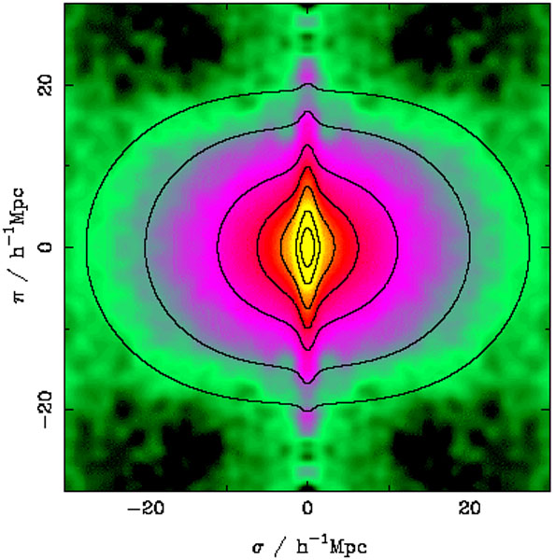

Large z-surveys：a key probe of the Universe
BAO
RSD
Dark Energy
Modified Gravity

Slide 18
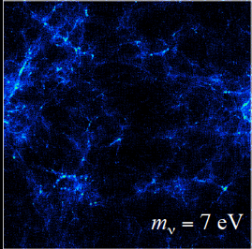
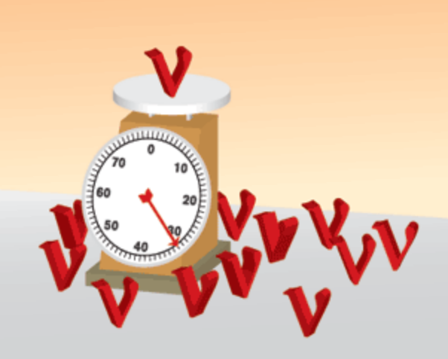
Large z-surveys：a key probe of the Universe
BAO
RSD
Free-streaming
Dark Energy
Modified Gravity
Neutrino masses

Slide 19
Large z-surveys：a key probe of the Universe
BAO
RSD
Free-streaming
Shaw’s prize (2014)
Nobel Prize (2011)
Nobel Prize (2015)
Dark Energy
Modified Gravity
Neutrino masses

Slide 20
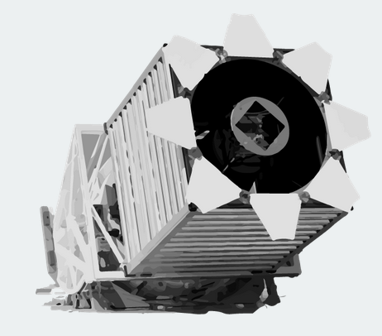

New Mexico
2.5m
2009
2014
2020
2021
2022
SDSS-III
Baryon Oscillation Spectroscopic Survey (BOSS) (z<0.6)
1.6M LRGs
The largest in last decade

Slide 21
2009
2014
2020
2021
2022
SDSS-IV
extended BOSS (eBOSS)
1M LRGs, ELGs and QSOs
(0.6<z<3.5)
The largest in the past 5 years

Slide 22


DESI & PFS
>30M LRGs, ELGs and QSOs
(0<z<3.5)
Largest ongoing surveys
2024
2025
2026
2027
2028
PFS, 10m
DESI, 4m

Slide 23
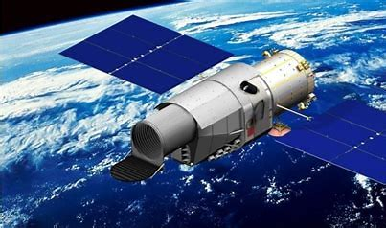

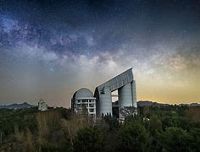
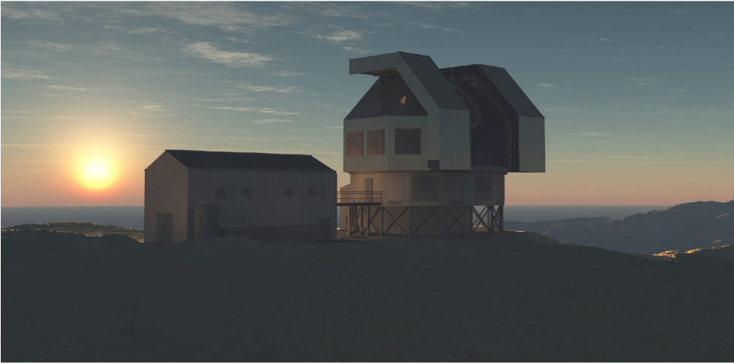
CSST, 2m in space
MUST, 6.5m
ESST, 10+m

Slide 24
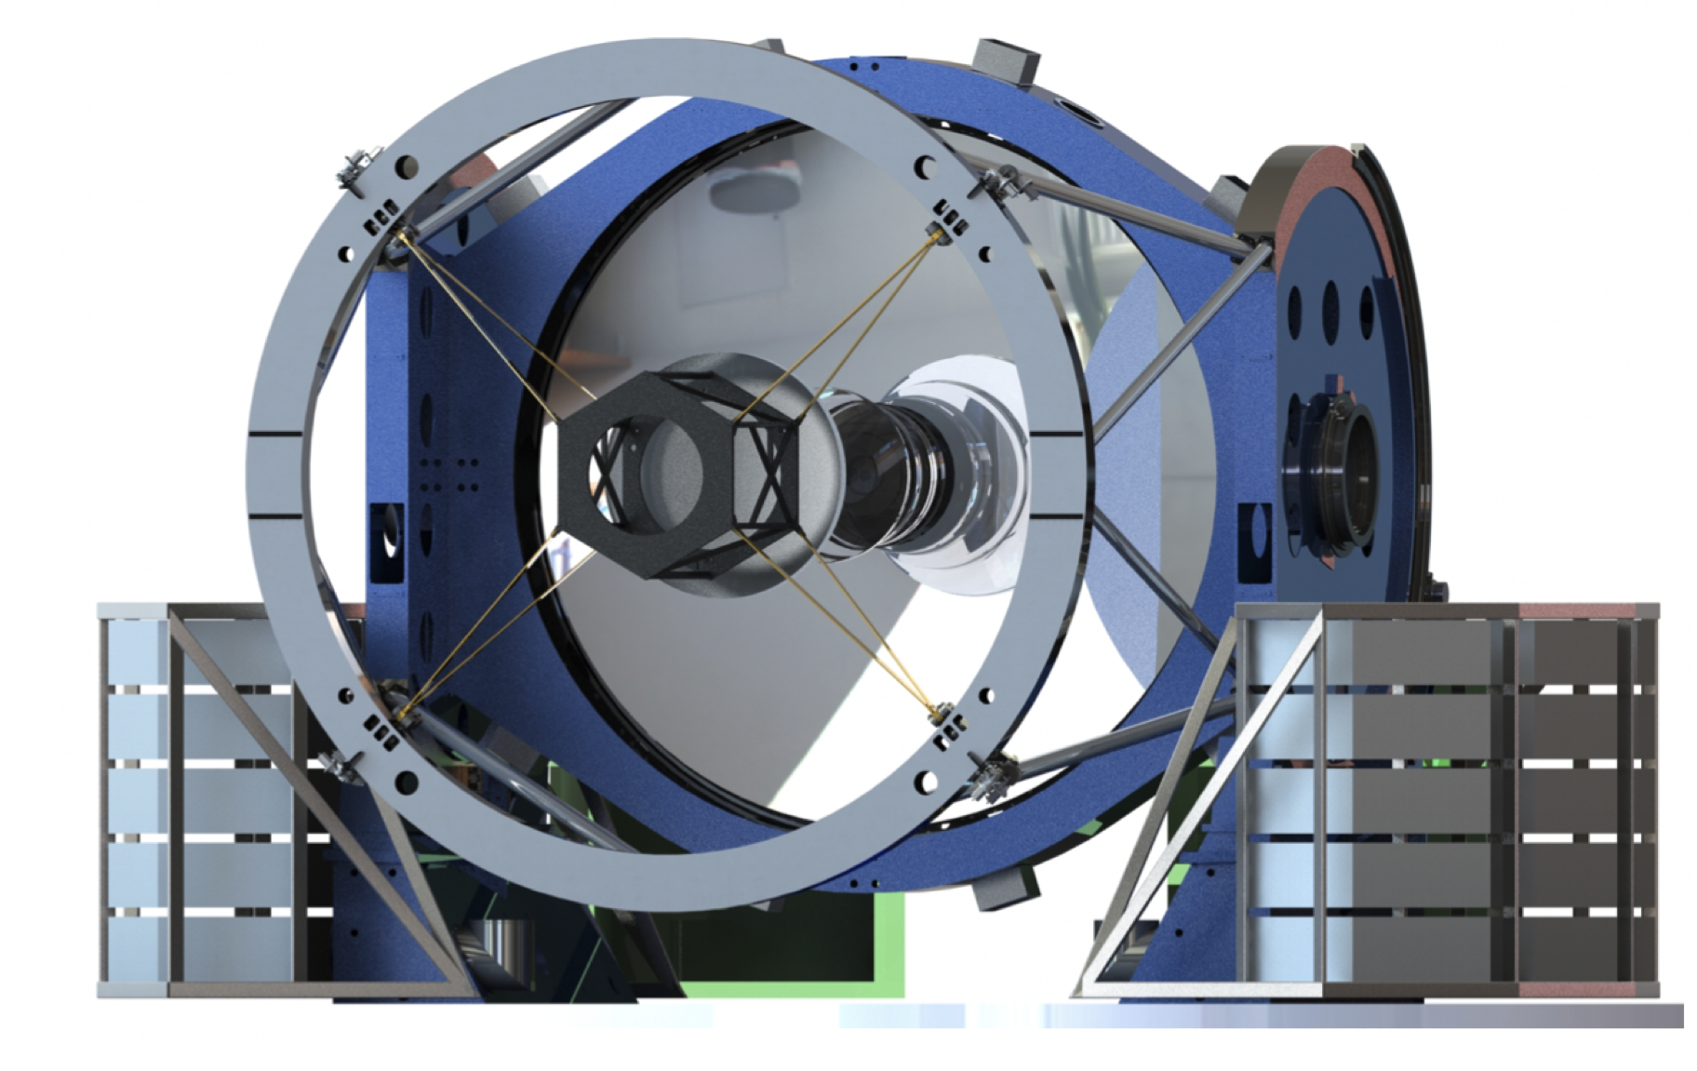
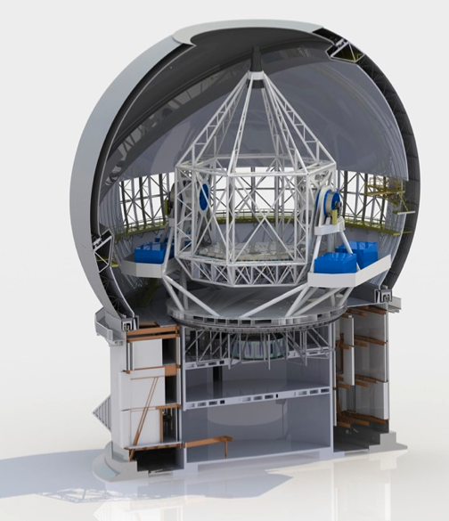
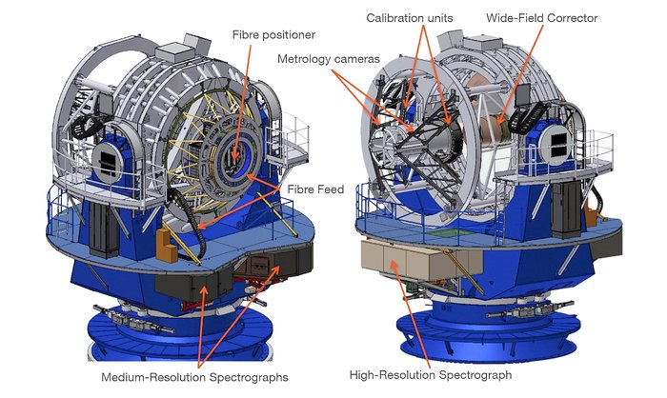
CSST, 2m in space
MUST, 6.5m
ESST, 10+m
4MOST, 4m
MegaMapper, 6.5m
WST, 10+m

Slide 25
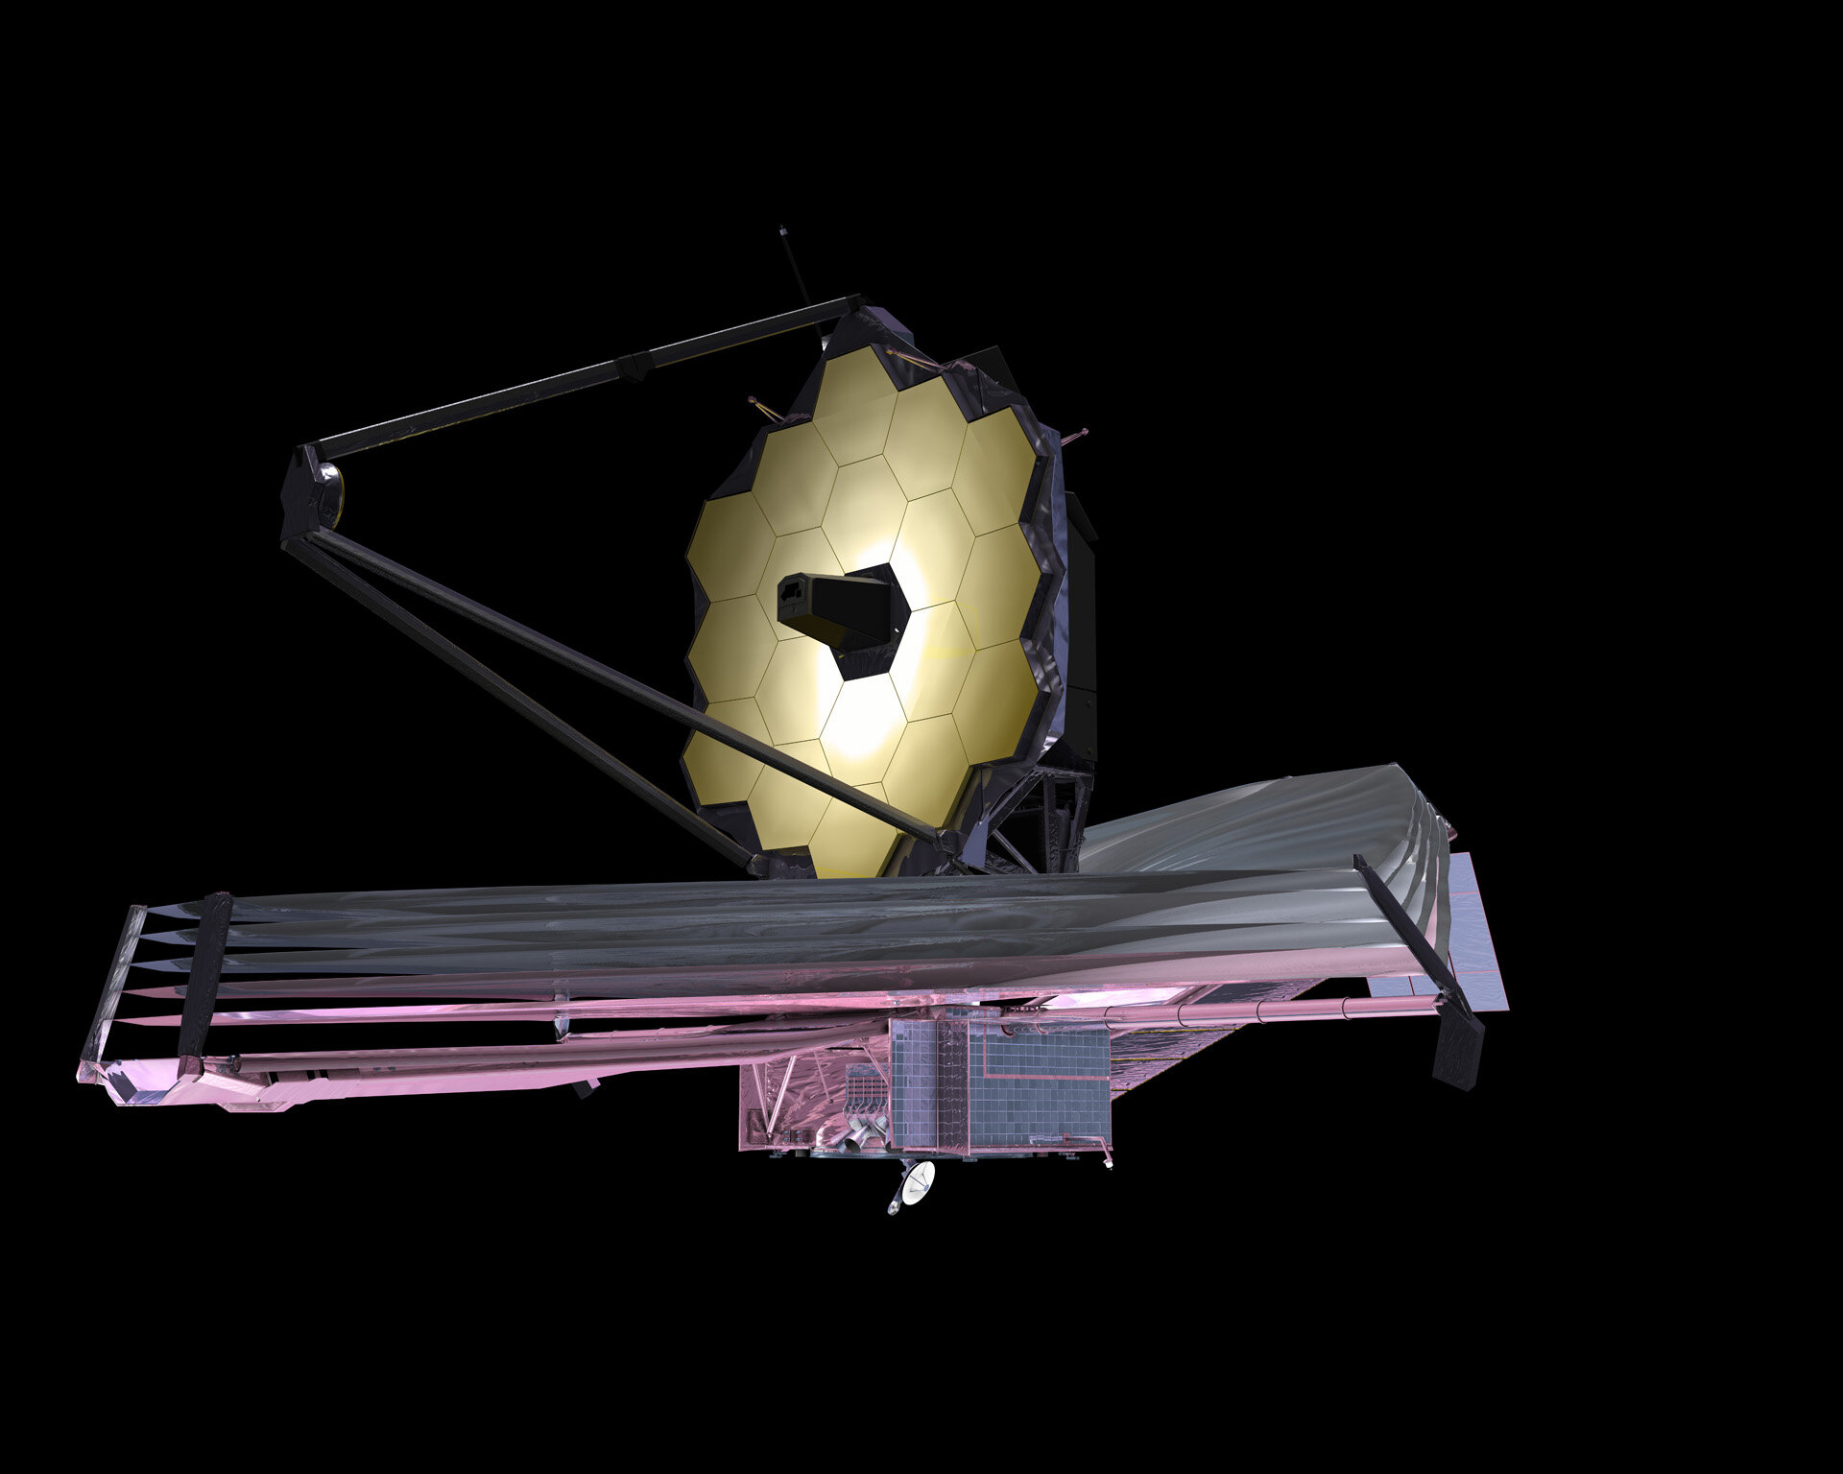
CSST, 2m in space
MUST, 6.5m
ESST, 10+m
280 m at L2!!
arXiv: 2010.06064
4MOST, 4m
MegaMapper, 6.5m
WST, 10+m

Slide 26
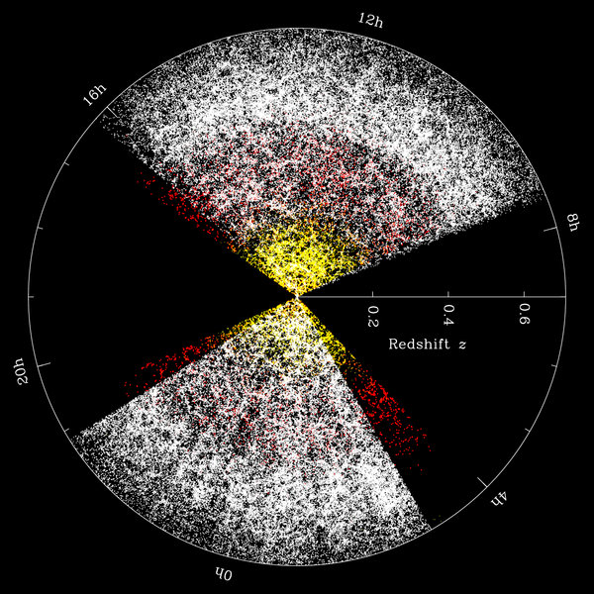
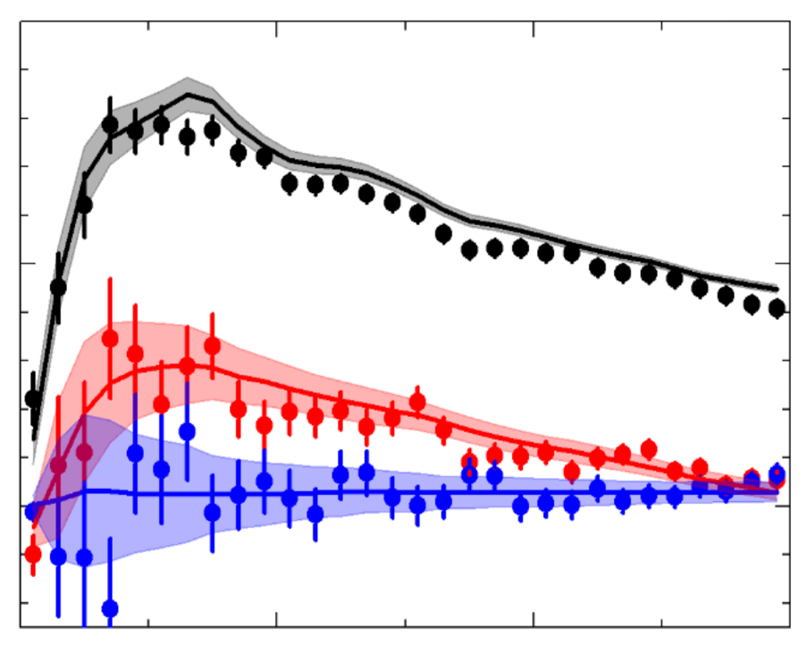
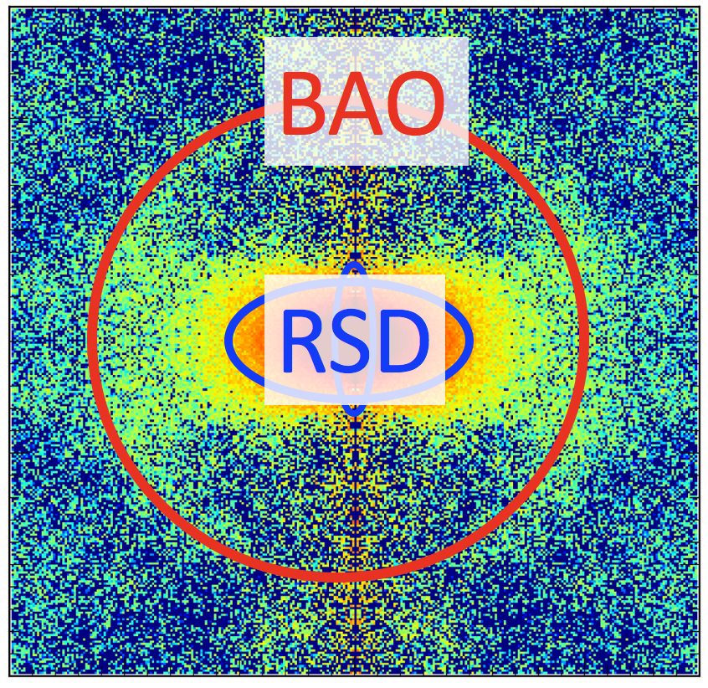
Cosmic acceleration
LSS survey
Model
Sim.
Stat.
Dark Energy
Modified Gravity
ξ(s), P(k)
Neutrino masses
BAO, RSD

Slide 27
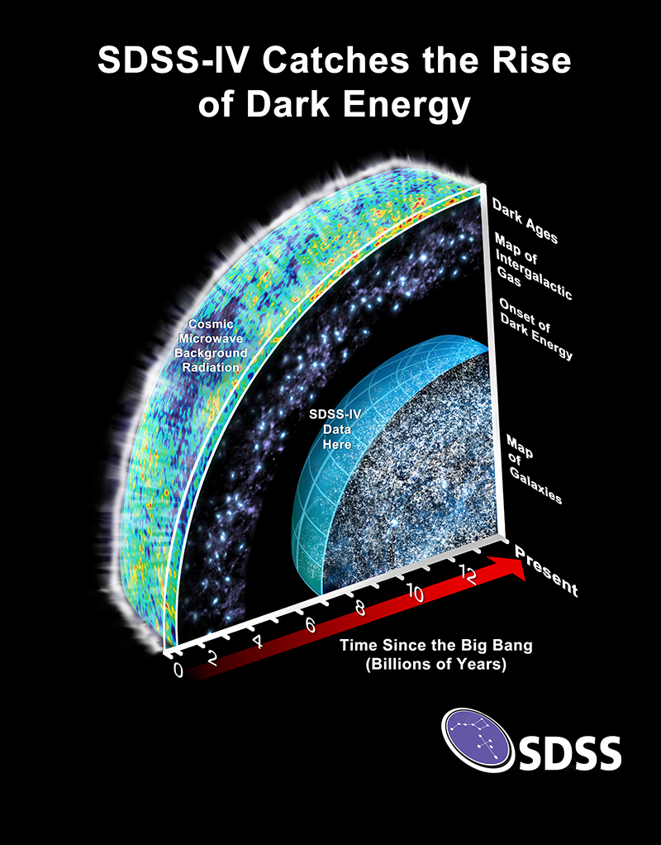
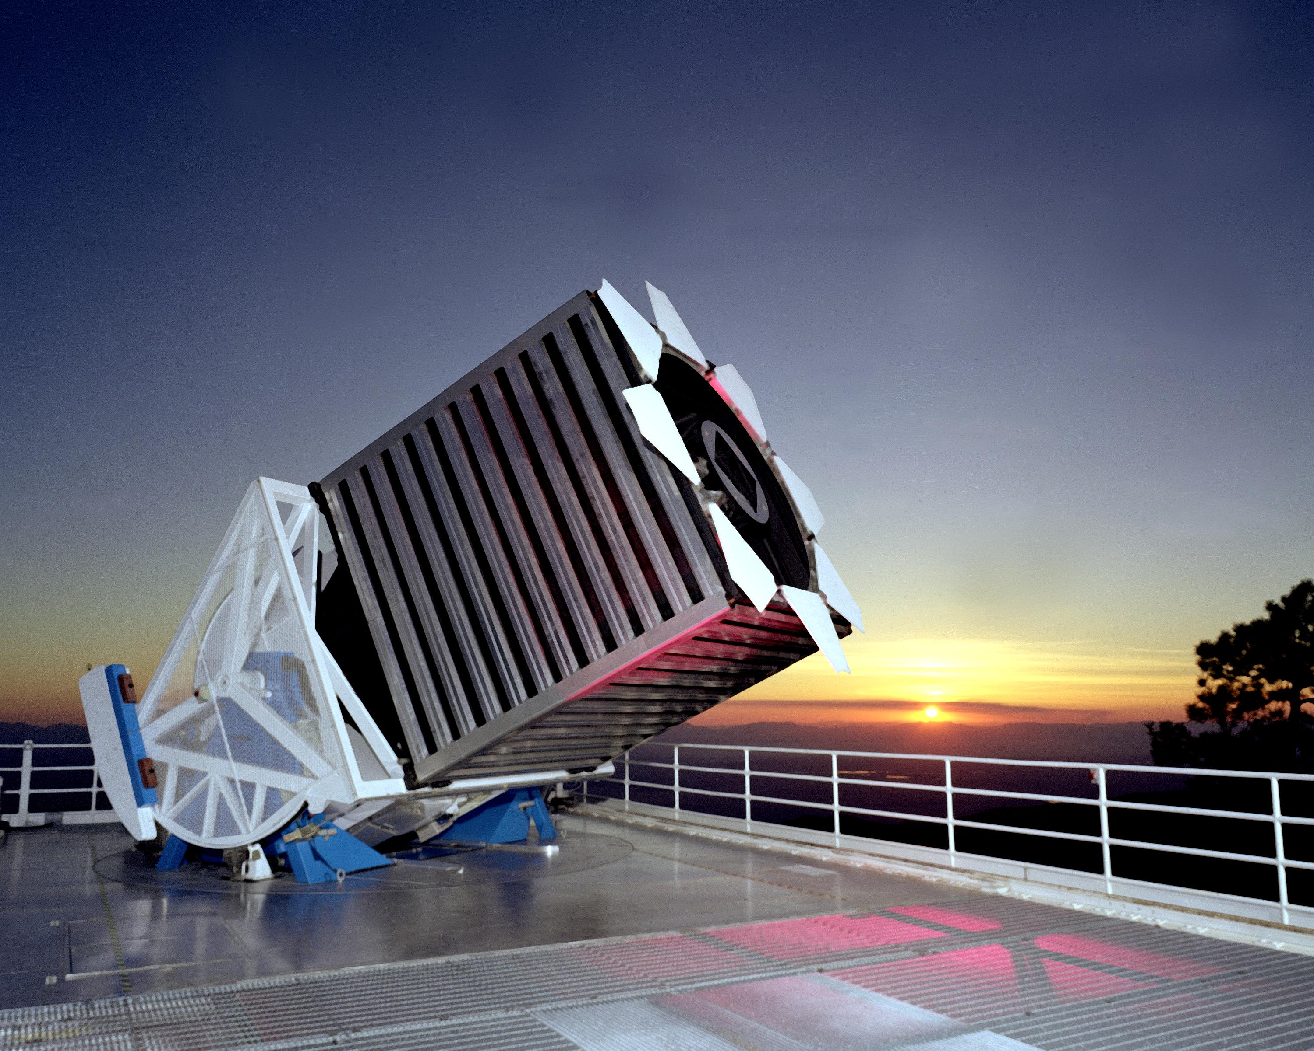
eBOSS (2014-2020)
2.5 m SDSS telescope @ New Mexico

Slide 28
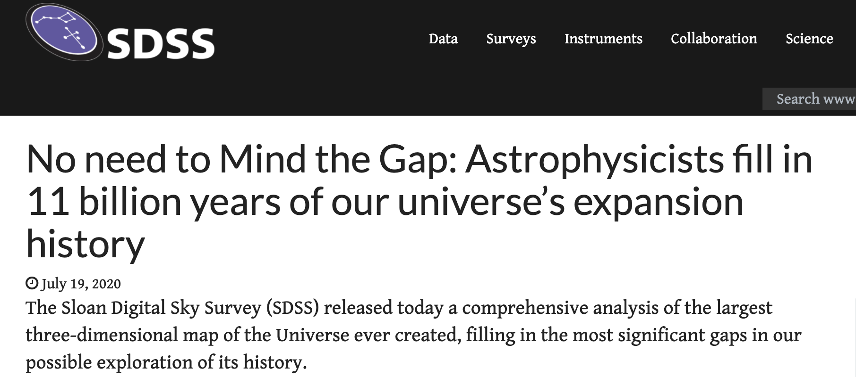
eBOSS result released on July 20, 2020 in 20+ papers
sdss.org

Slide 29
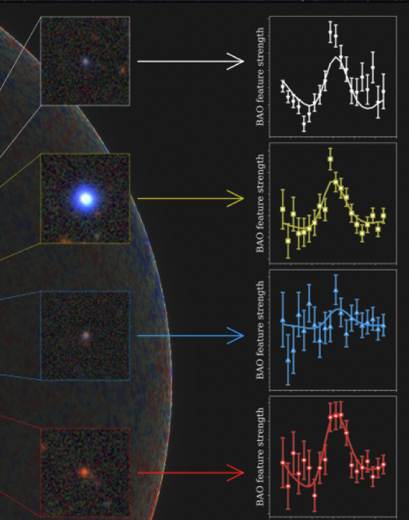
eBOSS tracers
Lyman-a forest
Clustering quasars
Emission Line Galaxies (ELGs)
Luminous Red Galaxies (LRGs)

Slide 30
ELG (k-space): De Mattia et al, 2007.09008
ELG (s-space): Tamone et al, 2007.09009
LRG (k-space): Gil-Marin et al, 2007.08994
LRG (s-space): Bautista et al, 2007.08993
ELG x LRG (k-space): G-B. Zhao et al, 2007.09011
ELG x LRG (s-space): Y. Wang et al, 2007.09010
QSO (k-space): Neveux et al, 2007.08999
QSO (s-space): Hou et al, 2007.08998
LyA BAO (s-space): du Mas des Bourboux et al, 2007.08995
Cosmological implications: Alam et al, 2007.08991
Mocks, Catalog papers

Slide 31
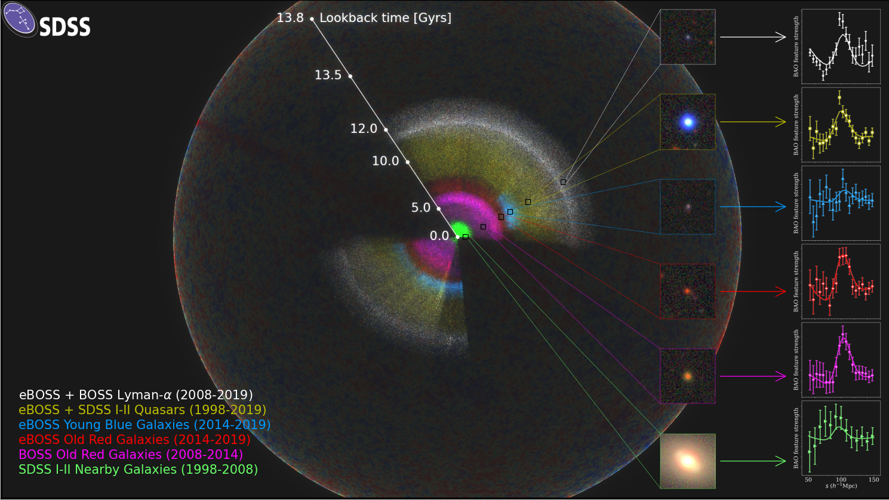

Slide 32
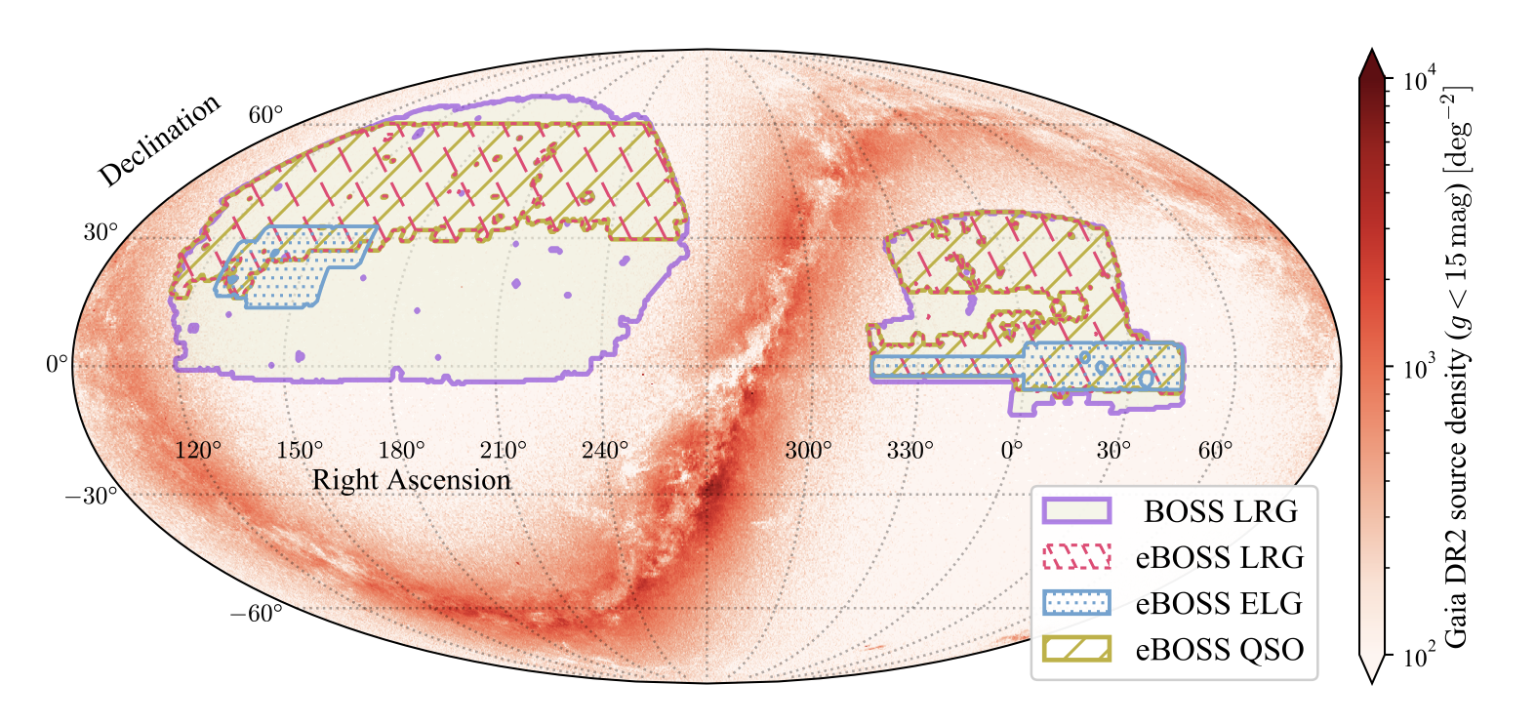
eBOSS footprint
C. Zhao+, 2020

Slide 33
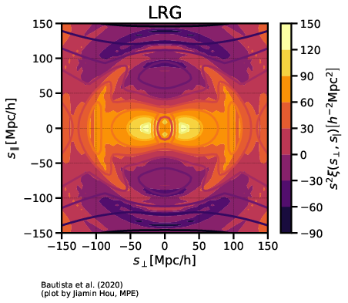
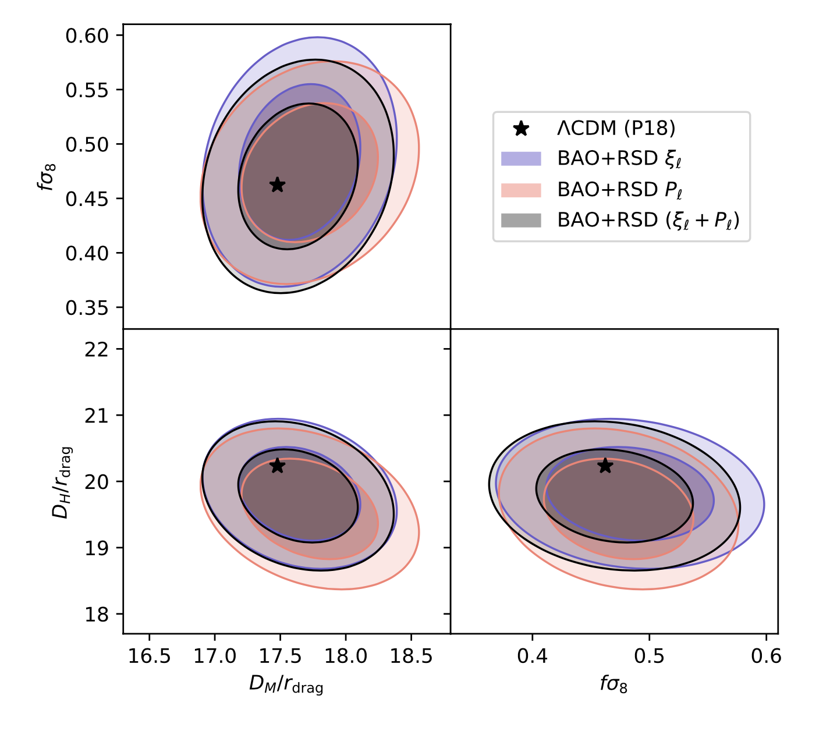
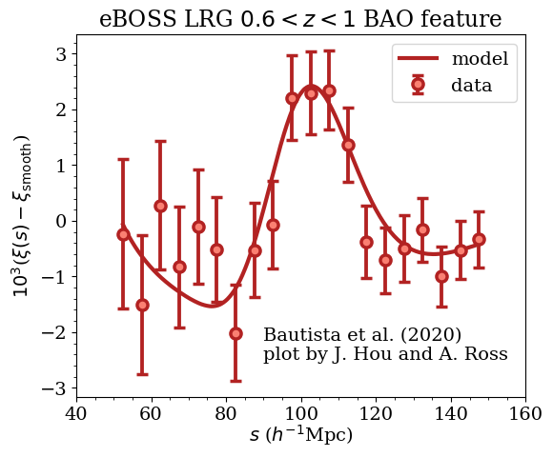
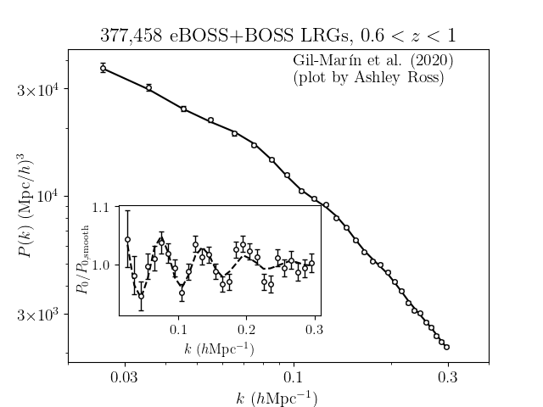
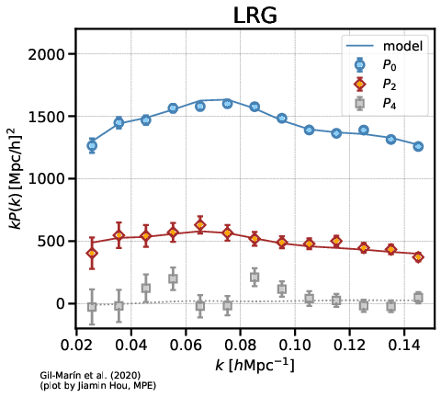
Luminous Red Galaxies (LRGs)
0.6 < z < 1.0, z_{eff} = 0.77
~9500 deg²
~400 K spectra
Bautista+, 2020; Gil-Marin+, 2020

Slide 34
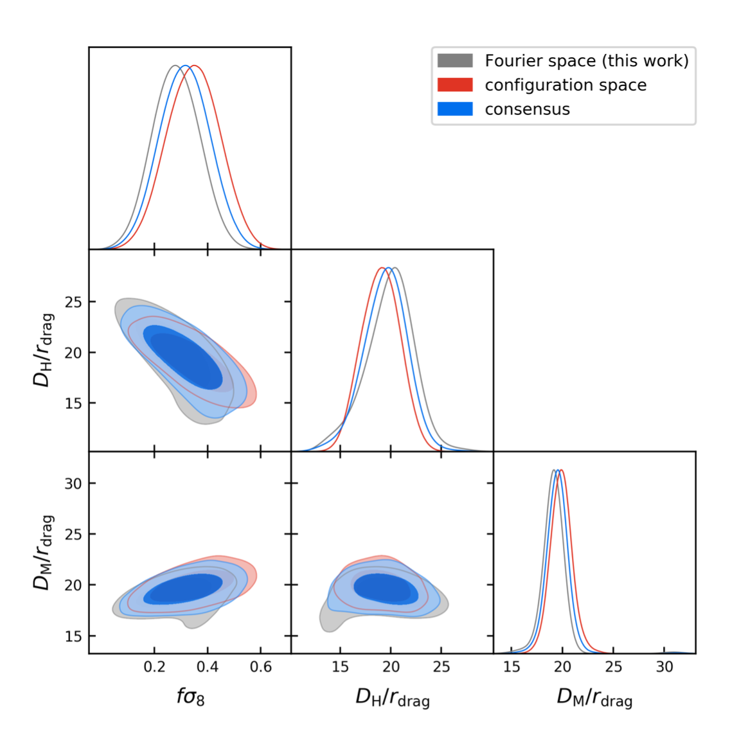
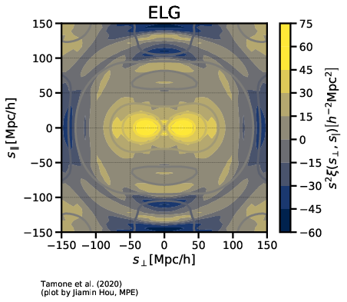
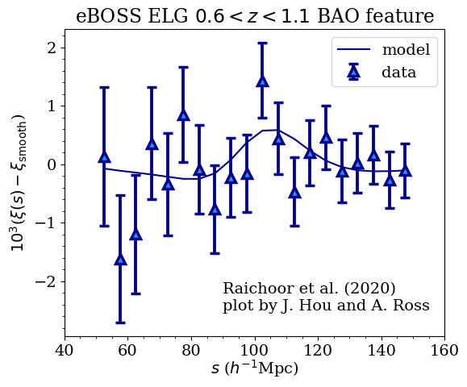
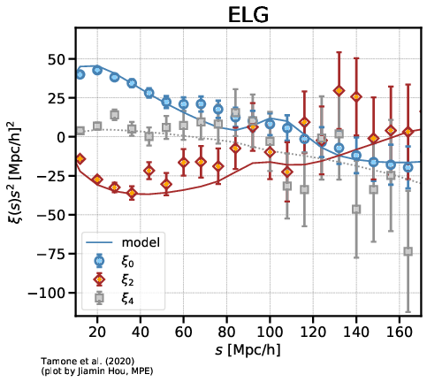
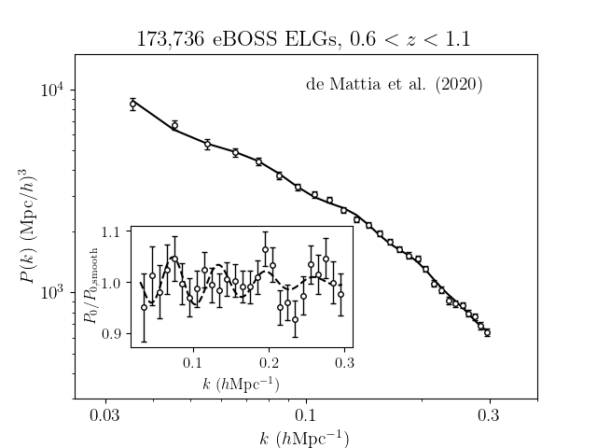
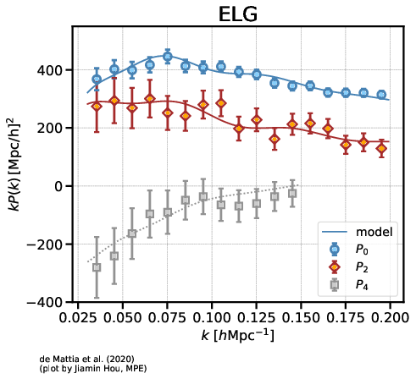
Emission line Galaxies (ELGs)
0.6 < z < 1.1, z_{eff} = 0.845
~730 deg²
~170 K spectra
de Mattia+, 2020; Tamone+, 2020

Slide 35
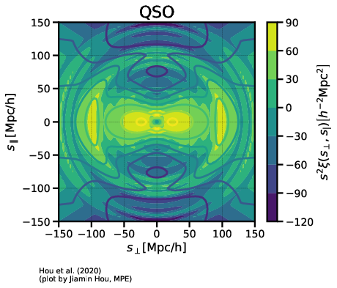
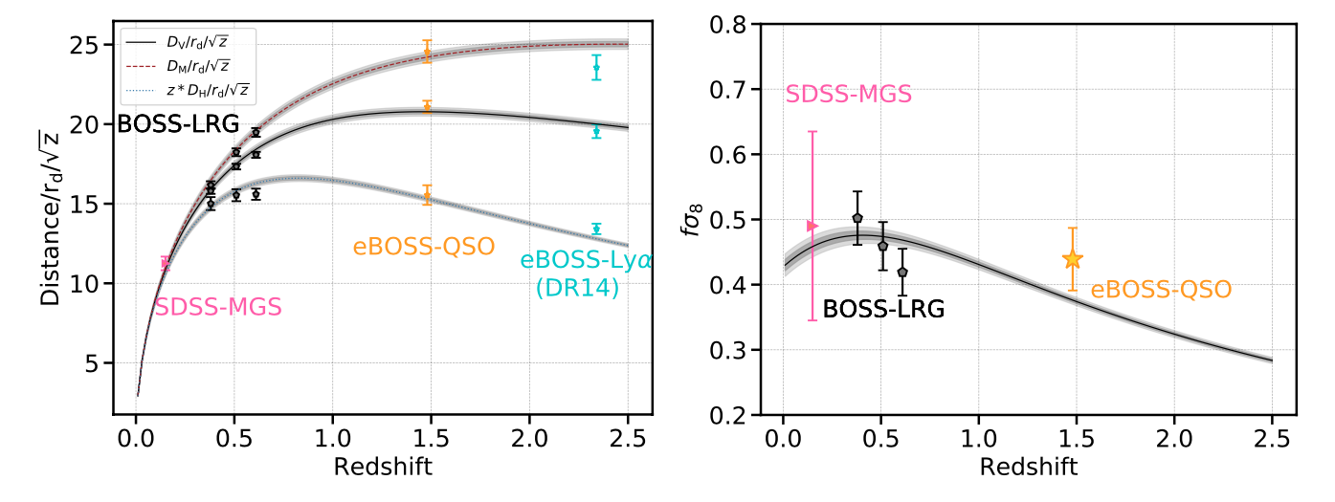
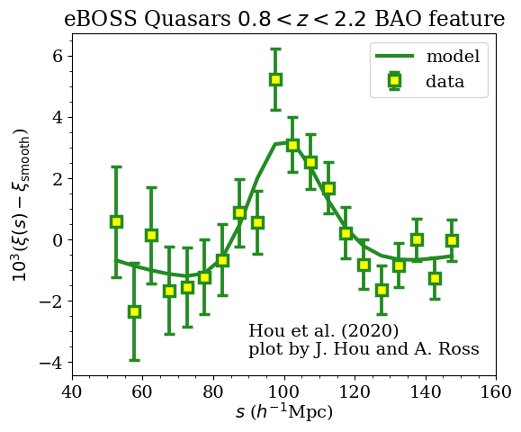
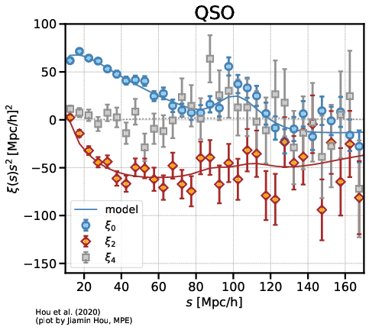


Clustering quasars (QSOs)
0.8 < z < 2.2, z_{eff} = 1.48
~4700 deg²
~340 K spectra
Hou+, 2020; Neveux+, 2020

Slide 36

Angular overlap
GBZ+, 2020

Slide 37

Radial overlap

Slide 38


Slide 40


Slide 41

GBZ+, 2020

Slide 42

GBZ+, 2020

Slide 43

GBZ+, 2020

Slide 44


Slide 45

A first detection of BAO from galaxy-ellipticity correlations
d’Assignies D. et al. 2021

Slide 46


Xu, Jing, GBZ et al, Nature Astronomy (2023)

Slide 47

A study of dynamical dark gravity using DESI
DESI paper: 2503.14738

Slide 48
A study of dynamical dark gravity using DESI
w(a) = w₀+w_{a}(1-a)
DESI DR1
DR1+SN1
DESI DR2
DR2+SN1
DR1+SN2
DR1+SN3
DR2+SN2
DR2+SN3

Slide 49
Two ways to study dynamics of dark energy
Indirect: get features of w(z) directly from distance measurements
✓: cheap; no data combination needed
✗: no w(z) derived

Slide 50
Two ways to study dynamics of dark energy
Indirect: get features of w(z) directly from distance measurements
✓: cheap; no data combination needed
✗: no w(z) derived
Direct: reconstruct w(z) from observations
✓: show w(z) with details
✗: expensive; usually requires datasets to be combined

Slide 51


Probing dynamical DE from distance measurements
(Gu et al, 2404.06303; Wang et al, 2404.06310)
(Zhu et al, 2015)

Slide 52




Slide 53


Slide 54




Gu, Wang, Wang, GBZ, et al [DESI collaboration], 2504.06118, to appear in Nature Astronomy

Slide 55




Reconstructing the evolution history of dark energy
Crittenden, Pogosian, GBZ (CPZ, JCAP 2009)
Crittenden, GBZ, Pogosian, Samushia, Zhang (JCAP 2012)

Slide 56

Theory-motivated correlated prior on w(z) (Raveri et al, 1703.05297)

Slide 57

Raveri et al, 1703.05297

Slide 58



Slide 59

Gu, Wang, Wang, GBZ, et al [DESI collaboration], 2504.06118, to appear in Nature Astronomy

Slide 60

Goldstein, Celoria & Schmidt, arXiv: 2507.16970

Slide 61

Bayesian Evidence

Slide 62
Summary and next steps
DESI BAO data show interesting signs of new physics, awaiting confirmation of Y5 and later observations;
As statistical errors get reduced, more work is needed to mitigate the systematics;
New statistics (MFs, wavelets, etc) and new ideas (tests of parity, etc) are needed to probe new physics from future galaxy surveys.

