Slide 1
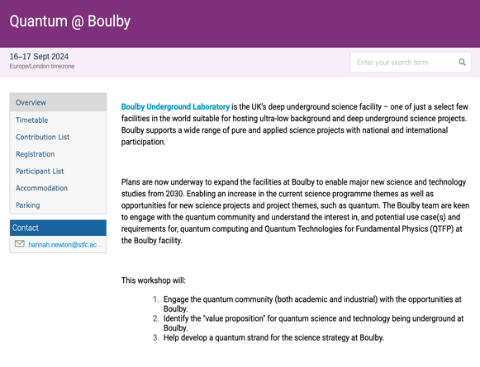


Quantum@Boulby 2024:
Opportunities, possibilities and requirements for future Quantum Sensor and Quantum Computing work at Boulby Underground Lab
Purpose:
Update all on expansion of facilities at Boulby and opportunities for Quantum
Discuss / identify how Boulby can help in future Quantum R&D. What is the Value Proposition?
Identify future quantum work areas that could/should be undertaken at Boulby by UK community.
Welcome!

Slide 2
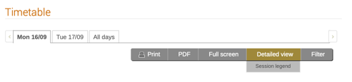
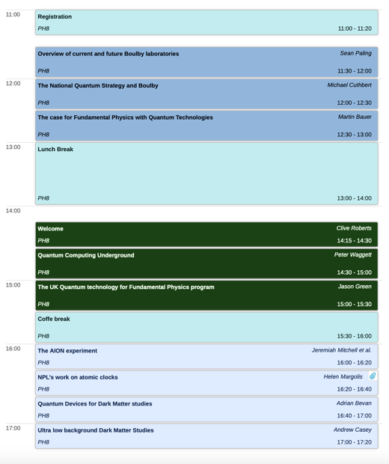
Quantum@Boulby 2024:
Day 1: Mon 16th
Introduction & Overview talks 11:30 – 17:00
Reception and Meal 18:00
Day 2: Tues 17th
Discussions 9:00 – 15:00
  What are the key science questions Boulby could answer?
  What key technological advantage could Quantum @ Boulby provide?
  Could quantum technologies enhance existing/future other projects at Boulby?
  Summary
End 15:00

Slide 3

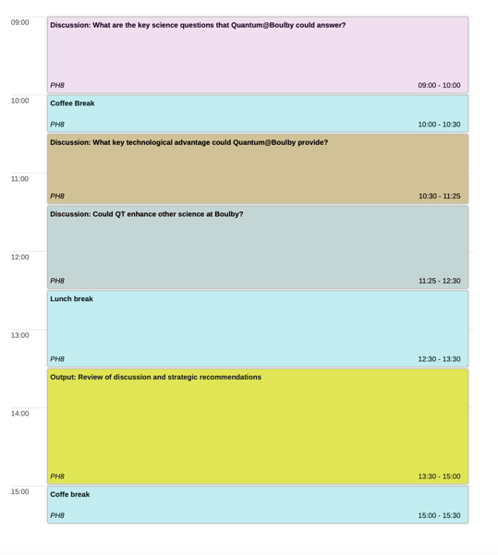
Quantum@Boulby 2024:
Day 1: Mon 16th
Introduction & Overview talks 11:30 – 17:00
Reception and Meal 18:00
Day 2: Tues 17th
Discussions 9:00 – 15:00
  What are the key science questions Boulby could answer?
  What key technological advantage could Quantum @ Boulby provide?
  Could quantum technologies enhance existing/future other projects at Boulby?
  Summary
End 15:00

Slide 4

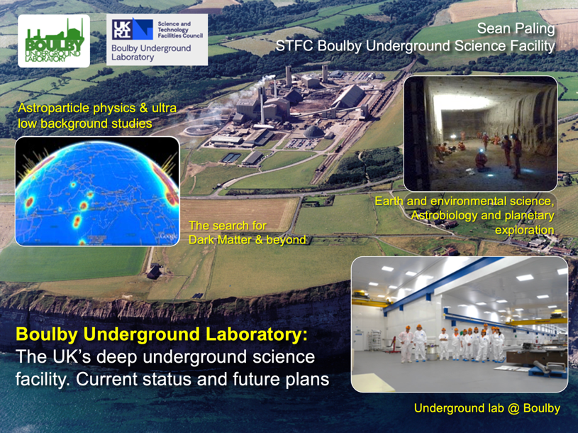
Boulby Underground
Laboratory:
Status and plans for the UK’s deep underground science facility.
Sean Paling
Boulby Underground Laboratory, UK
Sean Paling. Boulby Underground Lab. 2024

Slide 5

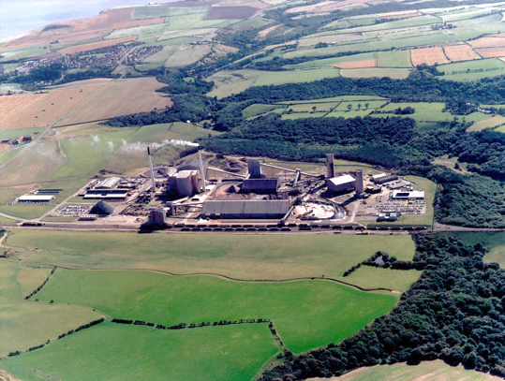




Boulby Mine
A working polyhalite and rock-salt mine on the North East coast of England.
Owned by Israel Chemicals Ltd. (ICL-UK). Locally operated as Cleveland Potash Ltd.
Major local employer: ~500 direct staff and 2000 indirect employment.
Polyhalite: K₂Ca₂Mg(SO₄)
Middlesborough
Ships worldwide for agricultural fertiliser
Staithes
Whitby
York
Deepest mine in Britain: 1300km
The world’s first polyhalite mine
12 miles North of Whitby, N. Yorks
View from Staithes

Slide 6
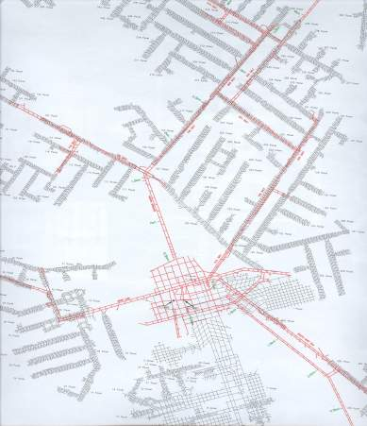
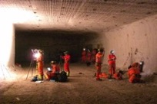
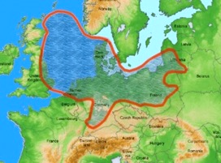
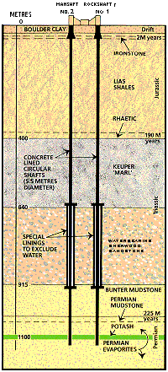



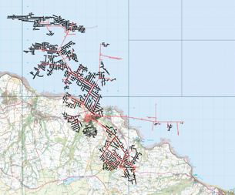


Boulby Geology & Mining
Excavations are in Salt (NaCl), Potash (KCl) and Polyhalite (K₂Ca₂Mg(SO₄)). Permian evaporite layers left over from the Zechstein Sea (250m.yrs past).
Over 40 kms of tunnel mined each year (now >1,000kms in total), the long-lived roadways being cut in the lower NaCl layer.
Typical Boulby Salt Roadway
Polyhalite
Potash
Zechstein Sea
Rock-Salt
Low activity salt
U ~67 ppb,
Th ~125 ppb
Mine Shafts
>1000kms of tunnel mined in 50 years
Current Lab
(2017)
Boulby Geology

Slide 7

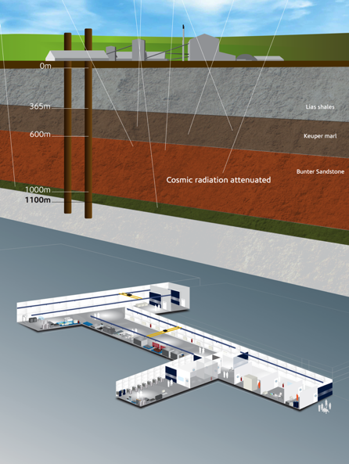
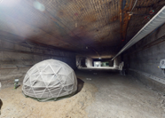
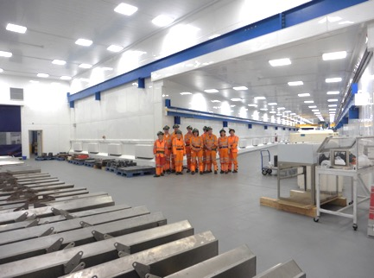
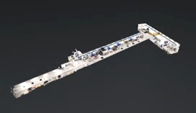
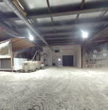


Boulby Underground Laboratory
The UK’s deep underground science facility operating in a working potash and salt mine.
1.1km depth (2805 mwe). With low background surrounding rock-salt
Operated by the UK’s Science & Technology Facilities Council (STFC) in partnership with the mine operators ICL-UK
Outside Experimentation Area (OEA)
4000m³ class 10k and 1k clean lab space
Permian Evaporites
Factor ~10⁶ reduction in cosmic ray flux
vs. surface
A QUIET place in the Universe
Lab entrance

Slide 8
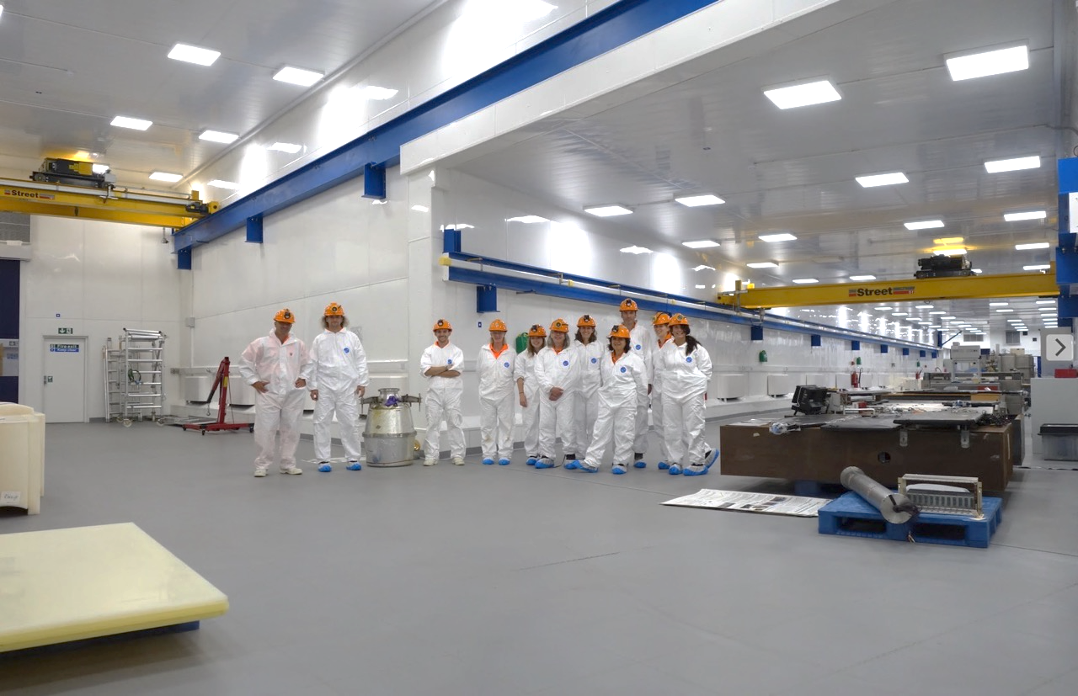
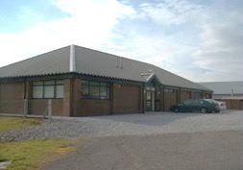
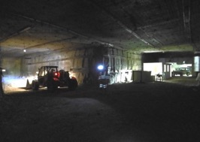


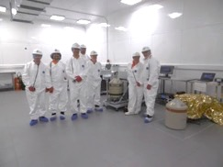
Office space, chemistry & clean prep lab, storage and staging space, IT room, conference room,
Supported access to surrounding geology & UG environs. Power, wifi/internet.
Surface support and staging building
3000m³ Outside Experimentation Area
Boulby Underground Lab Facilities 2023: >4000m³ class 1k & 10k (ISO 6 & 7) clean room lab space. 10Gb Internet. AC, air filtration, 5T & 10T lifting, LN generation, fume hood & clean prep space. 3000m³ Outside Experimentation Area (OEA) with power & internet. Supported access to wider mine environs.
BUGS Material screening

Slide 9

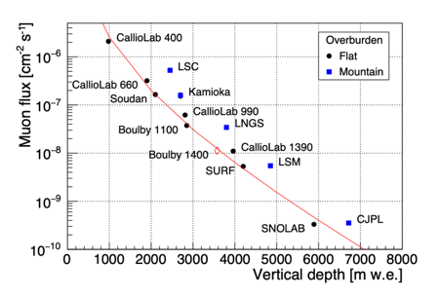
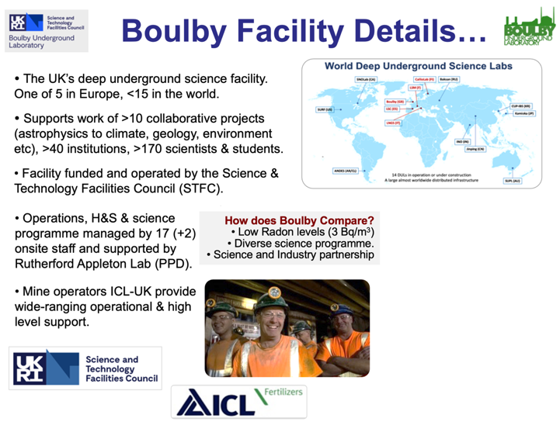


Boulby Underground Laboratory (UK)

Slide 10
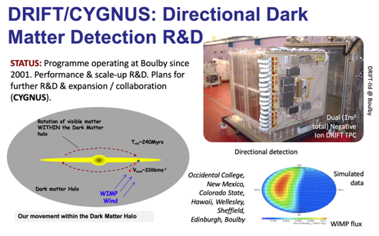
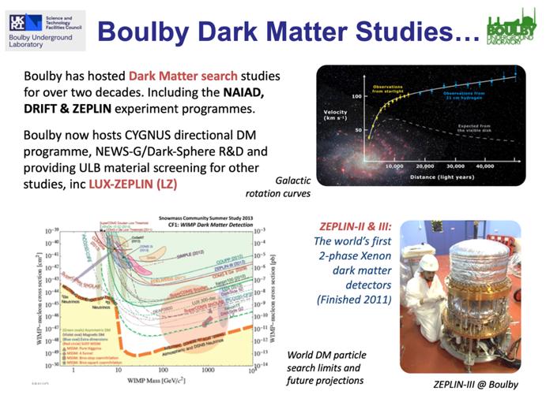
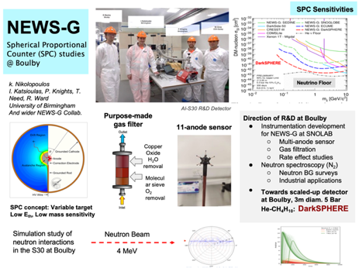
Boulby Science Now & Future
Particle physics and ultra-low background studies

Slide 11
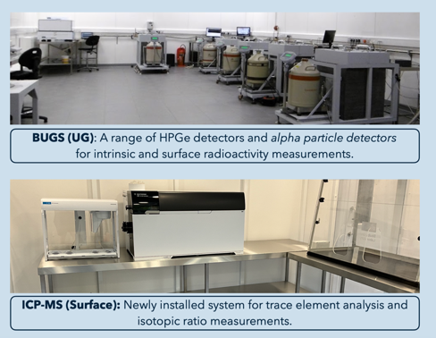
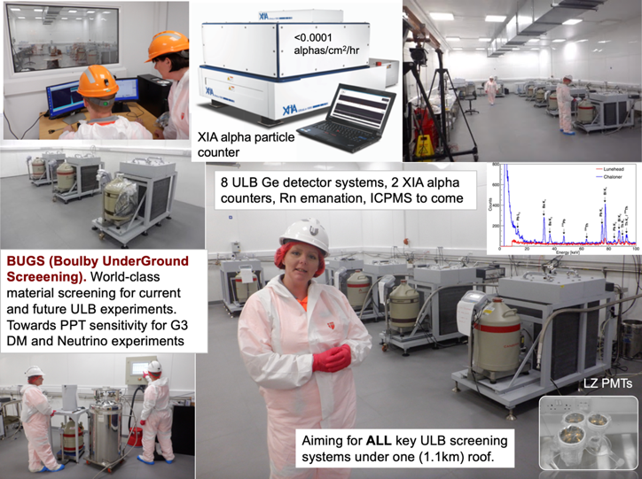
Boulby Science Now & Future
Particle physics and ultra-low background studies
BUGS Facility: (Boulby Under-Ground Screening)
  ULB Germanium (8)
  XIA: Surface alphas (2)
  Radon Emanation *
  ICPMS * * Commissioning

Slide 12
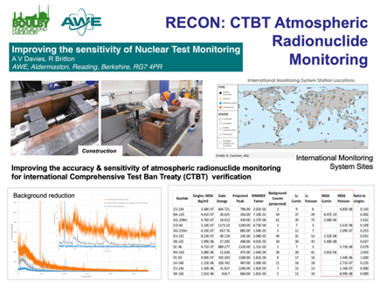

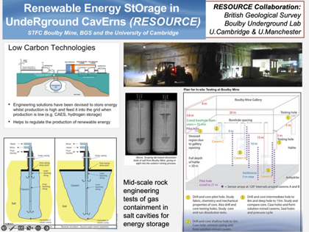
Multidisciplinary Science
RECON:
Atmospheric monitoring for nuclear
security
Applied low background particle physics, Earth and Environmental science, Astrobiology & Planetary Exploration Technology Development.
MINAR:
Astrobiology and planetary exploration technology development
RESOURCE:
Compressed gas energy storage R&D

Slide 13

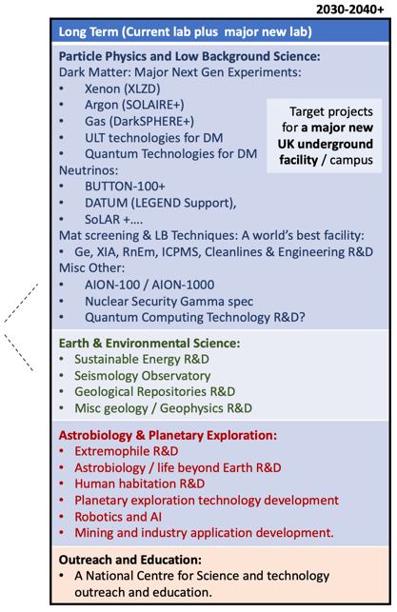
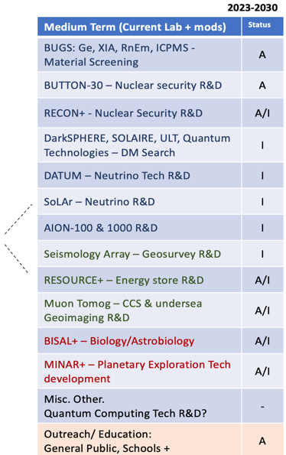
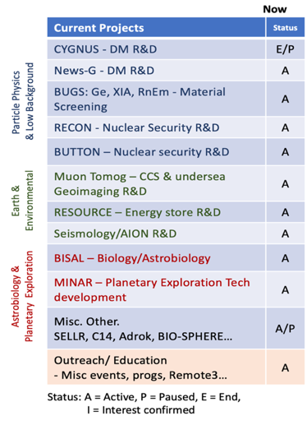
Future facilities & science @ Boulby?
Boulby Activities Now and in the Future

Slide 14
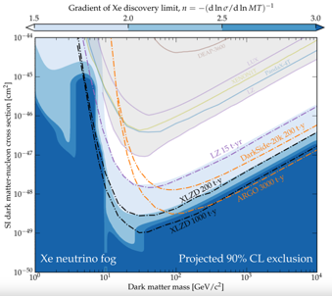
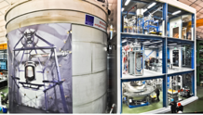
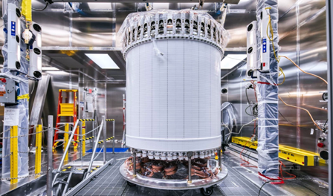

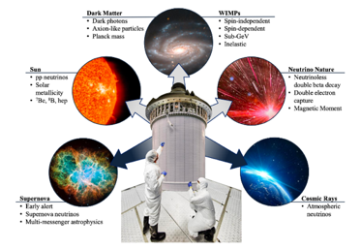

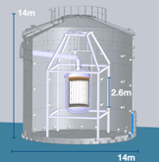
Next Generation Xe-based Dark Matter Detector (XLZD)
Projected sensitivity
(Akerib P5 town hall mtg 2023)
Lux-ZEPLIN (LZ). SURF, S. Dakota, USA
XLZD
2021 merging of LZ, Xenon and DARWIN teams
LZ:
10 T Liquid Xenon
Xenon-nT
LNGS, Italy
Next generation world’s best Dark Matter (+) detector. Expected 2030+
XLZD
50-100T LXe
Operation 2032+
Site evaluation underway 2023-5
DARWIN
(Proposed)
LZ: SURF, USA
Could XLZD be constructed and operated at Boulby 2030+?
LZ: 10T 2-phase Drk Matter detector operating in SURF lab, USA. Early 2-phase Xe technology developed in the UK. STFC/UK investment continues.

Slide 15
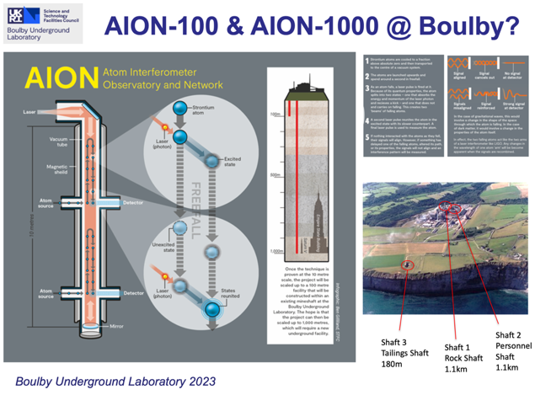

Future facilities & science @ Boulby?
Quantum Sensors and Quantum Computing
AION-100 & 100: Atomic interformetry for GW and light DM studies
Quantum Computing in Ultralow background environment

Slide 16


UK Underground Science Facilities. Now and the Future…
What Boulby Is:
An internationally-important centre for pure & applied multi-disciplinary science.
A local (North East) and national asset for science, technology and outreach/education.
A successful and proud example of science and industry partnership
A UKRI/UK facility with potential, opportunity and support for wide-ranging growth.
STFC/Boulby now looking to: continue to develop the UK underground science facilities to further enable truly internationally-important astro-particle physics and pure and applied multi-disciplinary science.
Short term: Maximally exploit the current Boulby facility to host world class Underground Science:
Medium-to long term: Prepare to build a major new deep underground science facility in the UK to host next-generation world-leading science projects coming 2030+
UKRI’s Future Underground Dark Matter Experiments Fund - 2024
Boulby Development Project:
Plans & preparations for a major new multi-disciplinary Deep Underground Science Facility in the UK

Slide 17


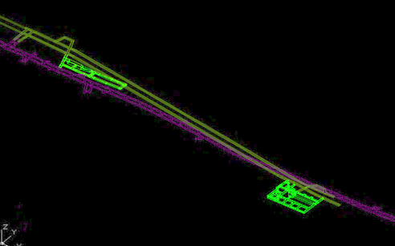
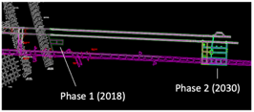

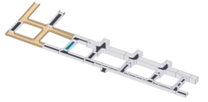
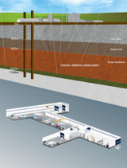
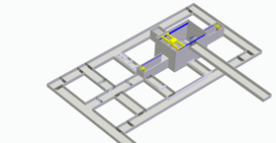
Boulby Development Project
Task 1: Site and design Development.
Stage 1: Clean manufacturing and multi-science lab in salt (1.1km) - 2028
Stage 1 (2028)
Stage 2 (2030)
Stage 2: Full depth science lab in Polyhalite (1.3km) ~2030+
A new lab @ Boulby
Stage 1 (Salt)
DRAFT: 2-stage Designs
~(30m)³ main cavity
Total volume
(Stage 1 + stage 2) ~120,000m³
Stage 2
(Polyhalite)
Stage 2 Polyhalite)
Excavations for stage 1 of expansion currently expected to begin mid-2024.
Phase 1 lab (salt 1.1km)

Slide 18
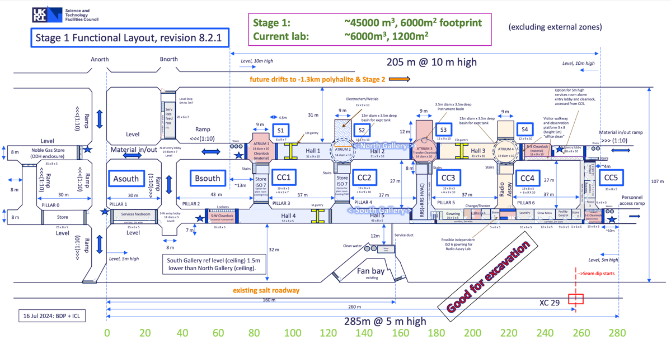
Boulby Development Project: Stage 1 Functional Design

Slide 19
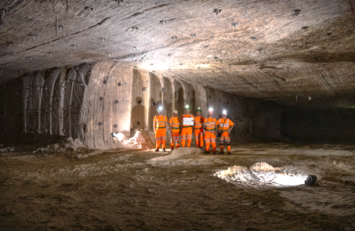
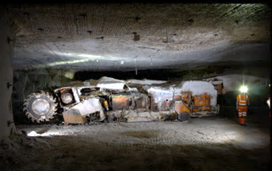
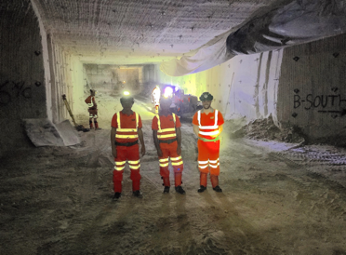
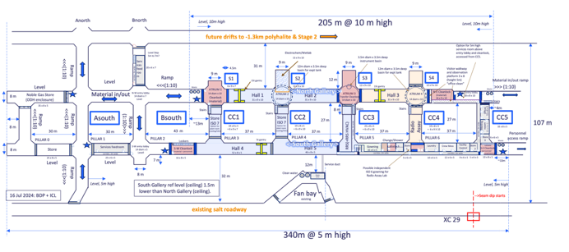
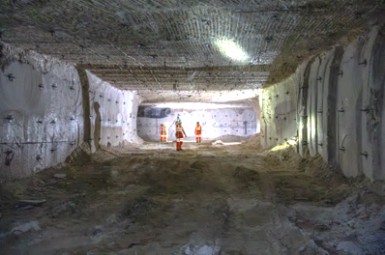
Boulby Development Project:
Stage 1 Excavation
Progress August 2024
Stage 1 Functional Design
Excavation well underway. Completion mid 2025 (Outfitting ~2028)

Slide 20
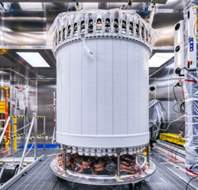



The Boulby Development Project (BDP)…
“Towards a major new underground science facility in the North East, with the potential to host a major international science infrastructure, such as a next generation dark matter experiment.”
LZ:
10 T Liquid Xenon
A new world-leading UK underground science facility hosting next-generation science 2030+
  Searches for Dark Matter (inc. XLZD)
  Neutrino studies
  Quantum Sensors, Quantum Computing
  Pure & applied low background particle physics
  Earth and Environmental Sciences
  Astrobiology & planetary exploration.
  Outreach, Education and more…
Next Generation (XLZD: 50-100T) to operate in the UK?
DRAFT design from 2021 Boulby Feasibility study
A LARGER and more ADVANCED lab is needed for major new science to be hosted in the UK
A new UK facility will bring:
HIGH-impact, world-leading science
LARGE multi-national collaborations
BIG fundamental science questions
MAJOR local & national investment, employment, impact and visibility
Government ‘fit’: Levelling Up, Strength in Places, UK Science Superpower…
Boulby Development Project (BDP)
3-year Preliminary IF-funded study
  ~£3M from 2022-2025
  Site & facility development
  Science prog development
  Business case development
  Stakeholder liaison
  Led by STFC/UKRI & UK science community

Slide 21
Quantum@Boulby 2024:
Opportunities, possibilities and requirements for future Quantum Sensor and Quantum Computing work at Boulby Underground Lab
Purpose:
Update all on expansion of facilities at Boulby and opportunities for Quantum
Discuss / identify how Boulby can help in future Quantum R&D. What is the Value Proposition?
Identify future quantum work areas that could/should be undertaken at Boulby by UK community.
Welcome!

