Slide 1





Slide deck status UK OFFICIAL non commercially sensitive
All collaborations, contracts and 3rd party references in public domain
© NQCC 2024
The National Quantum Strategy
and Boulby
Dr Michael N Cuthbert
Director – National Quantum Computing Centre
michael.cuthbert@stfc.ac.uk

Slide 2







Quantum 1.0
X-Rays
Lasers
Scanning Probe
Microscopy
Nuclear Power
Electronics &
Computing
Superfluids &
mK temperatures
Superconductivity
& MRI
Much of the technology we now take for granted developed during the 20th century with underpinning theoretical description using quantum physics we now label Quantum 1.0
This technology typically relies on two fundamental characteristics of quantum mechanics coherence and localisation
Slide deck status UK OFFICIAL non commercially sensitive
All collaborations, contracts and 3rd party references in public domain
© NQCC 2024
Notes:
Quantum 1.0 is a retrospective term for much of the technology we are familiar with developed in the second half of the 20th Century
It is worthy of note that many of the key applications identified are core to the history an growth of Oxford Instruments since our inception in 1959, for most applications the system integrator has lead commercial exploitation of these technologies, the most notable exception being Intel and their component delivery of processor chips into the electronics and computing industries.
Note:
Applications utilising ‘coherence’ include lasers, superfluids, superconductivity
Coherence is when multiple particle occupy the same energy state to form a single macroscopic ground state such as population inversion in lasers stimulating laser light, bose-einsetio condensation in super fluids creating a single superfluid ground state and electrons forming Cooper pairs in superconductors.
Applications utilising ‘localisation’ are SPM, electronics, computing, MRI, X-Rays
Localisation is when multiple wave forms constructively or destructively interfere to define a density of states in a particular energy state or physical location – this could be in a 2D electron gas in a semiconductor with confinement in 1 dimension and freedom in the other 2 or in a Quantum Dot with confinement in all 3 dimensions. Other examples include electron tunnelling in an STM tip, electron transport in semi-conductors, X-Ray generation from bremsstrahlung in X-ray tubes, Synchotrons and Cylotrons as well as Nuclear decay and Nuclear Magnetic Resonance.

Slide 3



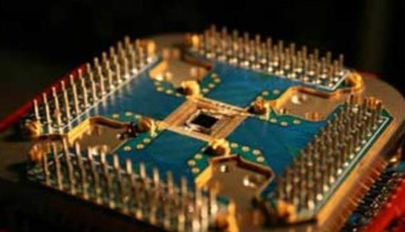
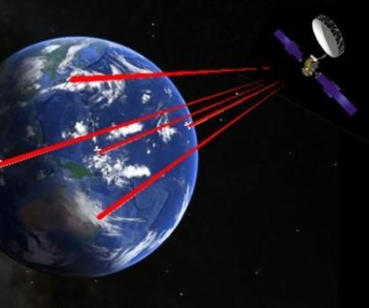
Quantum 2.0
Clocks &
Timing
Sensors &
Metrology
Imaging
Computation &
Simulation
Communications
& Encryption
There is a new technology revolution underway further exploiting the fundamental properties of quantum physics which will impact on the world around us we now label Quantum 2.0
This technology relies on two further fundamental characteristics of quantum mechanics superposition and entanglement
Slide deck status UK OFFICIAL non commercially sensitive
All collaborations, contracts and 3rd party references in public domain
© NQCC 2024
Notes:
Quantum 2.0 is a term coined to describe the new key technologies employing “superposition” and “entanglement” as the underpinning principles of operation
The key themes emerging in the Quantum Technologies sector are:
Quantum Clocks
Quantum Sensors & Metrology
Quantum Imaging
Quantum Computation & Simulation
Quantum Communications & Encryption
Many of the underpinning technology enablers cross disciplines and are complimentary
Note:
Superposition of states is when any 2 state system such as the spin of an electron (up or down) or the flow of current in a superconducting loop (clockwise or anticlockwise) can be prepared such that the state is quantum mechanically in both states simultaneously until either the system decays into one or other state or a measurement is made causing the system to collapse into one or other state. In classical computing the bits are either representative of a 1 or a 0, in Quantum Computing the Qubits are a ‘Superposition’ of both a 1 and a 0 and defined by a probabilty function 1/sqrt(2) x (|1>^2 + |0>^2)
Entanglement is the binding of particles, photon or Qubits together such that the measurement of one particle defines the status of the other entangled state. For example a pair of entangled electron spins prepared through a series of selection rules would require an up spin to be in existence on electron 1 if a down spin was measured on electron 2 even if they were physically separated and immediately prior to the measurement in a superposition of states. This was conjectured in the 1935 by Einstein, Podolski & Rosen in a thought experiment which conjectured the Heisenberg Uncertainty Principle could be broken unless ‘information’ could travel faster than the speed of light informing the second particle that the first particle had been measured. This is now often referred to in popular media as ‘spooky action at a distance’
It is worthy of note that the market opportunities in Quantum 2.0 are not yet clear whether they will be at a system or component level.

Slide 4
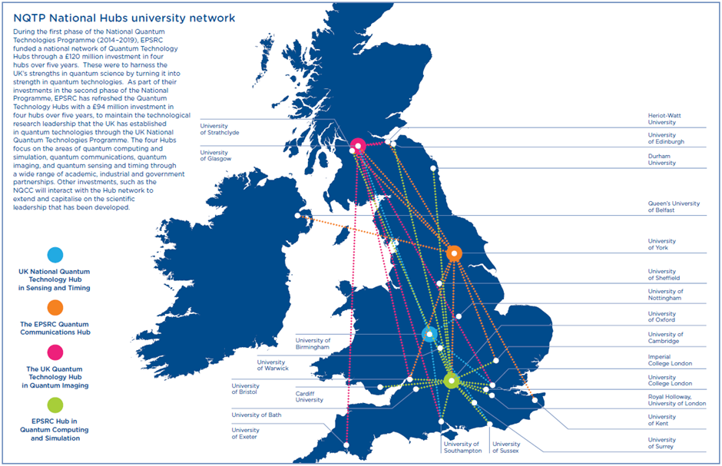











The seven technology families of UK strength and opportunity …
#5: Electronics, Photonics and Quantum
Quantum Technologies:
Phase 1 (5 year programme):
2014-2019
Initial budget commitment of £270m
Grew to >£400m by 2019
Research hubs, skills and industry support
Slide deck status UK OFFICIAL non commercially sensitive
All collaborations, contracts and 3rd party references in public domain
© NQCC 2024
Notes:
The National Quantum Technologies Programme was established in 2014
4 quantum hubs were established and then further refreshed in 2019
Phase 1 focused on converting research excellence into technology prototypes and plugging the skills deficit
Phase 2 seeks to drive commercialisation and economic impact
Onto this network of academic research, government engagement, industry and venture investment, supply chain growth and international collaboration the NQCC is established
The path to commercialisation for quantum computing is lengthy, hardware development costly, systems integration challenging and commercial end users laggard adopters
Recent analysis from Anchored In:
Startup growth up from £135m to £245m raised in the past year
Employment growth up from 370 to 590 in the past year

Slide 5
The seven technology families of UK strength and opportunity …
#5: Electronics, Photonics and Quantum
Quantum Technologies:
Phase 1 (5 year programme):
2014-2019
Initial budget commitment of £270m
Grew to >£400m by 2019
Research hubs, skills and industry support
Phase 2 (5 year programme):
2019-2024
Hubs renewed (£95m)
Skills & Training (£67m)
NQCC (£93m)
International Collaborations
ISCF Industry led projects (£173m/£205m)
QT for Fundamental Physics (£40m)
Slide deck status UK OFFICIAL non commercially sensitive
All collaborations, contracts and 3rd party references in public domain
© NQCC 2024
Notes:
The National Quantum Technologies Programme was established in 2014
4 quantum hubs were established and then further refreshed in 2019
Phase 1 focused on converting research excellence into technology prototypes and plugging the skills deficit
Phase 2 seeks to drive commercialisation and economic impact
Onto this network of academic research, government engagement, industry and venture investment, supply chain growth and international collaboration the NQCC is established
The path to commercialisation for quantum computing is lengthy, hardware development costly, systems integration challenging and commercial end users laggard adopters
Recent analysis from Anchored In:
Startup growth up from £135m to £245m raised in the past year
Employment growth up from 370 to 590 in the past year

Slide 6

The seven technology families of UK strength and opportunity …
#5: Electronics, Photonics and Quantum
Quantum Technologies:
Phase 1 (5 year programme):
2014-2019
Initial budget commitment of £270m
Grew to >£400m by 2019
Research hubs, skills and industry support
Phase 2 (5 year programme):
2019-2024
Hubs renewed (£95m)
Skills & Training (£67m)
NQCC (£93m)
International Collaborations
ISCF Industry led projects (£173m/£205m)
QT for Fundamental Physics (£40m)
National Quantum
Computing Centre
Slide deck status UK OFFICIAL non commercially sensitive
All collaborations, contracts and 3rd party references in public domain
© NQCC 2024
Notes:
The National Quantum Technologies Programme was established in 2014
4 quantum hubs were established and then further refreshed in 2019
Phase 1 focused on converting research excellence into technology prototypes and plugging the skills deficit
Phase 2 seeks to drive commercialisation and economic impact
Onto this network of academic research, government engagement, industry and venture investment, supply chain growth and international collaboration the NQCC is established
The path to commercialisation for quantum computing is lengthy, hardware development costly, systems integration challenging and commercial end users laggard adopters
Recent analysis from Anchored In:
Startup growth up from £135m to £245m raised in the past year
Employment growth up from 370 to 590 in the past year

Slide 7
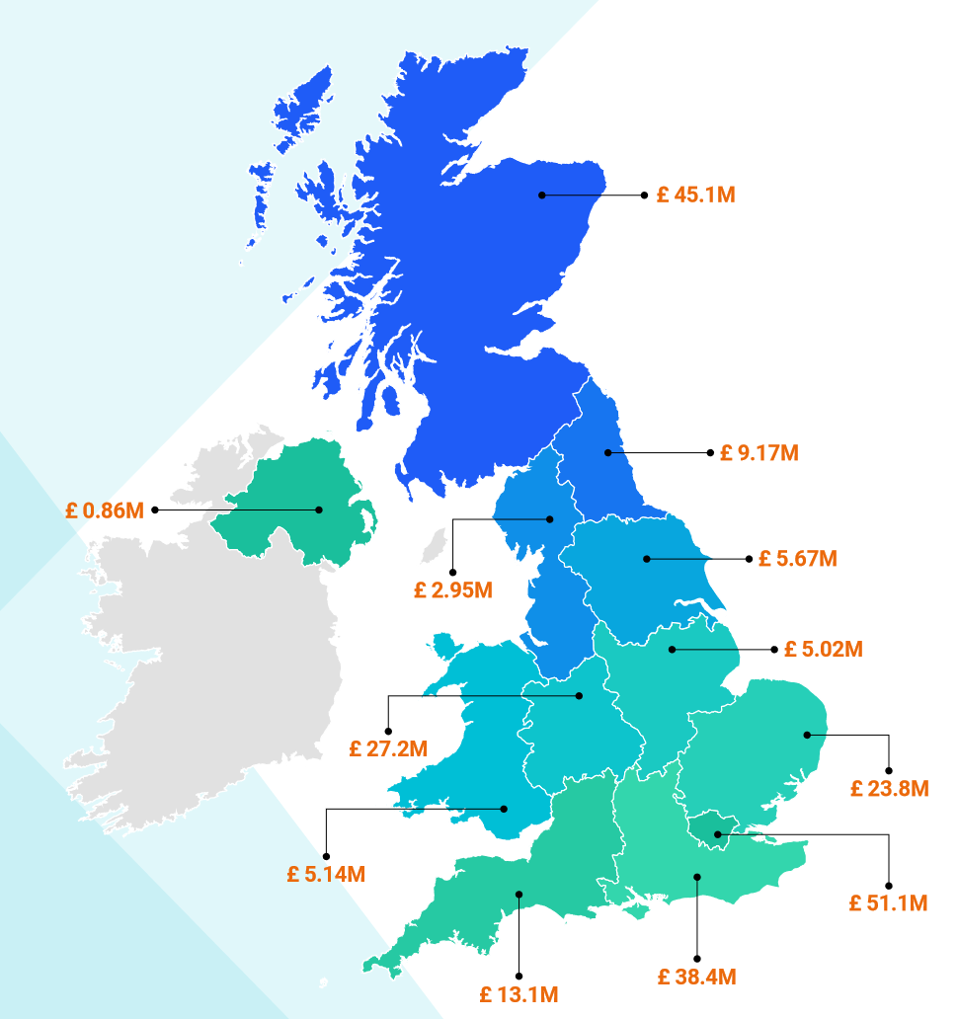
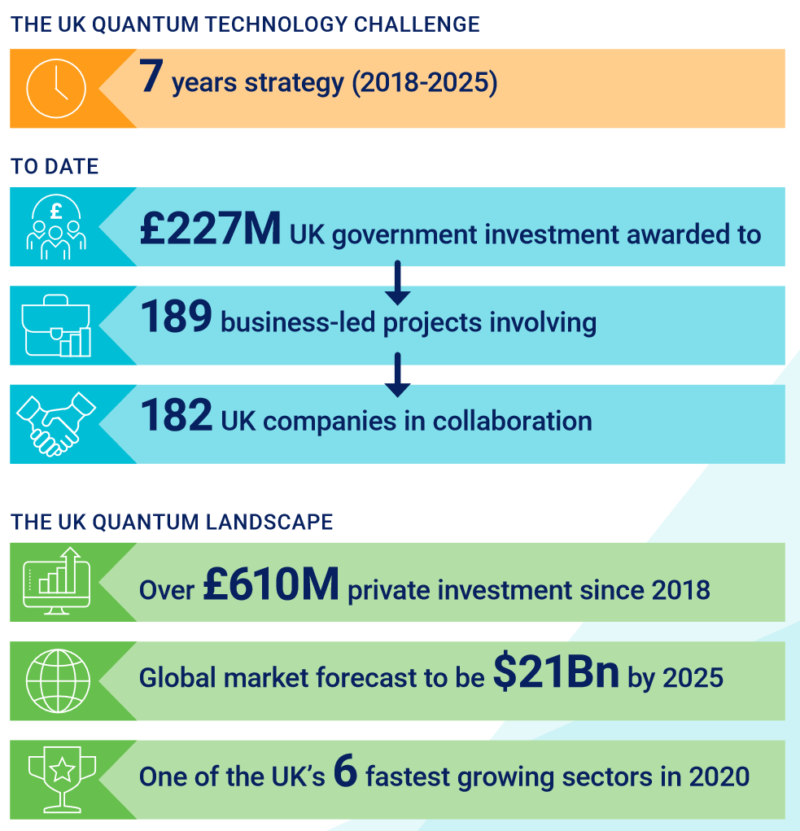
The seven technology families of UK strength and opportunity …
#5: Electronics, Photonics and Quantum
Quantum Technologies:
Phase 1 (5 year programme):
2014-2019
Initial budget commitment of £270m
Grew to >£400m by 2019
Research hubs, skills and industry support
Phase 2 (5 year programme):
2019-2024
Hubs renewed (£95m)
Skills & Training (£67m)
NQCC (£93m)
International Collaborations
ISCF Industry led projects (£173m/£205m)
QT for Fundamental Physics (£40m)
Slide deck status UK OFFICIAL non commercially sensitive
All collaborations, contracts and 3rd party references in public domain
© NQCC 2024
Notes:
The National Quantum Technologies Programme was established in 2014
4 quantum hubs were established and then further refreshed in 2019
Phase 1 focused on converting research excellence into technology prototypes and plugging the skills deficit
Phase 2 seeks to drive commercialisation and economic impact
Onto this network of academic research, government engagement, industry and venture investment, supply chain growth and international collaboration the NQCC is established
The path to commercialisation for quantum computing is lengthy, hardware development costly, systems integration challenging and commercial end users laggard adopters
Recent analysis from Anchored In:
Startup growth up from £135m to £245m raised in the past year
Employment growth up from 370 to 590 in the past year

Slide 8

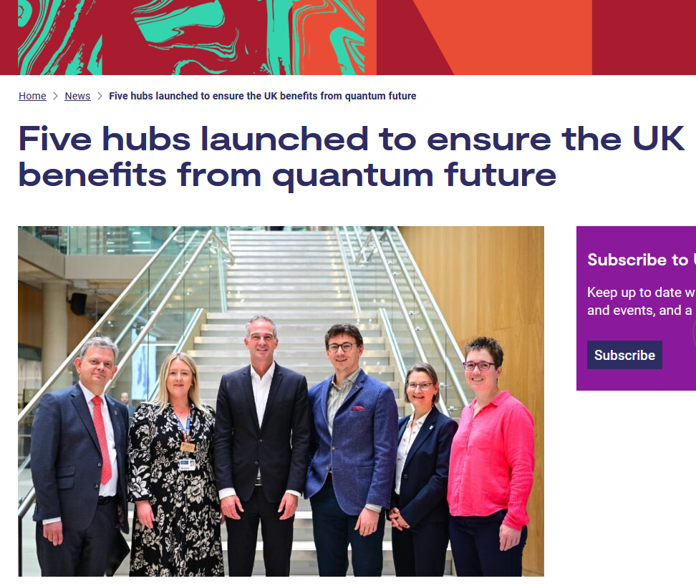





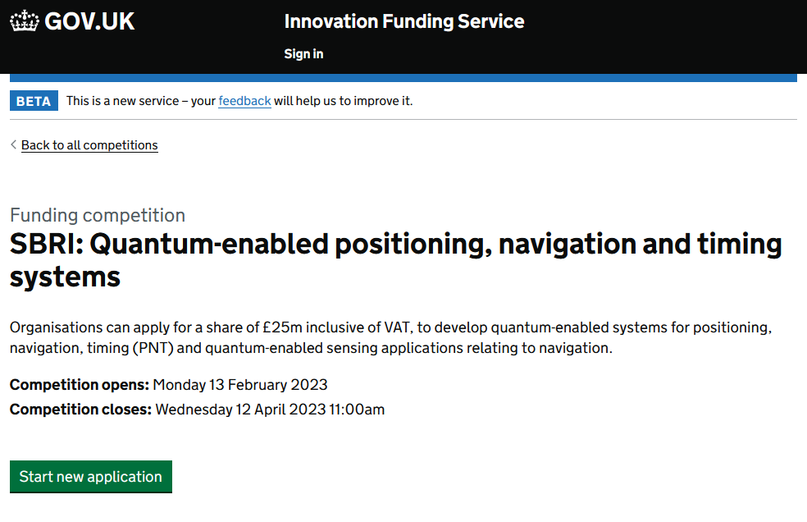
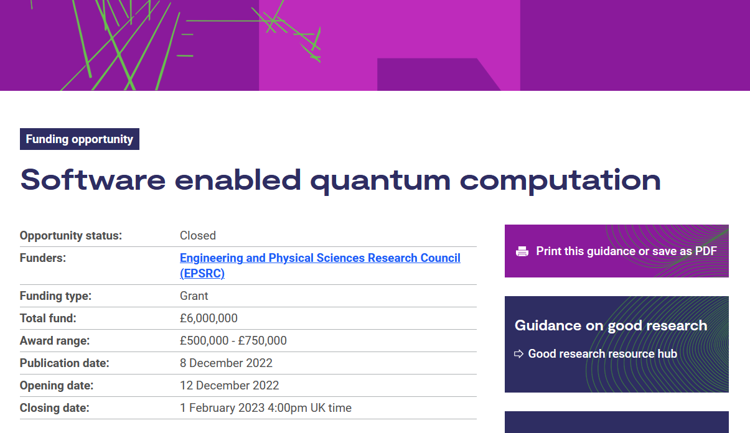
The five critical technologies …
#5: Quantum Technologies: devices and systems which rely on quantum mechanics, to provide capabilities that ‘classical’ machines cannot.
Quantum Technologies:
Phase 1 (5 year programme):
2014-2019
Initial budget commitment of £270m
Grew to >£400m by 2019
Research hubs, skills and industry support
Phase 2 (5 year programme):
2019-2024
Hubs renewed (£95m)
Skills & Training (£67m)
NQCC (£93m)
International Collaborations
ISCF Industry led projects (£173m/£205m)
QT for Fundamental Physics (£40m)
Phase 3 (5 year programme):
2024-2029
Technology Missions Fund:
  Quantum-enabled PNT (£35m)
  Demonstrable Quantum Advantage (£20m)
  Quantum Computing Testbed SBRI (£30m)
Quantum Hub refresh competition (£106m)
Doctoral Training Centres (£40m)
DSIT Office for Quantum
UK Quantum Strategy (10 year programme - £2.5bn)
Slide deck status UK OFFICIAL non commercially sensitive
All collaborations, contracts and 3rd party references in public domain
© NQCC 2024
Notes:
The National Quantum Technologies Programme was established in 2014
4 quantum hubs were established and then further refreshed in 2019
Phase 1 focused on converting research excellence into technology prototypes and plugging the skills deficit
Phase 2 seeks to drive commercialisation and economic impact
Onto this network of academic research, government engagement, industry and venture investment, supply chain growth and international collaboration the NQCC is established
The path to commercialisation for quantum computing is lengthy, hardware development costly, systems integration challenging and commercial end users laggard adopters
Recent analysis from Anchored In:
Startup growth up from £135m to £245m raised in the past year
Employment growth up from 370 to 590 in the past year

Slide 9


The five critical technologies …
#5: Quantum Technologies: devices and systems which rely on quantum mechanics, to provide capabilities that ‘classical’ machines cannot.
Quantum Technologies:
Phase 1 (5 year programme):
2014-2019
Initial budget commitment of £270m
Grew to >£400m by 2019
Research hubs, skills and industry support
Phase 2 (5 year programme):
2019-2024
Hubs renewed (£95m)
Skills & Training (£67m)
NQCC (£93m)
International Collaborations
ISCF Industry led projects (£173m/£205m)
QT for Fundamental Physics (£40m)
Phase 3 (5 year programme):
2024-2029
Technology Missions Fund:
  Quantum-enabled PNT (£35m)
  Demonstrable Quantum Advantage (£35m)
  Quantum Computing Testbed SBRI (£30m)
Quantum Hub refresh competition (£106m)
DSIT Office for Quantum
UK Quantum Strategy (10 year programme - £2.5bn)
QEPNT (University of Glasgow)
Quantum Enabled Position Navigation & Timing
IQN (Heriot-Watt University)
Integrated Quantum Networks
QuSIT (University of Birmingham)
Quantum Tech Hub in Sensing, Imaging & Timing
QCI3 (University of Oxford)
Quantum Computing via Integrated and Interconnected Implementations
Q-BIOMED (UCL/University of Cambridge)
Quantum Biomedical Sensing Research Hub
Slide deck status UK OFFICIAL non commercially sensitive
All collaborations, contracts and 3rd party references in public domain
© NQCC 2024
Notes:
The National Quantum Technologies Programme was established in 2014
4 quantum hubs were established and then further refreshed in 2019
Phase 1 focused on converting research excellence into technology prototypes and plugging the skills deficit
Phase 2 seeks to drive commercialisation and economic impact
Onto this network of academic research, government engagement, industry and venture investment, supply chain growth and international collaboration the NQCC is established
The path to commercialisation for quantum computing is lengthy, hardware development costly, systems integration challenging and commercial end users laggard adopters
Recent analysis from Anchored In:
Startup growth up from £135m to £245m raised in the past year
Employment growth up from 370 to 590 in the past year

Slide 10
National Quantum Strategy
Our ten-year vision is for the UK to be a world leading quantum-enabled economy, building on scientific excellence and creating a thriving quantum sector to ensure that quantum technologies are an integral part of the UK’s digital infrastructure and advanced manufacturing base, driving growth and helping to build a strong and resilient economy and society.
Ensure the UK is home to world-leading quantum science and engineering, growing UK knowledge and skills
Support business, making the UK the go-to place for quantum businesses and an integral part of the global supply chain, as well as a preferred location for investors and global talent
Drive the use of quantum technologies in the UK to deliver benefits for the economy, for society and for our national security
Create a national and international regulatory framework that supports innovation and the ethical use of quantum technologies, and protects UK capabilities and national security
Slide deck status UK OFFICIAL non commercially sensitive
All collaborations, contracts and 3rd party references in public domain
© NQCC 2024
Notes:
The National Quantum Technologies Programme was established in 2014
4 quantum hubs were established and then further refreshed in 2019
Phase 1 focused on converting research excellence into technology prototypes and plugging the skills deficit
Phase 2 seeks to drive commercialisation and economic impact
Onto this network of academic research, government engagement, industry and venture investment, supply chain growth and international collaboration the NQCC is established
The path to commercialisation for quantum computing is lengthy, hardware development costly, systems integration challenging and commercial end users laggard adopters
Recent analysis from Anchored In:
Startup growth up from £135m to £245m raised in the past year
Employment growth up from 370 to 590 in the past year

Slide 11
National Quantum Strategy
Our ten-year vision is for the UK to be a world leading quantum-enabled economy, building on scientific excellence and creating a thriving quantum sector to ensure that quantum technologies are an integral part of the UK’s digital infrastructure and advanced manufacturing base, driving growth and helping to build a strong and resilient economy and society.
Ensure the UK is home to world-leading quantum science and engineering, growing UK knowledge and skills
Support business, making the UK the go-to place for quantum businesses and an integral part of the global supply chain, as well as a preferred location for investors and global talent
10yr £2.5bn
Commercialisation
Infrastructure
Business support
Supply chain growth
Inward investment
Global trade
Drive the use of quantum technologies in the UK to deliver benefits for the economy, for society and for our national security
Create a national and international regulatory framework that supports innovation and the ethical use of quantum technologies, and protects UK capabilities and national security
Slide deck status UK OFFICIAL non commercially sensitive
All collaborations, contracts and 3rd party references in public domain
© NQCC 2024
Notes:
The National Quantum Technologies Programme was established in 2014
4 quantum hubs were established and then further refreshed in 2019
Phase 1 focused on converting research excellence into technology prototypes and plugging the skills deficit
Phase 2 seeks to drive commercialisation and economic impact
Onto this network of academic research, government engagement, industry and venture investment, supply chain growth and international collaboration the NQCC is established
The path to commercialisation for quantum computing is lengthy, hardware development costly, systems integration challenging and commercial end users laggard adopters
Recent analysis from Anchored In:
Startup growth up from £135m to £245m raised in the past year
Employment growth up from 370 to 590 in the past year

Slide 12
National Quantum Strategy
Our ten-year vision is for the UK to be a world leading quantum-enabled economy, building on scientific excellence and creating a thriving quantum sector to ensure that quantum technologies are an integral part of the UK’s digital infrastructure and advanced manufacturing base, driving growth and helping to build a strong and resilient economy and society.
Ensure the UK is home to world-leading quantum science and engineering, growing UK knowledge and skills
Support business, making the UK the go-to place for quantum businesses and an integral part of the global supply chain, as well as a preferred location for investors and global talent
10yr £2.5bn
Trusted Research
Technical Standards
Technical Assurance
Cyber Security
Economic protection
Ethical deployment
Drive the use of quantum technologies in the UK to deliver benefits for the economy, for society and for our national security
Create a national and international regulatory framework that supports innovation and the ethical use of quantum technologies, and protects UK capabilities and national security
Slide deck status UK OFFICIAL non commercially sensitive
All collaborations, contracts and 3rd party references in public domain
© NQCC 2024
Notes:
The National Quantum Technologies Programme was established in 2014
4 quantum hubs were established and then further refreshed in 2019
Phase 1 focused on converting research excellence into technology prototypes and plugging the skills deficit
Phase 2 seeks to drive commercialisation and economic impact
Onto this network of academic research, government engagement, industry and venture investment, supply chain growth and international collaboration the NQCC is established
The path to commercialisation for quantum computing is lengthy, hardware development costly, systems integration challenging and commercial end users laggard adopters
Recent analysis from Anchored In:
Startup growth up from £135m to £245m raised in the past year
Employment growth up from 370 to 590 in the past year

Slide 13
National Quantum Strategy
Our ten-year vision is for the UK to be a world leading quantum-enabled economy, building on scientific excellence and creating a thriving quantum sector to ensure that quantum technologies are an integral part of the UK’s digital infrastructure and advanced manufacturing base, driving growth and helping to build a strong and resilient economy and society.
Ensure the UK is home to world-leading quantum science and engineering, growing UK knowledge and skills
Support business, making the UK the go-to place for quantum businesses and an integral part of the global supply chain, as well as a preferred location for investors and global talent
10yr £2.5bn
Applications focus
Use case development
Test bed access
Gov procurement
Drive the use of quantum technologies in the UK to deliver benefits for the economy, for society and for our national security
Create a national and international regulatory framework that supports innovation and the ethical use of quantum technologies, and protects UK capabilities and national security
Slide deck status UK OFFICIAL non commercially sensitive
All collaborations, contracts and 3rd party references in public domain
© NQCC 2024
Notes:
The National Quantum Technologies Programme was established in 2014
4 quantum hubs were established and then further refreshed in 2019
Phase 1 focused on converting research excellence into technology prototypes and plugging the skills deficit
Phase 2 seeks to drive commercialisation and economic impact
Onto this network of academic research, government engagement, industry and venture investment, supply chain growth and international collaboration the NQCC is established
The path to commercialisation for quantum computing is lengthy, hardware development costly, systems integration challenging and commercial end users laggard adopters
Recent analysis from Anchored In:
Startup growth up from £135m to £245m raised in the past year
Employment growth up from 370 to 590 in the past year

Slide 14
National Quantum Strategy
Our ten-year vision is for the UK to be a world leading quantum-enabled economy, building on scientific excellence and creating a thriving quantum sector to ensure that quantum technologies are an integral part of the UK’s digital infrastructure and advanced manufacturing base, driving growth and helping to build a strong and resilient economy and society.
Ensure the UK is home to world-leading quantum science and engineering, growing UK knowledge and skills
Support business, making the UK the go-to place for quantum businesses and an integral part of the global supply chain, as well as a preferred location for investors and global talent
10yr £2.5bn
Research Hubs
Skills
International partners
Quantum missions
Innovation funding
Tech accelerators
Drive the use of quantum technologies in the UK to deliver benefits for the economy, for society and for our national security
Create a national and international regulatory framework that supports innovation and the ethical use of quantum technologies, and protects UK capabilities and national security
Slide deck status UK OFFICIAL non commercially sensitive
All collaborations, contracts and 3rd party references in public domain
© NQCC 2024
Notes:
The National Quantum Technologies Programme was established in 2014
4 quantum hubs were established and then further refreshed in 2019
Phase 1 focused on converting research excellence into technology prototypes and plugging the skills deficit
Phase 2 seeks to drive commercialisation and economic impact
Onto this network of academic research, government engagement, industry and venture investment, supply chain growth and international collaboration the NQCC is established
The path to commercialisation for quantum computing is lengthy, hardware development costly, systems integration challenging and commercial end users laggard adopters
Recent analysis from Anchored In:
Startup growth up from £135m to £245m raised in the past year
Employment growth up from 370 to 590 in the past year

Slide 15
National Quantum Strategy
Our ten-year vision is for the UK to be a world leading quantum-enabled economy, building on scientific excellence and creating a thriving quantum sector to ensure that quantum technologies are an integral part of the UK’s digital infrastructure and advanced manufacturing base, driving growth and helping to build a strong and resilient economy and society.
Ensure the UK is home to world-leading quantum science and engineering, growing UK knowledge and skills
Support business, making the UK the go-to place for quantum businesses and an integral part of the global supply chain, as well as a preferred location for investors and global talent
10yr £2.5bn
Research Hubs
Skills
International partners
Quantum missions
Innovation funding
Tech accelerators
Drive the use of quantum technologies in the UK to deliver benefits for the economy, for society and for our national security
Create a national and international regulatory framework that supports innovation and the ethical use of quantum technologies, and protects UK capabilities and national security
Slide deck status UK OFFICIAL non commercially sensitive
All collaborations, contracts and 3rd party references in public domain
© NQCC 2024
Notes:
The National Quantum Technologies Programme was established in 2014
4 quantum hubs were established and then further refreshed in 2019
Phase 1 focused on converting research excellence into technology prototypes and plugging the skills deficit
Phase 2 seeks to drive commercialisation and economic impact
Onto this network of academic research, government engagement, industry and venture investment, supply chain growth and international collaboration the NQCC is established
The path to commercialisation for quantum computing is lengthy, hardware development costly, systems integration challenging and commercial end users laggard adopters
Recent analysis from Anchored In:
Startup growth up from £135m to £245m raised in the past year
Employment growth up from 370 to 590 in the past year

Slide 16






By 2030, every NHS Trust will benefit from quantum sensing-enabled solutions, helping those with chronic illness live healthier, longer lives through early diagnosis and treatment.
By 2030, quantum navigation systems, including clocks, will be deployed on aircraft, providing next-generation accuracy for resilience that is independent of satellite signals.
By 2030, mobile, networked quantum sensors will have unlocked new situational awareness capabilities, exploited across critical infrastructure in the transport, telecoms, energy, and defence sectors.
By 2035, there will be accessible, UK-based quantum computers capable of running 10¹² operations and supporting applications that provide benefits in excess of classical supercomputers across key sectors of the economy.
By 2035, the UK will have deployed the world’s most advanced quantum network at scale, pioneering the future quantum internet.
Slide deck status UK OFFICIAL non commercially sensitive
All collaborations, contracts and 3rd party references in public domain
© NQCC 2024

Slide 17
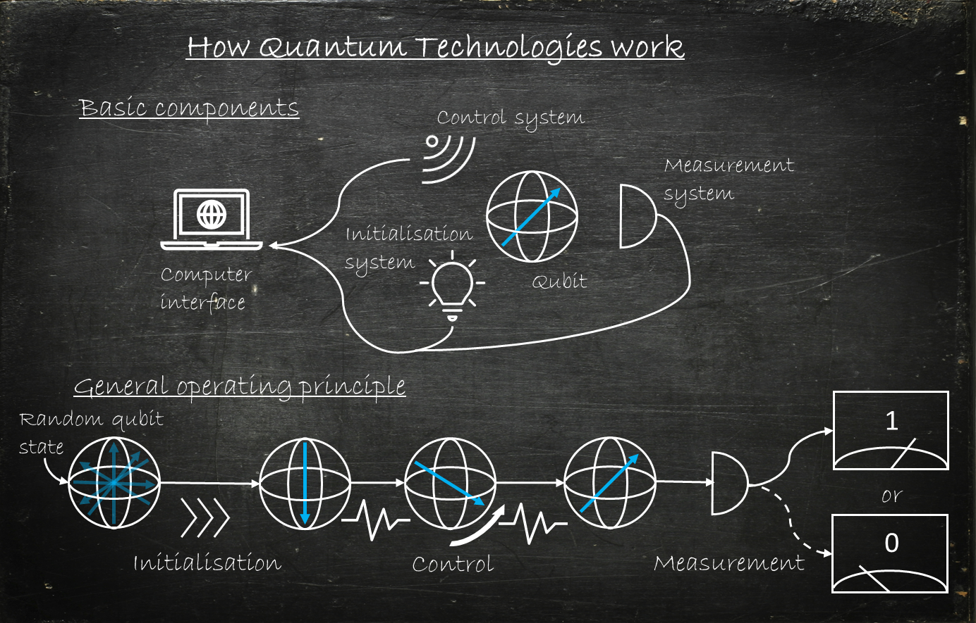
https://researchcentre.army.gov.au/library/land-power-forum/quantum-technology-introduction

Slide 18
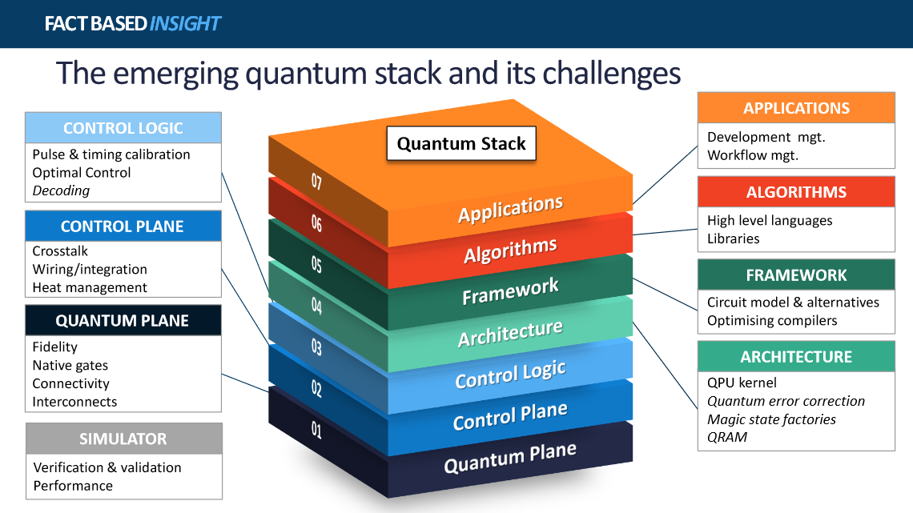

Slide 19
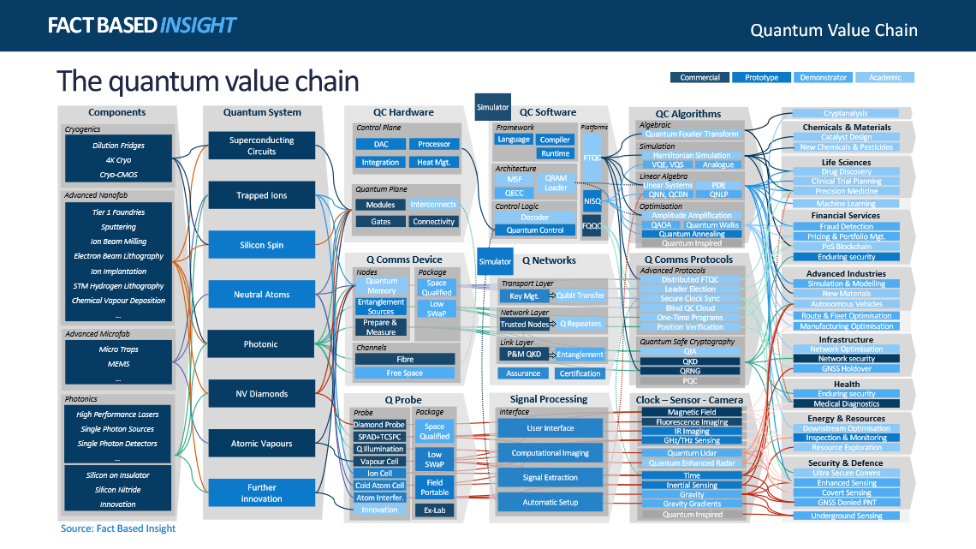


Slide 20
https://researchcentre.army.gov.au/library/land-power-forum/quantum-technology-introduction
The UK National Quantum Technologies Programme to commercialise quantum technology for economic and societal benefit is dependent on ever improving error rates, scalable technology, interconnected technologies and long-term operation.
We need to understand correlated errors in the quantum stack – what is the role and limitation placed on quantum technology by cosmic rays?
Computational time, decoherence, error rates, error mitigation & correction, material choices, control architectures, initialisation and detection, latency, bit-flips in classical hardware …
Slide deck status UK OFFICIAL non commercially sensitive
All collaborations, contracts and 3rd party references in public domain
© NQCC 2024

Slide 21
The five critical technologies …
#5: Quantum Technologies: devices and systems which rely on quantum mechanics, to provide capabilities that ‘classical’ machines cannot.
The UK National Quantum Technologies Programme to commercialise quantum technology for economic and societal benefit is dependent on ever improving error rates, scalable technology, interconnected technologies and long-term operation.
Quantum Technologies:
Phase 1 (5 year programme):
2014-2019
Initial budget commitment of £270m
Grew to >£400m by 2019
Research hubs, skills and industry support
Phase 2 (5 year programme):
2019-2024
Hubs renewed (£95m)
Skills & Training (£67m)
NQCC (£93m)
International Collaborations
ISCF Industry led projects (£173m/£205m)
QT for Fundamental Physics (£40m)
Phase 3 (5 year programme):
2024-2029
Technology Missions Fund:
  Quantum-enabled PNT (£35m)
  Demonstrable Quantum Advantage (£35m)
  Quantum Computing Testbed SBRI (£30m)
Quantum Hub refresh competition (£106m)
DSIT Office for Quantum
UK Quantum Strategy (10 year programme - £2.5bn)
IQN (Heriot-Watt University)
Integrated Quantum Networks
QEPNT (University of Glasgow)
Quantum Enabled Position Navigation & Timing
STFC Boulby Underground Laboratory
Low background quantum test infrastructure
QuSIT (University of Birmingham)
Quantum Tech Hub in Sensing, Imaging & Timing
QCI3 (University of Oxford)
Quantum Computing via Integrated and Interconnected Implementations
Q-BIOMED (UCL/University of Cambridge)
Quantum Biomedical Sensing Research Hub
Slide deck status UK OFFICIAL non commercially sensitive
All collaborations, contracts and 3rd party references in public domain
© NQCC 2024
Notes:
The National Quantum Technologies Programme was established in 2014
4 quantum hubs were established and then further refreshed in 2019
Phase 1 focused on converting research excellence into technology prototypes and plugging the skills deficit
Phase 2 seeks to drive commercialisation and economic impact
Onto this network of academic research, government engagement, industry and venture investment, supply chain growth and international collaboration the NQCC is established
The path to commercialisation for quantum computing is lengthy, hardware development costly, systems integration challenging and commercial end users laggard adopters
Recent analysis from Anchored In:
Startup growth up from £135m to £245m raised in the past year
Employment growth up from 370 to 590 in the past year

Slide 22
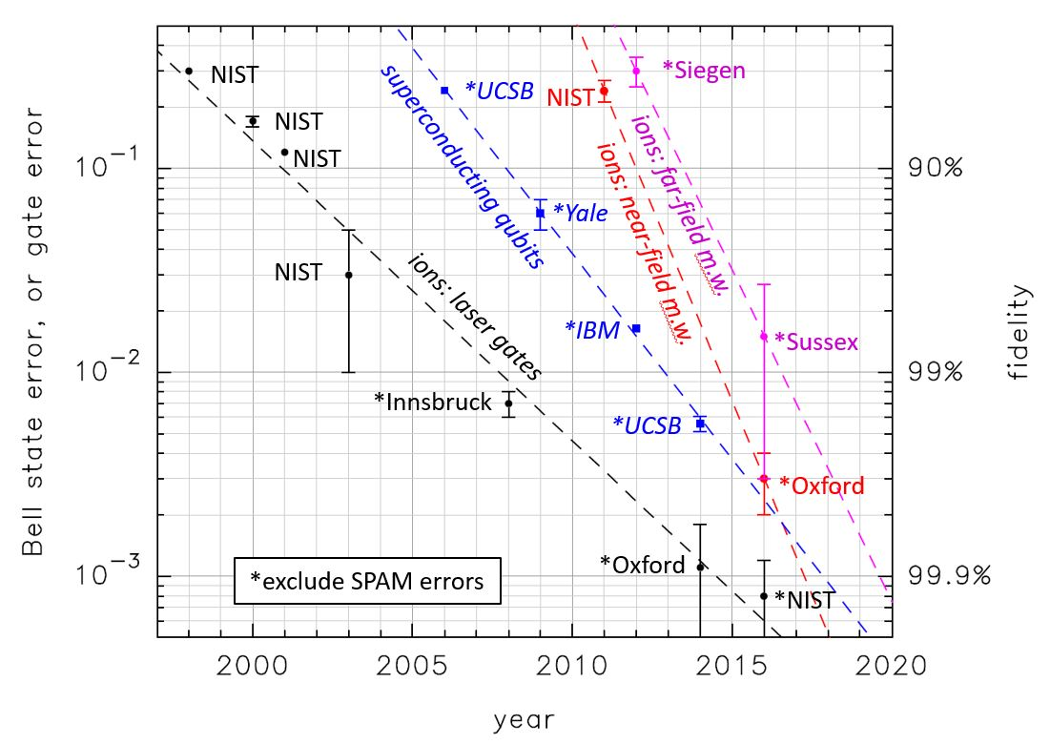
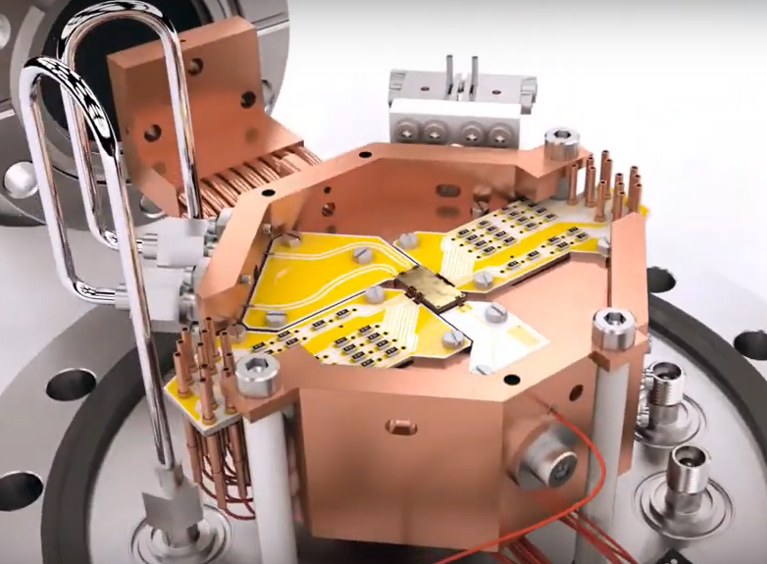
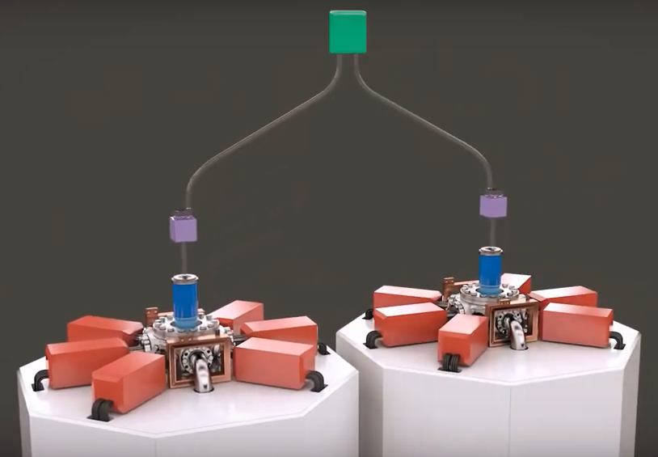
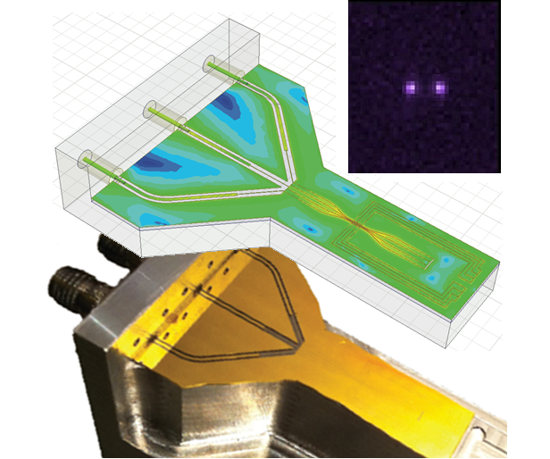


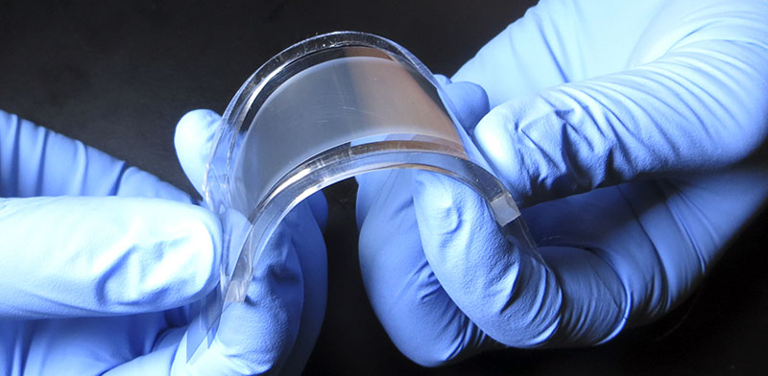

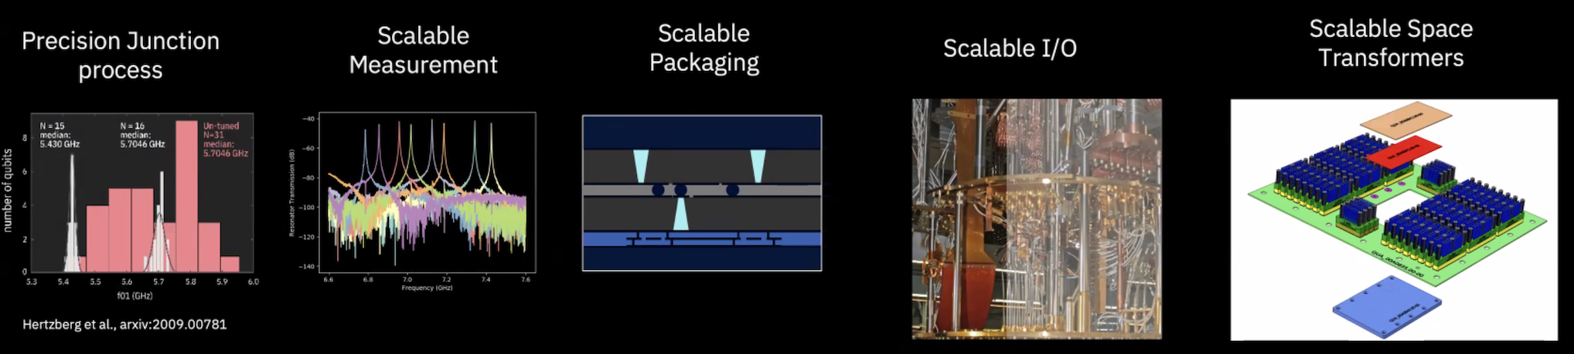
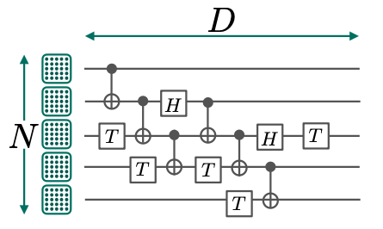
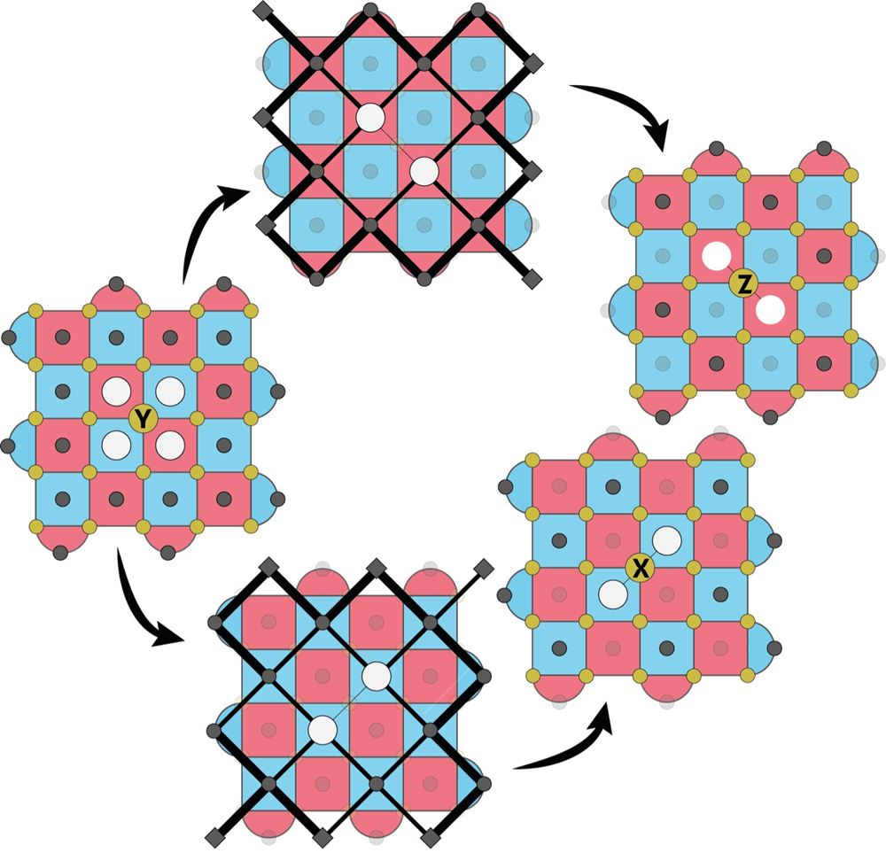

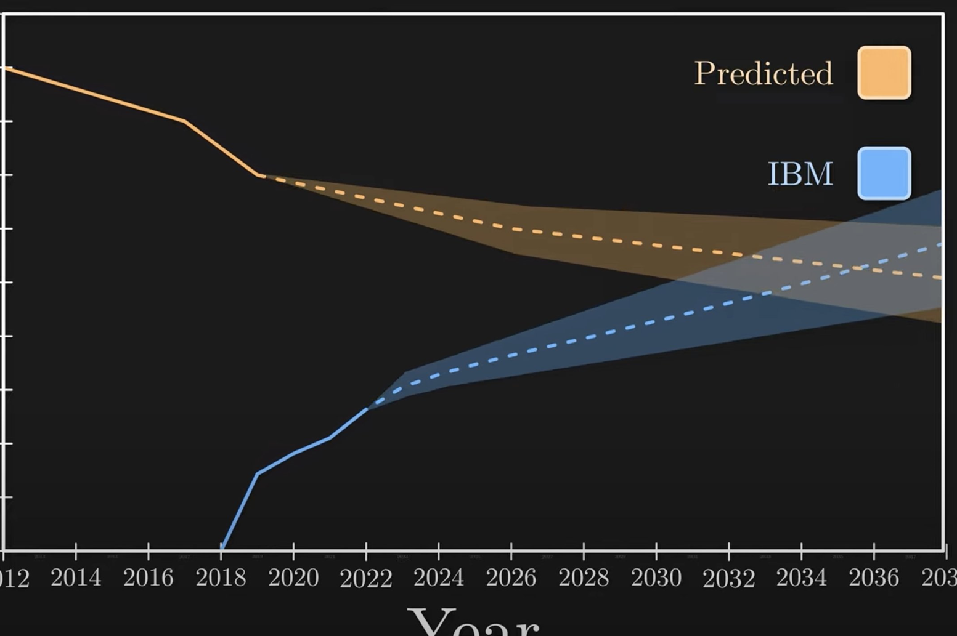
© NQCC 2024
2014-2021 |  | 2022-23 | 2024-25 | 2026-27 | 2028-29 | 2030-31 | 2032-33 | 2034-35 | 2036+
Applications |  |  |  | Resource estimation, bench marking and verification across a range of test-bed platforms | Quantum enhanced machine learning for financial Services Risk portfolio optimisation across finance, disease control and logistics | Simulation of chemical processes leading to improved catalyst design and improved EV battery performance | Quantum enhanced anomaly detection enabling early cancer detection from traditional scanning techniques Accelerated drug discovery through optimisation of target molecule identification | Optimisation of critical resources across the public sector including NHS and MOD Enhanced outcomes in fundamental science across particle physics, chemistry, soft matter and life sciences. | Clean hydrogen: Methane reforming with transition metal oxides. Carbon capture: Catalytic functionalisation of carbon dioxide Green fertiliser production
Technology |  |  | < 10²+qubits Portfolio of qubit platforms Error rates < 1:10² | 10²+ qubits Portfolio of qubit platforms Error rates < 1:10³ | 10³+ qubits Down-selection of scalable platforms Error rates < 1:10⁴ | 10⁴+ qubits Small-scale error correction demonstrated Device networking demonstrated | 10⁵ qubits Large-scale error correction demonstrated Fault tolerant algorithm performance demonstrated | 10⁶ qubits | 10⁸ qubits UK Quantum Datacentre(s) established
Performance |  |  | 10² QuOps Noisy small scale computation | 10³ QuOps Hardware specific algorithm enhancement | 10⁴ QuOps Error mitigation Hardware specific single-purpose QC | 10⁵ QuOps Error mitigation Hardware independent single purpose QC Hardware specific multi-purpose QC | 10⁶ QuOps Error correction Hardware independent general-purpose QC | 10⁹ QuOps Fault tolerance | 10¹² QuOps General-purpose QC at scale
NISQ-era |  |  |  |  |  | Quantum Advantage |  | Quantum Advantage at Scale
NQIT Research Hub
QCS Research Hub
Phase 3 Research Hub(s)
Architecture
Hardware
Applications
Engineering Support
Commercialisation
Outreach & Impact
Hardware
Software
Architectures
Algorithms
Applications
Quantum-Classical Interfaces
Hardware (qubit performance, noise sources, calibration and control)
Error mitigation and error correction, benchmarking, verification, theory and standards
Development and execution of applications for NISQ and fault tolerant platforms
Community building through networks & integration of high performance computation
NQCC Programme
NQCC Programme
Technology readiness TRL 4-7
Infrastructure & environment
Workforce & User Development
In-house development
Collaborative R&D
Government procurement
Hosting & co-location
Supporting inward investment
Supply Chain Development
Skills & training
User access & Technical Support
Eco-system & economic growth
SparQ User Engagement Programme
User Engagement
QC Cloud Access
Quantum Software Lab
Benchmarking
Software Enabled QC
Verification
ISCF Wave 3 CR&D
QA Feasibility
Control Architecture
Networking
ISCF Wave 3 Tech
Use Case & Algorithms
Supply Chain Development
Error Correction
Hardware Scaling
Nitrogen Fixation
Carbon Capture
Quantum Computing Mission
Efficiently convert nitrogen to fertilizer
100-200 qubits: Design catalysts to enable efficient fertilizer production
Capture carbon at any location directly from the air
100-200 qubits: Design catalysts to capture waste carbon using less energy
NQCC Testbed (2024)
NQCC Testbed (2028)
Delivery
Evaluation
Delivery
Evaluation
Room temperature superconductors & organic batteries
1000’s qubits: Simulate large solid state systems
Minimise GPU learning and approximate methods
100’s-1000’s qubits: Improve on approximate computational methods
Materials Science
Machine Learning

