Slide 1








At the limits of isolation: Low Background, Ultralow Temperature
Quantum Enhanced Superfluid Technologies for Dark Matter and Cosmology
QTFP funded project:
  Phase transitions in extreme matter
  Detection of sub-GeV dark matter with a quantum-amplified superfluid ³He calorimeter
Linked through an experimental approach of combining quantum sensors with ³He at ultralow temperatures and theoretically through beyond-standard model physics.
Andrew Casey, Quantum@Boulby, 16/09/24

Slide 2
At the limits of isolation: Low Background, Ultralow Temperature
Quantum Enhanced Superfluid Technologies for Dark Matter and Cosmology
In the process of applying Quantum technology to fundamental physics questions we are learning more about the effects of the environment on the quantum technologies and how to mitigate through going underground / low background.
Recent workshops:
Radiation Impact on Superconducting Qubits (Fermilab 2024), https://indico.fnal.gov/event/63132/
SQMS Quantum for Science (London 2024), https://indico.cern.ch/event/1379776/
Andrew Casey, Quantum@Boulby, 16/09/24

Slide 3
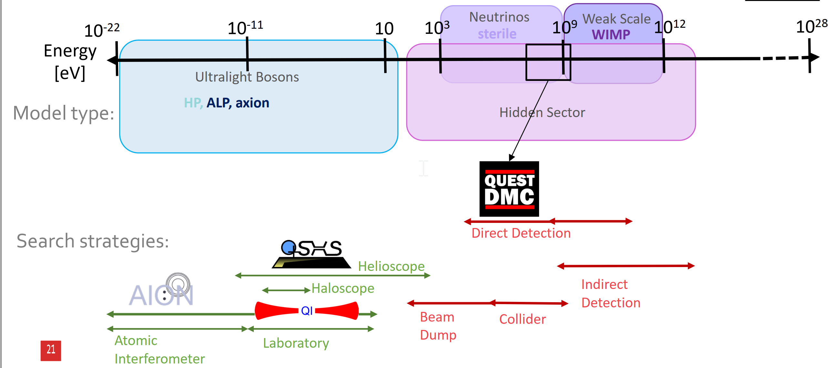
At the limits of isolation: Dark Matter Searches
Andrew Casey, Quantum@Boulby, 16/09/24

Slide 4
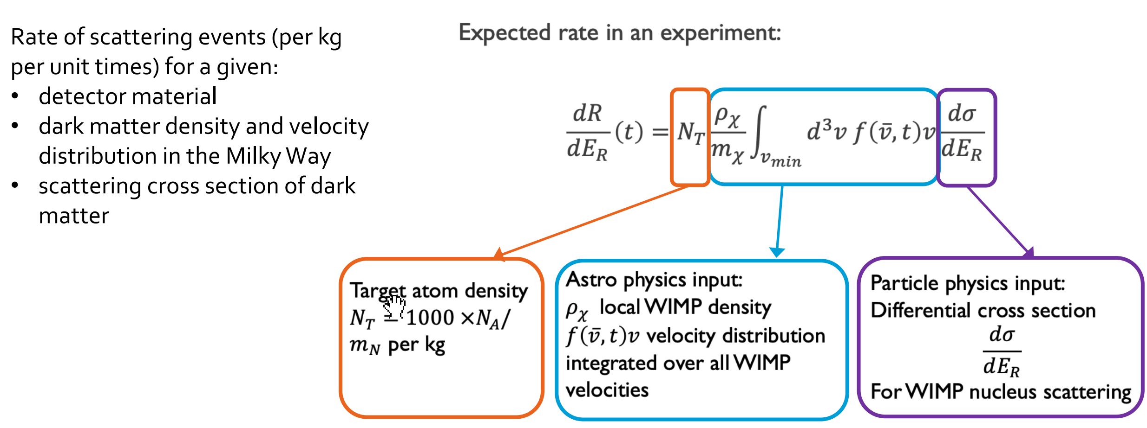
Rate of scattering event calculation
At the limits of isolation: Dark Matter Searches
Andrew Casey, Quantum@Boulby, 16/09/24

Slide 5
At the limits of isolation: Low Background, Ultralow Temperature
Rare event searches –
Dark Matter,
Gravitational Waves,
Coherent elastic neutrino-nucleus scattering.
Preparation and manipulation of macroscopic quantum states –
Qubits, Force sensors
Andrew Casey, Quantum@Boulby, 16/09/24

Slide 6
At the limits of isolation: Low Background, ULT
Rare event searches –
Dark Matter,
Gravitational Waves,
Coherent elastic neutrino-nucleus scattering.
Unwanted energy deposition
Preparation and manipulation of macroscopic quantum states –
Qubits, Force sensors
Andrew Casey, Quantum@Boulby, 16/09/24

Slide 7
At the limits of isolation: Low Background, ULT
Rare event searches –
Dark Matter,
Gravitational Waves,
Coherent elastic neutrino-nucleus scattering.
Events swamped by background counts
Unwanted energy deposition
Preparation and manipulation of macroscopic quantum states –
Qubits, Force sensors
Fragility - decoherence:
Andrew Casey, Quantum@Boulby, 16/09/24

Slide 8
At the limits of isolation: Low Background, ULT
Rare event searches –
Dark Matter,
Gravitational Waves,
Coherent elastic neutrino-nucleus scattering.
Events swamped by background counts:
Discrimination methods
Unwanted energy deposition
Preparation and manipulation of macroscopic quantum states –
Qubits, Force sensors
Fragility - decoherence:
Robustness – design, topological materials, quasi-particle traps
Andrew Casey, Quantum@Boulby, 16/09/24

Slide 9
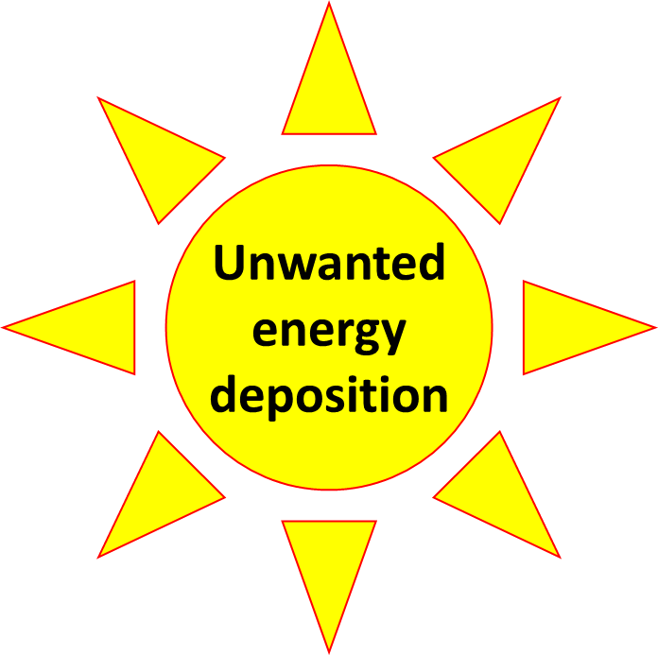
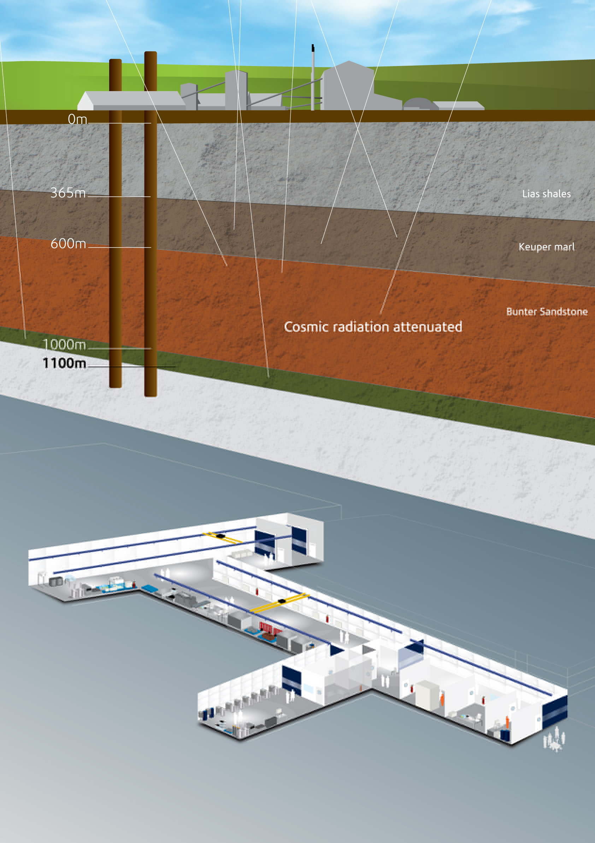
At the limits of isolation: Low Background, ULT
Rare event searches –
Dark Matter,
Gravitational Waves,
Coherent elastic neutrino-nucleus scattering.
Events swamped by background counts:
Discrimination methods
Combination of going underground and low radiogenic material selection can reduce BG
Preparation and manipulation of macroscopic quantum states –
Qubits, Force sensors
Fragility - decoherence:
Robustness – design, topological materials, quasi-particle traps
Andrew Casey, Quantum@Boulby, 16/09/24

Slide 10
At the limits of isolation: Low Background, ULT
Currently the UK has no sovereign capability of achieving the mK temperatures necessary to operate superconducting quantum technology in a deep underground low background environment.
Internationally there are labs with cryogen-free dilution refrigerators with new facilities coming online:
  The INFN’s LNGS Gran Sasso Lab, Canada’s SNOlab, Fermilab (NEXUS, SQMS (though not deep)), Australia’s Stawell Underground Physics Laboratory, possible DRs for the China Jinping Underground Laboratory
There are currently no ULT (sub mK) low background facilities in the world.
Andrew Casey, Quantum@Boulby, 16/09/24

Slide 11
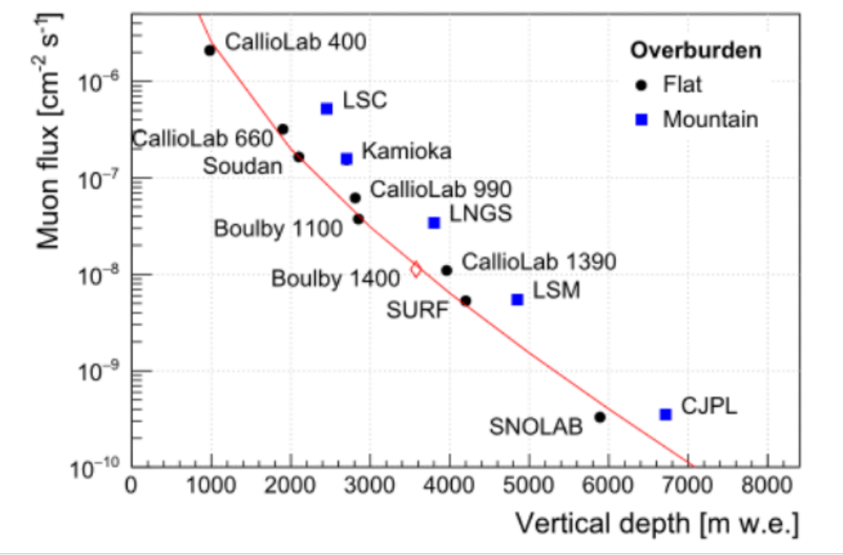
At the limits of isolation: Low Background, ULT
Andrew Casey, Quantum@Boulby, 16/09/24

Slide 12
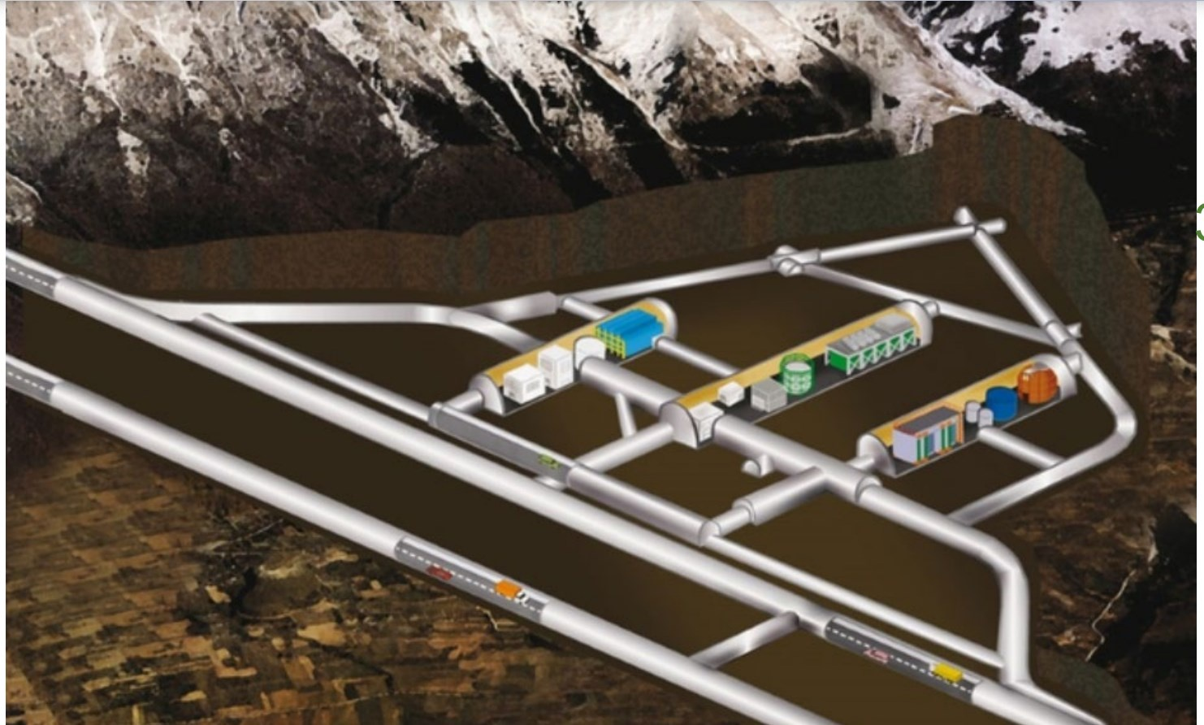
Rare Event Physics: INFN-LNGS Underground Lab
2x Oxford wet cryostat (Oxford 1000 and Oxford 200) belonging to the CUORE/CUPID collaboration 2x customized wet cryostats (Oxford 1000 and Leiden MNK-CF-500) belonging to the CRESST collaboration
1 Huge 10 years old wet cryostat (Leiden DRS-CF-2000) hosting the 1 Ton CUORE bolometric experiment
1 brand new (under commissioning in these days) custom Cryoconcept HEXA-DRY S hosting the COSINUS experiment
Andrew Casey, Quantum@Boulby, 16/09/24

Slide 13
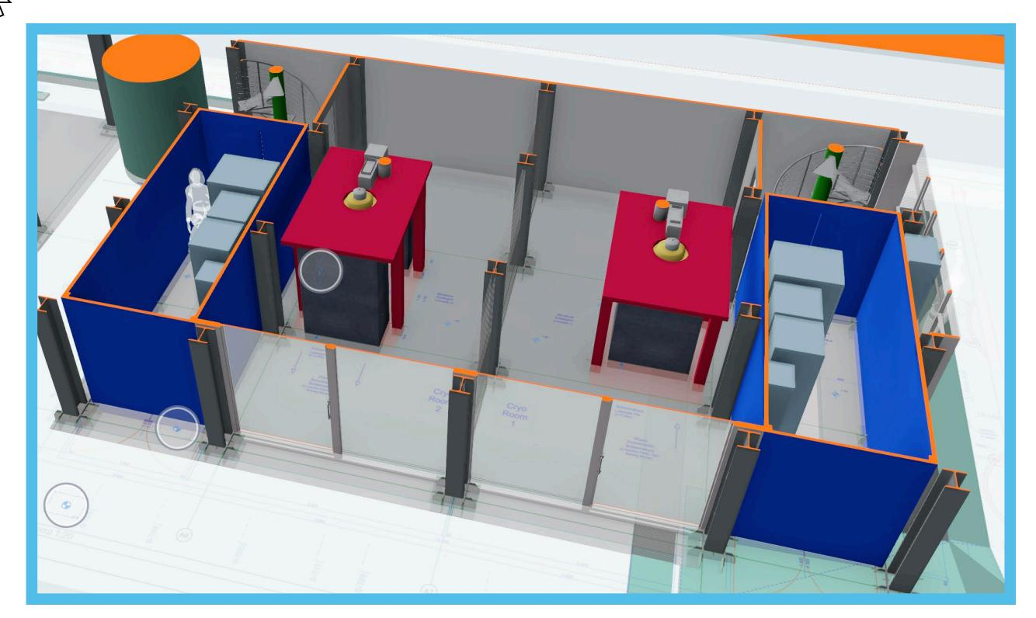
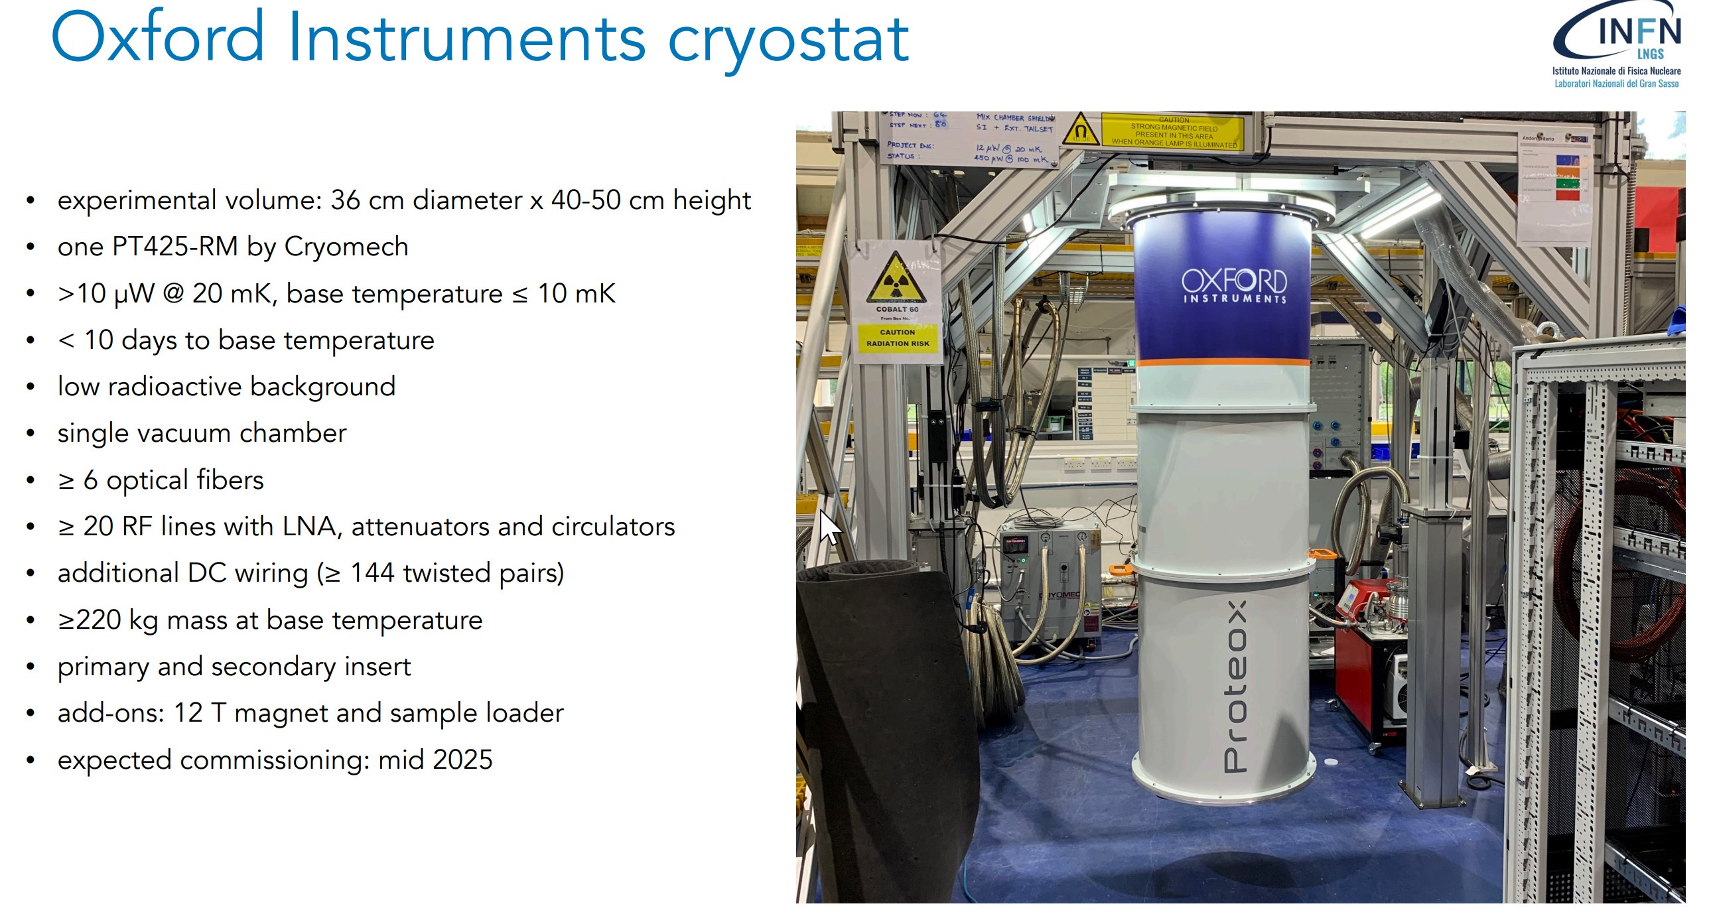
Cryo-P: 2025 cryogenics platform at LNGS
Andrew Casey, Quantum@Boulby, 16/09/24

Slide 14
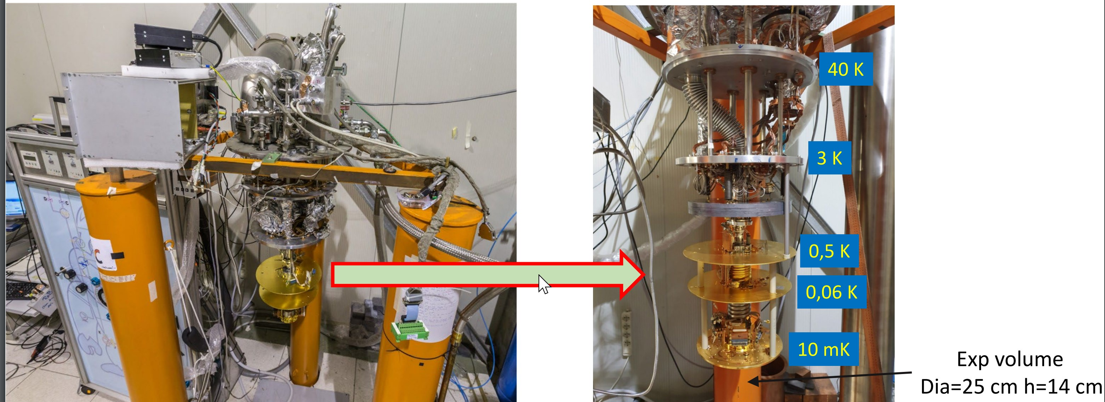
The IETI Facility: INFN-LNGS Underground Lab
Andrew Casey, Quantum@Boulby, 16/09/24

Slide 15
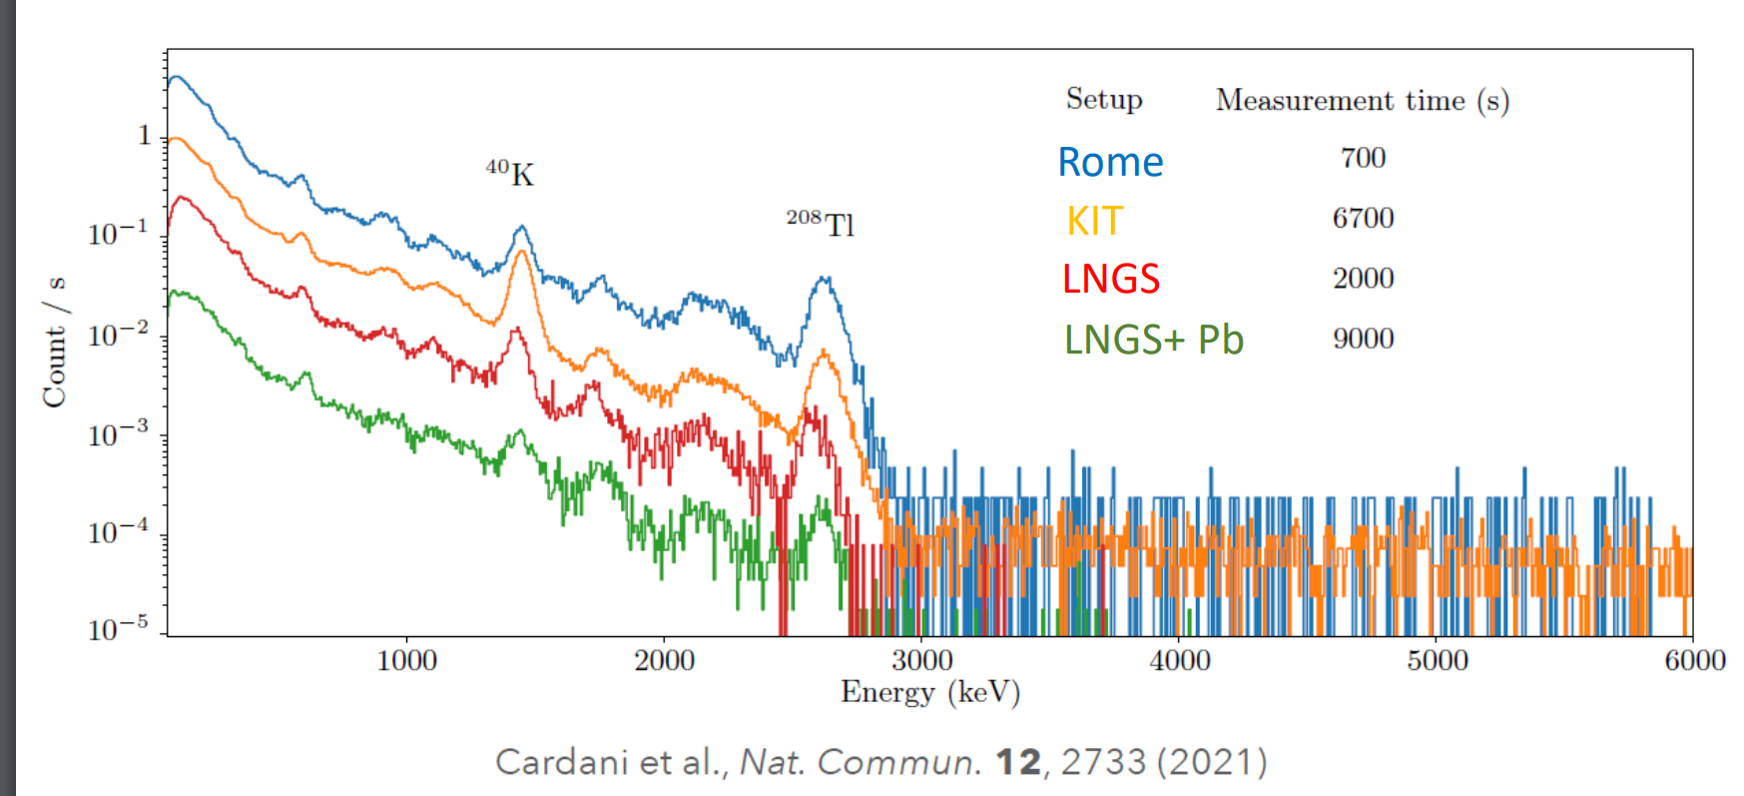
The IETI Facility: INFN-LNGS Underground Lab
Andrew Casey, Quantum@Boulby, 16/09/24

Slide 16
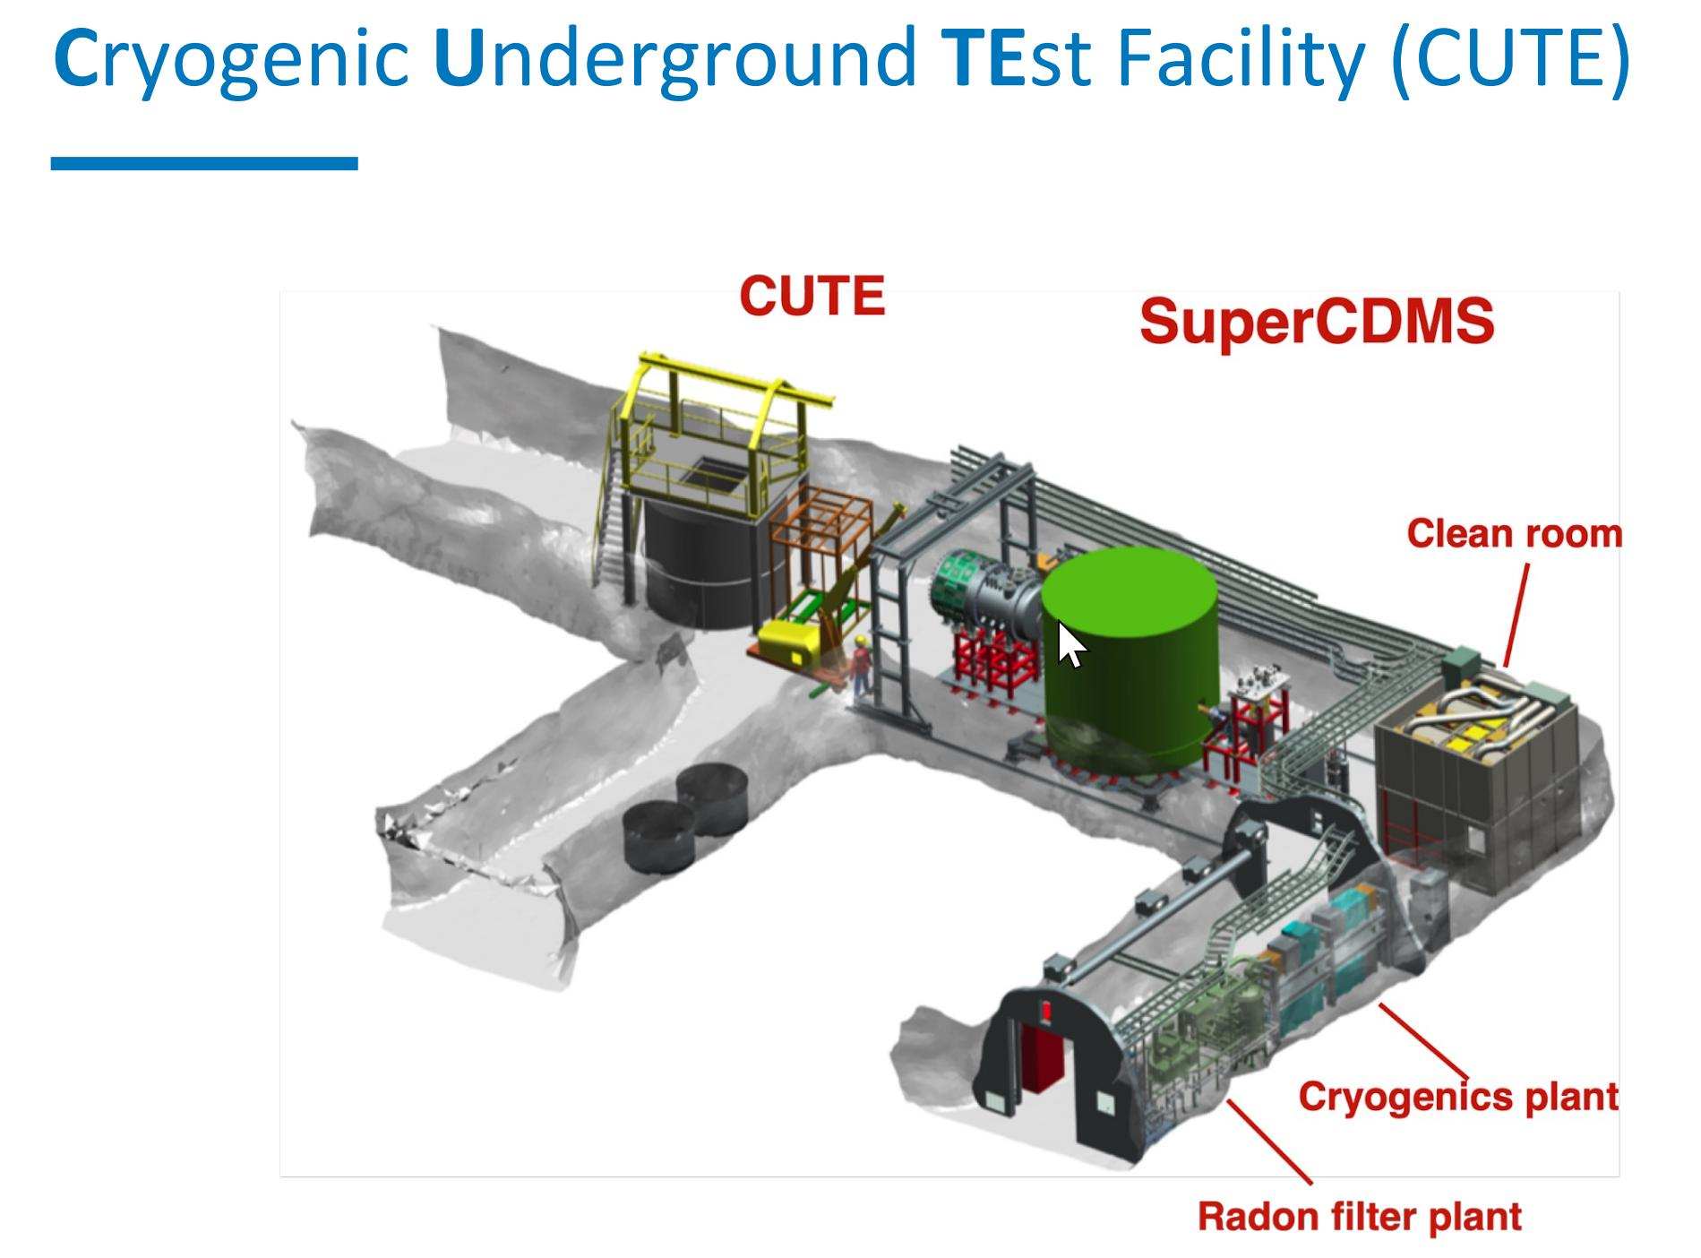
SNOLab
• Operational temperature to 12 mK
• Low overall radioactive background
• Minimal mechanical vibrations
• Low level of electromagnetic interference
• Availability of calibration sources (gamma, neutron)
• Full remote operations
• Low-radon, class 300 cleanroom to change payload
• Typical Rn level < 15 mBq/m³
Andrew Casey, Quantum@Boulby, 16/09/24

Slide 17
What are the Quantum Technolgies: Superconducting Devices
SQUIDs
  Coupled to Nano-electro-mechanical systems (NEMs)
HyQUIDs to replace SQUID
SiPM or Transition Edge Sensors to detect ionisation channel
Josephson Parametric Amplifiers (2nd generation ionisation channel)
Transmon Qubit coupled to NEMs beam to address multiple bolometers
Potentially Operating at ULT or remotely coupled to experiment
Lucas, M., Danilov, A.V., Levitin, L.V. et al. Quantum bath suppression in a superconducting circuit by immersion cooling. Nat Commun 14, 3522 (2023)
Andrew Casey, Quantum@Boulby, 16/09/24
Andrew Casey, Quantum@Boulby, 16/09/24
Notes:
These challenges have come at a time when there is an explosion of new quantum enhanced technologies. We are ideally positioned to implement the current generation of quantum sensors, in a new ultralow temperature regime using existing ULT platforms at RHUL and Lanc,.
And through our nanofabrication facilities ( Superfab in the UK Centre for Superconducting and Hybrid Quantum Systems at RHUL and the Quantum Technology Centre in Lancaster) and QT partners we are able to co-design hybrid quantum sensors explicitly to tackle these fundamental physics questions.

Slide 18
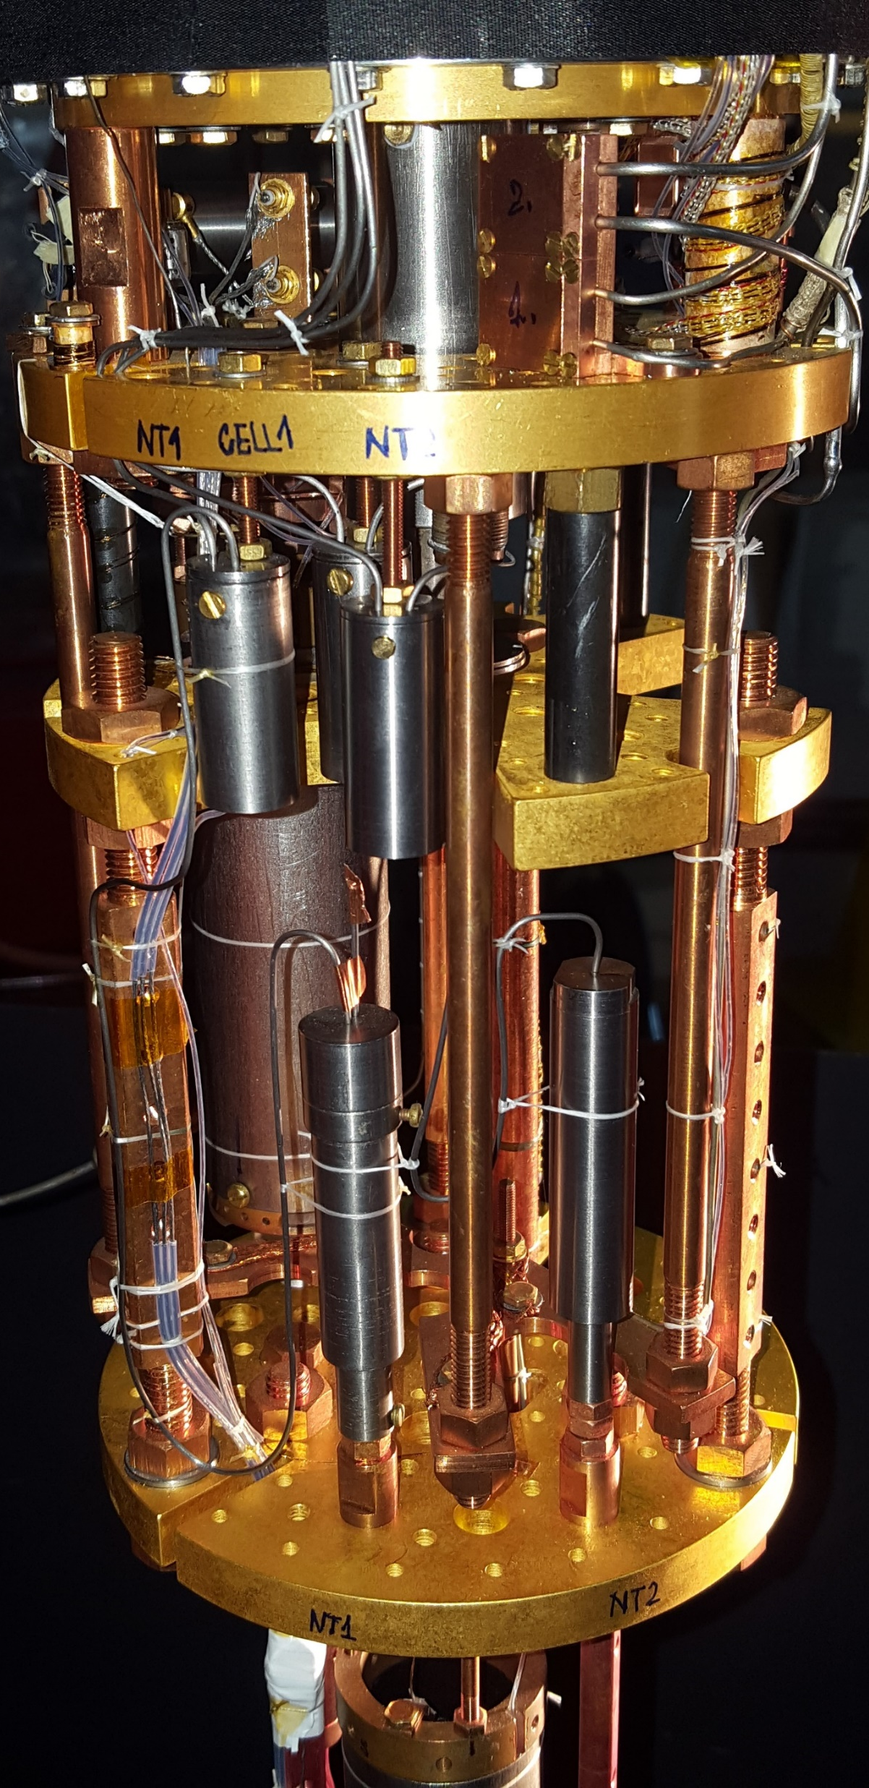
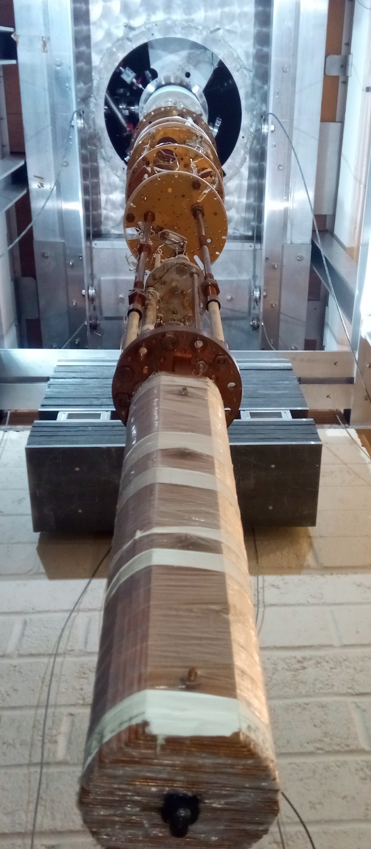
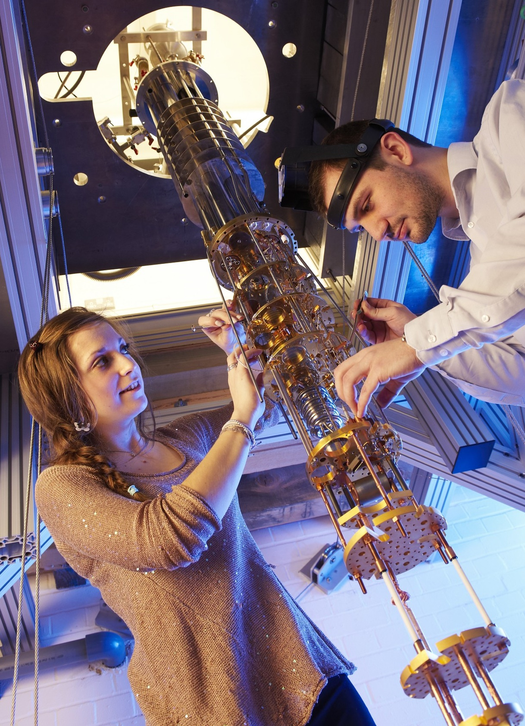
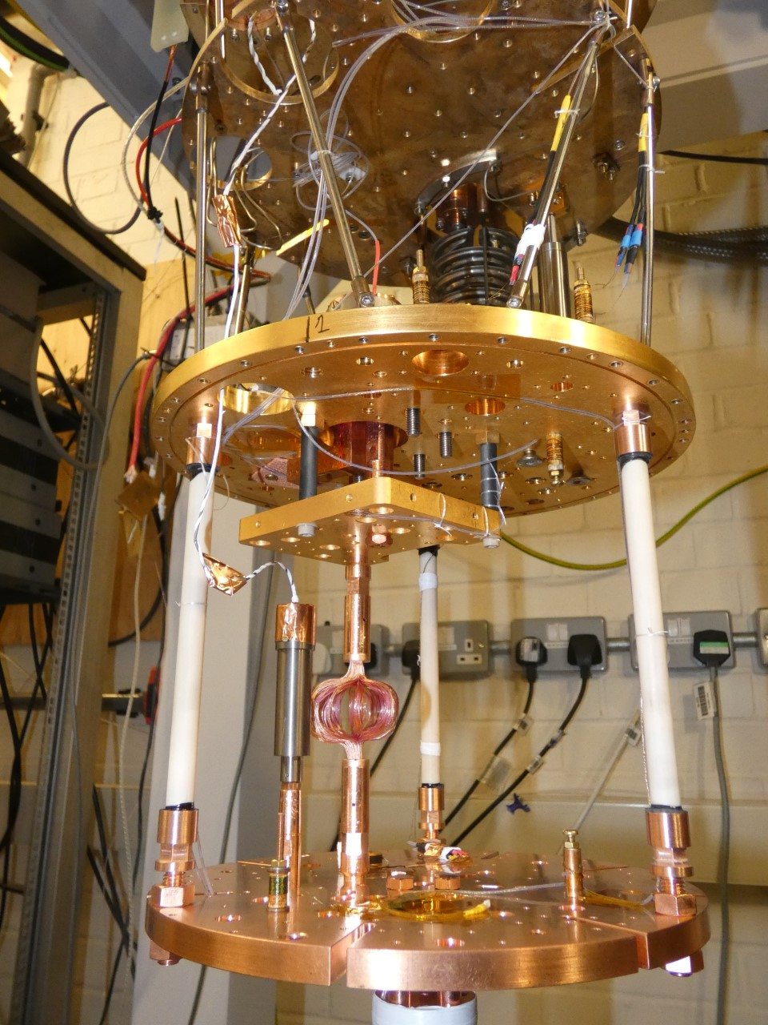
Quantum sensors operated in ultralow temperatures regime, 100 μK
ND1
ND2
ND3
ND4: Cryo-free
Lucas, M., Danilov, A.V., Levitin, L.V. et al. Quantum bath suppression in a superconducting circuit by immersion cooling. Nat Commun 14, 3522 (2023)
Andrew Casey, Quantum@Boulby, 16/09/24
Andrew Casey, Quantum@Boulby, 16/09/24
Notes:
These challenges have come at a time when there is an explosion of new quantum enhanced technologies. We are ideally positioned to implement the current generation of quantum sensors, in a new ultralow temperature regime using existing ULT platforms at RHUL and Lanc,.
And through our nanofabrication facilities ( Superfab in the UK Centre for Superconducting and Hybrid Quantum Systems at RHUL and the Quantum Technology Centre in Lancaster) and QT partners we are able to co-design hybrid quantum sensors explicitly to tackle these fundamental physics questions.

Slide 19

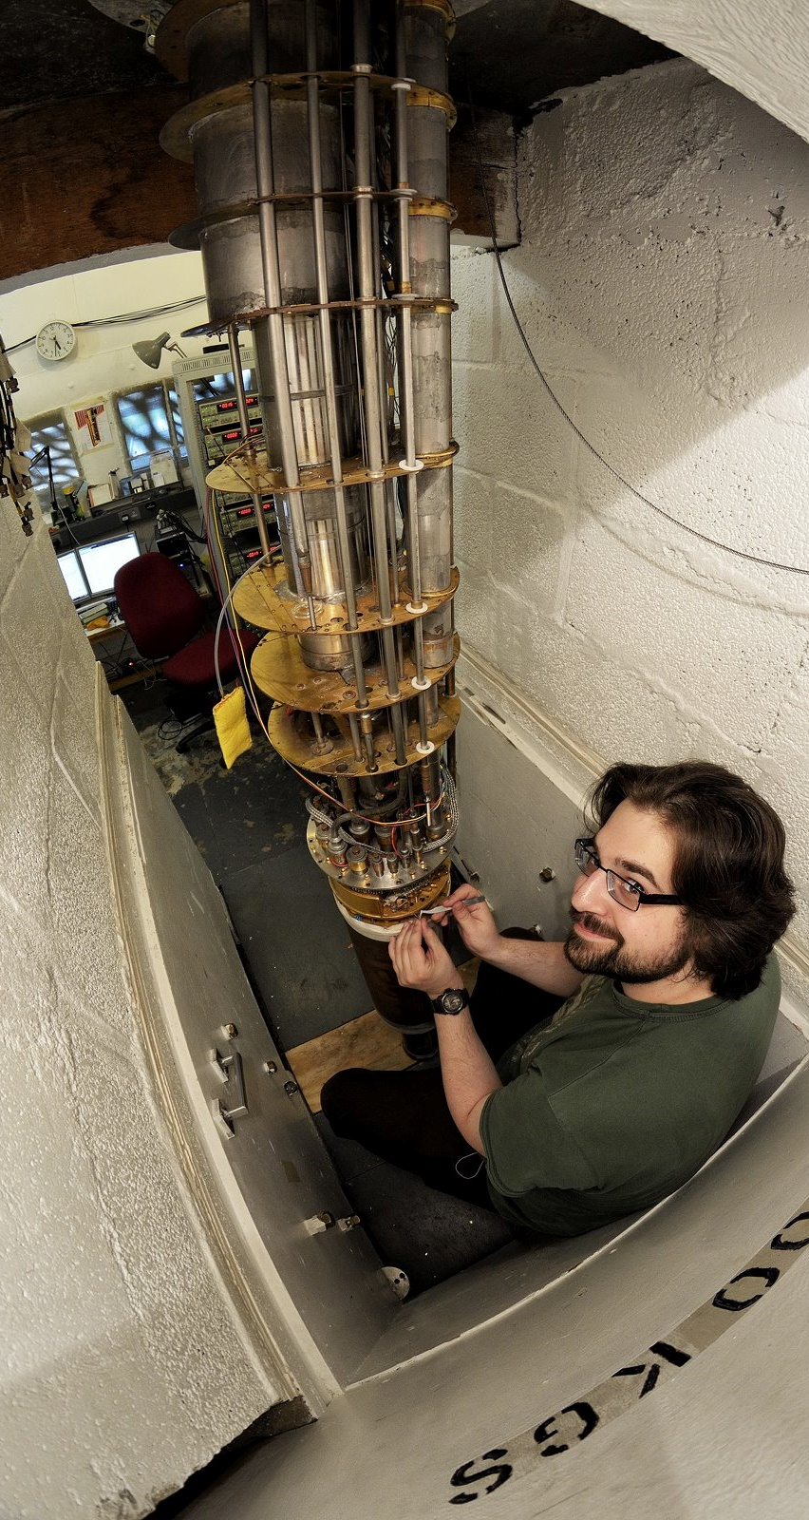
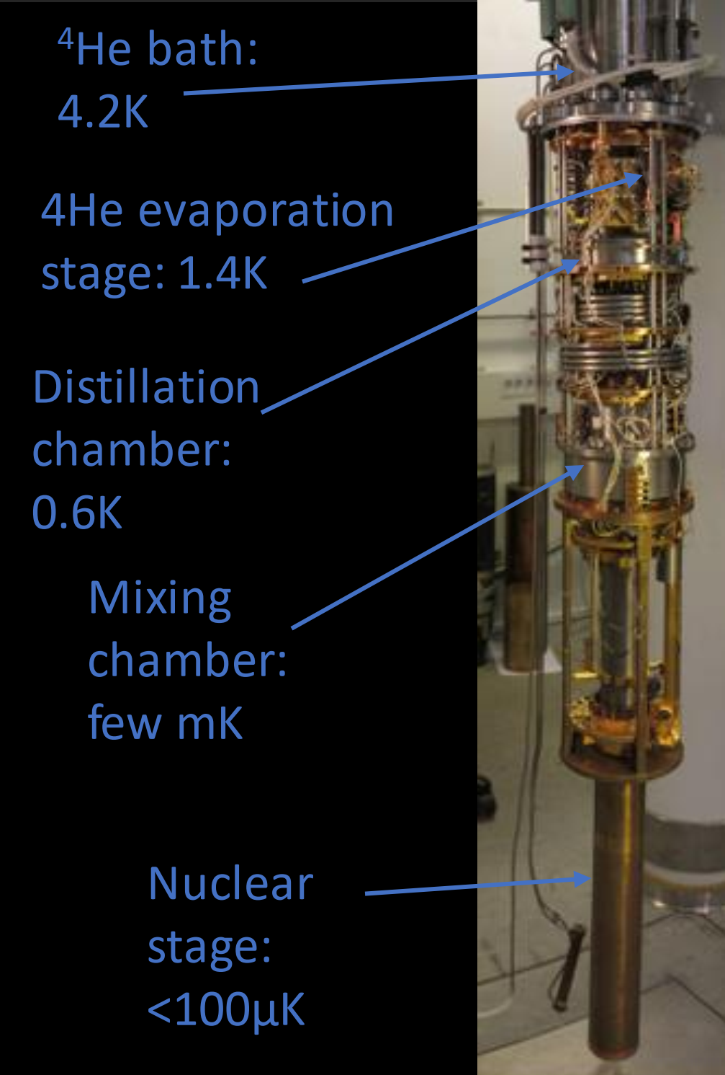
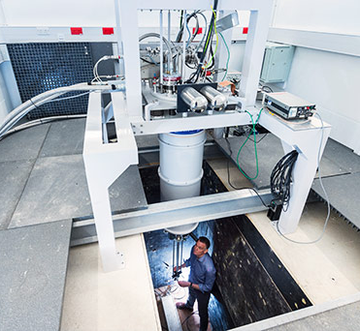
Quantum sensors operated in ultralow temperatures regime, 100 μK
Andrew Casey, Quantum@Boulby, 16/09/24

Slide 20
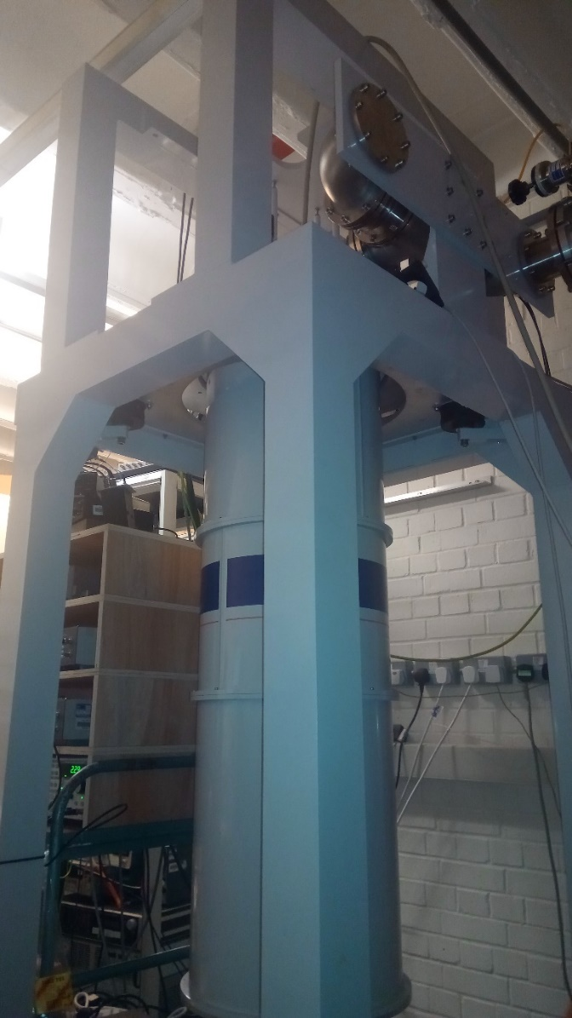
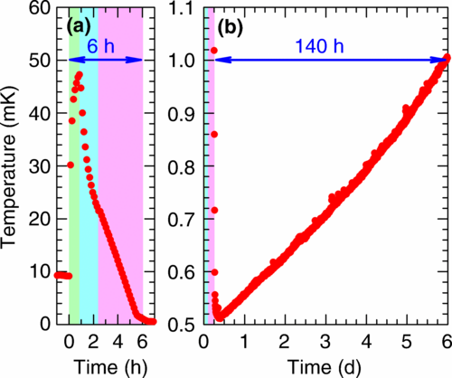

Cryogen-free ULT at RHUL
Cryogen-free microkelvin platforms, rapid access to ULT
High performance cryogen-free microkelvin platform J. Nyéki, M. Lucas, P. Knappová, L.V. Levitin, A. Casey, J. Saunders, H. van der Vliet, and A.J. Matthews, Phys. Rev. Applied 18, L041002 (2022)
10 mK
0.4 mK
Andrew Casey, Quantum@Boulby, 16/09/24

Slide 21
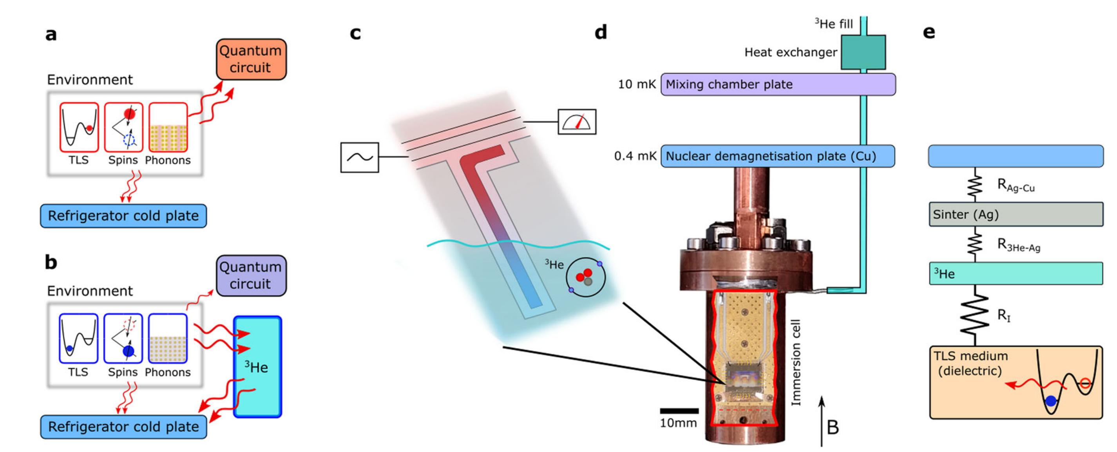
Quantum Technologies at ULT
Lucas, M., Danilov, A.V., Levitin, L.V. et al. Quantum bath suppression in a superconducting circuit by immersion cooling. Nat Commun 14, 3522 (2023). https://doi.org/10.1038/s41467-023-39249-z
Andrew Casey, Quantum@Boulby, 16/09/24

Slide 22
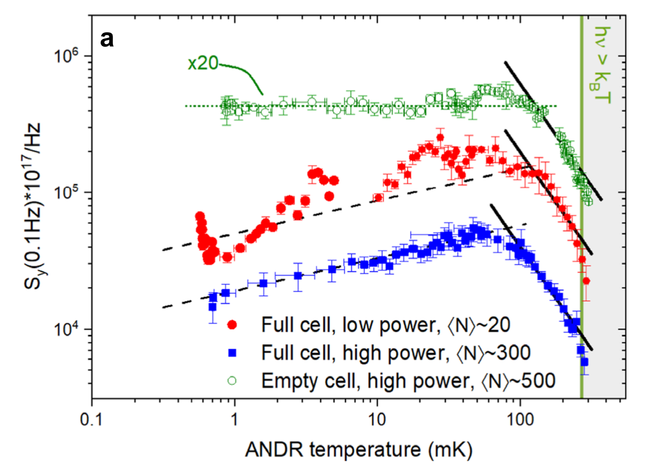
Quantum Technologies at ULT
Lucas, M., Danilov, A.V., Levitin, L.V. et al. Quantum bath suppression in a superconducting circuit by immersion cooling. Nat Commun 14, 3522 (2023). https://doi.org/10.1038/s41467-023-39249-z
Andrew Casey, Quantum@Boulby, 16/09/24

Slide 23
Quantum Technologies at ULT
Temperature dependence of qubit properties, not explored below ~ 30 mK.
Lucas, M., Danilov, A.V., Levitin, L.V. et al. Quantum bath suppression in a superconducting circuit by immersion cooling. Nat Commun 14, 3522 (2023). https://doi.org/10.1038/s41467-023-39249-z
Andrew Casey, Quantum@Boulby, 16/09/24

Slide 24
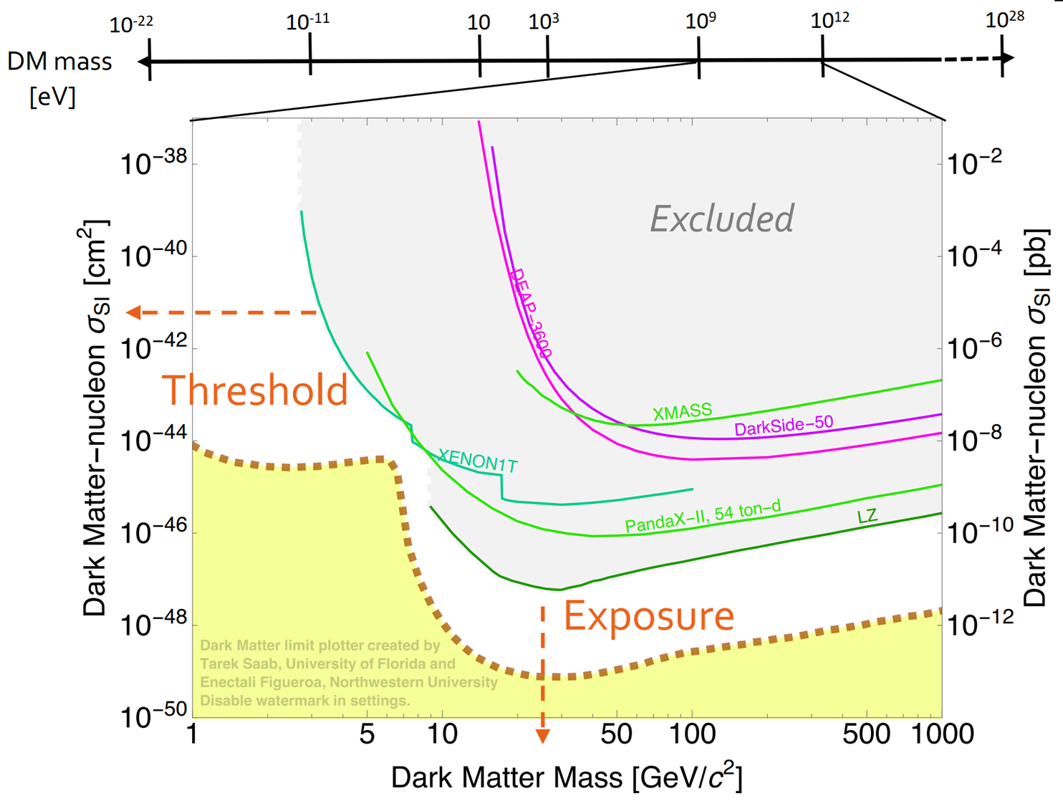
Optimising Search
At the limits of isolation: Dark Matter Searches
Lower the mass range
Reduce the energy thresholds
Lower cross-sections:
More exposure, maximise interaction rate
Lower backgrounds
Andrew Casey, Quantum@Boulby, 16/09/24

Slide 25
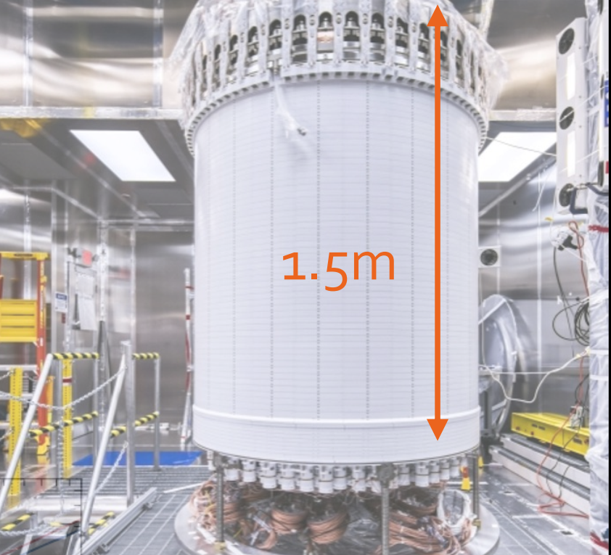
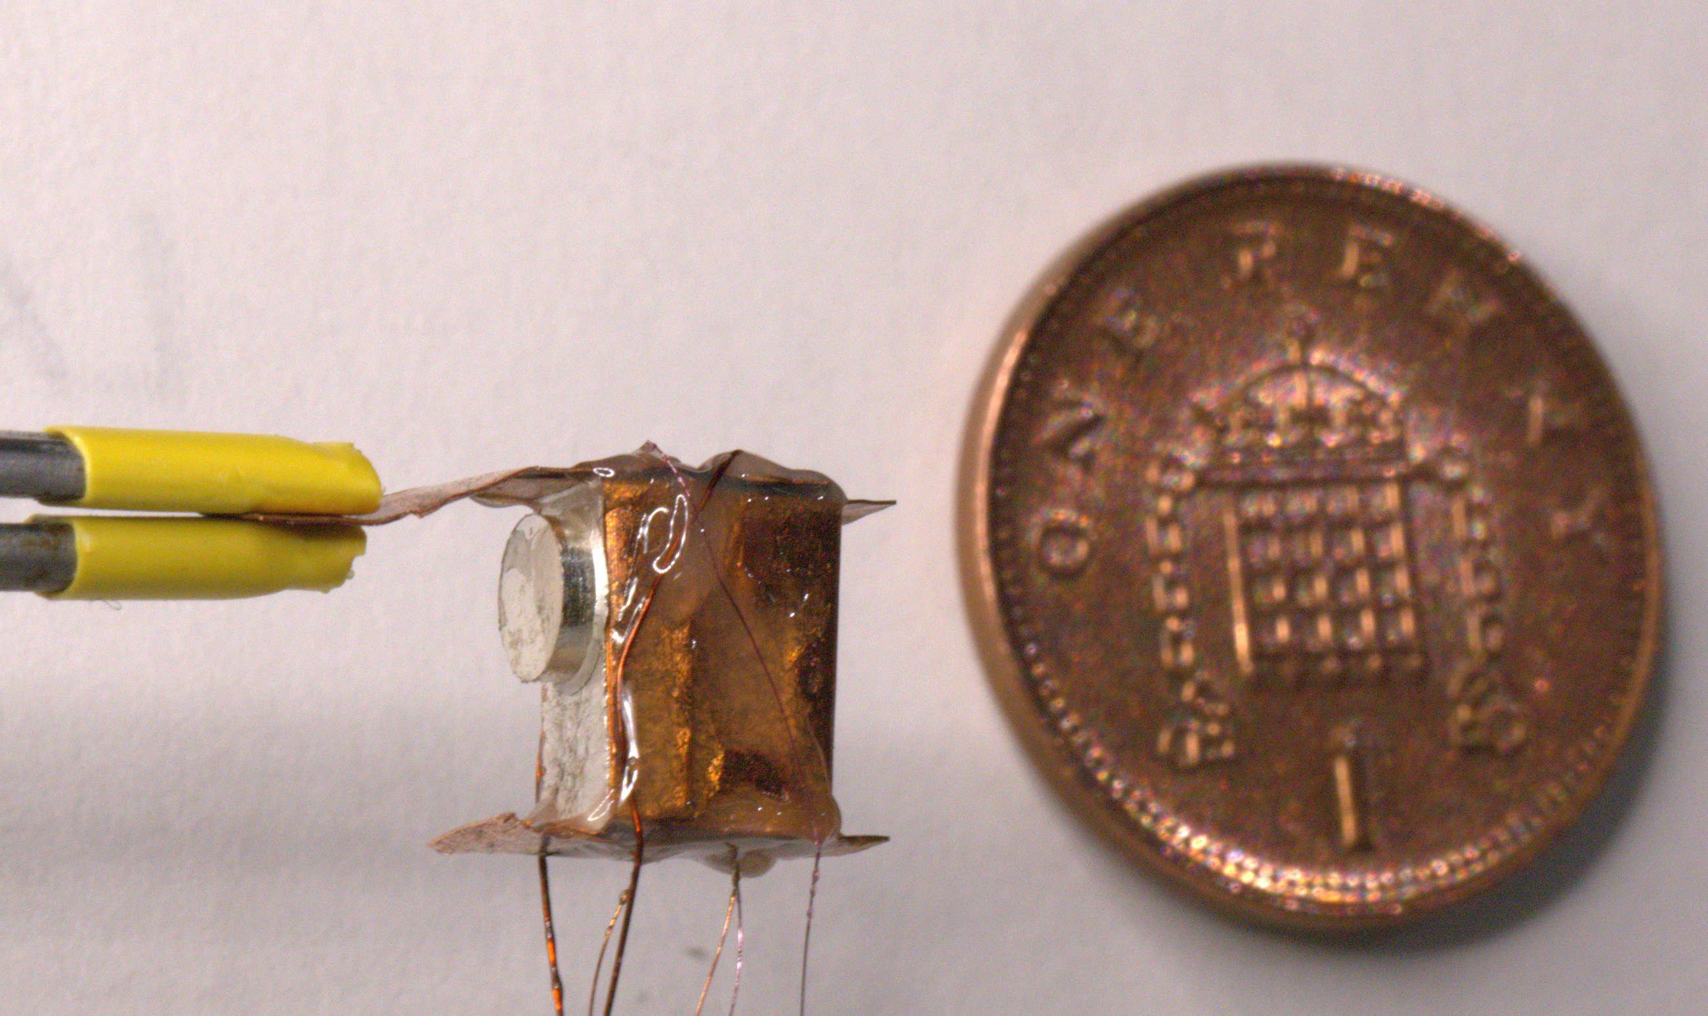
Bolometer for quasiparticle detection
Collision WIMP - ³He atom (mass 3 versus argon - 39.948, xenon -131.293)
0.3 g ³He vs 7 tonne Xe e.g.LZ,PRL,131,041002(2023)
ULTIMA: D.I. Bradley, et al., Nucl. Instrum. Methods A 370, 141 (1996); C.B. Winkelmann, et al., Nucl. Instrum. Methods A 559, 384 (2006); C.B. Winkelmann, et al., Nucl. Instrum. Methods A 574, 264 (2007). (Planned to go in Canfranc, but ceiling collapsed)
⁴He target HeRald: S. A. Hertel, A. Biekert, J. Lin, V. Velan, and D. N. McKinsey Phys. Rev. D 100, 092007 (2019)
Andrew Casey, Quantum@Boulby, 16/09/24

Slide 26
Bolometer for quasiparticle detection
Collision WIMP - ³He atom (mass 3 versus argon - 39.948, xenon -131.293)
0.3 g ³He vs 7 tonne Xe e.g.LZ,PRL,131,041002(2023)
QUEST-DMC superfluid ³He detector for sub-GeV dark matter.
S. Autti¹, A. Casey², N. Eng², N. Darvishi² , P. Franchini¹,², R. P. Haley¹, P. J. Heikkinen², A. Jennings³, A. Kemp², E. Leason², L. V. Levitin², J. Monroe², J. March-Russel⁴, M. T. Noble¹, J. R. Prance¹, X. Rojas², T. Salmon¹, J. Saunders², R. Smith², M. D. Thompson¹, V. Tsepelin¹, S. M. West², L. Whitehead¹, V. V. Zavjalov¹, D. E. Zmeev¹,
Eur. Phys. J. C 84, 248 (2024).
Andrew Casey, Quantum@Boulby, 16/09/24

Slide 27
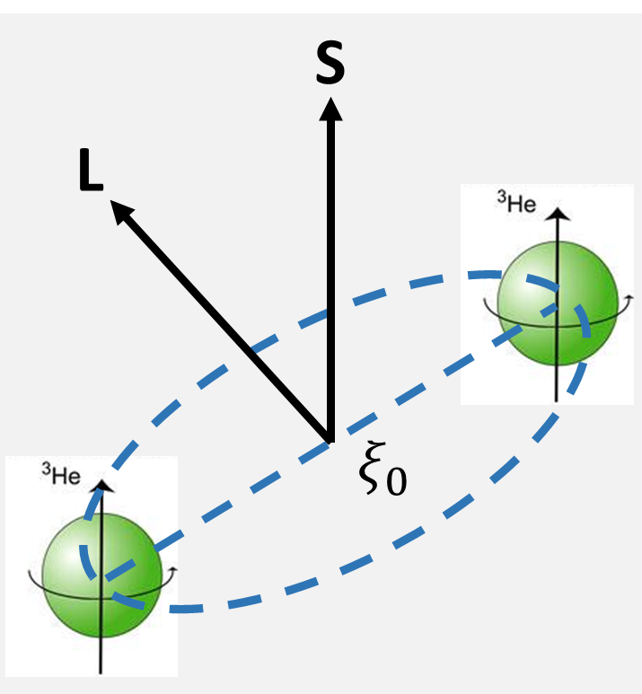
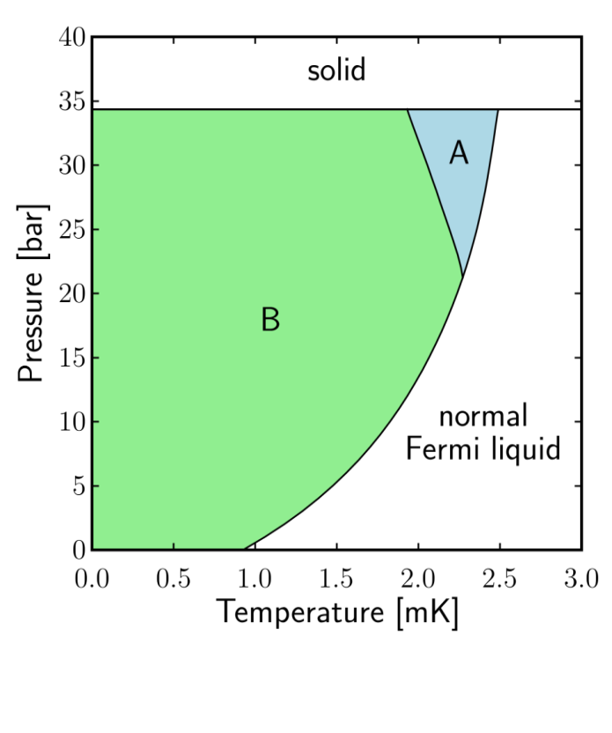
Superfluid Helium, ³He
Cooper pairs with L = S = 1
18-component order parameter
  L_{z} = -1, 0, 1
  S_{z} = -1, 0, 1
Multiple superfluid phases
  A-phase: Anderson-Brinkman-Morel
  B-phase: Balian-Werthamer
Broken Cooper pairs = thermal excitations with energy Δ ~ 10⁻⁷ eV
Andrew Casey, Quantum@Boulby, 16/09/24

Slide 28
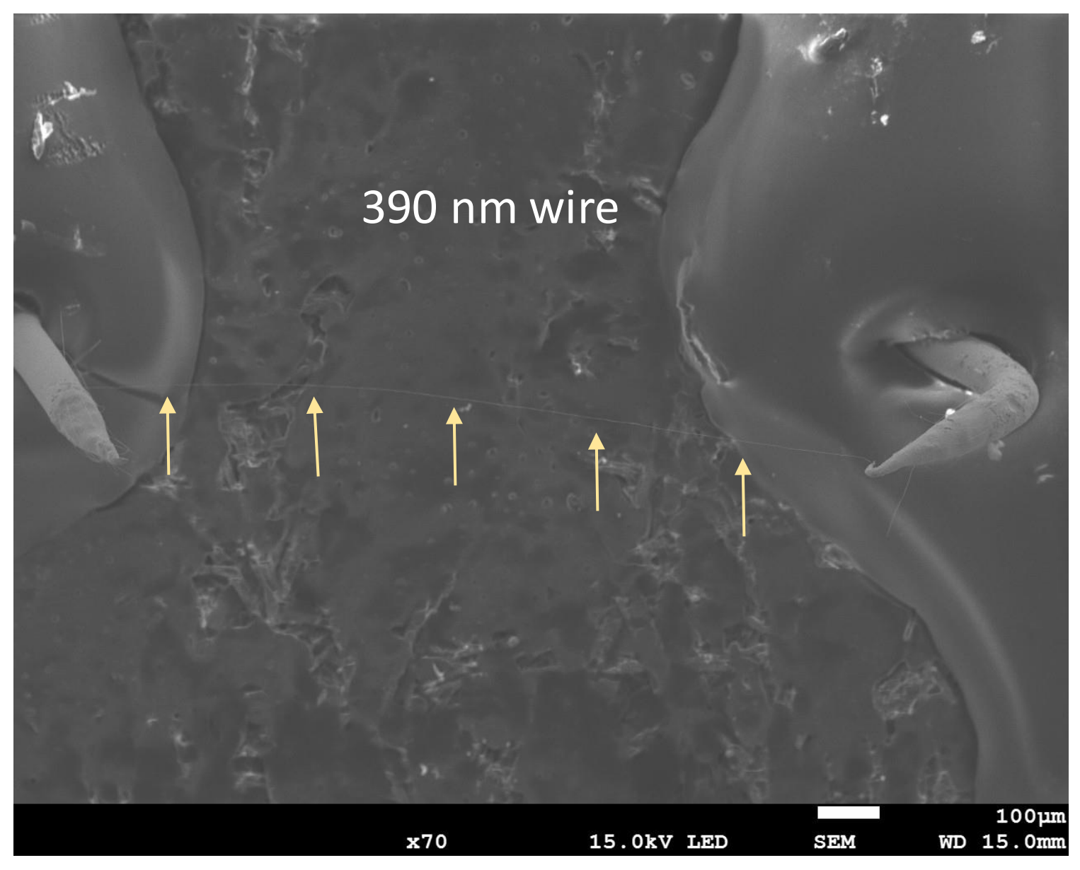
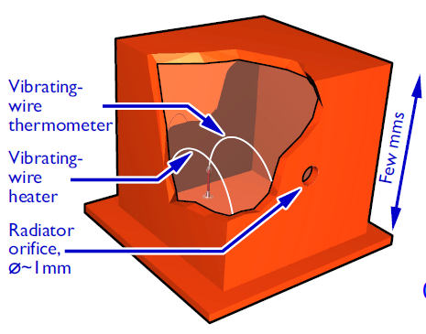
Optimising beam/wire geometry for and both He and SQUID response
Long nanomechanical resonators with circular cross-section, D. Zmeev et al. arXiv:2311.02452 (2023)
Andrew Casey, Quantum@Boulby, 16/09/24

Slide 29
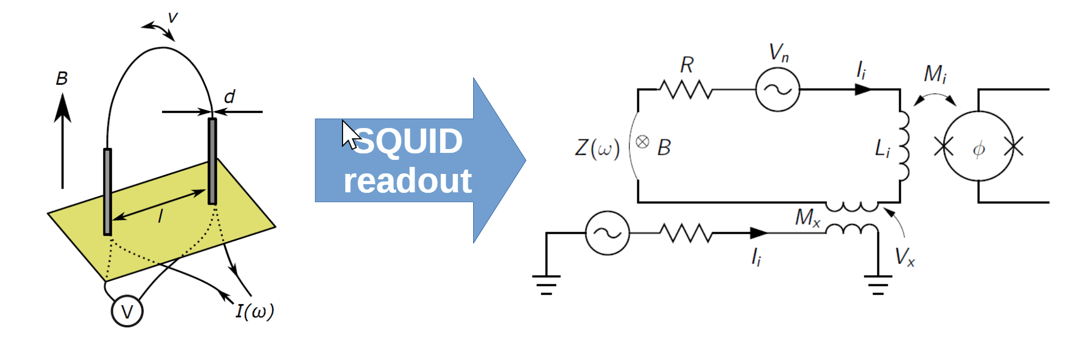
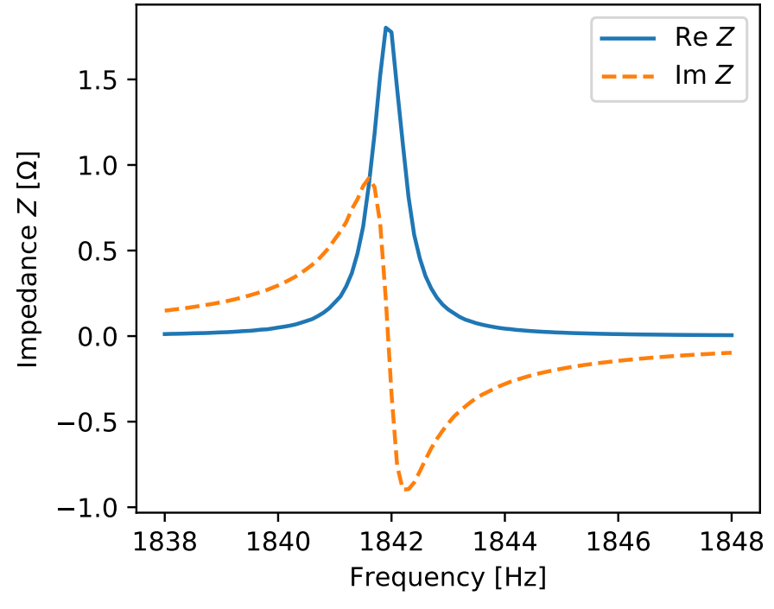
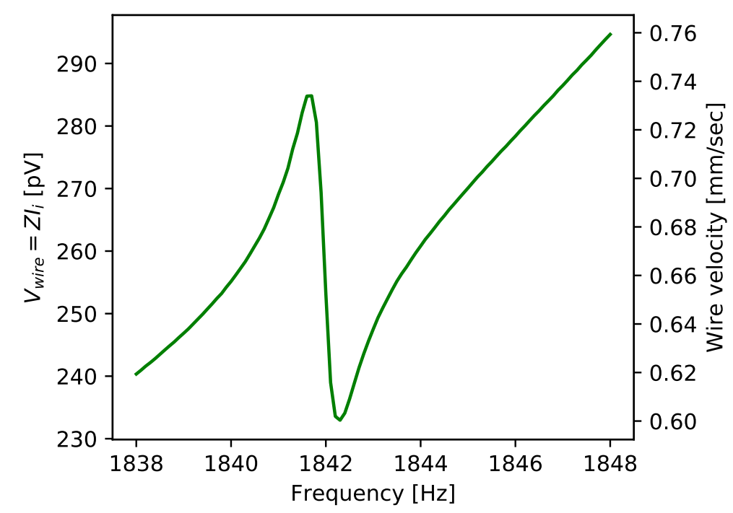
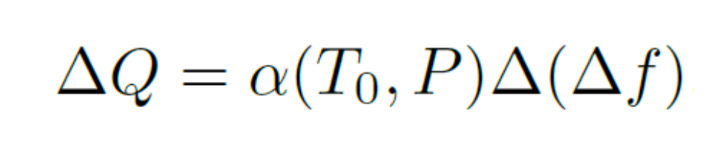
SQUID readout of nanowire
2-stage SQUID amplifier (PTB)
IEEE Trans. Appl. Supercond. 17 (2007)
Vacuum characterisation of SQUID nanowire readout. 315 nm wire, 8.5 mT, 4.2 K
Andrew Casey, Quantum@Boulby, 16/09/24

Slide 30
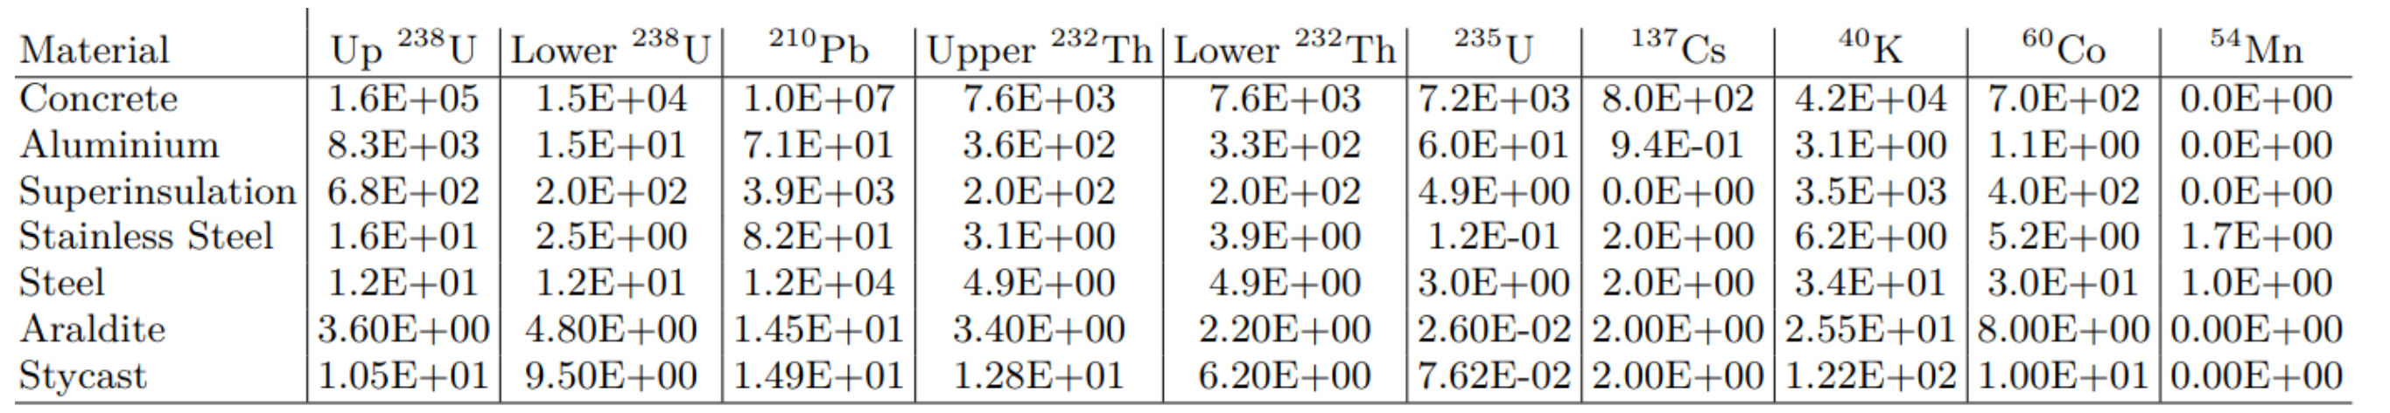
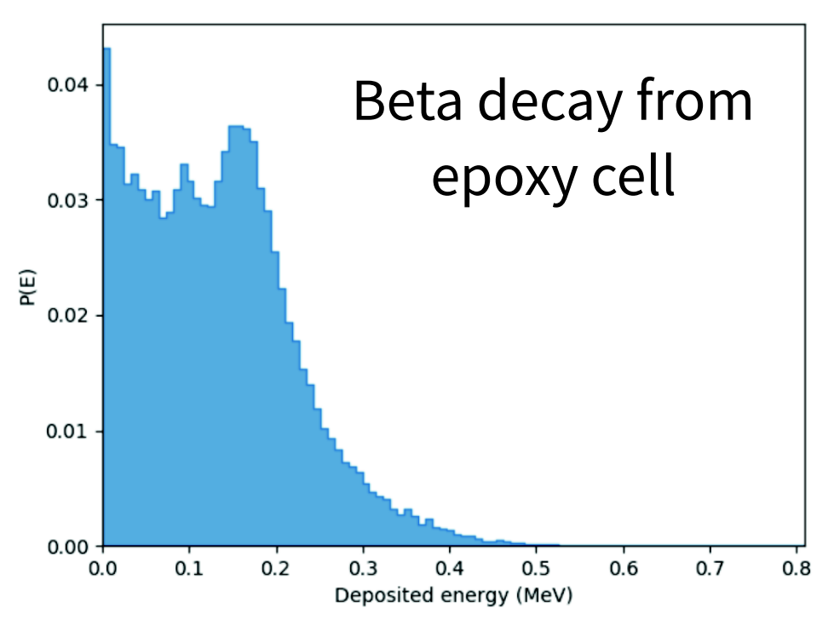
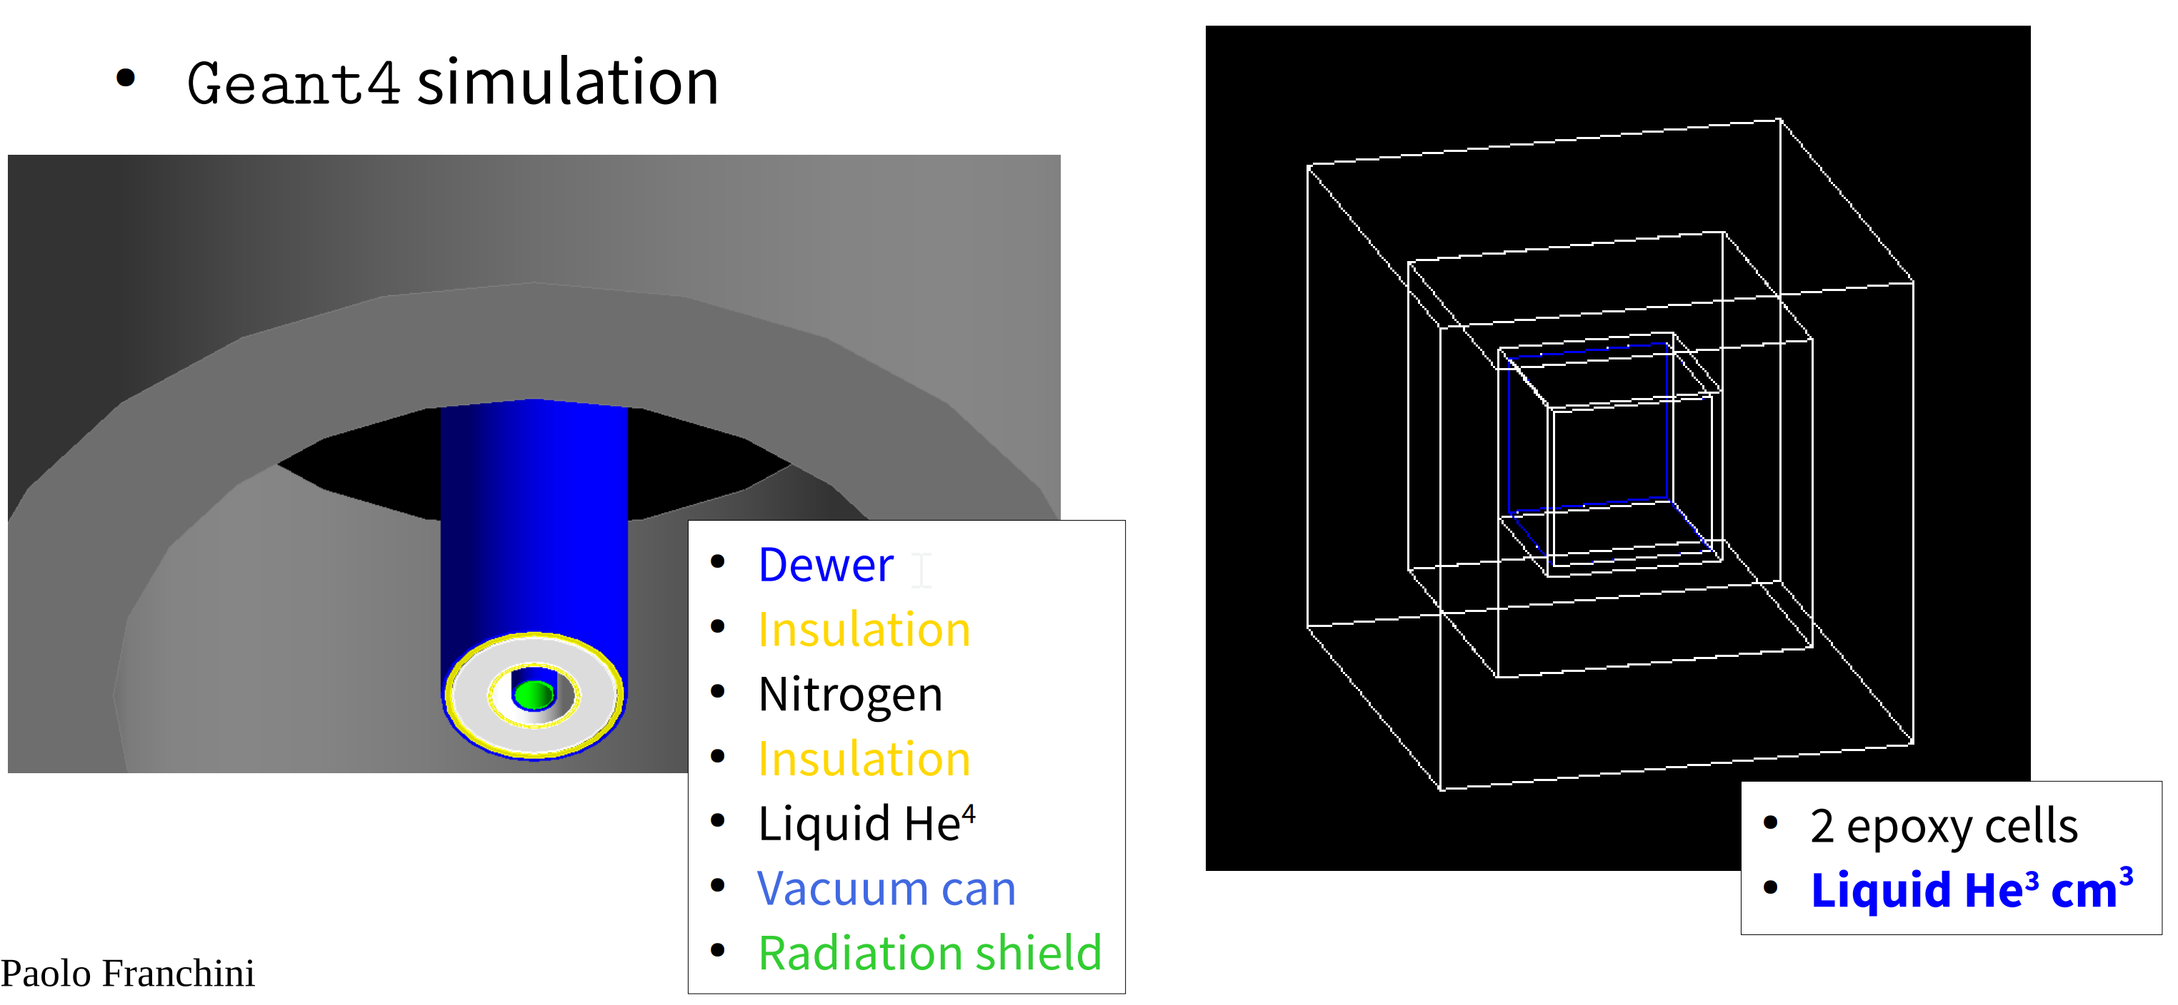
Simulation of decays, radiopurity screening (Boulby, database)
Dewar
Andrew Casey, Quantum@Boulby, 16/09/24
Notes:
In the case of Dark Matter , as you can see from this figure of potential DM candidates and their masses there is there is a very well theoretically motivated sub GeV mass regime, this has been largely inaccessible to traditional dark matter searches, with the application of quantum sensors we aim to investigate the region in dark green.
Baryon Asymmetry
Masses in the region of a Nucleon

Slide 31
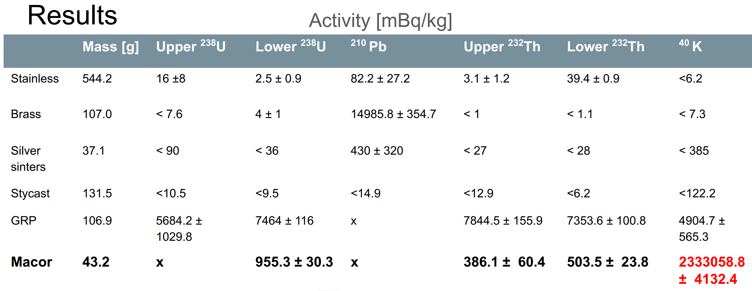
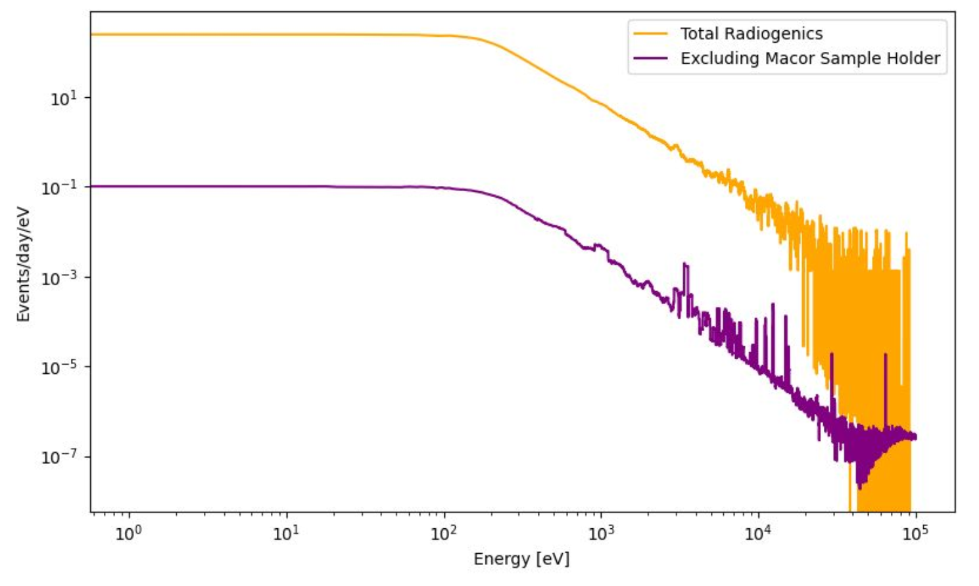
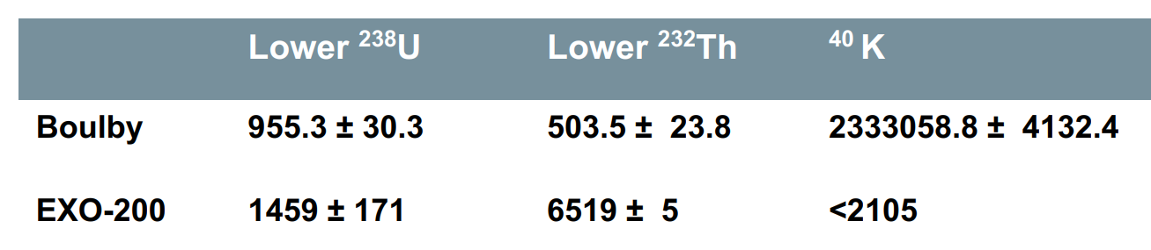
Boulby Radioassays
Andrew Casey, Quantum@Boulby, 16/09/24

Slide 32
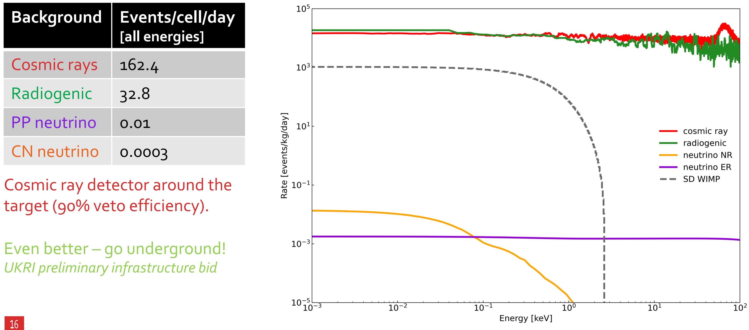
Surface Dark Matter search ULANC cryostat modelling
Andrew Casey, Quantum@Boulby, 16/09/24

Slide 33
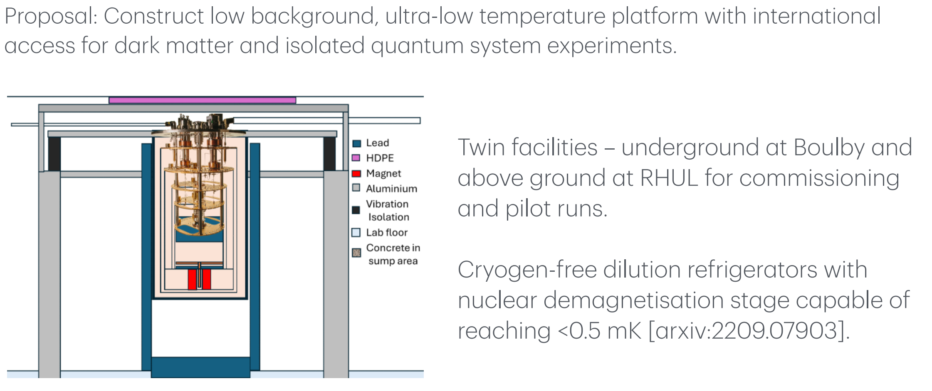
UltraDark (proposed low background ULT platform)
for a scaled-up QUEST DM Search
At surface cosmic rays dominate, 50m underground radiogenic background of materials dominate
Andrew Casey, Quantum@Boulby, 16/09/24

Slide 34
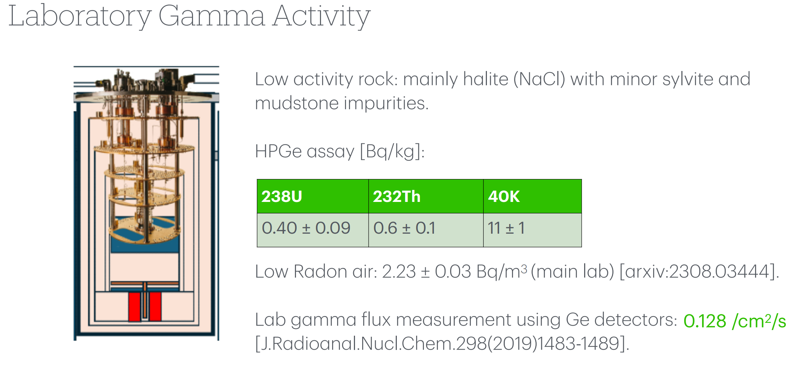
UltraDark (proposed low background ULT platform)
for a scaled-up QUEST DM Search
Andrew Casey, Quantum@Boulby, 16/09/24

Slide 35
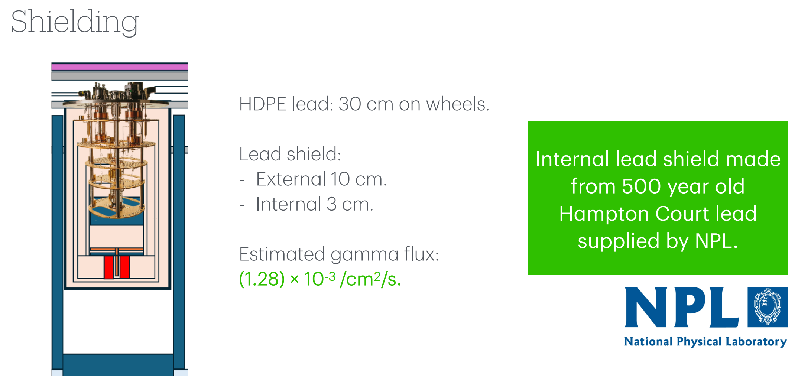
UltraDark (proposed low background ULT platform)
for a scaled-up QUEST DM Search
Andrew Casey, SQMS Quantum for Science, 22/03/24

Slide 36
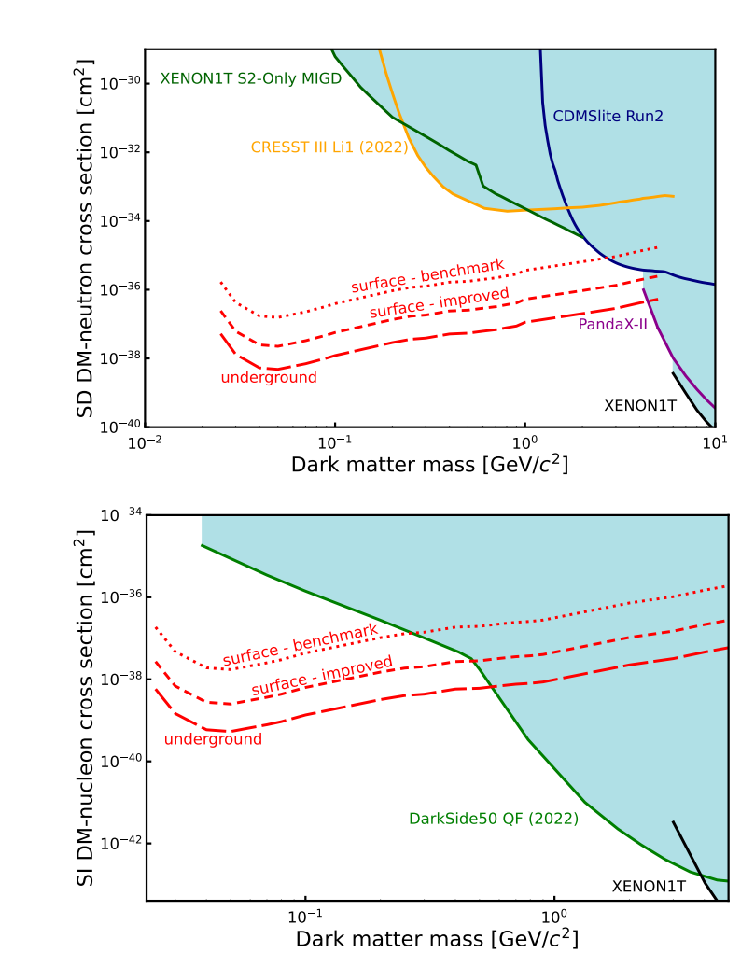
Projected 90% exclusion limit sensitivity to dark matter nucleon interactions
Cross section limit for spin-dependent
Cross section limit for spin-independent
Andrew Casey, Quantum@Boulby, 16/09/24

Slide 37
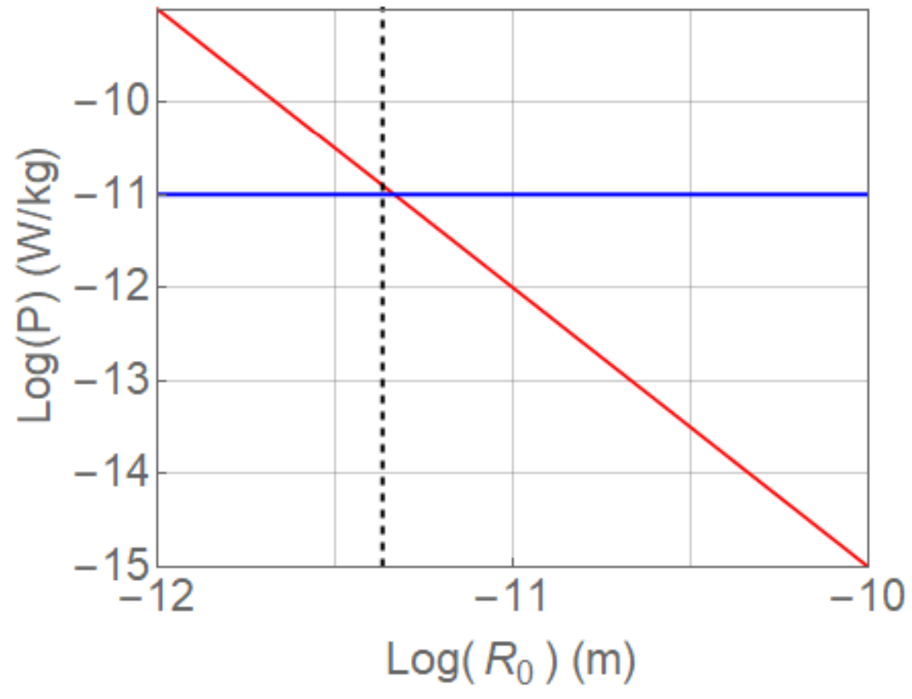
At the limits of isolation: Low Background, ULT
Gravity-related collapse of the wave function and spontaneous heating: revisiting the experimental bounds, Andrea Vinante and Hendrik Ulbricht AVS Quantum Sci. 3, 045602 (2021)
Red Line: model of specific power per unit mass predicted by the Diósi-Penrose model as a function of the renormalization length R₀
Blue Line: upper limit on the specific power inferred from heat leak measurements at ULT
K. Gloos, P. Smeibidl, C. Kennedy, A. Singsaas, P. Sekowski, R. M. Mueller, and F. Pobell, J. Low Temp. Phys. 73, 101 (1988)
10 pW / kg
Andrew Casey, Quantum@Boulby, 16/09/24

Slide 38
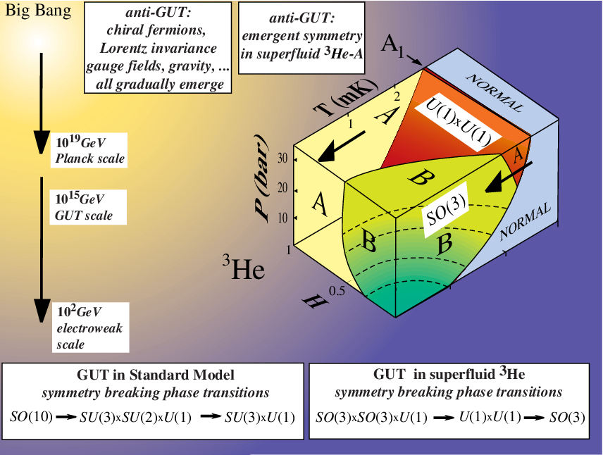
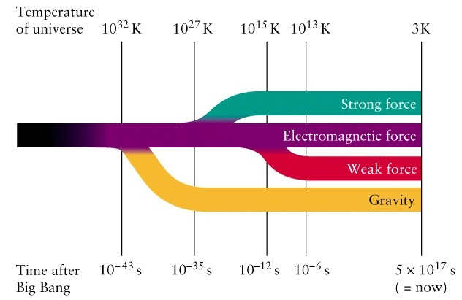
Phase transitions in extreme matter
Precise control of Quantum analogue system, Superfluid ³He & dynamics of phase transitions
open gravitational wave window to physics beyond the Standard Model in the early universe
Andrew Casey, SQMS Quantum for Science, 22/03/24

