Slide 1



Quantum Technologies for Fundamental Physics
Jason Green
Notes:
The abstract pattern can be removed or repositioned if required. Be careful to ‘Send to Back’ so that it does not obscure any important information.

Slide 2
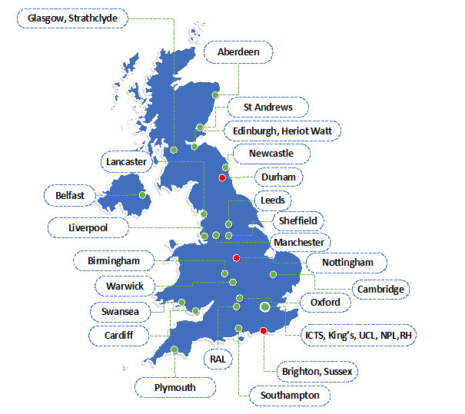
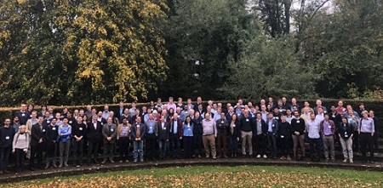
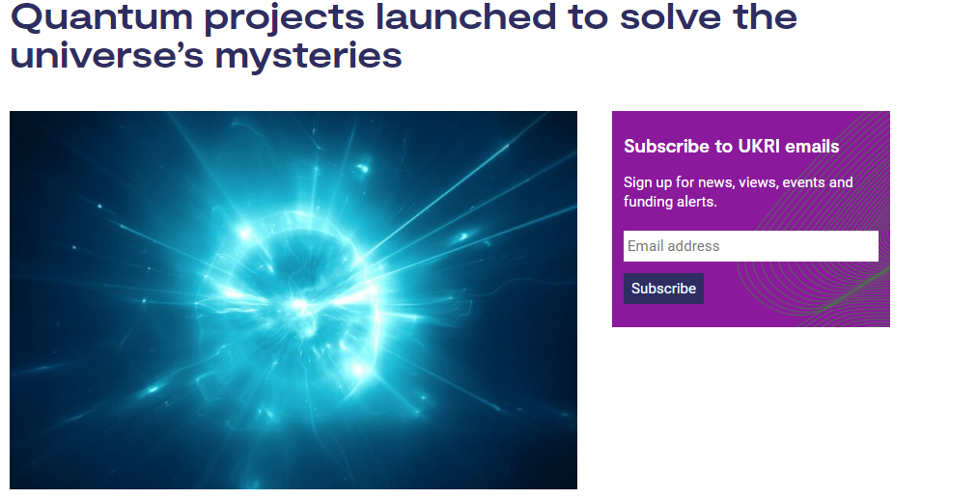
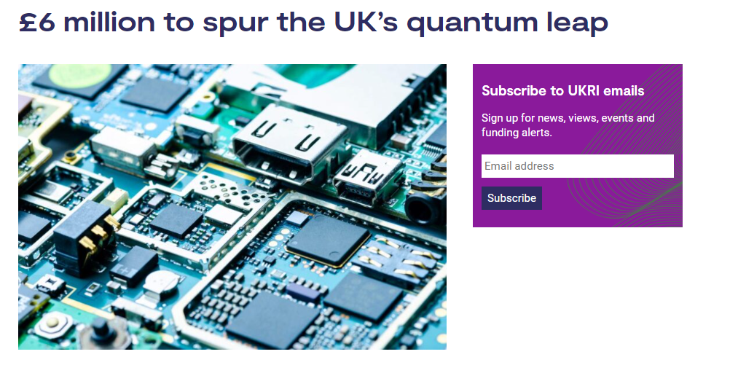

History of QTFP
July 2018 Idea presented to STFC
October 2018 Opportunities grant: Quantum Sensors for Fundamental Physics (QSFP) and Society awarded
Oct 2018/Jan 2019 QSFP Community workshops
March 2019 Business case approved
QSFP UK Institutions
May 2019 STFC Led Community workshop
September 2019 First Call announced
January 2020 QSFP 1st School
January 2021 Successful proposals announced
The first Quantum Sensors for Fundamental Physics Community Workshop
November 2021 QTFP
presence at NQTP Showcase
September 2022 Successful second call proposals announced

Slide 3
QTFP Programme
£40 million Strategic Priorities Fund (SPF) programme that aims to transform our approach to understanding the universe and its evolution
  QTFP brings together the expertise of EPSRC and STFC researchers to apply the latest advances in quantum science and technology to explore, and answer, long-standing research questions in fundamental physics
  The programme aims to answer questions on the search for dark matter, the nature of gravity, measurements of the quantum properties of elementary particles and much more..

Slide 4
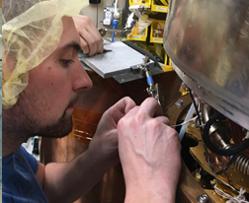
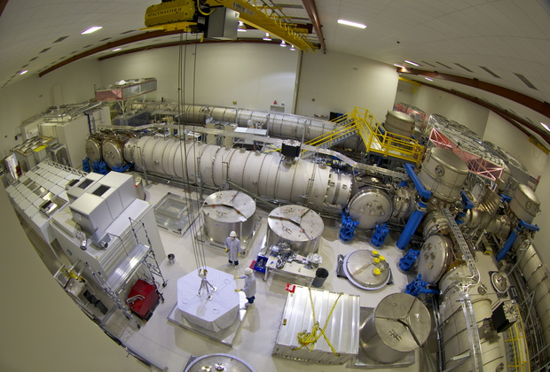
QTFP Objectives
Establish a new community to exploit quantum technology for fundamental physics. Generating research outputs deemed excellent by international peer review
Position the UK as a first rank nation in the scientific exploitation of quantum technology for physics applications
Become an active player in the National Quantum Technology Programme (NQTP)
Create the opportunity in the UK for new patents, new products and start-up companies as a result of developing new or improved equipment that will be needed to support the scientific work programme

Slide 5
QTFP Funding
The QTFP Programme has invested over £39m in 7 large consortia and 17 smaller projects.
Large consortia
  AION: A UK Atom Interferometer Observatory and Network
  QI: Quantum-enhanced Interferometry for New Physics
  QUEST-DMC: Quantum Enhanced Superfluid Technologies for Dark Matter and Cosmology
  QSHS: Quantum Sensing for the Hidden Sector
  QSNET: A network of clocks for measuring the stability of fundamental constants
  QSimFP: Quantum Simulators for Fundamental Physics
  QTNM: Determination of Absolute Neutrino Mass Using Quantum Technologies

Slide 6
QTFP Funding – key stats
Funding commenced in late 2020. First and second call projects are due to end FY24/25. New funding due to commence FY25/26.
 | First Call Large consortia | Second Call Smaller projects
Applications received | 24 | 37
Projects funded | 7 | 17
Average cost per project | ~£4.5m | ~£370k
Total funded cost | ~£31.4m | ~£6.3m

Slide 7
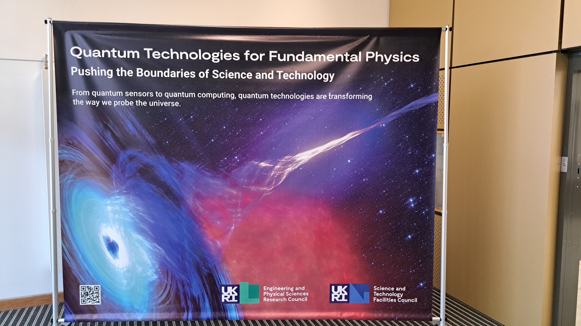
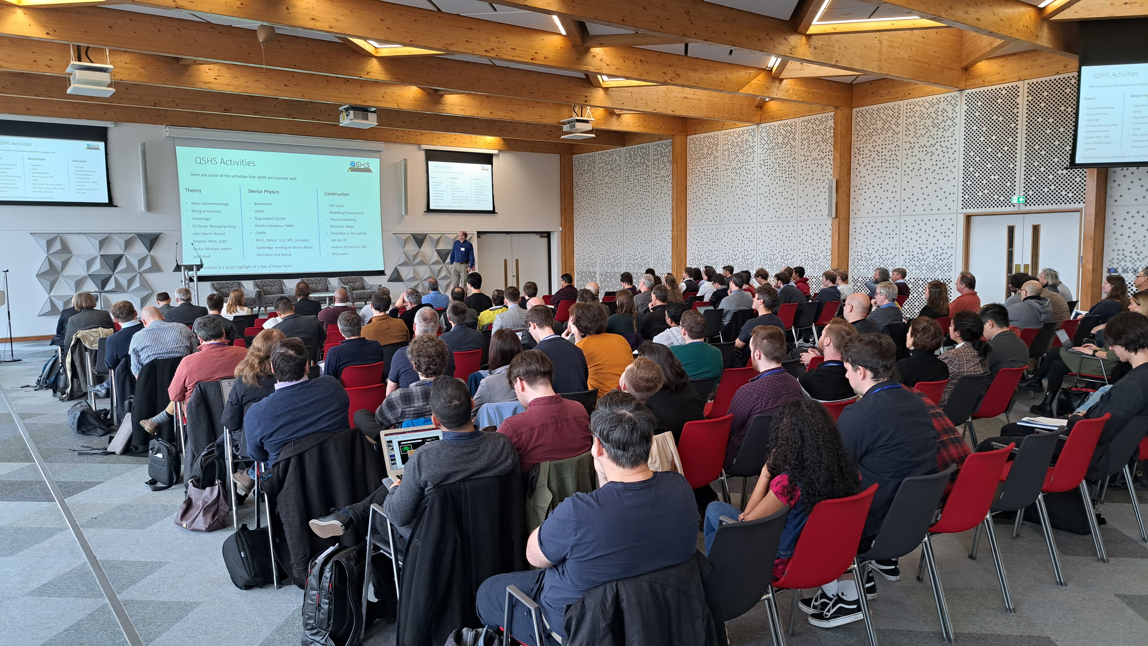
Quantum Technologies for Fundamental Physics – Networking event
Over 150 attendees met in Warwick in early February 2023

Slide 8
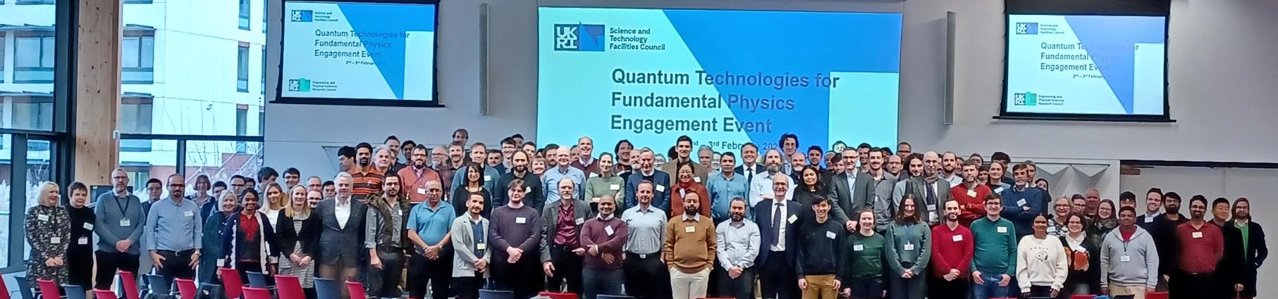
Event Sessions
Science talks and posters from the QTFP funded consortia and projects
International working – with CERN and Fermilab
Elevator pitches from potential community members
Parallel science sessions in quantum computing; quantum enhanced imaging; quantum metrology; quantum sensing; quantum communications
Beyond the Science sessions in equality, diversity and inclusion, career pathways, outreach and knowledge exchange

Slide 9
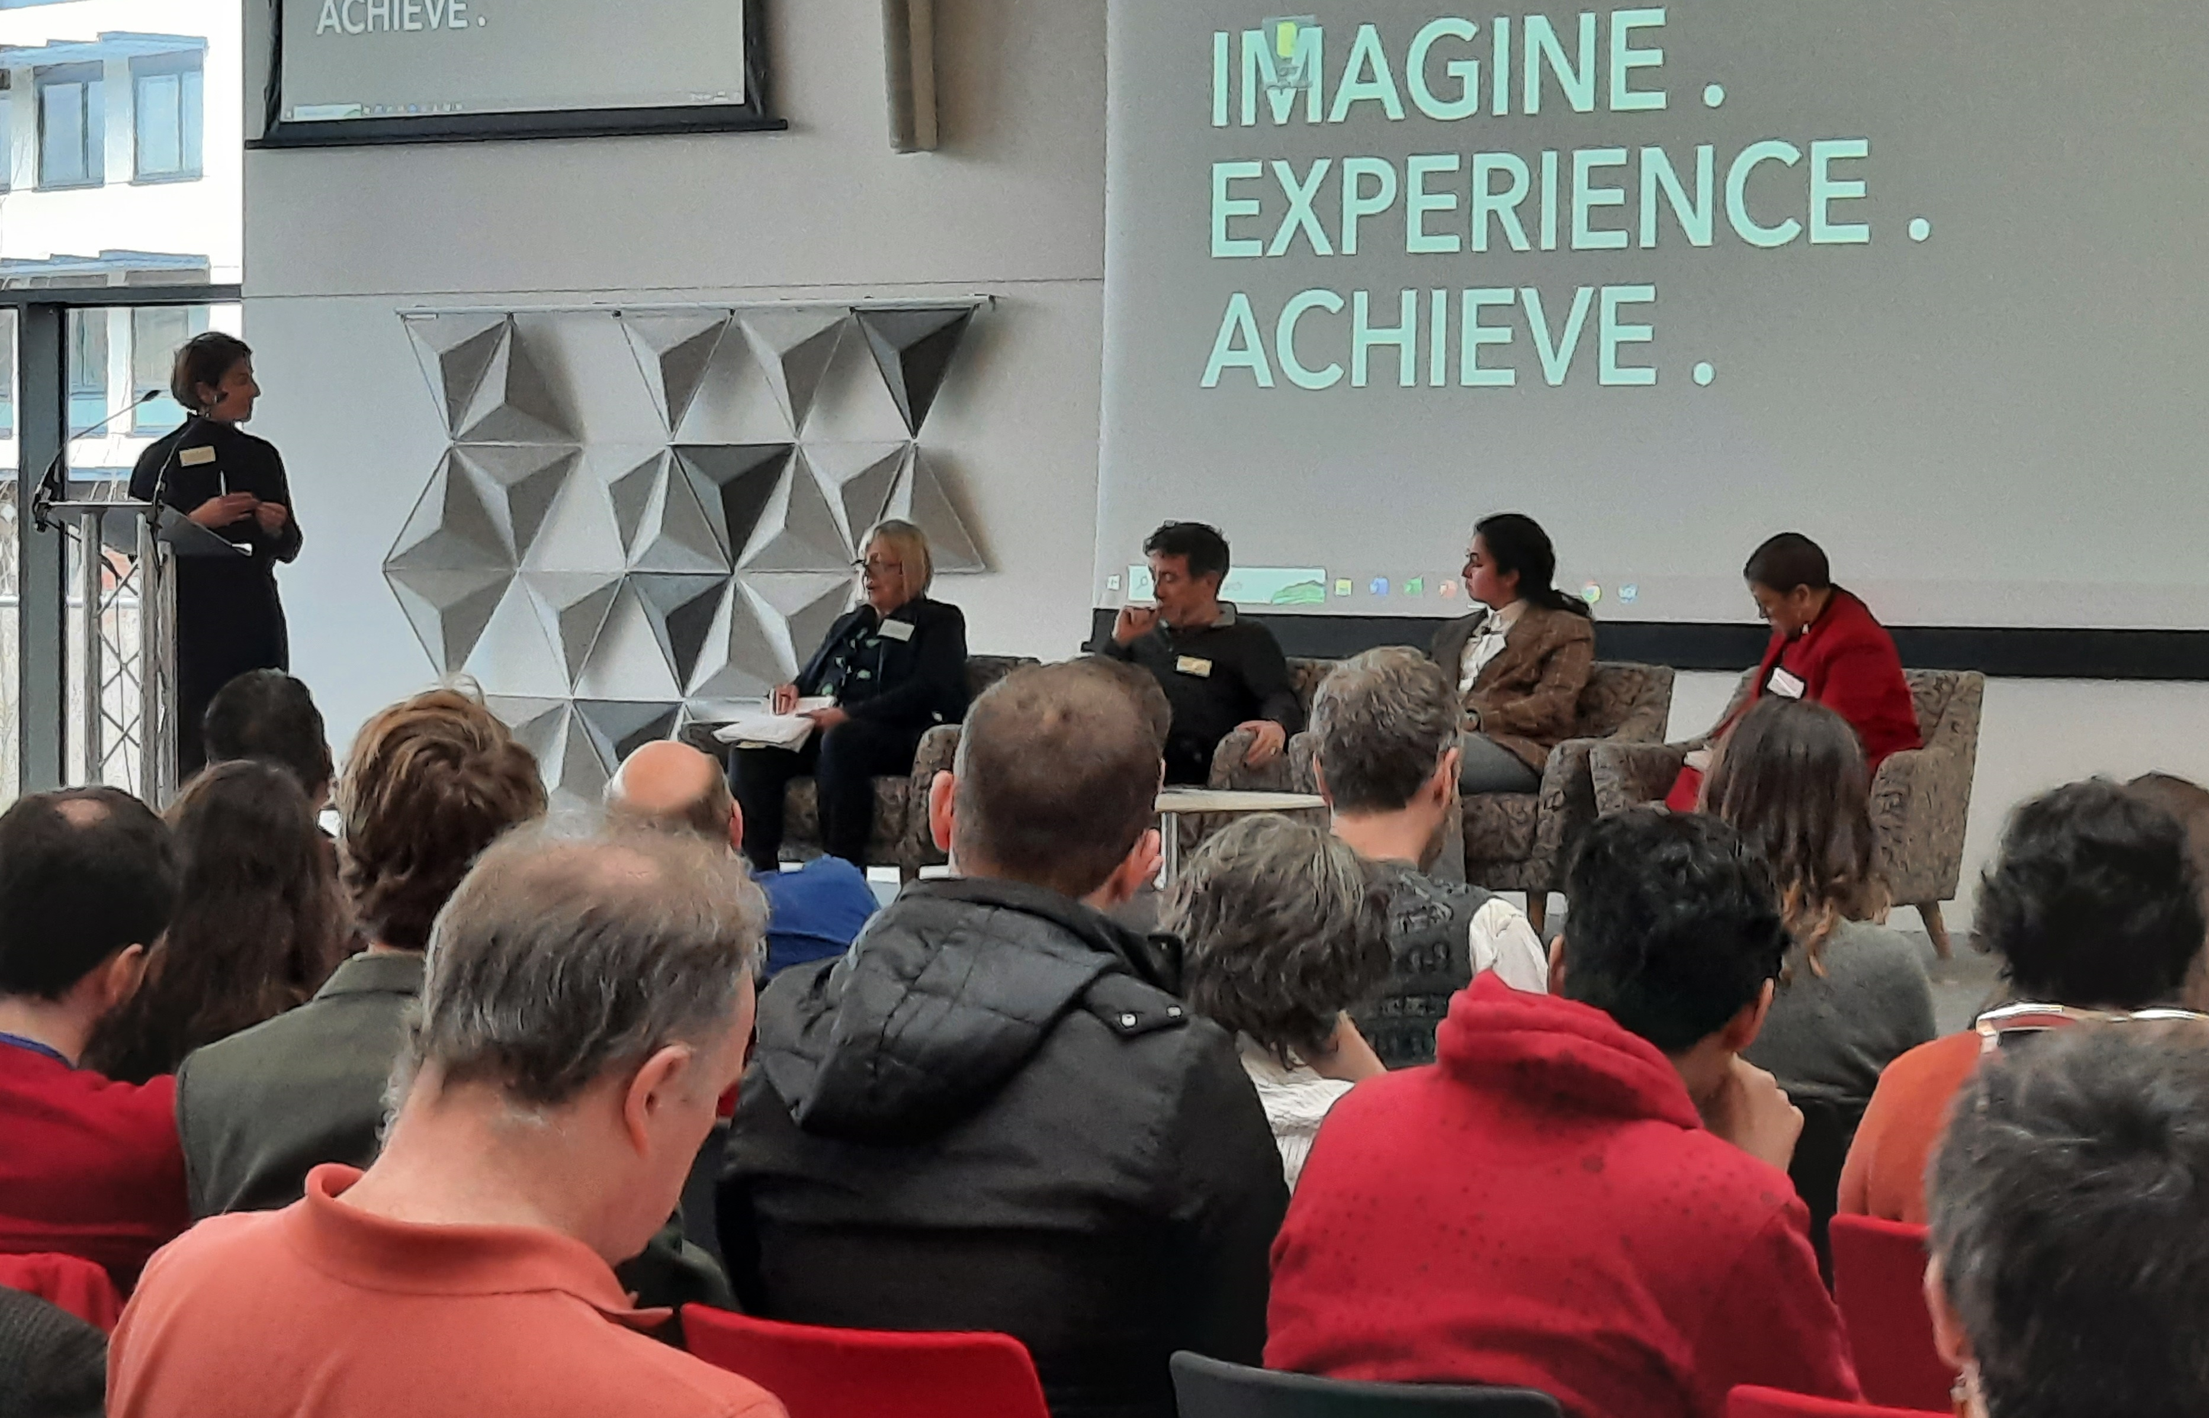
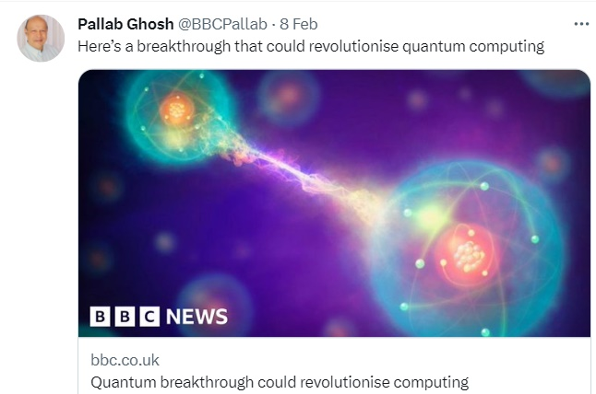
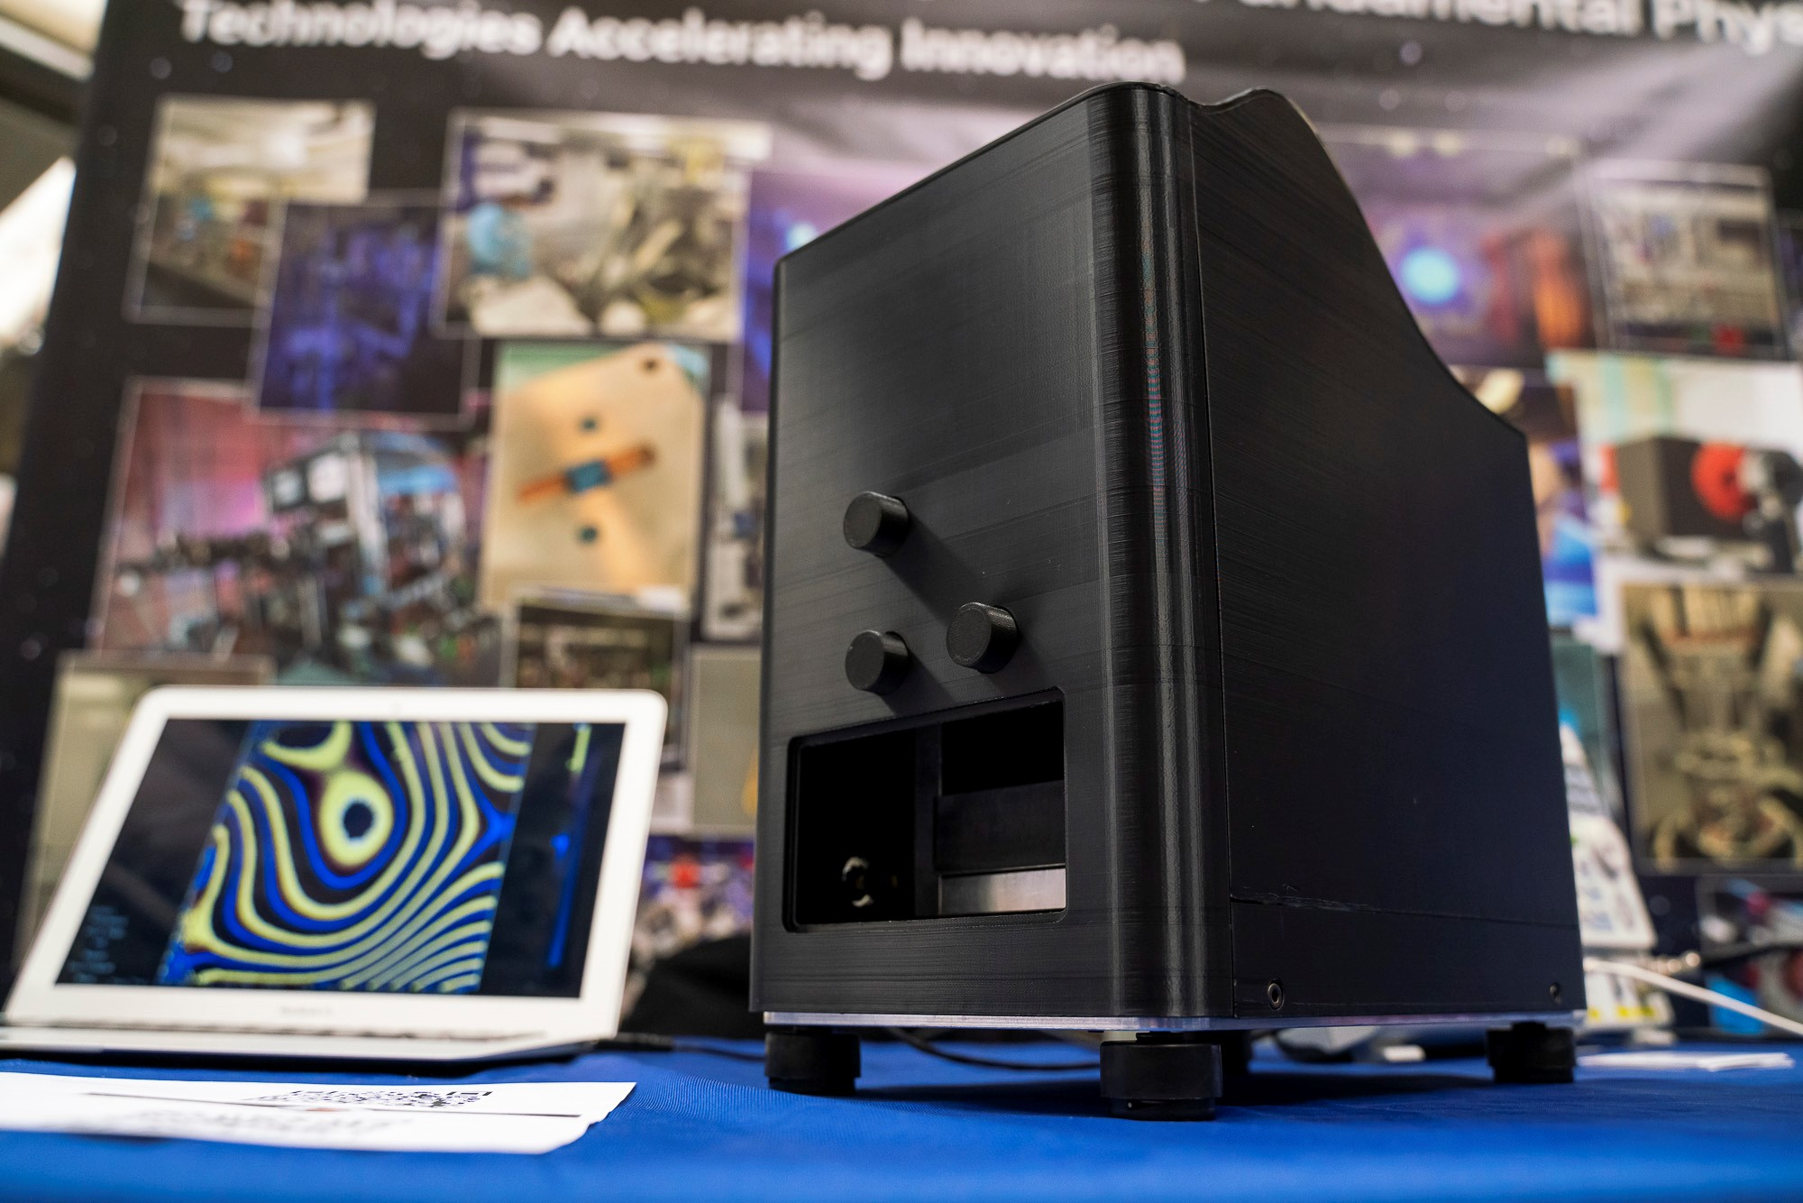
Beyond the Science
Equality Diversity and Inclusion Panel
Panel members included representation from STFC Council, Innovate UK KTN, Reverse Mentoring Practise & STFC Programmes
Addressing the issues of ED&I in an open environment, discussions continued over dinner
Knowledge Exchange
Outreach
Examples of how experiments are moving from the lab to industry and how UKRI can support this
Pallab Ghosh from the BBC attended the event to speak with PIs and gain knowledge of quantum research
Follow ups with formal interviews

Slide 10
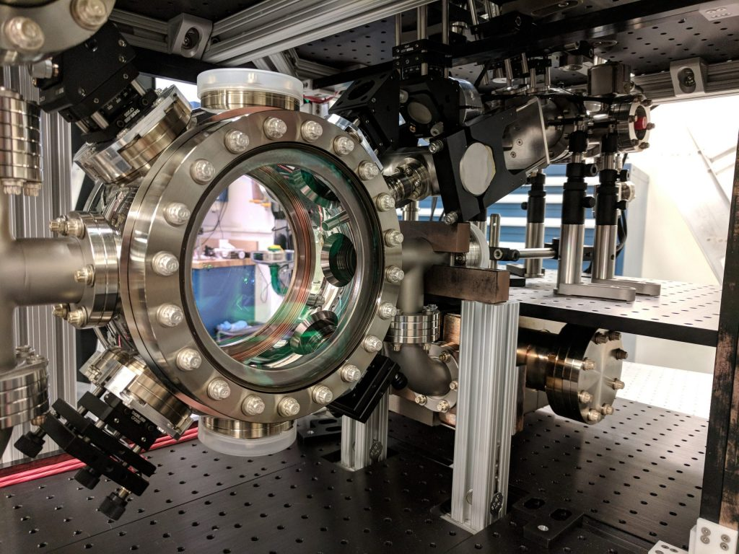
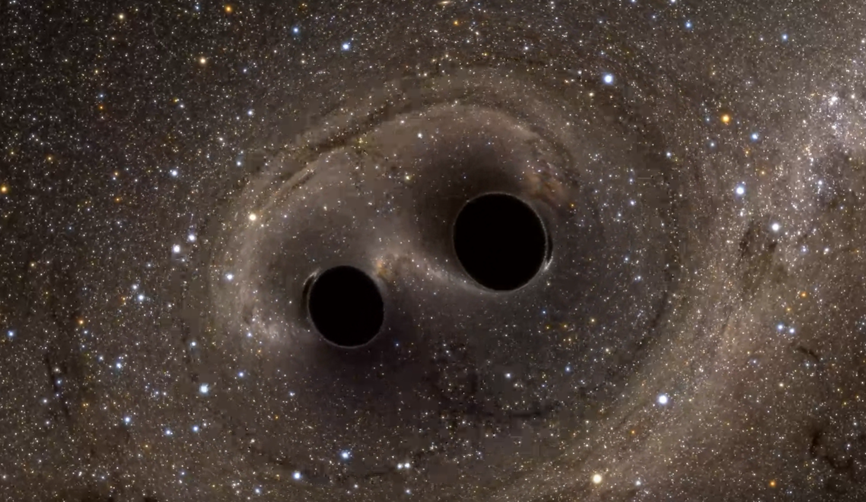
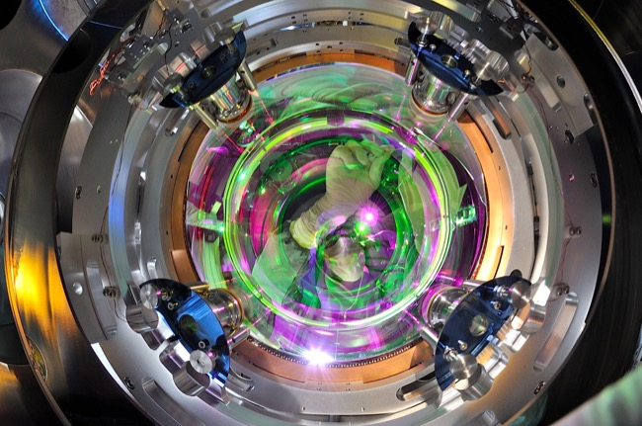
Examples of International Working
QTFP provides an opportunity for international working with the US being a key partner.
Atom Interferometry Observatory and Network – MAGIS (Fermilab)
Determination of Absolute Neutrino Mass Using Quantum - Project 8 Collaboration
Quantum Sensors for the Hidden Sector – ADMX
Quantum Enhanced Interferometry for New Physics – Deutsches Elektronen-Synchrotron (DESY), Germany as well as collaborators across the US
QSNET – Max-Planck Institute for Nuclear Physics, Germany
Quantum Simulators for Fundamental Physics - project partners in Canada, Germany and Austria
QUEST DMC – projects partners in US
Images: Simulating eXtreme Spacetimes (SXS) Project; Stanford University; Project websites
Notes:
Images: 1) MAGIS experiment, Stanford; 2) simulation of the the final merger of GW150914, showing the distortion of the star-field from gravity as the black holes orbit and merge; 3) Quantum Enhanced Interferometry for New Physics optical coating from LIGO/Virgo

Slide 11
QTFP Metrics
97 Publications with a field weighted citation impact of 1.94 (metric has removed hyper authored papers),above UK average. 65% of publications are international collaborations
26 unique international links across nine countries in Call 1 projects
Connections to key international facilities, including the National Accelerator Laboratory (SLAC), Fermilab and the Lurie Nanofabrication Facility in the US, and with CERN and Deutsches Elektronen-Synchrotron (DESY) in Europe
US institutions include: California Institute of Technology, Cornell University, Fermilab, Massachusetts Institute of Technology (MIT), Northwestern University, University of Delaware, University of Michigan

Slide 12
International Science Partnership Fund
QTFP related activities have been awarded through the International Science Partnerships Fund (ISPF) to support collaborations between UK researchers and innovators and their peers from around the world.
Tranche 1 awards (£1.5m until FY 24/25):
  Quantum Software for a Digital Universe: Collaboration between University of Edinburgh and University of California San Diego to develop new quantum software, namely quantum algorithms, to address fundamental physical questions.
  HiFAIS (High Flux Atom Interferometry Source): Collaboration between RAL PPD/RAL Space and Stanford University to conduct R&D activities to develop new versions of a cold atom injector and quantum state preparation system, for a cold atom quantum interferometer.
Tranche 3 awards (£4.55m until FY26/27):
  3-4 month scientific exchange visits awarded in FY 23/24. 14 grants awarded of which 10 are with the USA.
  Joint programme with Canada (NSERC - £4m) and USA (DOE) to fund collaborative activities starting in FY 24/25.

Slide 13
QTFP Review
Review of science undertaken focused around large awards
Headlines:
  The programme is of a high standard and is transformational in some aspects. It has produced a diverse range of science and technology developments and has been highly ambitious in its goals.
  The programme has achieved a considerable amount in a relatively short time, with some projects already producing world leading, peer reviewed results.
  Community building has been exemplary and a key strength running through all of the projects linking STFC and EPSRC researchers together, who would normally not have collaborated.
  The large consortia have been able to bring together different communities to focus on a mutually beneficial topic. This has allowed for better visibility and engagement as well as benefitting science and technology research.
  The programme has created a ‘quantum circular economy’ – the STFC Particle Physics model has pushed the Quantum Tech scientists benefiting greatly both communities.

Slide 14
QTFP Review cont’d
Review of science undertaken focused around large awards
Headlines:
  The projects have done well to attract and train early career researchers (ECRs). Maintaining support for ECRs will be crucial to ensure the success of any next phases of the projects.
  There is a lack of a clear vision for the future of the programme due to the current complex funding environment. STFC researchers want commitment to a long-term programme but, at present, there is no clear picture of the direction and funding of the programme.
  Infrastructure underpins several of the projects and should be considered alongside any future decisions whether from the UKRI Infrastructure Fund or elsewhere. A lot of long-term investment has been made in kit and laboratories and that should be capitalised on in any future work.
  Further breadth in the programme should be considered as part of any further phases as this is a rapidly developing field, which is being seen as a worldwide exemplar in the quantum technology area.
  The UK has set the standard in QTFP but will need a concerted effort to maintain that lead.

Slide 15
Next Stages for the Programme
Total funding now in excess of £50m
ECR contracts have been extended to end March 2025 through DSIT funding approx 80% of posts - £4.5m from DSIT
Final call for ‘Impact’ launched working with Innovate UK - £1m
NQTP SR planning ongoing – next phase of the programme under discussion working with EPSRC as part of National Quantum Strategy (NQS)
Focus on international and working with the new EPSRC hubs
STFC Quantum Strategy – signed off by Council, QTFP II at the heart of that and an SR bid priority for STFC

Slide 16
Next Stages for the Programme Cont’d
Further ECR support to October 2025 following STFC SB discussion in June
New call for QTFP II planned to be launched in early 2025
STFC Science Board considered QTFP review in mid-June and STFC Council – strong support for the programme to grow
PPAN prioritisation exercise being undertaken over next 6 months – where QTFP ‘fits’ being considered
QTFP and Hubs have signalled the strong requirement for a low background, low temperature facility
What would this look like at Boulby as part of the BDP?

Slide 17







Science and Technology Facilities Council
@STFC_Matters
Science and Technology Facilities Council
Notes:
The abstract pattern can be removed or repositioned if required. Be careful to ‘Send to Back’ so that it does not obscure any important information.

