Slide 1
Drafting Day
Project summaries
Sinead Farrington
4th November 2024
Notes:
The abstract pattern can be removed or repositioned if required. Be careful to ‘Send to Back’ so that it does not obscure any important information.

Slide 2
Inputs
High quality and many project inputs
We have a vital community, leading and contributing to international science
And we care about the future of our field
Mutual respect is not only required here but is actually rather rational when you look at the inputs
Plus ca change (SF in 2018)
We should as scientists all want all to be built – all yield fundamental insights
But we are limited by practicalities, so:
Order of magnitude improvement to be of interest?
Notes:
Much of our operation is linked into the UK PPAN program and thus defined by Programs directorate spending with advice from Science Board

Slide 3
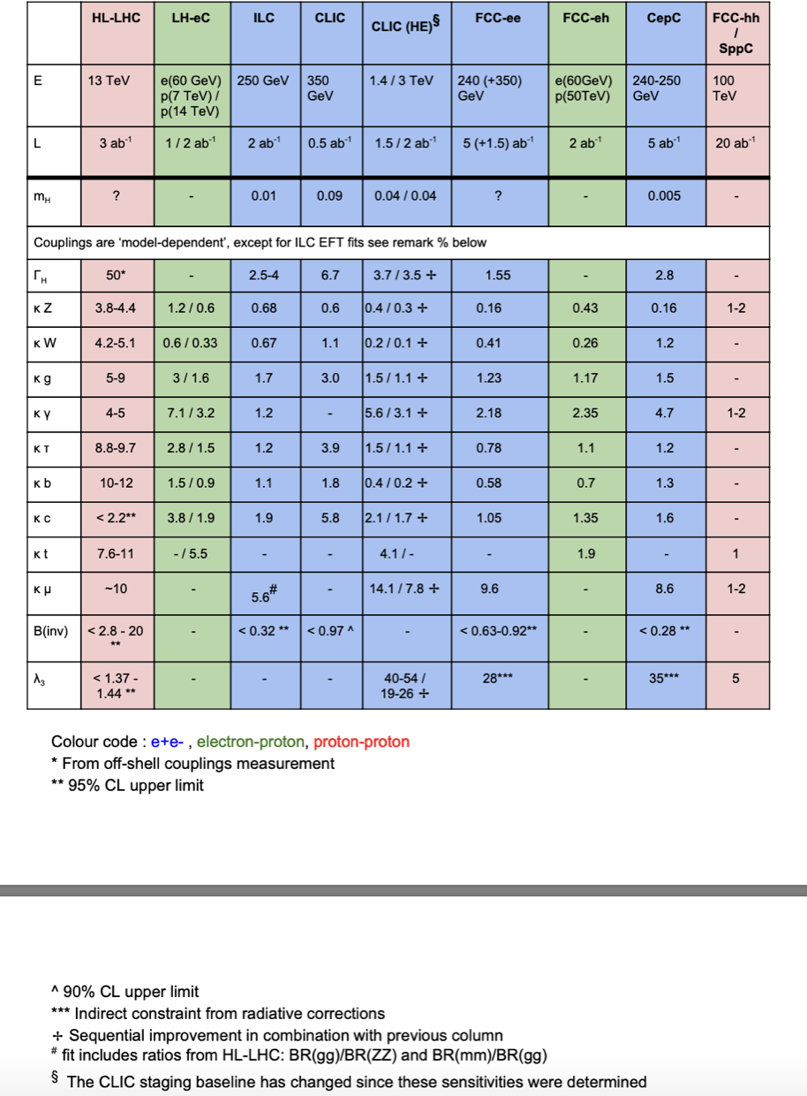
Table
Table can be an exemplary way to show how we make decisions: scientifically
2018: Durham workshop
Higgs table
(caution: numbers now outdated)
Notes:
Much of our operation is linked into the UK PPAN program and thus defined by Programs directorate spending with advice from Science Board

Slide 4
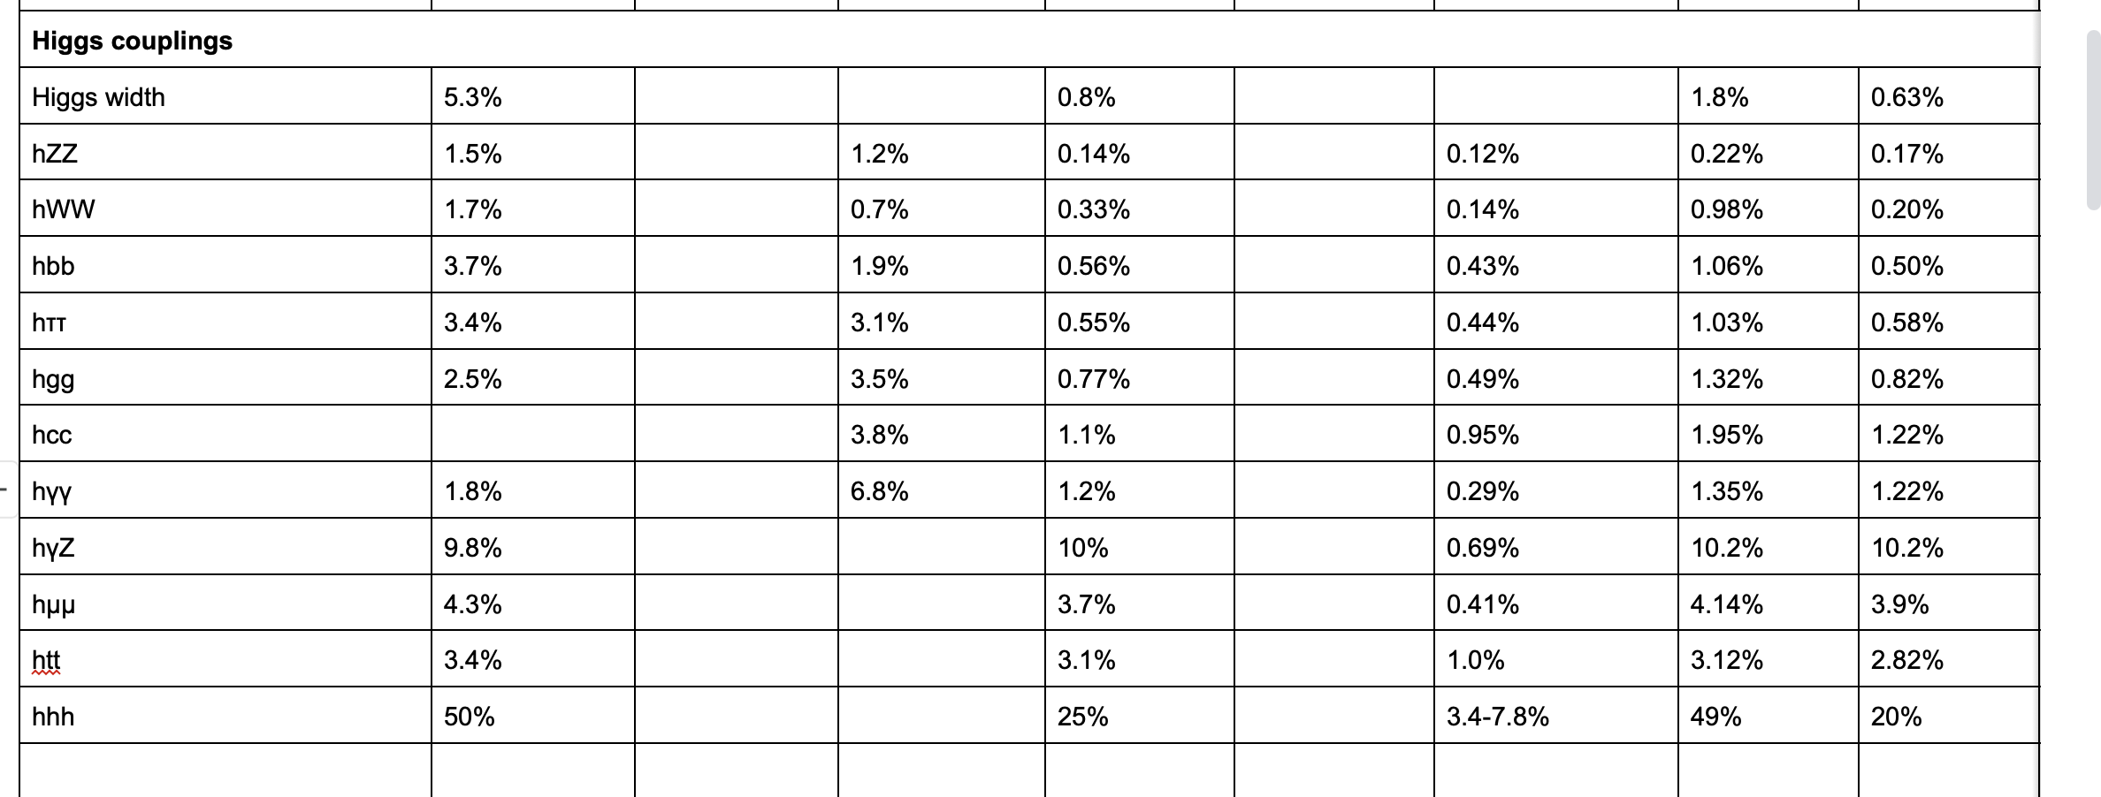
Table
Table can be an exemplary way to show how we make decisions: scientifically
2024 table:
There’s work to do…
Collider-based only so far
Find a way to tabulate
non-collider?
Example Higgs sector?
What’s missing: eh/hh
standalone and for
different energies?; LEP3?;
multi-TeV ee? Muon collider
Example Quark flavour:
only LHCb numbers
Notes:
Much of our operation is linked into the UK PPAN program and thus defined by Programs directorate spending with advice from Science Board

Slide 5
What we know
Standard Model is rather good…
But probably not the whole picture
What is then a reasonable thing to do?
Explore the sectors we know are there (Higgs being the most recent and still with large uncertainties)
Look for deviations
How precise is enough?
Map out phase space, systematically, in a way that’s sensitive to the unknown sectors
Direct/indirect dark matter
LLPs?
How to get broadest reach in phase space?
Using projects’ submitted slides, my comments added in highlighted text
Notes:
Much of our operation is linked into the UK PPAN program and thus defined by Programs directorate spending with advice from Science Board

Slide 6
Non-collider

Slide 7
Neutrinos

Slide 8
Proto DUNE – proton and electron beams at CERN to test DUNE technology - is a success story of the last ESPPU

Slide 9
CP violation sensitivity ~12 years
Oscillation parameters further 6-10 years if beam and far detector target upgraded

Slide 10
Kaon flavour

Slide 11
Kaon physics

Slide 12
Lepton flavour

Slide 13
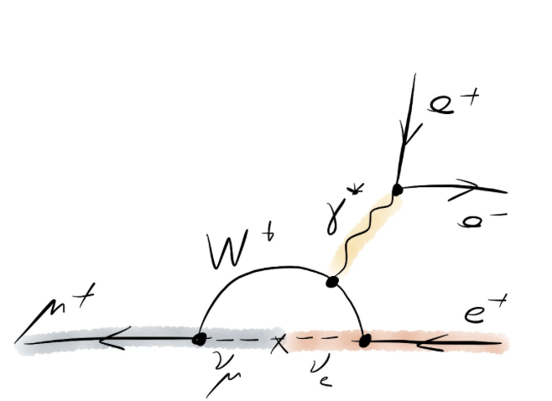
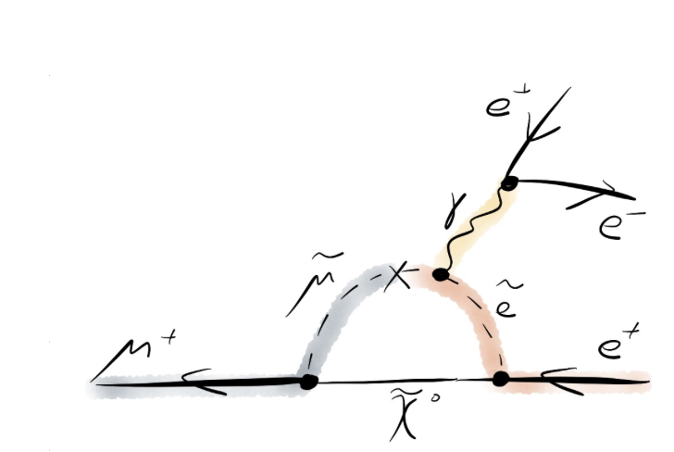

Slide 14
Dark Matter

Slide 17
Dark matter can belong both to ESPPU process and astroparticle equivalent: in the UK submission
it is reasonable to include astroparticle in both – this reflects our community composition and lack of silo

Slide 18
Gran Sasso, Liquid Argon

Slide 19
Quantum
Proposed mid-sized dark matter experiment at Boulby – complementary technologies using combined charge/light

Slide 20
Beam Dump

Slide 21
SHIP:
Approved project at CERN, 15 years at CERN SPS

Slide 22
Quantum

Slide 23
Quantum

Slide 24
Quantum
UK has acquired quantum technology capability that did not exist outside the US ~6 years ago

Slide 25
Network of clocks
Perhaps the time is ripe for an internationalised coordinated (geographically distributed?) quantum experiment program?

Slide 26
Collider

Slide 27
HL-LHC

Slide 28
Direct sensitivity to new physics at TeV energy scales and indirect sensitivity through precision measurements
Notes:
Much of our operation is linked into the UK PPAN program and thus defined by Programs directorate spending with advice from Science Board

Slide 29
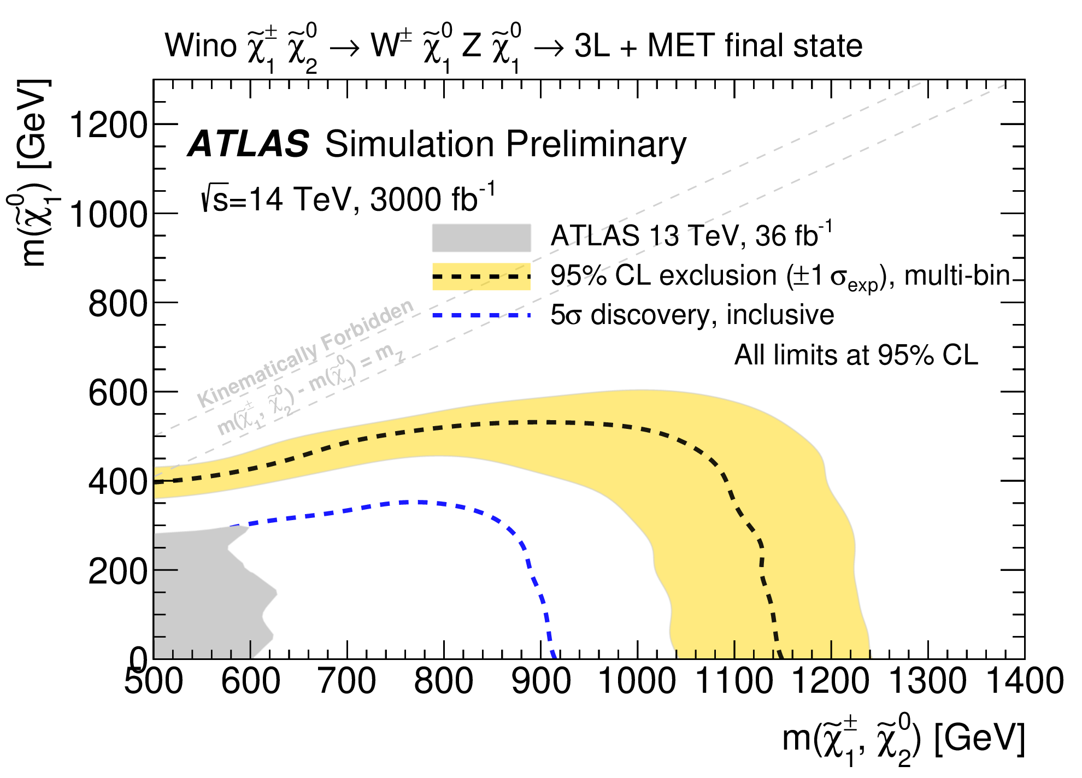
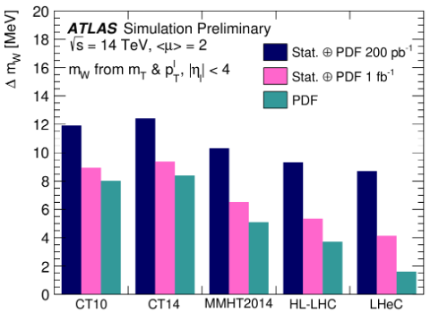
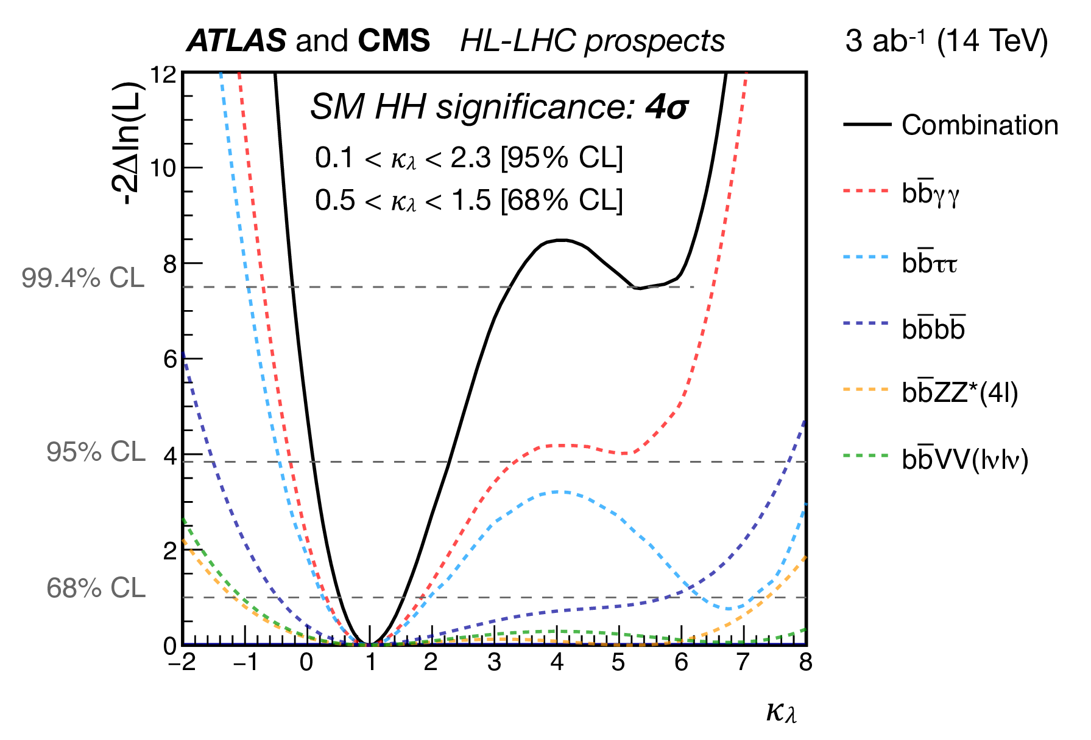
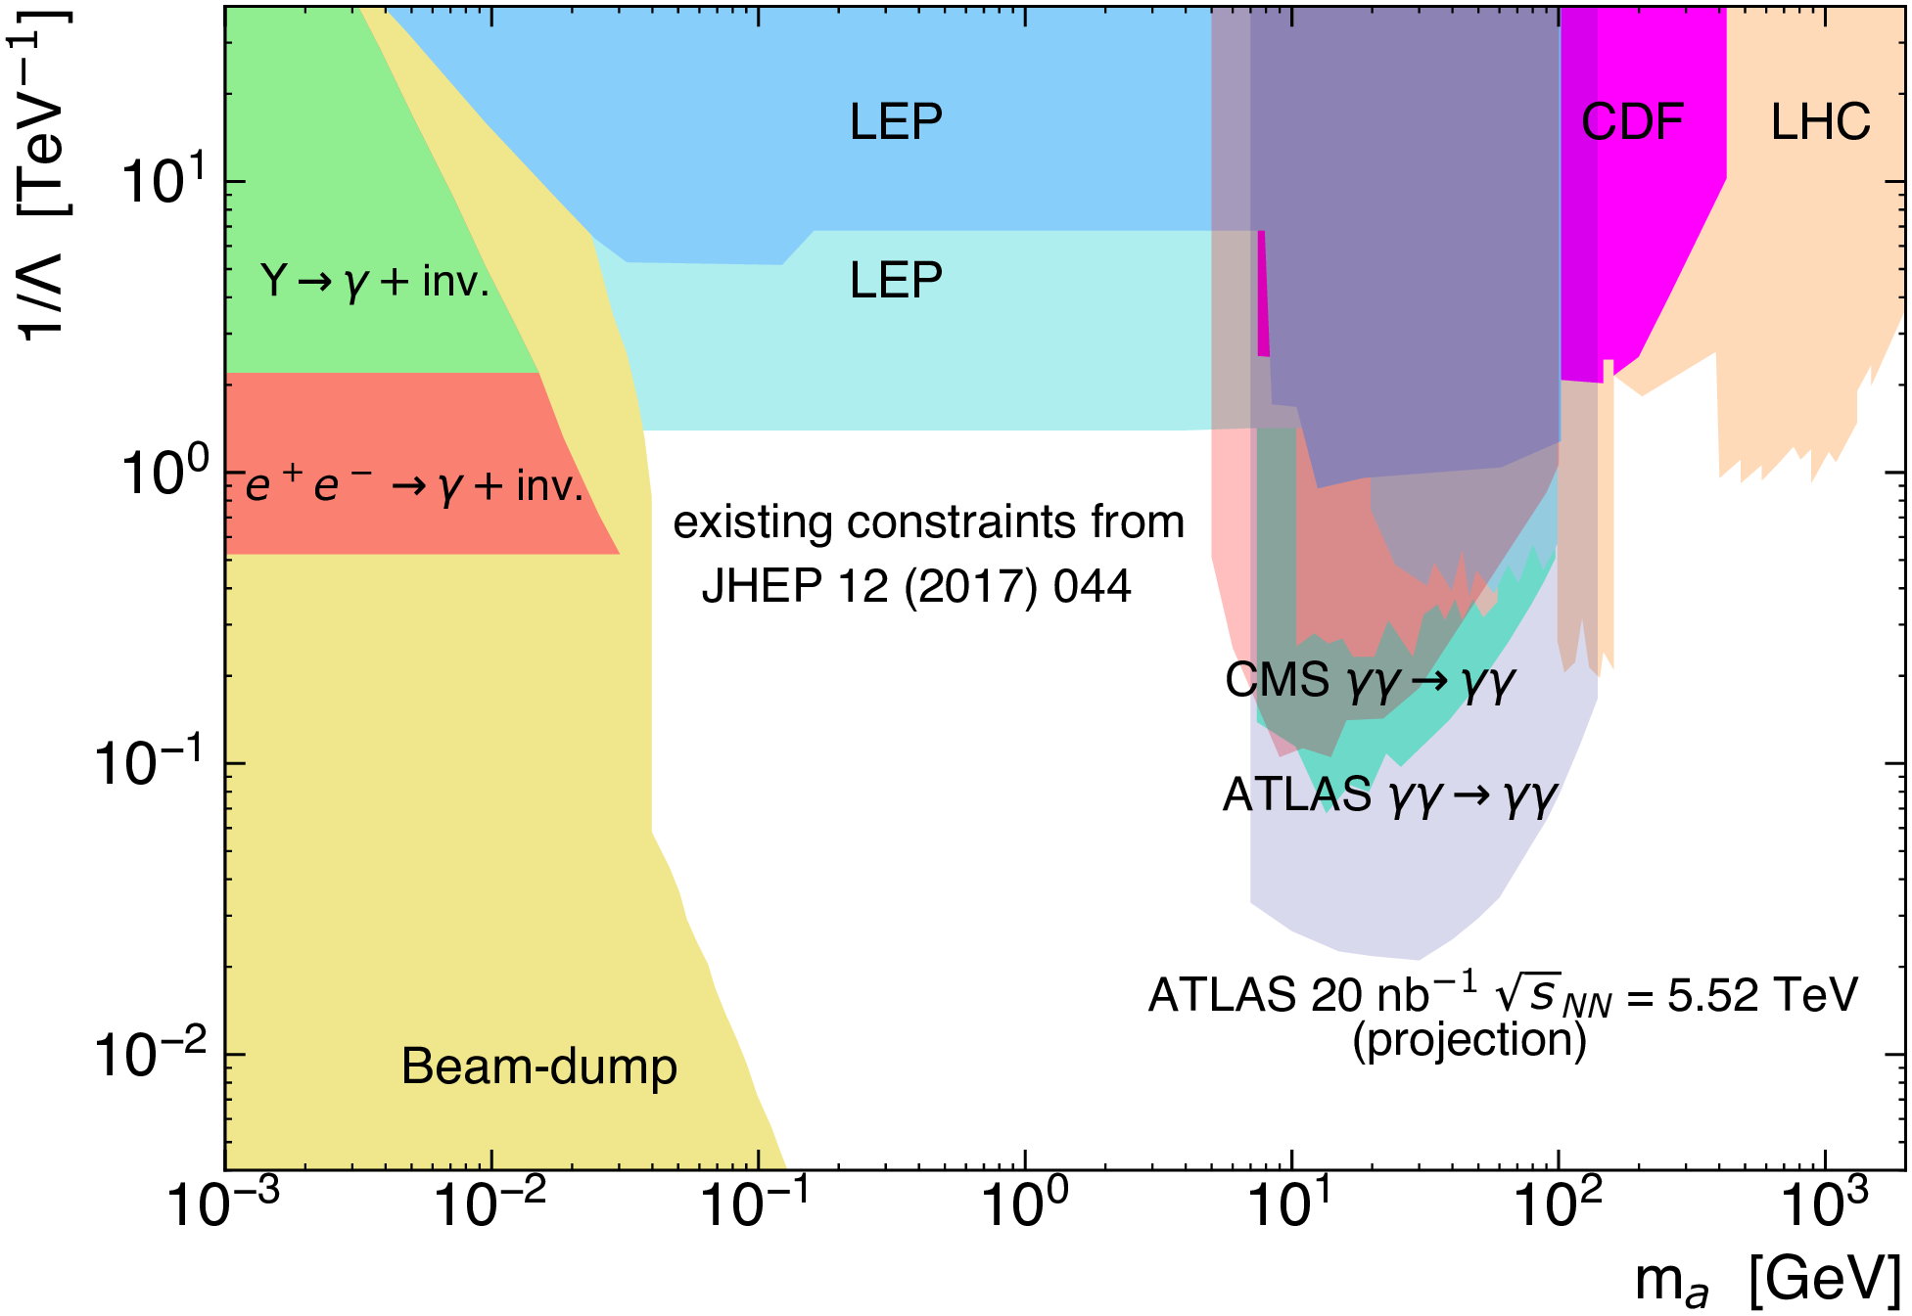
ATLAS Scientific deliverables
Key physics deliverables (stub):
Precision measurements of SM parameters including W and top mass, sin theta_eff, B-Physics, top physics and more
Precision measurements of the Higgs boson couplings and evidence / observation of di-Higgs
Direct exploration of hundreds of new physics scenarios (supersymmetry, new resonances, dark sectors, dark matter searches)
Indirect constraints of new physics through precision measurements
EWKS and Higgs-self coupling evidence (at least)
BSM searches
At least a factor of 2 expected in precision for W mass

Slide 30
Interplay of ATLAS/CMS end-stage timelines with LHCb is crucial to get right for full exploitation of all
Final word on HL-LHC projections available only towards March, suggest revisit national input *after* that
Hadron colliders notoriously do better than projections
Notes:
Much of our operation is linked into the UK PPAN program and thus defined by Programs directorate spending with advice from Science Board

Slide 31
Extended LHC

Slide 32
Extended LHC

Slide 33
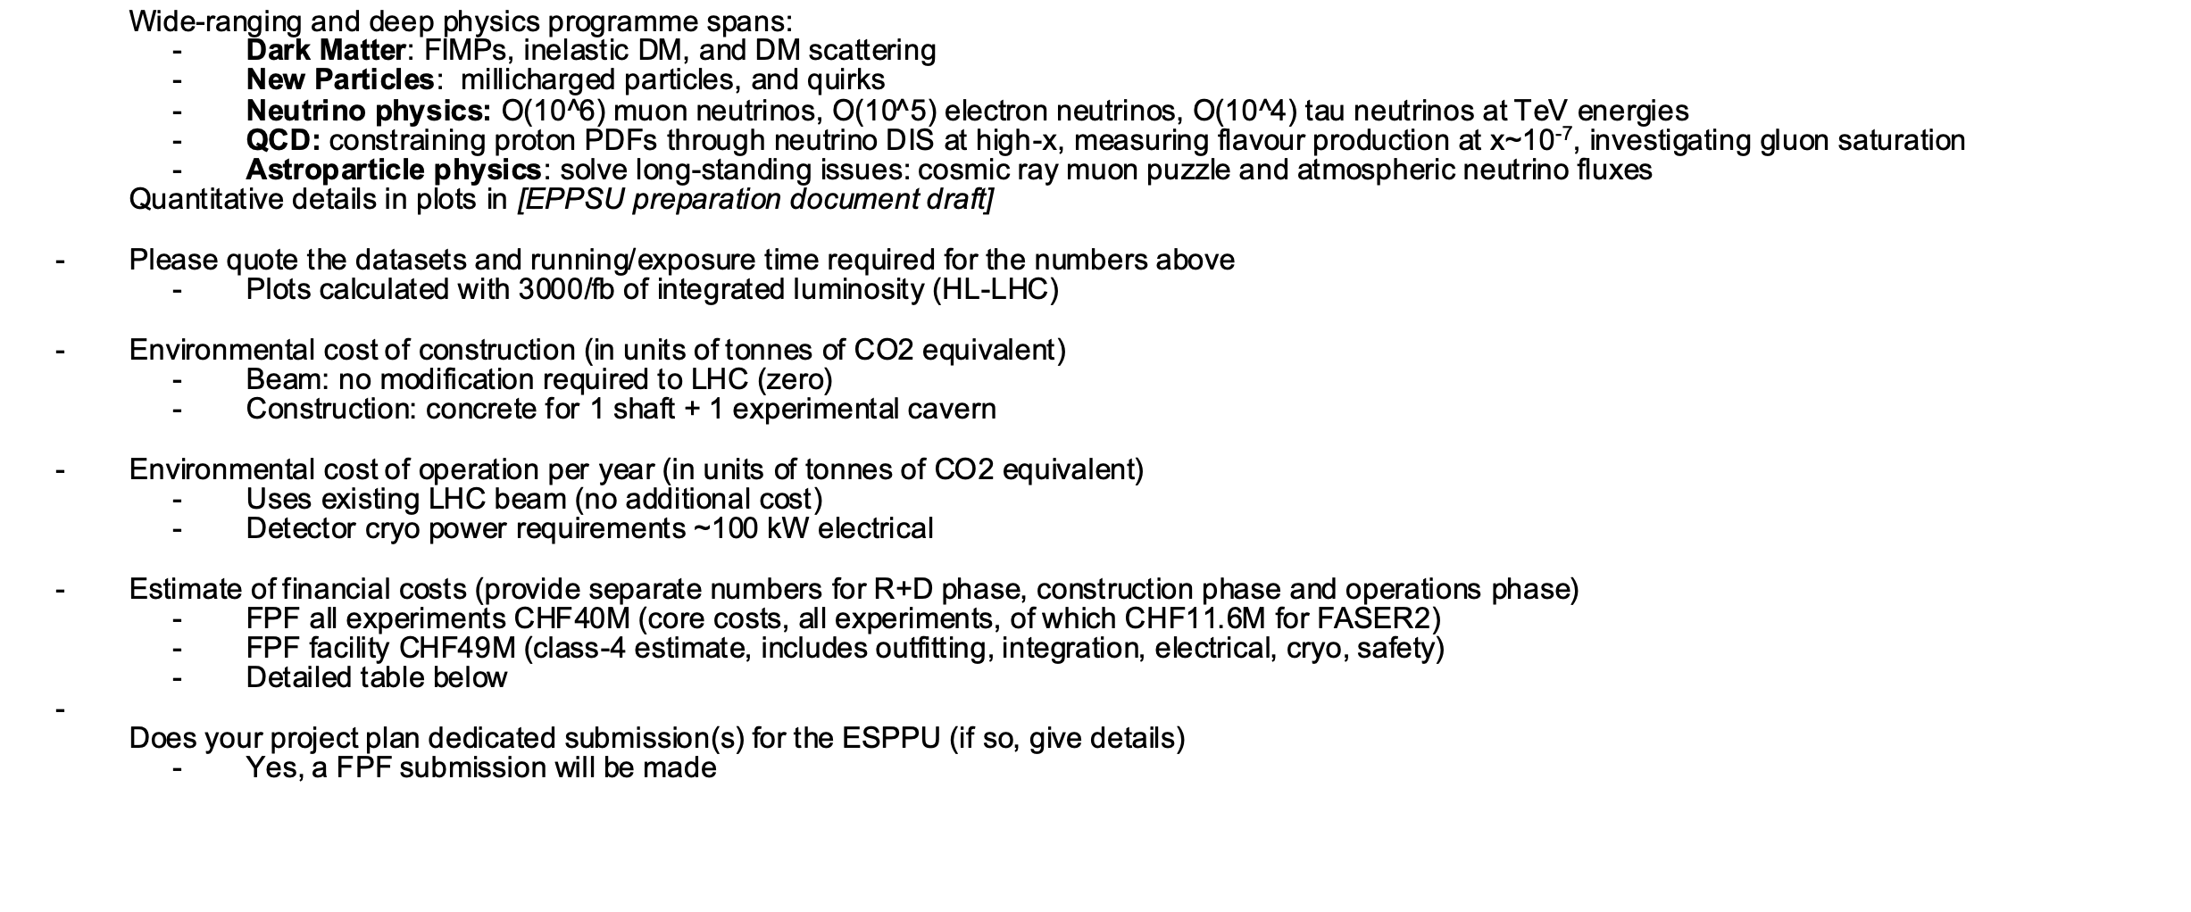
Run in LHC alongside existing program
does not use input from ATLAS detector signatures

Slide 34
Electron-proton collider

Slide 35
LHeC

Slide 37
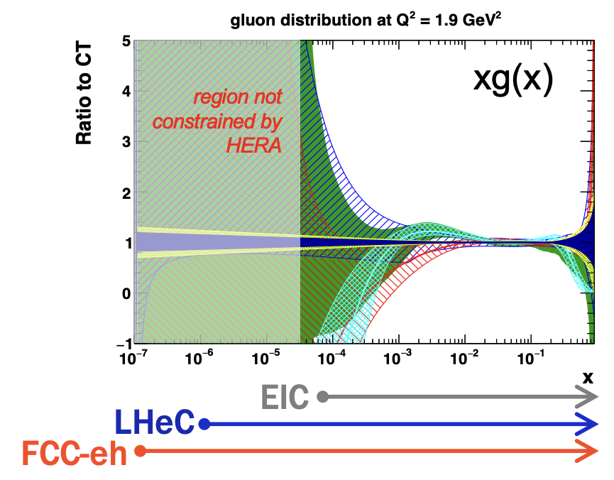
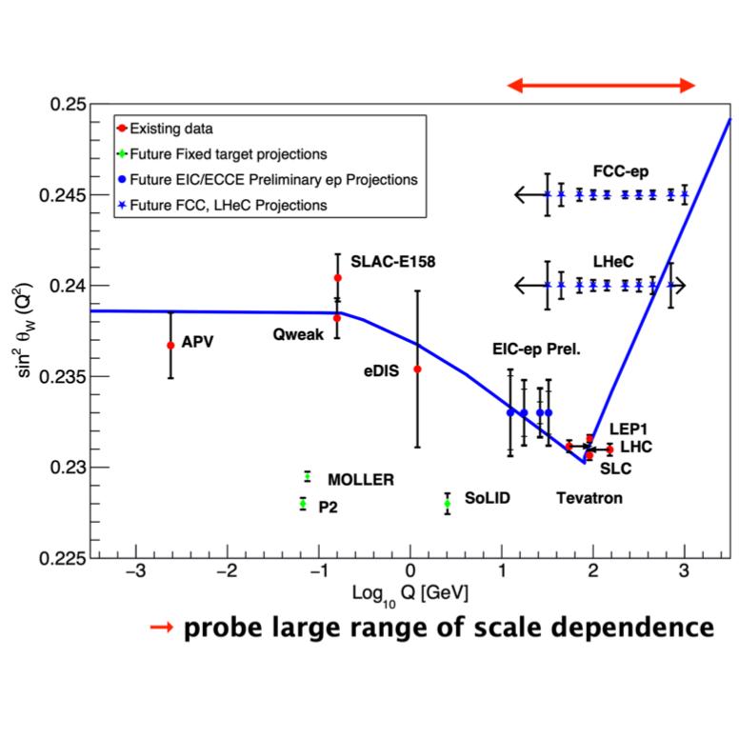
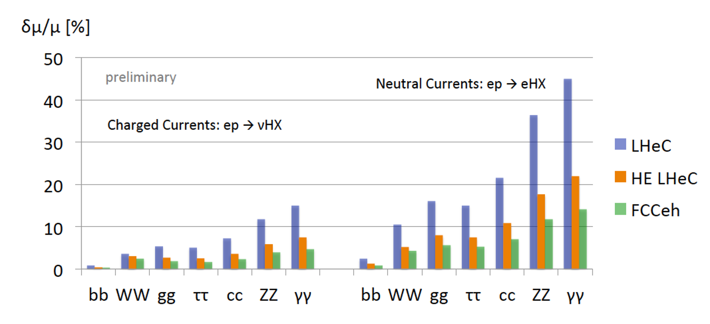
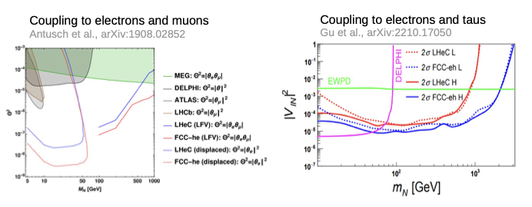
FCCeh: Physics case
Key physics deliverables (name up to 5). Be quantitative where relevant/possible.
Wide-ranging and deep physics programme spans:
PDFs, strong coupling constant, low-x measurements
W mass, sin2 theta, top mass, on other precision measurements in EWK and Top sectors
Higgs measurements with additional sensitivity à precision higgs facility together with LHC
Searches for new physics, including prompt and long-lived new scalars from Higgs, SUSY particles, heavy neutrinos, dark photons and axions
High-energy and high-density measurements of heavy ion collisions
signal strength measurements of Higgs decays
heavy neutrinos

Slide 38
Future Hadron Collider

Slide 39
Standalone hh numbers are the target of an FCChh taskforce, including other CoM energies
Notes:
Much of our operation is linked into the UK PPAN program and thus defined by Programs directorate spending with advice from Science Board

Slide 40
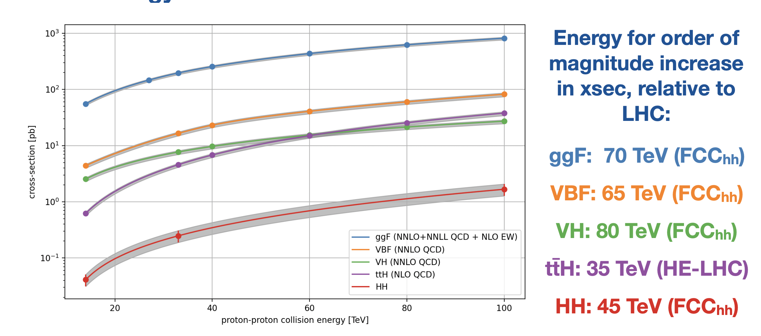
But: Highlight from Durham:
***jay plots
Technology demands on detectors too: readout, large scale silicon construction etc
Notes:
Much of our operation is linked into the UK PPAN program and thus defined by Programs directorate spending with advice from Science Board

Slide 41
Muon Collider
(10 TeV parton
centre of mass energy)

Slide 44
Want a clear picture on what is the near-term ask in Europe: cooling demonstrator in Europe? At CERN?

Slide 45
ee collider

Slide 47
2. ILC siting at CERN being
revisited since TDR and CLIC
siting studies
3. CLIC at CERN
See Phil Burrows’ talk

Slide 48
FCC-ee

Slide 51
Summing-up
Thoughts
Great set of projects
Suggest we need to get our (UK) thoughts together on the enabling technologies
Where these exist, great
Where they don’t, what are we doing about it? (Europe-wide since this is ESPPU)
Comment on Detector R&D in our submission
Comment on accelerator technology in our submission
Sets of projects suggest themselves
If we could only have collider (or collider-bolt-on) X, which Y and Z programs would we like along with it?
And vice versa
What if we can’t have any yet, what accelerator R&D do we do then?
Is the prior entirely flat or do we have notions of which parameters are more distinct and therefore provide a distinct window on new physics?
Back to the table of parameters
Notes:
Much of our operation is linked into the UK PPAN program and thus defined by Programs directorate spending with advice from Science Board

