Slide 1
QSHS – quantum sensors for the hidden sector
A resonant cavity search for halo dark matter axions.
Facility at Sheffield has achieved 6T magnetic field, cavity temperature of 18mK running in our dilution refrigerator. Facility has been developed from scratch since 2021 under QTFP.
Currently building up receiver electronics with a 1st stage travelling wave parametric amplifier to be housed in a multilayer passive magnetic field shield.
Collaboration with the US ADMX group on cavity development, novel resonators and data analysis techniques. Currently testing a niobium-tin coated tuning element in a 5.5T magnetic field at 50mK developed at Livermore Lab, USA by the ADMX collaboration.
First science data planned for early 2025.
We have the lowest base temperature of any axion detector world-wide. To take advantage of this, we need a large, high quality resonator and ultra low noise electronics. Developments in these areas are ongoing, in collaboration with our partner groups at Sheffield Oxford, Lancaster, UCL, NPL and Royal Holloway, as well as with ADMX.
Main risks are to funding – like other QTFP funded projects, we currently don’t have firm support beyond 31st March 2025, or any guarantees of further support for this area beyond October 2025. This makes it hard to retain staff, or to hire new staff.
Further science goals are to develop novel resonators with a wider tuning range and no moving parts using novel techniques such as resonant feedback. Collaborative work with US groups, ADMX (in particular C. Bartram at Stanford) is ongoing towards this goal.
Rival groups looking for QCD axions in the a similar mass range (25 to 40micro-eV) include Haystac (Yale, USA), Capp (South Korea), MaxMax (EU), QUAX (INFN).

Slide 2
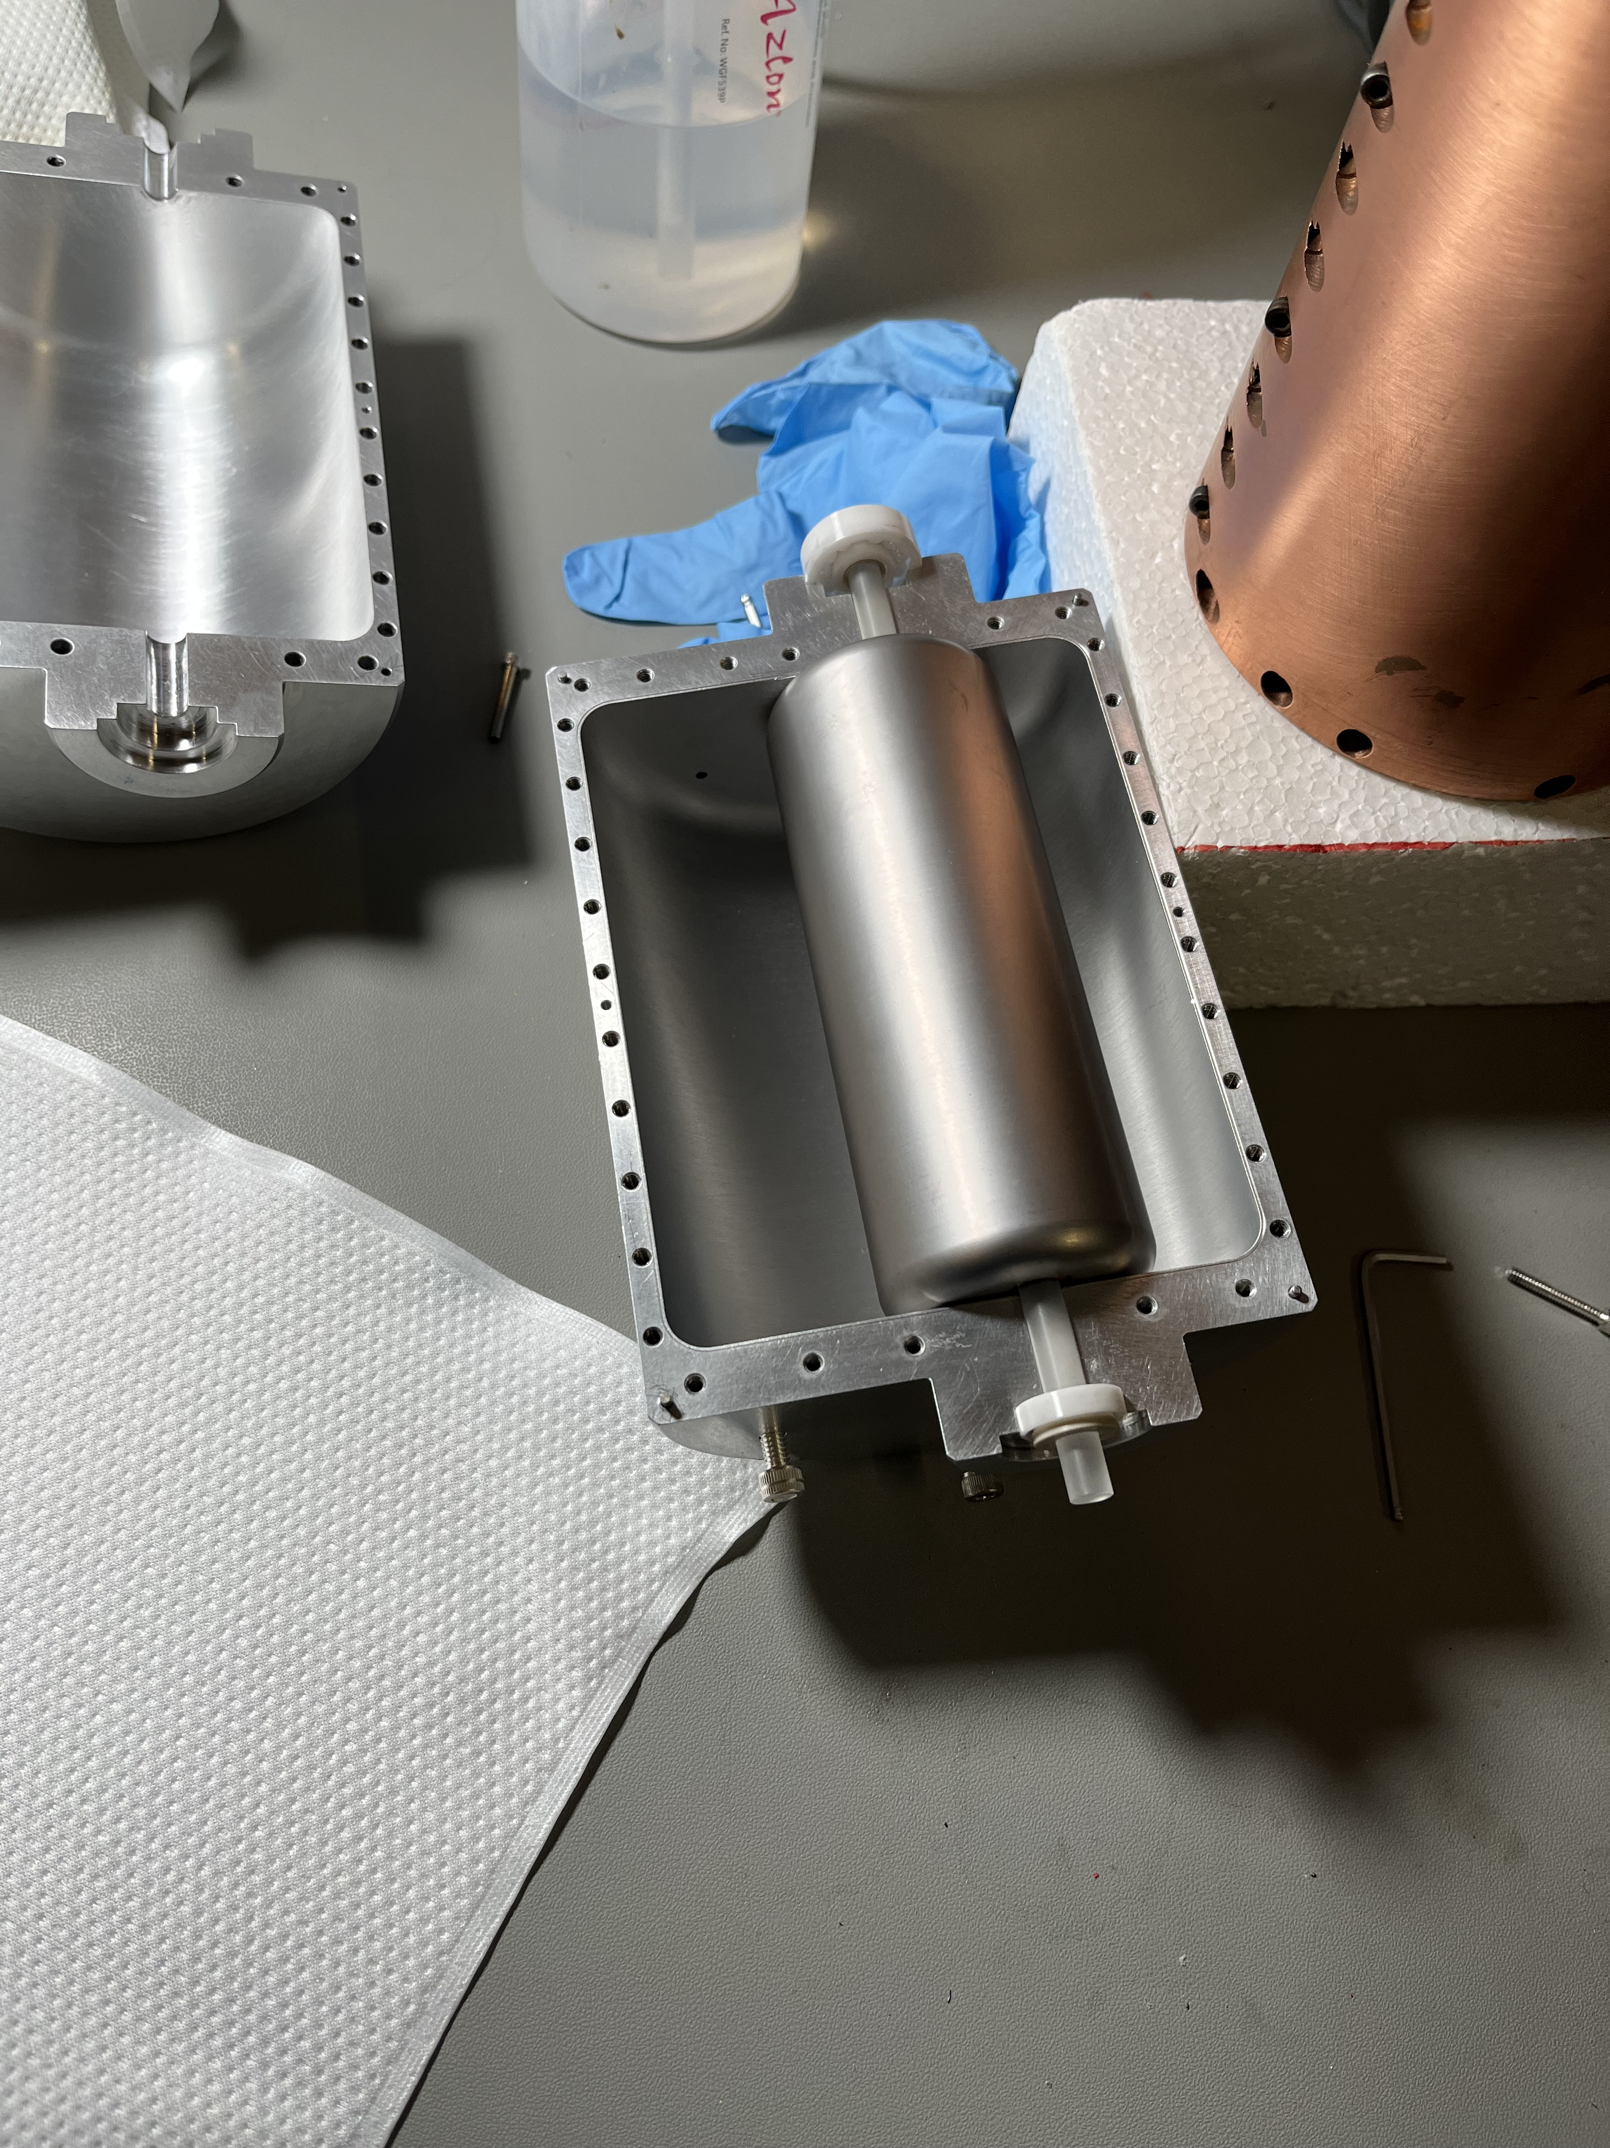
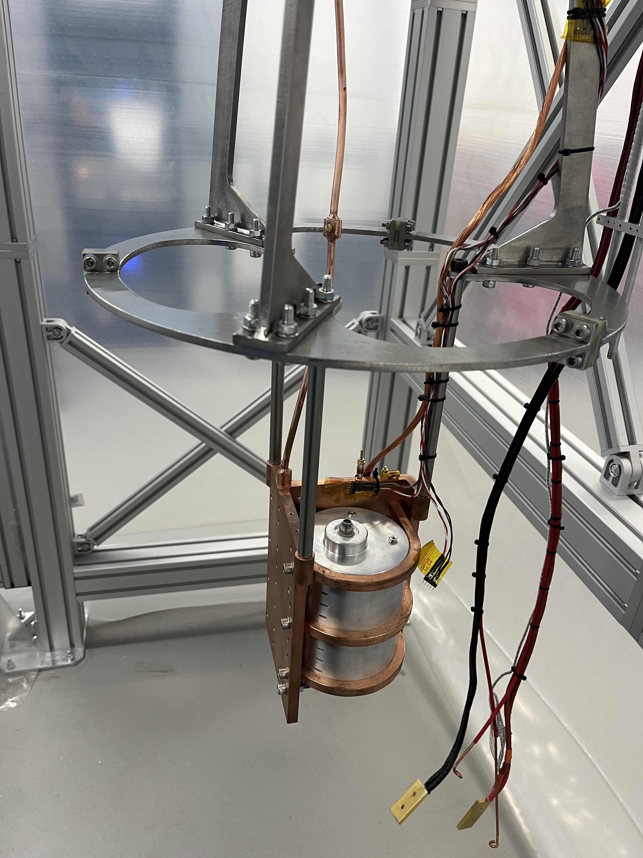
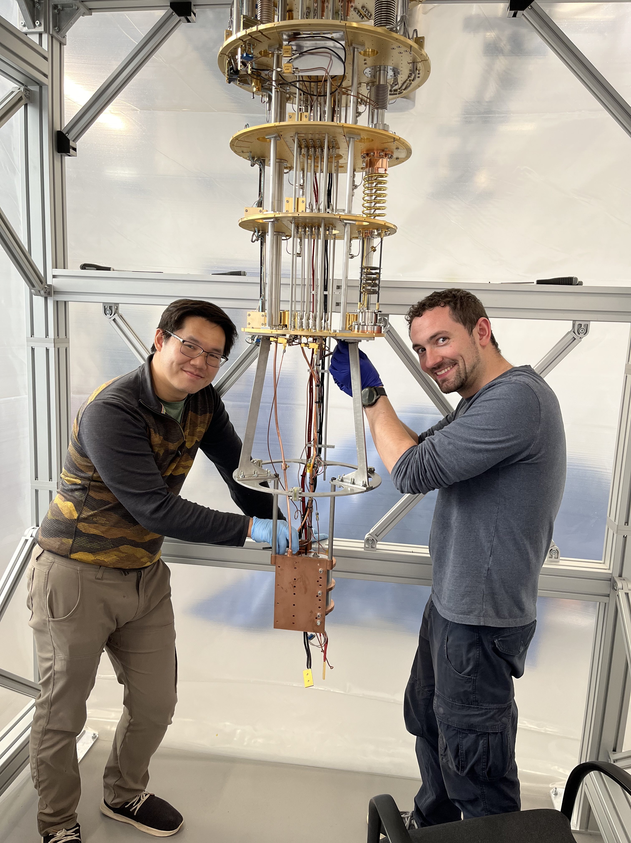
QSHS / ADMX superconducting cavity test
Livermore aluminium cavity containing a
niobium-tin coated niobium tuning rod.
Axles rotate to tune cavity modes.
Cavity clamped to copper holder,
mounted on stainless steel frame with
copper thermal links to dilution fridge
Nick Du (Livermore) and Mitch Perry
(Sheffield) with cavity and frame hung
on dilution fridge mixing chamber plate

Slide 3
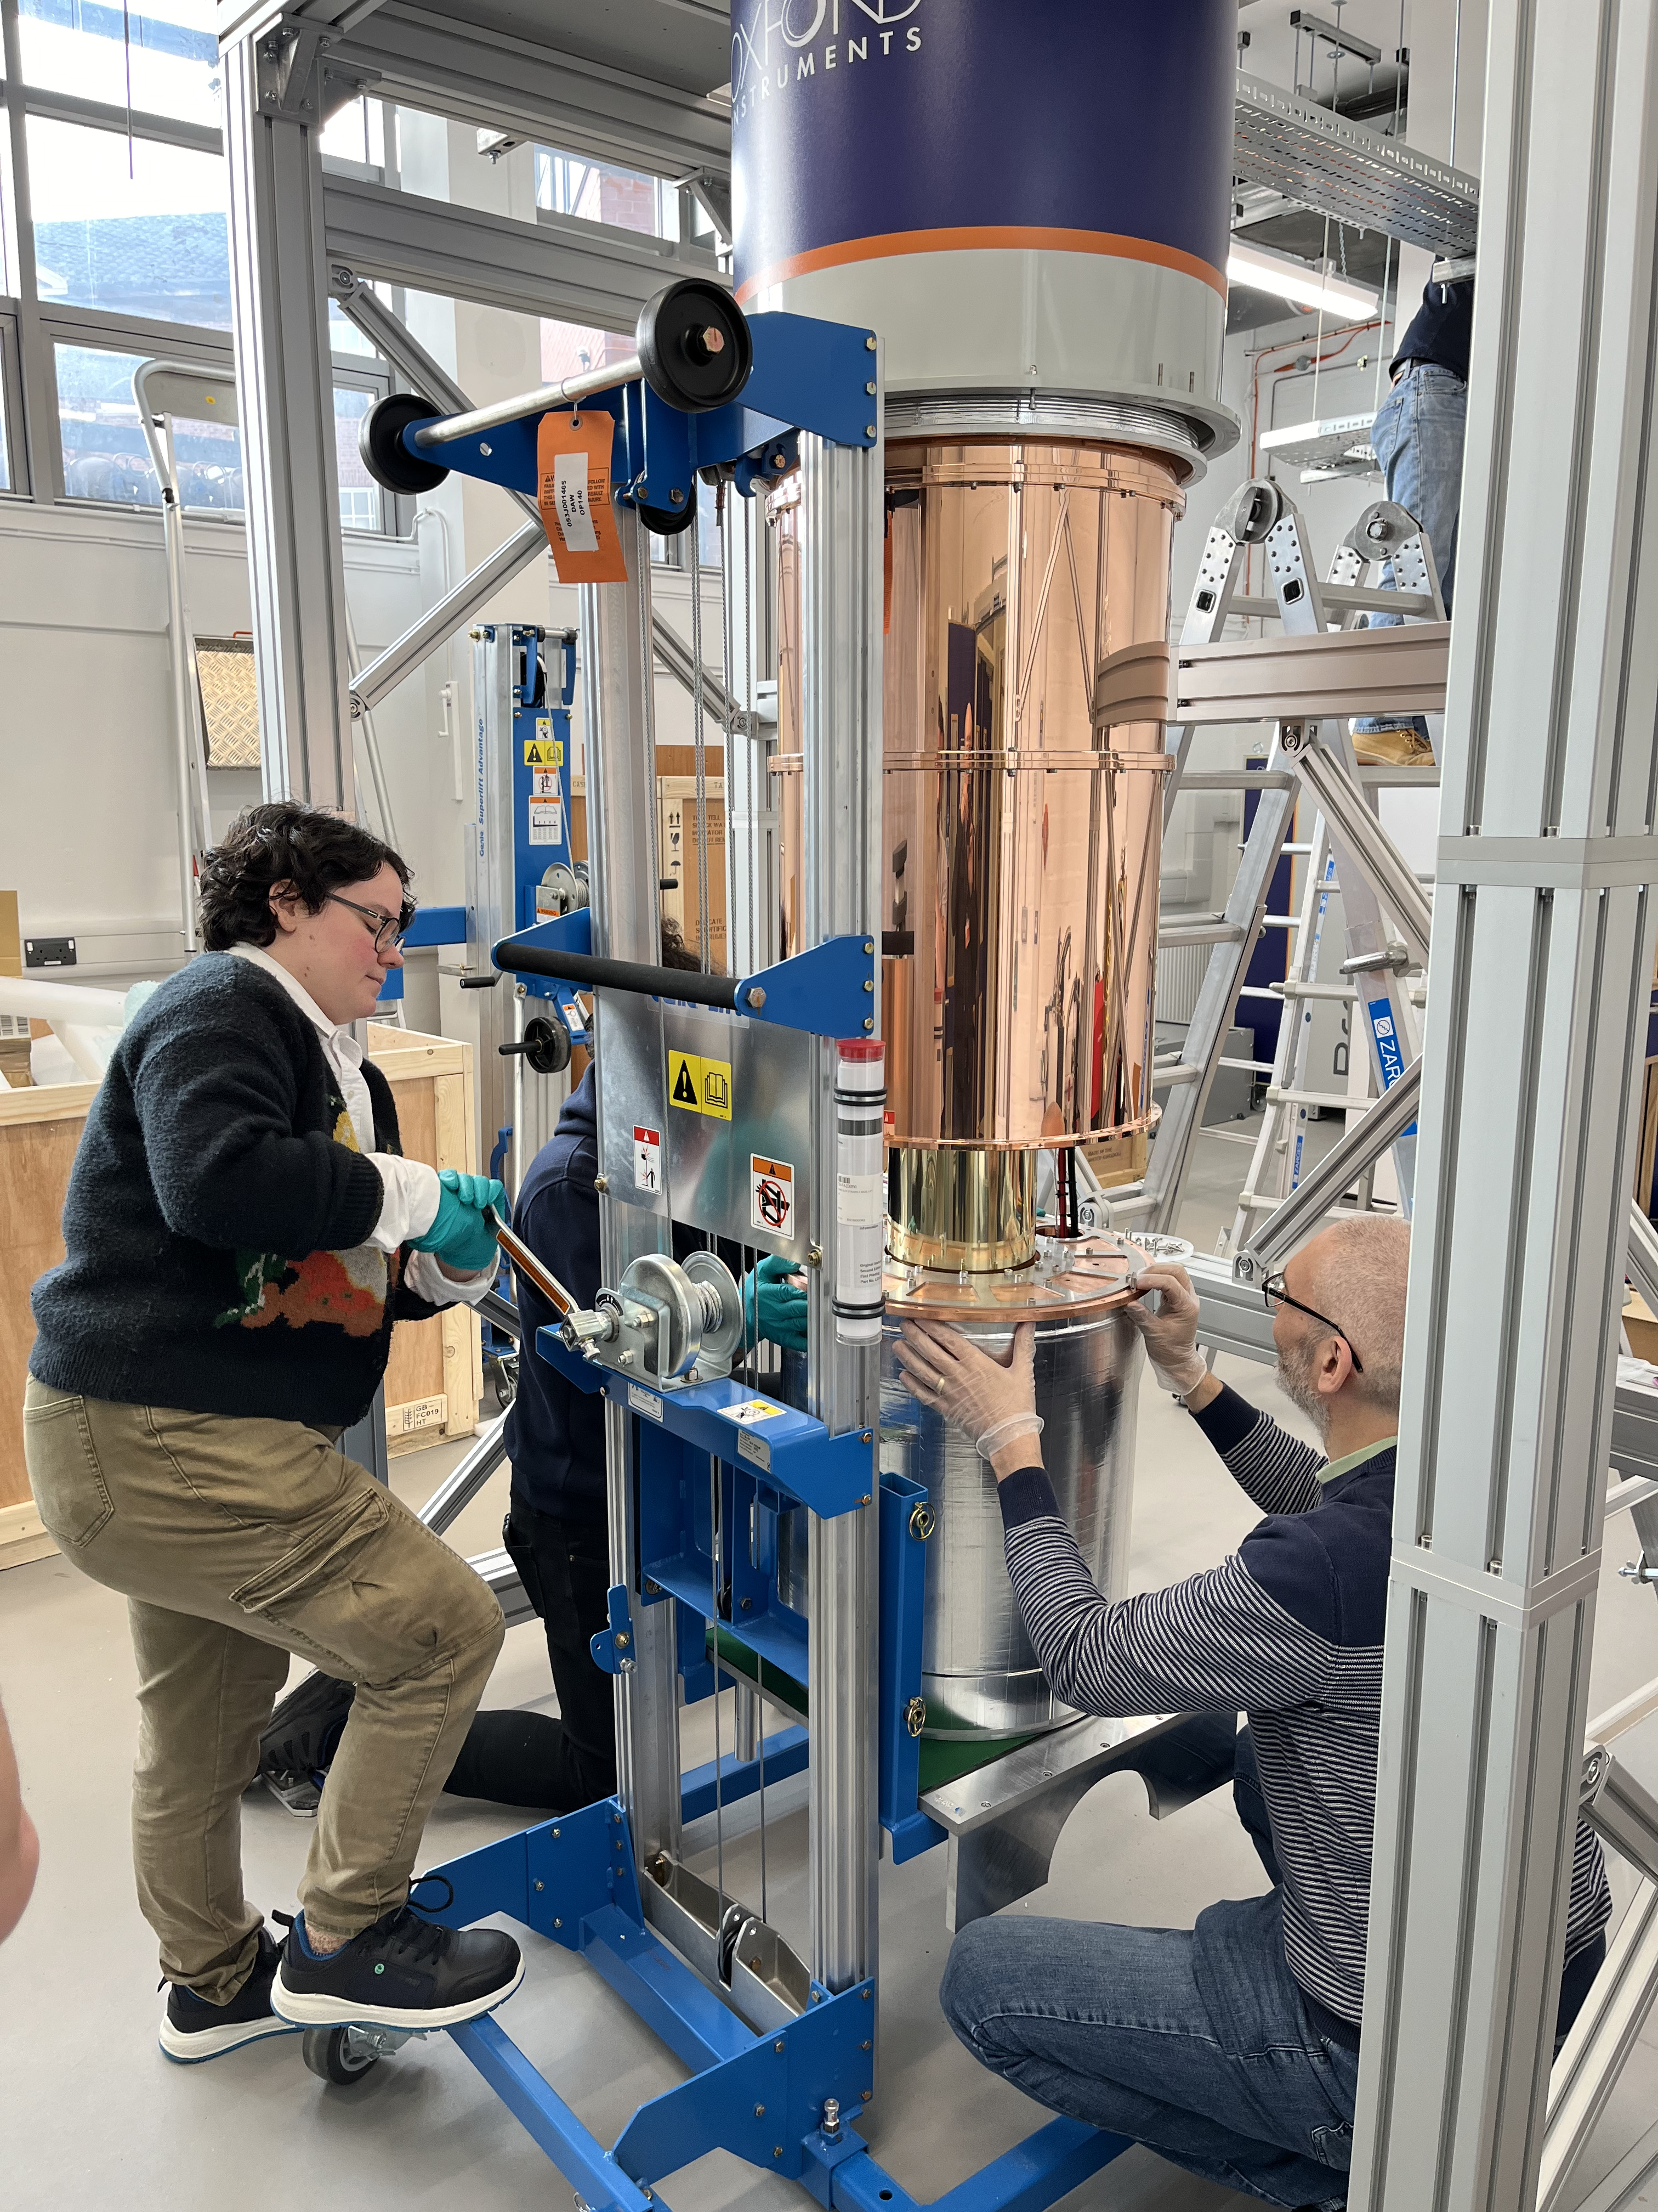
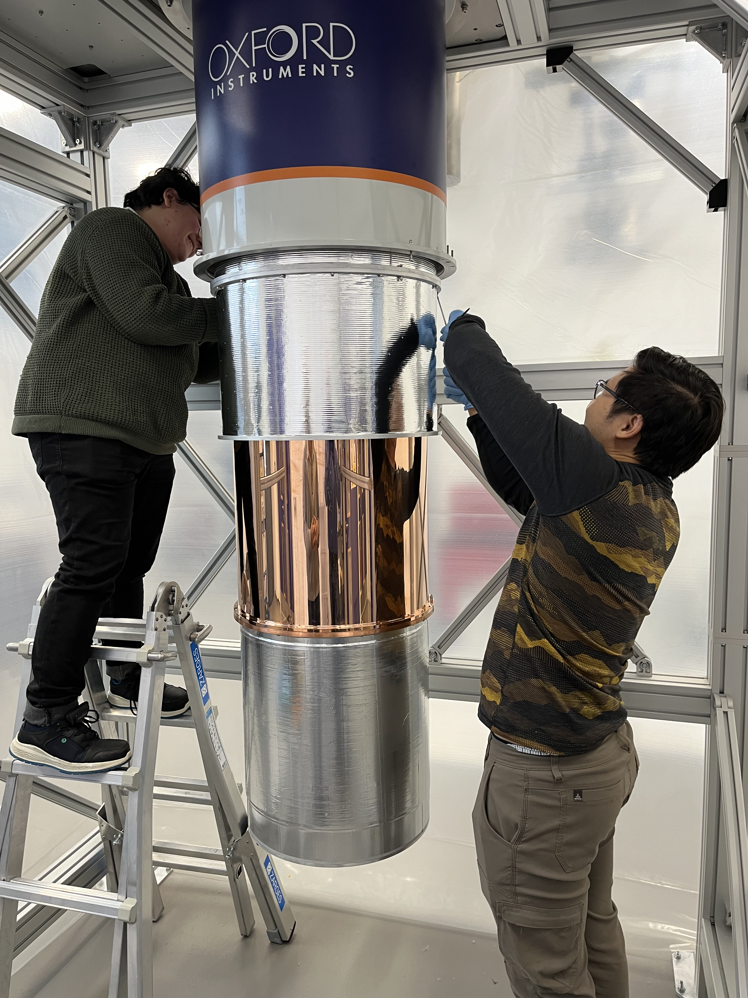
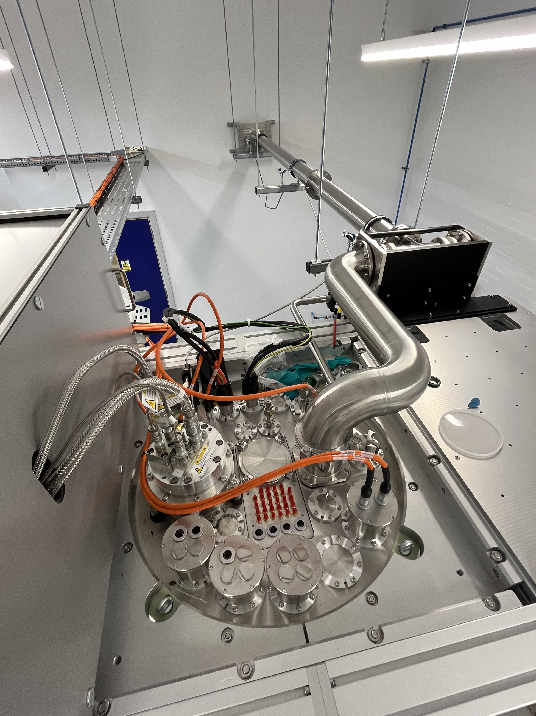
Reassembling the fridge for a cold run
Claude Mostyn and Paul Smith (Sheffield)
Jack magnet up to enclose 19cm
diameter experimental payload space
Nick Du and Claude Mostyn
fitting intermediate thermal shields.
Magnet is at the bottom
View of top flange of fridge and helium
lines. RF feedthroughs in cluster,
in the middle at the bottom.

Slide 4
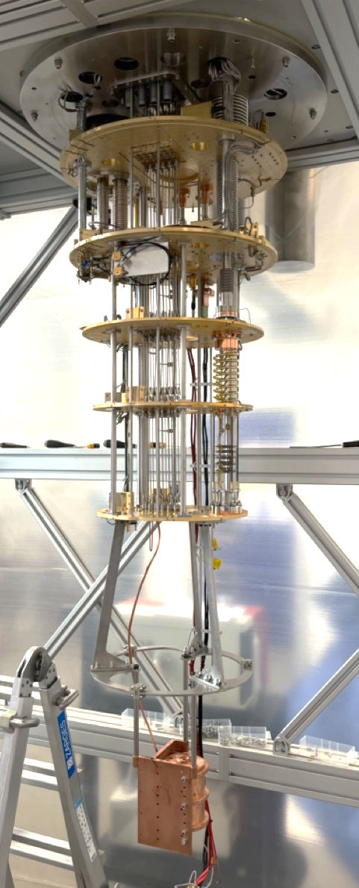
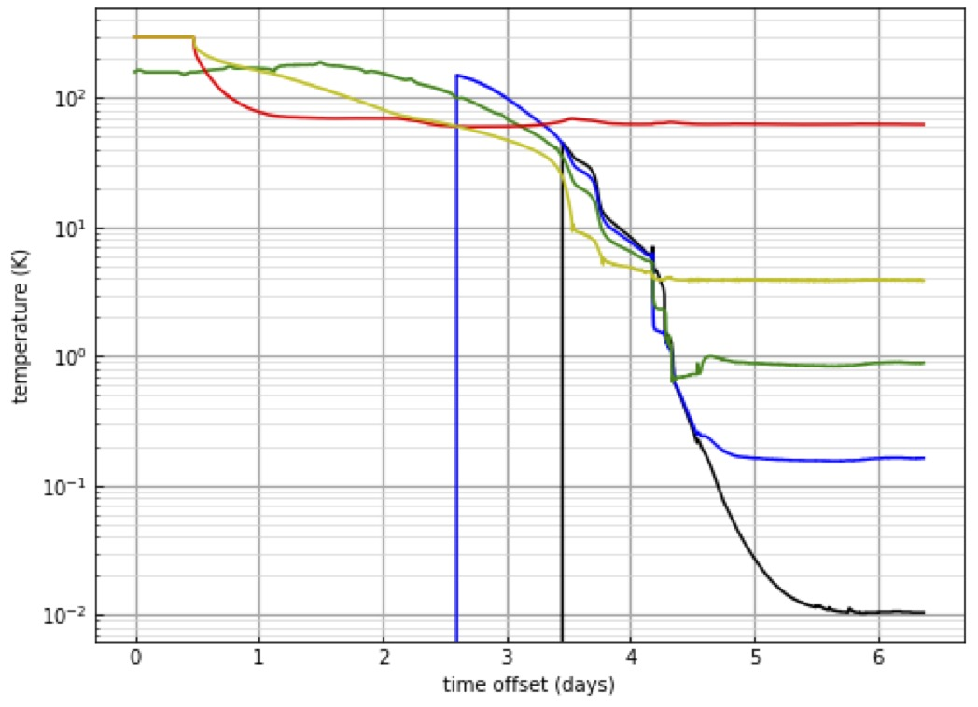
First Cavity/Magnet Cool-down
Cavity itself reached 18mK, which is lower than most (if not all) other axion detectors

Slide 5
Summary
QSHS are currently commissioning a cavity axion search.
Physical base temperature of 18mK achieved,
Magnet currently running at 6T, 8T upgrade scheduled for November
Operational carbon negligible; fridge uses standard 3-phase.
Embodied carbon: selected UK supplier to minimize carbon footprint, Oxford Instruments take sustainability very seriously.
Plans to operate the dilution fridge / magnet at Sheffield as a facility for more general cryogenic technology R&D are well advanced.
Project currently involves 6 postdocs, 4 Ph.D students, 15 faculty.
We plan to take our first science data in early 2025.
Our collaboration with ADMX is bearing fruit; studies of superconducting resonators from ADMX in the QSHS fridge have yielded excellent results, which will be published.
Looking forward to a bright future of quantum research.

