Slide 1
ATLAS at HL-LHC
Monica D’Onofrio, Sara Alderweireldt, Steve McMahon, Pedro Teixeira-Dias, Sarah Williams

Slide 2
ATLAS in UK: from run 3 to HL-LHC
ATLAS UK composition
14 universities + STFC Rutherford Lab
11.7% of ATLAS active authors
260 Physicists and 108 engineer/tech/admin
142 current doctoral students
Major roles and international leaderships
Just since 2021: 14 Level-1 coordinators, 15 Physics and Combined Performance group conveners (and >40 sub-group conveners) in diverse areas, ~55 Level-3 coordinators;
dynamic community, engaged in developing new ideas at all levels, including ECRs and students
~ 650 students awarded PhD since 2005
Project Funding: mainly from STFC
Additional funding: EPSRC, UKRI, Royal Society, ERC, Marie Curie, Schmidt Family Foundation, Leverhulme Trust
Run 4: UK Phase II upgrade responsibilities
ITk-Pixels ITk-Strips Calorimeter Trigger (eFEX & Global) High Level Triggering & DAQ Upgrade software
Upgrade funding so far: £128M for 12 years (2014-2026)

Slide 3
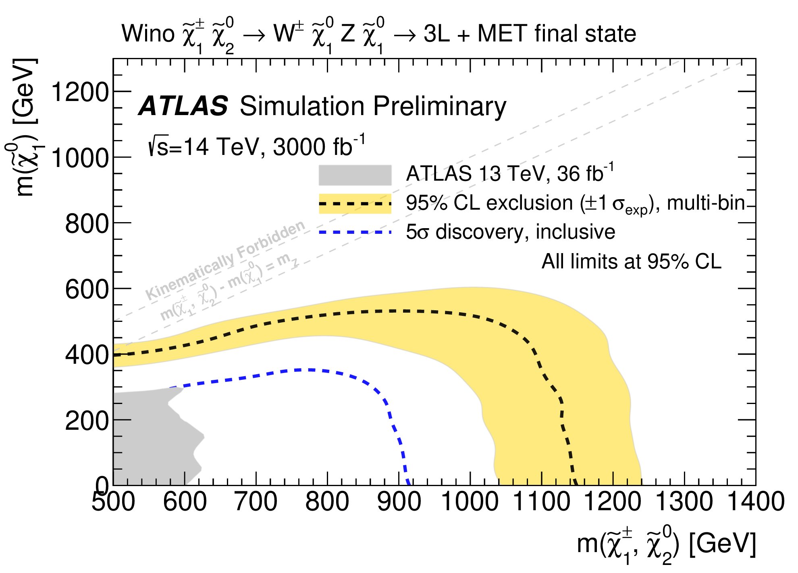
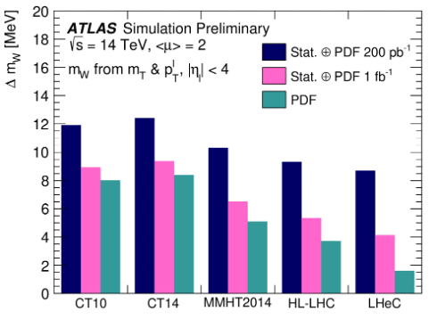
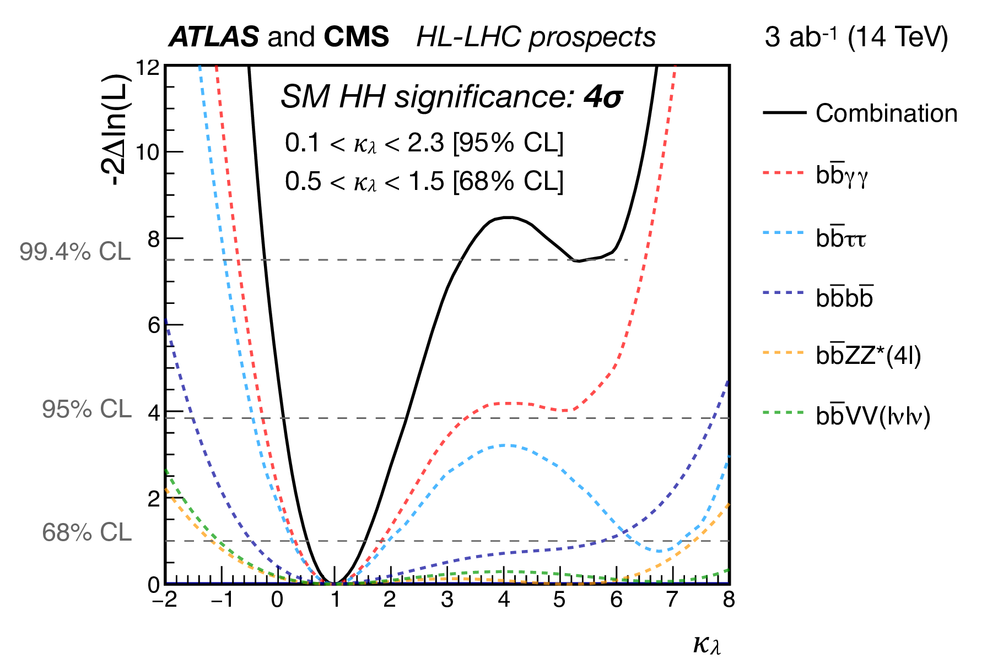
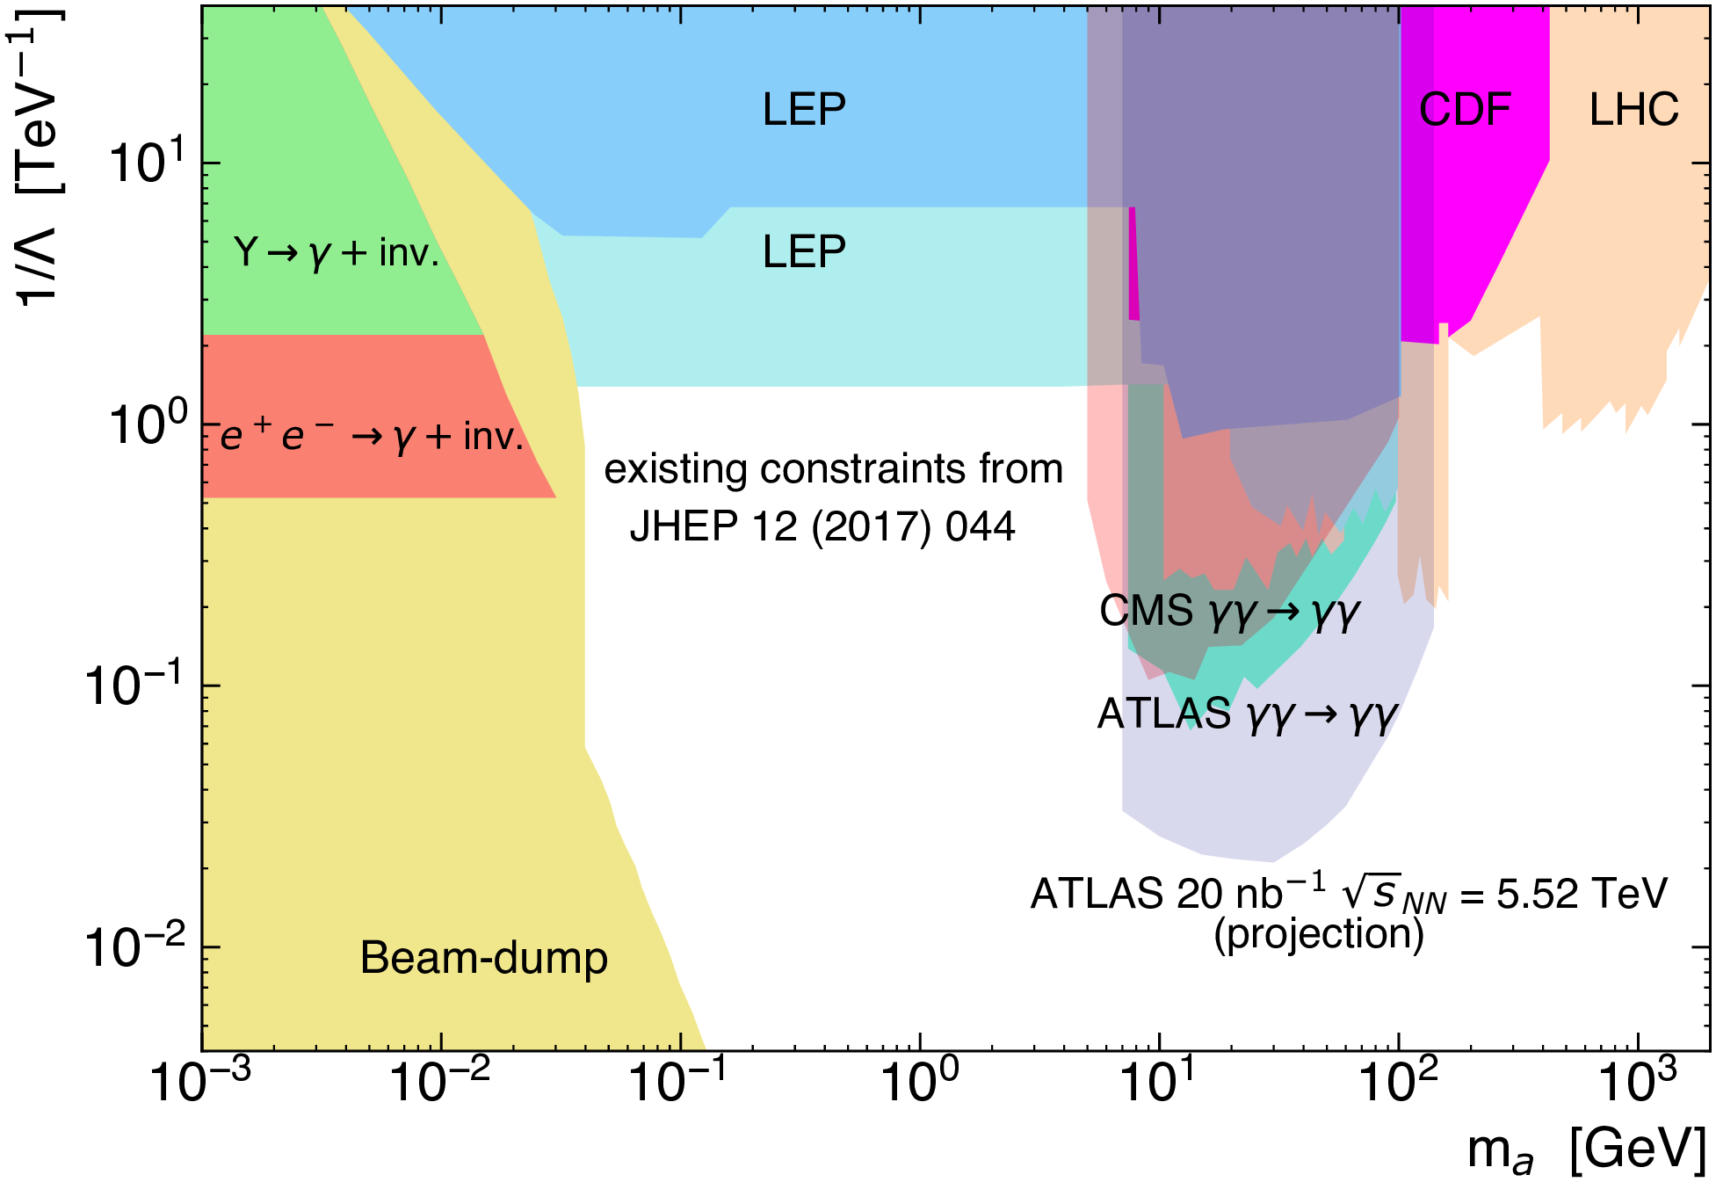
Scientific deliverables
Key physics deliverables (stub):
Precision measurements of SM parameters including W and top mass, sin theta_eff, B-Physics, top physics and more
Precision measurements of the Higgs boson couplings and evidence / observation of di-Higgs
Direct exploration of hundreds of new physics scenarios (supersymmetry, new resonances, dark sectors, dark matter searches)
Indirect constraints of new physics through precision measurements
EWKS and Higgs-self coupling evidence (at least)
BSM searches
At least a factor of 2 expected in precision for W mass

Slide 4
Some additional parameters and costs
centre-of-mass energy: 14 TeV
integrated luminosity: 3000/fb
number of interaction points: 1 (this is ATLAS)
time running at stage: 10 years
wall power to be checked
accelerator length: 27 km
estimated year for first collisions: 2030
future upgrade paths: 2033+ (LS5 and/or LS6)
Environmental cost of construction (in units of tonnes of CO2 equivalent) - check if available
Environmental cost of operation per year (in units of tonnes of CO2 equivalent) - check if available
Estimate of financial costs (provide separate numbers for R+D phase, construction phase and operations phase) -
Does your project plan dedicated submission(s) for the ESPPU (if so, give details) -
HL-LHC is already the highest priority according to the European Strategy, a submission is being prepared by the international collaboration (actually, there are more than one submission being prepared)

