Slide 1
CMS
ECFA UK Drafting Session

Slide 2
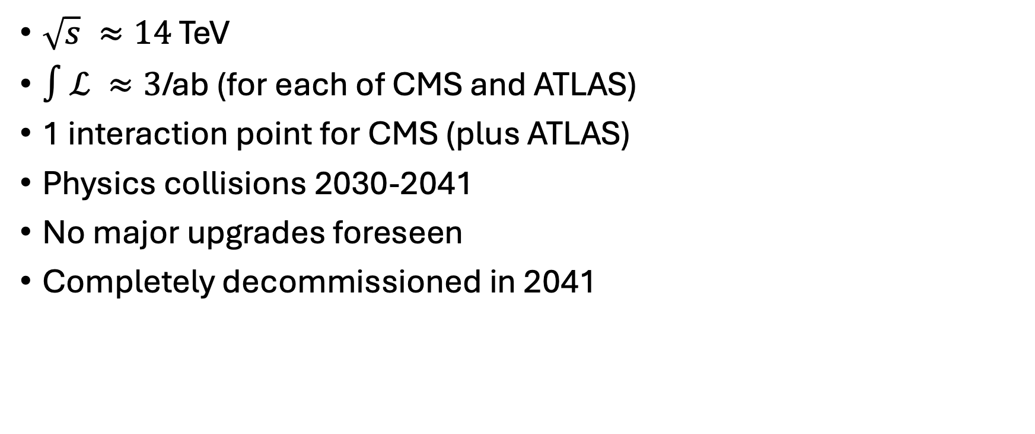
Parameters
$\sqrt{s} ≈14$ TeV
$∫ℒ ≈3$/ab (for each of CMS and ATLAS)
1 interaction point for CMS (plus ATLAS)
Physics collisions 2030-2041
No major upgrades foreseen
Completely decommissioned in 2041

Slide 3
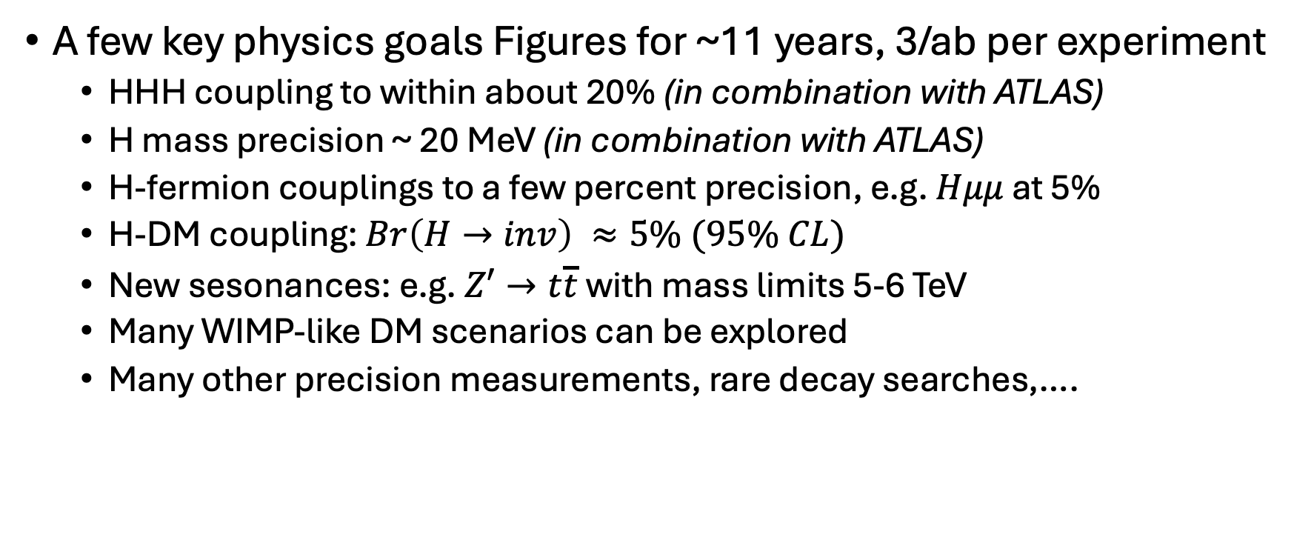
Physics Milestones
A few key physics goals Figures for ~11 years, 3/ab per experiment
  HHH coupling to within about 20% (in combination with ATLAS)
  H mass precision ~ 20 MeV (in combination with ATLAS)
  H-fermion couplings to a few percent precision, e.g. $Hμμ$ at 5%
  H-DM coupling: $Br\left(H→inv\right) ≈5\% (95\% CL)$
  New sesonances: e.g. $Z′→t\overline{t}$ with mass limits 5-6 TeV
  Many WIMP-like DM scenarios can be explored
  Many other precision measurements, rare decay searches,….

Slide 4
Costs and ESPPU
Environmental
  Electricity mainly nuclear
  Data processing distributed – CO2 per data centre varies
  Working to reduce gas leaks
Financial
  No significant capital costs after 2029
  Annual operations (M&O A + M&O B) ~ 20MCHF
Will be submitting to ESPPU (joint with ATLAS?)

