Slide 1
FCC-eh
Monica D’Onofrio, Uta Klein, Paul Newman, Claire Gwenlan et al.

Slide 2
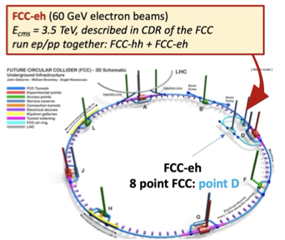
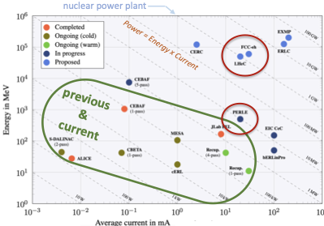
The FCC-eh complex
centre-of-mass energy: 3.5 TeV (assuming 60 GeV electron beam, 50 TeV proton beam)
integrated luminosity: 1 or 2 /ab
number of interaction points: 1
time running at stage: 10-20 years (as many as FCC-hh)
wall power: 100 MW for ERL?
accelerator length: same as FCC-hh for proton beam, ERL: 2 km arc, 1 km straight-length, 3 turns
estimated year for first collisions: 2050+
future upgrade paths: none at the moment
ERL development in progress

Slide 3
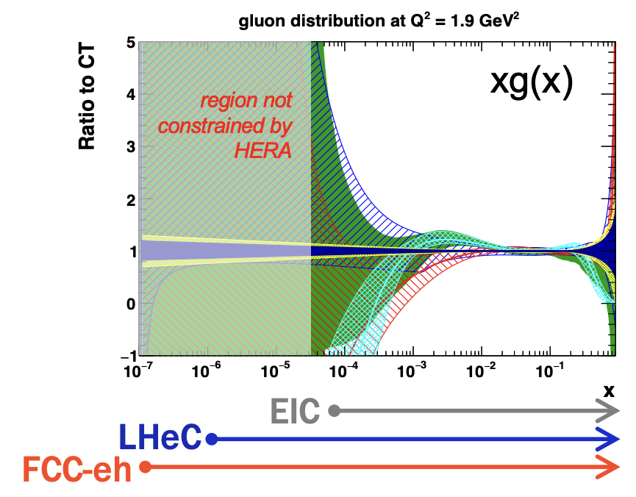
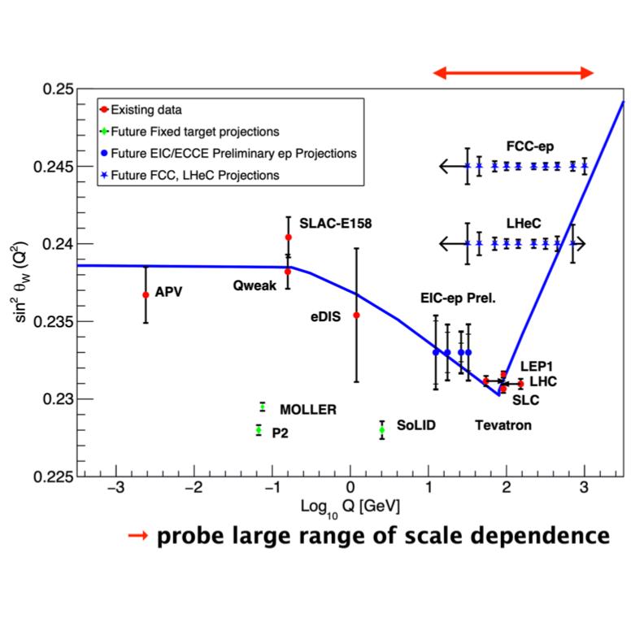
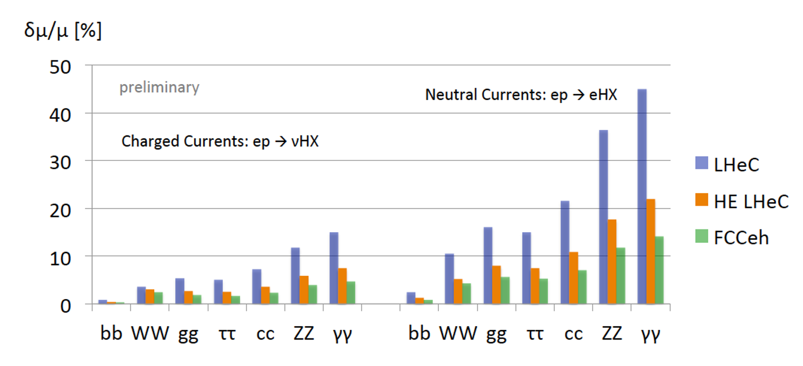
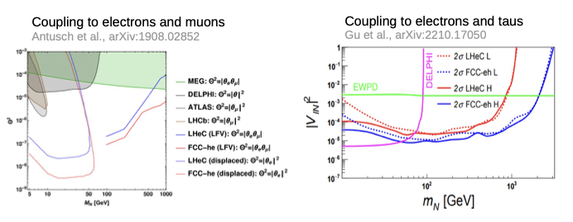
Physics case
Key physics deliverables (name up to 5). Be quantitative where relevant/possible.
Wide-ranging and deep physics programme spans:
PDFs, strong coupling constant, low-x measurements
W mass, sin2 theta, top mass, on other precision measurements in EWK and Top sectors
Higgs measurements with additional sensitivity à precision higgs facility together with LHC
Searches for new physics, including prompt and long-lived new scalars from Higgs, SUSY particles, heavy neutrinos, dark photons and axions
High-energy and high-density measurements of heavy ion collisions
signal strength measurements of Higgs decays
heavy neutrinos

Slide 4
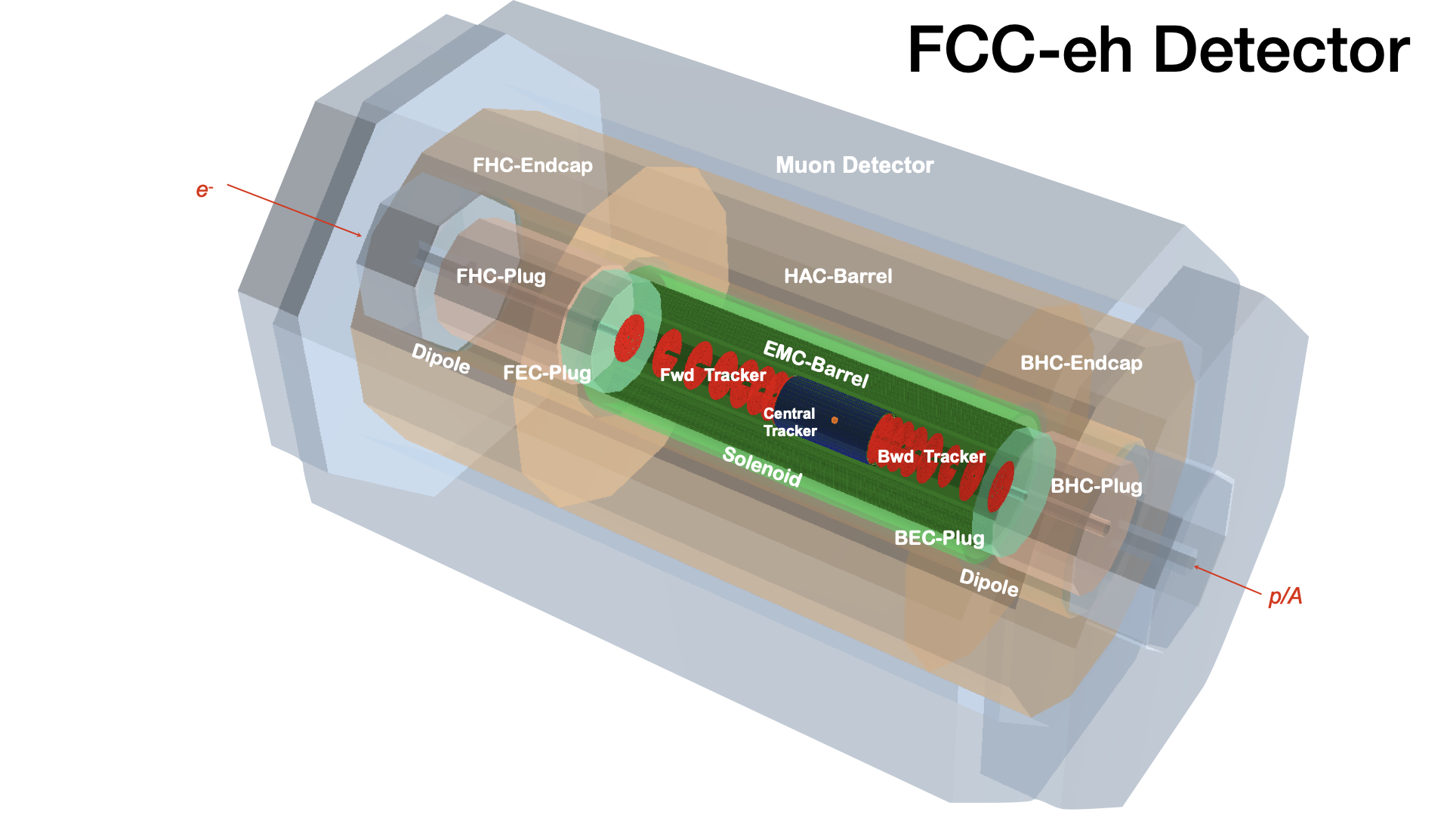
Detector and additional inputs requested
R=6.2 m
L=19.3 m, about CMS size
•Asymmetric, reflecting the beam energy asymmetry
•Could be built based on established technologies from ATLAS and CMS but highly benefit from advance in detector tech (e.g. FCC-ee)
•Must be highly hermetic
•Must have fine segmentation and good resolution for EM calo
•Must have good tracking capabilities (e.g. for b-tagging) also in forward region
Environmental cost of construction (in units of tonnes of CO2 equivalent)
Beam:
Construction:
Environmental cost of operation per year (in units of tonnes of CO2 equivalent)
Uses FCC-hh proton beam (no additional cost)
ERL
Detector
Estimate of financial costs (provide separate numbers for R+D phase, construction phase and operations phase)
??
Does your project plan dedicated submission(s) for the ESPPU (if so, give details)
Yes, a FCC-eh submission will be made (white paper in preparation)

