Slide 1
Terrestrial Very Large Scale Atom Interferometry (TVLBAI) Project
Formation of TVLBAI Proto-Collaboration:
MoU signing deadline: 31st October 2024
Over two dozen international institutions expected to sign, including key UK institutions
Physics Goals:
Observation of Ultra-Light Dark Matter (ULDM)
Detection of Gravitational Waves (GW) in the mid-frequency band
Complement existing laser interferometry experiments by exploring a different frequency range
Project Advantages:
Unique access to the mid-frequency band, unexplored by other experiments
Complements both existing and planned experiments
Preferred Locations:
CERN: Conceptual feasibility study complete
STFC Boulby Underground Laboratory: Feasibility study in progress
Other possible locations: Spain (no feasibility study yet)
Project Timeline (CERN example):
R&D completion: 2027
Construction of 100m experiment at CERN's PX47: 2028-2029 (during LS3)
Operations:
Phase 1 (2030-2033): ULDM-focused
Phase 2 (2033-2034): Upgrade for GW sensitivity
Phase 3 (2034-2039): Combined ULDM & GW operations
Rough Estimated Costs:
PX47 refurbishment: 2M CHF
Construction: 25M CHF
Upgrade: 15M CHF
Operation: 1M CHF/year
Main Risks/Obstacles:
Development of new technologies required
Construction and refurbishment of new facilities
UK Involvement:
AION (QTFP project) leads international collaboration building
AION and US partner MAGIS spearheading R&D efforts

Slide 2
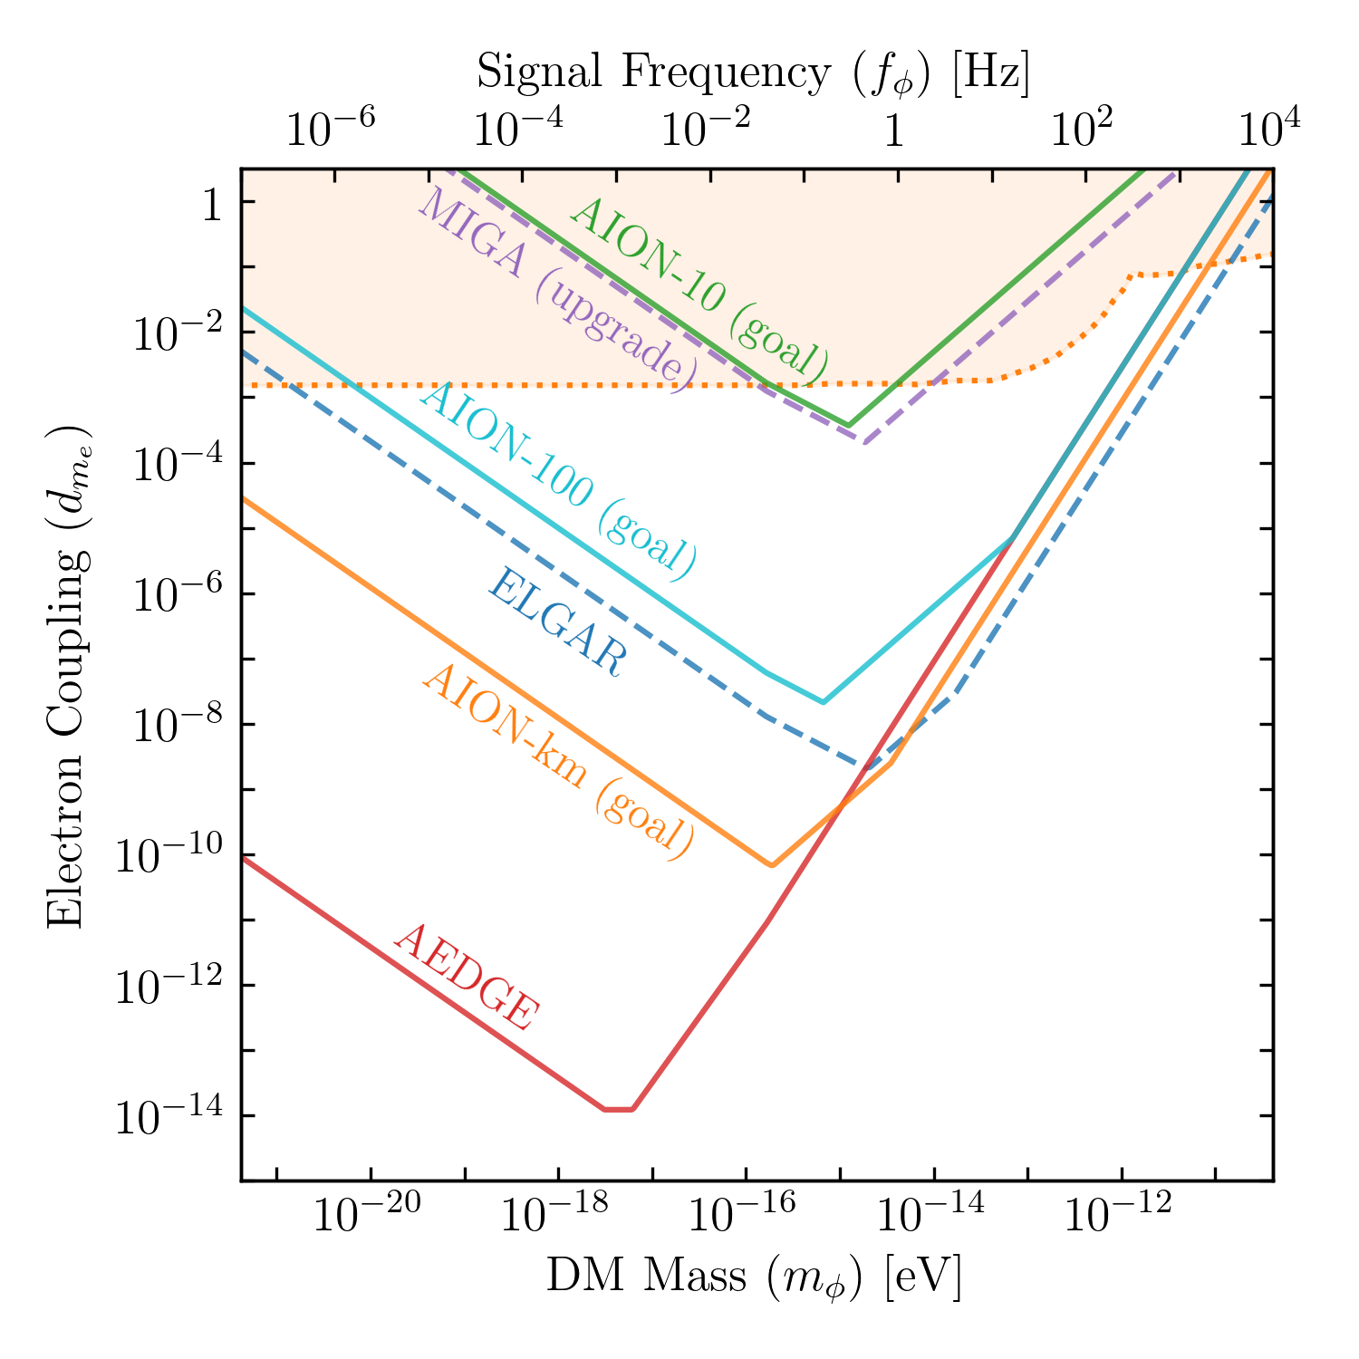
Physics Potential
Unlocking the potential for observation of Ultra-Light Dark Matter and Gravitational Waves from cosmological and astrophysical sources in the unexplored mid-frequency band

Slide 3
AION: A UK Atom Interferometer Observatory and Network
Collaboration: University of Birmingham, University of Cambridge, Imperial College London, King’s College London, University of Liverpool, University of Oxford, STFC Rutherford Appleton Laboratory
Partnership: UK National Quantum Technology Hub in Sensors and Timing, Birmingham, UK, The MAGIS Collaboration, US and the Fermi National Accelerator
Collaboration Composition: The collaboration consists of approximately 50 individuals, with equal contributions from the STFC (Science and Technology Facilities Council) and EPSRC (Engineering and Physical Sciences Research Council) communities. The composition is divided among academics, postdocs, PhD students, and technical/engineering staff in the ratios of 34%, 34%, 24%, and 12%, respectively.
Funding: Since its inception in May 2021, AION has secured approximately £12M from the Quantum Technologies for Fundamental Physics (QTFP) program and institutional sources. Additionally, several closely related Quantum Technology projects have received funding exceeding £2M.
Difficulties and Limitations: Despite having acquired scientific leadership in the international landscape of large-scale atom interferometry and meeting its initial ambitious goals within less than three years, the project struggles with a clear funding strategy. This lack of a defined financial path hinders its potential evolution from the current initial phase into a mature and enduring activity.
Scope: AION is a UK-led scientific initiative designed to construct a series of advanced atom interferometers. These instruments are aimed at exploring dark matter properties, detecting gravitational waves, and testing fundamental physics through high-precision measurements.

Slide 4
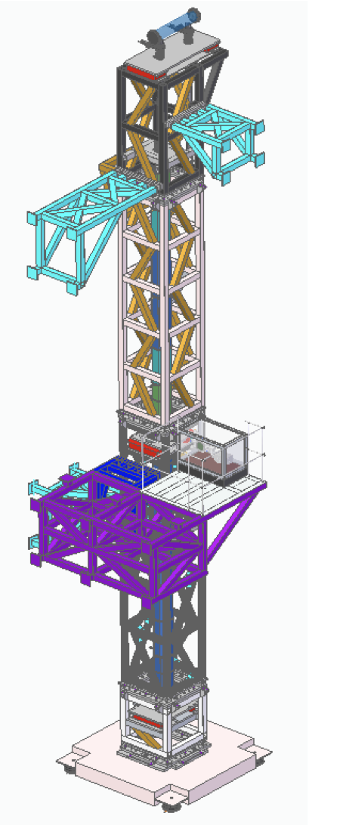
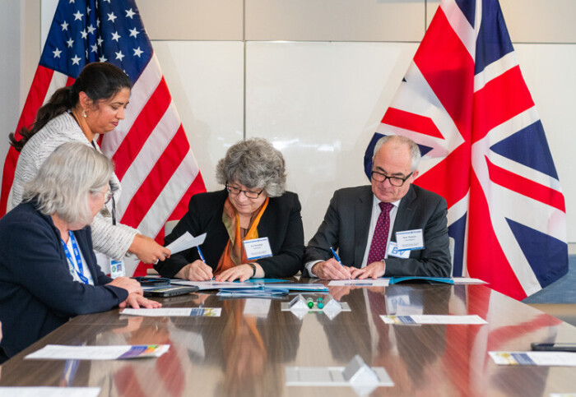
AION Major Milestones Accomplished in first 30 months
Build 5 AION Labs
Design of 10m Oxford Tower
Formlise UK-US Partnership
5 Ultra Cold Sr Labs build in less than 24 months using large scale Particle Physics production methods to significantly accelerate the turnaround – this will be critical for future success!
More than doubled the Ultra-Cold Sr R&D capacity in the UK and increased it by about 25% worldwide.
https://doi.org/10.1116/5.0172731
[published AVS Quantum Sci. 6, 014409 (2024)]
Discussing with established UK companies Torr Scientific and Kurt J. Lesker potential for spin-off.
Formalising the long-standing UK-US partnership between MAGIS and AION, in conjunction with the participating UK institutions.
This stands as a successful instance of UK-US cooperation in the fields of science and quantum technology development, with the potential to unlock additional synergies and opportunities.

