Slide 1
Supernova bound on new scalars from resonant (and soft) emission
Henry Stubbs
University of Oxford
2410.17347, Edward Hardy, Anton Sokolov, HS

Slide 2
Beyond the Standard Model...
Dark matter
Neutrino masses
BSM at low scales?
Renormalizable 'portals'
Strong CP problem
Hierarchy problem
Cosmological constant
Gravity

Slide 3
Higgs-portal scalars

Slide 4
Supernovae
Not to scale
Photons absorbed
T = 30MeV
Neutrinos escape as core cools
Dominated by surface emission
New scalars contribute to cooling
Can be produced from bulk
Want to look at the neutrino signal!

Slide 5
Raffelt bound
New energy loss speeds up cooling
Shorter neutrino burst
Conflict with observations of SN 1987A
Raffelt Bound:
Energy loss in new degrees of freedom $≲$ Energy loss in neutrinos
$L_{BSM}≲3⋅{10}^{52}$erg/s
Puts strong constraints on particles with masses 1-100 MeV

Slide 6
Ingredients
Production rate
Many processes
Thermal effects
Decay and re-absorption rate
Leads to the "trapping regime"
Realistic* supernova conditions
*This is somewhat controversial

Slide 7
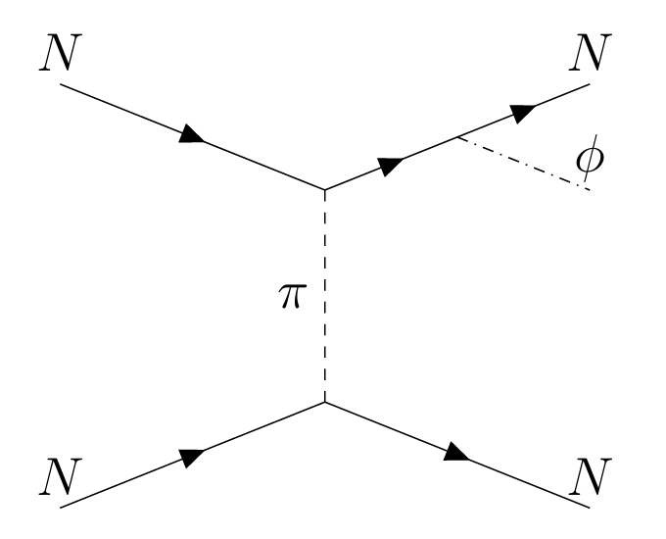
Production mechanisms
Bremsstrahlung
Resonant conversion

Slide 8
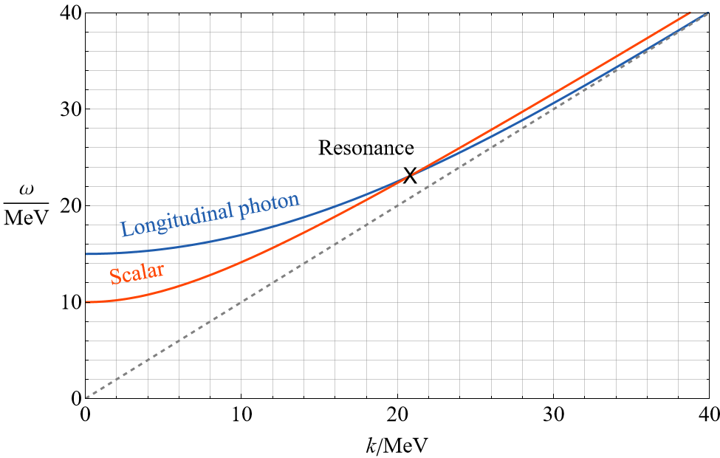
The resonant condition

Slide 9
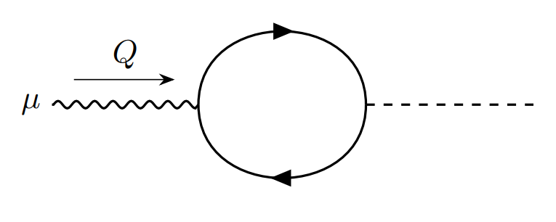
Plasma mixing
Generated by an electron loop → proportional to electron’s coupling to both scalar and photon
Requires charge conjugation symmetry to be broken by the medium
Vanishes when contracted with transverse polarization tensors and satisfies the Ward identity.
Lorentz invariant phase space for the fermion

Slide 10
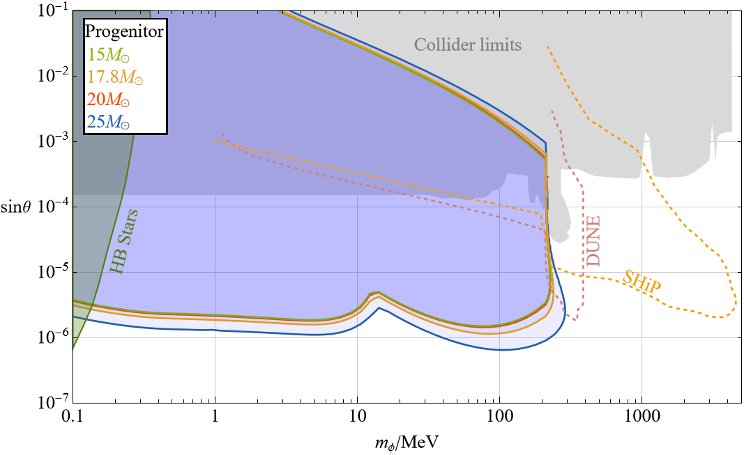
Results

Slide 11
Future directions
Other BSM signatures in supernovae?
Spin-2 particles?
Cosmology?
Thank you

Slide 12
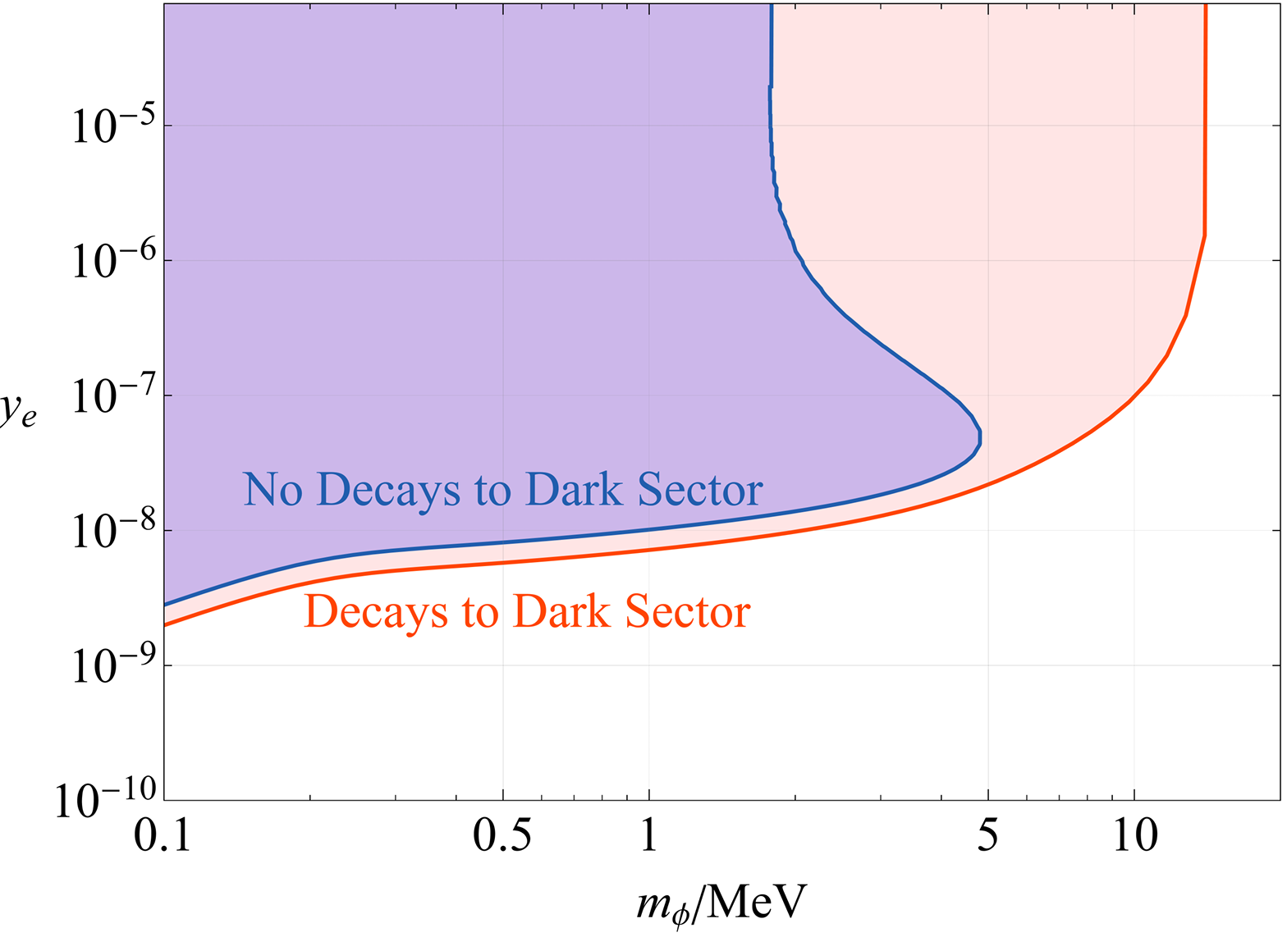
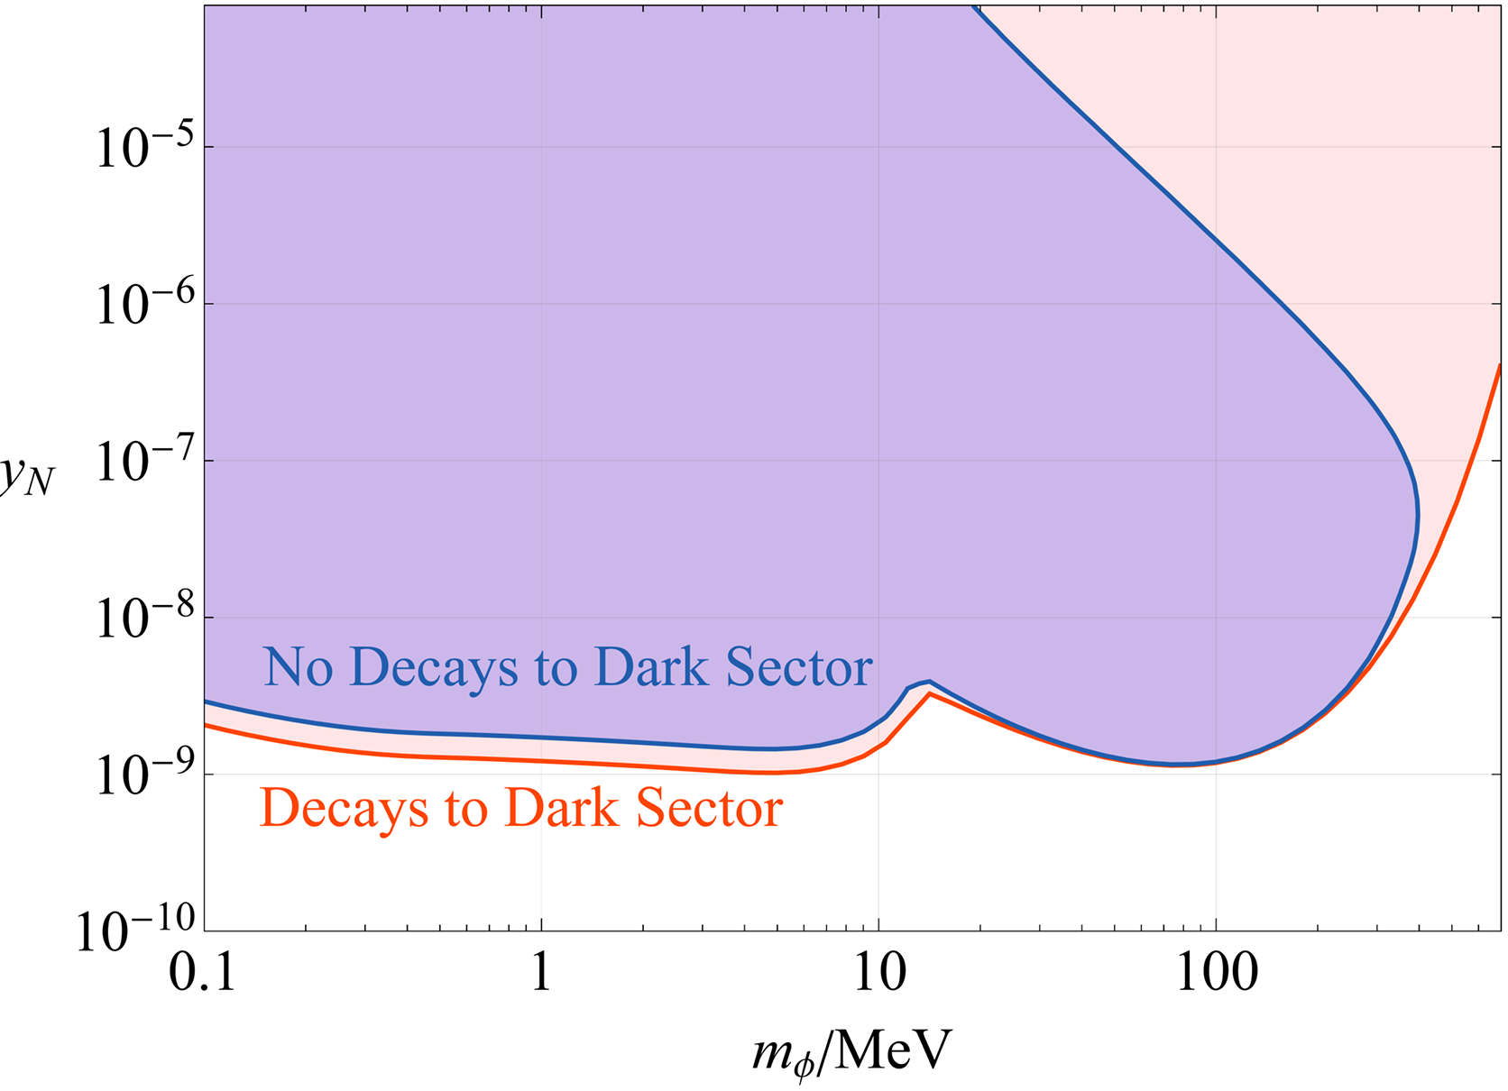
Model dependency

Slide 13
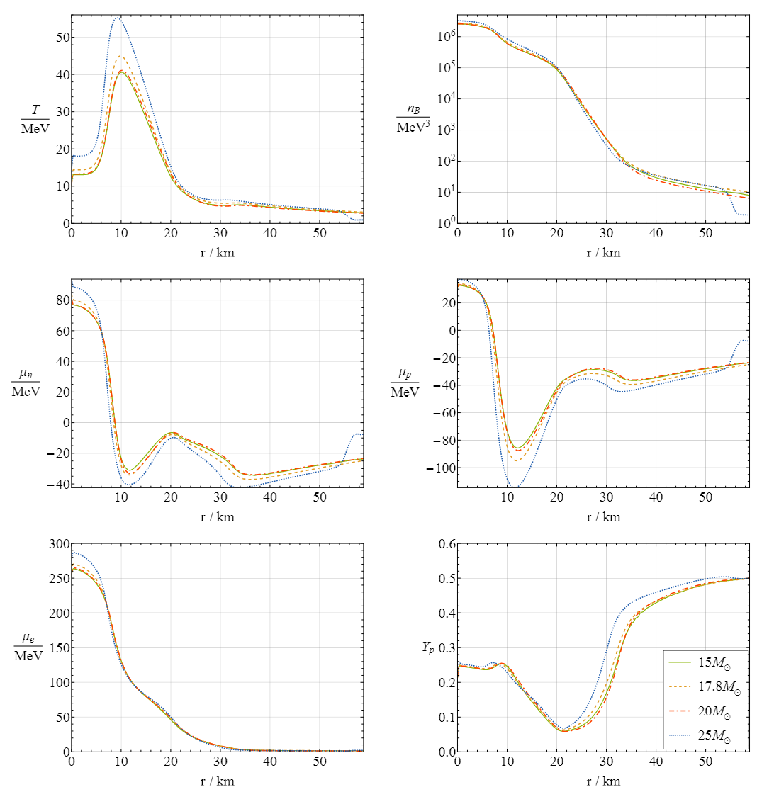
Progenitor profiles

Slide 14
Details of production rate

