Slide 1
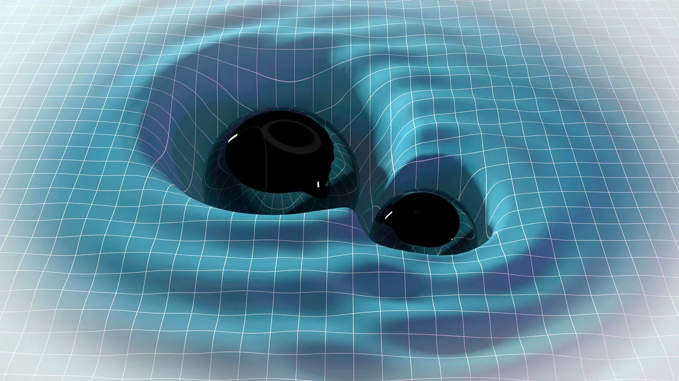
Gravitational Waves in de Sitter spacetime
David Waisman Andrade
Supervised by Dr Scott Melville
Queen Mary University London

Slide 2
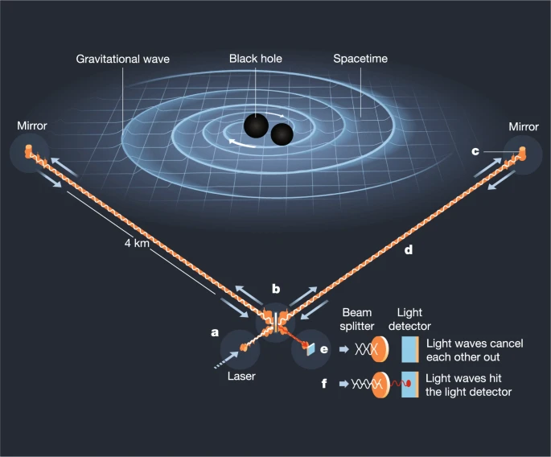
Outline
Motivation
Modelling GW’s in Minkowski.
Modelling GW’s in de Sitter.
Notes:
Start talking about GW’s: Since 2015 they have been measured, it took 100 years to verify their existence.
Remember to describe picture of gravitational wave detector.
Move on to talking about our current field theory ways of modelling them.
Lastly I will talk about how we model them in de Sitter and our current work.
Test GR in strong gravity regime.

Slide 3
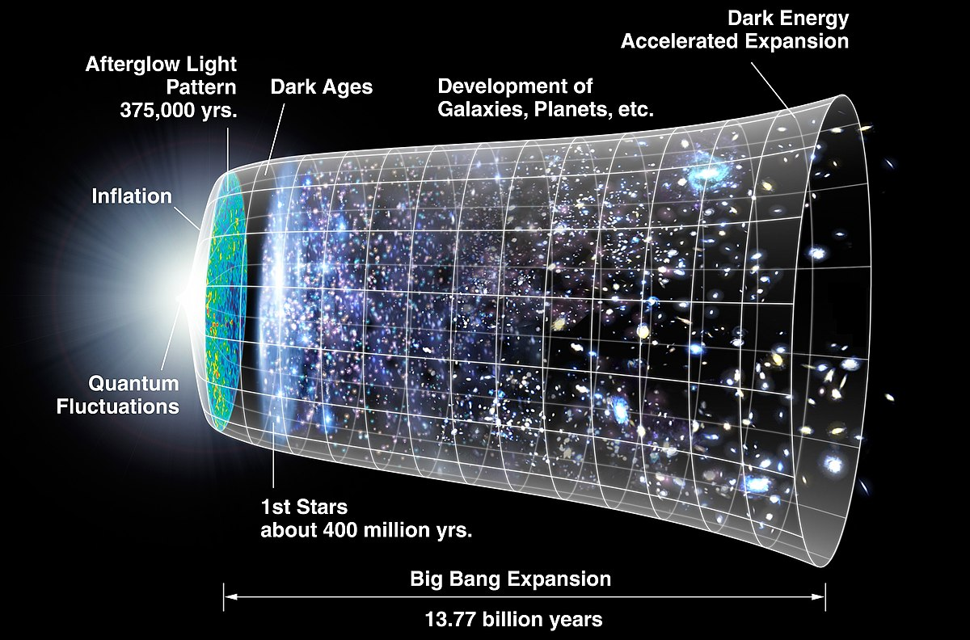
Motivation
Test for General Relativity and modifications.
Cosmology.
Notes:
de Sitter helpful approximation of expanding universe because it is maximally symmetric. [mention after cosmology]
- In future add slide with picture to talk about scales of this problem: - maximum orbit distance (for bounded system) – GW wavelength – Horizon distance.
- Mention that we look at the gravitational waves as they are emitted, not include effects of how they travel through cosmology.
The effect on gravitational waves of curved spaces as soon as they are emitted hasn’t been considered for curved spaces.

Slide 4
Horizon
$$ℓ_{D_{o}}$$
$$ℓ_{Λ}$$
$$ℓ_{w}$$
Scales:
$ℓ_{D_{o}}$ , $ℓ_{Λ}$ , $ℓ_{w}$
$$ℓ_{D_{0}}≪ℓ_{Λ}$$
Notes:
To be more specific here are the relevant scales.
For this case we consider that the separation of the black holes is much greater than the distance to the horizon. Therefore the biggest effect comes from the scale of the wavelength of the gravitational wave to the distance to the horizon.

Slide 5
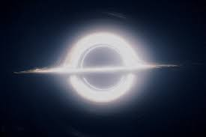
What classical* observable?
* General Relativity
$Δ$p = p_{out} - p_{in}
Black Hole #1
p_{out}
p_{in}
Black Hole #2
space
time
Notes:
Recall that p_{out} does not include the effect of GW backreaction at leading order.

Slide 6
Example for Potential of Scalar Field:
Obtain $Δ$p from Quantum Field Theory Amplitudes and setting $ℏ=0.$
Amplitude of
wavepackets in scalar QFT
Classical potential of 2 point particles
Fourier Transform
$$=\frac{1}{q^{2}}$$
$$V\left(r\right)=\frac{4π}{r}$$
$$𝒜 \sim$$
$$φ$$
Small $\vec{q}$ expansion &
Born approximation

Slide 7
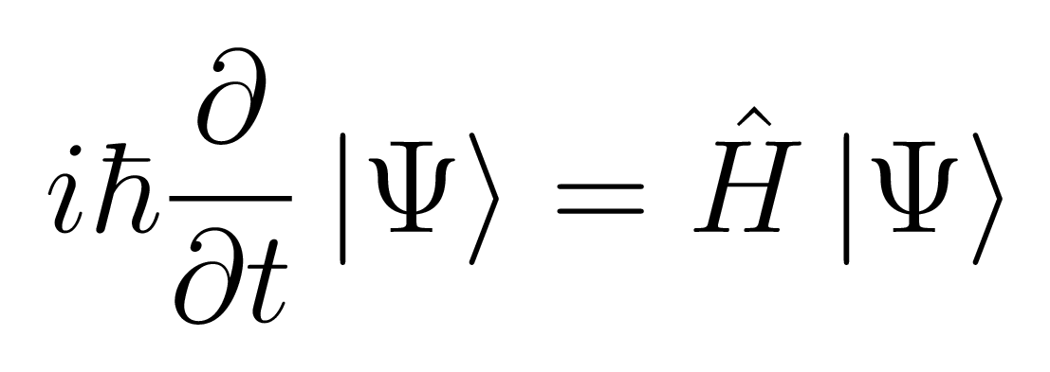
Gravity!
Instead of scalar field consider metric perturbations.
$$h_{μν}$$
$$+ {\left(\frac{Gm}{r}\right)}^{2} + …$$
$$V\left(r\right) = \frac{Gm}{r}$$
These are called post-Minkowski corrections.
Why this path?
$$F=ma$$
Unconstrained
Force can be anything we want!
Very constrained
- Needs Lorentz invariance, Locality, Hermiticity.

Slide 8
Our work so far:
We now consider a QFT in a de Sitter background.
Expression linking amplitude and impulse finished, as well as “classical limit” in dS.
Graviton amplitude in de Sitter finished (up to a constant).
Missing piece…
$$h_{μν}$$
$$≈$$
dS
$$φ$$
$$χ$$
Notes:
Mention that graviton amplitude is very long in de Sitter, so we won’t include it in the powerpoint.

Slide 9
Power emitted!
We can measure the power carried by emitted gravitational waves.
The impulse gives us the power!
For this we need something called the quadrupole formula in de Sitter. First derived by Ashtekar et al. in 2015*. It has many subtleties!
- Dilation charge
- 1/r expansion not valid due to presence of horizon.
- How to define time for spacelike asymptotic hypersurface?
* 1510.05593
Notes:
Impulse if not really an observable.

Slide 10
Penrose diagram & solutions:
Minkowski:
de Sitter:
Approach $τ=0$ for constant $r$.
Newtonian, and small orbit limit.
Calculate dilation charge flux through $ℑ^{+}$.
Use $r$ at $τ=0$ as time
for power expression.
Approach $r=∞$ for constant $t.$
But as of today, there is still disagreement on some terms of the formula!
[Ashtekar et al. 1510.05593]
Notes:
Instead of \tau say “conformal tau”.
Say that in Mink you increase r and keep the time constant, and in de Sitter you increase time and keep r constant.

Slide 11
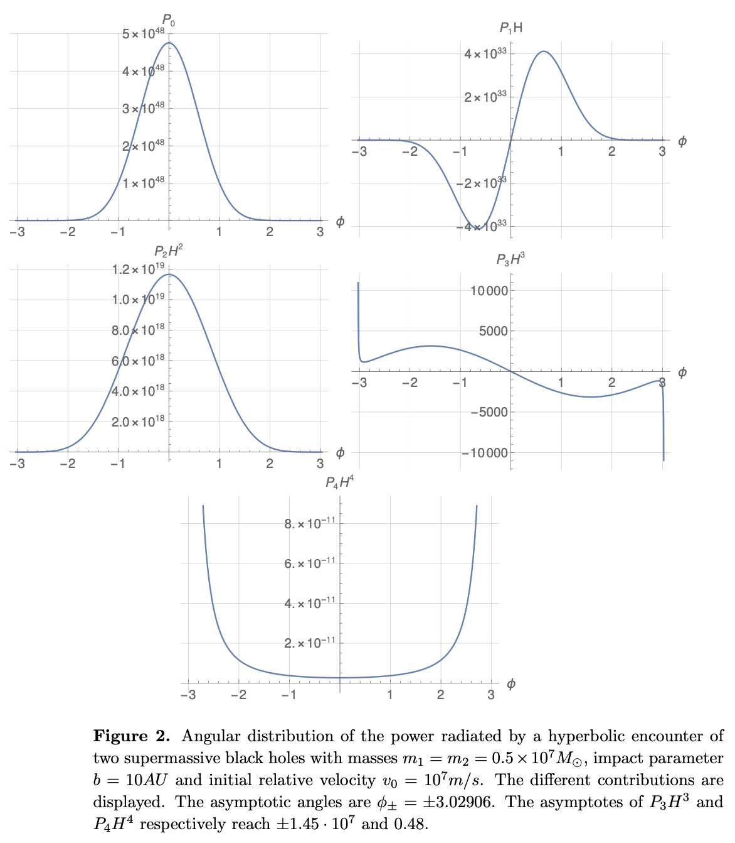
Hyperbolic encounter
Power emission for hyperbolic encounter.
Jetzer et al. 2407.12526
Peaks in gravitational radiation for incoming and outgoing black hole suggest breakdown of approximation near the horizon.
$P=P_{0}+P_{1} H+P_{2}{ H}^{2}+P_{3}{ H}^{3}$+ $P_{4}{ H}^{4}$

Slide 12
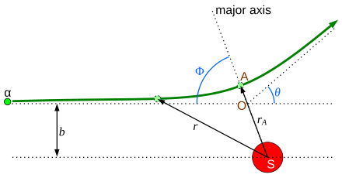
Warmup:
Two point particles in a scalar potential (in de Sitter!)
One of the particles is static (infinite mass).
Force with potential $φ=\frac{τ}{r}$ .
We obtain the leading perturbative correction to the geodesic.
Force $→$ Impulse $→$ Geodesic (path)
Geodesic (path) $→$ Power emitted.

Slide 13
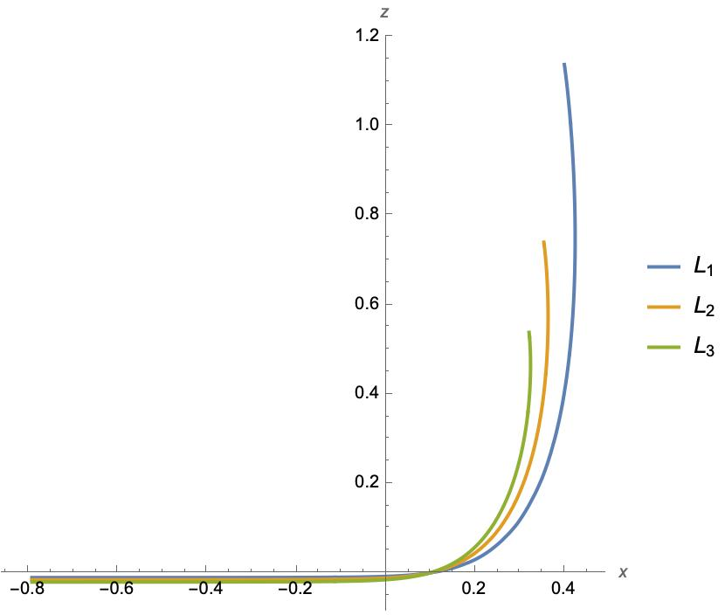
Path deviation
Geodesic corrected due to force.
Static particle in the origin.
Changing impact parameter (angular momentum)
Parameters – { $μ$, p, L, D, g₁, g₂ }
Newtonian approximation –
$\frac{p}{μ H}≪1$
Small orbit approximation –
$D\sim μ$ & L$\sim 0$

Slide 14
Conclusion
The effect of an expanding spacetime in gravitational waves is relevant at cosmological scales, and far enough into the past:
- black hole scattering & mergers
- stochastic gravitational background from primordial black holes.
Amplitude in dS has been calculated:
Work ongoing to obtain the power emission while carefully accounting for the de Sitter background.
Perhaps in the future we can obtain the first post-de Sitter corrections!
Thank you for listening!
$$h_{μν}$$
$$≈$$
dS
$$φ$$
$$χ$$
Notes:
Someone will ask me to say more about the post-de Sitter corrections.
Remember to talk that we have the amplitude (too complicated to show in powerpoint) but that we want to connect that to an observable (the power).

Slide 16
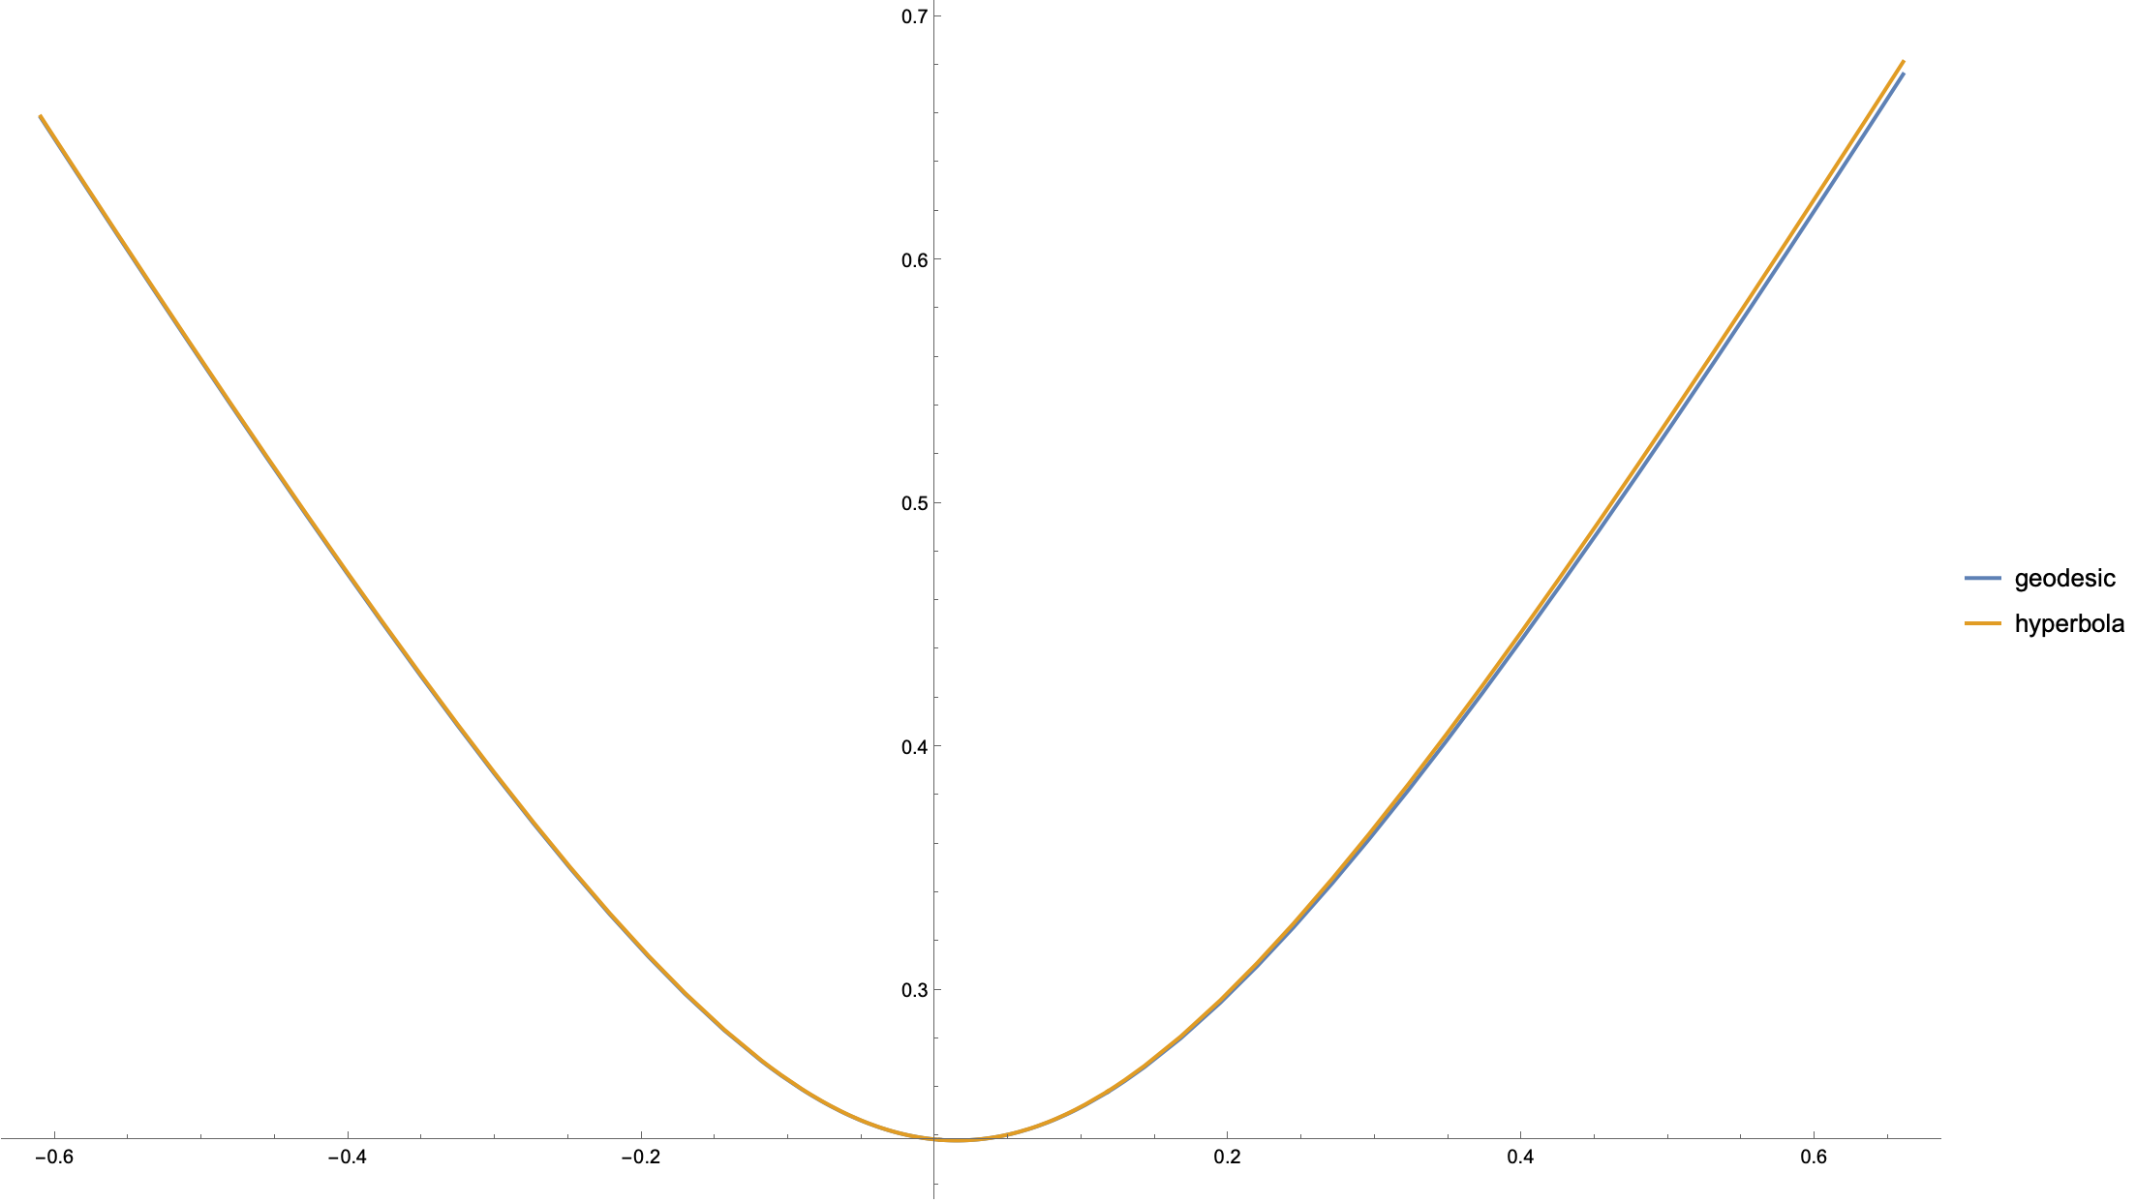
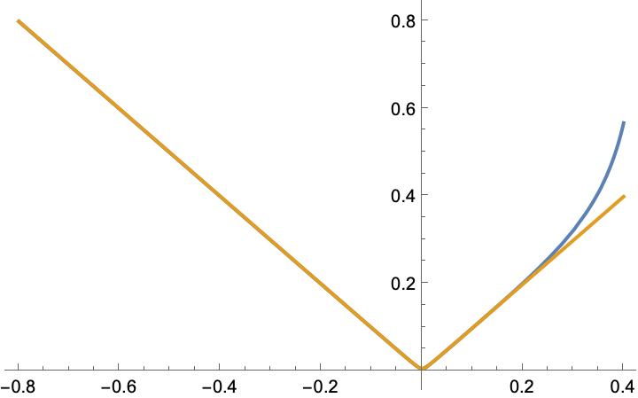
Hyperbola comparison
Jetzer paper* already tried this calculation with hyperbola (flat space leading order expansion).
Let’s see how close their approximation is at the level of the geodesic!
The plots below are radial distance against x coordinate.
[Jetzer et al. 2407.12526]

