Slide 1
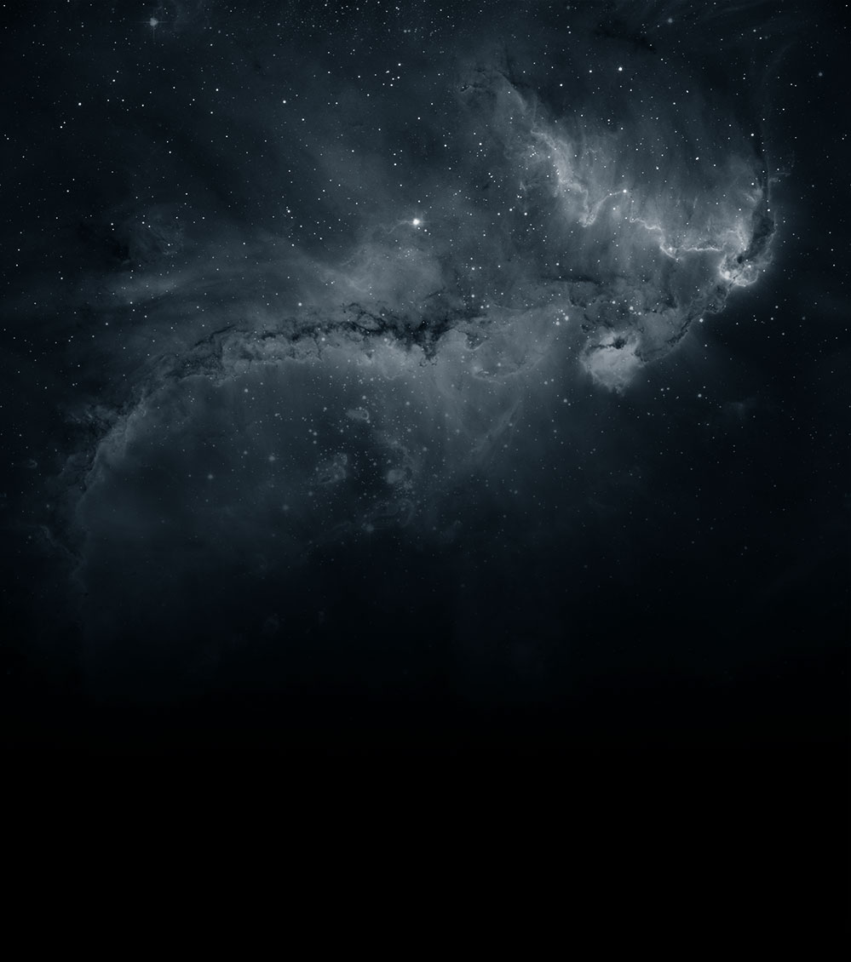
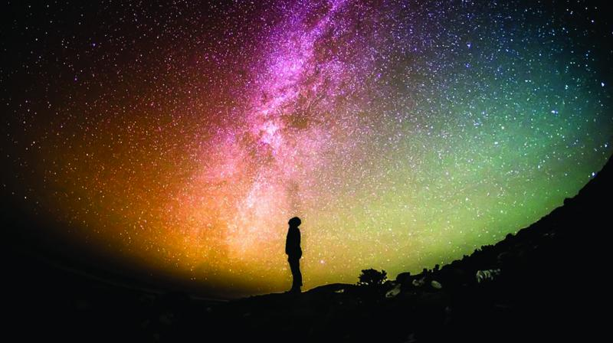


Positivity in Research & in the Sky
YTF plenary talks
18th Dec 2024
Claudia de Rham

Slide 2
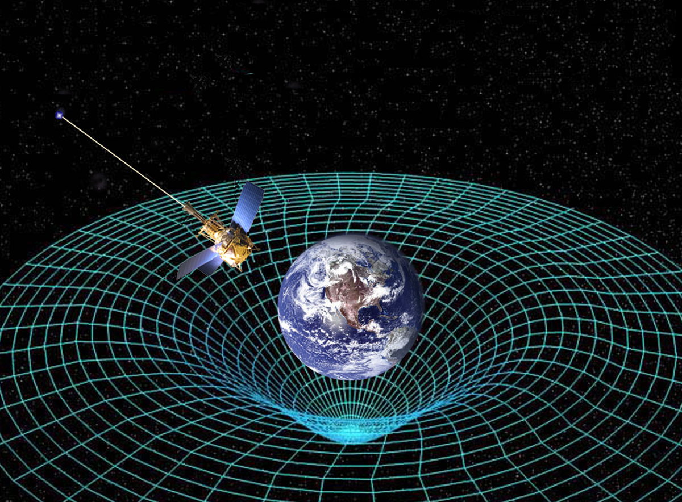
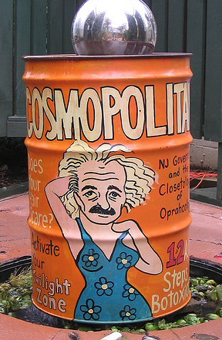

Our Accelerating Universe
Cosmology $≠$ Cosmetology
Cosmology: Study of Universe
Origin, evolution & composition of the universe
Notes:
Thank for the invitation, it’s a pleasure to be here. Today I talk about the 2 hierarchy problems that exist at the interface between particle physics and cosmology, more precisely when putting together the 3 standard forces with gravity and show how extra dimensions, and in particular 2 or more large extra dimensions provide very fruitful new directions to tackle them

Slide 3
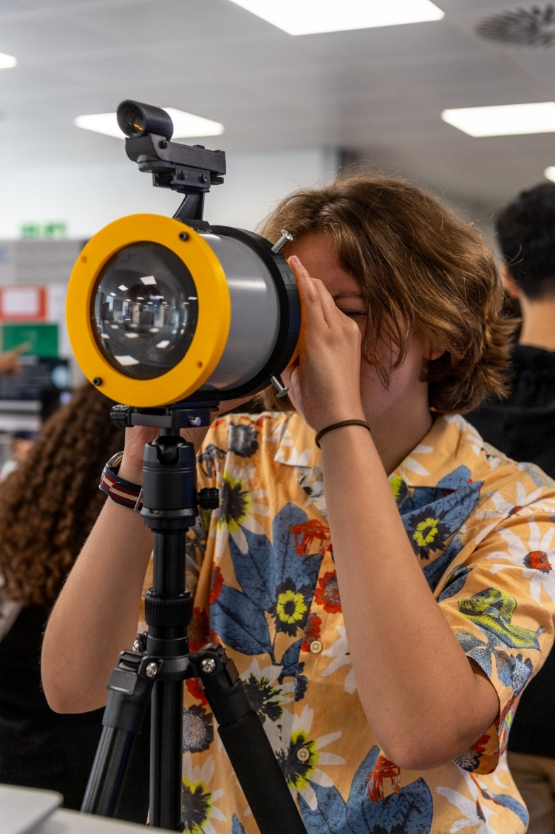
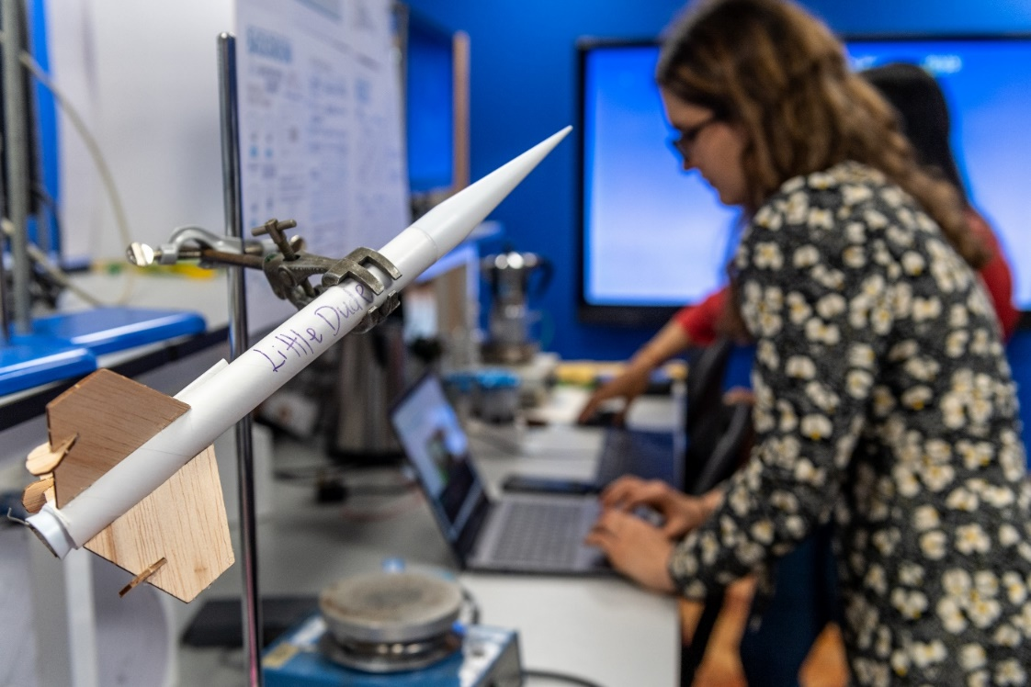
Physics is the
2nd most popular subject
among boys in the UK
Amongst girls it is the
15th
Why???

Slide 4
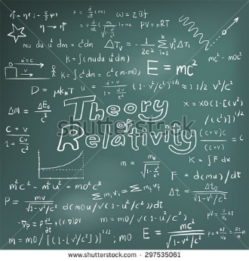
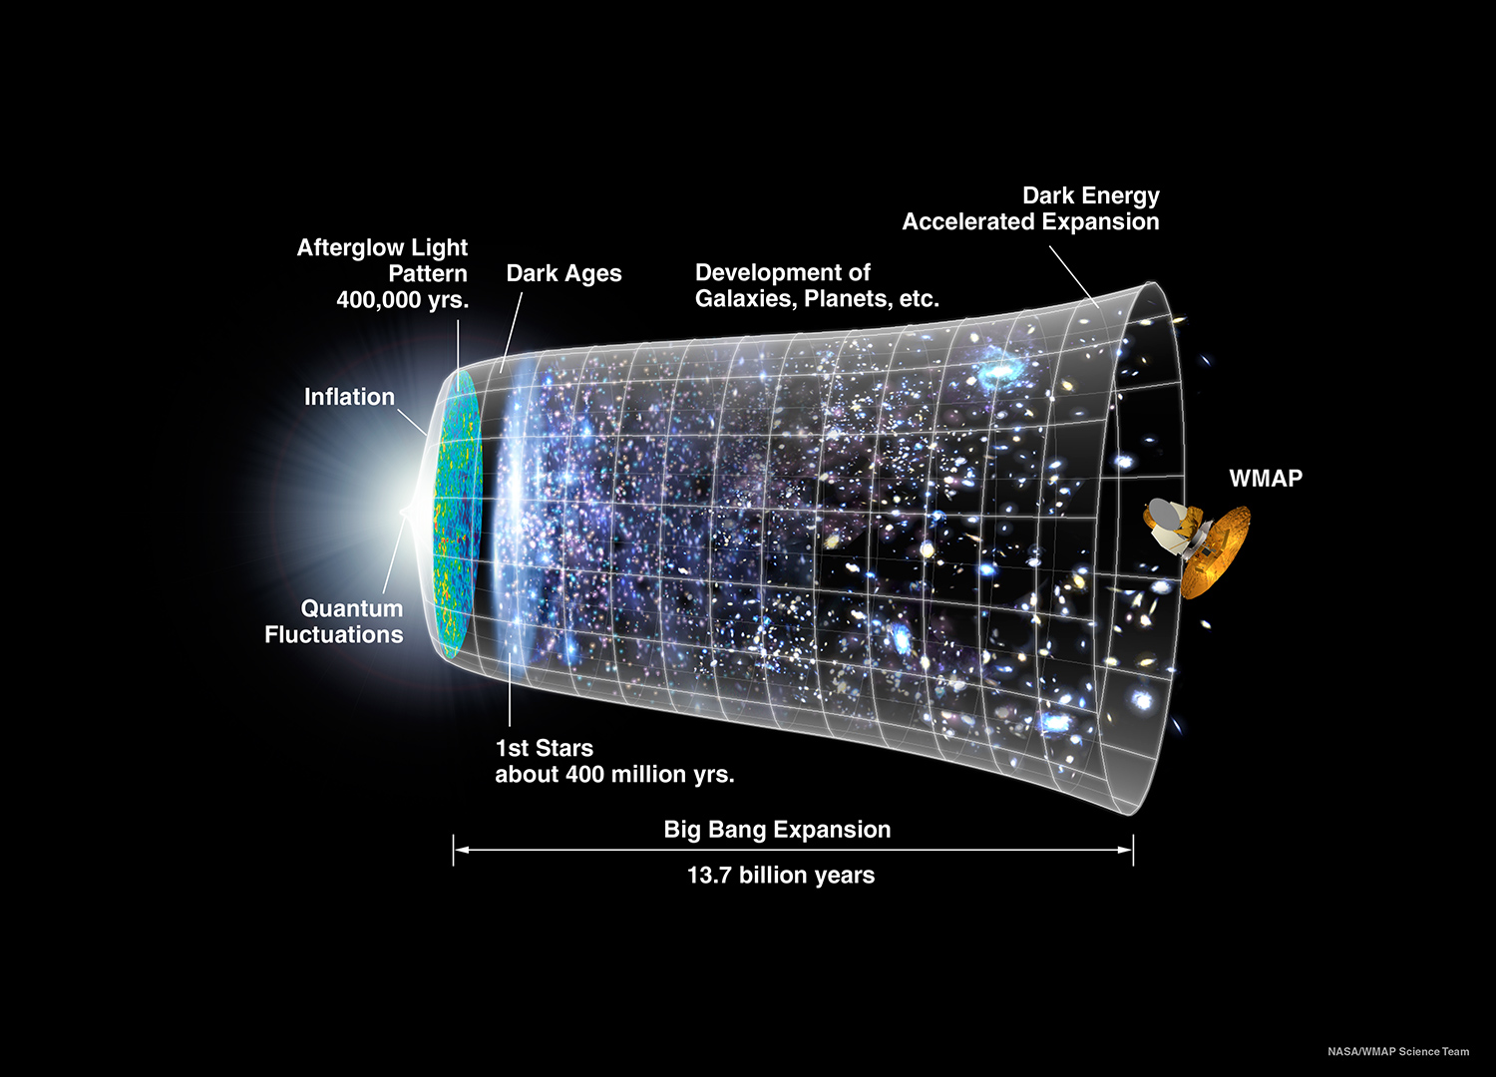
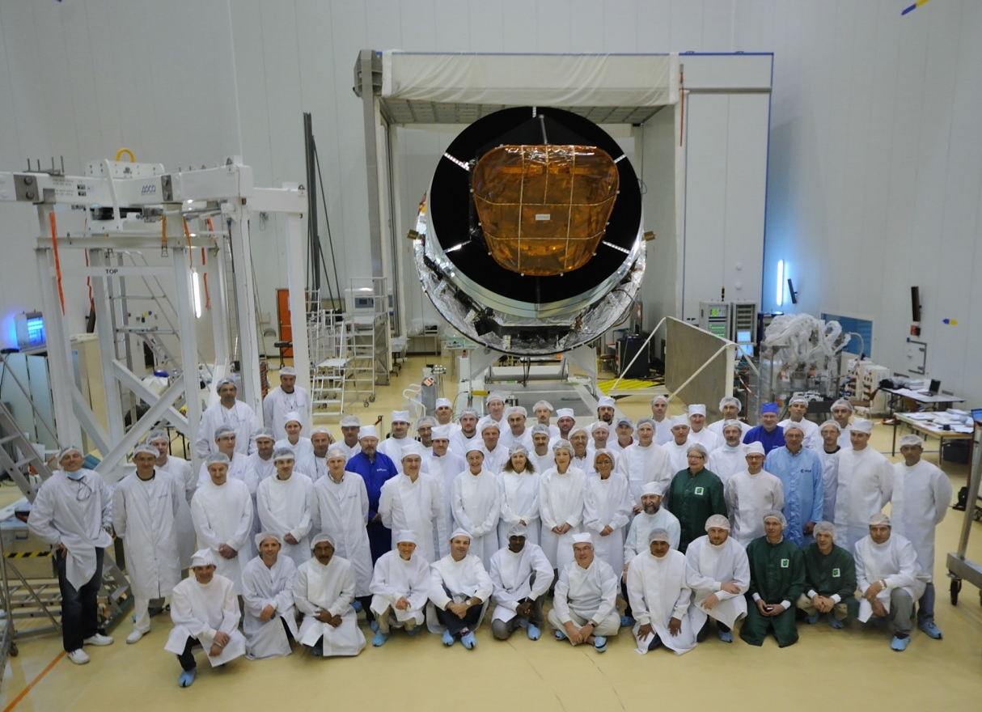
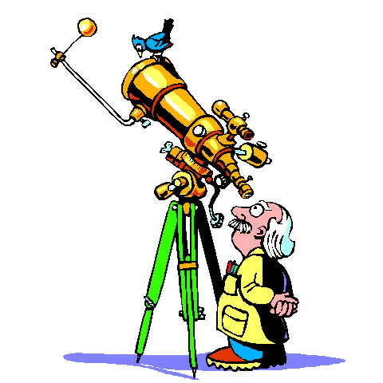

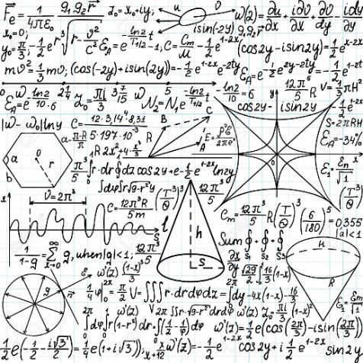
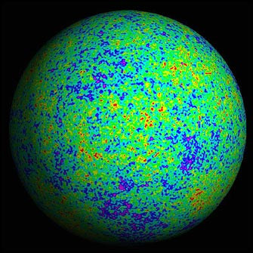
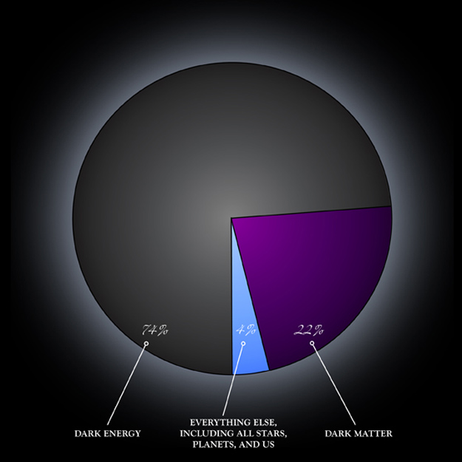
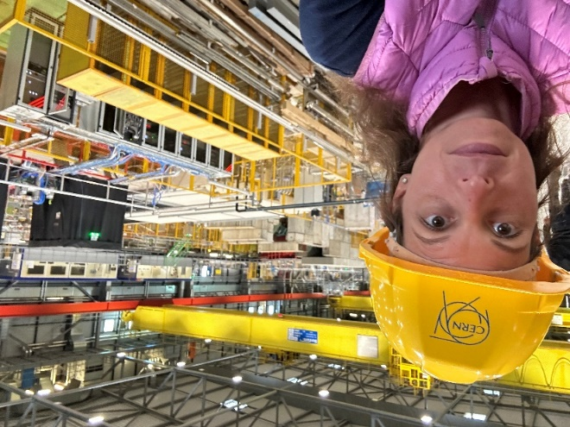
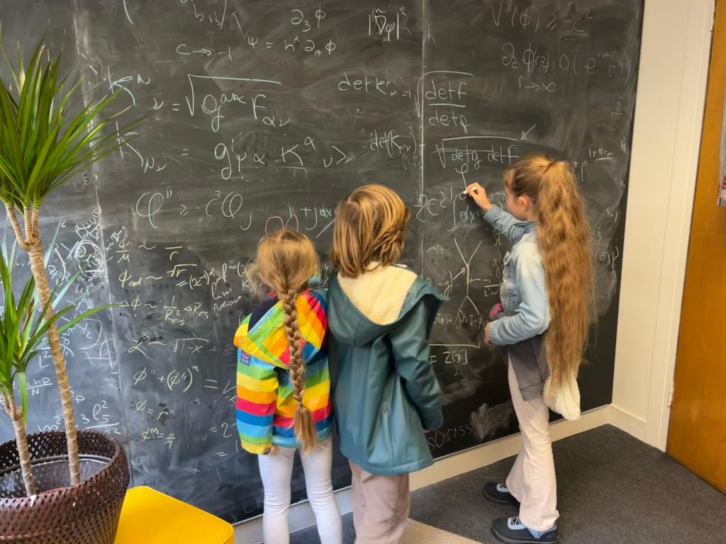
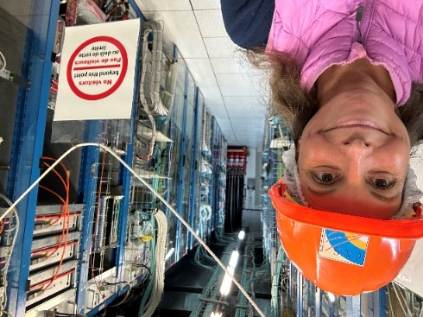
Life as a cosmologist

Slide 5
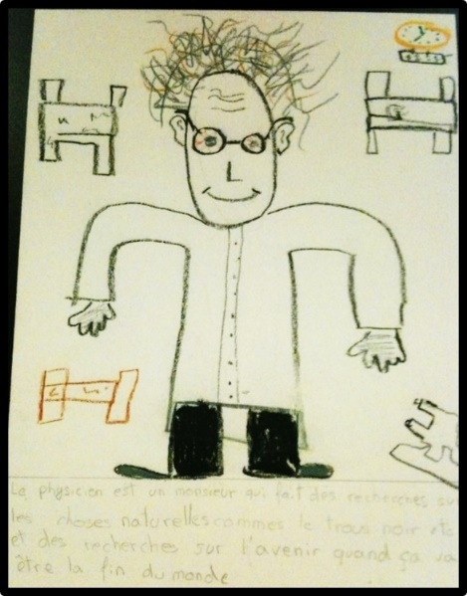
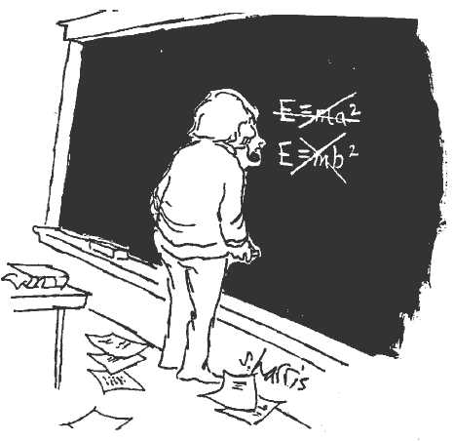
Life as a cosmologist means:

Slide 6
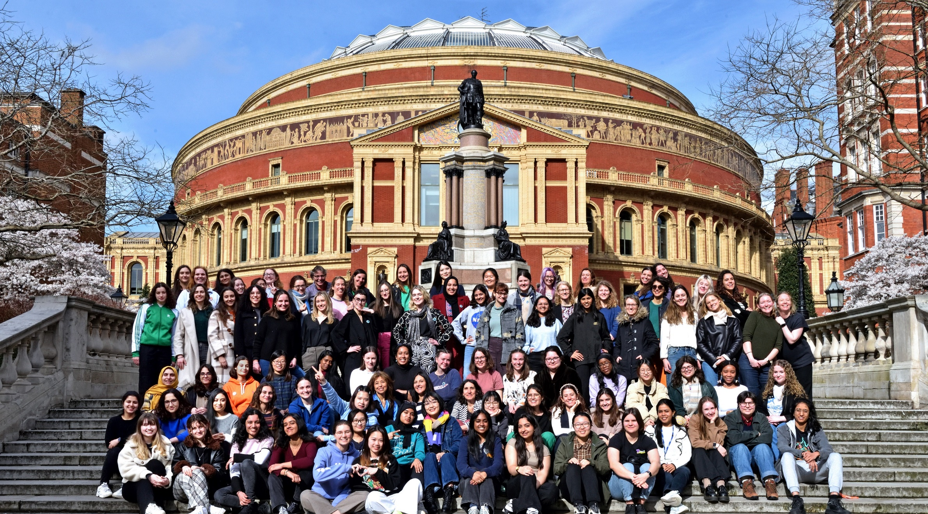

Slide 7
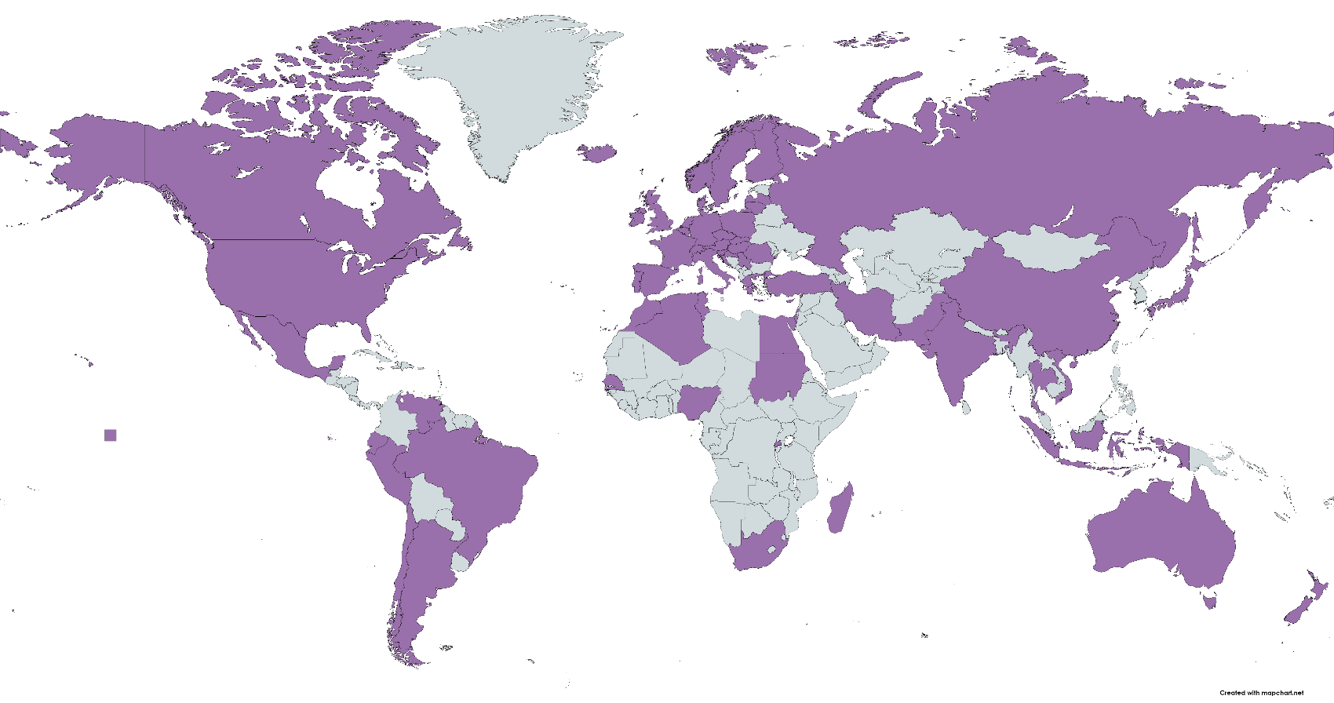
Life as a theoretical cosmologist still means:
Being part of a huge international collaborative network
More than
130 co-authors worldwide

Slide 8
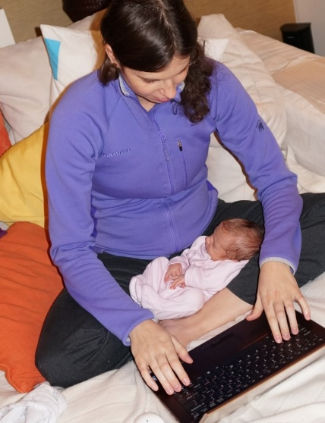
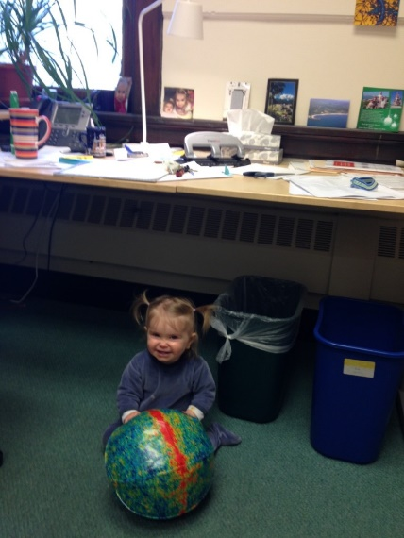
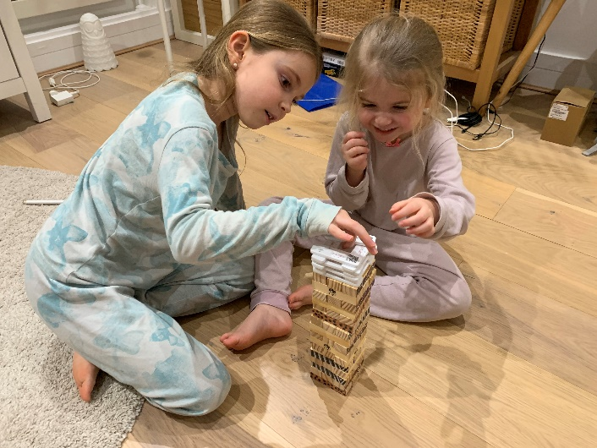
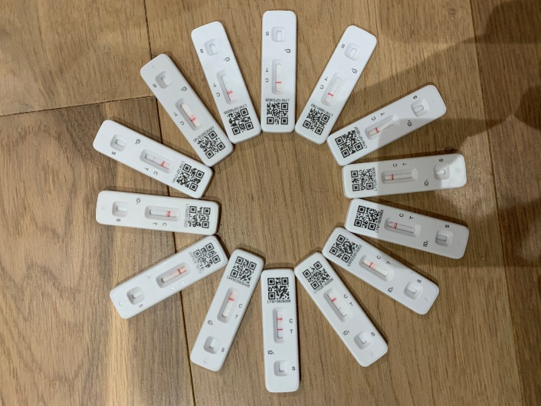
Life as a Theoretical Cosmologist means:
Being part of a huge international collaborative network
Contribute in discoveries big and SMALL !
Playing with positivity!
at a time where it can be negative to be positive and positive to be negative

Slide 9
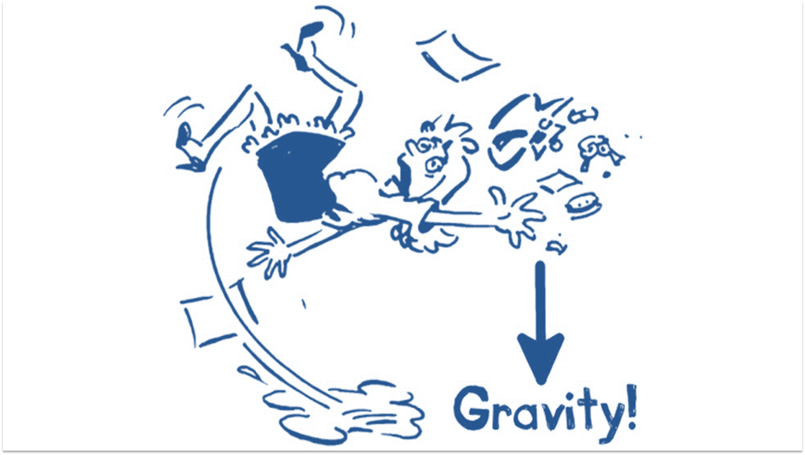


Photo credit: David Stock
Illustration: Olivia Waller
Notes:
In fact just the other day some of my “friends”, suggested a went sky-diving and highly encouraged me for some reason to go without a parachute – so I can really appreciate this feeling of freedom - for a little while
Although this is not complete free-fall yet because of the friction from the air pushing against the front of the body.
On the rest of your body, for instance on your back, you wouldn’t don’t feeling anything even though gravity is clearly acting on you.
That’s because gravity acts on each one of our cells in the same way. In fact there isn’t any single cell or taste bud in our body that can ever really feel or smell or taste or hears gravity

Slide 10
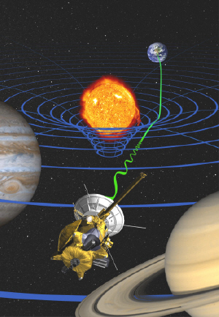
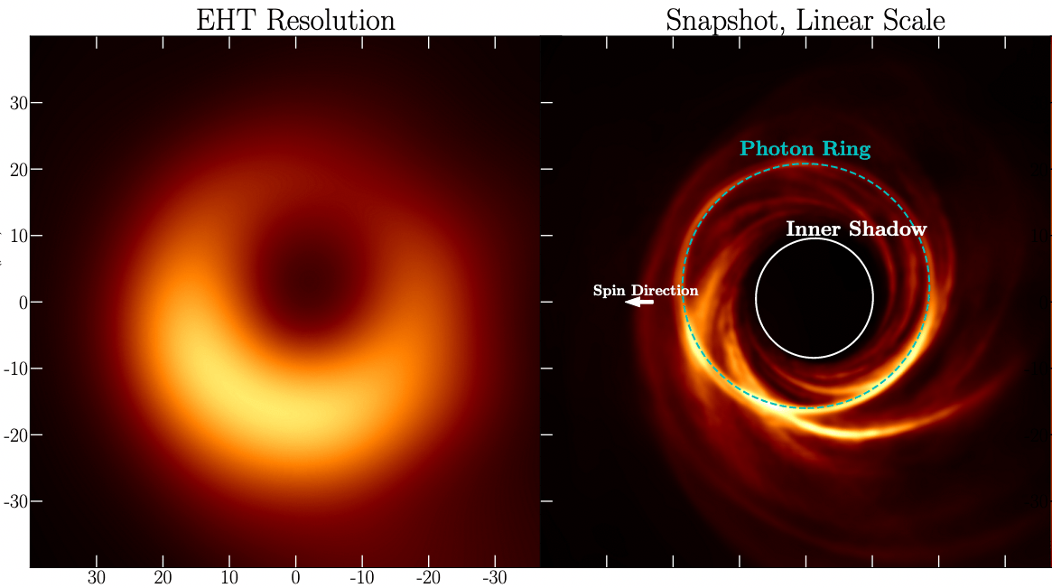
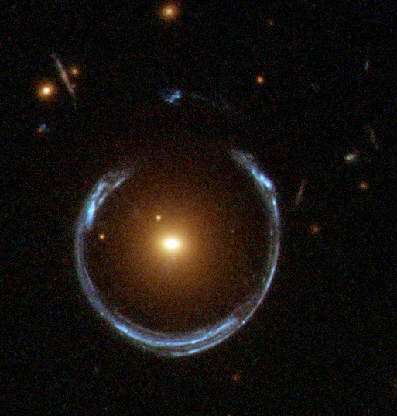
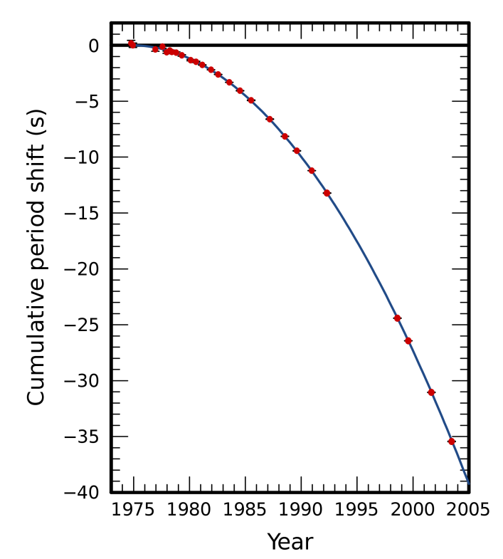
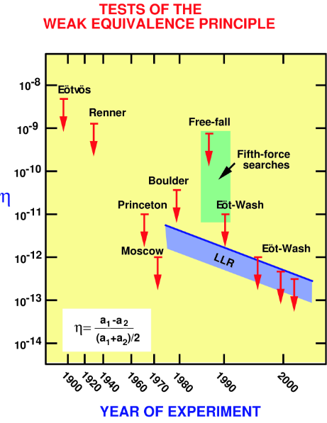
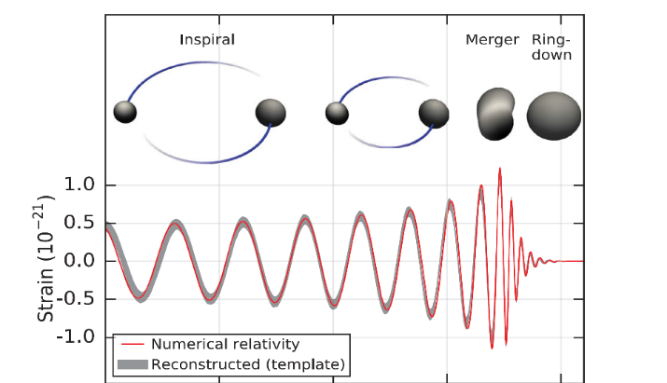
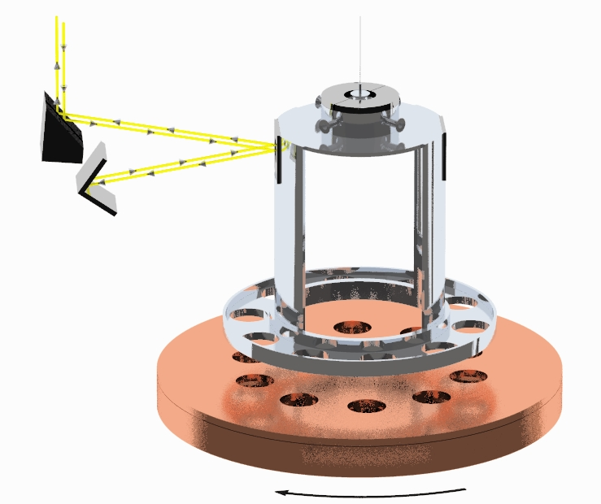
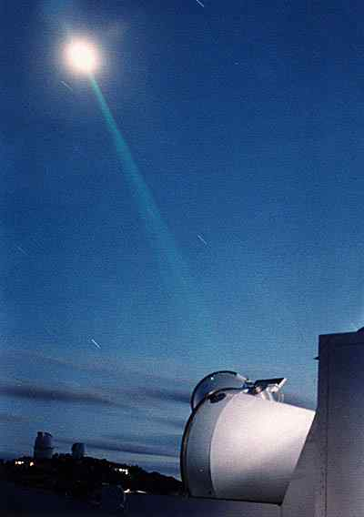
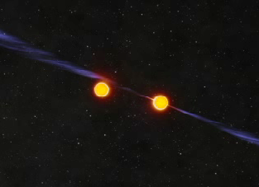
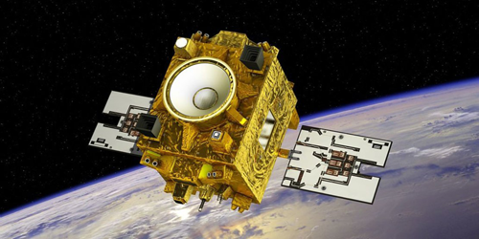

Strong Evidence for General Relativity
Frame Dragging
Gravitational Lensing
BH Shadow / Photon Ring
Tests of Equivalence Principle
Binary Systems & GWs

Slide 11
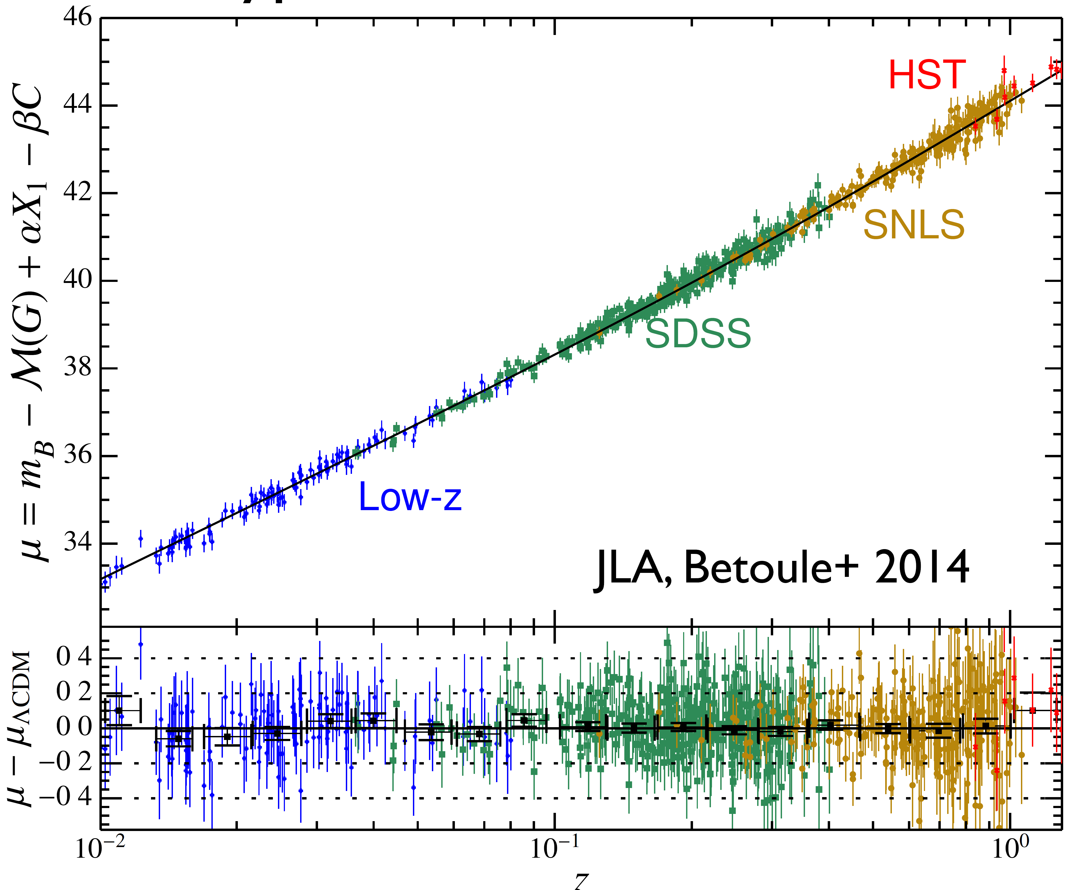
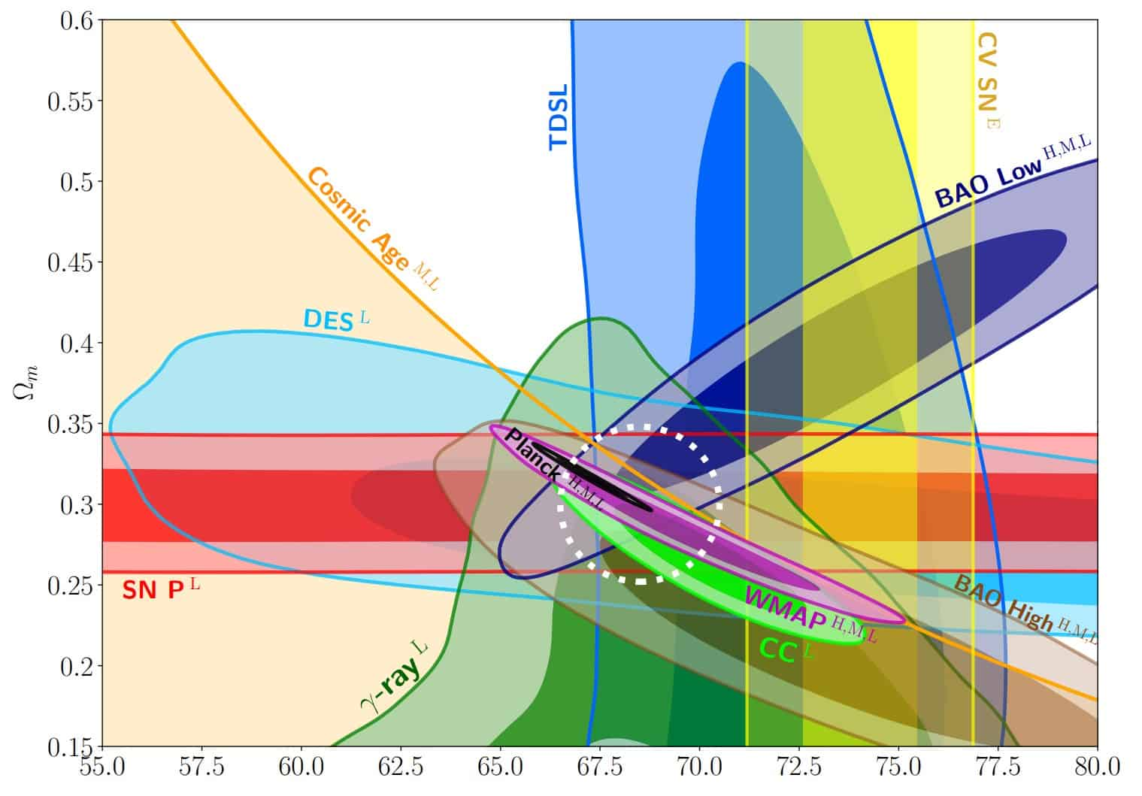
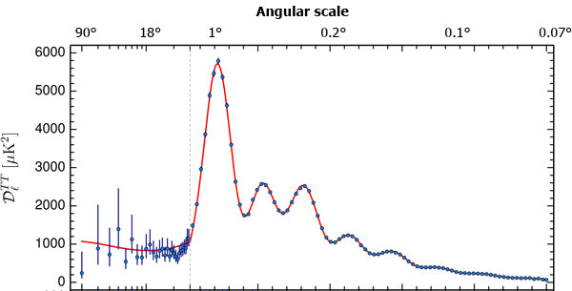
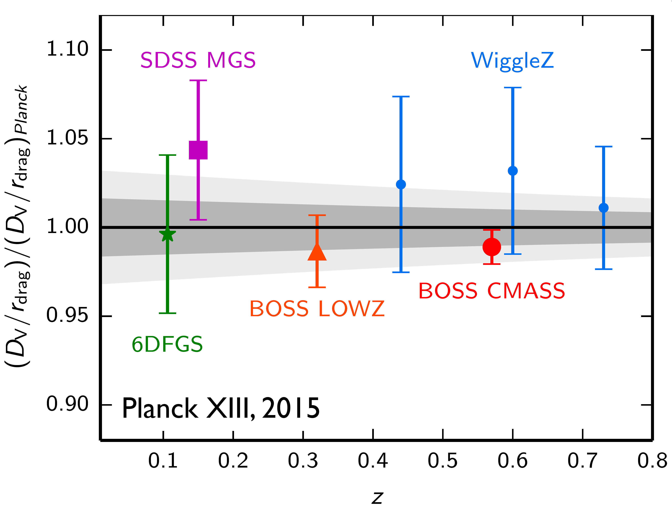
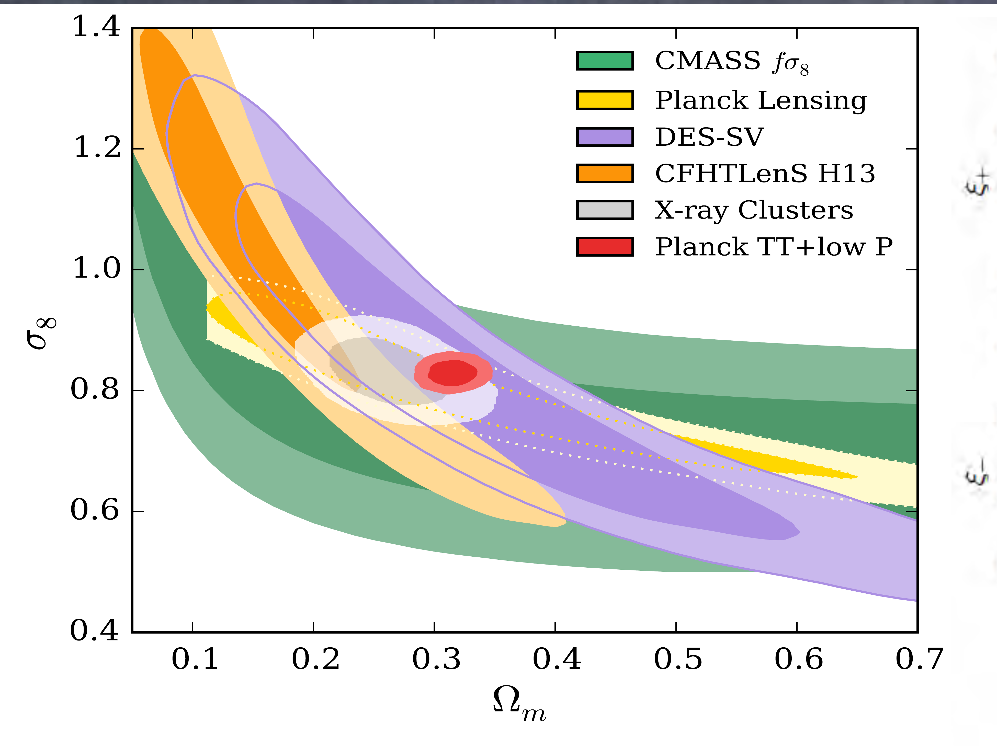
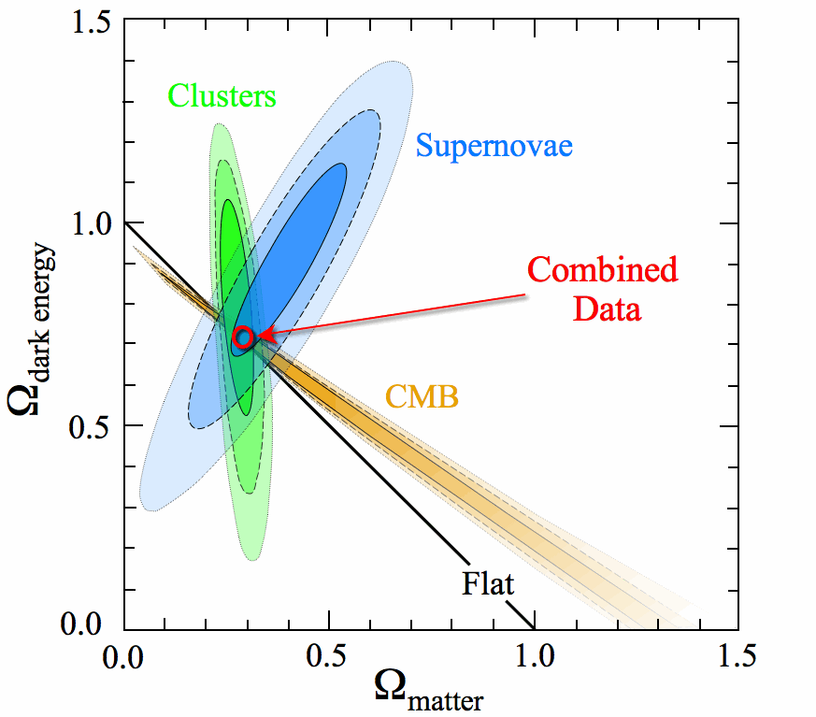
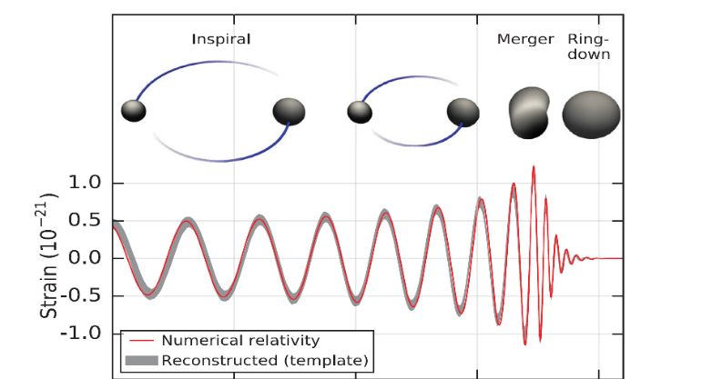
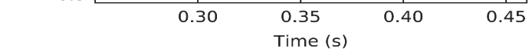


Converging in our Cosmological Paradigm
$$Ω_{matter}$$
Baryonic Acoustic Oscillations
Cosmic Microwave Background
Type Ia Supernovae
$$H_{0}$$
Gravitational Waves
Fluctuation amplitude
(DES Collaboration+ 2016)
Cosmological Paradigm

Slide 12
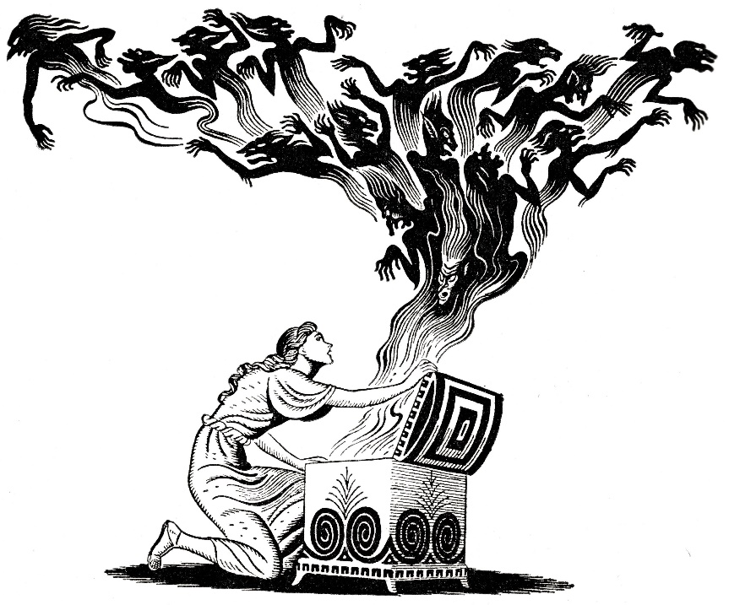
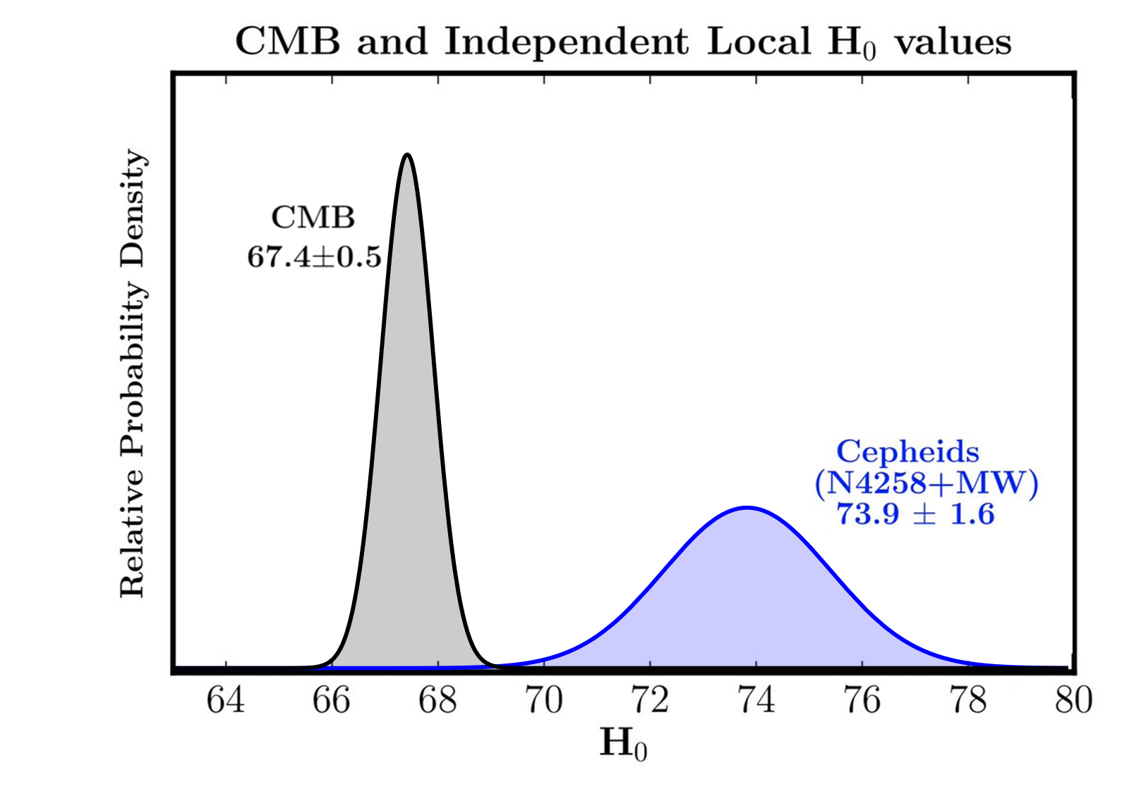
or we unlocking Pandora’s Box?
CC problem
Hierarchy Problem
Dark Energy
Neutrino mass
Matter-Antimatter
Dark Matter
Nature of inflaton
Origin of Universe
BH singularity

Slide 13

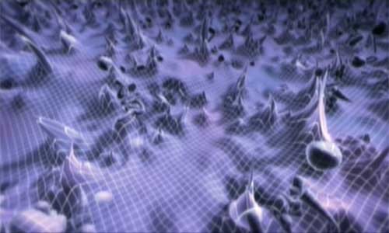
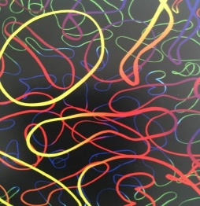
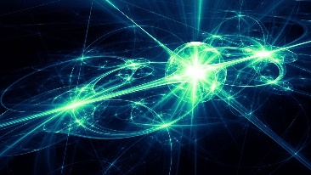
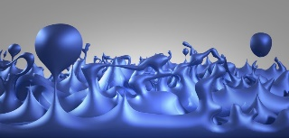
…or are we unlocking Pandora’s Box?
Our chance to uncover new layers of physics…
CC problem
Hierarchy Problem
Dark Energy
Neutrino mass
Matter-Antimatter
Dark Matter
Nature of inflaton
Origin of Universe
Black Hole singularity

Slide 14
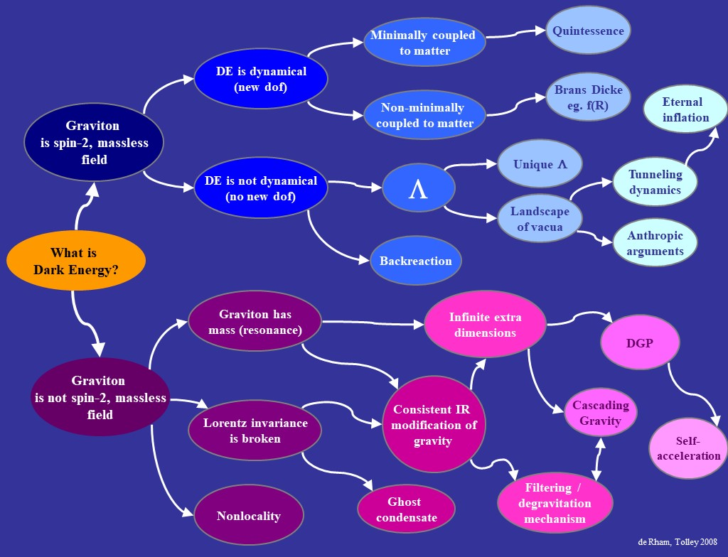
Beyond
Horndeski
Sym-metron
Horndeski
Galileons
EFT of Vector-Tensor
DHOST/
EST
Generalized Proca
Beyond
Generalized Proca
SLED
Proca-nuevo
biGravity/
Multi-
gravity
Warped MG
Mass-Varying
MG
Graviton has mass (local)
Quasi-dilaton
Partially Massless Gravity
Generalized Massive Gravity
Minimally Modified Gravity
Minimal Massive Gravity
Non-local massive gravity

Slide 15


Since Newton had his initial revelation about gravity, our understanding of this fundamental concept has evolved in unexpected ways. Theoretical physicist Claudia de Rham and co-host Janna Levin discuss the ways our current understanding of gravity needs to continue to evolve.
Massive Gravity a 14 (or 85)-years review

Slide 16
Modified Gravity
Lorentz-Violating
Lorentz-Invariant
LV-Massive
Gravity
Horava-
Lifshitz
Cuscuton
higher spin
Extended
HL
Gravity as a spin-2
partially-massless
spin-3
Ghost
Condensate
Massless spin-2
Non-minimally coupled
(Scalar-Tensor)
Massive Spin-2
DGP
f(R)
Massive
Gravity
Brans-Dicke
Galileon
Chameleon
Cascading
Gravity
DBI-Galileon
Massive
Graviton-Galileon
Bi/Multi
Gravity
Symmetron
Multi-Galileon
Quasi-
dilaton

Slide 17
An accelerating Universe
Many models of gravity (GR + dark energy field, Horndeski, Beyond Horndeski, DHOST, beyond beyond, f(R,T,Q,…)- modified gravity, Lorentz breaking gravity, massive gravity, bi-gravity, multi-gravity, DGP, non-local gravity…) are engineered to help tackling the
New Cosmological Constant Problem,
by providing a new source for the late-time acceleration of the Universe:
Either directly as Dark Energy or as
self-acceleration as an alternative to Dark Energy
Notes:
To see that, we can simply look at the linearized Einstein equation.
If I omit the tensor structure for a second, the Einstein equation looks like

Slide 18
Λ
An accelerating Universe
DE
vs
New dof in the
matter sector
New dof in the
gravity sector
New dof non-trivially coupled to gravity
eg. GR + dark energy field, Horndeski, Beyond Horndeski, DHOST, beyond beyond, f(R,T,Q,…) - modified gravity, Lorentz breaking gravity, massive gravity, bi-gravity, multi-gravity, DGP, non-local gravity, cartan gravity, …

Slide 19


Λ
An accelerating Universe
DE
vs
New dof in the
matter sector
New dof in the
gravity sector
Old Cosmological constant problem
New dof non-trivially coupled to gravity

Slide 20


Λ
An accelerating Universe
DE
vs
Old Cosmological constant problem
mGR
GR
Some models of gravity come hand in hand with mechanism that can potentially screen the effect of a cosmological const

Slide 21

Old & New CC problem
Many models of gravity (gravity + dark energy field, Horndeski, Beyond Horndeski, DHOST, beyond beyond, f(R,T,Q,…)- modified gravity, Lorentz breaking gravity, massive gravity, bi-gravity, multi-gravity, DGP, non-local gravity…) are engineered to help tackling the
New Cosmological Constant Problem
But the core of the challenge is the
Old Cosmological Constant Problem
Why is the CC $Λ⋘ M_{Pl}^{4}$ ???
Notes:
To see that, we can simply look at the linearized Einstein equation.
If I omit the tensor structure for a second, the Einstein equation looks like

Slide 22
Degravitation
Maybe the CC is not small, but simply gravitate weakly…
Arkani-Hamed, Dimopoulos, Dvali & Gabadadze, ’02 Dvali, Hofmann & Khoury, ‘07
Notes:
To see that, we can simply look at the linearized Einstein equation.
If I omit the tensor structure for a second, the Einstein equation looks like

Slide 23

Degravitation
Maybe the CC is not small, but simply gravitate weakly…
Λ
Phase transition
time
H²
1/m
time
Arkani-Hamed, Dimopoulos, Dvali & Gabadadze, ’02 Dvali, Hofmann & Khoury, ‘07
Notes:
To see that, we can simply look at the linearized Einstein equation.
If I omit the tensor structure for a second, the Einstein equation looks like

Slide 24
Degravitation
Massive gravity could lead to the degravitation of a CC
Λ
Phase transition
time
H²
1/m
time
Arkani-Hamed, Dimopoulos, Dvali & Gabadadze, ’02 Dvali, Hofmann & Khoury, ‘07
Notes:
To see that, we can simply look at the linearized Einstein equation.
If I omit the tensor structure for a second, the Einstein equation looks like

Slide 25


Flat Solutions with Tension
Original idea came from gravity in extra dimensions
A cod-2 brane with tension remains
flat but creates a deficit angle
The cosmology of a cod-2 brane is
extremely hard to study due to
the near brane divergences

Slide 26

Flat Solutions with Tension
3-brane with tension (ie cosmological constant) remains flat and solutions regular everywhere CdR, Khoury, Tolley, PRL 2009

Slide 27
Alternative to higher cod-brane
Working with higher dimensions is complicated…
Simpler alternative was to work instead with a local 4d effective analogue – where weakening from extra dimensions at large distances are captured by:
Graviton Effective Local Mass
Gabadadze 2009, CdR 2009
CdR&Gabadadze 2010
CdR, Gabadadze, Tolley, 2010, 2011, … Hassan, Rosen, Hinterbichler, … + many others

Slide 28


Tuning
From naturalness considerations, we expect a vacuum energy of the order of the most massive particle (at least 10²GeV if not higher… possible even Planck scale ?)
But observations tell us
If graviton had a mass, it should be
Notes:
To see that, we can simply look at the linearized Einstein equation.
If I omit the tensor structure for a second, the Einstein equation looks like

Slide 29



Tuning / Fine-tuning
The amount of tuning is the same
The real question is about technical naturalness
The observed value of the CC does not appear stable against quantum corrections
The graviton mass ‘could’ remain stable against quantum corrections
Notes:
To see that, we can simply look at the linearized Einstein equation.
If I omit the tensor structure for a second, the Einstein equation looks like

Slide 30



QC in massive gravity
The graviton mass ‘could’ remain stable against quantum corrections
At one-loop, stable against matter loops
from decoupling limit
CdR, Gabadadze, Heisenberg & Pirtskhalava, 1212.4128
CdR, Heisenberg & Ribeiro, 1307.7169, 1408.1678
Notes:
To see that, we can simply look at the linearized Einstein equation.
If I omit the tensor structure for a second, the Einstein equation looks like

Slide 31




QC in massive gravity
The graviton mass ‘could’ remain stable against quantum corrections
At one-loop, stable against matter loops
At higher loops, mixing could be fatal…
from decoupling limit
CdR, Gabadadze, Heisenberg & Pirtskhalava, 1212.4128
CdR, Heisenberg & Ribeiro, 1307.7169, 1408.1678
Notes:
To see that, we can simply look at the linearized Einstein equation.
If I omit the tensor structure for a second, the Einstein equation looks like

Slide 32
QC in massive gravity
The graviton mass ‘could’ remain stable against quantum corrections
At one-loop, stable against matter loops
At higher loops, mixing could be fatal…
Used an exact renormalization group approach
from decoupling limit
CdR, Gabadadze, Heisenberg & Pirtskhalava, 1212.4128
CdR, Heisenberg & Ribeiro, 1307.7169, 1408.1678
Appears stable (at least in toy-model using
derivative expansion)
CdR & Ribeiro, 1405.5213
Notes:
To see that, we can simply look at the linearized Einstein equation.
If I omit the tensor structure for a second, the Einstein equation looks like

Slide 33


Could the graviton have mass ?
h
2
graviton
The force carriers don’t need to be massless
It is not inconceivable that the photon has a mass
Could the graviton
also have a mass ?
Higgs mechanism for gravity ?

Slide 34



General Relativity
GR: 2 polarizations
Straight on view
Side view

Slide 35
Massive Gravity
The notion of mass requires a reference !

Slide 36

Massive Gravity
The notion of mass requires a reference !
Generates new dof
GR
Loss of 4 sym

Slide 37
In principle GW could have 4 other polarizations
2 ‘vectors’
2 ‘scalars’

Slide 38


Fierz-Pauli Massive Gravity
Mass term for the fluctuations around flat space-time
Fierz & Pauli, Proc.Roy.Soc.Lond.A 173, 211 (1939)

Slide 39

Fierz-Pauli Massive Gravity
Mass term for the fluctuations around flat space-time
Transforms under a change of coordinate
Typically involves some higher derivatives which leads to a ghost
Deffayet & Rombouts, 2005; Creminelli et. al. 2005

Slide 40

Massive Gravity
The notion of mass requires a reference !
Generates new dof
Boulware & Deser, PRD6, 3368 (1972)

Slide 41


Ghost-free Massive Gravity
In 4d, there is a 2-parameter family of ghost free theories of Lorentz-invariant massive gravity
CdR, Gabadadze, 1007.0443
CdR, Gabadadze, Tolley, 1011.1232

Slide 42
Ghost-free Massive Gravity
In 4d, there is a 2-parameter family of ghost free theories of Lorentz-invariant massive gravity
Absence of ghost has now been proved fully non-perturbatively in many different languages
CdR, Gabadadze, 1007.0443
CdR, Gabadadze, Tolley, 1011.1232
Hassan & Rosen, 1106.3344
CdR, Gabadadze, Tolley, 1107.3820
CdR, Gabadadze, Tolley, 1108.4521
Hassan & Rosen, 1111.2070
Mirbabayi, 1112.1435
Kluson, 1202.5899
Hassan, Schmidt-May & von Strauss, 1203.5283
Kluson, 1204.2957
Deffayet, Mourad & Zahariade, 1207.6338
Alexandrov, 1308.6586
Kugo, Ohta, 1401.3873
Golovnev, 1401.6343, …

Slide 43
Observational Tests
Solar System
Binary Pulsars
Black Holes
Modified Gravity
Gravitational Waves
Supernovae
Weak Lensing
Cluster of galaxies
CMB, …
Structure
Formation
Universe
Evolution
(Supernovae, BAO, CMB,…)

Slide 44






How light is gravity ???
CdR, Deskins, Tolley, Zhou, 1606.08462, RMP

Slide 45
How light is gravity ???
Cleanest
(least model dependent)
Only for models
that carry a helicity-0 mode
(ie. For Local and Lorentz-
invariant models)
CdR, Deskins, Tolley, Zhou, 1606.08462, RMP

Slide 46


How light is gravity ???
2310.07469
Constraints modifications of the dispersion relation
Generic for the helicity-2 modes of any Lorentz invariant model of massive gravity (including DGP at the level of spectral representation)

Slide 47





















Physics under the Gravitational Rainbow
Earth
Interferometer
Primordial GWs
Pulsar Timing Arrays
Space Interferometer
$$−18$$
$$−16$$
$$−14$$
$$−12$$
$$−10$$
$$−8$$
$$−6$$
$$−4$$
$$−2$$
$$0$$
$$2$$
Log k/Hz
$$H_{0}$$
B-mode polarization
Quasi-Normal Modes
Gravitational Radiation
Evolution of GWs

Slide 48

Massive gravity mental health??
They all ask “How massive is gravity?”
and “How can we rule it out?”
but nobody asks “How happy and positive
does massive gravity feel?”

Slide 49


Massive gravity 14 years Later….
Cosmology
Binary systems, Black Holes
& Numerical posedness
UV completion

Slide 50









Optical theorem
$$2$$
$$2$$
The optical theorem carries an infinite more information than just
$$σ>0$$
Explicit form of these bounds is derived in 1702.08577 CdR, Melville, Tolley, Zhou

Slide 51



Eg. Constraints on Massive Gravity from UV completion
(basic bound in forward limit)
2-parameter family for Ghost-free massive gravity
Has no ghost and a strong coupling scale $Λ^{3}=M_{Pl}m^{2}$
Cheung & Remmen, JHEP 1604 (2016)

Slide 52



Massive gravity from an EFT viewpoint
$$+…$$
has no ghost and a strong coupling scale $Λ^{3}=M_{Pl}m^{2}$
A priori, from a naïve EFT point of view, there is “nothing wrong” with considering other operators that would lead to “ghost” at a scale
$Λ^{5}=M_{Pl}m^{4}$ (for $Δc$) or $Λ^{4}=M_{Pl}m^{3}$ (for $Δd$)
It just means that the cutoff of the EFT is lower
Are these parameters constrained by the positivity bounds ?

Slide 53

Constraints beyond forward limit
$$+…$$
Measures the departure from ghost-free massive gravity
d₅
CdR, Melville, Tolley, Zhou, 2018

Slide 54


Constraints beyond forward limit
$$+…$$
Measures the departure from ghost-free massive gravity
d₅
As far as the tree-level 2-2 scattering amplitude is concerned, any massive spin-2 EFT needs to carry the ghost-free ($Λ_{3}$) parameters to have a chance of enjoying a standard UV completion
CdR, Melville, Tolley, Zhou, 2018

Slide 55



CFT- TTbar deformation
( )
S₀ is an exact CFT with stress-energy T(0)
Deformation can be solved exactly
Resulting full amplitude is equivalent to original with pre-factor
0

Slide 56
CFT- TTbar deformation
( )
S₀ is an exact CFT with stress-energy T(0)
Deformation can be solved exactly
Resulting full amplitude is equivalent to original with pre-factor
Grows exponentially in one direction of complex plane
non-local (would violate equivalent of positivity bounds in 2d)
0

Slide 57


Slide 58


TTbar = TT amplitude
TT exchange amplitude of a massive spin-2 field between two conserved forces in D dimensions is given by
TTbar deformation is most naturally interpreted as a
massive theory of gravity

Slide 59
Ghost-free (dRGT) Massive Gravity
Tolley 2019
massive gravity
CFT
With deformation parameter identified as
Equivalence at Classical and Quantum Level
Massive gravity in an example of exactly solvable deformed CFT in 2d

Slide 60

Outlook
Massive Gravity is a specific framework to study
IR modifications of Gravity or potentially other systems
It could play a role for
- the late-time acceleration of the Universe
- the cosmological constant problem
- condensed matter system
- others… (enter in TT bar amplitude in 2d…)
Exact FLRW solutions do not exist in massive gravity with Minkowski reference metric and no curvature
Many alternatives have been investigated with various signatures – recently increase of interest for models where tensor modes behave identically as in GR
Recent progress on well-posed formulation of massive gravity for numerical implementations (Black Holes, Cosmology, Binary systems,…)
Question of UV completion remains an interesting and on-going one

Slide 61

A poor woman’s apology…
for not being better prepared…

Slide 62


A poor woman’s apology…
for not being better prepared…

