Slide 1
Welcome

Slide 2
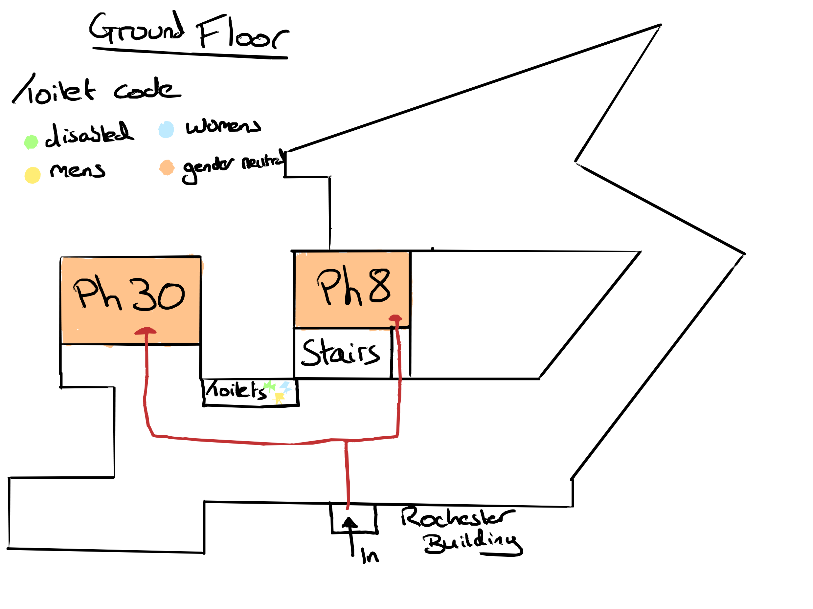

Slide 3
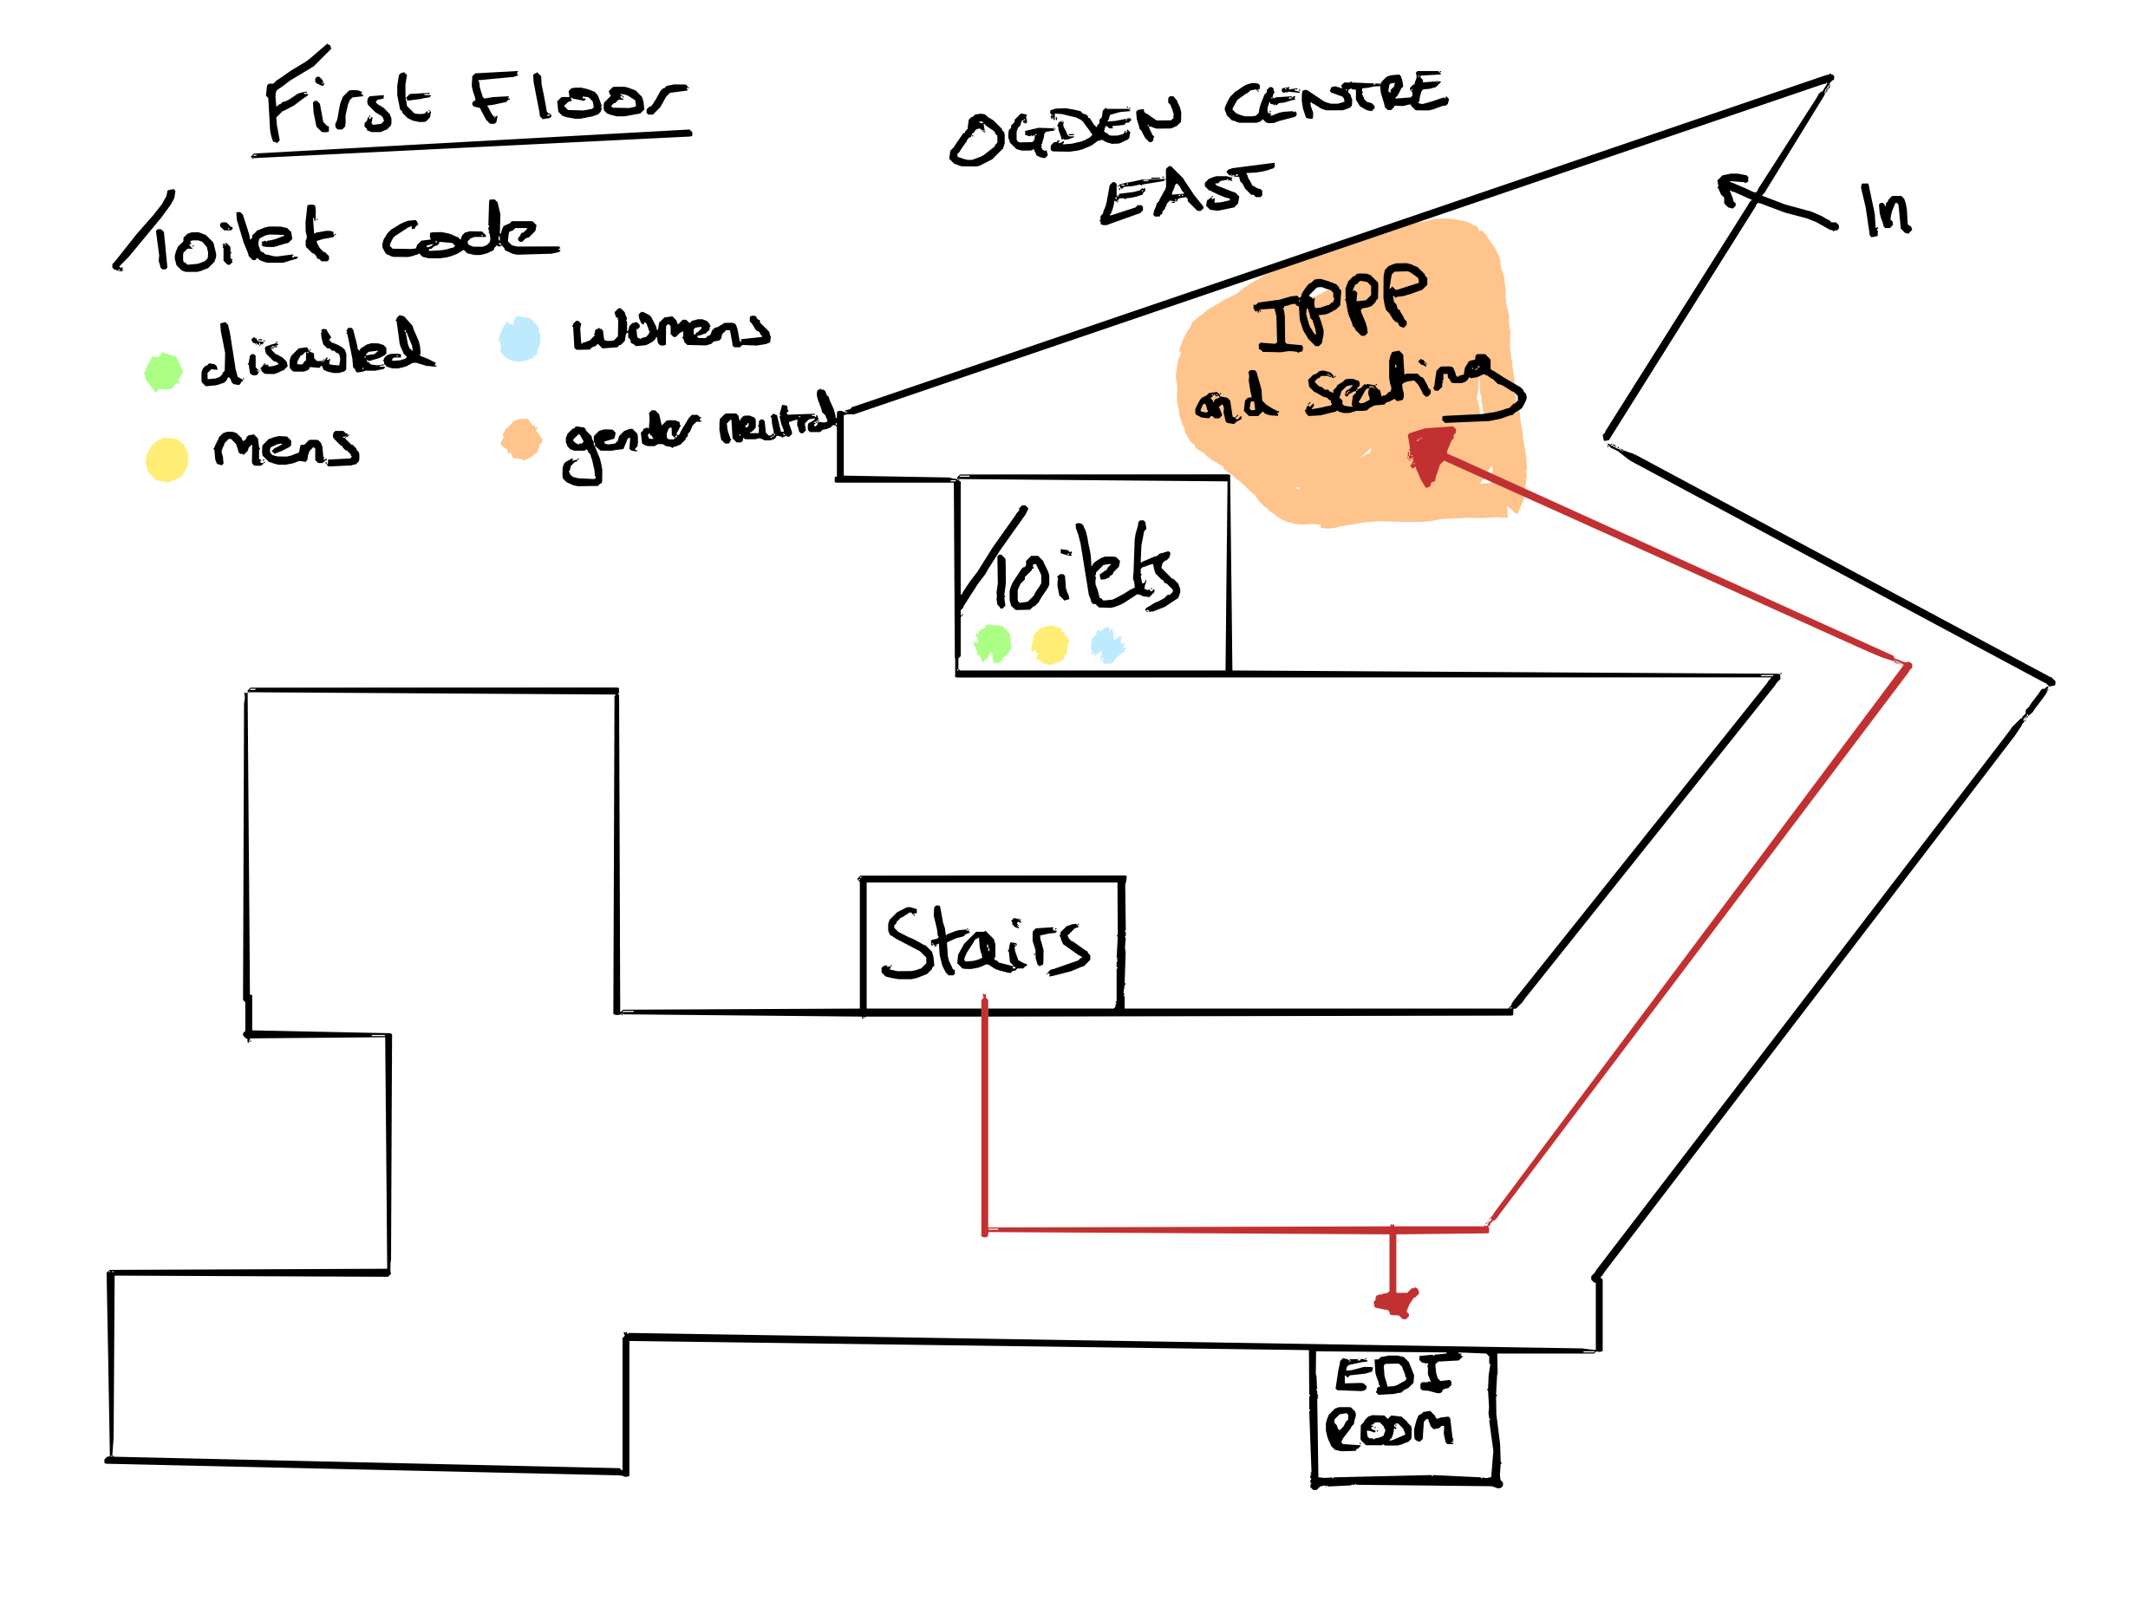

Slide 4
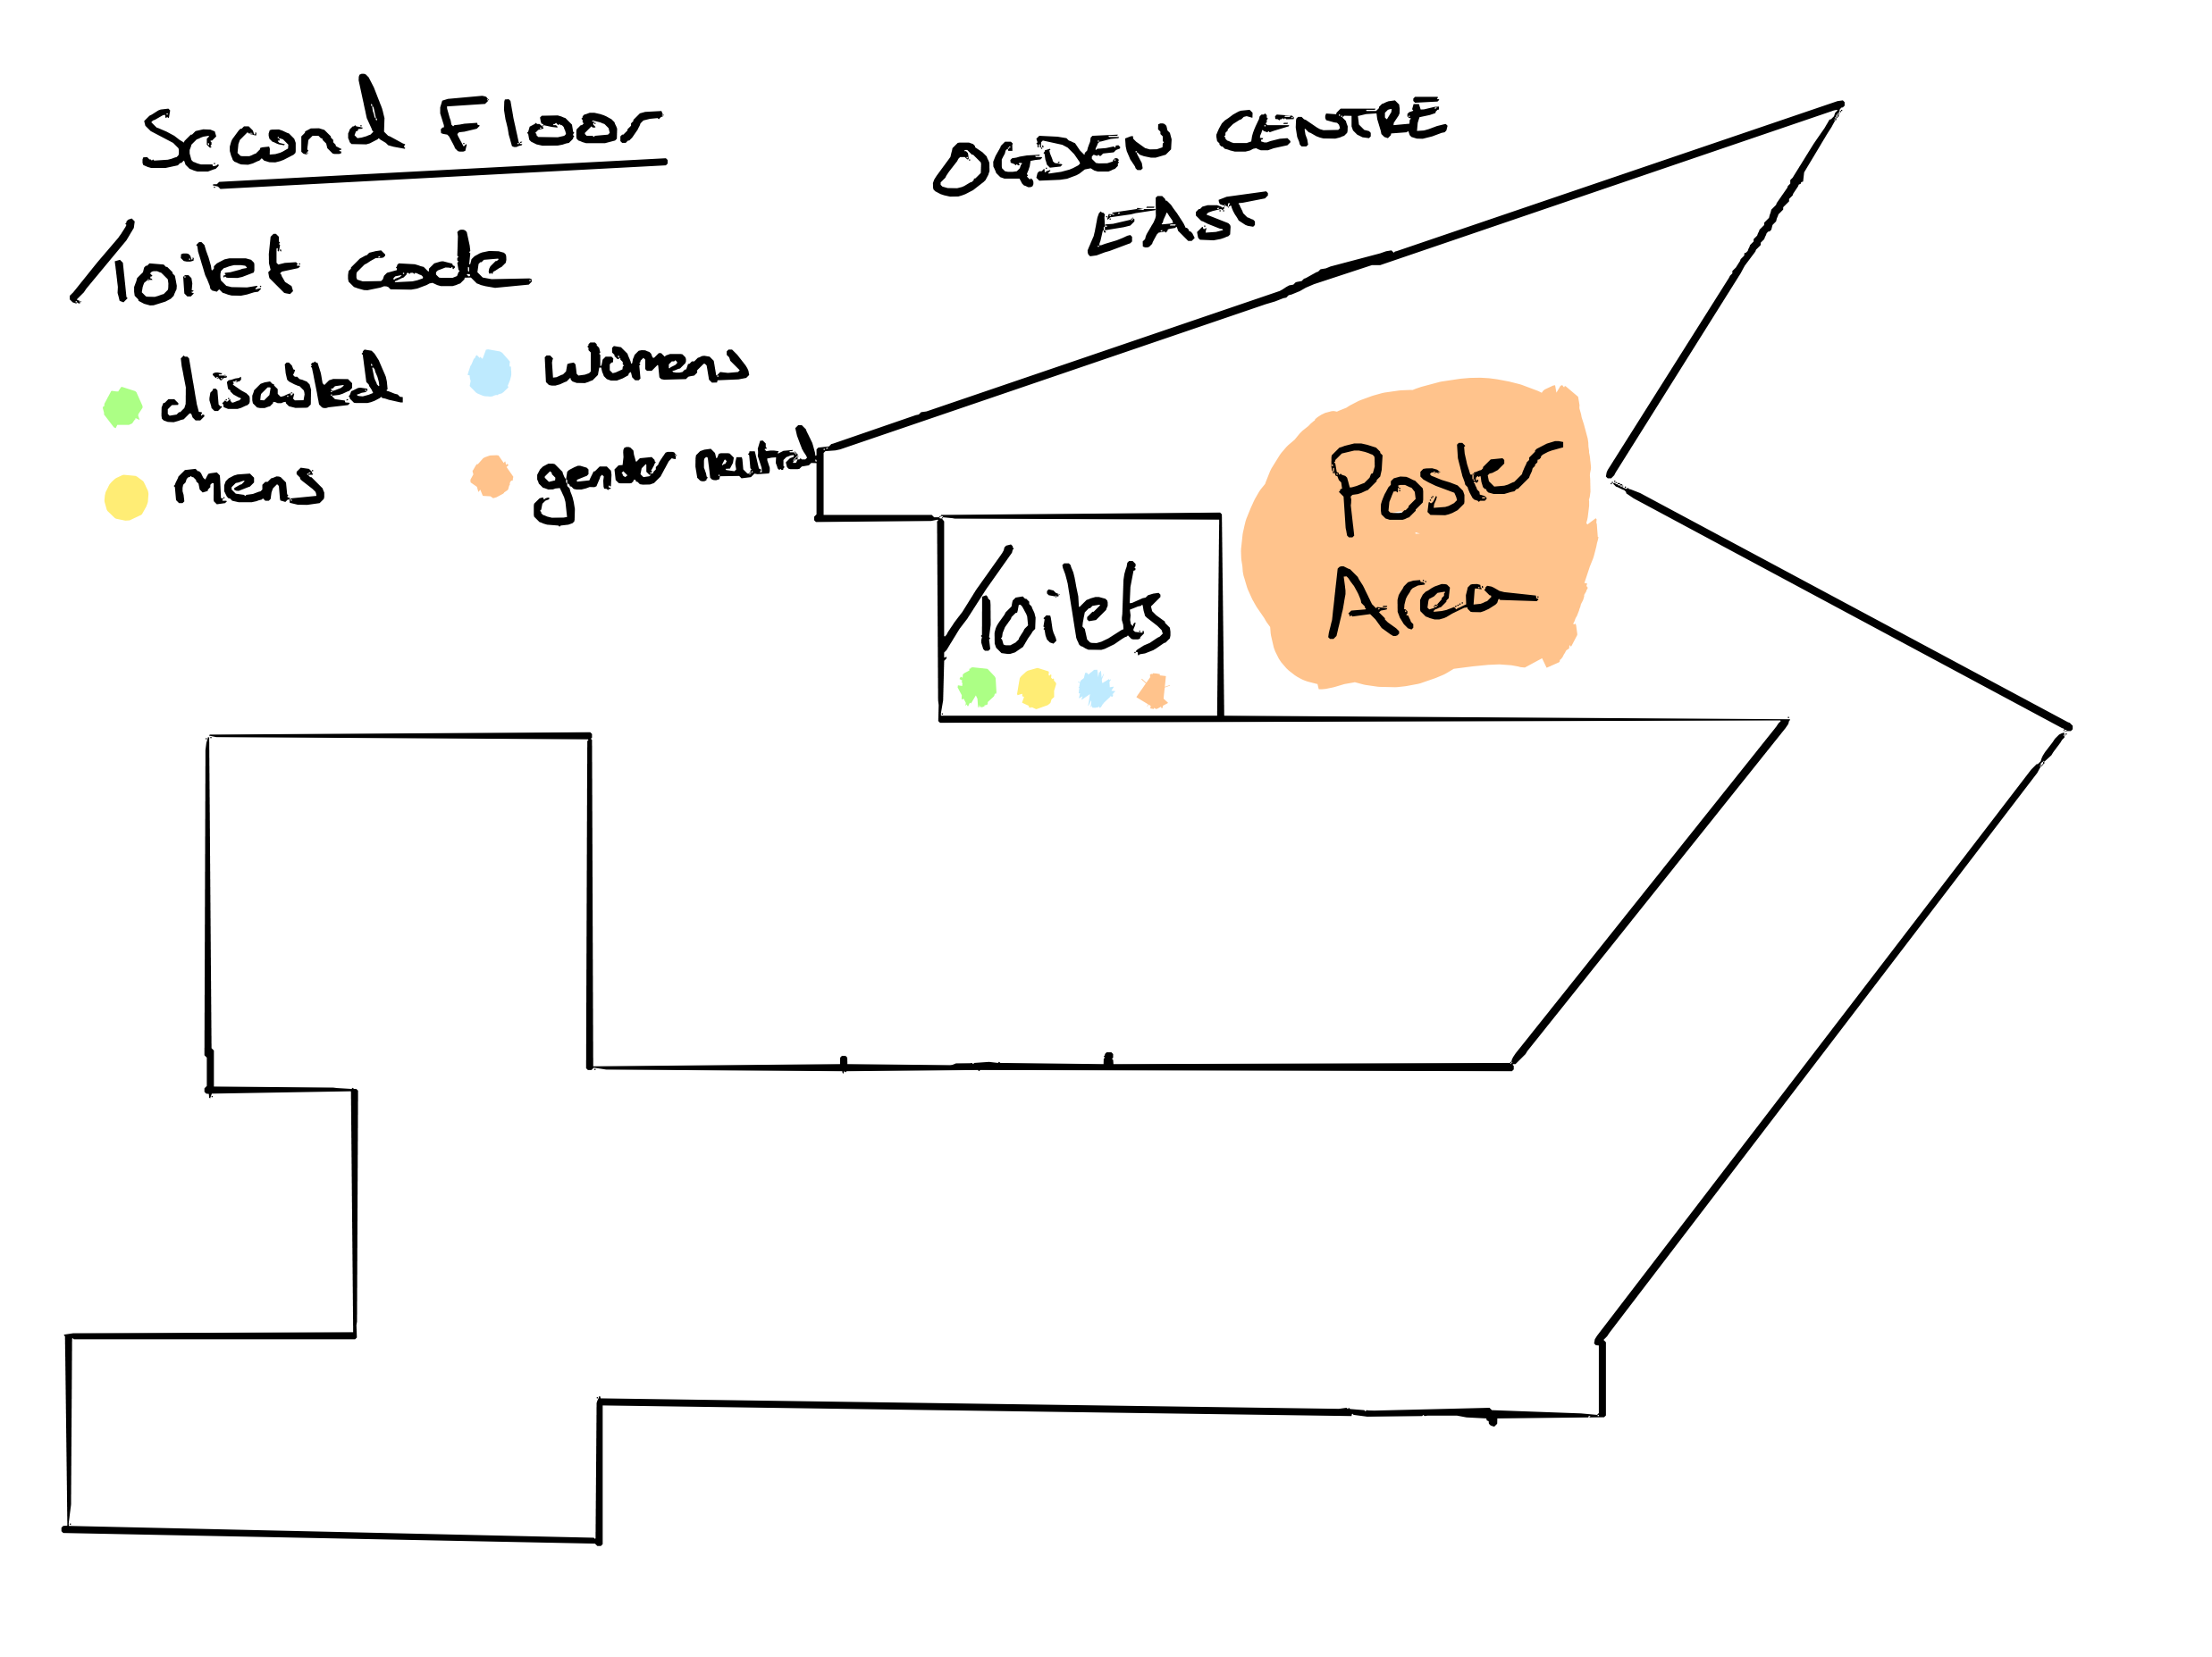

Slide 5
Book Keeping
A quick note that some sessions have been moved around – please check the timetable to see when you are presenting
A reminder for anyone who hasn’t uploaded their slides to the indico to do so in advance of their session.
If you are speaking in a session, introduce yourself to the session chair before the start of the session.
The doors to the physics department buildings are locked at 7pm. If anyone requires access after 7pm please ask on the WhatsApp group and someone will let you in.
If you have brought a poster with you, please put it upstairs in the poster room or pass it to us

Slide 6
Code of Conduct
Any actions that lead to an unsafe or uncomfortable environment will not be tolerated.
All participants are expected to behave professionally: be considerate, inclusive, respectful and collaborative.
Harassment and sexist, racist or exclusionary comments or jokes are not appropriate.
Harassment includes sustained disruption of talks or other events, sexual attention or innuendo, deliberate intimidation, stalking, and photography or recording of an individual without consent.
It also includes offensive or belittling comments related to age, gender, sexual orientation, ethnicity, nationality, disability, physical appearance or religion.
All communication should be appropriate for a professional audience including people of many different backgrounds. Sexual language and imagery is not appropriate.
Please try to be active bystanders! If you observe someone making anyone else feel unsafe, unwelcome or uncomfortable, please tell them so, and remind them of the Code of Conduct or report them to the YTF committee.

Slide 7
Contacts
General
Elliot
elliot.fox@
durham.ac.uk
EDI & Accessibility
Ery
ery.j.mcpartland@durham.ac.uk
Anyone in a YTF T-shirt

Slide 8
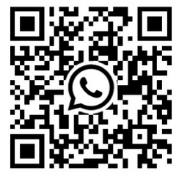
WhatsApp Chat

Slide 9
https://conference.ippp.dur.ac.uk/event/1428/overview

Slide 10
Thank you!

