Slide 1
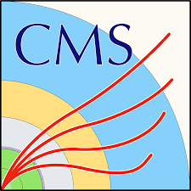
Precision measurements of Z boson production (with a focus on the Weak Mixing Angle)
Ahmed Abdelmotteleb
ahmed.abdelmotteleb@cern.ch
University of Warwick
On behalf of the ATLAS, CMS and LHCb collaborations
SM @ LHC 2025
08 April 2025

Slide 2
Topics
Introduction
ATLAS measurement
CMS measurement
LHCb measurement + bonus!
Summary and prospects

Slide 3
Introduction

Slide 4
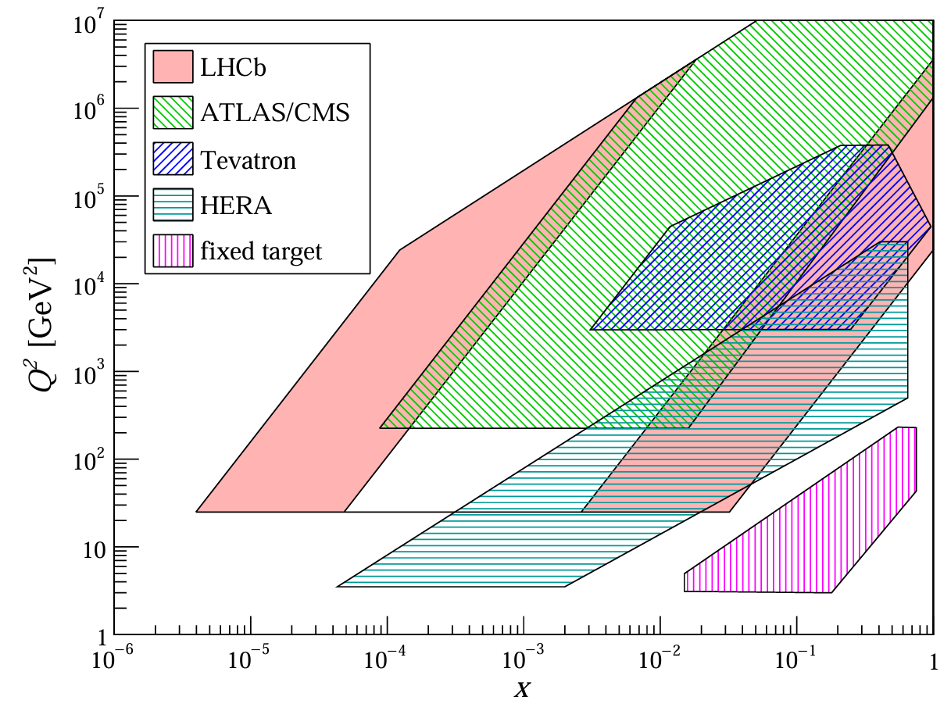
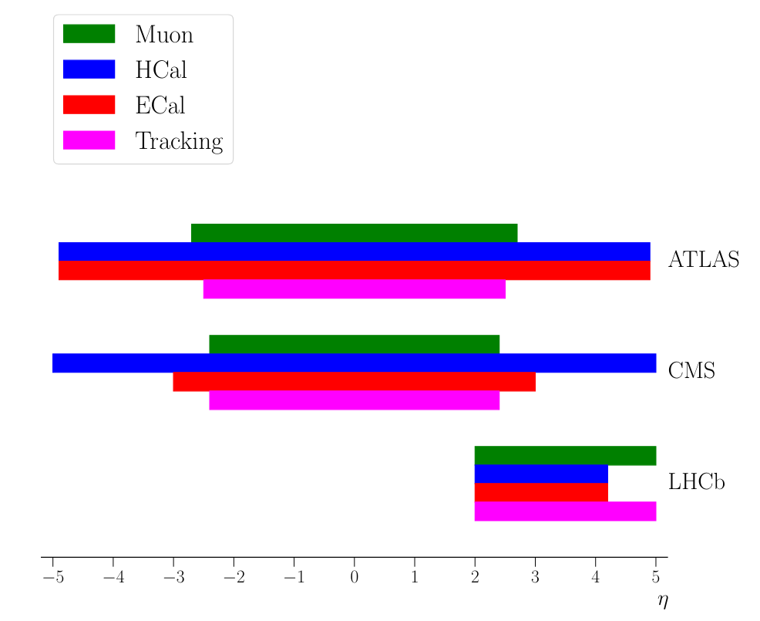
ATLAS, CMS, and LHCb
Both ATLAS and CMS cover the central pseudorapidity region
ECAL used to study electron modes in more detail
LHCb covers the forward region, with access to low and high Bjorken-$x$ regions of the phase-space
Focuses on muons with excellent tracking and detection
Having 3 experiments with complementary coverage has big implications on modelling – especially with PDFs
$$[arXiv:1512.06666]$$
[Int. J. Mod. Phys. A 30, 1530022 (2015)]

Slide 5
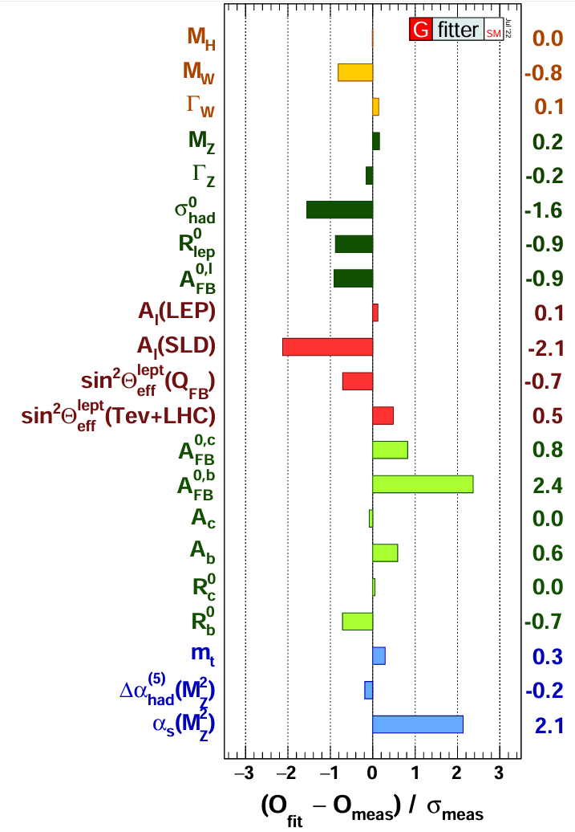
Weak mixing angle
Key parameter in SM
At the tree level:
$\sin^{2}{θ_{\text{eff}}^{\text{lept}}}$ accounts for higher-order corrections:
$k_{f}$is a flavour-dependent effective scaling factor absorbing higher order corrections ($k_{f}=1$ at LO)
$$cosθ_{W}=\frac{m_{W}}{m_{Z}}⇒\sin^{2}{θ_{W}}=\left(1−\frac{m_{W}^{2}}{m_{Z}^{2}}\right)$$
[arXiv:2211.07665]
$$\sin^{2}{θ_{eff}^{lept}=k_{f}\sin^{2}{θ_{W}}}$$

Slide 6
Angular coefficients
At leading order in EW theory, the 5D differential cross-section for $pp→Z/γ^{∗}→ll$can be expressed as a sum of 9 harmonic polynomials
Factorise out the unpolarised cross-section
The helicity cross-sections depend on Z boson $p_{T}$, rapidity ($y^{ll}$), and mass ($m^{ll}$)
End up with 9 harmonic polynomials and 8 dimensionless angular coefficients ($A_{0}−A_{7}$)
Each polynomial is multiplied by a helicity cross-section
$A_{4}$ deserves special attention as it includes info about the vector and axial-vector couplings of the Z boson

Slide 7
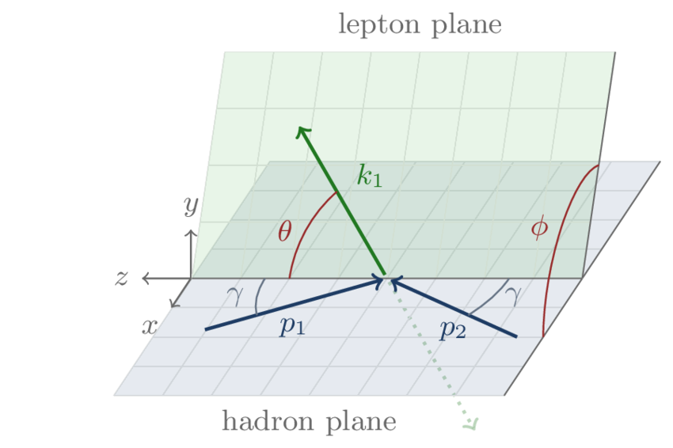
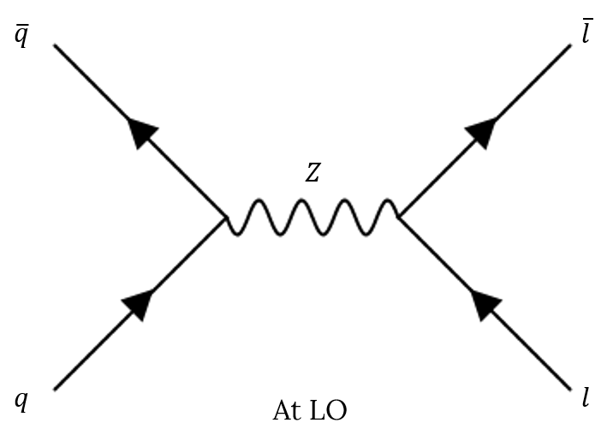
Forward-backward asymmetry
Presence of vector and axial-vector couplings that depend on $θ_{W}$ introduces a forward-backward asymmetry of angular distribution of lepton pairs in DY events
$$/γ^{∗}$$
$$∝1+\cos^{2}{θ^{∗}}+A_{4} cosθ^{∗}$$
$$A_{FB}=\frac{3}{8}A_{4}$$
$A_{FB}=\frac{N\left(cosθ^{∗}>0\right)−N(cosθ^{∗}<0)}{N\left(cosθ^{∗}>0\right)+N(cosθ^{∗}<0)}=\frac{N_{F}−N_{B}}{N_{F}+N_{B}}$
Collins-Soper frame

Slide 8
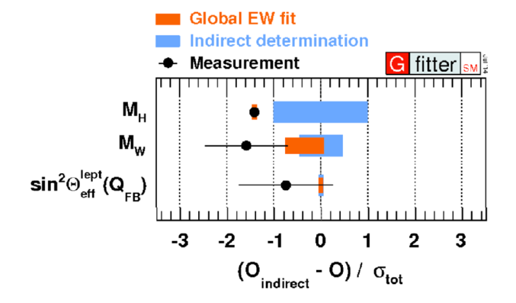
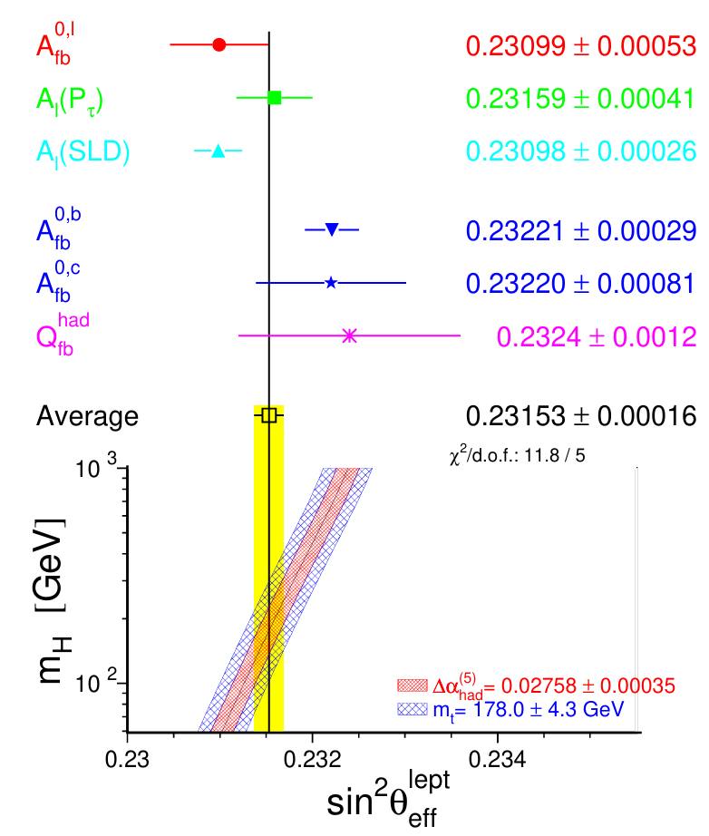
Motivation
A $3.2 σ$ difference exists between the two most precise individual measurements (SLD and LEP)
Potential BSM process dependence
Indirect determinations of $\sin^{2}{θ_{\text{eff}}^{\text{lept}}}$ are more precise than current experimental measurements
Further studies needed – now performed by LHC experiments
Can we reach Global EW fit precision with LHC?
[arXiv:1803.01853]
[arXiv:hep-ex/0509008]

Slide 9
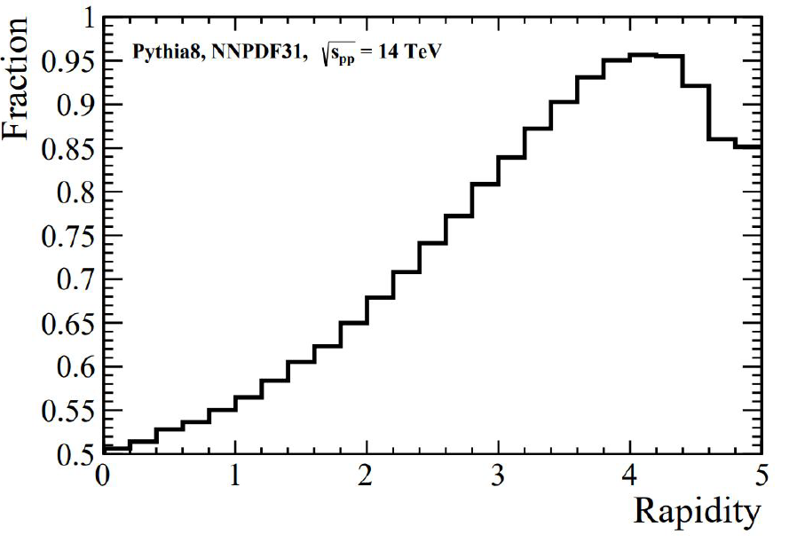
Dilution
Measured $A_{FB}$ is diluted because it relies on PDFs to infer the initial state quark direction
At large rapidities have asymmetric initial state:
One parton at high 𝒙 tends to be a valence quark
Other at low 𝒙 tends to be an anti-quark
PDF uncertainty is smaller in the forward region
LHCb (with forward-region detector) seems to have an advantage here where the dilution between proton and parton level is reduced
Can also decrease uncertainty with PDF profiling
Fraction of events where the Z boson travels in direction of initial state quark
[arXiv:1902.04070]

Slide 10
General Analysis Strategy
All backgrounds are estimated through simulation and then scaled to the data
Template fit for $A_{FB}/A_{4}$ distribution
Create MC predictions of the $A_{FB}/A_{4}$ distribution with different values of $\sin^{2}{θ_{eff}^{lept}}$
Compare predictions with data to extract the value of $\sin^{2}{θ_{eff}^{lept}}$that best matches the data

Slide 11
ATLAS measurement

Slide 12
Setup
Latest result from ATLAS-CONF-2018-037 with 2012 dataset @ $\sqrt{s}=$ 8 TeV → 20.2 ${\text{fb}}^{−1}$. Same dataset used in measuring angular coefficients
3 analysis channels:
$e−e$ in central region $(ee_{CC})$→ 6 million events
$μ−μ$ in central region $({μμ}_{CC})$ → 7.5 million events
$e−e$ in central and forward region $(ee_{CF})$→ 1.5 million events
Significant enhancement compared to measurement using the central- central channels alone
The background contamination for the $ee_{CC}$ and ${μμ}_{CC}$ channels amount to ~0.5%, whereas in the $ee_{CF}$ it is about 3% in the Z pole region
Central: ($\left|η\right|<2.4)$
Forward: (2.5 <$\left|η\right|<4.9)$

Slide 13
Strategy
Binned templates in dilepton mass and absolute rapidity → constrain PDF uncertainties
Extract $A_{4}$ by fitting $P_{i}$ polynomial templates to the angular distributions ($cosθ, φ$) of the leptons in the rest frame of the Z boson (Collins-Soper frame)
Compare extracted angular coefficients to previous measurements, then focusing on 𝐴₄
Use DYTurbo predictions for $A_{4}(\sin^{2}{θ_{\text{eff}}^{\text{lept}}})$ at LO in EW and NLO in QCD, with $α(0)$ scheme: $G_{μ},m_{Z}, α(0)$
Predictions are compared to measured data

Slide 14
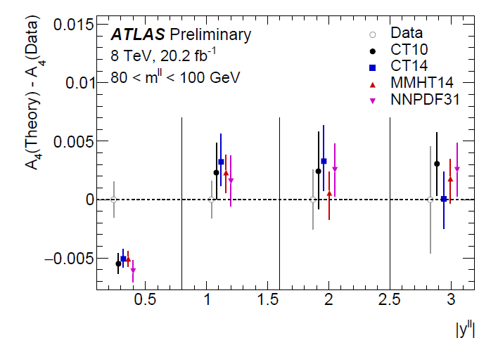
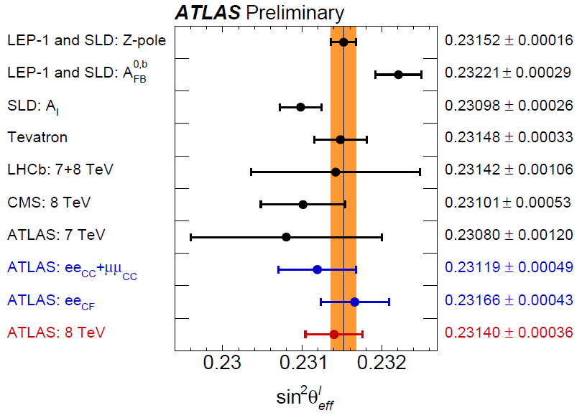
Results
Final result:
$$\sin^{2}{θ_{\text{eff}}^{\text{lept}}}=0.23140±{0.00021}_{stat}±{0.00016}_{syst} ±{0.00024}_{PDF}$$
Consistent with previous measurements and indirect determinations from global electroweak fit
PDFs are the biggest source of uncertainty
Uncertainty is estimated by assessing variations given each PDF set replica and profiling
Used MMHT14 PDF set as default
ATLAS-CONF-2018-037

Slide 15
CMS measurement

Slide 16
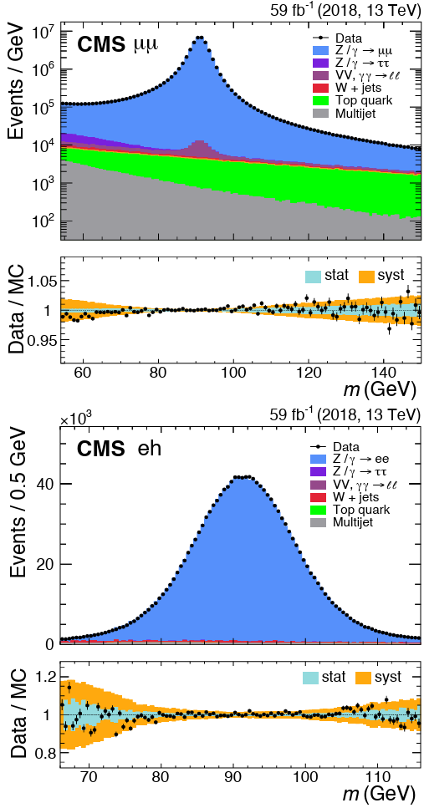
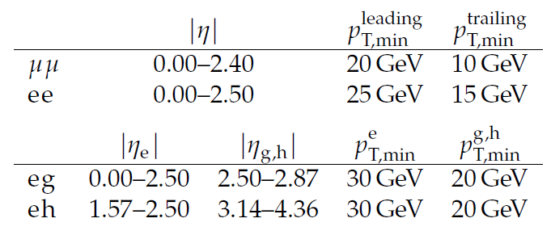
Setup
Latest result from CERN-EP-2024-208 with full Run-2 pp collision dataset (2016-2018) @ $\sqrt{s}=13$ TeV → $138$ ${\text{fb}}^{−1}$
Uses forward calorimeters to gather more electron events
4 dilepton analysis channels:
$μμ→$ 111 million
$ee→$59 million
$eg→$ 5 million
$eh→$ 3.3 million
g – forward ECAL electron
h – forward HCAL electron
[CERN-EP-2024-208]

Slide 17
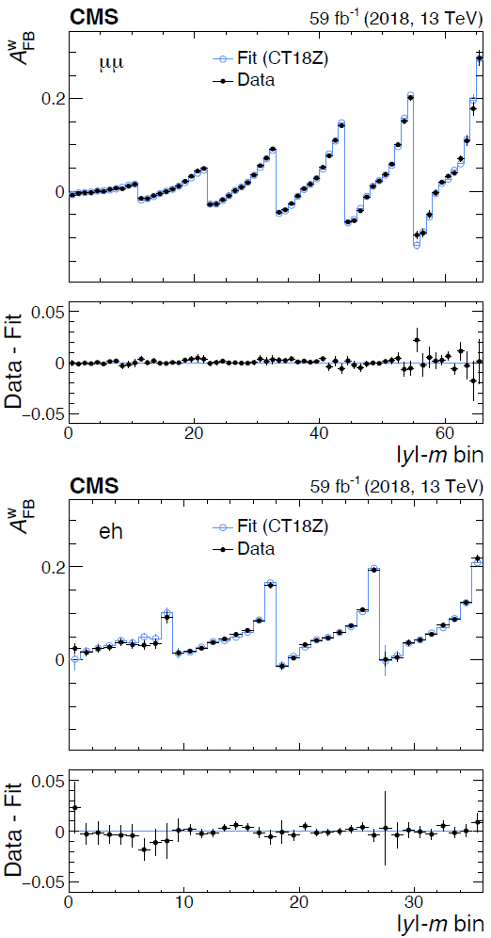
Strategy
Template fits of weighted detector-level $A_{FB}$ in bins of mass and absolute rapidity
9 bins of dilepton rapidity, with $y^{ll}<$ 3.4 and in 11 bins of dilepton mass, with ${54<m}^{ll}<150$ GeV
Signal MC sample generated using the Zj-MiNNLOPS program in POWHEG-BOX at NNLO QCD
EW corrections calculated at NLO with Powheg Z_EW-BMNNPV program using xW scheme: $G_{μ},\sin^{2}{θ_{eff}^{lept}},m_{Z}$
Use PDF profiling to improve PDF uncertainties and reduce differences between final results that use different PDF sets
[CERN-EP-2024-208]

Slide 18
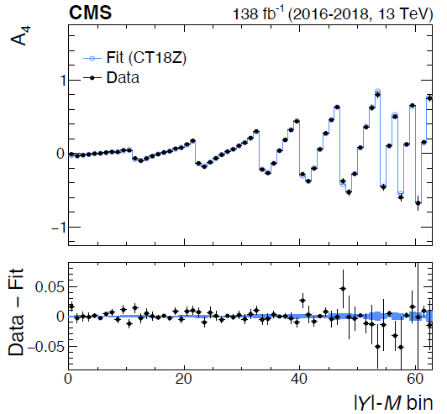
Strategy 2
Template fits unfolded $A_{4}$ in full phase space in bins of mass and absolute rapidity at Born level, pre-FSR
Also use PDF profiling - float and extract $\sin^{2}{θ_{\text{eff}}^{\text{lept}}}$ and PDF nuisance parameters simultaneously
Result from unfolded $A_{4}$ can be used for reinterpretations and combinations
Result compatible with first strategy
[CERN-EP-2024-208]

Slide 19
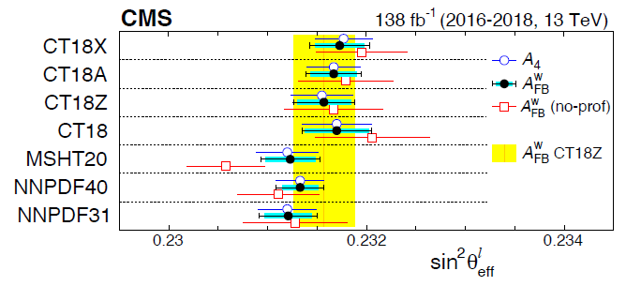
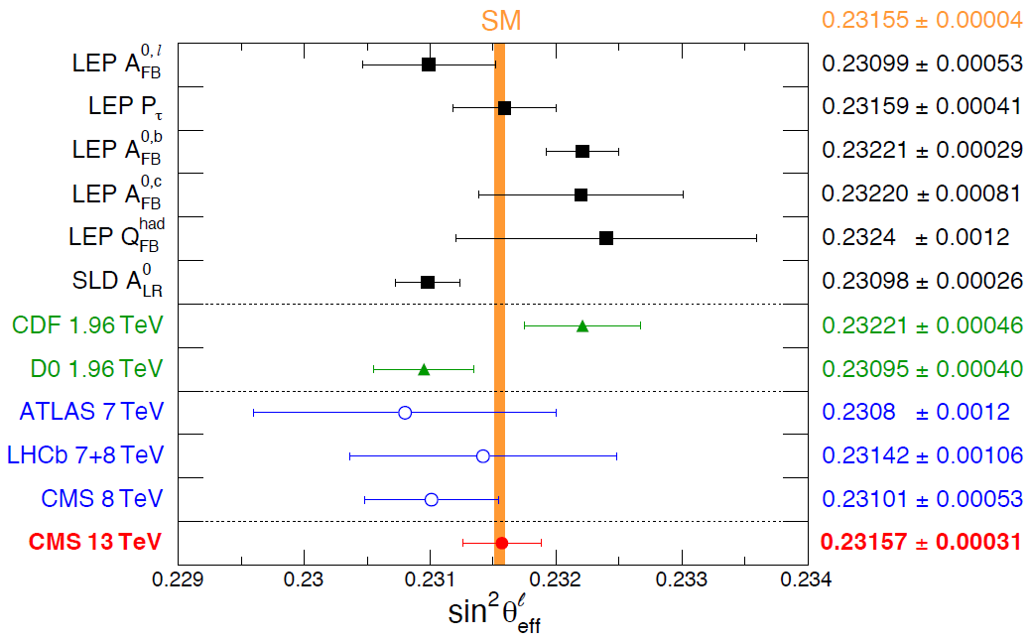
Results
Final result:
$$\sin^{2}{θ_{\text{eff}}^{\text{lept}}}=0.23157±{0.00010}_{stat} ±{0.00015}_{exp}±{0.00009}_{theo} ±{0.00027}_{PDF}$$
$\sin^{2}{θ_{\text{eff}}^{\text{lept}}}$result extracted from $A_{FB}$ is the baseline result because systematics cancel out to a large extent
PDFs are the biggest source of uncertainty
Used CT18Z PDF as default – covers the central values obtained by other sets
[CERN-EP-2024-208]

Slide 20
LHCb measurement

Slide 21
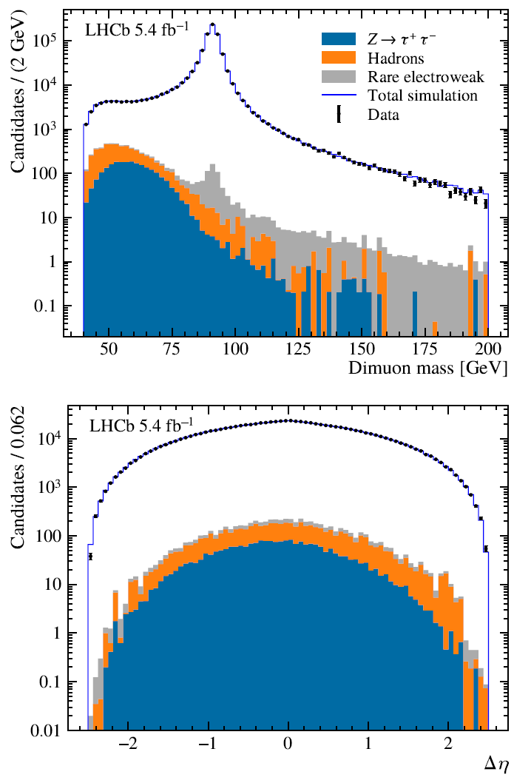
Setup
Latest result from JHEP12(2024)026 with full Run-2 pp collision dataset (2016-2018) @ $\sqrt{s}=13$ TeV → $5.3$ ${\text{fb}}^{−1}$
($×26$ smaller)
Fiducial region:
$2.0<η_{μ}<4.5$
$p_{T}^{μ}>20$GeV/c
$66<M_{μμ}<116$GeV/$c^{2}$
Hadronic and heavy-flavour backgrounds are suppressed to the percent level by isolation, muon track fit, and muon impact parameter requirements
Total background fraction, within the fiducial kinematic region for the measurement is just $2×{10}^{−3}$
Roughly 860,000 events selected for this measurement
[JHEP12(2024)026]

Slide 22
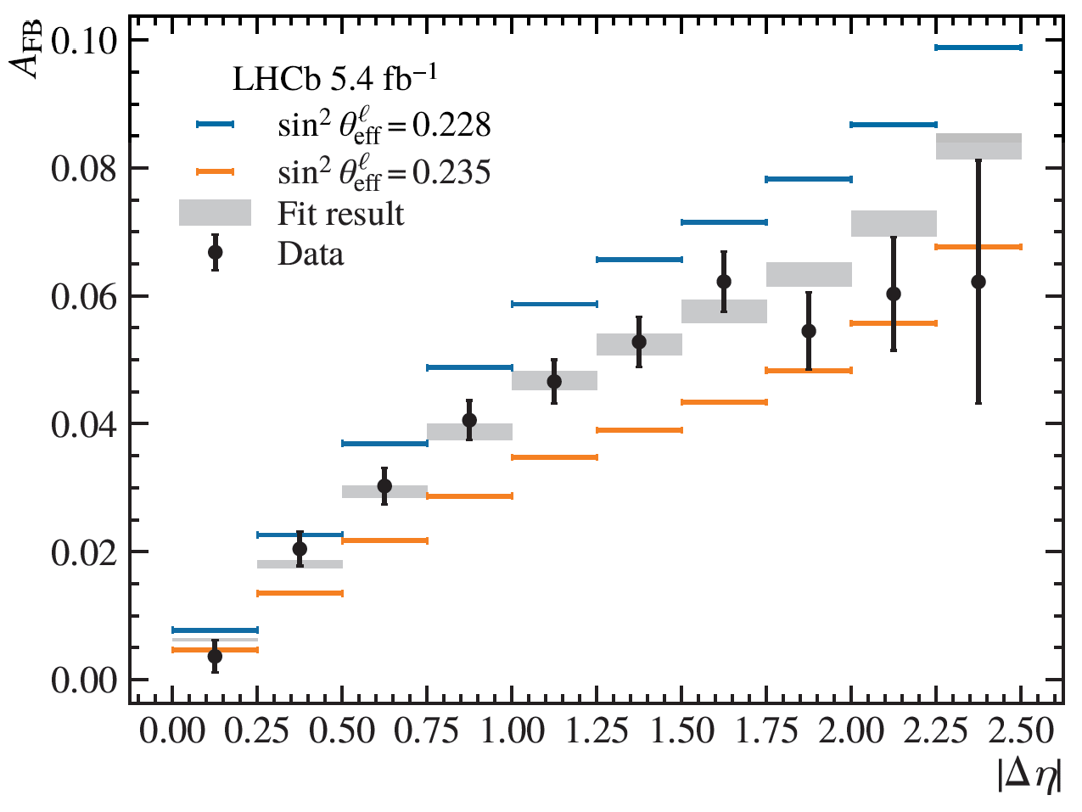
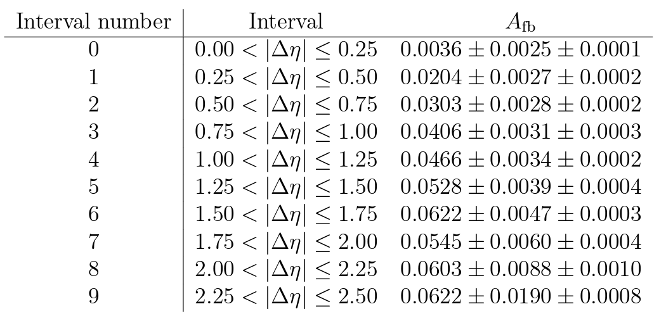
Strategy
Fit $A_{FB}$ in (10) intervals of $\left|Δη\right|$ with a single mass bin ($cosθ^{∗}\sim \tanh{\frac{Δη}{2}}$) - improves sensitivity to the weak mixing angle by 14% in simulation
Unfold using simulation to get generator-level $A_{FB}$
$\sin^{2}{θ_{\text{eff}}^{\text{lept}}}$is extracted using predictions of $A_{FB}(\sin^{2}{θ_{\text{eff}}^{\text{lept}}})$ at NLO in the strong and EW couplings using POWHEG-BOX - uses xW scheme: $G_{μ},\sin^{2}{θ_{eff}^{lept}},m_{Z}$
Compare data with predictions to extract the value of $\sin^{2}{θ_{\text{eff}}^{\text{lept}}}$ that best corresponds to the data
[JHEP12(2024)026]

Slide 23
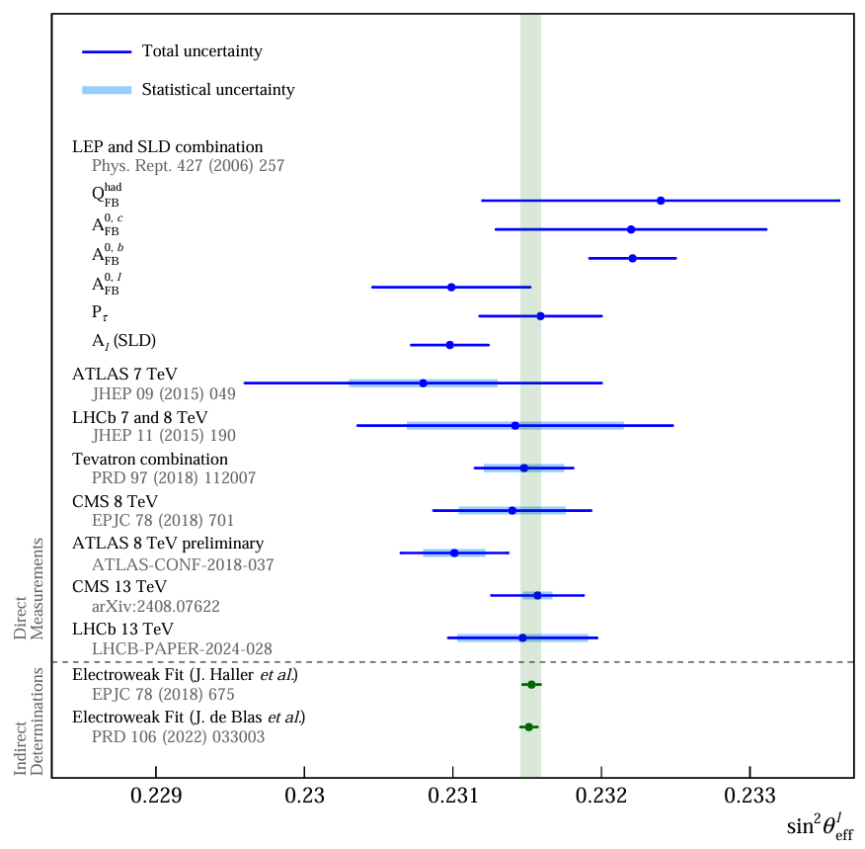
Results
Final result:
$$\sin^{2}{θ_{\text{eff}}^{\text{lept}}}=0.23152±{0.00044}_{stat}±{0.00005}_{syst}±{0.00022}_{theo}$$
Experimental uncertainty is much smaller than the statistical uncertainty
Consistent with previous measurements and indirect determinations from Global EW fit
Aim to improve statistical uncertainty with LHCb Upgrade I, which includes a fivefold increase in instantaneous luminosity
[JHEP12(2024)026]

Slide 24
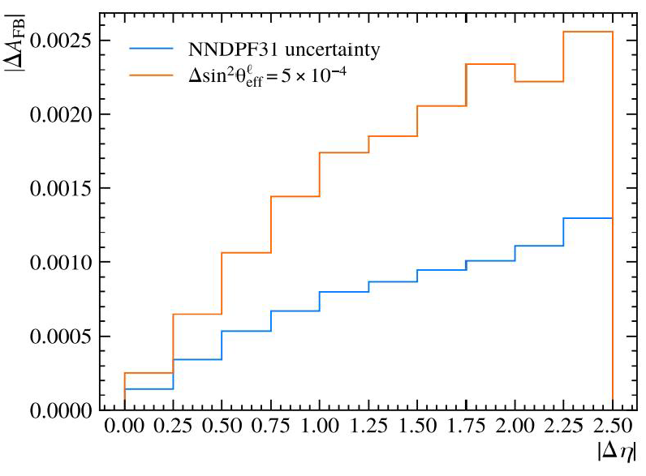
PDF uncertainty
PDF uncertainty is estimated by assessing variations given each PDF set replica
Use NNPDF31 PDF set as default
PDF uncertainty << statistical uncertainty because of the unique LHCb acceptance
Profiling was not used to reduce PDF uncertainty
Advantage LHCb offers so far is that by not profiling we are able to examine if the profiled results are robust
[JHEP12(2024)026]

Slide 25
Z boson mass

Slide 26
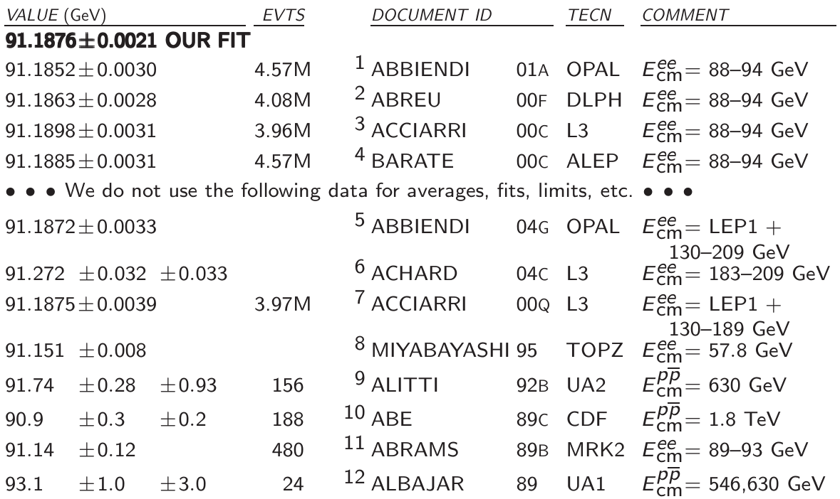
Intro
[PDG]
LEP experiments measured the Z boson mass with 2 MeV precision
With LHC, Z boson mass have been primarily in the context of calibrations for the W mass analyses
Can LHC collectively challenge LEP?

Slide 27
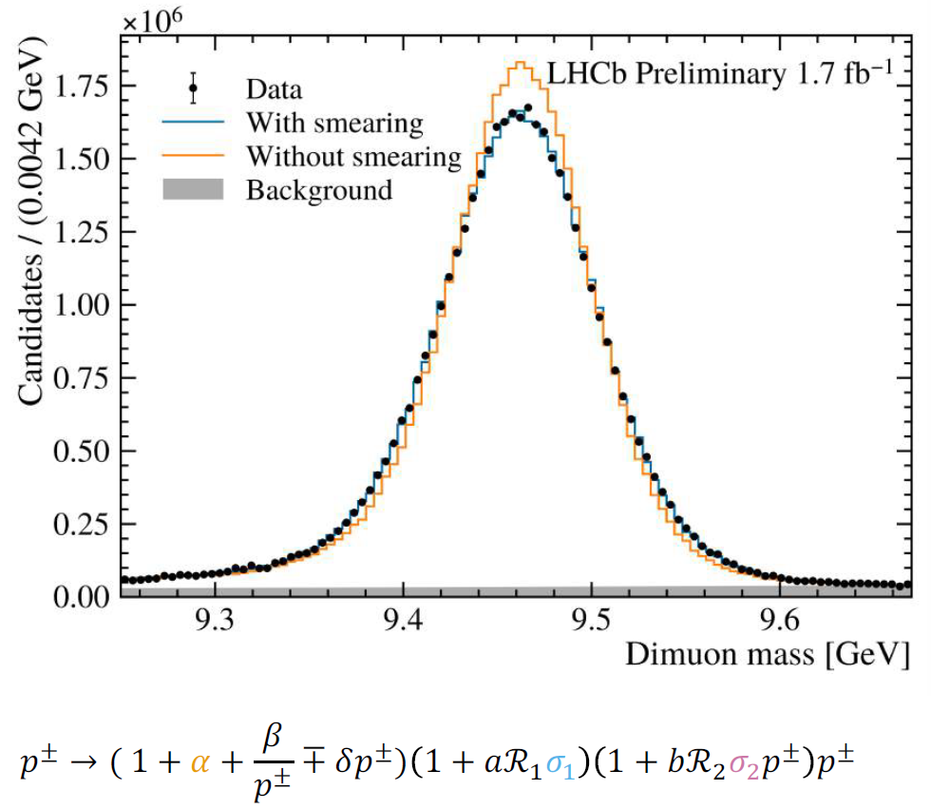
Analysis strategy
$Z→μμ$; 2016 data; 1.7 ${\text{fb}}^{−1}$ - feasibility study
Uses Weak Mixing analysis tools
Use $Υ\left(1S\right)→μμ$ for momentum calibration, $J/ψ→μμ$ as cross-check
Dimuon mass fit comparing full simulation with the data
Reweight the events to NLO accuracy
Uses POWHEG box with EW scheme: $G_{μ}, m_{W}, m_{Z}$
[LHCb-PAPER-2025-008]

Slide 28
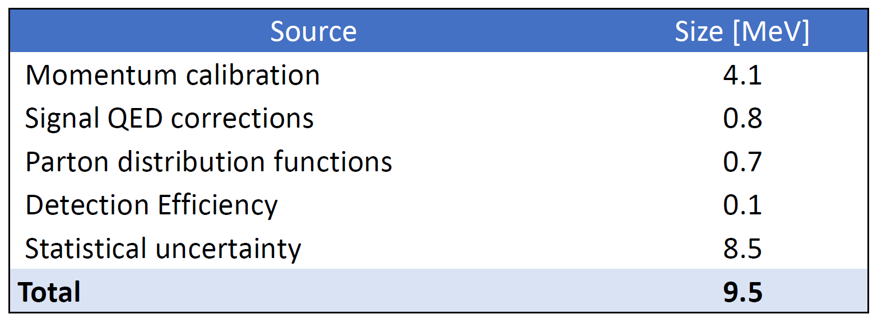
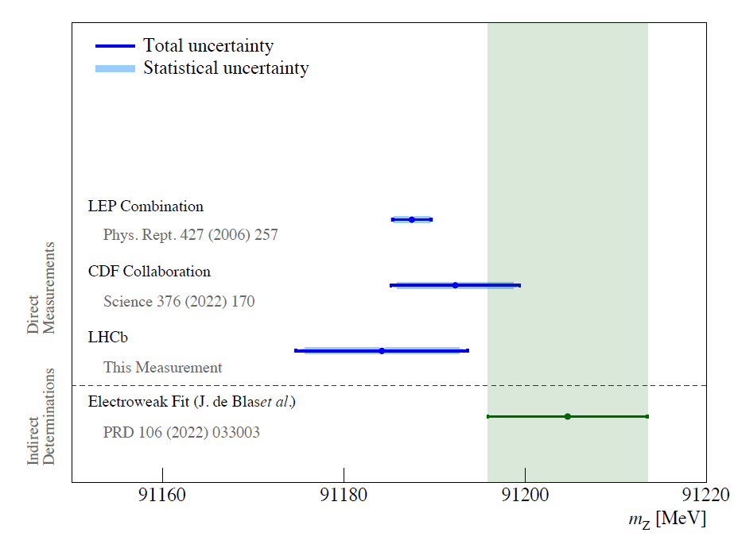
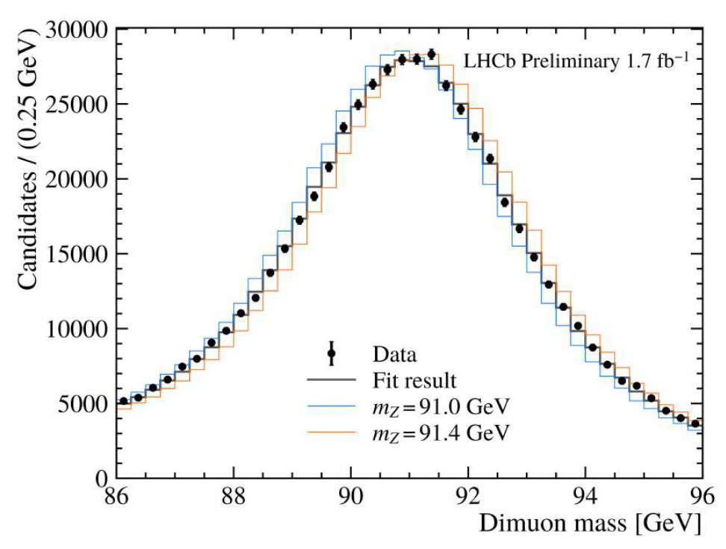
Results and status
LHCb-PAPER-2025-008 targeting Phys. Rev. Lett.
Latest CERN seminar talk
LHCb Preliminary
Reached EW fit precision!
$m_{Z}=91184.2±9.5$ MeV (8.5 MeV statistical)

Slide 29
Summary and prospects

Slide 30
Summary – Weak mixing angle
Experiment | $\sqrt{s}$ [TeV] | Luminosity [${\text{fb}}^{−1}$] | $$\sin^{2}{θ_{\text{eff}}^{\text{lept}}}$$ | Statistical uncertainty | Systematic uncertainty | Theory uncertainty (including PDF) | Total uncertainty
ATLAS | 8 | 20.2 | 0.23140 | 0.00021 | 0.00016 | 0.00024 | 0.00036
CMS | 13 | 138 | 0.23157 | 0.00010 | 0.00015 | 0.00028 | 0.00031
LHCb | 13 | 5.3 | 0.23152 | 0.00044 | 0.00005 | 0.00022 | 0.00049
Experiment | Strategy | Pseudorapidity region | Default PDF set | PDF profiling
ATLAS | $$A_{4}$$ | $η<3.6$ | MMHT14 | Yes
CMS | $$A_{FB} (+unfolded A_{4})$$ | $η<3.4$ | CT18Z | Yes
LHCb | $$A_{FB}$$ | $$η<4.5$$ | NNPDF31 | No
suffers from statistics
and suffer from PDFs

Slide 31
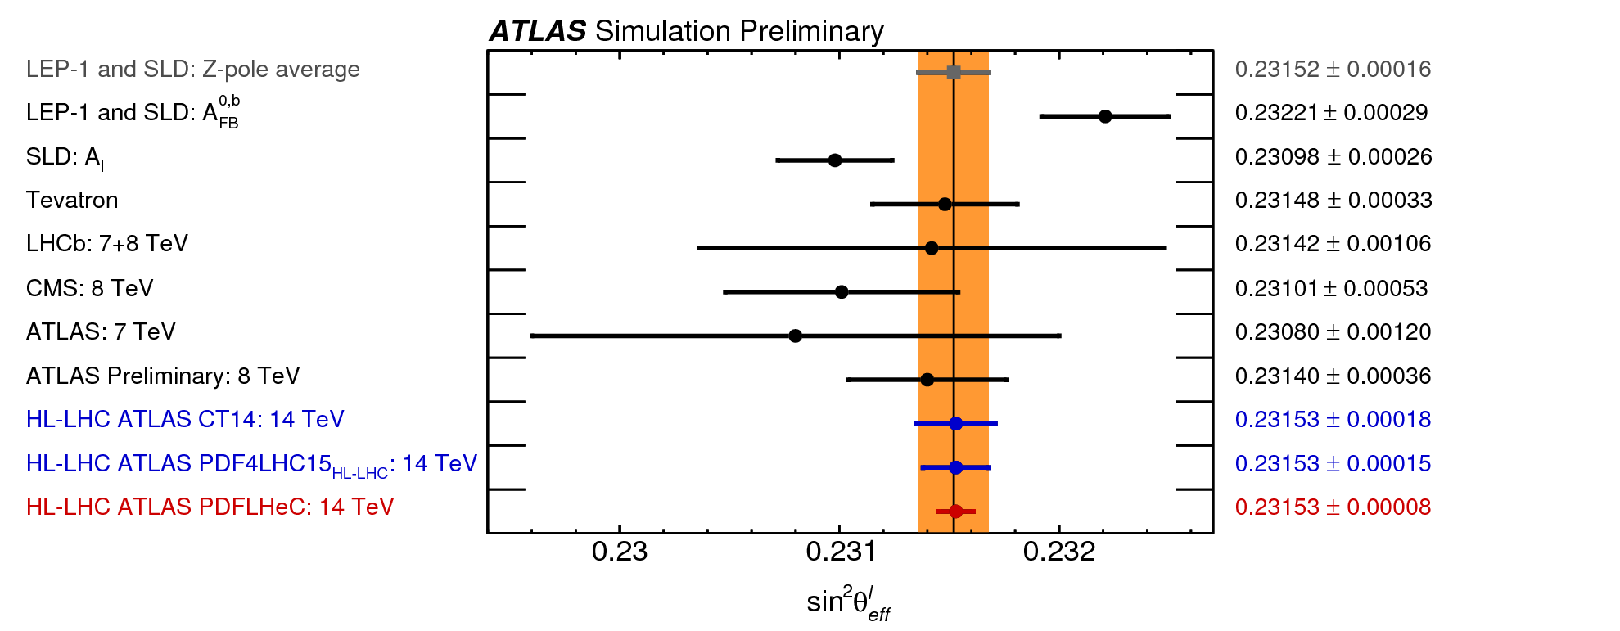
Summary and prospects
Run 2 @ $\sqrt{s}=$13 TeV measurements from CMS and LHCb – still waiting for ATLAS
Precision and accuracy of measurement limited by PDFs
Already looking forward to Run 3 results
Aim to beat LEP/SLD ($26−29 ×{10}^{−5}$)
$m_{Z}$ with LHCb full Run 2 data → ~5 MeV precision
LHC average could challenge LEP soon!
[JHEP12(2024)026]
[arXiv:1902.04070]

Slide 32
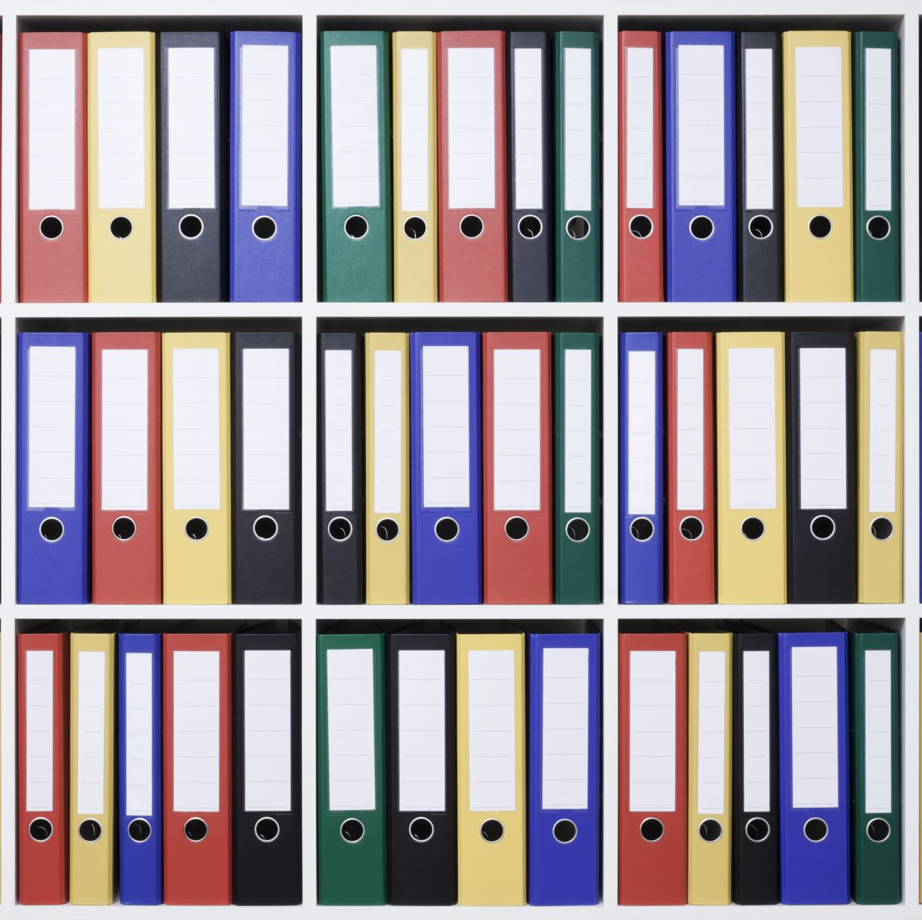
Backup Slides

Slide 33
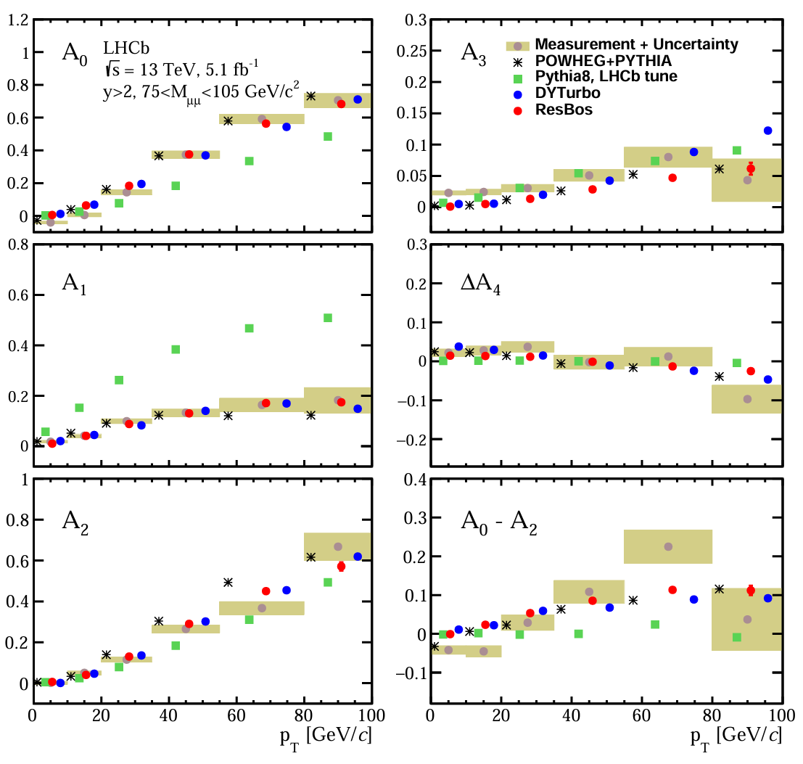
Angular coefficients - LHCb

Slide 34
PDF profiling
Compare experimental data to PDF predictions to find best matches
Reweight or rescale PDF replicas based on their agreement with the data to create a profiled PDF set that reflects the new constraints
Use the profiled PDFs to reduce uncertainties
Hessian sets quantify PDF uncertainties, showing error bands and variations in the PDFs

