Slide 1




The View from 2050
Sinéad M. Farrington (STFC PPD and Edinburgh)

Slide 2
Some Key measurements 2025-2050

Slide 3
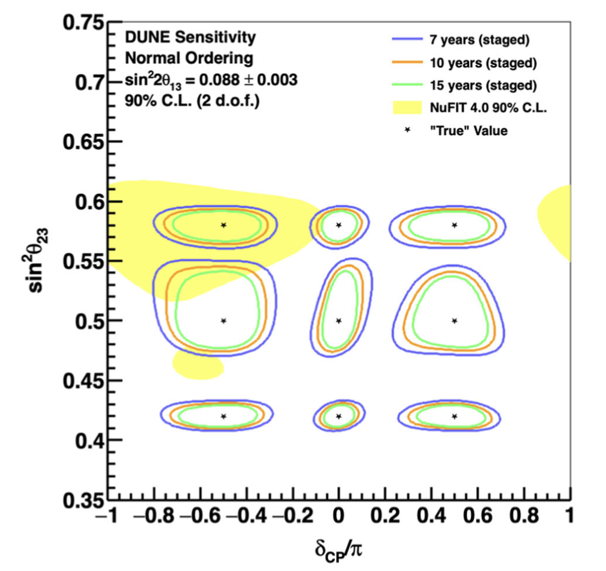
Neutrino Oscillations
Neutrino nucleus interactions become key uncertainty
  IPPP theorists!
  If no surprises then ask
    why three flavours,
    why the mixings are
    the way they are,
    why three generations

Slide 4
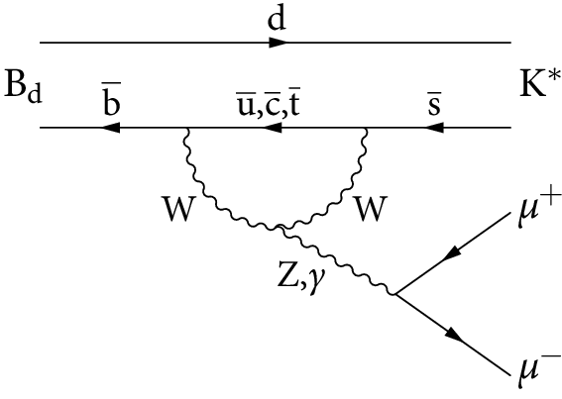
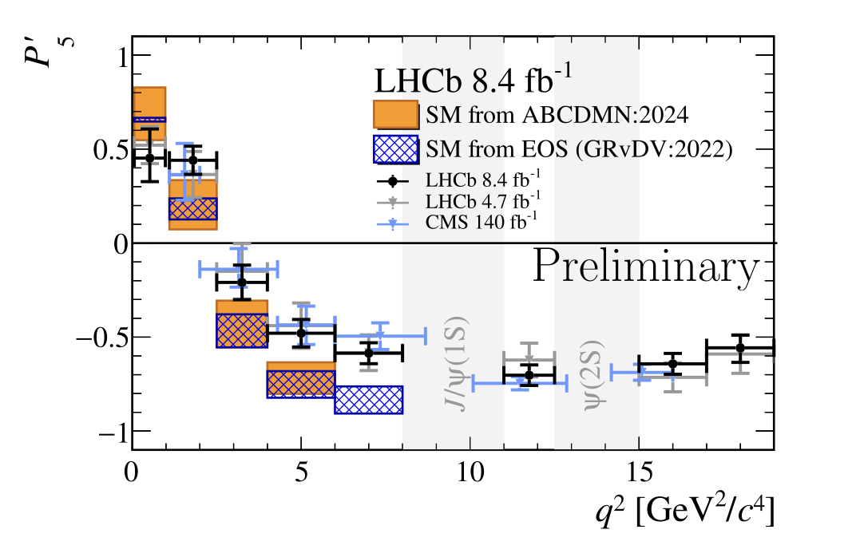
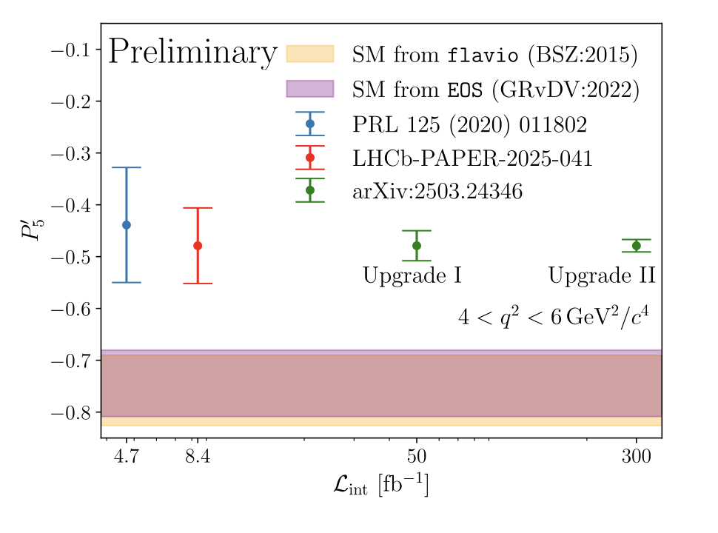
Flavour Anomalies
Requires understanding of charm loop contributions
  Answers to be found at IPPP…
  Future holds more precision experimentally: demands more theoretically

Slide 5
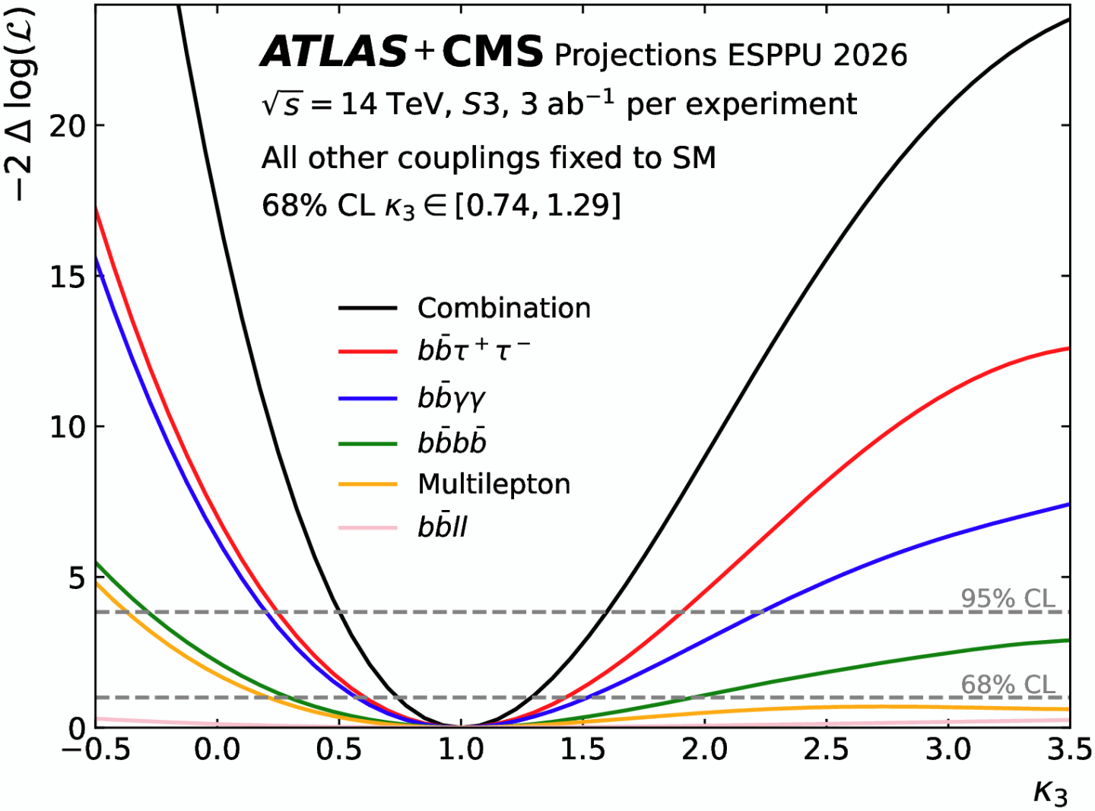
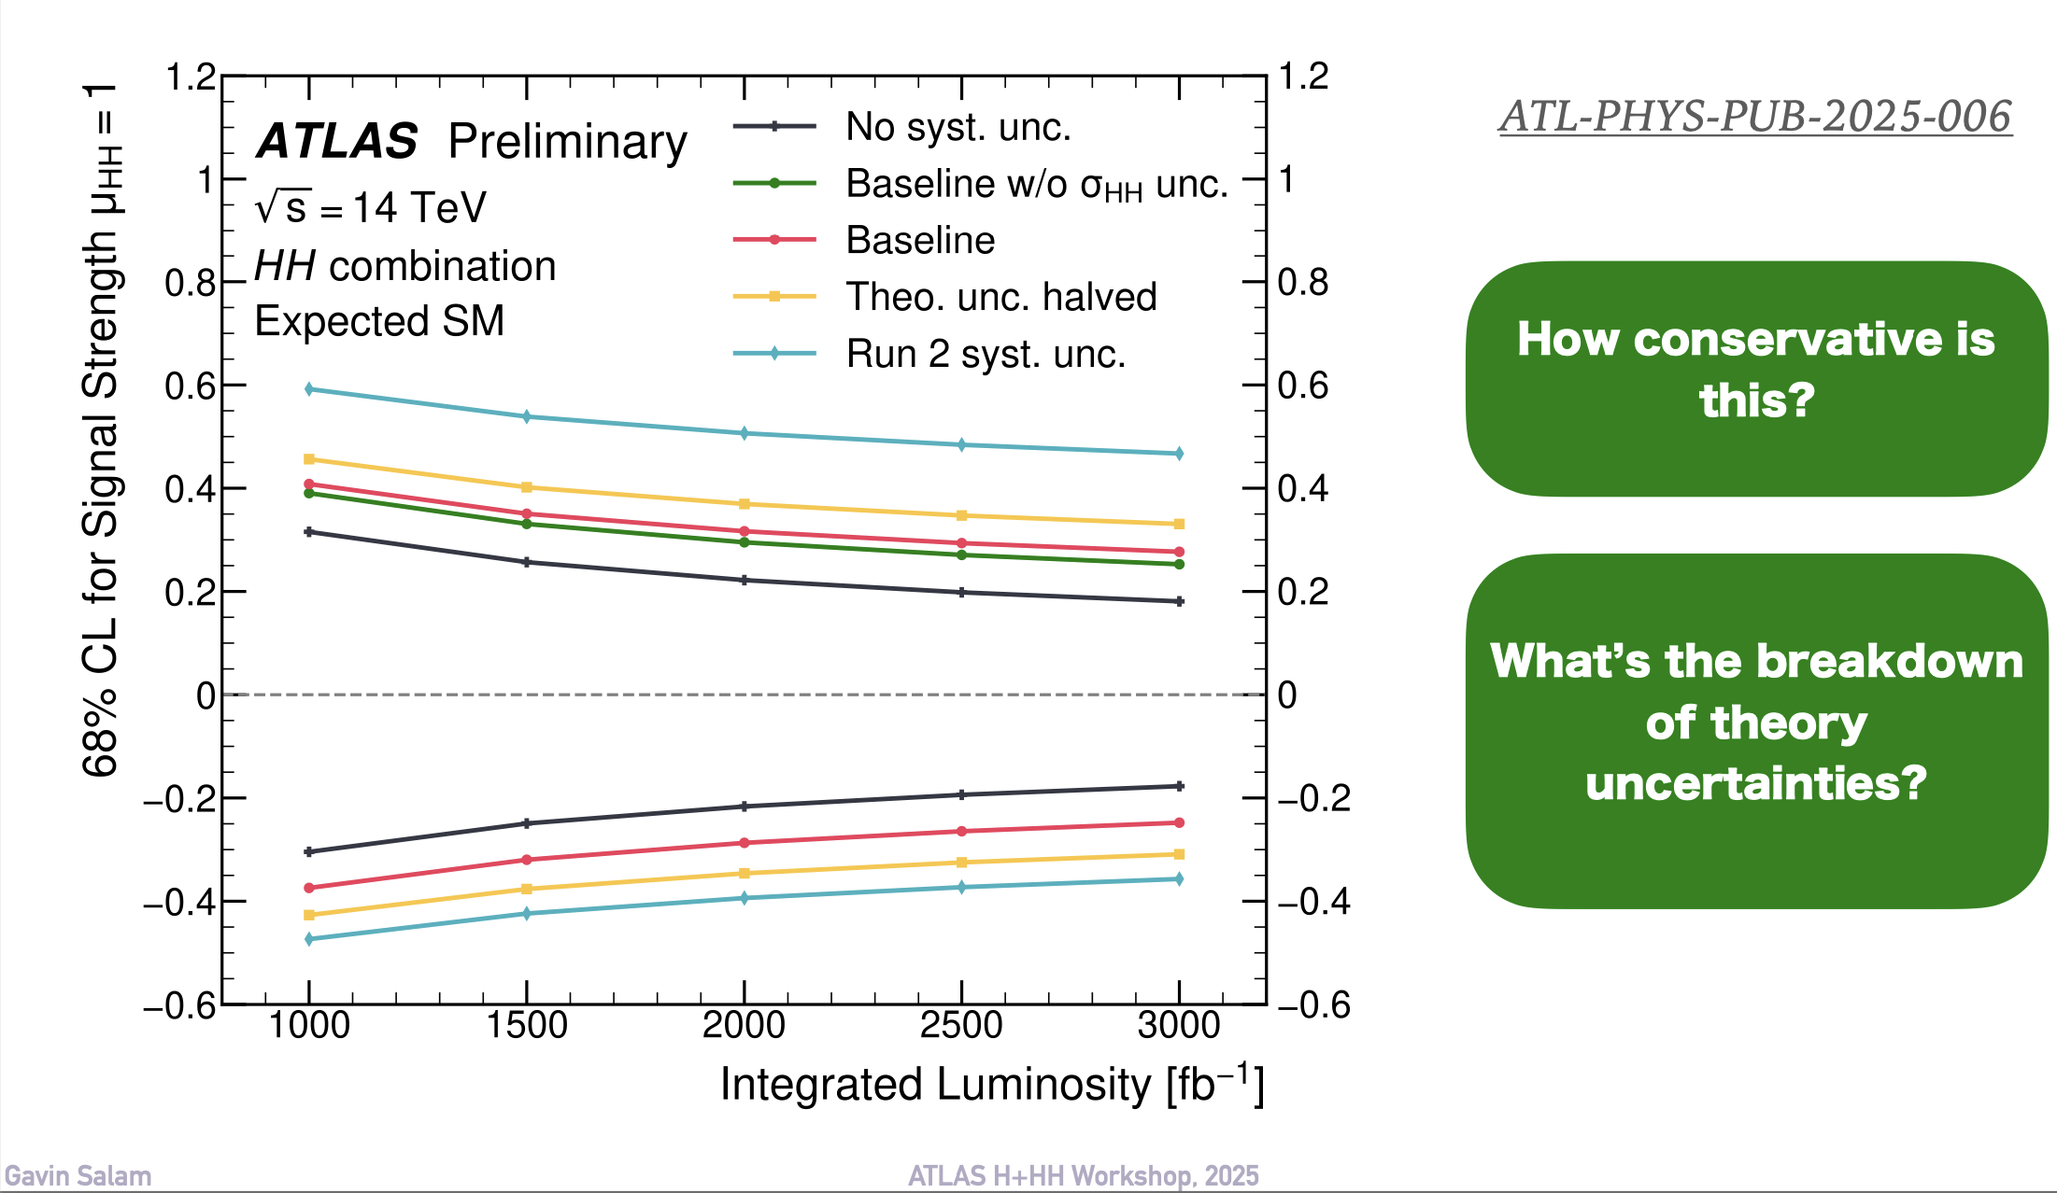
Higgs Sector: di-Higgs
IPPP can unlock the precision
  Calculations++
  Monte Carlo simulation codes
  Parton showers…
  And ultimately legacy data management too

Slide 6
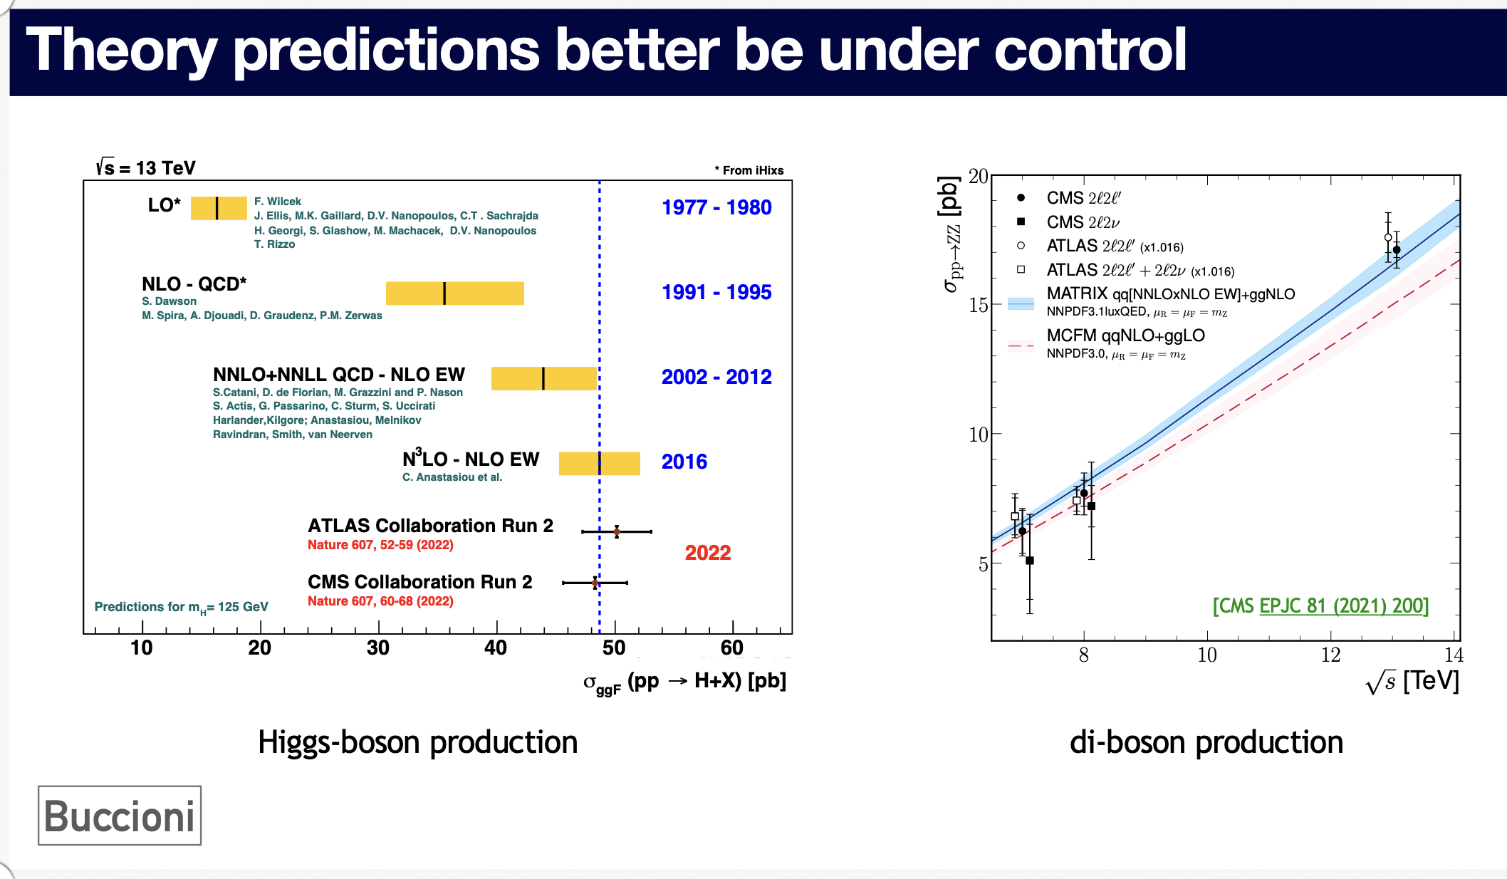
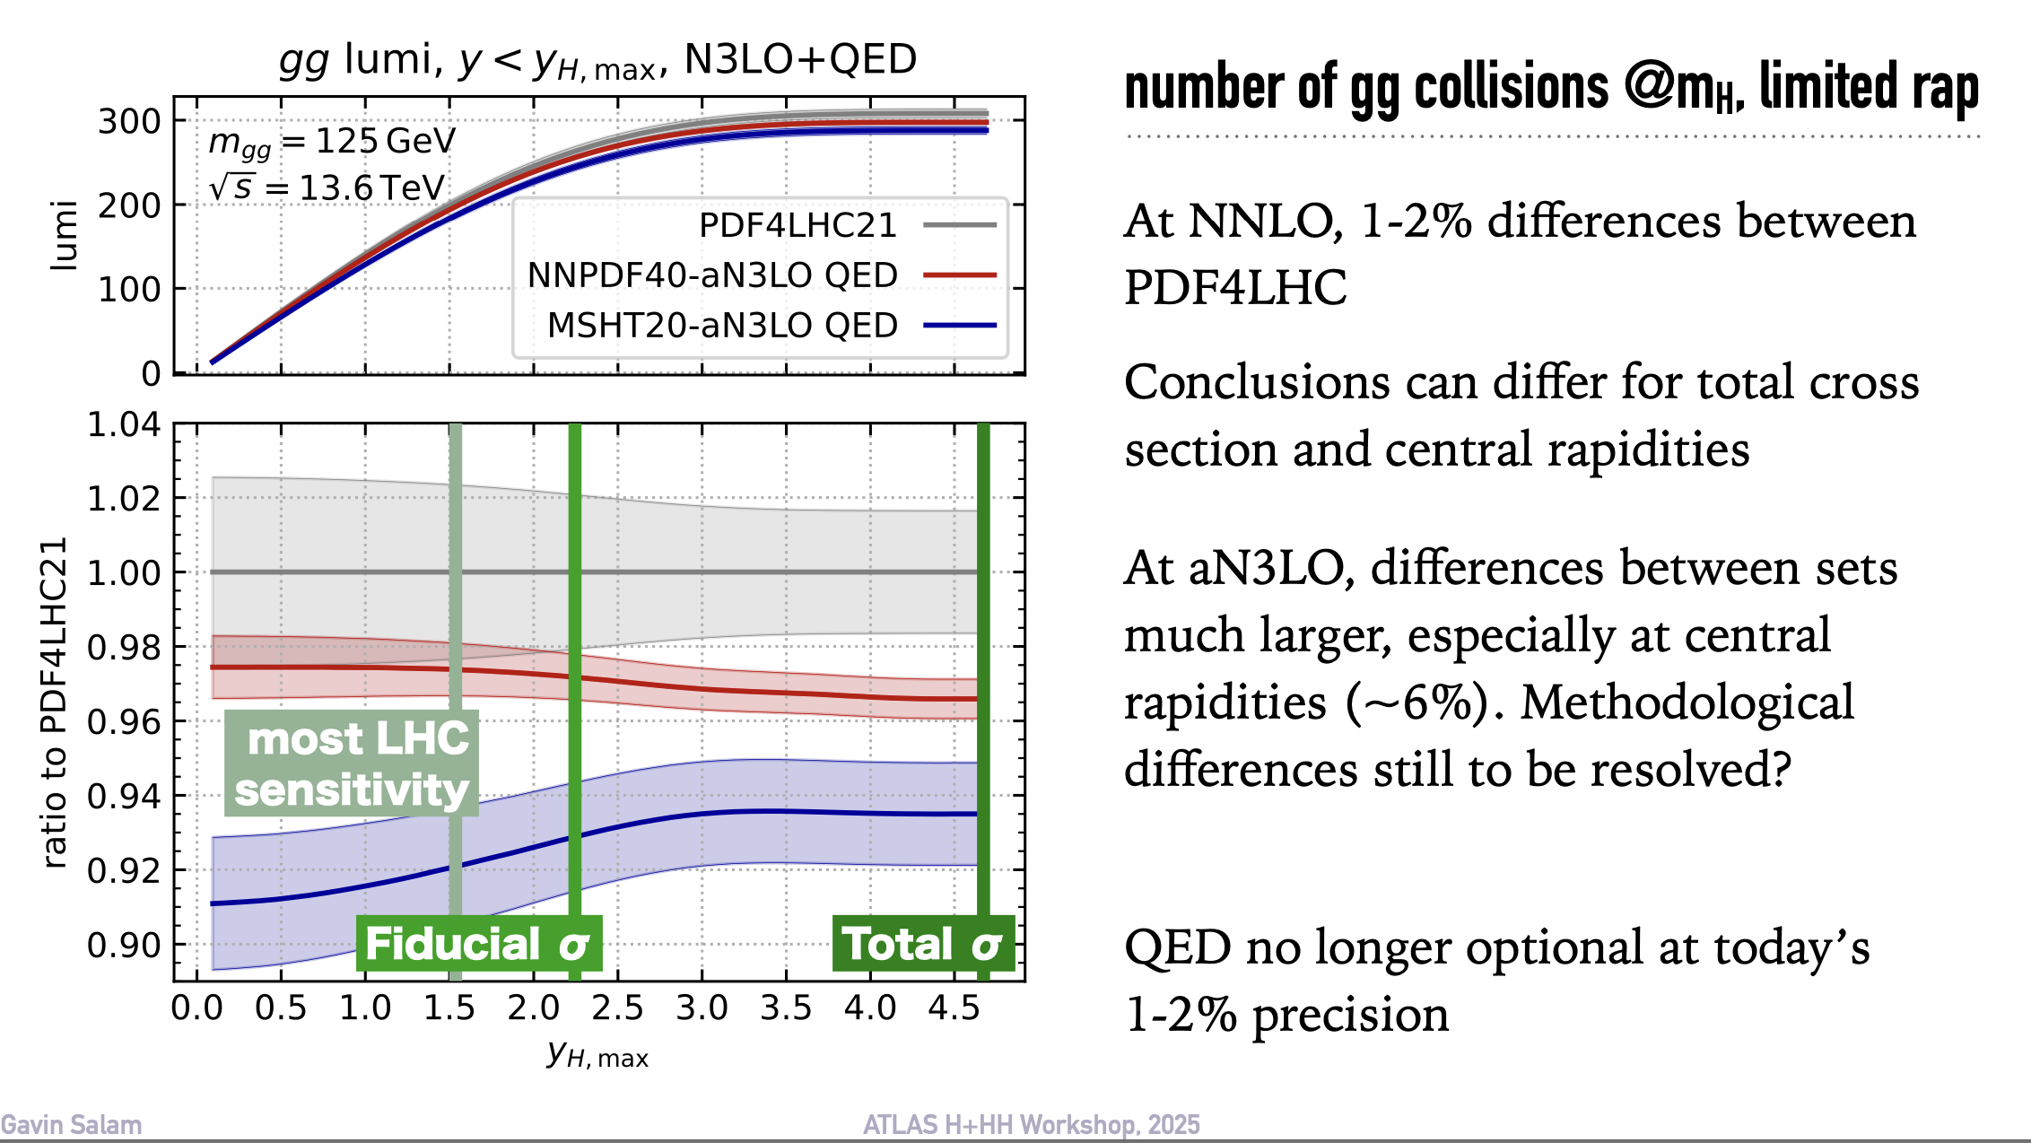
Higgs Sector

Slide 7
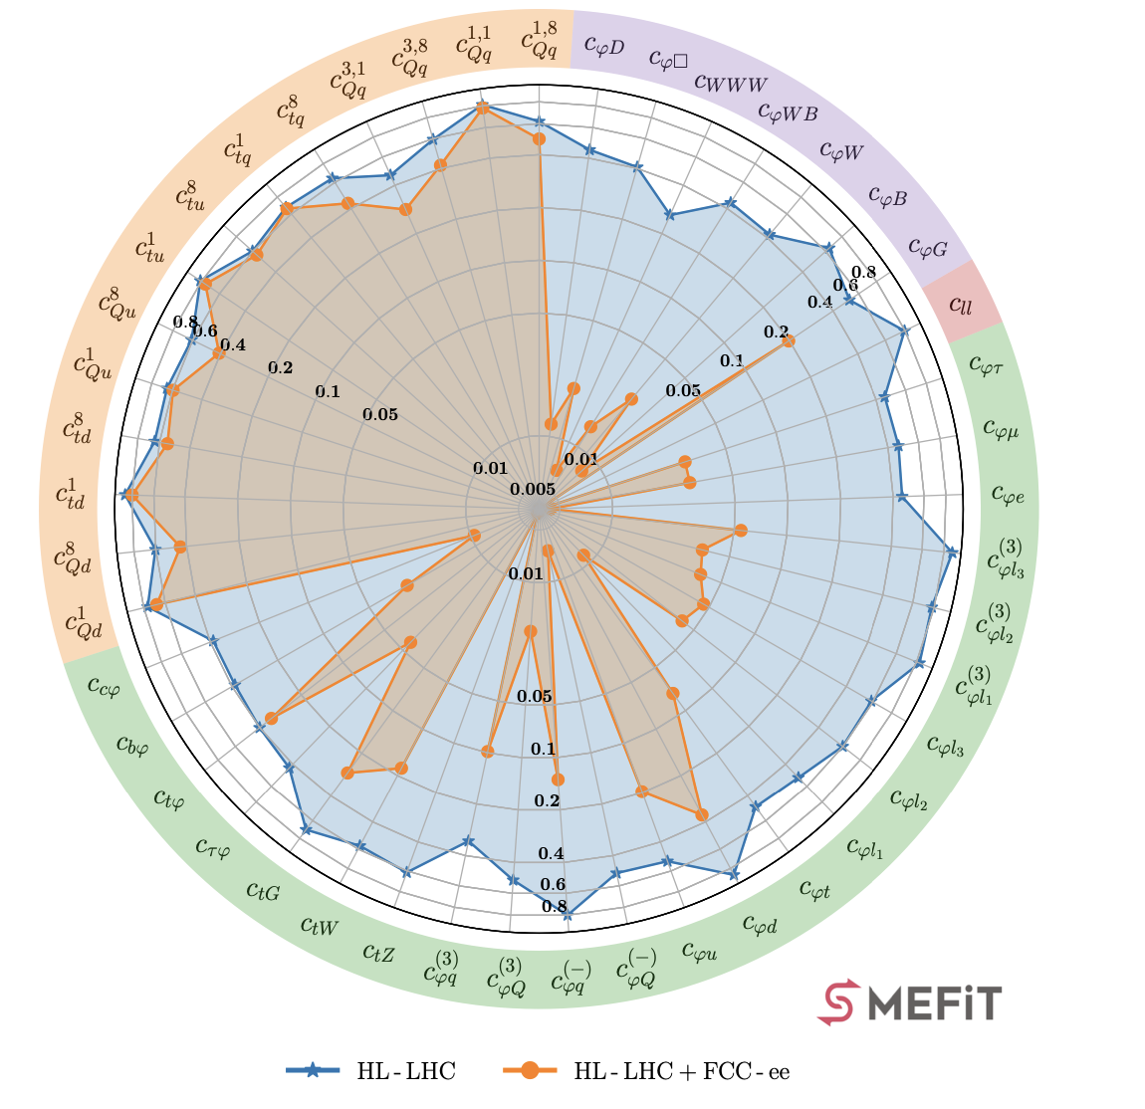
Finding new physics
Inspiration and perspiration
  Where to look – model building
  And how to interpret
  (And how to record for interpretation:HEPData)
  Measurement = search

Slide 8
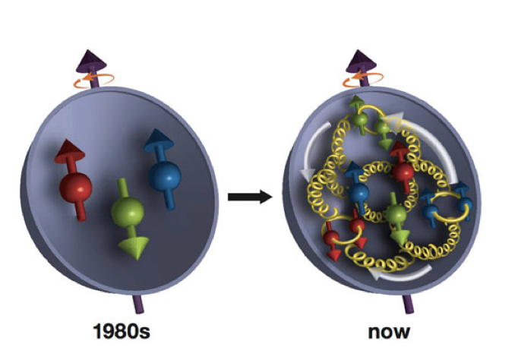
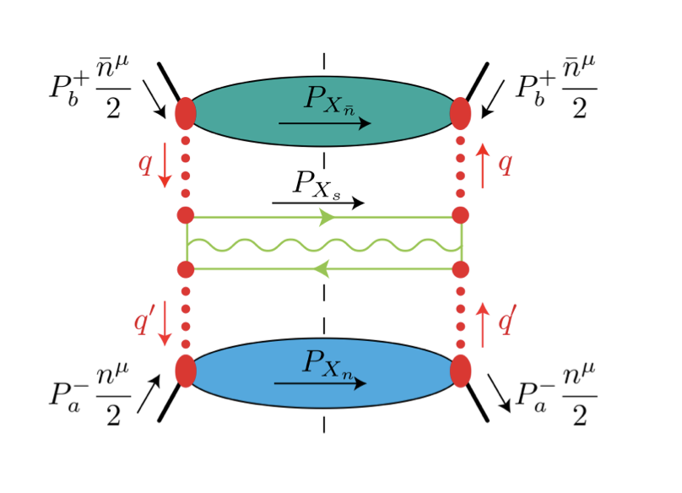
Nuclear Physics
Proton structure at EIC
QCD factorisation

Slide 9
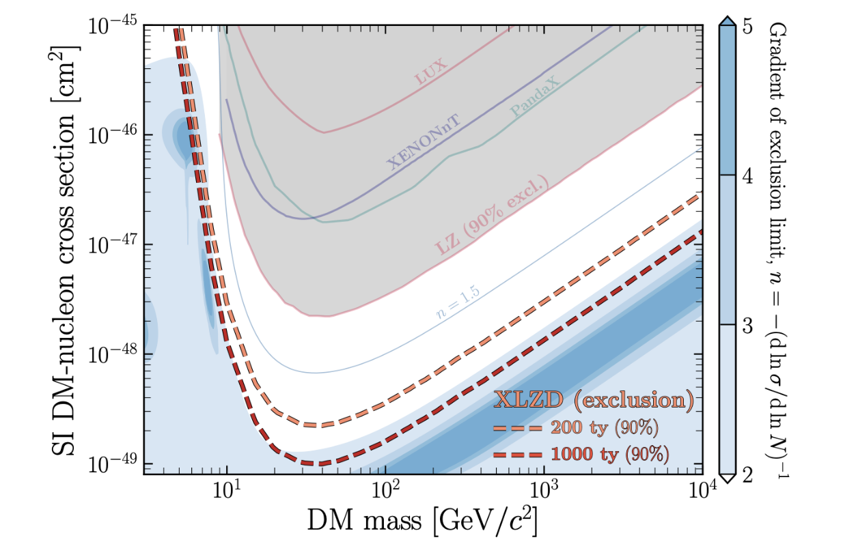
Dark Matter detection in the North East??
Nuclear recoil understanding also here at IPPP
  And if we rule out this phase space of WIMP DM then what next?: theory inspiration in the vast search space?

Slide 10
New Directions

Slide 11
Explaining the inexplicable
One of several worlds? (or none of these…)
Effective Field Theory (or alternative) and look for subtle hints (or less subtle)
Or one stand out thing?
Or many??
Or NO deviations
Whatever the scenario, IPPP is a trusted place to make sense of it all
A national centre for phenomenology

Slide 12
Quantum computing applications?
Parton showers
Anomaly detection
Hybrid approaches? Classical + quantum where there is an advantage
  Questions on simulation at scale – IPPP to drive this?
(Join up IPPP with NQCC, … also at Boulby?)
Find dark matter in qubits? (north east again?)

Slide 13
Old and new…
What to find at the boundaries...
  Cosmology
  Quantum
  Nuclear
  Collider/non-collider
    in preparing for a new collider we may yet face many choices – theorists should be a strong part of this
    An ee collider gives an opportunity to understand parton showers arguably the least well understood regime of QCD
    Or in Europe may we go straight to more hadrons depending on world events?

Slide 14
Reasons for Optimism
A look back to 2003…
A convening voice
Place for ideas

Slide 15
Reasons for Optimism
A look back to 2003…
A convening voice
Place for ideas
A national asset
Thanks to A. Buckley, J. Butterworth, C. Hays,
J. Monroe, N. Tuning, A. Pilkington, A. Robson, C. Shepherd- Themistocleous, A. Szlec, D. van Dyk for perspectives

