Slide 1
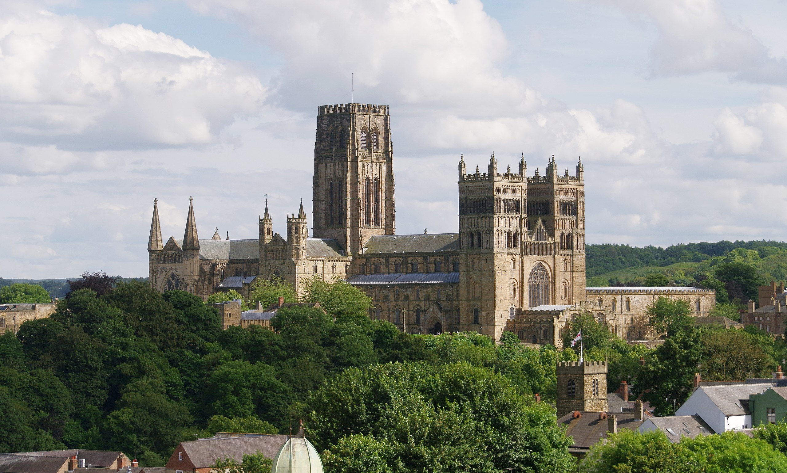
Echoes of Durham:
Particles, People and Principles
Adnan Bashir
University of Huelva

Slide 2
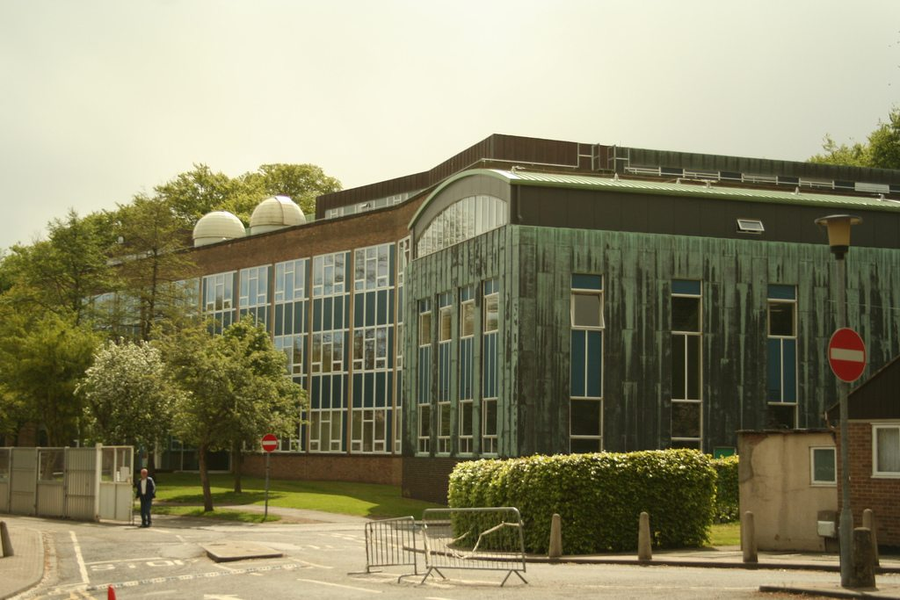
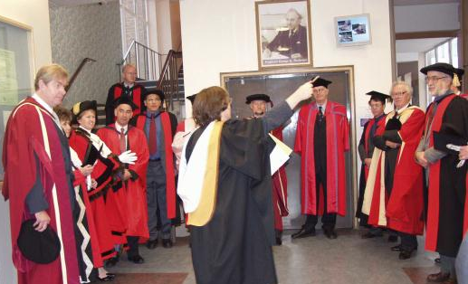
Particles: Where my journey began…
The Physics Building
The Entrance

Slide 3
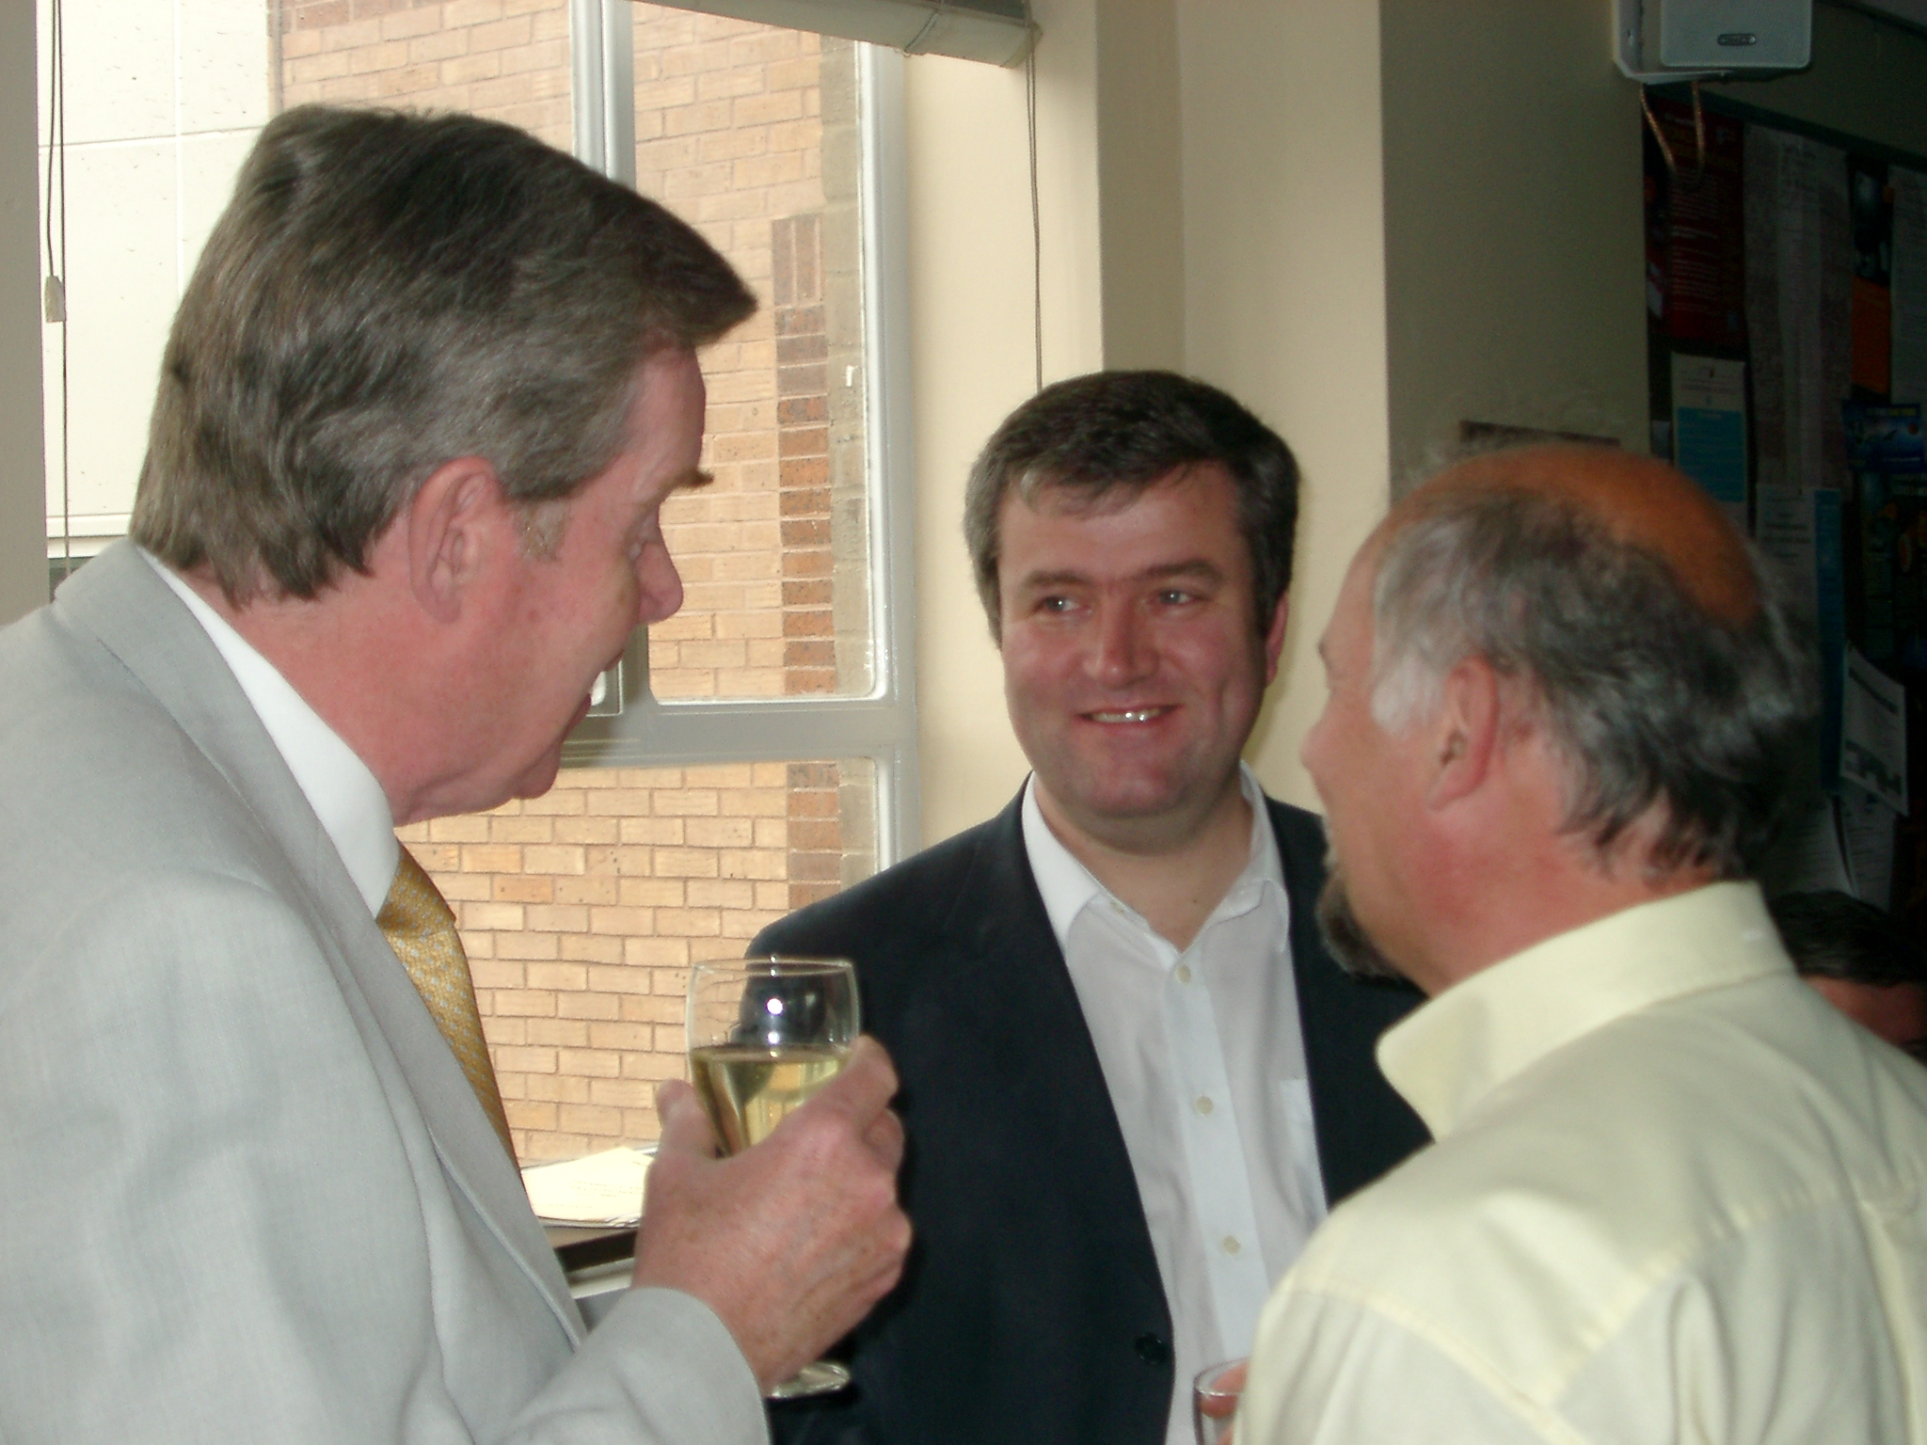
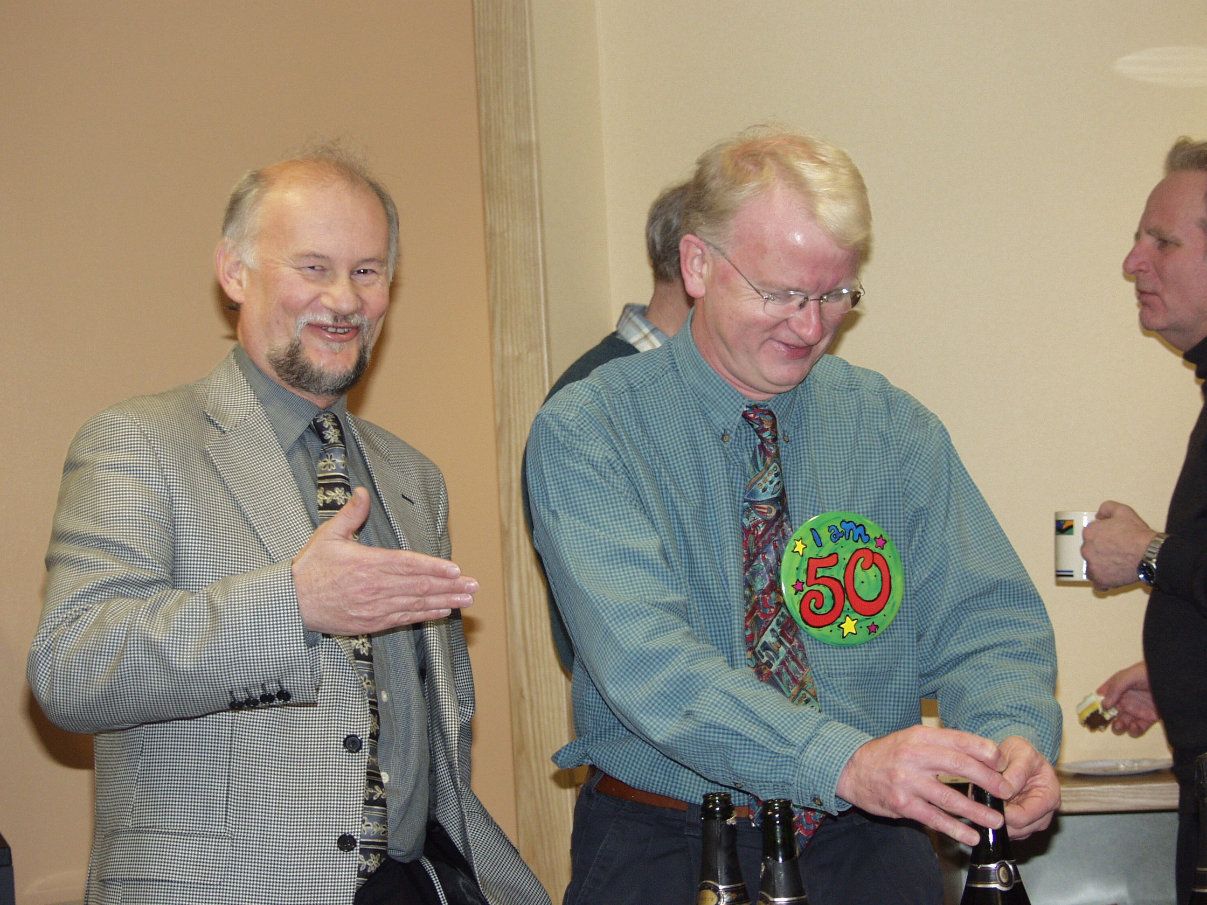
The artists of scientific thinking…
Alan Martin, Mike Pennington and Nigel Glover
Mike Pennington and James Stirling

Slide 4
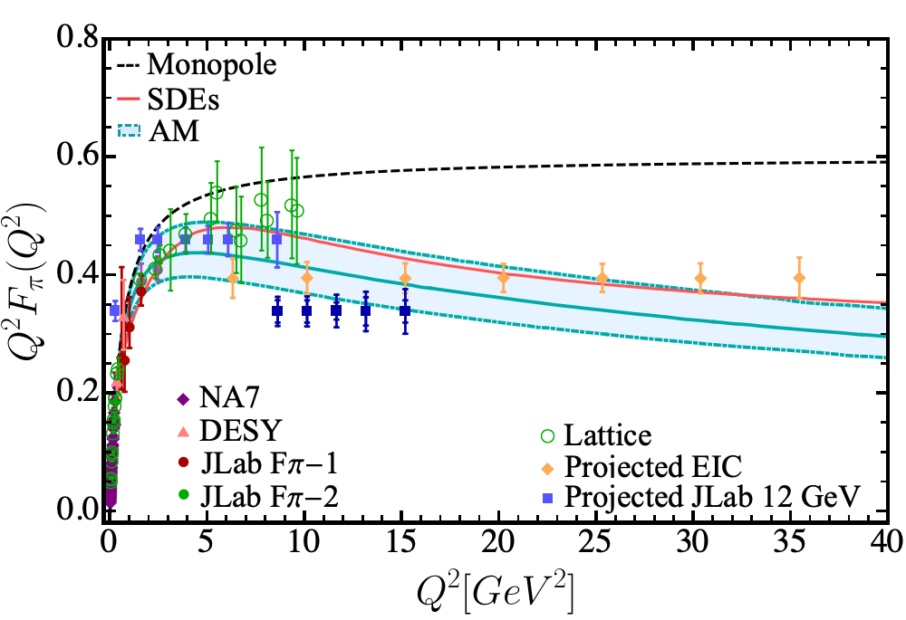
A seed planted in Durham…
Probing the internal structure of the lightest hadron, i.e., the pion by computing its electromagnetic form factor:
Experimentally measured at:
1) The Jefferson Lab
2) Electron-Ion Collider
I. M. Higuera, R. J. Hernández, K. Raya, AB, Phys. Rev. D 110, 034013, (2024)

Slide 5
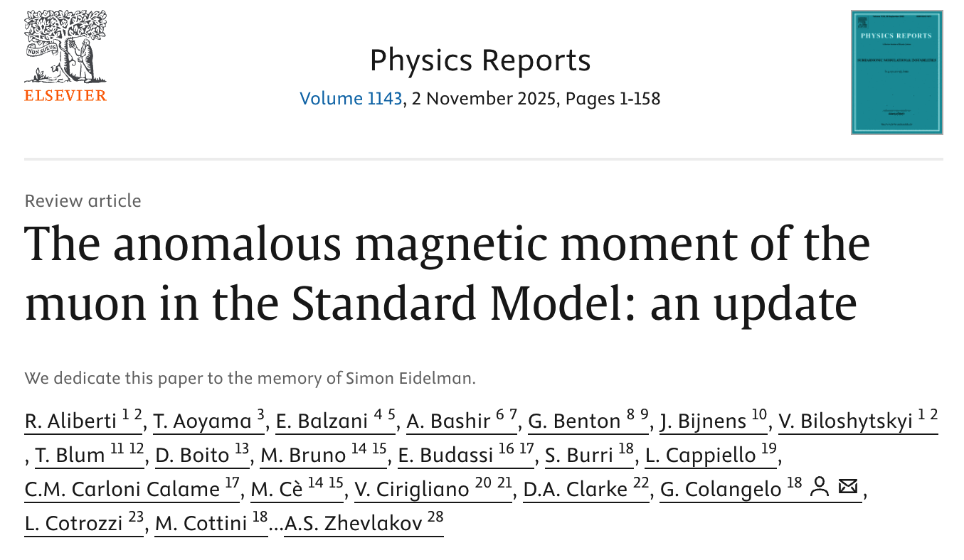
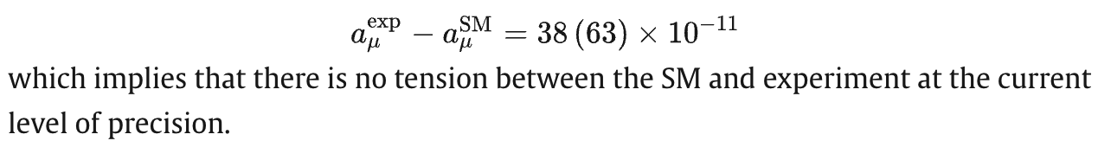
From foundations to frontiers…

Slide 6
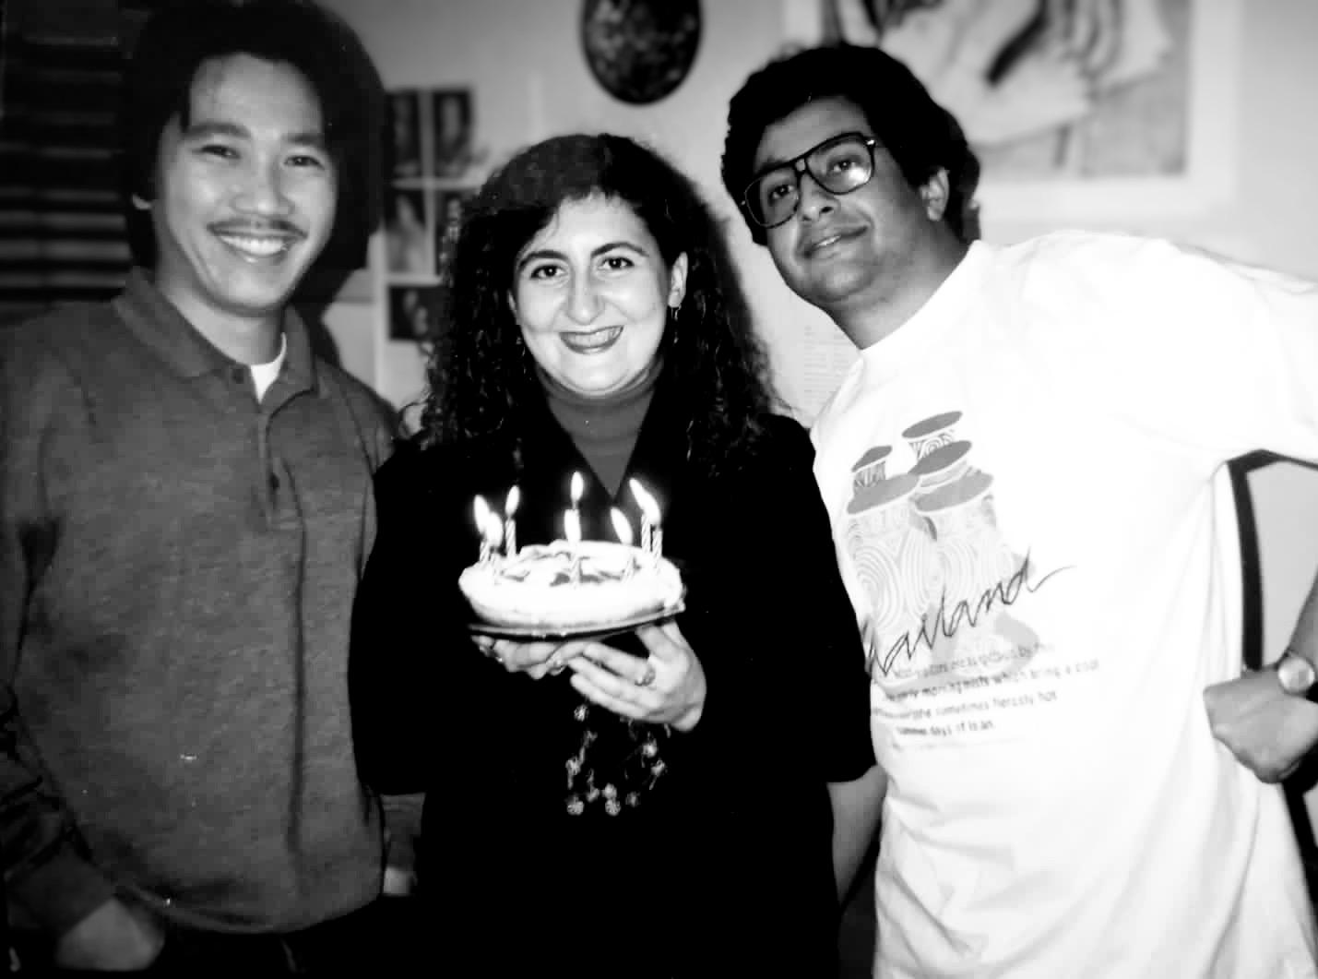
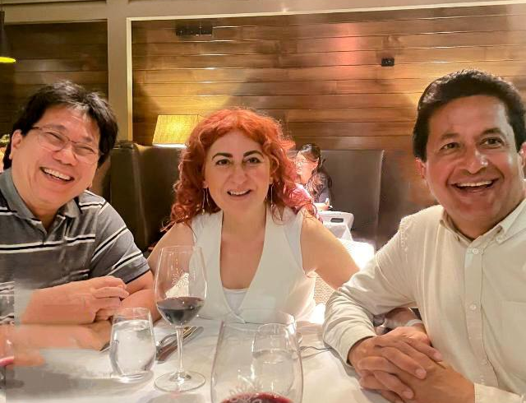
People: Camaraderie among students…
Alexander Iskandar, Ayse Kizilersu and Adnan Bashir – Durham 1993
Alexander Iskandar, Ayse Kizilersu and Adnan Bashir – Cairns 2024

Slide 7
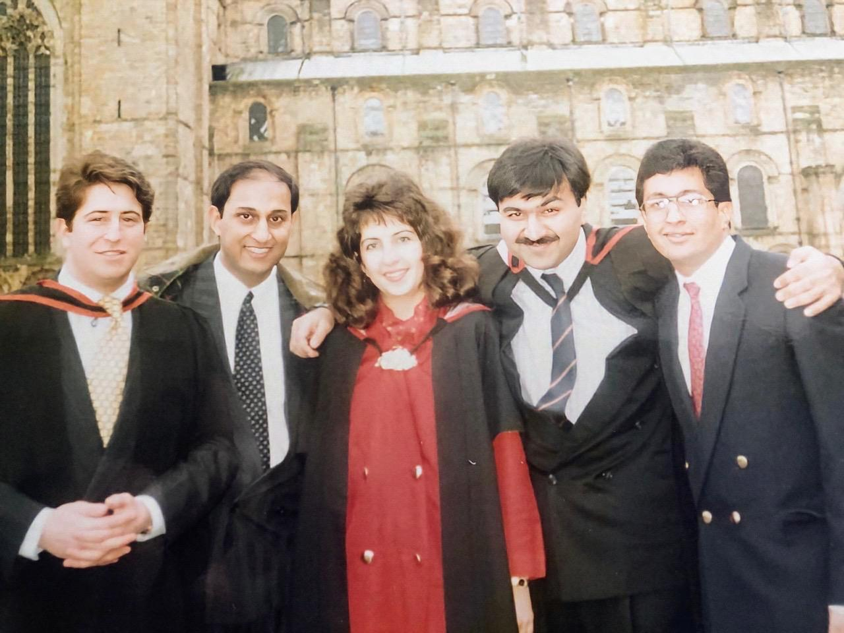
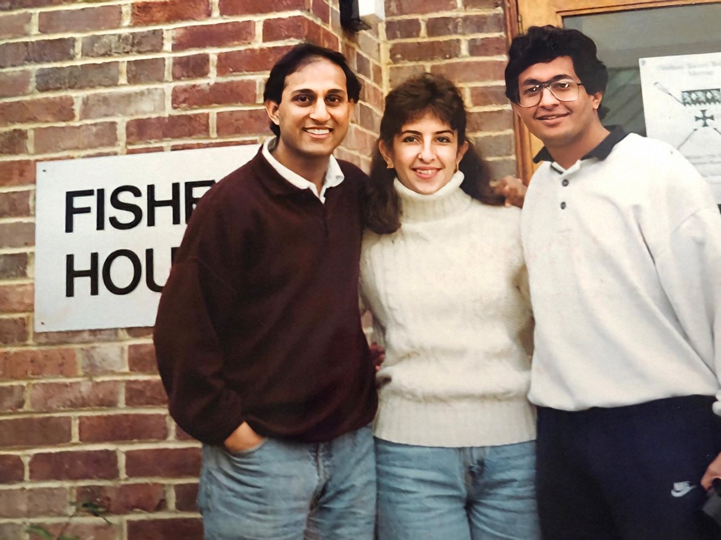
Different faiths, shared journeys…
Irtiza Hasnain, Marlene Lopez and Adnan Bashir – Durham 1993
Durham 1994

Slide 8
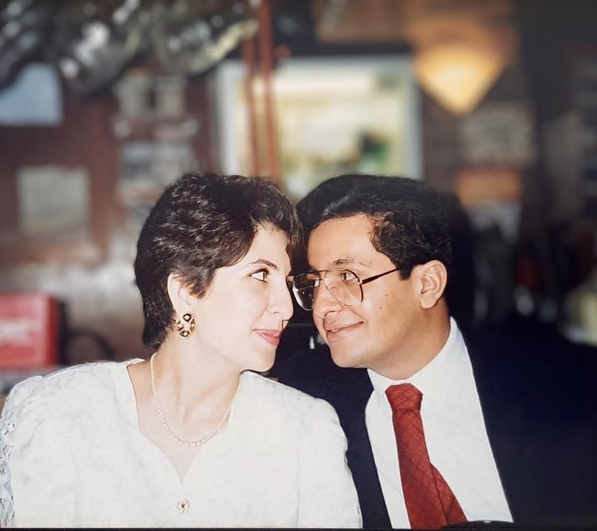
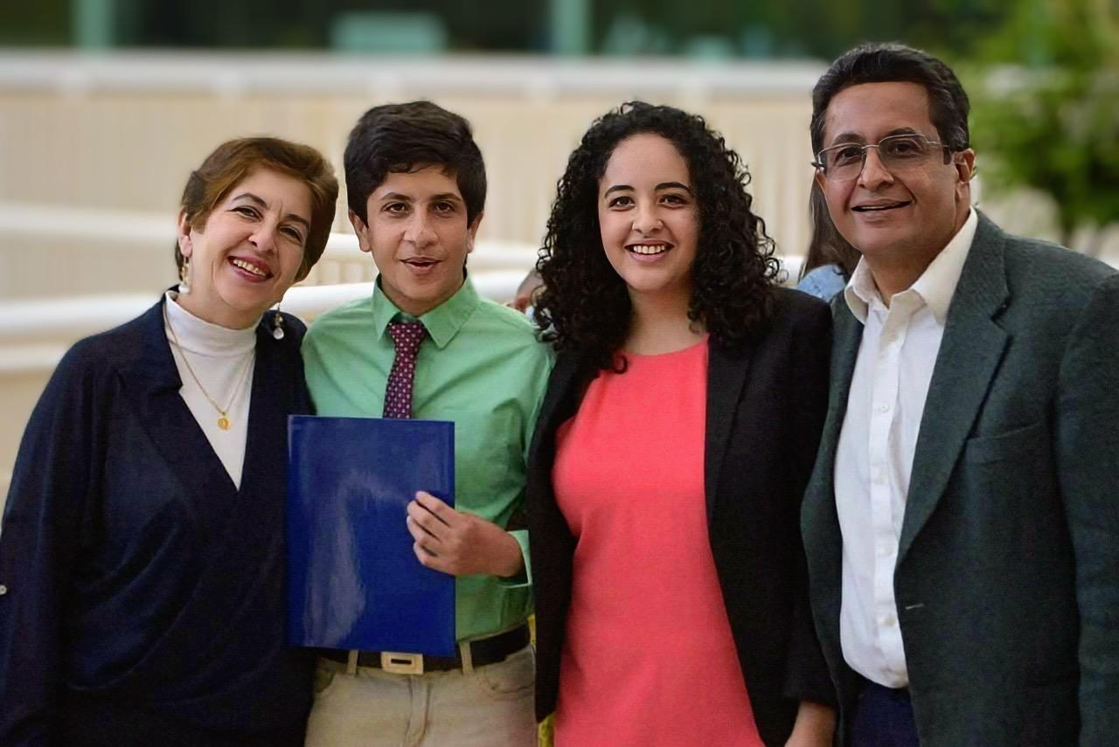
Love and family…
Marlene, Bennett, Asha and Adnan– Morelia 2019

Slide 9
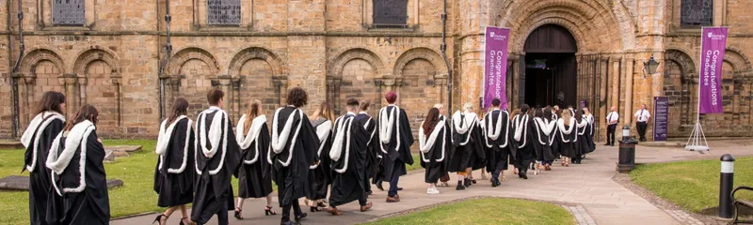
Principles: Values that define IPPP…
Sir Peter Ustinov delivered a memorable address at the graduation ceremony in 1994. He said:
“I don’t expect Durham graduates to love each other, because love is a feeling which comes and goes of its own accord. But I do expect them to respect others always, because respect is an attitude we can all choose to develop.”
These are also the values the IPPP has stood for: not only through its scientific achievements, but through the openness, collaboration, and humanity that continue to define it today.

Slide 10
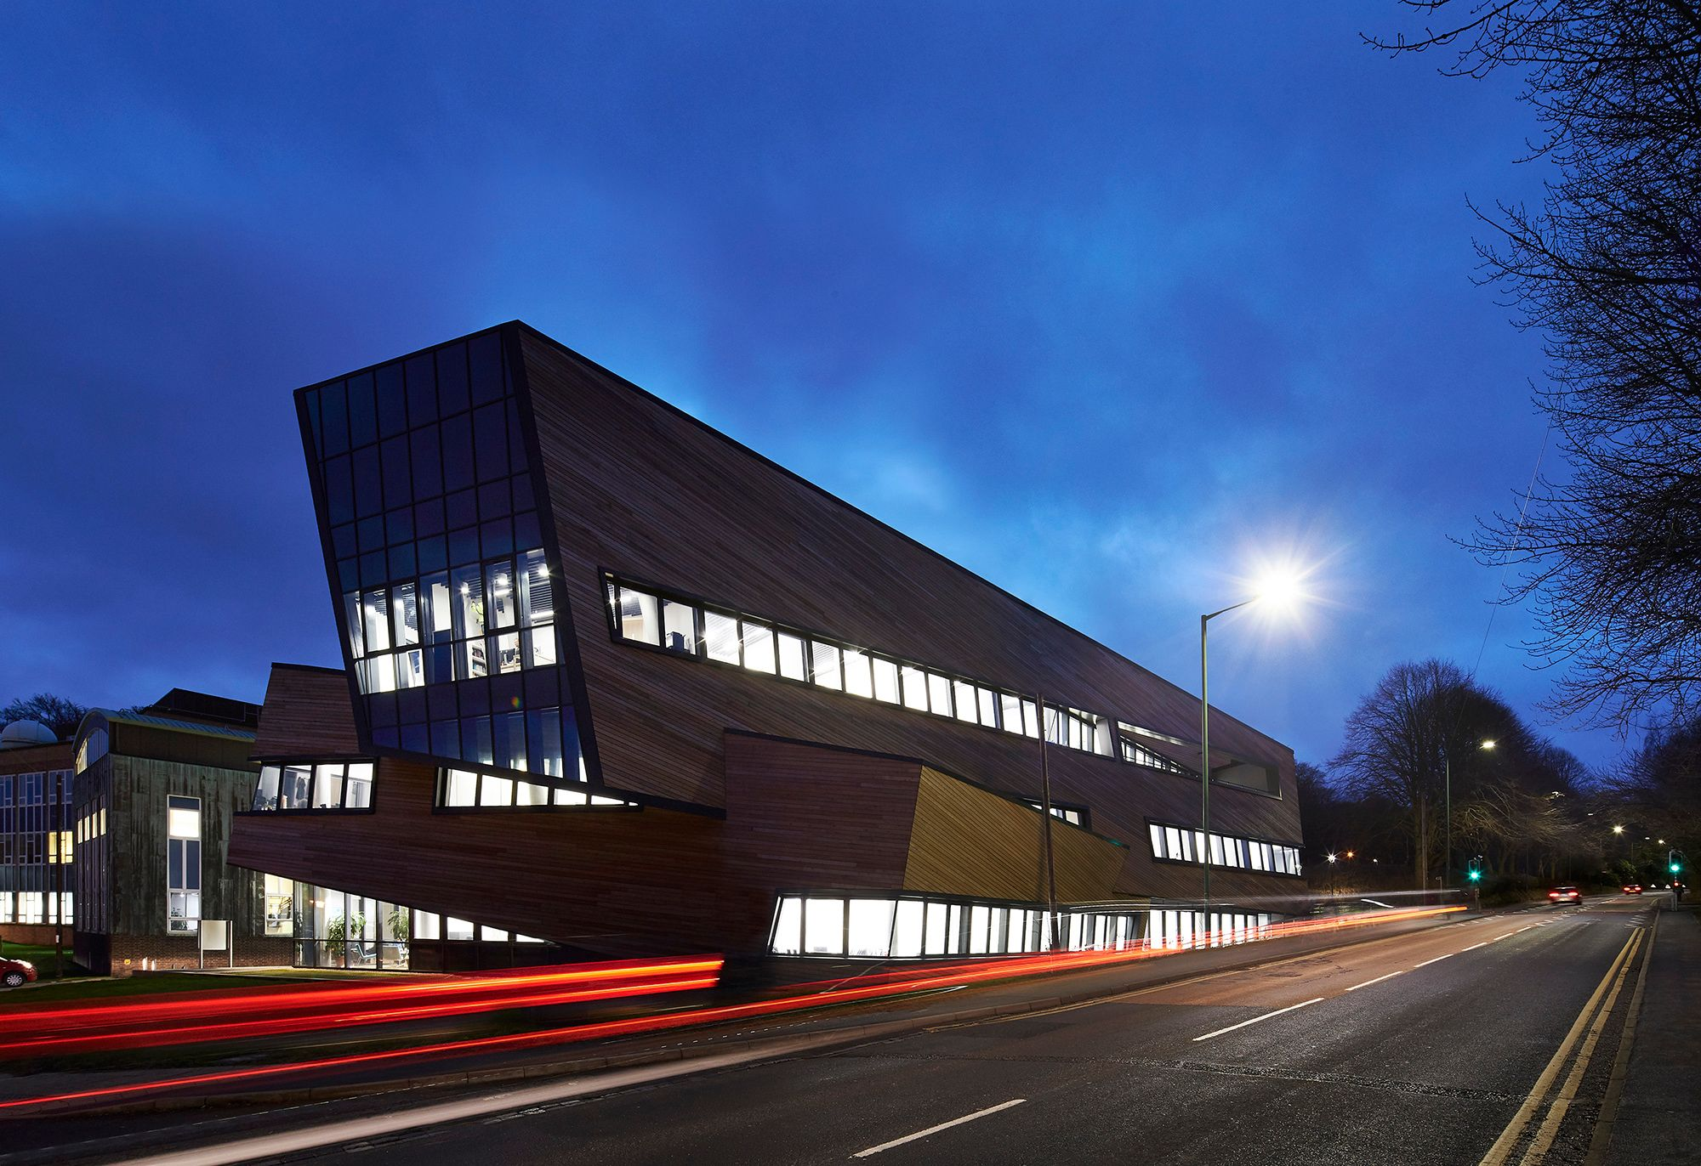

¡Enhorabuena!
Happy 25th Anniversary
Institute of Particle Physics Phenomenology

