Slide 1

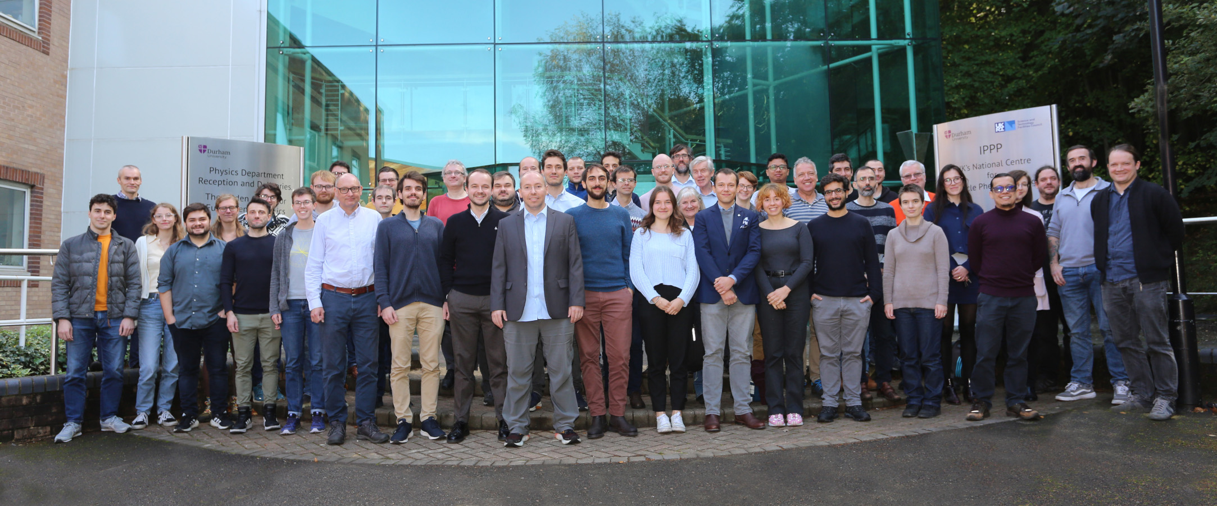

Ideas, People and Precision Phenomena
Tony Doyle

Slide 2
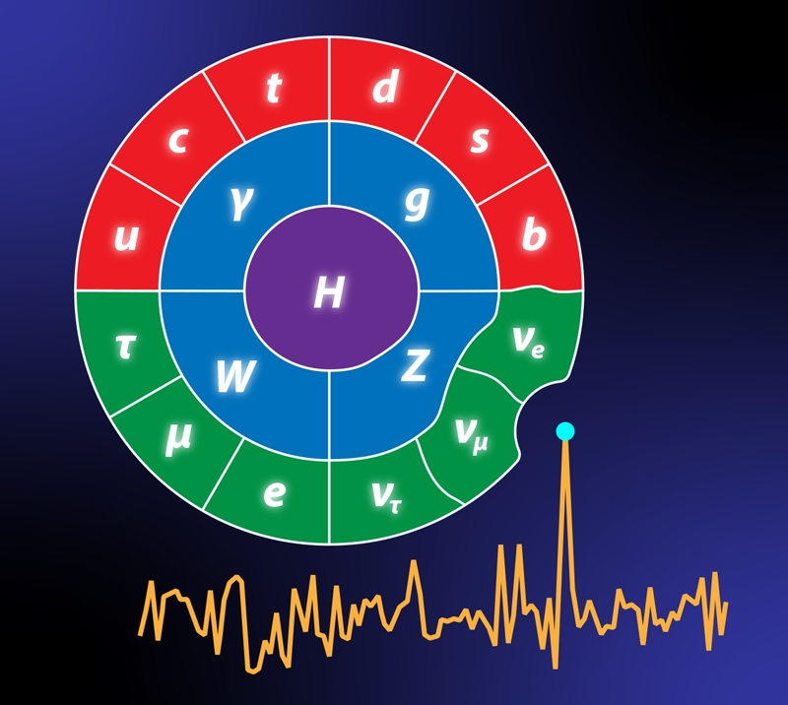
Ideas
Nineties
QCD
People
Noughties
Grid
Precision
Teens
Higgs
Phenomena
Twenties
AI
People
I de
as

Slide 3

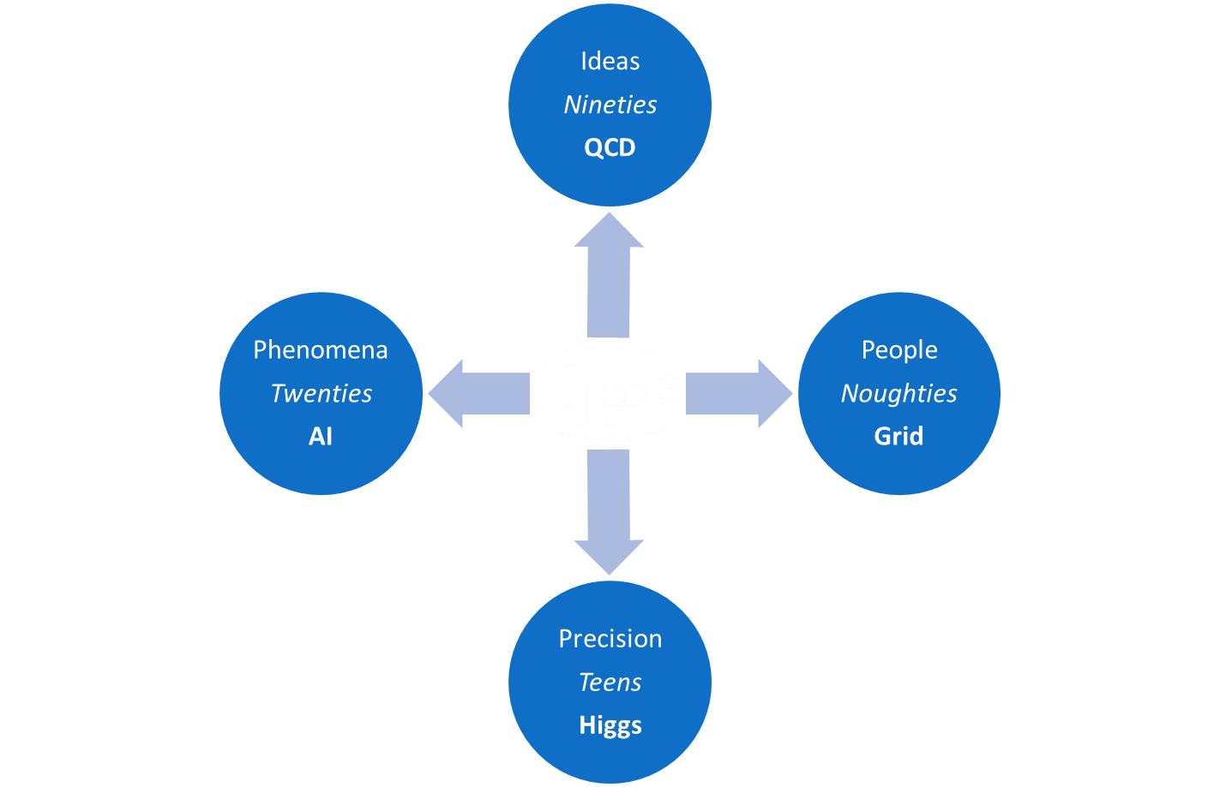
Pilgrim’s Path
Phenomenology Perspective
Historical Perspective
People
Summer Schools
Pictures
Experiment Perspective
Workshops
Transformers
Precision Phenomena

Slide 4

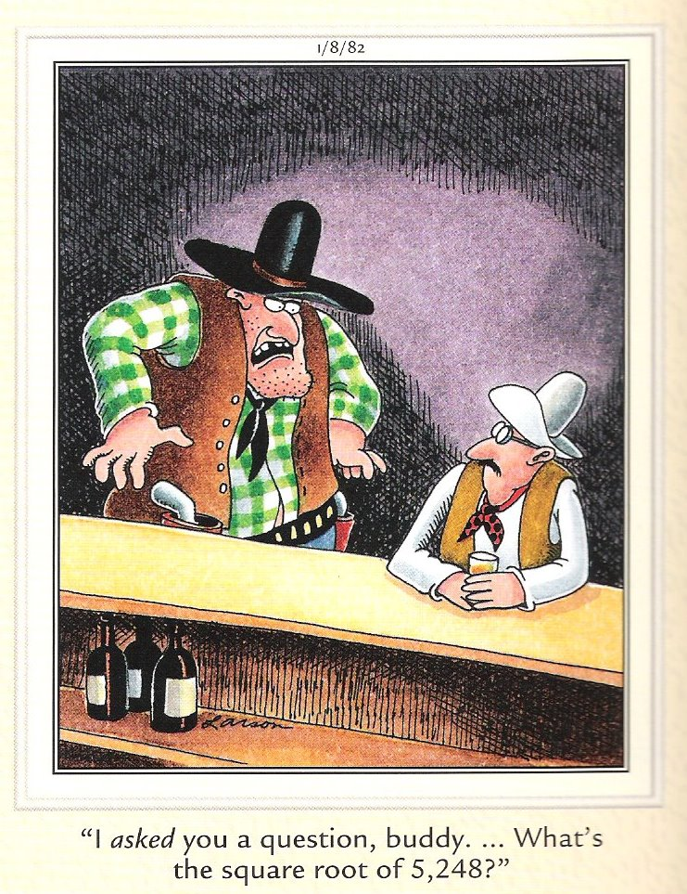
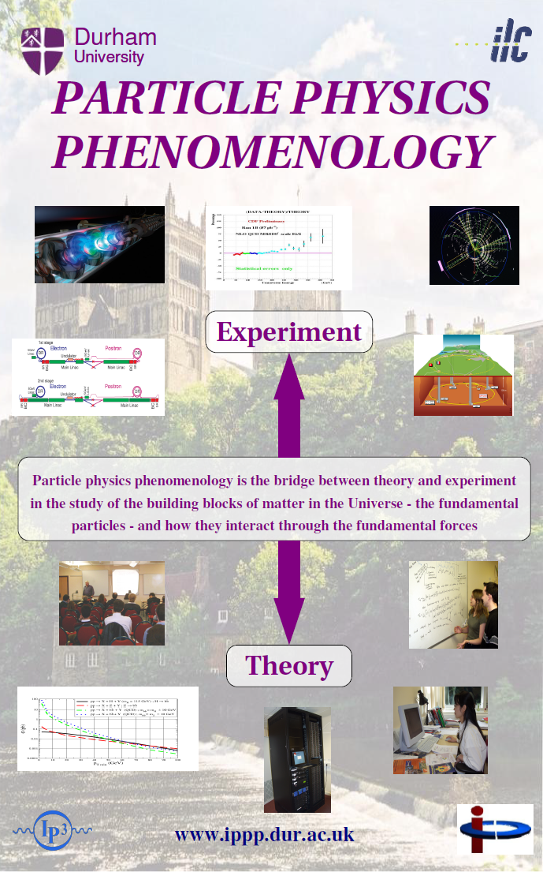
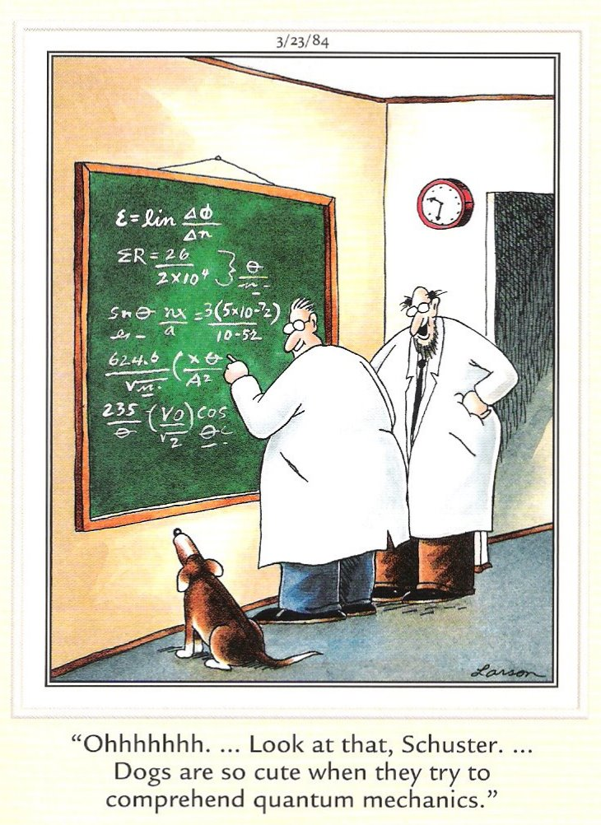
Perspective
Experiment
Phenomenology
Theory

Slide 5
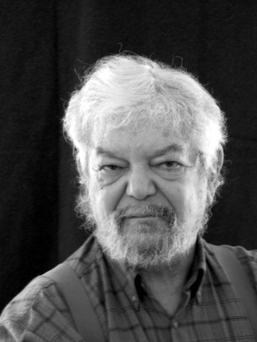
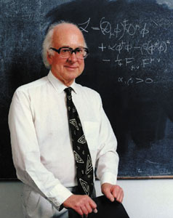
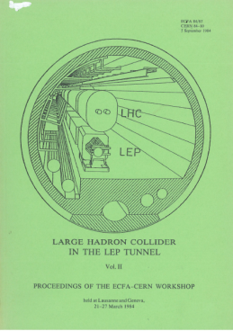
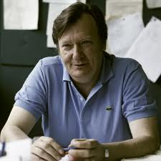
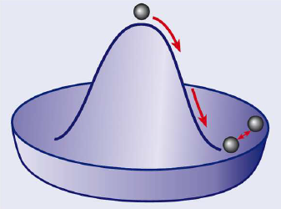

Ginzburg-Landau
Historical Perspective
Nambu
Goldstone
1961 Schwinger
1962 Anderson
1964 Brout, Englert, Higgs, Guralnik,Hagen,Kibble
1967 Weinberg, Salam Faddeev,Popov
Glashow, Iliopoulos,
Maiani, ‘t Hooft, Veltman…..
1983 Rubbia, van der Meer, Banner, Darriulat, Di Lella, … discovery of W and Z at CERN
1989 construction of the LEP ( e+ e- collider ) tunnel finished
beginning of the R & D of LHC experiments
1992
1994
1995
1996
1998
1999
2006
2008
2010
2012
LOI of ‘large’ LHC experiments
TP of ATLAS and CMS approval of LHC
discovery of top by CDF and D0
approval of LHC in one step
approval of the 4 largest LHC experiments (ATLAS,CMS, LHCb, ALICE)
ATLAS Physics TDR CERN/LHCC/99-14 CERN/LHCC/99-15
CMS Physics TDR J. Phys. G: Nucl. Part. Phys. 34 (2007) 995–1579
ATLAS Expected Performance arXiv:0901.0512
start-up at 3.5 + 3.5 TeV
4th July discovery of a boson

Slide 6
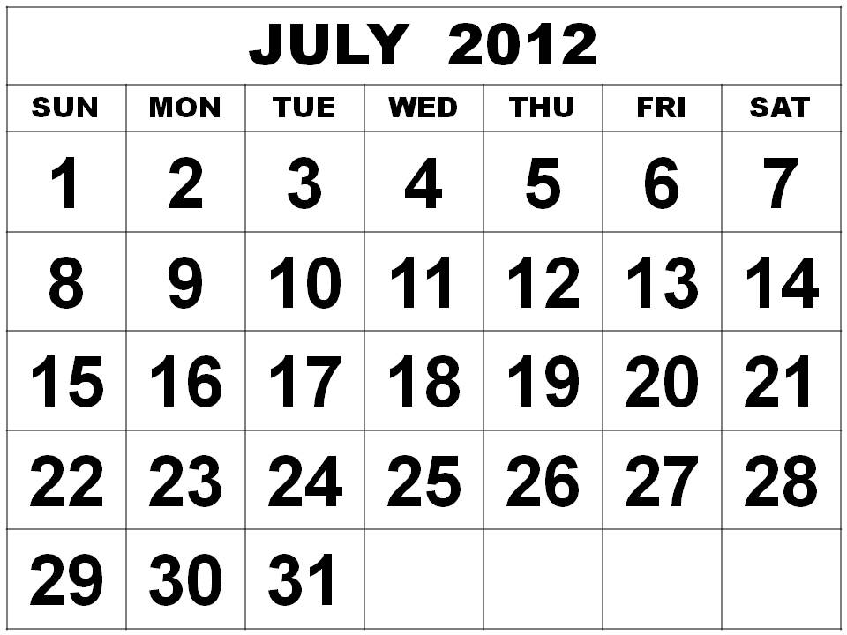
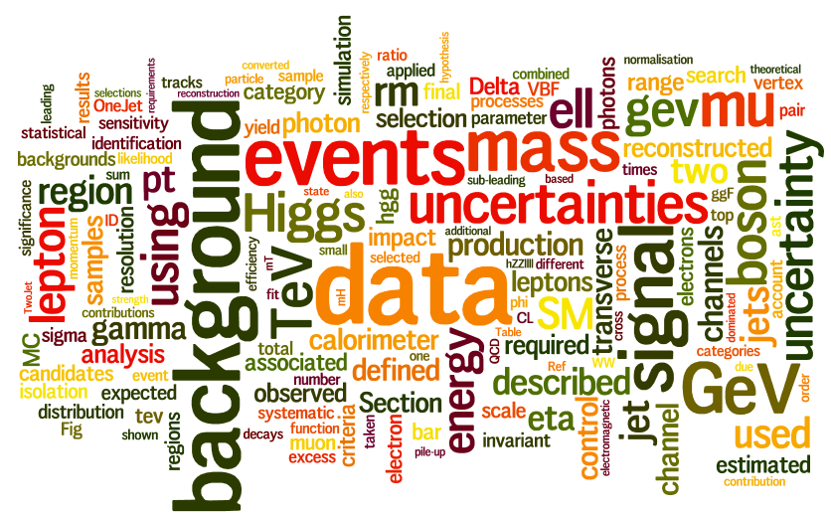
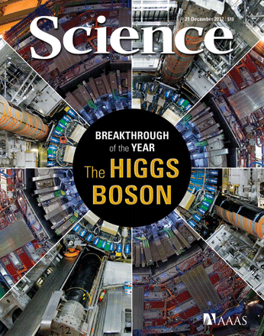
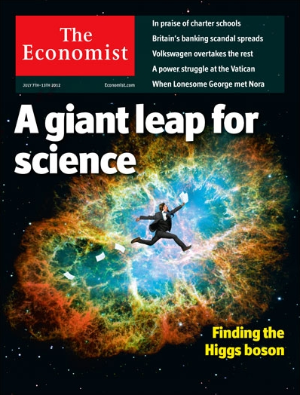
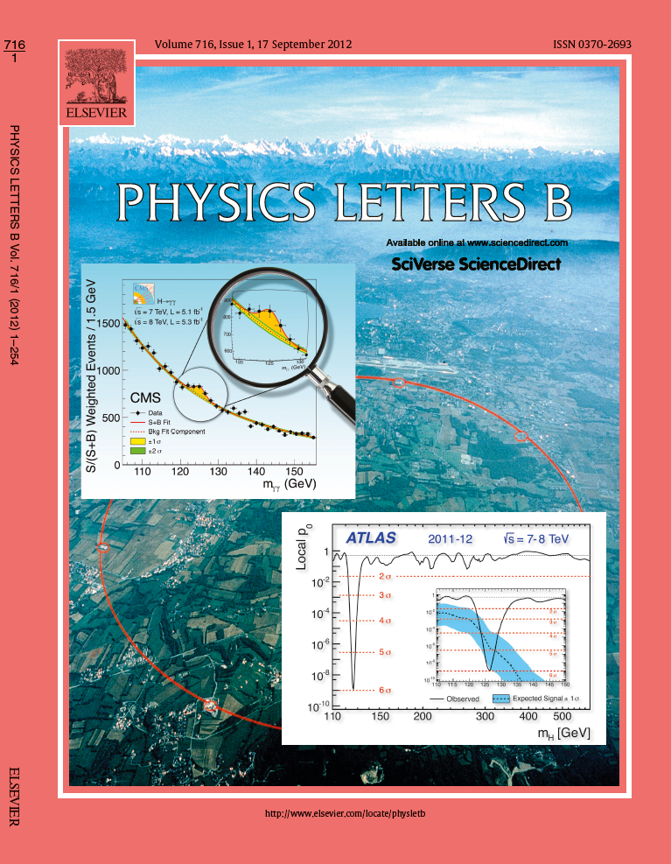
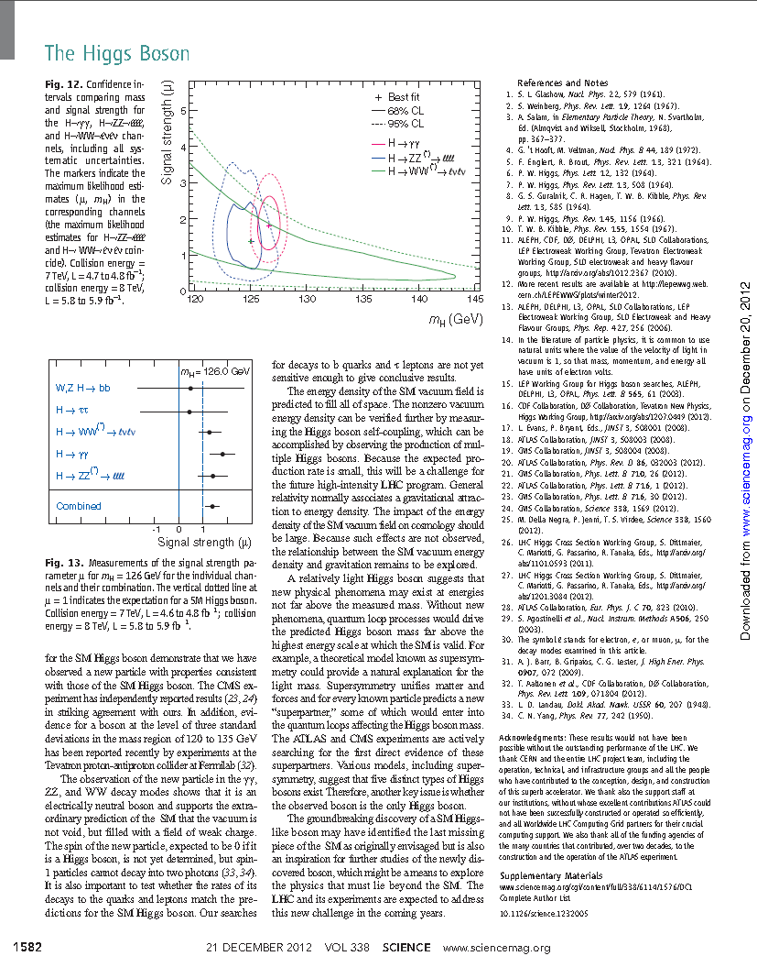
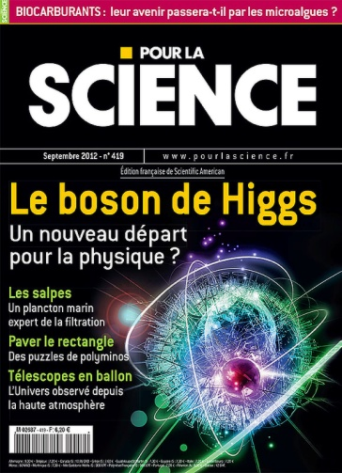
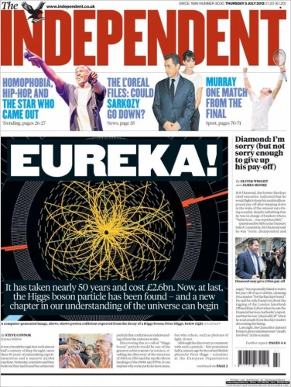
A Giant Leap For Science
July Revolution (2012)
From stats [3σ publication], to presentation, to discovery [>5σ publication]

Slide 7
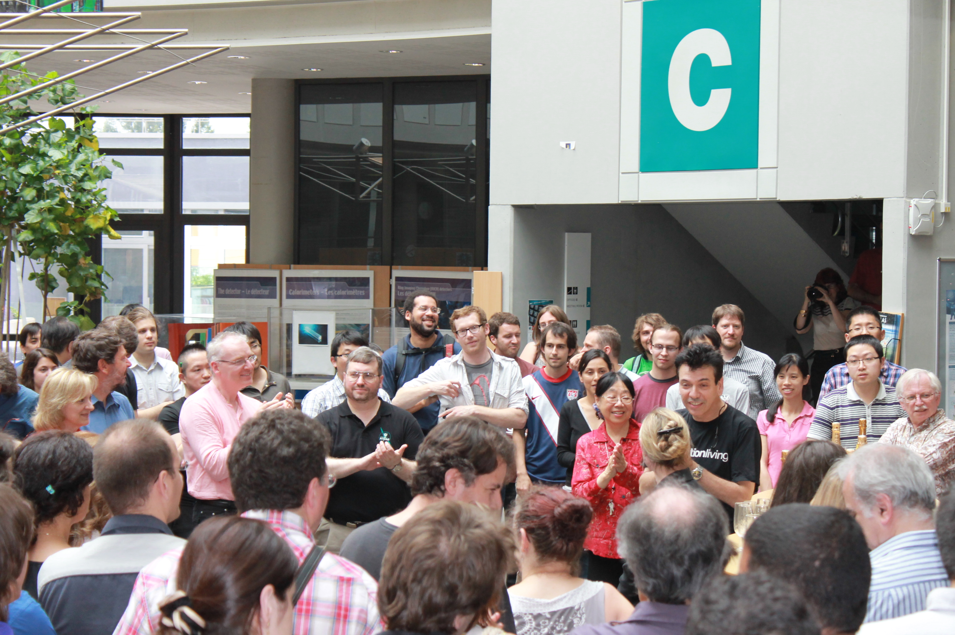

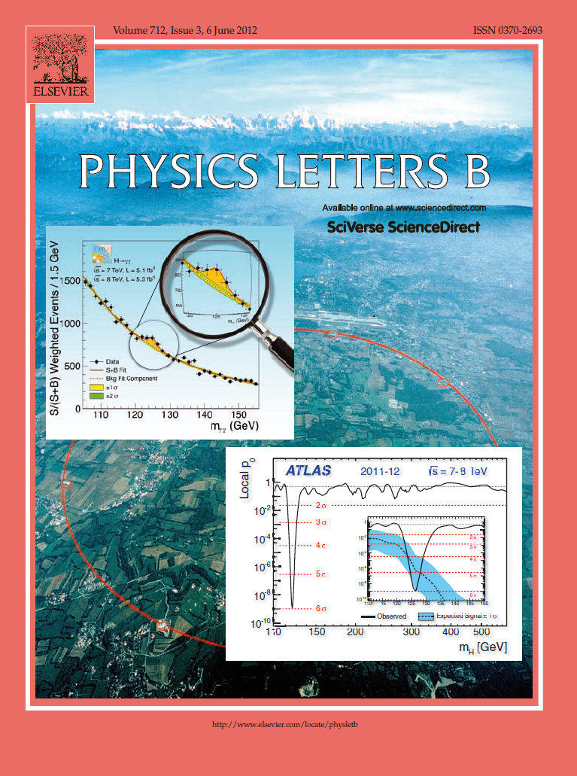
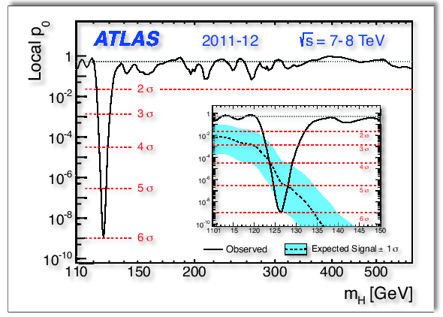
Observation.. Halfway Point on the IPPP Pilgrimage
Publication
July Revolution (2012)

Slide 8
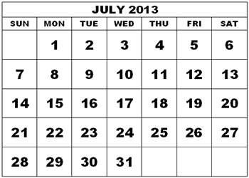
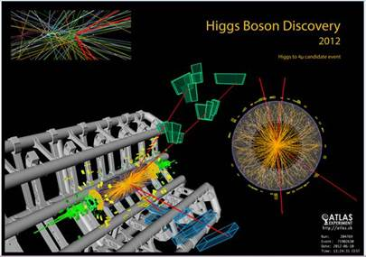
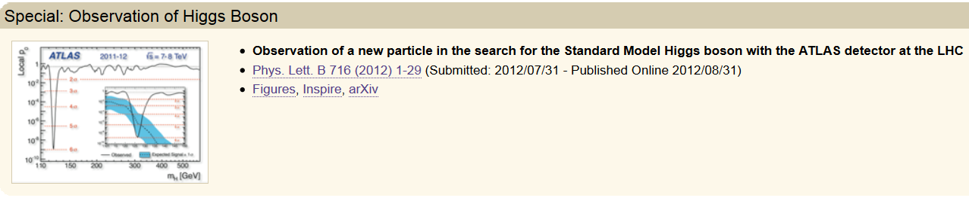
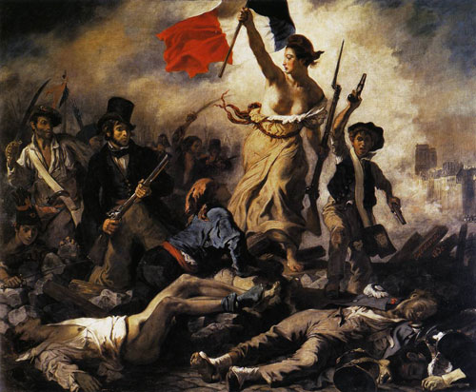

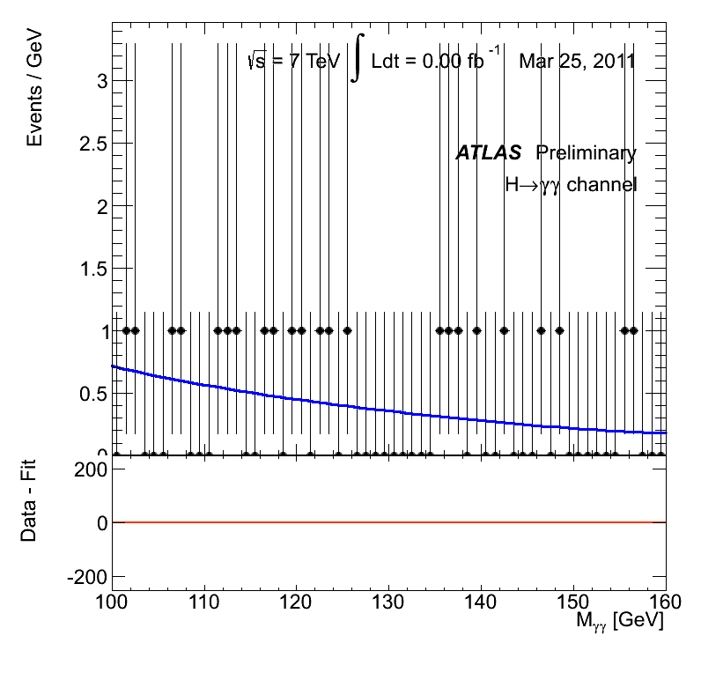
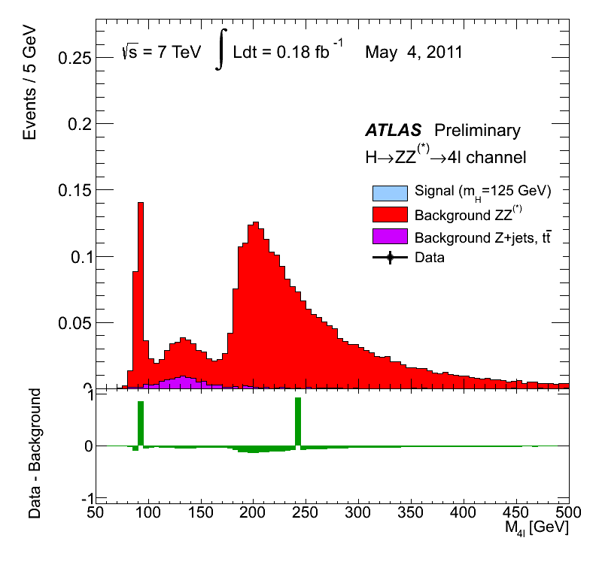
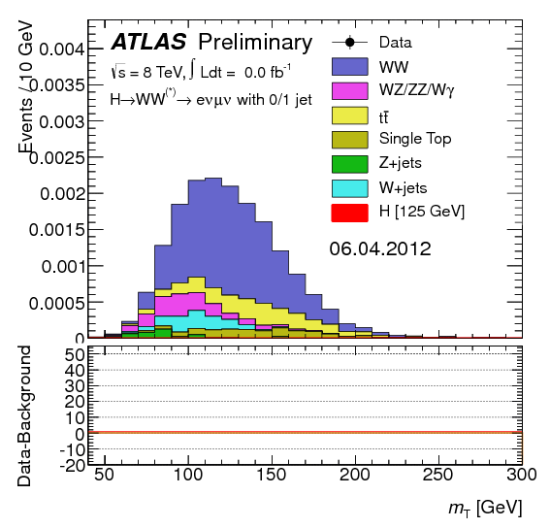
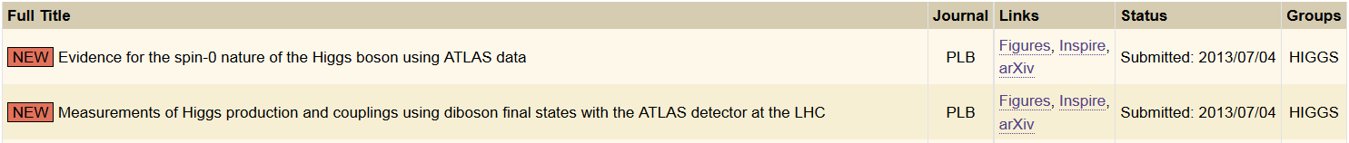

One year on from the July Revolution..
Old World
1830 French Revolution.. Trois Glorieuses.. Three Glorious signals..
NewWorld
1831 French Foreign Legion.. Marche ou crève.. Standard Model?

Slide 9
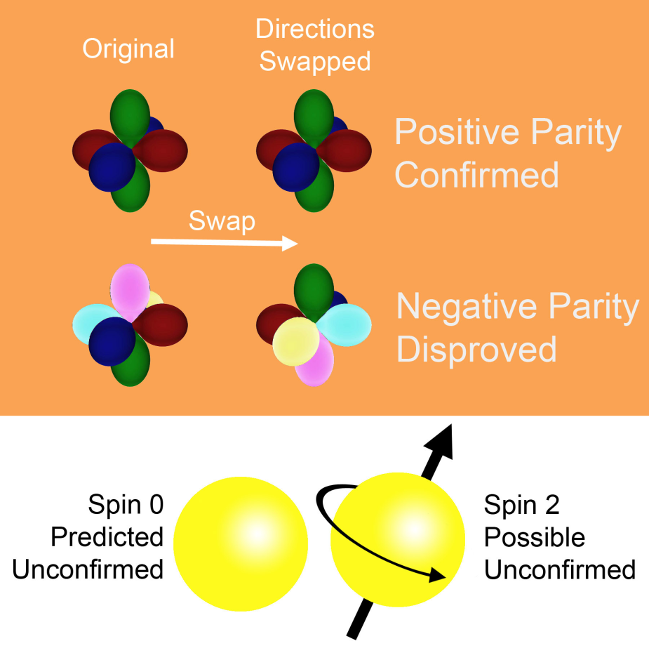
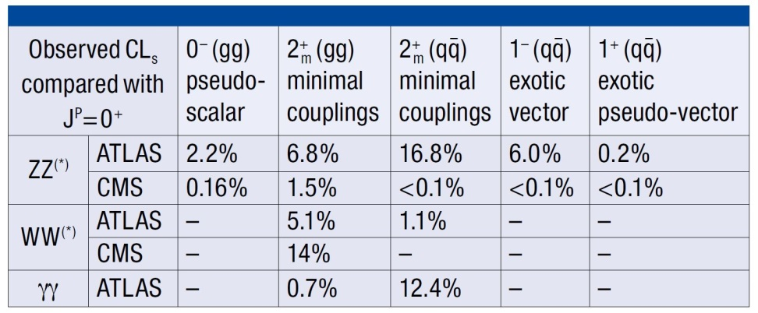
Birth of a Higgs Boson (2013) Testing SM alternative hypotheses?
2012
2013
Alternatives to Standard Model spin, parity hypothesis ruled out (to varying degrees)

Slide 10
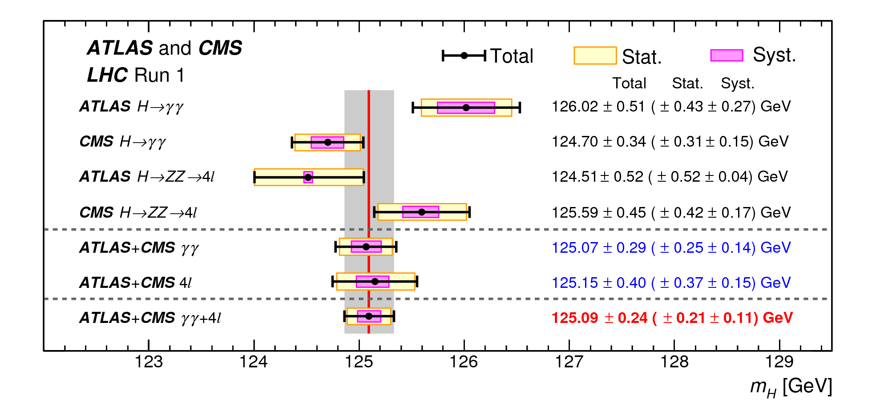
Birth of a Higgs Boson (LHC Run 1) Combined ATLAS and CMS mass
m_{H} = 125.1 ± 0.3 GeV

Slide 11
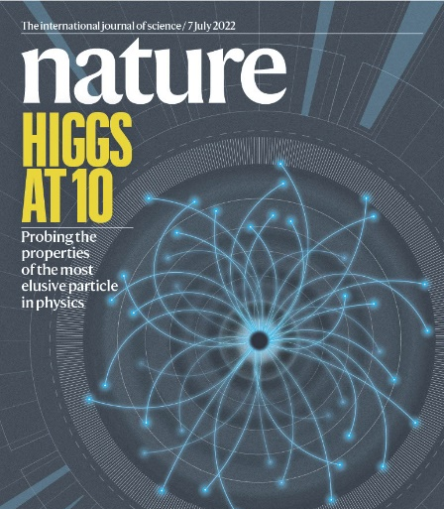
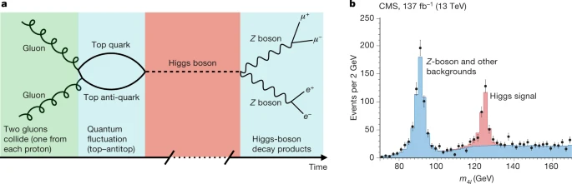
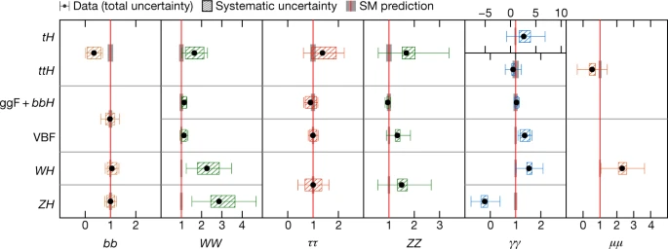
Higgs Boson @ 10

Slide 12
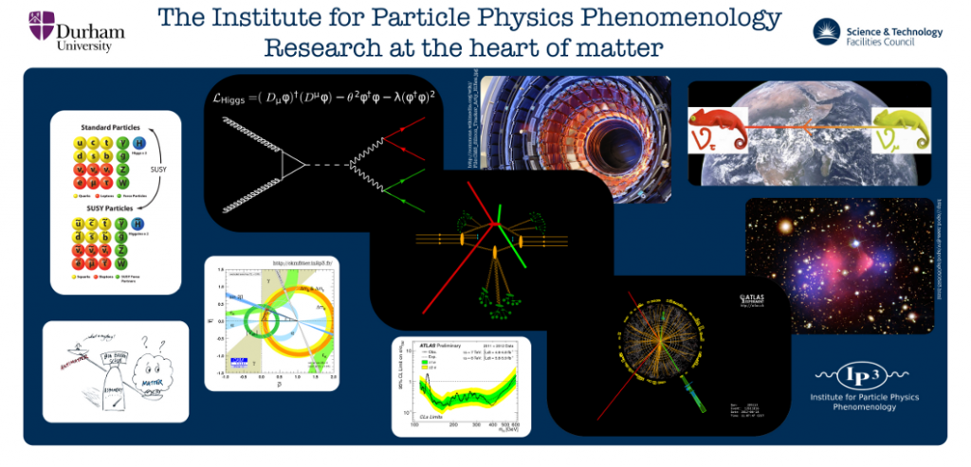
Precision Processes
Ideas..
Inspiring the youth(ful on their see-saws..)

Slide 13
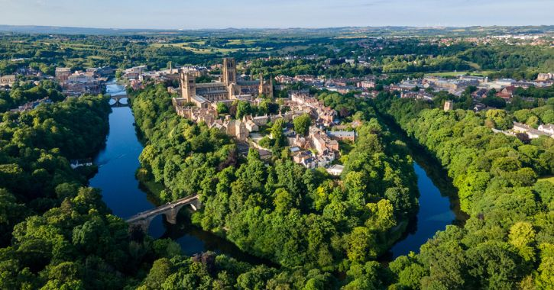
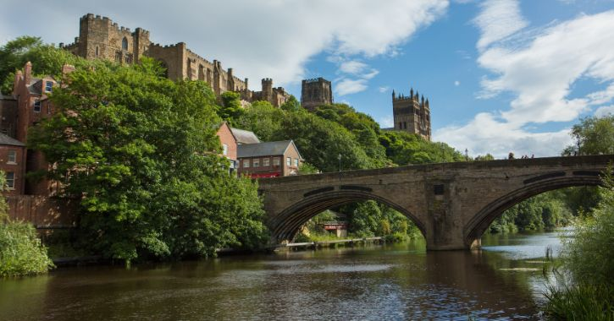
Land of the Prince Bishops
Bishop William Walcher (1071-1080)
Bishop Ranulf Flambard (1099-1128)
Bishop Thomas Hatfield (1345-1381)
Bishop Cuthbert Tunstall (1530-1559)
Bishop John Cosin (1660-1672)
Bishop Richard Trevor (1752-1771)
Bishop William Van Mildert (1826-1836)
Historical Perspective
2000
2007
2011
2012
2020
2025
Professor W James Stirling
Professor Valya Khoze
Professor E W Nigel Glover
Professor Keith Ellis
Professor Michael Spannowsky
Silver Anniversary
Institute of Phenomenology Prince Professors
(AKA Directors)

Slide 14
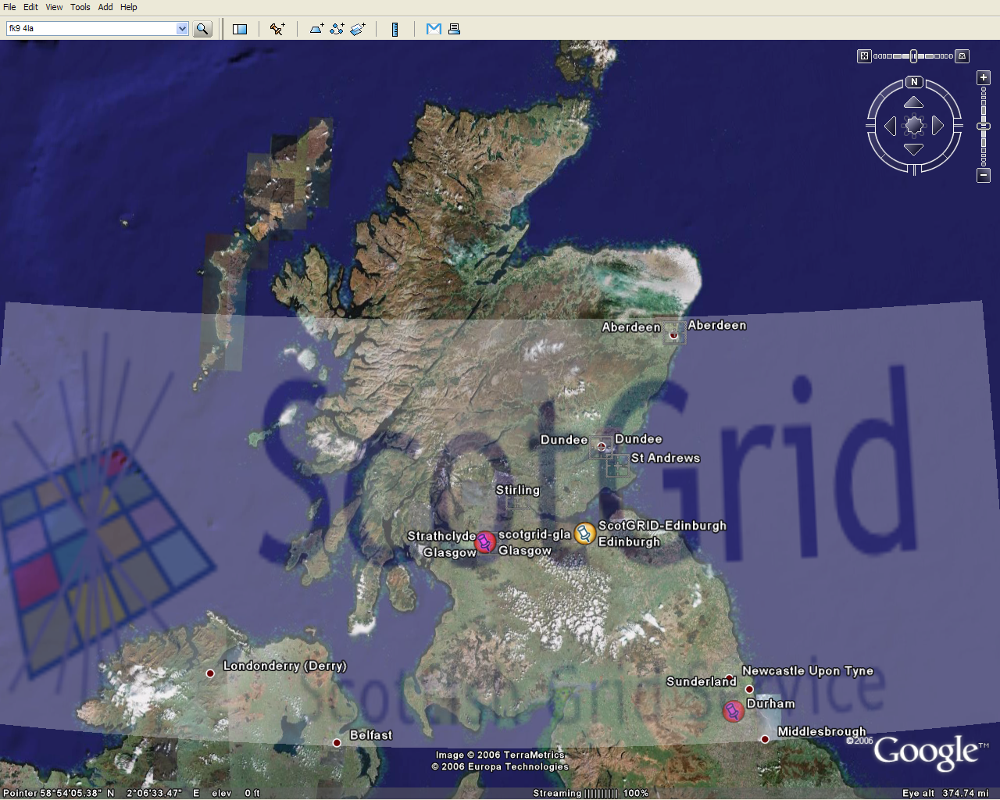
In 1075 William the Conqueror the King created the Palatine of Durham
and its Prince Bishops to protect the North from invading Scots..
925 years later..
In 2000 the Northerners worked together In Peaceful Physics Pursuits
on ScotGrid, SUSSP Summer Schools and Higgs Maxwell Workshops for 25 years..

Slide 15
People https://www.ippp.dur.ac.uk/former-members/
Professor Steve Abel | University of Durham | 2004-2007
Professor Ben Allanach | University of Cambridge | 2008-2010
Professor Patrizia Ball | University of Durham | 2011-2014
Professor Alan Barr | University of Oxford | 2011-2017
Professor Oliver Buchmueller | Imperial College | 2011-2016
Professor Jon Butterworth | University College London | 2007-2010
Professor Tony Doyle | University of Glasgow | 2004-2007 2011-2016
Dr Nicolo De Groot | Nijmegen | 2004-2007
Professor Robin Devenish | Oxford | 2000-2007
Professor Lance Dixon | SLAC | 2010-2015
Professor Ulrich Egede | Imperial College London | 2007-2010
Professor E.W. Nigel Glover FRS (ex officio) | University of Durham | 2011-2016
Professor Paul Harrison | University of Warwick | 2010-2018
Professor Beate Heinemann | University of Freiburg | 2007-2010
Dr Ian Hinchliffe | LBNL (Berkeley) | 2007-2010
Professor Joey Huston | Michigan State University | 2016-2019
Professor Steve F. King | University of Southampton | 2007-2010
Professor Valya Khoze (ex officio) | University of Durham | 2007-2010
Professor Cristina Lazzeroni | University of Birmingham | 2013-2017
Dr. Daniel Maitre | IPPP | 2015-2017
Dr. Michelangelo Mangano | CERN | 2015-2019
Dr. Norman McCubbin | RAL | 2007-2010
Professor Ken Peach | University of Edinburgh | 2000-2007
Professor Michael Pennington (ex officio) | University of Durham | 2007-2010
Professor Arnulf Quadt | University of Gottingen | 2011-2016
Professor Graham Ross FRS | Oxford University | 2010-2015
Professor Veronica Sanz | University of Sussex | 2016-2019
Professor Michael Seymour | University of Manchester | 2007-2010
Professor Paul Soler | University of Glasgow | 2016-2019
Professor Dan Tovey | University of Sheffield | 2007-2010
Dr. Claire Shepherd-Themistocleous | RAL | 2007-2010
Prof. Robert Thorne | UCL | 2011-2017
Professor W. James Stirling FRS (ex officio) | University of Durham | 2004-2007
Professor T.S. Virdee FRS | Imperial College | 2000-2007
Professor Georg Weiglein (ex officio) | DESY Hamburg | 2004-2007

Slide 16
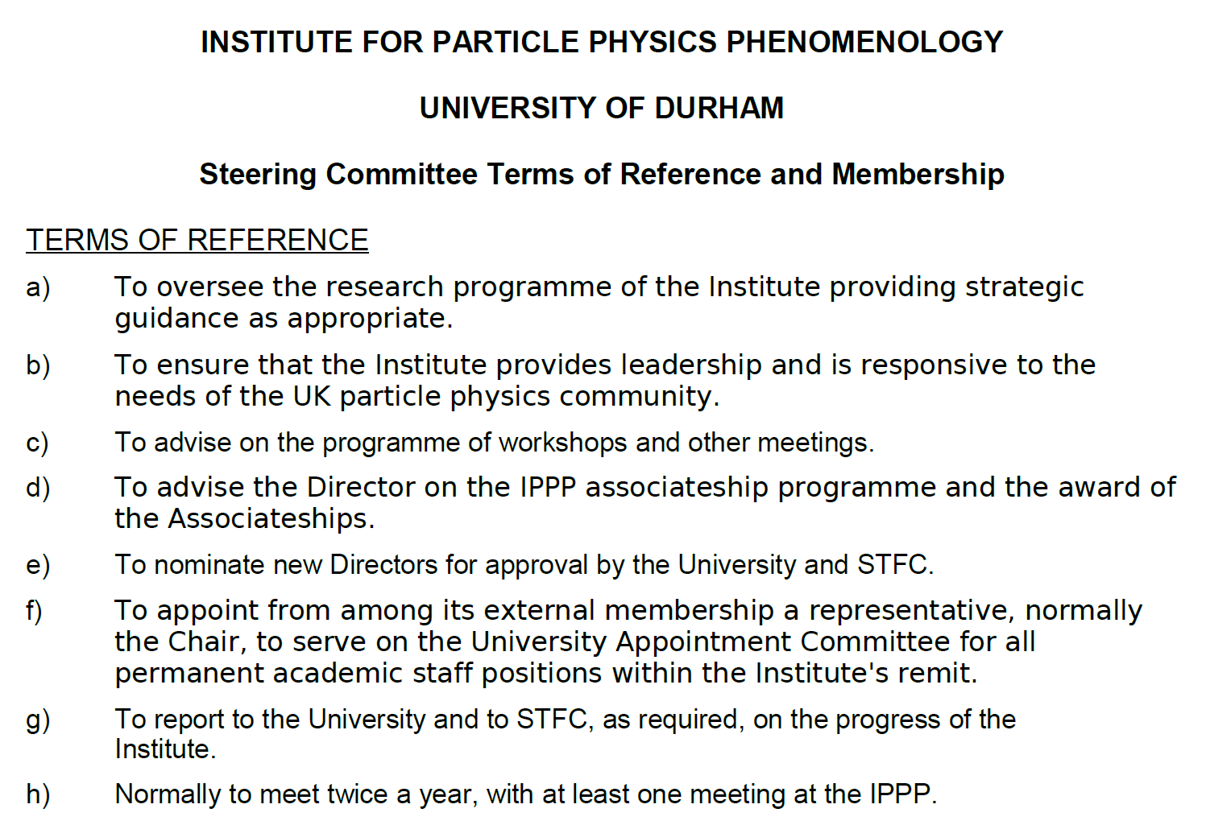

More People https://www.ippp.dur.ac.uk/former-members/
Who were we?
What were we doing?
Where’s Alan?
Michelangelo Mangano
Joel Goldstein
Val Gibson
Tao Han
Gavin Salam
Feya Blekman
Ed Copeland
Morgan Wascko
Dave Charlton
Keith Ellis
Sinead Farrington | University of Edinburgh | 2022-2024
Professor Clare Burrage | University of Nottingham | 2021-2024
Professor Aidan Robson | University of Glasgow | 2021-2024
IPPP Steering Committee
Looking for new Ideas, People and Phenomena to support.. not Particularly Precise
Official
15th May 2009

Slide 17
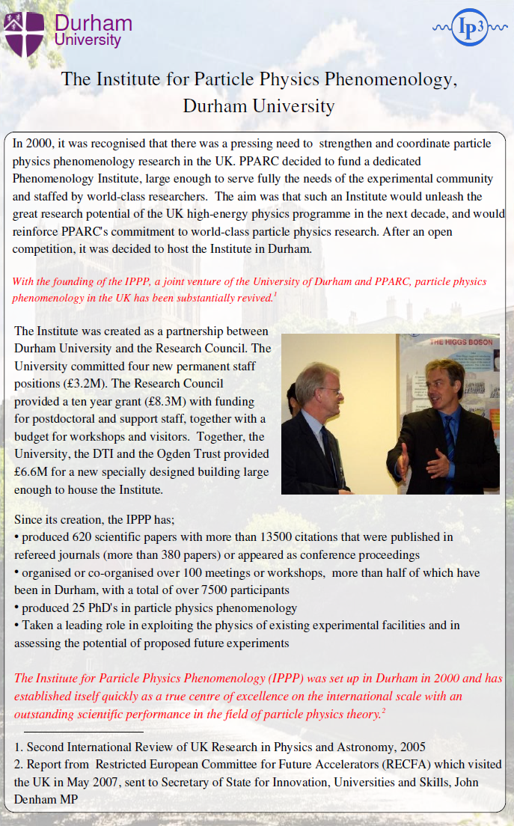
Inauguration and Transformation Nineties to Noughties
Durham Workshop on Jet Studies at LEP and HERA
IPPP Inauguration
December 1990
October 2000
Durham algorithm
Deep Inelastic Scattering
Structure Functions
PDFs
Ian Halliday Chief Executive PPARC
1998-2005
Tony Doyle Member PPARC Particle Physics Theory Grants Committee
1999-2001
Anti-k_{T} algorithm
Grid
LHC
Higgs
James Stirling
Inaugural Director
2000-2007

Slide 18
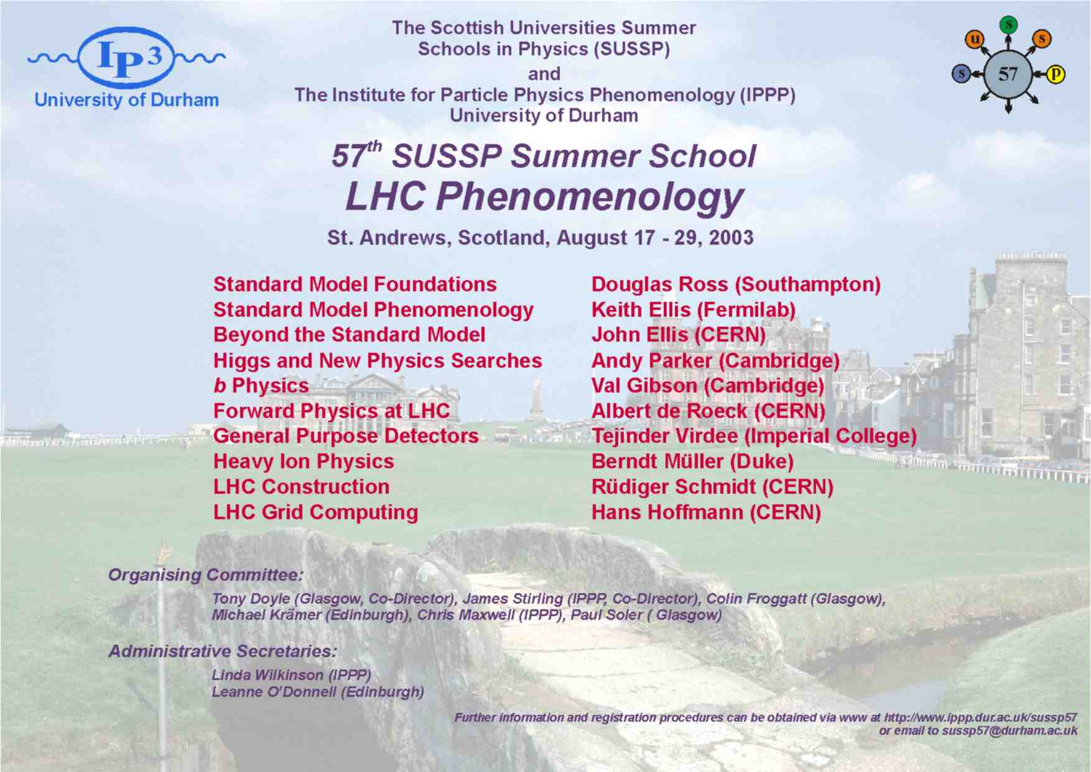
Pictures.. Summer Schools SUSSP57 LHC Phenomenology (Aug 2003)

Slide 19
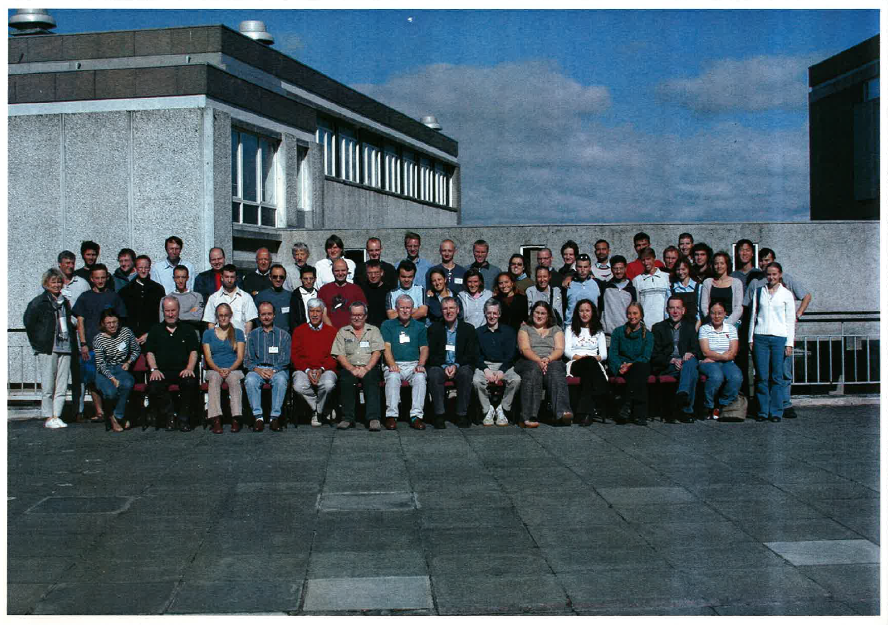
Pictures.. Summer Schools SUSSP57 LHC Phenomenology (Aug 2003)

Slide 20

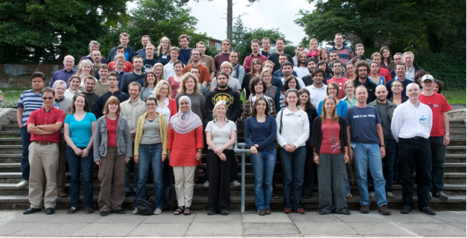
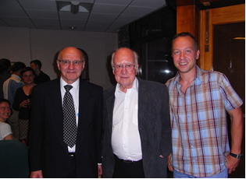
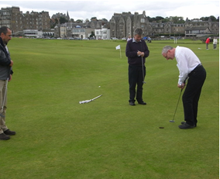
Pictures.. SUSSP69 LHC Physics (Aug 2012)
Alan Walker, Peter Higgs and one of our “students”, Sven Heinemeyer
Thomas Binoth, Nigel Glover and
Tony Doyle putting on the “Himalayas”

Slide 21
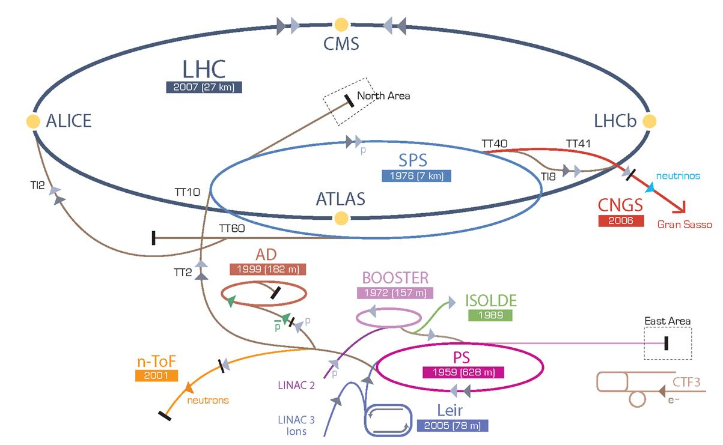
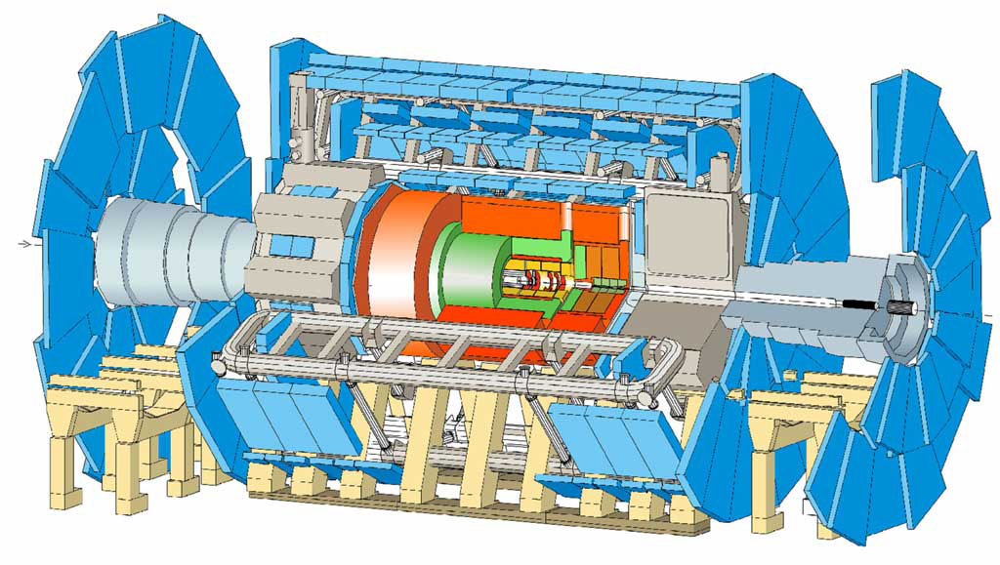
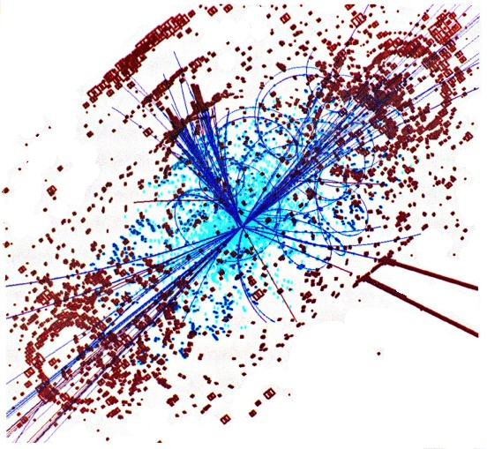
ATLAS also takes pictures..

Slide 22



Experiment Perspective
The LHC is a synchrotron ring powered by RF cavities contained with cooled 1.9K magnets
The ATLAS and CMS detectors take snapshots every 25 nanoseconds
One in ten billion of these events is due to the Higgs Boson
Worldwide Grid of 1.4 million computer cores and 1.5 exabytes of storage
From a historical perspective these technical developments took more than 25 years
July 4th 2012 was our Big Bang moment with first observation of the Higgs Boson
Careful analysis of three decay channels were required to make this discovery
Run 1 focused on establishing the properties of this new Standard Model (SM) particle
Run 2 looked more closely for effects which may go beyond the SM
Future accelerators are currently being considered to improve this precision

Slide 23

Higgs Production In PP Collisions

Slide 24

The Grid
Archeology
Astronomy
Astrophysics
Civil Protection
Comp. Chemistry
Earth Sciences
Finance
Fusion
Geophysics
High Energy Physics
Life Sciences
Multimedia
Material Sciences
…
>250 sites
48 countries
>50,000 CPUs
>20 PetaBytes
>10,000 users
>150 VOs
>150,000 jobs/day
Notes:
24

Slide 25



QCD: PDFs – MRS (and later MRST and MSTW) (and now NNPDF, by the artist formerly known as KwikFit..)
Global fits to all data by MRS(T) (MSTW,CTEQ,HERA,NNPDF)
"MRS Parton" likely refers to the late 1980s British television sitcom "Mrs Parton“…

Slide 26





QCD Jets in e⁺e⁻ (Yuri Dokshitzer) Durham Workshop on Jet Studies at LEP and HERA [December 1990, t-10.. St John’s College]

Slide 27


The jet gold standard (Gavin Salam) The anti-k_{t} jet clustering algorithm [2008] Matteo Cacciari, Gavin P. Salam, Gregory Soyez

Slide 28


Higgs Maxwell Workshops Noughties to Twenties
“Particle Physics at the Limits”
"Machine Learning and the Future.."
February 2002
February 2025
Sherpa
Higgs Boson
Higgs + Associated Top
Transformer Networks
Atiyah, Higgs, Saxon and Witten, 2010
The Royal Society of Edinburgh, George Street

Slide 29


Transformers
To do..
Deep Learning Improvements
Explainable AI
Data-Driven Insights
Human-AI Collaboration
https://conference.ippp.dur.ac.uk/event/1438/
Neural Network architecture for Large Language Models (LLMs)
Replace sequential recurrence with a global attention mechanism
Capture long-range and complex dependencies between input elements
Widely used “Machine Learning and the Future..” Higgs Maxwell Workshop (2025)
AI
HPC
GridPP
CSS

Slide 30



ATLAS Transformers
AI used for Signal-Background Separation (and Higgs reconstruction, and b-tagging, and event reconstruction, and anomaly detection..)
Data Analysis:
AI algorithms are trained on large datasets where signals and backgrounds are present
Feature Extraction:
The AI identifies distinct features that differ between the signal and backgrounds
Pattern Recognition:
By learning these patterns, the AI develops the ability to classify incoming data
Disentanglement:
The learned model then processes unseparated data to isolate and extract the signal
Find the (one in ten billion) Higgs signal events using subtle correlations (and correlations of correlations), whilst monitoring the (hundreds of) systematics…
Beware the decepticons…

Slide 31

1 Process: Higgs + Associated Top
Higgs analyses require sophisticated theory predictions
Higher-order perturbative calculations
Resummations
Reliable non-perturbative tools:
PDFs
Parton Showers
Jets
Everything Everywhere All Time Ordered
IPPP at the forefront of these developments
Sherpa semi-leptonic ttH event

Slide 32



Backgrounds everywhere.. +signal Dominating the uncertainties

Slide 33


1 Personal Physics Pilgrimage.. From A to B to Z.. with Ip^{n} along the way.. 25 years analysing ttH..
Driven by the Backgrounds
“b quark tagging performance and Higgs detection via top production using the ATLAS detector” Andrew Pickford (2001)
“Measurement of the associated production of a top quark pair and a Higgs boson (ttH) with boosted topologies” Bruno Borbely (2023)
To observe a Signal
Inspiratio^{n} from James, Valya, Nigel, Keith, Michael, and Frank (EG²K²S Collaboration)
“Measurement of the ttH(bb) process using the ATLAS detector and its effective field theory interpretation” Zefran Rozario (2025)
https://doi.org/10.1140/epjc/s10052-025-13740-x

Slide 34


Must Improve the background modelling, and the S/B classification.. and the Higgs reconstruction, and the b-tagging..
2022 Result
(Bruno’s thesis)
2025 Result
(Zef’s thesis)
tt+b(b)
modelling

Slide 35

ttH Transformer Networks
Classification Network:
Output of the final attention block is aggregated by a cross-attention pooling layer
Pooled features mapped through a softmax layer to produce class probabilities
Class probabilities are transformed into discriminant observables to improve S/B separation
Discriminant observables define the signal and control regions
Reconstruction Network: jet-pairing layer to identify jets associated with the Higgs boson (p_{T}^{H})

Slide 36



Improvements Pilgrimage.. towards an observation
Looser selection requirements
Enhanced b-tagging
Raised the overall signal acceptance
Classification network
Control regions enriched in different tt+jets components
Dedicated simulation and systematic models for the tt+1b background
Data-driven corrections for the tt+ 1c and tt+light jets
Greater control of backgrounds
Reconstruction network
Improved Higgs reconstruction
New high p_{T} extrapolation uncertainties
Overall sensitivity
SM interpretation: signal strength μ
SMEFT: Chromomagnetic c_{tG}
and Yukawa-like c_{tϕ} Wilson Coefficients
Improved by ~factor 2
Enough for an observation?

Slide 37



ttH Run-2 (almost an) observation.. μ precision improved by ~factor 2
2022 Result
Same Scale
Same Data
4.6σ observed
(5.4σ expected)
2025 Result

Slide 38



Precision: Improve the Standard Model
Prediction of the range
for the Higgs mass
Indirect determination of the top mass
Prediction is very difficult, especially about the future..
(Neils Bohr)
but it won’t stop us trying
(IPPP)
possible due to • precision measurements • known higher order electroweak corrections
LEP

Slide 39



Success of the Standard Model
Higgs mass consistent with top mass and W mass
Improving measurements of the Higgs mass, top mass and strong coupling constant will determine the nature of our vacuum

Slide 40








Anomaly Detection: BSM Phenomena?
New Gauge Bosons
Supersymmetry
ZZ/WW resonances
Technicolor
Little Higgs
Extra Dimensions
Hidden Valleys
Black Holes
A large variety of possible signals
Notes:
40

Slide 41


IPPP@25 Silver Anniversary Solving Infinitesimal Puzzles in Particle Physics
Thank you
Inspiratio^{n}
Passing on your expert knowledge
Providing a warm welcome at Workshops and Summer Schools
Putting up with experimental “ideas” and questions..
Congratulations on your Silver Anniversary

Slide 42
What about the next quarter-century? More scalar boson discoveries?? IPPP@50 Golden Anniversary Great Institute Predicting the Properties of Particles
(i) The Higgs field – is neither matter nor force – what is a scalar boson?
(ii) Inflation needs an ‘inflaton’ – another scalar field – what is it?
Be prepared for more ideas and questions..
(iii) Dark Energy is ~2/3rd of our Universe – scalar field?
(iv) Dark Matter is ~1/4 of our Universe – another scalar field??
Understanding infinitesimal scalar fields will change our view of the infinite Universe

