Slide 1

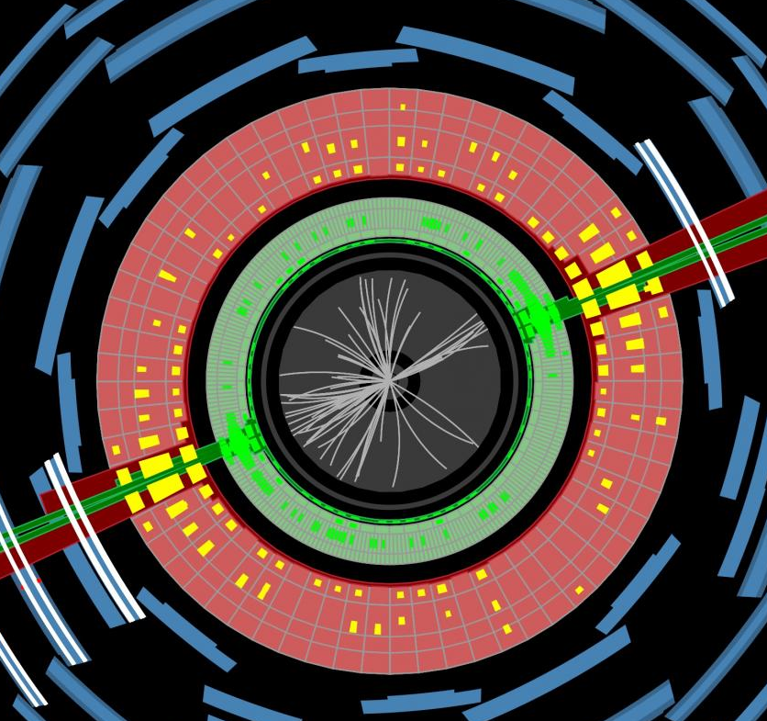
IPPP 25th Anniversary Durham 24/9/2025 Jon Butterworth University College London Physics & Astronomy
“Memories”

Slide 2
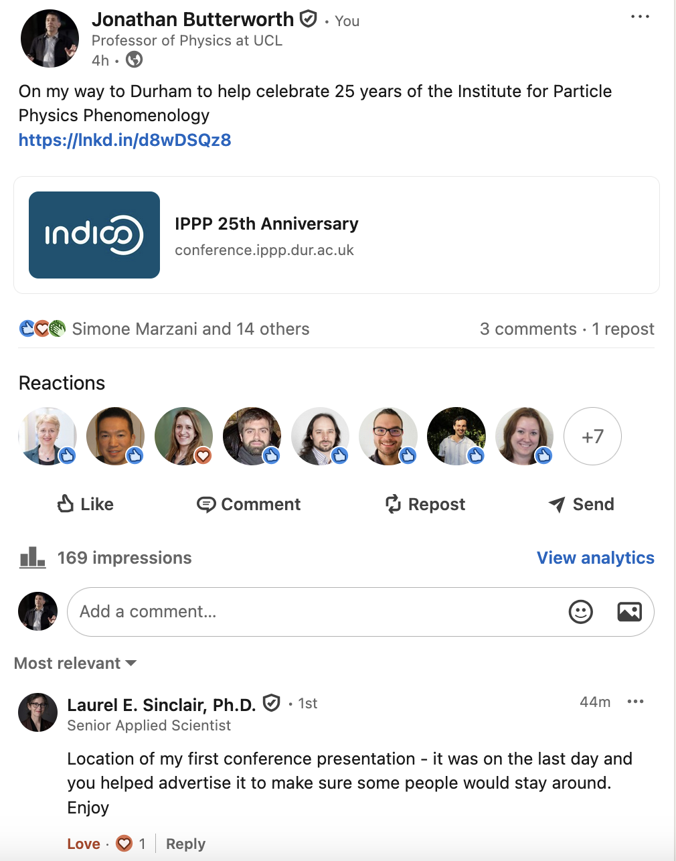

Slide 3
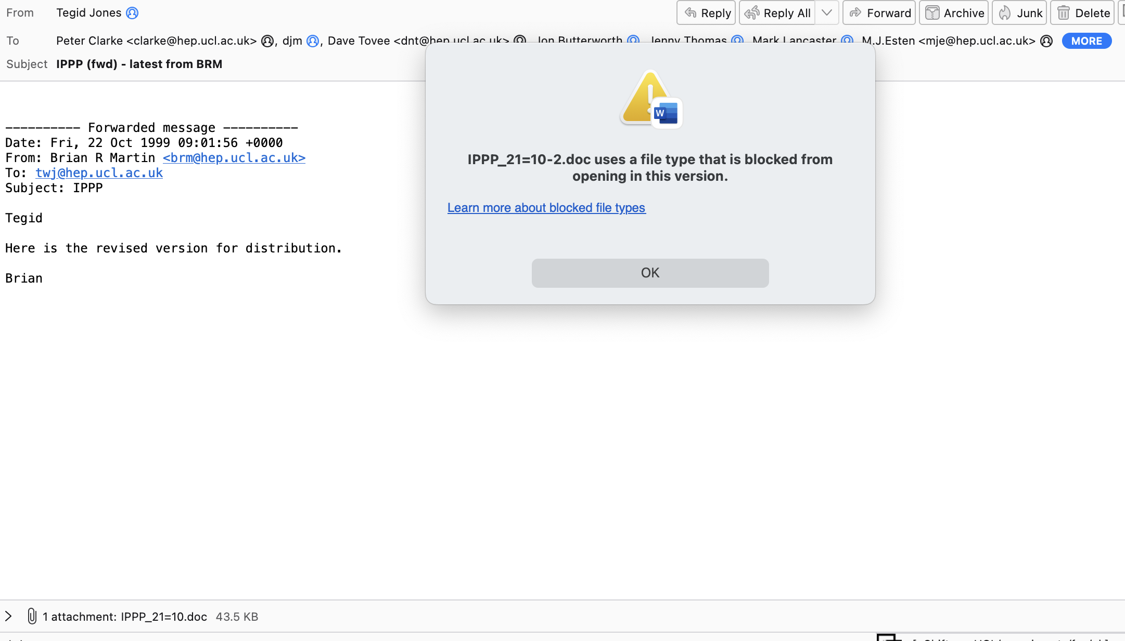
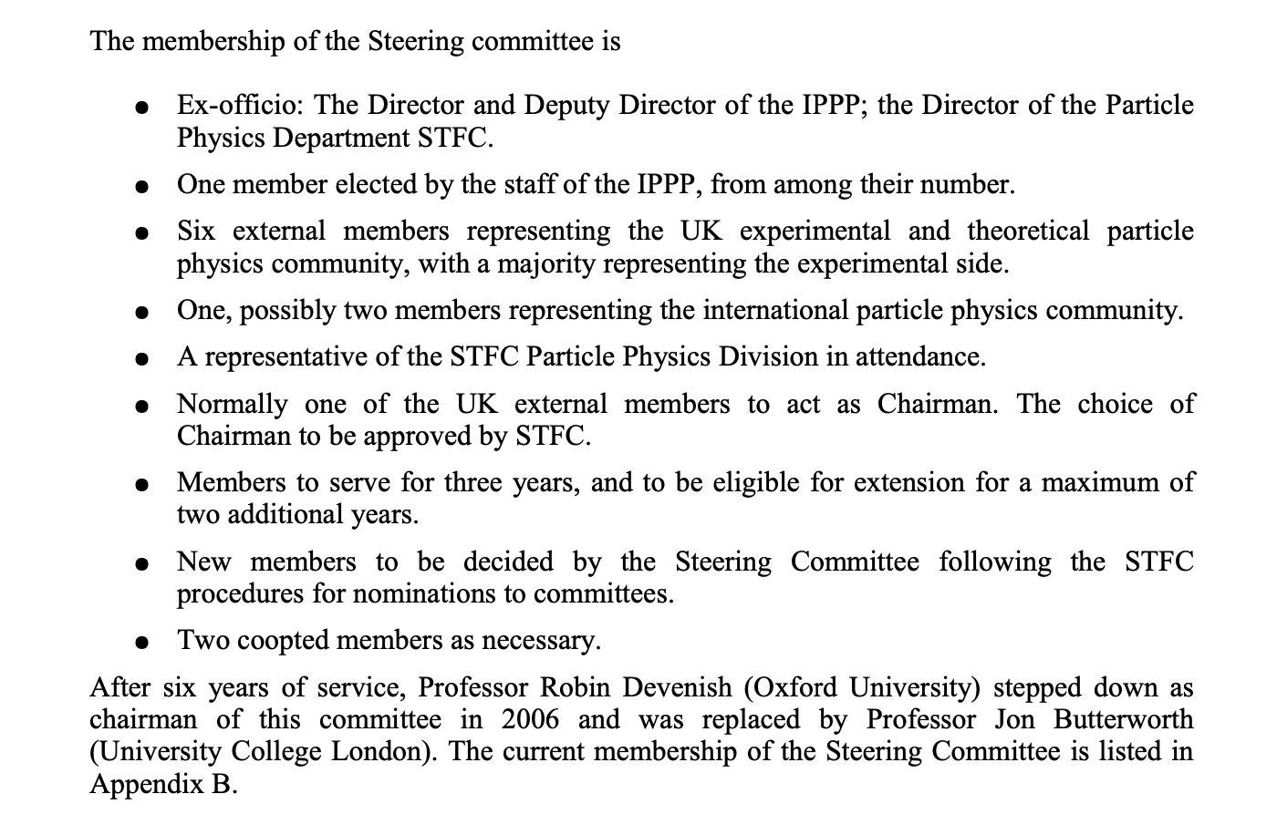
IPPP & Me
First contact with Durham
DIS 1993. HERA F₂, St. John’s College
Failed UCL bid ☺ 2000
ZEUS–IPPP experimental contact 2002-?
Steering committee (chair) 2005, (2006-2011)
IPPP Associate 2014-2016
With James Ferrando, boosted Higgs, jet substructure etc

Slide 4

Memories

Slide 5
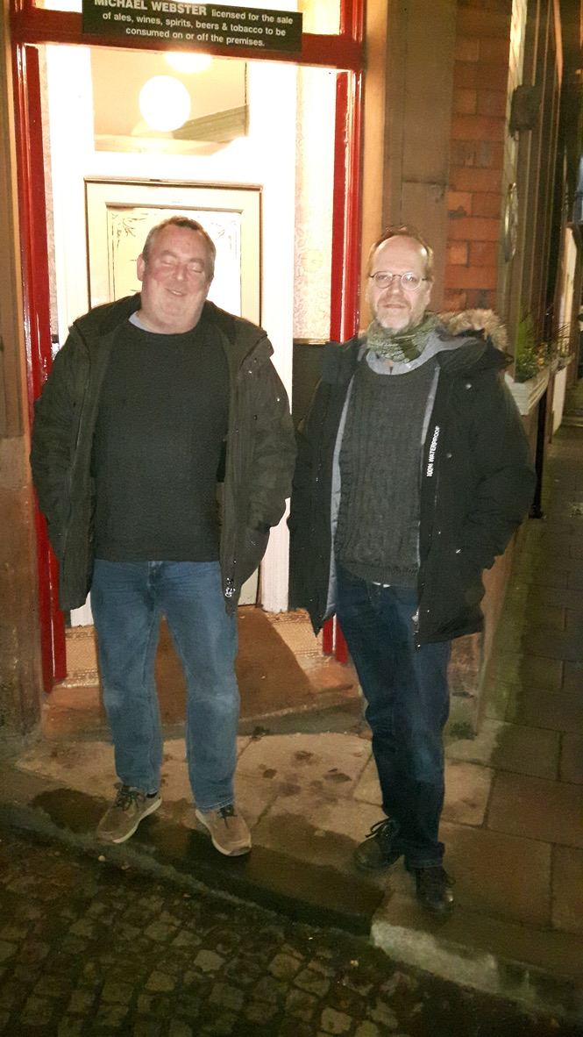
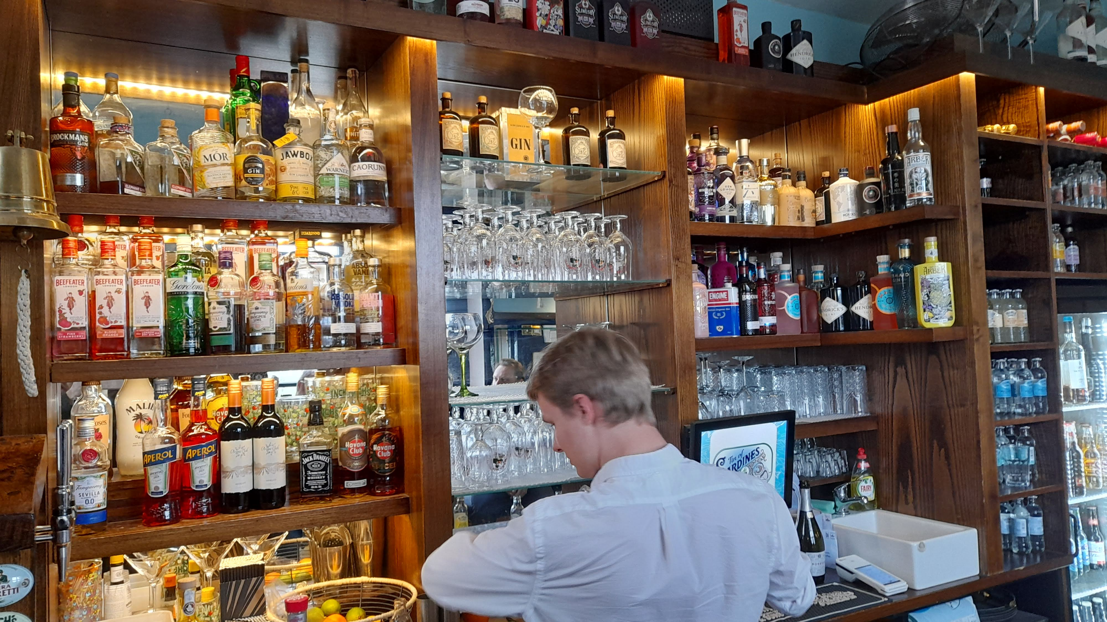
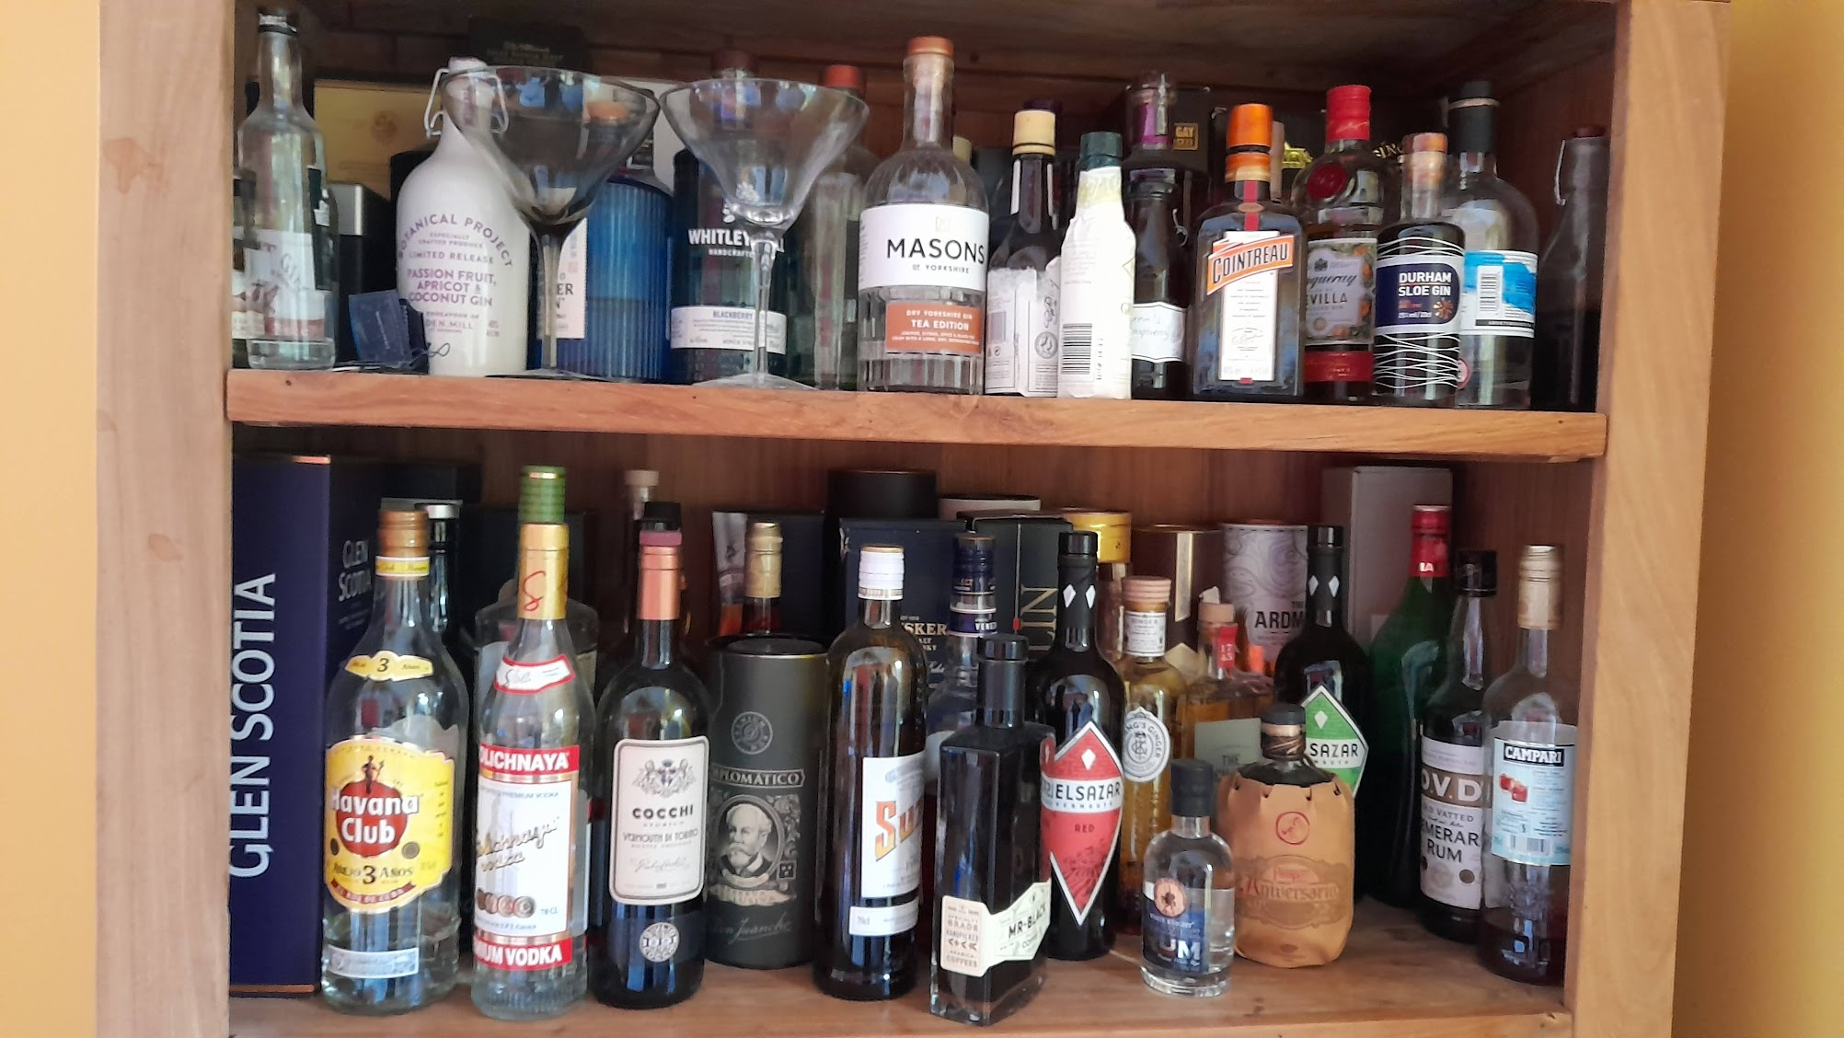
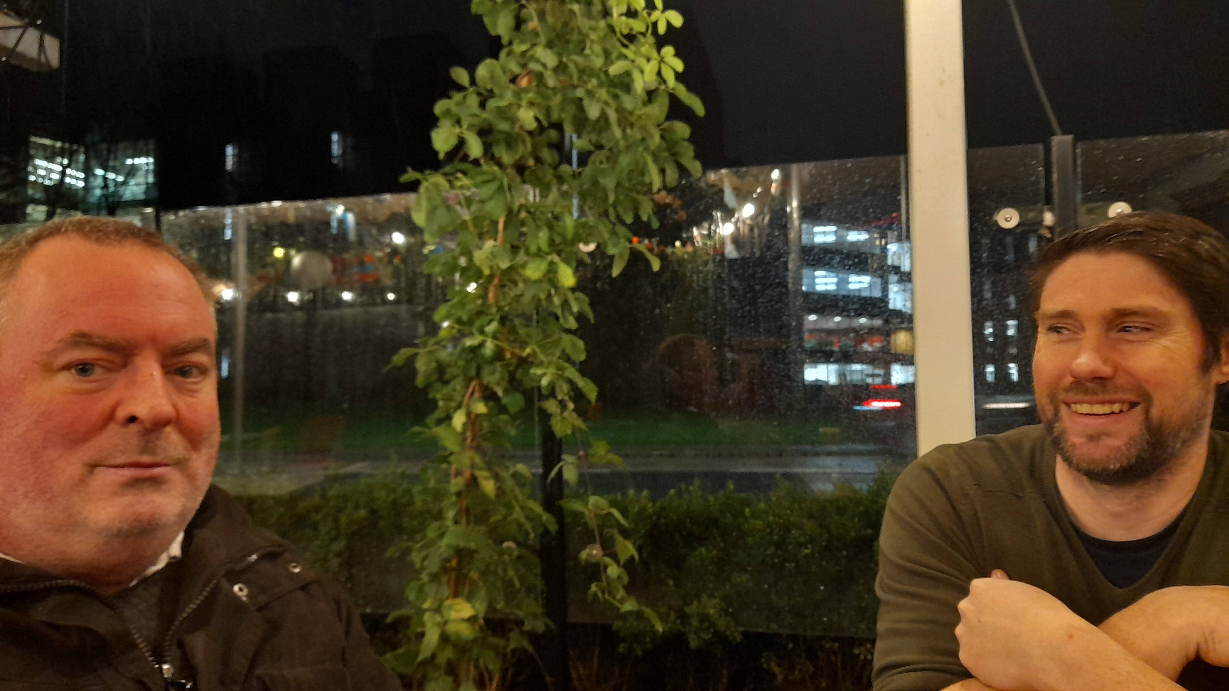
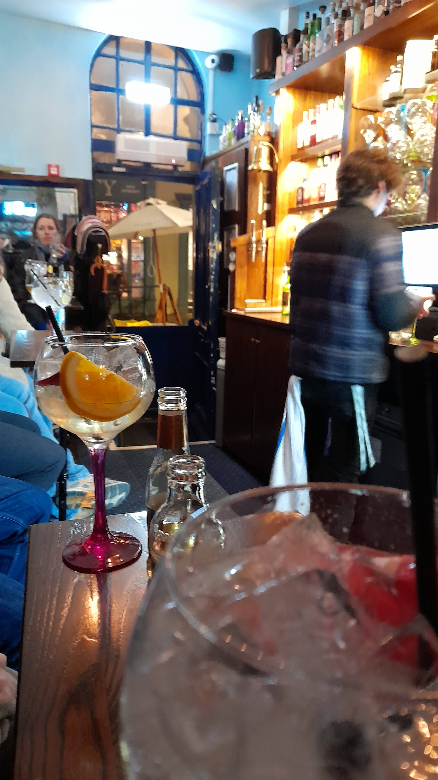
Notes:
New Inn “tuna”. Grey College Food.

Slide 6
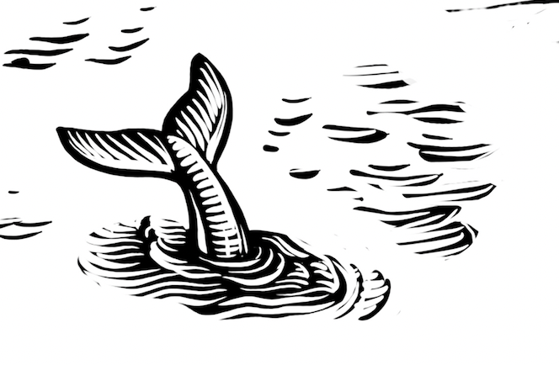
And food?

Slide 7
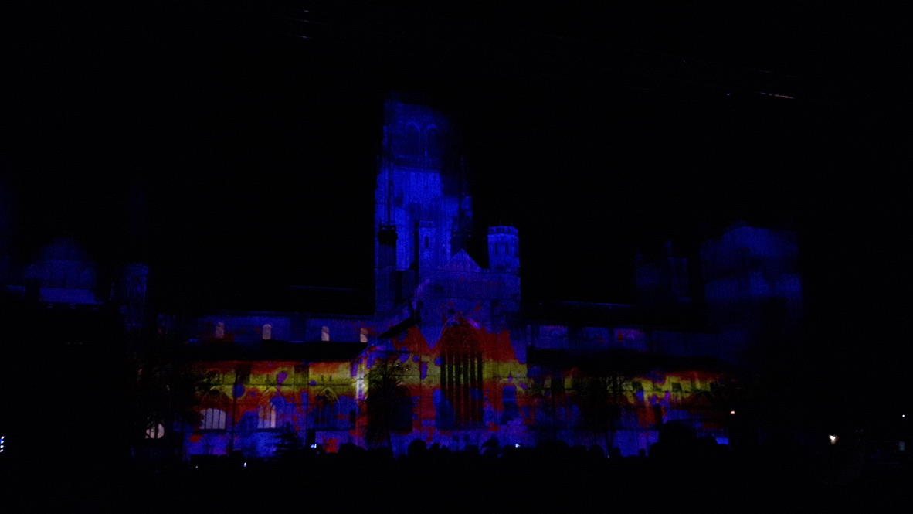
Notes:
Used to be upstairs

Slide 8
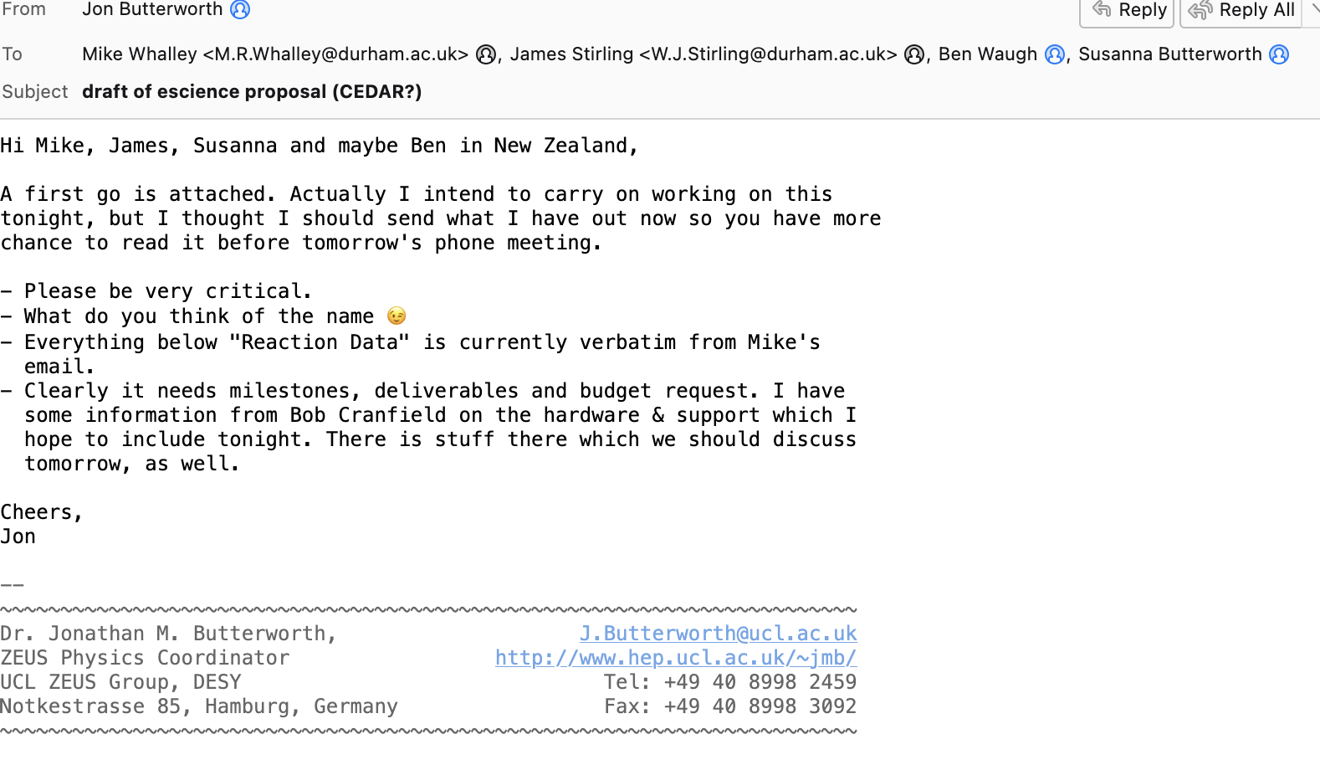
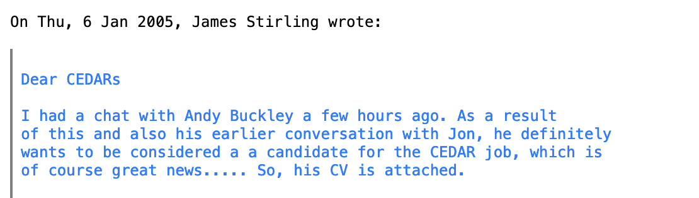
The Biggest Impact?

Slide 9
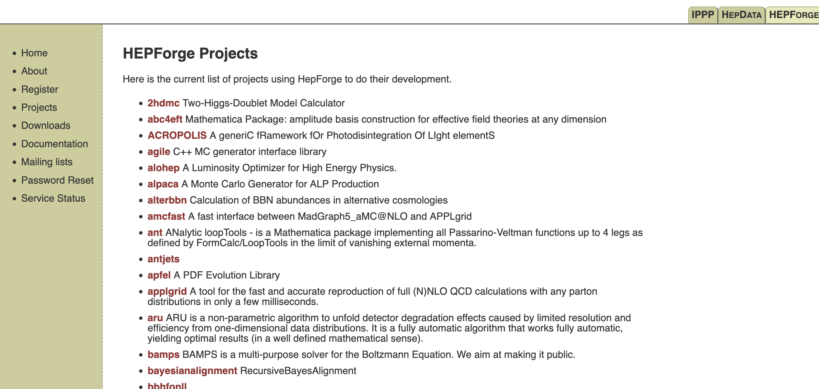

Slide 10
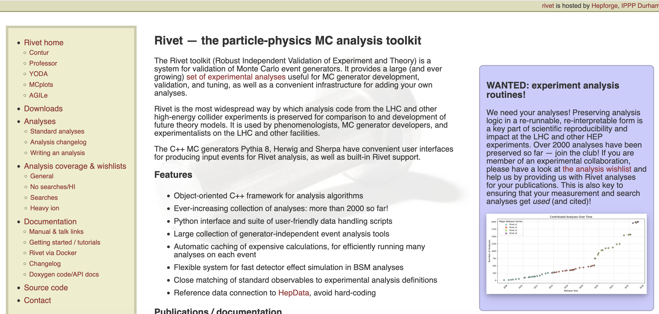

Slide 11
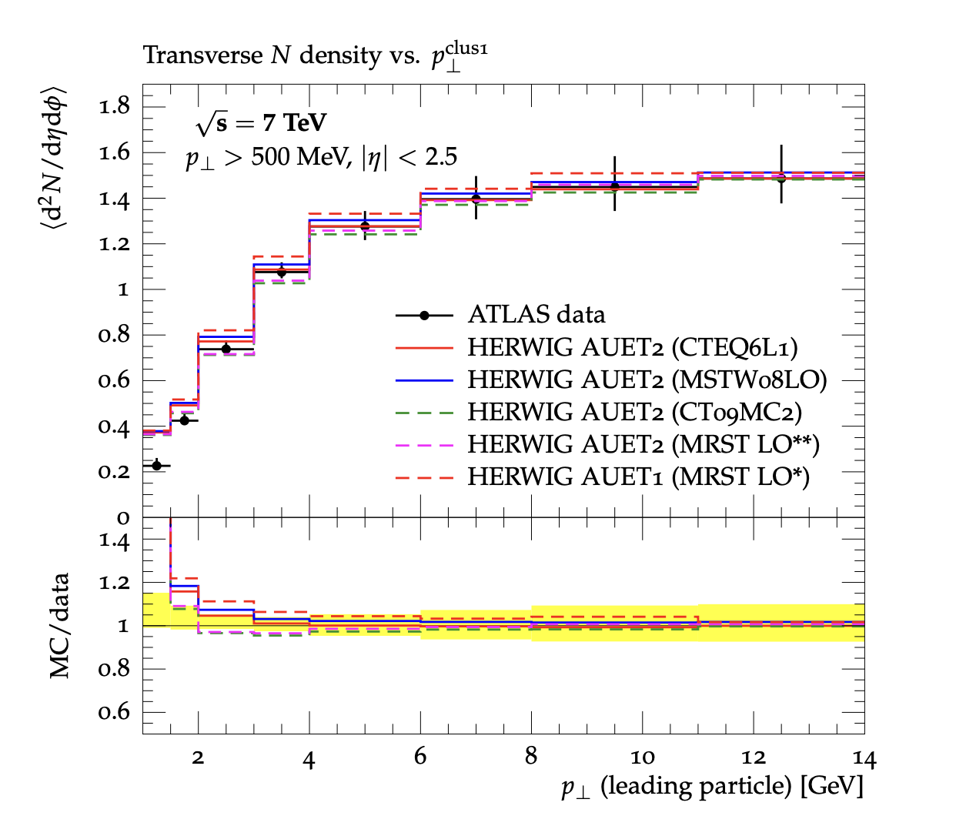

Introducing Rivet “Robust Independent Validation of Experiment and Theory” arXiv:1003.0694, arXiv:1912.05451
Direct legacy from HERA (1990s, HZTOOL)
Developed by for tuning and validation of new MC event generators
e.g. What does the underlying event look like in 7 TeV pp collisions?
Vast library of measurements of final state particles produced in collisions, and variables derived from them
Buckley et al, Bierlich et al
From ATL-PHYS-PUB-2011-008

Slide 12
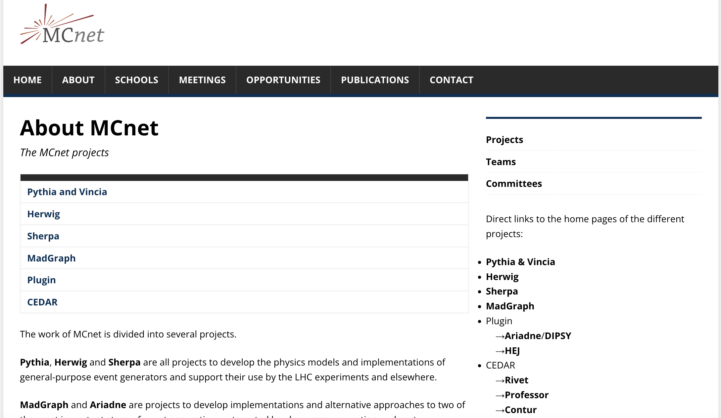

Slide 13
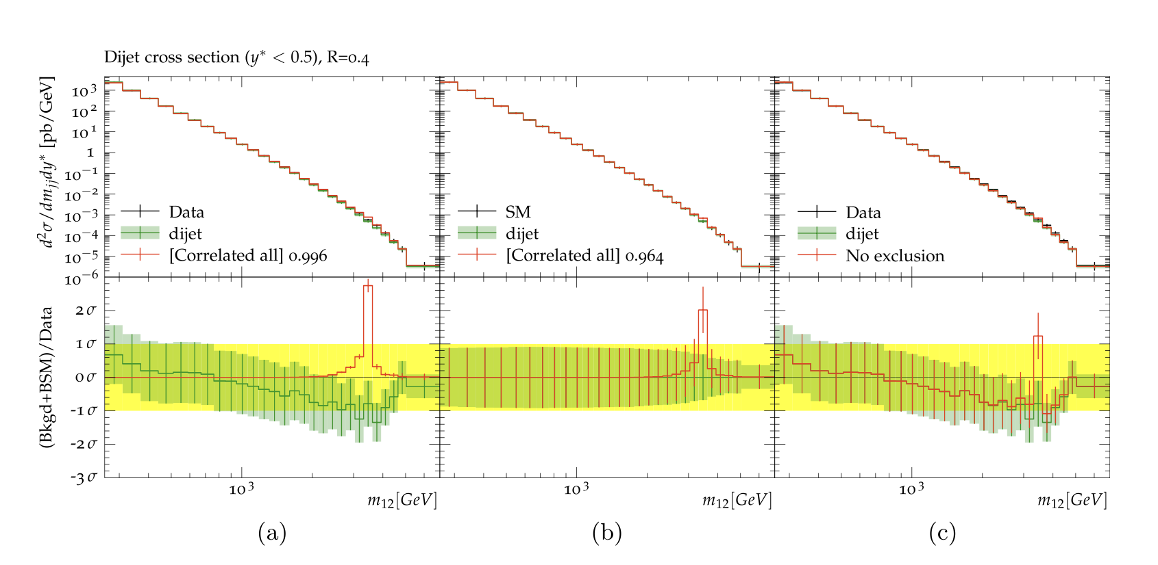
Introducing Contur “Constraints On New Theories Using Rivet”
Extend the power of Rivet beyond the Standard Model
Signal-injection of final-state particles from Beyond-the-SM physics events on to the measured cross sections in Rivet
From Altakach, JMB, Ježo, Klasen, Schienbein arXiv:2111.15406 (SciPost Core)
Increasingly precise measurements and calculations together extend the reach
JMB, Grellscheid, Krämer, Sarrazin, Yallup; Buckley et al
arXiv:1606.05296 (JHEP), arXiv:2102.04377 (SciPost)

Slide 14
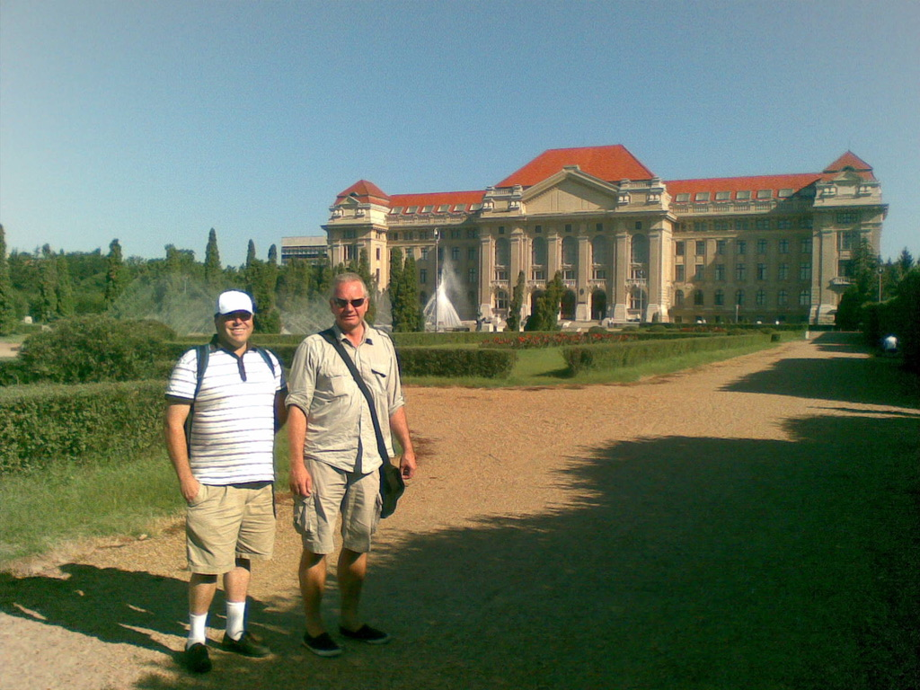
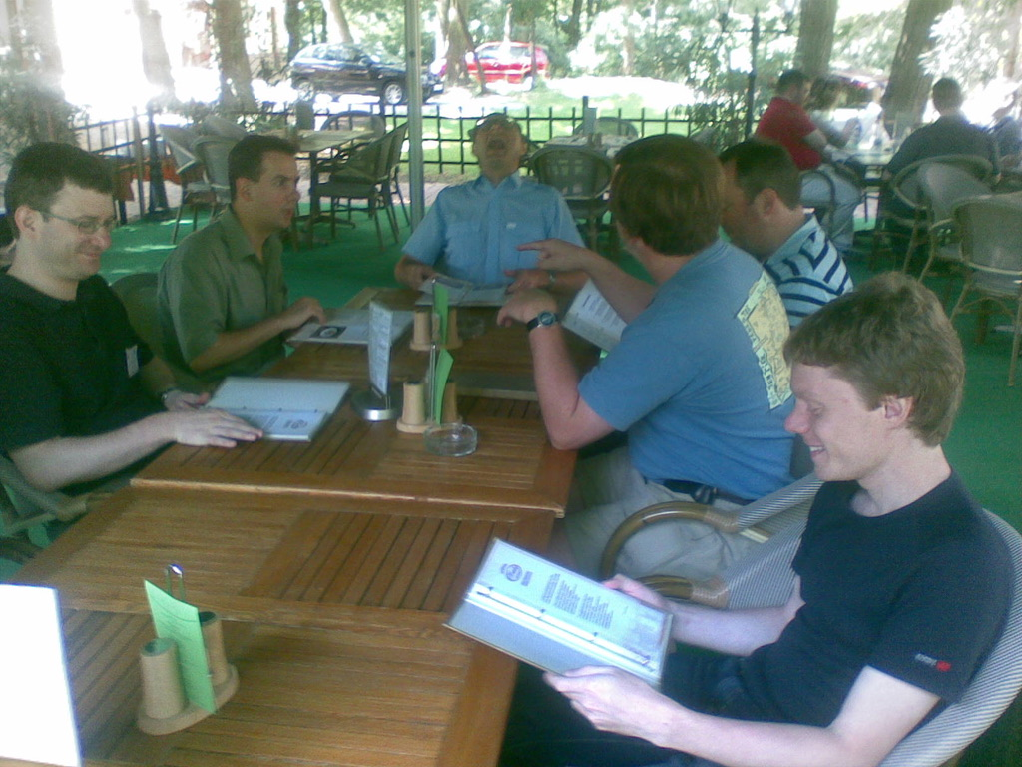
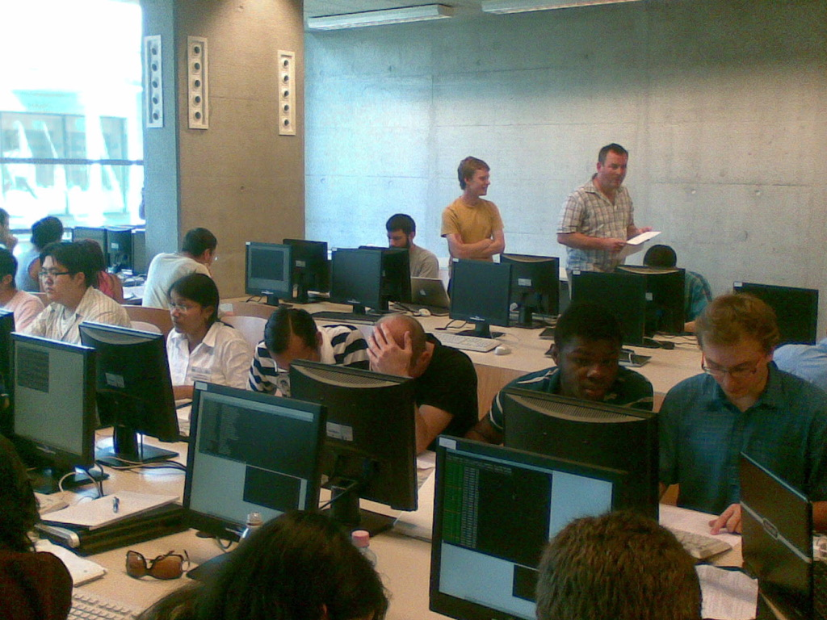
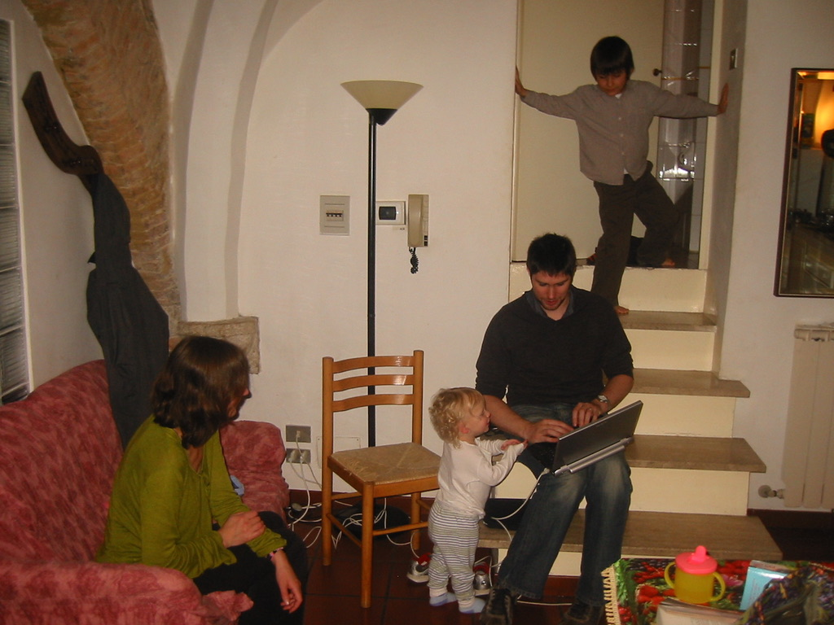

Slide 15
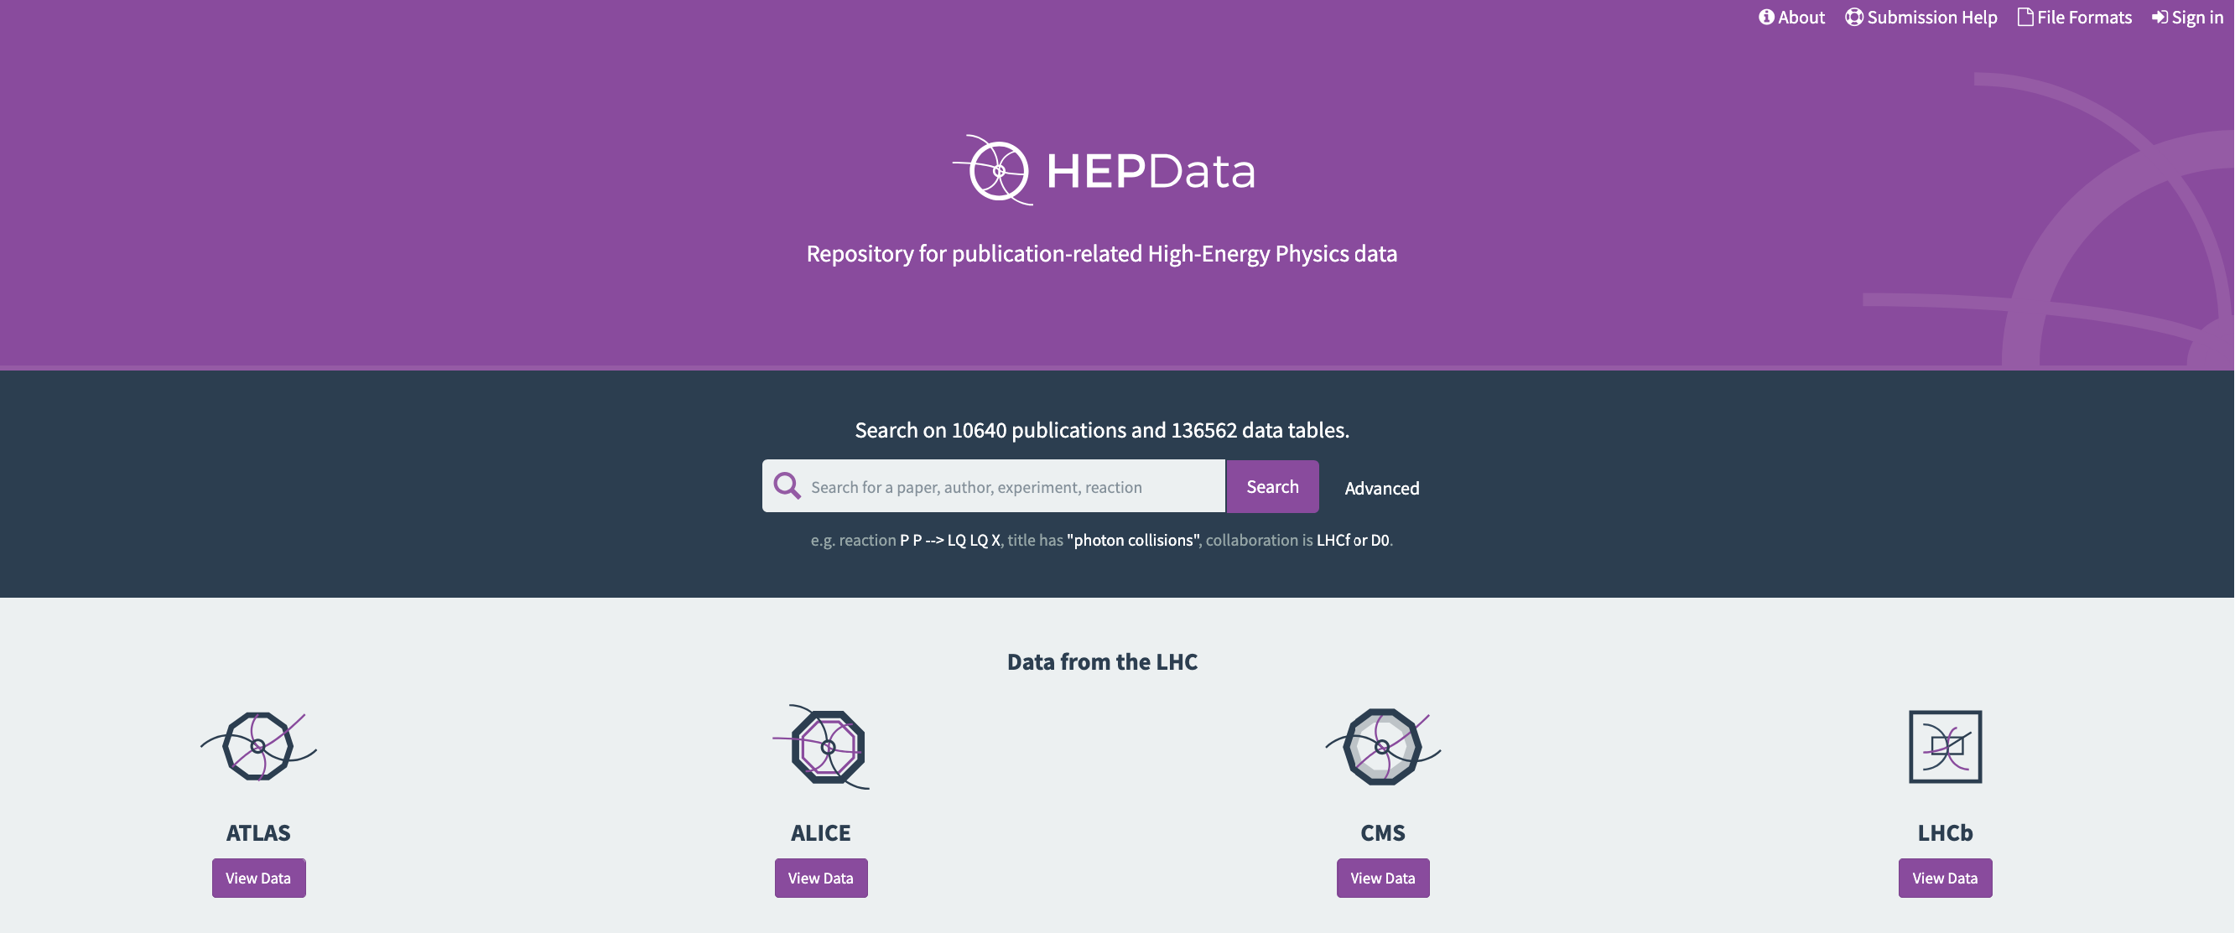


Slide 16
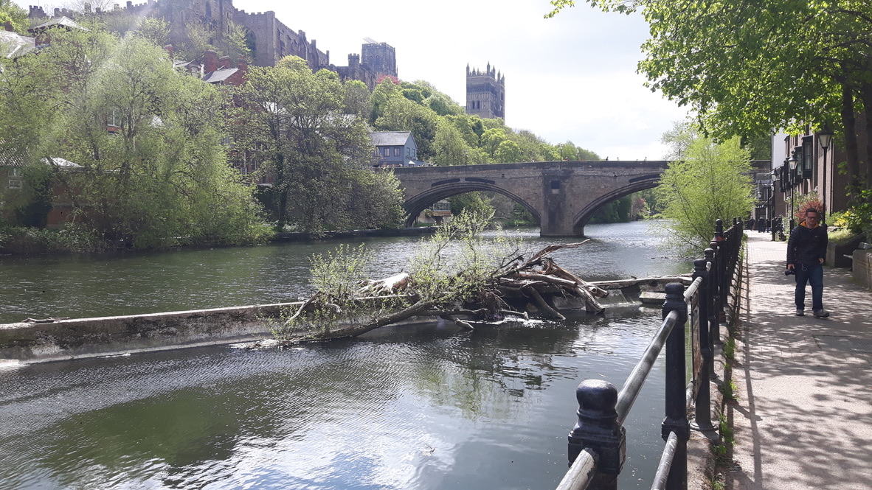
It is always sunny in Durham

Slide 17
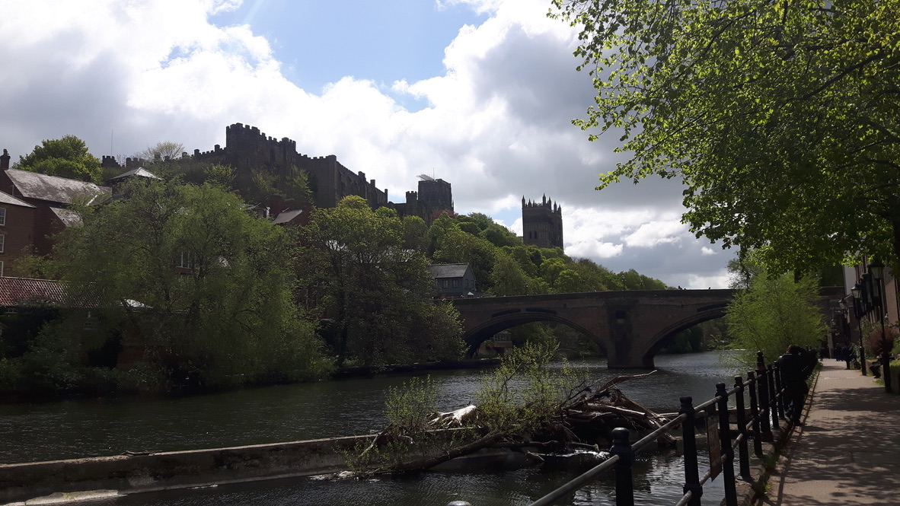
It is always sunny in Durham

Slide 18
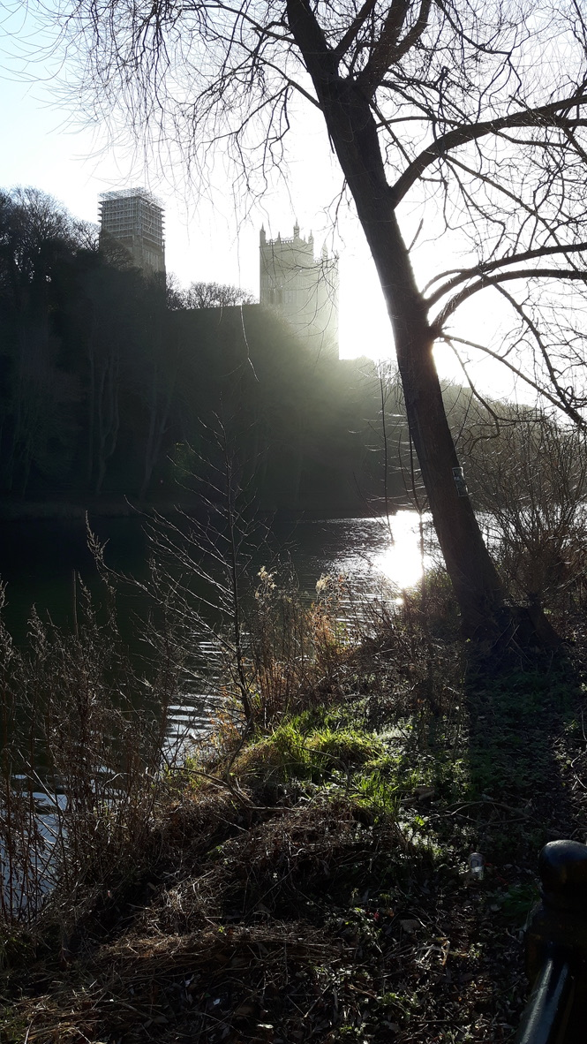
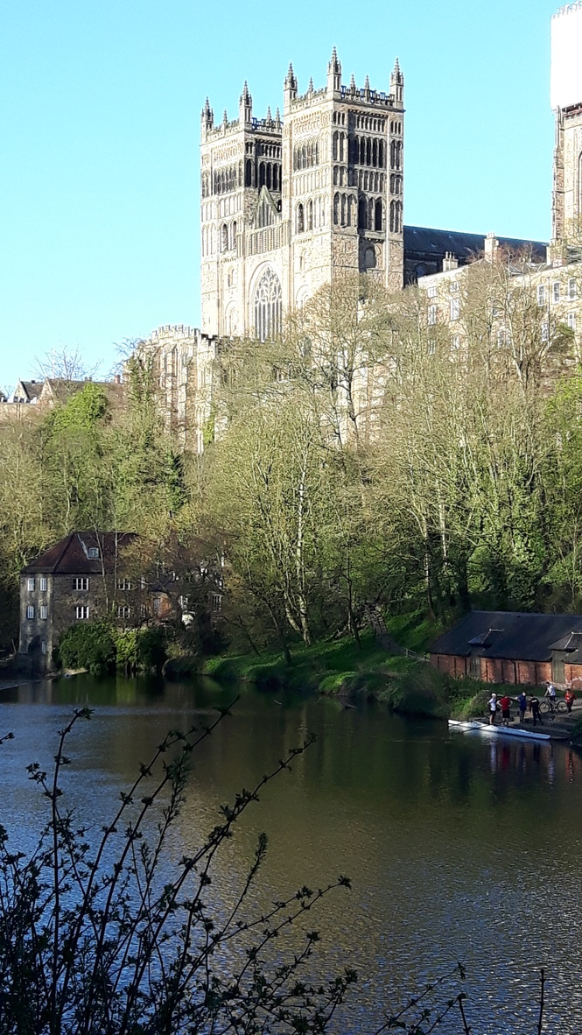
It is always sunny in Durham

Slide 19
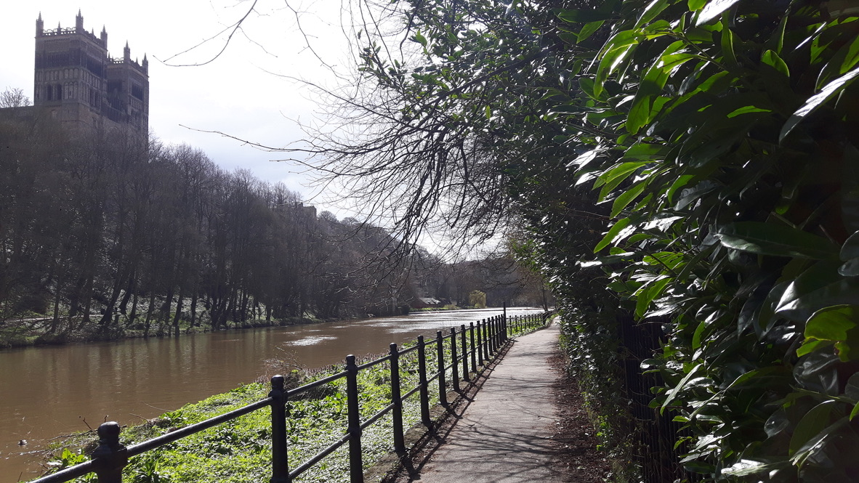
It is always sunny in Durham

Slide 20
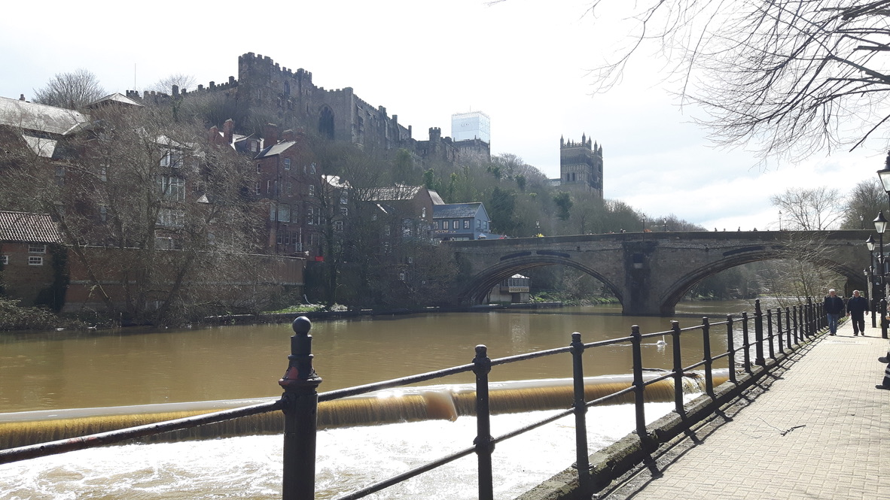
It is always sunny in Durham

Slide 21
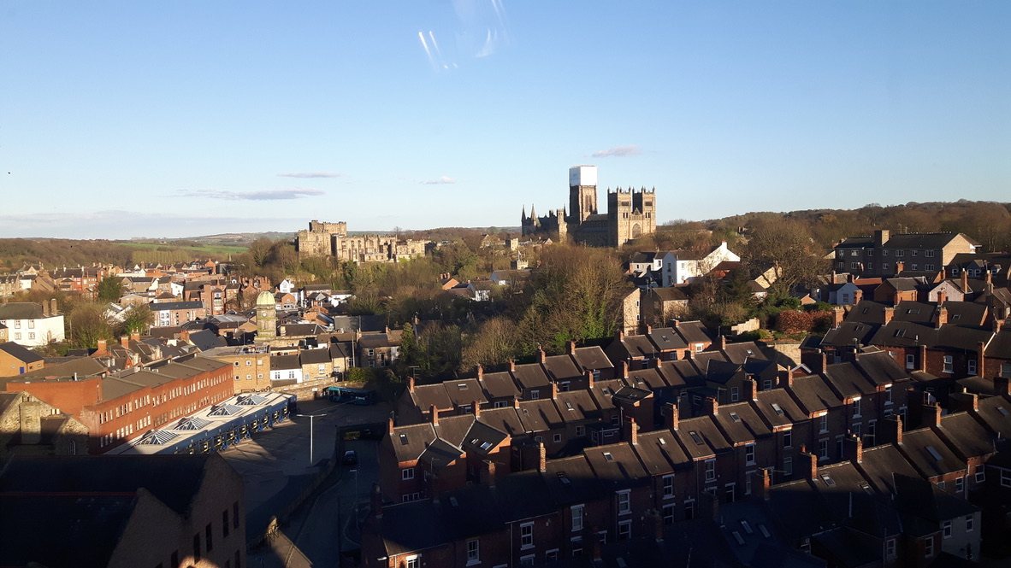
It is always sunny in Durham

Slide 22
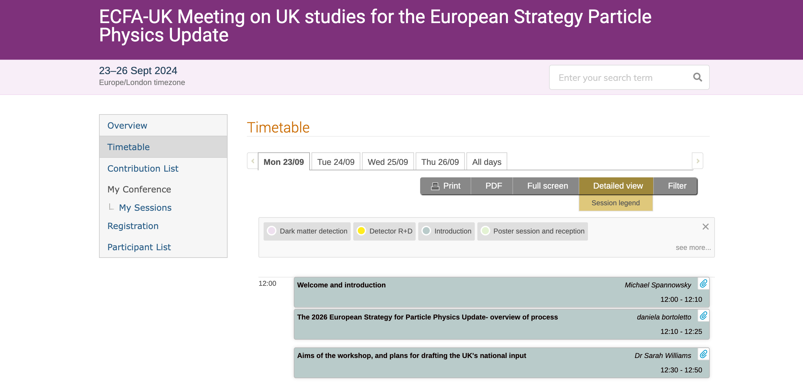
Except when it isn’t

Slide 23
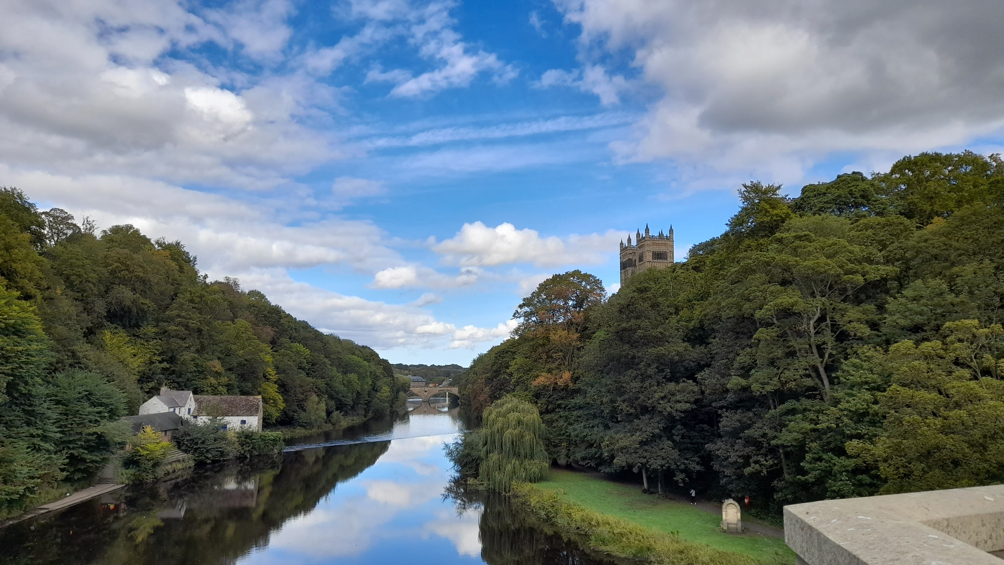
It really is always sunny in Durham

Slide 24
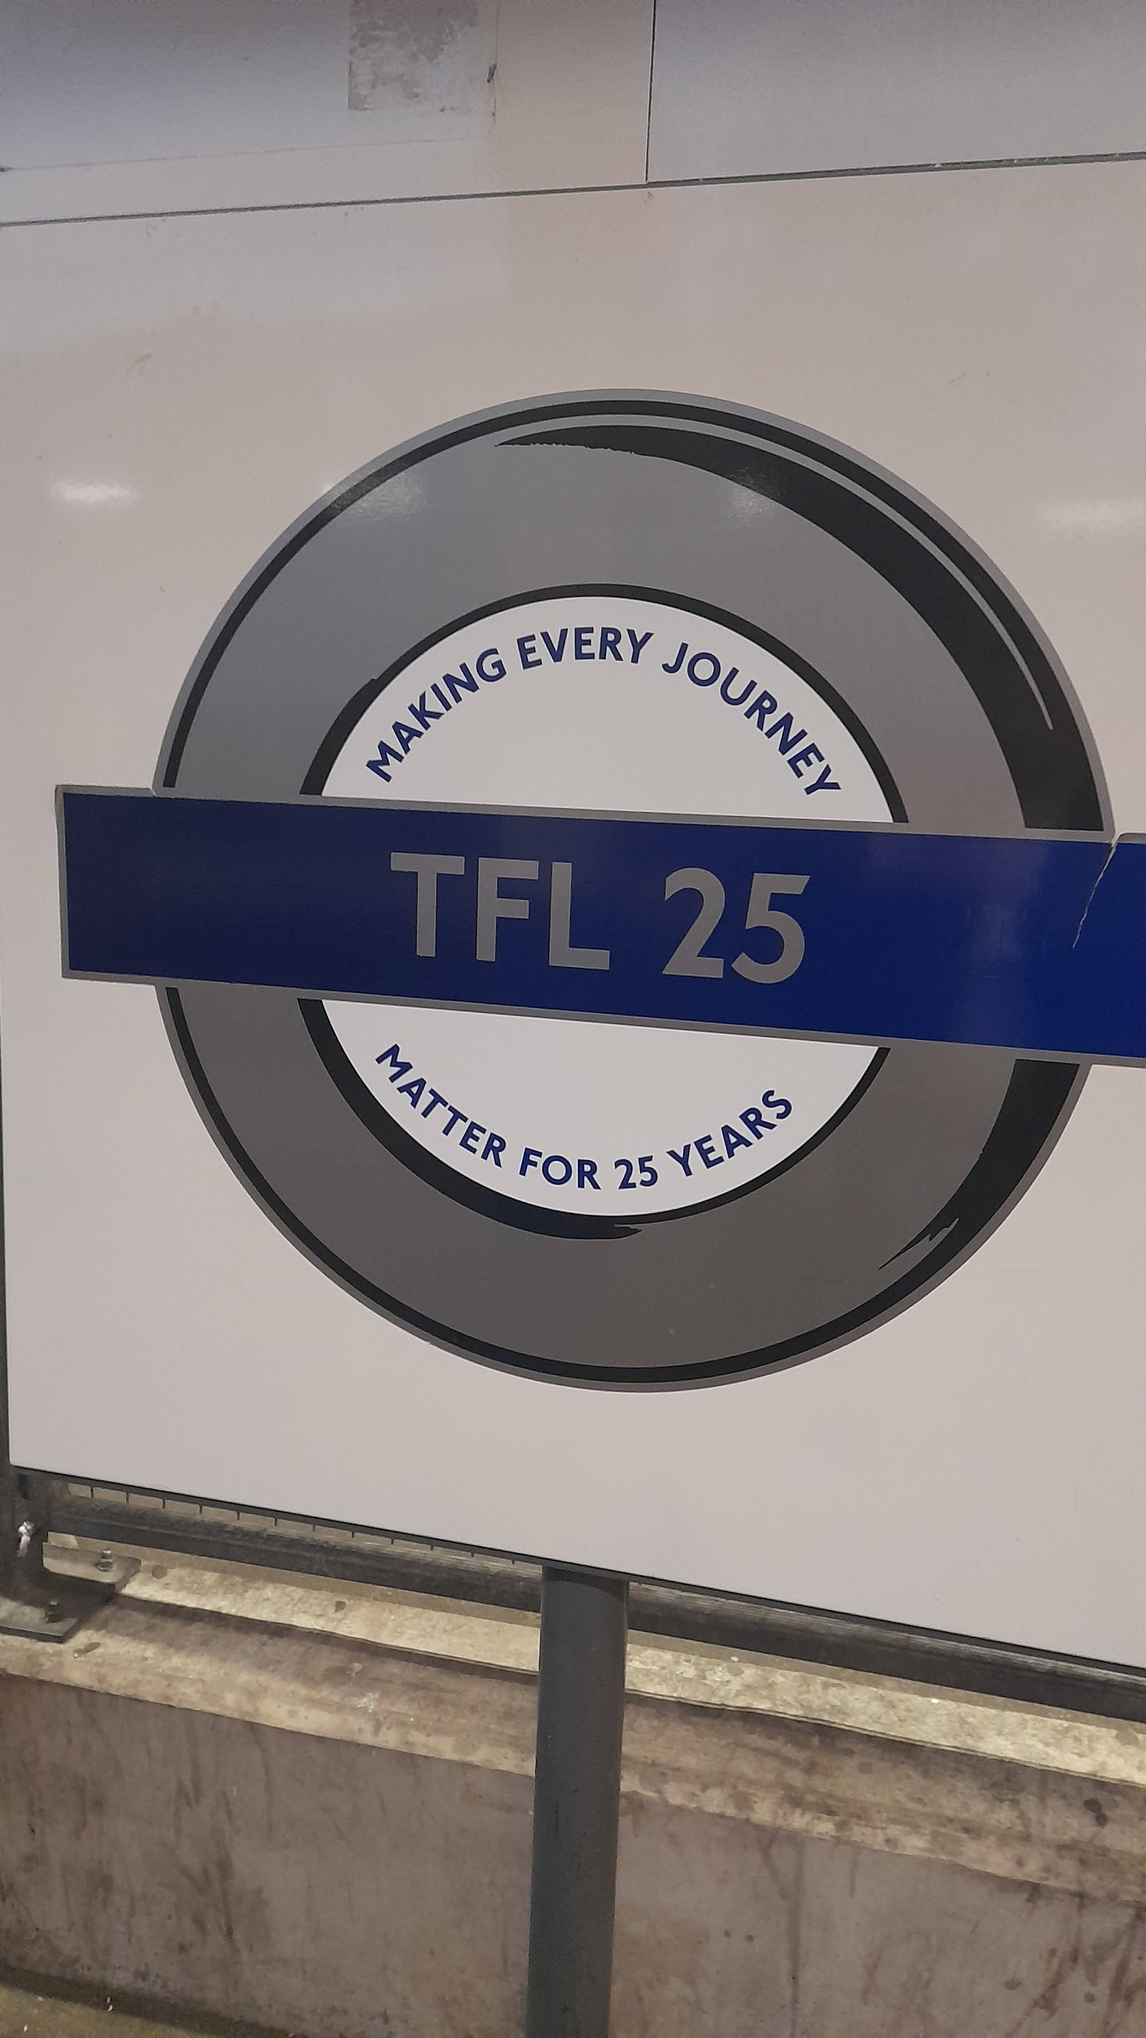
IPPP 25

