Slide 1
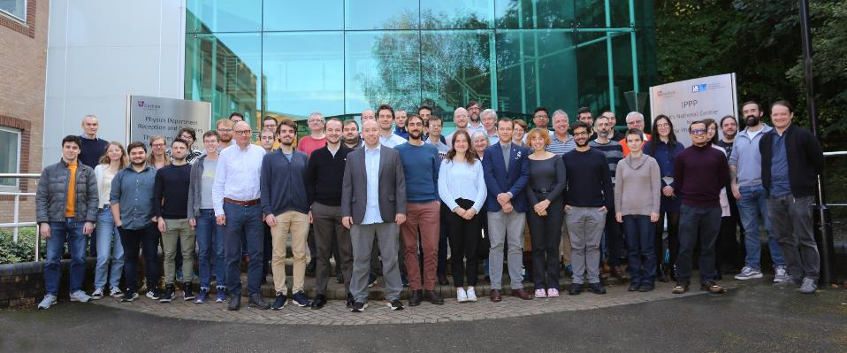
The IPPP and Me
Stolen from the IPPP Website
Ken Peach
25th September 2025
25th Anniversary of the Institute for Particle Physics Phenomenology
Durham

Slide 2
… in the beginning …
Durham April 1970
IoP High Energy Physics Conference
My first Conference presentation
Durham September 2025
Probably my last Conference presentation
Thanks for inviting me back
December 1991
PPC; UK Phenomenology Initiative
2nd Workshop: December 1991, Edinburgh
Peter Clarke¹, Frank Close², KP³, Dave Richards³
B-Phenomenology [J.Phys.G. 18 1573-1724 1992]
Two (out of 39) participants from Durham: James Stirling & David Summers
1st Workshop: December 1990, Durham
JET Studies at LEP and HERA [J.Phys.G. 17 1441-1624 1992]
1 Brunel; 2 RAL; 3 Edinburgh

Slide 3
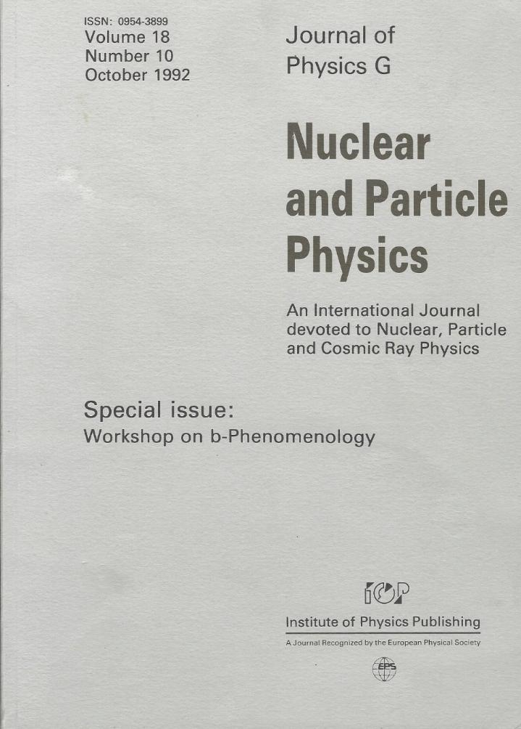
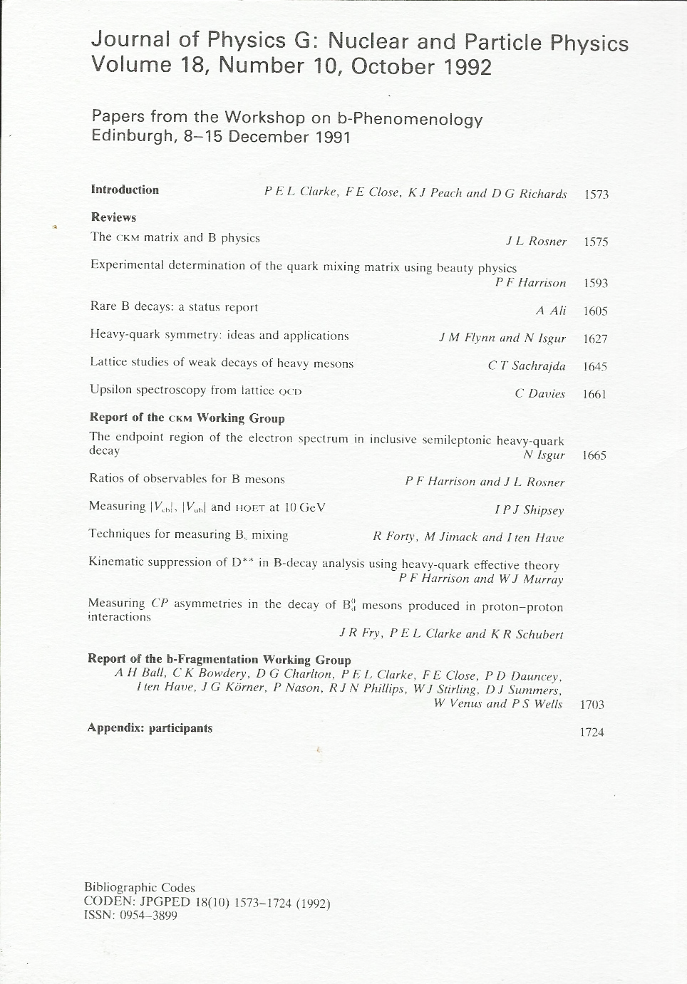
Proceedings

Slide 4
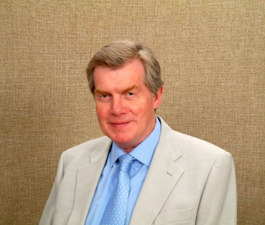
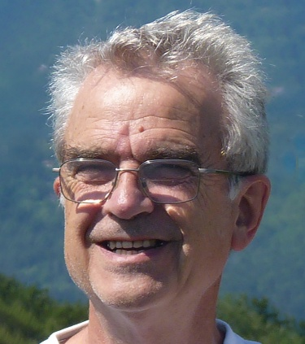
1998-2000
PPARC created the IPPP 2000
Initiative of Ian Halliday, CEO PPARC
MRS (Martin¹, Roberts², Stirling¹)
Phenomenology at its best
>9,000 citations³
Alan Martin
Kaons, CKM, …
Dick Roberts
Retired from RAL in 2000, after 30 years
The RAL Theory group was disbanded
and the IPPP rose from its ashes
1937 -
1940 - 2020
A
B
Durham
RAL
INSPIRE-HEP
A) Http://durham.ac.uk
B) Graham Ross
C) https://royalsocietypublishing.org/doi/10.1098/rsbm.2019.0031, Fair use, https://en.wikipedia.org/w/index.php?curid=62668412

Slide 5
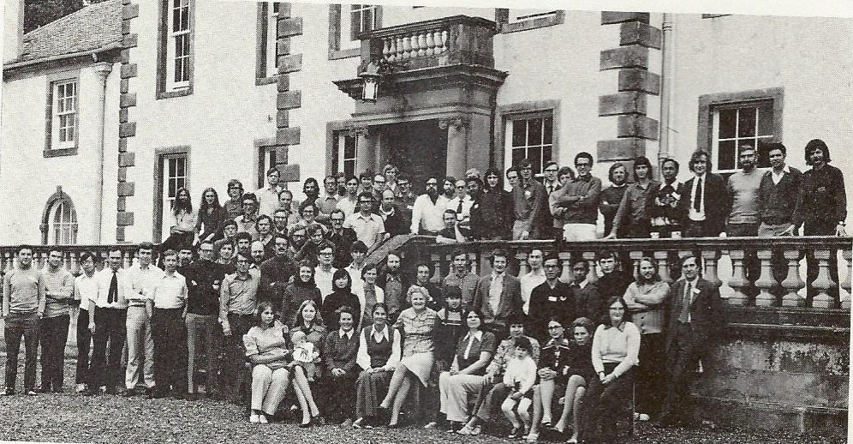


SUSSP14 Middleton Hall 1973
Phenomenology of Particles at High Energy

Slide 6
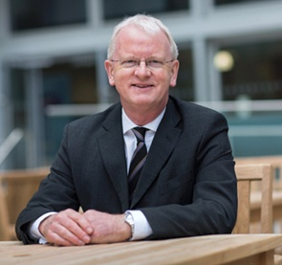
1998-2000
PPARC created the IPPP 2000
Initiative of Ian Halliday, CEO PPARC
MRS (Martin¹, Roberts², Stirling¹)
Phenomenology at its best
>9,000 citations³
Alan Martin
Kaons, CKM, …
Dick Roberts
Retired from RAL in 2000, after 30 years
The RAL Theory group was disbanded
and the IPPP rose from its ashes
James Stirling: IPPP Director
Remembering James
1937 -
1940 - 2020
A
B
1953 - 2018
Durham
RAL
INSPIRE-HEP
C
A) Http://durham.ac.uk
B) Graham Ross
C) https://royalsocietypublishing.org/doi/10.1098/rsbm.2019.0031, Fair use, https://en.wikipedia.org/w/index.php?curid=62668412

Slide 7
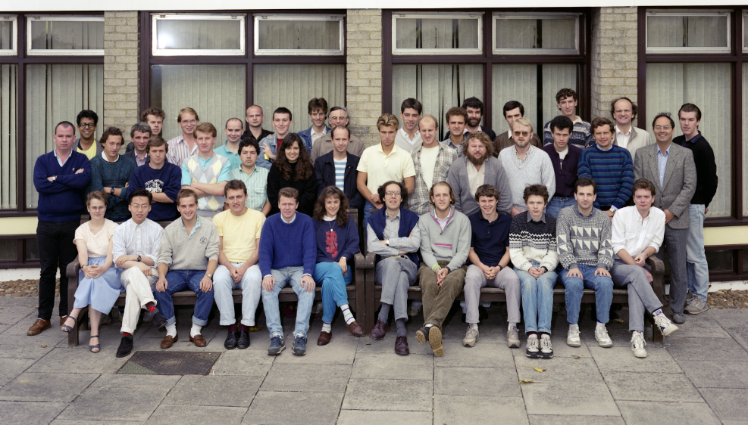

RAL Summer School 1988
https://www.ppd.stfc.ac.uk/Pages/Past-Schools.aspx

Slide 8
1998-2000
PPARC created the IPPP 2000
Initiative of Ian Halliday, CEO PPARC
MRS (Martin¹, Roberts², Stirling¹)
Phenomenology at its best
>9,000 citations³
Alan Martin
Kaons, CKM, …
Dick Roberts
Retired from RAL in 2000, after 30 years
The RAL Theory group was disbanded
and the IPPP rose from its ashes
James Stirling: IPPP Director
Remembering James
1937 -
1940 - 2020
A
B
1953 - 2018
Durham
RAL
INSPIRE-HEP
C
A) Http://durham.ac.uk
B) Graham Ross
C) https://royalsocietypublishing.org/doi/10.1098/rsbm.2019.0031, Fair use, https://en.wikipedia.org/w/index.php?curid=62668412

Slide 9
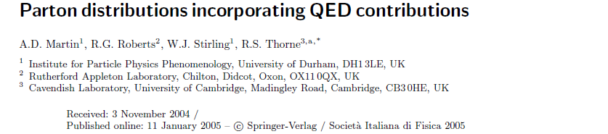
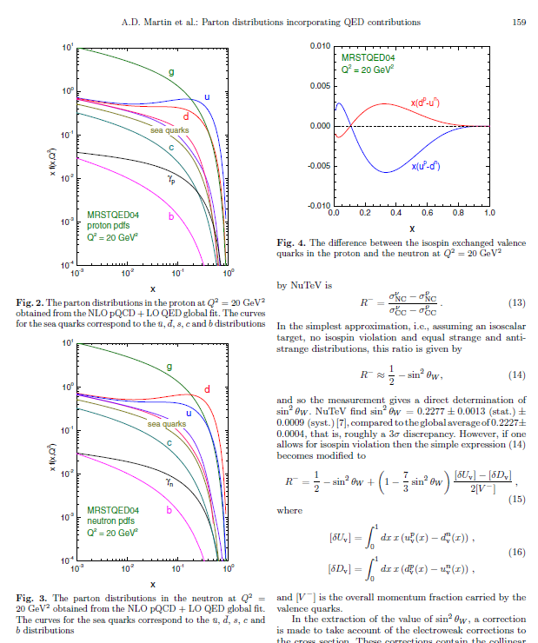
An example (2004)
Abstract. We perform a global parton analysis of deep inelastic and related hard-scattering data, including O(α_{QED}) corrections to the parton evolution. Although the quality of the fit is essentially unchanged, there are two important physical consequences. First, the different DGLAP evolution of u and d type quarks introduces isospin violation, i.e. up = dn, which is found to be unambiguously in the direction to reduce the NuTeV sin² θ_{W} anomaly. A second consequence is the appearance of photon parton distributions γ(x,Q²) of the proton and the neutron. In principle these can be measured at HERA via the deep inelastic scattering processes eN → eγX; our predictions are in agreement with the present data.
544 Citations (INSPIRE-HEP)

Slide 10
1998
January 5th: started as Director PPD@RAL
February: Report by Peter Norton
Workshop on Muon Colliders, Montauk
During the talk, I realised that half a Muon Collider
would make a superb Neutrino Beam
Ideal for CP-violation in the neutrino sector
Disappointed that many people had the same idea
The key to a Neutrino Factory
A multi-MW ~ 10 GeV Proton Driver
ISIS: a 0.25MW 0.8 GeV Proton Driver - UK Expertise!
Already 10% of a Neutrino Fcatory
Formed UK NF Accelerator Programme
Floated idea of hosting in UK
Fits on the RAL Site
Long Baselines
Gran Sasso, Soudan, Sudbury (SNOLab), Kamiokande

Slide 11
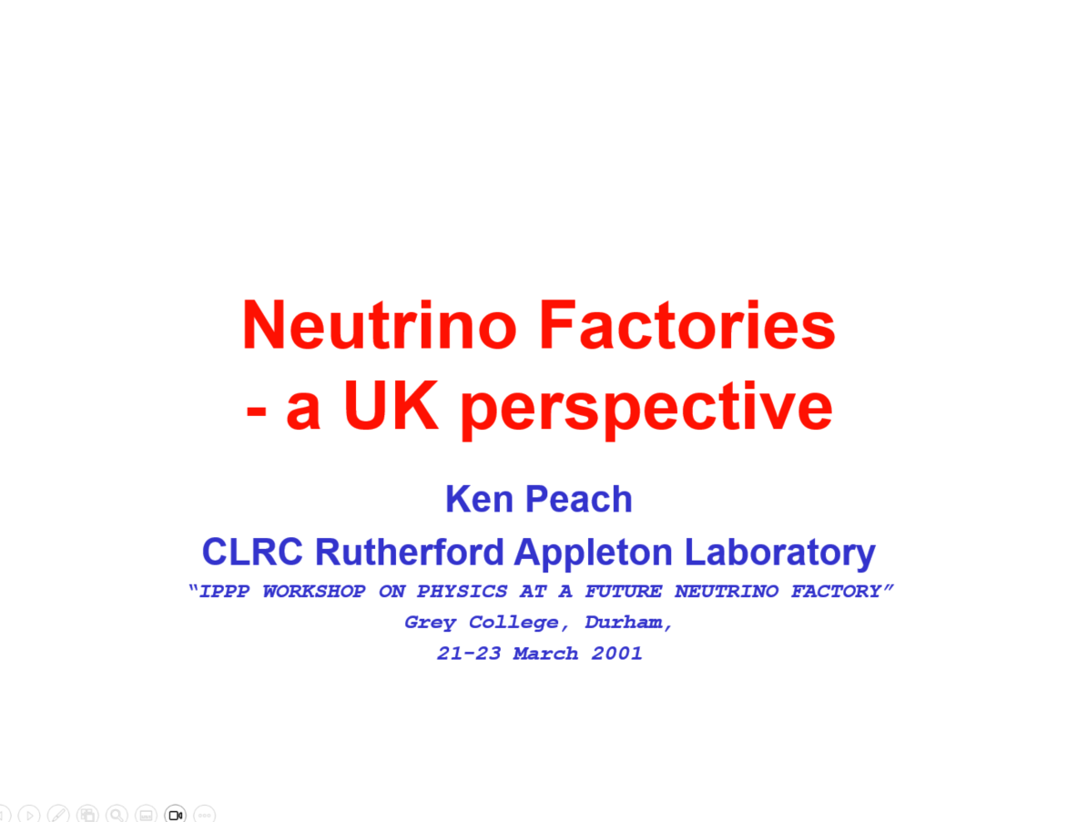
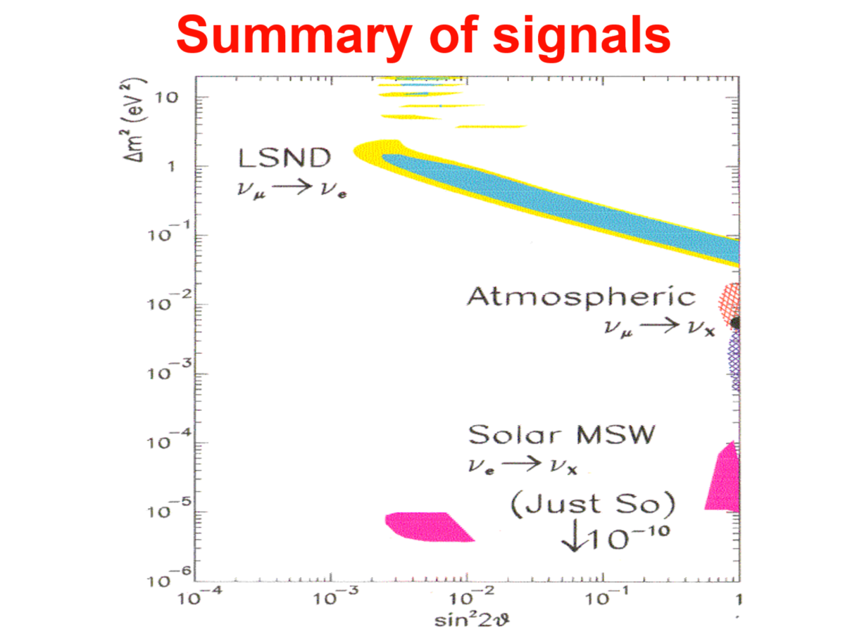
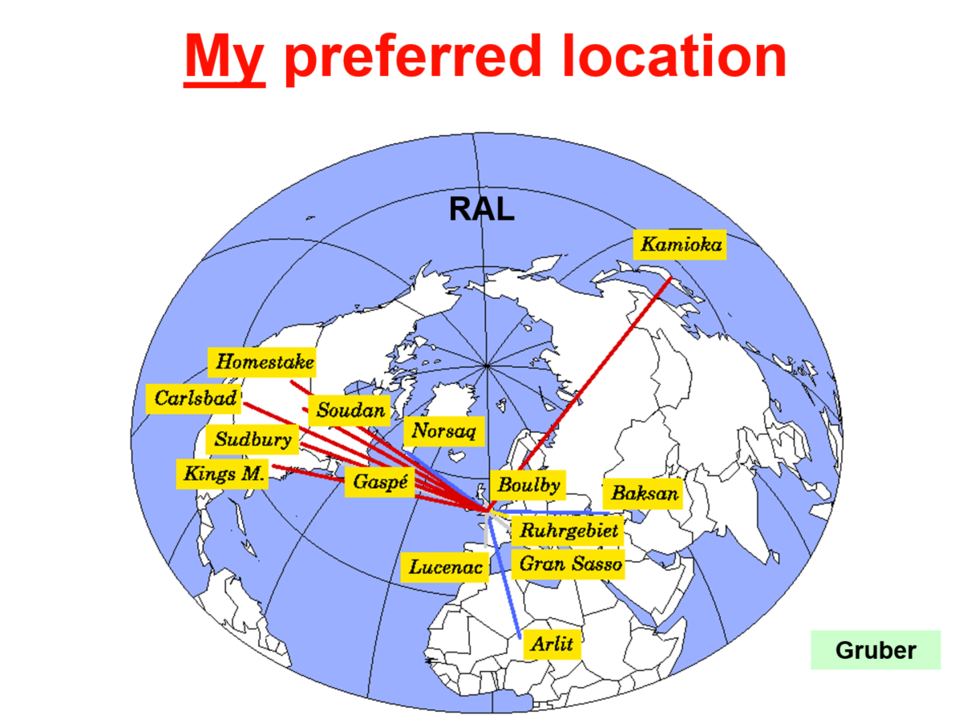
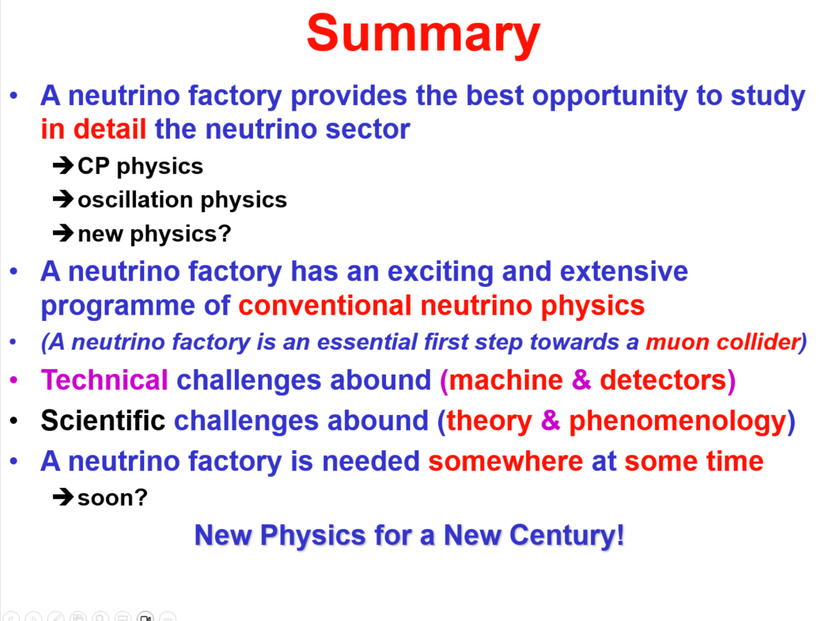
IPPP 21-23 March 2001

Slide 12
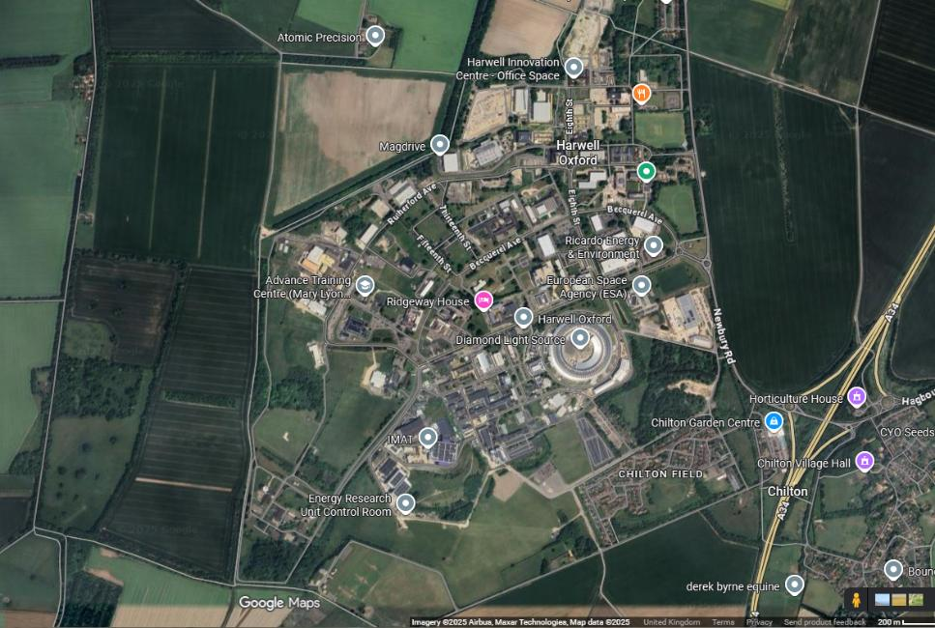
Sketch Layout @ RAL
[ 900–1000 m below ground ]
Return leg
To Soudan or SNOLab
To G Sasso
To Super-K
3 × FFAGs 3–8 GeV 8–20 GeV 20–50 GeV
A daydream
3 GeV linac
Cooling
Phase rot.
Target
~10 GeV synch. + booster + linac
Google Maps

Slide 13

Supporting Neutrino Physics
Silvia Pascoli
Silvia joined the IPPP in 2005
When I transferred to Oxford as Director, JAI
UK Neutrino Factory Project well-established
During my 5 years at the JAI (2005-2010)
Silvia wrote or co-wrote 23 papers on neutrino physics
more than 2,600 citations, including
The search for heavy Majorana neutrinos,
Atre, Han, Pascoli, Yang, JHEP 5 30 (2009, 710 citations)
Theory of neutrinos; A white paper
Mohapatra et al, Rep. Progr. Phys. 70 1757 (2007, 416 citations)
Leptogenesis and low energy CP-violation in neutrino physics
Nucl. Phys. B 774 1 (2007, 177 citations)
This was a major contribution to neutrino physics
Unibo.it

Slide 14

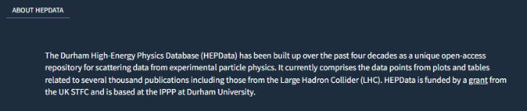
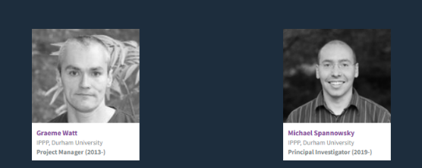
A vital resource
Complementary to the Particle Data Tables
Images: http://hepdata.net

Slide 15
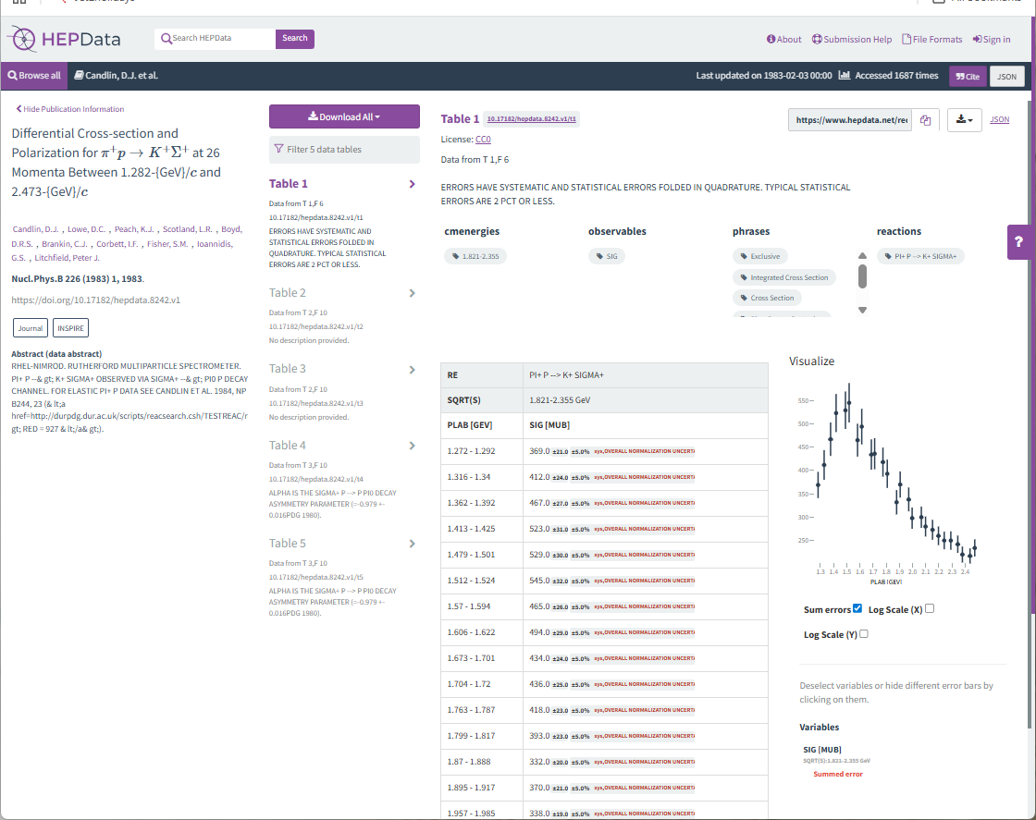
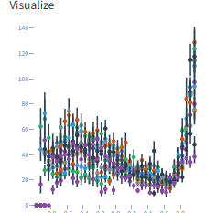
π⁺p → K⁺Σ⁺

Slide 16
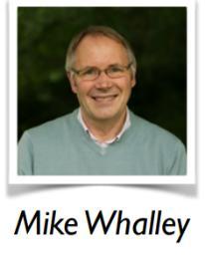
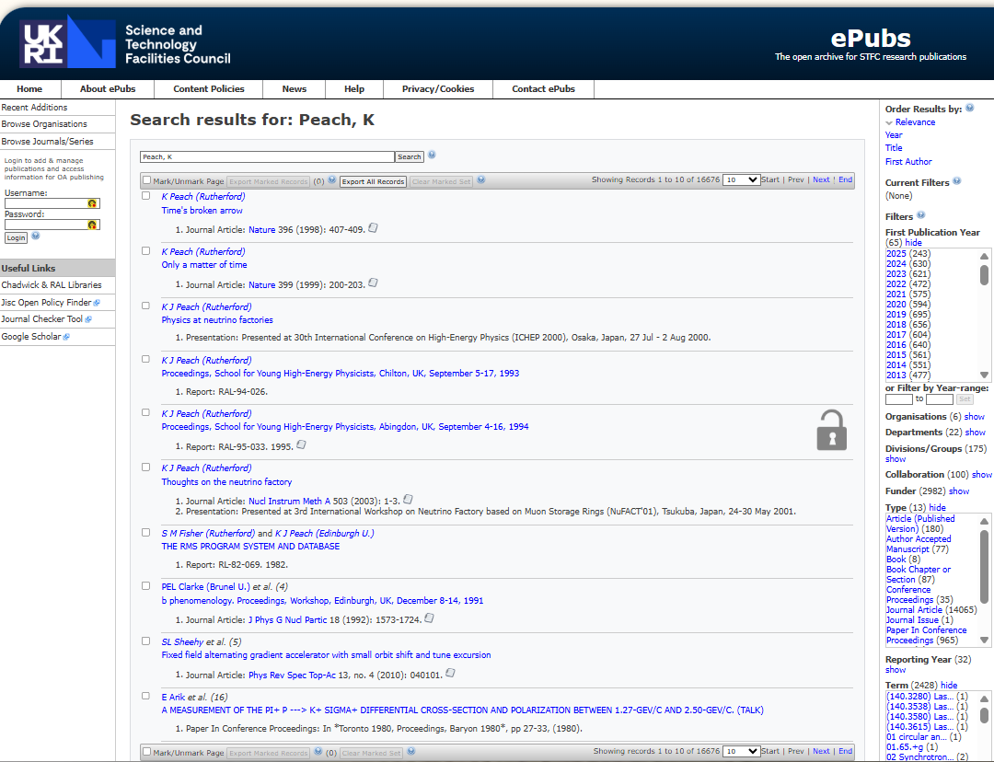
STFC (né CCLRC in ~ 2003) e-Pubs
Institutional Repository https://epubs.stfc.ac.uk/
Hepdata Users’ tutorial 2016
Uploaded from the Durham/IPPP copy of the database by Mike Whalley, transferred to CCLRC Library in Dublin Core (DCMI) format.
Instantly created the world’s largest institutional repository.

Slide 17
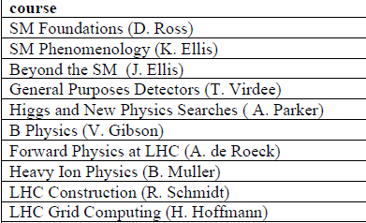

Other IPPP Contributions
SUSSP57
(August 17-28 2003 St. Andrews)
Tony Doyle (Glasgow), James Stirling (IPPP)
co-Directors
LHC Phenomenology
SUSSP61
(August 8-23 St. Andrews)
Nigel Glover (IPPP), KP (JAI) co-Directors
Neutrinos in Particle Physics, Astrophysics and Cosmology
SUSSP61

Slide 18
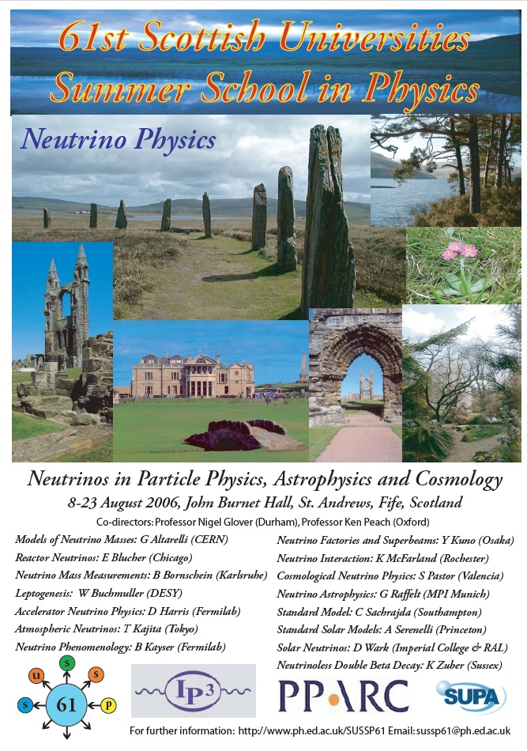
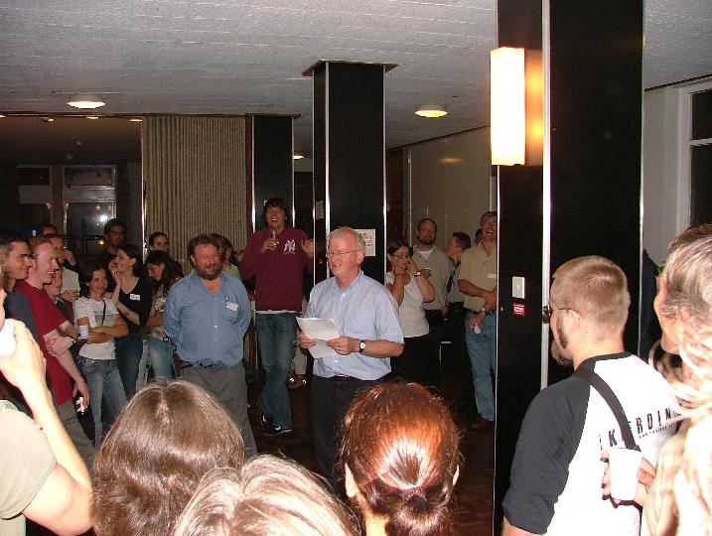

Poster Session
The A to Z of Neutrinos
Nobel Prize (2015)

Slide 19

From the Preface to the Proceedings
But Summer Schools are not just about science - they are about dialogue, discussion, meeting people, and forming lifelong friendships. The School succeeded in this secondary aim, aided by a full social programme, including a memorable whisky tasting provided by Colin Scott and his team from Chivas Bros Ltd, and the friendly environment provided by the staff of the John Burnet Hall. Within this relaxed atmosphere, the scientific discussions and personal interactions flourished.
[…]
Neutrinos may be elusive, but they are important. Without them, the sun does not shine, supernovae do not happen, the trace elements which make life possible would not exist, and perhaps the Universe itself would be a cold, empty space. We hope that you will find all that you want to know about the neutrino, and more, in this book.
Nigel Glover and Ken Peach
Co-Directors, January 2008

Slide 20
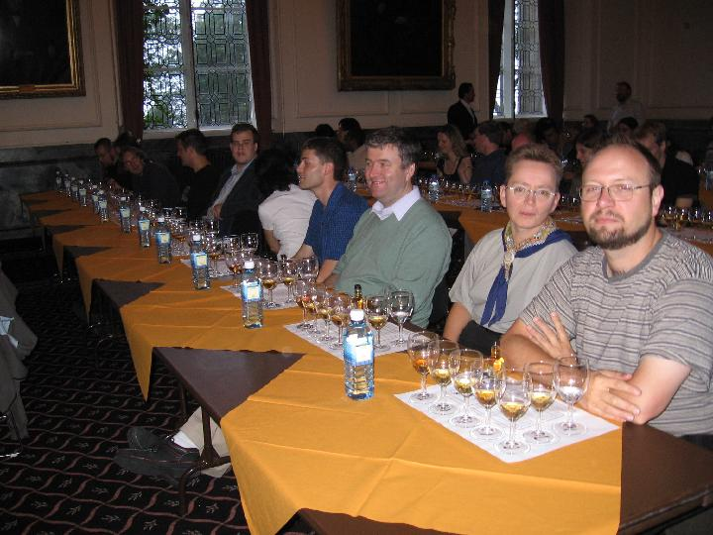
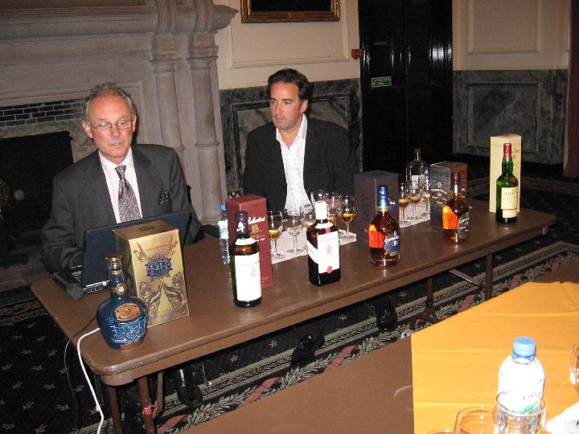
Whisky tasting (Chivas Bros Ltd)
SUSSP61
SUSSP61

Slide 21
Summary
From the Preface to SUSSP61
But Summer Schools are not just about science - they are about dialogue, discussion, meeting people, and forming lifelong friendships.
I think the same can be said of the IPPP
It is not just about the science,
but about building a community
Over the past 25 years, the IPPP has done just that

Slide 22
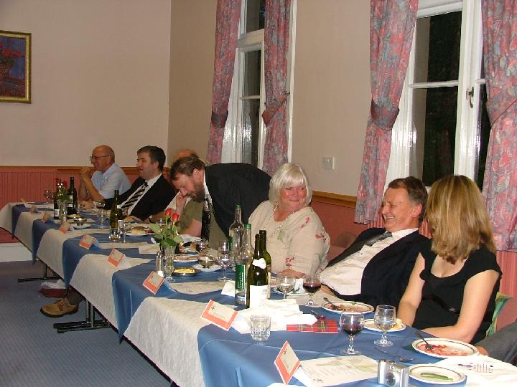
One last image from SUSSP61
Alan Walker
David Saxon
Nigel Glover
Liz Peach
Ian Halliday
Victoria Martin

