Slide 1
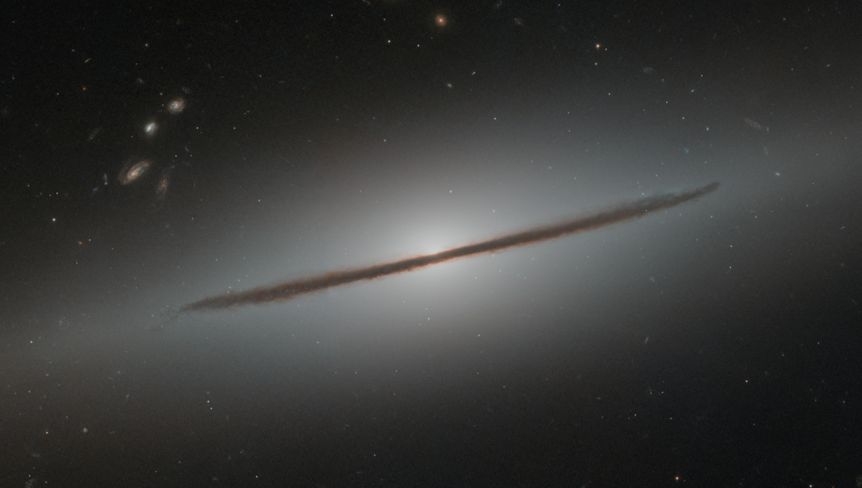

Dark Matter Theory “Overview”
Malcolm Fairbairn
King’s College London

Slide 2
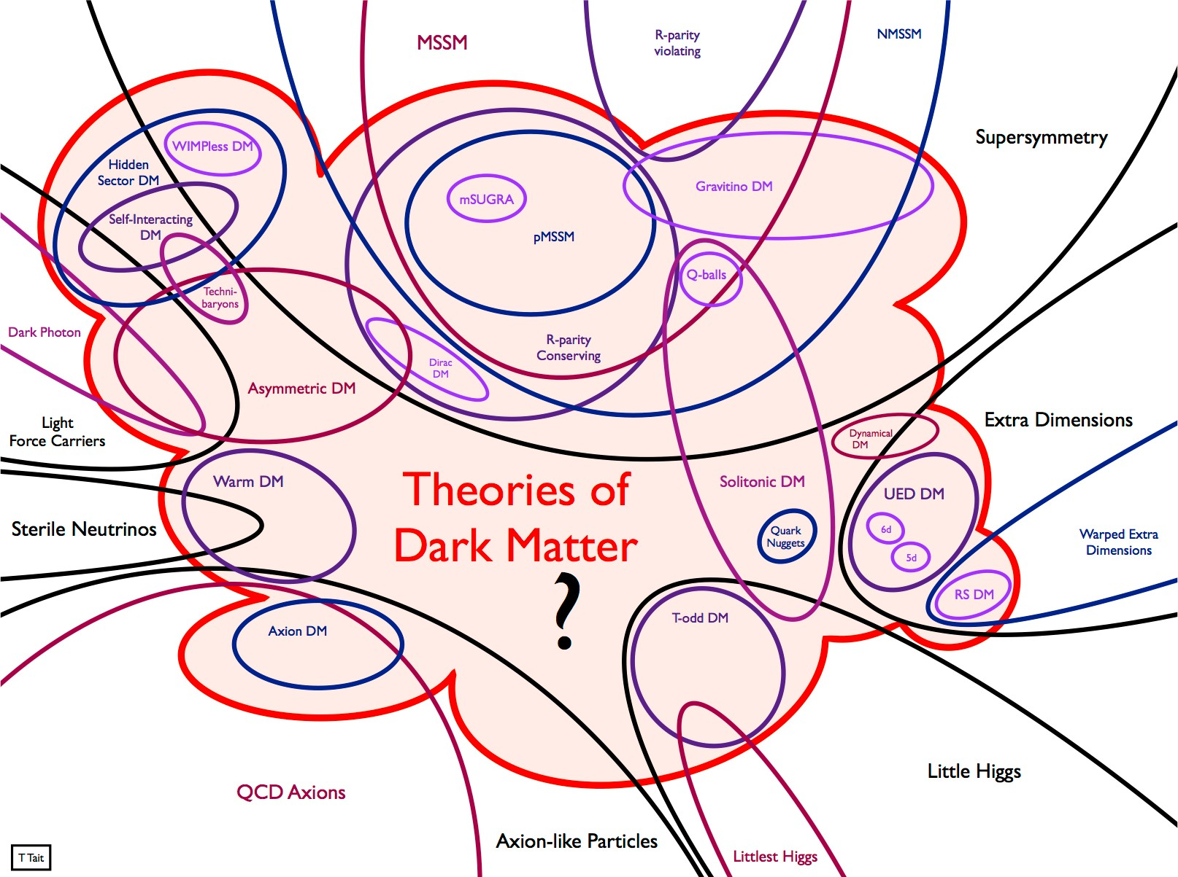
From Tim Tait

Slide 3
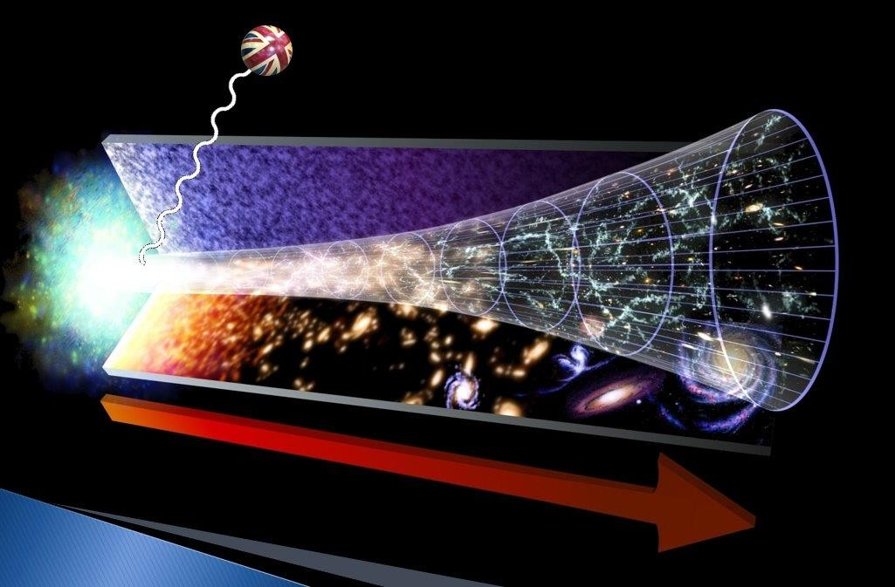
The Brexiton
Goes out of thermal equilibrium then acts as a decoupled spectator field while it decays

Slide 4
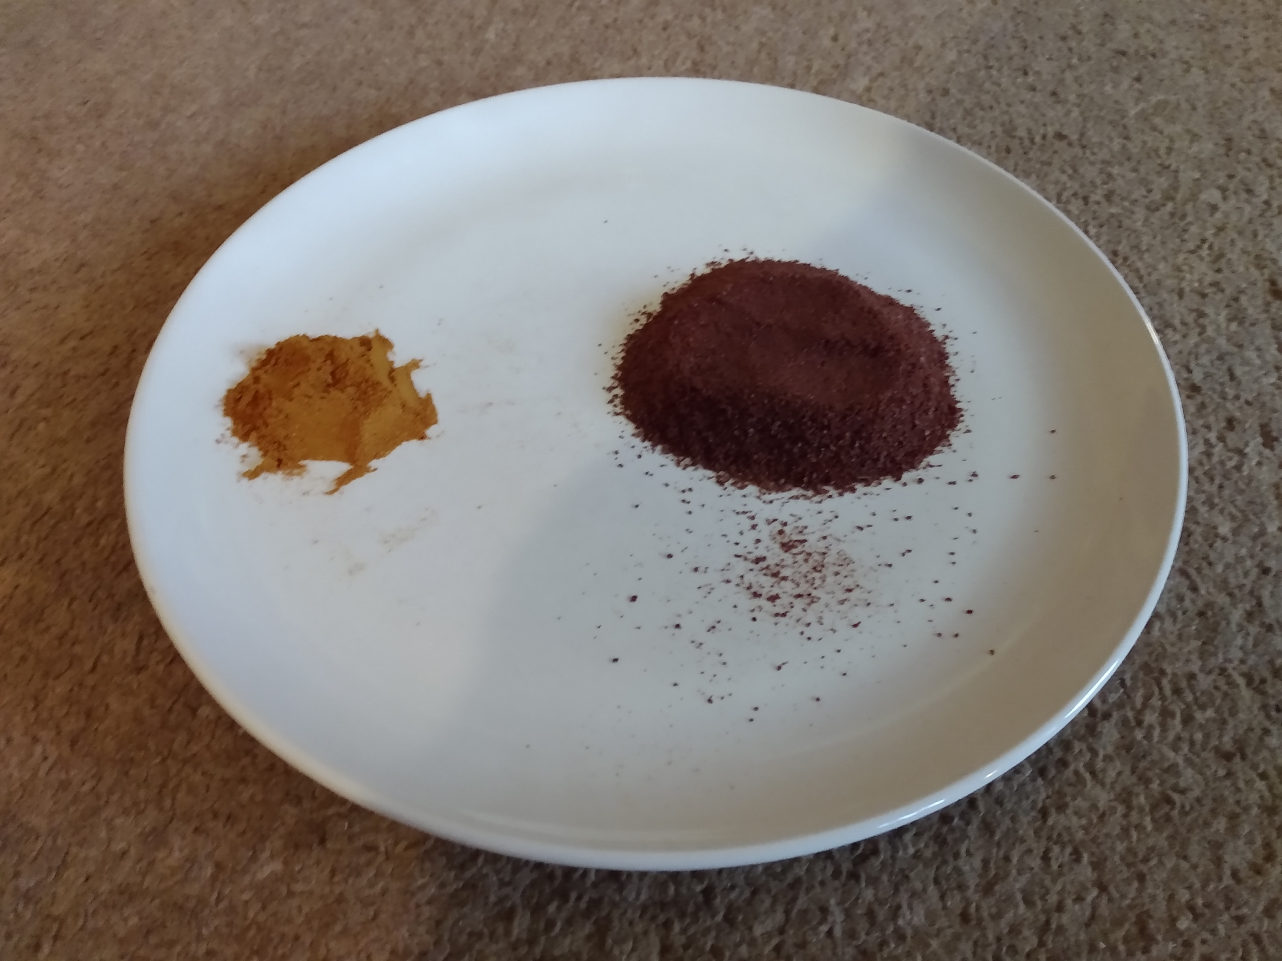
There is 6 times as much dark matter as normal matter.

Slide 5

If Dark Matter is a Particle, what kind of Particle is it?
It is certainly invisible, we cannot see it...

Slide 6
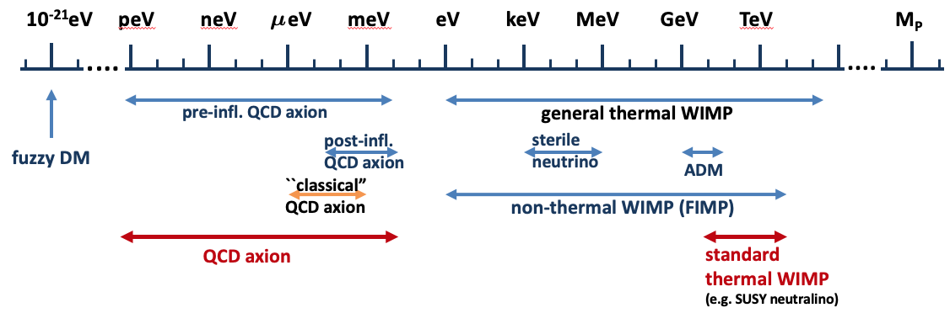

Slide 7
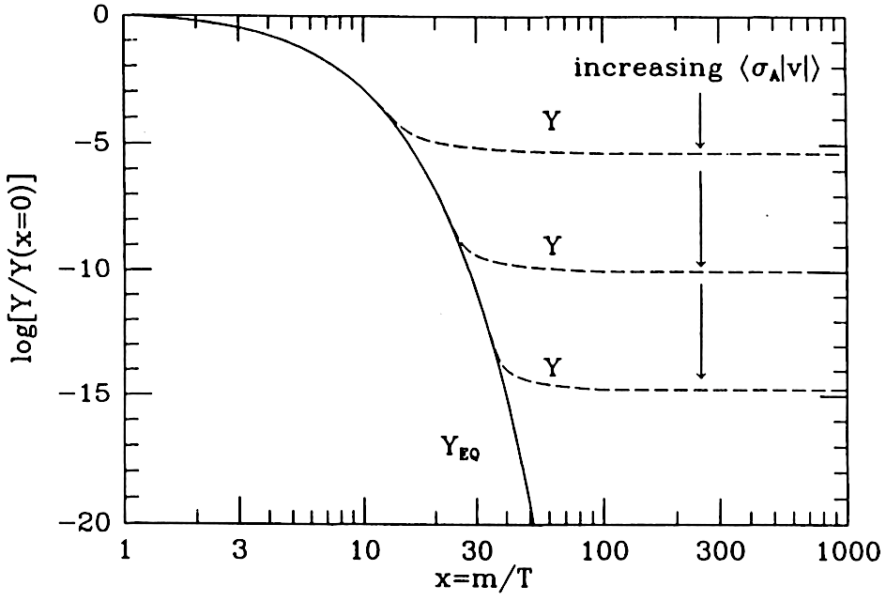
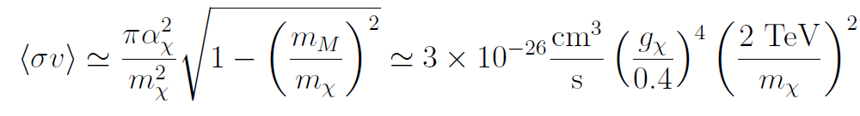
Thermal Freeze out
Dark Matter
SM Particle
Dark Matter
SM Particle

Slide 8
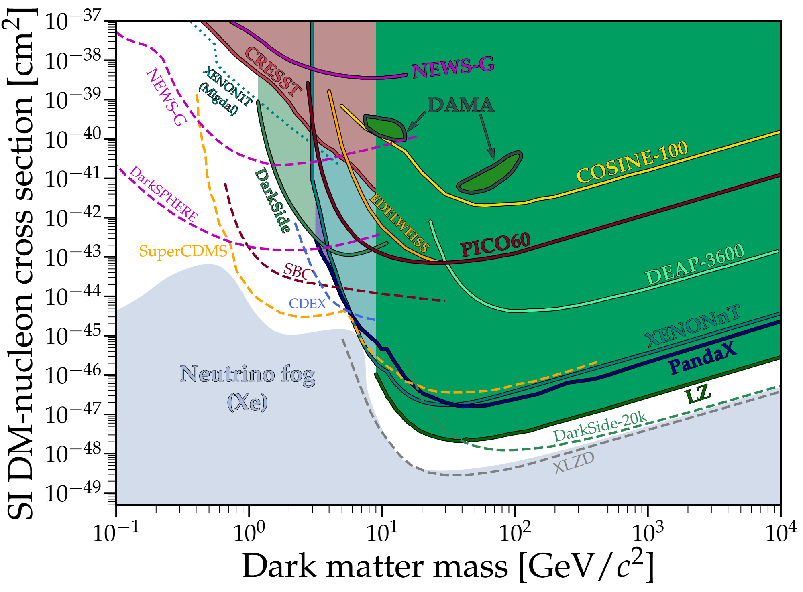
Current constraints on DM-nucleon scattering.

Slide 9

No dark matter has been detected yet though.
We know how much dark matter is around us and how fast it is moving, so why can’t we see it?
Possible explanations:-
it’s too light to make the machine go off

Slide 10




Too light dark matter
Dark Matter Detector
slow light dark matter particles

Slide 11


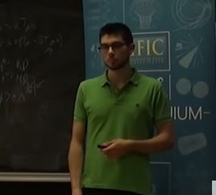
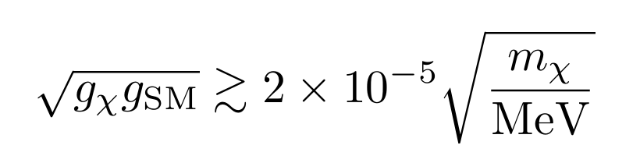
Can still try to find light dark matter in other ways
If the dark matter is too light, it can change the prediction for how much helium and deuterium is left behind after the big bang…
These constraints assume

Slide 12
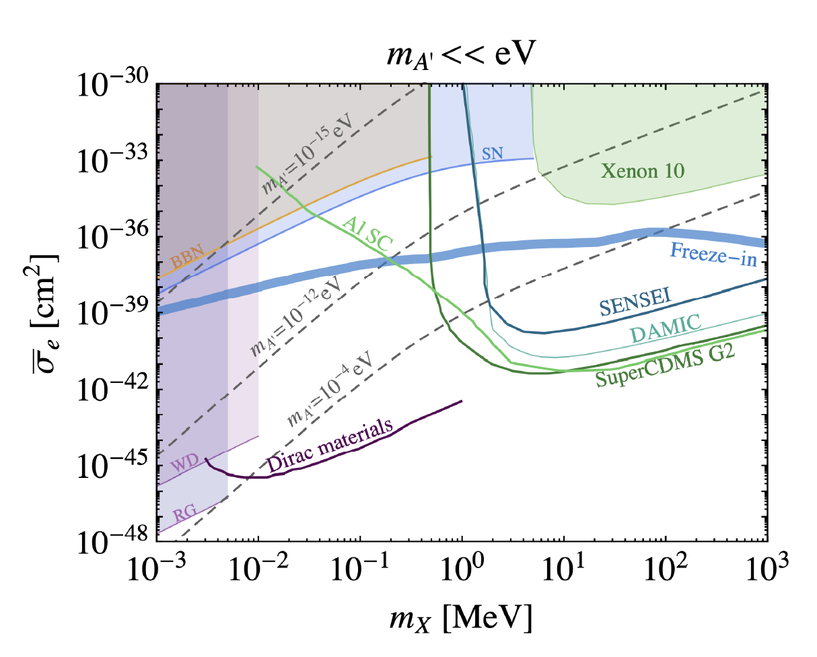
Dark Matter CAN be lighter…..
….. But then the coupling must also be lighter.
For relic abundance and also to evade constraints…
From review by Zurek 2401.03025

Slide 13
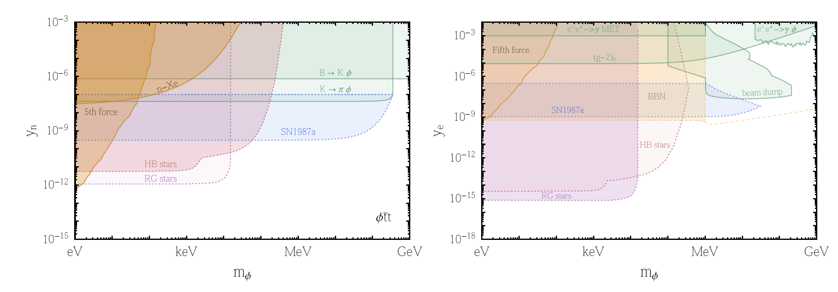


Constraints on the coupling between particles and mediators themselves are important…
φ
From review by Zurek 2401.03025

Slide 14
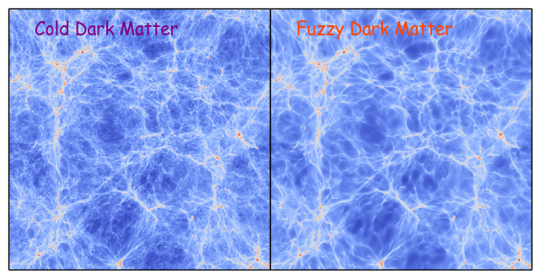


Dark Matter could be VERY light, around 10⁻²⁰ eV

Slide 15
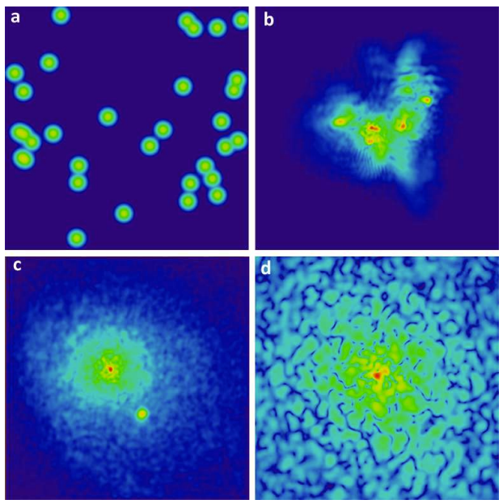
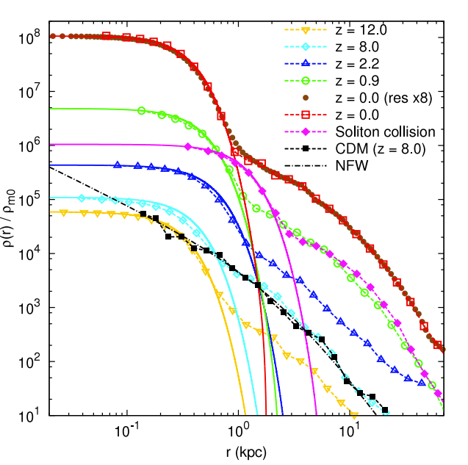
This is the idea anyway, Can you do this properly?
Schive et al 2014

Slide 16
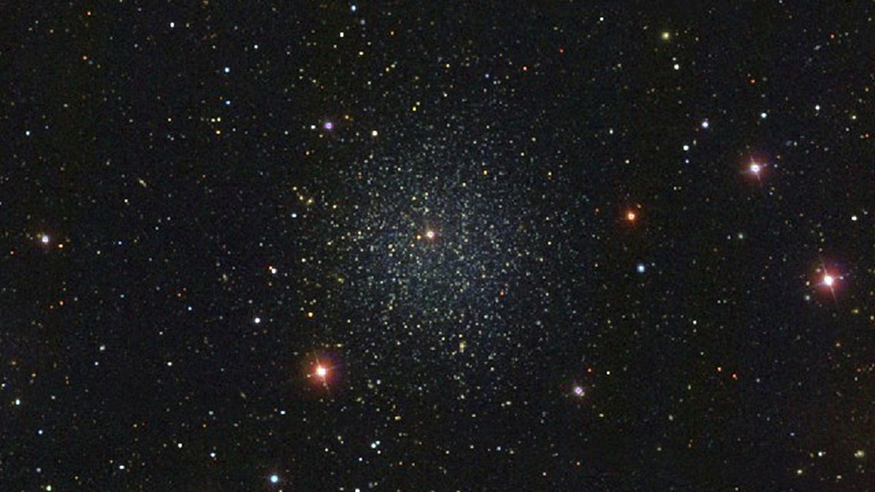
Leo II
Ultra Faint Dwarf
Mass 2.5x10⁷M_{Ꙩ}

Slide 17
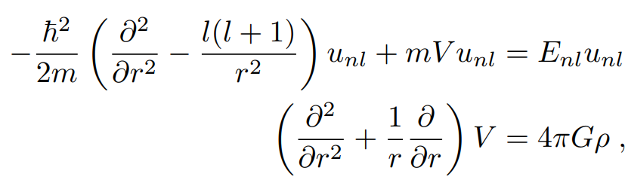

Can obtain wavefunctions of DM within the gravitational potential from that density.
Now you check THIS density reproduces the actual density from the Jeans analysis.

Slide 18



Nobody ever actually does this in real life. need to construct library of tens of thousands of wavefunctions then combine them to reconstruct your potential.
Nobody sane anyway.
Tim Zimmermann James Alvey

Slide 19
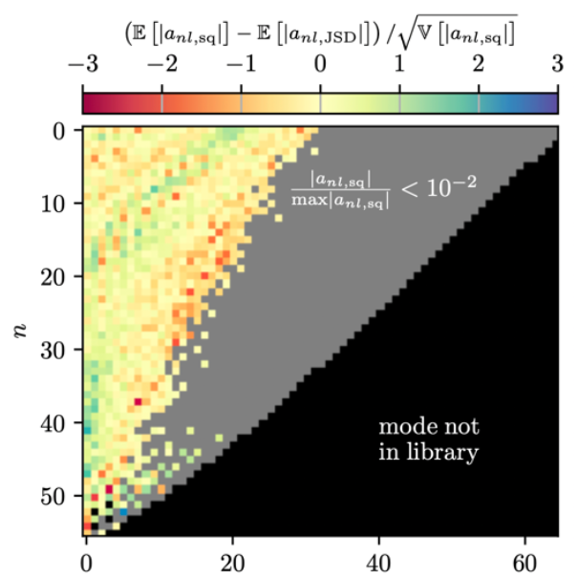
An example of the heat map of weights applied to different solutions to reconstruct the potential of Leo II
l

Slide 20
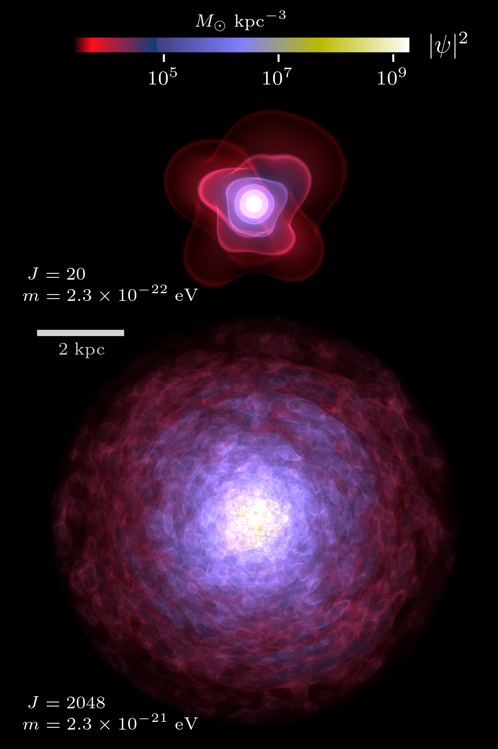

Slide 21
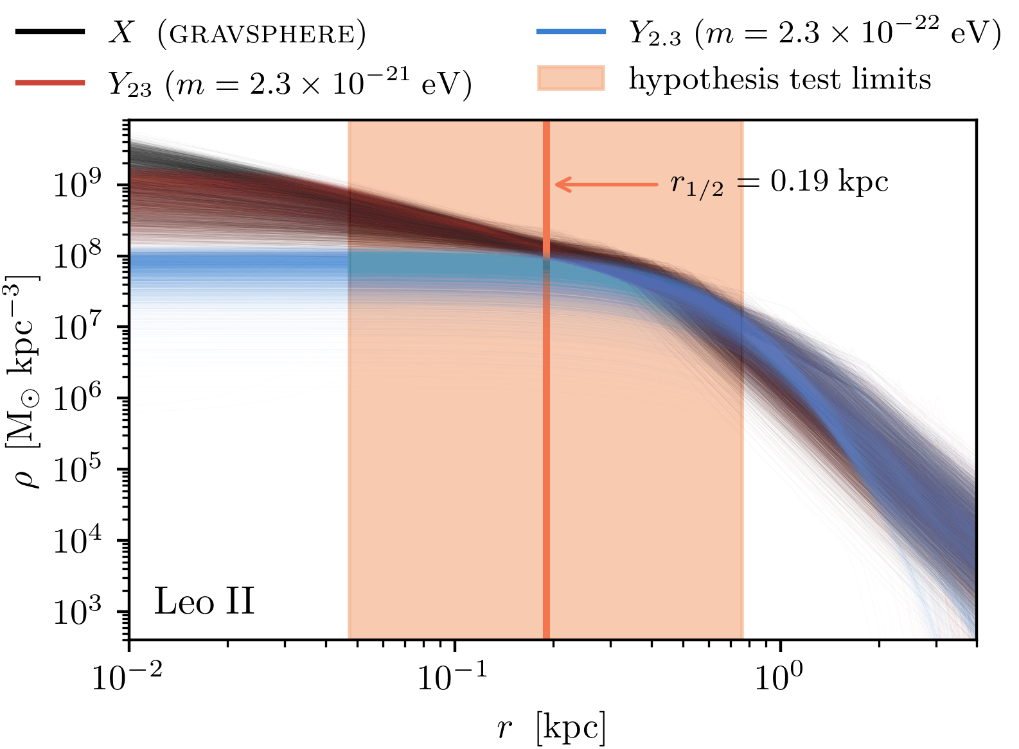

Slide 22
No dark matter has been detected yet though.
We know how much dark matter is around us and how fast it is moving, so why can’t we see it?
Possible explanations:-
2) it’s colliding with the detector inelastically

Slide 23

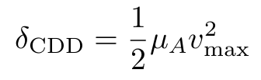
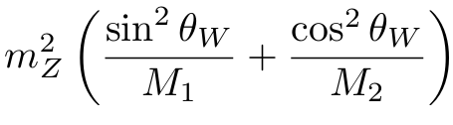
1.1 TeV Higgsino Inelastic DM candidate
One of the only remaining corners of MSSM DM parameter space
Two almost degenerate Higgsino particles with LARGE direct detection cross section
But only interact inelastically if the momentum exchange is high enough
>
Mass of Bino Mass of Wino
See e.g. Krall and Reese 1705.04843

Slide 24
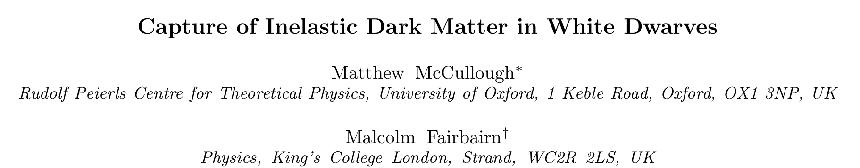
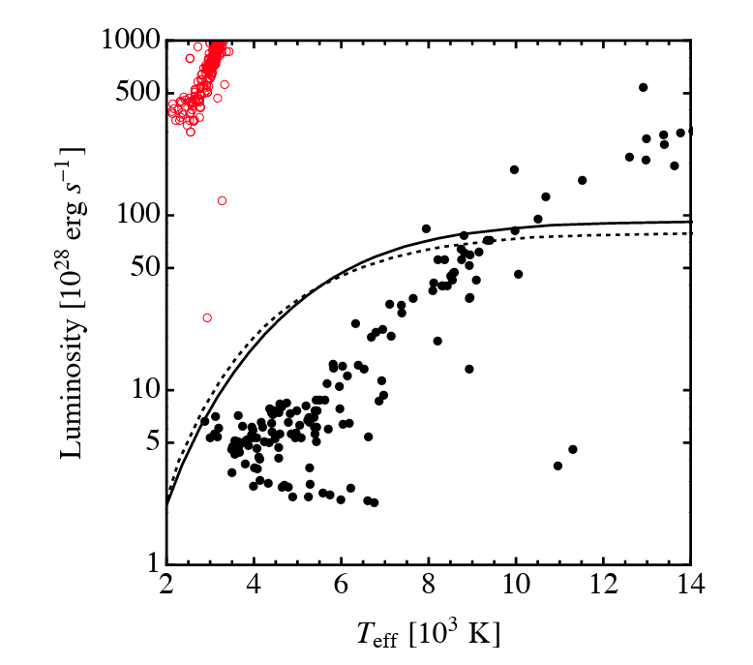
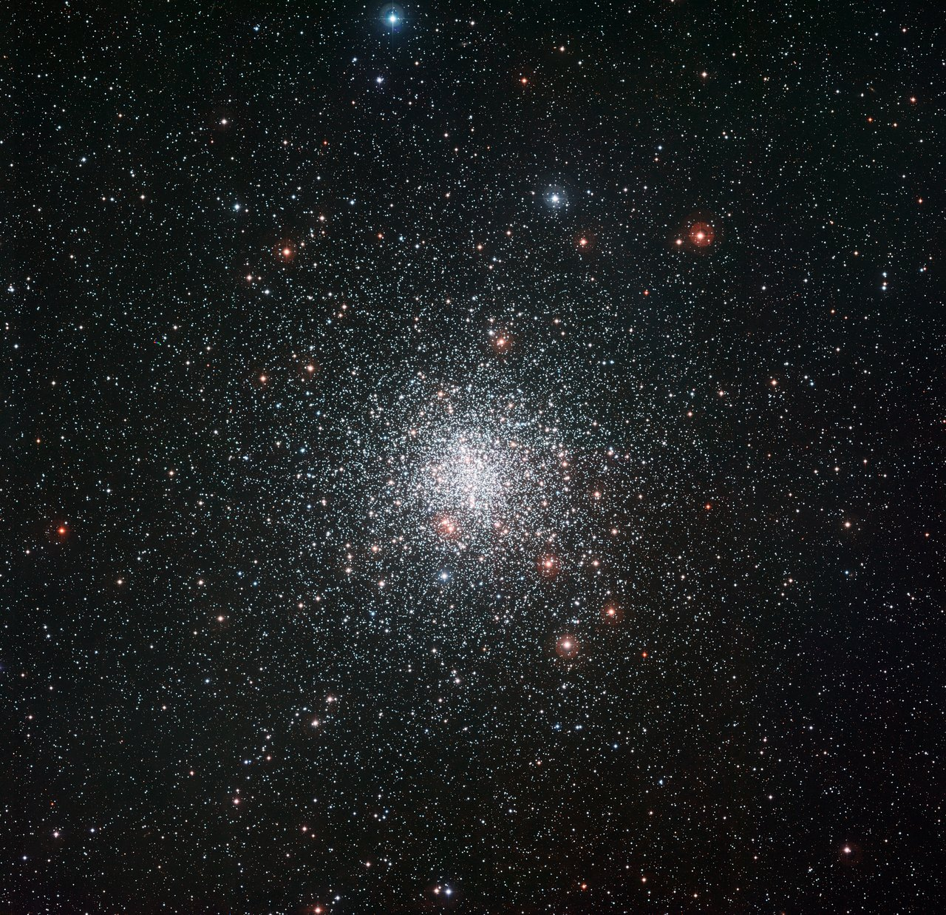

Slide 25
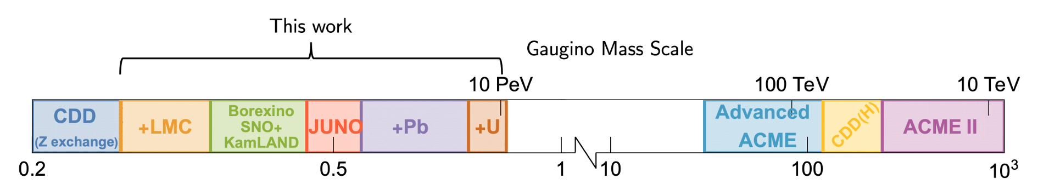

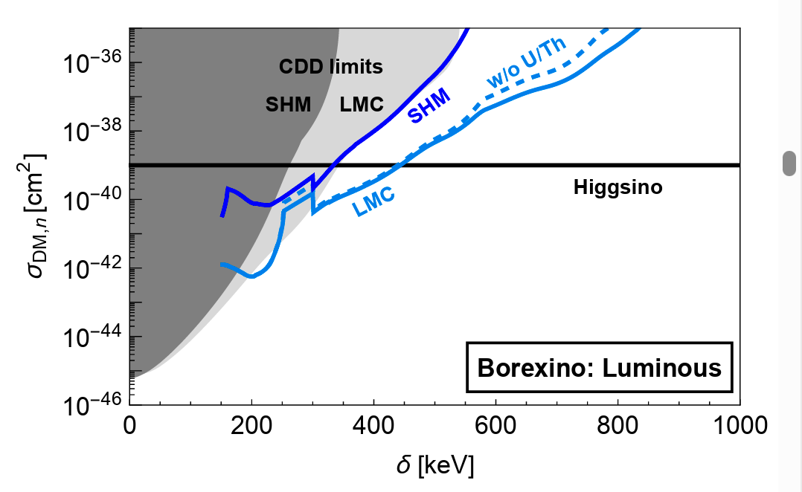
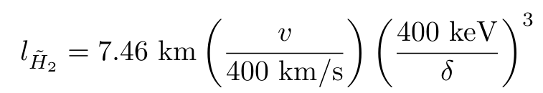
1.1 TeV Higgsino indirect DM
From Graham et al 2409.7768
Constraints from EDM
Proposal is to place large mass of uranium close to Borexino to boost signal. Theorists gonna theorise.

Slide 26
No dark matter has been detected yet though.
We know how much dark matter is around us and how fast it is moving, so why can’t we see it?
Possible explanations:-
3) Maybe it is too massive

Slide 27
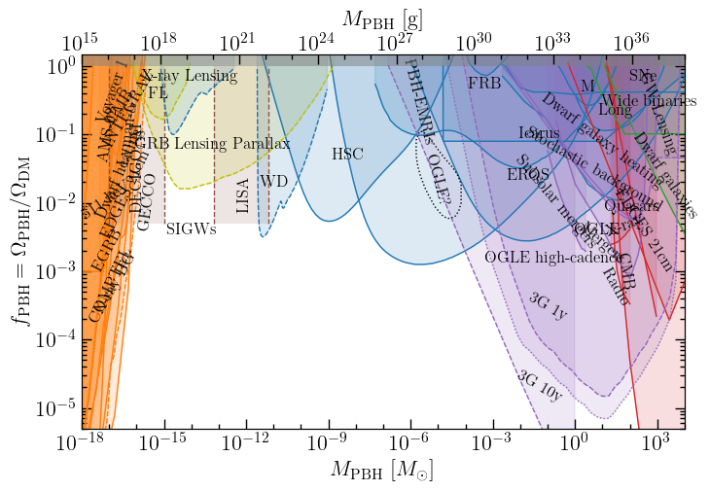
The Dark Matter could be Primordial Black Holes
Highly contentious but could be in this region
Plot Stolen from Bradley Kavanagh

Slide 28
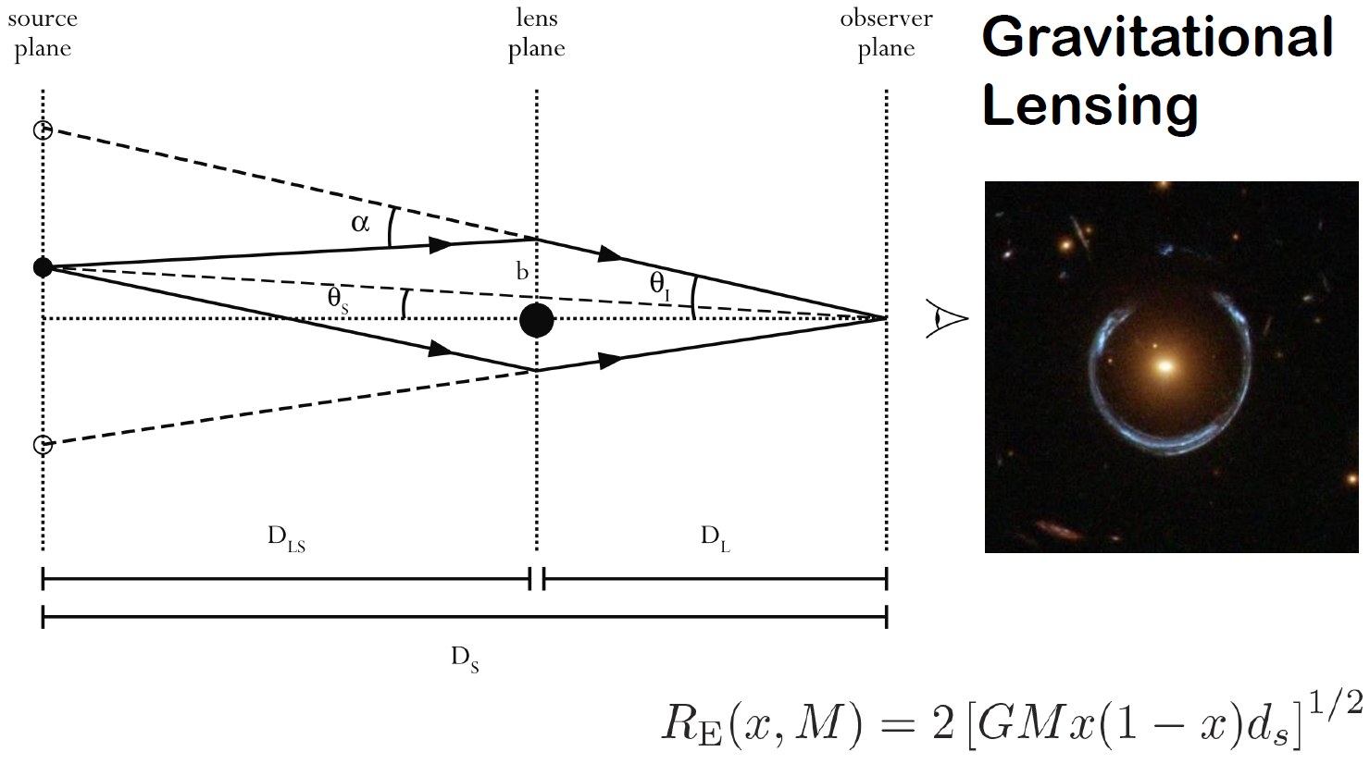

Slide 30
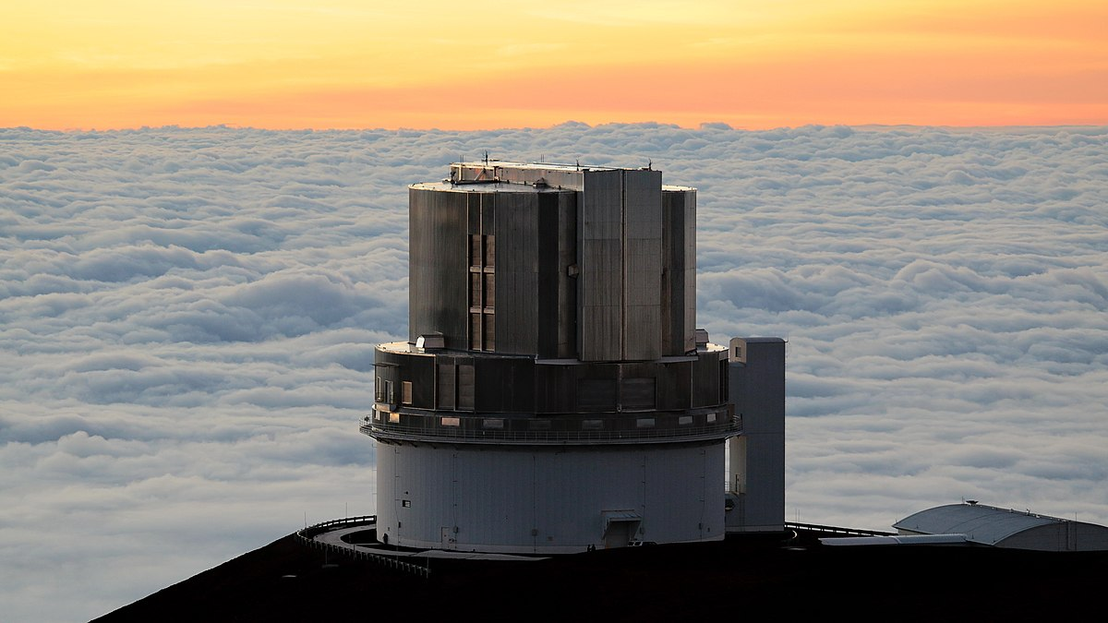
Subaru Telescope Mauna Kea Hawaii

Slide 31
The Dark Matter could be Primordial Black Holes
Highly contentious but could be in this region

Slide 32
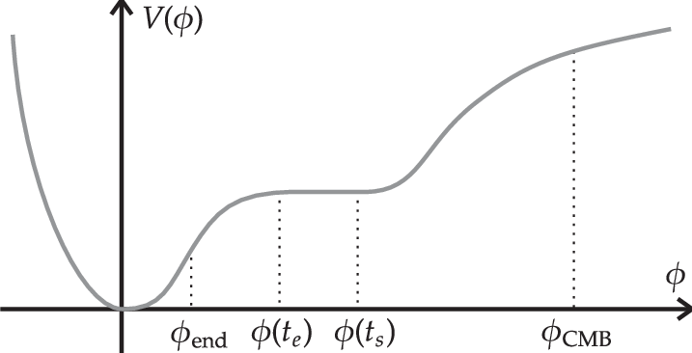
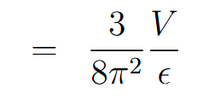
Primordial black holes could be produced conceivably during inflation, magnitude of perturbations given by
Kristiano and Yokoyama arXiv:2405.12149
Primordial black holes could also be produced during bubble collisions

Slide 33
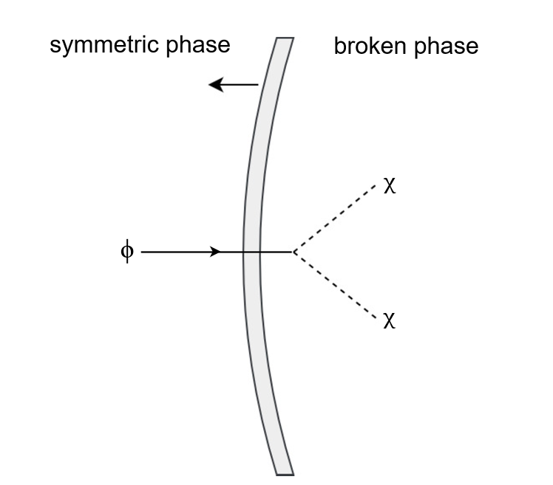
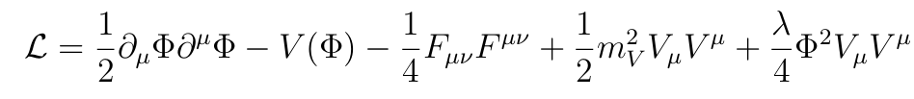
Heavy Dark Matter Production via Bubble Walls
See e.g. Azatov et al 2101.05721, Ai et al 2406.20051
V
If bubble wall moves fast can create particles with m higher than any of the scales in the Phase transition.
V

Slide 34
No dark matter has been detected yet though.
We know how much dark matter is around us and how fast it is moving, so why can’t we see it?
Possible explanations:-
3) It just doesn’t want to interact with the standard model

Slide 35
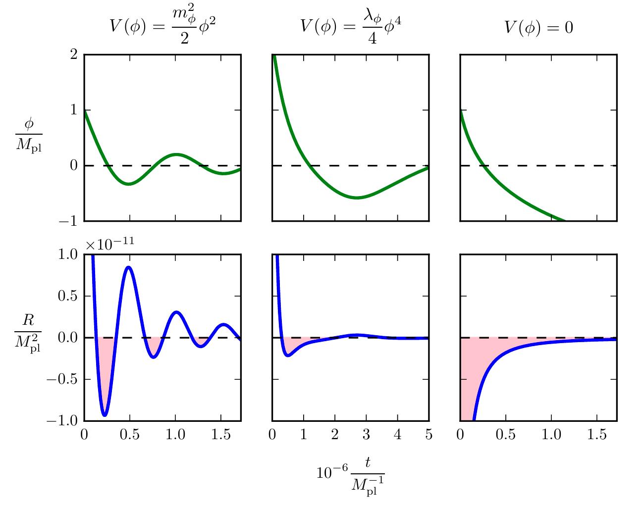
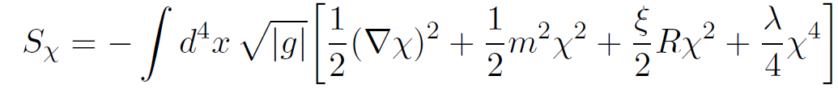
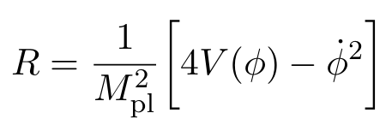

A Despicable example – Despicable Dark Matter
Non minimally coupled scalar field (not the inflaton)
Excited during reheating after inflation
In principle this completely avoids any coupling to SM particles.
Fairbairn et al. 1808.08236

Slide 36
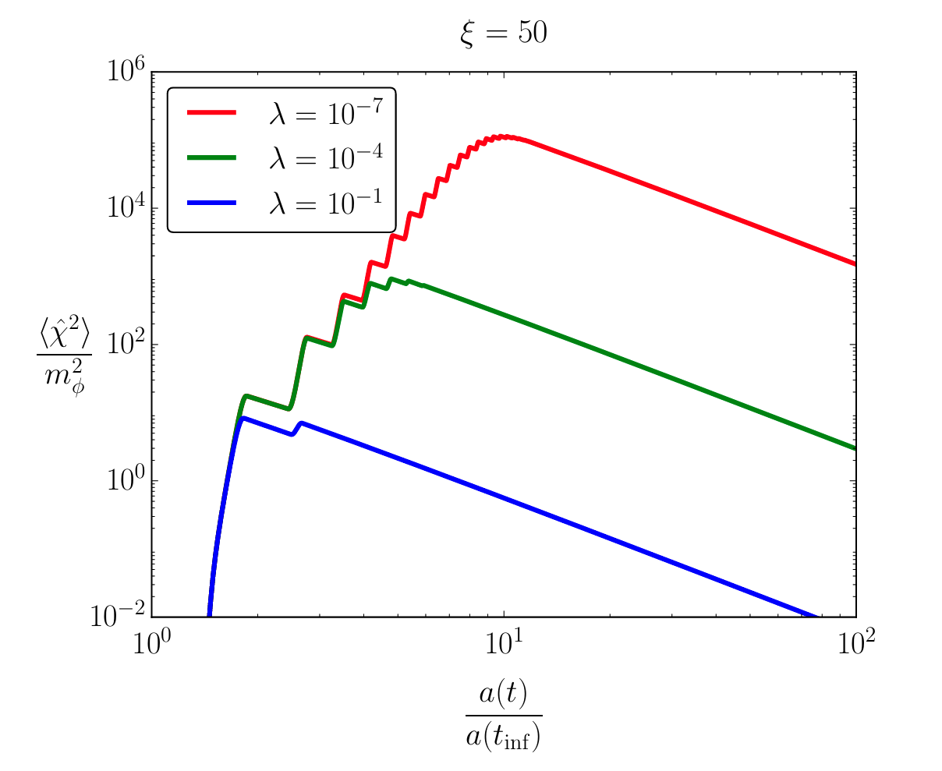
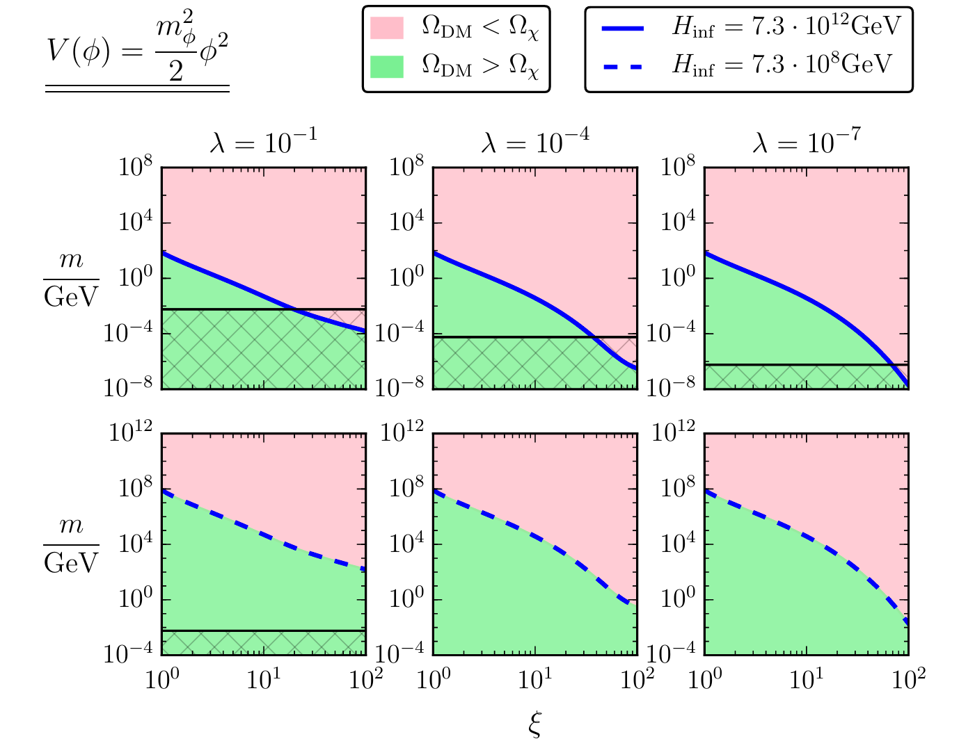
Can achieve good relic abundance and cold enough DM
Fairbairn et al. 1808.08236

Slide 37
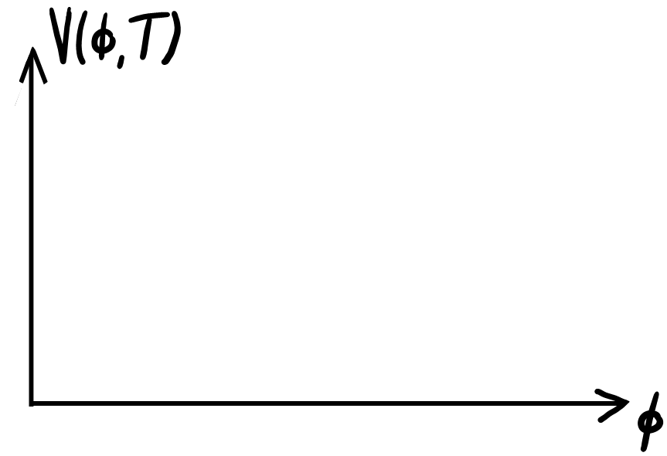

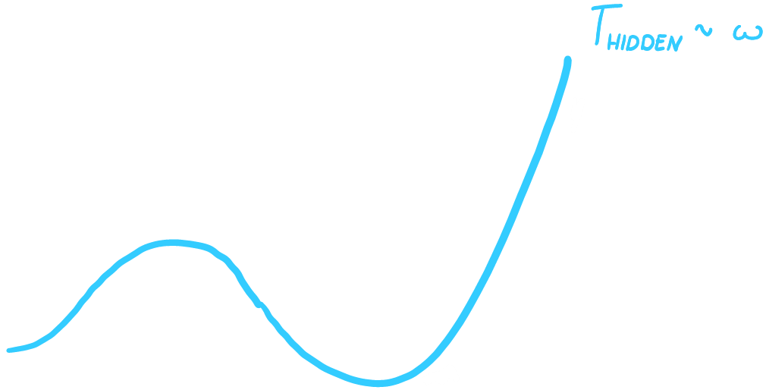
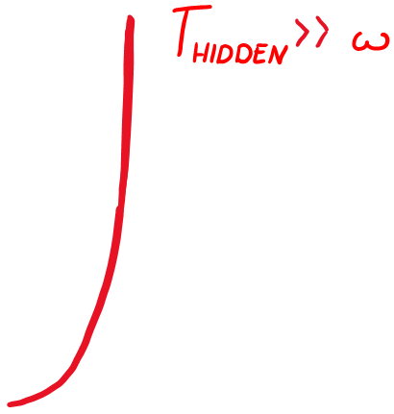

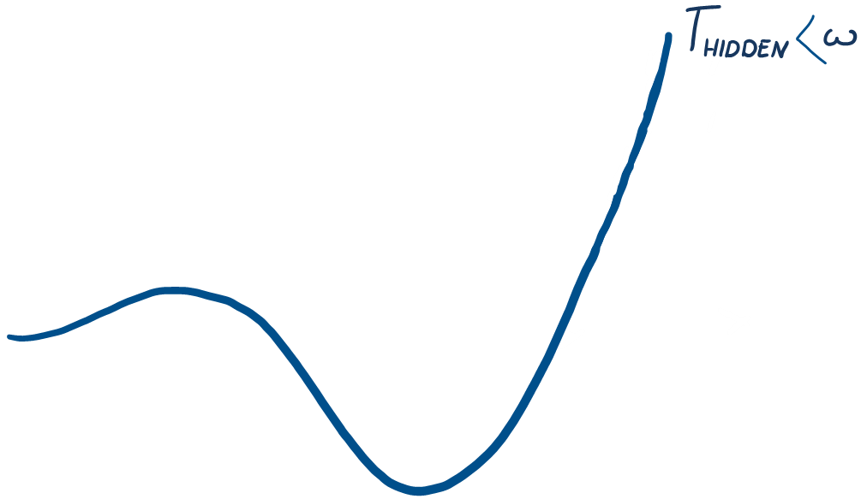
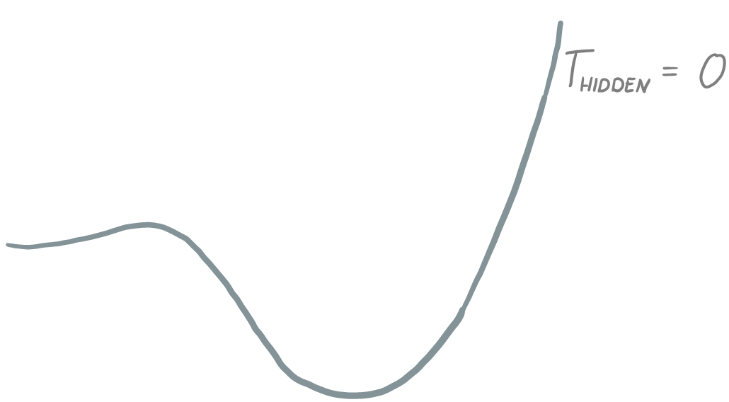




How could we probe the temperature of hidden sectors?
The two types of transition
Thermal Transition
Happens when $Γ_{thermal}{\left(t\right)}^{\frac{1}{4}}>H(t)$
Tunnelling transition
Happens when $Γ_{tunnel}{\left(t\right)}^{\frac{1}{4}}>H(t)$
37
Notes:
When the temperature of the hidden sector is still high enough such that there is sufficient thermal energy then a transition can happen via thermal fluctuations over the barrier and one can can calculate a nucleation rate of thermal bubbles that varies with temperature.
As we drop the hidden temperature further and it gets closer to its zero temperature form the barrier height will not be varying very much whilst the thermal energy in the hidden plasma is rapidly dropping and so transition via thermal fluctuations become more difficult and the nucleation rate rate drops off.
Now quantum tunnelling nucleation rate only does not have explicit temperature dependence only dependence on barrier height. Thus transition via quantum tunnelling becomes easier and easier as barrier height drops until you reach a roughly constant nucleation rate where the barrier height is not changing much with the hidden sector temperature

Slide 38
Cold hidden sectors
The two types of transition
Thermal phase transition
Tunneling Phase transition
Both temperature dependent
Notes:
When the temperature of the hidden sector is still high enough such that there is sufficient thermal energy then a transition can happen via thermal fluctuations over the barrier and one can can calculate a nucleation rate of thermal bubbles that varies with temperature.
As we drop the hidden temperature further and it gets closer to its zero temperature form the barrier height will not be varying very much whilst the thermal energy in the hidden plasma is rapidly dropping and so transition via thermal fluctuations become more difficult and the nucleation rate rate drops off.
Now quantum tunnelling nucleation rate only does not have explicit temperature dependence only dependence on barrier height. Thus transition via quantum tunnelling becomes easier and easier as barrier height drops until you reach a roughly constant nucleation rate where the barrier height is not changing much with the hidden sector temperature

Slide 39
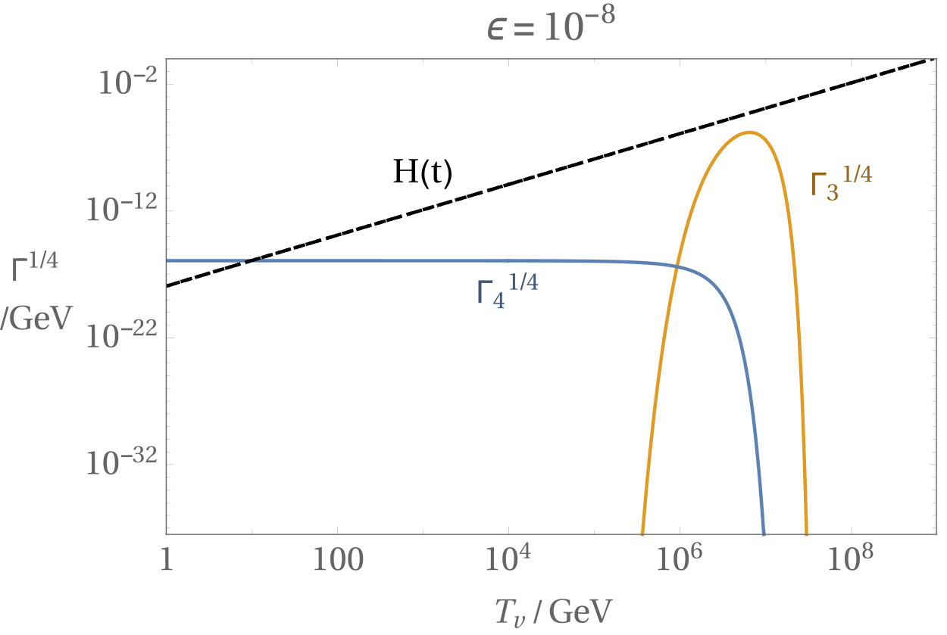
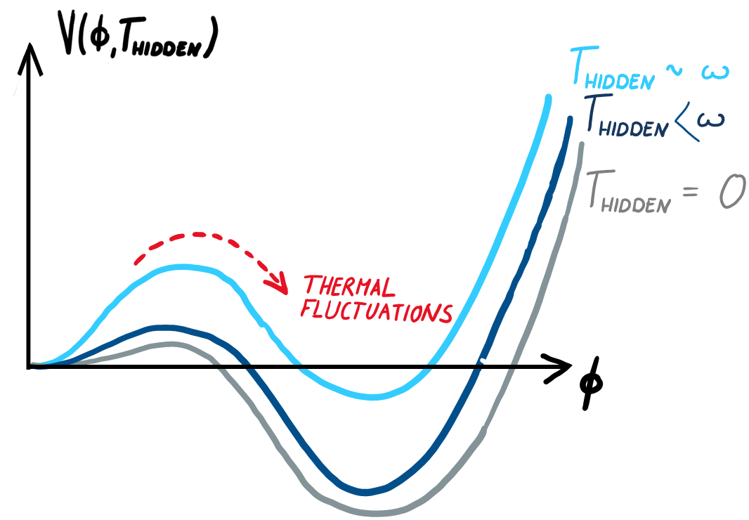










Thermal phase transition
The two types of transition: concrete example
Optimal point for thermal transition
Thermal fluctuations are very small
$$Γ_{thermal}^{\frac{1}{4}}$$
Nucleation rate $[Γ^{\frac{1}{4}}]$
Barrier is very high
$${10}^{−8}$$
$${10}^{−6}$$
$${10}^{−4}$$
$${10}^{−2}$$
$${10}^{0}$$
$T_{hidden}$ /GeV
Notes:
Talk about size of thermal fluctuations relative to height of barrier.

Slide 40
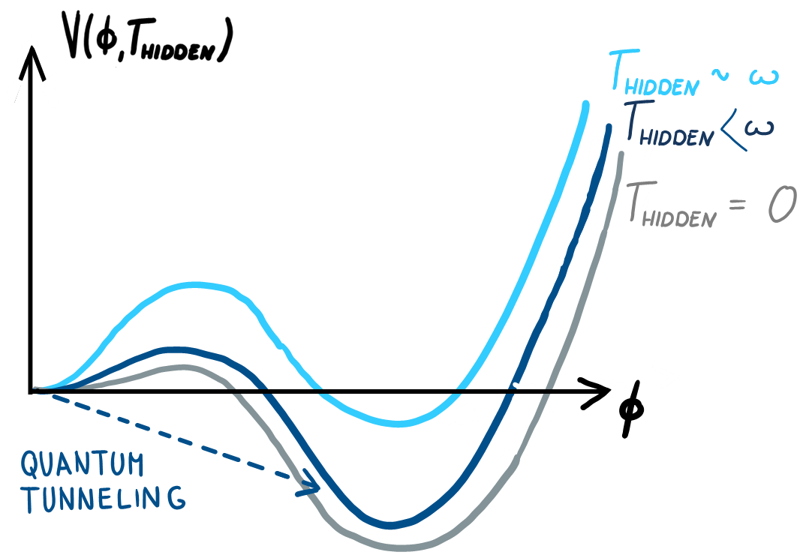




Tunnelling phase transition
Case 1: $ε=\frac{T_{hidden}}{T_{visible}}≈1$
The two types of transition: concrete example
Tunnelling nucleation rate stays constant
$$Γ_{thermal}^{\frac{1}{4}}$$
Barrier close to $T_{hidden}=0$ form
Nucleation rate $[Γ^{\frac{1}{4}}]$
$$Γ_{tunnelling}^{\frac{1}{4}}$$
Barrier height very high
$${10}^{−8}$$
$${10}^{−6}$$
$${10}^{−4}$$
$${10}^{−2}$$
$${10}^{0}$$
$T_{hidden}$ /GeV
Notes:
Now we want to work out the hubble expansion rate to see if either the thermal or tunnelling nucleation rate beats hubble rate. Choosing the case where T_vis = T_hiden first we can use this to work out the hubble expansion at each hidden sector temperature….see next slide

Slide 41






Phase transitions
Case 1: $ε=\frac{T_{hidden}}{T_{visible}}≈1$
$$Γ_{thermal}^{\frac{1}{4}}$$
Nucleation rate $[Γ^{\frac{1}{4}}]$
$$Γ_{tunnelling}^{\frac{1}{4}}$$
Thermal transition takes place when hidden plasma is hot
$$H\left(t\right)$$
$${10}^{−8}$$
$${10}^{−6}$$
$${10}^{−4}$$
$${10}^{−2}$$
$${10}^{0}$$
$T_{hidden}$ /GeV
Hot plasma $→$High friction$→$ Sound wave signal

Slide 42











Phase transitions
Case 2: $ε=\frac{T_{hidden}}{T_{visible}}≪1$
Thermal transition window missed
$$H\left(t\right)$$
$$Γ_{thermal}^{\frac{1}{4}}$$
Nucleation rate $[Γ^{\frac{1}{4}}]$
$$Γ_{tunnelling}^{\frac{1}{4}}$$
Tunnelling transition happens later when hidden plasma is cold
$${10}^{−8}$$
$${10}^{−6}$$
$${10}^{−4}$$
$${10}^{−2}$$
$${10}^{0}$$
$T_{hidden}$ /GeV
Cold plasma $→$ Low wall friction $→$ Bubble collision signal?
Notes:
Visible sector dominates energy density and drives expansion.
Talk about visible sector being hot/cold relative to hidden sector.

Slide 43

very different hidden sector temperatures, but visible sector temperature
of phase transition can be the same (or bigger, or smaller)

Slide 44


1901.11038
1901.11038
1901.11038
Gravitational Waves : example 1
here visible temperature at transition is around TeV
Hidden sector temperature different
Decreasing $ε=\frac{T_{hidden}}{T_{visible}}$ decreases friction on bubble wall
Sound wave → bubble collision
Changes the shape of the gravitational wave signal
A tunnelling transition where a sound wave is expected could be a signal of a hidden cold sector
Fairbairn et al 1901.11038

Slide 45
No dark matter has been detected yet though.
We know how much dark matter is around us and how fast it is moving, so why can’t we see it?
Possible explanations:-
4) Maybe we are about to see it?

Slide 46
Current constraints on DM-nucleon scattering.

Slide 47


Proposed very large Xenon detector (potentially could be built in Boulby)
Will not just look for dark matter, also neutrinoless double beta decay, other standard model physics.

Slide 48


you might not see the dark matter for all the neutrinos…

Slide 49


Tests of BSM Physics
Momentum exchanged for pp-neutrino electron events is around 10 keV
Momentum exchanged for neutrino-nucleon events is about MeV scale
Both Q² unstudied in those settings, can probe new interactions.
Exotic mediator

Slide 50
Tests of BSM Physics
U(1)_{B-L} gauge boson
couples to B-L
charge of SM
particles
Dashed electron, solid nucleon.
Green future xenon
Blue G2 xenon
Red G2 germanium
arXiv : Cerdeno et al1604.01025

Slide 51



Slide 52
Axions
Lagrangian of QCD
Quark kinetic term
Gluon kinetic term
Quark masses
?

Slide 53


Neutron Dipole Moment and strong CP problem
predicts electric dipole moment for neutron d~ 10 θ’ e cm
-16
-27
However, no edm observed down to d~ 10 e cm
Why is θ’ so small ? Solution – first promote θ to expectation value of a field with U(1) symmetry then…

Slide 54


Axions and Axion-like particles
U(1) degenerate minimum
symmetry breaks
vacuum chooses random direction
Peccei-Quinn Like Field

Slide 55
U(1) degenerate minimum
symmetry breaks
vacuum chooses random direction
If before inflation, same random direction spread out over observable Universe.

Slide 56




Axion gets a Mass at some later Stage

Slide 57
Axion gets a Mass at some later Stage
i.e. matter!!!

Slide 58

Depends on the details of the calculation
However, roughly speaking
20 μeV < m_a < 1000 μeV
Borsanyi et al 1508.06917

Slide 59

U(1) degenerate minimum
symmetry breaks
vacuum chooses random direction
If after inflation, different values in different regions of the Universe.

Slide 60



Kibble Mechanism

Slide 61


Need to evolve String Network and trace emission into axions
Stolen from
Ed Hardy

Slide 62

Post Inflationary QCD axion mass prediction
Roughly Speaking 100 μeV < m_a < 1000 μeV

Slide 63

Stolen from Ciaran O’Hare

Slide 64

Proposed Experiments will test this region
Stolen from Ciaran O’Hare

Slide 65



In the Post Inflationary Scenario, a Fraction End up in Mini Clusters
Moment at which they form depends on temperature dependence of mass.
Collapse to form (very) dense small objects
Kavanagh et al 2011.05377
For example, for QCD axion R~ 1 AU, M~10⁻¹⁰Msun

Slide 66


Admx problems
If the axionic Dark Matter is not smoothly distributed, this will affect the ability to detect axions with experiments like ADMX.

Slide 67


Search for Solar axions
look for axions produced in the sun and turn them back into photons down here

Slide 68

CAST: cern-axion-solar-telescope

Slide 69



Encounters of mini-clusters with neutron stars

Slide 70

As Theorists, we can contemplate many possible deaths for these dense cores…

Slide 71


Slide 72



Photon Effective Mass can prevent Decay!

Slide 73

Exploding Axion Stars Heat IGM
Fig by Charis Pooni

Slide 74
Reionization Histories

Slide 75

New Constraints on Axions

Slide 76

Search for dark matter goes on, including tests only sensitive to its gravitational effects.
New Data which is arriving all the time is amazing!

