Slide 1

Searching for Primordial Black Holes with LSST
21.10.2025
& The Impact of False Positives on Microlensing Detection
Benedict Crossey
Institute of Particle Physics Phenomenology
Durham University
In collaboration with Djuna Croon, Miguel Crispim Romão & Daniel Godines
JCAP10 (2025) 066
arXiv:2506.20709
Credit: RubinObs/NOIRLab/SLAC/NSF/DOE/AURA

Slide 2
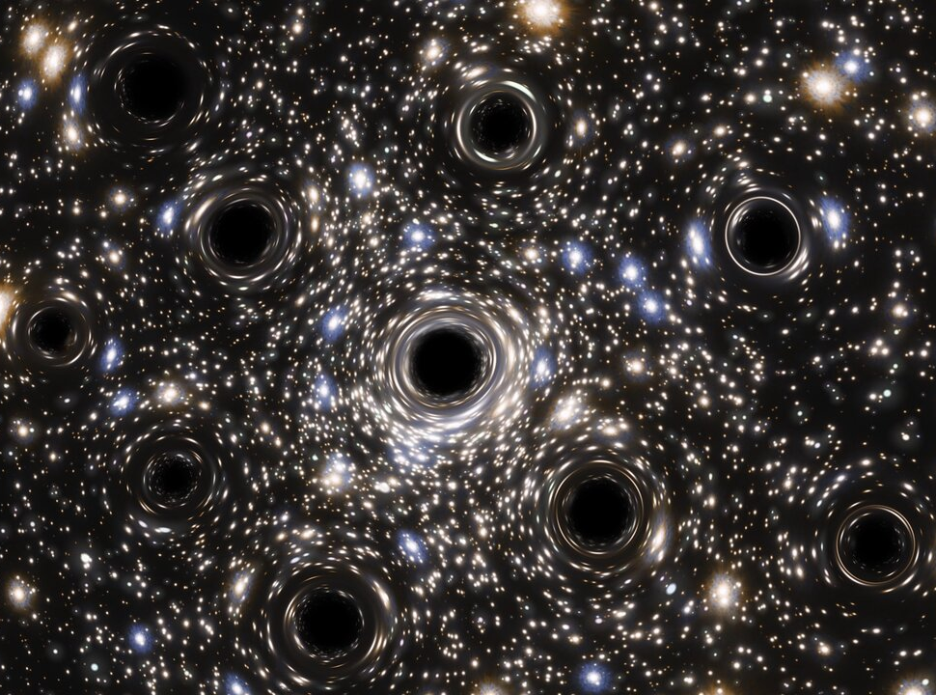
Introduction
The Legacy Survey of Space and Time (LSST) is a full-sky survey which launched this summer at the Vera C. Rubin Observatory in Chile
It will run for 10 years and observe ~10⁹ stars in our galaxy
Can be used to search for gravitational microlensing events
Microlensing events can be used to identify - or put bounds on - primordial black holes (PBHs)
Credit: ESA/Hubble, N. Bartmann
Benedict Crossey | Searching for PBHs with LSST

Slide 3
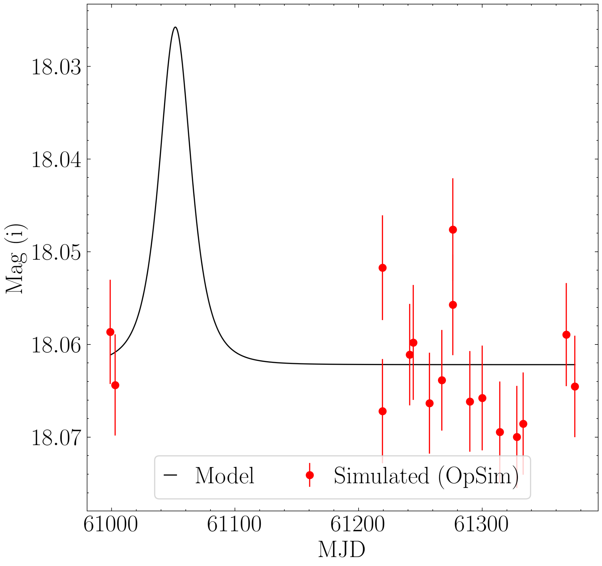
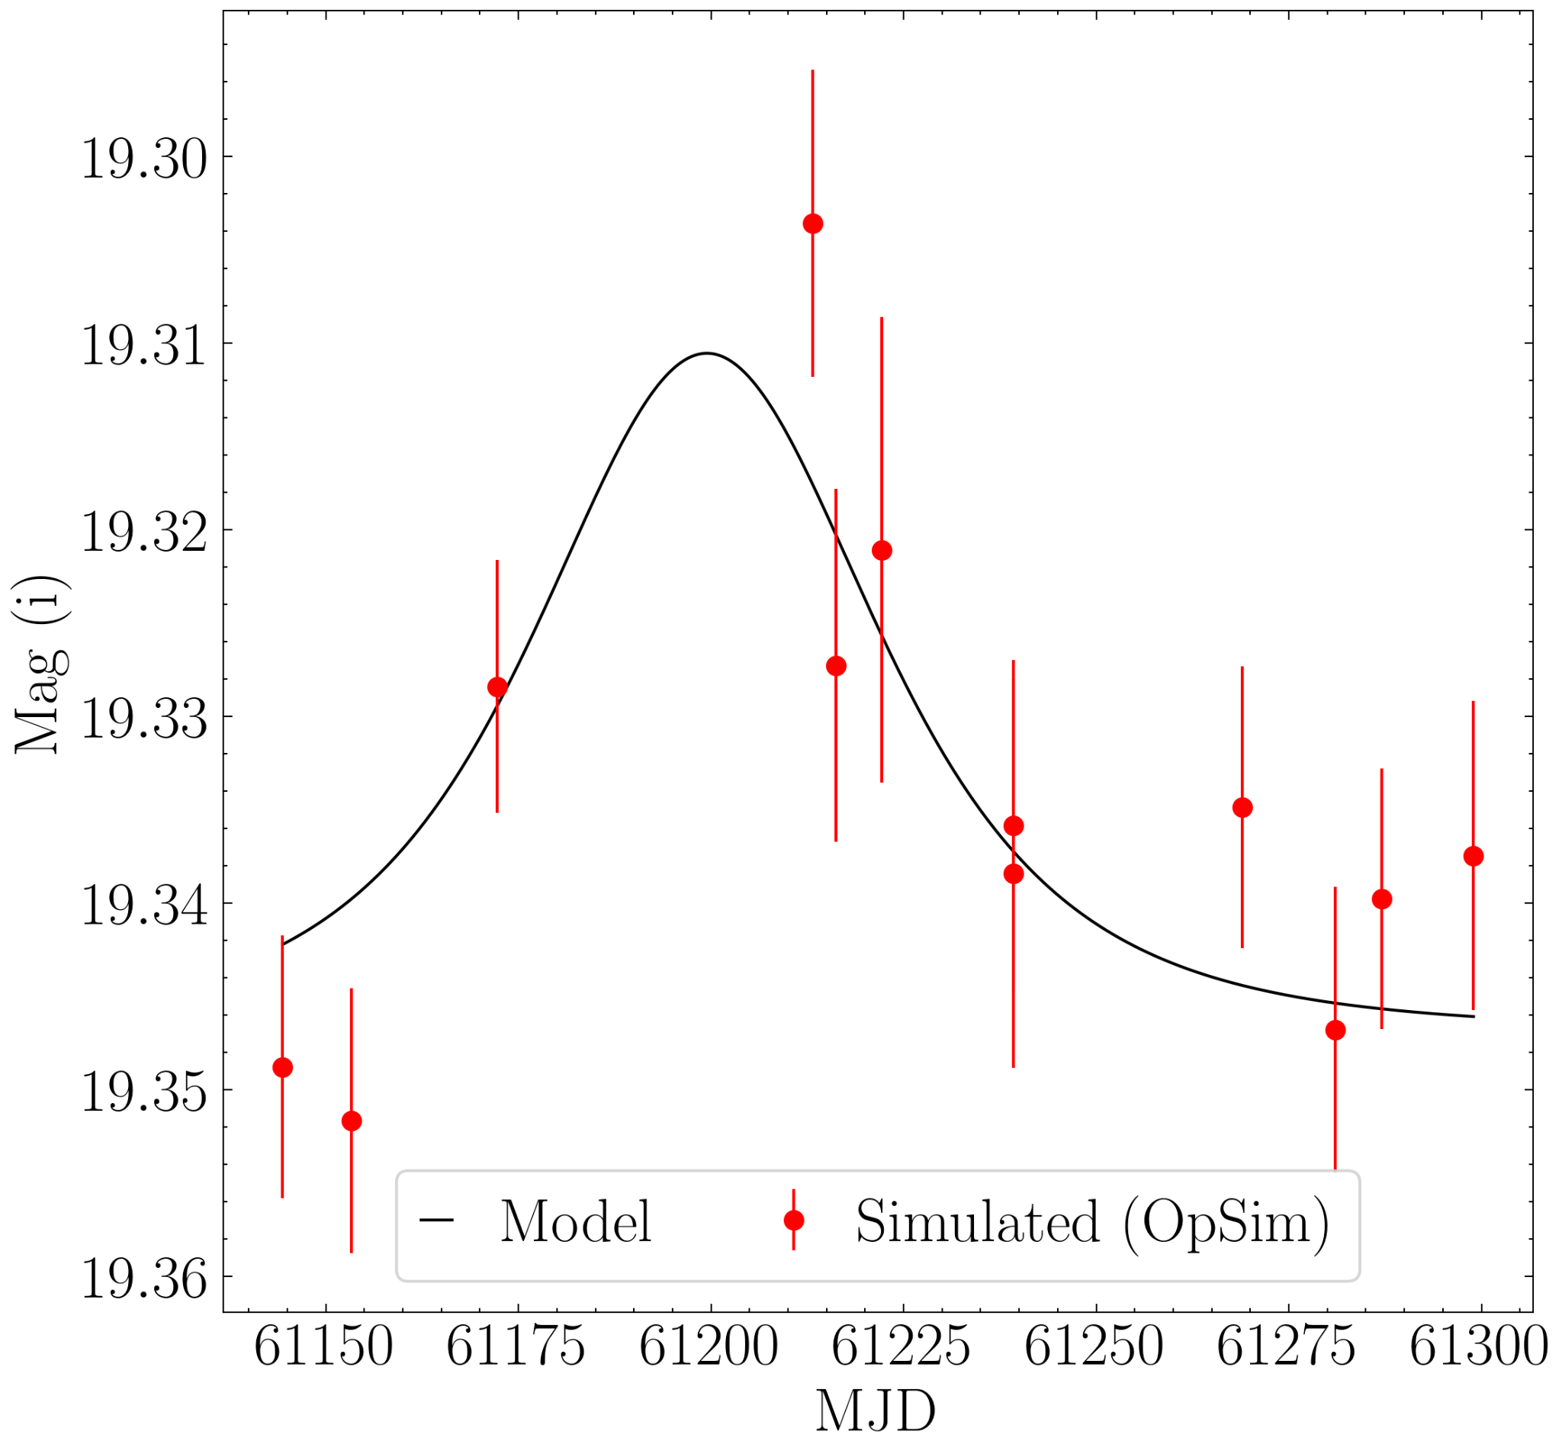
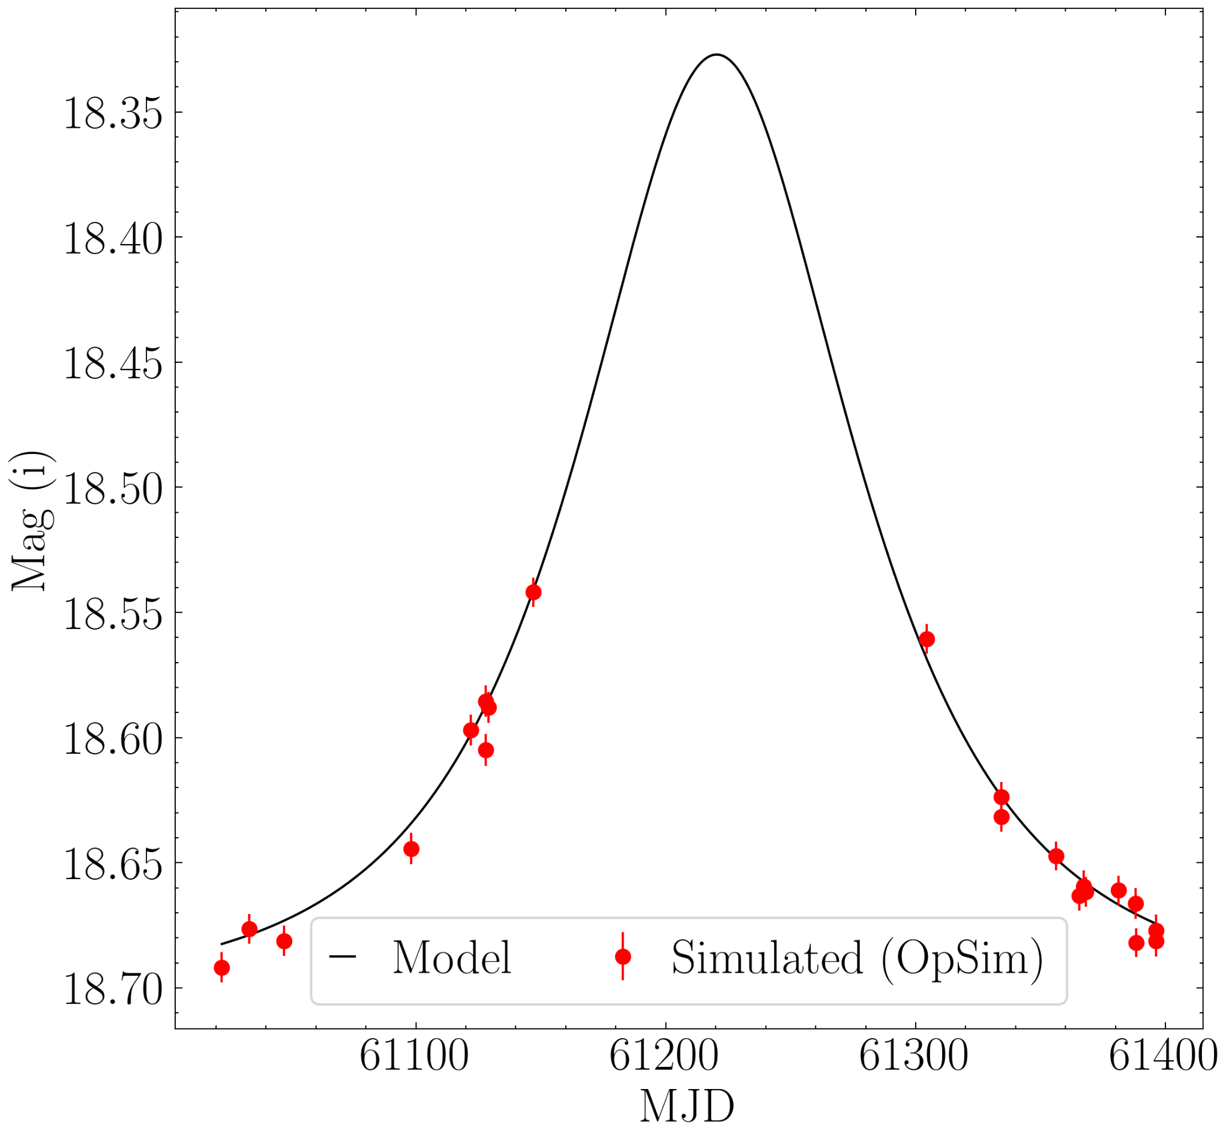
Identifying Microlensing in LSST Data
Simulated ~10⁶ Constant and point-like Microlensing (ML) light curves using the Operations Simulator (OpSim) codebase from Rubin
Due to LSST cadence, can only expect to see ~800 observations in the bulge over the full 10 years
Clearly classification is a challenge!
Benedict Crossey | Searching for PBHs with LSST

Slide 4


BDT and BIC Ratio as Classifiers
In order to distinguish between the two light curve classes (Constant and ML), we trained a boosted decision tree (BDT) on a subset of the data:
0 = Constant Class
1 = ML Class
Bayesian Information Criterion (BIC):
Can compare the Constant and ML BICs for a given light curve using BIC ratio:
Benedict Crossey | Searching for PBHs with LSST

Slide 5
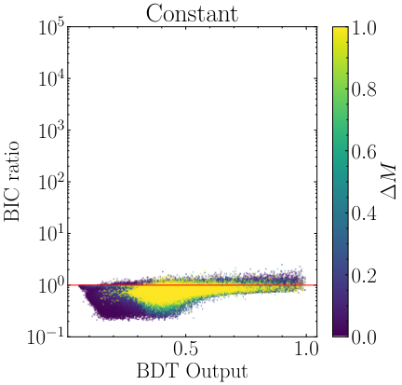
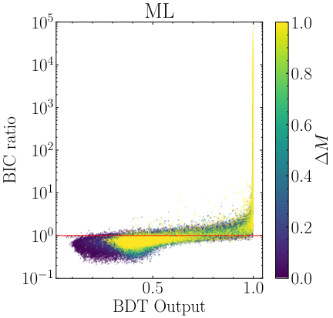
BDT and BIC Ratio as Classifiers
Benedict Crossey | Searching for PBHs with LSST

Slide 6
The Importance of False Positives
Expect some amount of false positives to contaminate the data:
False Positive Rate (FPR) = N_{FP} / (N_{FP} + N_{TP})
With ~10⁶ light curves simulated, cannot predict an FPR of lower than ~10⁻⁶ per star per year (without extrapolation)
Bad news for LSST - ~10⁹ stars visited, so with this FPR we would expect ~10³ false positives - completely drowning out the expected foreground (from our modelling ~10² foreground events expected per year)
Therefore it is absolutely crucial to effectively control the false positive rate if we want to set novel constraints on PBHs using Rubin.
Benedict Crossey | Searching for PBHs with LSST

Slide 7
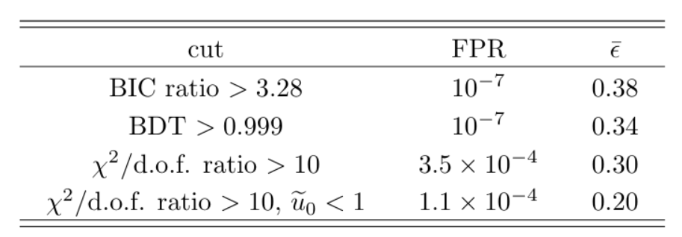
Extrapolating to Lower FPR
Benedict Crossey | Searching for PBHs with LSST

Slide 8
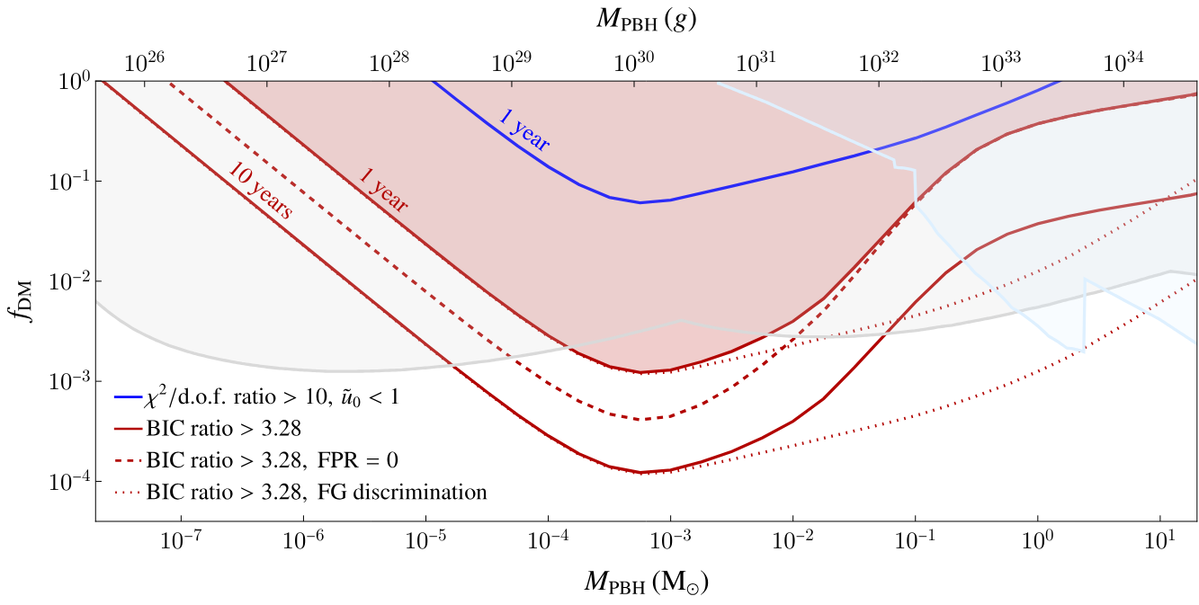
Projected Constraints on PBHs
Benedict Crossey | Searching for PBHs with LSST

Slide 9
Thank you for listening!
Any questions?
Benedict Crossey | Searching for PBHs with LSST

Slide 10
Backup Slides
Benedict Crossey | Searching for PBHs with LSST

Slide 11
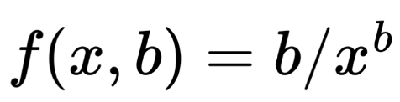
Tail Fits
Pareto Distribution:
Johnson S_{B}:
where 𝜙 is the normal distribution probability distribution function.
Benedict Crossey | Searching for PBHs with LSST

Slide 12
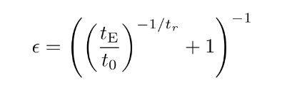
Analytic Efficiency Function

Slide 13
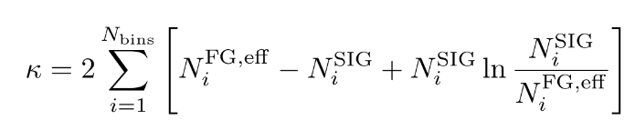
Calculating Constraints
90% CL found by locating (M_{PBH}, f_{DM}) for which 𝜿 = 4.61
Benedict Crossey | Searching for PBHs with LSST

Slide 14
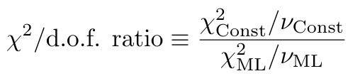
𝝌² Ratio
Even for Constant class lightcurves, can often get low 𝛘² values for ML fits by fitting to the noise
Can compare the Constant and ML goodness-of-fits for a given lightcurve using the ratio of the reduced 𝛘²:
𝛎_{Const} = n - 1; 𝛎_{ML} = n - 5
Often get very large values for Constant lightcurves, suggesting ML model fits better than Constant model!
Benedict Crossey | Searching for PBHs with LSST

Slide 15
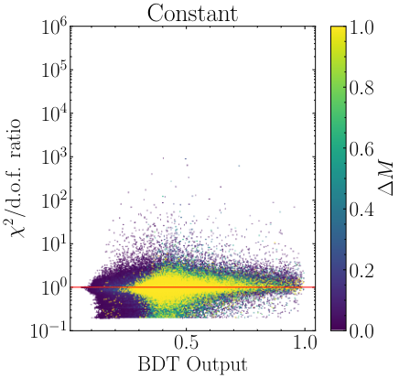
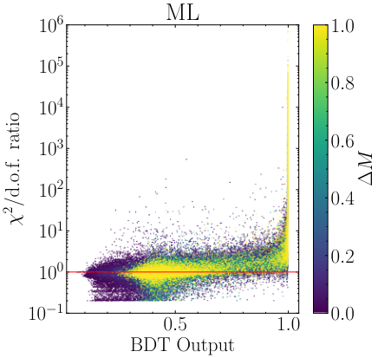
𝝌² Ratio
Benedict Crossey | Searching for PBHs with LSST

Slide 16
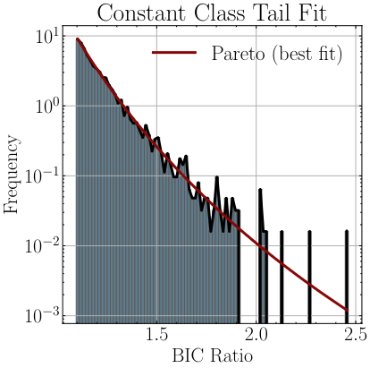
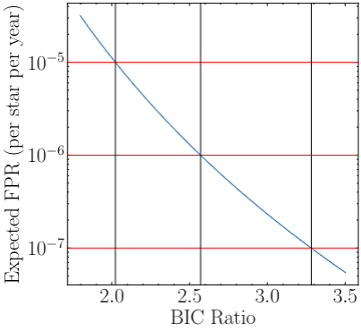
Extrapolating to Lower FPR
BIC Ratio
To bring number of false positive events expected per year down to same level as foreground, need FPR ~ 10⁻⁷
Zooming into tail composed of top 1% of BIC ratios for Constant class, we find we can fit the tail well with a Pareto distribution using distfit:
By extrapolation, a cut on the
BIC ratio > 3.28 gives an expected FPR of 10⁻⁷
Benedict Crossey | Searching for PBHs with LSST

Slide 17
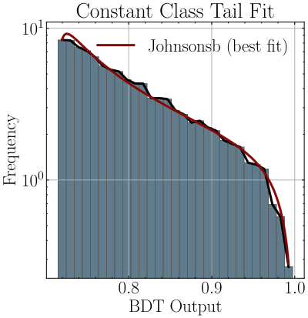
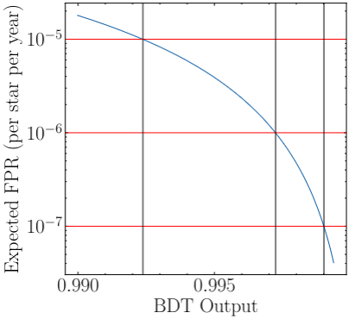
Extrapolating to Lower FPR
BDT Output
BDT output is bounded between 0 and 1, but can fit with a bounded distribution
Zooming into tail composed of top 1% highest values of BDT, find the Johnson S_{B} to be a good fit using distfit:
A cut on BDT output > 0.999 gives an expected FPR of 10⁻⁷
Benedict Crossey | Searching for PBHs with LSST

Slide 18
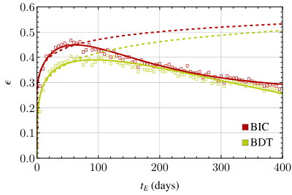

Effective ML Detection Efficiency
Can define an effective efficiency per binned t_{E} as ε = N_{>cuts}/N_{total}
We find an analytic function to fit the efficiency (solid line):
This doesn’t asymptote to 1 for large t_{E} as some other fits suggested in the literature do (dashed line)
We use this efficiency and foreground estimates to calculate the number of expected point-like microlensing events and hence put constraints on PBHs
Benedict Crossey | Searching for PBHs with LSST

