Slide 1
Ultra-high purity electroforming for rare event searches
P. Knights¹, K. Nikolopoulos^{1,2}, G. Rogers¹, D. Spathara¹, P. Walters¹
¹University of Birmingham, ²University of Hamburg

Slide 2
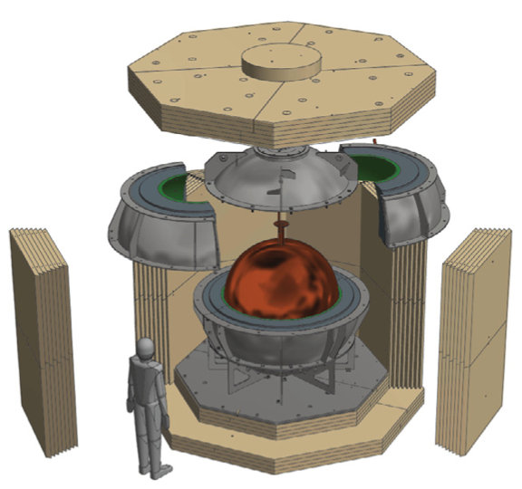
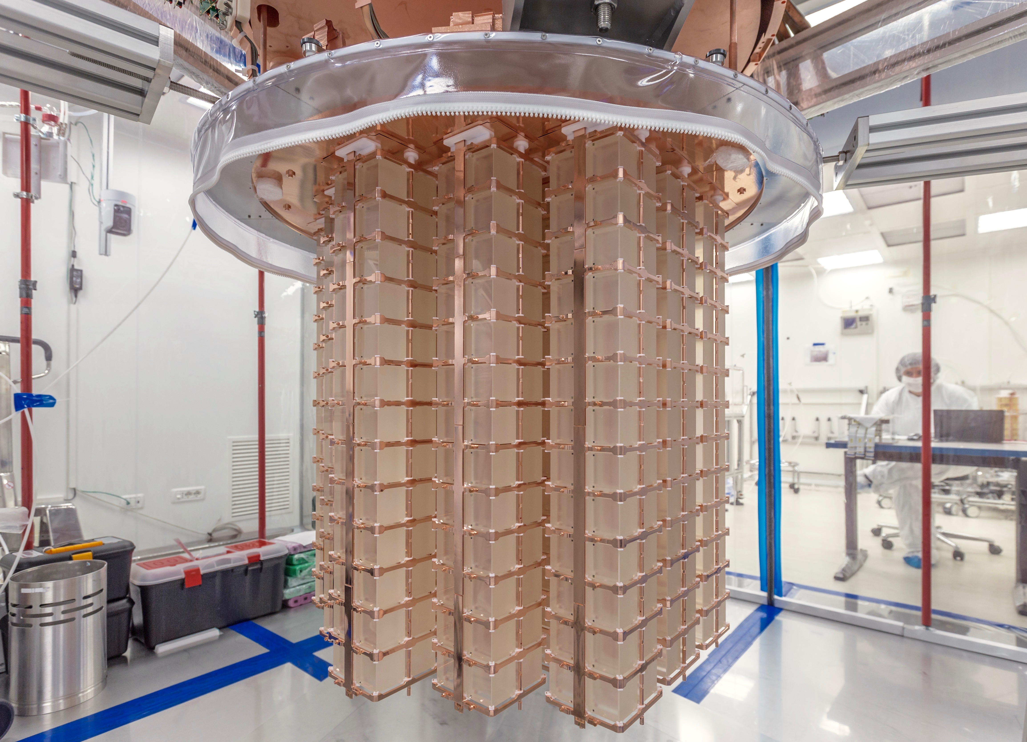

Copper as a detector material
Copper is a common detector material for rare event searches
  Commercially available at high-purity up to high-purity
  Good mechanical and electrical properties
  No long-lived radio-isotopes
NEWS-G collaboration
https://www.snolab.ca/experiment/news-g/
CUORE collaboration
https://cuoreexperiment.org

Slide 3
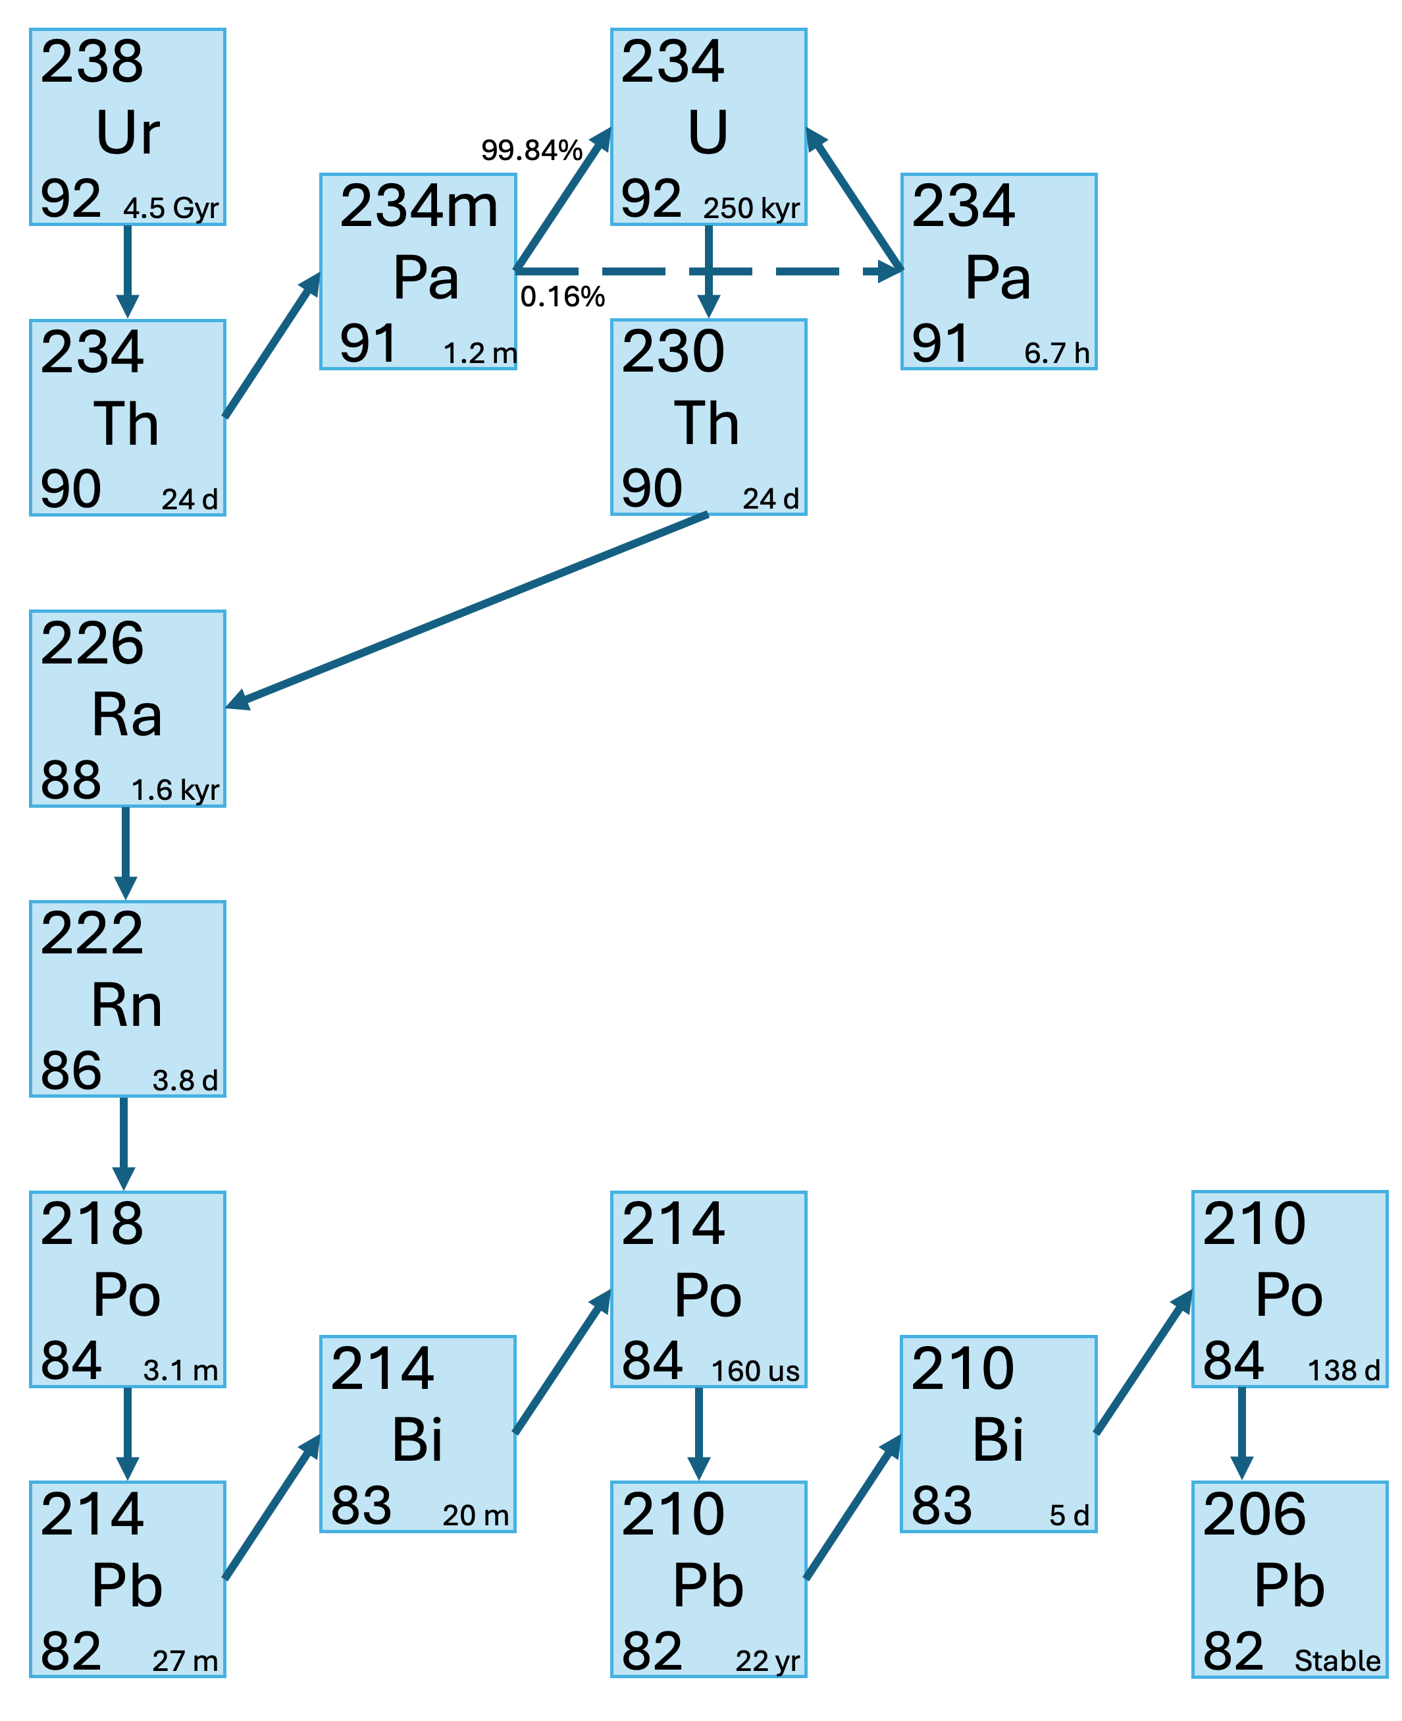
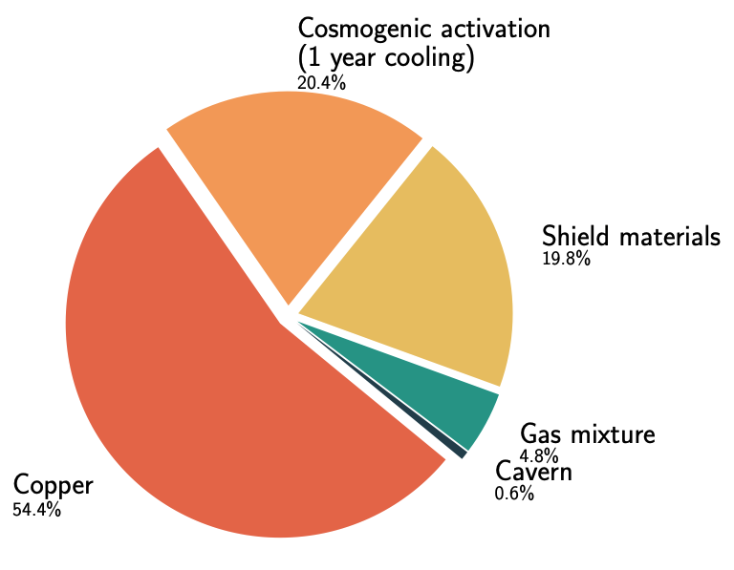
Copper background
Copper can still represent an important background
Commercial copper contaminated - ²³⁸U and ²³²Th decay chains:
  Natural ore contamination
  Cosmogenic activation
  Implanted during manufacture
²³⁸Ur decay chain
Simulated backgrounds for NEWSG’s current detector

Slide 4
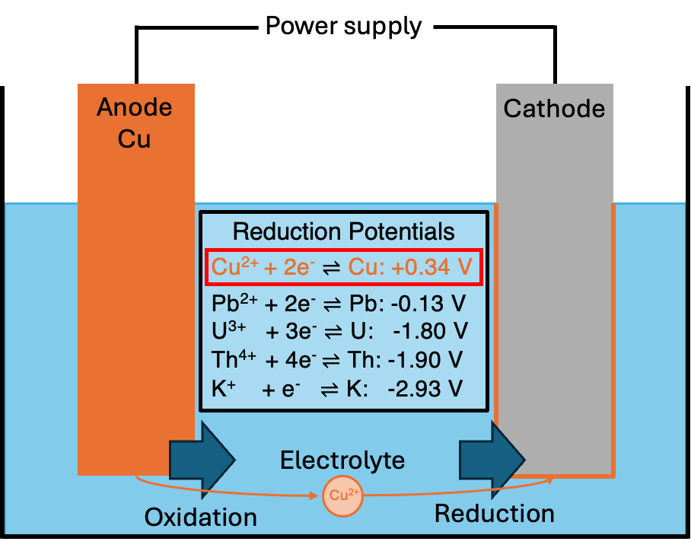
Electrodeposition
Deposit Cu²⁺ ions onto a cathode by applying a voltage
Copper has a higher reduction potential than contaminants -> more easily reduced onto the cathode
Electroplating
Electroforming
Cu plated onto existing structure (i.e. cryostat) acting as an ultra-pure shield
Cu plated onto a mould (called mandrel)
Remove the mandrel leaving a pure copper structure

Slide 5
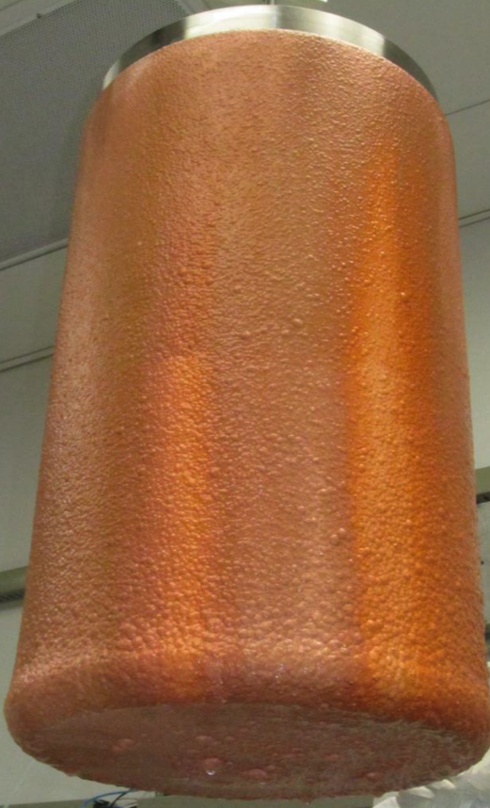
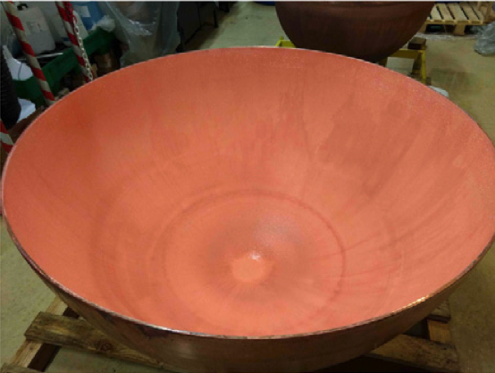
Electrodeposition
Deposit Cu²⁺ ions onto a cathode by applying a voltage
Copper has a higher reduction potential than contaminants -> more easily reduced onto the cathode
Electroplating
Electroforming
Cu plated onto existing structure (i.e. cryostat) acting as an ultra-pure shield
Cu plated onto a mould (called mandrel)
Remove the mandrel leaving a pure copper structure
Majorana demonstrator
Electroformed Cu
OSTI (2012) 1039850
NEWS-G electroplated Cu
NIMA 988 (2021) 164844
Sample of copper | ²³²Th [uBq/kg] | ²³⁸Ur [uBq/kg]
Commercial C10100 | 8.7 ± 1.6 | 27.9 ± 1.9
NEWS-G plated NIMA 988 (2021) 164844 | <0.24 | <0.11
Majorana demonstrator electroformed NIMA 828 (2016) 22-36 | <0.119 | <0.099

Slide 6
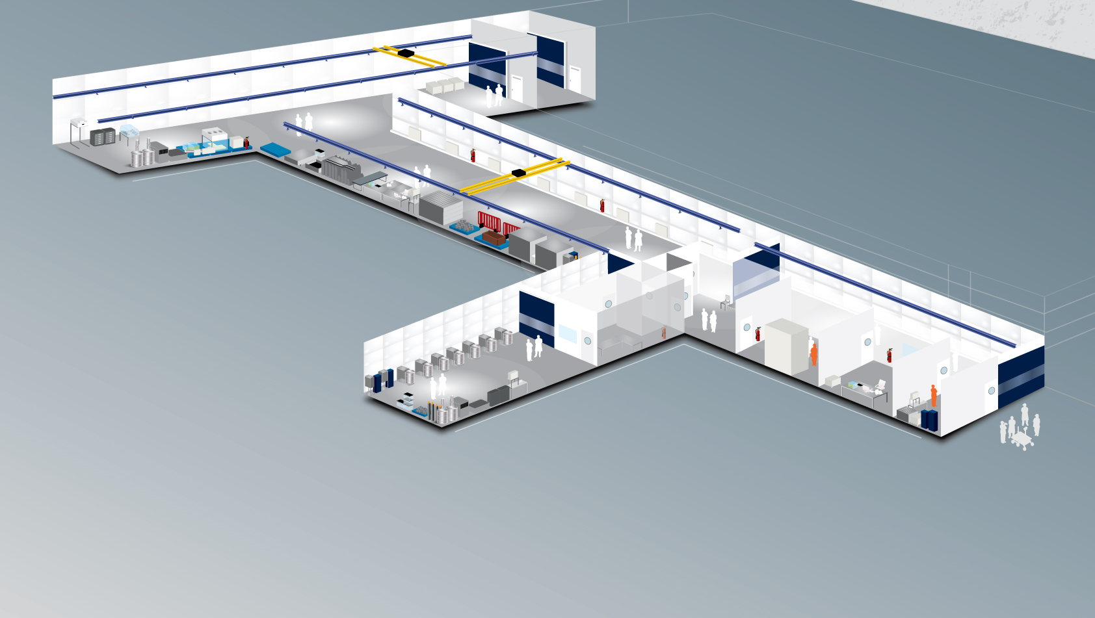
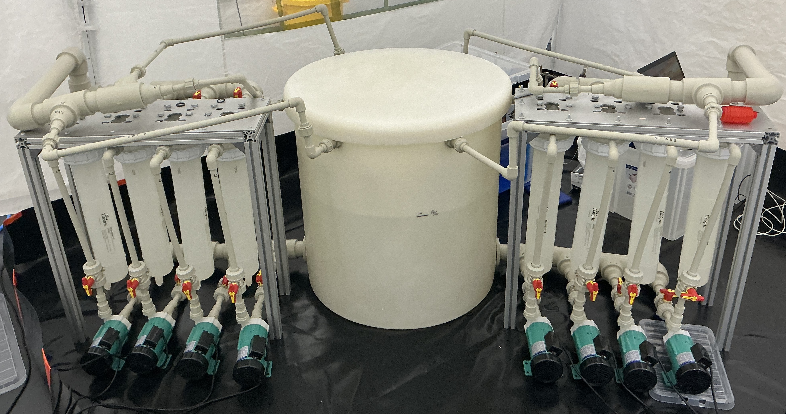
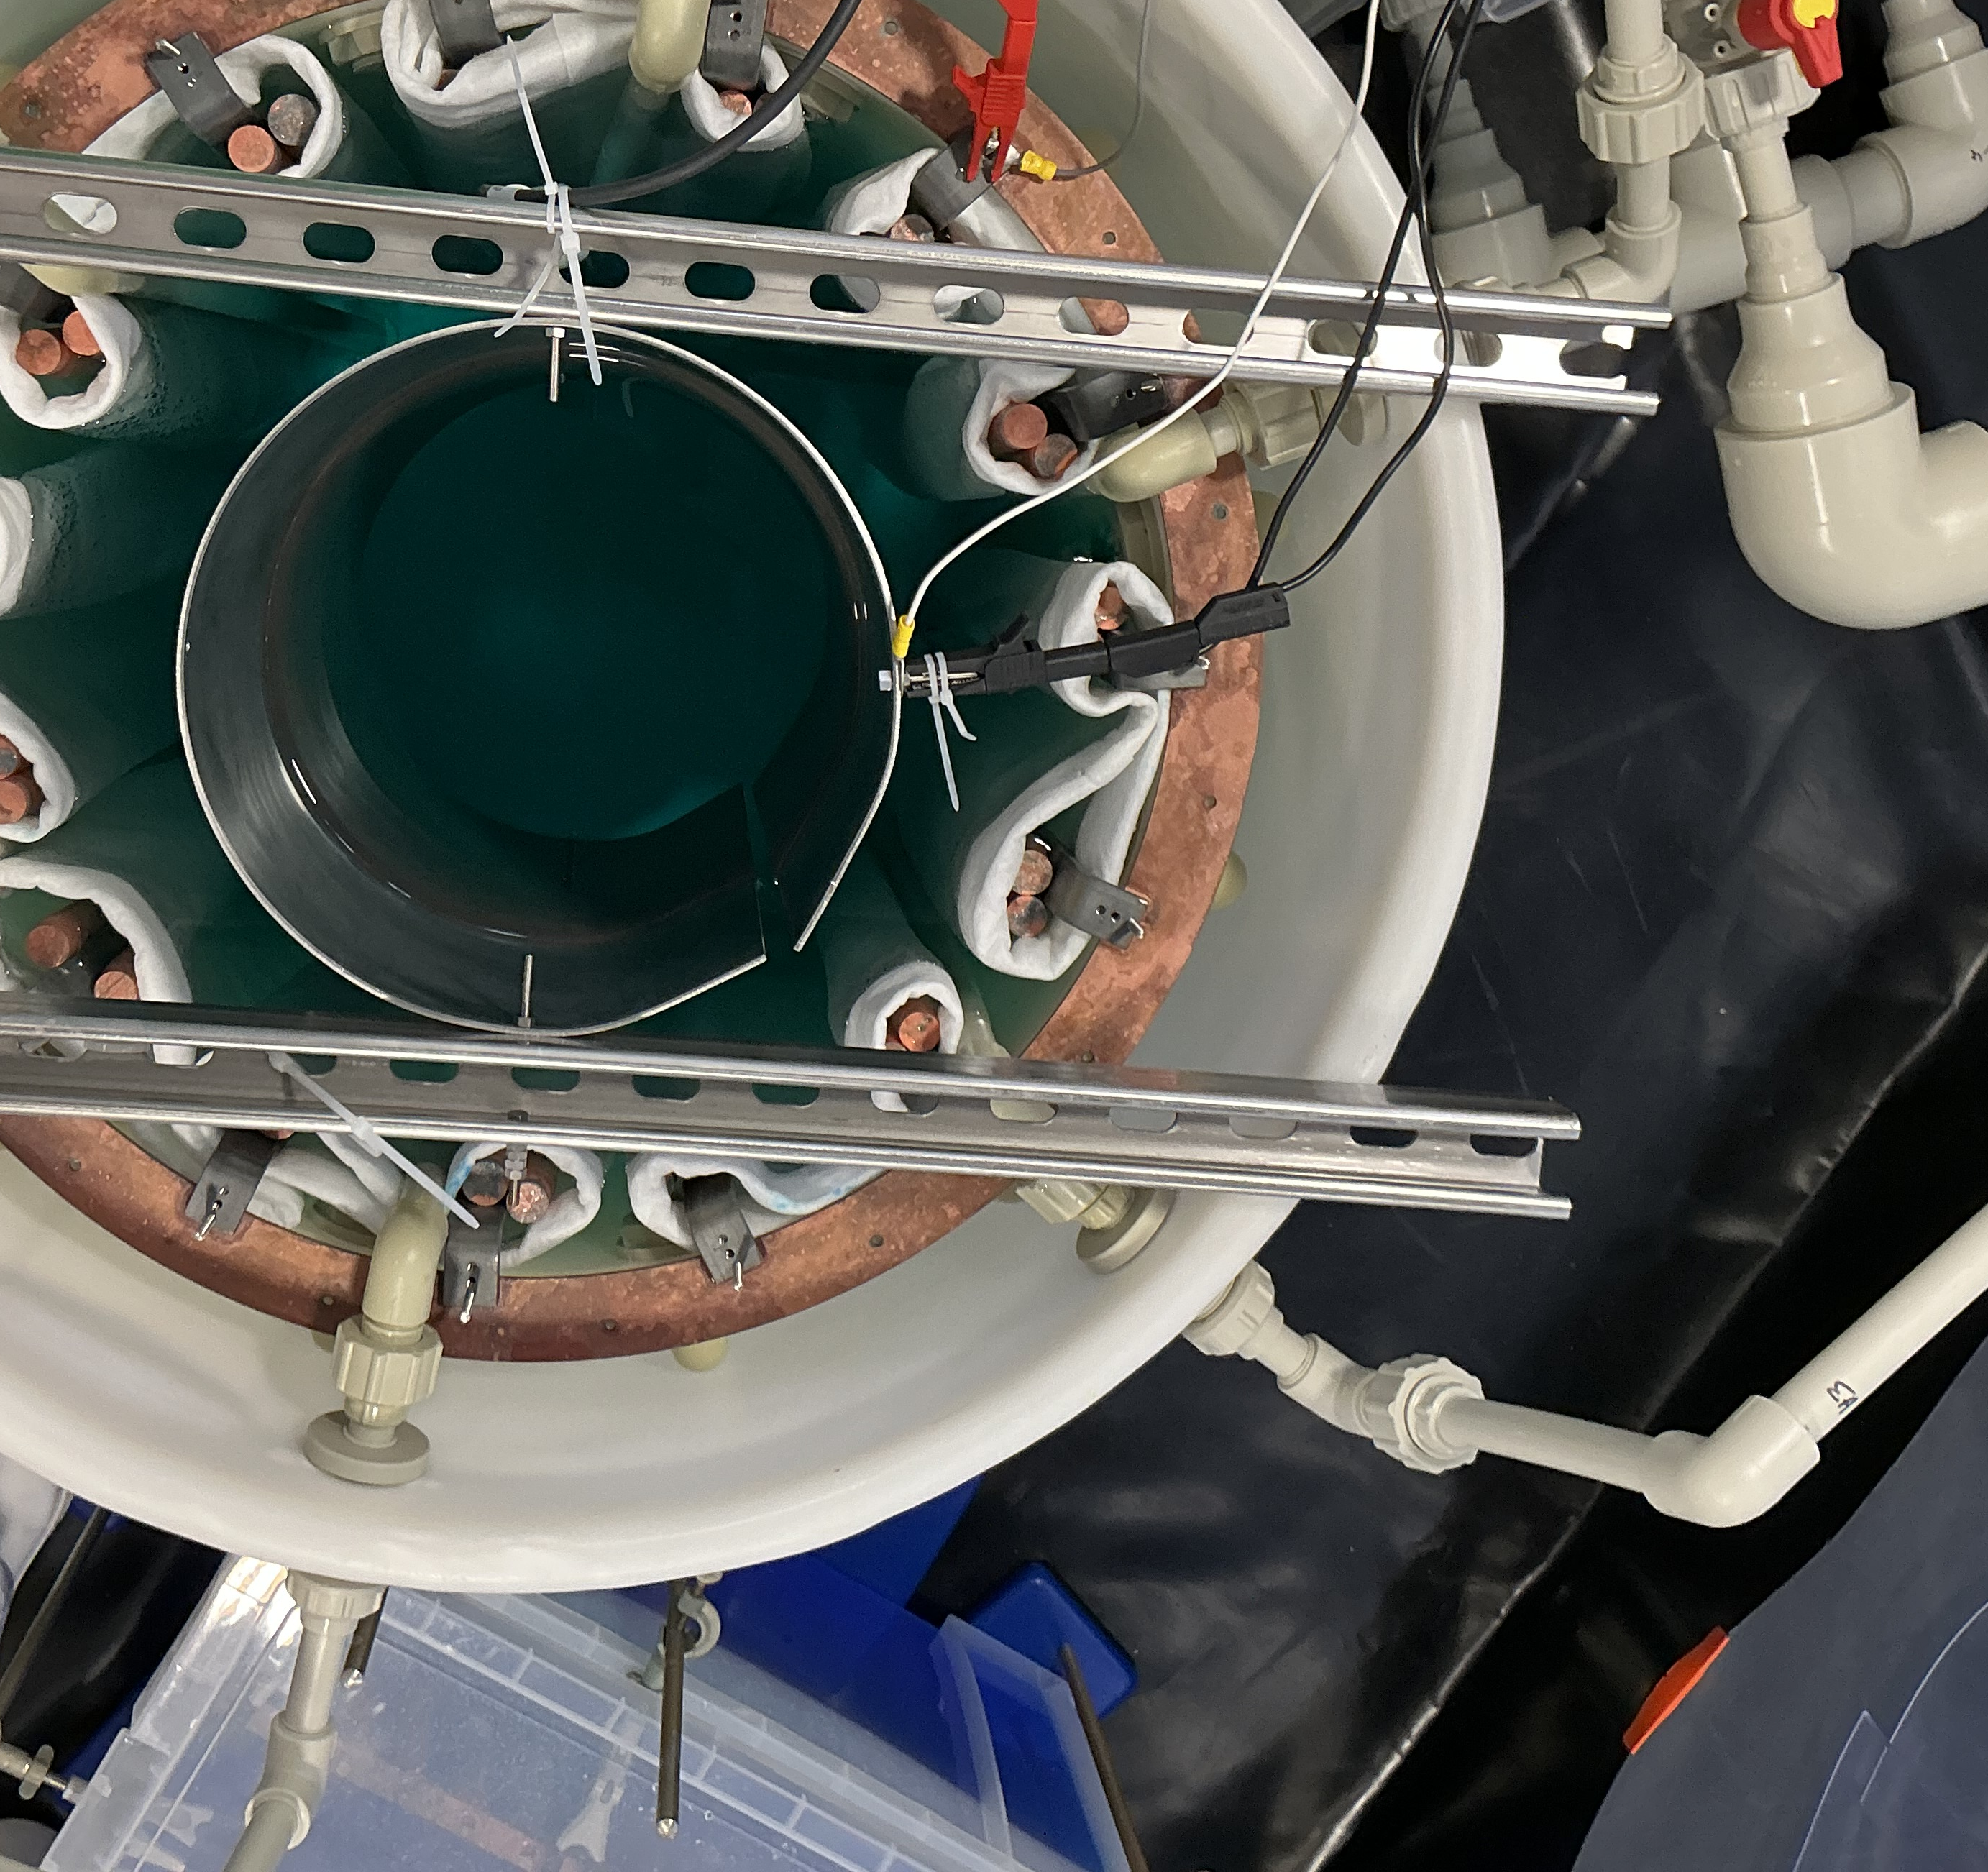
Electroforming facility at Boulby
1.1km underground at the UK’s deep underground laboratory Boulby -> reduce cosmogenic activation
Construction and cleaning finished
Currently commissioning with cylindrical mandrels
Immediate goal: electroform a ⌀30cm SPC DarkSPHERE-30
Ultimate goal: DarkSPHERE 𝒪[⌀3m]
Boulby underground lab
https://www.boulby.stfc.ac.uk/Pages/home.aspx
5.5N Cu feedstock
Recirculating filters
Inlets
CuSO₄ electrolyte
Ti anodes
Cu bus bar
Electroforming bath at Boulby
Steel cylindrical mandrel

Slide 7
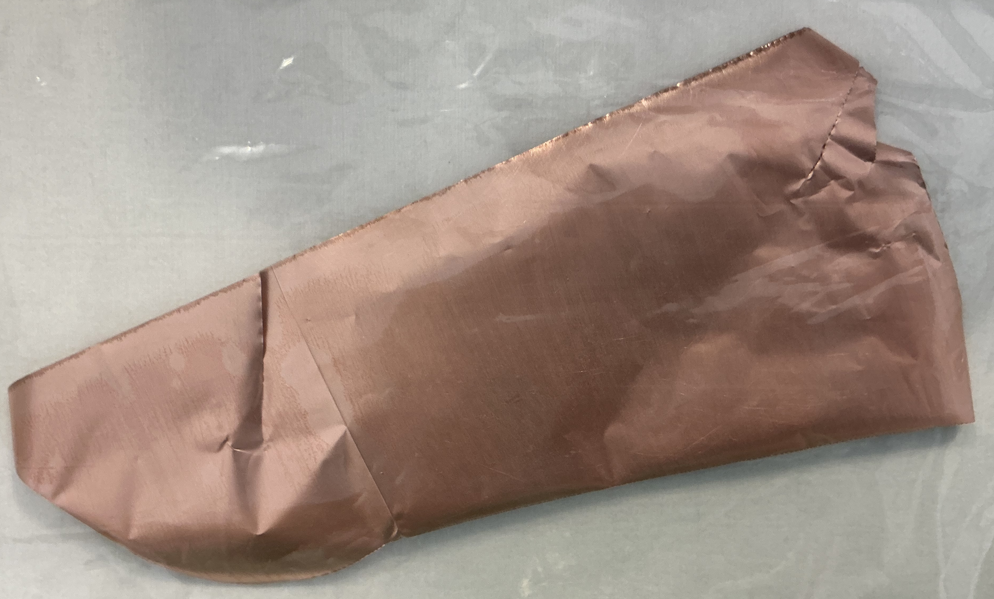
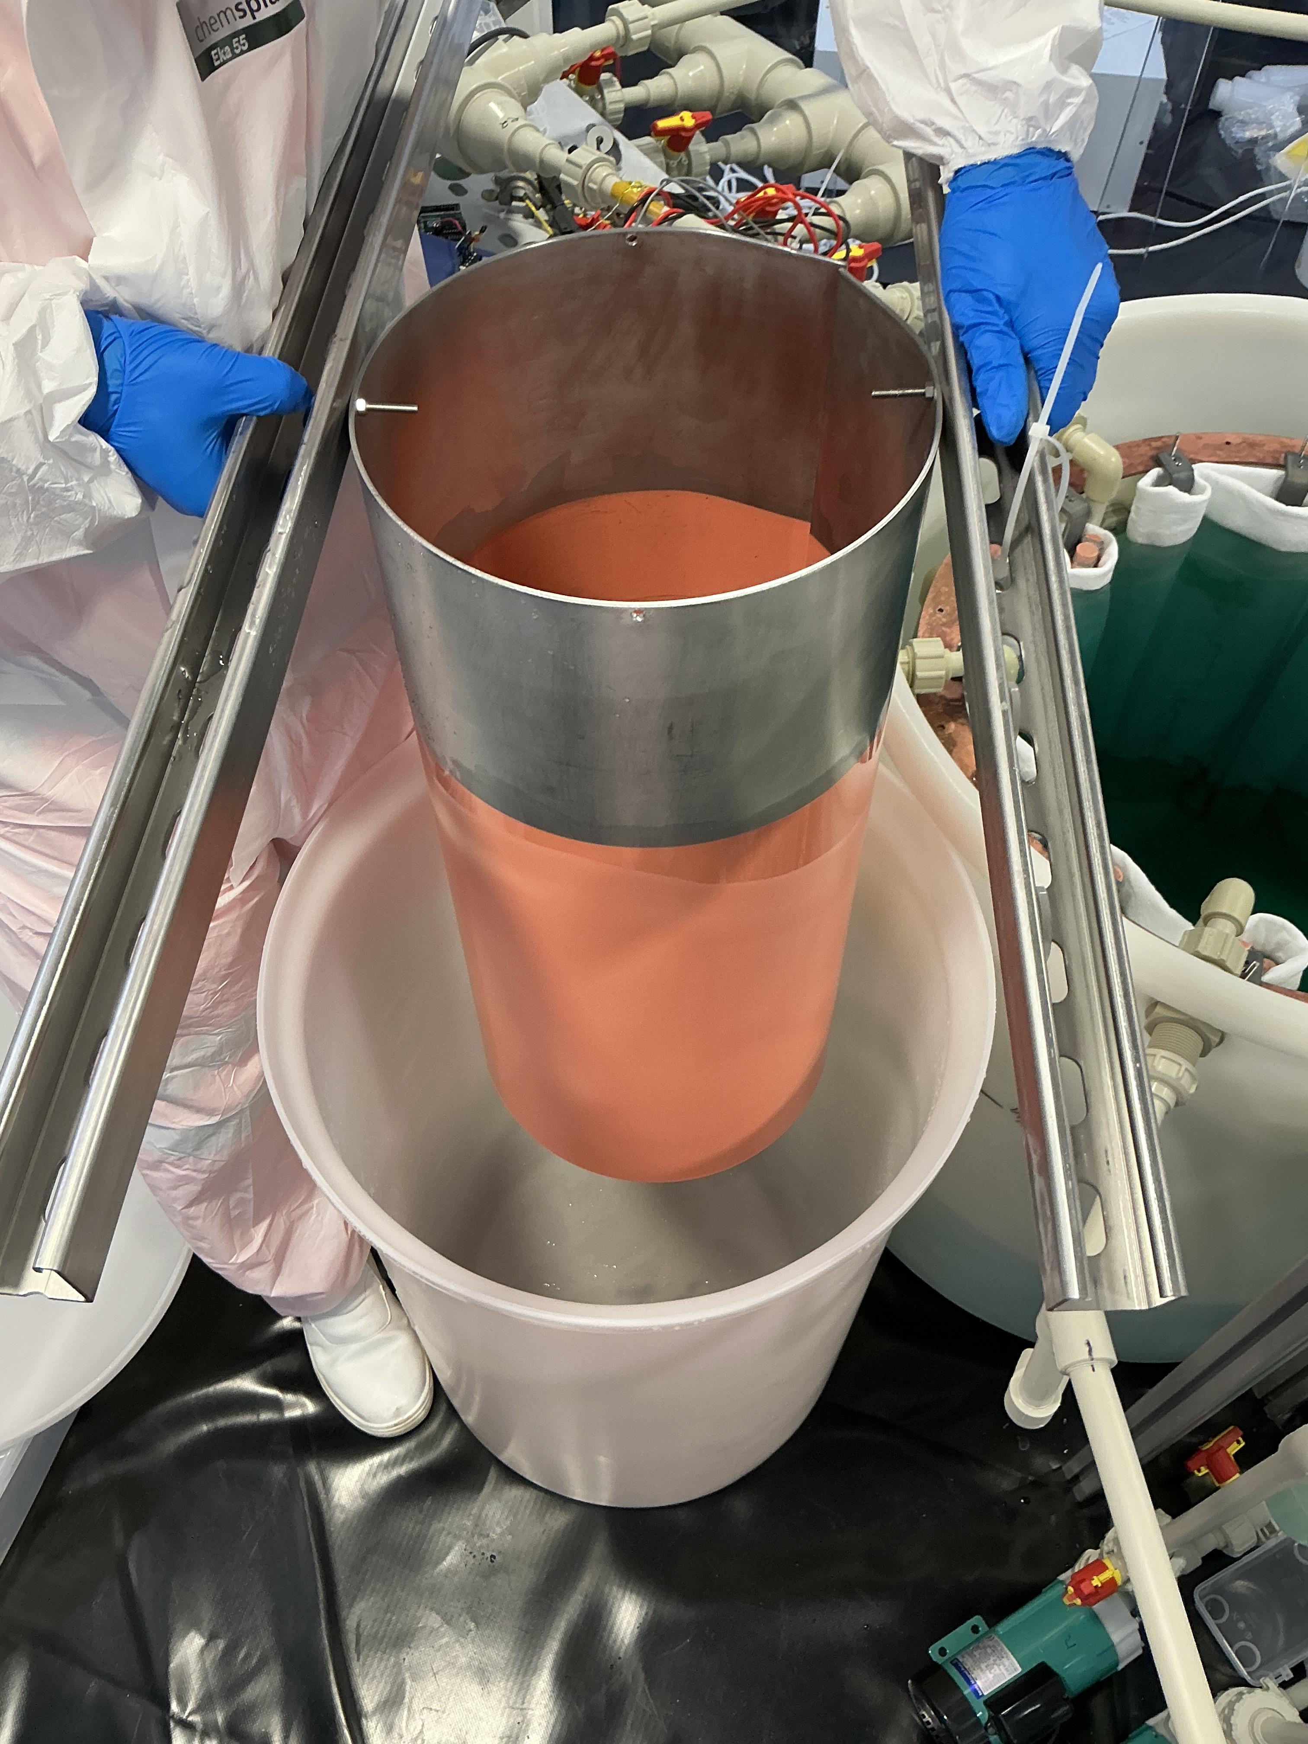
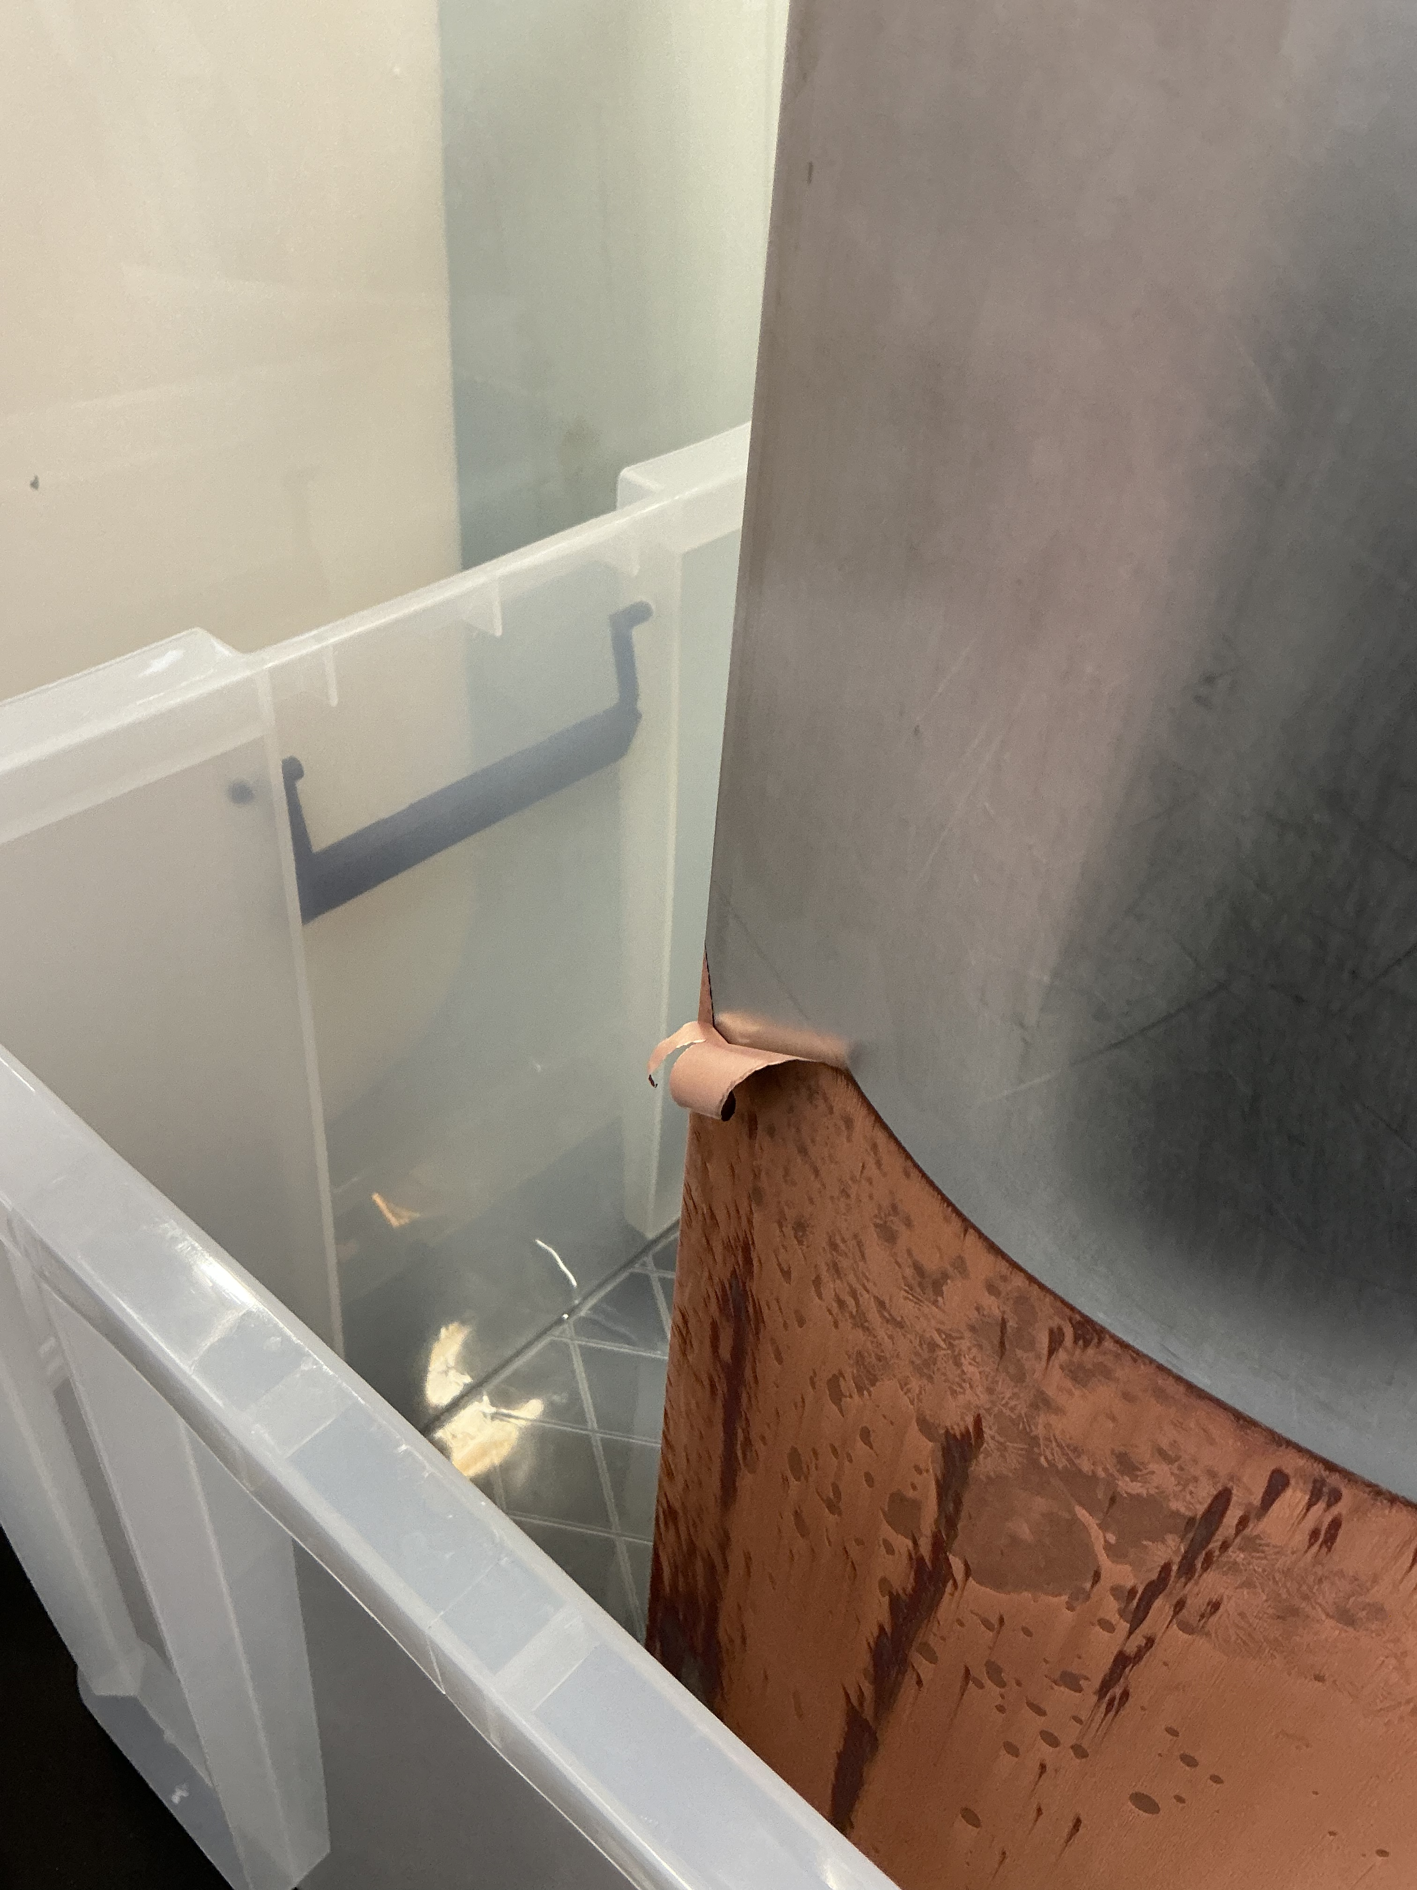
Commissioning
Copper plated onto stainless steel cylinder
Peeled copper off mandrel -> assay results pending

Slide 8
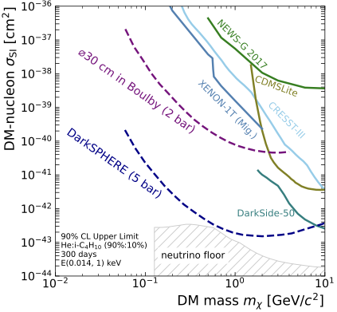
Physics Potential
Fully electroformed SPCs will have world leading sensitivity to low-mass dark matter
DarkSPHERE-30 will begin construction in the coming months
Alloys being explored to improve the properties of electroformed copper – PureAloys project
  NIMA 1082 (2026) 170970
  arXiv.2507.00799

Slide 9
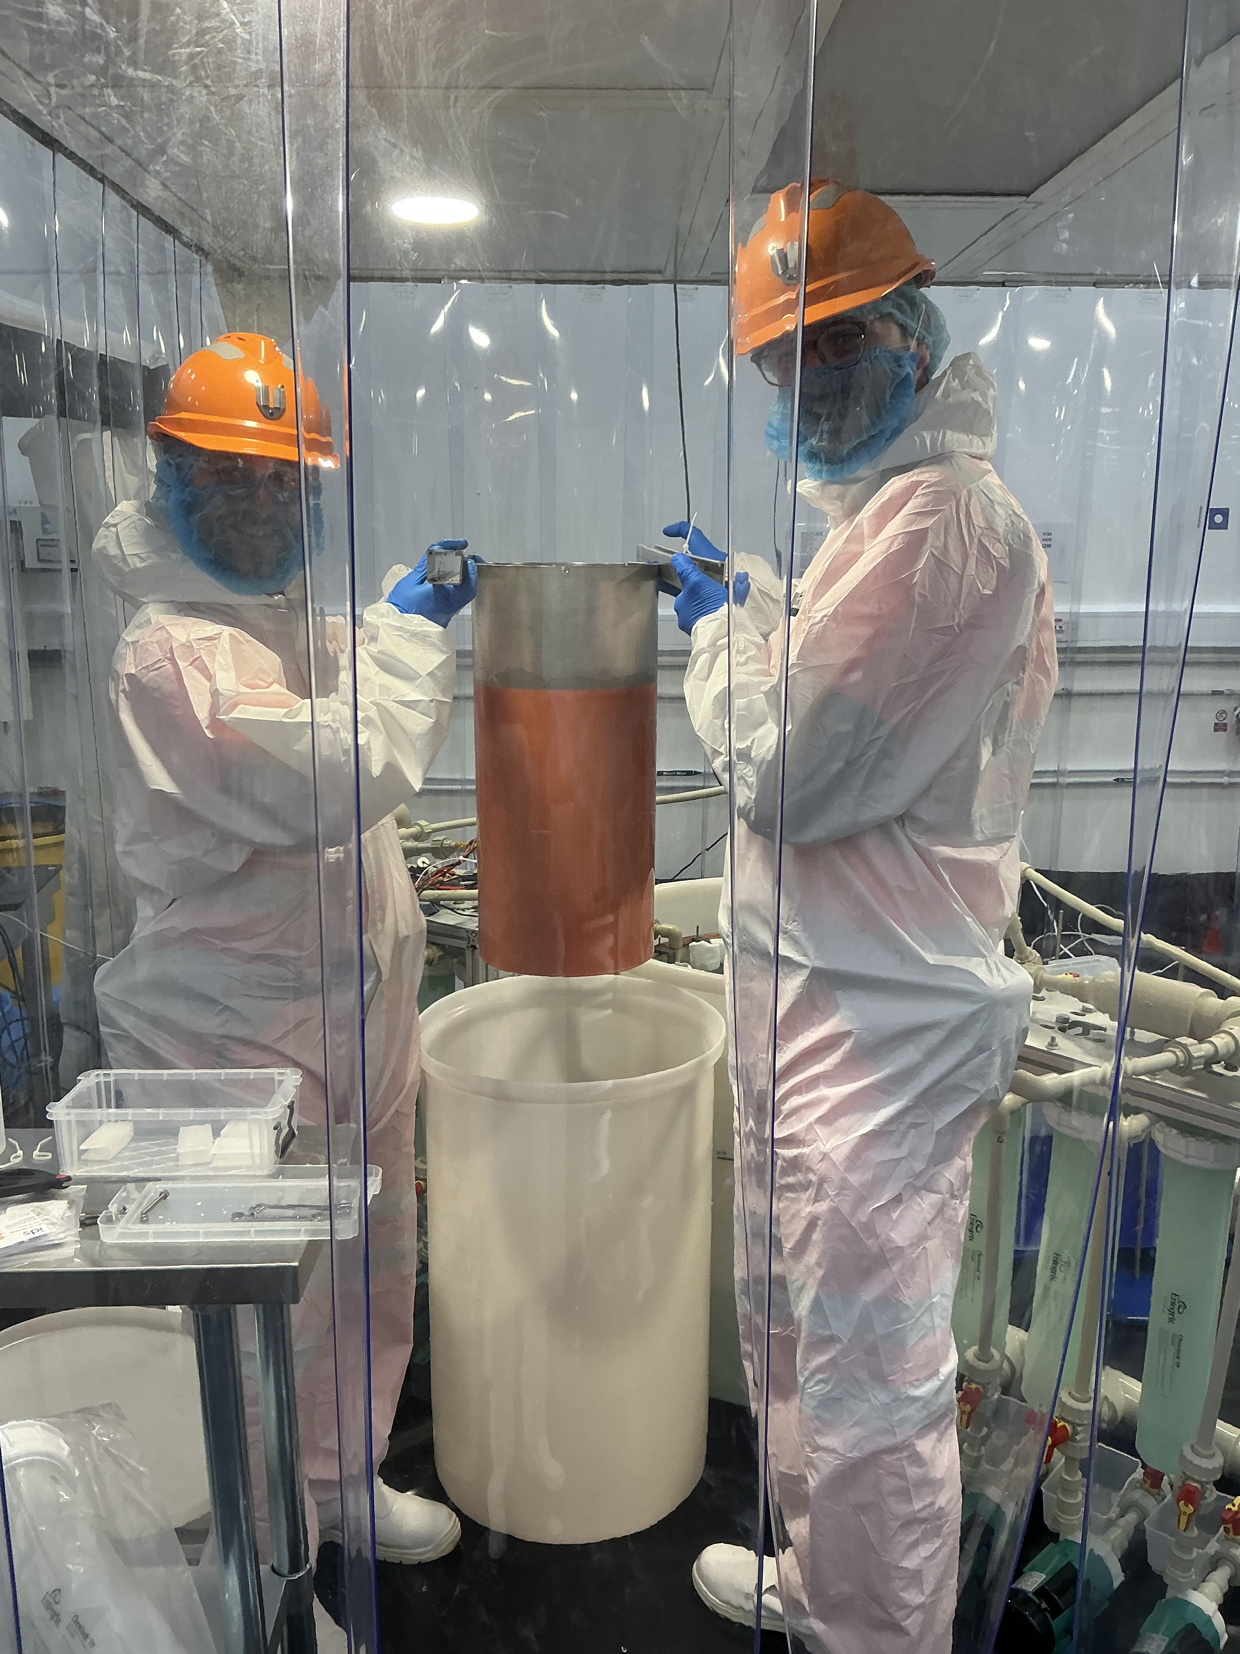
Summary
Copper electroforming for radio-pure detectors
Electroforming facility constructed at Boulby
First copper plated onto stainless steel cylinder
Electroforming a ⌀30cm SPC in the coming months
Many other experiments exploring the use of electroformed Cu

Slide 10
BACKUP SLIDES

Slide 11
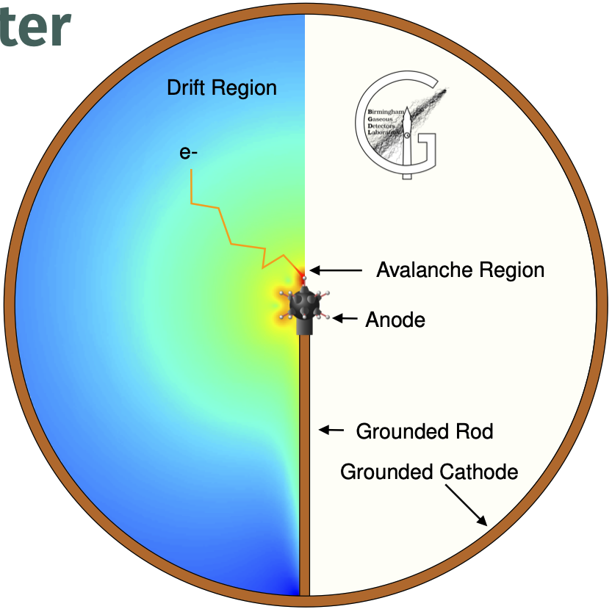
Spherical proportional counter
Proportional counter filled with gas
Choice of gas -> kinematic matching
Low capacitance -> Single electron detection
Simple design -> Radiopure construction
Optimised for light dark matter searches
NewsG operate several SPCs – current detector is Snoglobe at Snolab
JAIS 2025 (2025) 548

