Slide 1

The Future of Collider Physics
Jon Butterworth
University College London
Annual Theory Meeting, UK
17/12/2025
Leaning heavily on
European Strategy Inputs,
and to some extent the output…
Plus some personal bias/opinion… from an experimentalist
Notes:
Experiments.
Would we have found it anyway?
DIS
4l
Roman villa/cms. Traces of the SM will exist as long as there is a civilisation.

Slide 2
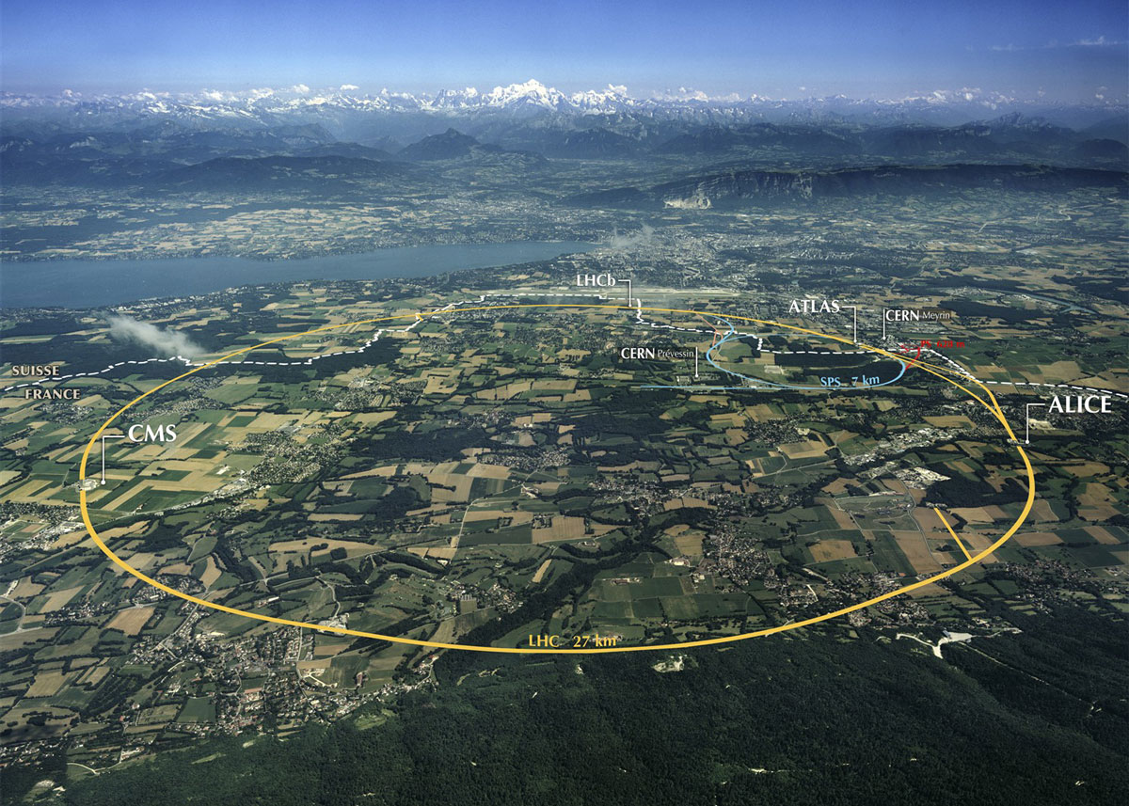
Outline
This tunnel
  Hadrons
  Electrons
Other tunnels
New tunnels
  Electrons
  Hadrons
  Muons

Slide 3

Why?

Slide 4
Conventional Wisdom
Hadrons for exploration
Leptons for precision
Lepton-hadron for QCD
e⁺e⁻ Higgs factory next (c.f. ESPP 2020)
Hadrons in half a century or so
ep … not high priority
Muons one day. Maybe.
Circular colliders will reach the point of diminishing returns (synchrotron radiation, magnetic field strength)

Slide 5


Slide 6
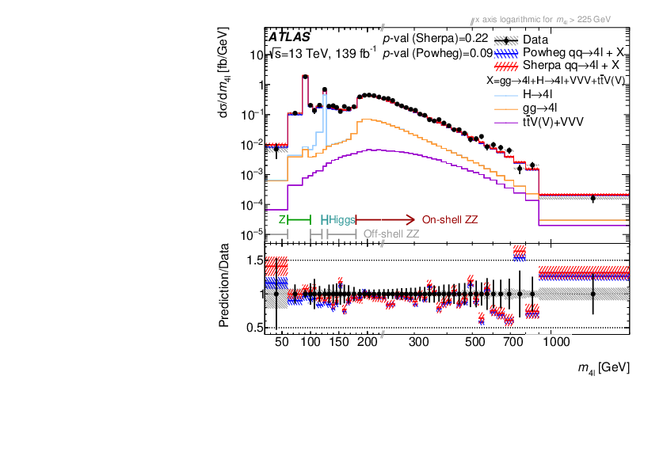
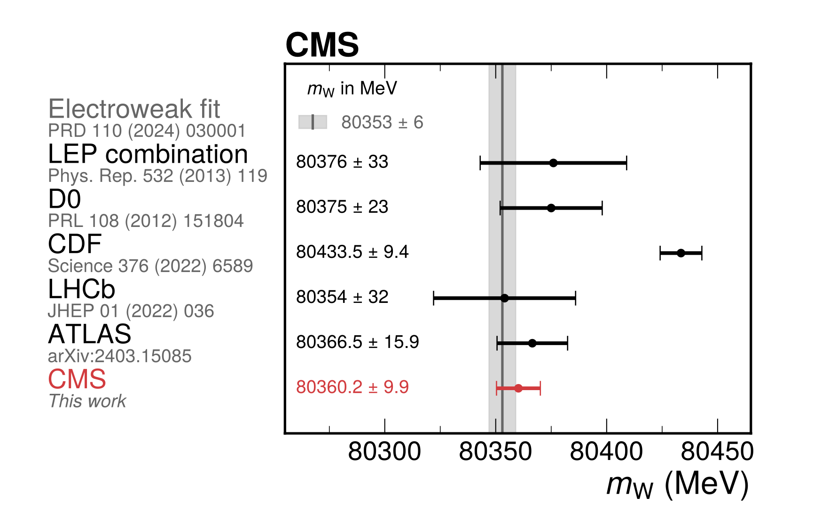
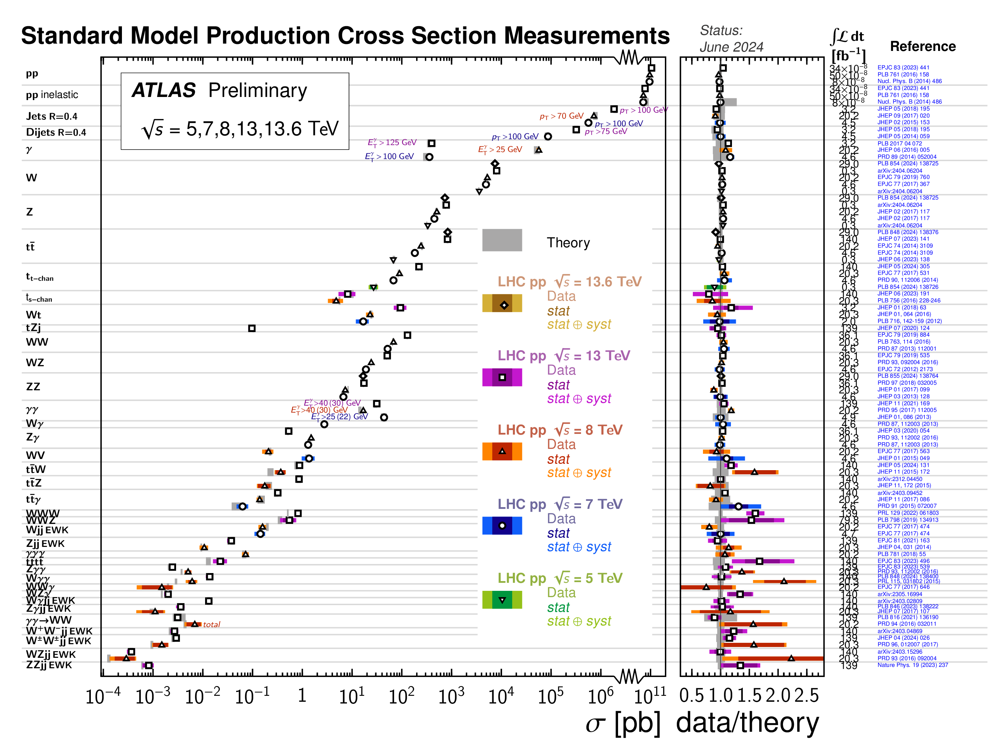
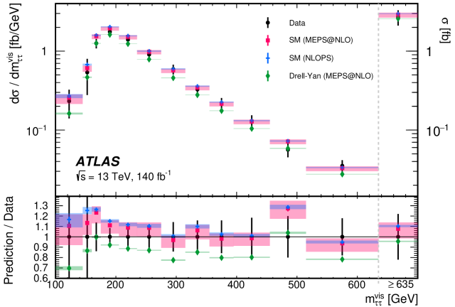
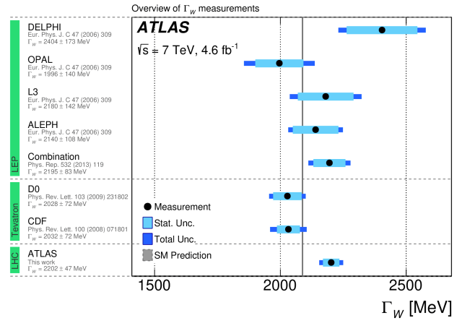
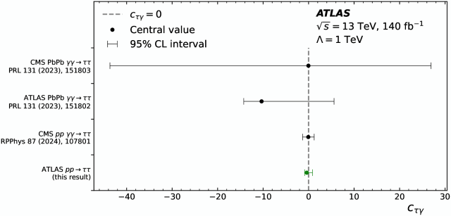
LHC: A precision Machine

Slide 7
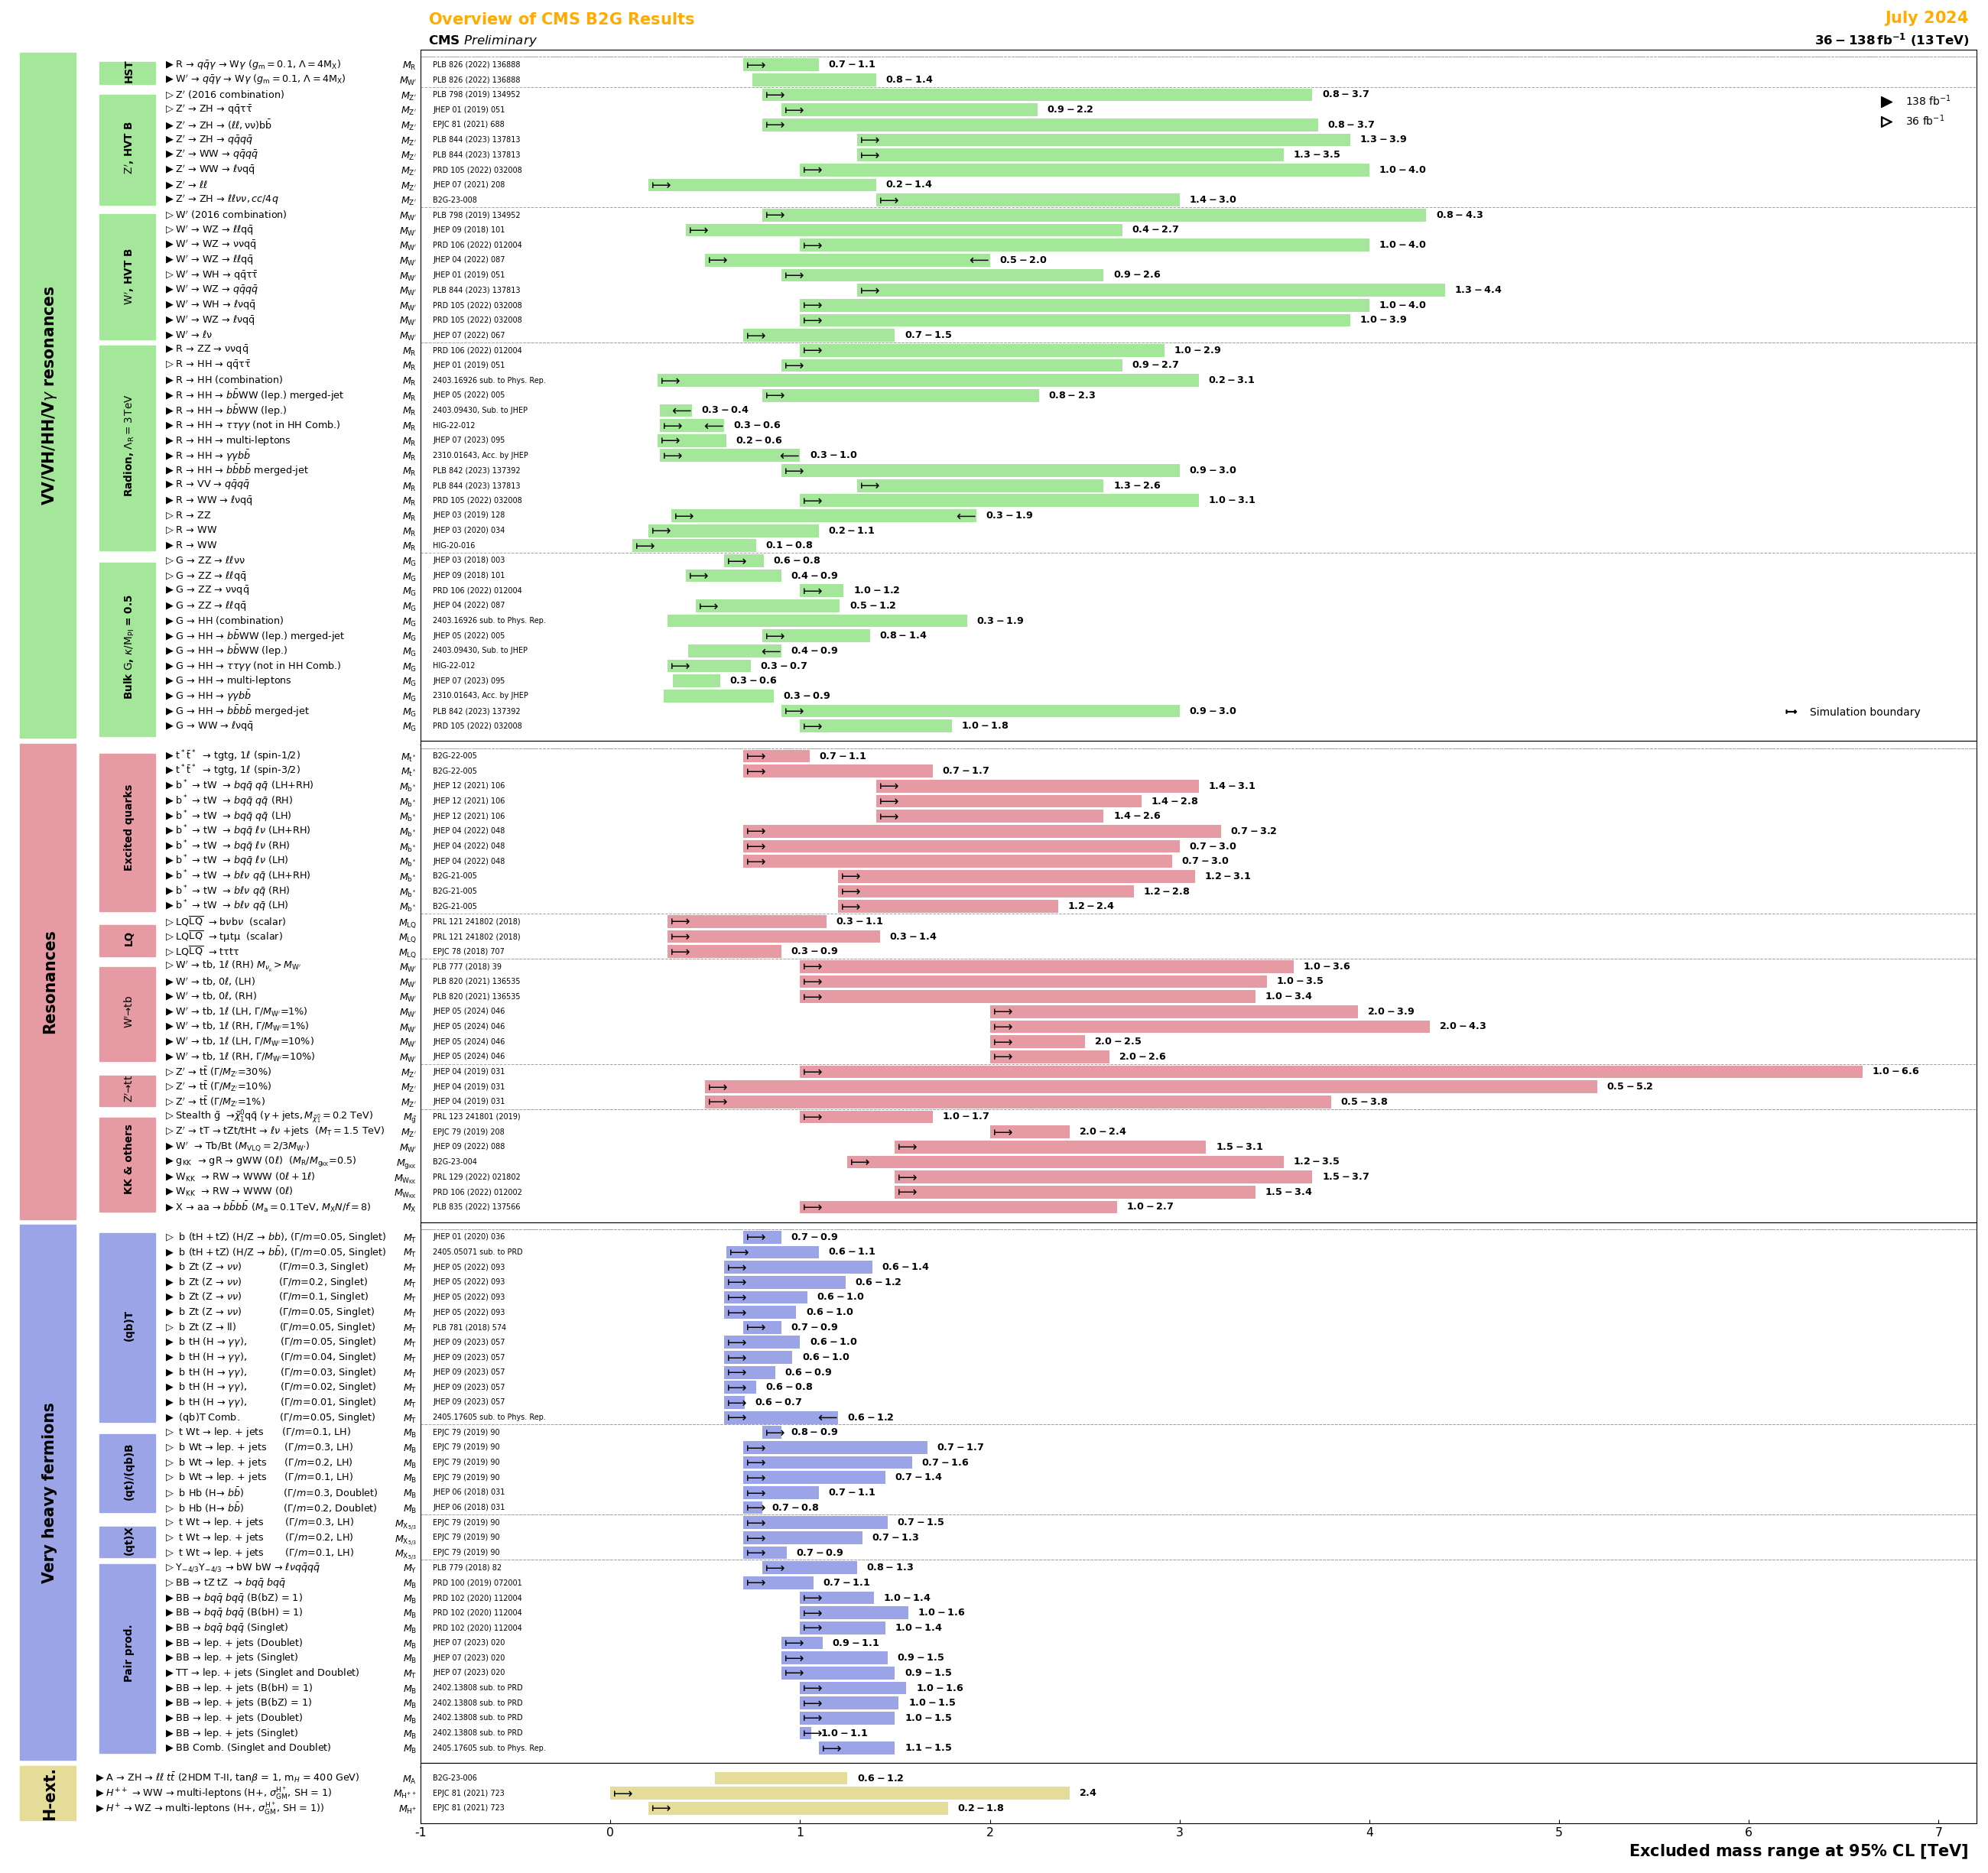
Searches
e.g. CMS Beyond SM particles decaying 2(to) Higgs, top and Gauge bosons (B2G) group
2 TeV

Slide 8
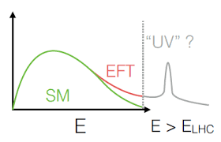
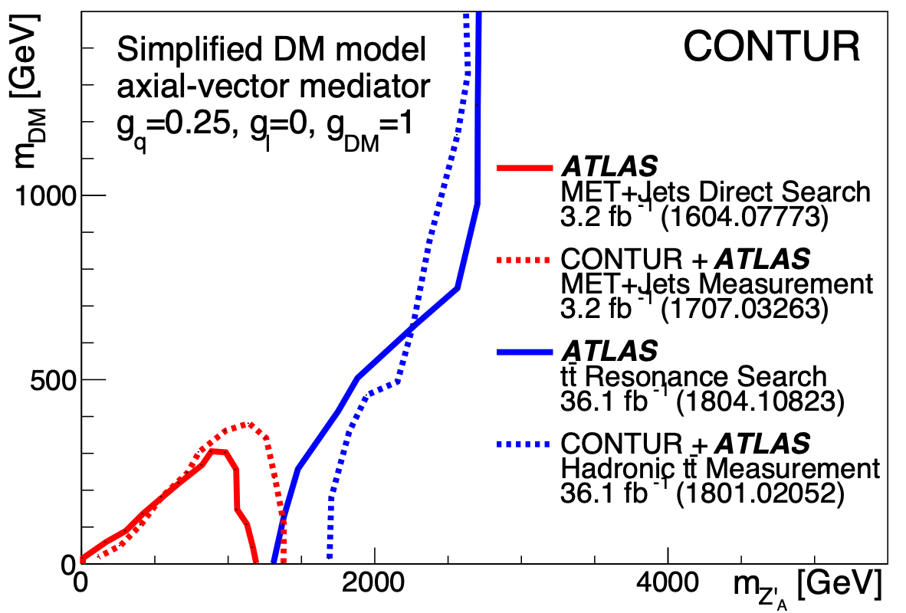
Measure-to-search
BSM well above the line
  (SM)EFT, using measurements
  Very generic, efficient
Below or near the line?
  Dedicated search per detailed model (slow, not future-proof?)
  Stick to some generic benchmark/simplified scenarios (convincing coverage? Easy to dodge)
  Use the (differential cross section) measurements (won’t be optimized, but good coverage, efficient and future-proof)
Louie Corpe

Slide 9

Example: Axion-like Particles
JMB, M. Cullingworth, J. Egan, F. Esser, V. Sanz, M. Ubiali
2508.21660 [hep-ph] JHEP (to appear)

Slide 10
Axion-like Particles
Axion (Peccei-Quinn) results from a spontaneously-broken global symmetry, introduced so explain why QCD conserves CP.
  BONUS! Dark Matter candidate
Axion-like particles appear in many SM extensions which have such spontaneously-broken symmetries
  Can also be DM candidates
  Often (very!) light [mass depends on 1/Λ]
  Can couple to any SM particle, for fermions, coupling proportional to fermion mass

Slide 11
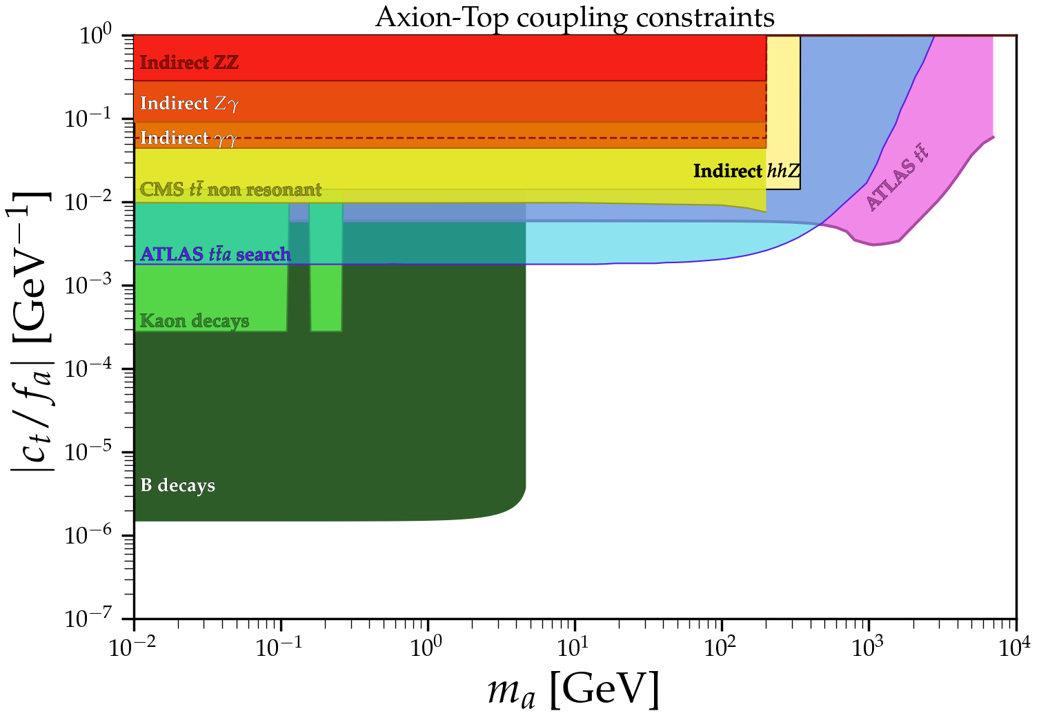
Axion-like Particles
Top coupling particularly well-motivated
Resonant searches for high mass ALPs
Off-shell ALP mediators at low mass
What about the gluon coupling?
source

Slide 12
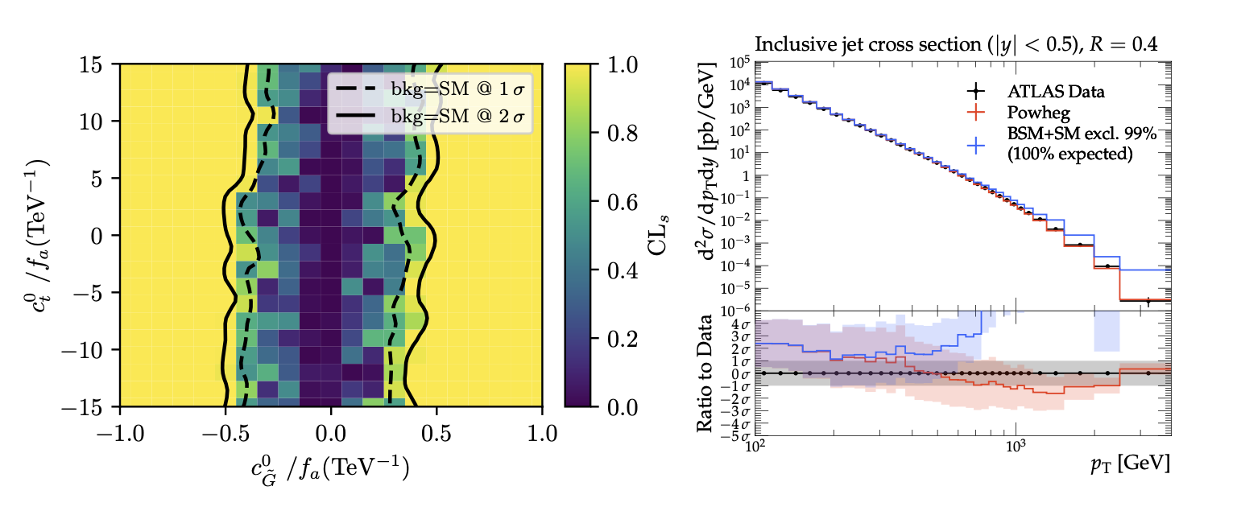
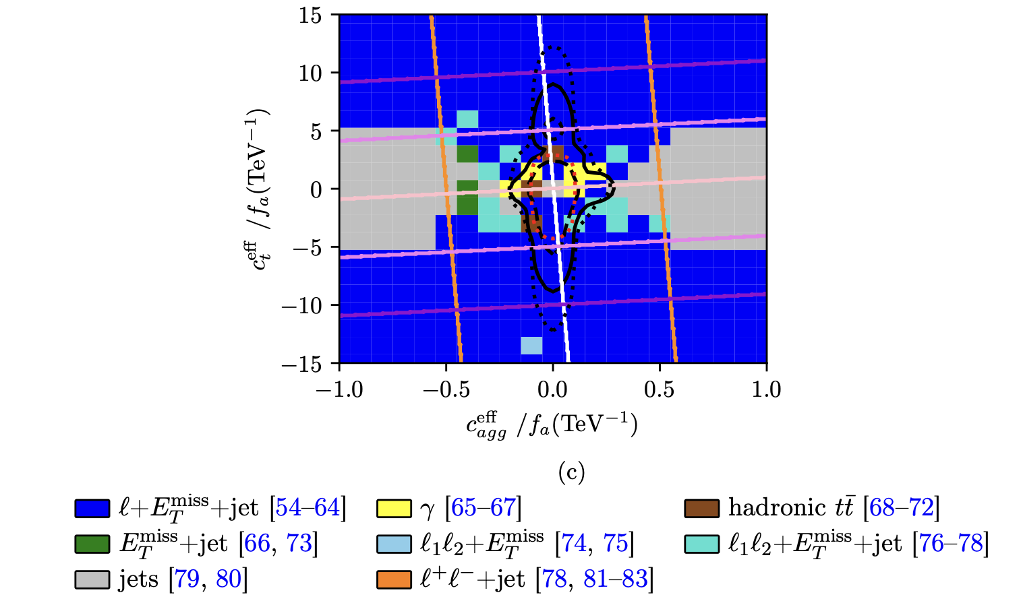
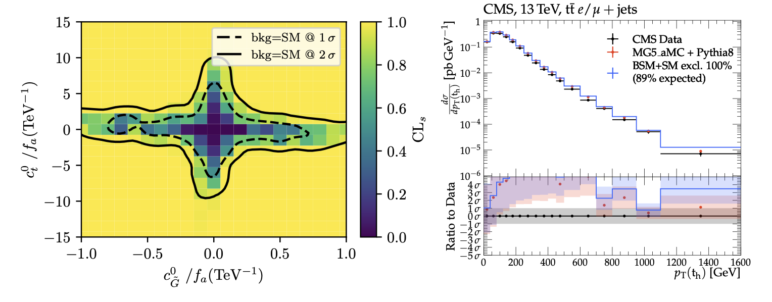
Axion-like Particles
Simulate all events with ALP as internal or external line, for non-zero top and/or gluon coupling (Madgraph+Pythia)
Fire events through Rivet/Contur and compare to data
Set exclusion bounds

Slide 13
Example: Quark-lepton unification
JMB, H. Debnath, P. Fileviez Perez, P. Wang
arXiv:2512.00143

Slide 14
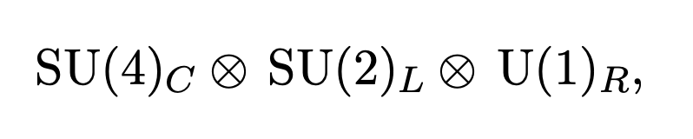
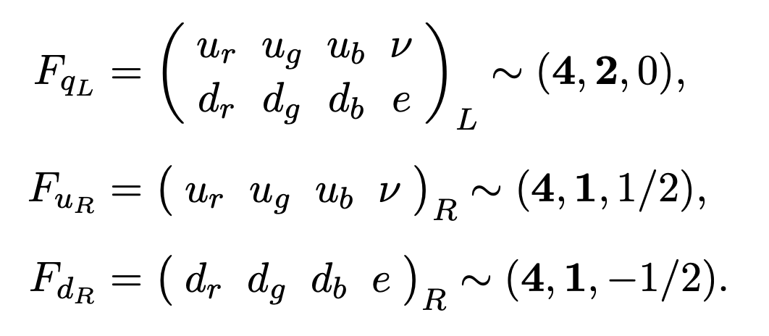
Quark-Lepton Unification
Lepton number as a fourth colour
  Pati & Salam, Phys. Rev. D 10, 275–289 (1974)

Slide 15
Quark-Lepton Unification
Lepton number as a fourth colour
  Pati & Salam, Phys. Rev. D 10, 275–289 (1974)
Can actually happen at scales close to EWSB, and the scalar leptoquark masses can be nearby
  Fileviez Perez & Wise, Phys. Rev. D 88, 057703 (2013)
Additional heavy neutrino to allow light neutrinos without fine tuning
Yukawa couplings depend on fermion mass differences within a generation
  Leptoquarks decay to 3rd generation fermions (sometimes via the heavy neutrino)

Slide 16
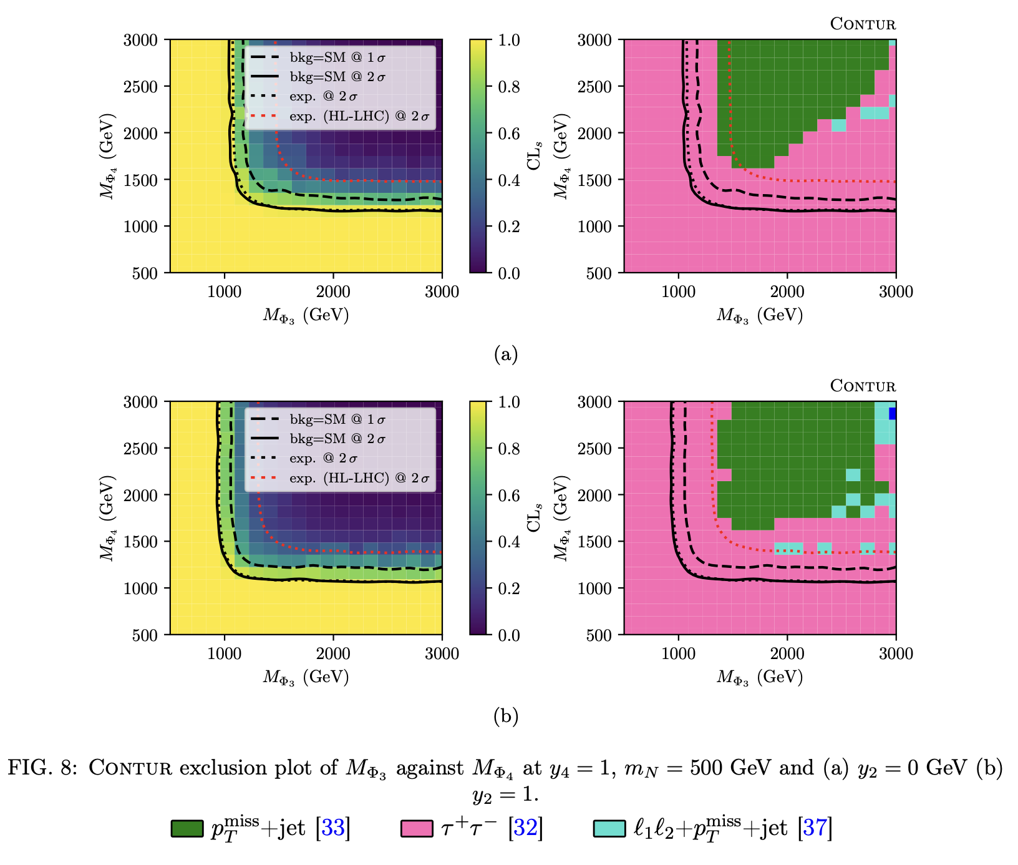
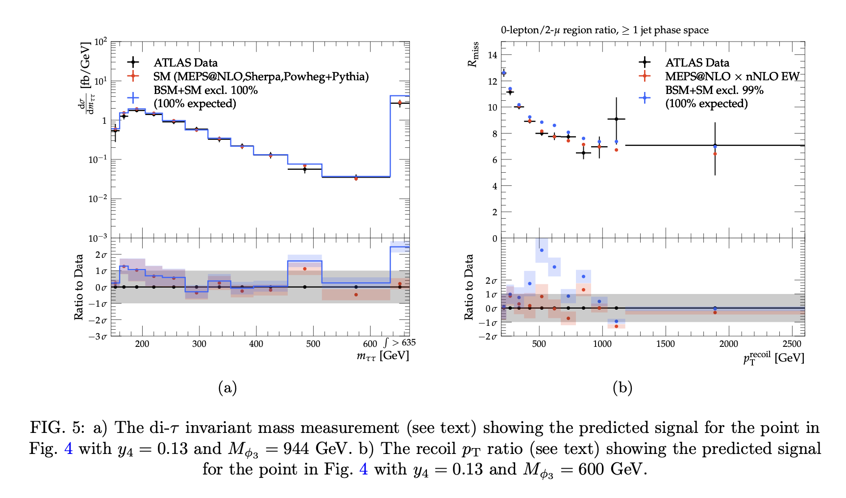
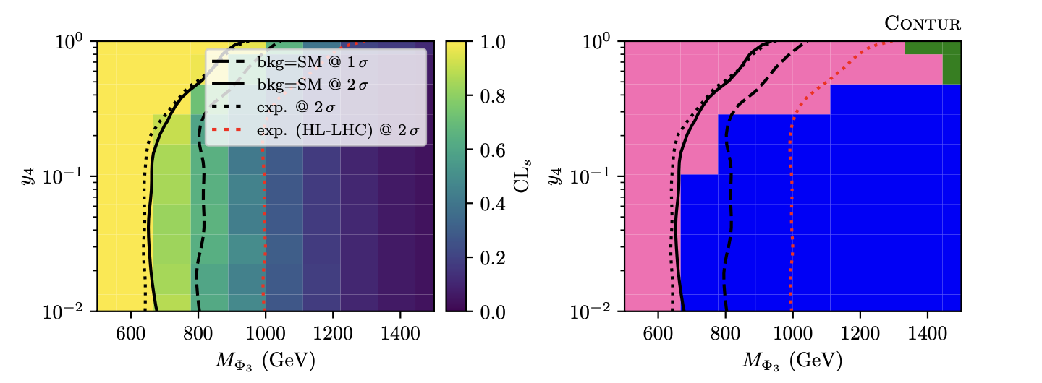
Quark-Lepton Unification

Slide 17
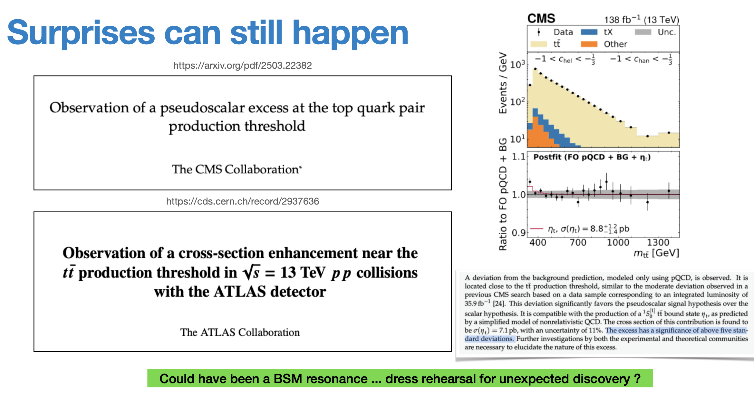
From Louie Corpe, ATLAS LPCC BSM Summary

Slide 18
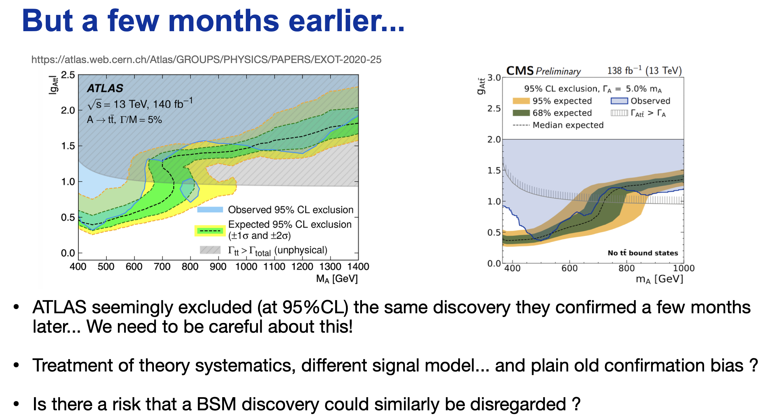
From Louie Corpe, ATLAS LPCC BSM Summary

Slide 19
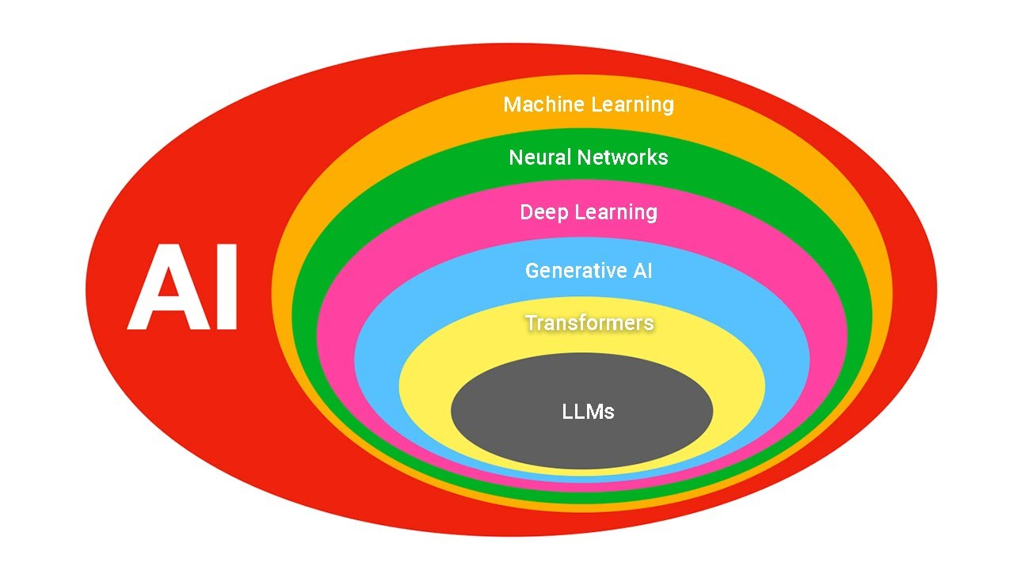
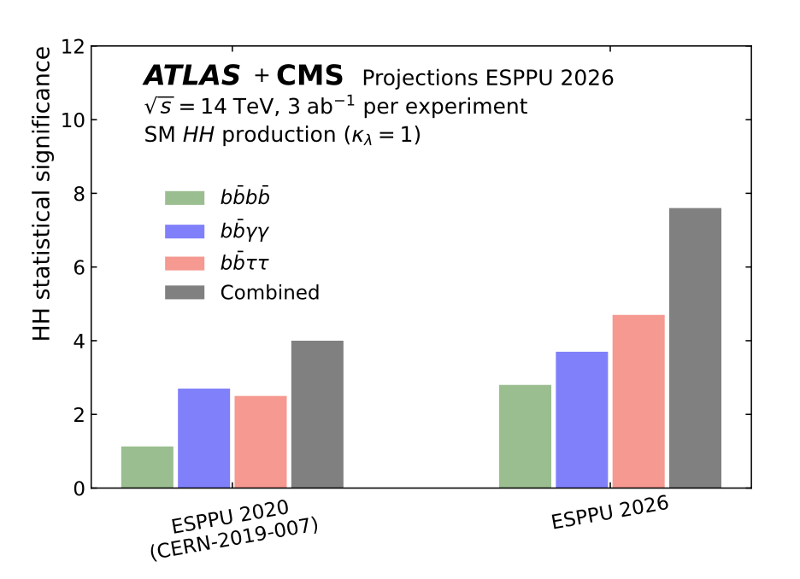
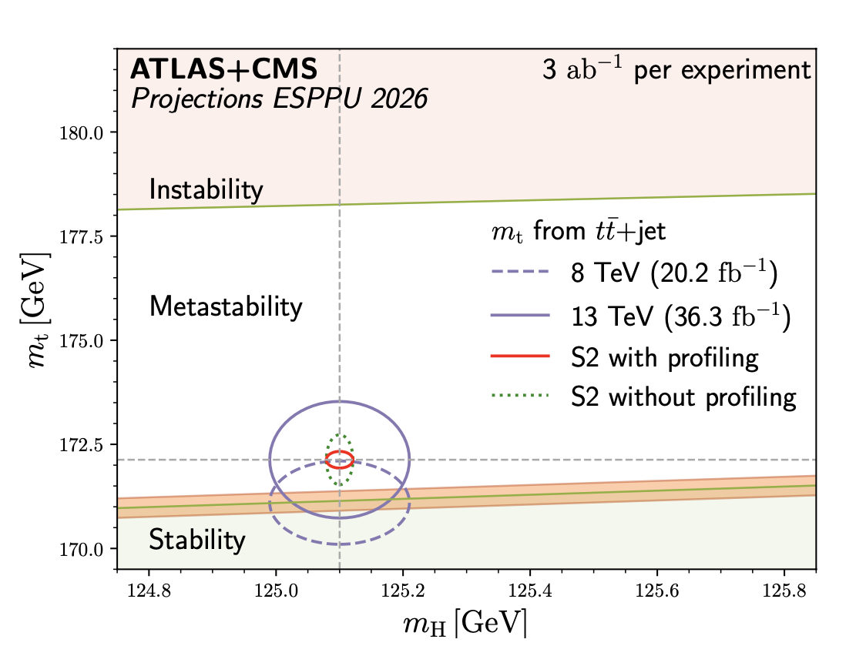
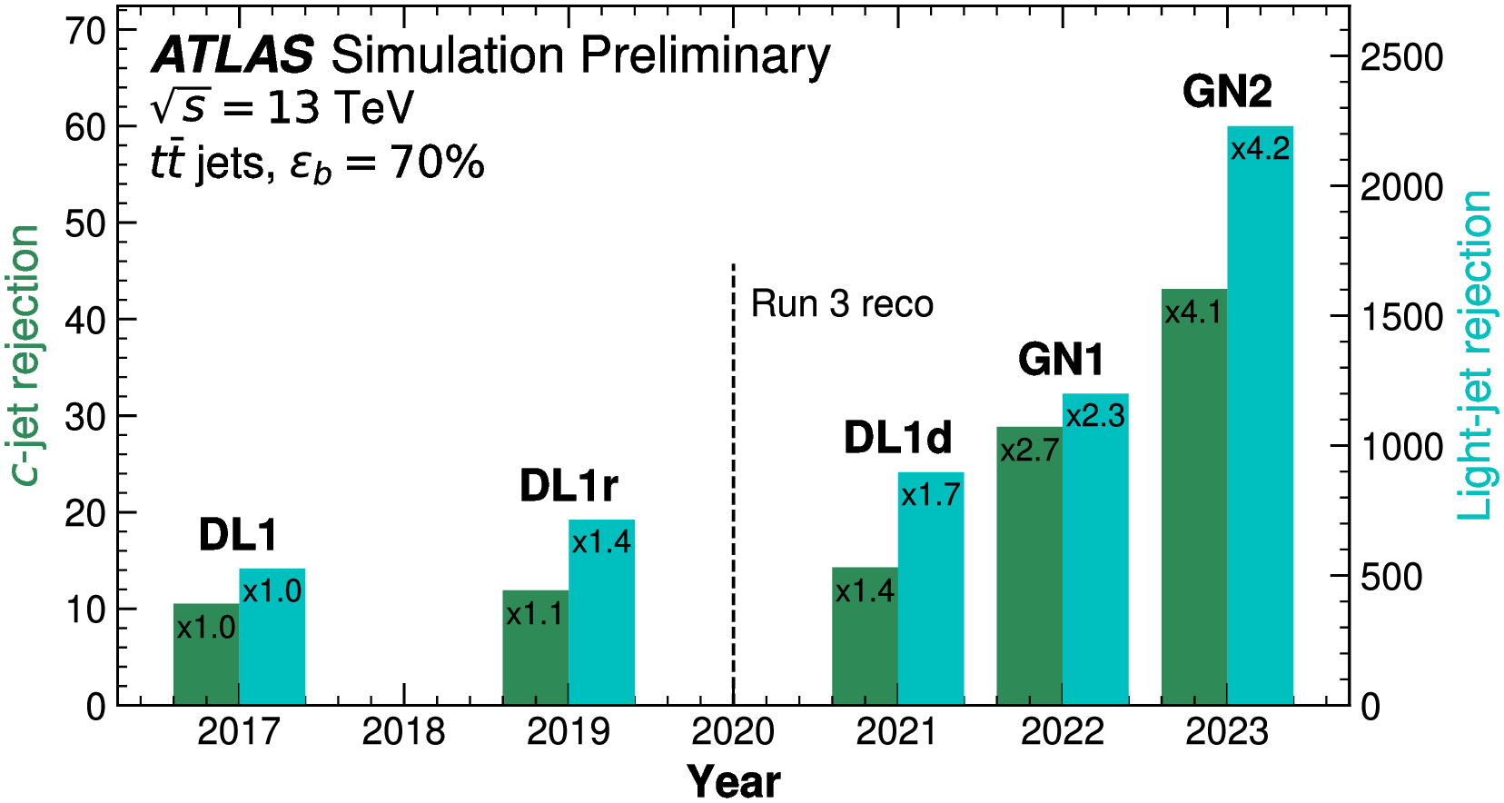
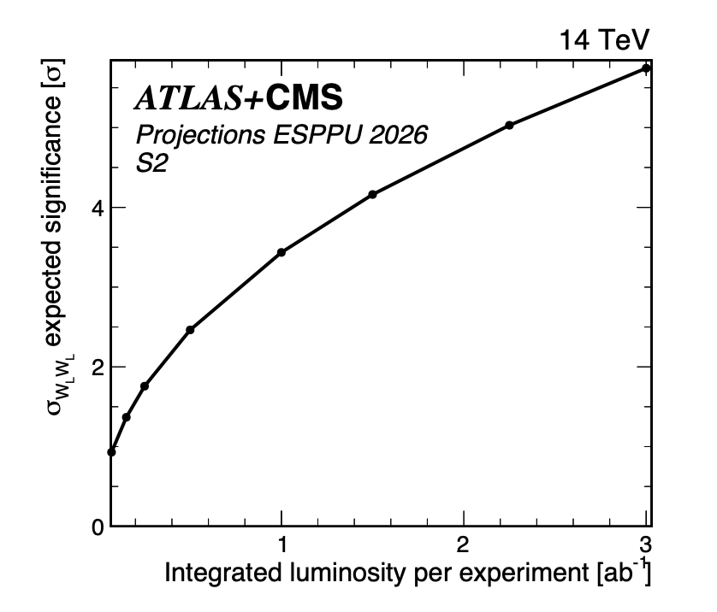
HL-LHC: A precision machine
Big - largely ML-led - improvements in performance
4-top cross section @ 6%
Charm Yukawa @1.5 x SM
ATLAS & CMS, arXiv:2504.00672

Slide 20
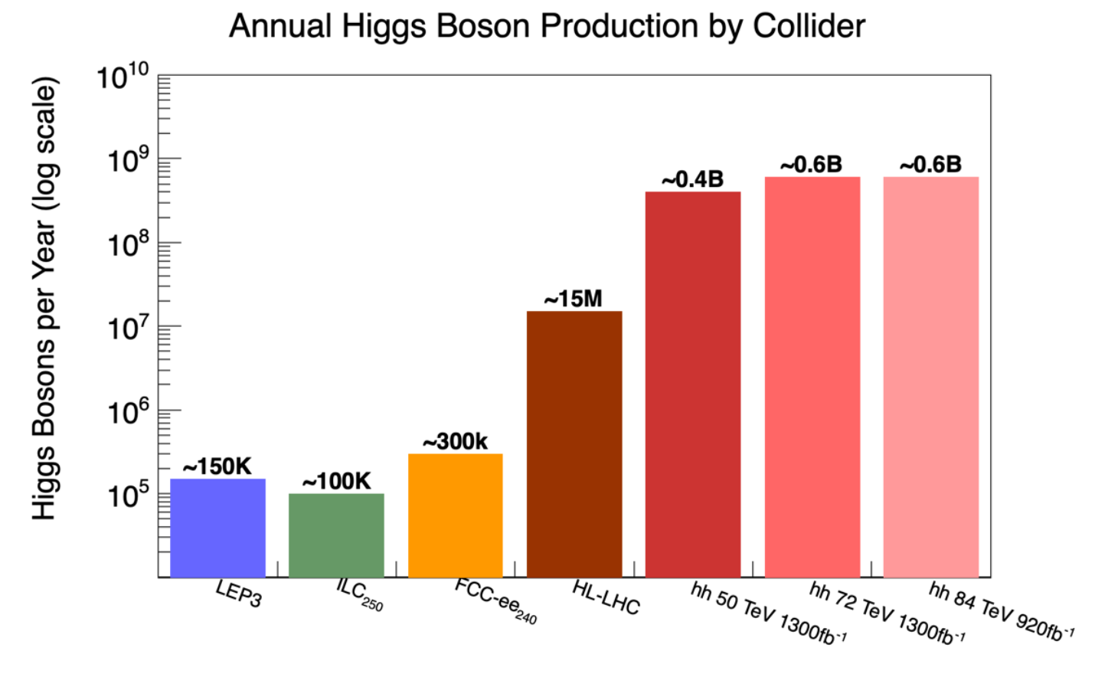
Higgs “Factories”?

Slide 21
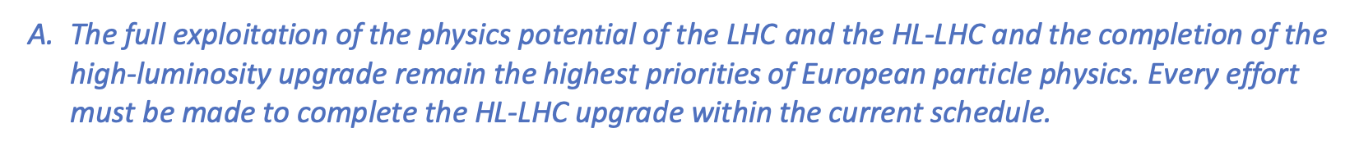
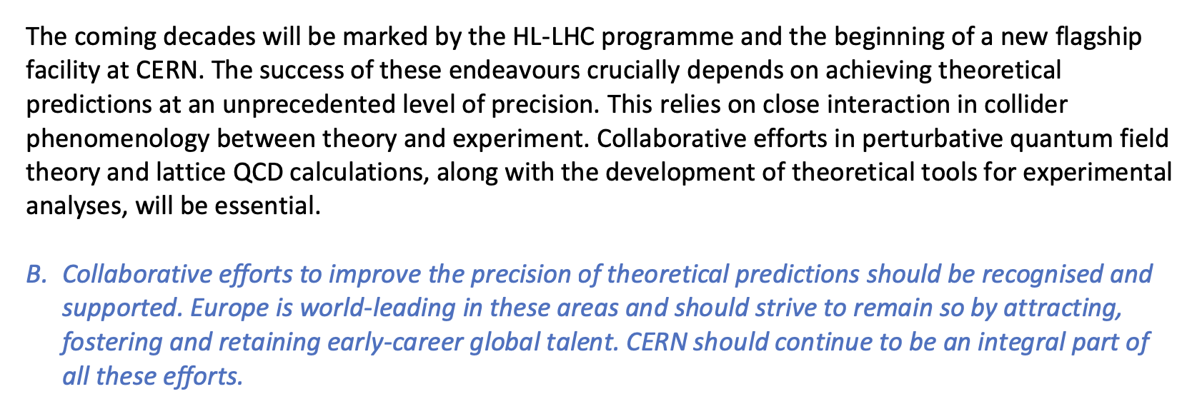
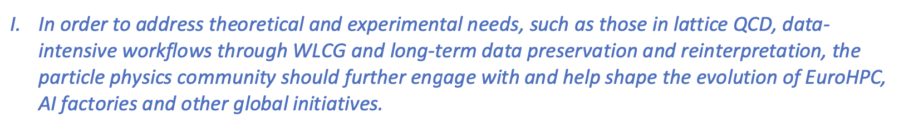
And so?

Slide 22
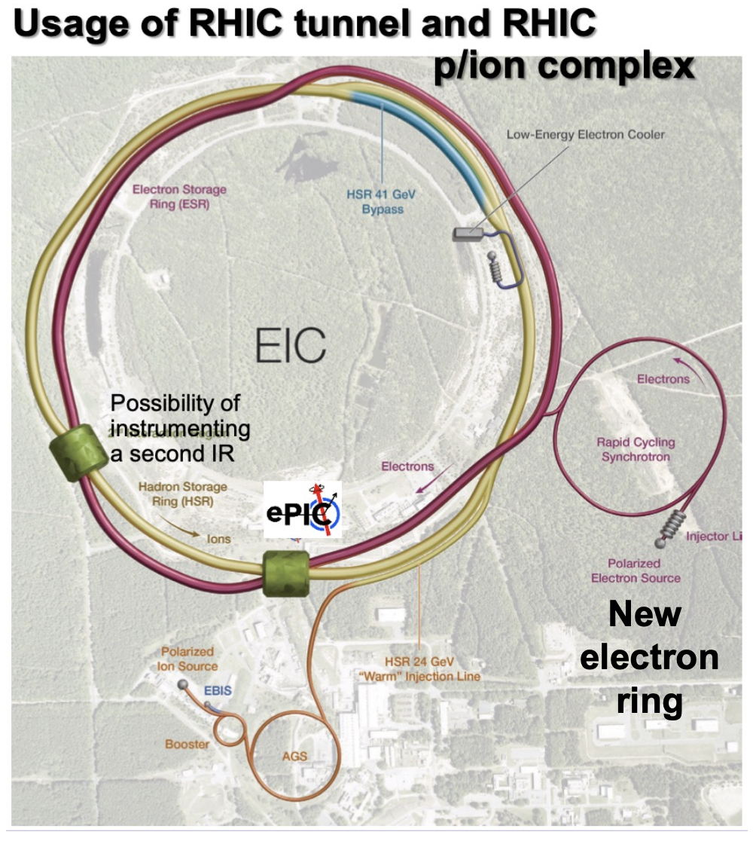
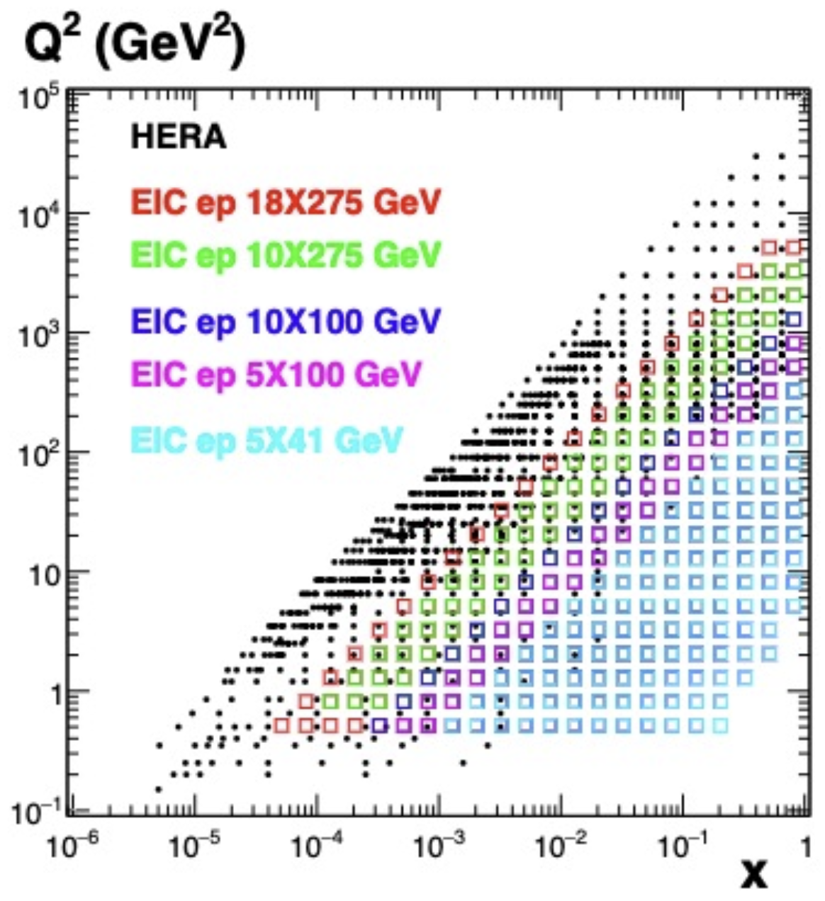
Electron-Ion Collider

Slide 23
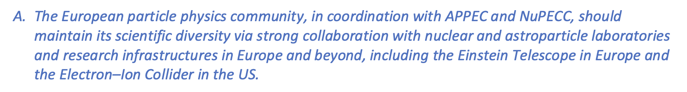
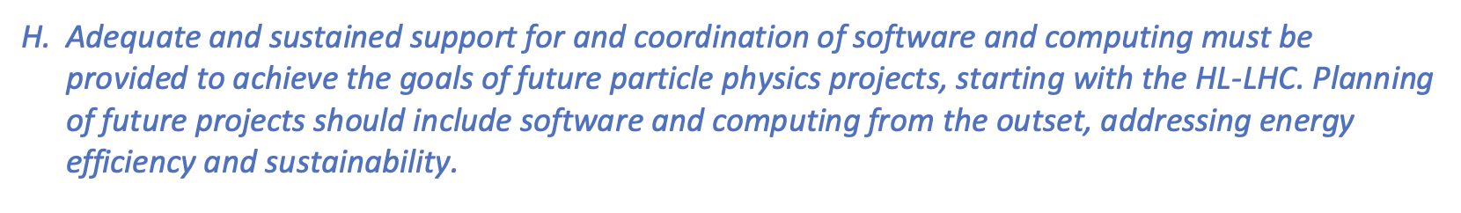
Electron-Ion Collider
Some physics headlines
  Improved parton densities, especially at high x
  Factor of two in strong coupling
  Polarisation → Proton spin
First physics middle of next decade

Slide 24
Back to the CERN Tunnel…

Slide 25
HE-LHC
In currently proposed form, energy max 34 TeV, only achievable in the 2070s.
Current cost estimate 7.2 BCHF (excluding experiments)
(24 TeV earlier?)
“based on the current physics landscape emerging from the LHC and other results, the HE-LHC offers a very limited physics reach.”
From FCCE Working Group Report

Slide 26
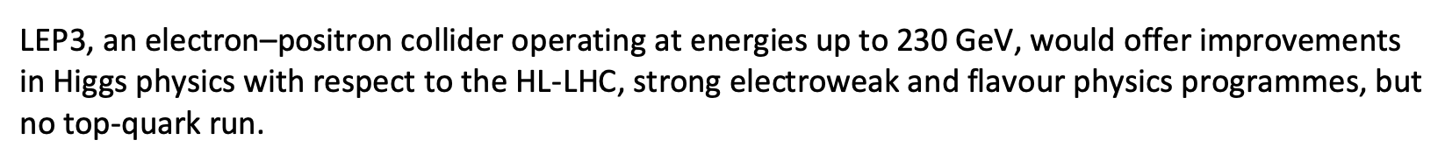
LEP3
New e⁺e⁻ collider in the LEP/LHC tunnel
CM energy range 91.2 – 230 GeV
  Not possible to interleave low and high energy
Two interaction points
2045 earliest start of operation
Synchrotron power loss 50MW per beam
  Consumption similar to FCC-ee [see later]
Detailed accelerator design work required
Current cost estimate 3.9BCHF
Estimated precision mostly taken from FCC-ee (see next slides),
  Scaling statistical uncertainty up by 1.9.

Slide 27
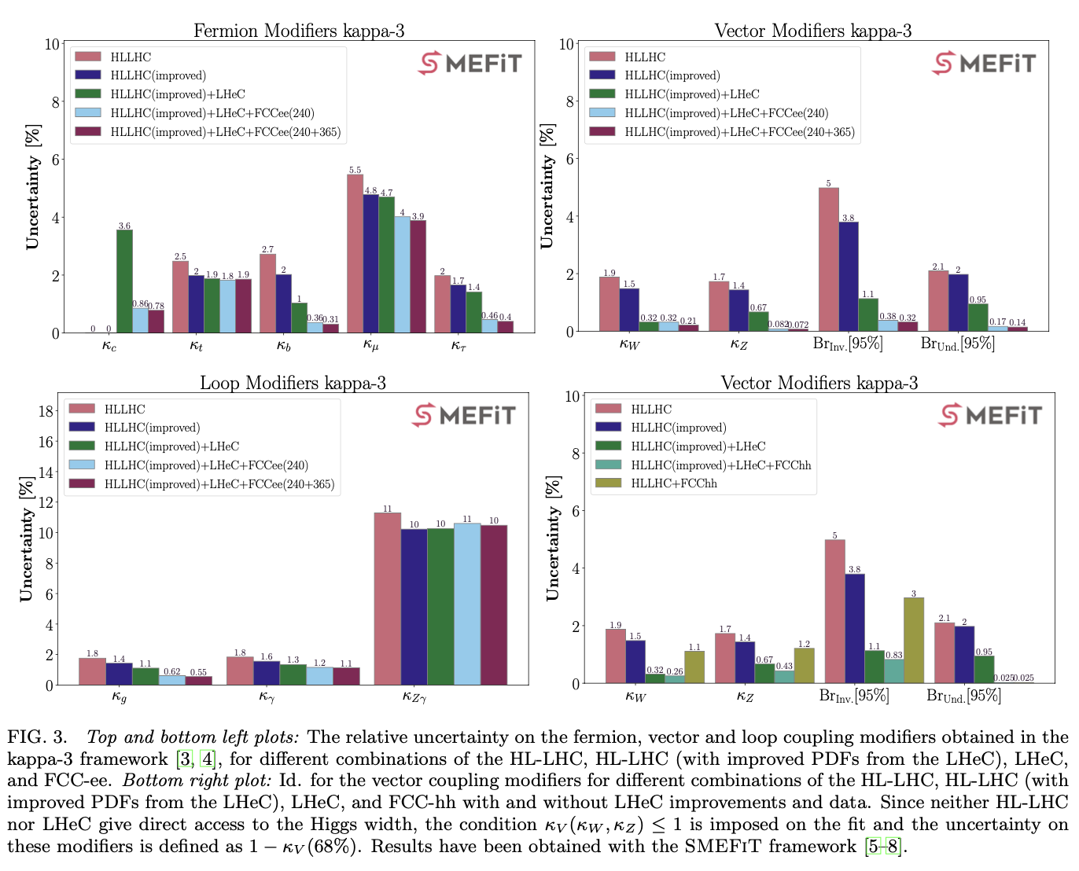
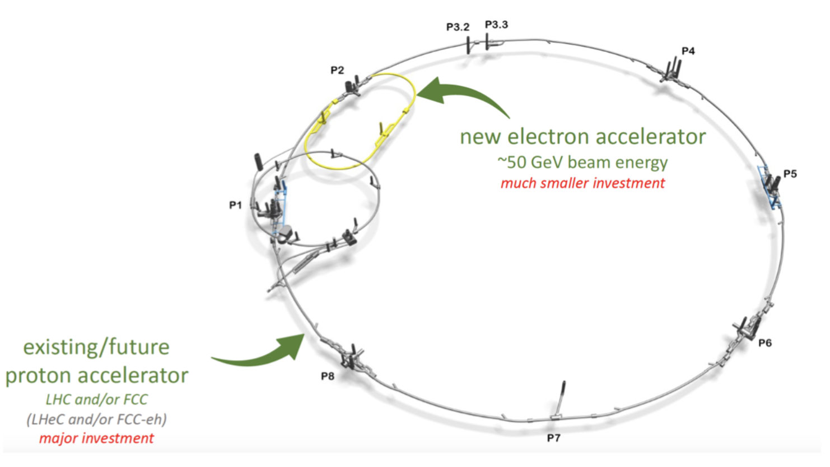
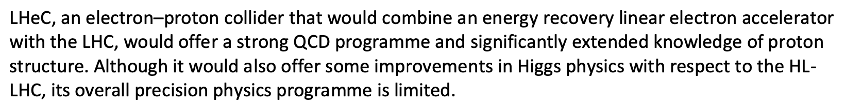
LHeC
> 50 GeV Electrons vs LHC protons, ECM=0.2–1.3 TeV (Q2,x) range beyond HERA;
Energy-recovery Linac 1/3 circumference of LHC
Likely post-LHC running.
Cost estimate 2.4BCHF
Bridge between HL-LHC and future large facility?

Slide 28
And so?
“… LEP3 or LHeC, would entail major infrastructure investments and operating costs and therefore delay the implementation of a next-generation collider by at least one to two decades. For this reason, they cannot be considered as “bridges”, but rather as alternative options to other proposed colliders”
From FCCE Working Group Report
LEP3 and LHeC are colliders that would reuse the LHC tunnel, offering an intermediate physics programme at significantly lower construction costs than the other options. Neither, on its own would be a flagship collider. To provide a long-term physics programme, they would need to be complemented by an energy-frontier machine, such as a hadron collider.

Slide 29
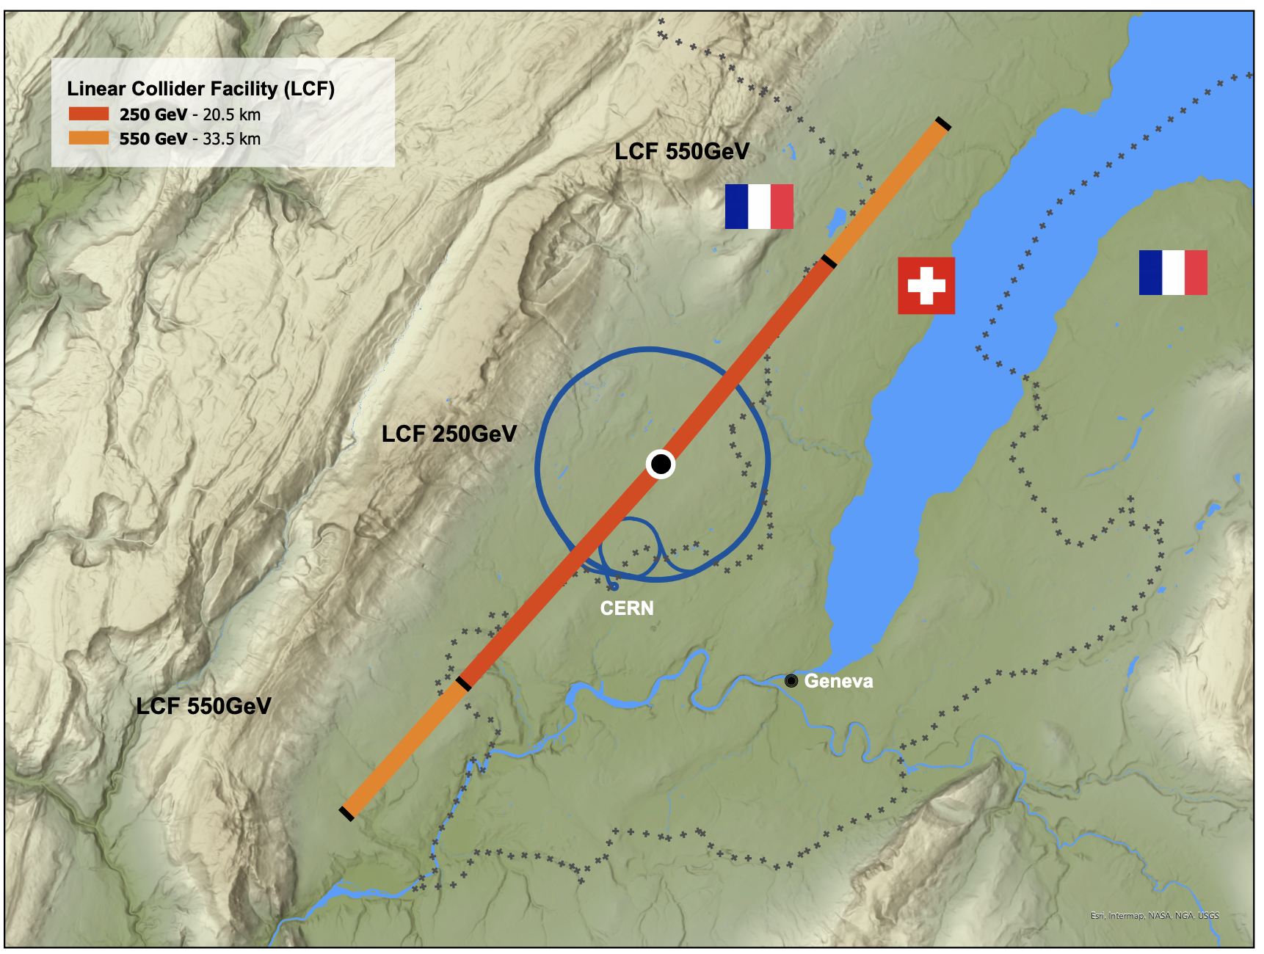
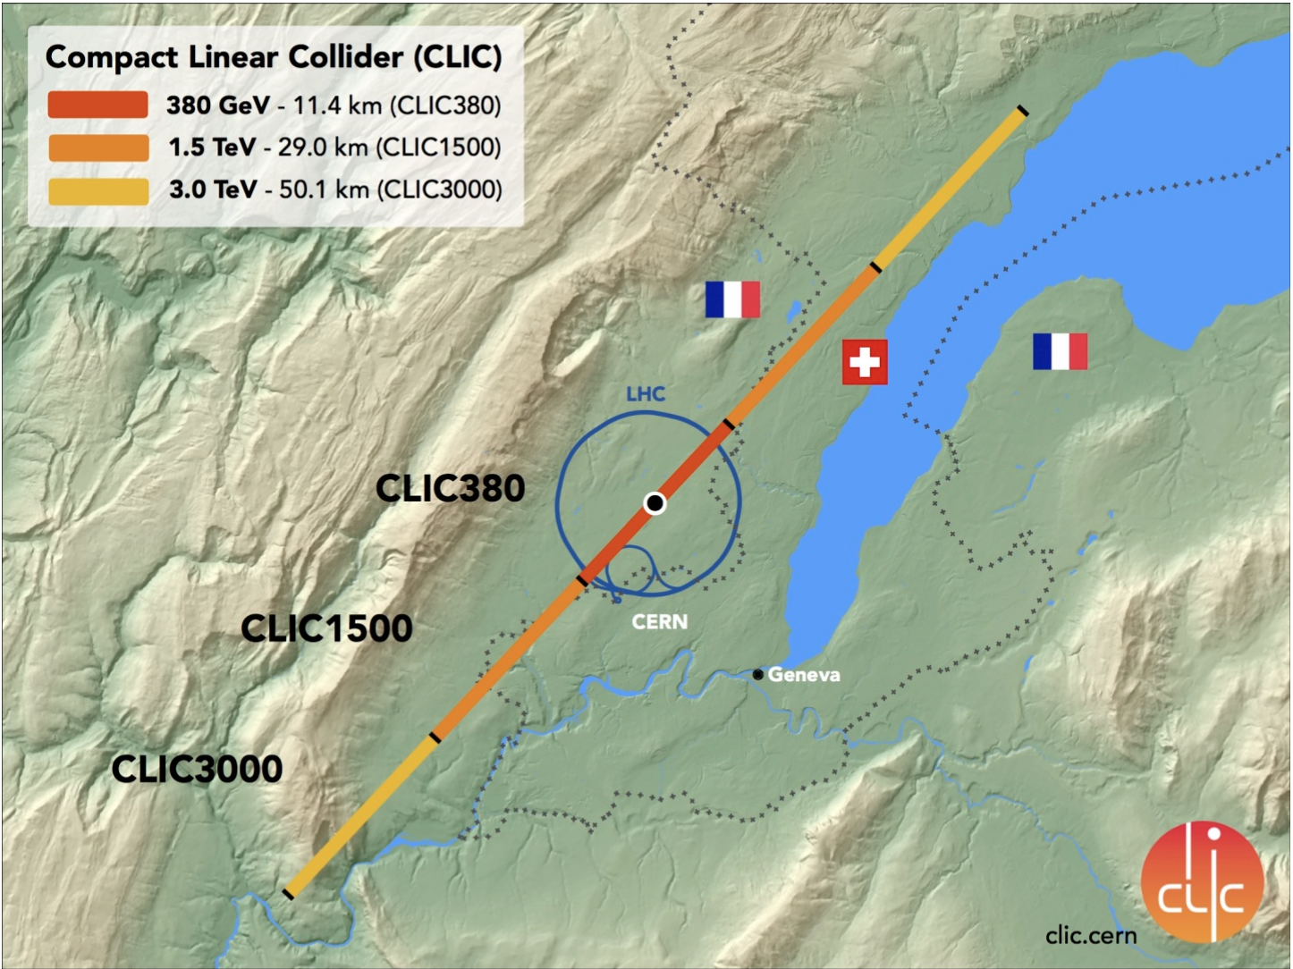
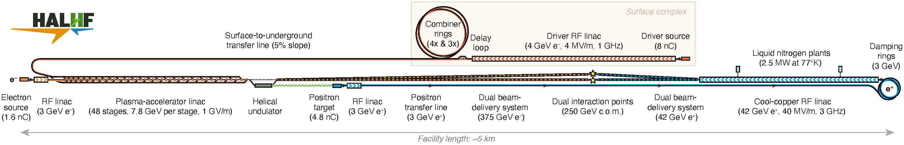
A new straight tunnel
Electron-positron collisions
LCF
  superconducting ILC@CERN)
CLIC
  drive beam
HALHF
  asymmetric Higgs factor, with plasma wakefield acceleration

Slide 30
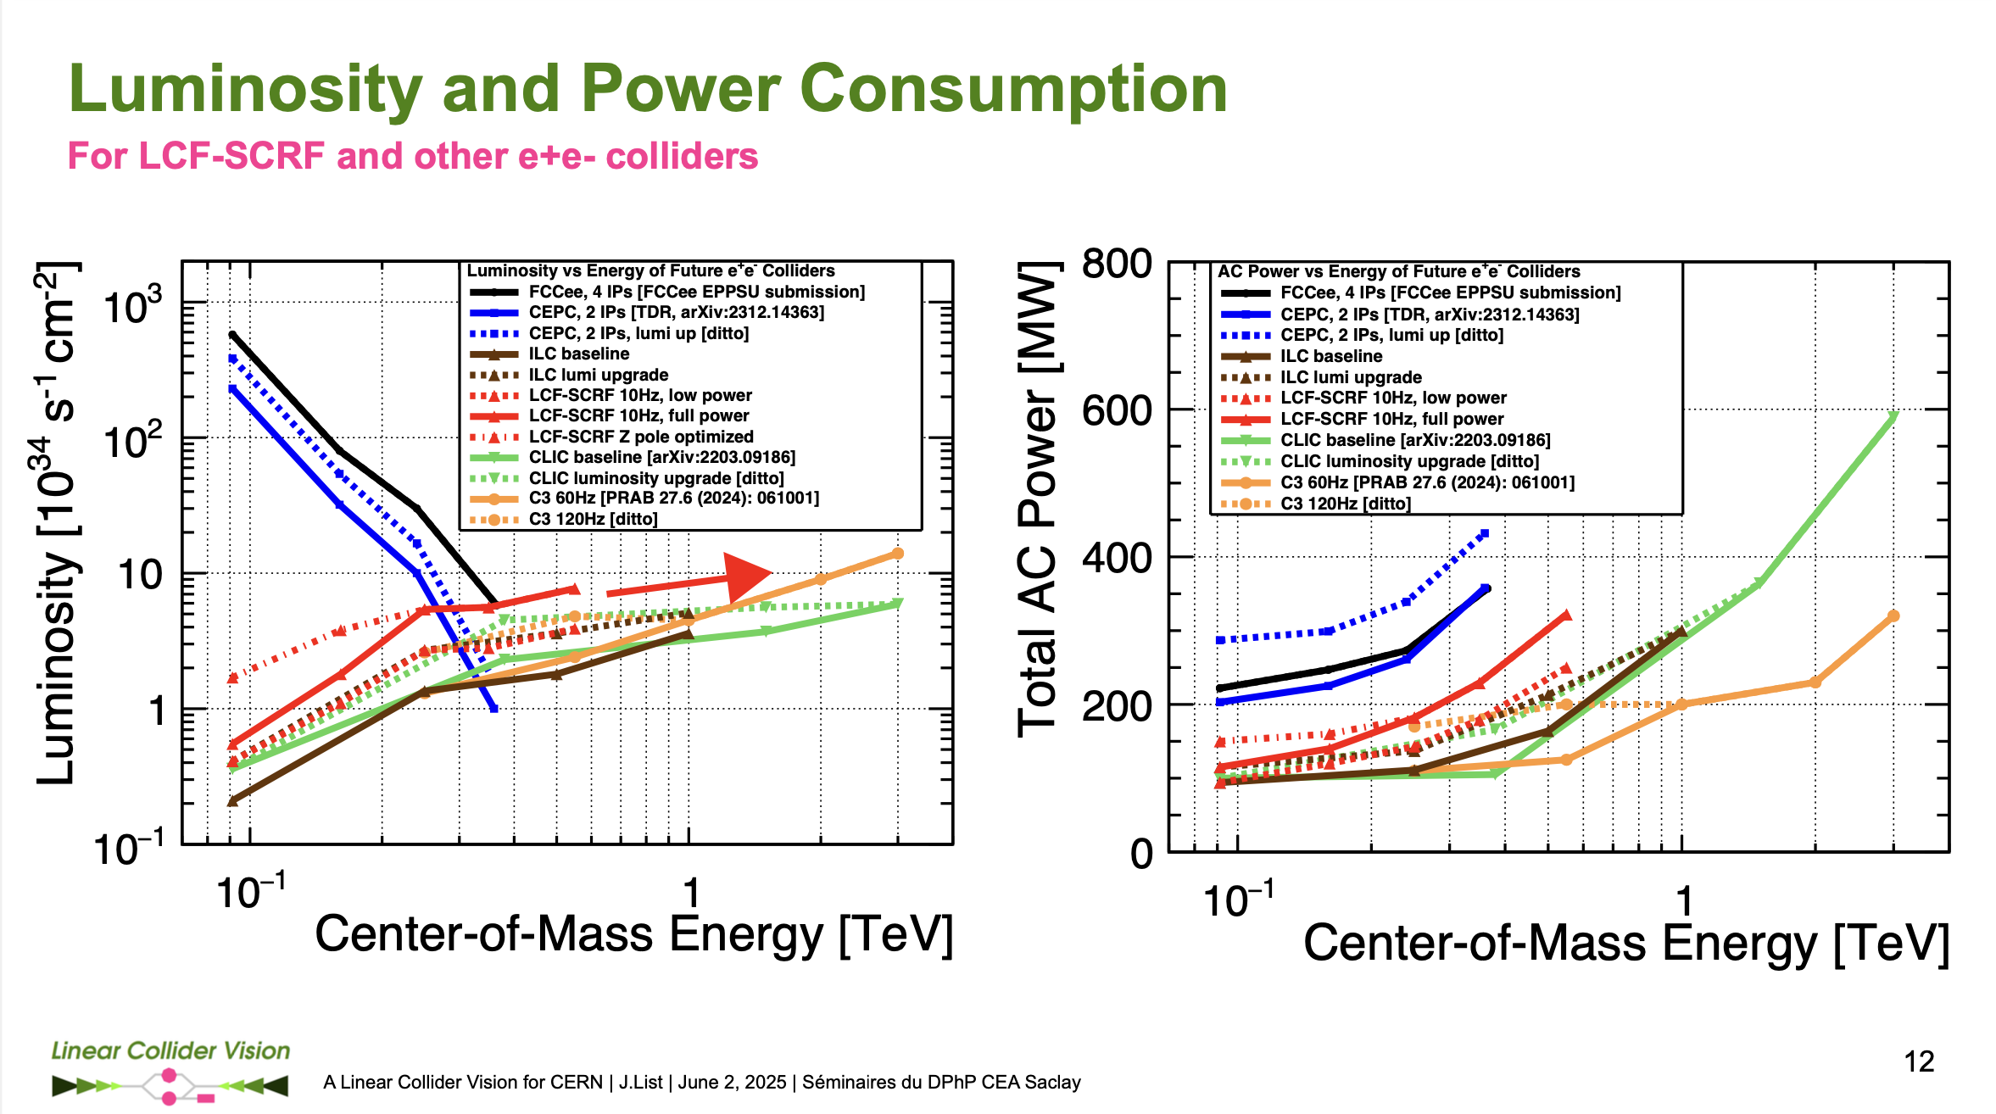
Notes:
Linear wins at high energy but stops at 2-3 TeV

Slide 31
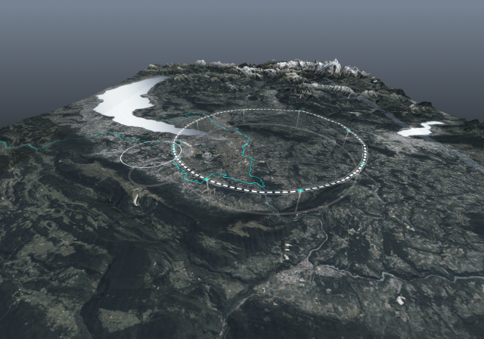
A new circular tunnel
FCC feasibility study
91km circumference
Very significant civil engineering, geology, legal, safety, sustainability, societal preparation and studies undertaken already

Slide 32
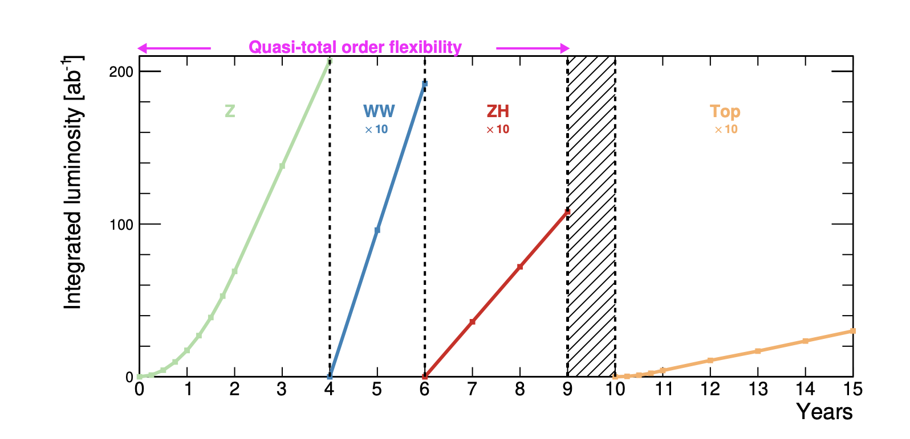
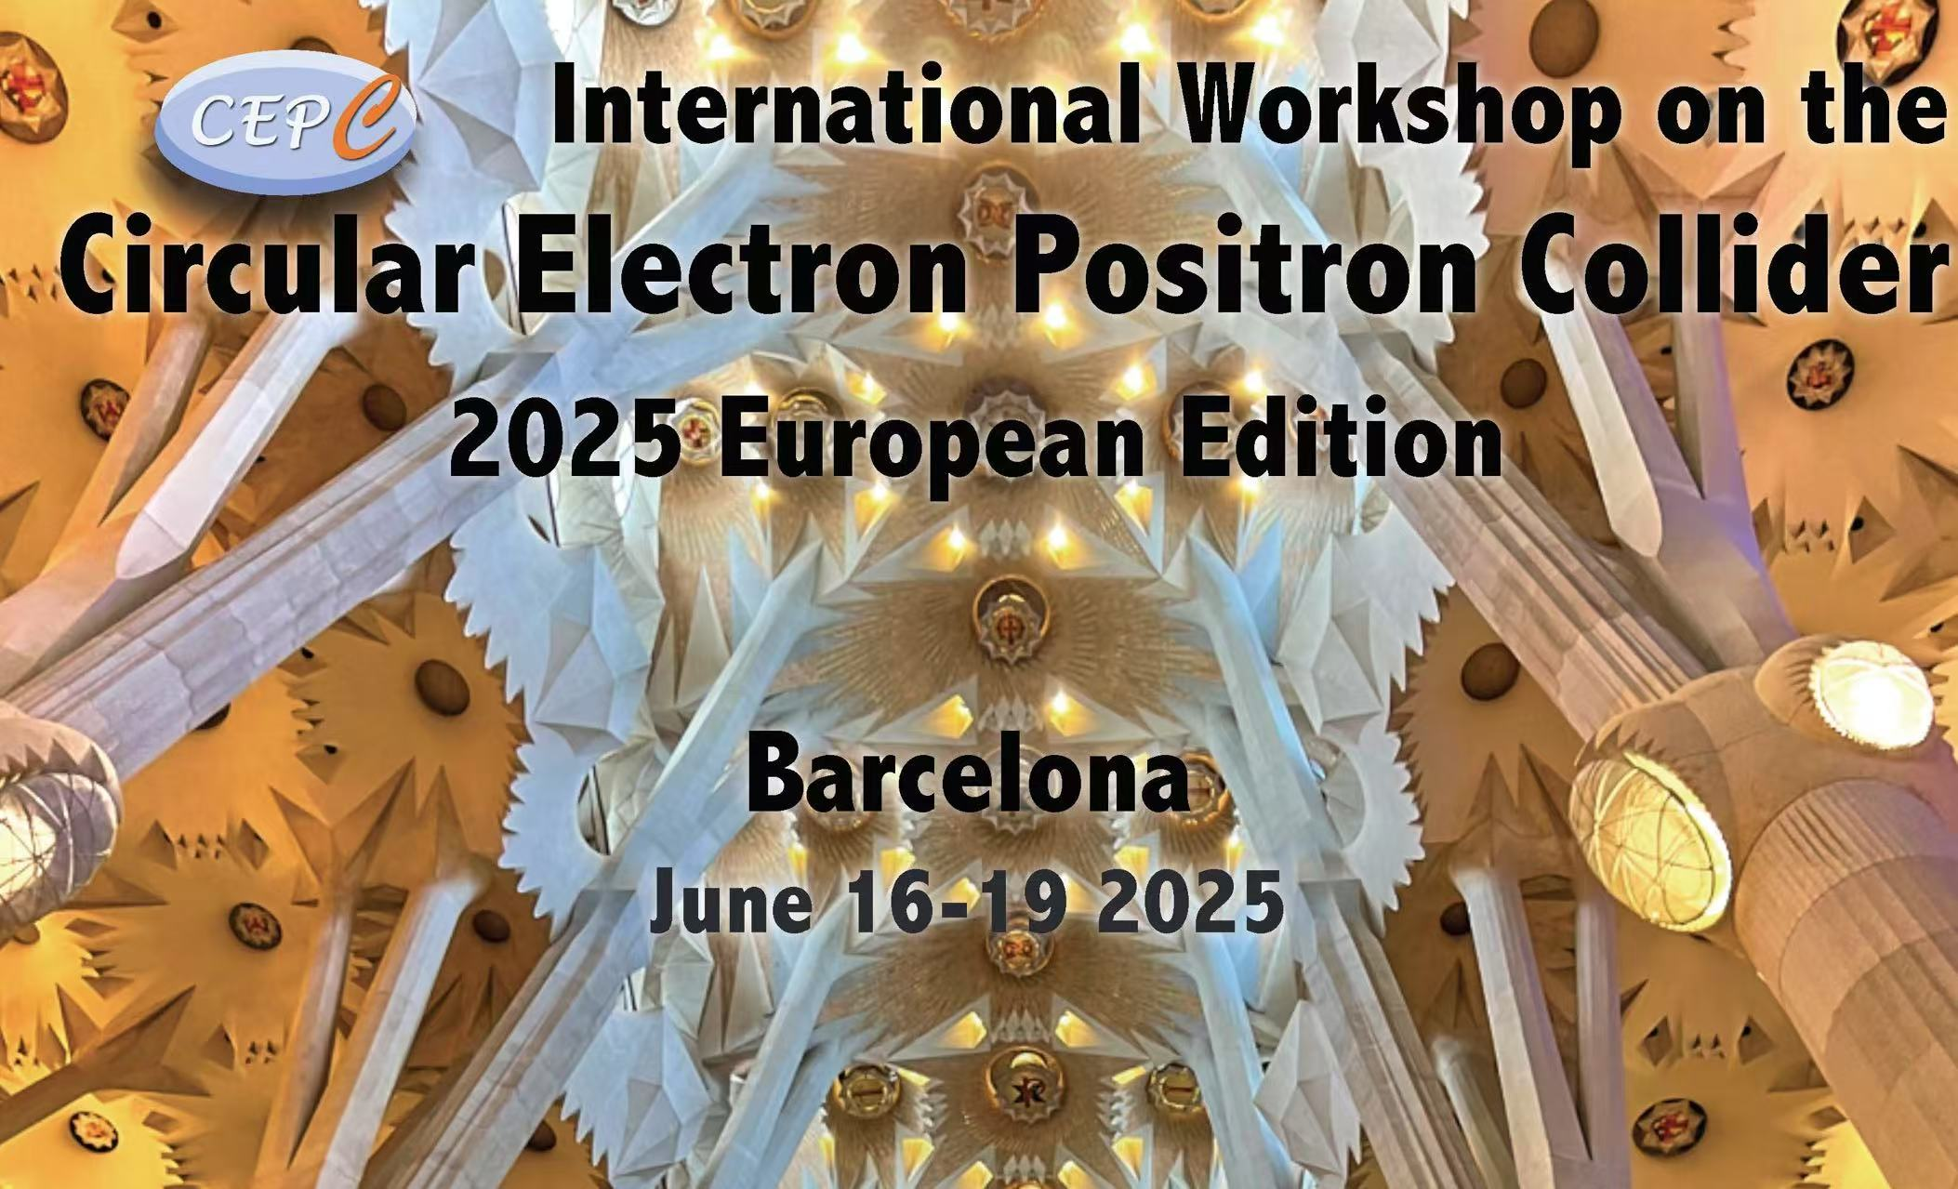
Electrons and positrons
FCC-ee
  Z-pole running 2048
  then WW, Higgs, top
  Four interaction points
  Current cost estimate 15.3BCHF (inc 6BMCH tunnel)
CEPC
  Similar science case
  Related technologies
  (Different politics, and not in the current 5 year plan)

Slide 33
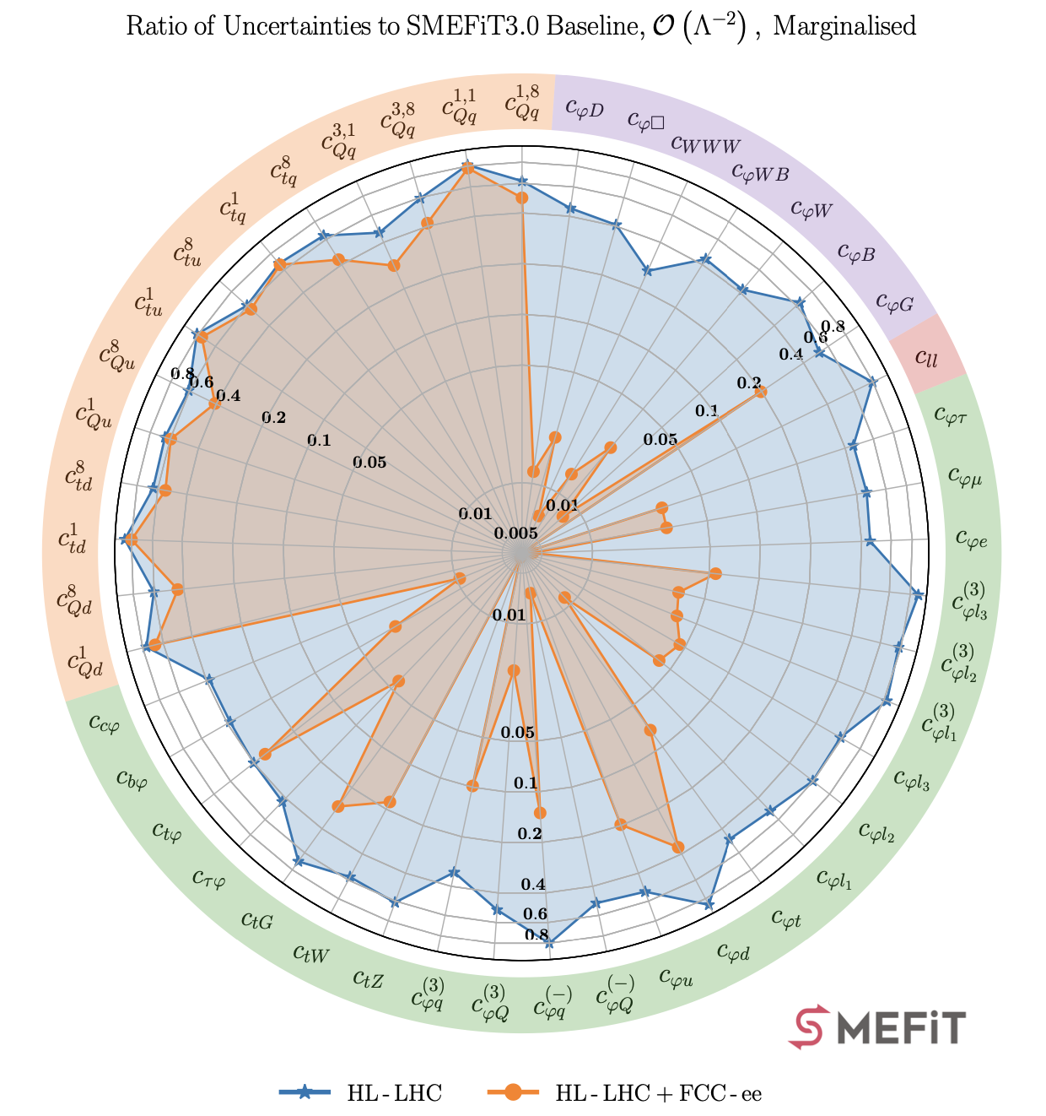
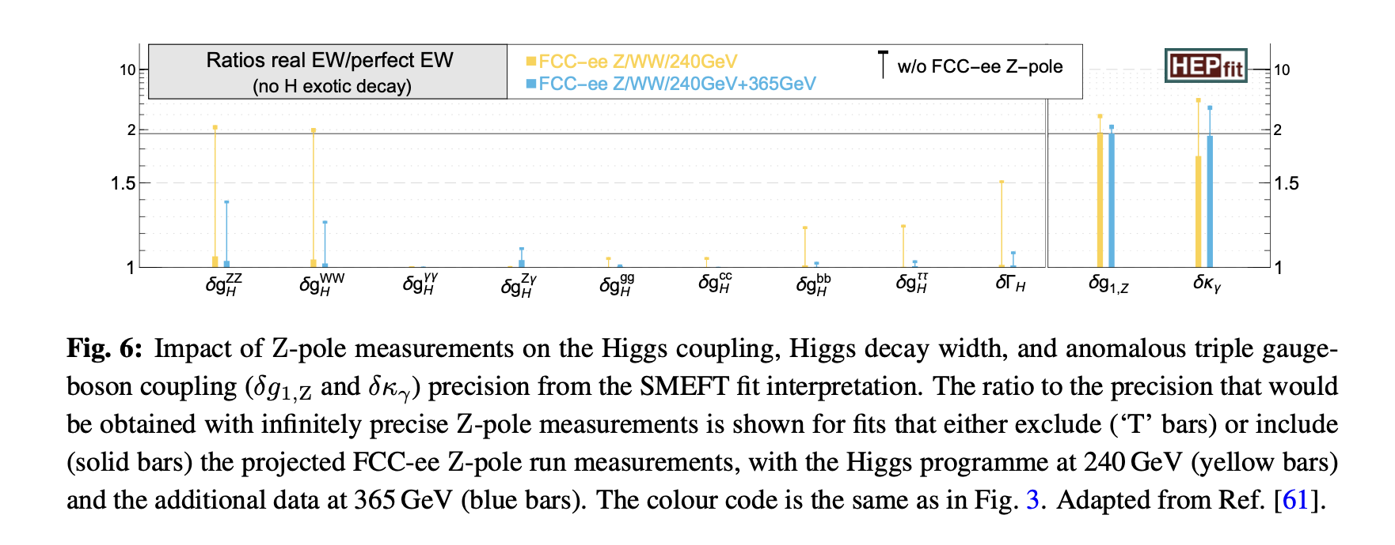
FCC-ee physics
Major (roughly order of magnitude) impact on 22/50 of SMEFT operators
Significant impact of Z –pole and 356 GeV measurements on Higgs parameters from WW+ “Higgs factory” configurations
Celada et al

Slide 34
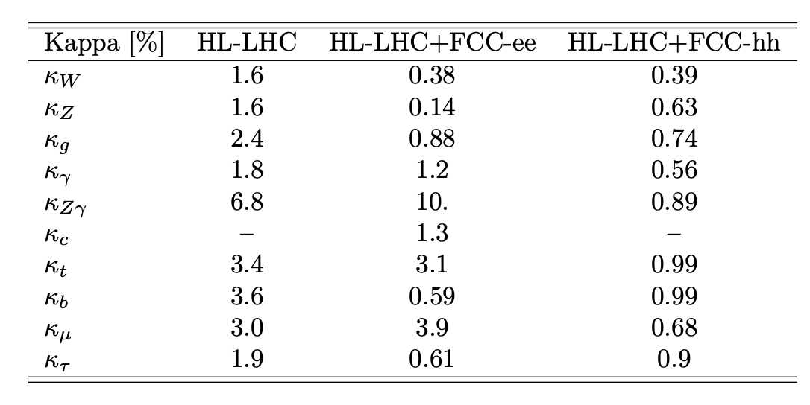
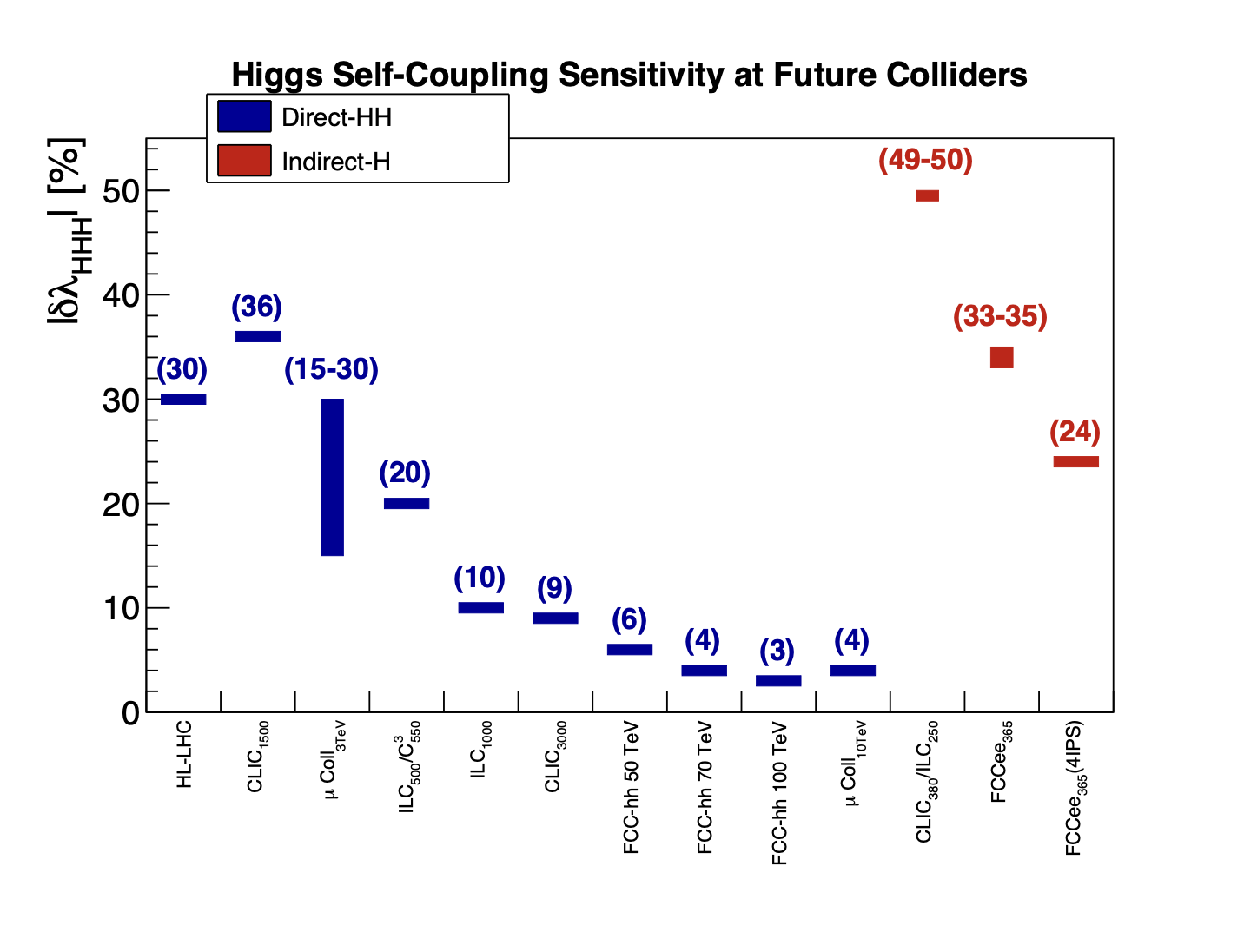
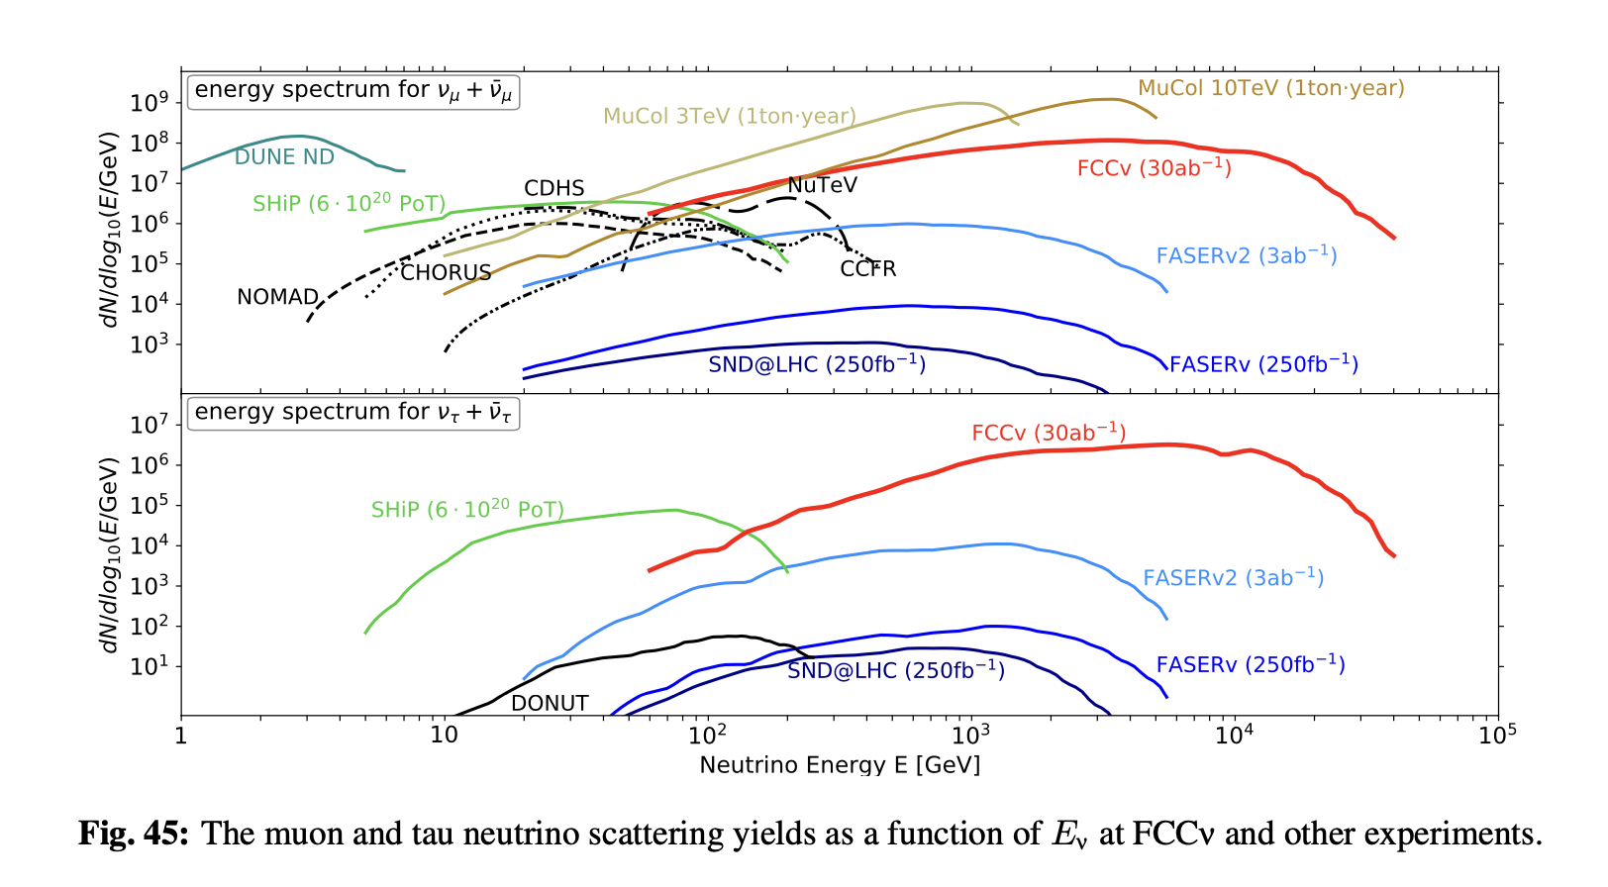
Next-generation Hadron Collider
2025
2019
2019
The “ambition” Europe should have
  cf ESPP 2020.
Current FCC-hh baseline 85 TeV in 2074.
Current cost estimate 19BCHF (post FCC-ee)
Or 2055 if skip FCC-ee.
Intermediate energy 50-70 TeV? Sooner?
Relevant “detail”: Forward neutrino flux

Slide 35



Muon collider
Smaller tunnel etc ✓
Neutrino background ⨯
125 GeV, 3 TeV, 10 TeV CoM energy studied at some level.
  Main focus still on accelerator feasibility
  Energy spread a challenge for Higgs pole running
  Staging/reuse of cooling and injection for energy upgrades
  Current cost estimate 10-25BCHF
At 10 TeV, electroweak bosons are “partons” inside the beam particle (e, μ or p)
  though the ”remnant” will be very different!

Slide 36

And so?
HALHF?

Slide 37


And so?
LEP3 and LHeC are colliders that would reuse the LHC tunnel, offering an intermediate physics programme at significantly lower construction costs than the other options. Neither, on its own would be a flagship collider. To provide a long-term physics programme, they would need to be complemented by an energy-frontier machine, such as a hadron collider.
Sooner/ lower energy? Not discussed?

Slide 38
Some personal thoughts. In flux.
Is the energy frontier still worth the effort?
  Given the unknowns, yes.
  But how long does it take and how far is far enough?
Is precision enough?
  No, but it does a lot
  Historically, it has been smaller scale (g-2, EDMs, B-factories) but actually the main imacts from HERA and LEP(2) were precision measurements in the end, and paved the way for LHC
  Maybe the same will be true of (HL-)LHC?
  Will be true of the FCC-ee by design
I find the prospect of the HL-LHC exciting, and of EIC interesting, and I will hopefully see their outcomes…
The FCC tunnel offers a way back to the energy frontier … for future generations

Slide 39

Conventional Wisdom
And precision. How far will this go?
Hadrons for exploration.
Leptons for precision.
Lepton-hadron for QCD.
e⁺e⁻ Higgs & electoweak factory next (c.f. ESPP 2020)
Hadrons in half a century or so
ep … not high priority
Muons one day. Maybe.
Circular colliders will reach the point of diminishing returns (synchrotron radiation, magnetic field strength)
Theory permitting. And muons also explore.
… and Higgs/electroweak
Circular machine, at CERN. Top too?
Seems so. Barely mentioned in the strategy…
Confirmed by the strategy
Not in Europe
Well, that day may come…

