Slide 1

Particle Physics Masterclass
Network Workshop
Tuesday, 9 September 2025

Slide 2
Welcome – Some thanks
IOP, and the IOP HEPP and Physics Communicators Groups for financial and in-kind support
IPPP for in-kind support (Indico)
University of Manchester for in-kind support (Zoom)
All of you!

Slide 3
Welcome – Aim
Framed around but not limited to the Particle Physics Masterclass programmes, the aim is to share good practice and discuss how we can pool engagement resources and better coordinate the Masterclasses across the UK and ROI.

Slide 4
Welcome – Programme
10:10 – 11:00 Perspectives from the IOP
11:00 – 12:30 Spotlight: Resources
12:30 – 13:15 Lunch
13:15 – 14:45 Spotlight: Events and Programmes
14:45 – 15:00 Break
15:00 – 16:00 Next steps: Repository and Coordination
16:10 Close

Slide 5
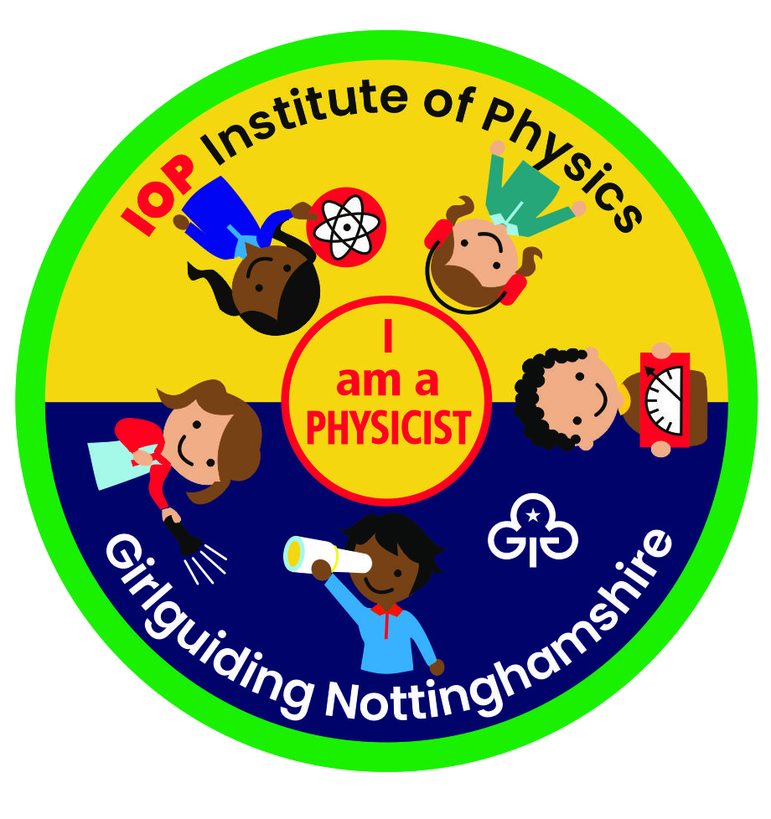
IOP I am a physicist Girlguiding badge

Slide 6
Structure of the badge
Experience
Simple and fun activities using equipment rescued from your recycling bin, delivered by GG leaders using step-by-step instructions provided
Create
Objects or devices to build – again, delivered by GG leaders
Investigate
Experiments “what happens if…?”, followed by feeding back the results of the experiment – some topics suggested; older girls encouraged to think of their own
Meet or visit
Meet a physicist or visit a museum or science centre or attend a public event

Slide 7
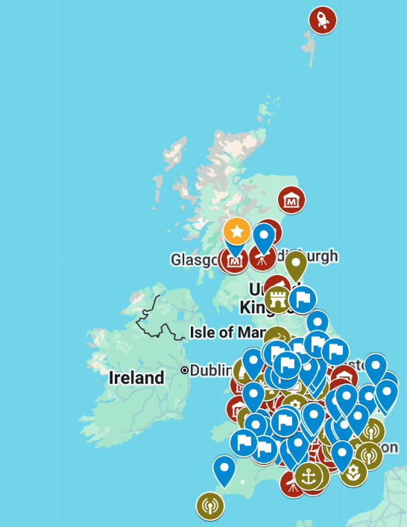
https://www.iop.org/girlguiding-i-am-physicist-challenge
Map of Science and Physics related places is sparsely populated in parts
- More suggestions for places would be great.
We will be creating boxes of ‘equipment’ and training Guide Leaders.
If you’re interested, please get in touch!
clare.burrage@nottingham.ac.uk

