Slide 1



Slide 2
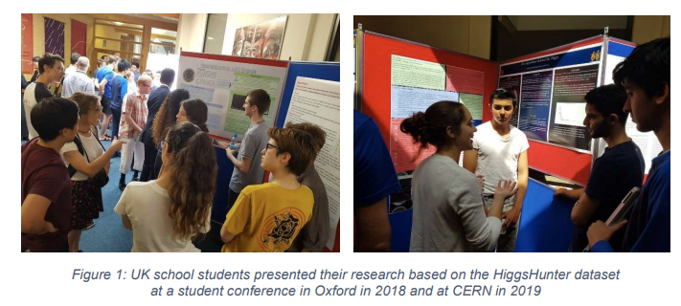
School students can do amazing research
GOALS:
Raise STEM aspirations in a future generation
Develop scientific-enquiry skills in posing and selecting interesting scientific questions
Develop technical skills, such as numerical analysis & coding
Engage underrepresented communities in research

Slide 3
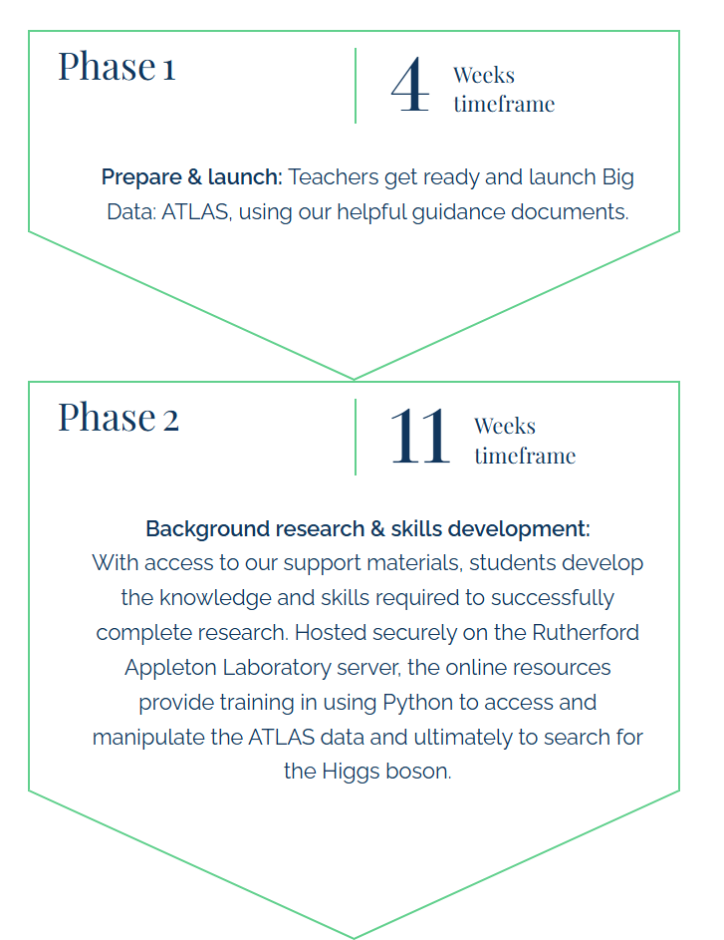
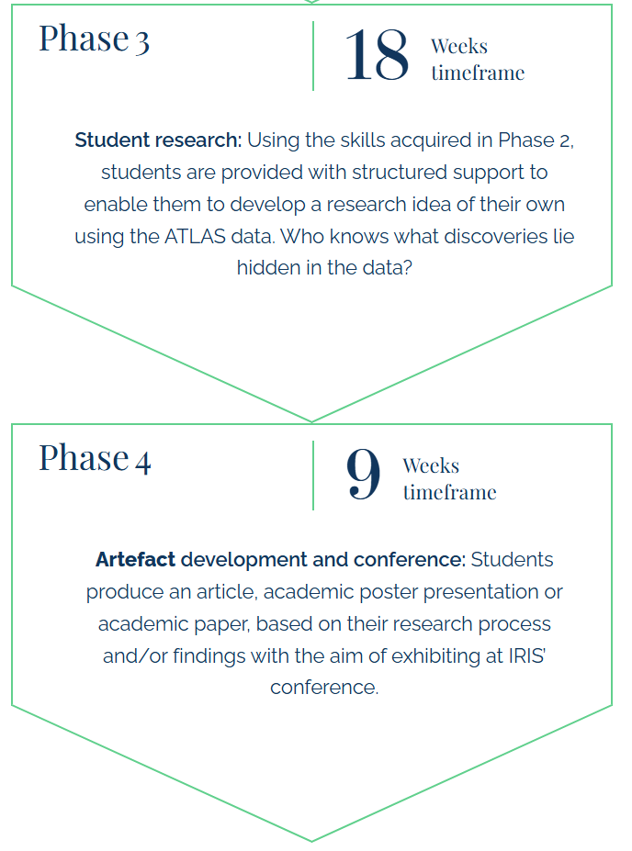
Programme developed, tweaked, improved since initial proposal in 2019
https://researchinschools.org/projects/big-data-atlas/

Slide 4
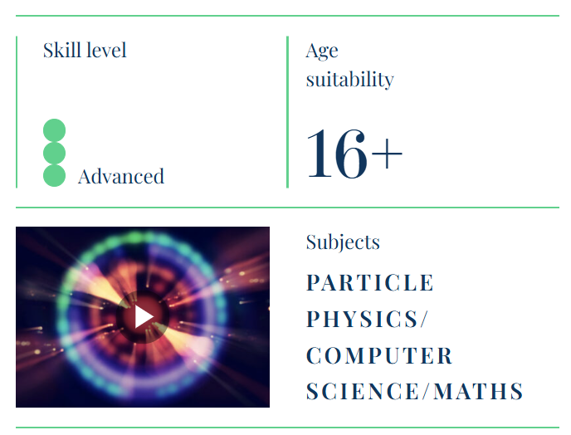

Slide 5
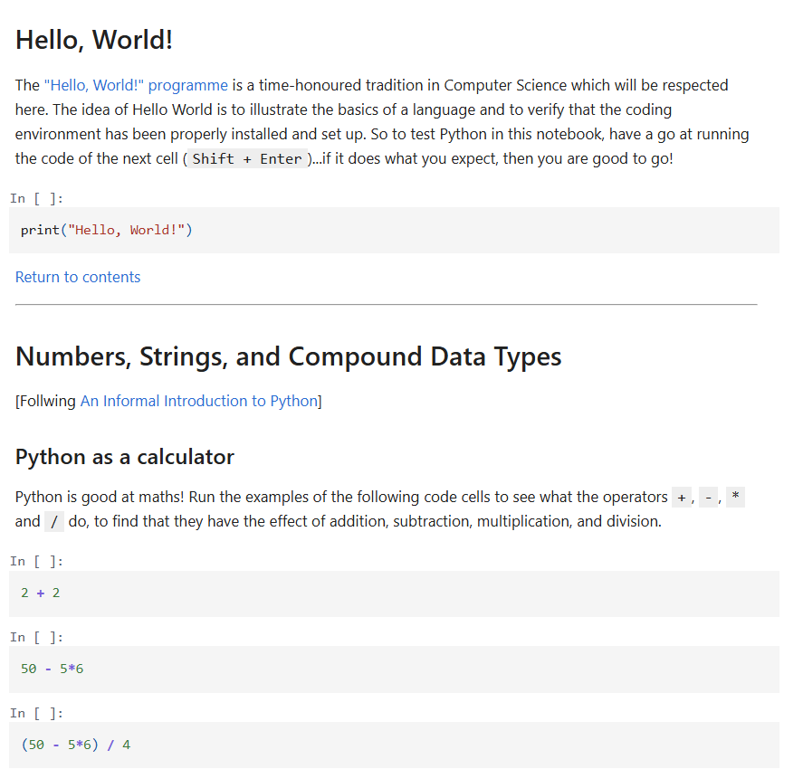
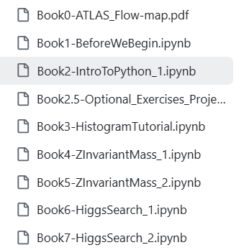
Series of Jupyter notebooks

Slide 6
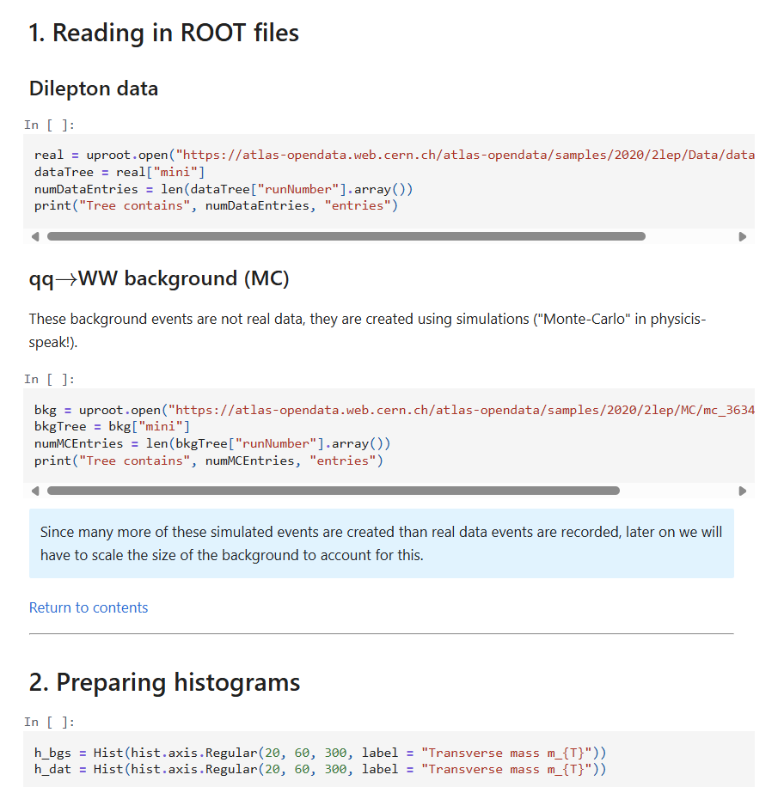

Slide 7


Slide 8
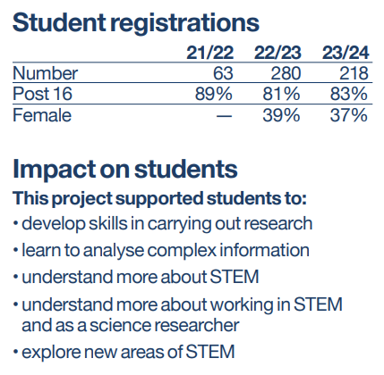
24/25
300
89%
30%

Slide 9
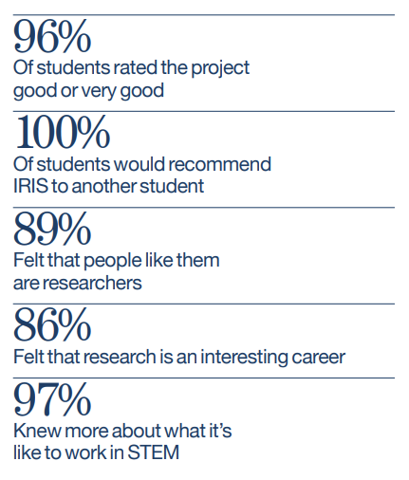
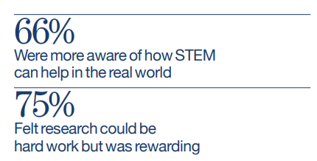

Slide 10
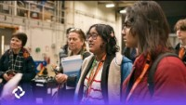
Masterclasses held annually at RAL

Slide 11
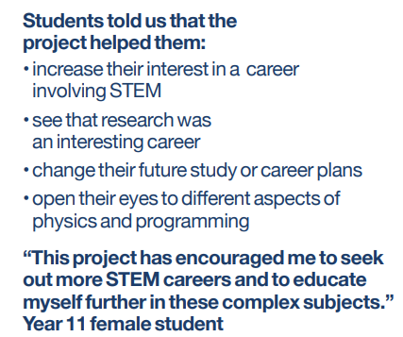
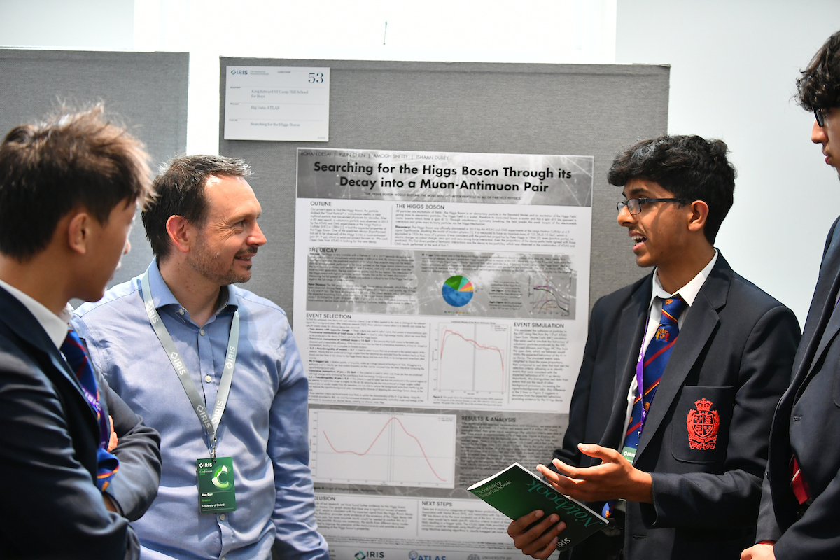
IRIS conference

Slide 12
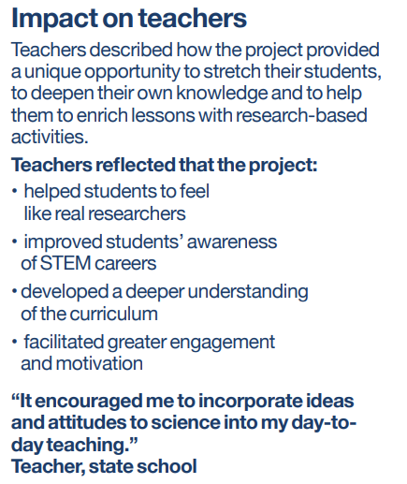
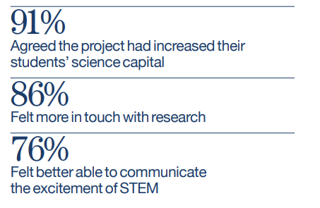

Slide 13
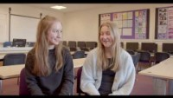
Feedback from the students

Slide 14
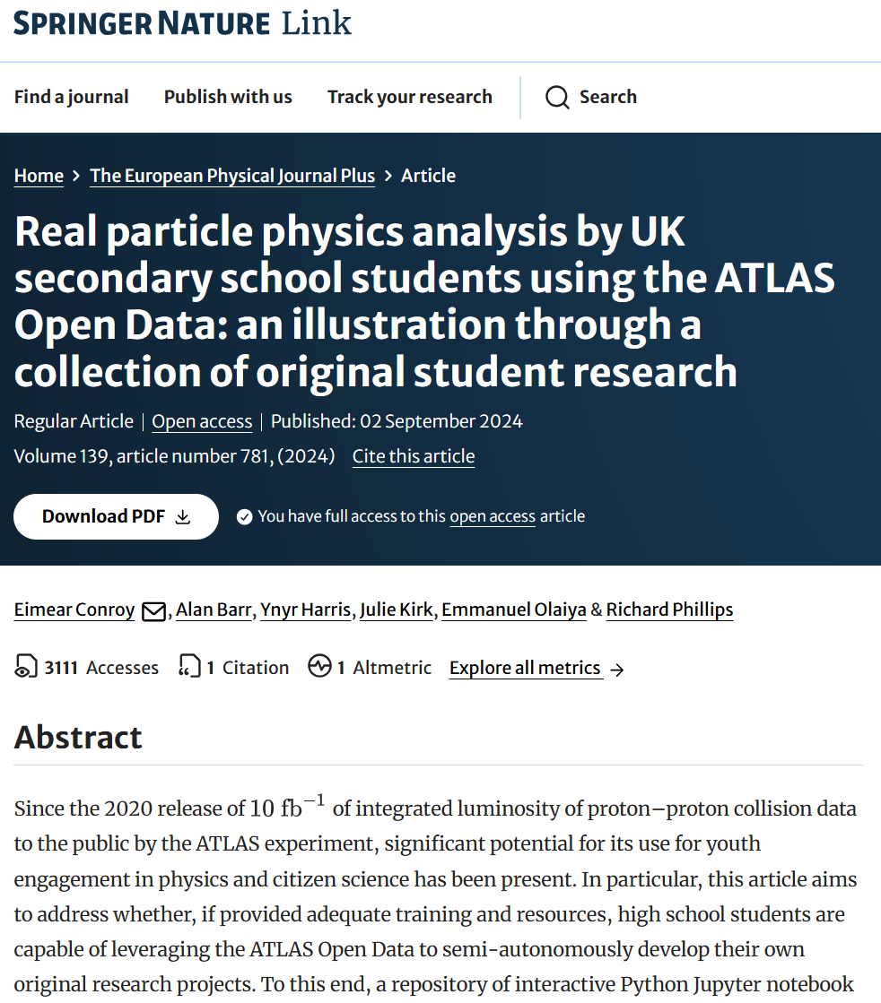
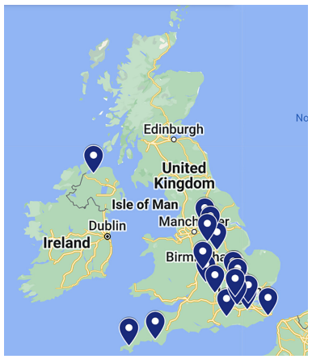
https://link.springer.com/article/10.1140/epjp/s13360-024-05518-z

Slide 15
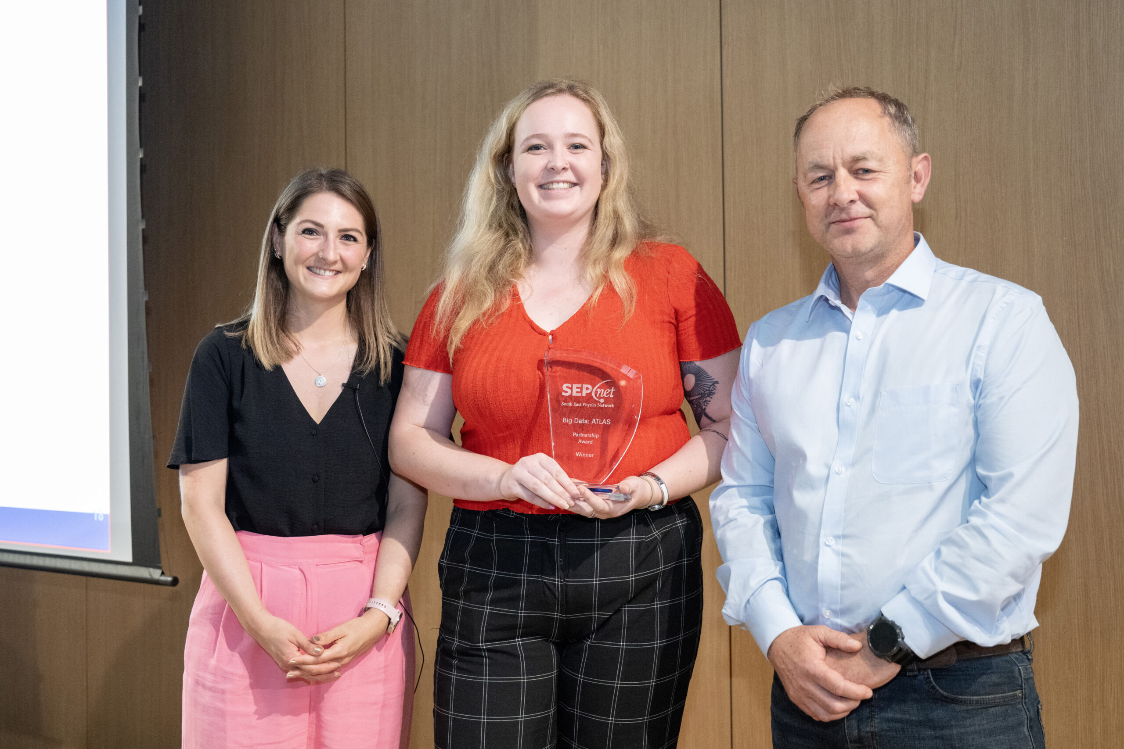
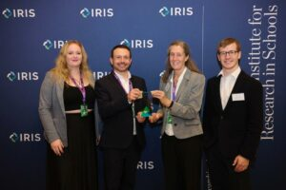
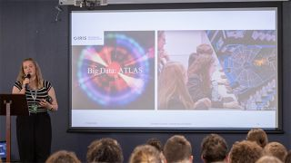
SEPnet partnership award 2024
IRIS partnership award 2023
University of Oxford Divisional Early Career Public Engagement with Research Award: Dr Eimear Conroy 2025

Slide 16
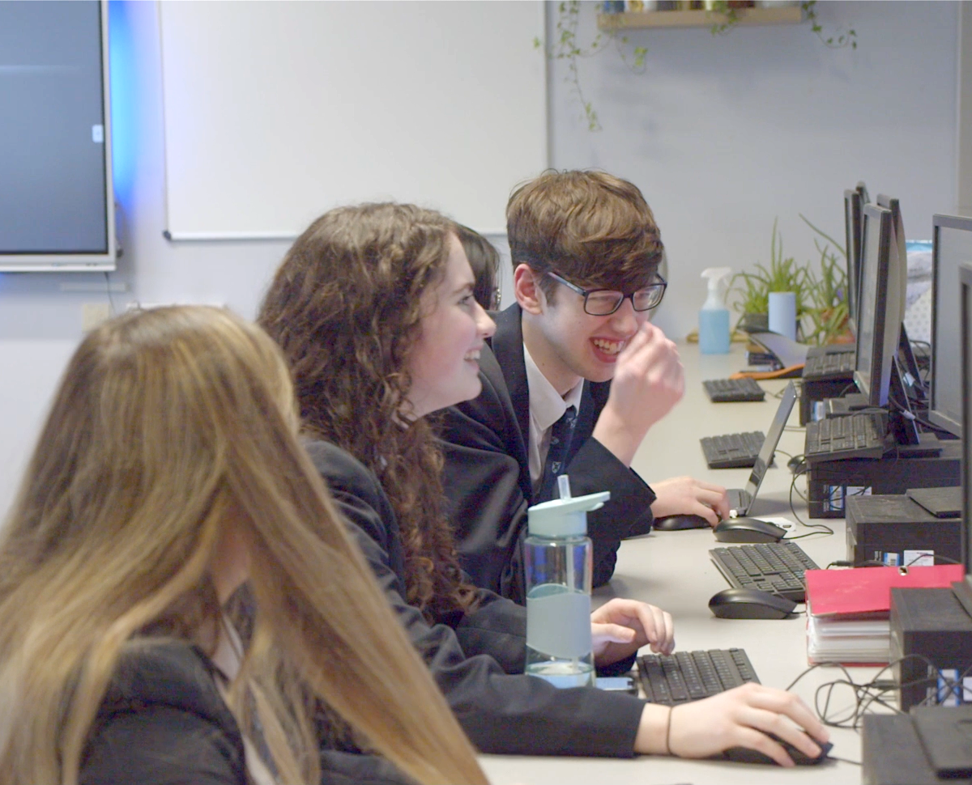
New this year:
New notebook on Machine Learning / AI
Developed by Ben Gladwyn, under test
Ambition to go multinational

