Slide 1
Particle Physics Masterclasses at Liverpool
Carl Gwilliam and Saskia Charity
9th September 2025
PPMC Workshop, IOP

Slide 2
Particle Physics Masterclasses
@ Dominika Vasilkova
In March, Liverpool hosted 1st Masterclass in over a decade
  Two lead organisers (Carl and Saskia)
  Help from >25 staff + PhD students, + 10 undergraduate students
  Support from dedicated outreach coordinators (Department and School)
Goals
  Show what it is like to be a particle physicist for the day
  Encourage students to come to Liverpool to do Physics
Attended by more than 150 year-12 A-level students
  ~20 schools from across north-west & as far away as Jersey
  50 places dedicated to widening-participation schools
Pre/Post-questionnaires for feedback
  Different questionnaires for students and teachers

Slide 3
Demographics

Slide 4
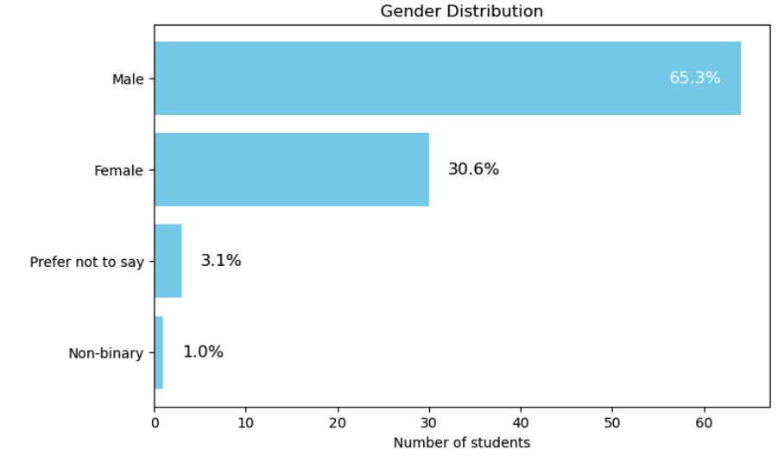
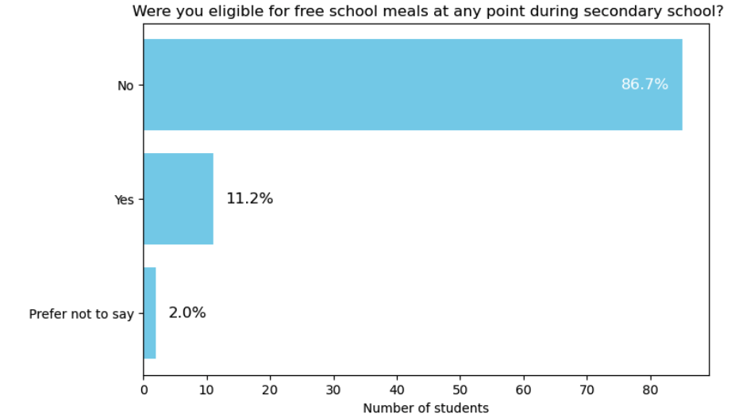
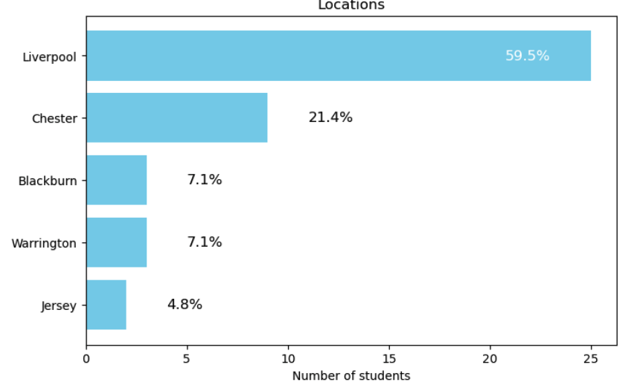
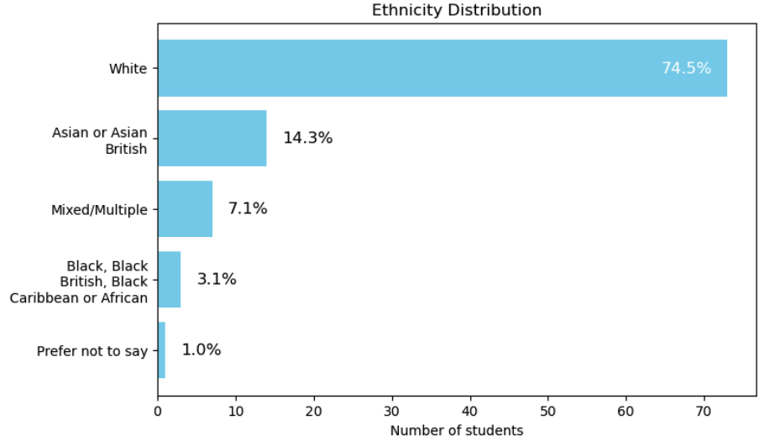
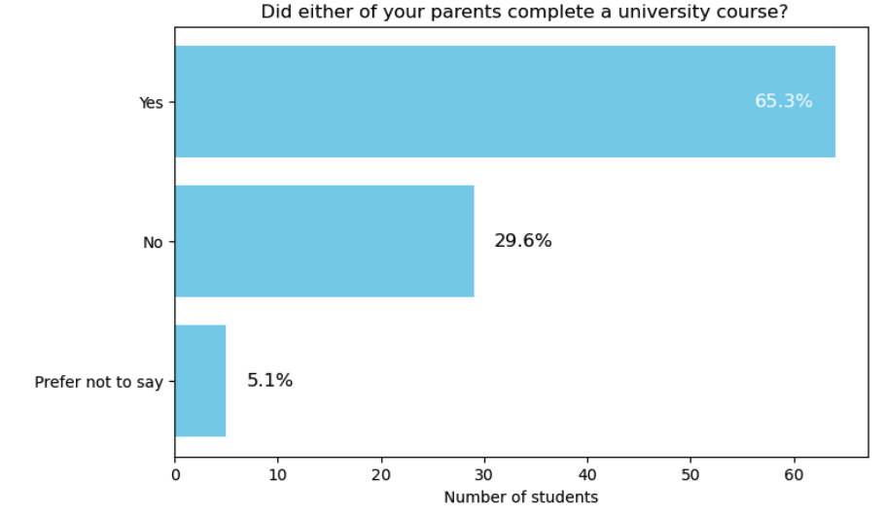
Demographics
Gender
Free school meals
Locations
Parents went to Uni
Ethnicity

Slide 5
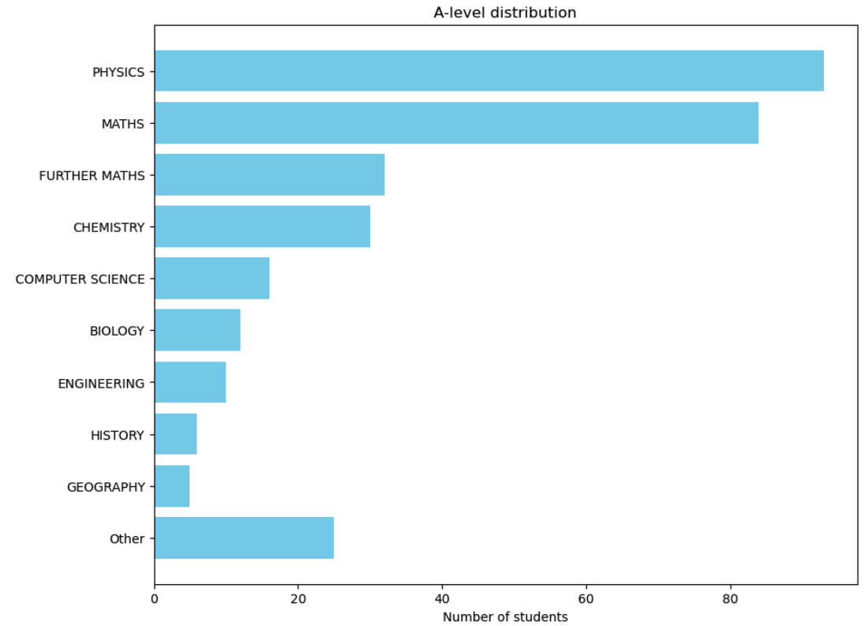
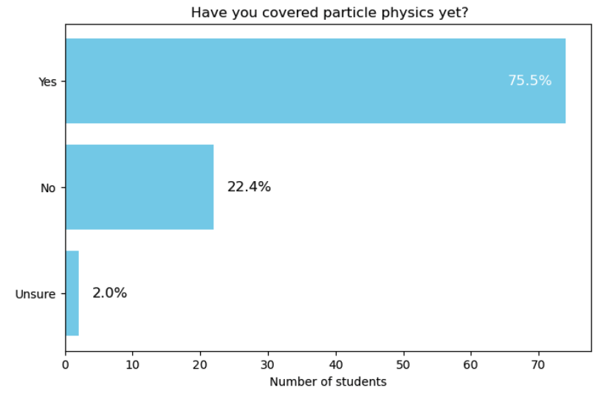
A-levels
Fairly standard A-level distribution, with ~3/4 having covered PP already
Covered PP
A-levels

Slide 6
Agenda on the day

Slide 7
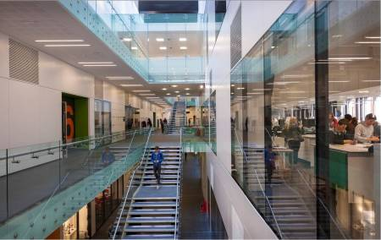
Planning the day
Needed not to run in university Easter break
  Local schools have different holidays
  Outreach team advised on suitable dates
Needed to run on Wednesday (no lectures in PM)
Chose to offer 150 students based on max computer room capacity
  Sold out in 2 days, several requests for waiting list
  Could have filled two days
  People want to go to masterclasses!
Decided to offer free lunch
  Several schools mentioned this was appreciated
We were advised to charge nominal fee to ensure attendance
  Charged £3/student (except WP)
Much organisation and liaison with schools was done by the outreach team
  Very helpful to us that there were existing links
  Helped develop feedback questionnaires
  WP links, parking, signage, registration, payment etc
Intro lectures, computing activity, lunch and UG lab tours all in same building (Central Teaching Laboratories)

Slide 8
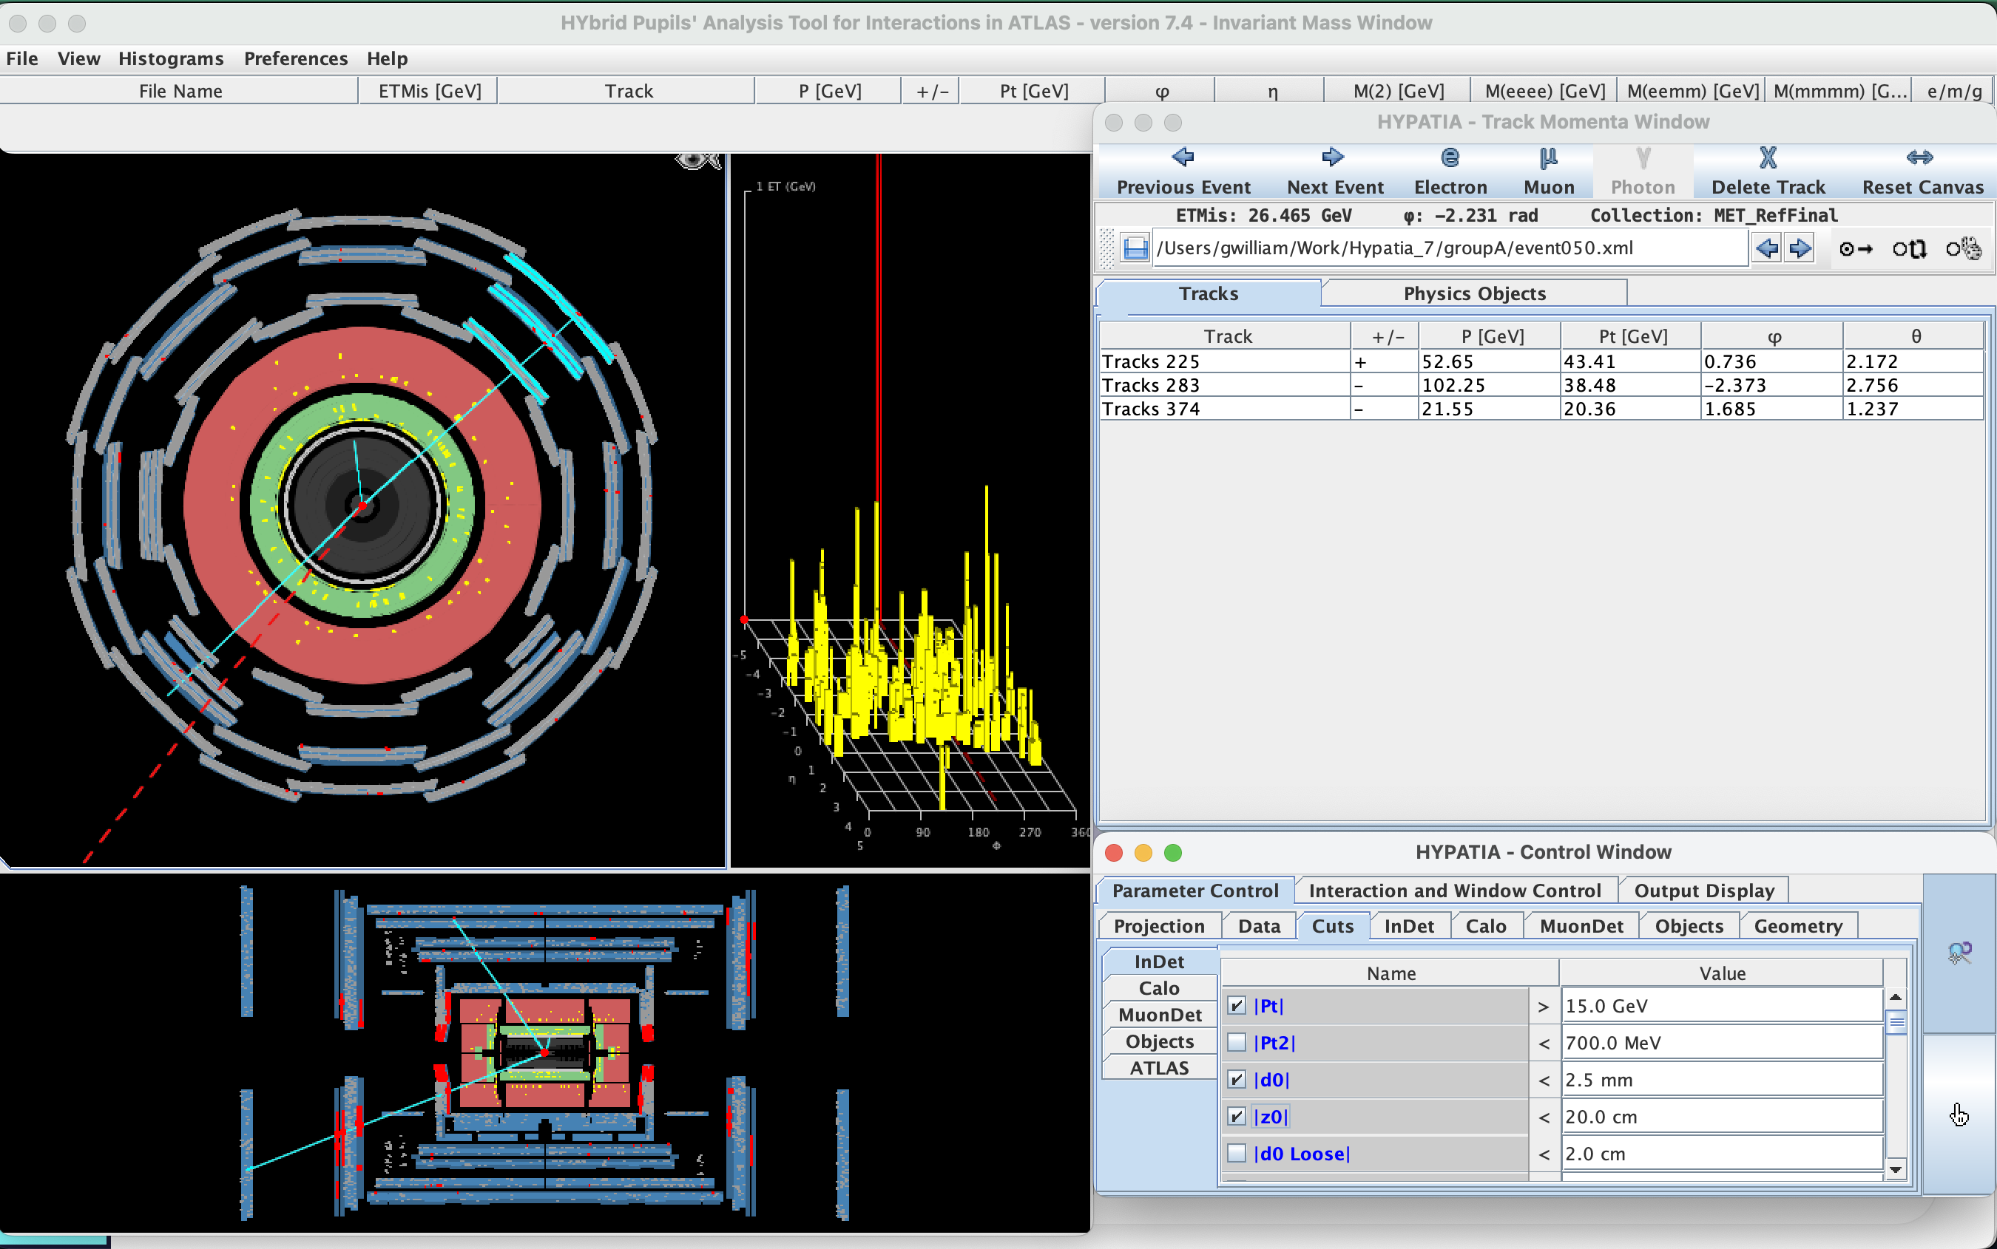
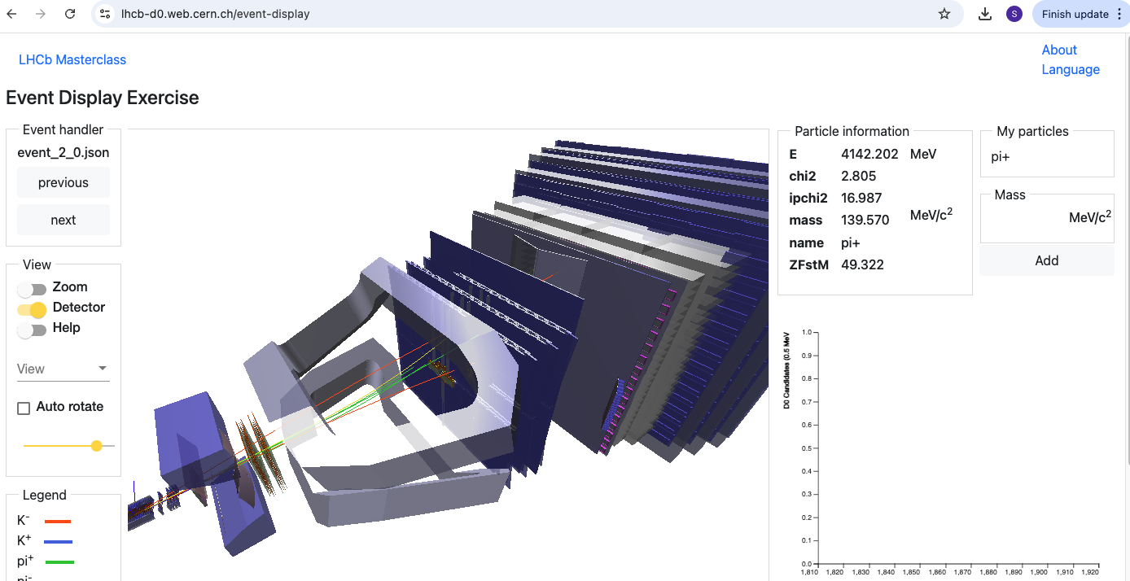
Choice of activity
Spent quite some time choosing which activity to run
  Choosing from LHCb or ATLAS IPPOG classes
  Wanted experiment with Liverpool involvement
  Decided to stick to IPPOG for now
Different helpers (staff/post-docs/PhD) tested the activities and gave feedback
  Some felt ATLAS activity good but graphics etc outdated
  Some felt LHCb activity more attractive but some issues with the activity e.g. annoying clicking
  Some staff had run the LHCb activity for different events in recent years
Went with LHCb for 2025 masterclass
  May revisit this in future

Slide 9
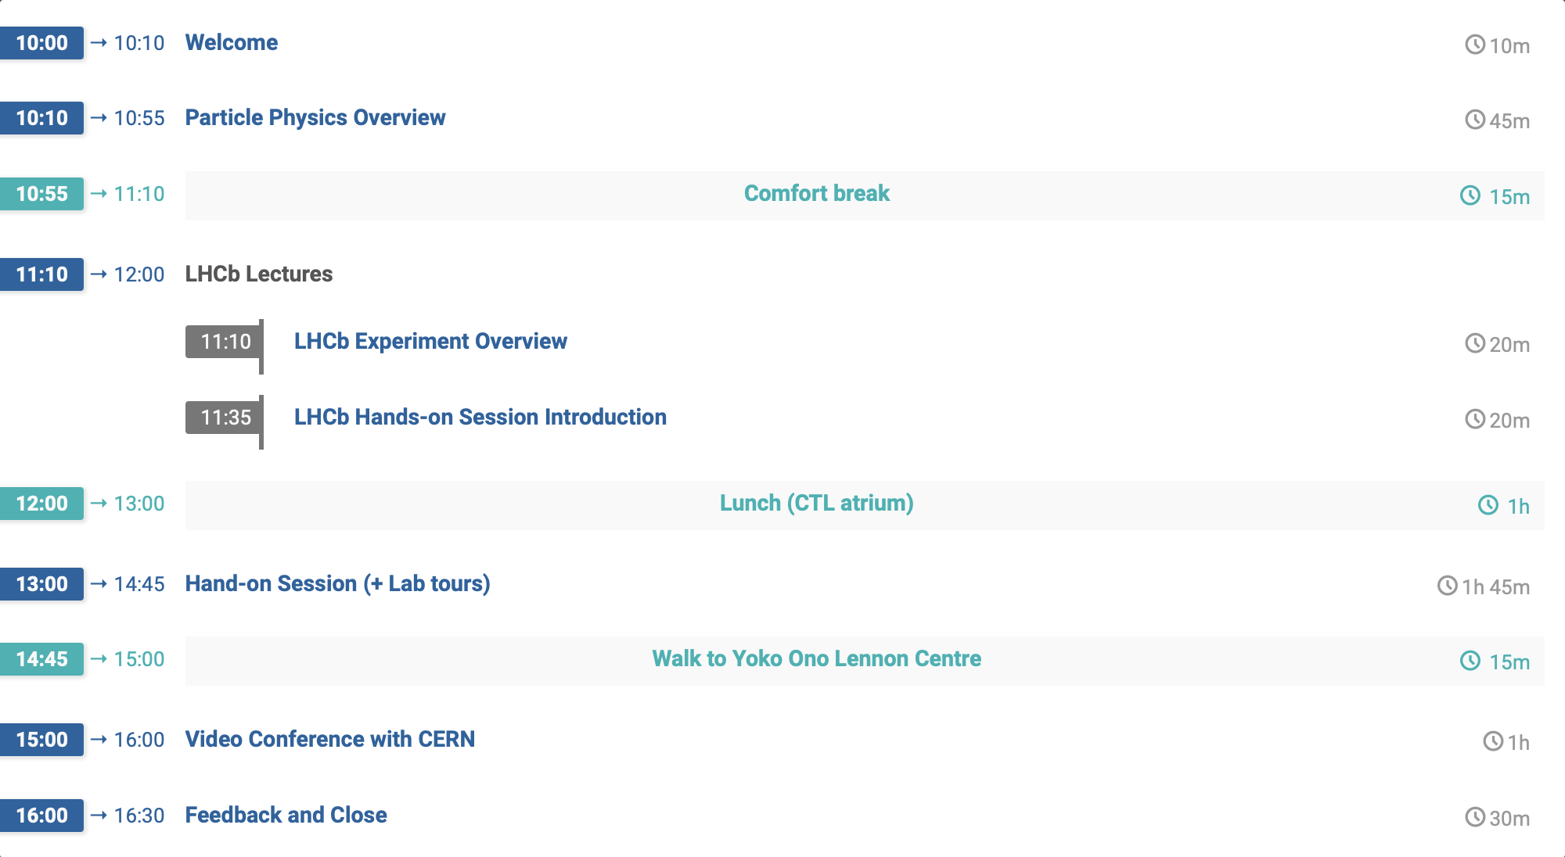
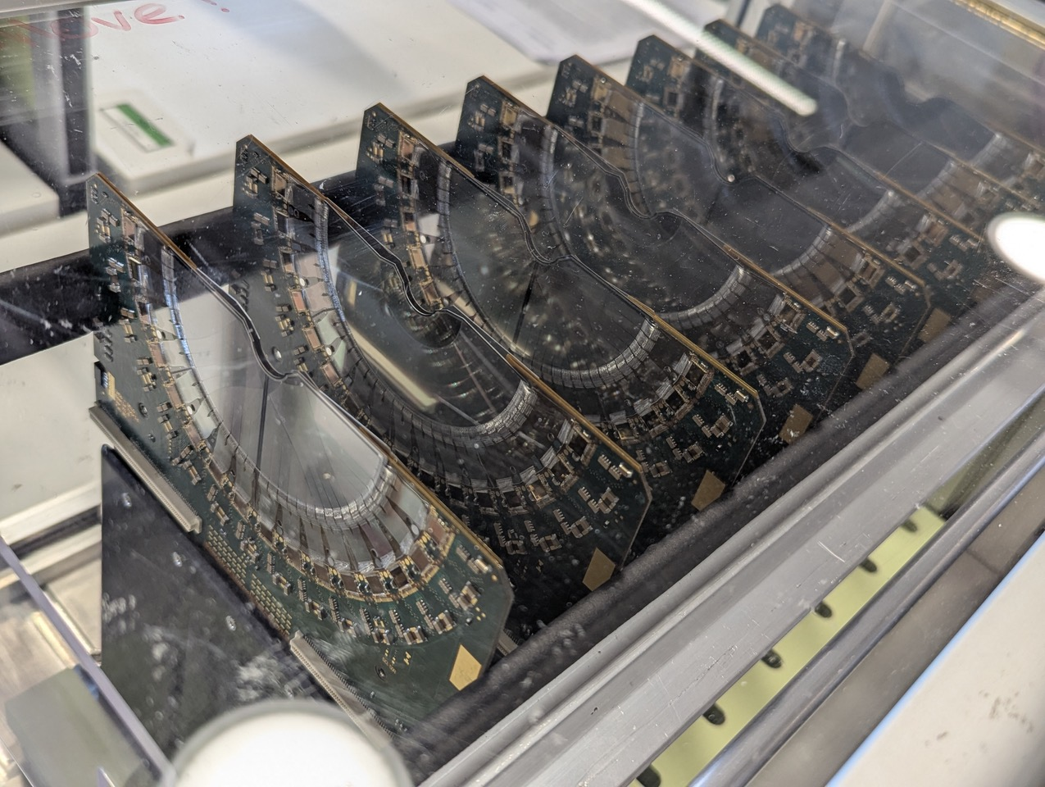




Agenda of the Day
https://indico.ph.liv.ac.uk/event/1883/
Introductory talk linked to A-level
Talks on LHCb with Liverpool-built VELO detector on display
Hands-on activity on real LHCb data
+ tours of teaching labs with demonstrations by UGs
Compare results with other groups + virtual tour of LHCb led by Liverpool PhD student

Slide 10
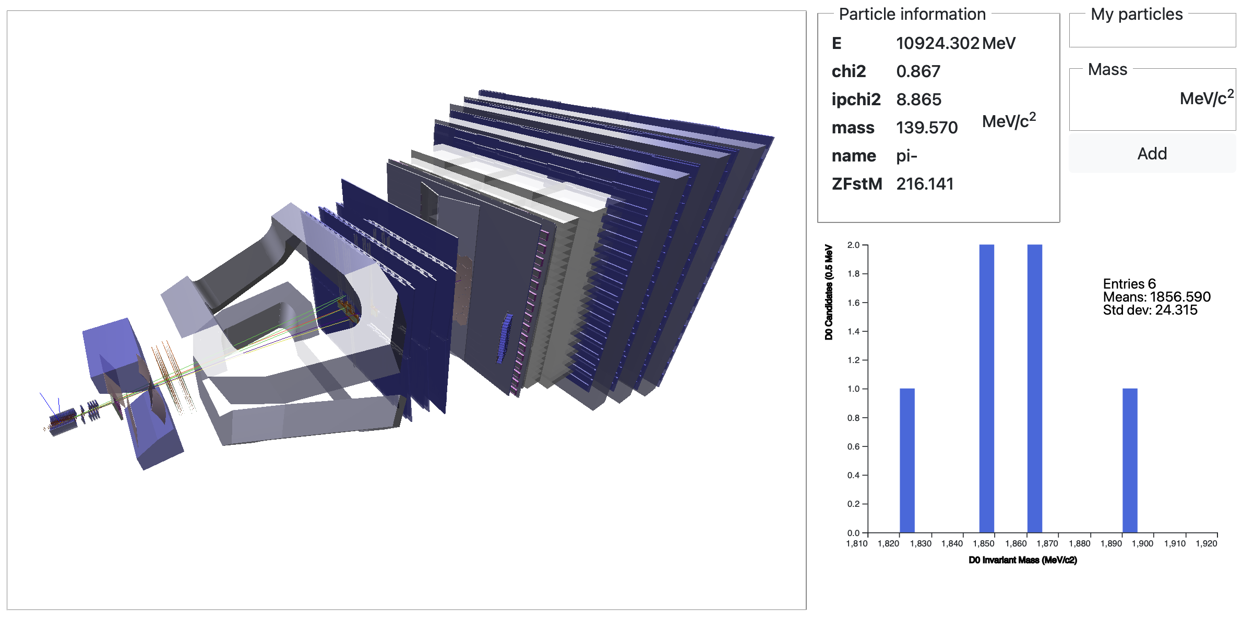
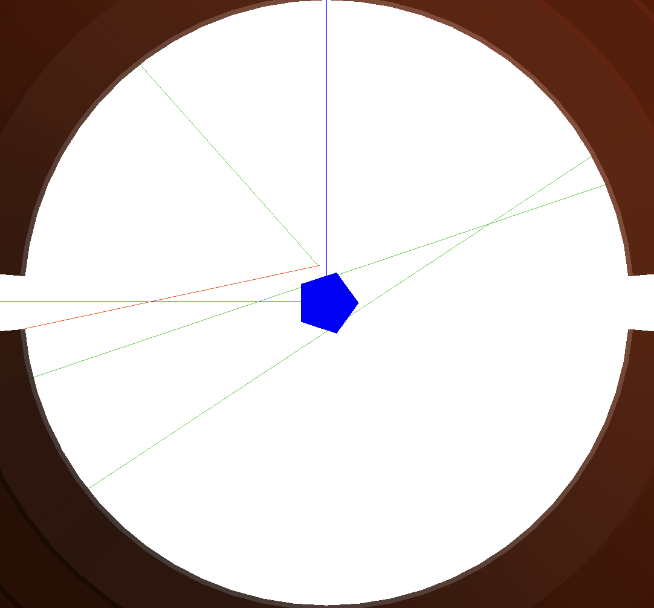
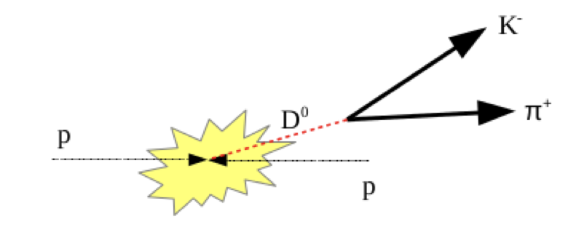
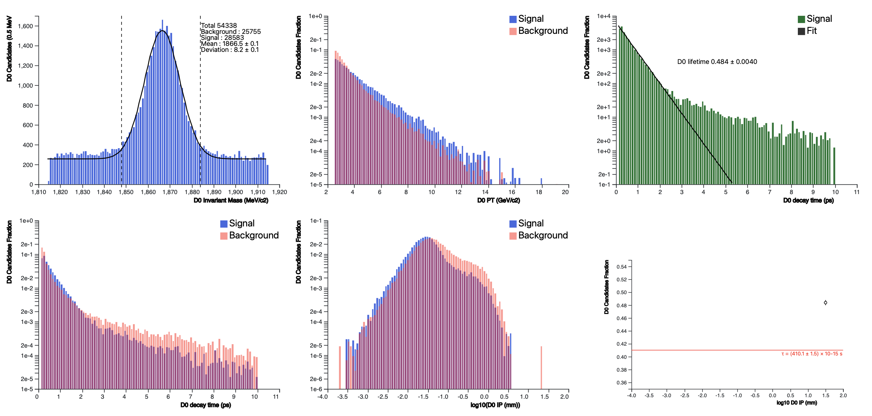
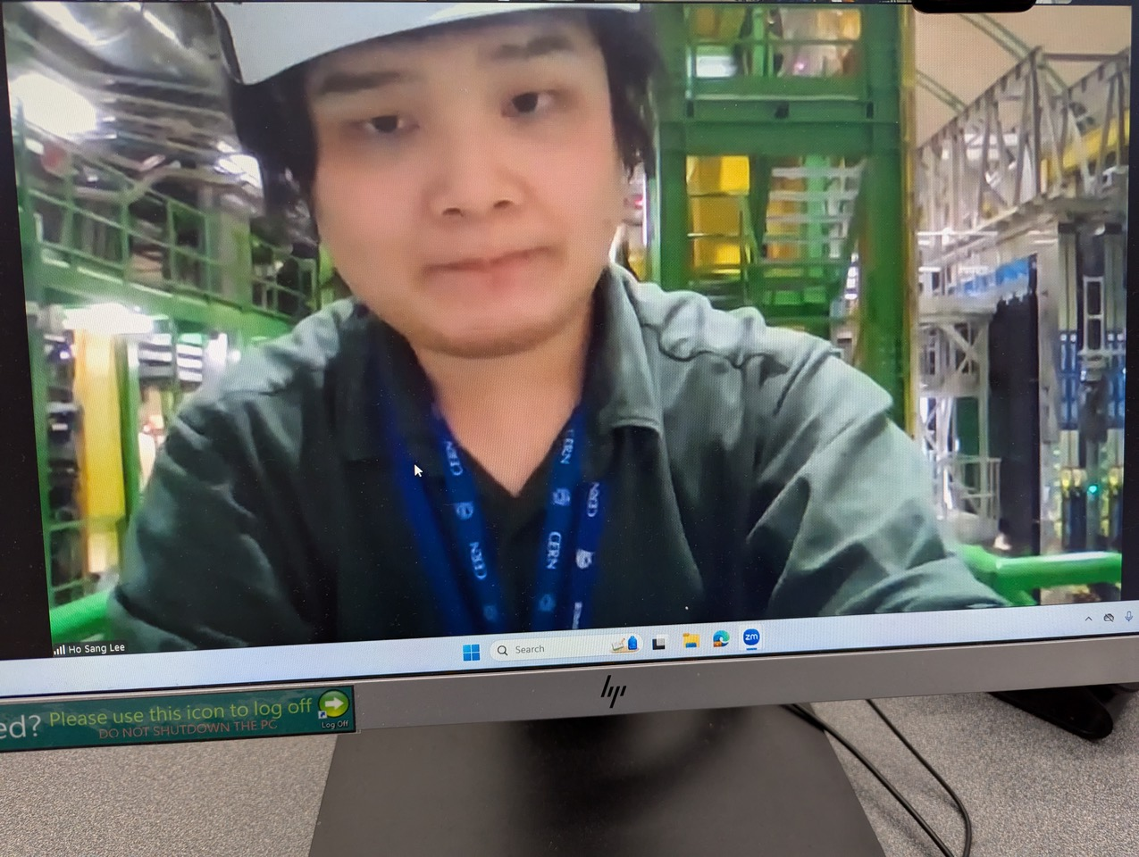
Hands-on Activities
https://lhcb-outreach.web.cern.ch/lhcbinternationalmasterclasses/d0-lifetime/
Identify D⁰ → k±π∓ events in LHCb
  Find decay tracks + plot mass
π⁺
k⁻
Invariant Mass
Separate signal from background
via cuts and extract D⁰ lifetime
  Report at video conference
Ho in LHCb cavern

Slide 11
Feedback

Slide 12
Feedback
Day was a huge success with positive feedback from both teachers and students
  100% of schools would come back and >50% of students more likely to come to Liverpool afterwards
Good constructive feedback to improve for next year

Slide 13
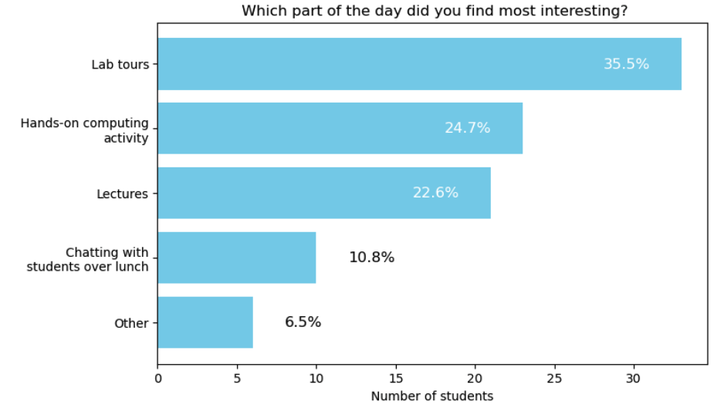
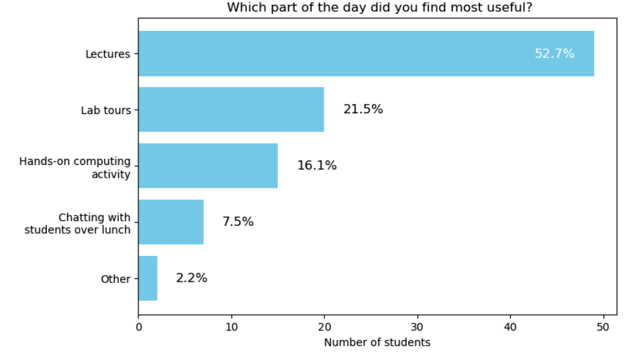
Most Interesting / Useful
Students found teaching lab tours and hands-on exercises most interesting
  But lectures were considered most useful
Somehow forgot to include Video Conference in options
  But general feeling (and in teacher feedback) was that this was the least useful part
  Not what we were expecting – interested to understand why and how to make this more effective in future
Most interesting
Most useful

Slide 14
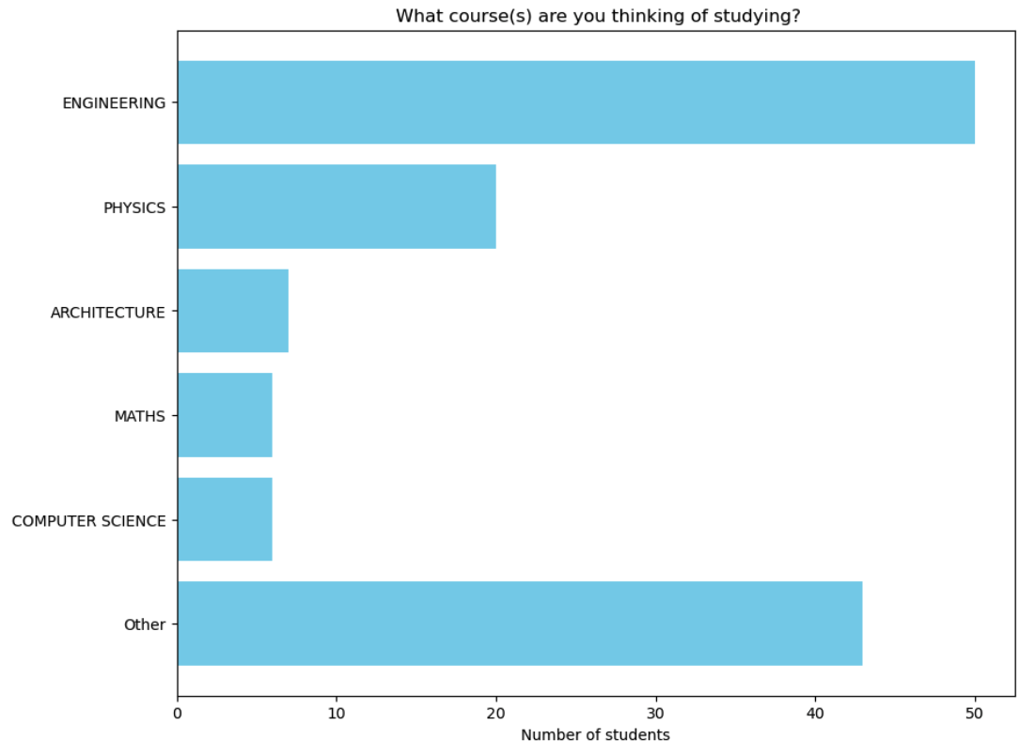
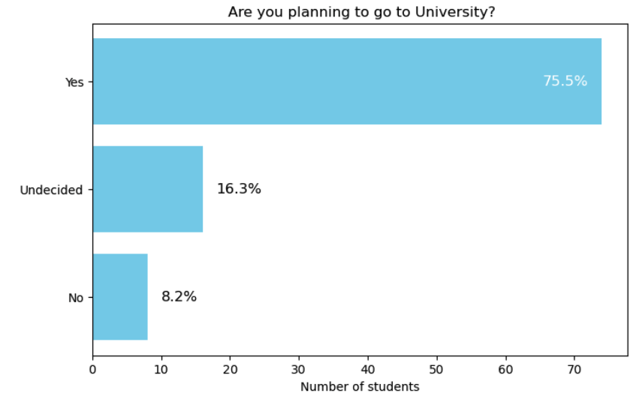
Uni Plans: Pre
~3/4 planning to go to Uni with physics second most common course (selection bias)
Uni course thinking about?
Planning to go to Uni

Slide 15
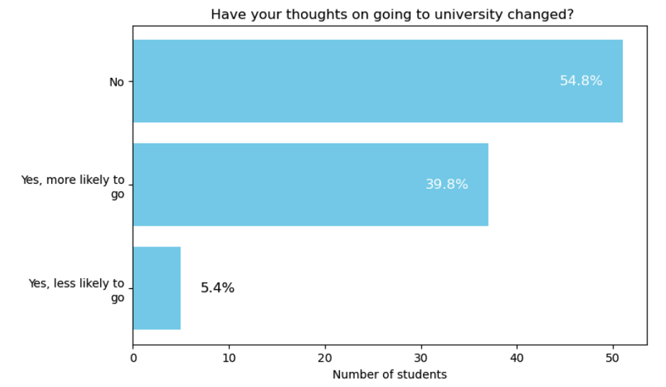
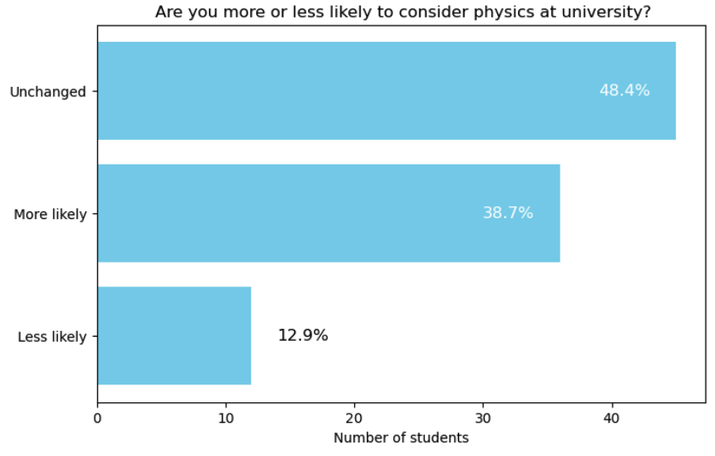
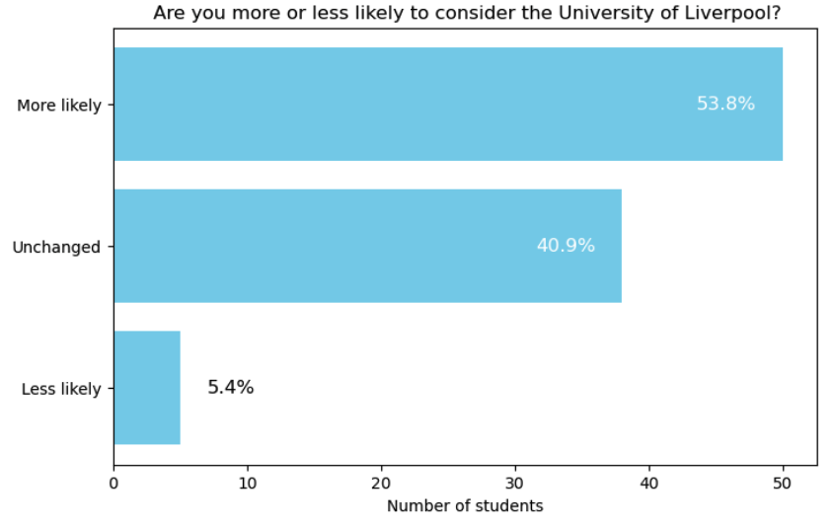
Uni Plans: Post
More likely to choose physics
More likely to go to Uni
Around 40% more likely to go to Uni
  Similar amount more likely to choose to study physics (though 13% less so)
>50% more likely to go to Liverpool
More likely to go to L’pool

Slide 16
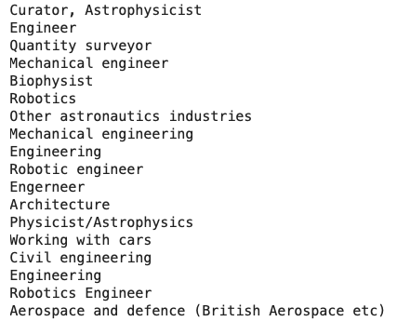
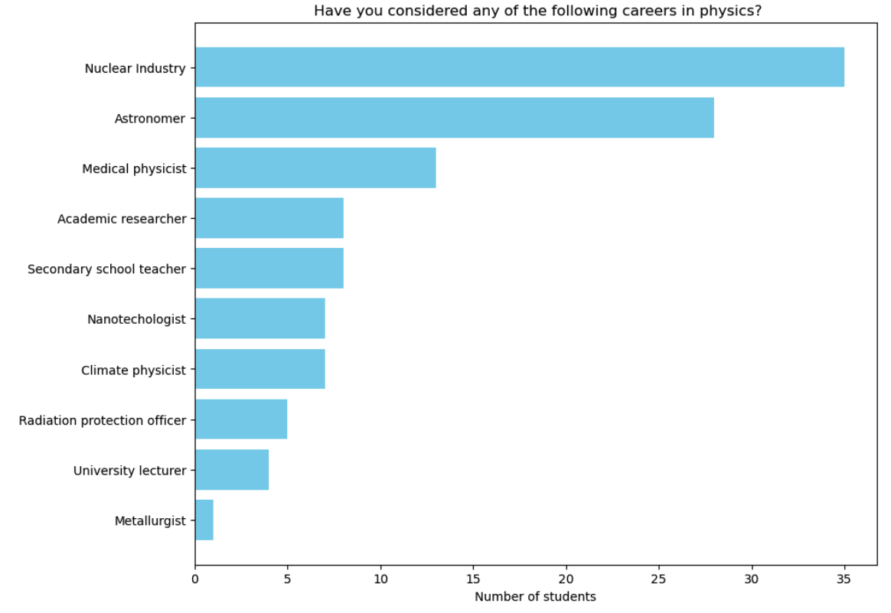
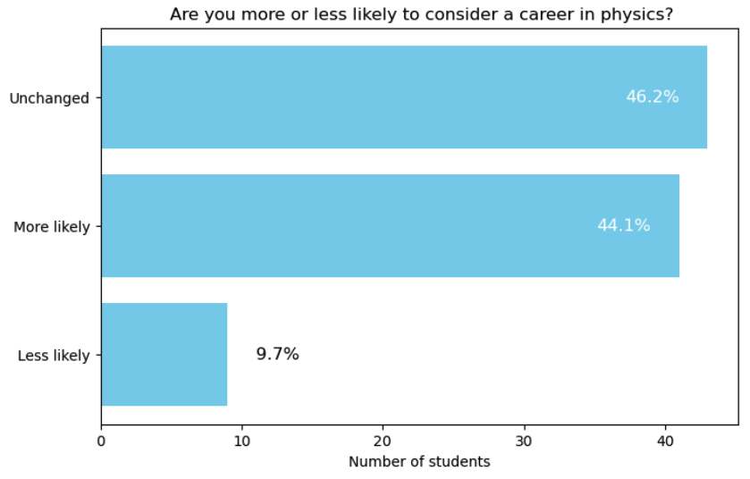
Career Plans: Before and After
Other
≈40% more likely to consider a career in physics (10% less likely)
Physics Careers Considered
More likely to choose
physics as a career

Slide 17
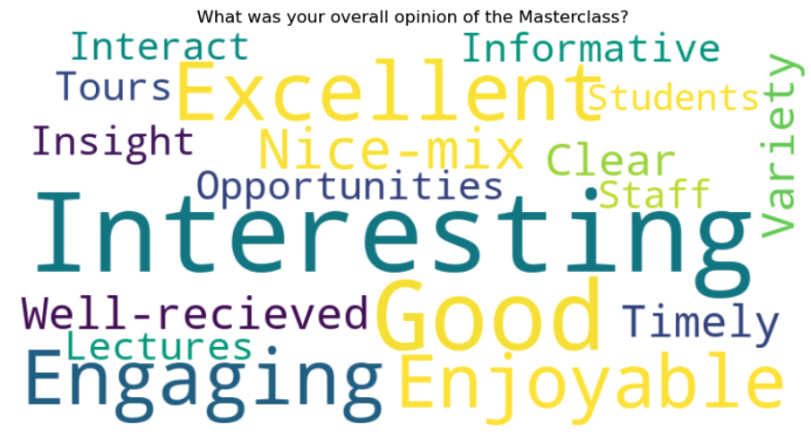
Teacher feedback on the Masterclass
Generally, very good feedback
Some thought the timetable was a bit long
  Too many talks / too long spent in lectures
  Not enough interactivity
Generally positive feedback about the computing activity
  Some concerns about timing (the first groups to go on the lab tour ended up being behind)
  Some found the instructions hard to follow
  Some wanted more stretch
Student and teachers enjoyed the UG lab tours
  But scheduling was an issue (see above)
Teachers also commented the video conference was the least useful part
  Large group; didn’t pre-arrange questions
Next year: plan some tweaks to the day to respond to suggestions and feedback

Slide 18
Next Year

Slide 19
What could/should we change?
Do we want to change the exercise?
  Some issues with mouse location but overall OK with positive feedback + have experience now
  Should check for improvements to the ATLAS one – considering switching if the activity can be improved (more on this later)
Lectures
  Consolidate two LHCb lectures, focusing on explanation of hands-on part
  Have some interactive exercises between the two lectures. What do others do?
Lab tours
  Having the lab tours staggered during the hands-on exercise didn’t work so well as people got
  out of sync with the two parts and missed the averaging of the mass
  Possibilities:
    Have a morning slot with 3 staggered activities, including lab tour, rotating?
    Have a longer staggered lunch with lab tours during that? Others?
Lunches
  Need a way to avoid long queues and lack of food at end
  Packed lunches? Staggered lunches?

Slide 20
What could/should we change? (2)
Do we still want to be part of the IPPOG or do standalone?
  Standalone would give us more leeway on when and timing of day
  Can we organise our own VC with Liverpool LHCb at CERN?
    Is there a virtual tour of LHCb in case we can’t go down
  Can still do the quiz (which was the most interesting part)
Do we want to do more than one day?
  Could have easily filled more places this year (”sold out” in 2 days)
  Two days would accommodate more (can’t do on one), likely with each slightly less packed
  Would depend strongly on availability of staff/students to help
Following debriefing discussion we decided
  Stick with LHCb activity for now
  Stick with IPPOG structure for another year (at least)
  Change a few things based on feedback (lunch / lab tour staggering, fewer lectures etc)
  Re-evaluate larger scale changes after that

Slide 21
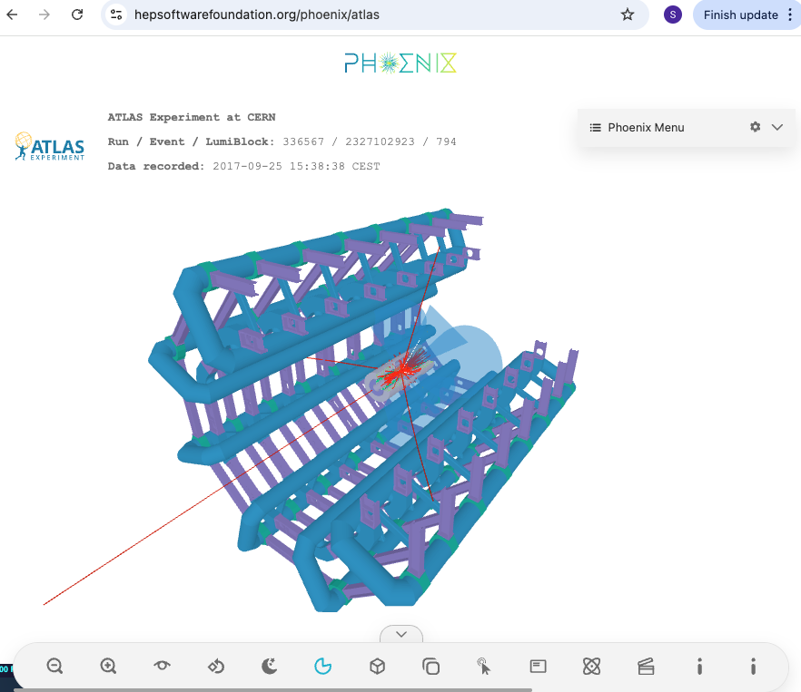
Longer-term plans
Our testers felt the ATLAS activity is nice for teaching PP concepts
  Event displays nice, learn about different detectors, etc
  But graphics very old and out-of-date: needs improving to be engaging
Discussed with Ed Moyse (ATLAS computing) about updates to activity using Phoenix
  Some efforts already planned/discussed
  Need to add some functionality to Phoenix page to replicate existing activity
    E.g. table for calculating invariant masses
  We advertised a BSc project this year to work on Phoenix version of activity
  We’re interested to hear about other efforts in this area
Our Dark Matter group is working on developing a DM activity (based on LZ)
  Happy to collaborate if others interested

Slide 22
Thank you

