Slide 1


Catching Four-Fermions SMEFT Operators in the Drell-Yan Process
YTF 25
Martina Fusi
Ken Mimasu

Slide 2
Table of Contents
Introduction
Toy Model
Global DY fit
Outlook
SMEFT in DY

Slide 3
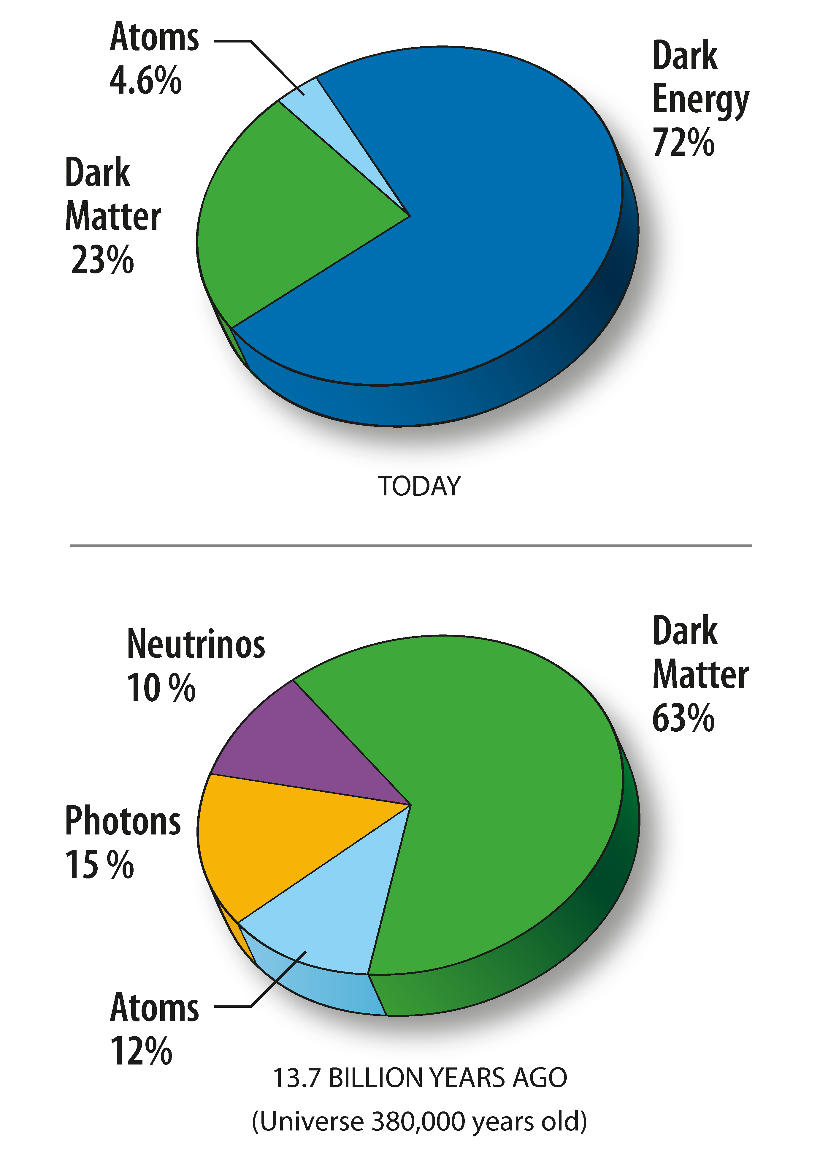
Introduction and Motivation
Strengths and Limitations of the Standard Model
The most successful theory in particle physics
It predicted the Higgs boson
Allowed the most precise measurement in physics: Electron Anomalous Magnetic Momentum
However, it cannot explain several observed phenomena
Matter-Antimatter asymmetry
Gravity
Dark Matter
Dark Energy
Ultimately, it describes only around 5% of the energy in the universe
It is both renormalizable and mathematically self-consistent
Neutrino Oscillations

Slide 4

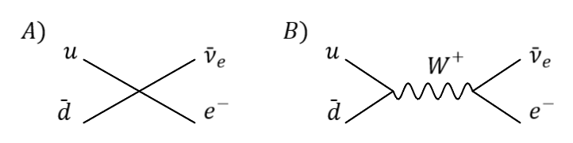
Effective Field Theory (EFT)
Introduction and Motivation
Search for new physics through "bump-hunting" at the LHC have so far been unsuccessful
We need to look for indirect signs of new physics, particularly in scenarios where the mass of the new particles lies well above the collider energy
In this context, an EFT can help
A classical example of EFT is the Fermi interaction, the low-energy effective field theory of weak interactions
Fermi vertex
SM vertex

Slide 5
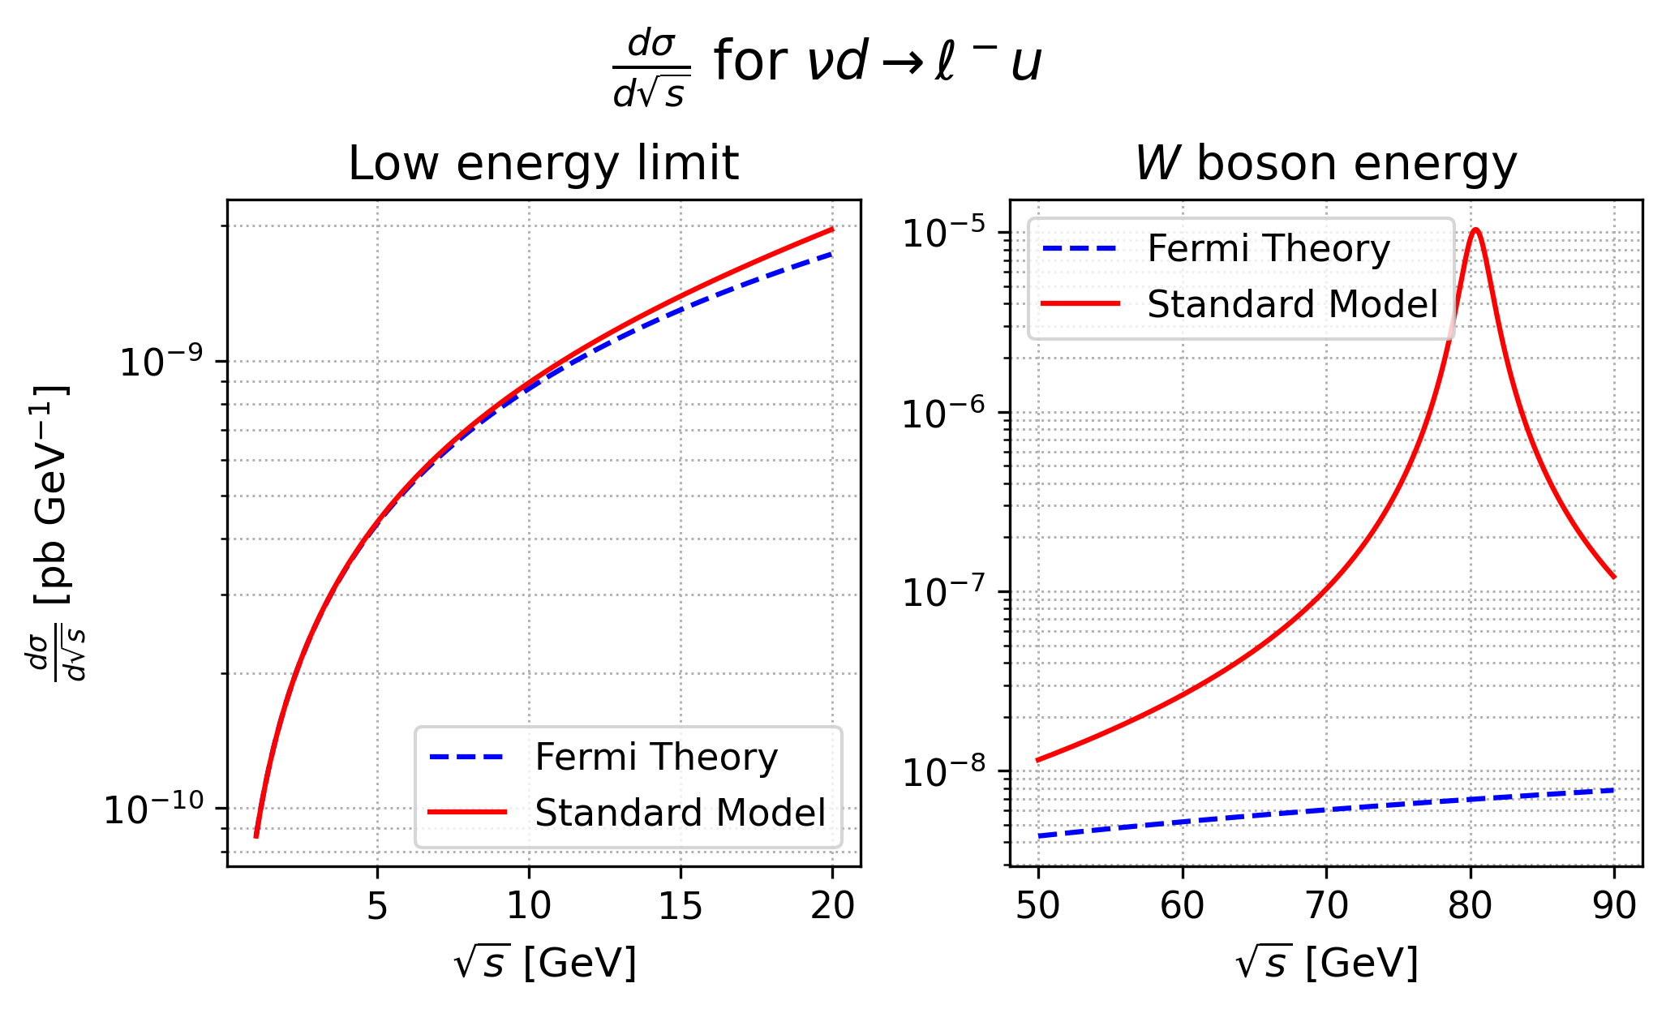
Fermi Theory as an EFT
Introduction and Motivation
We can look at the differential cross section predictions of SM and Fermi theory
At low energy, the two theories give the same result
At slightly higher energy, deviations from the Fermi prediction would become visible
Around W boson energy, the Fermi theory becomes completely inapplicable

Slide 6

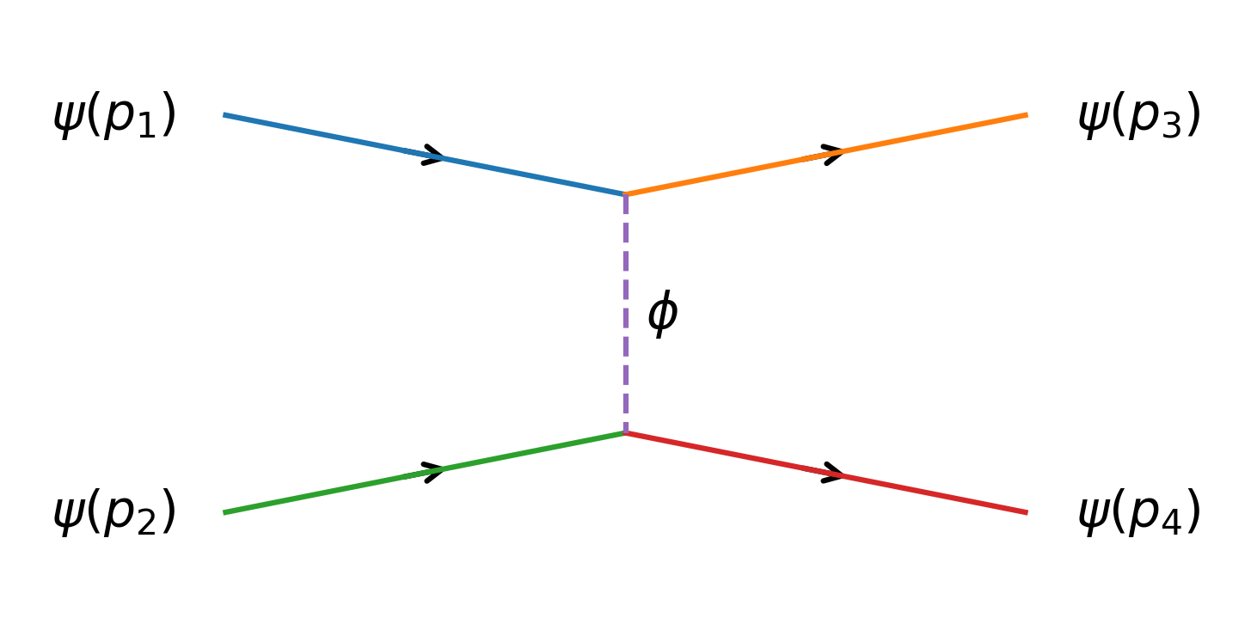
A Toy Effective Field Theory⁺
A Toy Model for matching
Let's consider this toy model:
Ψ is a fermionic field with small mass
Φ is a scalar field with high mass m << M
y, λ << 1 so that we can work in perturbation theory
The matrix element for an elastic scattering of two fermions is:
⁺An Introduction to Effective Field Theories - arXiv:2006.16285v1

Slide 7

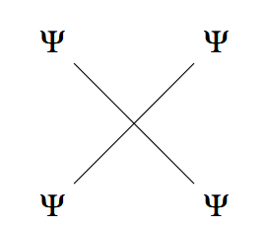
A Toy Effective Field Theory
A Toy Model for matching
The scalar propagator can be expanded in powers of momenta (considering m² ≪ p² ≪ M²).
The first term is:
We would have obtained the same result with the effective theory:
At low energy (E≪ M) the two theories are indistinguishable
The effective theory does not postulate a scalar boson

Slide 8

Standard Model as an EFT (SMEFT)
SMEFT Effects in Drell–Yan
Just like Fermi theory is an EFT for the SM, we can consider the SM to be an EFT of some bigger underlying theory
SMEFT extends the SM in a model-independent way, capturing possible effects of high-energy new physics from lower-energy data
Λ is the energy scale of new physics (here fixed at 1 TeV)
C_{i} are the so-called Wilson coefficients
Any relevant operator that is compatible with the symmetries of the system should in principle be included
O_{i}⁽⁵⁾ and O_{i}⁽⁷⁾ are not considered because they violate either leptonic or baryonic number⁺
⁺arXiv:1604.05726

Slide 9

SMEFT Operators in the Amplitude
SMEFT Effects in Drell–Yan
The matrix element will then be:
And the cross section will be proportional to:
The second term is the interference between SMEFT and SM (~1/Λ²) and is a linear combination of the Wilson coefficients
The third term is the pure SMEFT contribution (~1/Λ⁴), sometimes referred to as the squared term, and it is a quadratic combination of the Wilson coefficients
The interference between SM and dim-8 SMEFT operators also contributes to ~1/Λ⁴

Slide 10
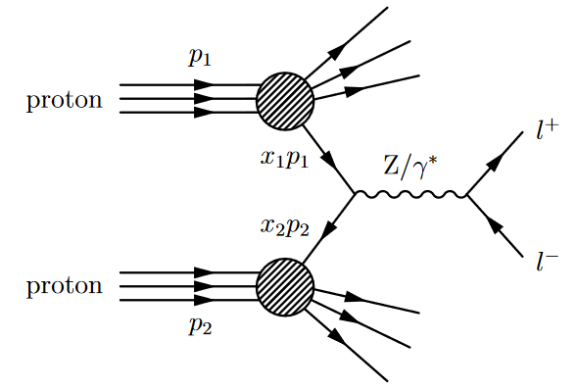
The Drell-Yan (DY) Process
Towards a global DY fit
The Drell–Yan process consists of a quark from one hadron and an antiquark from another hadron annihilating to produce a virtual photon or Z boson, which subsequently decays into a pair of oppositely charged leptons
Why choose DY?
With 2499 dimension-6 operators in the SMEFT, we must target specific processes where only a subset contributes significantly
DY has a simple final state
Many measurements of DY have already been performed at colliders

Slide 11
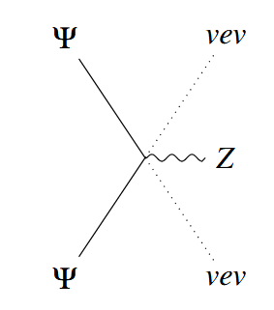
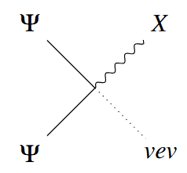
Dim-6 SMEFT Operators in DY
Towards a global DY fit
There are three classes of dim-6 operators for DY:
Ψ²φ²D: these operators include a single derivative, a Higgs doublet and two fermions
They shift the SM coupling of the fermions to gauge bosons
They have already been constrained at LEP
Ψ²Xφ: two fermions coupled to a gauge boson (X = B_{μν}, G_{μν}, W_{μν}) and a Higgs.
They don’t interfere with the SM
Ψ⁴: four-fermion operators
10 different operators (7 interfere with the SM)
They grow with E²/Λ²

Slide 12
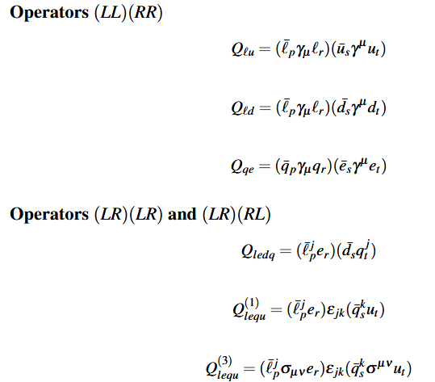
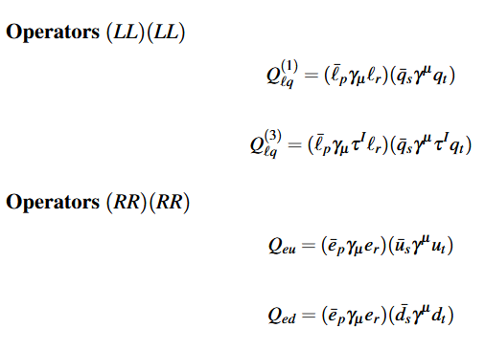
SMEFT Operators in DY
Results and Interpretations
The relevant 4-fermion operators are:⁺
*
*In the code: c_{dls}, c_{uls}, c_{ult}
⁺ Dimension-Six Terms in the Standard Model Lagrangian - arXiv:1008.4884v3

Slide 13
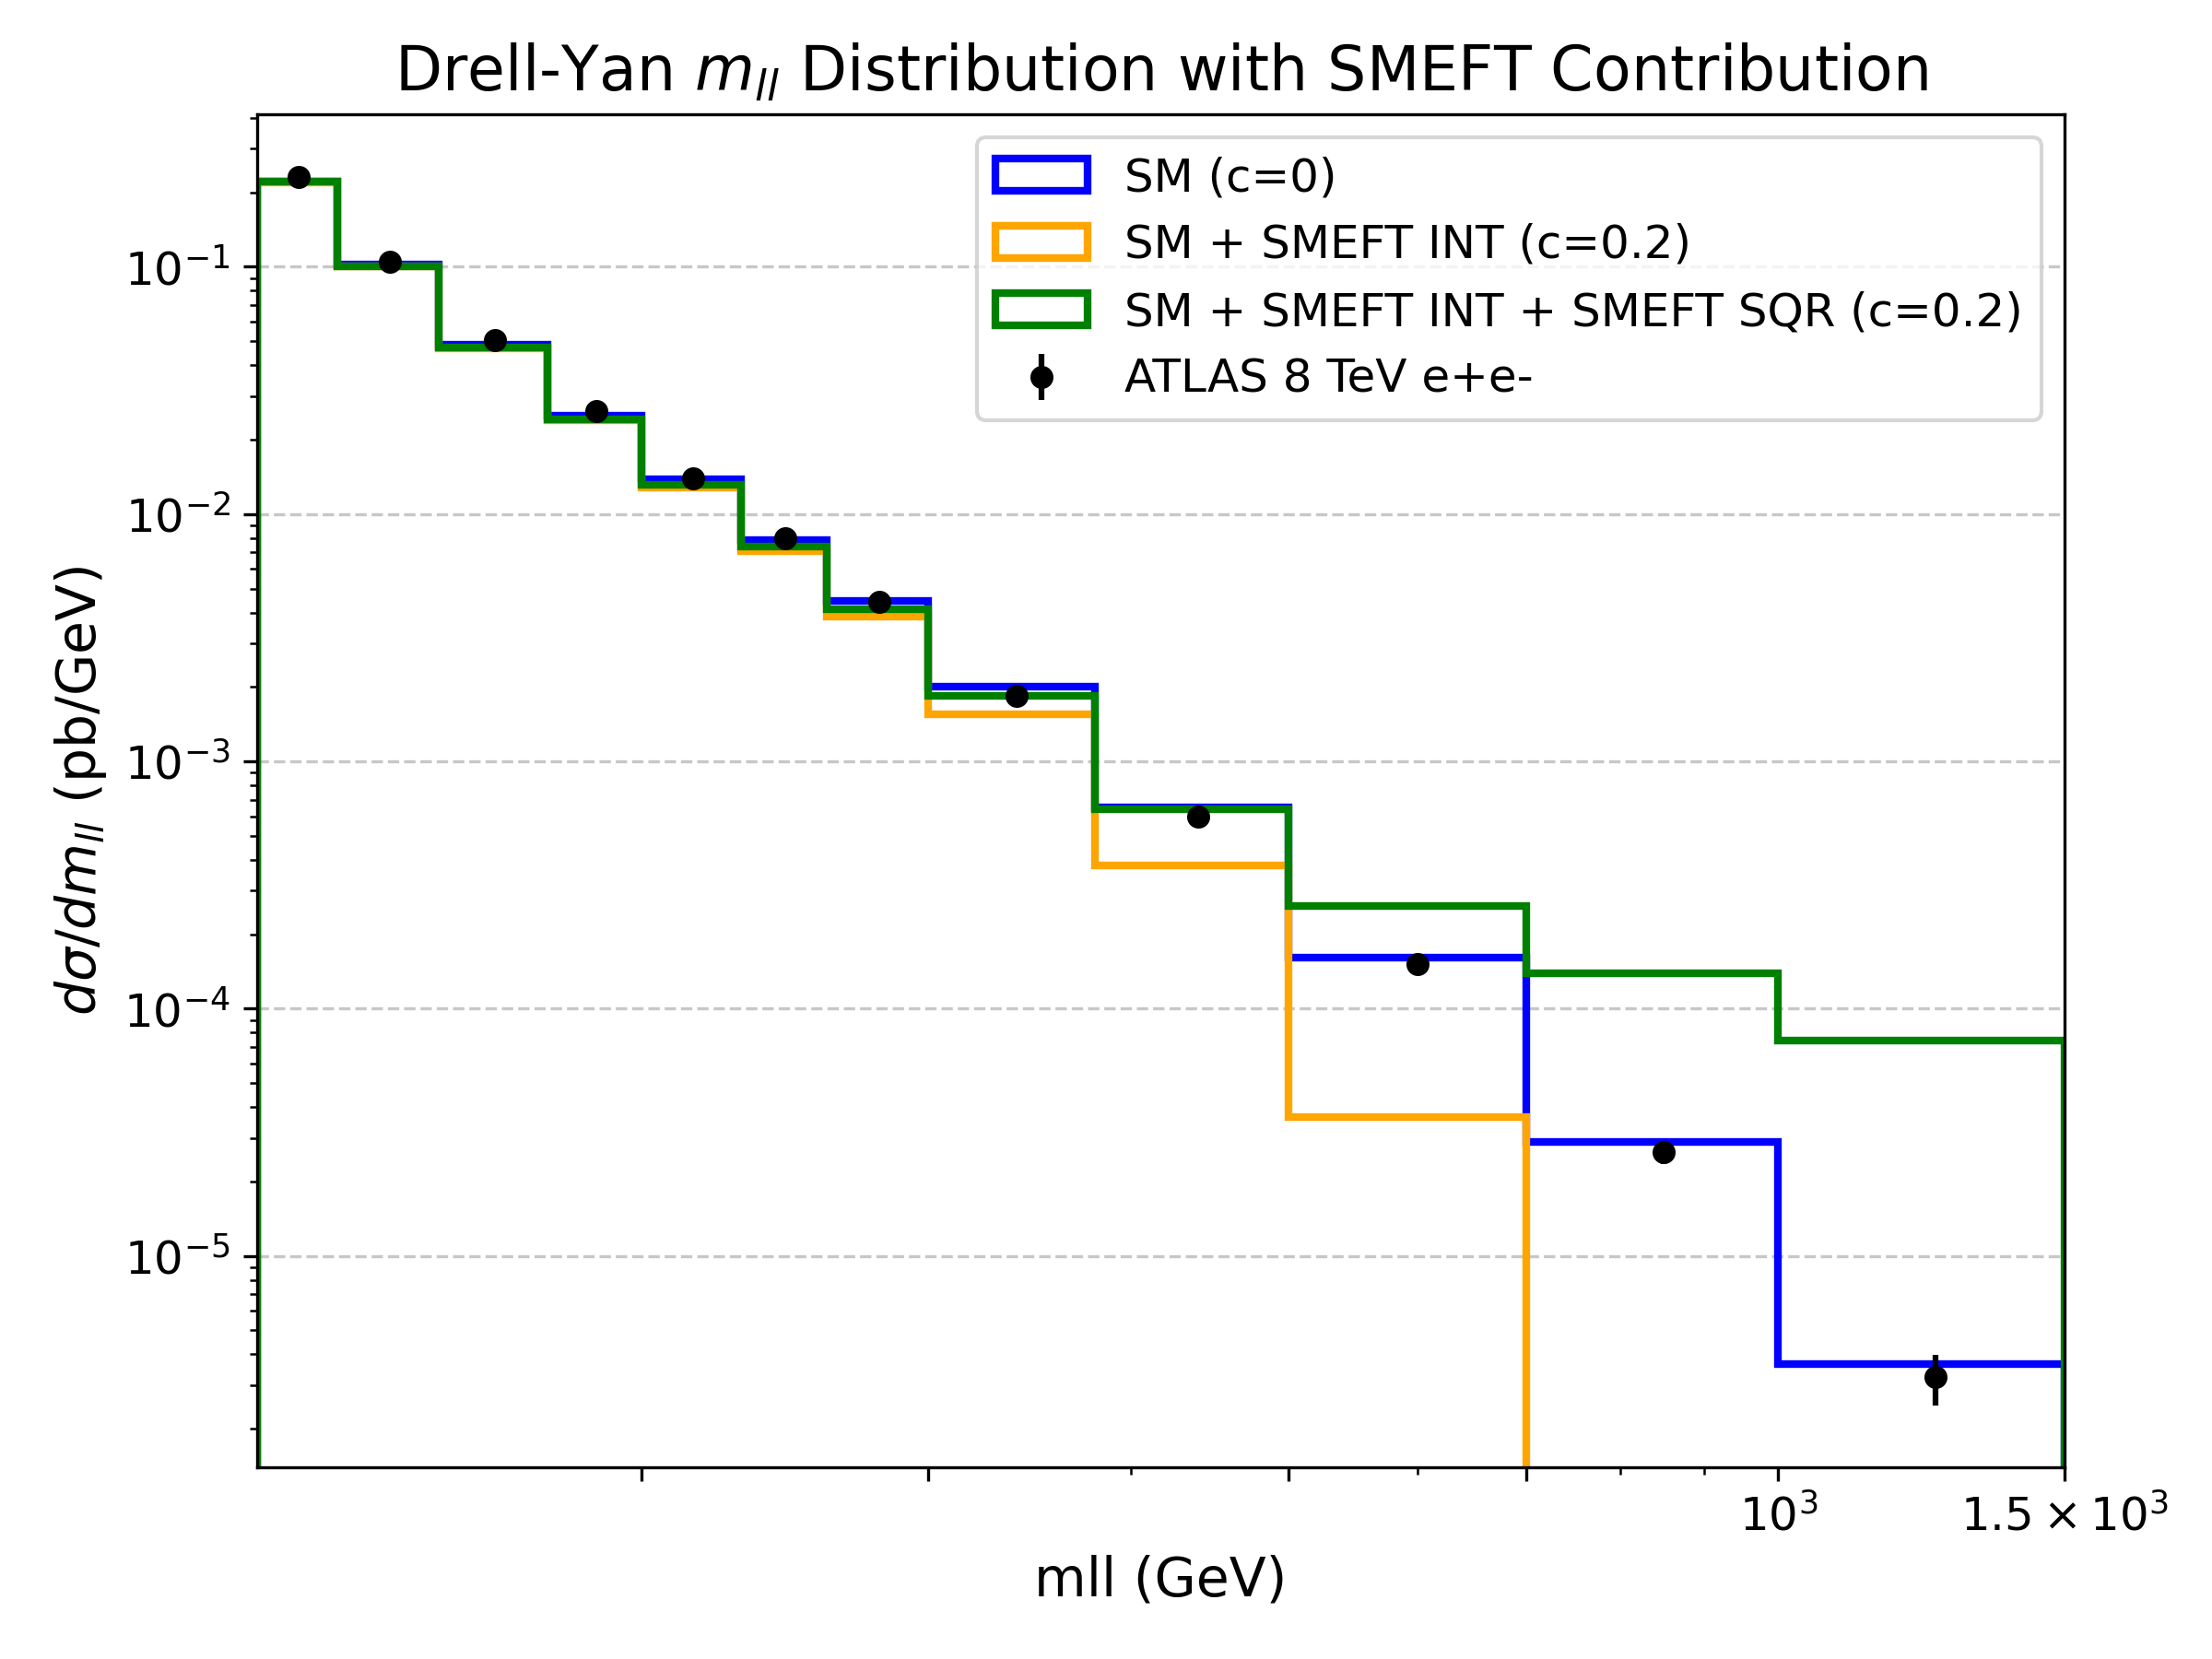
Including SMEFT Terms
Towards a global DY fit
At higher energies, data are more sensitive to 4-fermion SMEFT operators
We can vary c to fit the data

Slide 14



Fitting strategy
Towards a global DY fit
For the fit, we use the signal strenght µ:
And minimize the χ²:
Where:
C is a vector of the Wilson coefficients
V is the full covariance matrix
µ_{th} is defined as:

Slide 15
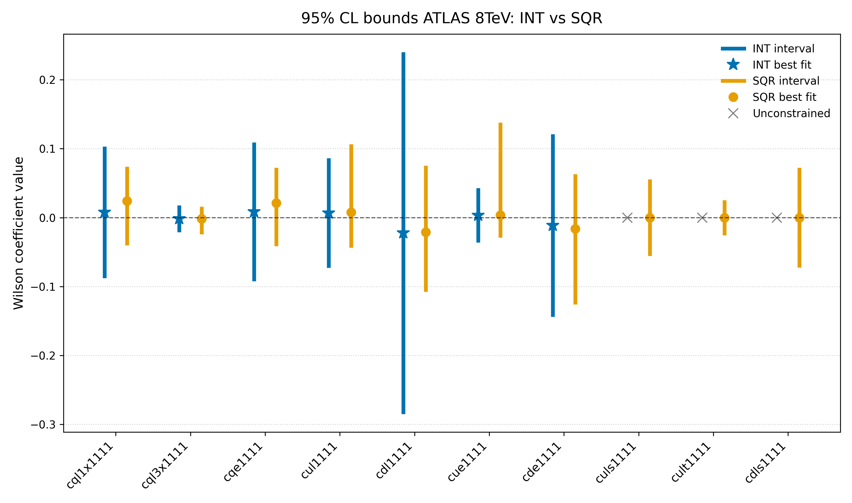
Preliminary SMEFT constraints from Drell–Yan
Towards a global DY fit
Two SMEFT fits
one retaining only interference (INT) terms
one including also quadratic (SQR) contributions
Input observable
Single-differential Drell–Yan cross section dσ/dm from arXiv:1606.01736
Fit setup
One Wilson coefficient at a time, all others set to zero

Slide 16
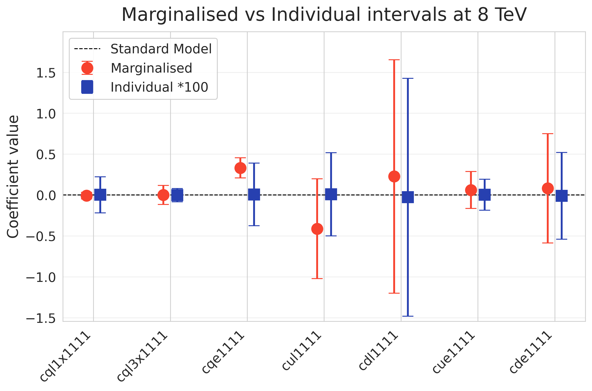
Preliminary SMEFT constraints from Drell–Yan
Towards a global DY fit
Input observable
Double-differential Drell–Yan cross sections (from arXiv:1606.01736)
Fit setup
Interference terms only (INT)
Treatment of Wilson coefficients
individual fits: one coefficient at a time
marginalised fit: all coefficients varied simultaneously

Slide 17
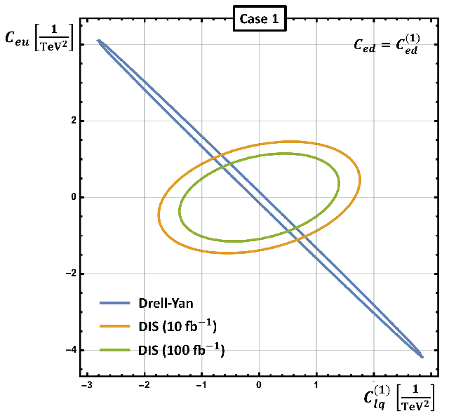
Flat Directions
Towards a global DY fit
A common issue in Drell–Yan SMEFT fits
Flat directions in the Wilson coefficient parameter space
Origin of flat directions
One coefficient, or a linear combination of coefficients, remains unconstrained or weakly constrained by the data
Strategies to resolve flat directions
Additional observables (e.g. forward–backward asymmetry, angular coefficients)
Increased differential information (double- or fully-differential distributions)
Complementary processes (e.g. charged Drell–Yan, low-energy measurements
Boughezal et al arXiv:2004.00748

Slide 18

Conclusions and Outlook
Conclusions and Outlook
Conclusions
Presented first results from a SMEFT fit to ATLAS 8 TeV double-differential Drell–Yan data
Compared individual and marginalised constraints at interference level
Highlighted the role of flat directions in DY-only fits
Outlook
Implement a fitting framework based on analytic EFT predictions
Address flat directions by including:
Low-energy observables
Charged Drell–Yan measurements
+
*
⁺ arXiv:1706.03783
*arXiv:2502.12250v1

Slide 19
Thank you for your attention!
Conclusions and Outlook

Slide 20
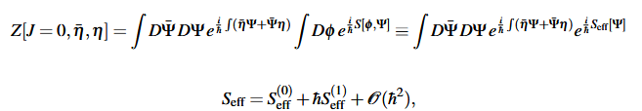

Matching Amplitudes
A Useful Toy Model
In order to understand the procedure it is useful to look at the generating function:
Recalling that it is possible to evaluate the amplitude from Z through the LSZ formulae:
S_{eff}⁽⁰⁾ describes an EFT that reproduces all tree-level amplitudes of fermions in the full theory
S_{eff}⁽¹⁾ describes all 1-loop corrections
And so on...

Slide 21




Matching Amplitudes
A Useful Toy Model
Let's focus on the tree-level effective action S_{eff}⁽⁰⁾ and assume:
The Lagrangian equation of the full theory with respect to Φ will be:
We can solve this equation using a perturbative expansion:
And obtain:

Slide 22
Matching Amplitudes
A Useful Toy Model
We can now use this result in the starting generating functional to obtain the complete effective action at tree level:
The first dim-6 term is the same as the one obtained from the 4-fermions elastic scattering
The other terms capture all possible tree-level amplitudes
The EFT contains an infinite number of non-renormalizable interactions
The coefficients before each operator are a specific function of the full theory parameters
Here, a complete matching procedure was possible because we knew the full theory

Slide 23
Summary of the SMEFT approach
SMEFT Effects in Drell–Yan
Contrary to the toy model, we don't know the full theory
A matching procedure for the Wilson coefficients is not possible
All dim-6 and dim-8 SMEFT operators have been categorized⁺
We can include them in our calculations and try to constrain the Wilson coefficients
A non-zero Wilson coefficient would suggest new physics
The SMEFT is not a final theory, but a framework that may offer hints about the underlying one
At new physics energy, it will break and a new theory will be needed
⁺DOI: 10.1016/0550-3213(86)90262-2 , arXiv:1008.4884v3, DOI: 10.1007/JHEP10(2020)174, DOI: 10.1103/PhysRevD.104.015026

Slide 24

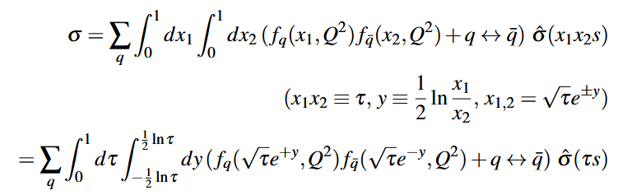


Differential Cross Section in DY
Results and Interpretations
The hadronic differential cross section in cos⁡θ is obtained by integrating over PDFs:
To express σ in terms of the invariant mass, we perform a change of variables:
We obtain this result for the single differential cross section:

Slide 25
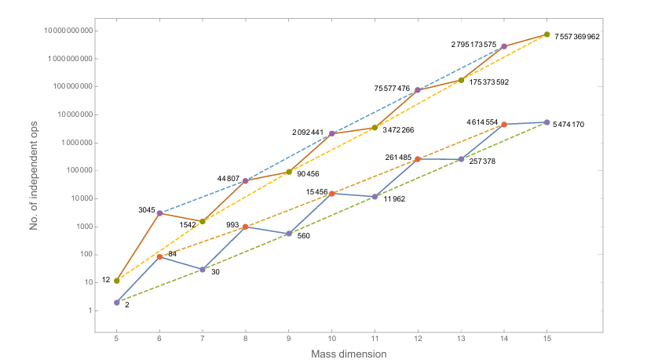
How many SMEFT operators?
Back-up slides
Growth of the number of independent operators in the SM EFT up to mass dimension 15. Points joined by the lower solid line are for one fermion generation; those joined by the upper solid line are for three generations. Dashed lines are to guide the eye to the growth of the even and odd mass dimension operators in both cases.
Ref: arXiv:1512.03433v2

Slide 26
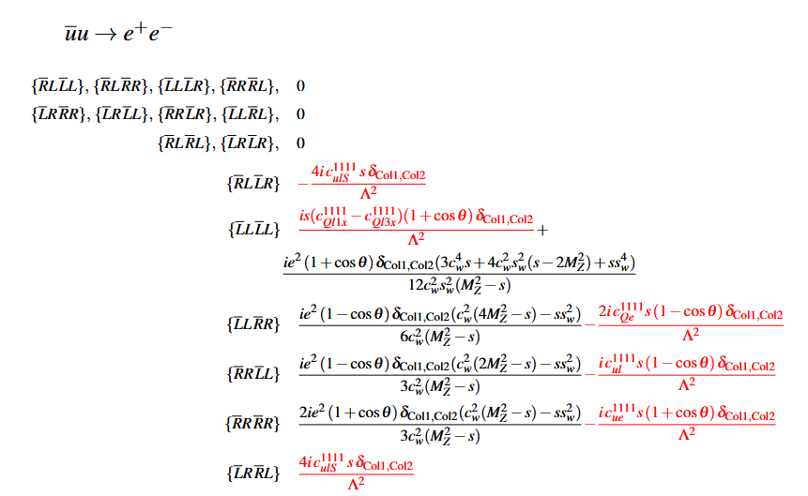
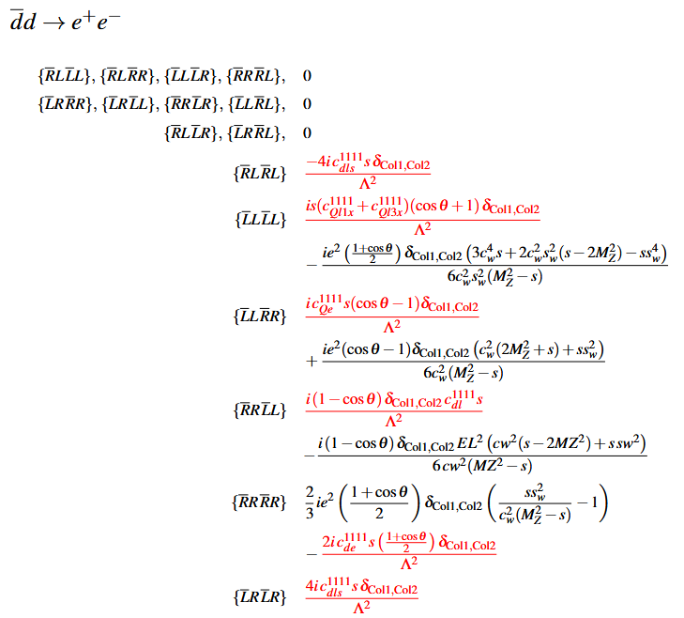
Helicity Amplitudes
Results and Interpretations
These are the subprocesses helicity amplitudes at order ~1/Λ²
(SM is marked in black, interference terms are in red)

Slide 27
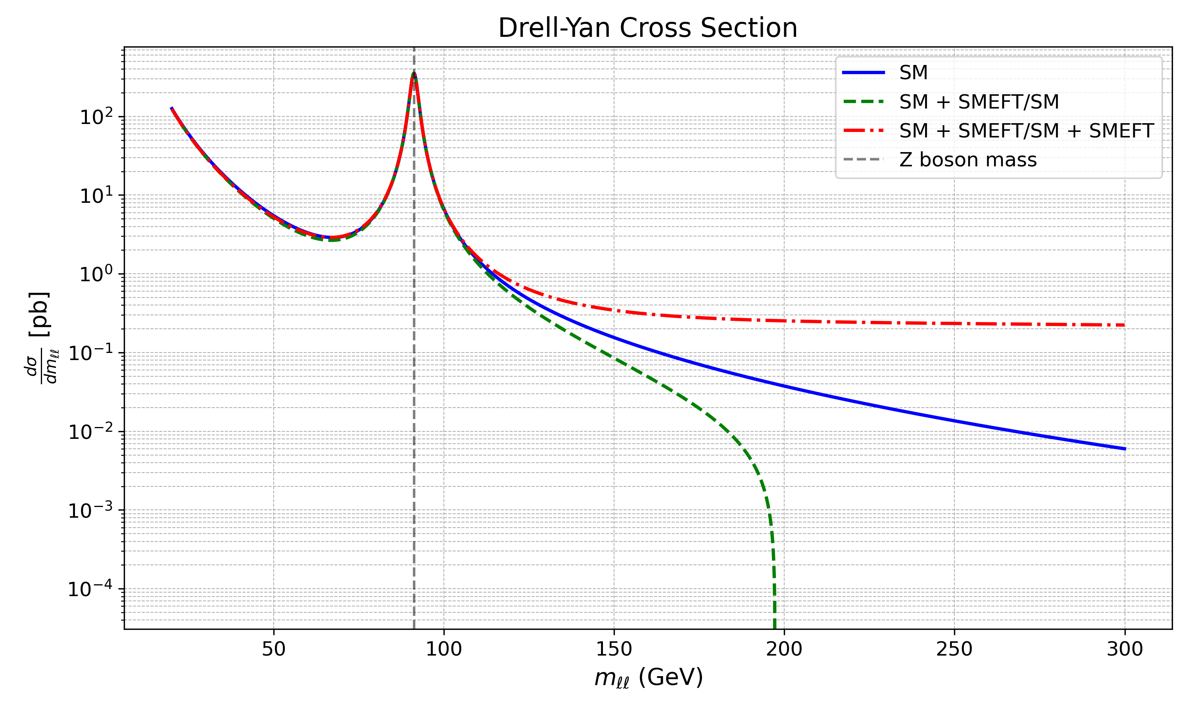
Differential Cross Section: p p e⁺e⁻
Results and Interpretations
In this plot Λ = 1TeV, c_{Ql(1)}¹¹¹¹ =10
Effects from the SMEFT operators are relevant at high m_{ll}
Results up to 1/Λ² are negative at high m_{ll} for the chosen Wilson coefficient

Slide 28
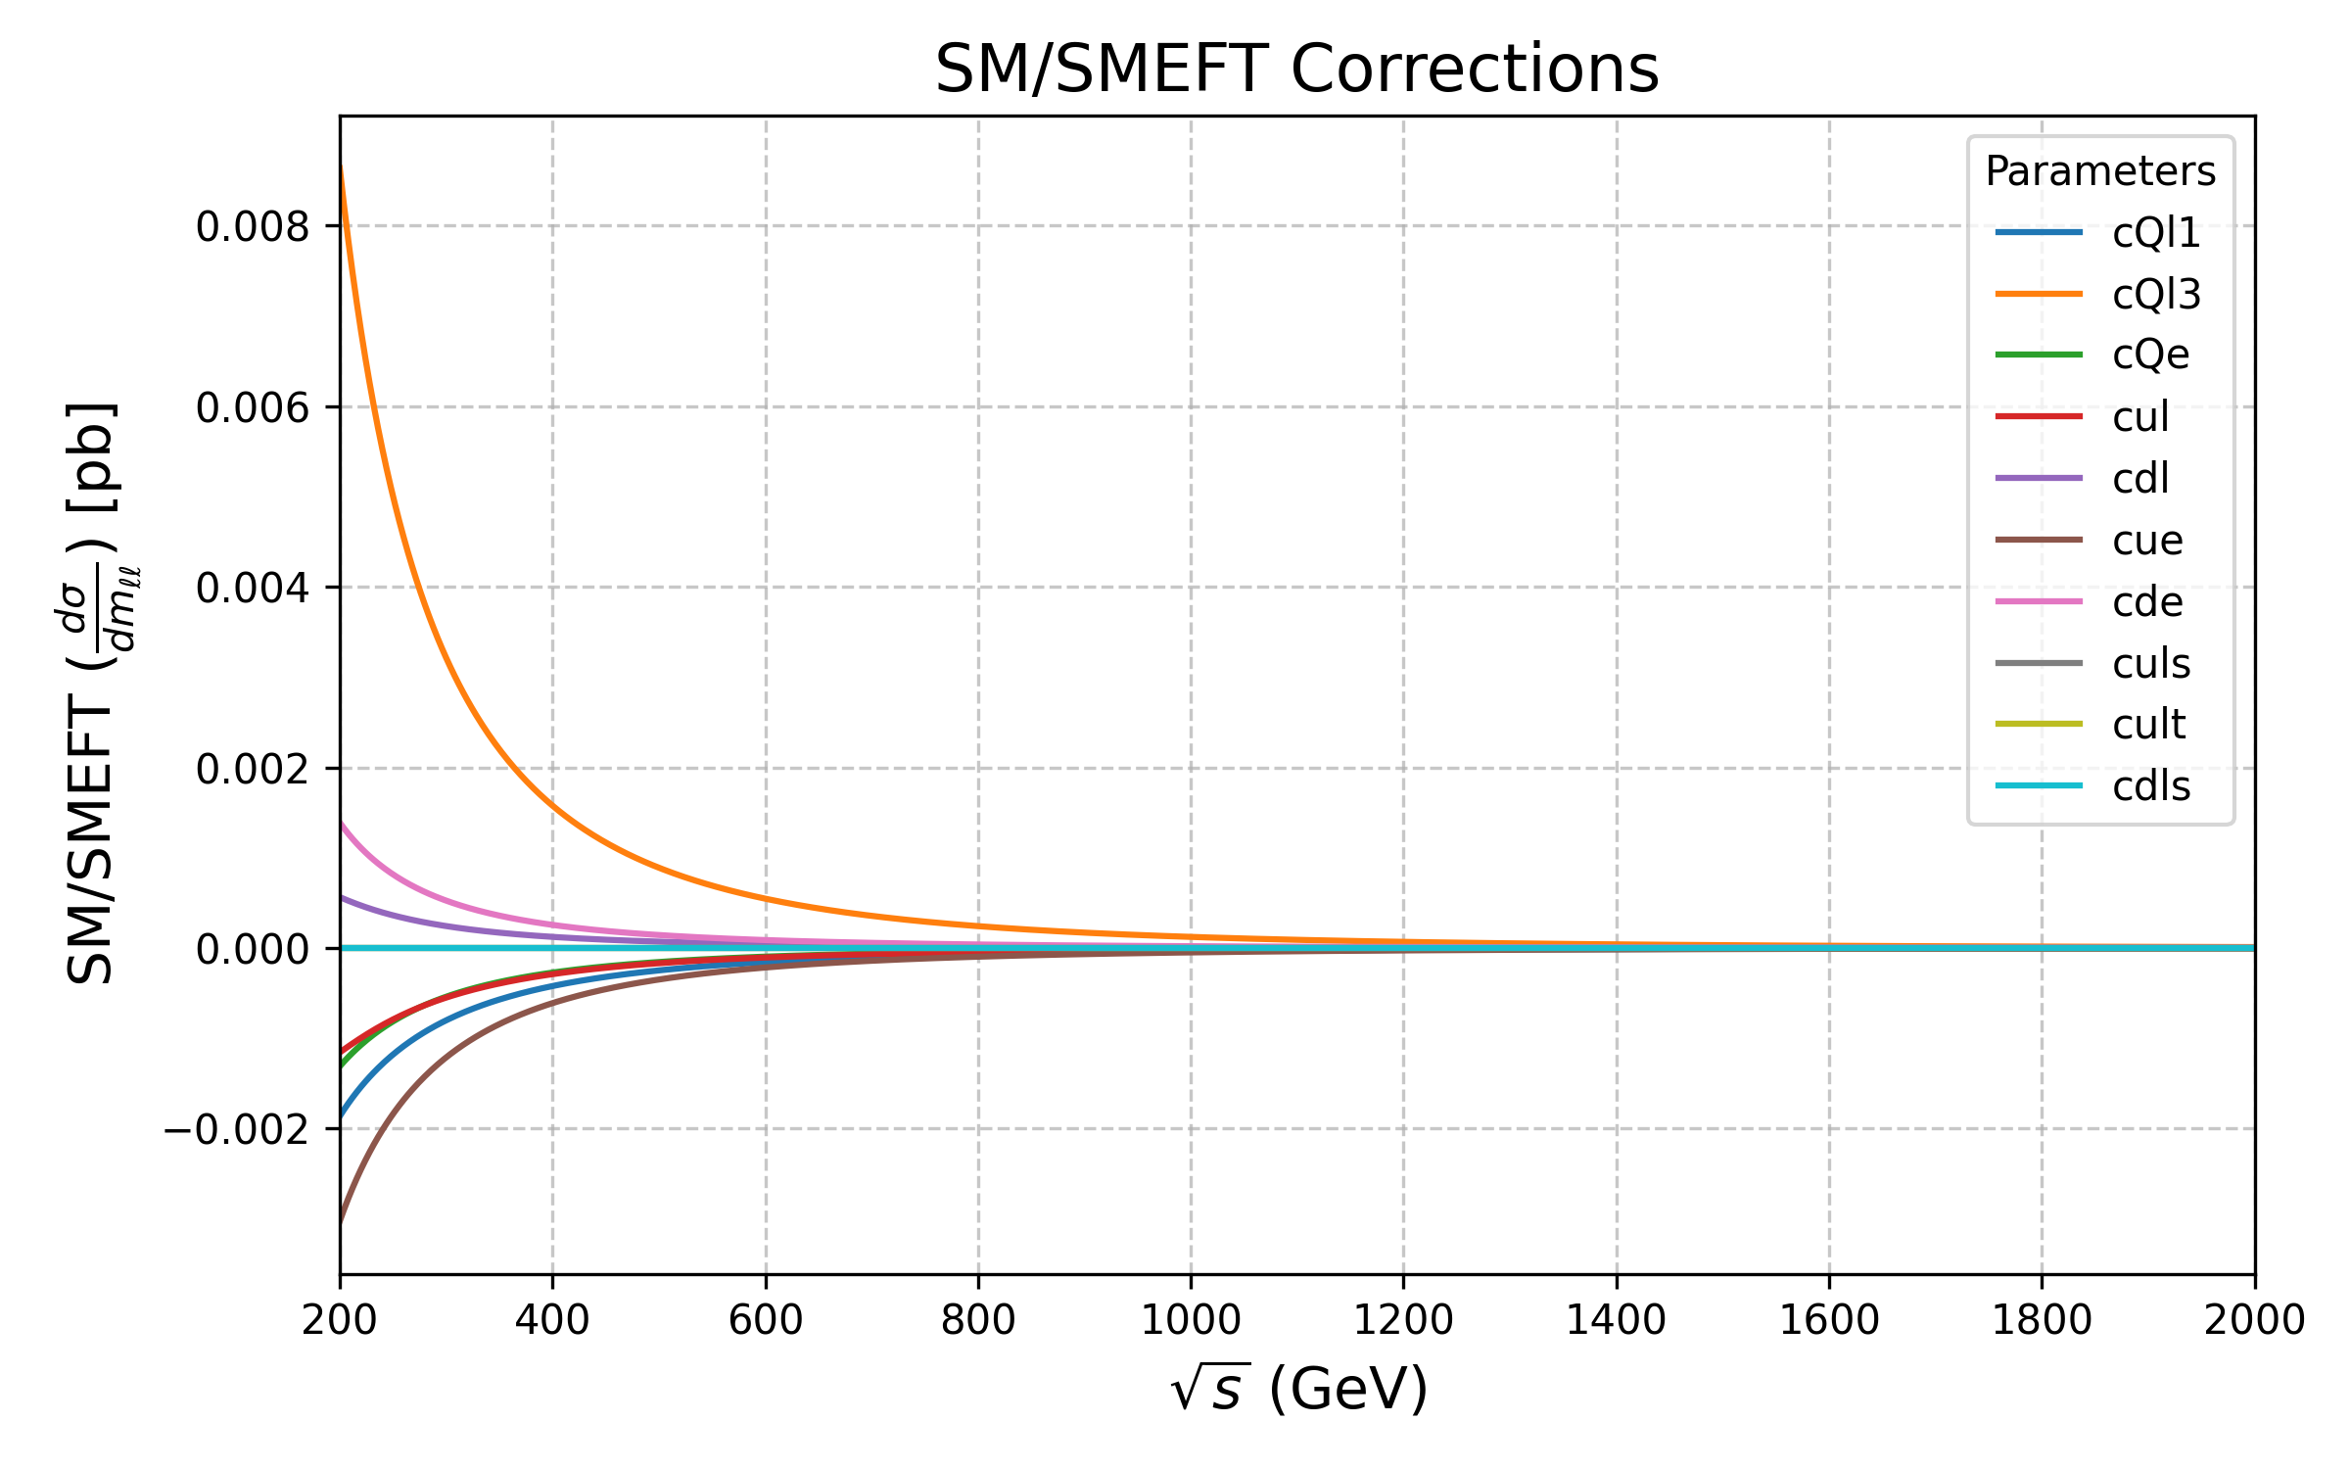
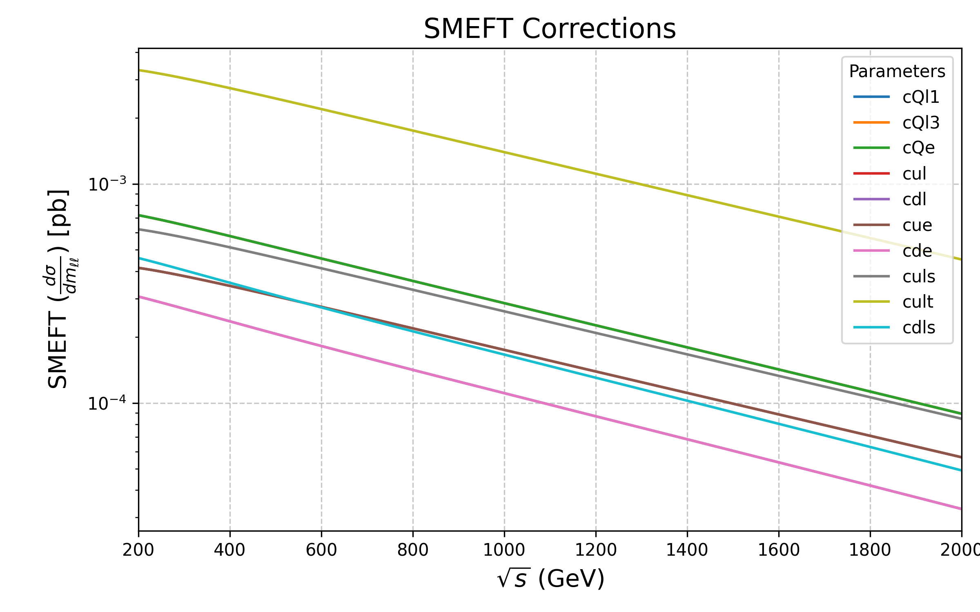
SMEFT Contributions: p p e⁺e⁻
Results and Interpretations
Each class of operators is tested by setting its coefficient to 0.5, while the others are set to zero
Some interference terms are identically zero
Both the interference and the squared contributions go to zero at high energy due to PDFs

Slide 29
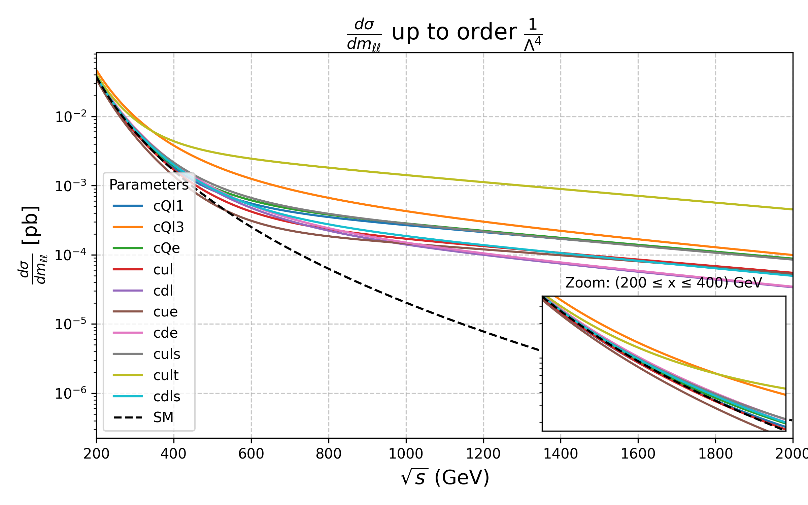
Results and Interpretations
Differential Cross Section: p p e⁺e⁻
Summing these contributions to the SM, we obtain:

Slide 30
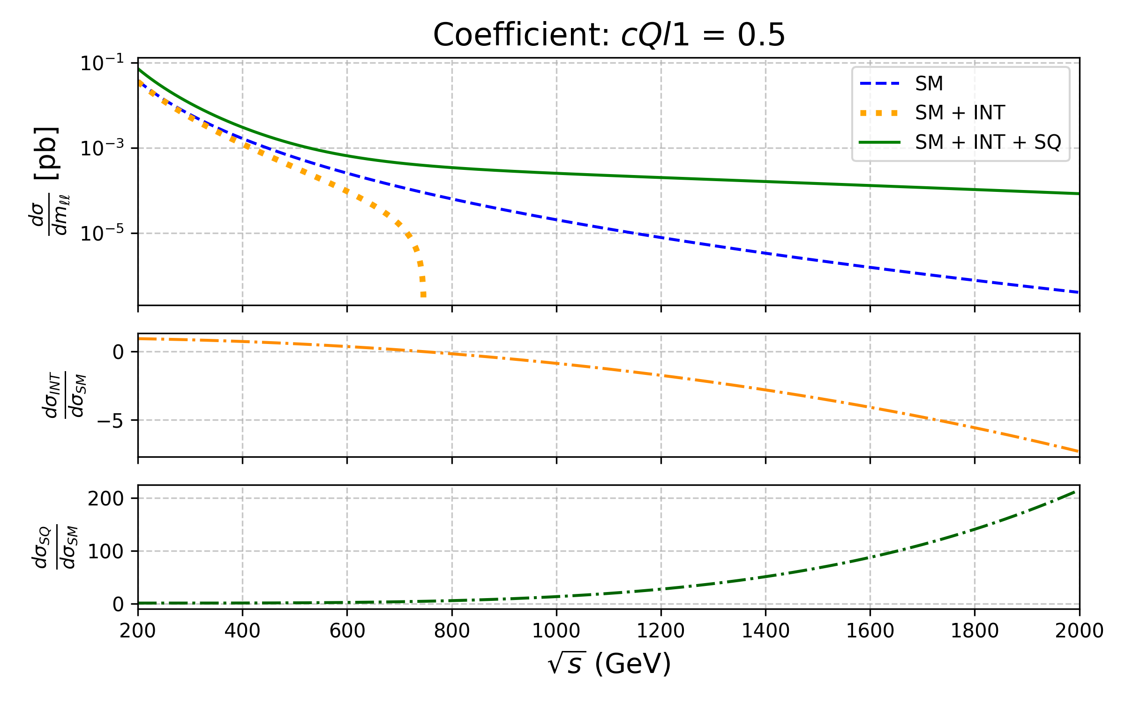


Relative impact of the SMEFT contributions
Results and Interpretations
In this plot Λ = 1TeV, c_{Ql(1)} = 0.5
The second panel displays the ratio:
The third panel displays the ratio:
In both cases the absolute value of the ratio increases at high energy
This makes these operators of particular interest

Slide 31
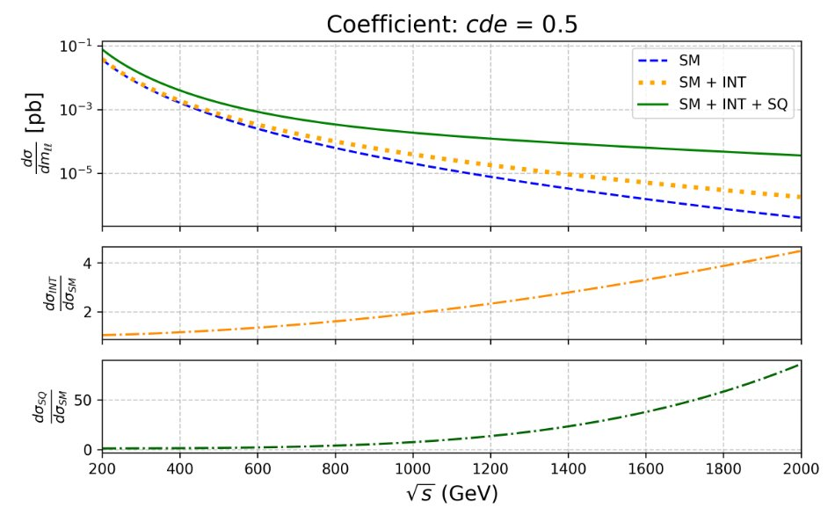
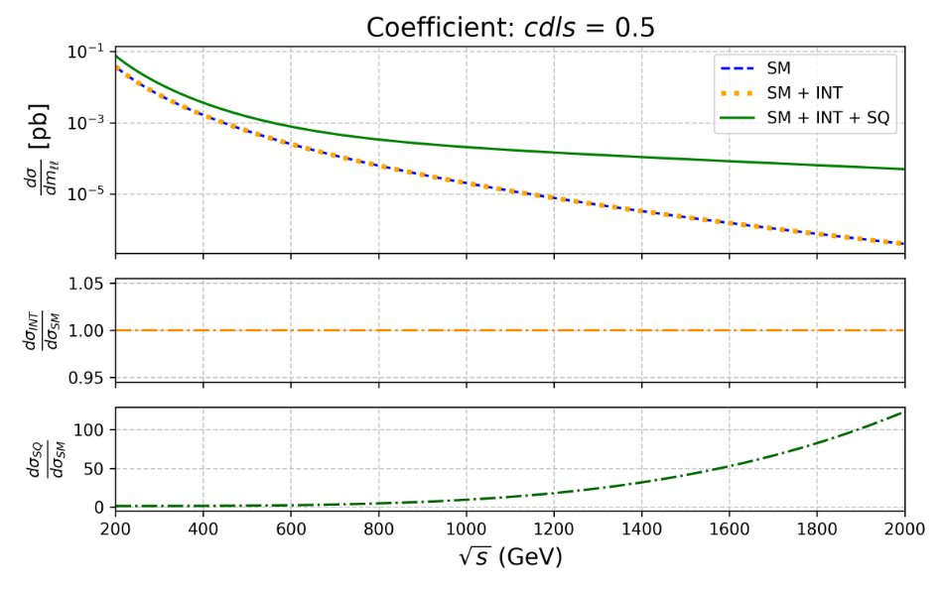
Relative impact of the SMEFT contributions
Results and Interpretations
The same plot can be replicated for all operators:
The operators shown here yield, respectively, positive and zero interference terms
This, once again, shows a ratio that increases with energy

Slide 32
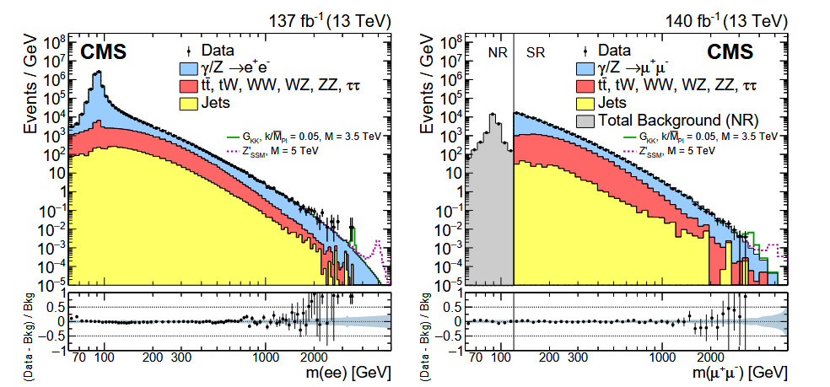
Conclusions
Conclusions and Outlook
I have shown analytic calculations of helicity amplitudes for different subprocesses
I used these results to compute a single differential cross section, which allows for future predictions at collider energies
The results have been validated with MadGraph5 aMC@NLO ⁺ and require less computational resources than a Monte Carlo simulation to be produces
arXiv:2103.02708v2
⁺ arXiv:1405.0301

