Slide 1
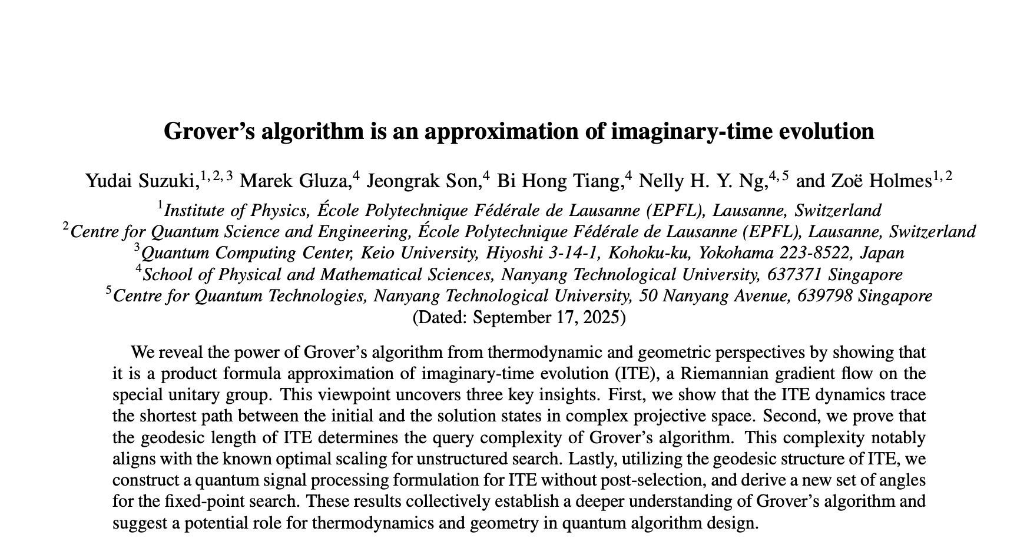
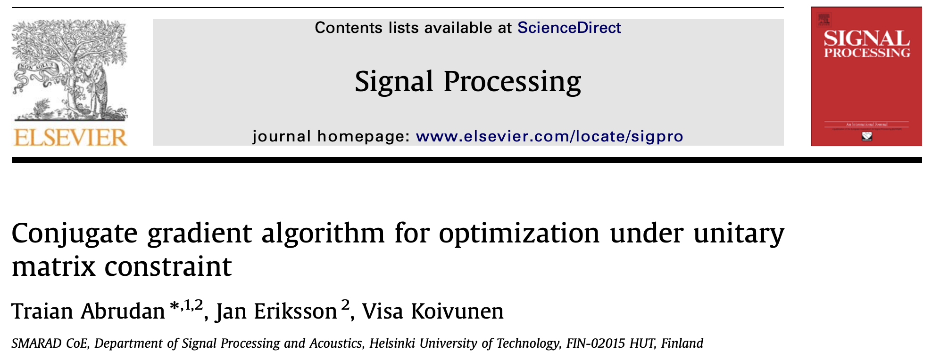

Optimisation on Riemannian Manifolds & Quantum Algorithms
Big Picture
Objective
Andres Arcia Lopez
andres.arcialopez@ntu.edu.sg
Notes:
Say greetings and introduce myself: I’m Andres, I just graduated from Cambridge, where I completed my master's degree in Maths. There, I focused on theoretical physics and took general relativity and quantum field theory-related courses. I’ve also done a bit of Quantum Computing during my undergrad and also through a summer school with the Wolfram Institute.
Now I am working with Cyrus and Marek on a project that aims to shed light on the design and understanding of quantum algorithms through the lens of optimisation on Riemannian manifolds.

Slide 2
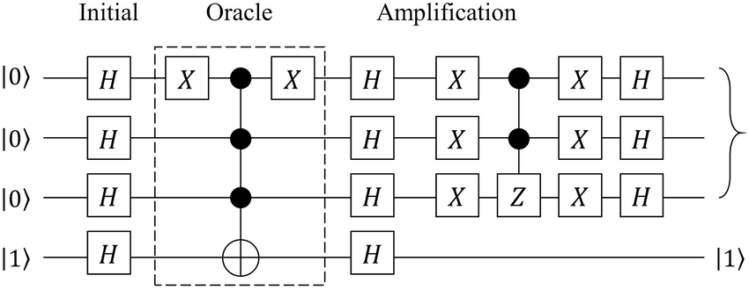
Optimisation on Riemannian Manifolds & Quantum Algorithms
Quantum algorithms are confusing and unintuitive.
Big Picture
Objective
Andres Arcia Lopez
andres.arcialopez@ntu.edu.sg
Notes:
Say greetings and introduce myself: I’m Andres, I just graduated from Cambridge, where I completed my master's degree in Maths. There, I focused on theoretical physics and took general relativity and quantum field theory-related courses. I’ve also done a bit of Quantum Computing during my undergrad and also through a summer school with the Wolfram Institute.
PRESS
Now I am working with Cyrus and Marek on a project that aims to shed light on the design and understanding of quantum algorithms through the lens of optimisation on Riemannian manifolds.

Slide 3
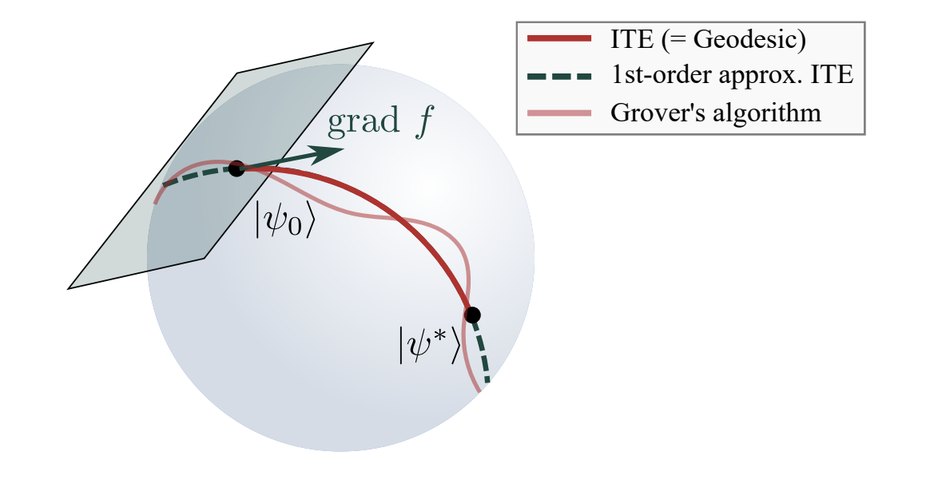
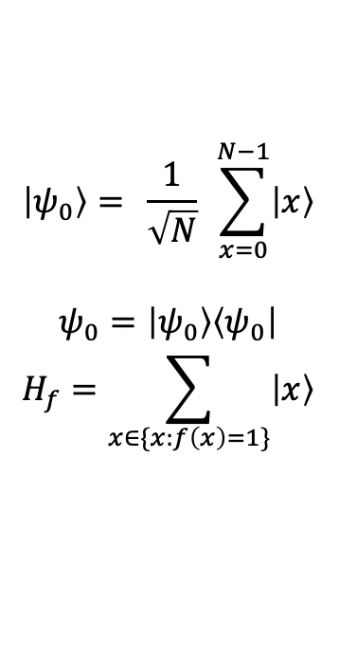
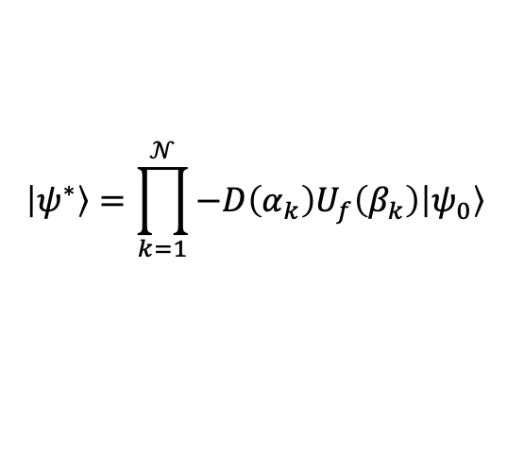
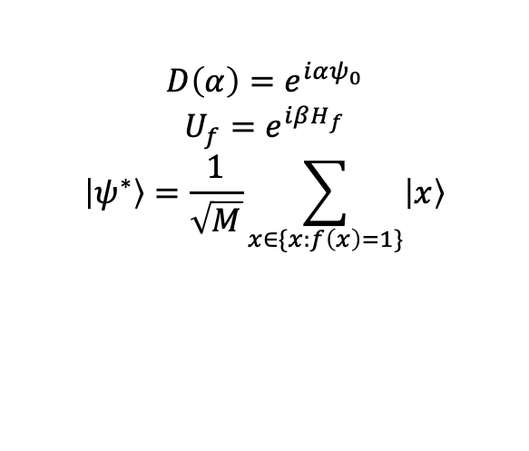
Optimisation on Riemannian Manifolds & Quantum Algorithms
Objective
Big Picture
Quantum algorithms are confusing and unintuitive.
$$\left|ψ_{0}\right\rangle = \frac{1}{\sqrt{N}} \sum_{x=0}^{N−1}{\left|x\right\rangle }$$
$$ψ_{0}=\left|ψ_{0}\right\rangle \left\langle ψ_{0}\right|$$
$$H_{f}=\sum_{x∈\{x:f\left(x\right)=1\}}{\left|x\right\rangle }$$
$$D\left(α\right)=e^{iαψ_{0}}$$
$$U_{f}=e^{iβH_{f}}$$
$$\left|ψ^{∗}\right\rangle =\frac{1}{\sqrt{M}}\sum_{x∈\{x:f\left(x\right)=1\}}{\left|x\right\rangle }$$
$$\left|ψ^{∗}\right\rangle =\prod_{k=1}^{𝒩}{−D\left(α_{k}\right)U_{f}\left(β_{k}\right)\left|ψ_{0}\right\rangle }$$
Andres Arcia Lopez
andres.arcialopez@ntu.edu.sg
Notes:
Quantum algorithms are unintuitive to understand, and it is difficult to see what aspect makes them succeed. Something Dr Gluza mentions in his paper is that after decades of research, we have remarkably few classes of quantum algorithms. One of these classes encompasses unstructered search problems. A key algorithm in this class is Grover’s algorithm, which serves as a template for other algorithms within this class. This class is important because it provides a quadratic speed up to its classical counter part.
Compared to the hardware side of quantum computing, “quantum software” has lagged behind, with no newclasses of algorithms proposed since 1995. In part, this is due to the lack of a unifying framework to uncover the key factors for the success of algorithms like Grover’s.

Slide 4
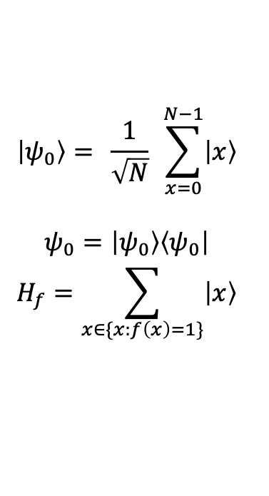
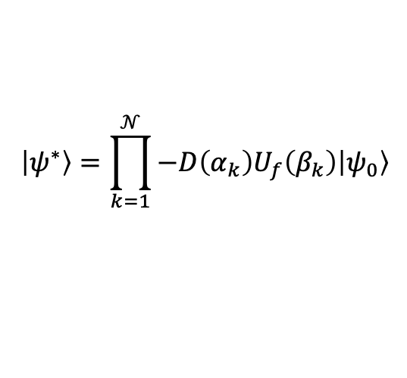
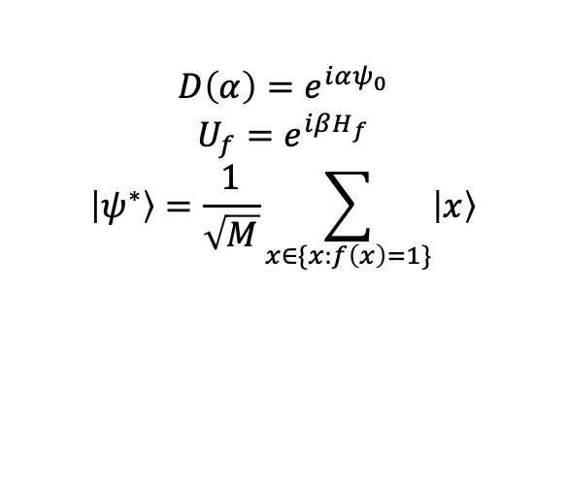
Optimisation on Riemannian Manifolds & Quantum Algorithms
Quantum algorithms are confusing and unintuitive.
Objective
Big Picture
$$\left|ψ_{0}\right\rangle = \frac{1}{\sqrt{N}} \sum_{x=0}^{N−1}{\left|x\right\rangle }$$
$$ψ_{0}=\left|ψ_{0}\right\rangle \left\langle ψ_{0}\right|$$
$$H_{f}=\sum_{x∈\{x:f\left(x\right)=1\}}{\left|x\right\rangle }$$
$$D\left(α\right)=e^{iαψ_{0}}$$
$$U_{f}=e^{iβH_{f}}$$
$$\left|ψ^{∗}\right\rangle =\frac{1}{\sqrt{M}}\sum_{x∈\{x:f\left(x\right)=1\}}{\left|x\right\rangle }$$
$$\left|ψ^{∗}\right\rangle =\prod_{k=1}^{𝒩}{−D\left(α_{k}\right)U_{f}\left(β_{k}\right)\left|ψ_{0}\right\rangle }$$
Andres Arcia Lopez
andres.arcialopez@ntu.edu.sg
Notes:
Explain briefly Grover’s algorithm.
So, how do we frame a search problem in the context of quantum computing?

Slide 5
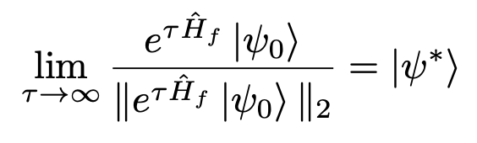
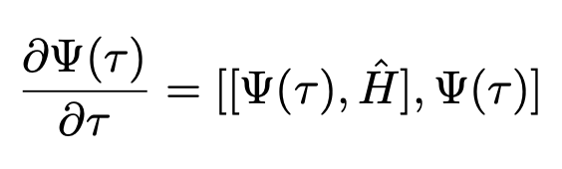
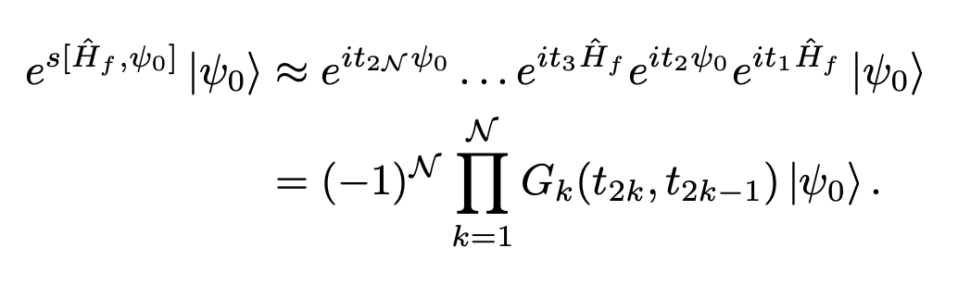
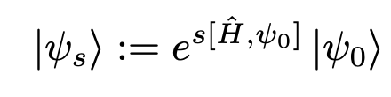
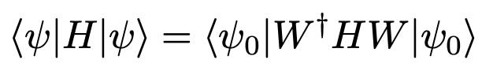
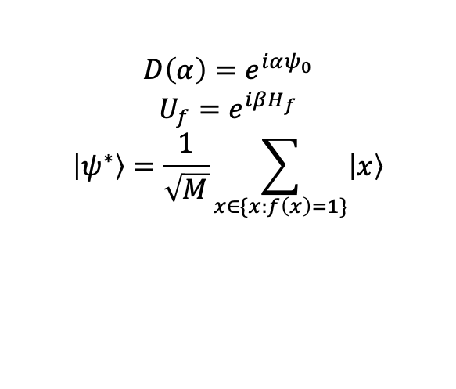
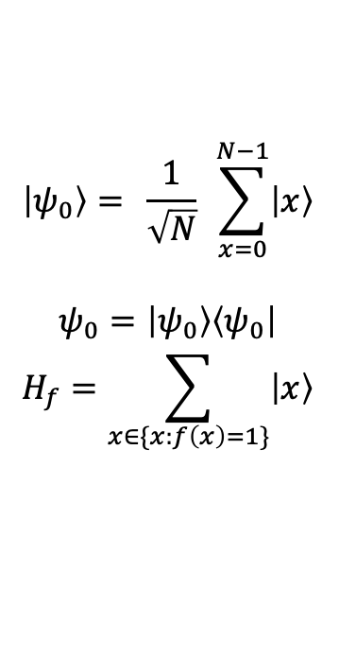
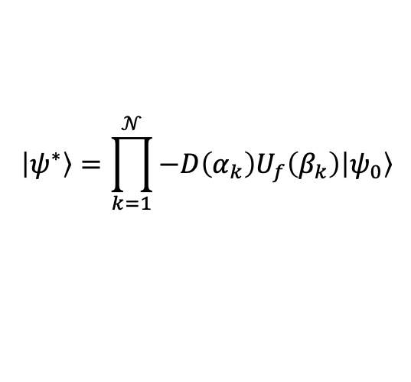
Optimisation on Riemannian Manifolds & Quantum Algorithms
Objective
Big Picture
$$\left|ψ_{0}\right\rangle = \frac{1}{\sqrt{N}} \sum_{x=0}^{N−1}{\left|x\right\rangle }$$
$$ψ_{0}=\left|ψ_{0}\right\rangle \left\langle ψ_{0}\right|$$
$$H_{f}=\sum_{x∈\{x:f\left(x\right)=1\}}{\left|x\right\rangle }$$
$$\left|ψ^{∗}\right\rangle =\prod_{k=1}^{𝒩}{−D\left(α_{k}\right)U_{f}\left(β_{k}\right)\left|ψ_{0}\right\rangle }$$
$$D\left(α\right)=e^{iαψ_{0}}$$
$$U_{f}=e^{iβH_{f}}$$
$$\left|ψ^{∗}\right\rangle =\frac{1}{\sqrt{M}}\sum_{x∈\{x:f\left(x\right)=1\}}{\left|x\right\rangle }$$
Andres Arcia Lopez
andres.arcialopez@ntu.edu.sg
Notes:
In Dr Gluza’s paper, they show that a natural framework for understanding quantum algorithms, and specifically Grover, is optimisation on Riemannian manifolds.
What Grover essentially achieves is that it gets you from your initial state psi_0 to a state that contains information about the elements you are interested in.
The idea is that ITE recovers the solution state of Grover’s algorithm. Notice that ITE is a solution to DBF, and that solutions to DBF can be approximated by the following equation.
PRESS
We can get rid of the commutator by using a product formula that in the end recovers Grover’s algorithm. Using this framework recovers key results like the optimal query complexity from geodesic length.
PRESS
Notice as well that this equation corresponds to the steepest descent direction of a least squares function corresponding to the energy of the state.

Slide 6
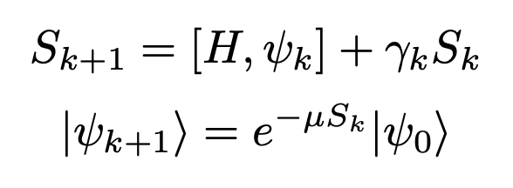
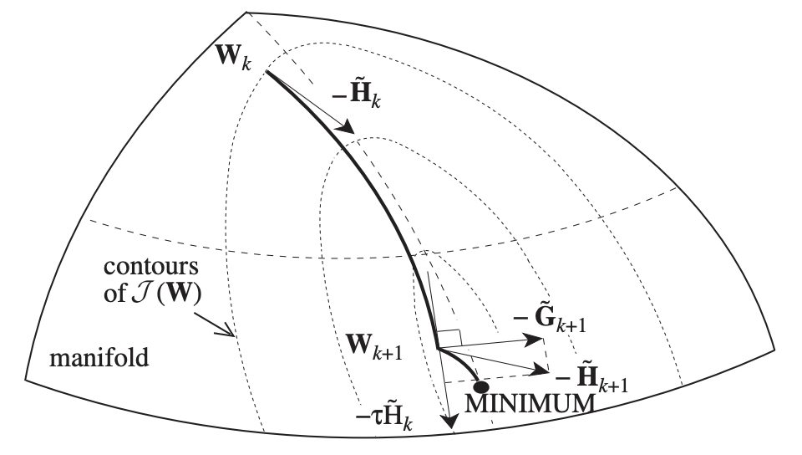
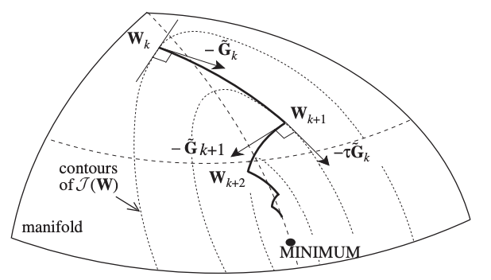
Optimisation on Riemannian Manifolds & Quantum Algorithms
Big Picture
Objective
Andres Arcia Lopez
andres.arcialopez@ntu.edu.sg
Notes:
Now that we have a direct link between optimisation on U(n) and quantum algorithms, we can explore other optimisation algorithms on our cost function. For example, CG. There is already work detailing how to do CG optimisation on U(n). The objective now would be to translate it into a QC perspective.

