Slide 1
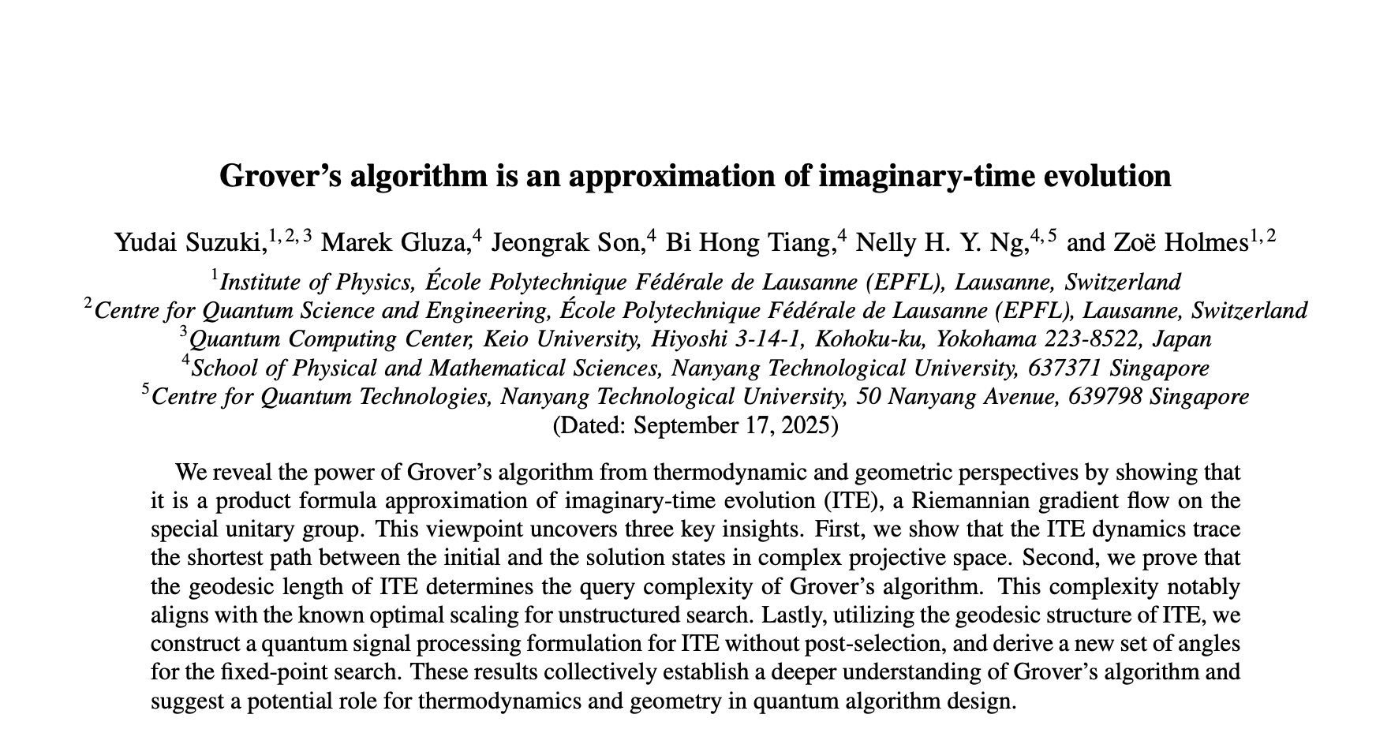
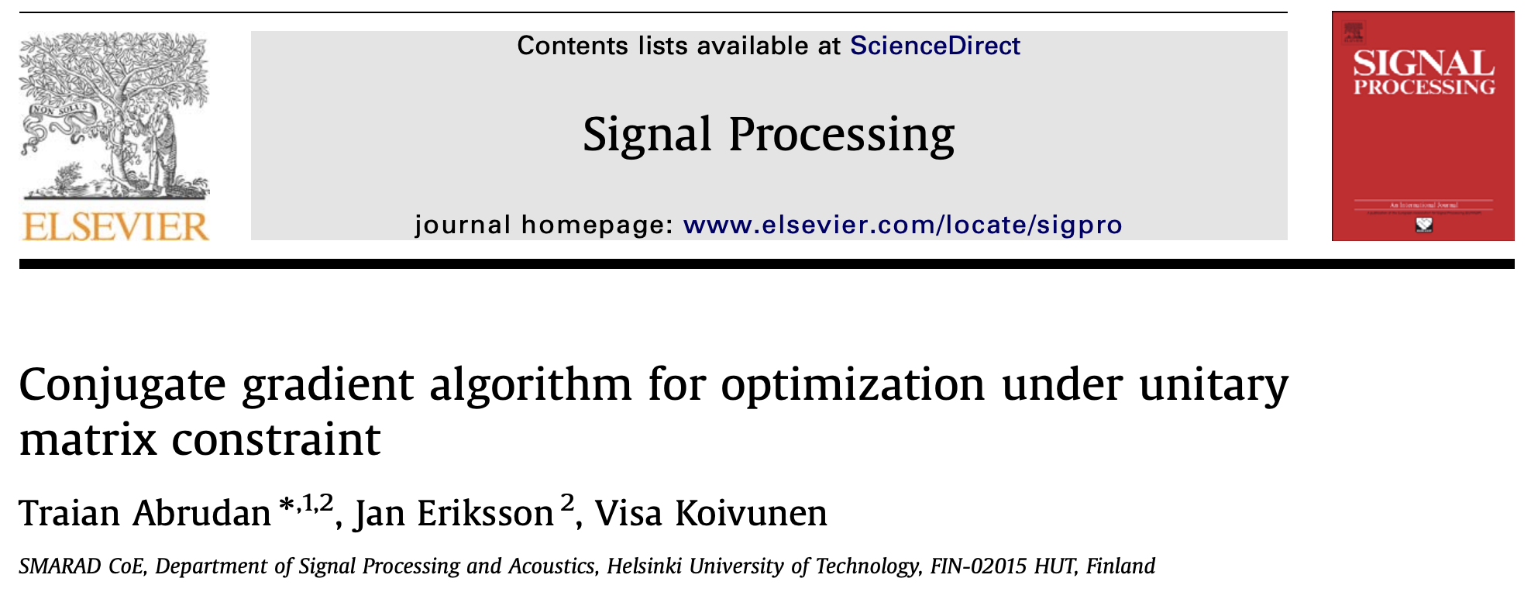

Optimisation on Riemannian Manifolds & Quantum Algorithms
Big Picture
Objective
Andres Arcia Lopez
andres.arcialopez@ntu.edu.sg
Professor Mostajeran, Dr Gluza
Notes:
Introduction:
Hello everyone, my name is Andres. Last month I started a research project at Nanyang Technological University in Singapore under the supervision of Professor Mostajeran and Dr Gluza. The project is still in its initial stage; but broadly, the aim is to shed light on the design and understanding of quantum algorithms through the lens of optimisation on Riemannian manifolds.
PRESS

Slide 2
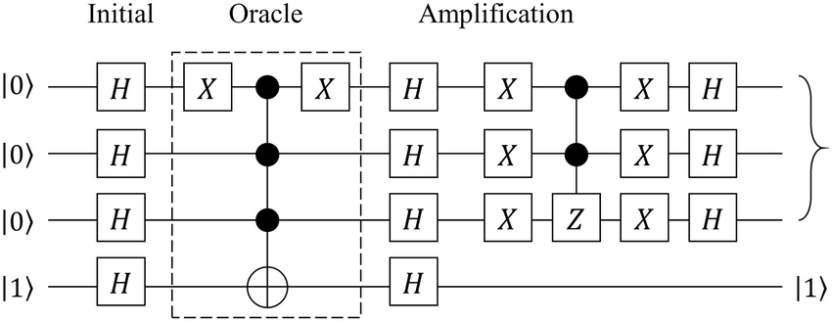
Optimisation on Riemannian Manifolds & Quantum Algorithms
Quantum algorithms are confusing and unintuitive.
Big Picture
Objective
Andres Arcia Lopez
andres.arcialopez@ntu.edu.sg
Notes:
During my talk, I will take you on the journey that links these two areas as outlined in the paper on the top right, in which Dr Gluza is a major contributor. My work so far mainly focuses on these two papers. Let’s start with some context.
PRESS

Slide 3
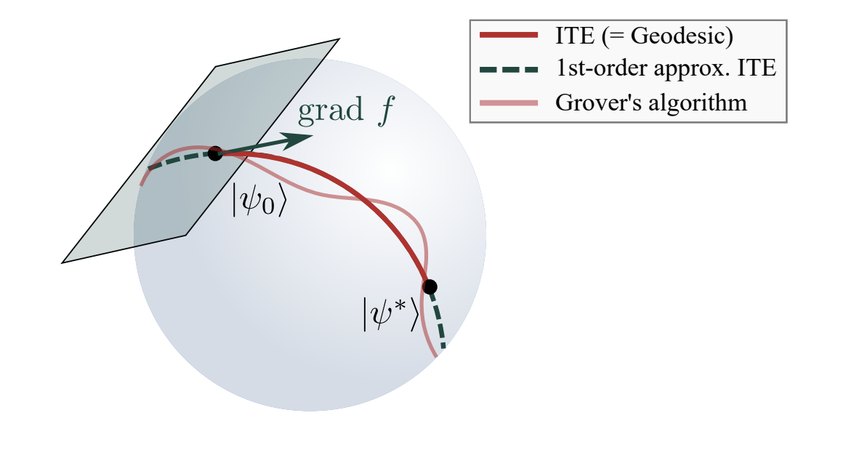
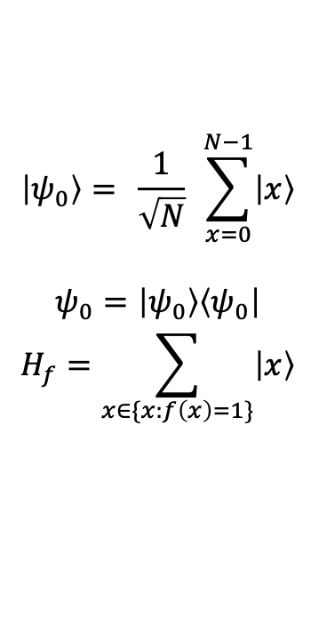
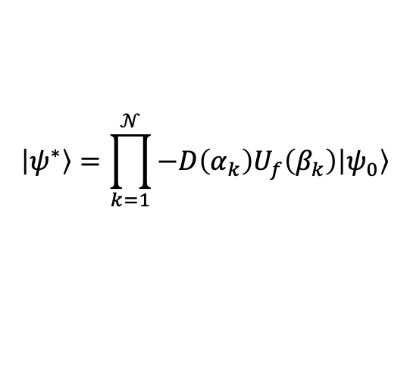
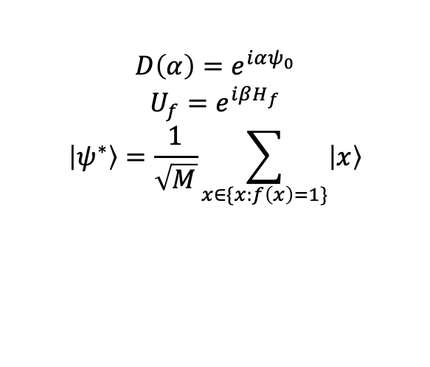
Optimisation on Riemannian Manifolds & Quantum Algorithms
Objective
Big Picture
Quantum algorithms are confusing and unintuitive.
$$\left|ψ_{0}\right\rangle = \frac{1}{\sqrt{N}} \sum_{x=0}^{N−1}{\left|x\right\rangle }$$
$$ψ_{0}=\left|ψ_{0}\right\rangle \left\langle ψ_{0}\right|$$
$$H_{f}=\sum_{x∈\{x:f\left(x\right)=1\}}{\left|x\right\rangle }$$
$$D\left(α\right)=e^{iαψ_{0}}$$
$$U_{f}=e^{iβH_{f}}$$
$$\left|ψ^{∗}\right\rangle =\frac{1}{\sqrt{M}}\sum_{x∈\{x:f\left(x\right)=1\}}{\left|x\right\rangle }$$
$$\left|ψ^{∗}\right\rangle =\prod_{k=1}^{𝒩}{−D\left(α_{k}\right)U_{f}\left(β_{k}\right)\left|ψ_{0}\right\rangle }$$
Andres Arcia Lopez
andres.arcialopez@ntu.edu.sg
Notes:
Famously, quantum algorithms are unintuitive to understand, and it is difficult to see what aspect makes them succeed, as in what makes them better than classical algorithms. Something Dr Gluza mentions in his paper is that after decades of research, we have remarkably few classes – building blocks - of quantum algorithms. One of these classes encompasses unstructured search problems. A key algorithm in this class is Grover’s algorithm, which serves as a template for other algorithms within this class. This class is important because it provides a quadratic speed up to its classical counterpart.
Compared to the hardware side of quantum computing, “quantum software” has lagged behind, with no new classes of algorithms proposed since 1995. In part, this is due to the lack of a unifying framework for uncovering the key factors behind the success of algorithms like Grover’s.
PRESS

Slide 4
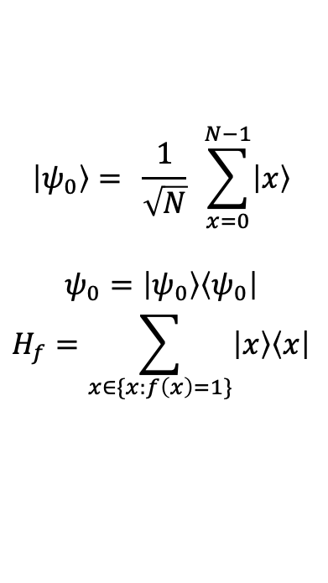
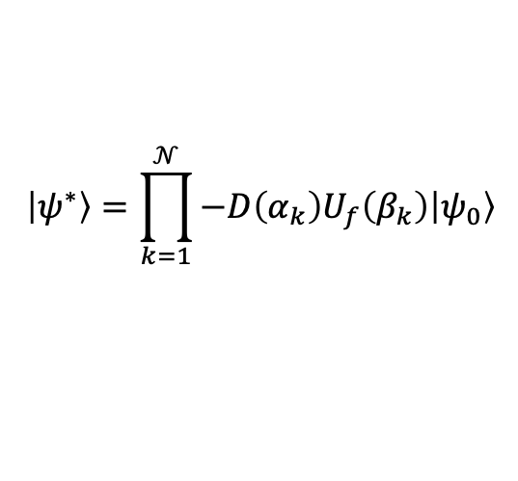
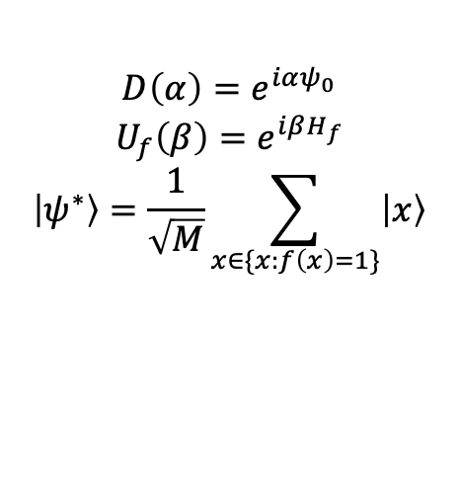
Optimisation on Riemannian Manifolds & Quantum Algorithms
Quantum algorithms are confusing and unintuitive.
Objective
Big Picture
$$\left|ψ_{0}\right\rangle = \frac{1}{\sqrt{N}} \sum_{x=0}^{N−1}{\left|x\right\rangle }$$
$$ψ_{0}=\left|ψ_{0}\right\rangle \left\langle ψ_{0}\right|$$
$$H_{f}=\sum_{x∈\{x:f\left(x\right)=1\}}{\left|x\right\rangle \left\langle x\right|}$$
$$D\left(α\right)=e^{iαψ_{0}}$$
$$U_{f}\left(β\right)=e^{iβH_{f}}$$
$$\left|ψ^{∗}\right\rangle =\frac{1}{\sqrt{M}}\sum_{x∈\{x:f\left(x\right)=1\}}{\left|x\right\rangle }$$
$$\left|ψ^{∗}\right\rangle =\prod_{k=1}^{𝒩}{−D\left(α_{k}\right)U_{f}\left(β_{k}\right)\left|ψ_{0}\right\rangle }$$
Andres Arcia Lopez
andres.arcialopez@ntu.edu.sg
Notes:
For context, let me briefly outline Grover’s algorithm. Imagine we have a set of N=2^n objects and we are interested in finding M of them.
We need an initial state and an operator, which contains information about our search targets.
Then we form these operators, which will make up our algorithm. The aim is to get to this state.
By composing the operators in this way, we achieve a quadratic speedup. That is, while normally it would take us in the order of N queries to find our targets, using a quantum algorithm, it takes us in the order of root N queries.
So, how does this algorithm arise in the context of optimisation?

Slide 5
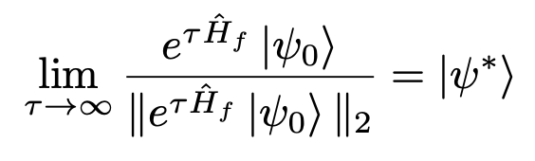
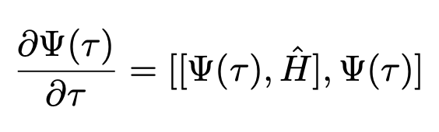
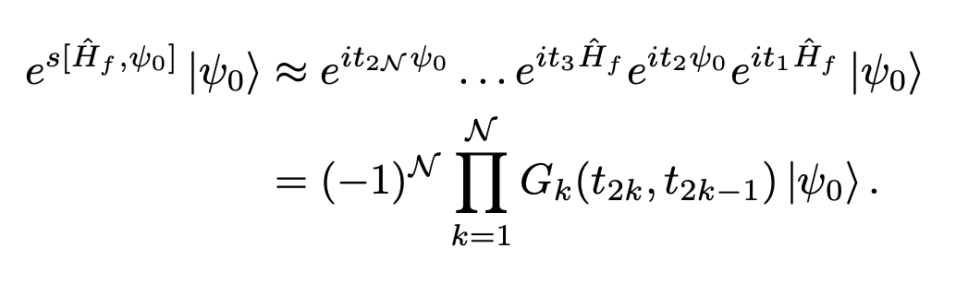
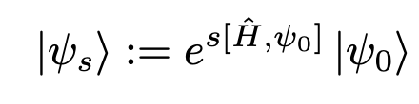
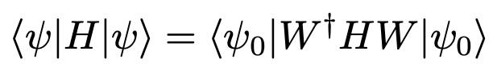
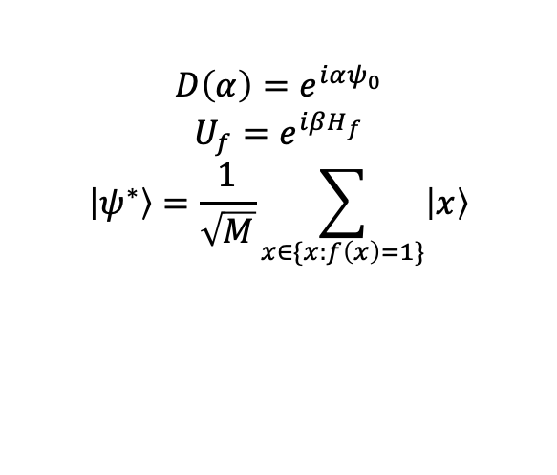
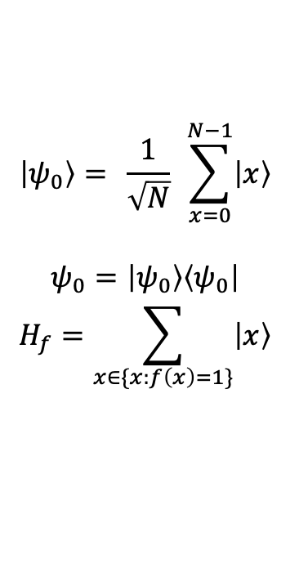
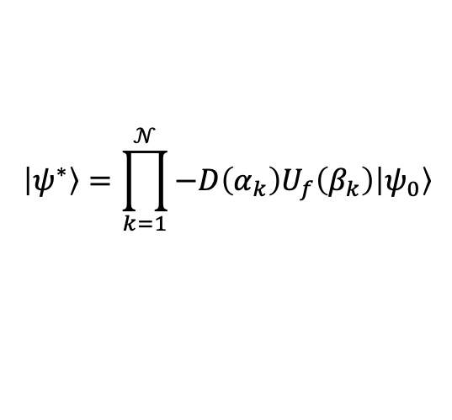
Optimisation on Riemannian Manifolds & Quantum Algorithms
Objective
Big Picture
$$\left|ψ_{0}\right\rangle = \frac{1}{\sqrt{N}} \sum_{x=0}^{N−1}{\left|x\right\rangle }$$
$$ψ_{0}=\left|ψ_{0}\right\rangle \left\langle ψ_{0}\right|$$
$$H_{f}=\sum_{x∈\{x:f\left(x\right)=1\}}{\left|x\right\rangle }$$
$$\left|ψ^{∗}\right\rangle =\prod_{k=1}^{𝒩}{−D\left(α_{k}\right)U_{f}\left(β_{k}\right)\left|ψ_{0}\right\rangle }$$
$$D\left(α\right)=e^{iαψ_{0}}$$
$$U_{f}=e^{iβH_{f}}$$
$$\left|ψ^{∗}\right\rangle =\frac{1}{\sqrt{M}}\sum_{x∈\{x:f\left(x\right)=1\}}{\left|x\right\rangle }$$
Andres Arcia Lopez
andres.arcialopez@ntu.edu.sg
Notes:
What Grover essentially achieves is that it gets you from your initial state psi_0 to a state that contains information about the elements you are interested in psi^*. We can think of these states as living on the Unitary manifold, since we can get to any valid state by applying a unitary matrix to it.
PRESS
Another way to move from state to state is ITE. Which is quite natural as it moves the state along a geodesic. In this way, we exactly recover the solution state.
PRESS
Notice that for any tau, ITE is a solution to DBF. A DBF is just a differential equation for matrix valued functions.
Solutions to DBF can be approximated by the following equation. An in our case, since H_f is a projector operator, it actually is exact. We can find for any tau, an s that gives us the same state.
PRESS
We can get rid of the commutator by using a product formula approximation. This recovers Grover’s algorithm.
PRESS
Notice as well that this equation corresponds to the steepest descent direction of a least squares function corresponding to the energy of the state.
Using this framework we can recover key results like the optimal query complexity root N from the geodesic length.

Slide 6
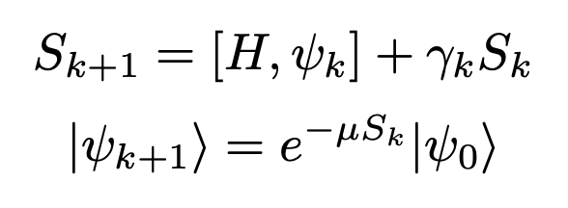
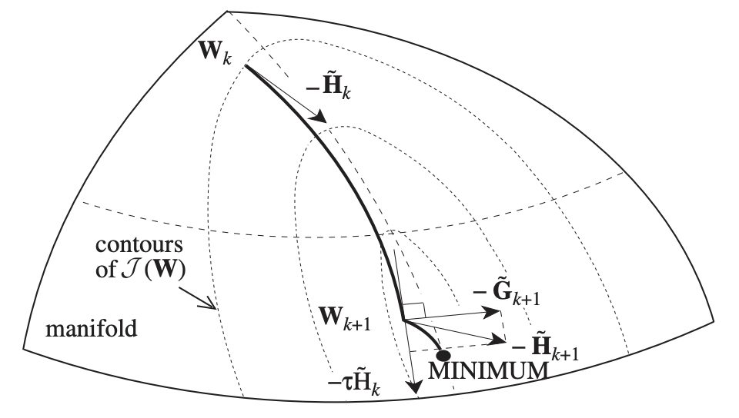
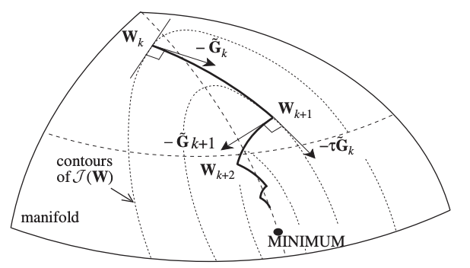
Optimisation on Riemannian Manifolds & Quantum Algorithms
Big Picture
Objective
Andres Arcia Lopez
andres.arcialopez@ntu.edu.sg
Notes:
Noiw, the idea is that by considering different ways of moving about in U(n) we can hope to discover new quantum algorithms or understand current ones better. We can exploit this link between optimisation on U(n) and quantum algorithms, and consider different optimisation algorithms for our cost function. For example, CG. There is already work detailing how to do CG optimisation on U(n). The objective now would be to translate it into a QC perspective.

