Slide 1
Spectrum of radiation from global (axion) strings
Lukasz Bunio
YTF 2025
Based on: R. Battye, L. Bunio, S. Cotterill and P. Manoj, in prep

Slide 2

Strong CP problem

Slide 3

Strong CP problem
Requires fine-tuning

Slide 4

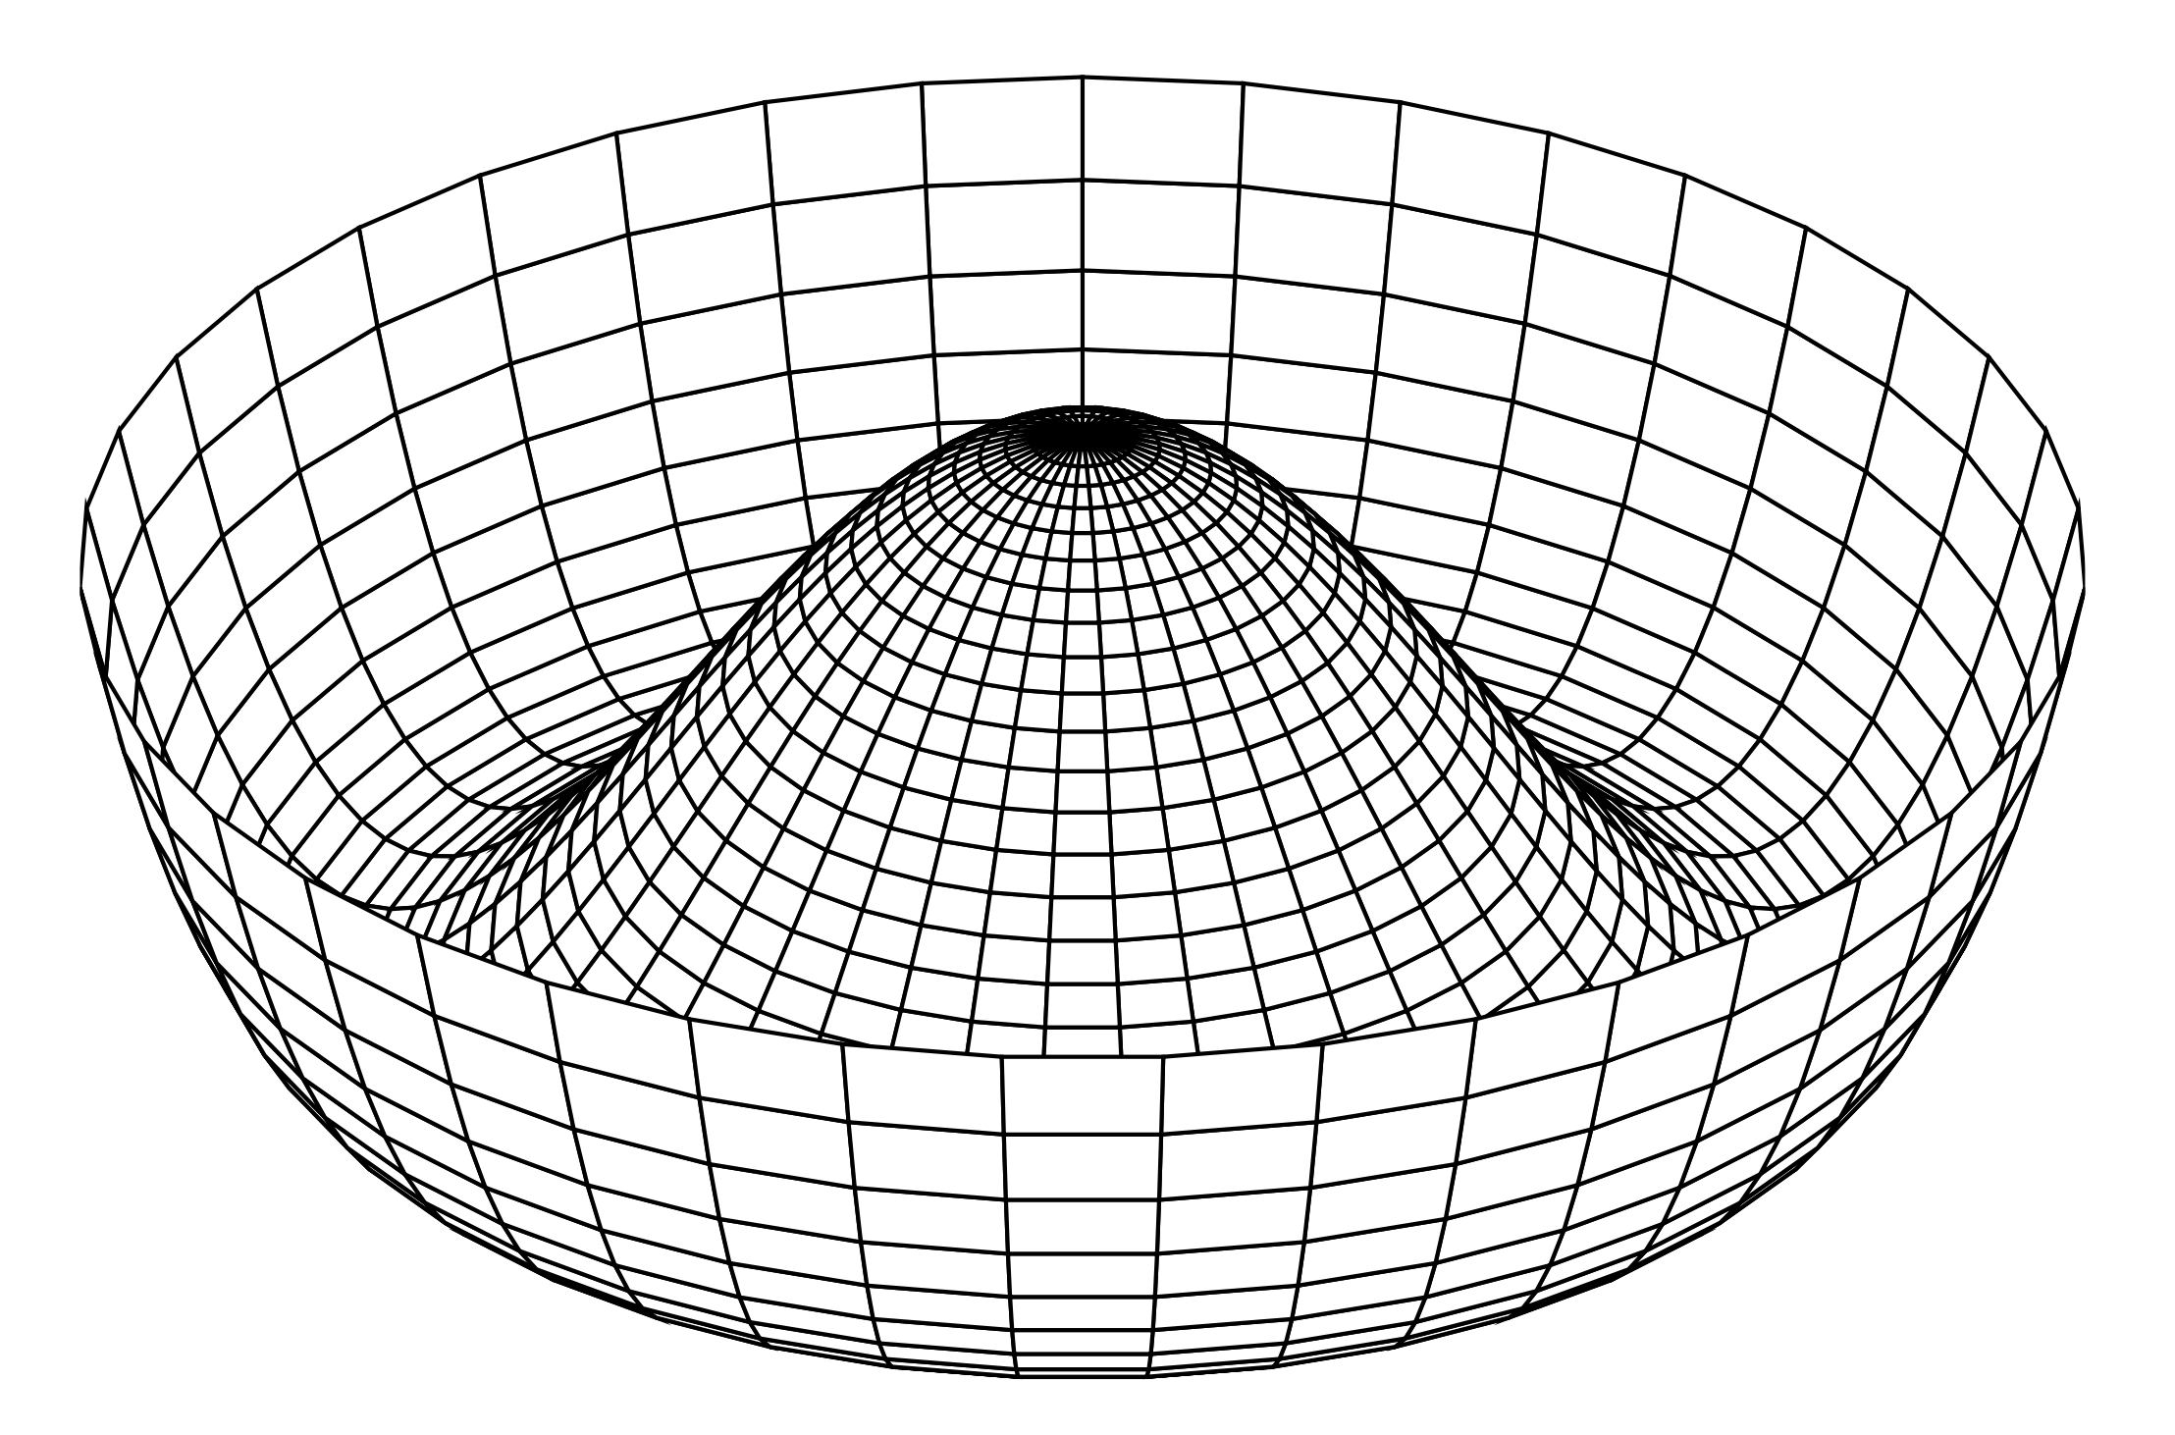

Peccei – Quinn solution
PQ potential:
At temperatures lower than
QCD scale (200 MeV)

Slide 5

Cosmic strings

Slide 6
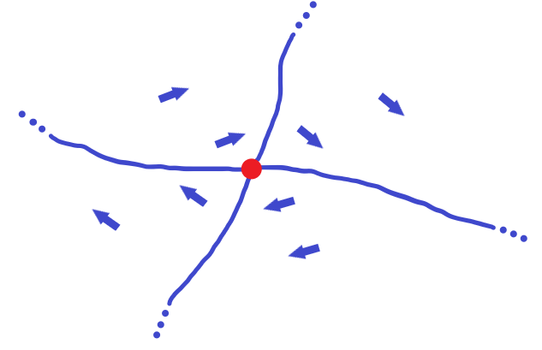
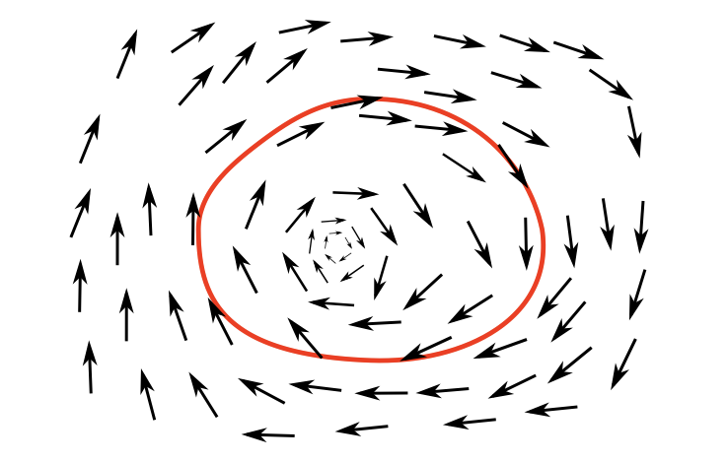
Cosmic strings
Fig 6.1 from "An Introduction to Spontaneous Symmetry Breaking" by J. Beekman et al. (2019)

Slide 7
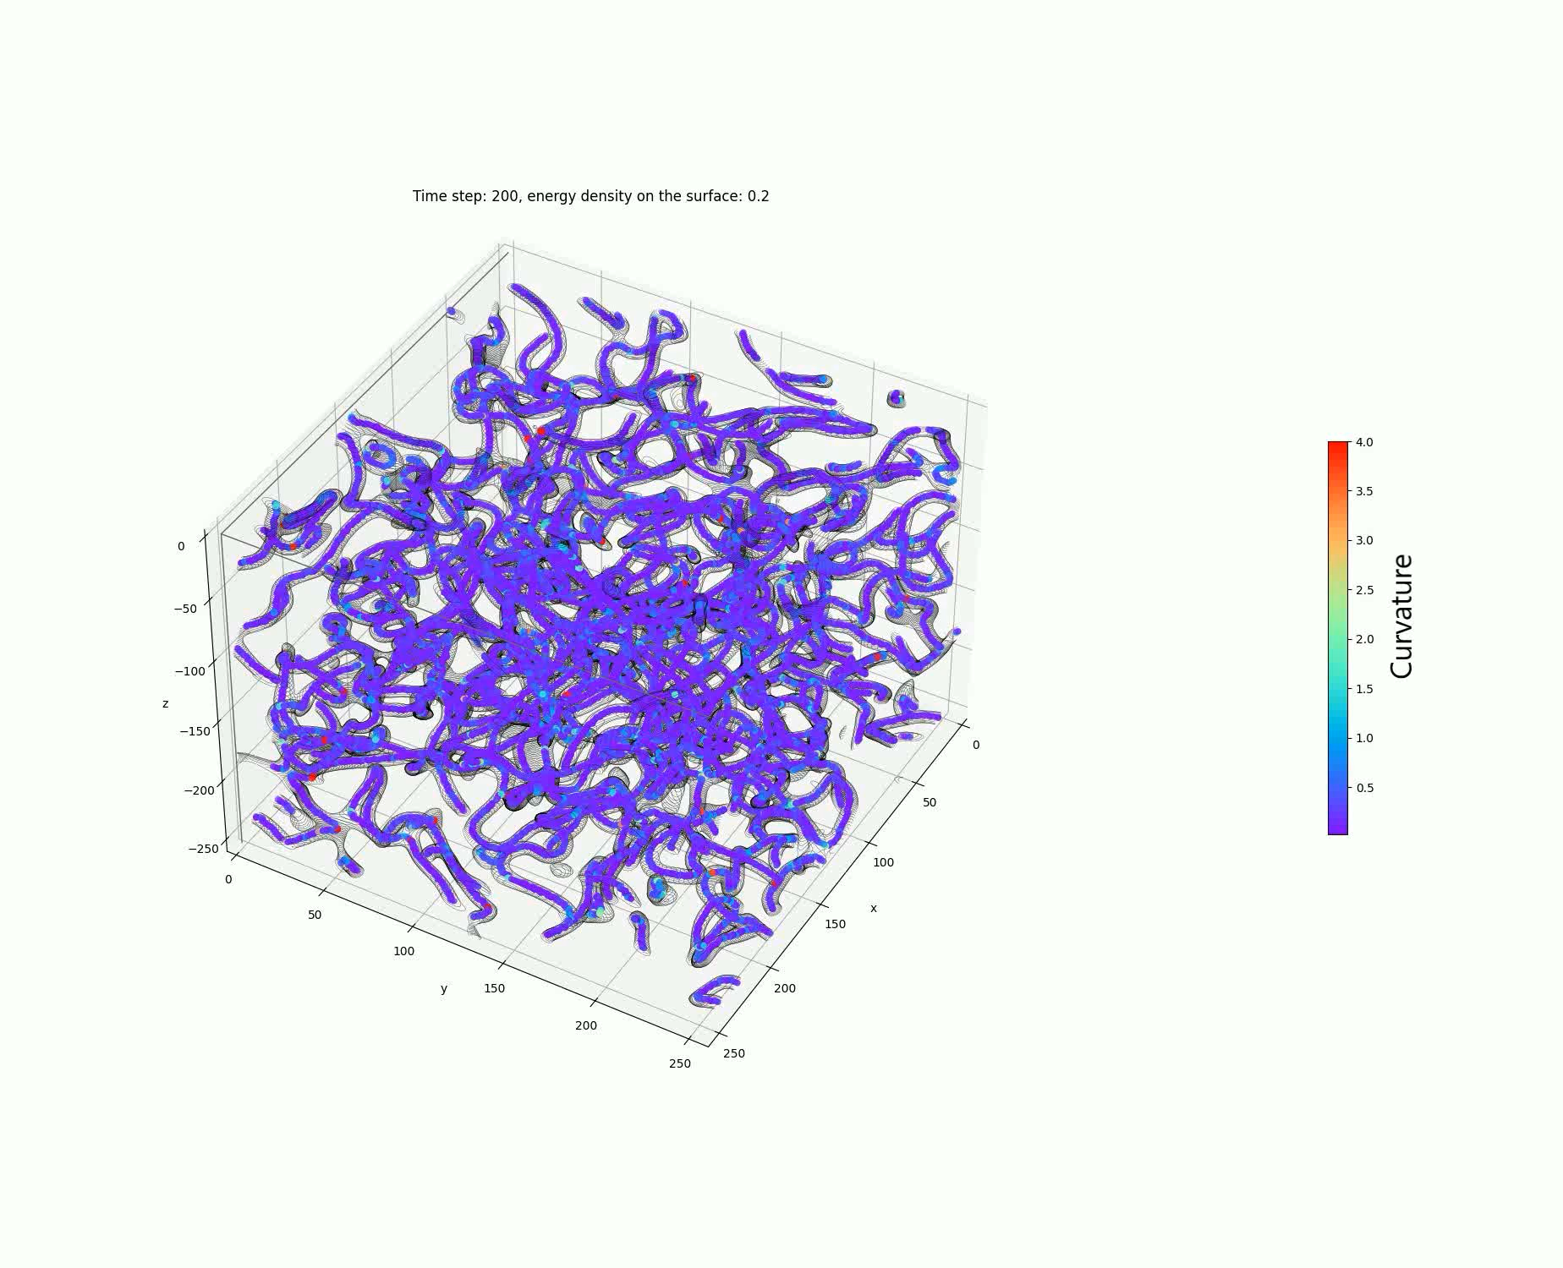


Slide 8



Numerical simulations
Based on the low temperature effective Lagrangian
derive equations of motion.
2) Discretise space and time, approximate derivatives as finite differences.
3) Solve equations numerically on a cubic lattice starting with some initial conditions.
First problem:
what we have:
what we need:

Slide 9
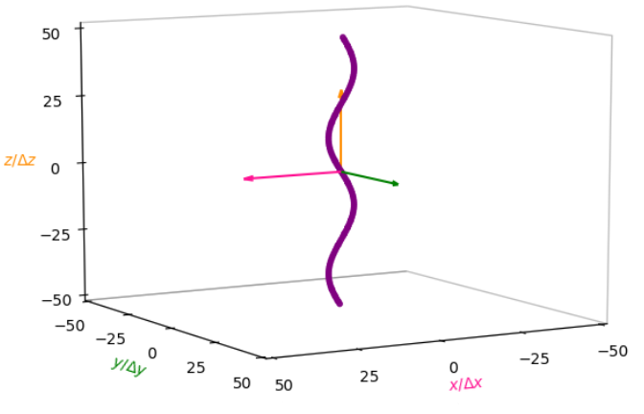

Sinusoidally perturbed straight string
Initial displacement

Slide 10


Axion radiation
Energy density
„Axion energy density”
The self-field contribution

Slide 11
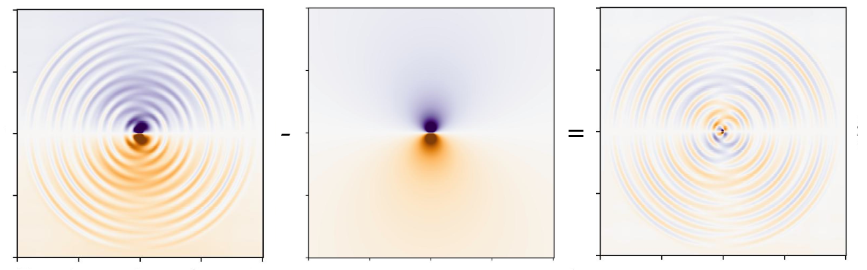



Self-field subtraction

Slide 12



Axion energy spectrum
Energy spectrum defined as
same for
Then the instantaneous emission spectrum (power spectrum)
Axion mass depends on spectral index as

Slide 13
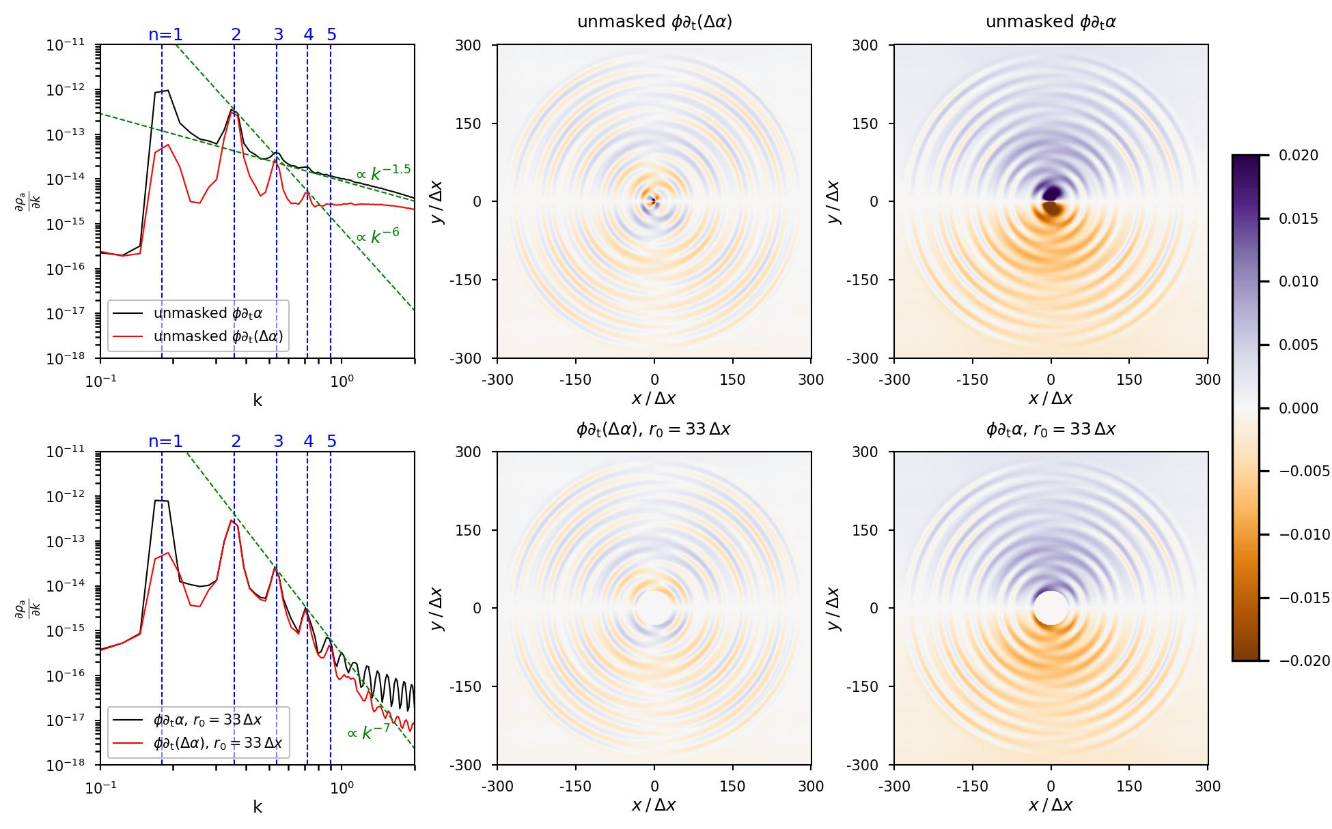

Slide 14
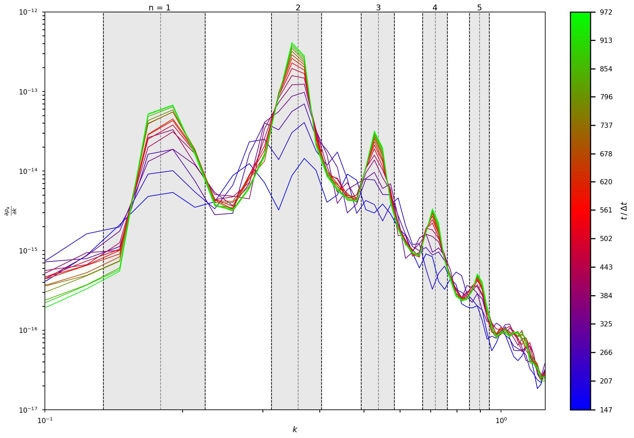

Slide 15
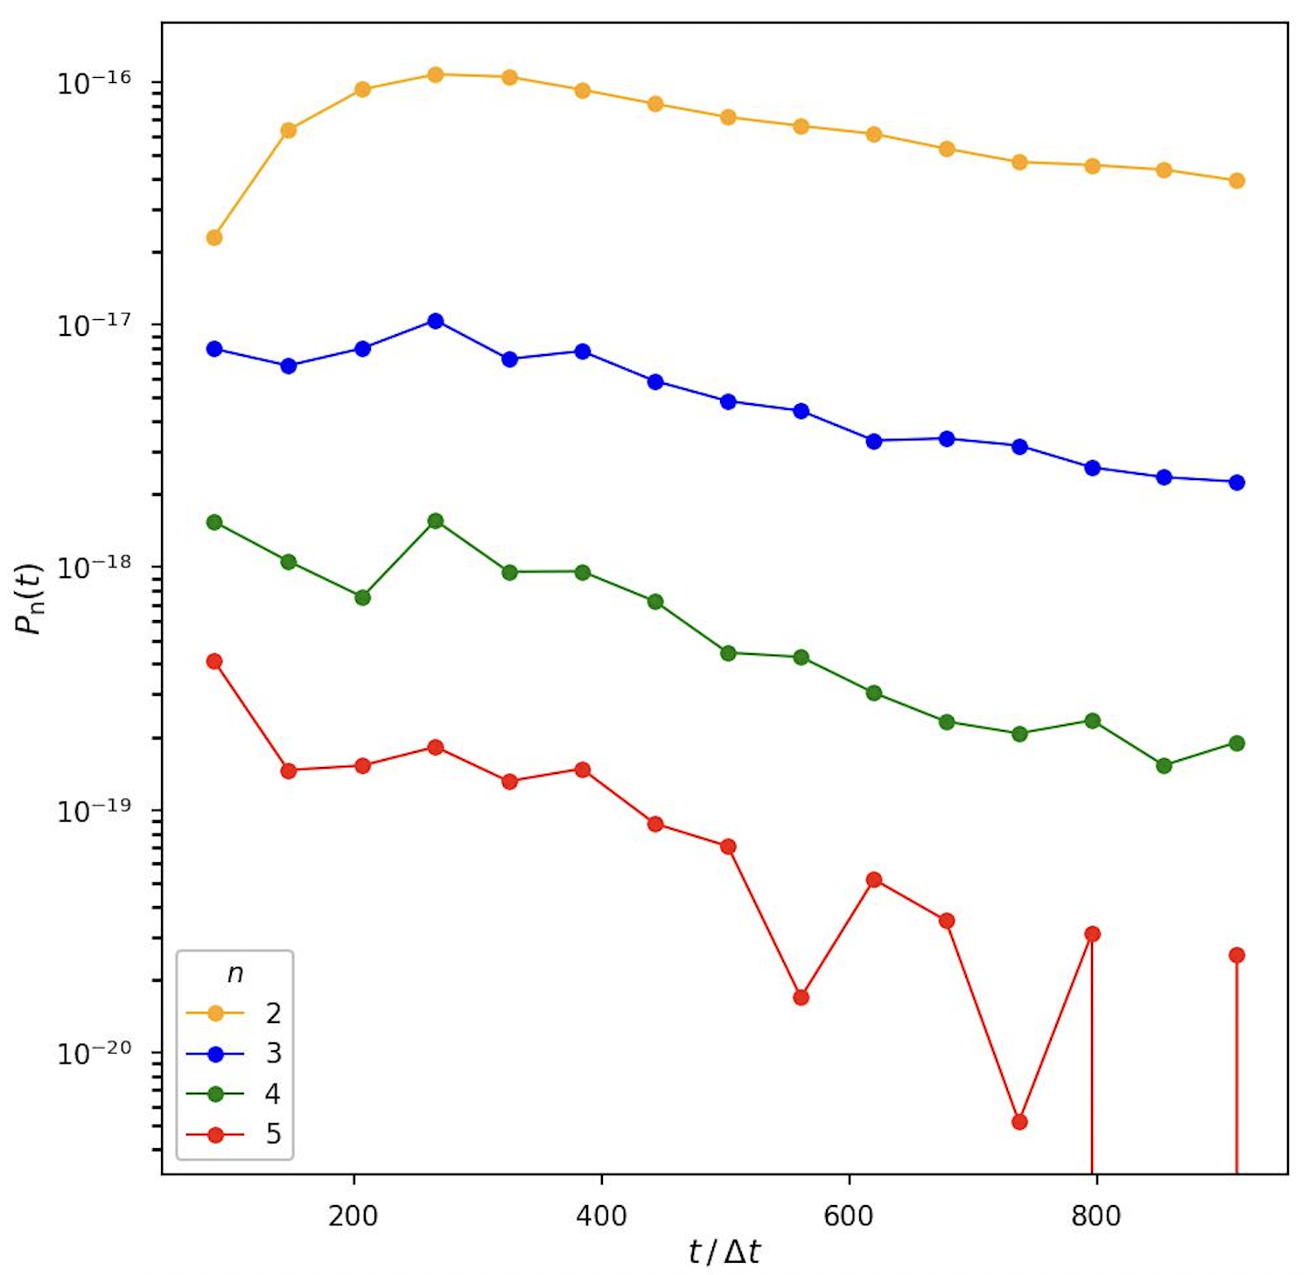

Slide 16


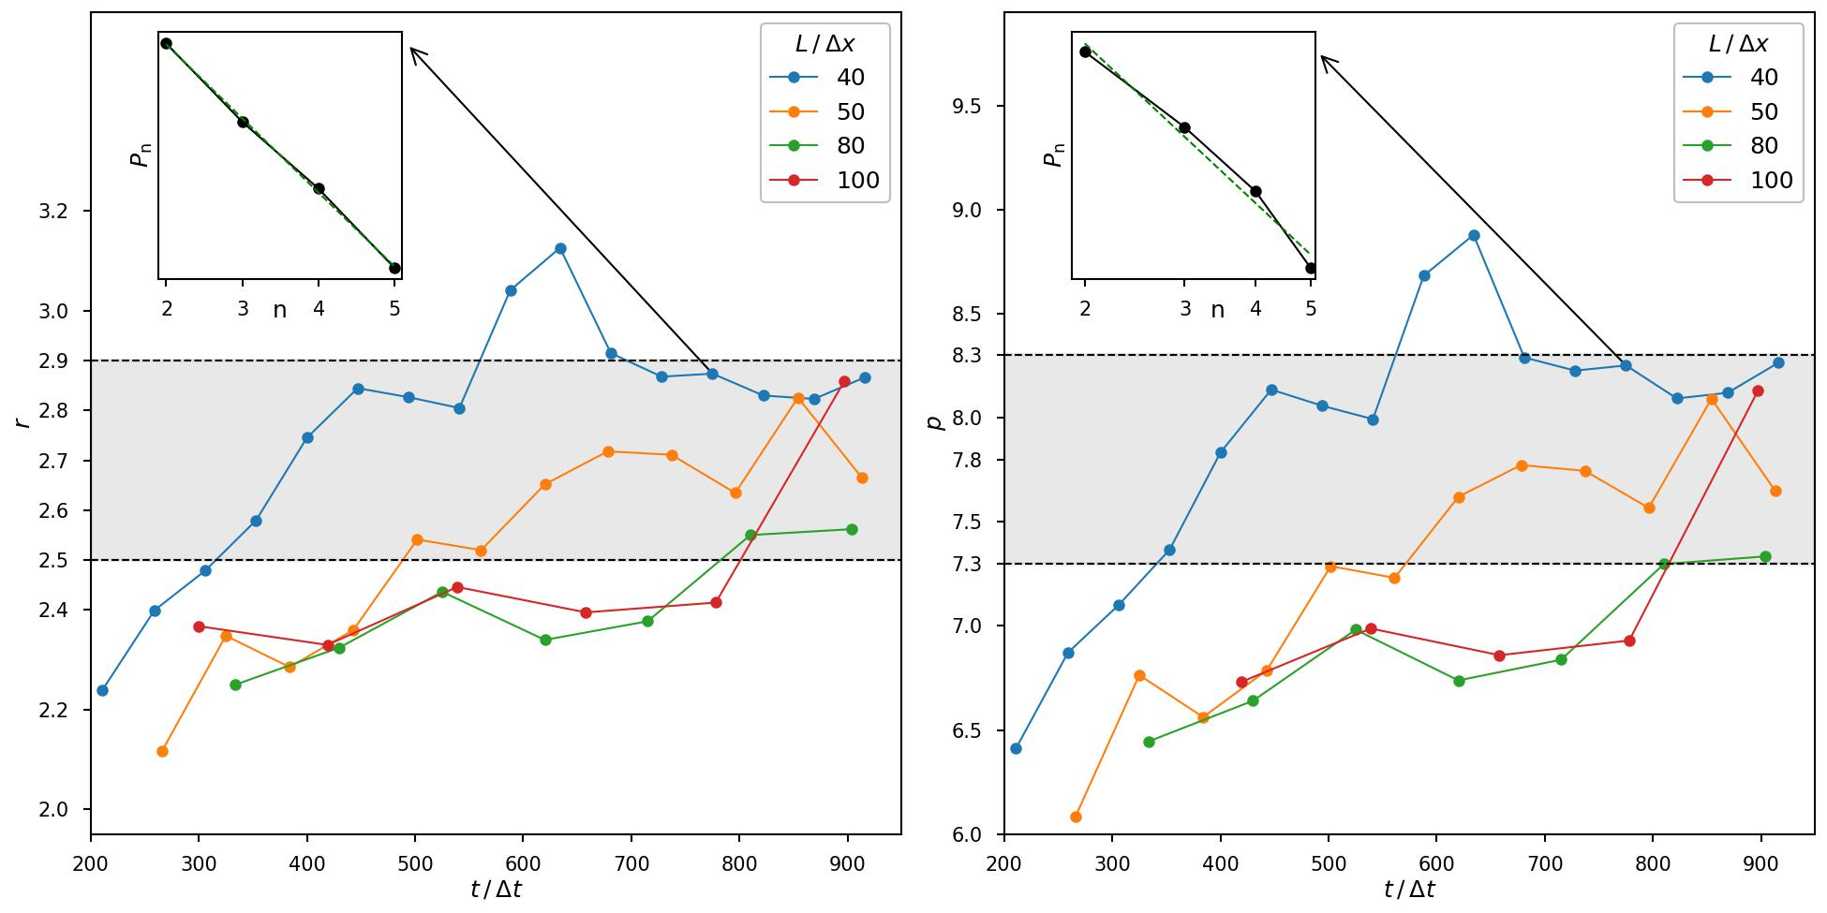

Slide 17
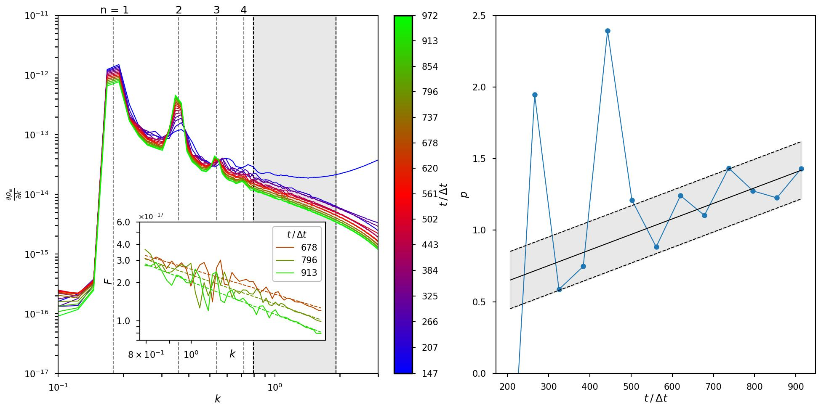

Slide 18
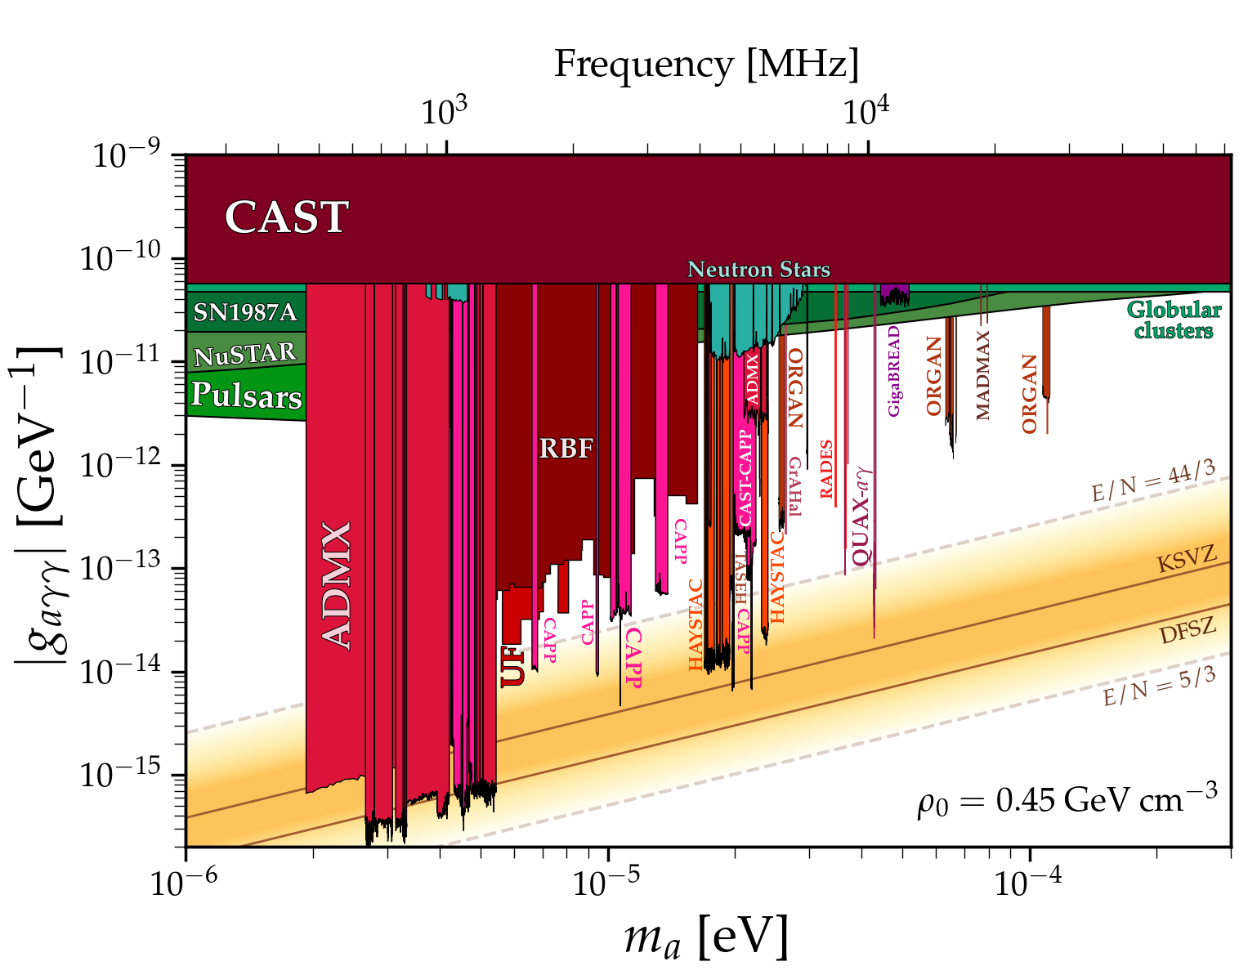


https://cajohare.github.io/AxionLimits/

Slide 19
Thank you for your attention!

