Slide 1

Effectiveness of Symmetry Verification for the Variational Quantum Eigensolver Algorithm
Alexander Tomlinson | 18th December 2025
Supervisor: Bipasha Chakraborty
Collaborators: Graham Van Goffrier, Zhenyu Cai
arXiV: Coming soon…

Slide 2
Outline
Motivation for quantum computing and current hardware.
Variational quantum eigensolver algorithm.
Symmetry verification as a quantum error mitigation technique.
Results and the potential to mislead.
Outlook.
1

Slide 3
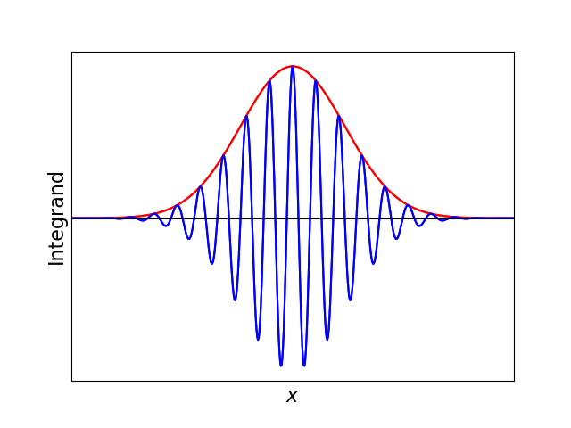
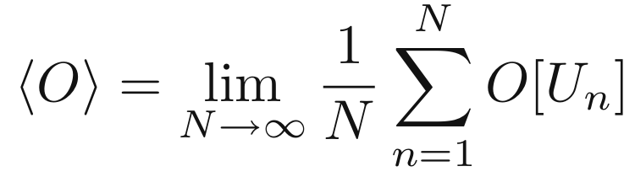
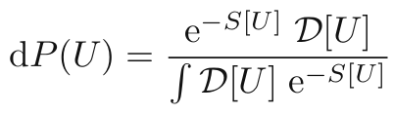
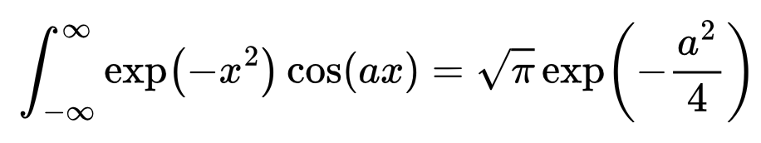
Why Use Quantum Computers?
Lattice field theory targets non-perurbative regimes, but can struggle with the numerical sign problem.
Quantum computing can circumvent this by working in the Hamiltonian formalism.
2
Notes:
Importance sampling – if weight factor e^-S in Gibbs measure is complex then behaviour is highly oscillatory - "every x is important"
Complex action features in many cases e.g. topological terms, chemical potentials, real time dynamics
Hamiltonian formalism is only accessible for classical computing for small lattice sizes - Hilbert space grows exponentially

Slide 4
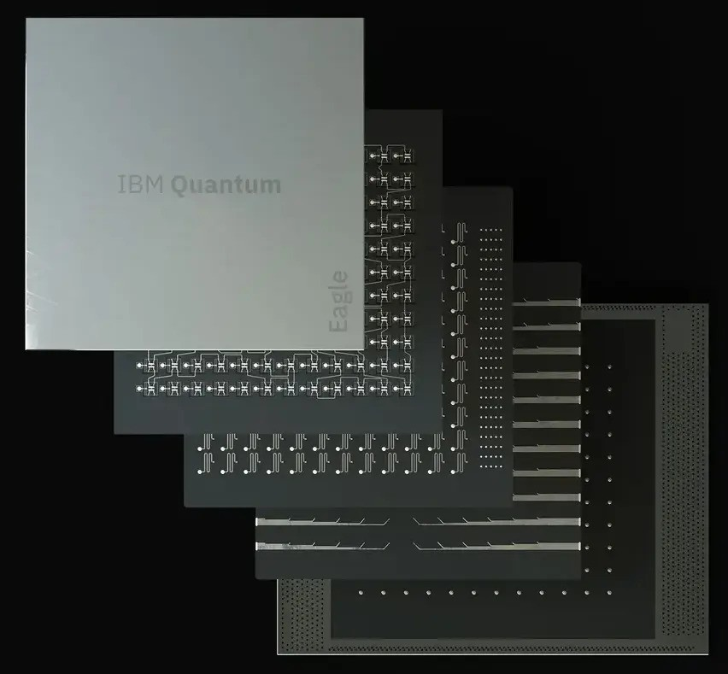
NISQ Era
Currently at order ~100-1000 qubits.
Issues with fidelity and decoherence over large circuits.
e.g. IBM Eagle has ~2% error rate for 2-qubit gates.
“Noisy Intermediate-Scale Quantum Era”
Important to understand what is possible with current and near-term hardware
IBM Eagle Processor - 127 qubits
Image credit: IBM
3

Slide 5



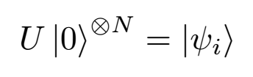

Variational Quantum Eigensolver (VQE)
Hybrid quantum/classical algorithm to prepare ground states.
Variational principle:
State
Initialisation
Parametrised
Ansatz
Hamiltonian
Expectation
.
.
.
.
.
.
.
.
.
Classical
Optimisation
New
Puruzzo et al. (2014) Nat Commun 5, 4213
4
Notes:
Utilising classical optimisation means quantum circuit doesn't need to run for high depths

Slide 6
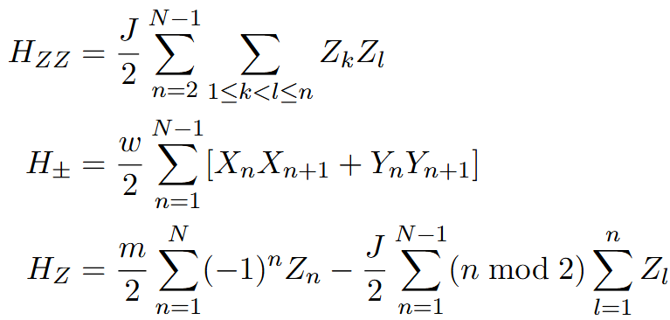
Variational Quantum Eigensolver (VQE)
Hamiltonian measurement – need to convert from fermions to qubits.
e.g U(1) gauge theory in 1+1-dimensions (Schwinger model)
Default measurements are in the eigenbasis of Pauli Z operator.
Need to rotate qubits to other Pauli bases for some terms.
Find qubit-wise commuting groups to minimise measurements.
5

Slide 7

Quantum Error Mitigation and Symmetry Verification
Quantum error correction is the target for full fault tolerance – but not possible near-term.
Quantum error mitigation techniques seek to reduce the impact of noise.
Cai et. al. Rev. Mod. Phys. 95 (2023)
Symmetry verification exploits expected symmetries of the desired state, discarding runs within the wrong symmetry sector.
Trade off is increased sampling overhead.
For Schwinger ground state, we verify parity:
6

Slide 8
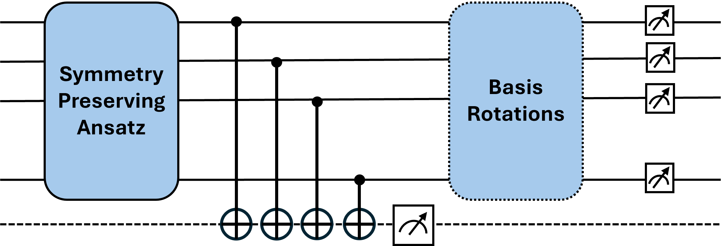
Symmetry Verification
Particle number preserving ansatz:
Gard et al. npj Quantum Inf 6,10 (2020)
University of Southampton | 13/06/24
7

Slide 9
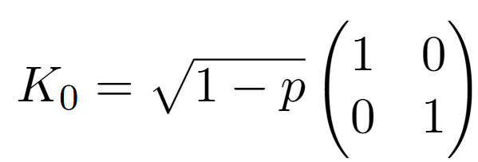
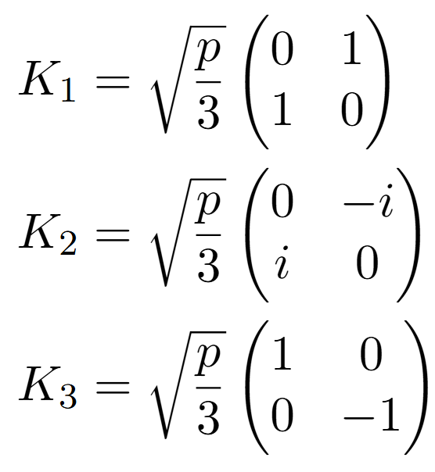
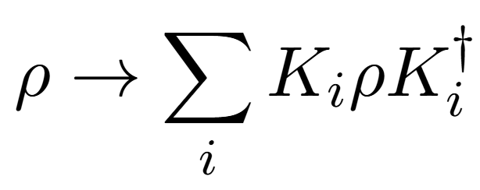
Noise Profile for Simulation
Utilise a depolarising channel at every gate.
Completely positive trace preserving map defined using Kraus operators.
“Worst-case” noise due to mapping onto a linear combination of original input and maximally mixed state.
We aim for a circuit fault rate of order unity.
8

Slide 10
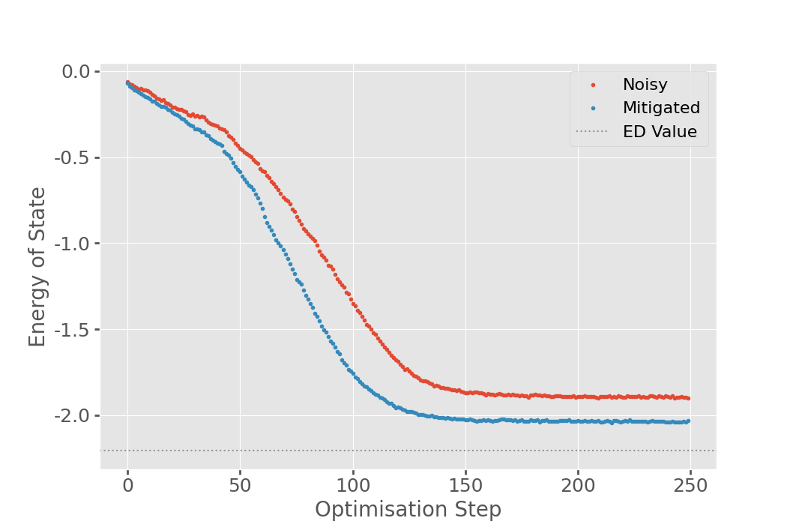
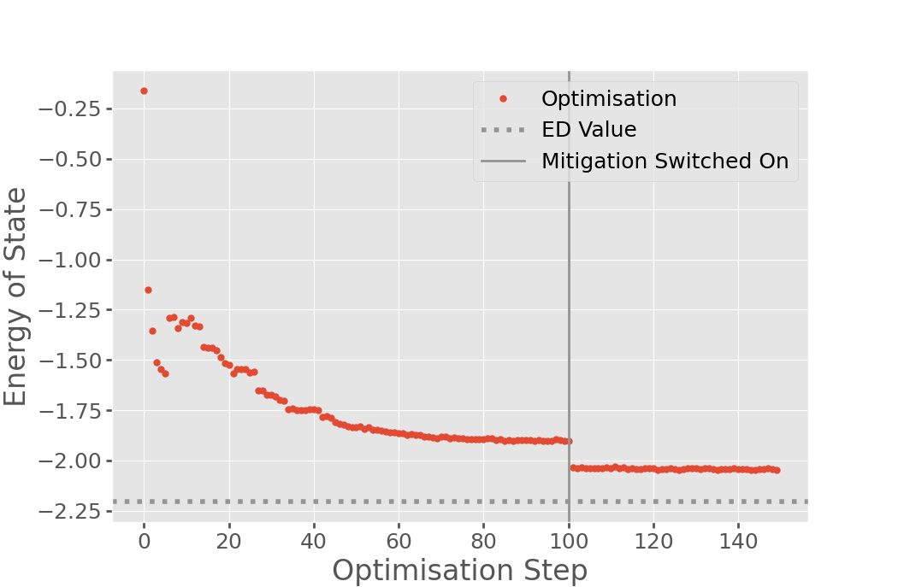
Simulation Results
N=4
N=4 with Toggled Mitigation
Hybrid result suggests that parameters are not updating after mitigation is switched on.
9
Notes:
Pauli string + spin lowering operator, similarly fermionic creation operator corresponds with spin raising operator

Slide 11
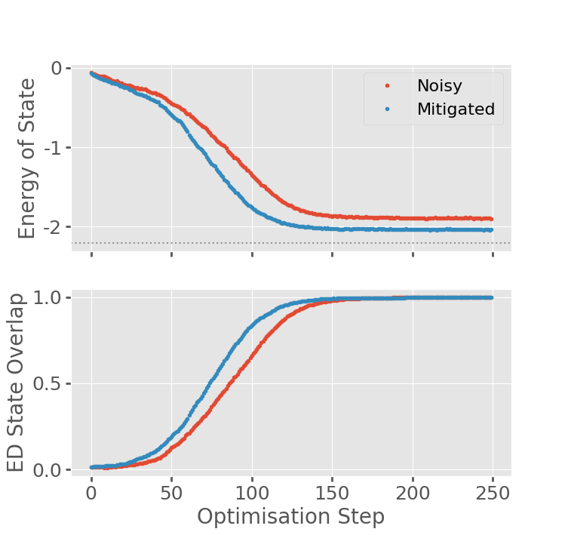
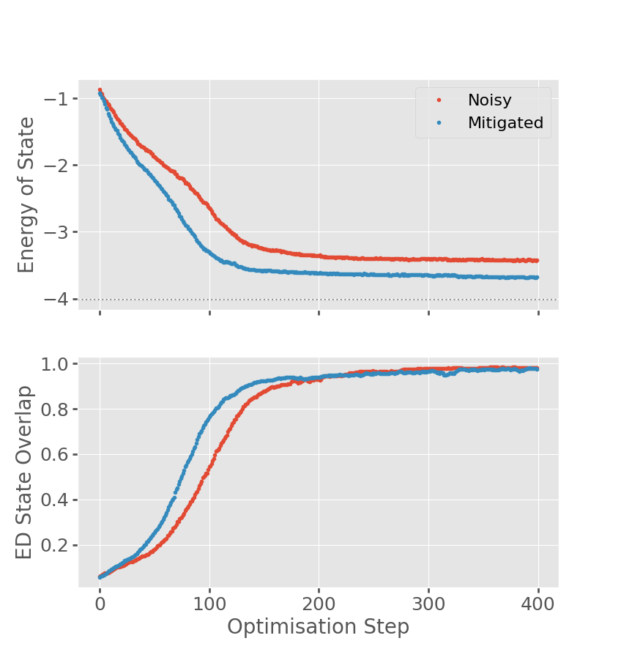
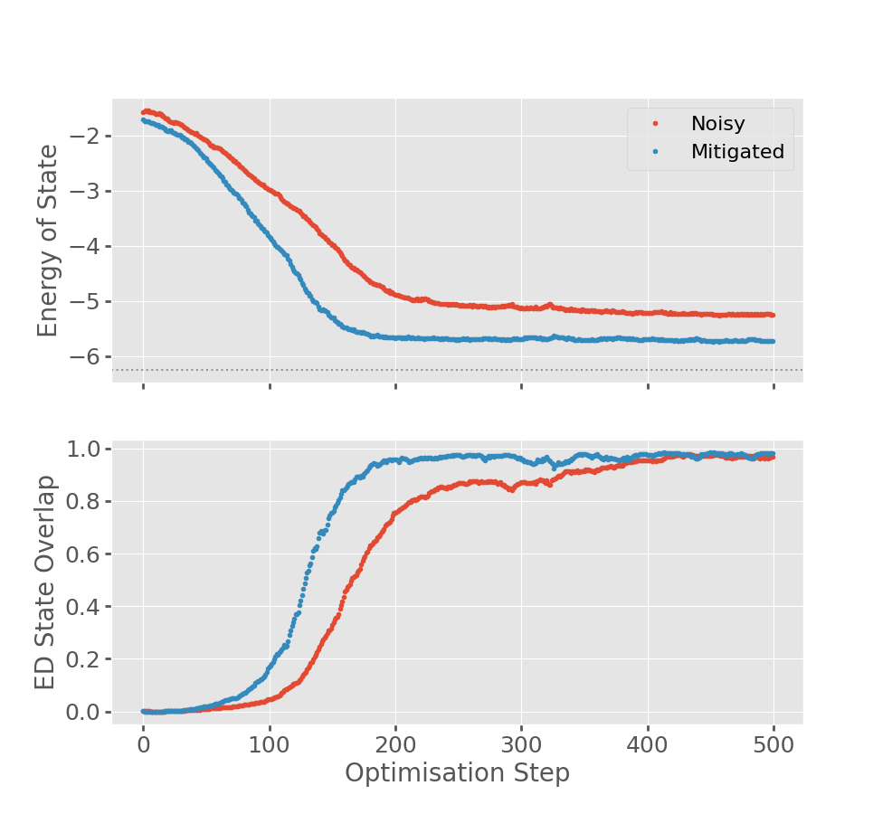
Simulation Results
N=4
N=6
N=8
10
Notes:
Pauli string + spin lowering operator, similarly fermionic creation operator corresponds with spin raising operator

Slide 12
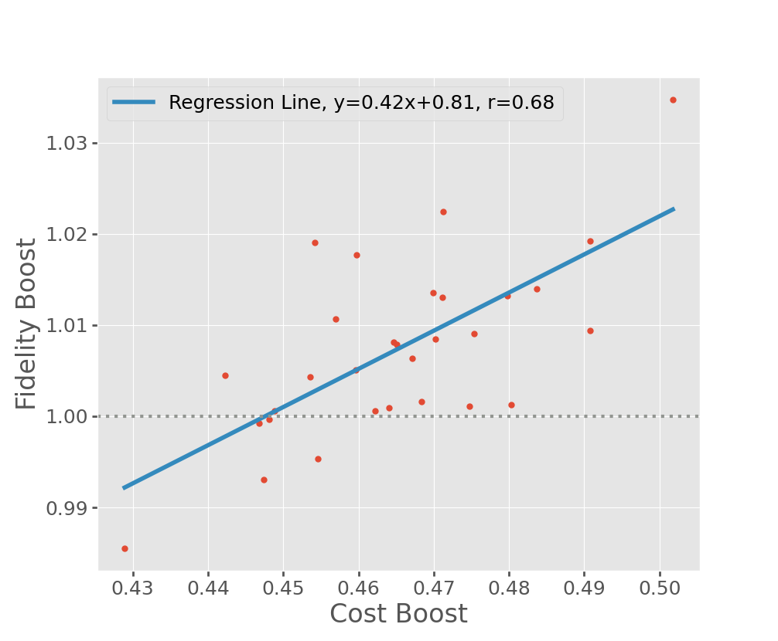
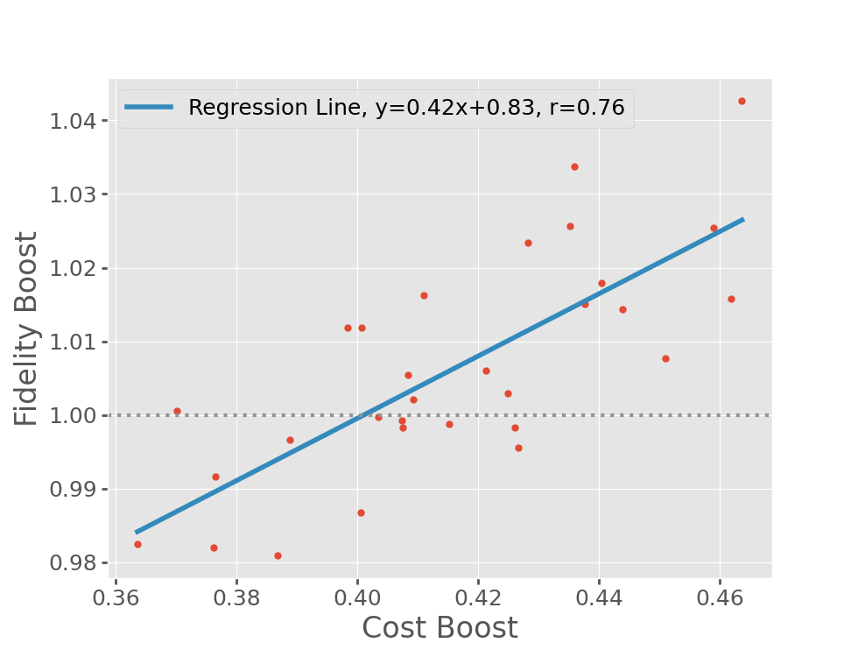
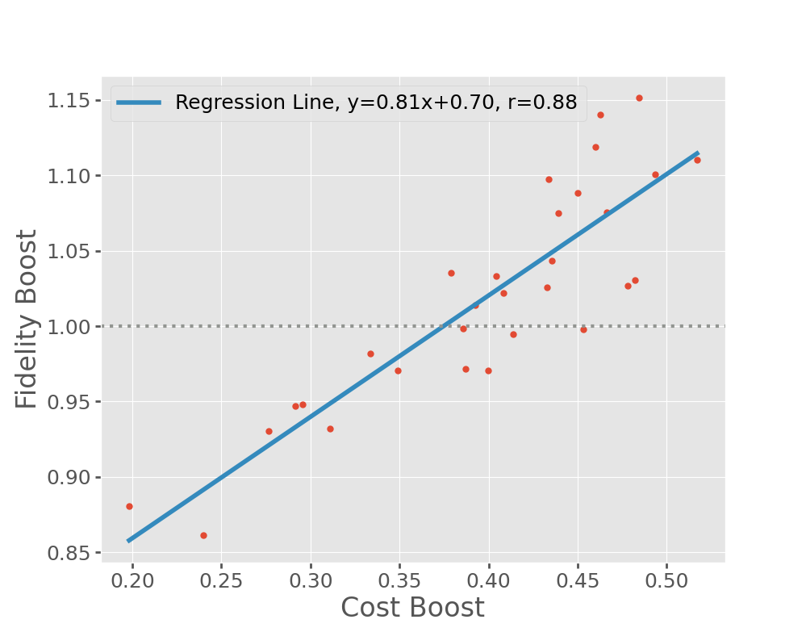
Simulation Results
N=4
N=6
N=8
Chance of worsened result!
Could repeat the algorithm several times for more confidence at the cost of runtime.
11
Notes:
Pauli string + spin lowering operator, similarly fermionic creation operator corresponds with spin raising operator

Slide 13
Outlook
Symmetry verification works, however actual benefit is more nuanced in this case.
Still effective in other situations.
See arXiv: coming soon!
Exact understanding of why would be insightful.
Further trend as system size increases also of interest.
University of Southampton | 13/06/24
12

