Slide 1
Black hole hair transplant with ultra light dark matter
(Based on arxiv 26xx.xxxx with Diego Blas and Chirstopher McCabe)
Dhruv Pathak Govardhan
King’s College, London

Slide 2
Hair?
Any physical measurable property of a BH other than M, J, Q.
For this talk, we stick to scalar hair i.e. a non-trivial scalar field profile outside the horizon.
The no hair theorem is not violated because it only holds as t-> infinity
Notes:
Consider your scalp as the event horizon. It is characterized by the radius, and hence the mass, the elongation, and hence the spin, and the charge, which I am assuming no one here has. Any observable thing other than that is the hair.

Slide 3
Transplant?
This hair can form via superradiance.
For astrophysical black holes, this process can only happen for ULDM scalar fields.
The hair eventually falls off via GWs, and this hairfall, if detected, would mean ULDM exist, and if not, then we can constrain their masses.

Slide 4
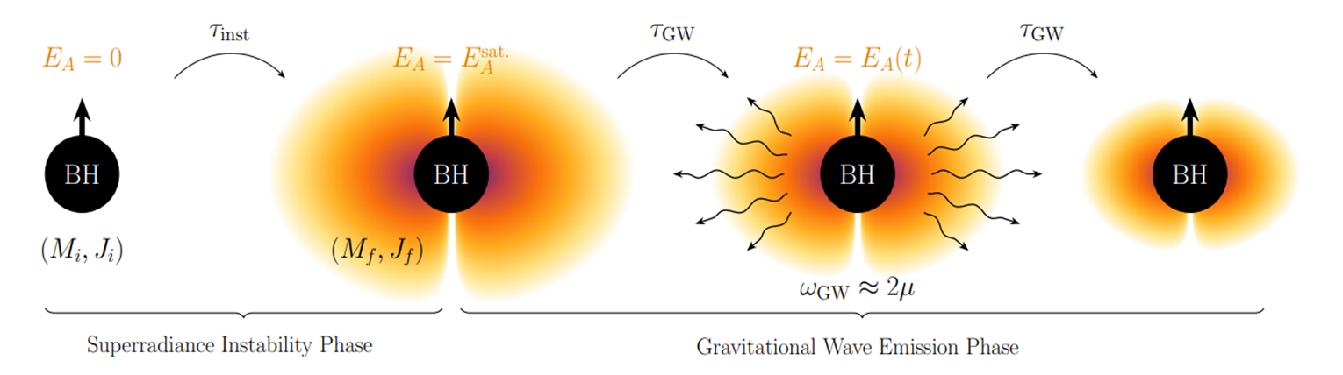
Notes:
How to say one is not bald

Slide 5
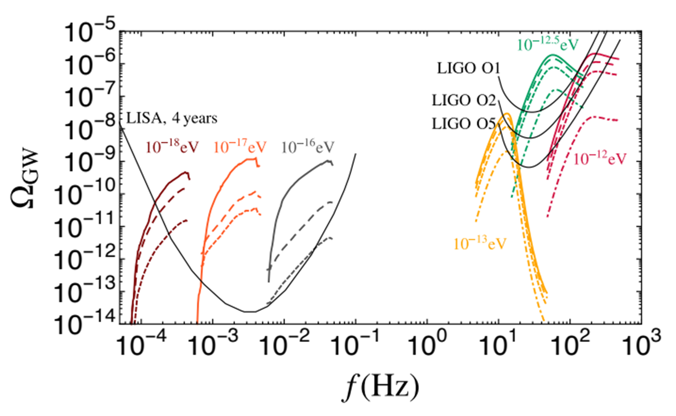
Works?
AION?

Slide 6
Act 1 - Gaining the Hair
Act 2 - Losing the Hair
Act 3 - Detecting the Hair

Slide 7

Act 1
Gaining the Hair

Slide 8
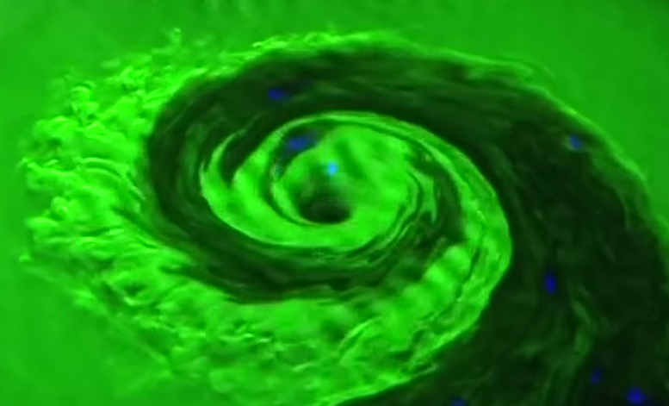
Superradiance
Scattering of a mode off an active medium, with outgoing amplitude increased by extracting energy / angular momentum from the medium.
Credits : https://www.youtube.com/watch?v=XYiZW-j1ywc
Notes:
Vortex creating superradiance in bath tub

Slide 9
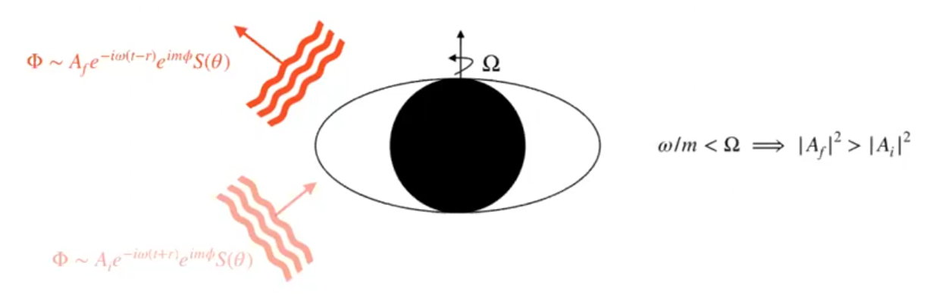
Superradiance for BHs
Credits : https://www.youtube.com/watch?v=KDCOo6sWevY
Notes:
Black holes are like bath tubs

Slide 10
BH Bomb
Put mirrors around a black hole and the wave keeps on coming back. And keeps taking and taking.
This confinement mechanism creates a feedback loop.
For massive fields, the mass itself acts like a confinement mechanism.

Slide 11
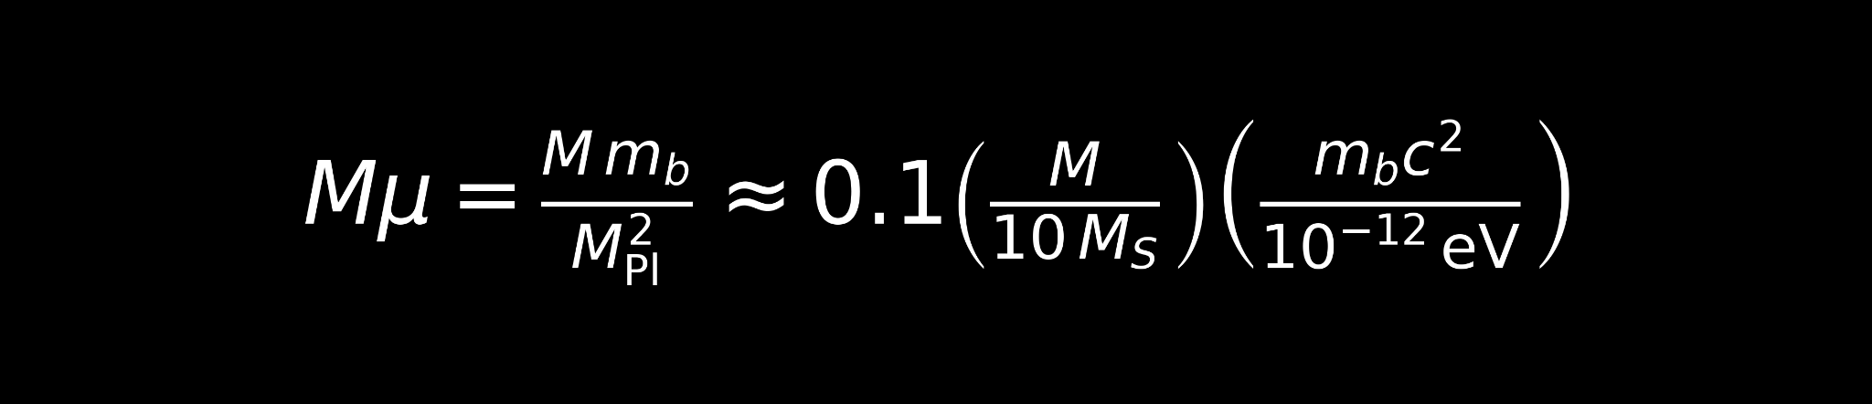
Gravitational fine structure constant
The bound state of the Kerr BH and the bosonic cloud can be treated as a hydorgenic system.
The gravitational analog of the fine structure constant is gravitational fine structure constant.
Notes:
It governs the dynamics and gives a coupling between mass of BH and mass of boson. If the product is too small, the timescales are poor.

Slide 12

Modes and timescales
Just like Hydrogen, you have now multiple modes.
The first mode is the largest (talk about how higher modes do not significantly contribute for masses lower than 10^-12 eV).

Slide 13
Act 2
Losing the Hair

Slide 14
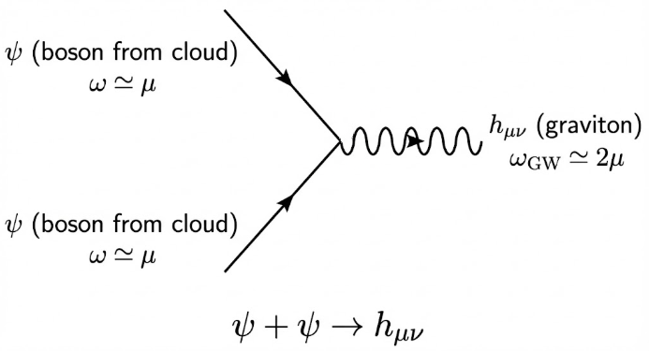
Annihilation
Notes:
There are others like transition channels, but they produce lesser magnitude SGWB. So a star collapses, forms a stellar BH, which spurns this hair around it, assuming ULDM exists, and within that cloud annihilation starts happening.

Slide 15

Monochromatic GWs
These emitted GWs are almost monochromatic, with the frequency determined by the mass of the boson.
This is in contrast to compact-binary coalescences and bursts which are broadband, short-lived, chirping signals.
Notes:
Frequency drift exists but is really small and negligible.

Slide 16
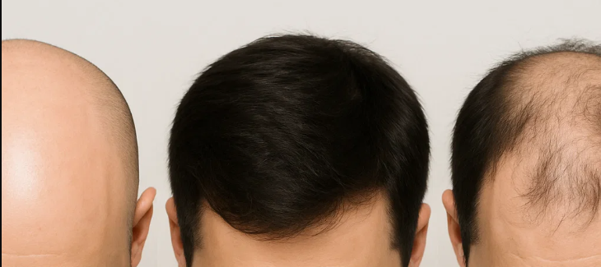
Vacuum to hair to annihilation

Slide 17
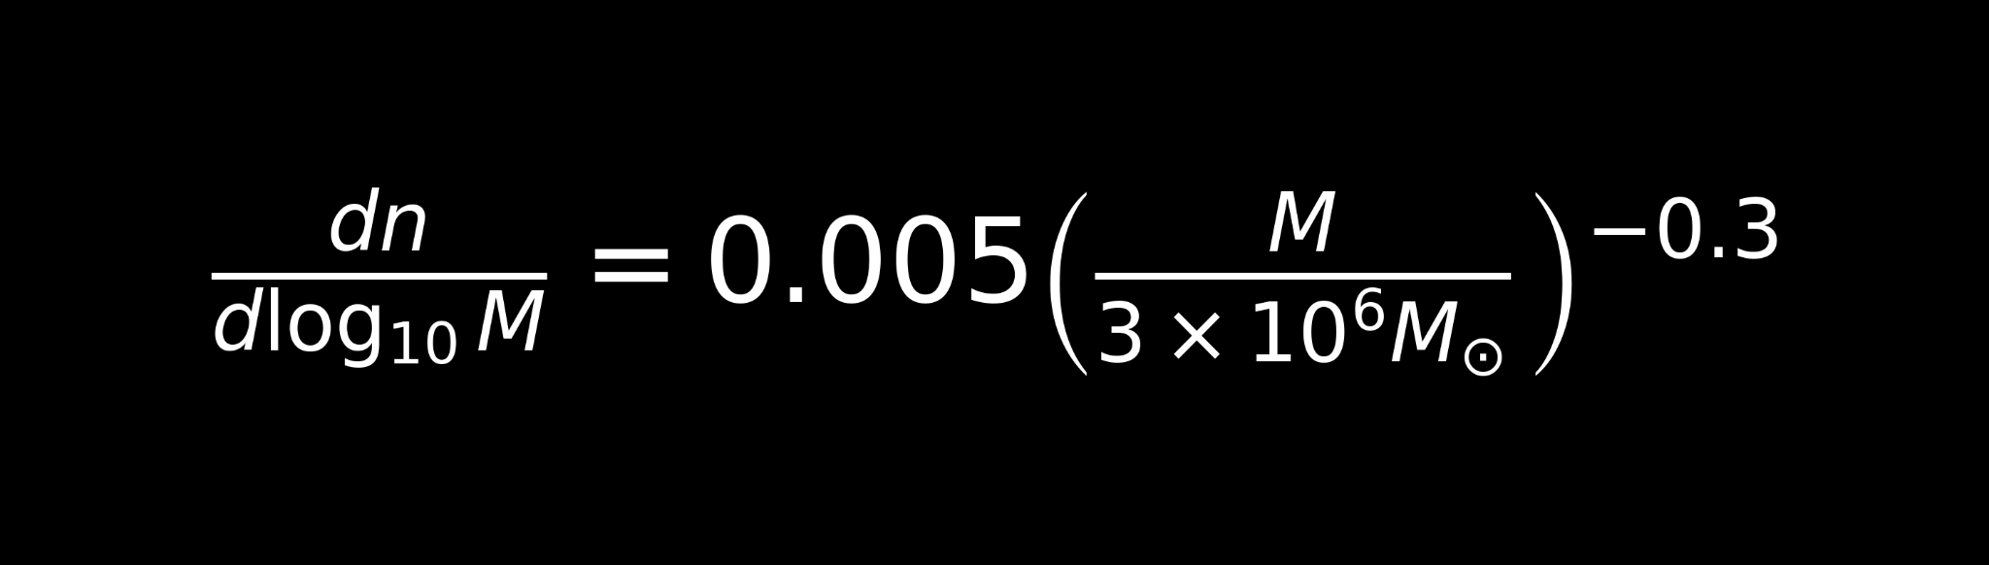
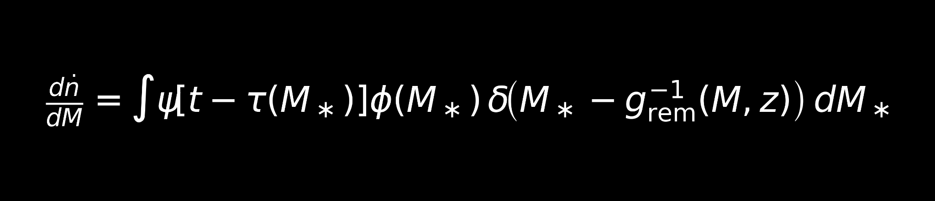
Distribution
Supermassive
Stellar
Isotropic
Homogeneous
Power Law
Isotropic & homogeneous
BH to remnant
Distribution of remnant

Slide 18
The Observable
The “memory” of this process is encoded in the fourth Newman Penrose scalar ψ₄.
ψ₄ is encoded in the gravitational strain induced by the GWs coming from this process.
This is in principle detectable.
Notes:
The question is how is this loss encoded as an observable? And the answer is the Newman penrose constant.

Slide 19
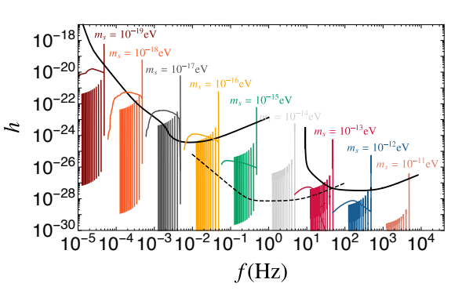
The Strain
Want
Statistical
Individual
Credits : https://arxiv.org/pdf/1706.05097

Slide 20
Act 3
Detecting the Hair

Slide 21

Stochastic GWB
Isotropic & Homogeneous
Uniform in spin
Isolated

Slide 22
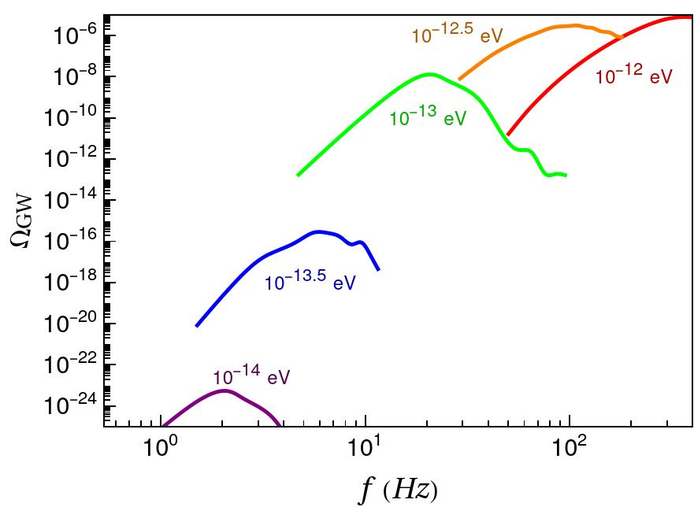
Stellar
Notes:
Talk about why this is going to be the pattern. Why some frequency has the peak

Slide 23
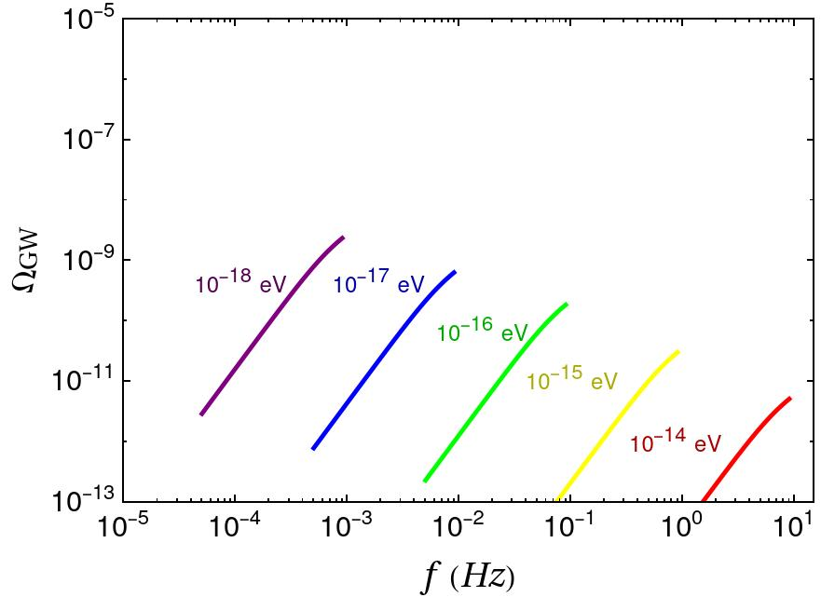
DI Supermassive

Slide 24
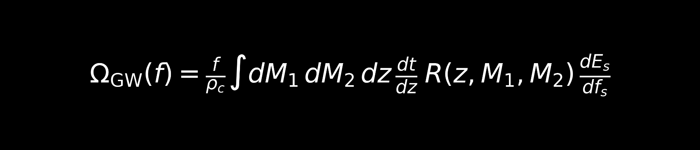
Giving them Company
Instead of stellar collapse, we can talk about remnants of binary mergers.
The cloud formation then remains the same but there can be new features assuming that the colliding BHs were already hairy.
Notes:
The isolated assumption is important because it contributes most.

Slide 25
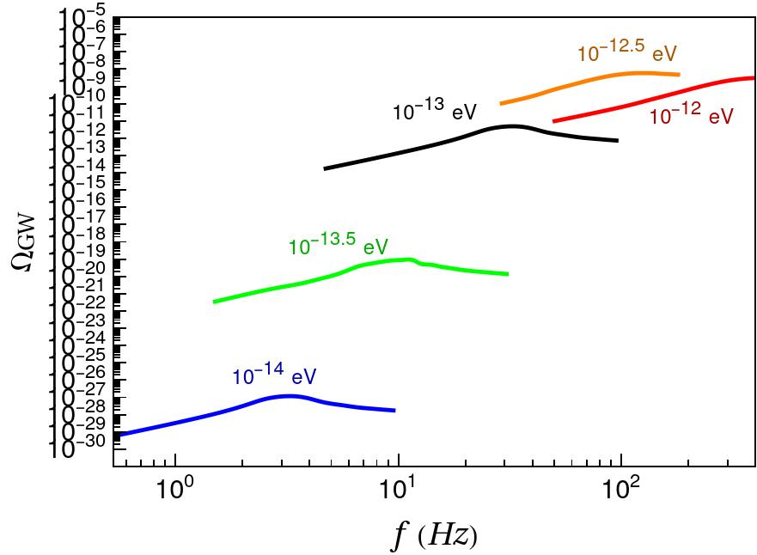
Binaries

Slide 26
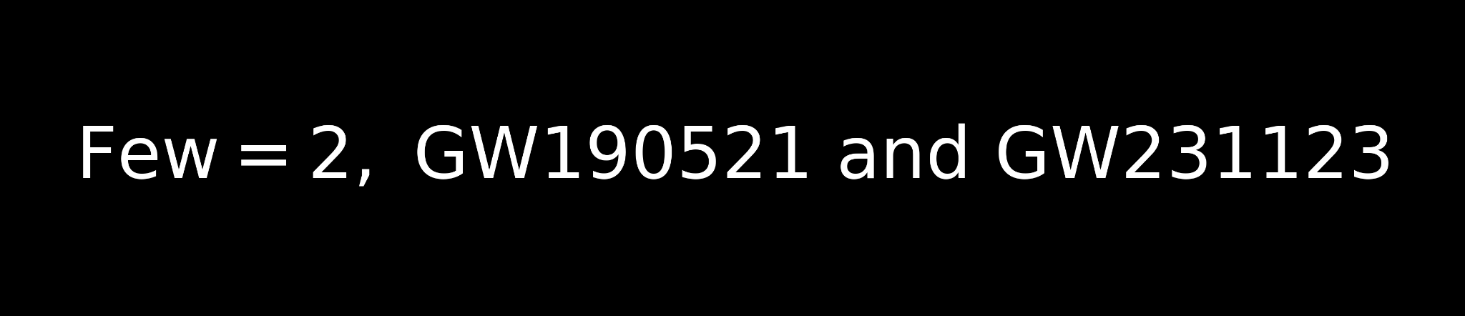
IMBH
If we assume IMBHs exists and model their distribution, the midband contributions will be dominated by those signals.
So far only a few has been detected so there is a lot of ambiguity in the model. However, numerical simulations suggest possible mechanisms.

Slide 27

Make your head a Kerr BH
Spin around some ULDM
Get permanent hair and Nobel Prize

Slide 28
Summary
Act 1 - Superradiance, gravitational fine structure constant, instability timescale
Act 2 - Annihilation channel, monochromatic GWs, distribution of BHs, the GW strain
Act 3 - Stochastic GWB, stellar and supermassive plots, binary remnant contributions, role of IMBHs for midband

Slide 29
What to refer?
Superradiance: New Frontiers in Black Hole Physics by Brito, Cardoso, and Pani
Gravitational wave searches for ultralight bosons with LIGO and LISA by Brito, Ghosh, Barausse, Berti, Cardoso, Dvorkin, Klein, and Pani
Stochastic and resolvable gravitational waves from ultralight bosons by Brito, Ghosh, Barausse, Berti, Cardoso, Dvorkin, Klein, and Pani
Modeling and searching for a stochastic gravitational-wave background from ultralight vector bosons by Tsukada, Brito, East, and Siemonsen
Black hole superradiance to search for new particles by Diego Blas
Probing ultralight dark matter with future ground-based gravitational-wave detectors by Yuan, Brito, and Cardoso

