Slide 1

QCD-Aware Jet Algorithm
Barry Tan

Slide 2
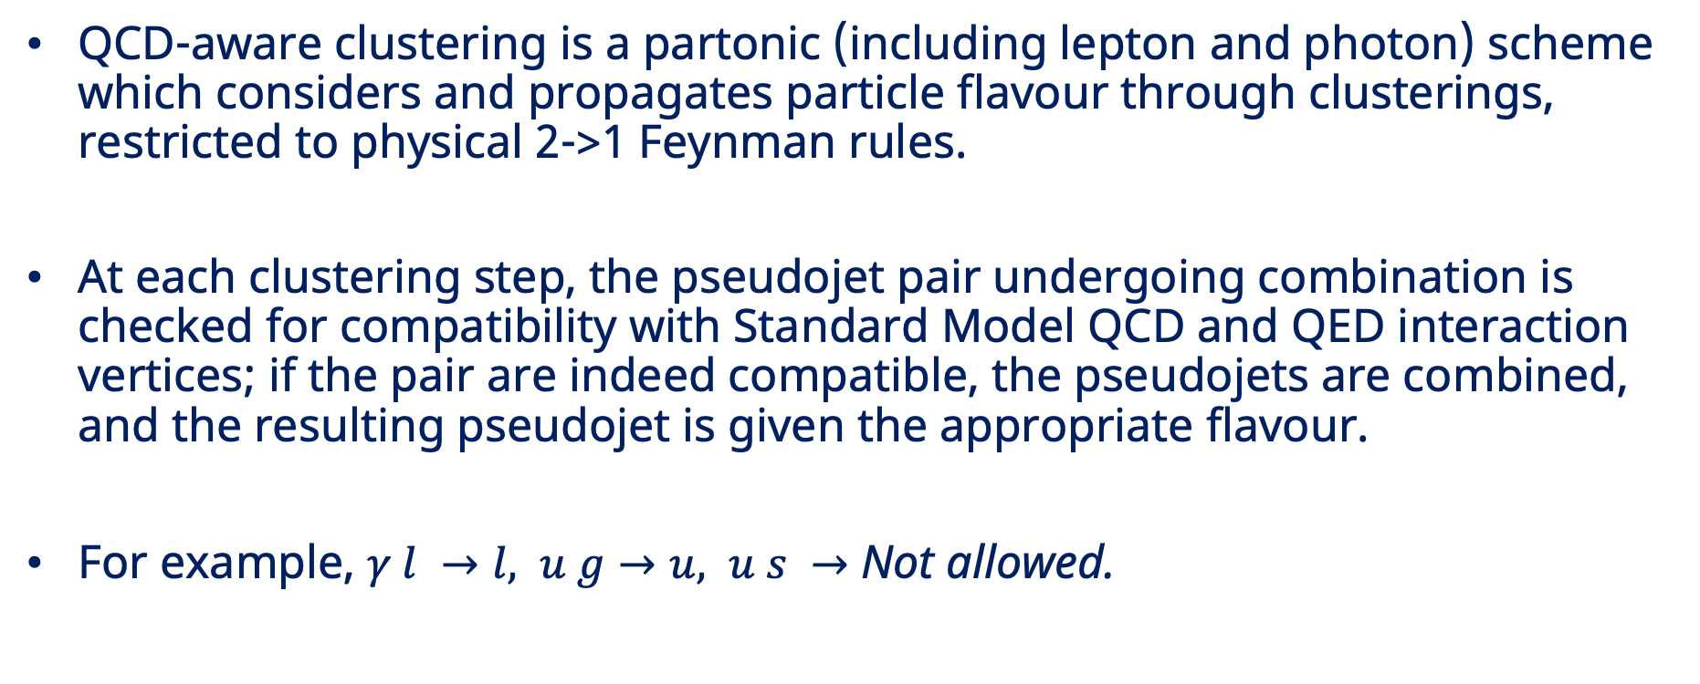
Fastjet::QCDAwarePlugin
QCD-aware clustering is a partonic (including lepton and photon) scheme which considers and propagates particle flavour through clusterings, restricted to physical 2->1 Feynman rules.
At each clustering step, the pseudojet pair undergoing combination is checked for compatibility with Standard Model QCD and QED interaction vertices; if the pair are indeed compatible, the pseudojets are combined, and the resulting pseudojet is given the appropriate flavour.
For example, $γ l →l, u g→u, u s →$ Not allowed.

Slide 3
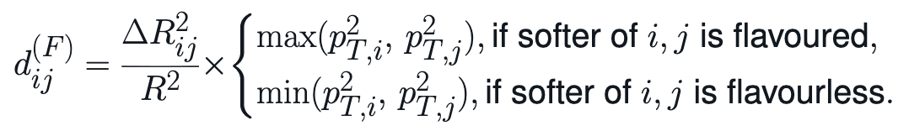

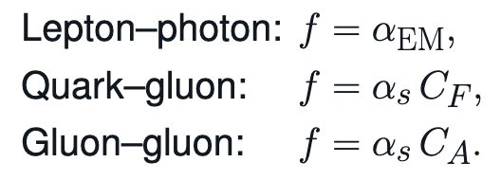
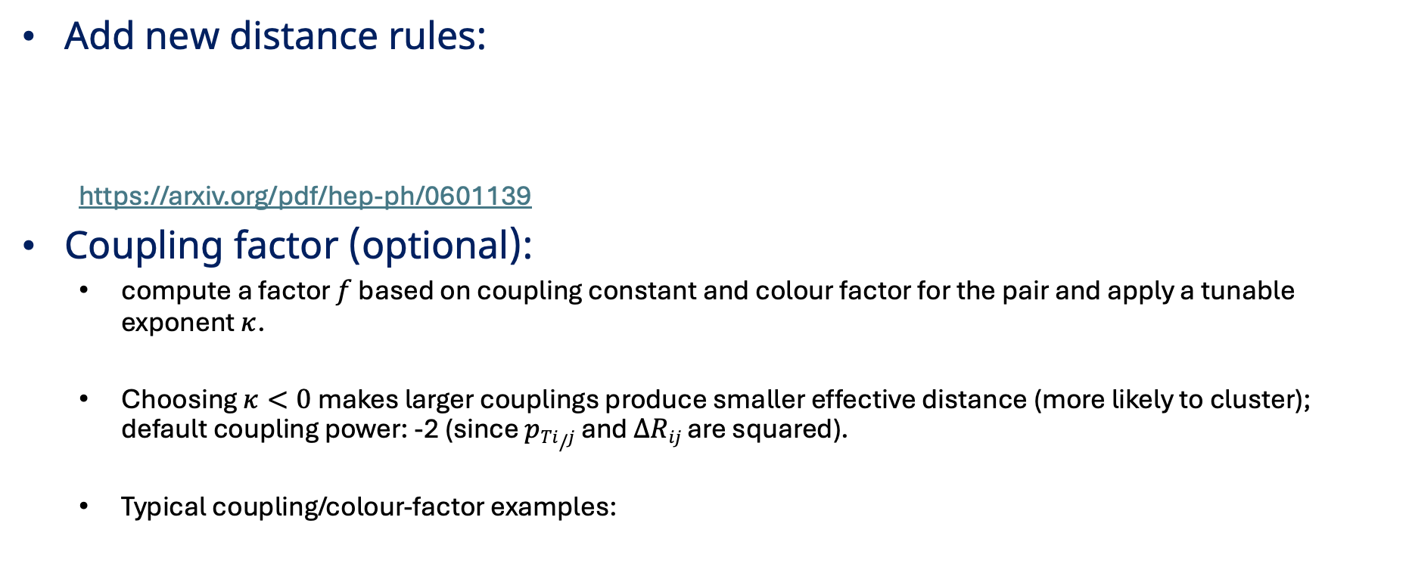
Fastjet::QCDAwarePlugin
Add new distance rules:
https://arxiv.org/pdf/hep-ph/0601139
Coupling factor (optional):
compute a factor $f$ based on coupling constant and colour factor for the pair and apply a tunable exponent $κ$.
Choosing $κ<0$ makes larger couplings produce smaller effective distance (more likely to cluster); default coupling power: -2 (since $pTi/j$ and $ΔRij$ are squared).
Typical coupling/colour-factor examples:

Slide 4
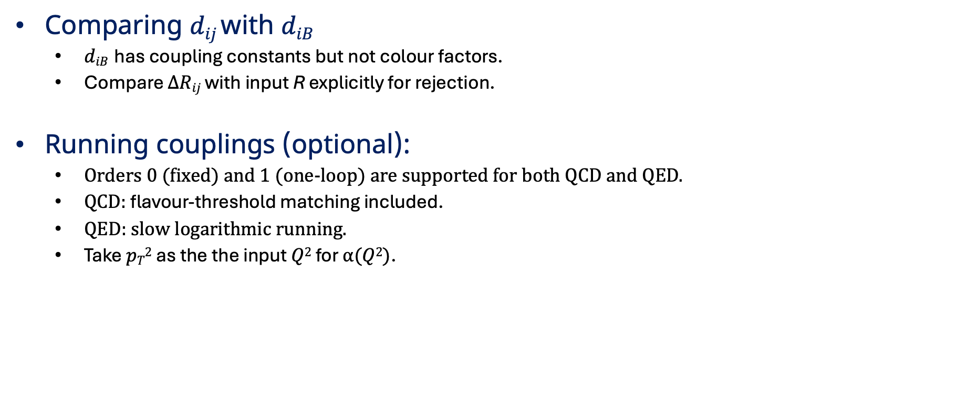
Fastjet::QCDAwarePlugin
Comparing $dij$with $diB$
$diB$ has coupling constants but not colour factors.
Compare $ΔRij$ with input R explicitly for rejection.
Running couplings (optional):
Orders 0 (fixed) and 1 (one-loop) are supported for both QCD and QED.
QCD: flavour-threshold matching included.
QED: slow logarithmic running.
Take $pT2$ as the the input $Q2$ for $α(Q2)$.

Slide 5
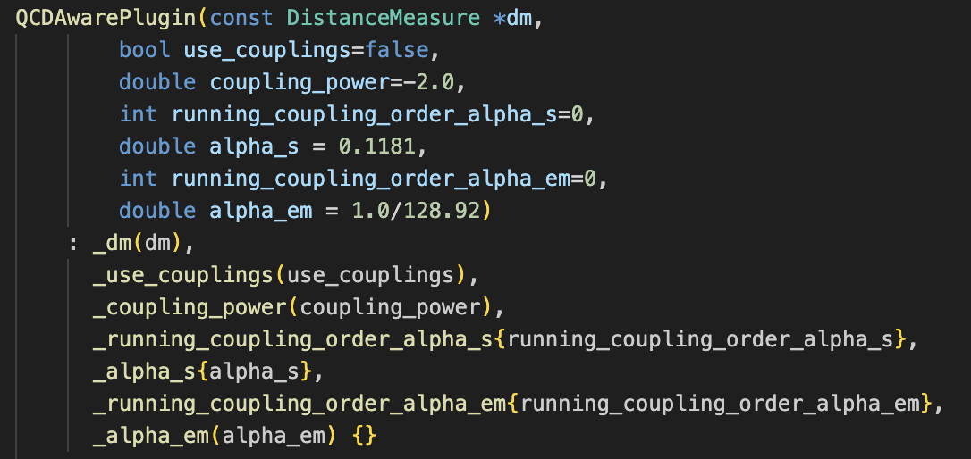
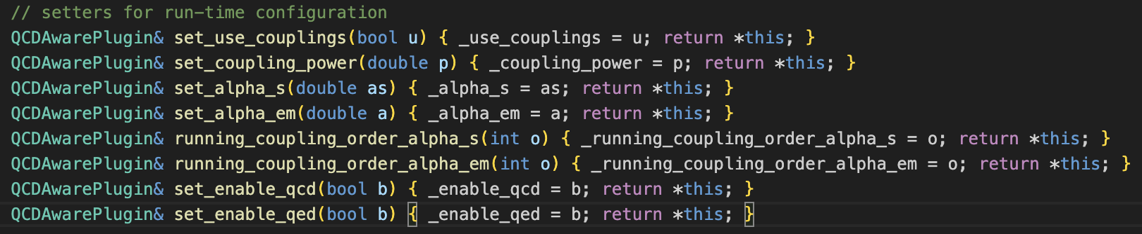
Parameters and Functions

Slide 6
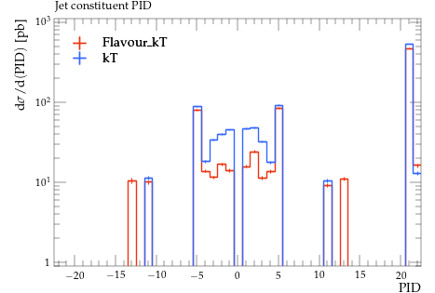
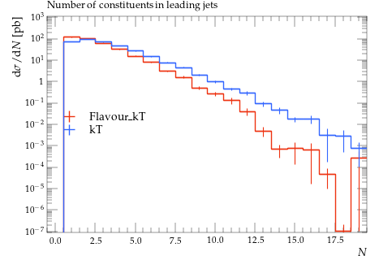
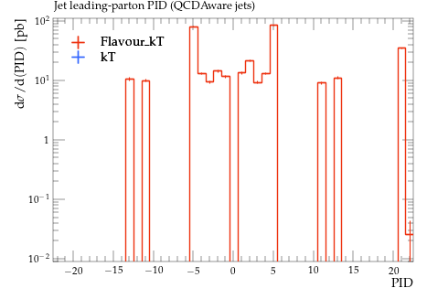
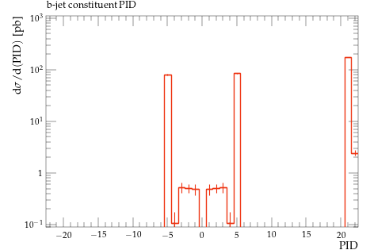
Validations with Semileptonic ttbar Events

Slide 7
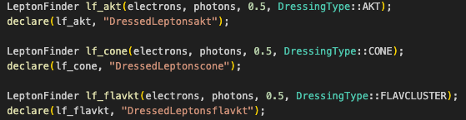
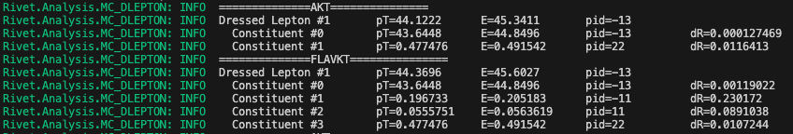
Application in Rivet Leptonfinder Projection
Goal: Add general particles such as e+e- to dressed lepton.
Add a new option of dressing mode Dressingtype::FLAVCLUSTER (code not yet pushed to Rivet).

