Slide 1

The fits behind the physics
Based on: 2311.18011, 2505.11492, and 2510.13969
Alexandre Jean
In collaboration with R. Bertiaume (U Montreal), B. Bhattacharya (LTU), M. Bouchard (U Montreal), R. Boumris (U Montreal), L. Hudy (LTU), S. Kumbhakar (U Montreal), D. London (U Montreal), C. MacKenzie (LTU), I. Ray (U Montreal)

Slide 2
The physics side of things

Slide 3
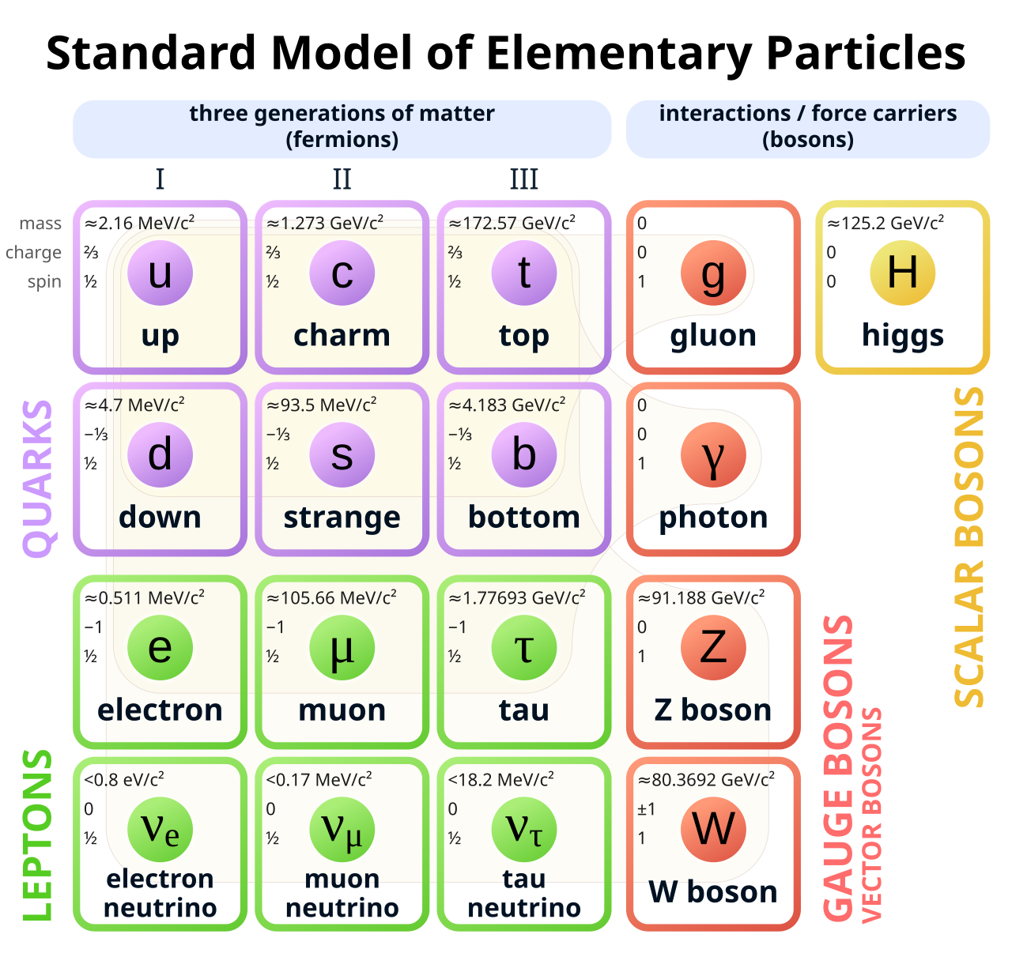
Standard Model
SU(3)-flavour
Expected to be broken
B meson decays

Slide 4
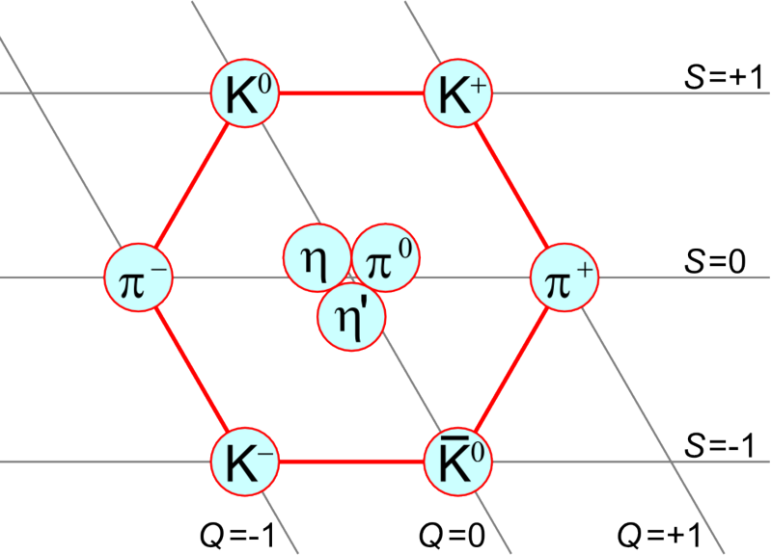



SU(3)-Flavour
($u,$ $d$, $s$) form a triplet
($\overline{u}$, $\overline{d}$, $\overline{s}$) form an anti-triplet
The light-pseudoscalar mesons form an octet + singlet
The $B$ mesons form a triplet ($B^{+}, B^{0}, B_{s}^{0}$)

Slide 5
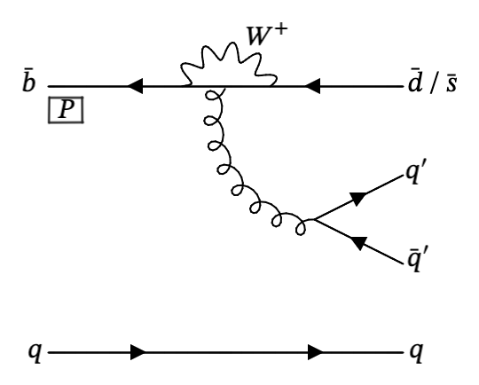
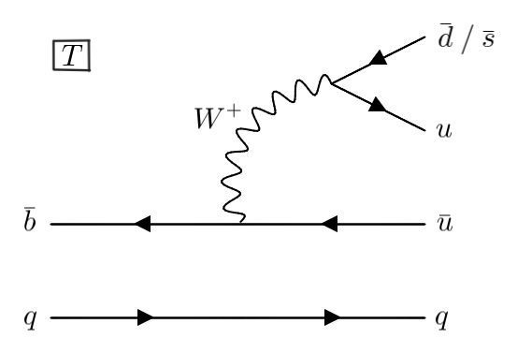
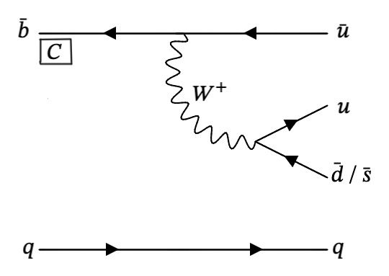
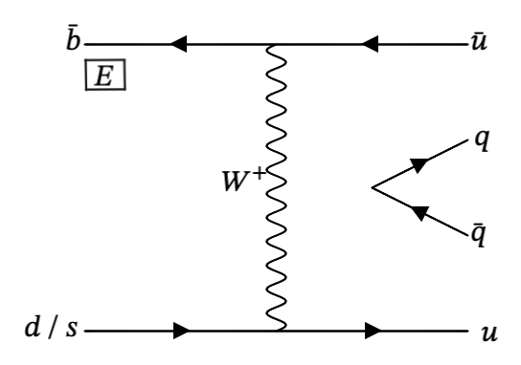
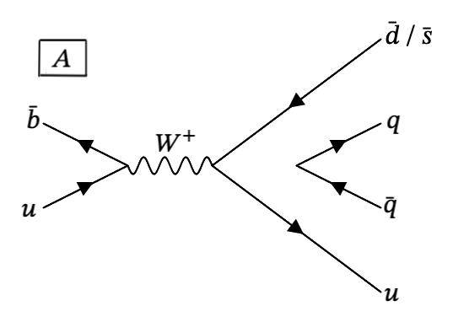
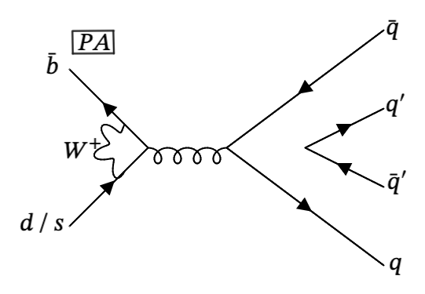
Diagrams

Slide 6
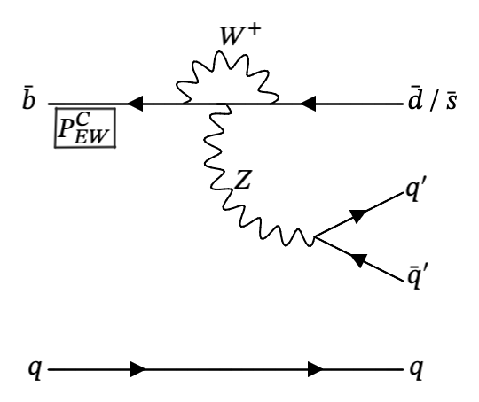
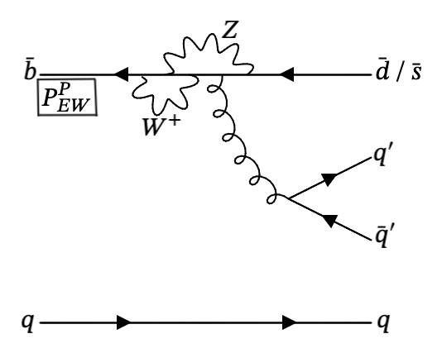
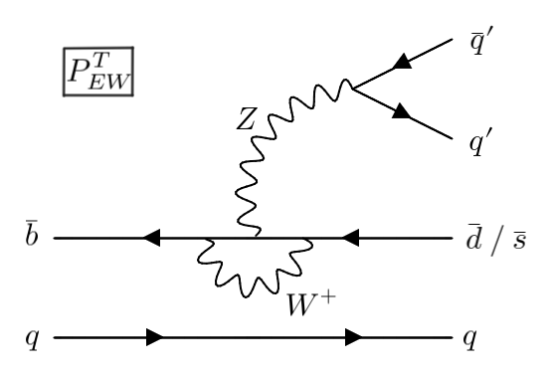
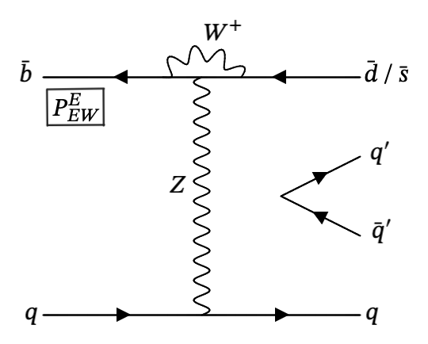
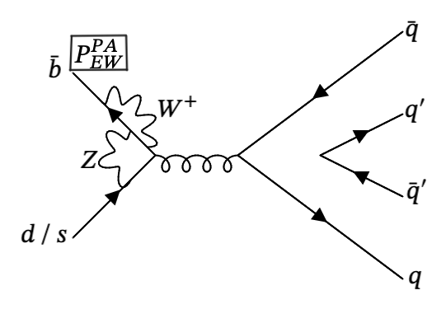
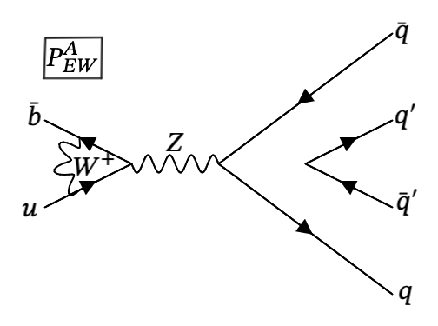

Electroweak penguin diagrams

Slide 7


RMEs
The Hamiltonian
$ΔS=0: \overline{b}→\overline{u}u\overline{d}$ or $\overline{b}→(\overline{d}d+\overline{s}s)\overline{d}$
$ΔS=1: \overline{b}→\overline{u}u\overline{s}$ or $\overline{b}→(\overline{d}d+\overline{s}s)\overline{s}$
$\overline{3}⊗3⊗\overline{3}∝\overline{3}⊕6⊕\overline{15}$
Final state
${\left(8⊗8\right)}_{S}∝1⊕8⊕27$
Initial state
$3$
Combining it
$A_{1}=⟨1|\left|\overline{3}\right||3⟩$
$A_{8}=⟨8|\left|\overline{3}\right||3⟩$
$R_{8}=⟨8|\left|6\right||3⟩$
$P_{8}=⟨8|\left|\overline{15}\right||3⟩$
$P_{27}=⟨27|\left|\overline{15}\right||3⟩$

Slide 8

EWP-tree relations
$$H_{(q)}^{eff}=\frac{G_{F}}{\sqrt{2}}\left(λ_{u}^{(q)}\sum_{i=1}^{2}{c_{i}^{(q)}Q_{i}^{(q)}}−λ_{t}^{(q)}\sum_{i=3}^{10}{c_{i}^{(q)}Q_{i}^{(q)}}\right)$$
$Q_{1}^{(q)}={\left(\overline{b}u\right)}_{V−A}{\left(\overline{u}q\right)}_{V−A}$ $Q_{2}^{(q)}={\left(\overline{b}q\right)}_{V−A}{\left(\overline{u}u\right)}_{V−A}$
$$Q_{3,5}^{(q)}={\left(\overline{b}q\right)}_{V−A}\left[{\left(\overline{u}u\right)}_{V∓A}+{\left(\overline{d}d\right)}_{V∓A}+{\left(\overline{s}s\right)}_{V∓A}\right]$$
$$Q_{4,6}^{(q)}={\left(\overline{b}u\right)}_{V−A}{\left(\overline{u}q\right)}_{V∓A}+{\left(\overline{b}d\right)}_{V−A}{\left(\overline{d}q\right)}_{V∓A}+{\left(\overline{b}s\right)}_{V−A}{\left(\overline{s}q\right)}_{V∓A}$$
$$Q_{7,9}^{(q)}=\frac{3}{2}{\left(\overline{b}q\right)}_{V−A}\left[{\frac{2}{3}\left(\overline{u}u\right)}_{V∓A}−\frac{1}{3}{\left(\overline{d}d\right)}_{V∓A}−\frac{1}{3}{\left(\overline{s}s\right)}_{V∓A}\right]$$
$$Q_{8,10}^{(q)}=\frac{3}{2}\left(\frac{2}{3}{\left(\overline{b}u\right)}_{V−A}{\left(\overline{u}q\right)}_{V∓A}−\frac{1}{3}{\left(\overline{b}d\right)}_{V−A}{\left(\overline{d}q\right)}_{V∓A}−\frac{1}{3}{\left(\overline{b}s\right)}_{V−A}{\left(\overline{s}q\right)}_{V∓A}\right)$$

Slide 9
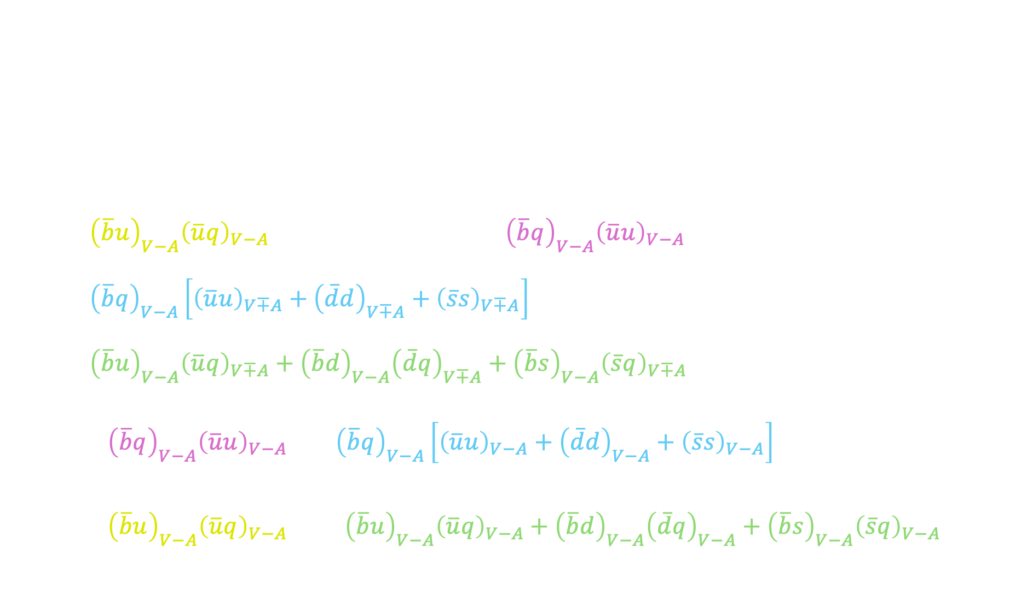
EWP-tree relations
$$H_{(q)}^{eff}=\frac{G_{F}}{\sqrt{2}}\left(λ_{u}^{(q)}\sum_{i=1}^{2}{c_{i}^{(q)}Q_{i}^{(q)}}−λ_{t}^{(q)}\sum_{i=3}^{10}{c_{i}^{(q)}Q_{i}^{(q)}}\right)$$
$Q_{1}^{(q)}={\left(\overline{b}u\right)}_{V−A}{\left(\overline{u}q\right)}_{V−A}$ $Q_{2}^{(q)}={\left(\overline{b}q\right)}_{V−A}{\left(\overline{u}u\right)}_{V−A}$
$$Q_{3,5}^{(q)}={\left(\overline{b}q\right)}_{V−A}\left[{\left(\overline{u}u\right)}_{V∓A}+{\left(\overline{d}d\right)}_{V∓A}+{\left(\overline{s}s\right)}_{V∓A}\right]$$
$$Q_{4,6}^{(q)}={\left(\overline{b}u\right)}_{V−A}{\left(\overline{u}q\right)}_{V∓A}+{\left(\overline{b}d\right)}_{V−A}{\left(\overline{d}q\right)}_{V∓A}+{\left(\overline{b}s\right)}_{V−A}{\left(\overline{s}q\right)}_{V∓A}$$
$$Q_{9}^{(q)}=\frac{3}{2}{\left(\overline{b}q\right)}_{V−A}{\left(\overline{u}u\right)}_{V−A}−\frac{1}{2}{\left(\overline{b}q\right)}_{V−A}\left[{\left(\overline{u}u\right)}_{V−A}+{\left(\overline{d}d\right)}_{V−A}+{\left(\overline{s}s\right)}_{V−A}\right]$$
$$Q_{10}^{(q)}=\frac{3}{2}{\left(\overline{b}u\right)}_{V−A}{\left(\overline{u}q\right)}_{V−A}−\frac{1}{2}\left[{\left(\overline{b}u\right)}_{V−A}{\left(\overline{u}q\right)}_{V−A}+{\left(\overline{b}d\right)}_{V−A}{\left(\overline{d}q\right)}_{V−A}+{\left(\overline{b}s\right)}_{V−A}{\left(\overline{s}q\right)}_{V−A} \right]$$

Slide 10
The fit side of things

Slide 11

Gradient descent (simple example)

Slide 12
Gradient descent (more parameters)

Slide 13
Minuit: Migrad

Slide 14

Dimension problem

Slide 15
Bayesian fits

Slide 16
Nested sampling

Slide 17
Fitting the physics

Slide 18

Parametrisation
Two ways of writing the amplitudes ($𝒫$: diagram or RME):
$$A=\sum_{i}{a_{i}λ_{i}𝒫_{i}}$$
Connection between RMEs and diagrams
10 parameters – 3 ETRs = 7 complex parameters (assuming $c_{7},c_{8}≪c_{9},c_{10}$)
$$\left(\begin{matrix}A_{1} \\ A_{8} \\ \begin{matrix}R_{8} \\ \begin{matrix}P_{8} \\ P_{27}\end{matrix}\end{matrix}\end{matrix}\right)=\left(\begin{matrix}\frac{−3}{2\sqrt{3}} & \frac{1}{2\sqrt{3}} & \begin{matrix}\frac{−8}{2\sqrt{3}} & 0 & \frac{−12}{2\sqrt{3}}\end{matrix} \\ \frac{−3}{8}\sqrt{\frac{5}{3}} & \frac{1}{8}\sqrt{\frac{5}{3}} & \begin{matrix}−\sqrt{\frac{5}{3}} & \frac{−3}{8}\sqrt{\frac{5}{3}} & 0\end{matrix} \\ \begin{matrix}\frac{\sqrt{5}}{4} \\ \frac{1}{8\sqrt{3}} \\ −\frac{1}{2\sqrt{3}}\end{matrix} & \begin{matrix}−\frac{\sqrt{5}}{4} \\ \frac{1}{8\sqrt{3}} \\ −\frac{1}{2\sqrt{3}}\end{matrix} & \begin{matrix}\begin{matrix}0 & −\frac{\sqrt{5}}{4} & 0\end{matrix} \\ \begin{matrix}0 & \frac{5}{8\sqrt{3}} & 0\end{matrix} \\ \begin{matrix}0 & 0 & 0\end{matrix}\end{matrix}\end{matrix}\right)\left(\begin{matrix}\tilde{T} \\ \tilde{C} \\ \begin{matrix}{\tilde{P}}_{uc} \\ \tilde{A} \\ {\tilde{PA}}_{uc}\end{matrix}\end{matrix}\right)$$

Slide 19




Observables (without $η/η′$)
Branching ratio
$$B_{CP}=F_{PS}({\left|A\right|}^{2}+{\left|\overline{A}\right|}^{2})$$
$ΔS=0$: 7 observables
$ΔS=1$: 8 observables
Total: 15 observables
Direct CP violation
$$A_{CP}= \frac{{\left|\overline{A}\right|}^{2}−{\left|A\right|}^{2}}{{\left|\overline{A}\right|}^{2}+{\left|A\right|}^{2}}$$
$ΔS=0$: 6 observables
$ΔS=1$: 5 observables
Total: 11 observables
Indirect CP violation
$$S_{CP}=−η_{CP}2Im\left(\frac{q}{p}\frac{AA^{∗}}{{\left|\overline{A}\right|}^{2}+{\left|A\right|}^{2}}\right)$$
$ΔS=0$: 2 observables
$ΔS=1$: 2 observables
Total: 4 observables

Slide 20


Fit results (without $η/η′$)
13 parameters: 7 amplitudes + 6 phases (7 real parts + 6 imaginary parts)
$ΔS=0:$ 15 observables - 13 parameters = 2 d. o. f.
$χ_{min}^{2}=1.057 \sim 0.5 σ$ ✅
$ΔS=1:$ 15 observables - 13 parameters = 2 d. o. f.
$χ_{min}^{2}=1.547 \sim 0.7 σ$ ✅
Full fit: 30 observables – 13 parameters = 17 d. o. f.
$χ_{min}^{2}=43.19 \sim 3.5 σ$ ❌

Slide 21
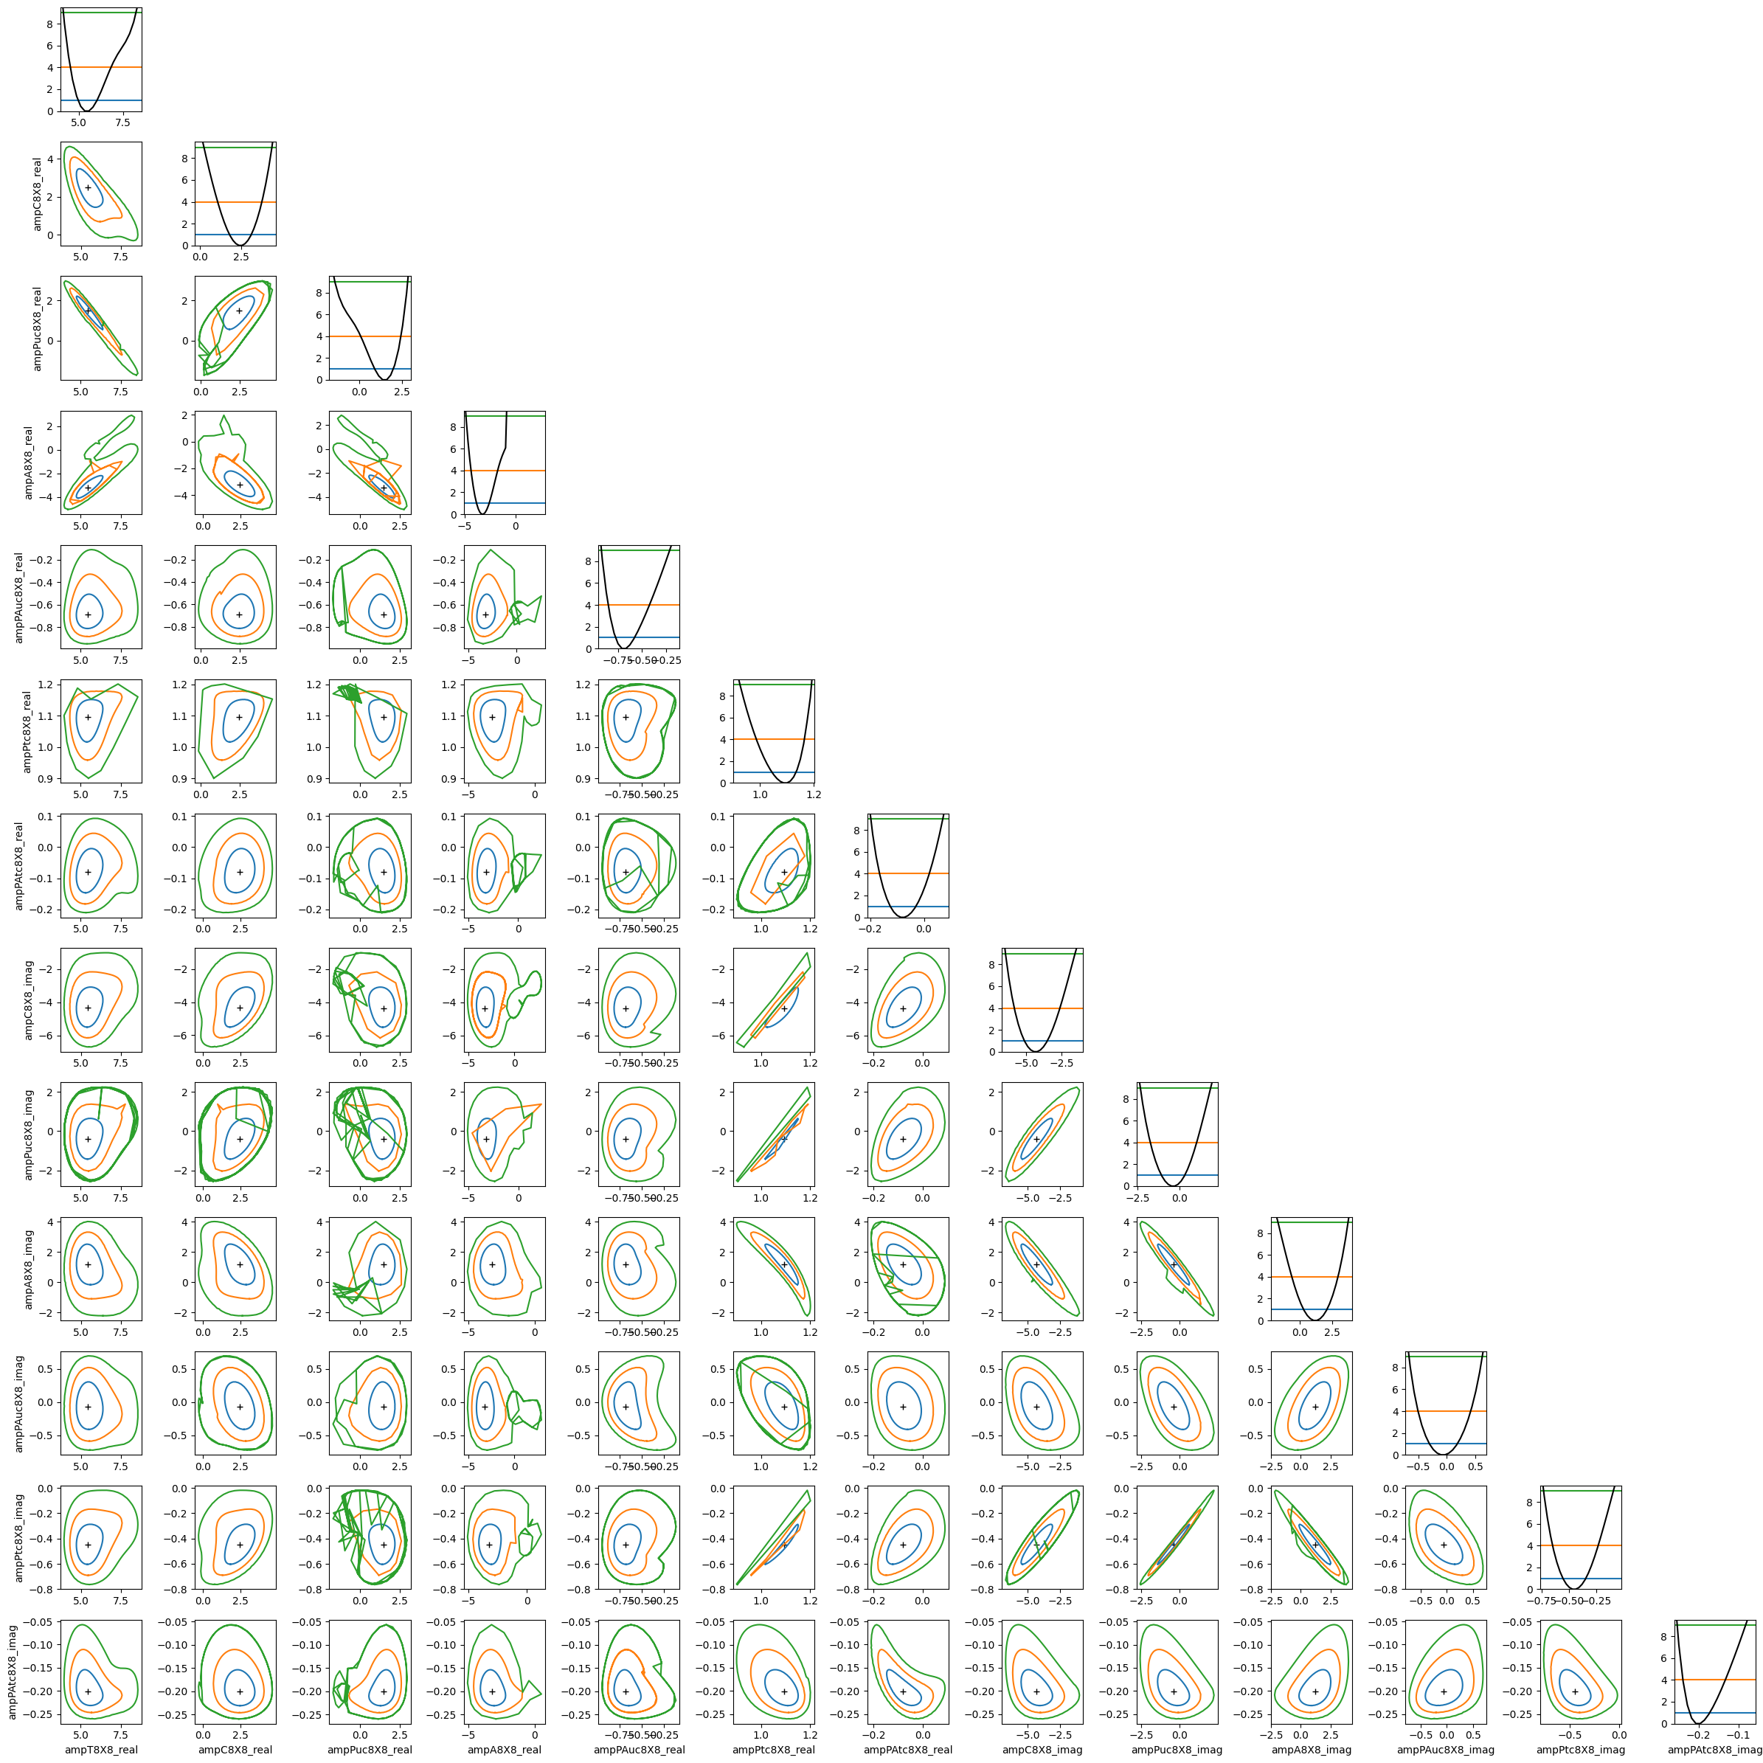
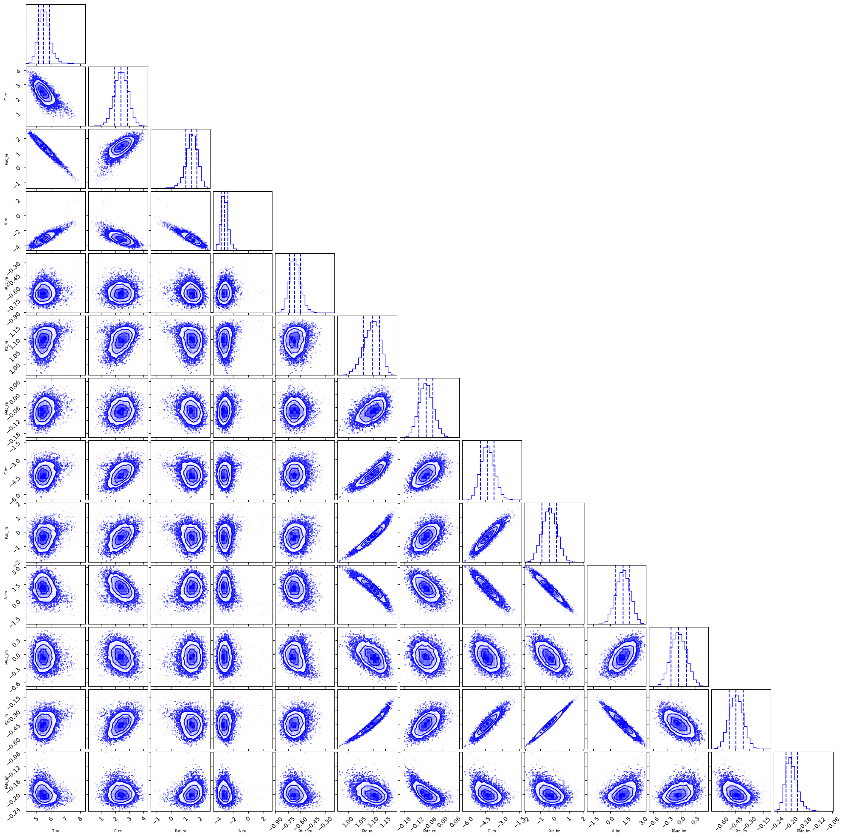
Fit results (without $η/η′$)
Minuit
Dynesty

Slide 22
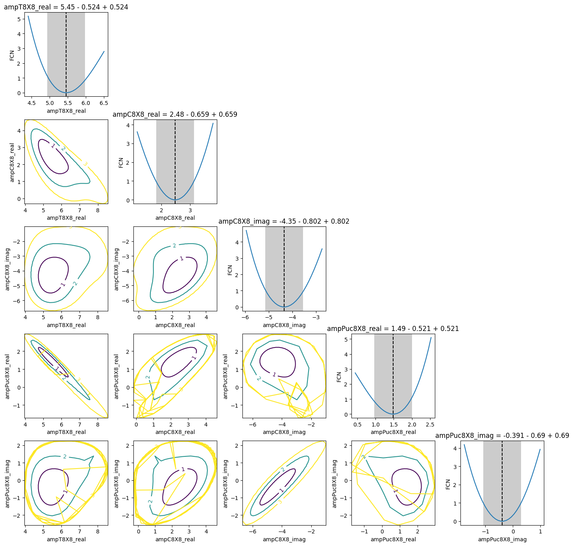
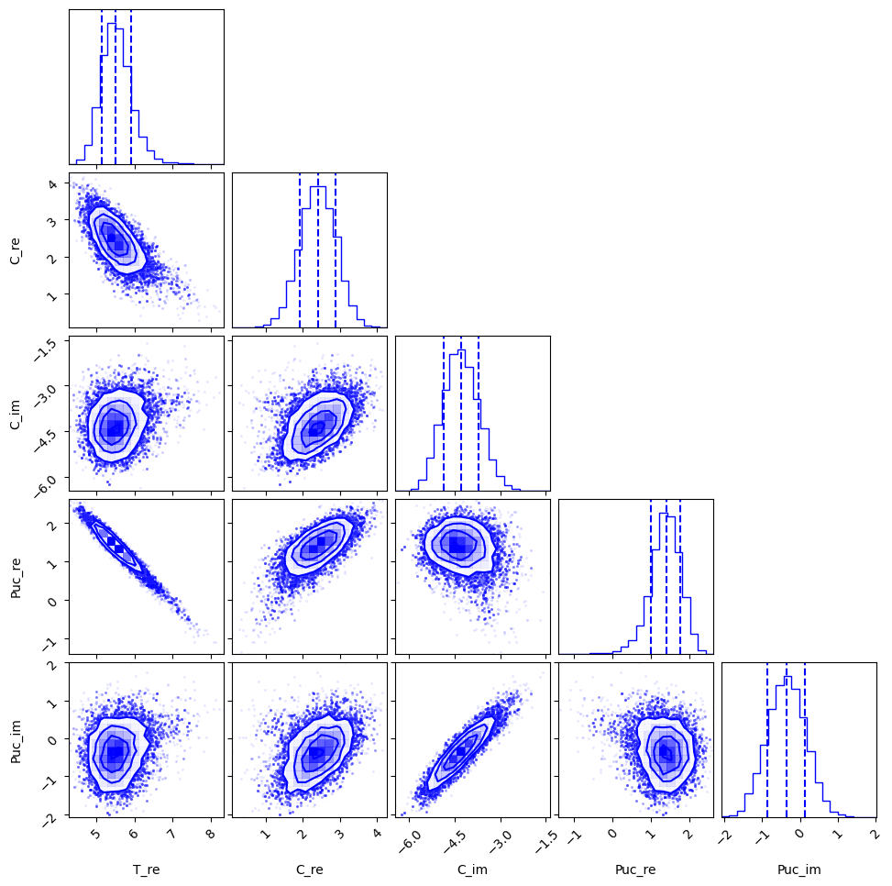
Fit results (a closer look)

Slide 23
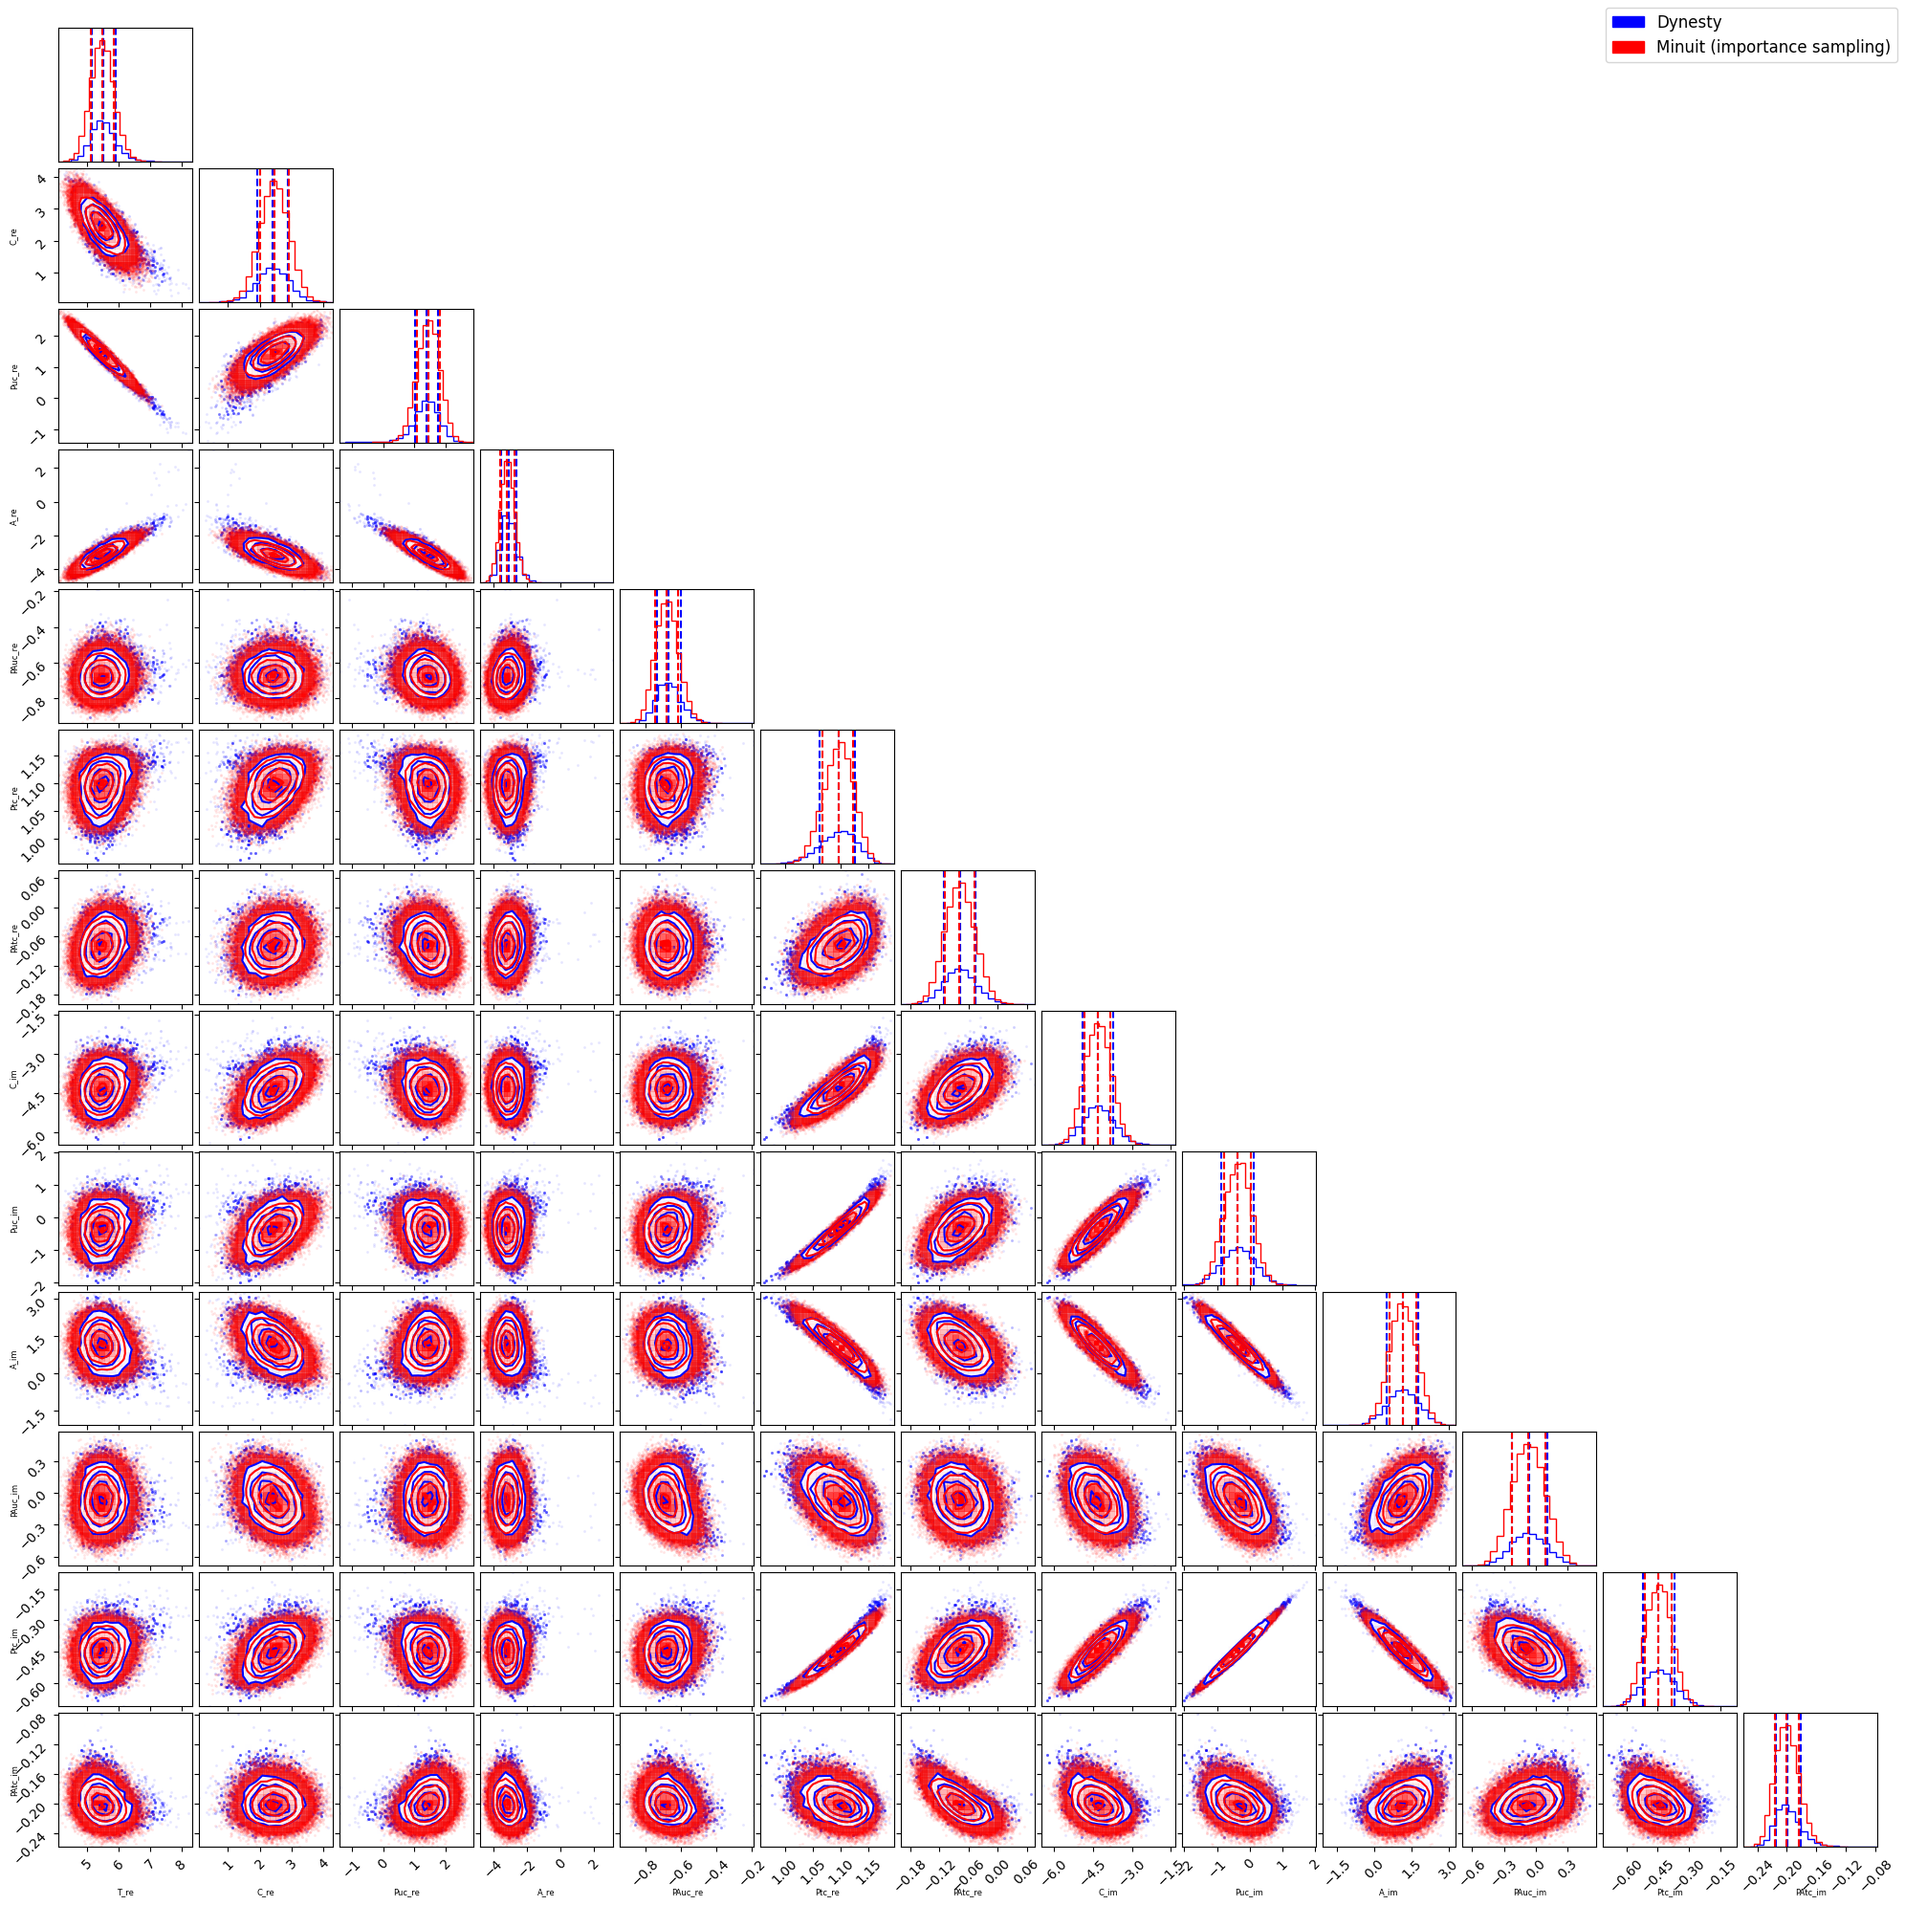
Fit results
Both fits overlap
The fits agree
Global minima?

Slide 24




Observables (with one $η/η′$)
Branching ratio
$$B_{CP}=F_{PS}({\left|A\right|}^{2}+{\left|\overline{A}\right|}^{2})$$
$ΔS=0$: 11 observables
$ΔS=1$: 12 observables
Total: 23 observables
Direct CP violation
$$A_{CP}= \frac{{\left|\overline{A}\right|}^{2}−{\left|A\right|}^{2}}{{\left|\overline{A}\right|}^{2}+{\left|A\right|}^{2}}$$
$ΔS=0$: 8 observables
$ΔS=1$: 8 observables
Total: 16 observables
Indirect CP violation
$$S_{CP}=−η_{CP}2Im\left(\frac{q}{p}\frac{AA^{∗}}{{\left|\overline{A}\right|}^{2}+{\left|A\right|}^{2}}\right)$$
$ΔS=0$: 2 observables
$ΔS=1$: 3 observables
Total: 5 observables

Slide 25


Fit results (with one $η/η′$)
21 parameters: 11 amplitudes + 10 phases (11 real parts + 10 imaginary parts)
$ΔS=0:$ 21 observables - 21 parameters = 0 d. o. f.
$χ_{min}^{2}=1. 057$ ✅
$ΔS=1:$ 23 observables - 21 parameters = 2 d. o. f.
$χ_{min}^{2}=1.547 \sim 0.7σ$ ✅
Full fit: 44 observables – 21 parameters = 23 d. o. f.
$χ_{min}^{2}=55.62 \sim 3.8 σ$ ❌

Slide 26
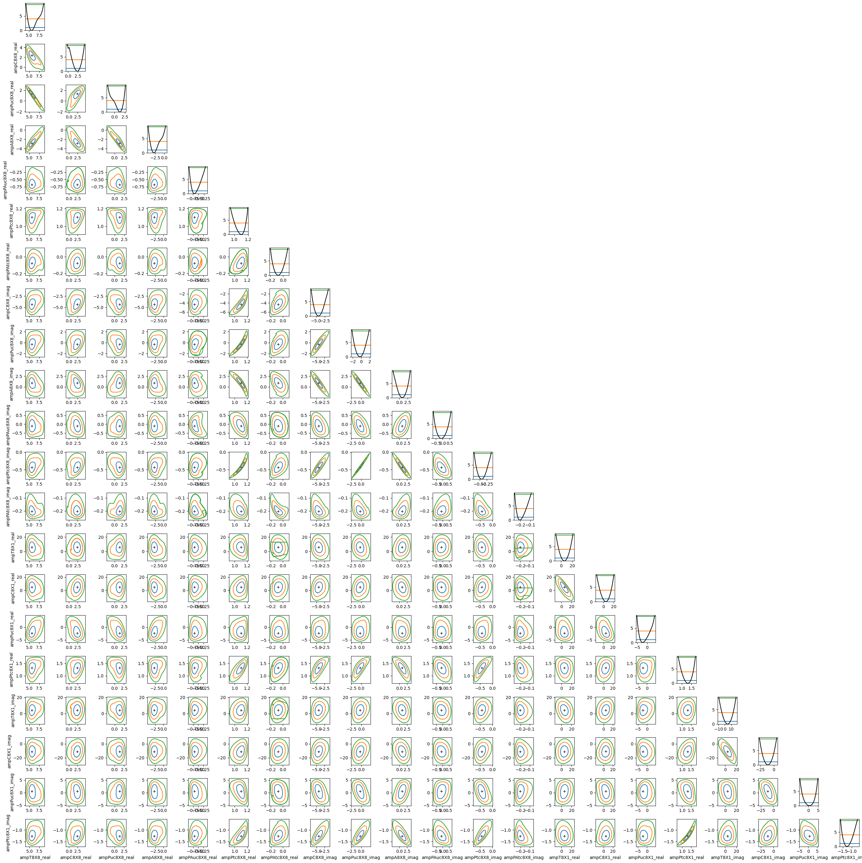
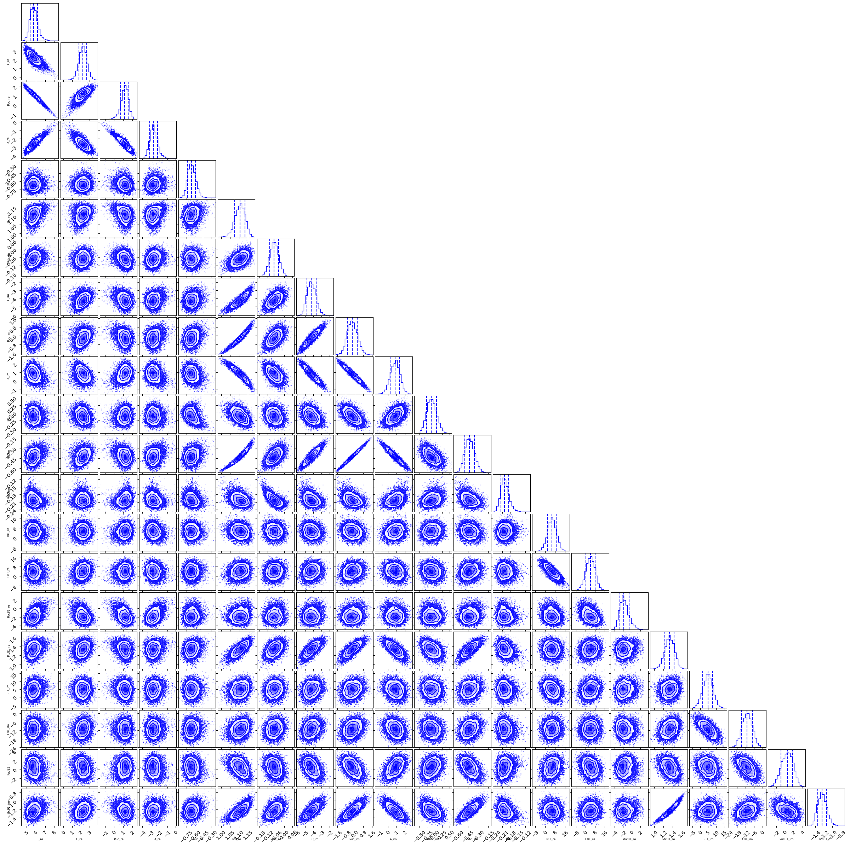
Fit results (with one $η/η′$)
Minuit
Dynesty

Slide 27
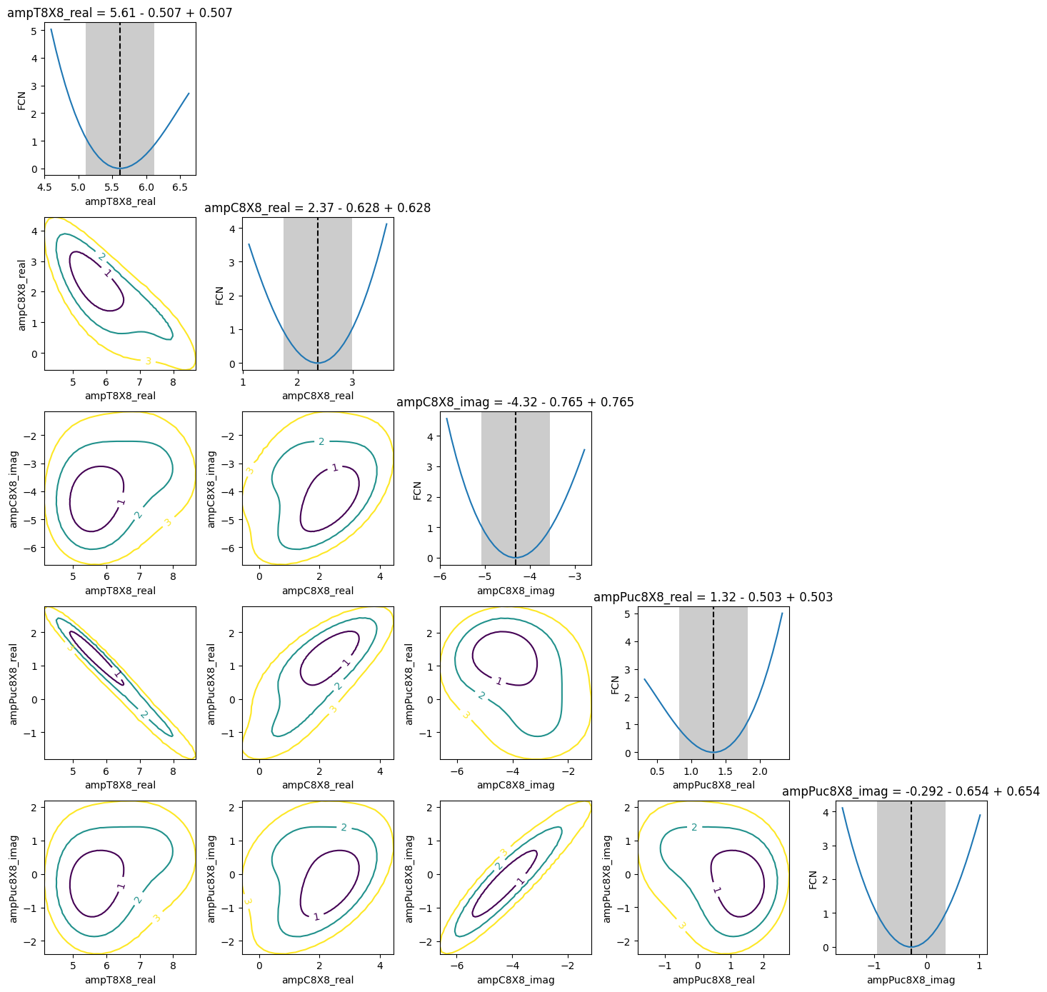
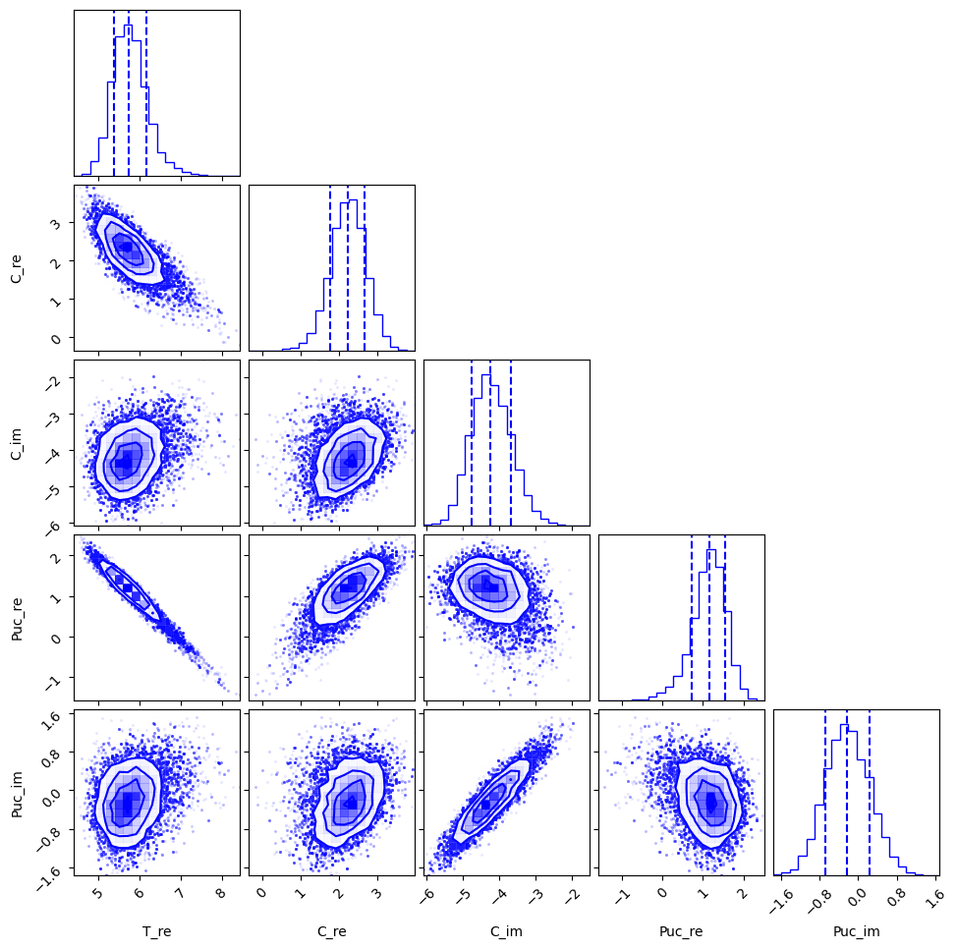
Fit results (a much needed closer look)

Slide 28
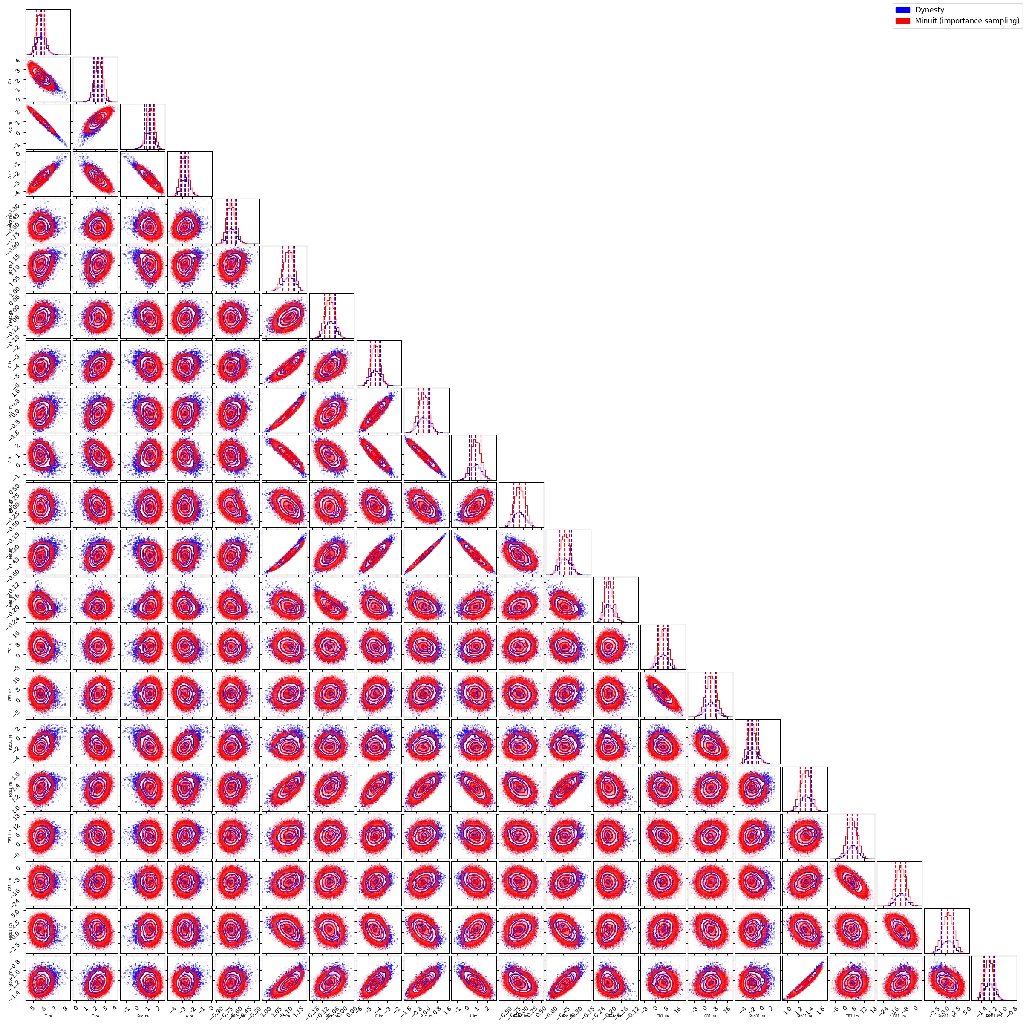
Fit results
Both fits overlap
The fits agree
Global minima?

Slide 29

Observables (all data)
Branching ratio
$$B_{CP}=F_{PS}({\left|A\right|}^{2}+{\left|\overline{A}\right|}^{2})$$
$ΔS=0$: 13 observables
$ΔS=1$: 15 observables
Total: 28 observables
Direct CP violation
$$A_{CP}= \frac{{\left|\overline{A}\right|}^{2}−{\left|A\right|}^{2}}{{\left|\overline{A}\right|}^{2}+{\left|A\right|}^{2}}$$
$ΔS=0$: 8 observables
$ΔS=1$: 8 observables
Total: 16 observables
Indirect CP violation
$$S_{CP}=−η_{CP}2Im\left(\frac{q}{p}\frac{AA^{∗}}{{\left|\overline{A}\right|}^{2}+{\left|A\right|}^{2}}\right)$$
$ΔS=0$: 2 observables
$ΔS=1$: 3 observables
Total: 5 observables

Slide 30

Fit results (all data)
25 parameters: 13 amplitudes + 12 phases (13 real parts + 12 imaginary parts)
$ΔS=0:$ 23 observables - 25 parameters < 0 d. o. f.
Not conclusive
$ΔS=1:$ 26 observables - 25 parameters = 1 d. o. f.
Not conclusive*
Full fit: 49 observables – 25 parameters = 24 d. o. f.
$χ_{min}^{2}= 60.77\sim 4.1 σ$ ❌

Slide 31
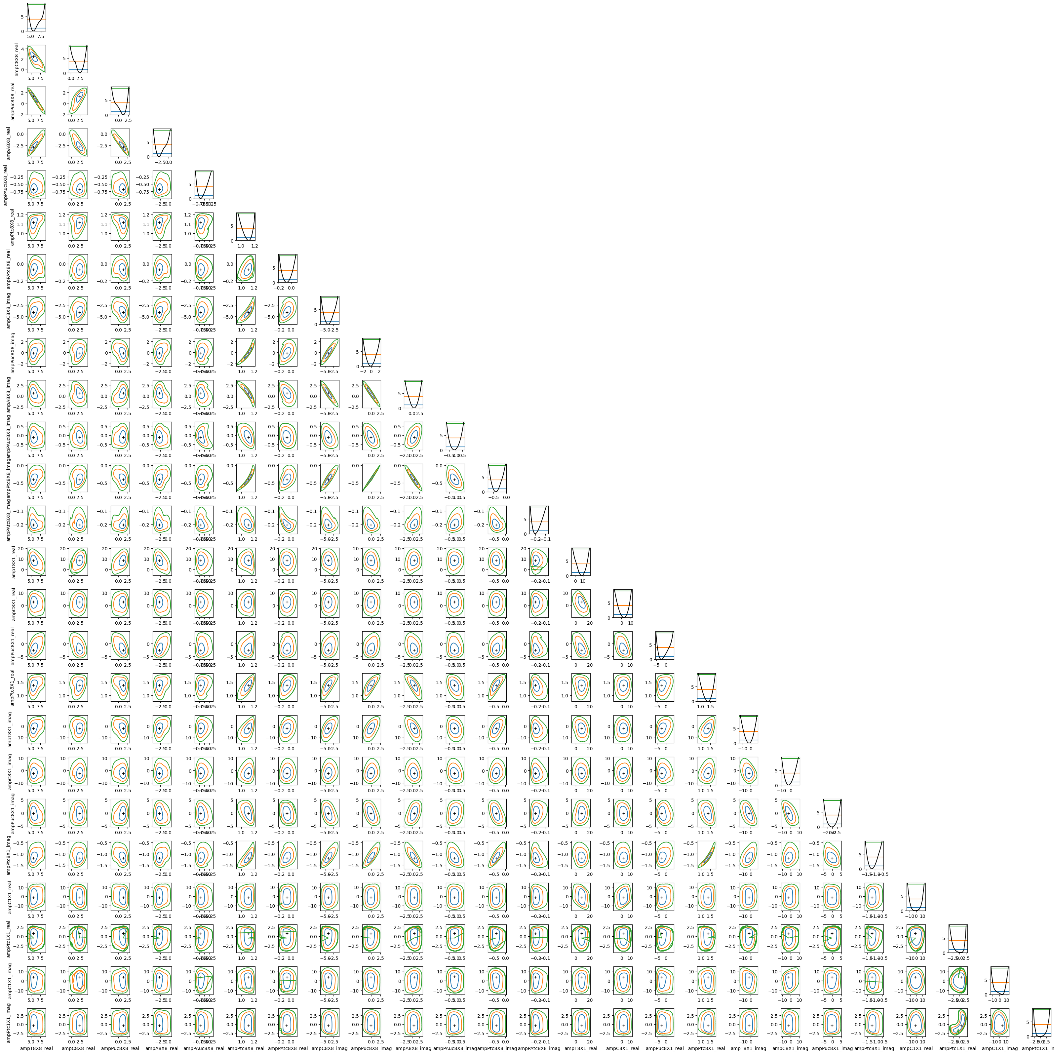
Fit results (full fit)
Minuit
A triangle

Slide 32
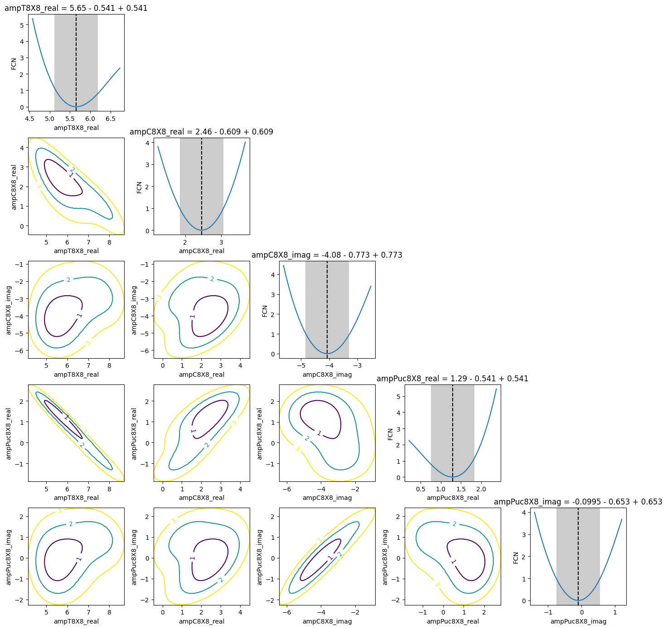
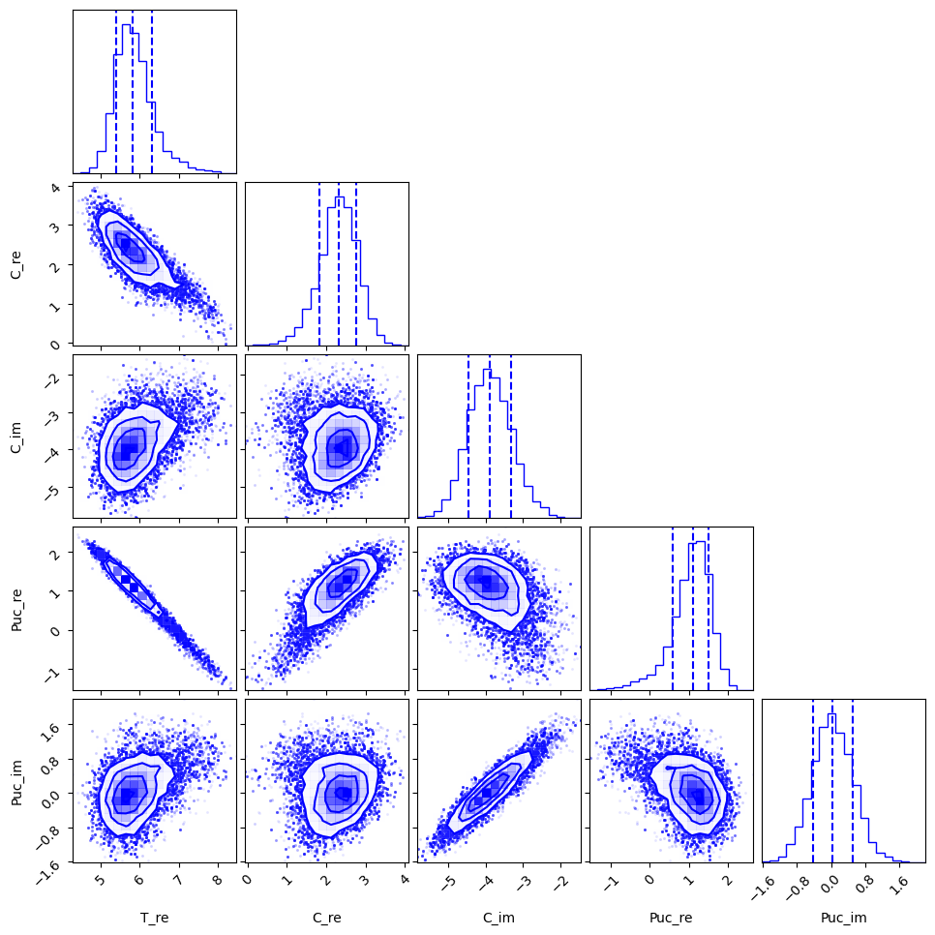
Fit results (a mandatory closer look)

Slide 33
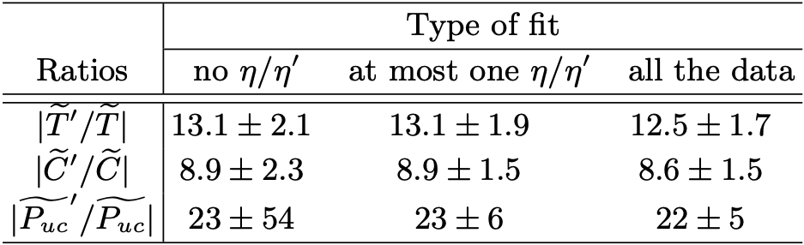
Fit parameters
Reason behind the bad fits
Huge ratio between parameters
Does this imply large SU(3)-flavour breaking?

Slide 34

Summary
Fits using both methods agree for all fits
$ΔS=0$ and $ΔS=1$ fits are good fits
The complete fits are bad
Some parameters exhibit large breaking
How do we measure this breaking? (work in progress)
Thank you!

