Slide 1
Bounds on the strength of a spin-independent fifth force:
Current reach of hydrogen and helium spectroscopy
R M Potvliege
with A Nicolson, M P A Jones and M Spannowsky
Physics Department, Durham University, UK

Slide 2
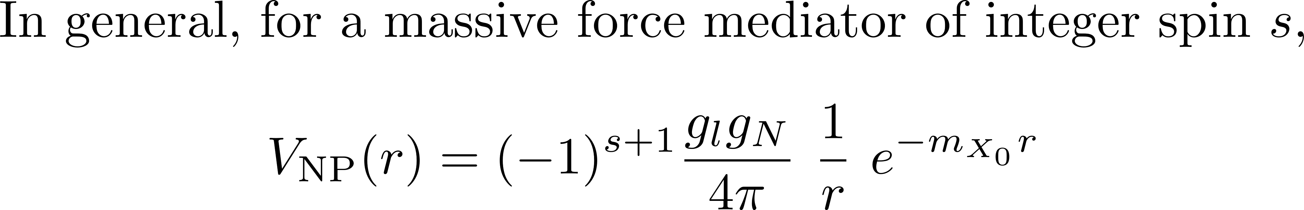
Type of new physics interaction considered here

Slide 3
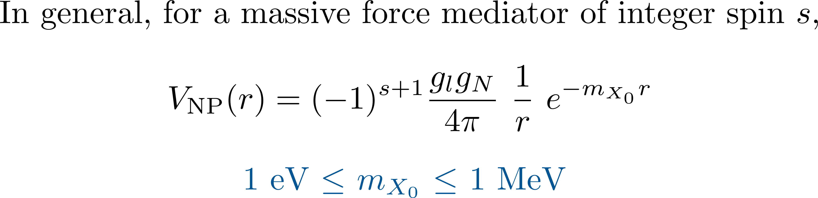
Type of new physics interaction considered here

Slide 4
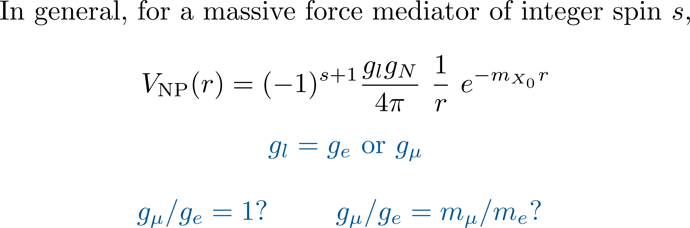

Type of new physics interaction considered here

Slide 5
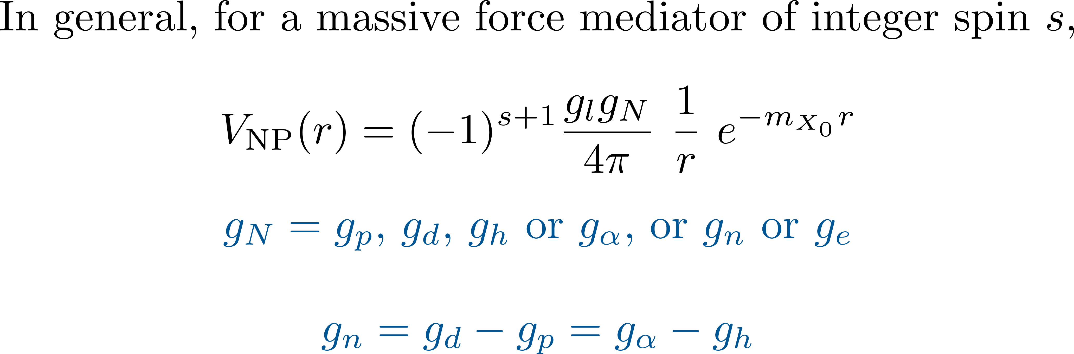
Type of new physics interaction considered here

Slide 6
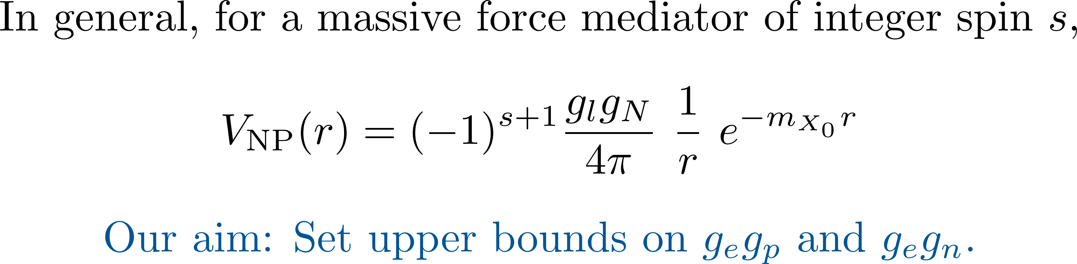
Type of new physics interaction considered here

Slide 7
Type of new physics interaction considered here
Using light atoms spectroscopic data in searching for such an interaction: E.g.,
Karshenboim [PRL 104, 220406 (2010) and PRD 82 073003 (2010)]
Jaekel and Roy [PRD 82, 125020 (2010)]
Brax and Burrage [PRD 83, 035020 (2011)]
Delaunay et al [PRD 96, 115002 (2017)]
Jentschura and Nandori [PRA 97, 042502 (2018)]
Jones et al [PRRes 2, 013244 (2020)]
Frugiuele and Peset [JHEP 05, 002 (2022)]
Delaunay et al [PRL 130, 121801 (2023)]
Potvliege et al [PRA 108, 052825 (2023)]
Potvliege [NJP 27, 045002 (2025)]

Slide 8
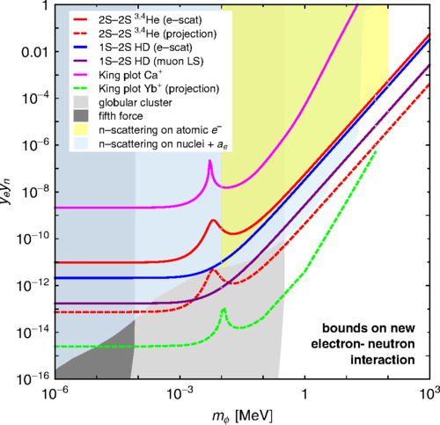
Bounds on gegn as of 2017
Status of this bound?
From C Delaunay et al, Phys. Rev. D 96, 115002 (2017)

Slide 9
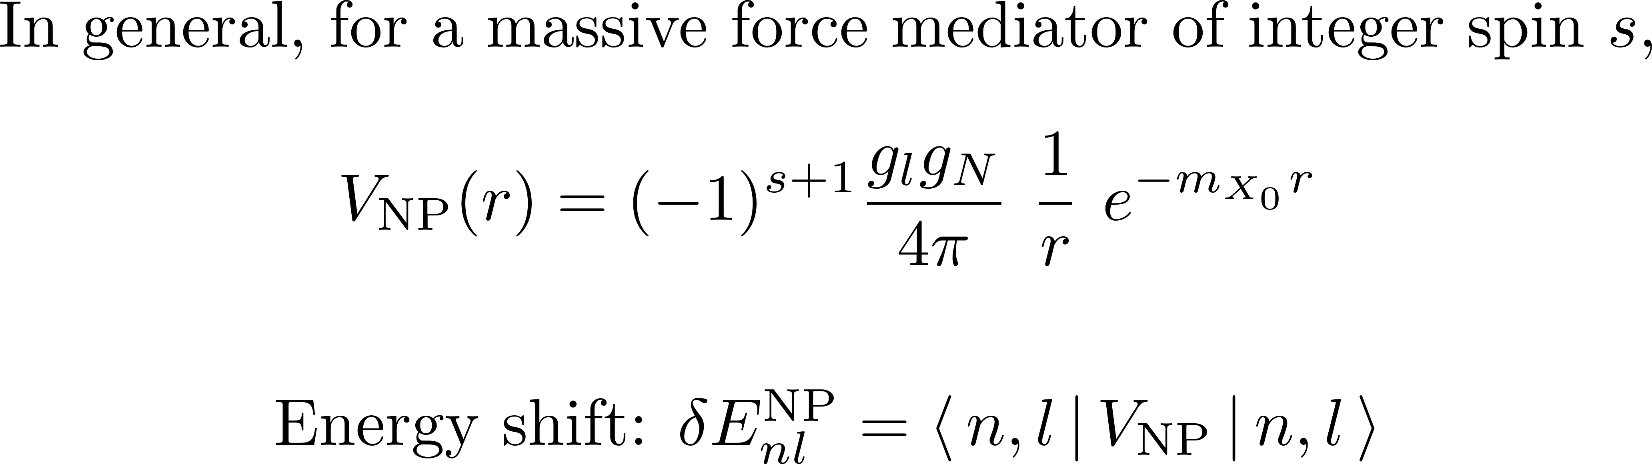
NP shifts

Slide 10
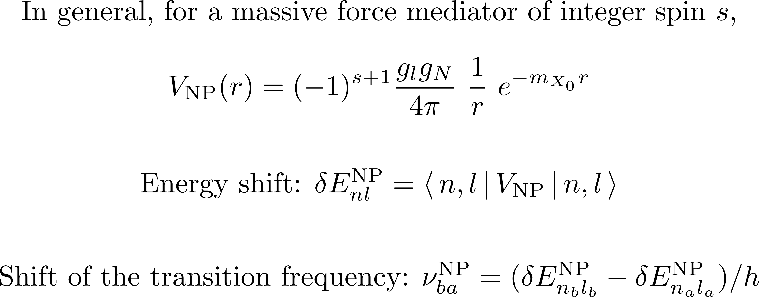
NP shifts

Slide 11
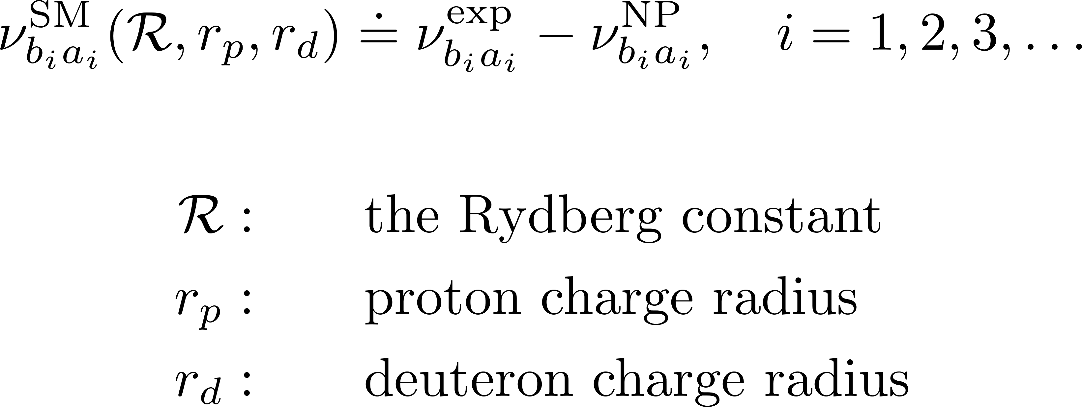
Chi-squared fitting to the standard model
How compatible is experiment with theory, assuming a NP interaction?

Slide 12
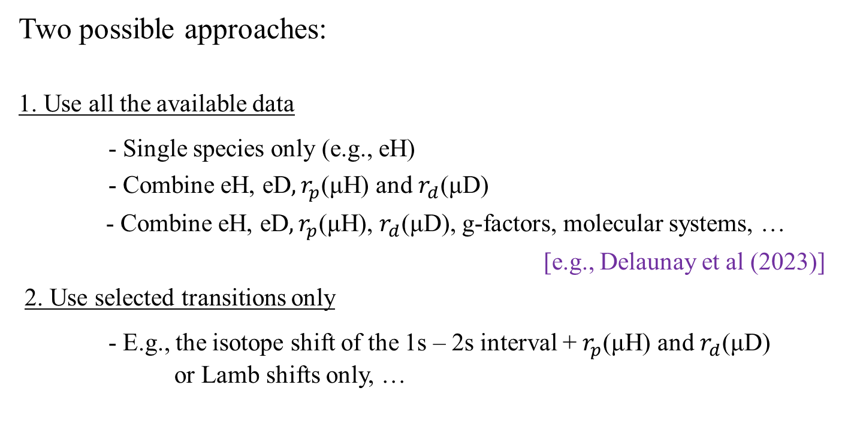
Chi-squared fitting to the standard model
Two possible approaches:
1. Use all the available data
- Single species only (e.g., eH)
- Combine eH, eD$, r_{p}$(μH) and $r_{d}$(μD)
- Combine eH, eD$, r_{p}$(μH), $r_{d}$(μD), g-factors, molecular systems, …
[e.g., Delaunay et al (2023)]
2. Use selected transitions only
- E.g., the isotope shift of the 1s – 2s interval + $r_{p}$(μH) and $r_{d}$(μD)
or Lamb shifts only, …

Slide 13
Chi-squared fitting to the standard model
1. Use all the available data
Pros: Use a number of independent measurements; broad range of transitions
Cons: Discrepancies in the data tend to make the bounds more stringent
for no good reasons; need to magnify the experimental errors; large
number of degrees of freedom may hide trends

Slide 14
Chi-squared fitting to the standard model
1. Use all the available data
Pros: Use a number of independent measurements; broad range of transitions
Cons: Discrepancies in the data tend to make the bounds more stringent
for no good reasons; need to magnify the experimental errors; large
number of degrees of freedom may hide trends
2. Use selected transitions only
Pros: Reduces discrepancies, focuses on the most precise data
Cons: Relies on the accuracy of a small number of measurements

Slide 15
Helium issues
Large differences between SM theory and experiment in the binding energy of several states
2 ³S state in helium-4: Δ = 0.477(52) MHz
2 ³S state in helium-3: Δ = 0.482(53) MHz
2 ³P state in helium-4: Δ = 0.444(17) MHz
[Clausen’s PhD thesis (2025)]

Slide 16
The proton radius issue
[Nature 650, 845 (2026)]
[PRL 136, 123001 (2026)]
[From V Wirthl et al, to be submitted to Rep. Prog. Phys.]

Slide 17
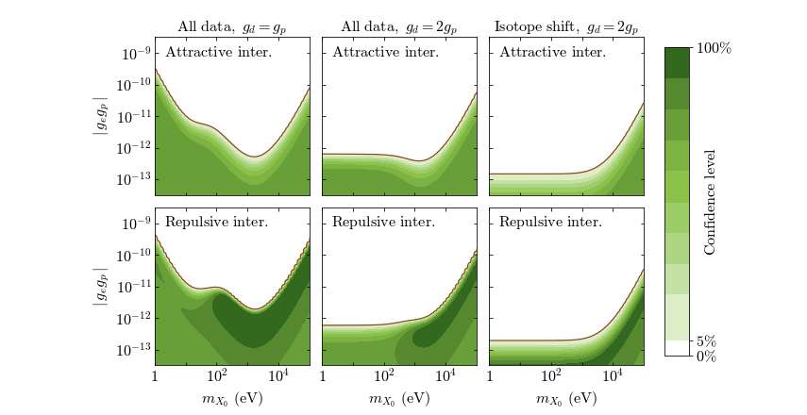
Two issues of methodology…
1. Overall bounds or bounds for specific models? And which models?
E.g., bounds on gegp based on eH, eD, µH and µD spectroscopy (gµ =ge)
[Phys. Rev. A 108, 032825 (2023)]

Slide 18
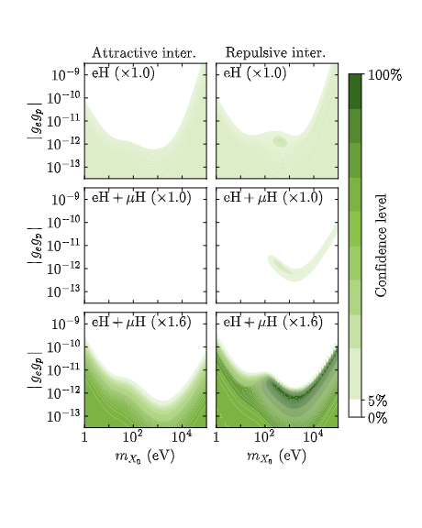
Bounds on gegp
Without µH
With µH
With µH, errors expanded by 60%
[PRA 108, 052825 (2023)]

Slide 19
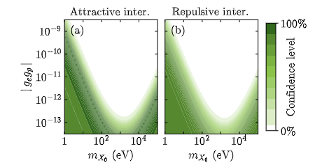
Bounds on gegp
Without µH
With µH
Only µH, eH(1s-2s) and eH(2s-6p)

Slide 20
Bounds on gegp
Only µH, eH(1s-2s) and eH(2s-6p)
With µH, eH(1s-2s), eH(2s-6p)
and eH (circular states)
[V. Wirthl et al, to be submitted to Rep. Prog. Phys.]

Slide 21
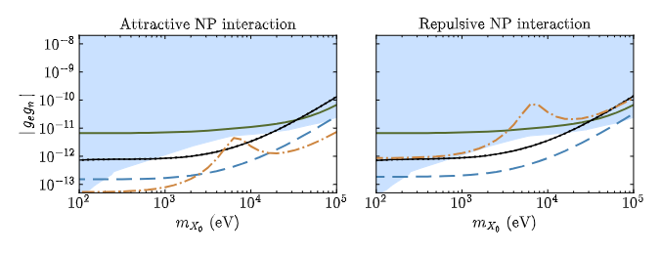
Two issues of methodology…
2. Should we reduce any difference between experiment and SM theory to zero?
E.g., the bounds on gegn based on the isotope shift of the 2 ³S – 2 ¹S interval of He
(dash-dotted curves) are strongly asymmetric…
[NJP 27, 045002 (2025)]

Slide 22
Two issues of methodology…
2. Should we reduce any difference between experiment and SM theory to zero?
E.g., the bounds on gegn based on the isotope shift of the 2 ³S – 2 ¹S interval of He
(dash-dotted curves) are strongly asymmetric…
Excluded by neutron scattering data + anomalous magnetic moment of the electron
[Delaunay et al (2017)]

Slide 23
Two issues of methodology…
2. Should we reduce any difference between experiment and SM theory to zero?
E.g., the bounds on gegn based on the isotope shift of the 2 ³S – 2 ¹S interval of He
(dash-dotted curves) are strongly asymmetric…
Bounds from Ca isotope shift [Wilzewski et al (2025)]

Slide 24
Two issues of methodology…
2. Should we reduce any difference between experiment and SM theory to zero?
E.g., the bounds on gegn based on the isotope shift of the 2 ³S – 2 ¹S interval of He
(dash-dotted curves) are strongly asymmetric…
Black curves: bounds based on eH, eD, µH and µD for gµ = ge
Dashed blue curves: isotope shift bounds

Slide 25
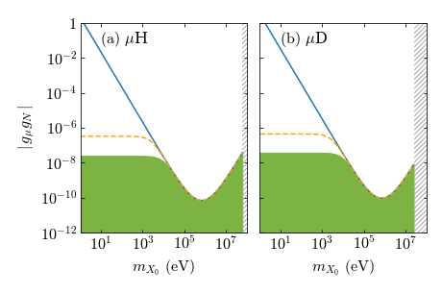
Sensitivity of the muonic species on NP
Dirac wave functions for the Uehling potential and the nucleus charge distribution
[PRA 108, 052825 (2023)]
See also Jaeckel and Roy (2010), Frugiuele and Peset (2022), Huang and Wang (arXiv 2026)

Slide 26
Sensitivity of the muonic species on NP
Dirac wave functions for the Uehling potential and the nucleus charge distribution
Non-relativistic wave functions for 1/r potential
Dirac wave functions for 1/r potential
[PRA 108, 052825 (2023)]
See also Jaeckel and Roy (2010), Frugiuele and Peset (2022), Huang and Wang (arXiv 2026)

Slide 27
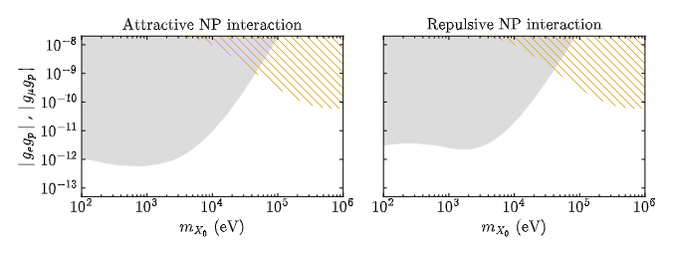
Bounds on gegp (any gn)
Excluded by eH spectroscopy alone
Significant NP contribution to the muonic data
[NJP 27, 045002 (2025)]

Slide 28
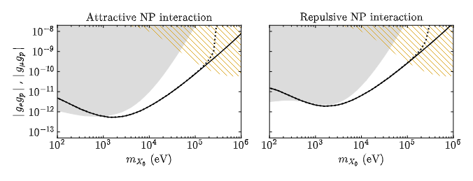
Bounds on gegp (any gn)
Solid curves: bounds based on eH, eD, µH and µD for g_µ = g_e
Dotted curves: bounds based on eH, eD, µH and µD for -g_e ≤ g_µ ≤ 100 g_e
[NJP 27, 045002 (2025)]

Slide 29
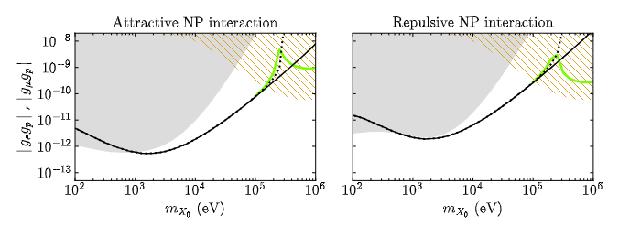
Bounds on gegp (any gn)
Green curves: bounds based on eH, eD, µH and µD for g_µ = 207 g_e
[NJP 27, 045002 (2025)]

Slide 30
Forthcoming measurements
In the next few years…
2s – ns transition frequencies in deuterium
2s – 6p transition frequency in deuterium
1s – 3s transition frequency in deuterium
1s – 3s transition frequency in hydrogen (higher precision)
Circular Rydberg transitions in hydrogen
1s – 2s transition frequency in He+
1s – 2s transition to 0.4 ppb in orthopositronium
.
.
.

Slide 31
Bounds on ge from positronium spectroscopy
Red curves: bounds based on Ps (1s – 2s)
Blue curves: bounds based the electron gyromagnetic factor
[From C Frugiuele et al, PRD 100, 015010 (2019)]

Slide 32
Bounds on ge from the 3D states of He-4
Bound based on the binding energies of the 3D states, assuming negligible interaction with the nucleus (work in progress)

Slide 33
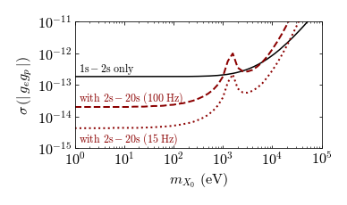
Reach of the isotope shift approach
Bounds based on the isotope shifts of two different transitions (gn = gp)
No µH or µD data
Phys. Rev. A 108, 032825 (2023), also Delaunay et al (2017)

Slide 34
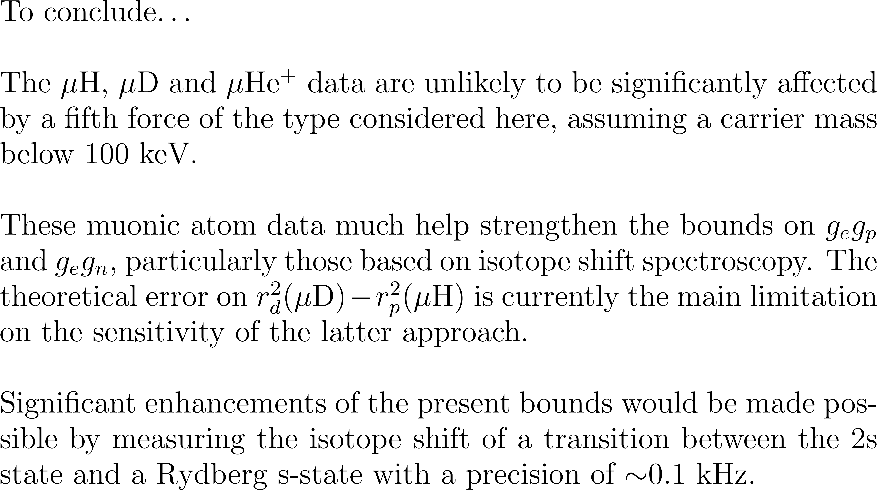
Conclusions

